Slide 1
pfRICH Design Update
By Alex Eslinger (JLAB)
3 March 2023

Slide 2
Summary
Early November 2022
Mid December 2022
Mid February 2023
Today
Notes:
So, today I will talk about the current design of the pfRICH. But I thought it would be interesting to go back and look at how quickly the design developed at first and how much longer the details take to start filling in. I thought it’d be nice to give a visual timeline of where we’ve come from and a quick look at what we’ll be discussing today. But first, I will talk briefly about each of the components and some design features and highlights.

Slide 3
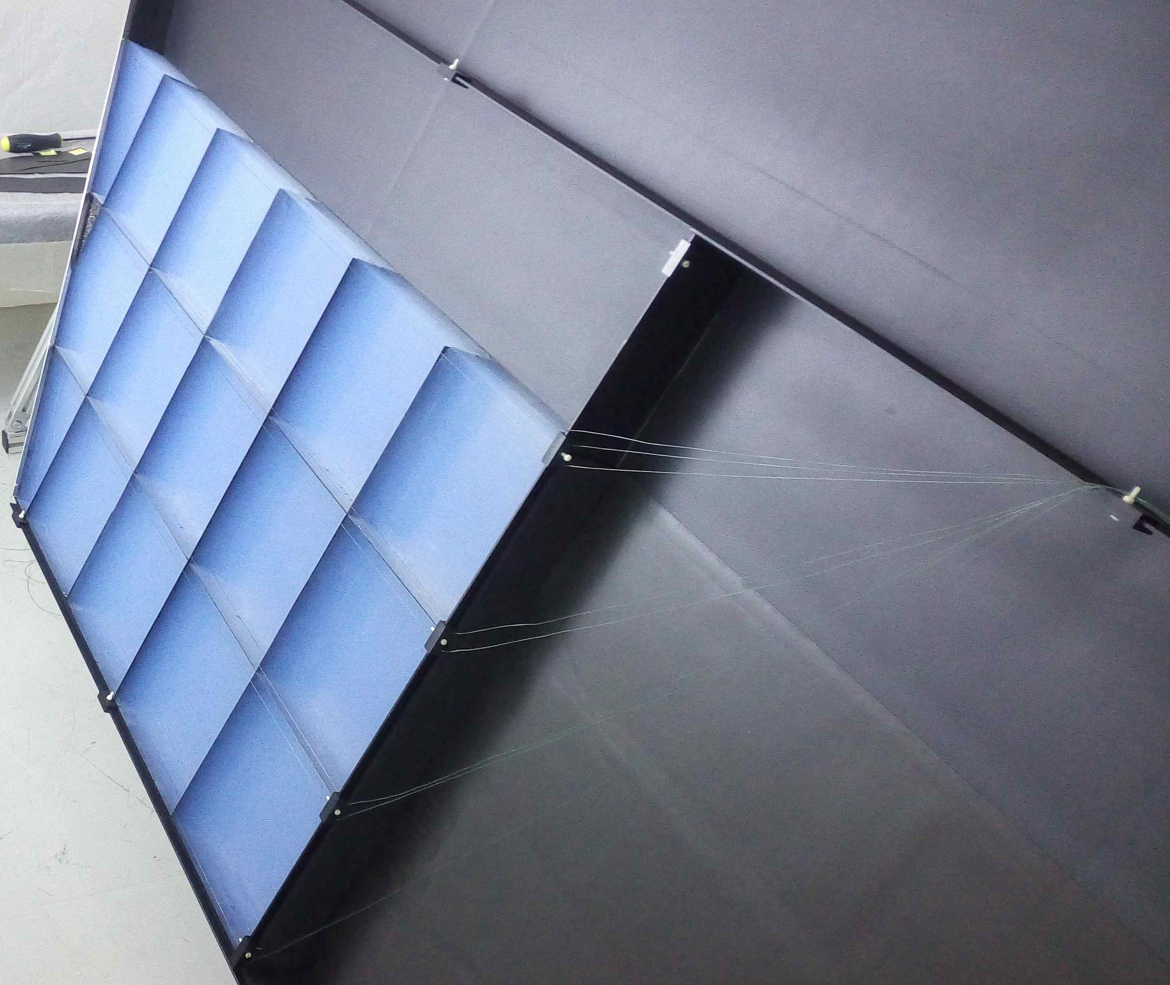
Aerogel Wall Details
Material: Carbon Fiber Disc/Dividers (~0.5mm thickness).
Dimensions:
Outer Radius -> ~62.5cm
Inner Dimension -> Beam pipe flange + 5mm clearance for installation.
More Details:
3 radial bands of aerogel tiling
Thin clear filament to be strung across the grid to hold tiling into place. (Detail not shown; conceptual)
Aerogel tiles are kept within 20x20 cm maximum dimension to allow for production
Estimated weight: ~1.8kg
Notes:
We’ll start with the aerogel wall, as you can see. The current design concept is to use very thin – on the order of about a half millimeter thick – carbon fiber sheets to separate and create compartments for each aerogel tile. The tiles themselves have been patterned in a similar fashion to Belle II with three radial bands outwards creating bands of 8, 14, and 20 tiles respectively. The size of the tiles was our main limitation here, so we made sure that we kept all tiles within a 20x20 centimeter footprint. This is – as far as we understand – an approximate limitation for current manufacturing methods. You can see here that by utilizing such lightweight materials, we expect this whole structure to weigh in around the 2kg range. Also, although this detail has not been drawn into CAD, the idea for containing the tiles is straight from CLASS12. As shown in the picture on the bottom right sent to me by Brian Eng, the plan is to use thin, clear filament to retain the tiles within the structure.

Slide 4
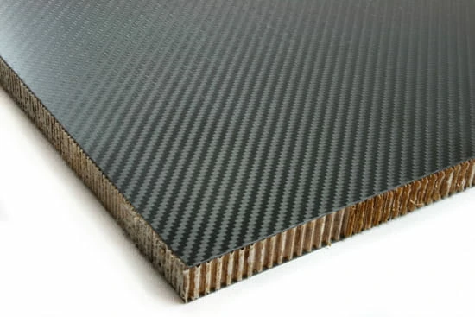
Containment Walls
Material: Carbon Fiber Sandwich Structure with aluminum rings around the edge
Dimensions:
Outer Radius -> ~63.8cm
Inner Dimension -> Beam pipe flange + 5mm clearance for installation.
More Details:
Front Wall and Inner Wall thickness = ~1/4” (6.35mm)
Outer Cylindrical Wall thickness = ~1/2” (12.7mm)
Aluminum sealing rings around outside perimeter are 1/2“ (12.7mm) in size
Aluminum Sealing rings around beam pipe are 1/4“ (6.35mm) in size
Estimated Cylinder Weight: ~7.1kg
Estimated Front Wall Weight: ~2.8kg
Estimated Inner Wall Weight: ~0.5kg
Estimated Total (with hardware): ~10.7 kg
Notes:
Next, moving outwards, we can talk about the containment walls. As shown here, the containment walls consist of primarily three pieces (the fourth, that houses the sensor plane) will be discussed later. Either way, these three pieces are: a front disc which we plan to make about ¼” thick, a cylinder which will be ½” thick, and a ¼” thick section in the shape of the beam pipe flange that runs through the middle of the detector. As you can see in these pictures, the current design concept is to use a carbon fiber nomex honeycomb material with bonded rings on the edge. There are ongoing discussions about the material choice for these rings, but they are shown here as aluminum. The purpose for having the mating flanges made out of a machinable material is that we can include a sealing material (like copper) between the flanges as well as having the ability to tap it and use standard screws or bolts to connect them together. The thicknesses and material type for this section were discussed with Prakhar from Stoneybrook who has experience with the TPC construction for sPHENIX. At the bottom, you can see the estimated weight for each component. As a whole, I expect the containing structure to weigh in the neighborhood of 11kg.

Slide 5
Outer Conical Mirror System
Material: Carbon fiber sandwich with reflective surface (~1/4” [6.35mm] thick)
Dimensions:
Upstream Radius: ~62.4cm
Downstream Radius: 54cm
More Details:
Intended to be segmented into 8 sections radially
Mounting points will be provided by machinable foam pads around the circumference
Current thought for foam is polyurethane foam available in different densities
3 mounting points per mirror segment
Mirrors have a tapered section as they approach the aerogel to maximize internal space
Weight per mirror (total): ~0.3kg (~2.5kg)
Notes:
The next component up is the outer conical mirror system shown here. This mirror system uses a similar ¼” honeycomb carbon fiber sheet, however, there is a reflective surface on the inside wall. Due to its size and shape, we expect to have to subdivide the mirrors into eight or so pieces so that they can be easily manufactured and installed. As far as installation goes, you can see that in the picture to the right, I’ve made the outer wall semi-transparent to show the foam blocks that are inserted between the mirrors and the outside containment structure. These are made of a rigid, machinable, polyurethane foam which can be purchased in various densities. You can also see that each mirror segment has two mounting blocks, a long one and a short one. The idea here is that there can be 3 mounting points per mirror to allow for slight adjustments, as necessary. Lastly, you can see that each mirror weighs very little – on the order of 300 grams or so for a combined weight around 2.5kg.

Slide 6
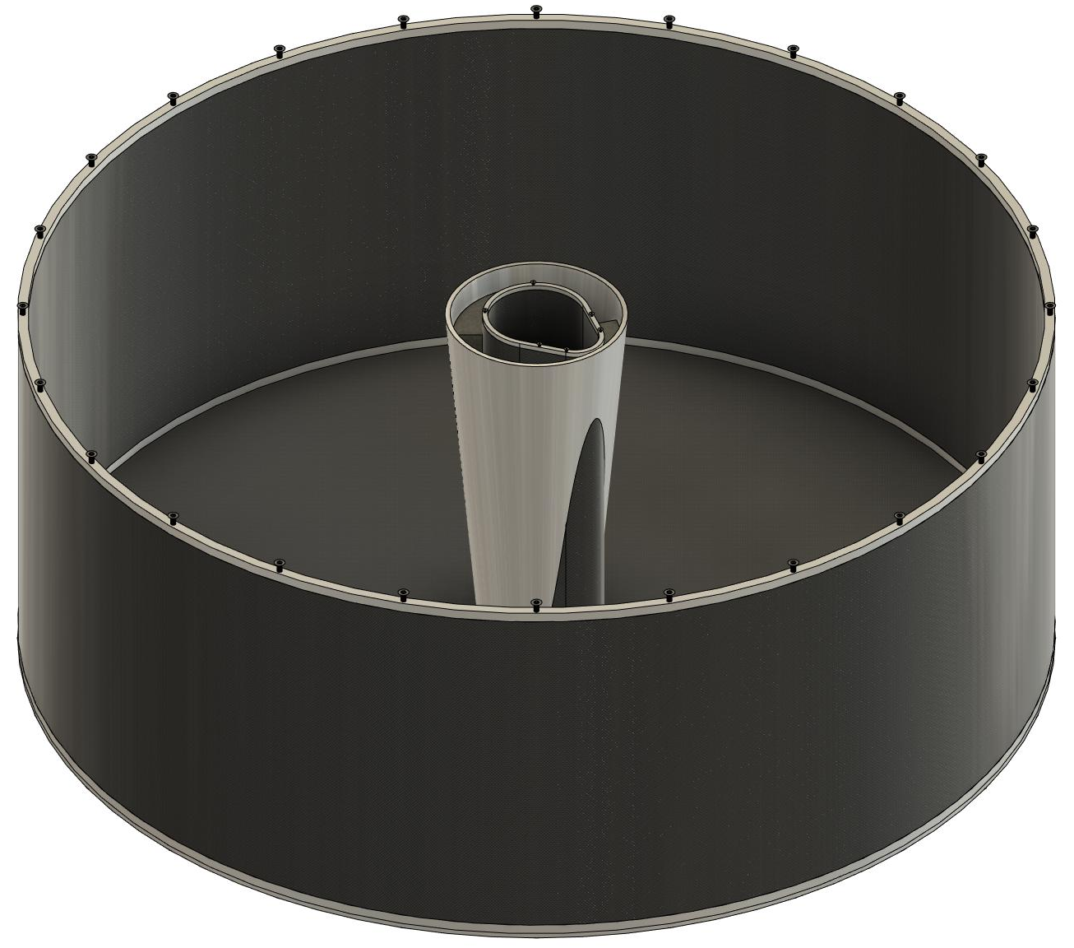
Inner Conical Mirror System
Material: Carbon fiber sandwich with reflective surface (~1/4” [6.35mm] thick)
Dimensions:
Upstream Radius: 66 mm
Downstream Radius: 12 cm
More Details:
Mirror cut around the inner containing wall creating a saddle shape
Mounting points will be provided by machinable foam pads around the inside circumference
Current thought for foam is a polyurethane foam available in different densities
Weight: ~0.4kg
Notes:
The inner conical mirror is very similar to the outer mirror system. However, there is a key difference in the shape of the mirror. Since the inner wall is parallel to the outer cylinder and shaped like the beam pipe flange that it is designed to clear, there is an intersecting cut out between the two pieces. This saddle shaped cutout works to the advantage of the mirror mechanically in that it creates a natural stop for the mirror as it is lowered into position. The same machinable foam is planned to be used – you can just barely see the top of it in this picture – and is there mainly to center the mirror on the inner containment wall.

Slide 7
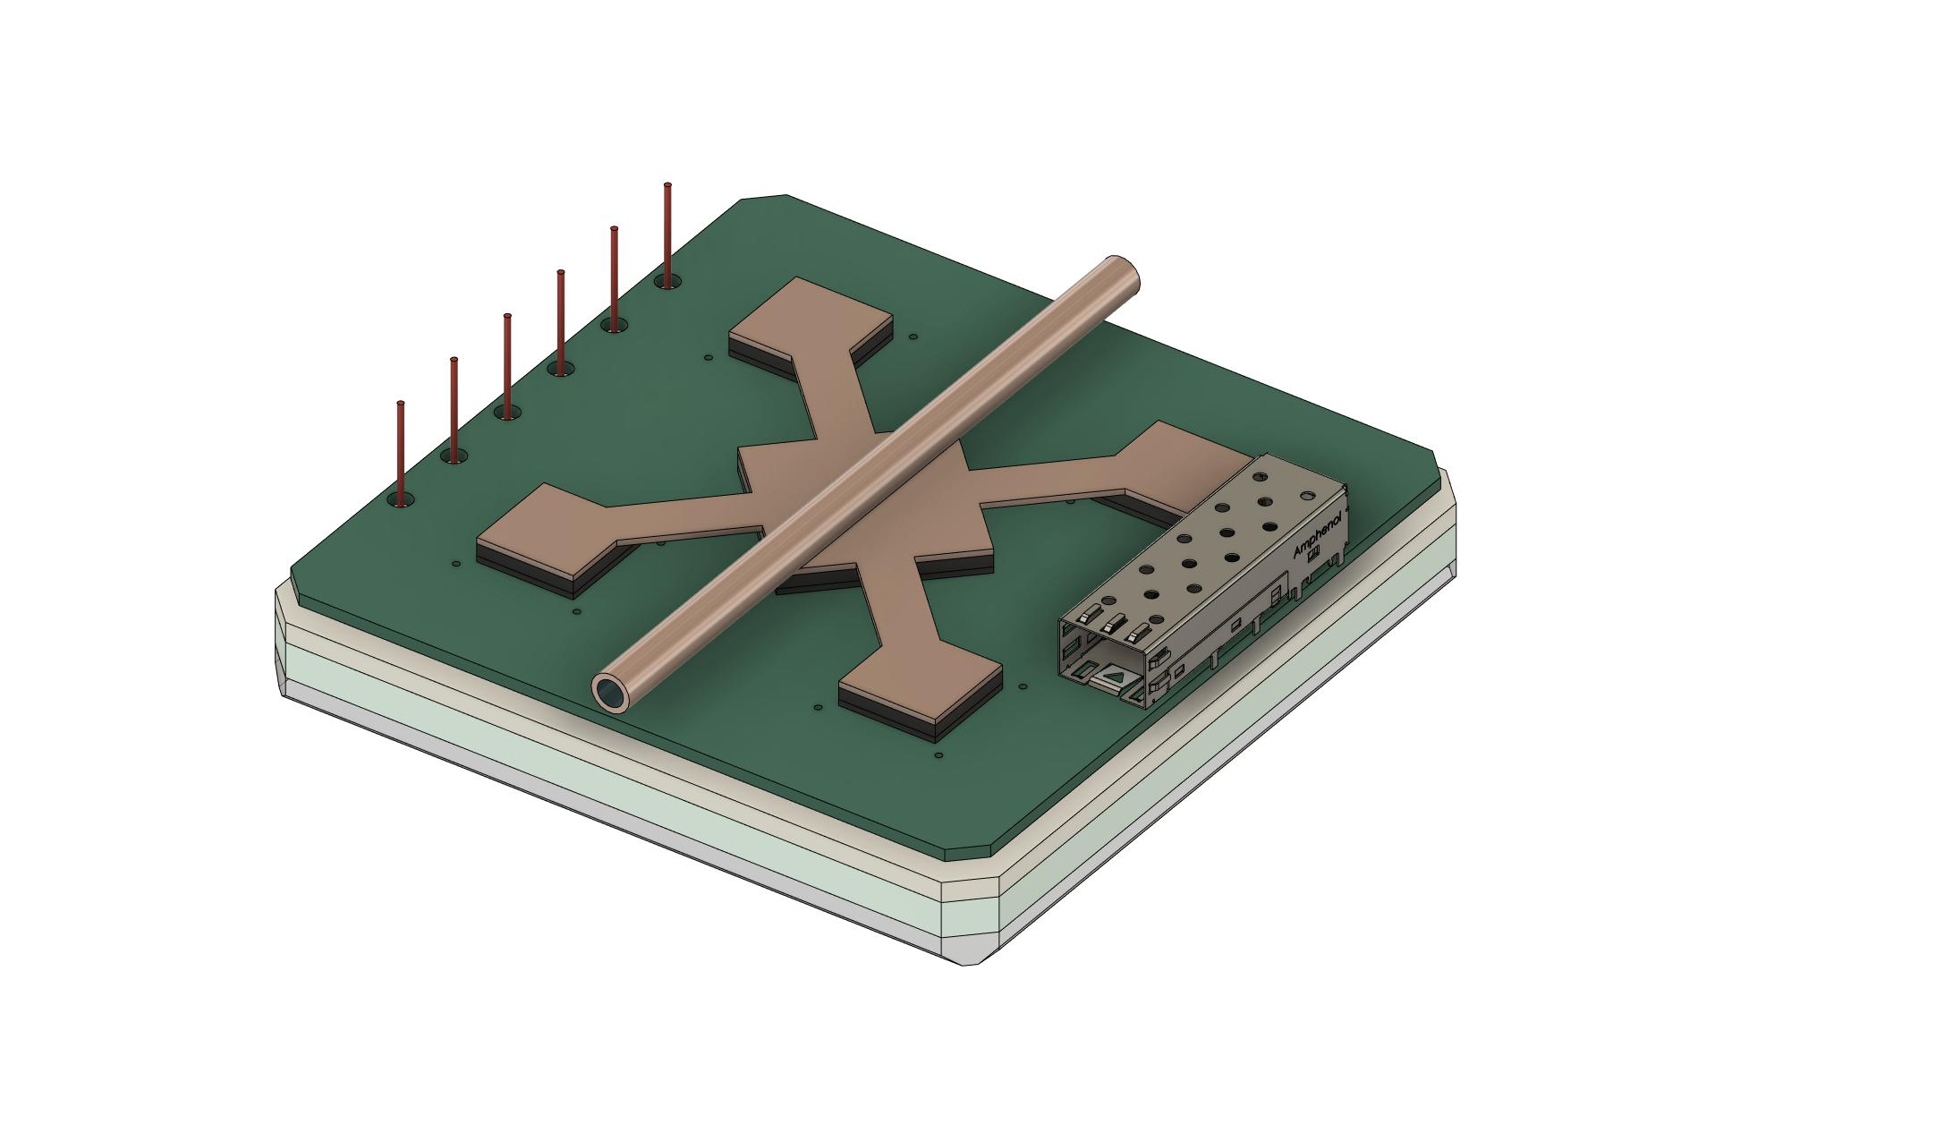
(Most) Current Sensor Design
HV Cabling
Cooling Representation
5-6cm clearance for cable bends and routing
SFP Fiber Port
- Sensor design shown here is changing frequently; however, it is a good visual for the rest of the design - Estimated sensor weight: ~485g (~34kg for 68 sensors)
Notes:
Now, without stepping on Alexander’s toes too much, lets take a look at the HRPPD sensor that has been used in the most current design layout for the pfRICH. As you can see, I mention that this is the MOST current. That is because this design changes very frequently as more information becomes available and the design naturally progresses. Either way, you can see that the plan – as of this design iteration – is to liquid cool the card using a heat spreader across the ASICs and the FPGA. This has recently changed again, but the changes haven’t propagated into my design yet, so we’ll present on this iteration. The high voltage cabling is represented by the red wires coming out on the left-hand side and the SFP fiber port comes out on the right-hand side (as you see it in the picture). Now, I do want to point out that since the design has recently reduced the depth of the sensor from approximately 8cm down to 3cm, we still plan to keep a 5-6cm clearance from the front face of the sensor. Leaving that area open allows us room to route cabling and services. Overall, each sensor weighs about half a kilo and when you add that up, you can see that 34kg of the detector is the sensors.

Slide 8
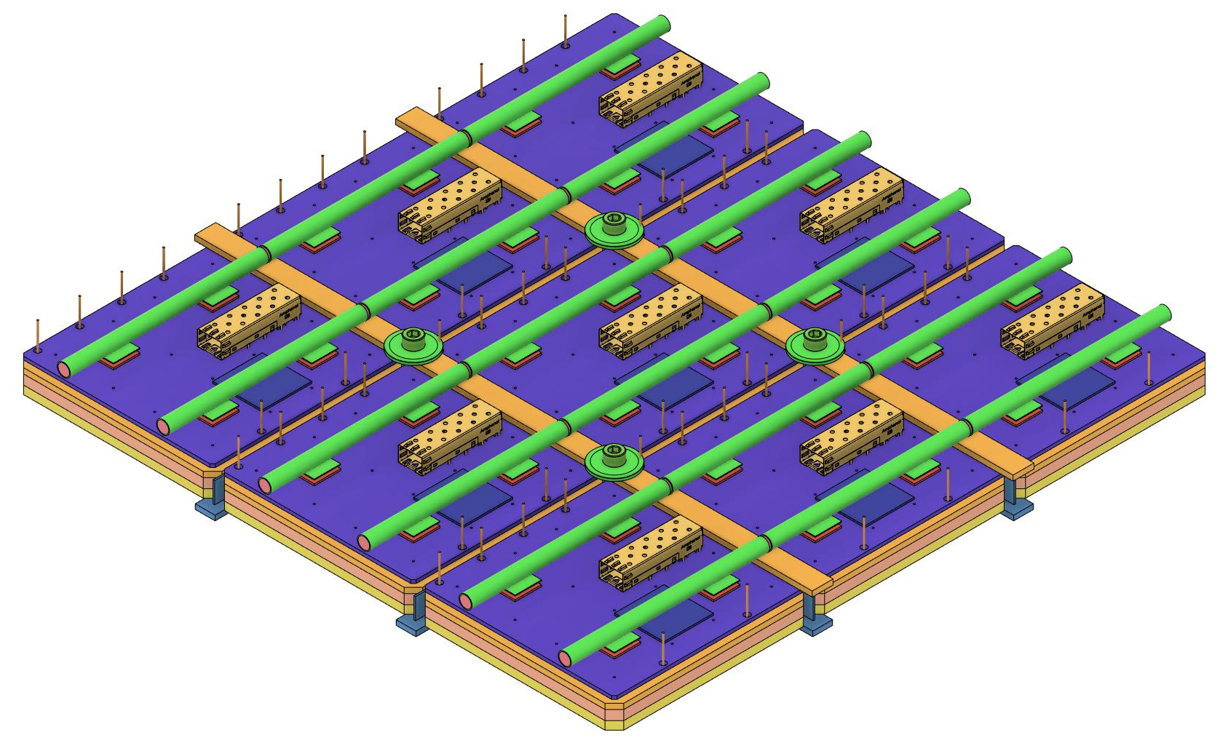
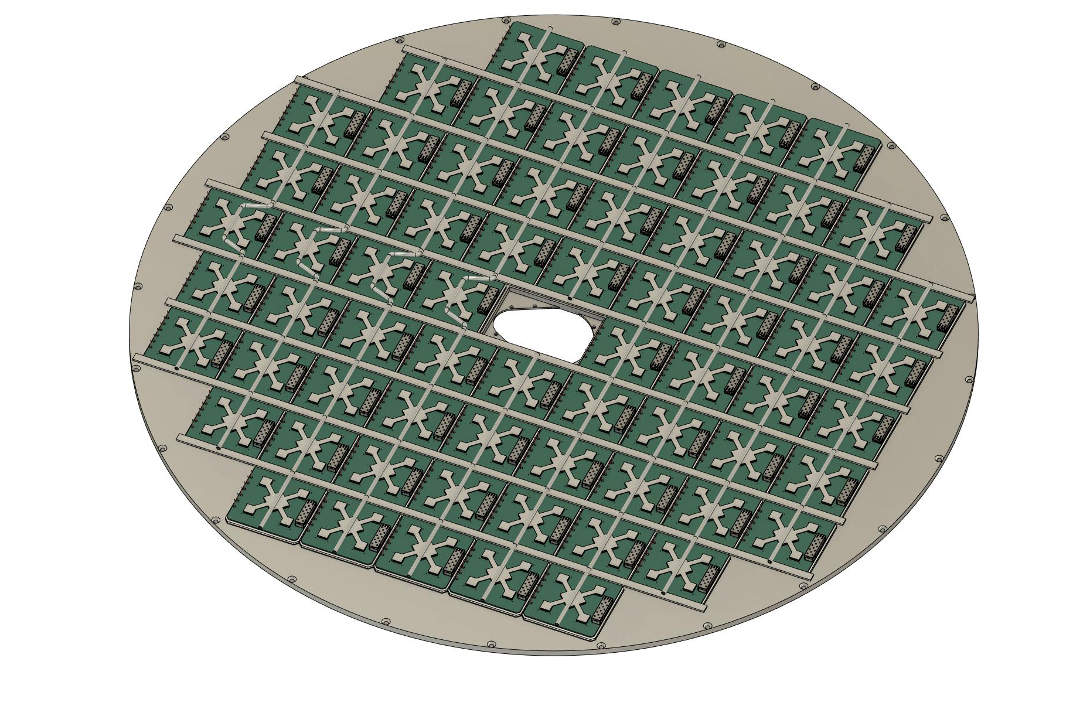
Sensor Wall/Grid
Material: Aluminum (1/2” [12.7mm] maximum thickness)
Dimensions:
Outer Radius -> ~63.8cm
Inner Dimension -> Beam pipe flange + 5mm clearance for installation.
More Details:
68 Sensors; 12cm x 12cm
Estimated weight for Aluminum Disc = ~10.7kg
Countersunk fasteners along perimeter allow bolting and sealing to center cylinder section of the containment structure.
Intended to be machined from one piece of aluminum for rigidity
Strapping perpendicular to the liquid cooling pipes
Allows for mounting of the pipes
Creates a more rigid structure
Strapping is intended to be standard 1/8” (3.175mm) thick aluminum
Weight for all strapping: ~0.9kg
Notes:
Now, a big change recently for the design was to switch to a one-piece machined aluminum disc that holds the sensors in by inserting them from the back. The design concept is to use a maximum material thickness of ½” for the stock and machine it to accept the sensors while leaving an approximately 12mm wide grid on the front face. This front face allows us to insert the sensor from the back and attempt to seal it air-tight and light-tight along the front face and the sides. That being said, we realize that this isn’t a perfect solution and i’ll discuss this more later. You can see that this disc weighs as much as the rest of the containment vessel combined, but most of the material exists on the outer circumference where it is less critical.

Slide 9
Sensor Wall/Grid (Cont’d)
Liquid Cooling Assy
Sensor hold down hardware
Strapping
Sensor Assemblies
Webbing: 1mm between sensors
Aluminum Grid
Grid Face: 12mm x 3mm
Tapped holes at corners
Notes:
Here, you can actually see an older revision of the sensor design where we thought we might need two liquid cooling pipes per sensor. Moving along though, you can kind of get a feel for how we plan to put this together. The aluminum grid will be bolted to the carbon fiber containment vessel around the perimeter and the sensors will drop in from the back side. Then, the strapping can be placed on top of the sensors perpendicular to the cooling pipes. This strapping should also add rigidity in this direction by making a near-I-beam shape with the webbing that is between the sensors. Moving up you can see that the hardware can bolt the strapping down by utilizing the tapped holes in the cut-out corners for the sensors. The liquid cooling comes last and uses the strapping as a mounting location for the cooling tubing.

Slide 10
Electronics/Readout Notes
The picture below was taken from Belle II ARICH slides (L. Burmistrov, 2019)
When we initially began designing EIC pfRICH, we assumed that the heat requirements would require that we use a similar approach
As we’ve narrowed down ASIC and other component choices, we realize that we may not need liquid cooling at all.
Air cooling could be considered with plastic shrouds running horizontally across the sensor plane… this option is still under consideration.
Notes:
A quick note about the electronics and readouts since we’ve been covering that – more specifically, the cooling. When we initially began designing the pfRICH for the EIC, we assumed that the heat requirements would end up being similar to the BELLE II ARICH which is shown in the series of pictures at the bottom of the slide. As we’ve been able to narrow down ASICs and other components, its becoming more evident that the cooling requirement might not be as dramatic as we originally anticipated. Therefore, we are looking into the option of dropping the liquid cooling altogether and investigating the option to run air cooling with shrouds that run horizontally across the sensor plane. As the slide says, this option is still under consideration, but I expect that if we pursue this change, it will have a non-trivial impact the overall design.

Slide 11
Detector Assembly Procedure (Concept)
Build out the aerogel wall
Build out the containment wall by adding the foam support blocks and mirrors
Insert aerogel wall while containment vessel is face down
“Close in” the aerogel wall with the front wall
Place aluminum grid on top of containment vessel
Add sensors into aluminum grid and affix with the strapping
Add cooling to the back of the sensors
Fixture the vessel so that it is upright
Notes:
Now that we’ve defined all of the major components, we can look visualize how we could actually build this detector. Currently, the design concept is to build out the entire detector as one piece (in a clean room, or similar) and then fixture it and take it to the assembly hall where it can be inserted into its final position. One way we can imagine doing this is shown on the slide. We could build out the aerogel wall, then the containment wall by adding the foam support blocks, and the inner and outer mirrors. This assembly could be placed over top of the aerogel wall and sealed up with the front wall for the containment vessel. Next, we would add the aluminum grid to the containment wall add in the sensors, strapping and cooling. Lastly, we would have to fixture the whole assembly and rotate it so that it is upright and ready to carefully move.

Slide 12
Estimated Weights
Component | Estimated Weight
Aerogel Wall | 1.8kg
Containment Vessel | 10.7kg
Outer Mirror System | 2.5kg
Inner Mirror | 0.4kg
68 HRPPD Sensors with Accessories | 34kg
Aluminum Sensor Grid | 10.7kg
Total | 60.1kg (not including mounting system)

Slide 13
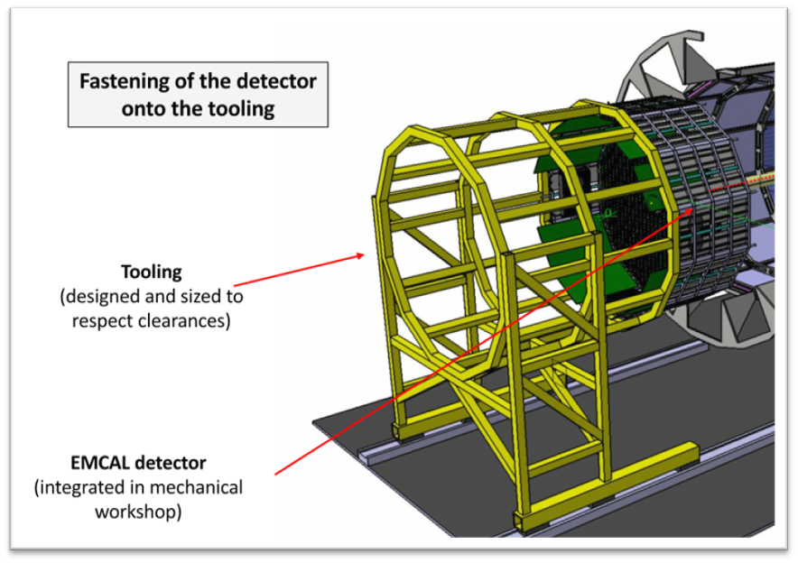
Detector Installation (Concept)
The picture on the right is from J. Bettane’s EIC Calorimetry Review slide on December 6-7, 2022.
For pfRICH installation/removal, we could take the existing tooling for the backward EMCAL, add an adaptor/extension (to reach the pfRICH final location) and reuse the existing bolt holes.
Since the EMCAL expects to use the same beam pipe clearance tolerance (+5mm) and it weighs ~3T vs ~100kg, the tooling would be overbuilt for pfRICH and allow for less duplication of effort in design
Notes:
To install the pfRICH, I think the best solution is to take the tooling for the backwards EMCAL and design an adaptor that extends its reach and adapts its existing bolt pattern to one that works with the pfRICH. You can see the yellow tooling design concept in this picture that I took from the EIC Calorimetry Review. The design criteria for that tooling is that it will have to hold a 3-ton calorimeter out cantilevered in such a way that it will not deflect more than the 5mm or so tolerance that they have given themselves around the beam pipe. The pfRICH will weigh a fraction of the weight with identical beam pipe flange tolerance. Therefore, I think it makes sense to not reinvent the wheel, but work with our backward EMCAL colleagues to adapt this tooling with an extension and not duplicate the design effort. The only downside I can see from this approach would be that we might need two of these fixturing units during a pfRICH removal if that is more cost effective than taking the backward EMCAL off of its tooling and placing onto some kind of stand.

Slide 14
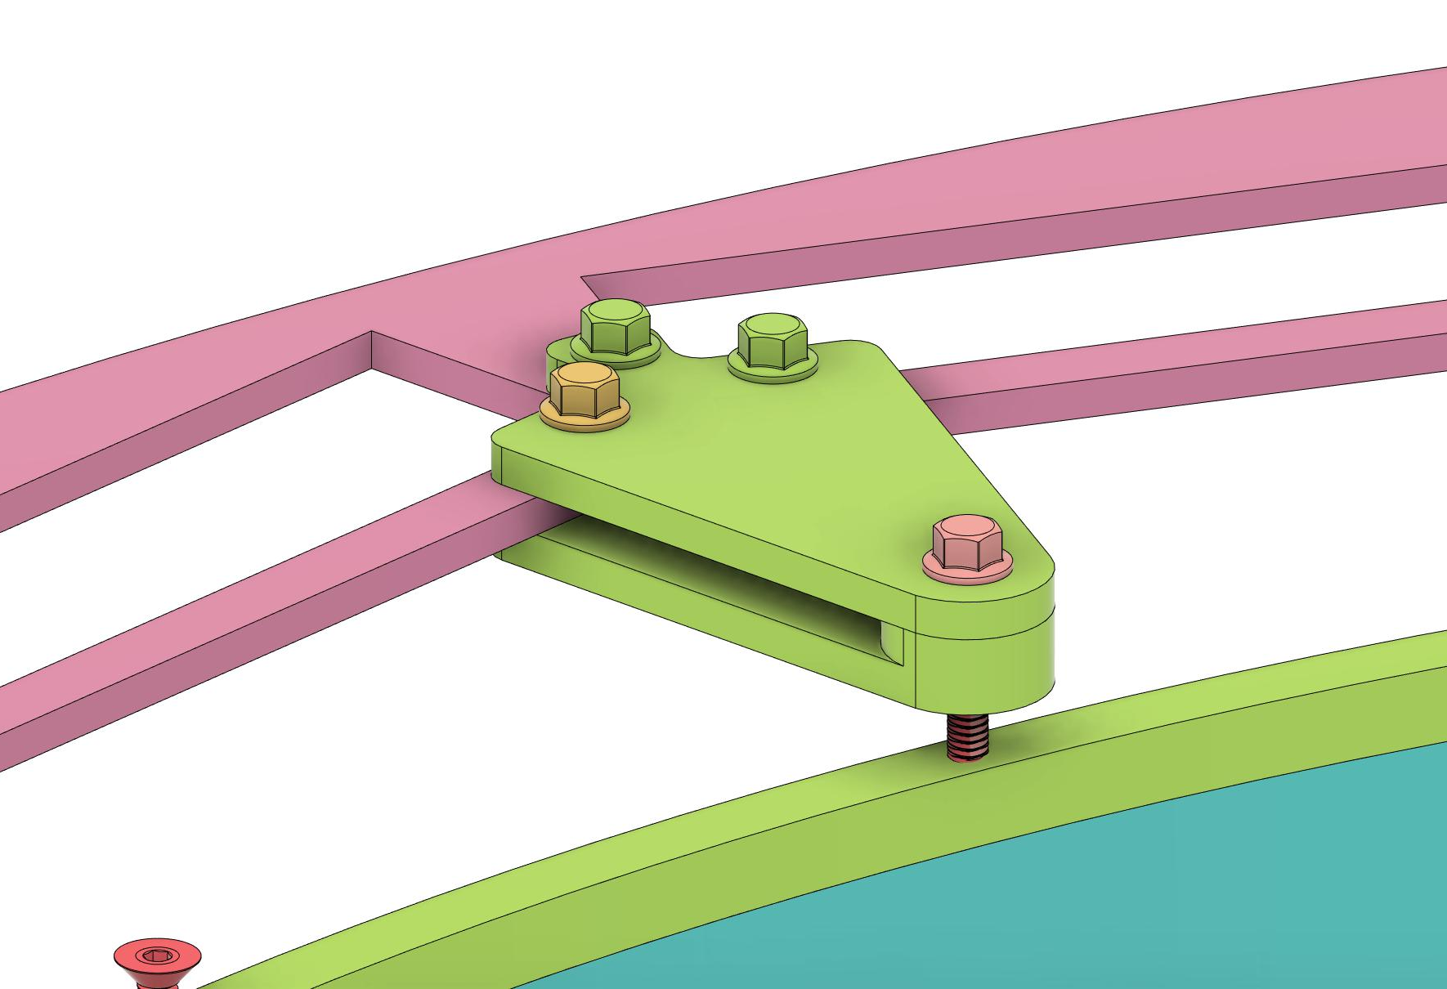
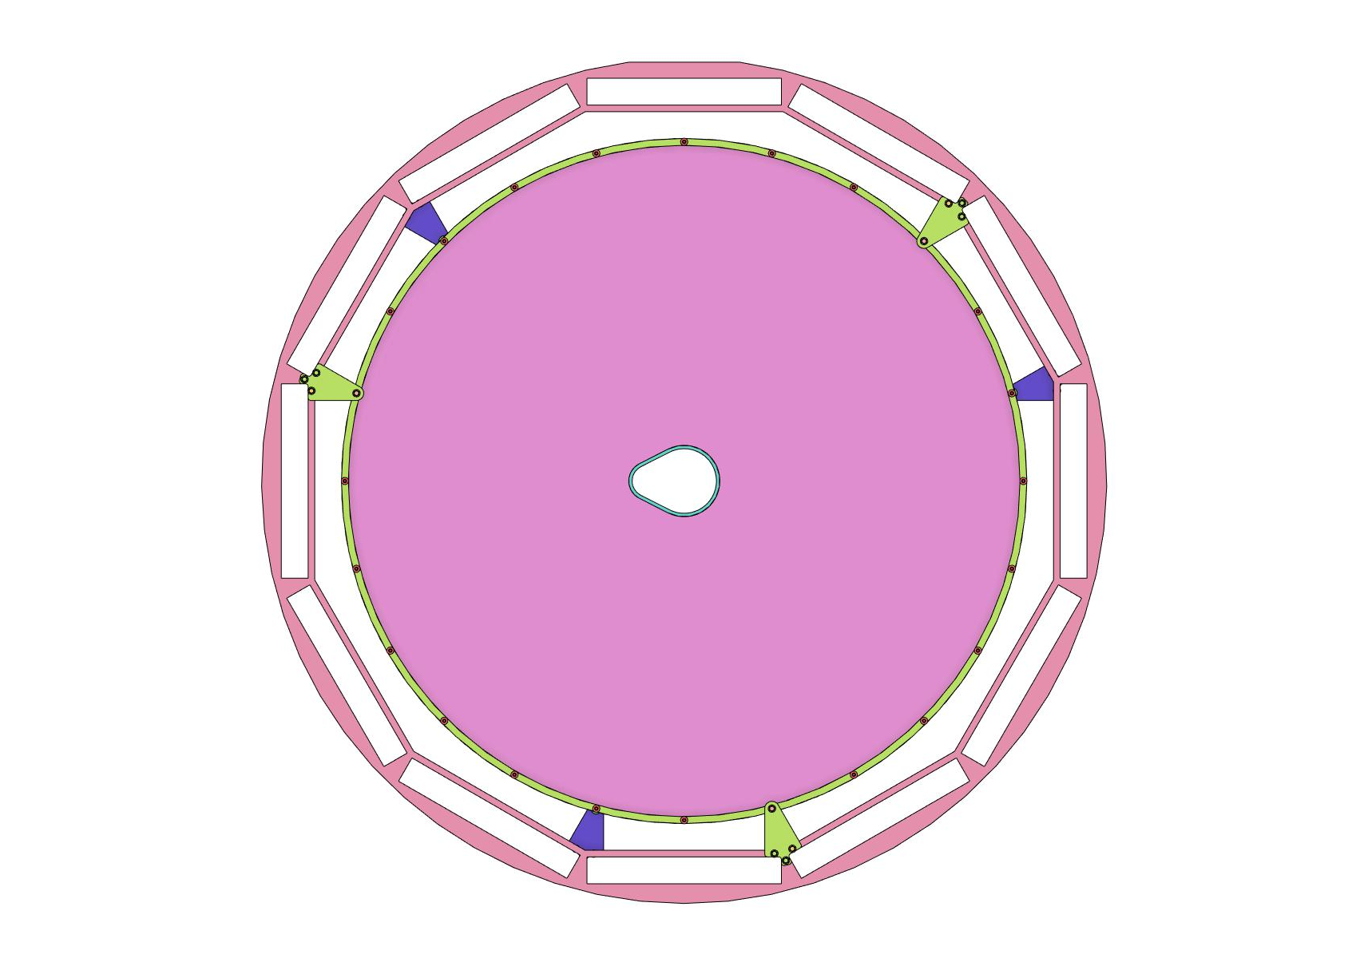
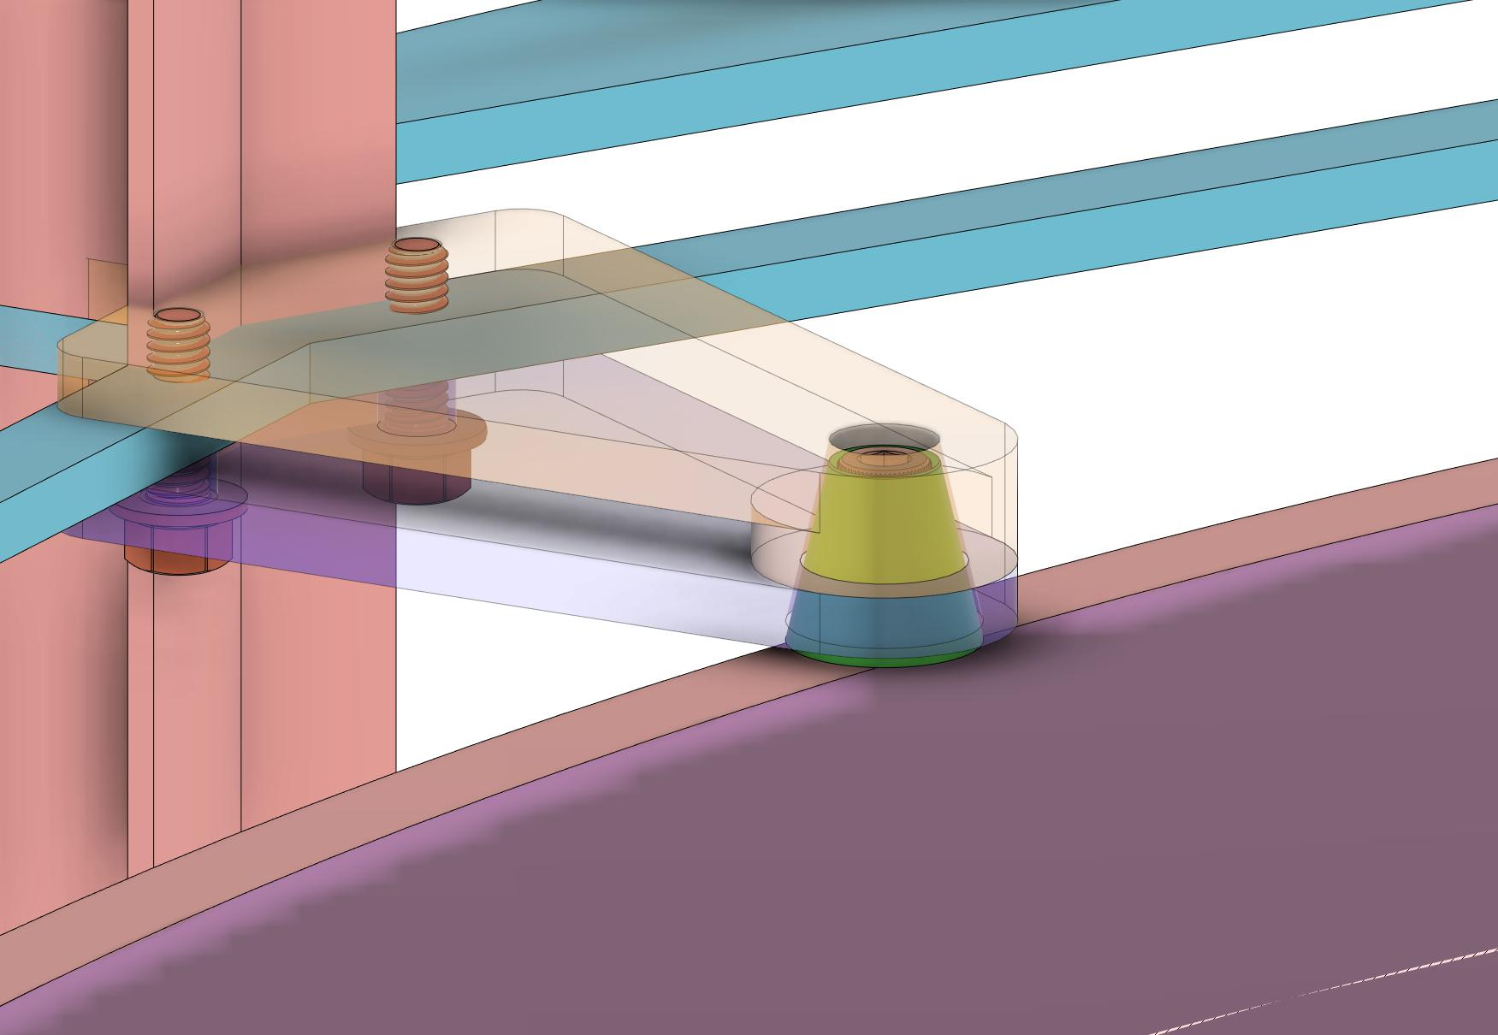
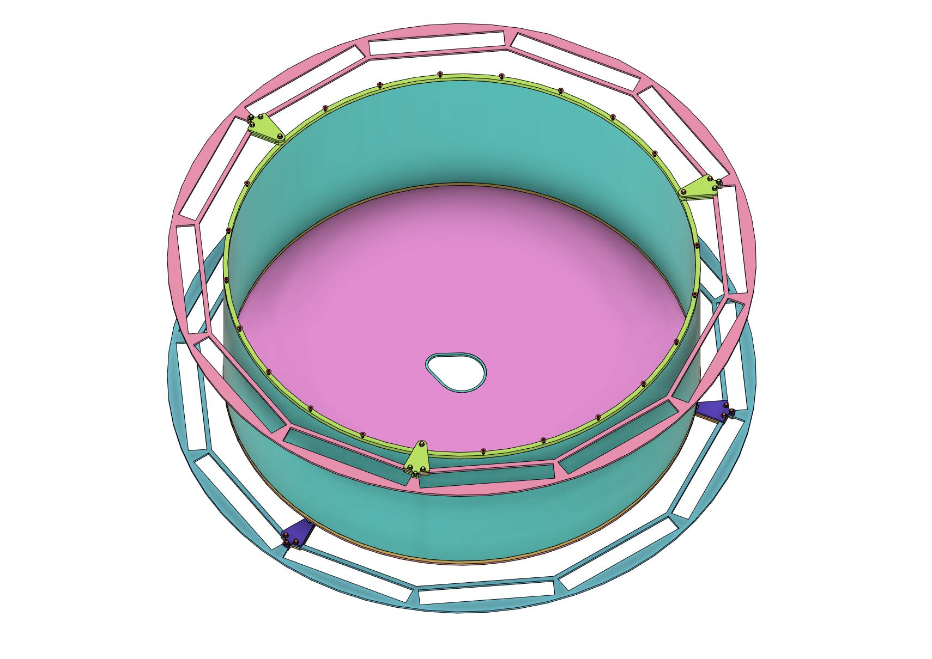
Detector Support (Concept)
Propose we add two additional rings into the DIRC structure at the specified locations.
Conical mounting mechanism on the upstream side
Bolt through into the half-inch circumferential ring on the downstream side
Bolt into the circumferential ring
Upstream Conical Mounts
Proposed additional support rings
Notes:
Here are a few pictures of some designed componentry for the detector support. As I have mentioned and shown through the slides, the weight of the pfRICH seems like it will end up being 100kg or less in total weight once everything has been tallied up, so it shouldn’t be a huge undertaking to fix it within the DIRC support frame. The basis for this design is that we would add two additional rings on the DIRC support frame that are as stripped down as possible. Then we could affix ears (shown in lime green and purple around the perimeter) to these rings where conical mounting pins could “land” and bolts could be affixed.

Slide 15
Detector Support (Cont’d)
When ready to install the detector (as a single piece), the conical locating pins will be preinstalled on the upstream end
The mounting ears on the upstream end can be installed before the pfRICH is slid into place
Once the pfRICH self-locates on the conical pins, the ears for the downstream end can be installed
Then, the pfRICH can be bolted to the downstream ears and removed from the tooling
The number of mounting ears and conical pins can easily be scaled according to a static structural analysis of the system (to be completed)
Notes:
Using the details from the previous slide, you can see a conceptual procedure to the insertion process of the pfRICH. (Read slide)

Slide 16
What’s Missing?
System for optical isolation has not been fully developed. Current concept is that we should be able to seal the sensors at the front face where the grid meets the glass and cover the side walls of the individual sensors with an epoxy, but this solution is far from ideal.
Services and cooling will need to be roughly finalized before the review. Conceptually, I feel we have a handle on how to accomplish this, but the junction boxes and bend radii need to be considered as well as the full liquid or air cooling loop.
Thermal analysis needs to be done for the situation where the detector is in place for the beam pipe bakeout (i.e. are the sensors able to handle the thermal load, or will we need to insulate? Can the containment vessel handle the thermal load?)
A static simulation should be done to optimize and verify the mounting solution that was just presented within the DIRC frame.

Slide 17
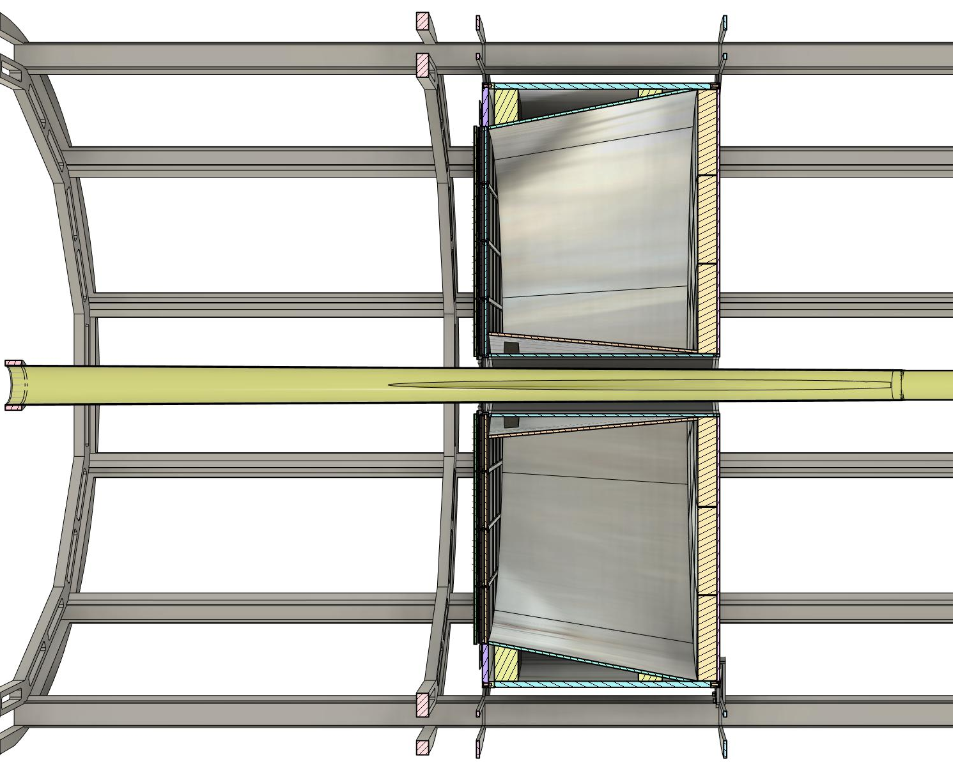
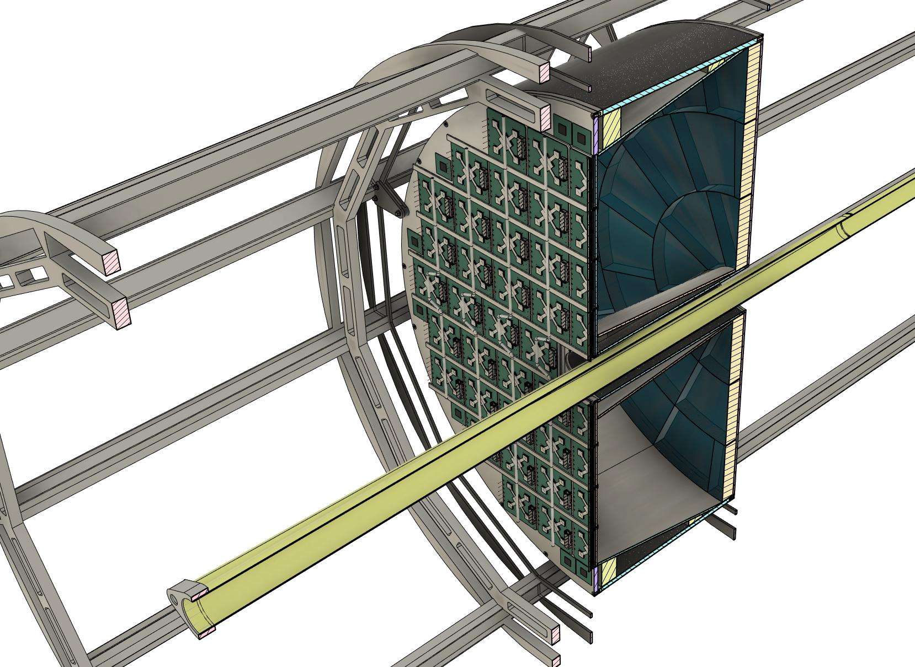
Entire Assembly (a/o 3Mar23)
Notes:
Alright, so here are a couple pictures of everything in a section view. You can see where the components are in relation to each other, and this might give a better idea of how it all goes together. I’ll quickly go to my CAD program to give everyone a visual while I answer any questions.

Slide 18
Questions?

