Slide 1
Development of HRPPDs for EIC:
Status update
A. Lyashenko (on behalf of Incom Inc.)

Slide 2
Schedule
now
Task | 2023
 | Jan | Feb | Mar | Apr | May | Jun | Jul | Aug | Sep | Oct | Nov | Dec
0. Project Management
Window to Ceramic Sealing (60% complete)
Anode Design and Fabrication (50% complete)
Internal Connections (80% complete)
Internal Components Design and Procurement (80% complete)
Readout Board Design (50% complete)
Tile Performance/Process Optimization (50% complete)
BNL/EIC Tile Test Plans
Fabricate 5 HRPPDs for EIC delivery

Slide 3
Task 1: window to ceramic seal
Ceramic metallization for reliable indium wetting
Performing 3 sealing trials to verify sealing
60% complete
Responsible Individuals: A. Lyashenko

Slide 4
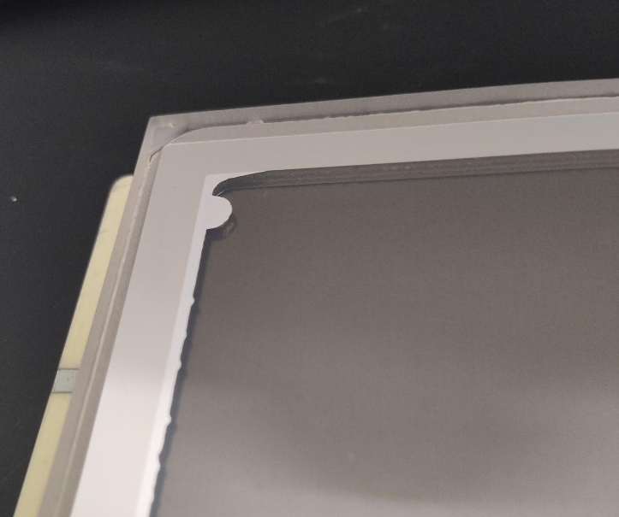
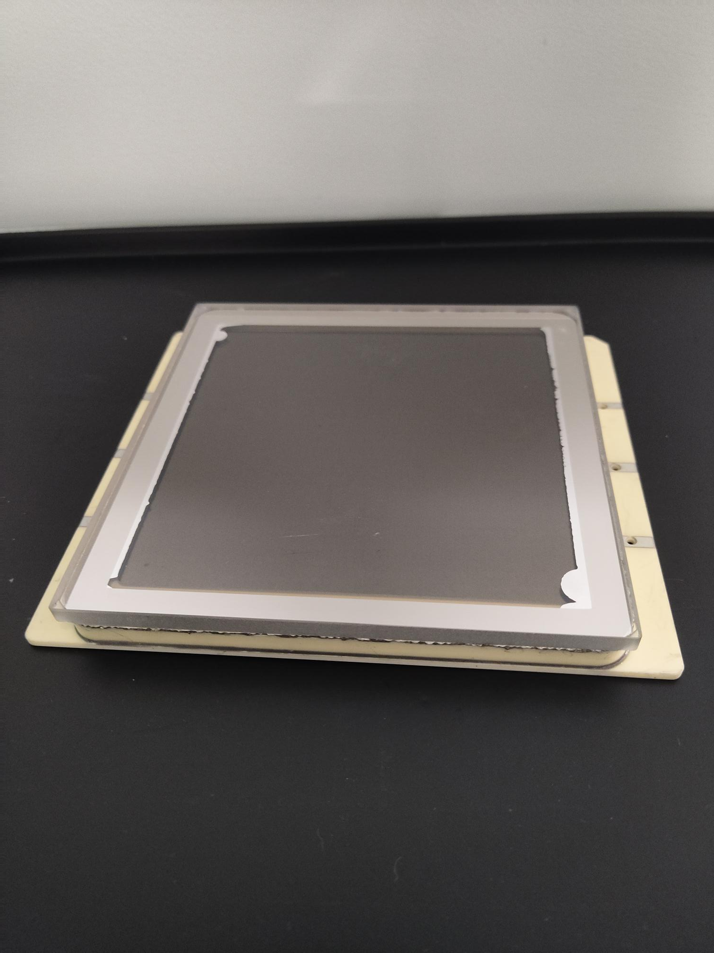
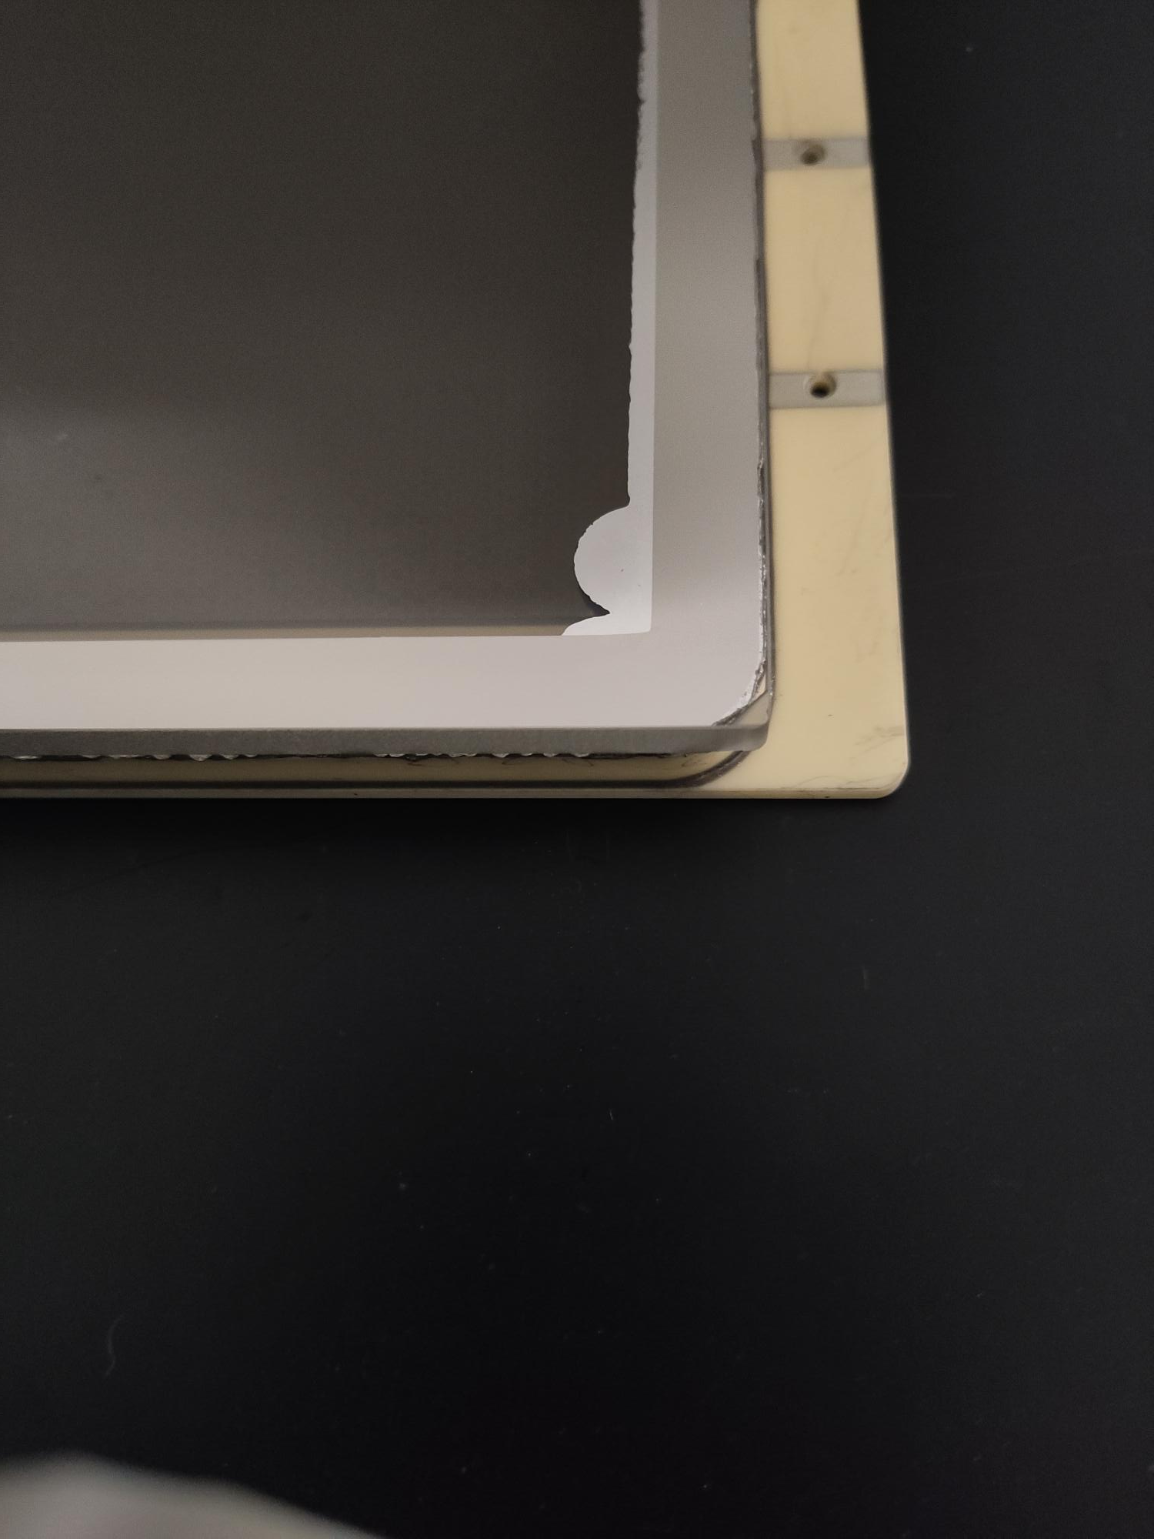
HRPPD9
LTA: Ceramic, 0.229”
MCPs: CJ17936001-004 / CJ17936001-003 (10um, C14)
Spacers: square
Window: 5mm FS
Anode: Resistive
Photocathode: Na-K-Sb
Sealed, but Indium alloy leaked in
No photocathode discoloration after two weeks

Slide 5
Task 1 Summary
Metallization figured out
Backup options available
Three sealing trials planned; one completed
Two other trials will be completed by end of May

Slide 6
Task 2: Anode Design and Fabrication
Design of LTCC anode
Fabrication of a test anode (3”x3” form factor)
Fabrication of a full size anode
50% complete (see talk by A. Kiselev)
Responsible Individuals: A. Lyashenko, M. Popecki, A. Kiselev

Slide 7
Two Test Anodes Fabricated
Electrical integrity verified
Trace capacitance have been measured to be within 10pF

Slide 8
Task 3: Internal Connections
Improving reliability of internal connections
Getting rid of compression springs
Brazing contacts directly onto the anode plate
Test connections in a sealed device
80% complete
Responsible Individuals: A. Lyashenko

Slide 9
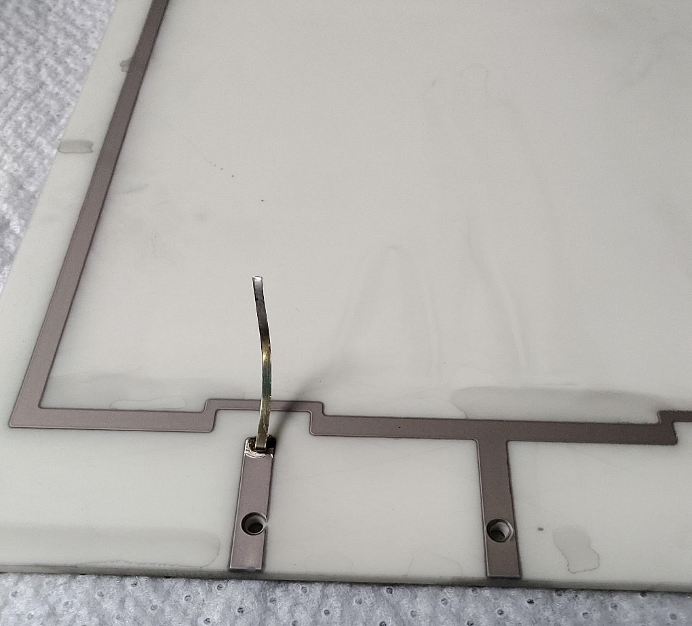
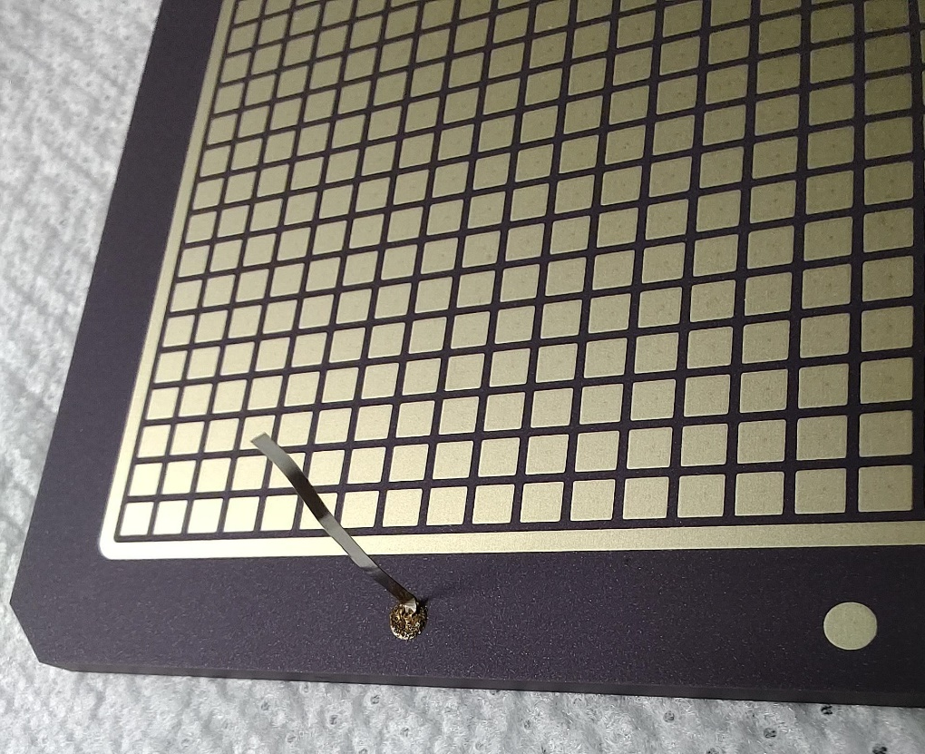
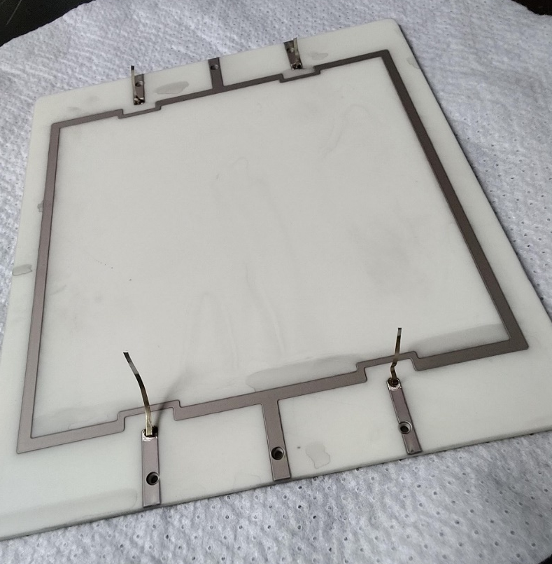
Brazed Contacts

Slide 10
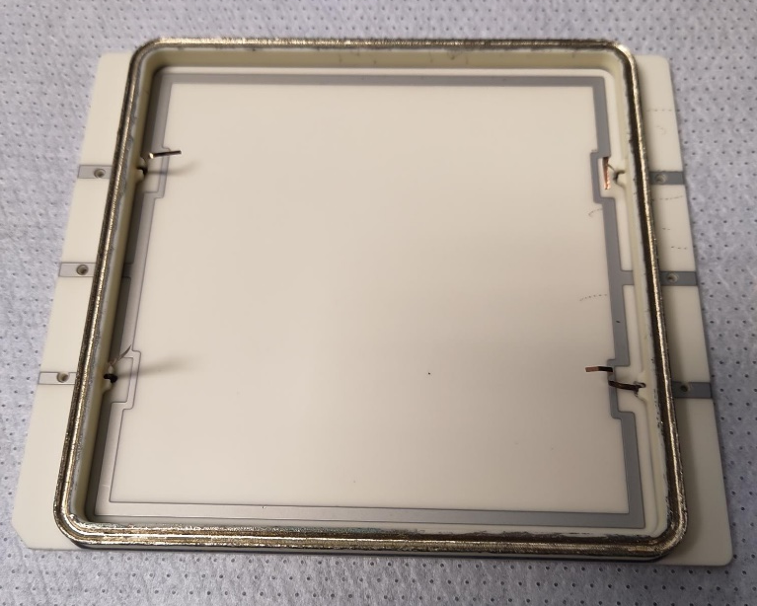
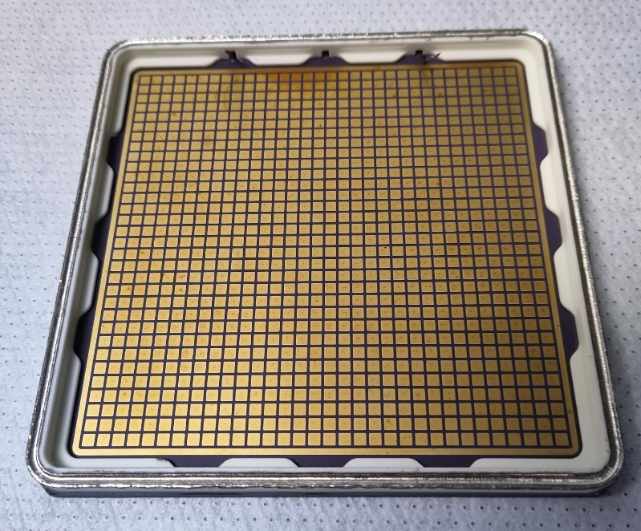
Ceramic HRPPD packages
Capacitively Coupled
Directly Coupled

Slide 11
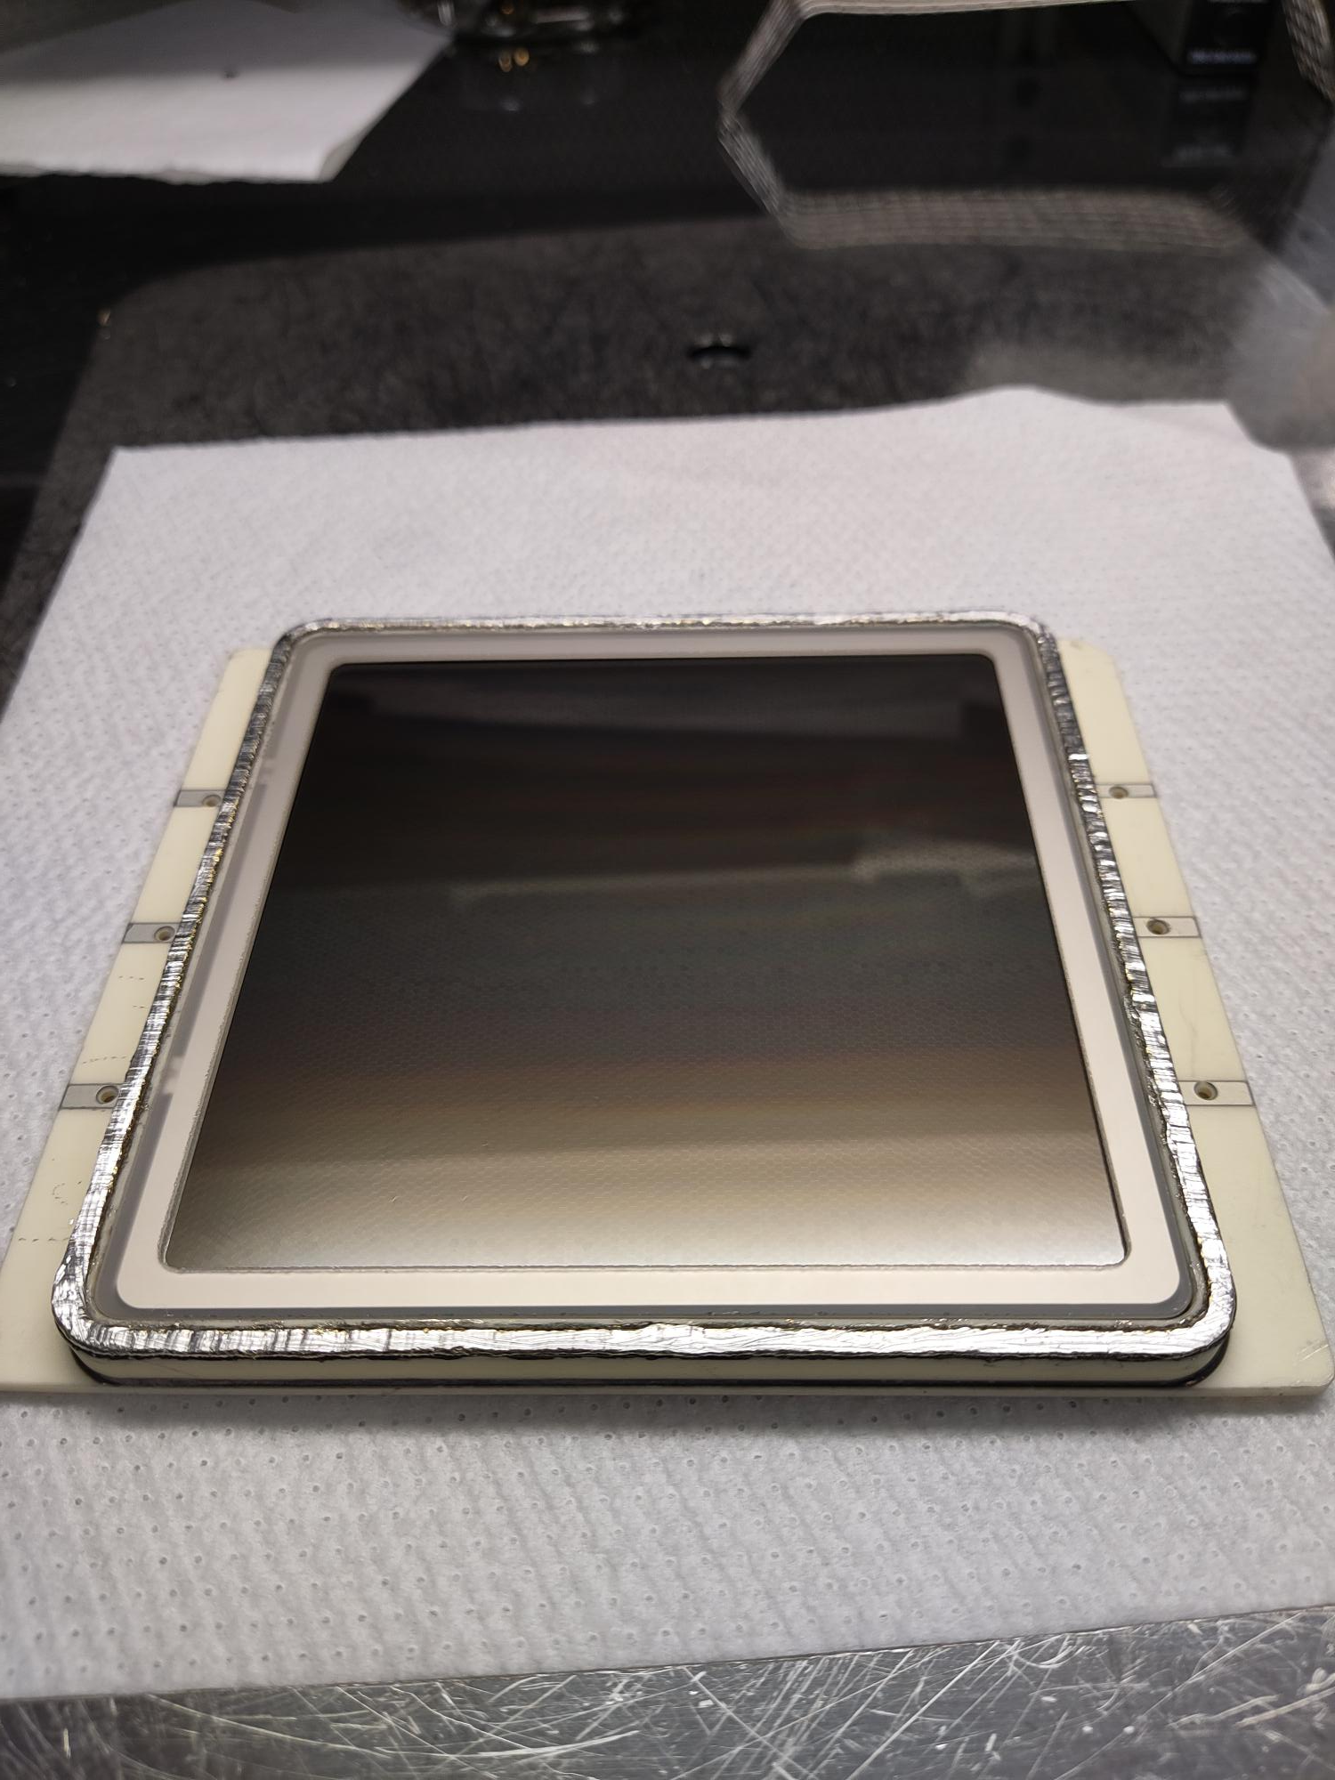
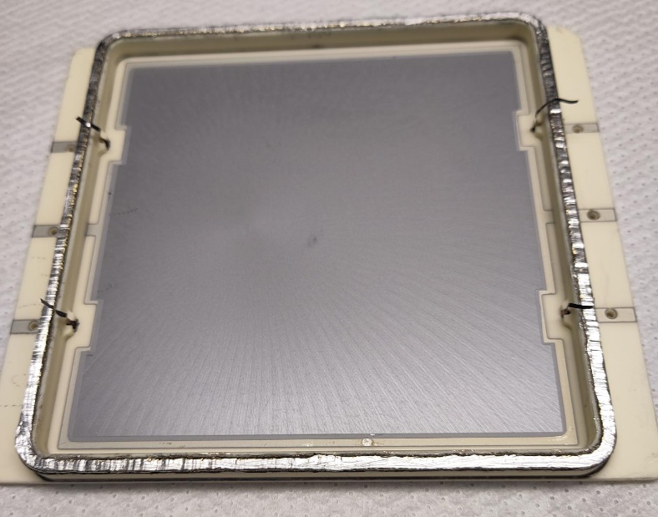
HRPPD9 (sealing trial)
No Springs
Spot-welded MCP contact electrodes to brazed contacts
Gapped MCPs

Slide 12
Task 3 Summary
Brazed contacts seem reliable
Will be tested on Techtra anodes in June 2023

Slide 13
Task 4: Internal Components Design and Procurement
Design of internal stack components for 75% OAR including spacers, shims, getter connections
Ordering components from a third party vendor
80% complete
Responsible Individuals: A. Lyashenko, D. Mensah, M. Foley

Slide 14
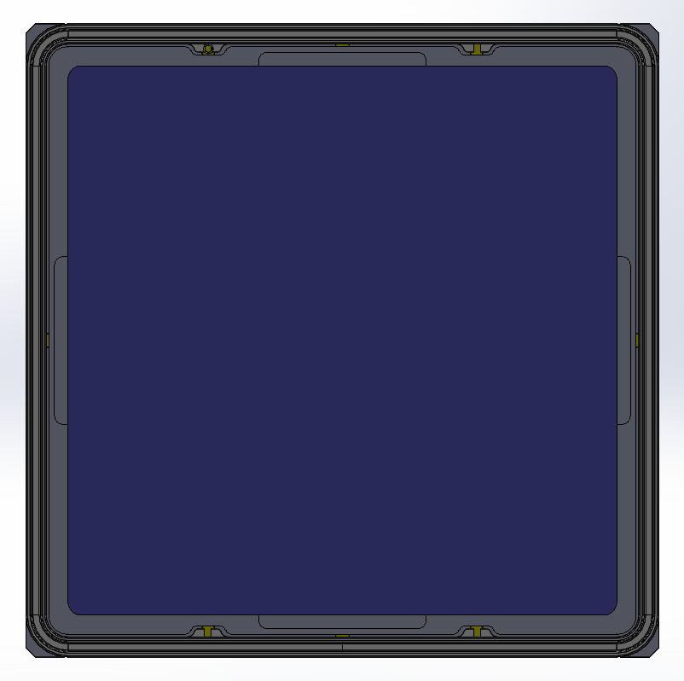
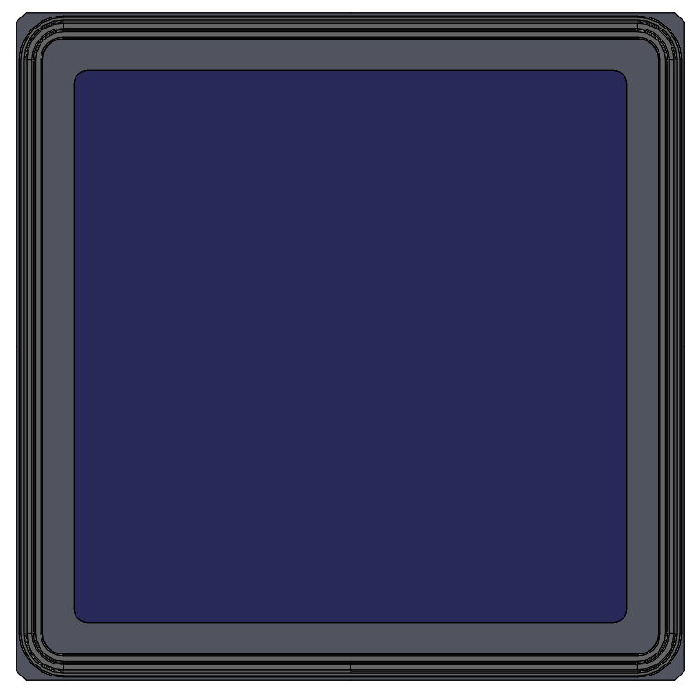
HRPPD active area
Thinner Spacers
Present design
104 mm
100 mm
75% active area fraction
69% active area fraction

Slide 15
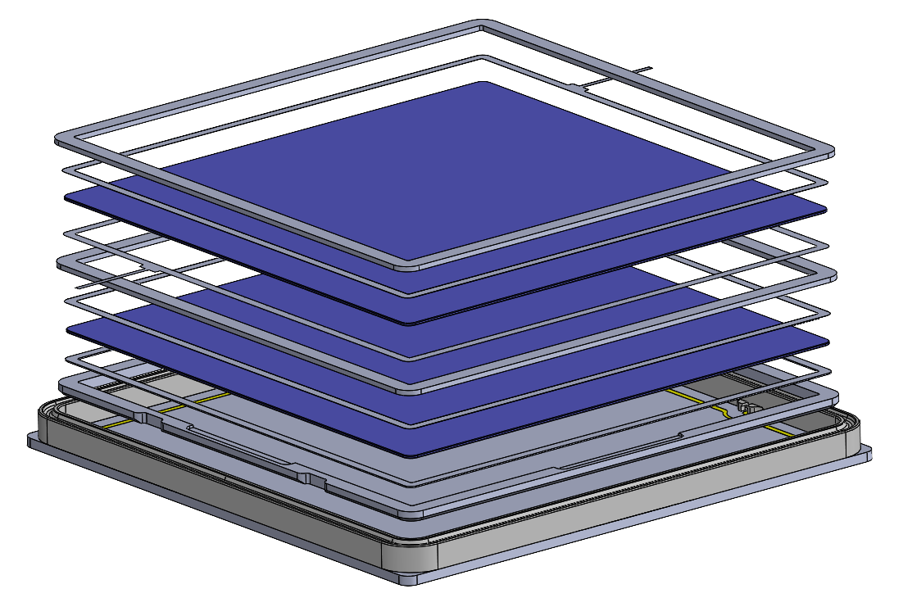
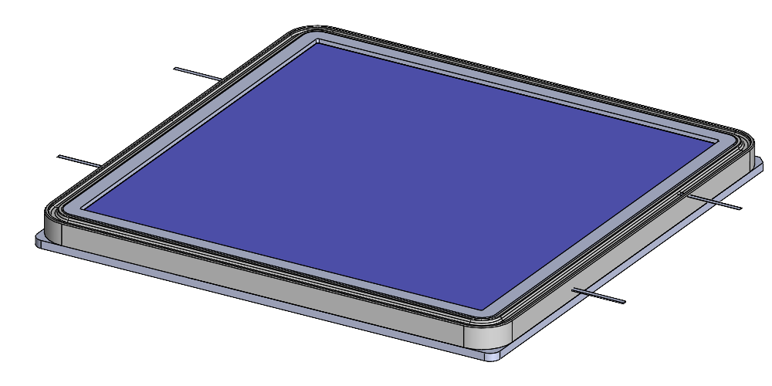
HRPPD active area
75% OAR components

Slide 16
Task 4 Summary
Internal components ordered; expected delivery mid-May 2023

Slide 17
Task 5: Readout Board Design and Procurement
Design and Fabrication of PCB board to connect with LTCC anode
Connectivity options
50% complete (see talk by A. Kiselev)
Responsible Individuals: A. Kiselev, M. Popecki, A.Lyashenko

Slide 18
Task 6: Tile Performance / Process optimization
Photocathode optimization
Tilablity
Gapped MCPs
50% complete
Responsible Individuals: A.Lyashenko

Slide 19
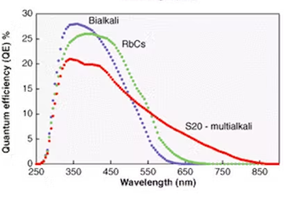
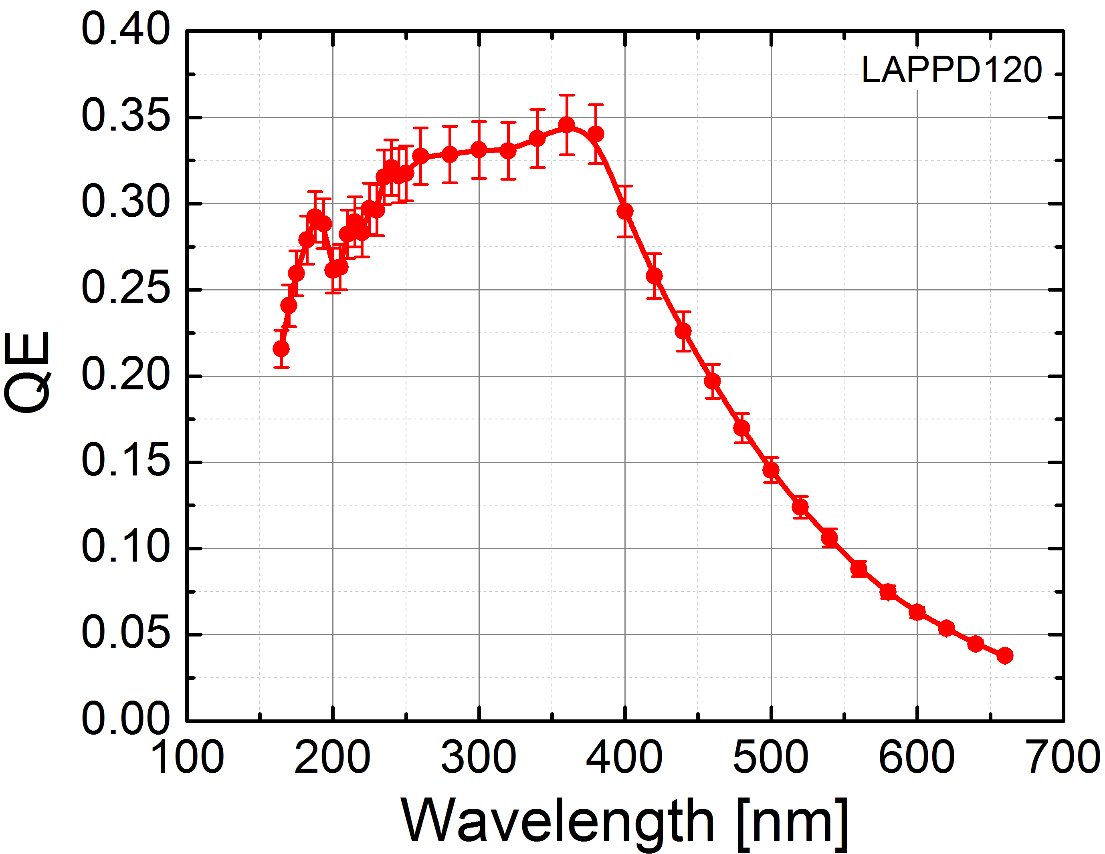
Photocathode development
Goal: Shift QE max to longer wavelengths
Na₂KSb

Slide 20
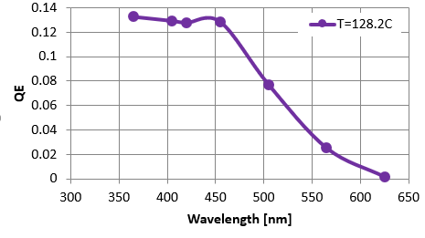
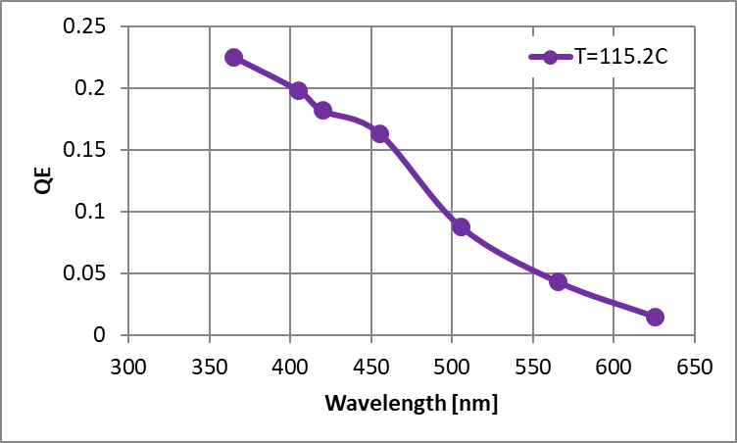
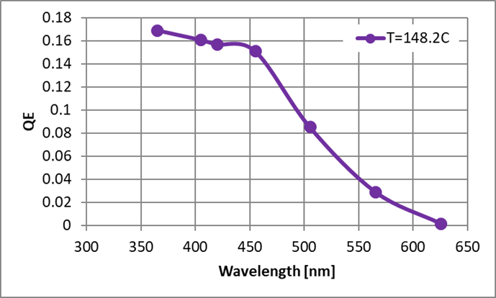
Rb-K-Cs-Sb photocathode trials
Rb-K-Cs-Sb
Na₂KSb

Slide 21
Photocathode: Summary
Several Rb-K-Cs-Sb Trials Performed
Underlayer to improve Sb quality
Thermal noise reduction

Slide 22
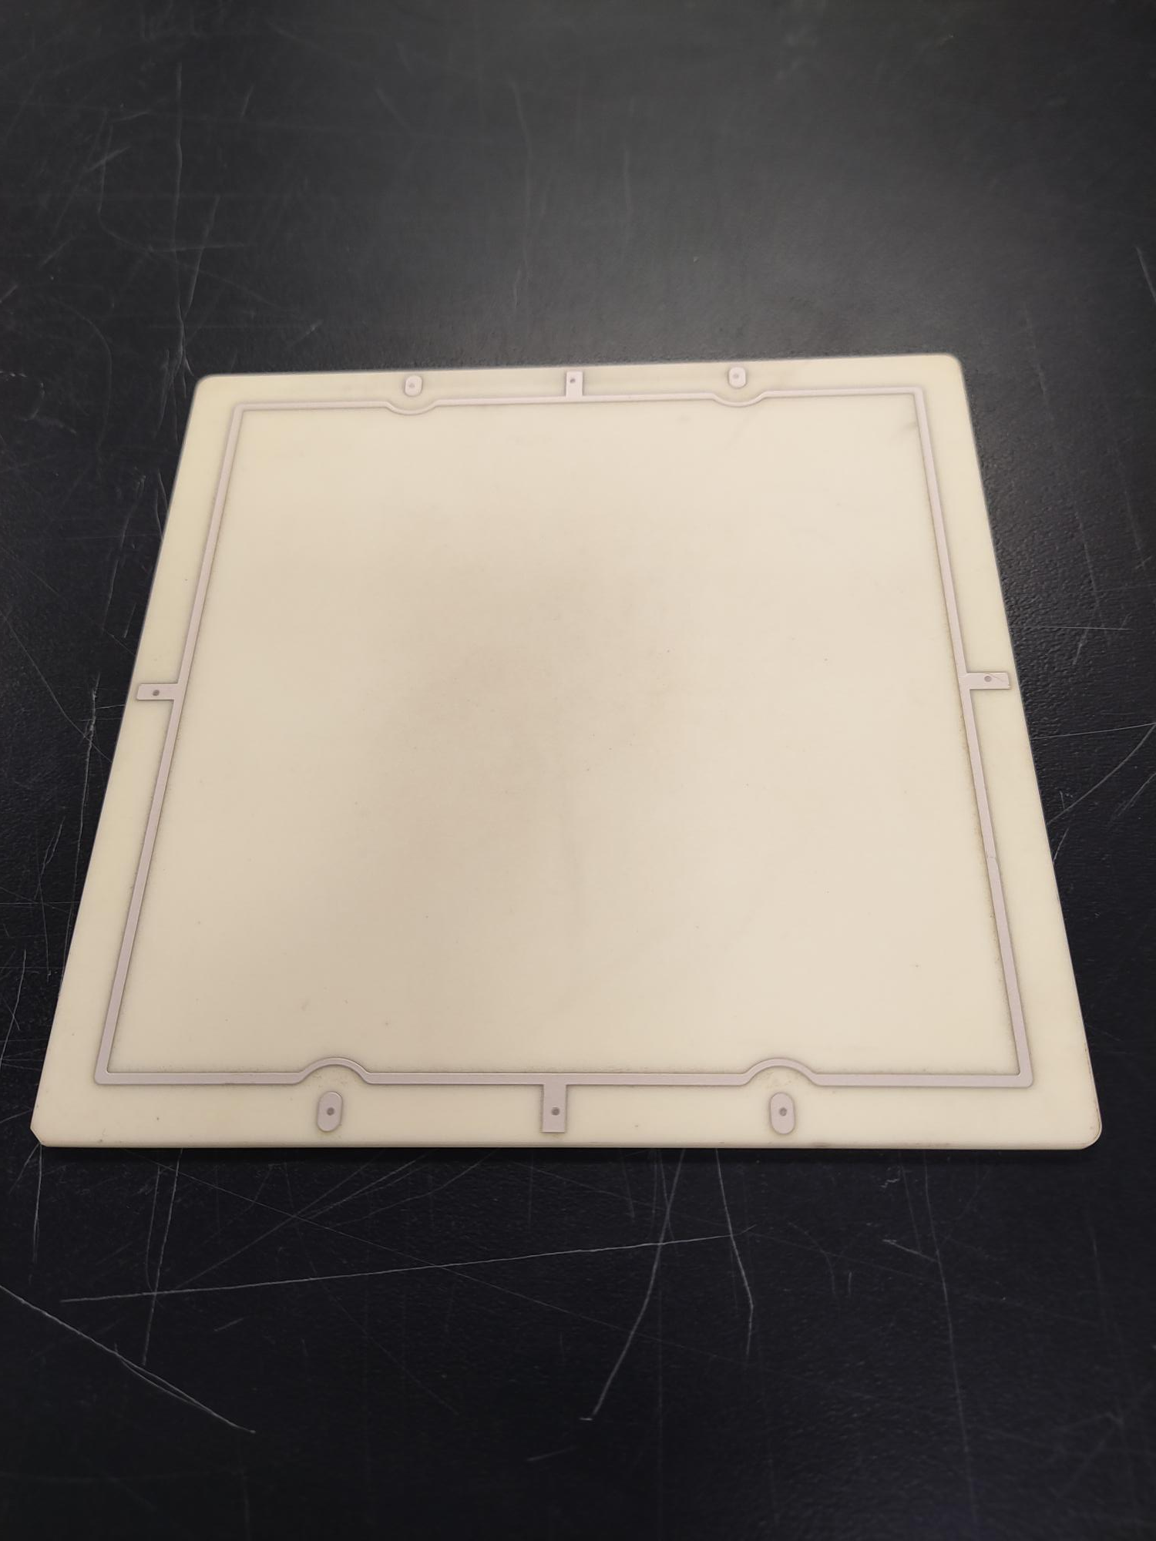
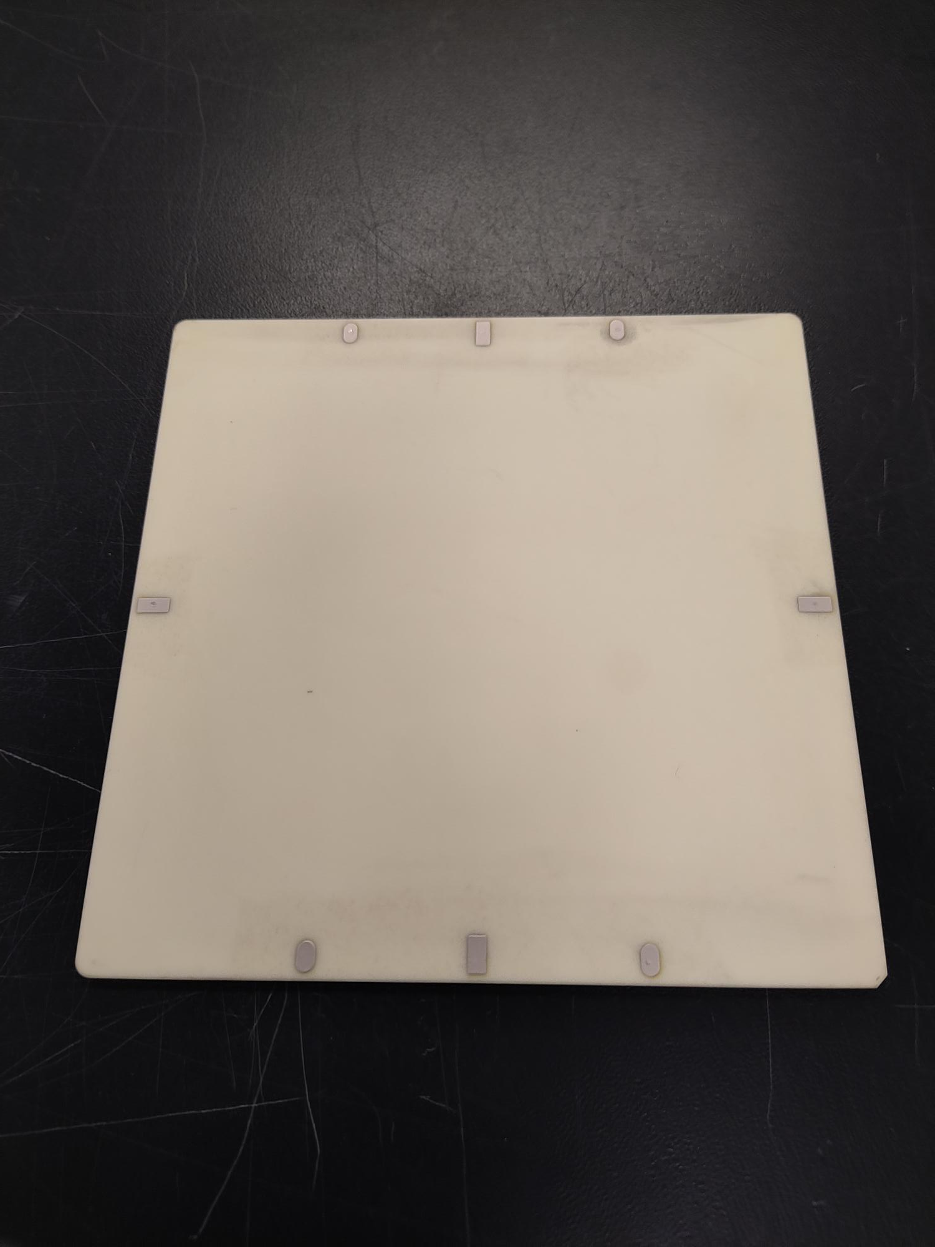
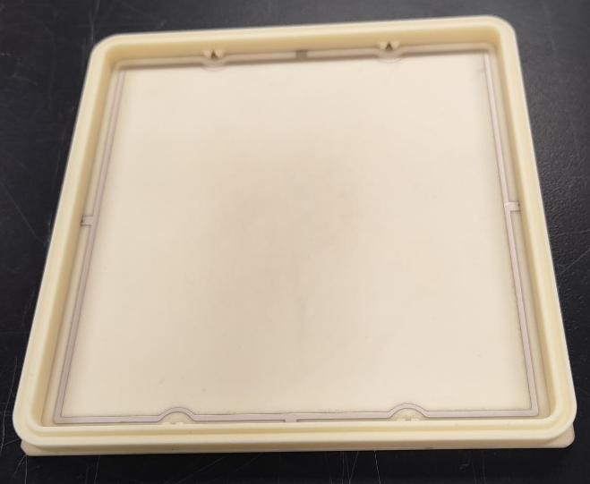
Tilability
Tilable capacitively coupled anode (75% OAR)

Slide 23
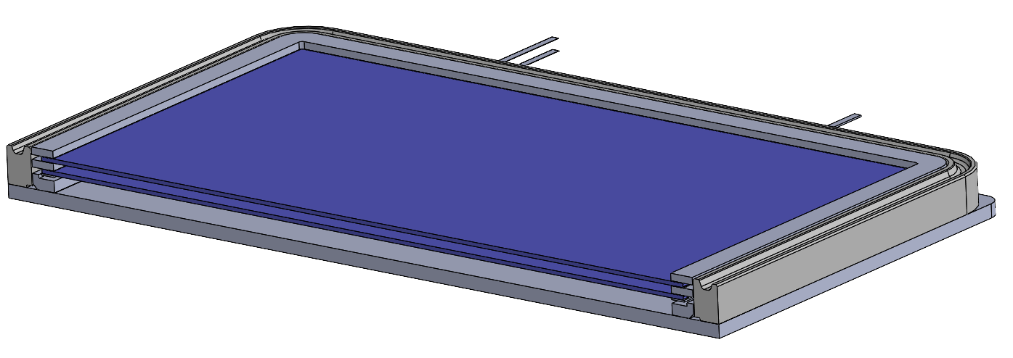
Gapped MCPs
Realized in the new HRPPD package

Slide 24
Summary
HRPPD SBIR grant is ending on May 2
Most tasks are on schedule
Manufacturing of first tiles for EIC will start in August

