Slide 1
Magnetic Field Testing at Argonne National Laboratory
M. Popecki, Junqi Xie & Jack McKisson
February, 2023

Slide 2
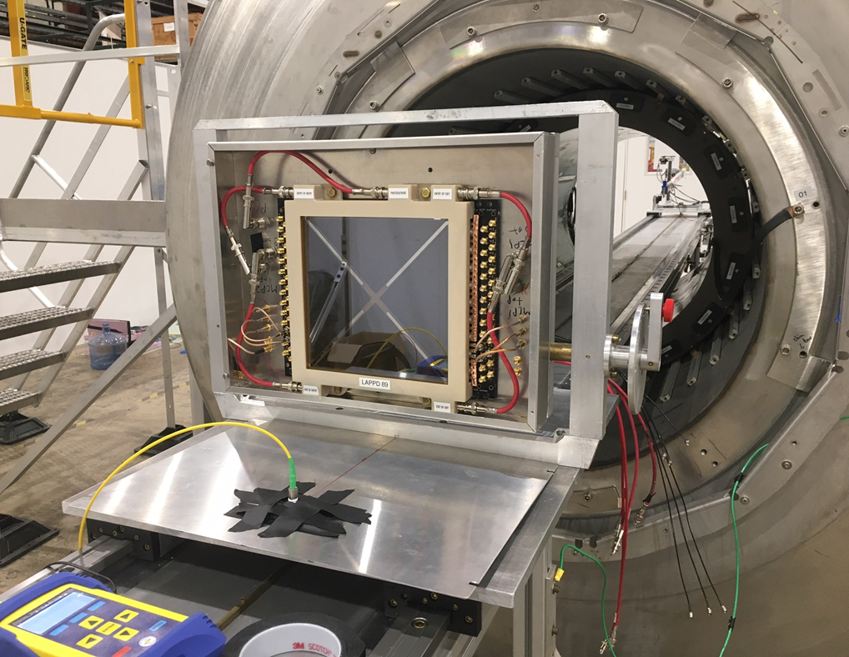
One LAPPD & One HRPPD at a Solenoid Magnet
Two capacitively coupled LAPPDs and One HRPPD
144, 20 um, glass
One directly-coupled HRPPD: 6
Magnetic field strength: 0.02 T to 2.0 T
Dark box
Aluminum case
Laser input fixed in the center near the bottom – on the centerline of the solenoid when the LAPPD is vertical.
Waveforms collected for 12 pixels (LAPPD) and 16 pixels (HRPPD D/C)
Rotation in the magnetic field:
LAPPD tips into or out of the region of stronger magnetic field
Move the LAPPD in or out at each angle to compensate for the change in field strength
Data products
Gain
Position
Position resolution
Transit Time Spread
Afterpulse rate
Detection efficiency estimate
Dark rates
Stripline Lappd 89 shown

Slide 3
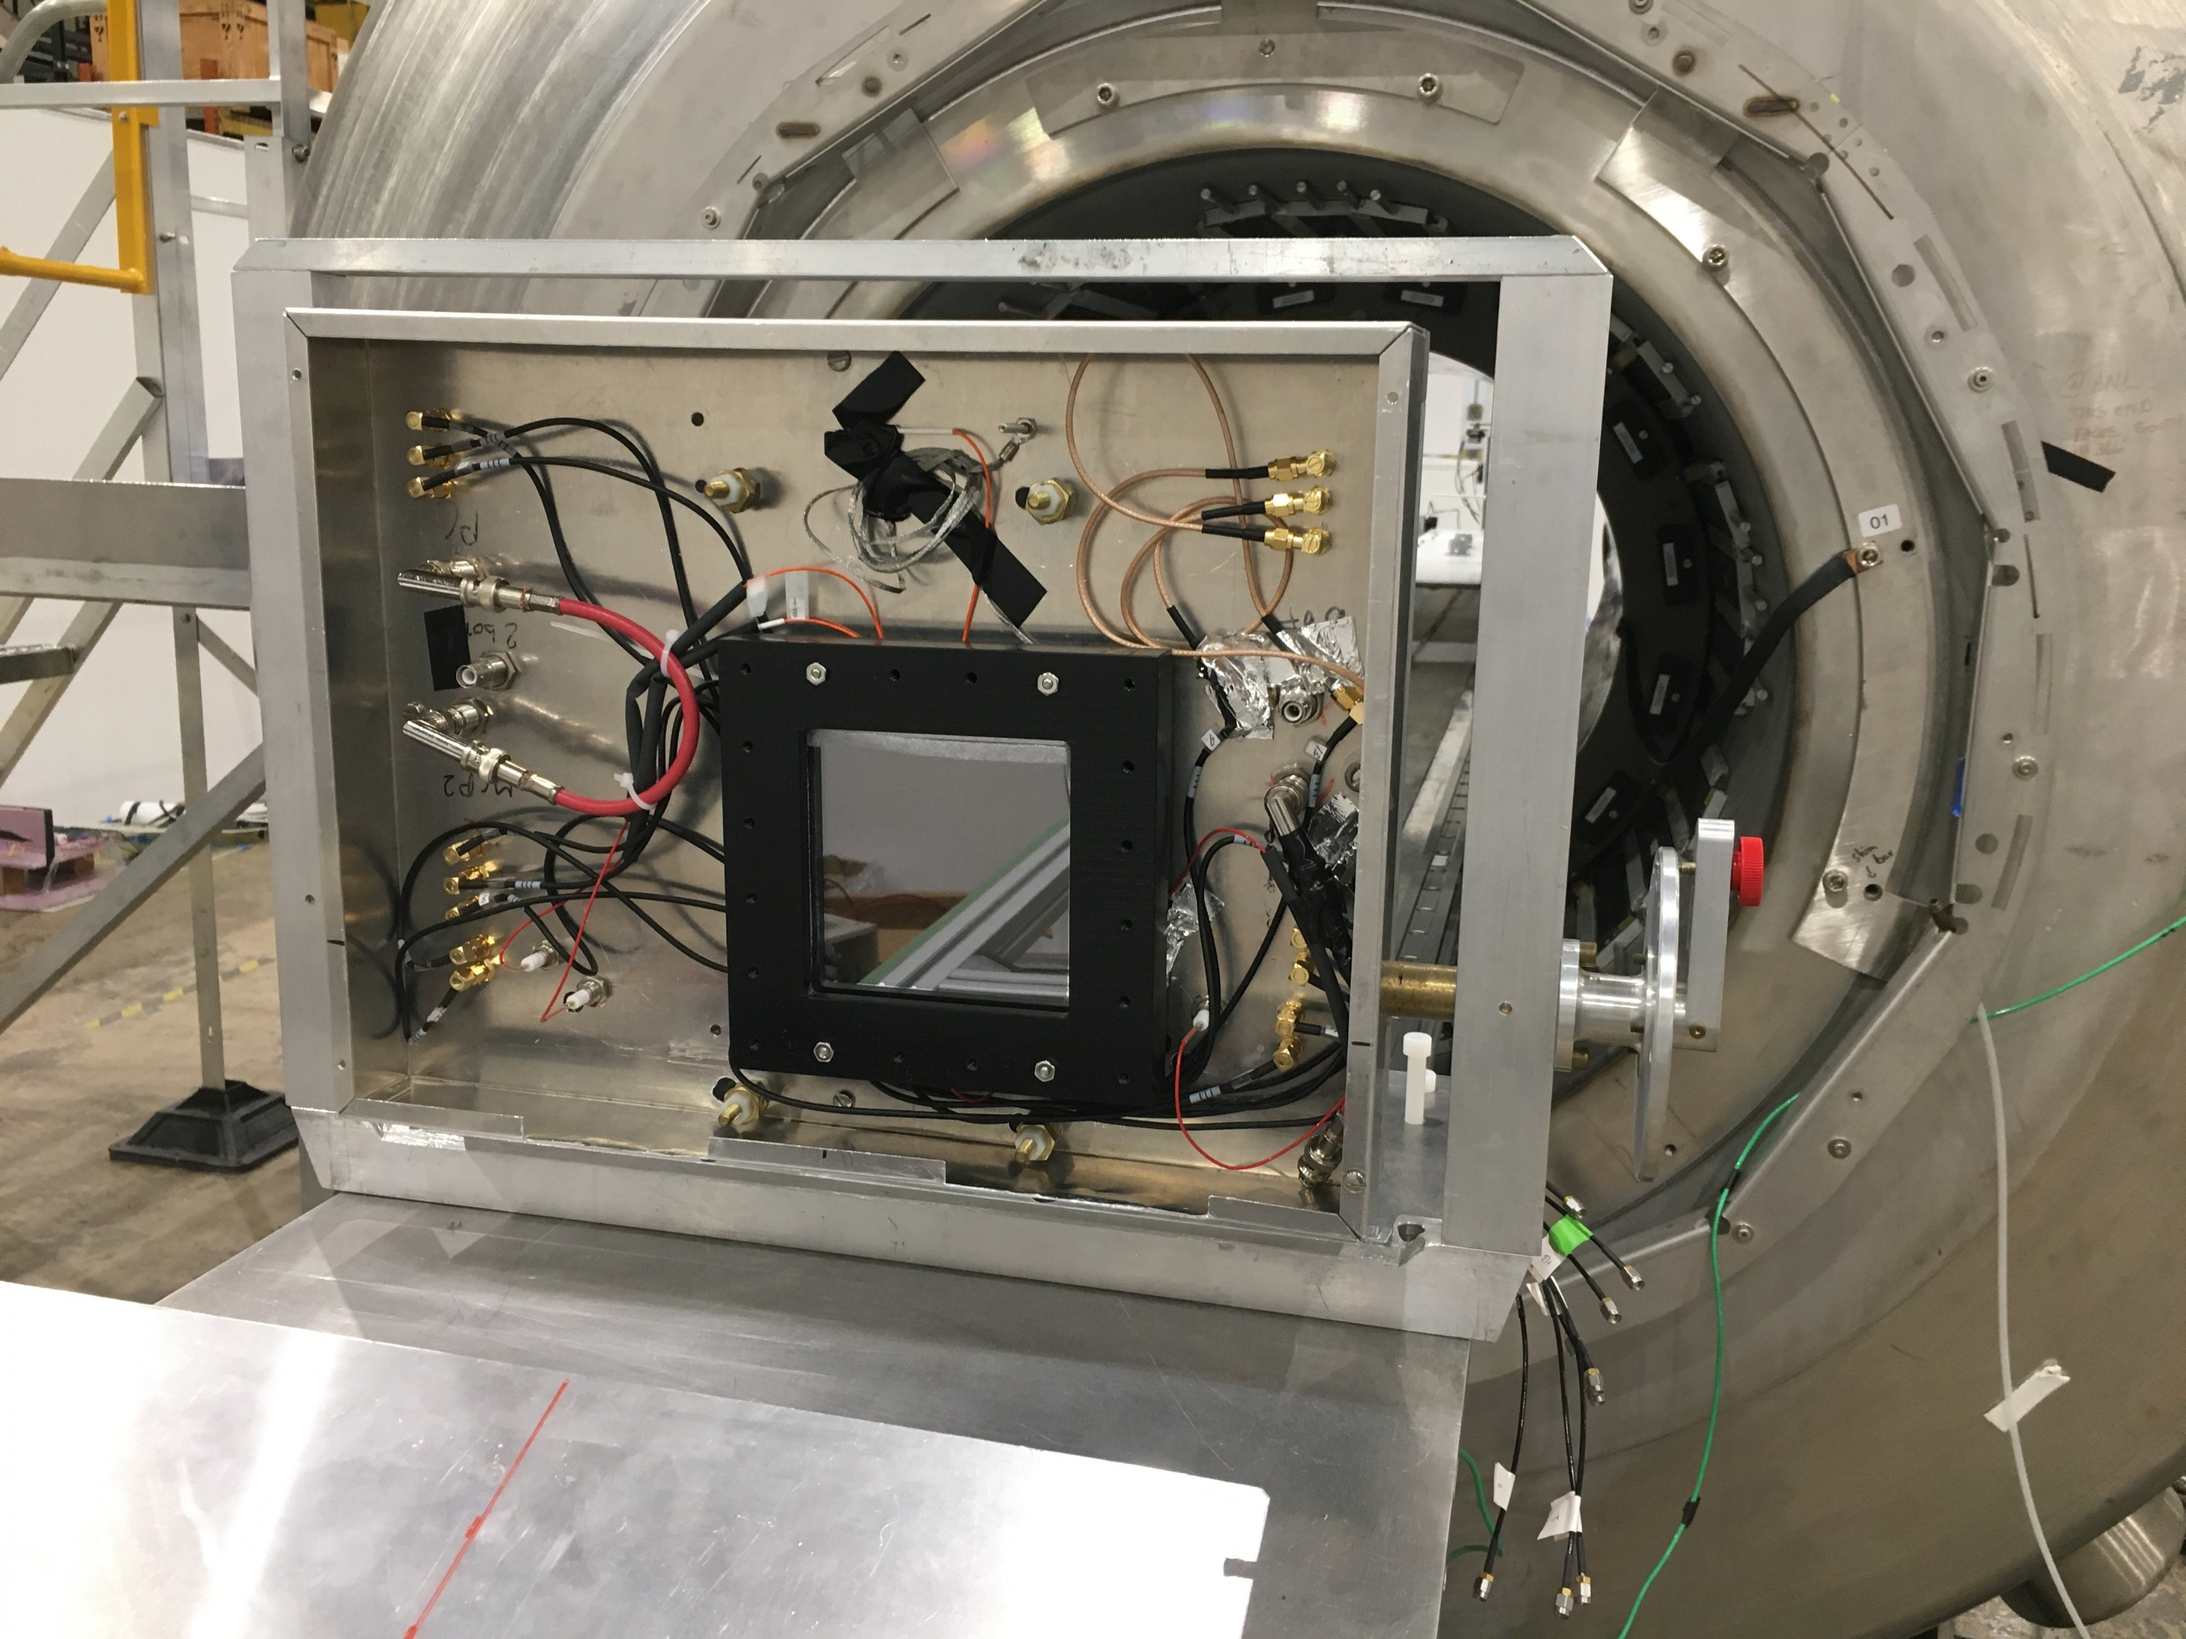
High voltages here
HRPPD 6
MCP chevron orientation
Laser here

Slide 4
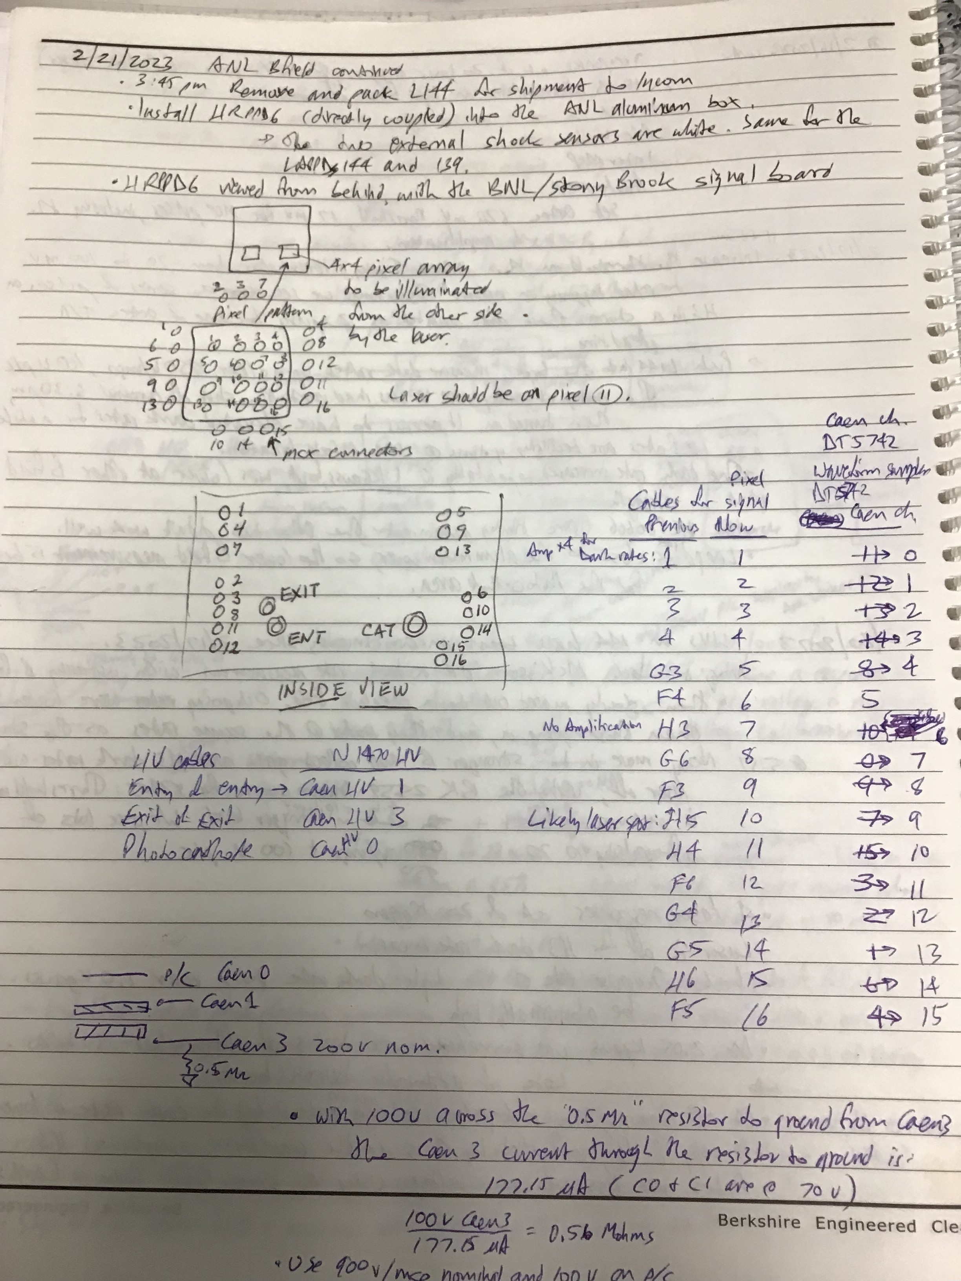
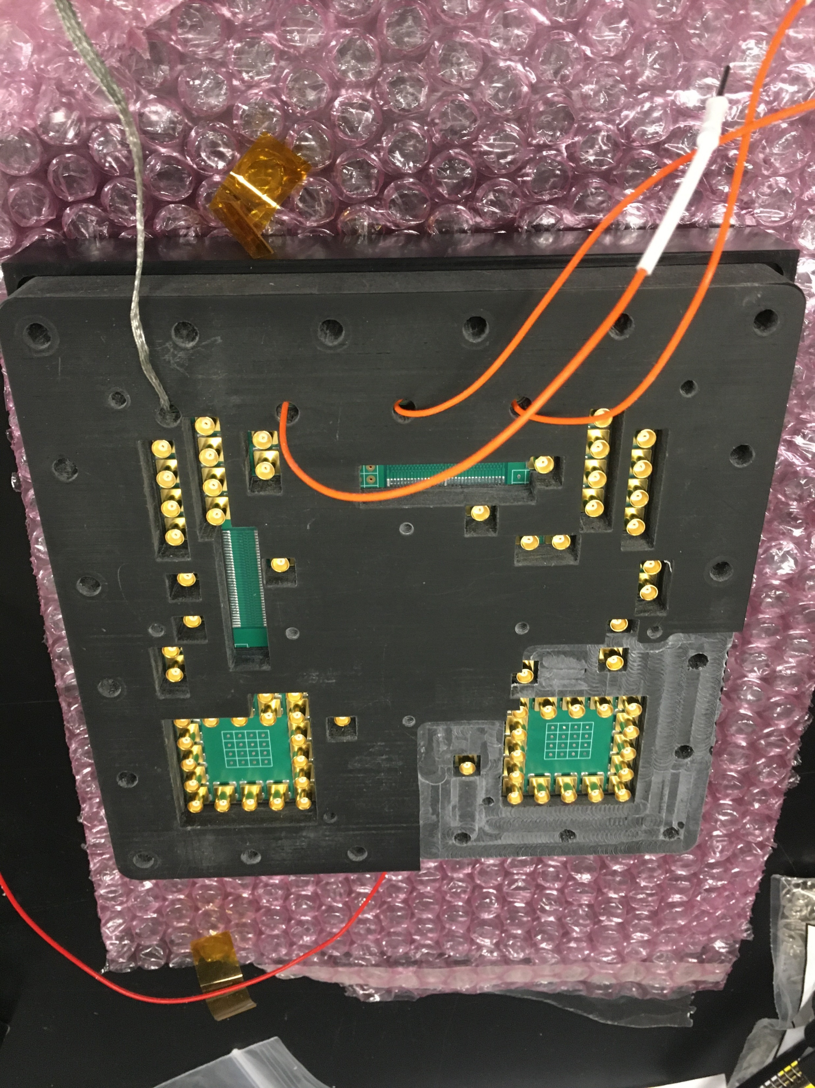
H6 Installation Notes
View from behind H6 through the HRPPD toward the laser
1
2
3
4
5
6
7
8
Laser here
9
10
11
12
13
14
15
16
Top of H6, with HV inputs
View from the laser
4
3
2
1
Laser here
8
7
6
5
12
11
10
9
Laser here
16
15
14
13

Slide 5
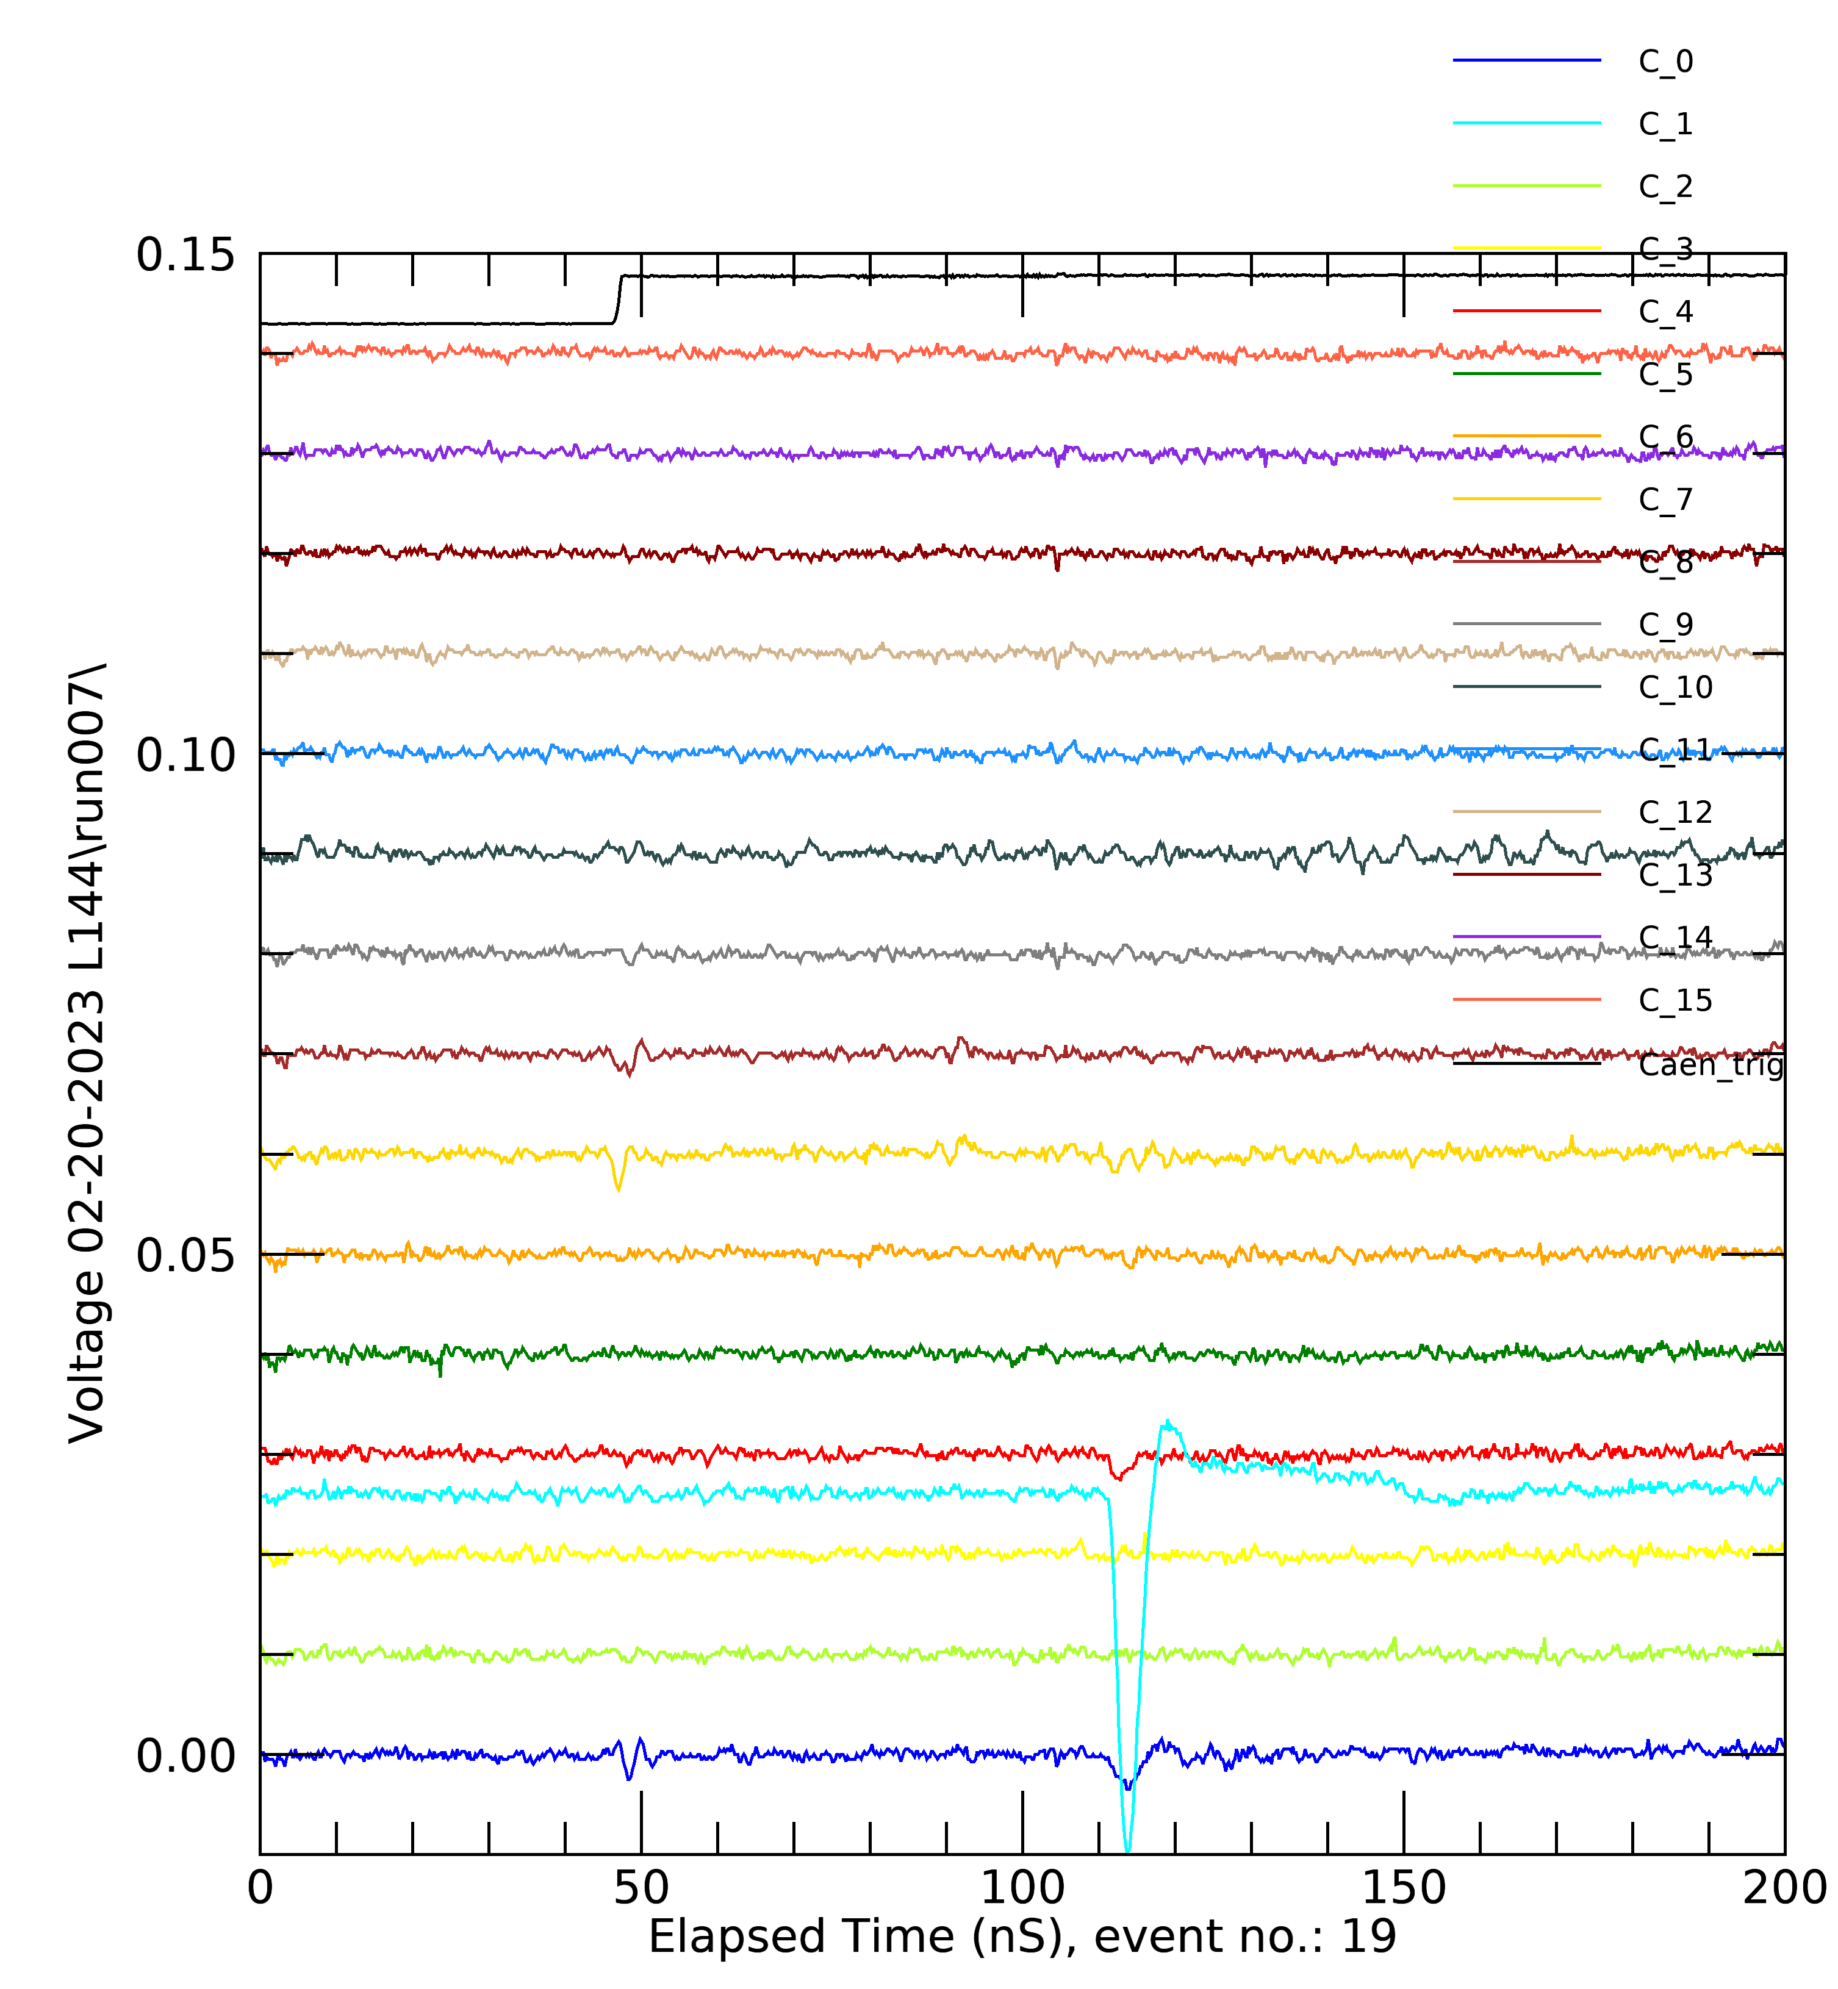
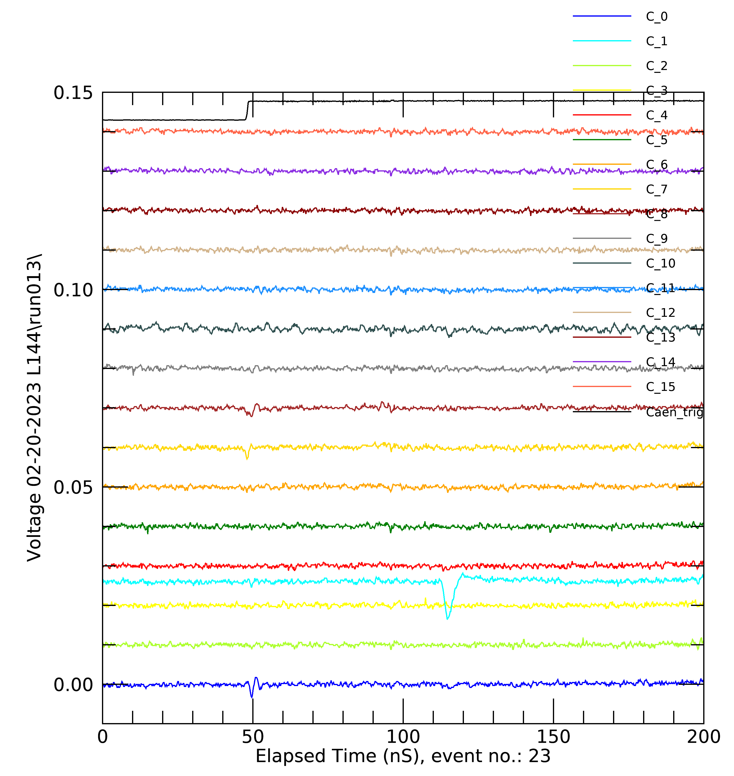
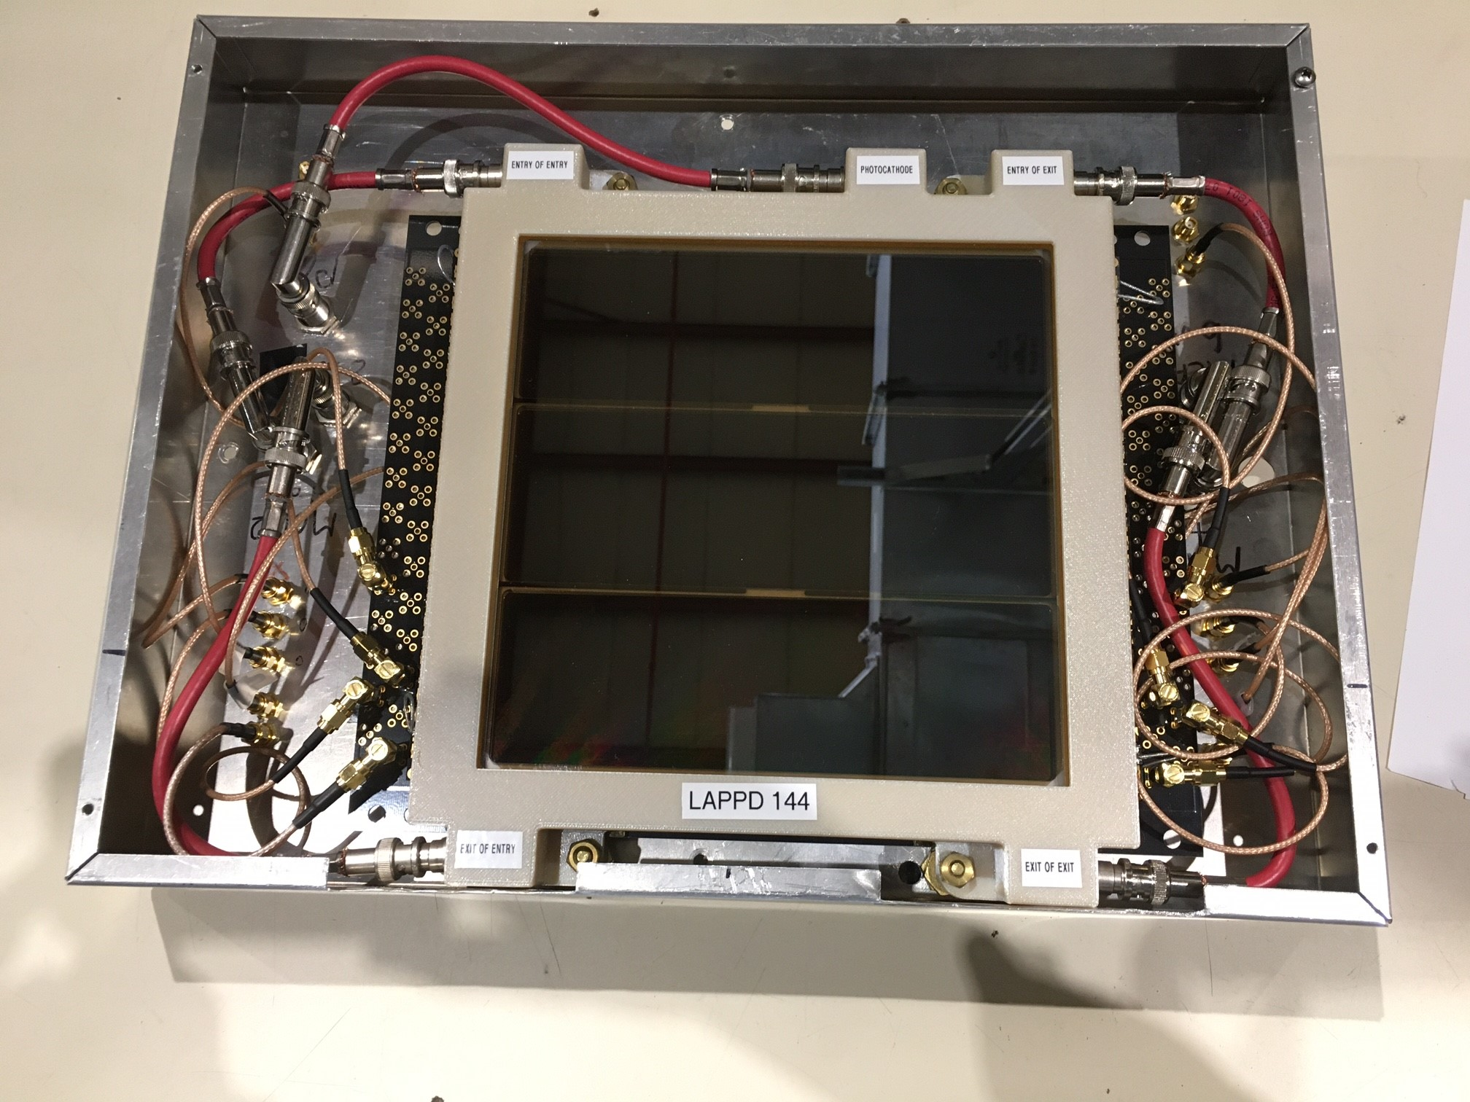
Localization of the Capacitively-Coupled Signal
L144
25 mm pixels
Laser on pixel G5
Neighbors G6, F5 also responded
G5
0.205 T
0.873 T

Slide 6
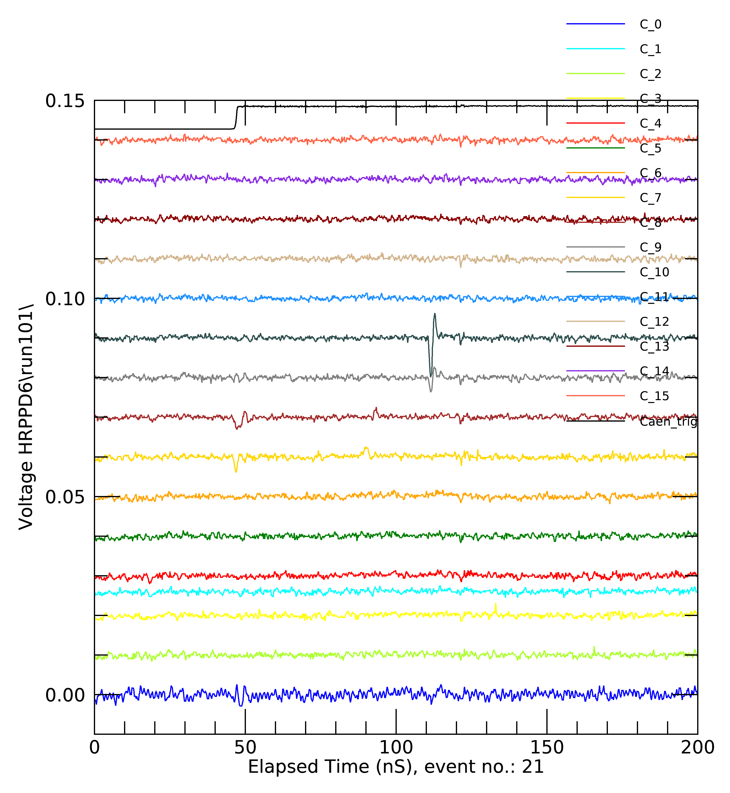
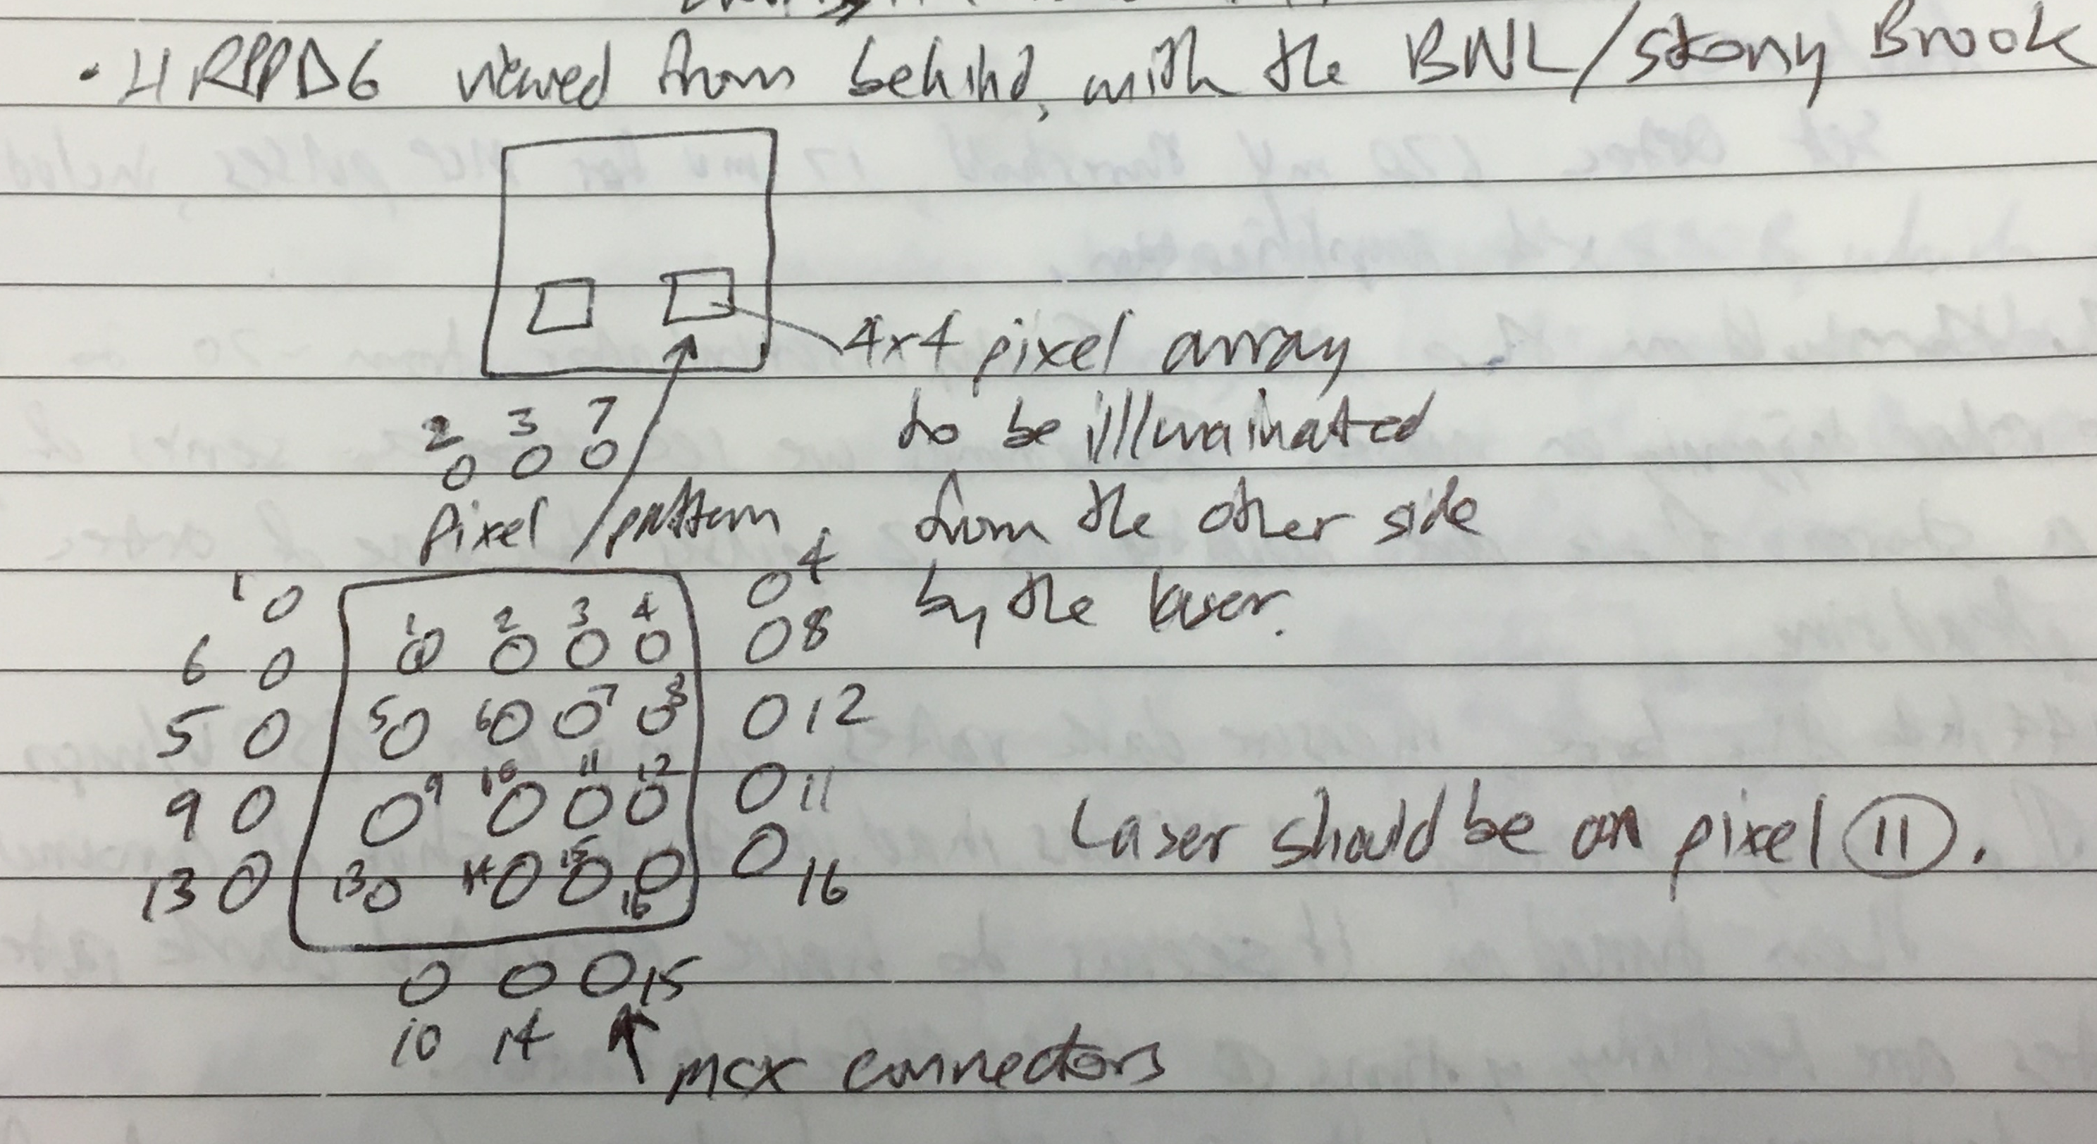
Localization of Directly Coupled Signal: H6
0.0425 T
B field perpendicular to the window
3 mm discrete pixels
The signal appears to be confined to two adjacent 3 mm pixels.
Pixel 11
Pixel 12
Pixel 10

Slide 7
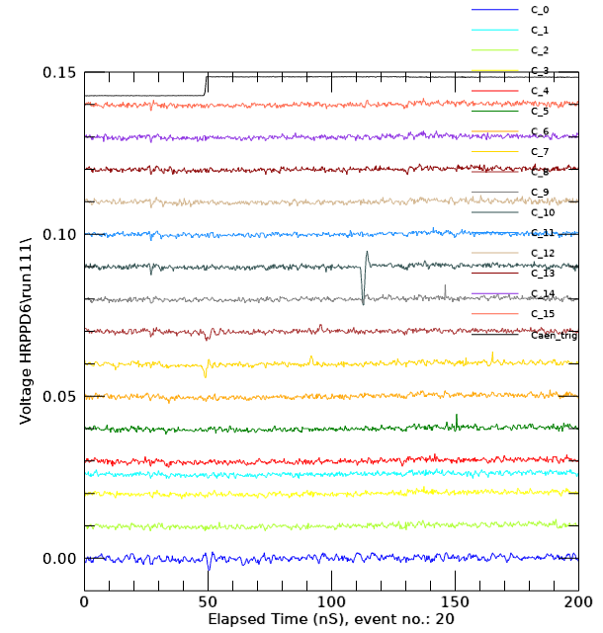
Localization of Directly Coupled Signal: H6
1.0 T
B field perpendicular to the window
3 mm discrete pixels
The signal appears to be confined to a single 3 mm pixel.
Laser trigger
Pixel 11
Pixel 12
Pixel 10

Slide 8
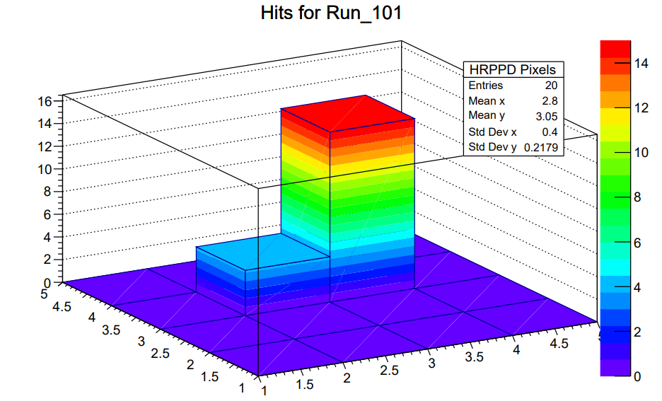
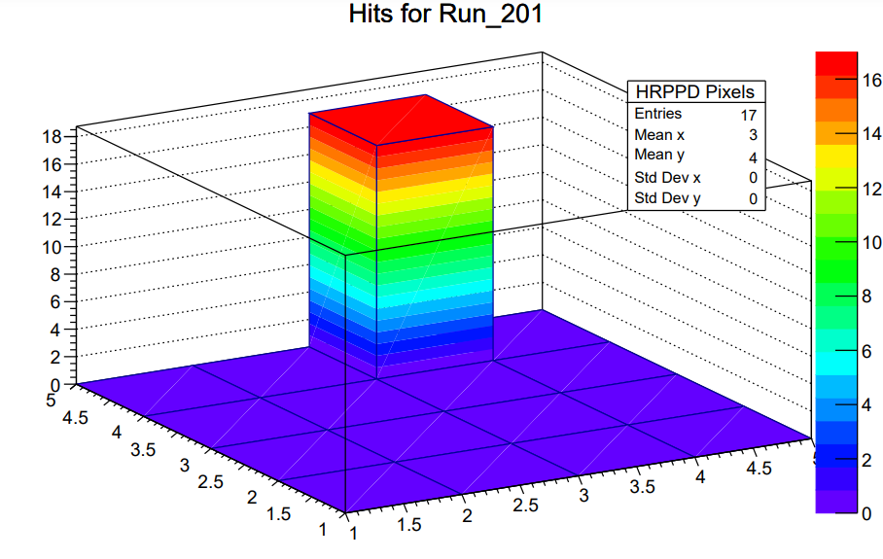
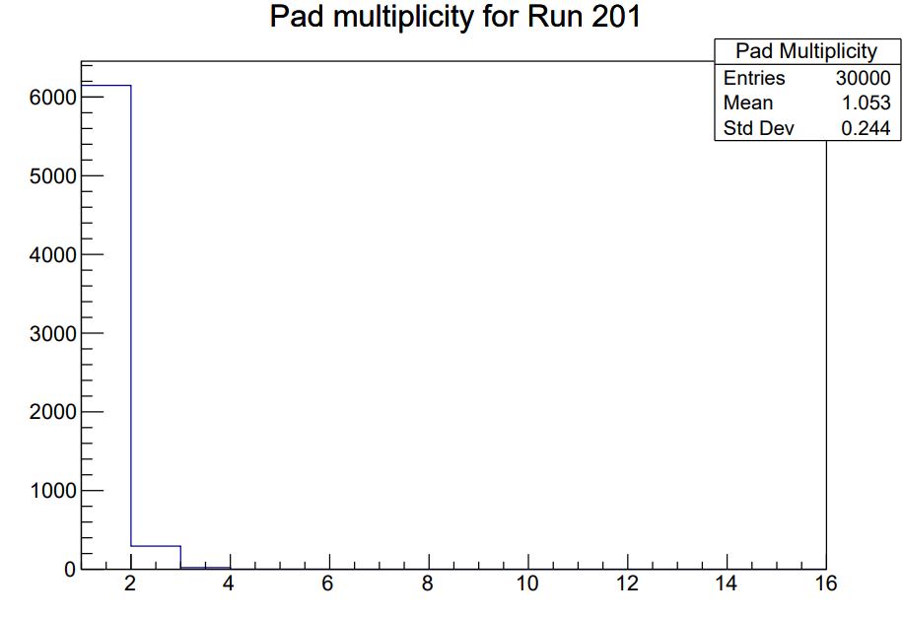
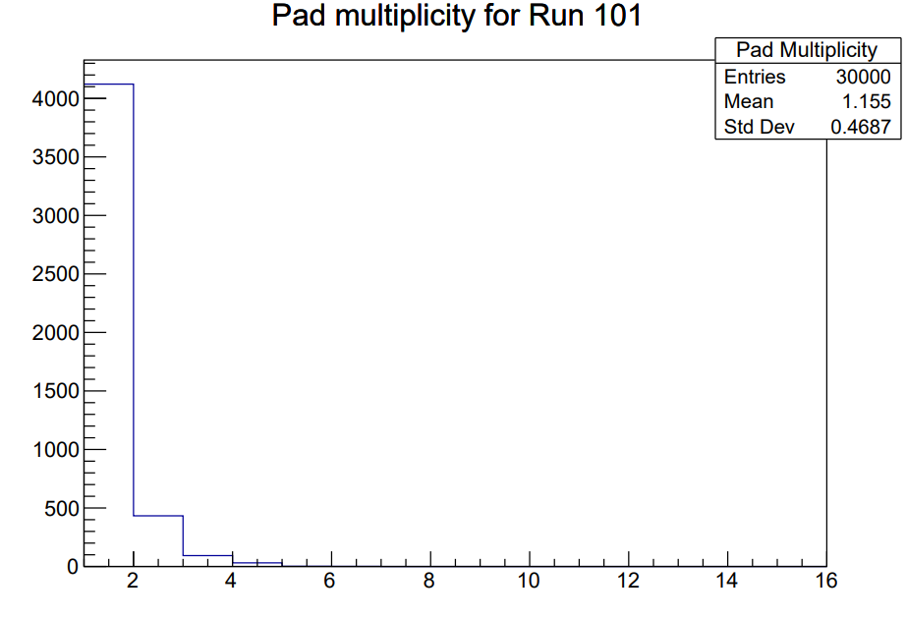
Localization and Movement of the H6 Signal
Directly coupled vias through the anode
At 0.4 T, the signal is localized principally to one 3 mm pixel, but with a neighbor response.
When the magnetic field is at an angle to the window, the MCP spot moves: 1.4 T, -15 degrees tilt.
0.0425 T
B perpendicular to window
1.4 T
B: -15 deg to window

Slide 9
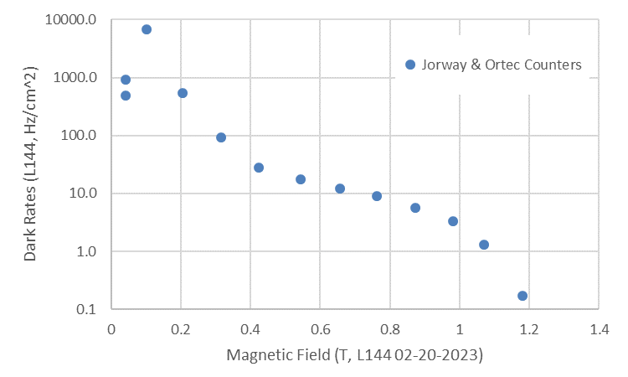
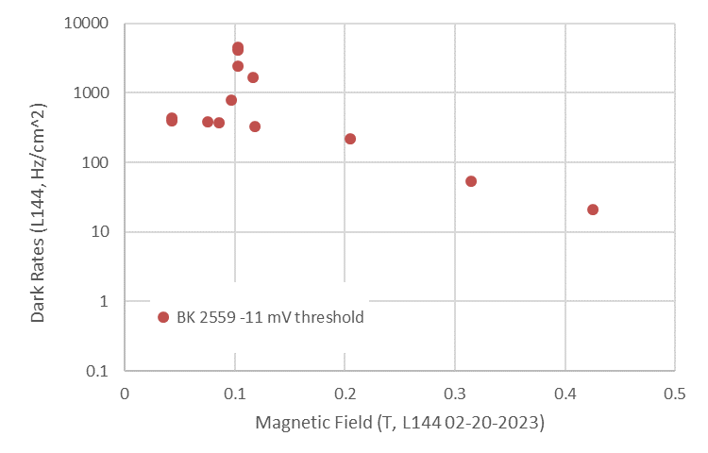
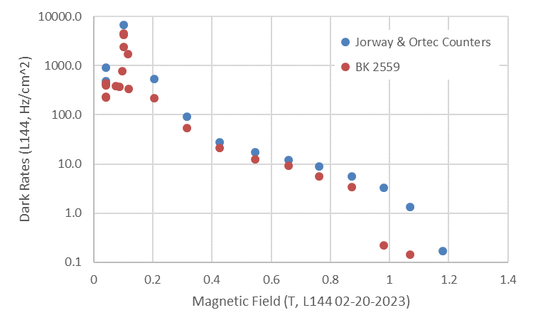
Dark Rates vs. Field Magnitude
Dark rates measured using:
Two pulse counters – Jorway counter and an Ortec 778
BK 2559 oscilloscope with trigger crossing counter
Dark counts decline with increasing magnetic field strength
A persistent count rate peak was observed at one field strength.
The response was isolated to a narrow range of field strength, much like a resonance.
LAPPD144 02-15-2023.xlsx, see AF78

Slide 10
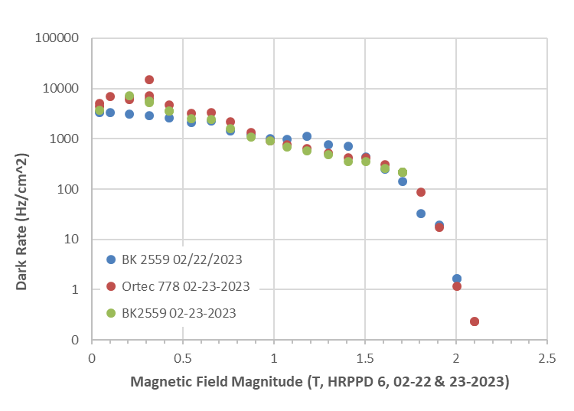
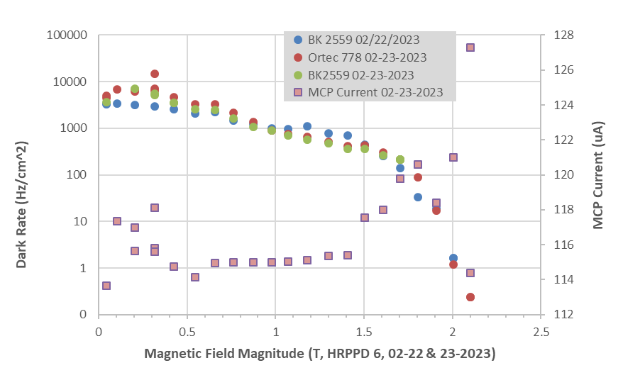
Dark Rates & Magnetic Field Magnitude: HRPPD 6
HRPPD 6
B field perpendicular to the window.
Dark rates were measured with both an oscilloscope counting trigger threshold crossings and two integrating counters. Results were similar.
The MCP current increased at stronger magnetic fields, even though the signal amplitude was reduced.
The previously observed resonance-like feature in dark rates on L144 was not as strong here with H6. See 0.65 T.
The dark rates continue in H6 out to 2.0T, rather than falling off at 1.2 T as with the 20 um L144.
HRPPD 6
LAPPD 144

Slide 11
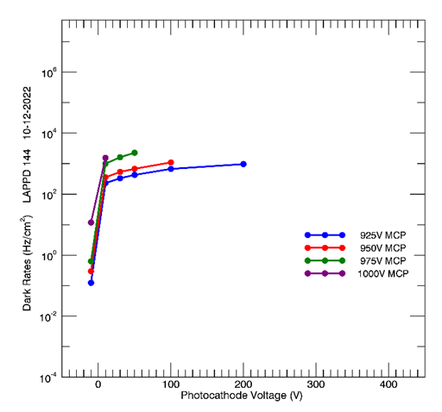
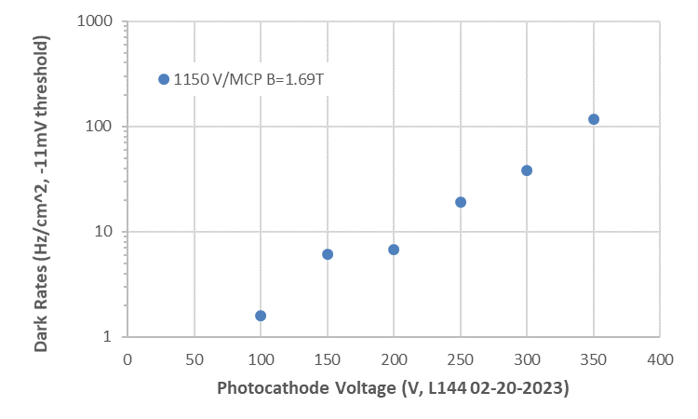
Dark Rates vs. Photocathode Voltage
Dark rates increased with photocathode voltage.
Rates are lower at 1.69 T than at the Earth’s field.
Is the magnetic field reducing the emission from the photocathode more than reducing the gain?
-11 mV threshold
1.69T
-4 mV threshold
Earth’s B field

Slide 12
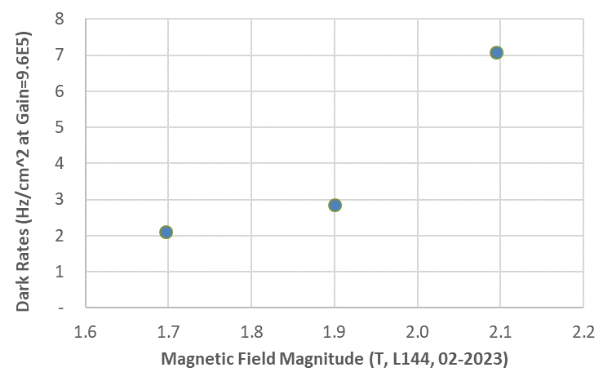
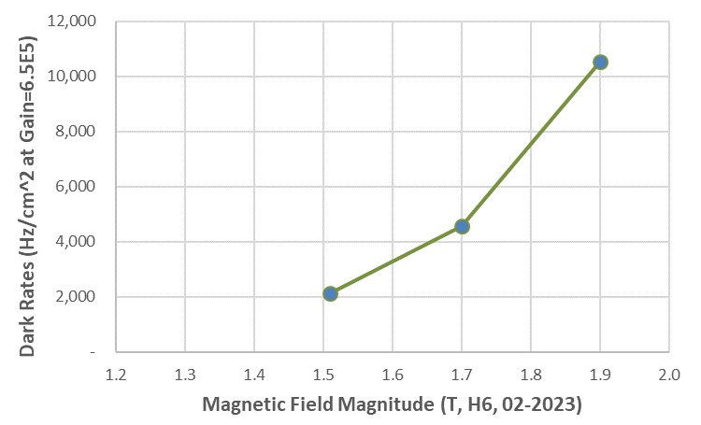
Dark Rates vs. Field Magnitude at Fixed Gain
Dark rates decrease with increasing magnetic field magnitude, using a fixed MCP and photocathode voltage.
If the gain is maintained in stronger magnetic fields by increasing the MCP voltage alone, the dark rates increase with magnetic field magnitude.
However, dark rates for the LAPPD are still quite low.
HRPPD 6 shows the same trend, but the dark rates are unusually high.
LAPPD 144
HRPPD 6

Slide 13
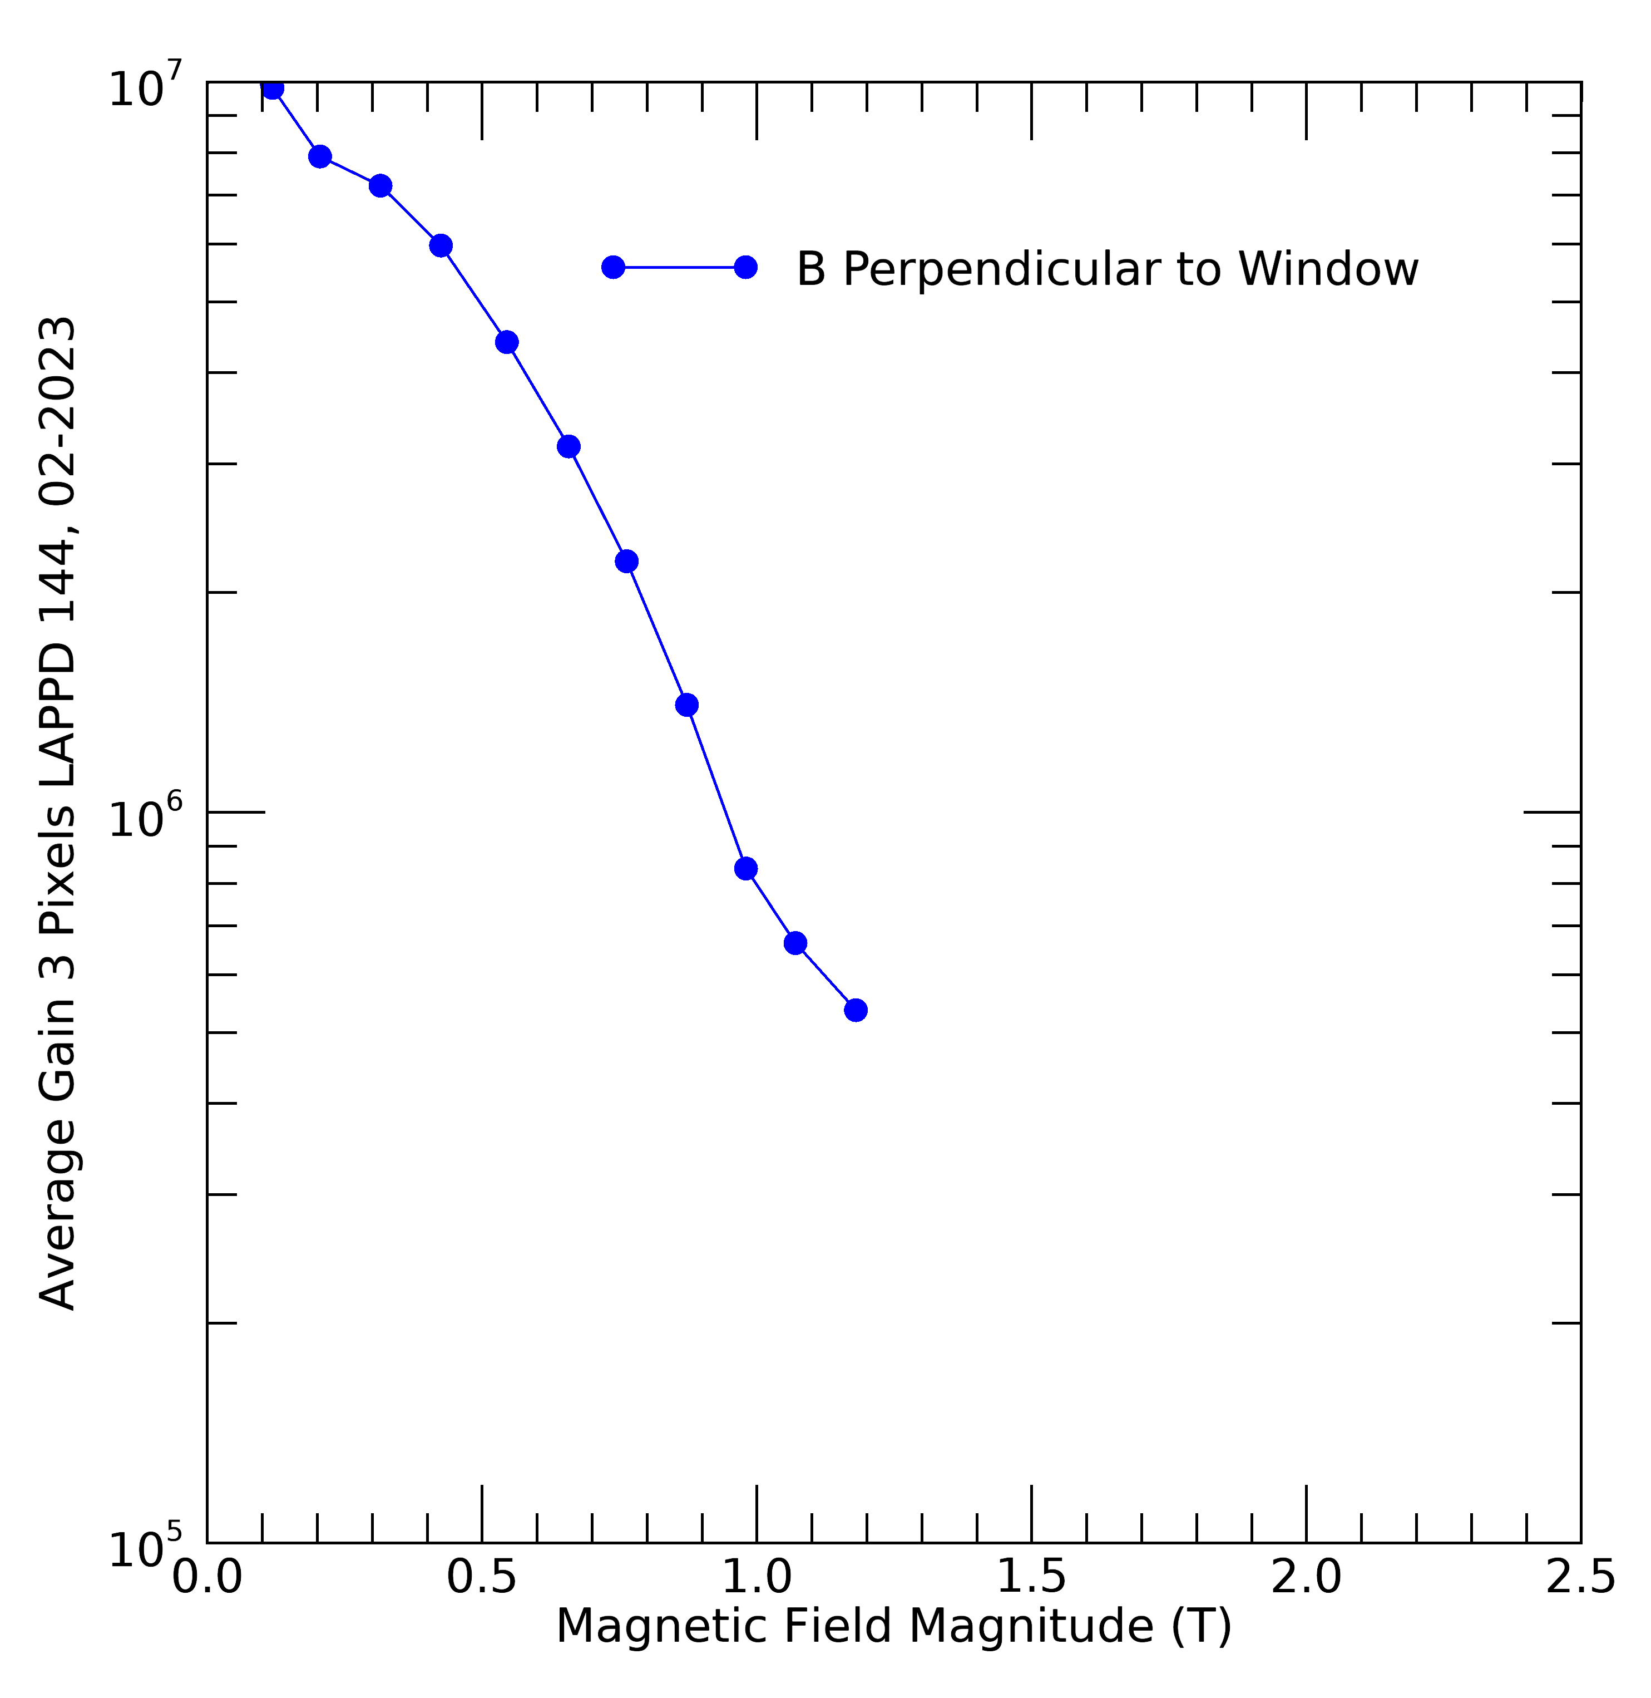
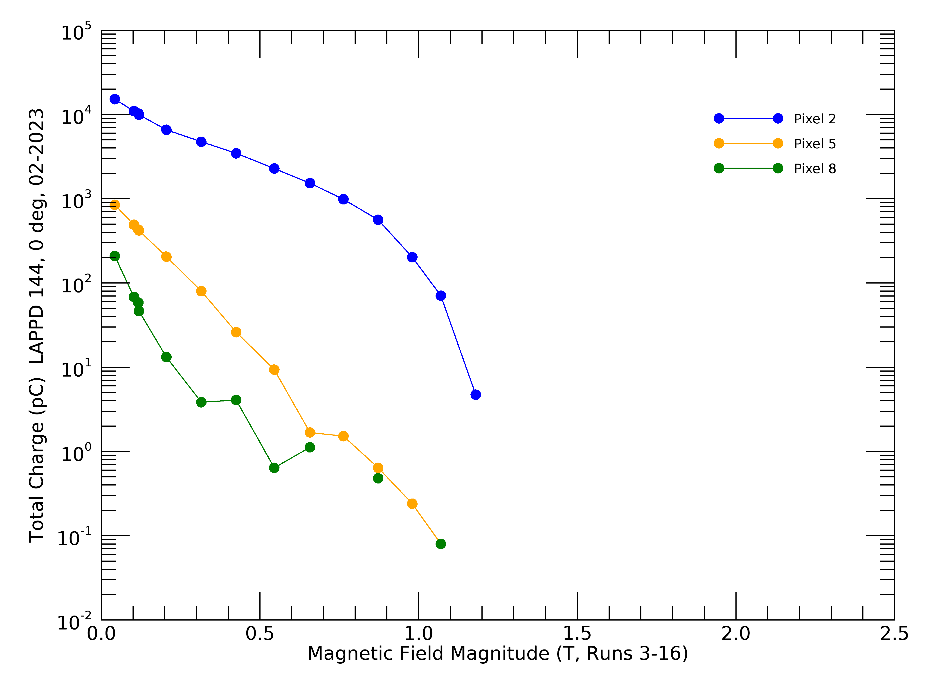
Gain vs. Magnetic Field Magnitude: L144
LAPPD 144
Capacitively-coupled
Glass anode, 5 mm thick
02-2023, ANL
MCP V: 950 V/MCP nominal
P/C V: 100 V

Slide 14
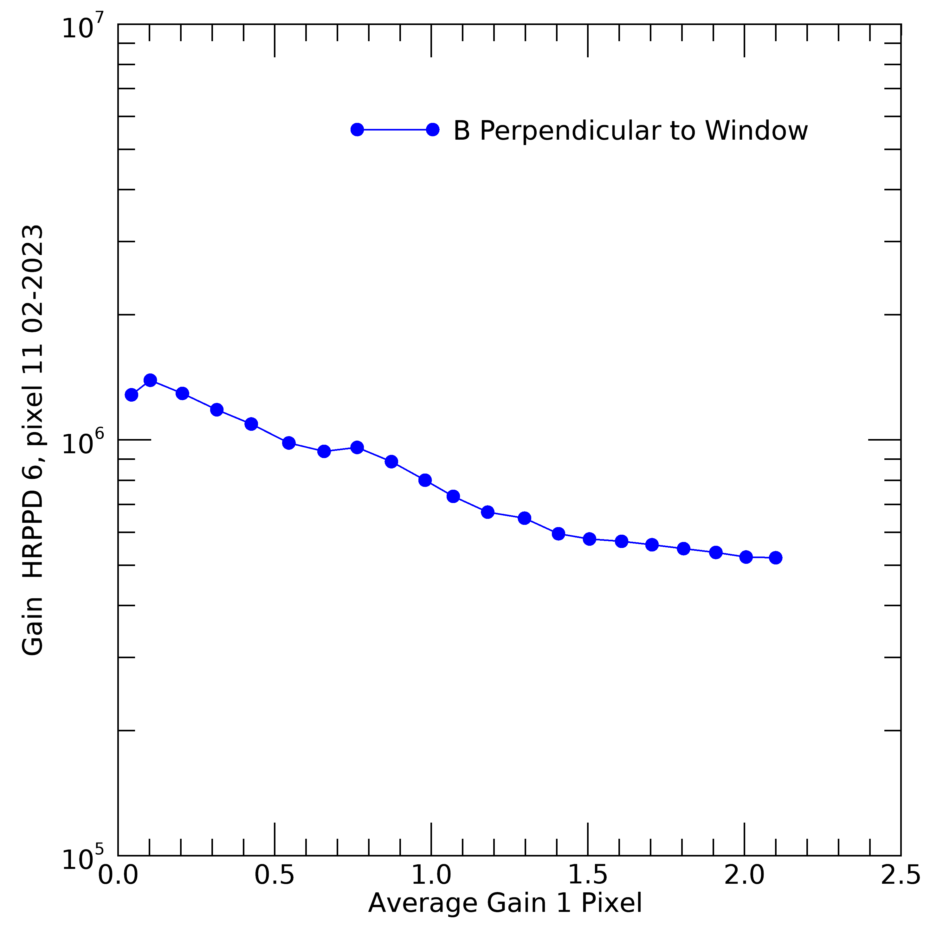
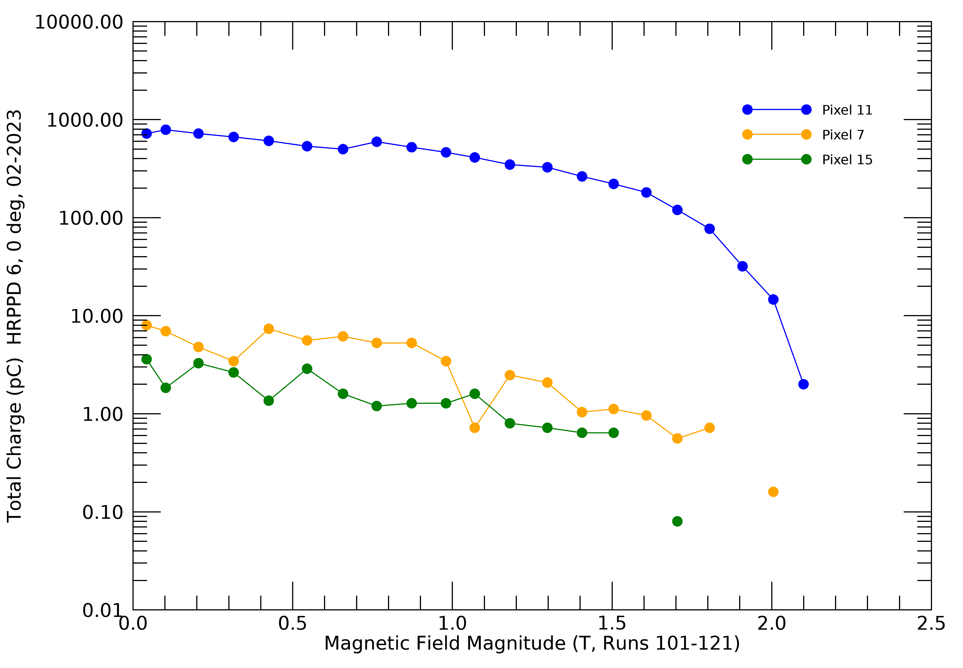
Gain vs. Magnetic Field Magnitude: H6
HRPPD 6, Directly coupled anode, stacked MCPs
02-2023, ANL
MCP V: 950 V/MCP nominal
P/C V: 100 V
See files from: b_field_summ_H6,scan

Slide 15
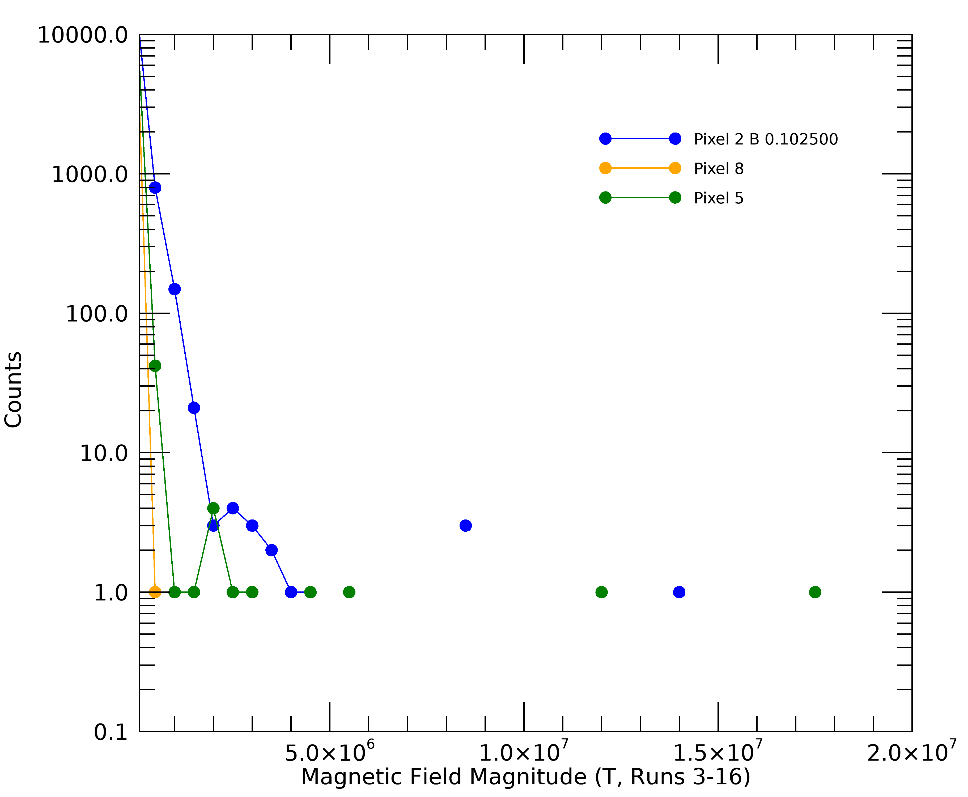
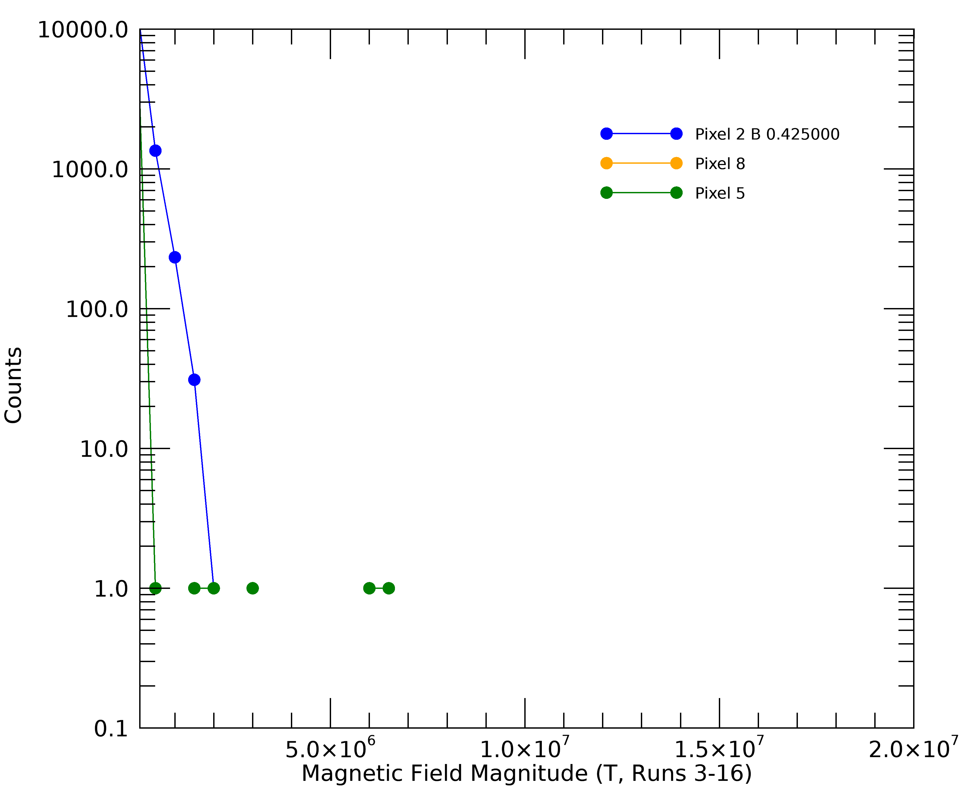
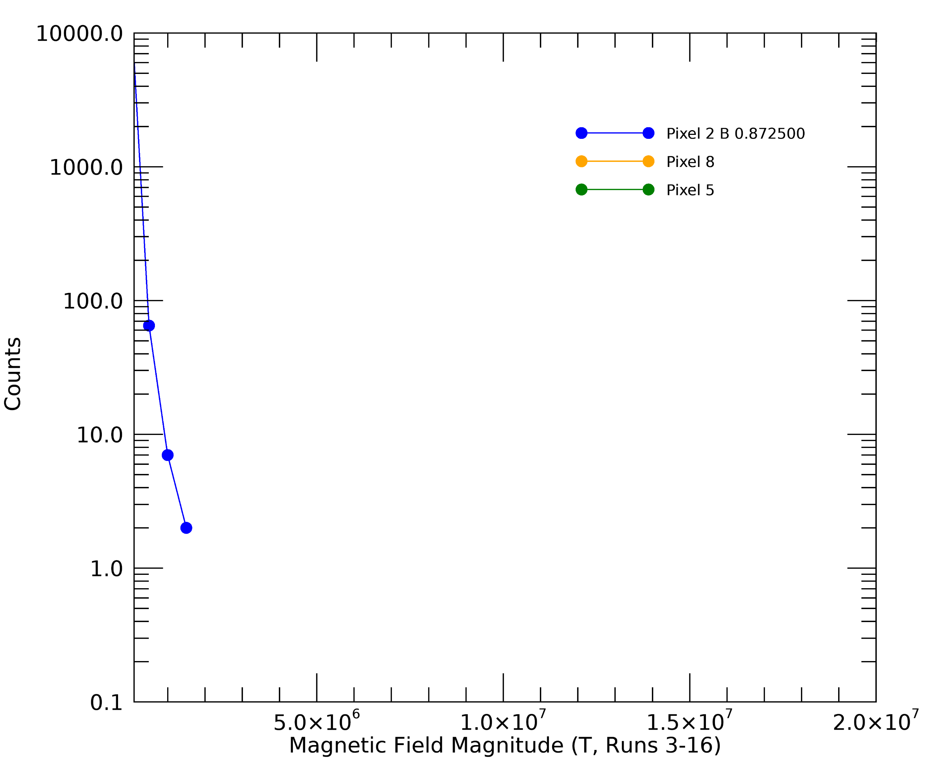
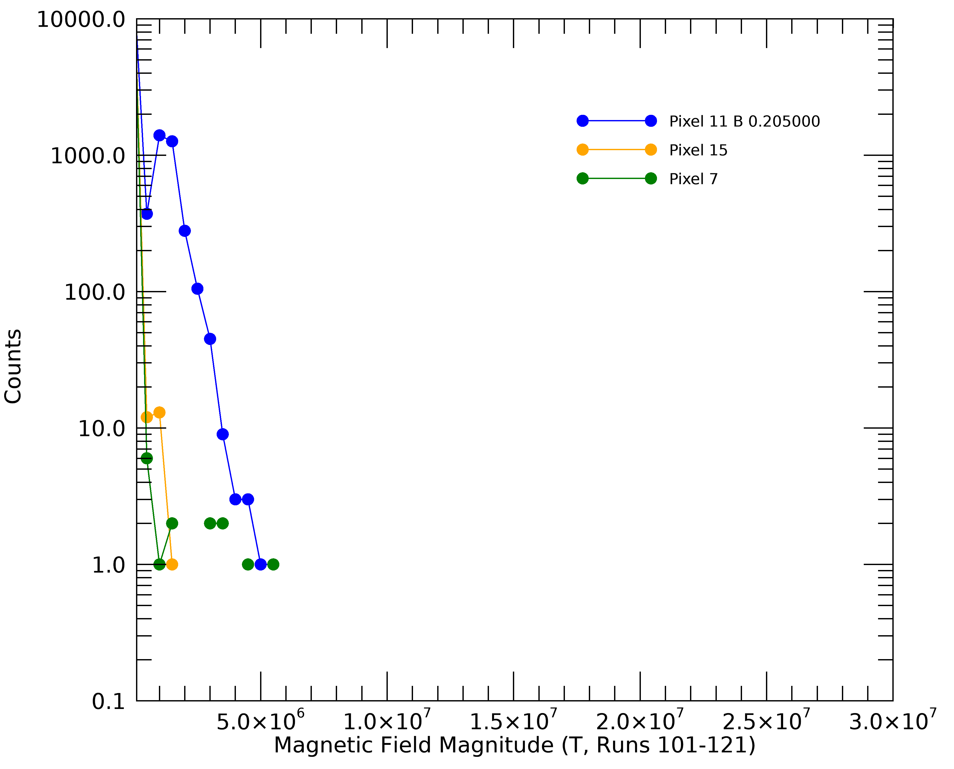
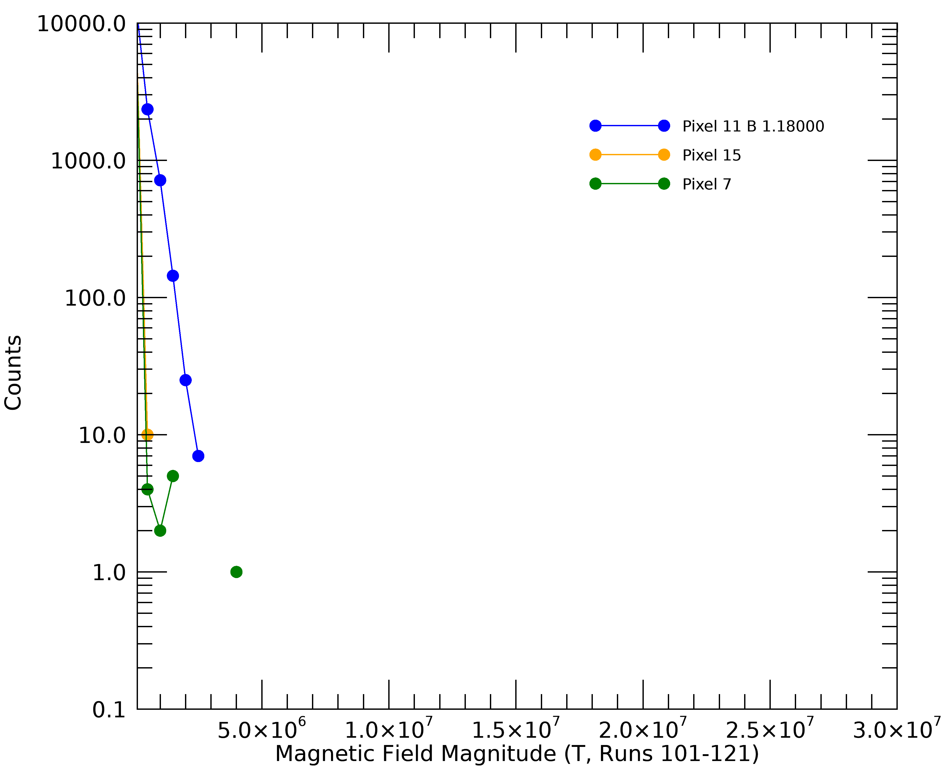
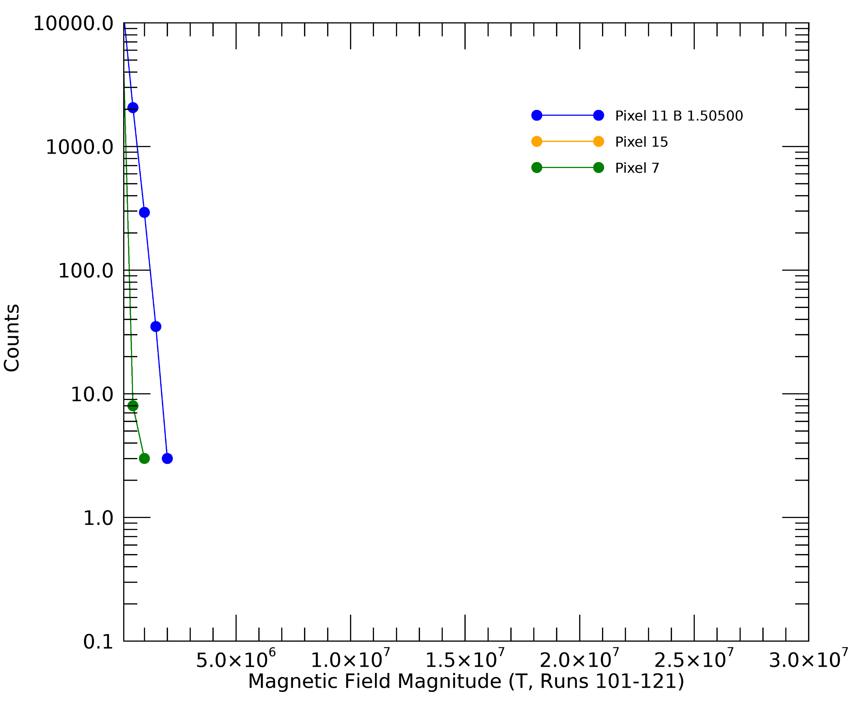
Pulse Height Distributions: L144 & H6
Pixel G5 - laser
0.103 T
0.425 T
0.873 T
LAPPD 144
Pixel 11 - laser
HRPPD 6
0.205 T
1.18 T
1.51 T

Slide 16
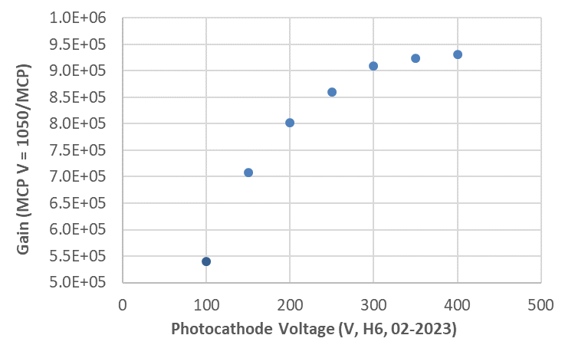
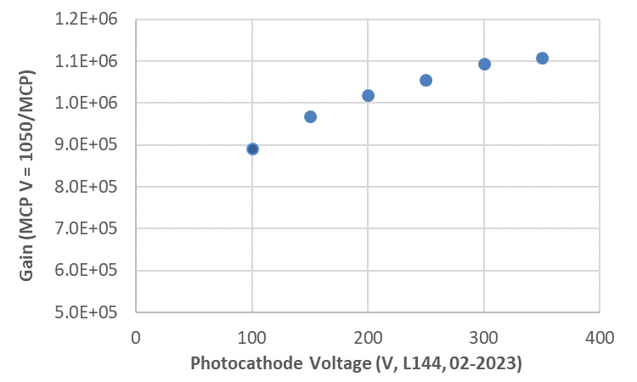
Gain vs. Photocathode Voltage
Gain increases slightly with photocathode voltage.
HRPPD 6 approaches maximum gain at 400 V.
HRPPD 6
1.5 T
LAPPD 144
1.7 T
HRPPD 6 02-22-2023 v1.xlsx
LAPPD 144 02-15-2023.xlsx

Slide 17
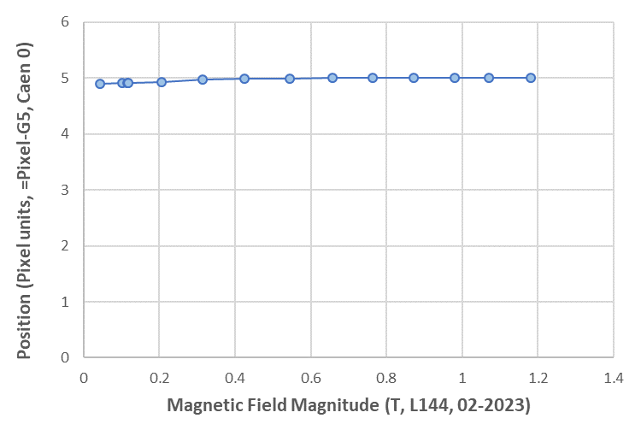
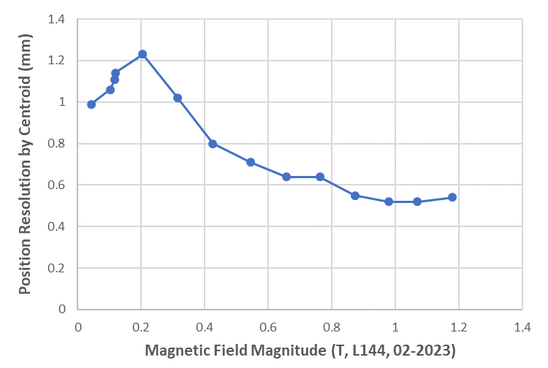
Position and Position Resolution: LAPPD 144
The laser was not quite centered on pixel G5.
Two neighboring pixels also detected the laser, with the capacitive coupling through the 5 mm glass anode.
The centroided position was near pixel G5 at weak fields, but locked onto G5 at strong fields.
The position resolution improved with stronger fields – smaller MCP pulse footprint?
Position
Position Resolution

Slide 18
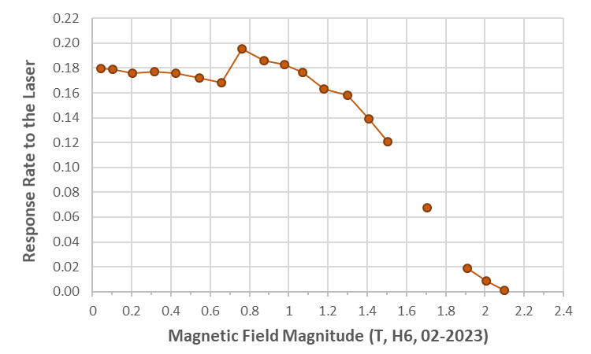
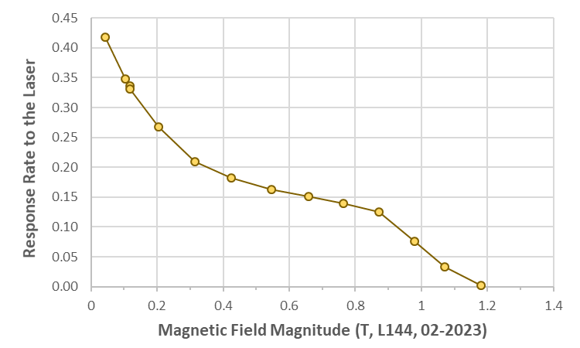
Detection Efficiency
HRPPD 6
Detection efficiency may be estimated by the fraction of laser pulses that produce a response at the MCP-PMT.
Detection efficiency for both LAPPD 144 and HRPPD 6 decrease with increasing magnetic field strength.
LAPPD 144

Slide 19
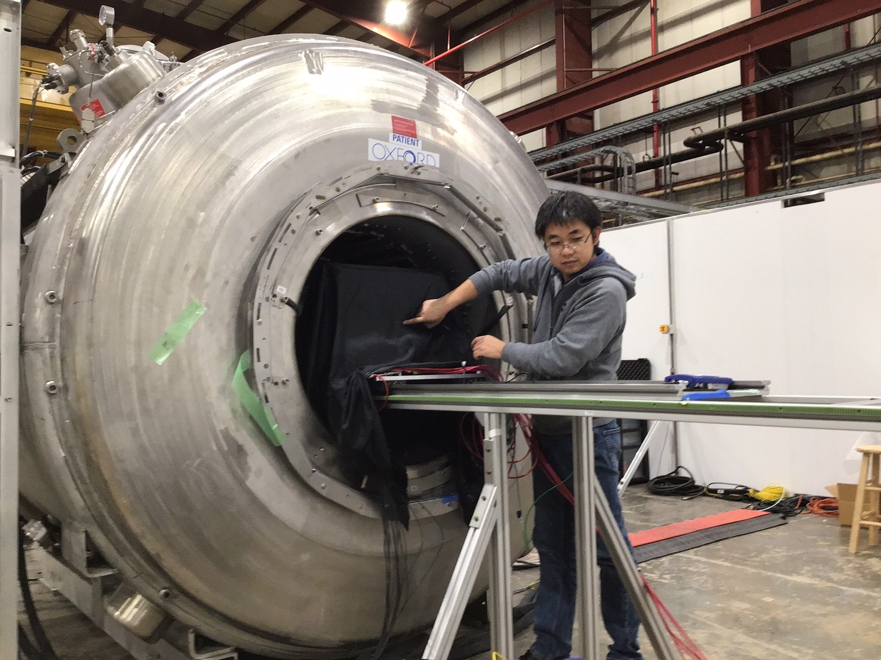
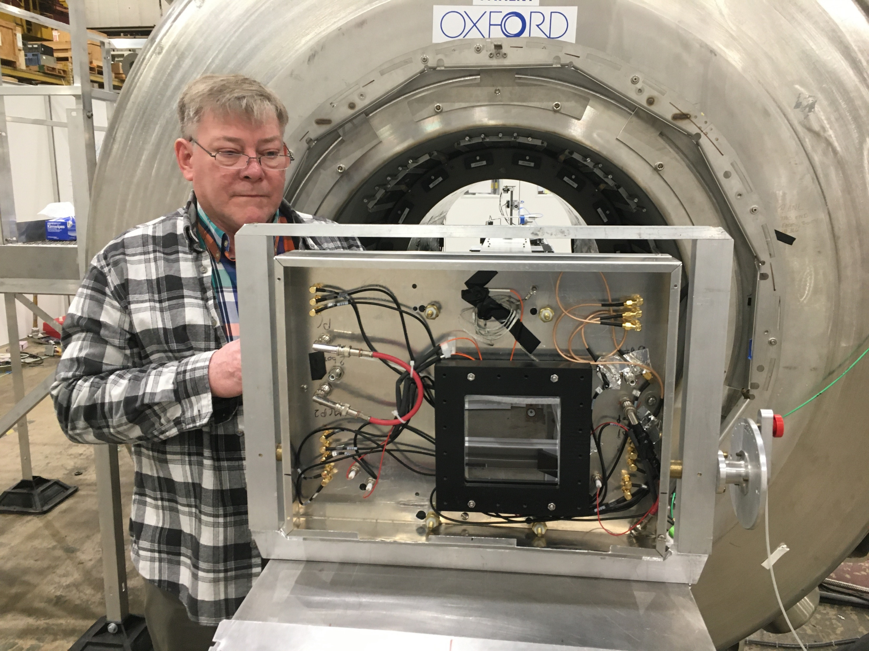
Summary
Performance of LAPPD 144 and HRPPD 6 is assessed as a function of magnetic field strength, with B perpendicular to the window.
The 20 micron LAPPD does well up to a field of ~1.2 T, while the 10 micron HRPPD can operate up to 2.1 T or more.
Gain may be recovered, either with an increased MCP voltage or photocathode voltage.
The LAPPD high voltage design is very stable at 1250 V/MCP and 100 volts on the photocathode at 1.2 T.
The LAPPD interior design strengths will be incorporated into the HRPPD directly coupled device design.
Dark rates for the LAPPD are low in the strong magnetic field.
The MCP pulse position appears to become more localized in the strong field.
Detection efficiency has been estimated for both the LAPPD and HRPPD, and it falls off with increasing field strength.

Slide 20
Next Steps
Data characterizing performance with fields at an angle to the window will be processed next.
Time resolution data have been partially processed. The uncertainty in the laser trigger must be measured and incorporated in the resolution calculation.
Improved HRPPDs will be fabricated.
HRPPD 6 has MCPs with hotspots that generate afterpulses.
It is the first operating HRPPD, and undesirable features were accepted as a means of uncovering unknown design flaws.
The magnet test revealed two issues, which will be resolved in the next few devices:
The top clamp for the MCPs has rather sharp edges that produce unwanted electron emission at the very high voltages needed for strong fields. This will be revised to the stable LAPPD design.
The HRPPD directly coupled device has MCPs face to face with no gap in between. This appears to drive the MCPs rapidly to saturation in strong fields or large field angles. A gap will be introduced, as in the LAPPD design.

Slide 21
Backup Slides

Slide 22
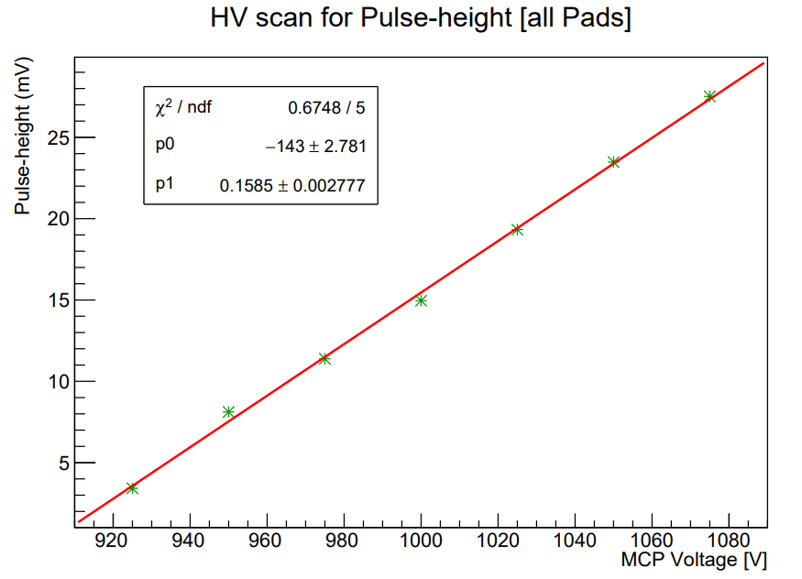
Gain recovery tests with the field at an angle to the window featured a linear increase of signal with MCP voltage.

Slide 23
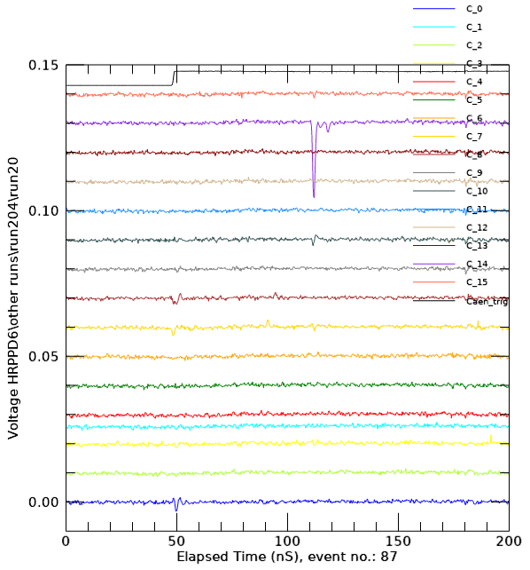
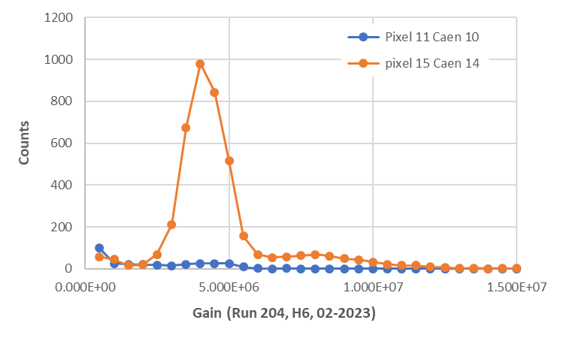
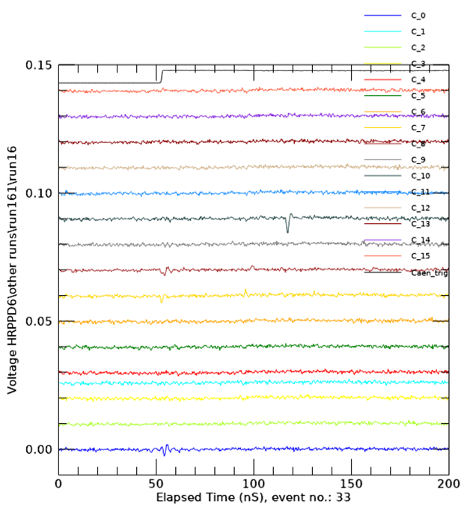
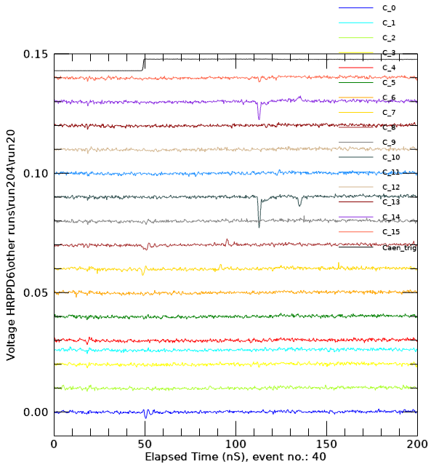
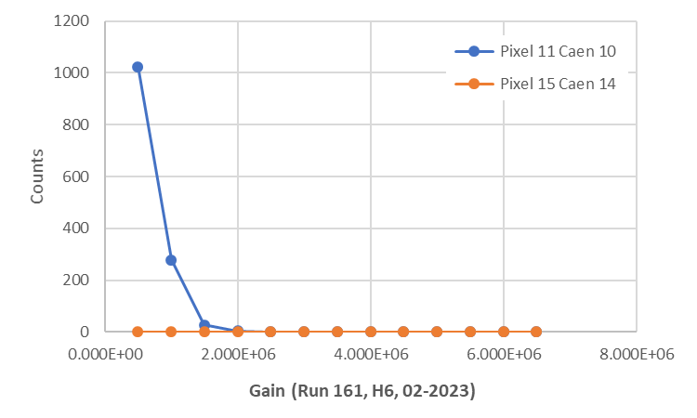
Runs 161 & 204
Narrow pulse height distribution
Variation of field angle.
Pulses in Run 161 are localized to Pixel 11.
Pulses in Run 204 are in both Pixels 11 and 15, and largest in Pixel 15.
Different angle? J/X lab notes:
Run 161: +15 deg
Run 204: -15 deg
Run 204, Event 40
Run 204, Event 87
Response to laser
Run 161:
6.7% Pixel 11
Run 204:
1.6% Pixel 11
20.9% pixel 15
Run 161, Event 33

Slide 24
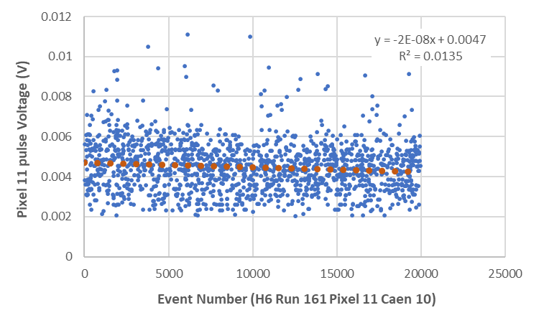
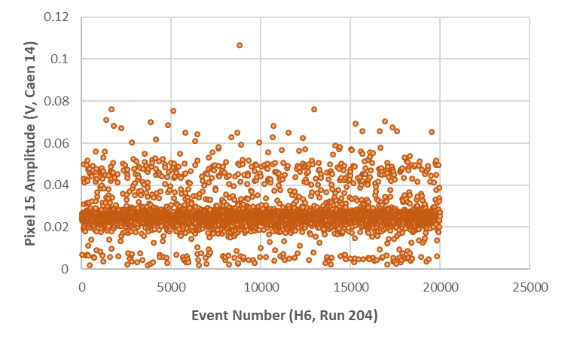
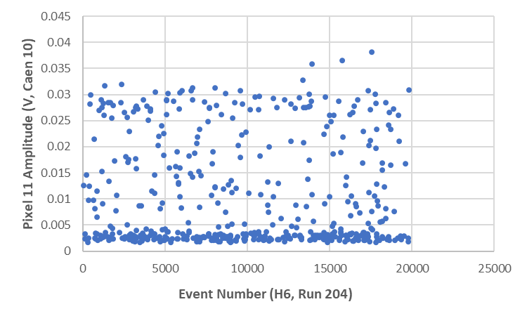
asciiout with pixel 11 plot Caen 10.xlsx
Runs 161 & 204
Run 161
Pixel 11 Caen 10 Pulse amplitude vs. event number.
Gradual decrease of amplitude with time
PC = 100 V,
MCP = 1075 V,
Transfer = 200 V
B = 1.4 T,
angle = Scan (deg)
Run 204
Pixel 15 Caen 14 Pulse amplitude vs. event number.
Pixel 11 has low signal – MCP electron spot appears to have moved compared to Run 161.
Fixed, amplitude with time with narrow pulse distribution. Saturated gain, bright laser, multiple p/e?
PC = 100 V,
MCP = Scan,
Transfer = 200 V
B = 1.4 T,
angle = -15 deg
asciiout with pixel 15 plot Caen 14.xlsx

