Slide 1
Background embedding for ACTS tracking
Dmitry Romanov
09 March 2023

Slide 2
Current data flow
DD4Hep
EICrecon
Detector
Detector
Detector
Detector
Digitization
Reco
Global reco
hepmc
Hits in detectors edm4hep
Reconstructed Particles edm4eic
t

Slide 3
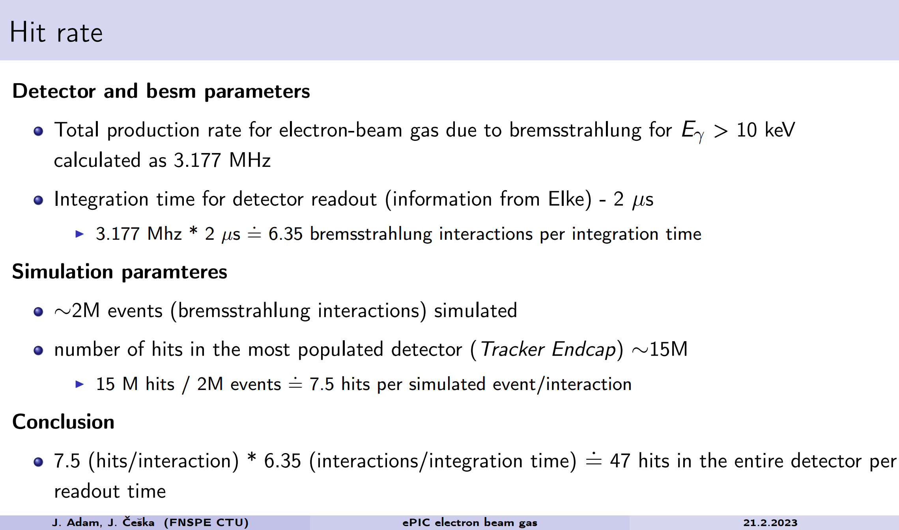
Jaroslav Adam and Jakub Češka (link to slides)

Slide 4
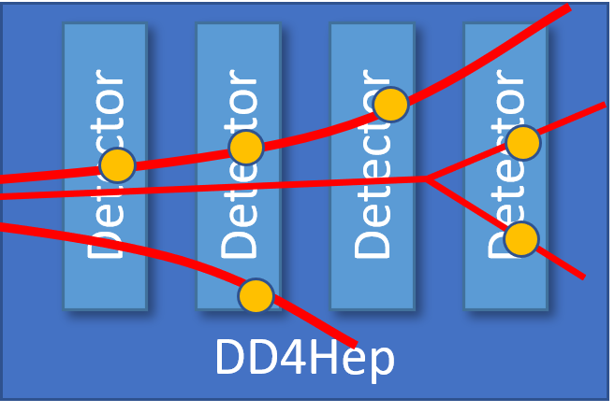
Where to merge background
hepmc
Background Embedding
EICrecon
hepmc + background
Digitization
Reco
Global reco
Hits in detectors edm4hep
Background

Slide 5
Timing
DD4Hep
EICrecon
Detector
Detector
Detector
Detector
Digitization
Reco
Global reco
hepmc
Hits in detectors edm4hep
Reconstructed Particles edm4eic
Physics
Geometry fly through
Detectors data integration time
(times scales are completely off)
t

Slide 6
Timing
DD4Hep
EICrecon
Detector
Detector
Detector
Detector
Digitization
Reco
Global reco
hepmc
Hits in detectors edm4hep
Reconstructed Particles edm4eic
Physics
Geometry fly through
Detectors data integration time
Background events
t
(times scales are completely off)

Slide 7
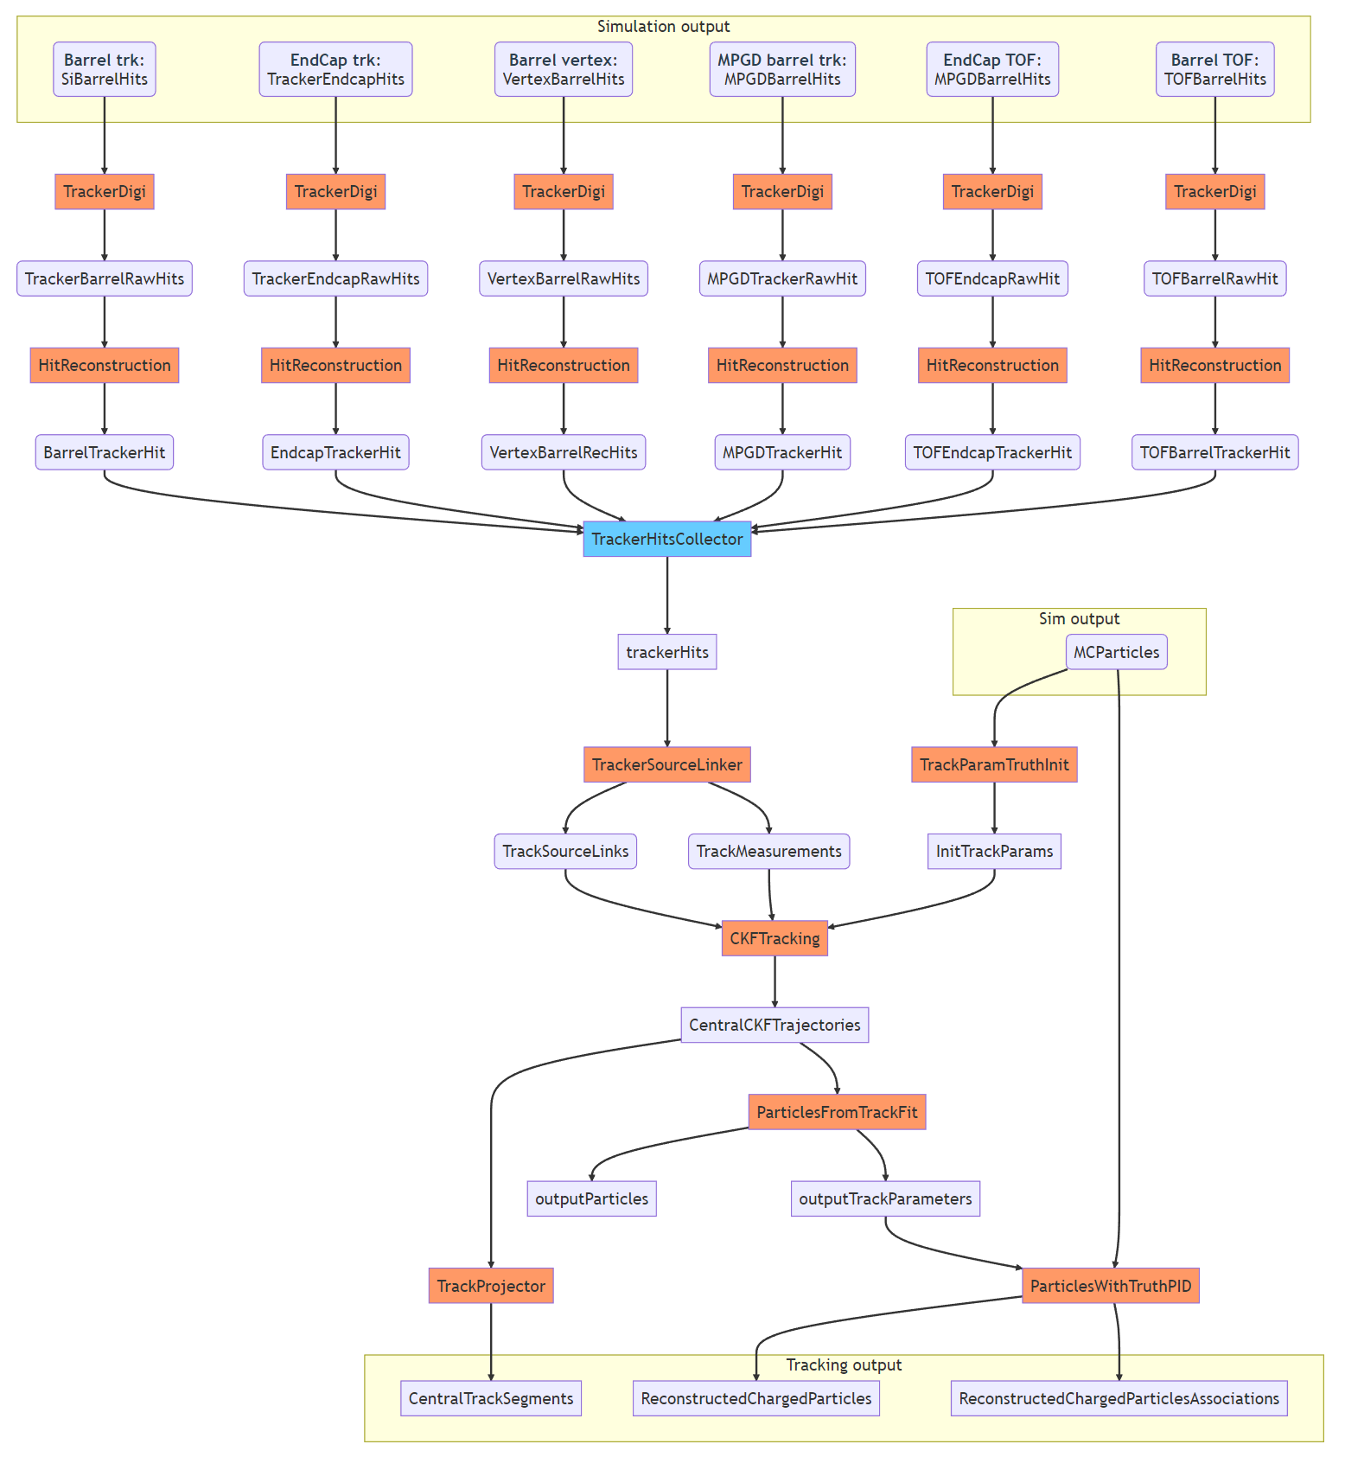
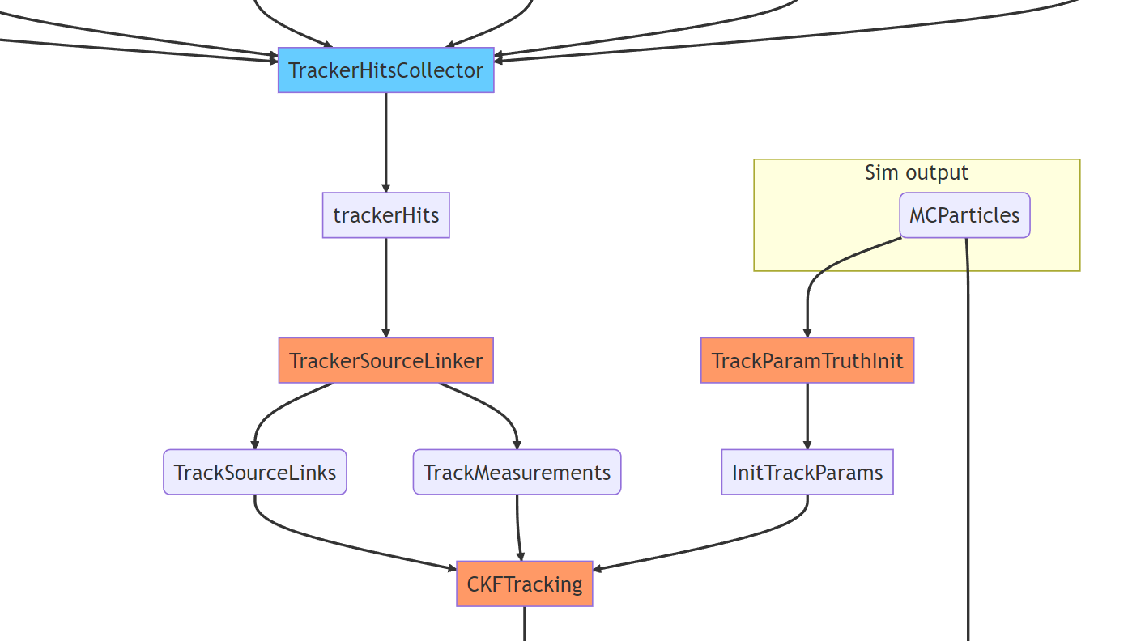
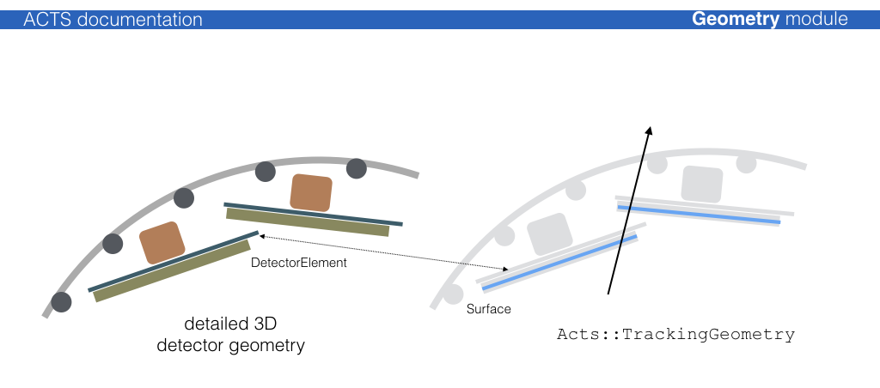
What happens inside EICrecon (tracking example)
Time info exists
Time info not added to CKFTracking

Slide 8
Deadlines and priorities
“There is no need to go with the simulation campaign without this”©
Add time info to CKFTracking – time, volunteers?
What about track seeding?
What is to use as a test events? (Kolja proposed to start with double DIS events, before correct background is simulated)

Slide 9
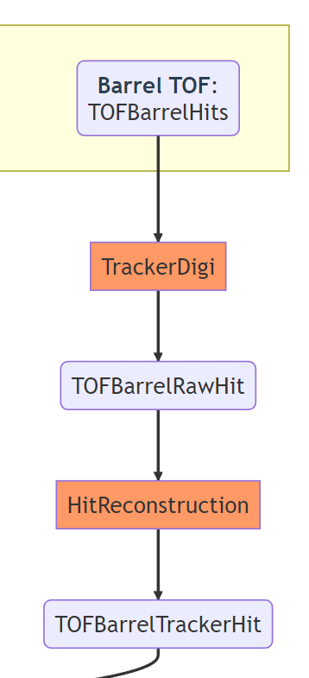
What happens inside EICrecon (tracking example)
Geo element ID #87468734
(This picture is from ACTS documentation. the geometry on pictures is not from EPIC)

