Slide 1
EIC Project Update
Elke Aschenauer and Rolf Ent
Co-Associate Directors for the Experimental Program
ePIC General Meeting
April 14th 2023

Slide 2
Some (select) slides on recent progress
Resource Review Board meeting of April 3-4

Slide 3
Select Examples of What is Ongoing
Multiple meetings with subgroups to discuss progress and organization – THANK YOU!!!!
Multiple contracts related to EIC project detector R&D with BNL and JLab procurements, many are out but some are still in the works – apologies… Some contracts for PED also ongoing.
Magnet “mid-project” review (~75% design completion) next week.
Much progress on forward calorimeter design, assembly procedure much simplified in present design.
Continued progress on backward EM calorimeter design – required as it accompanies an NSF-MSRI proposal and the PbWO4 is envisioned as Long-Lead Procurement.
Discussions on AC-LGAD detectors, both barrel and forward: needed next steps in PED, setting up organization structure how to work and include all interested parties.
Next iteration of service material especially thanks to the help from Si-consortium
Preparations for a CERN visit April 24-25:
  Work hand-in-hand with Si Consortium as the main objective is MAPS/ITS3 collaboration between ALICE and EIC
  Elke/Rolf had pre-meeting with ALICE leadership April 12 – very constructive
  Will also include meeting on joint work on photo-sensors and RICH detectors.
Work on detailing installation schedule for the EIC experimental equipment

Slide 4
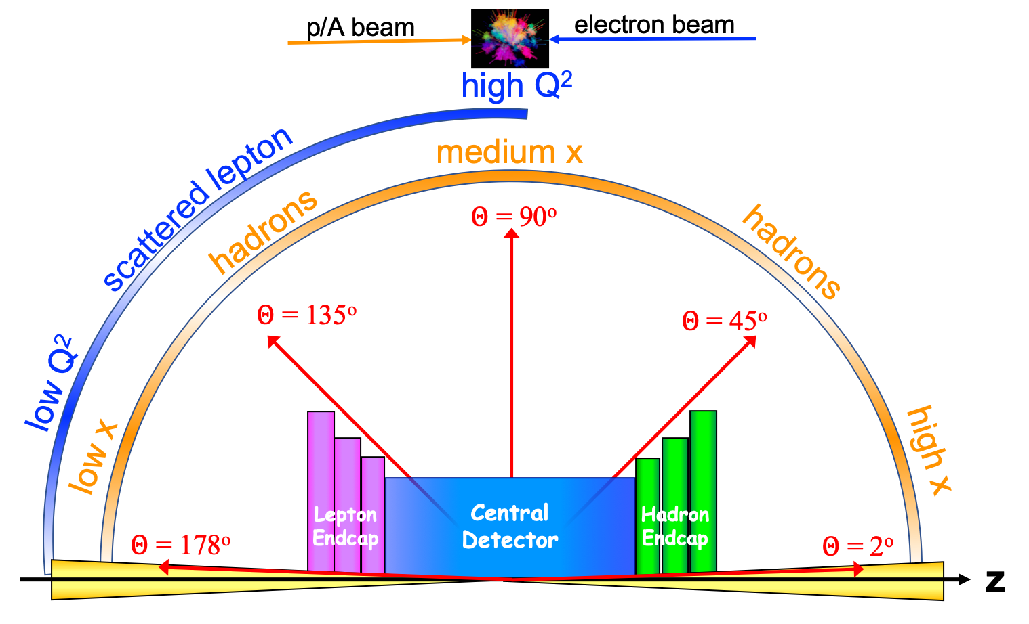
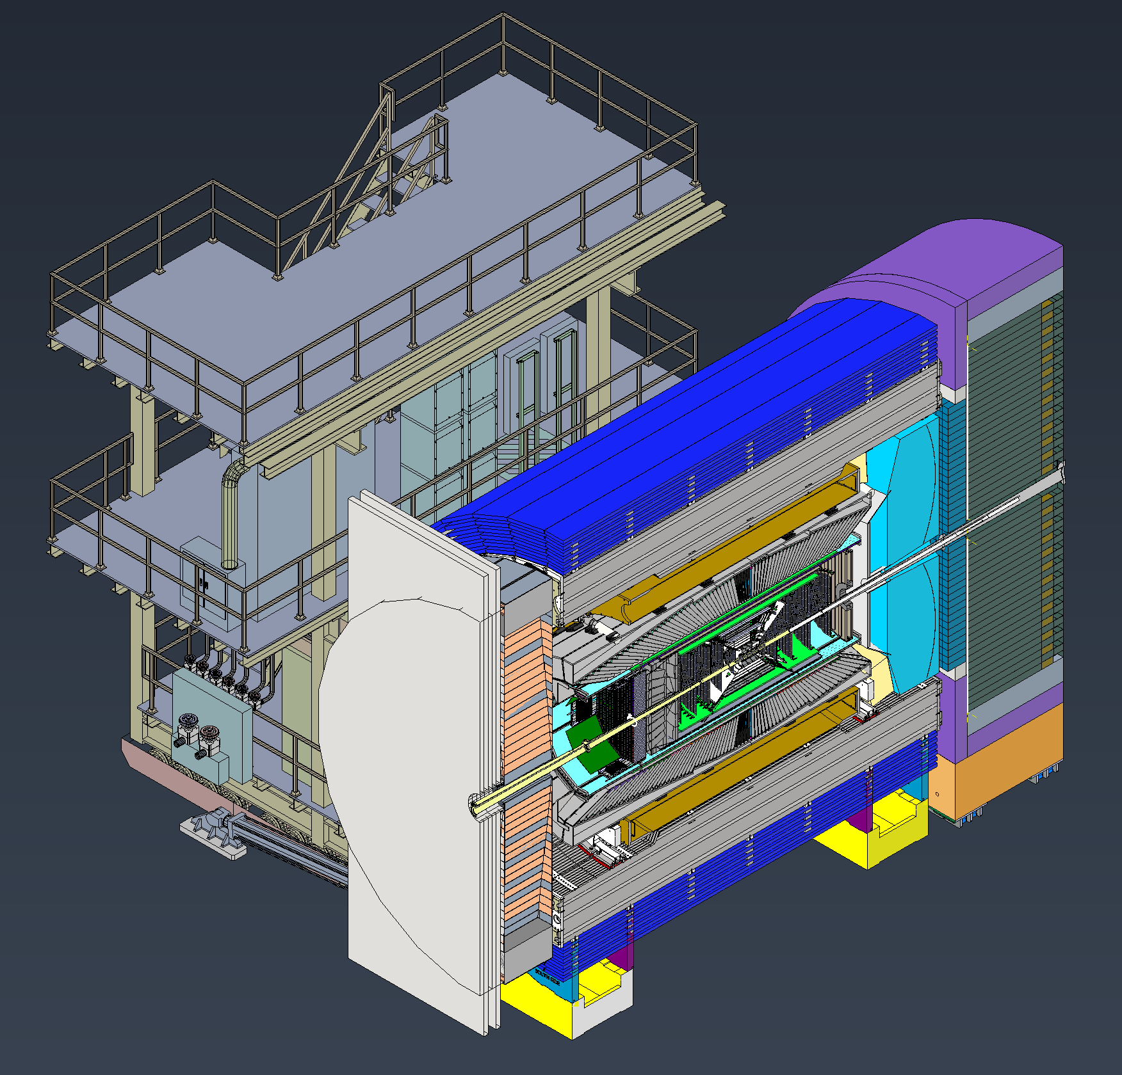

The ePIC Detector
Detailed CAD model of central detector and extended IR region continuously refined as design progresses

Slide 5
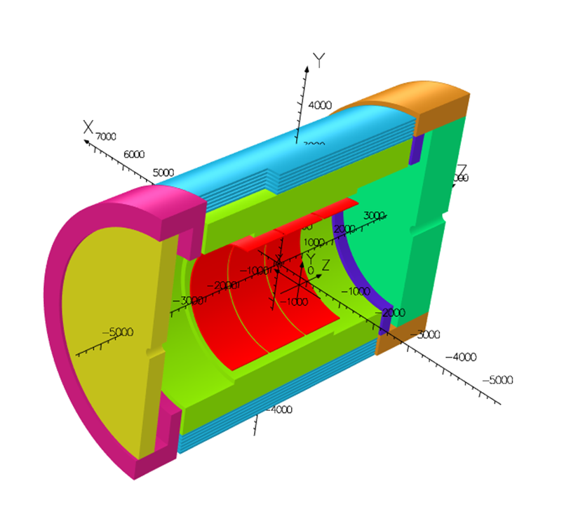
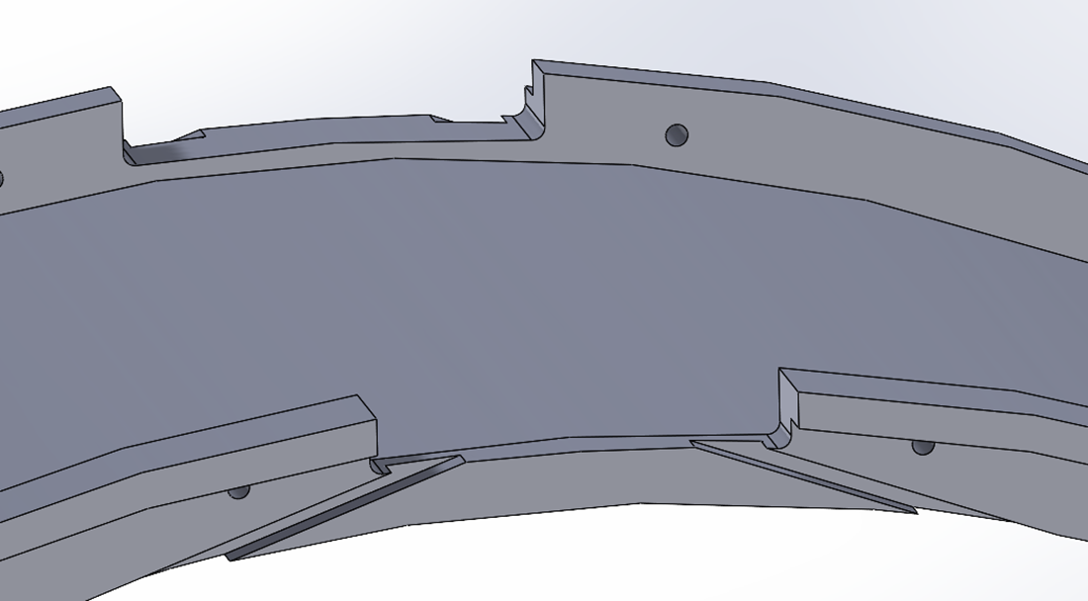
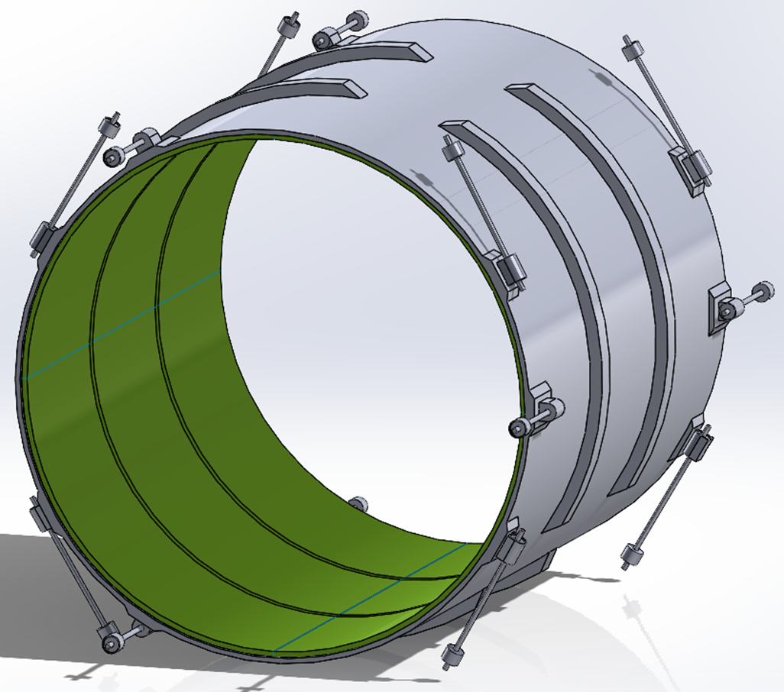
MARCO Magnet Design Details
Order for conductor test samples in the works
Magnet RFI is out → expect at least 4 responses by April 16th
Solenoid “Mid-(FY23)Project” (~75% design) overview meeting April 18th
Conductor is based on CEA-Saclay experience as used for previous magnets
Coil is divided in 3 modules with 557 Turns each. This is done mainly to accommodate possible conductor length.
The two most important design parameters are conservative: large temperature margin and large critical current margin
Mechanical analysis Ongoing
Conductor exits
Joint CEA-Saclay-JLab-BNL effort

Slide 6
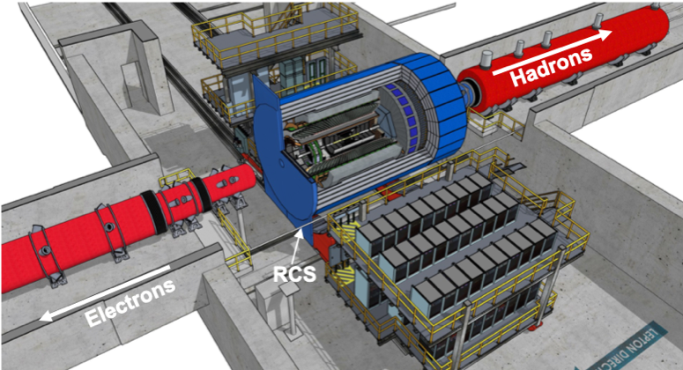
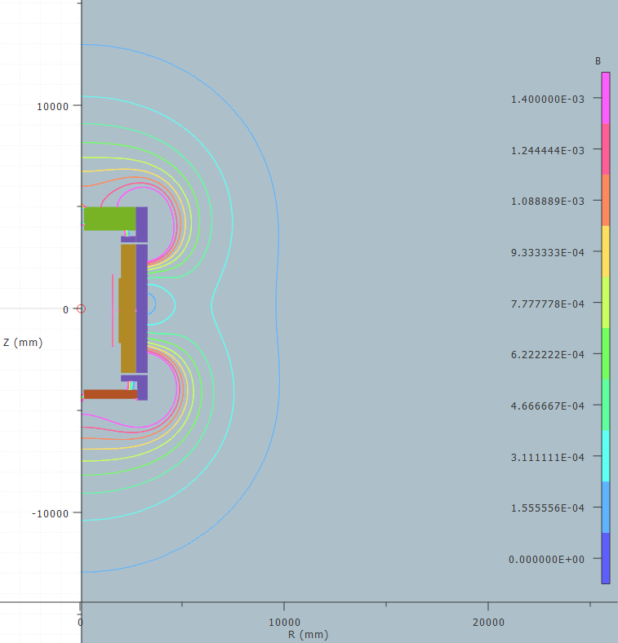
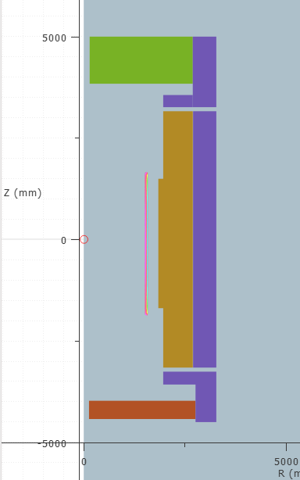
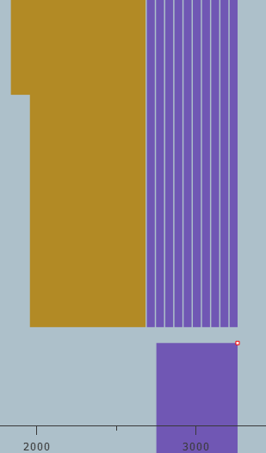
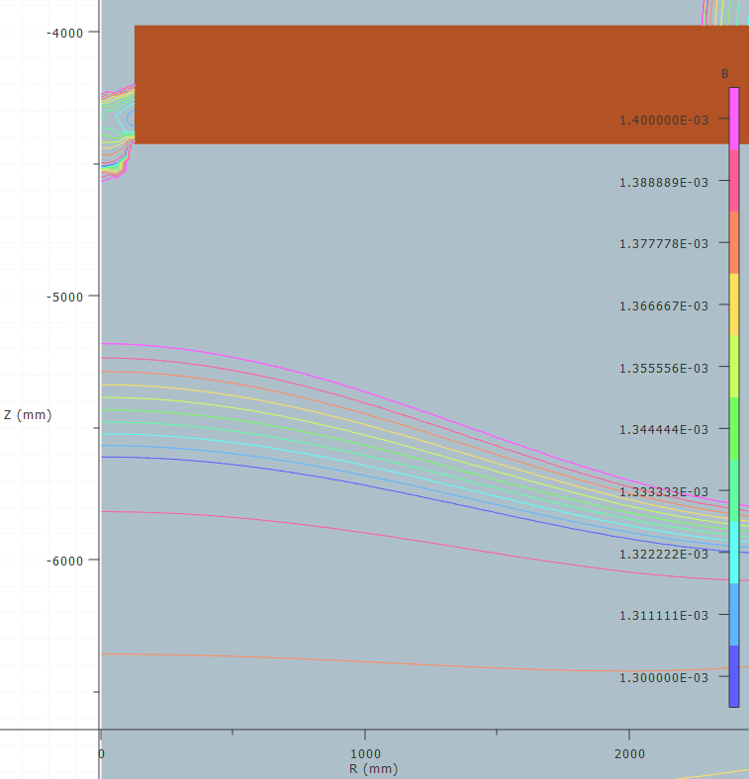
Flux Return Details
Requirement for fringe field: <10 Gauss at forward and backward side
and at RCS location
Challenges detector design not symmetric
→ critical that forces get balanced
Consequences on design:
backward HCal moved as far back as possible
add both sPHENIX flux return doors behind bHCal
forward HCal need to have first tungsten/Sc
and then Steel/Sc
add additional steel around barrel HCal
layered barrel extra flux return
6 layers 50 mm steel 40 mm air
Reach 14 gauss and lower

Slide 7
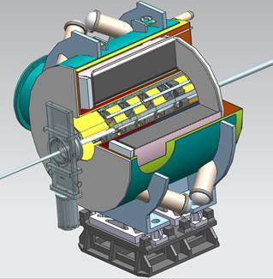
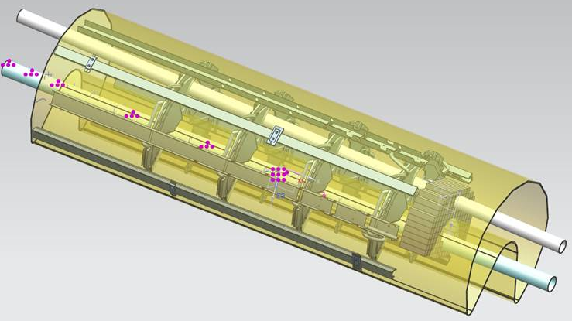
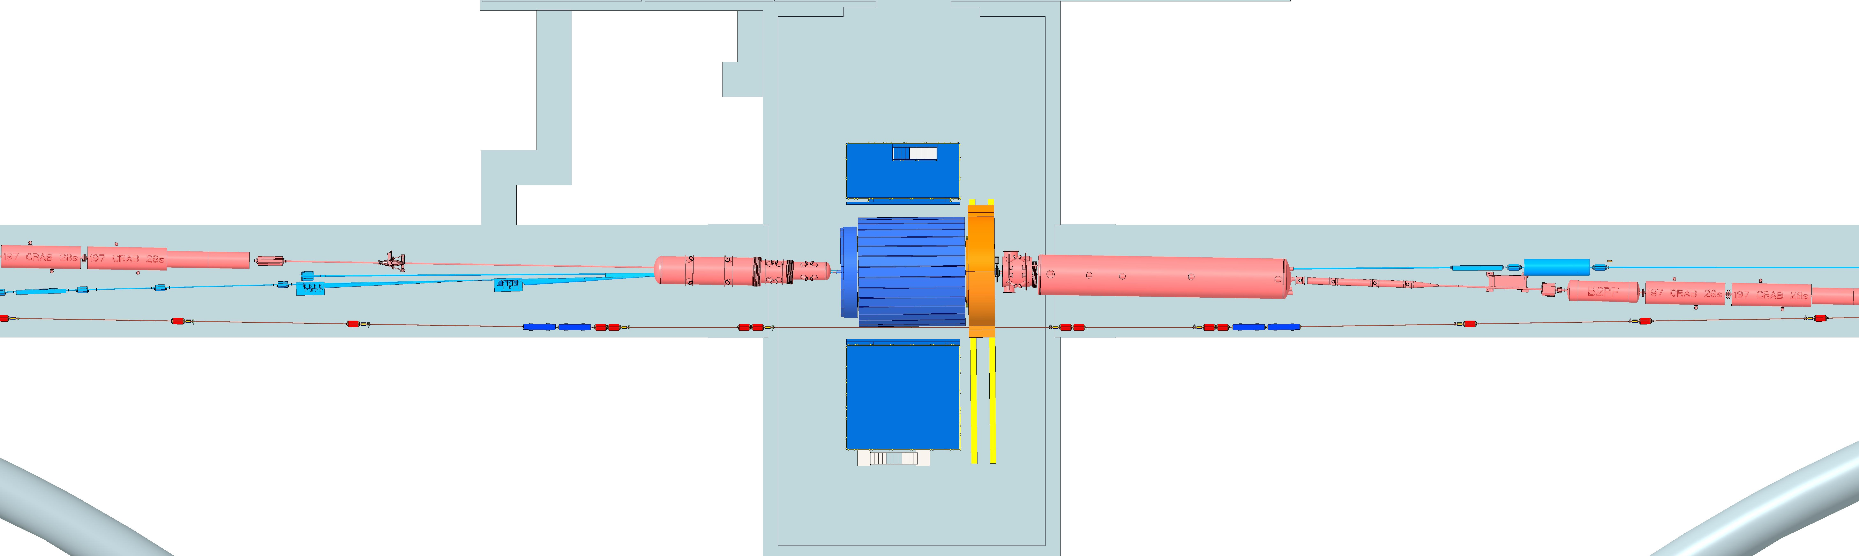
IR-Integration
HSR: Hadron Storage Ring
ESR: Electron Storage Ring
RCS: Rapid Cycling Synchrotron
SC: Superconducting
local
h-Pol
B0
detectors
HSR
Rear Side
ESR Forward side
ZDC
low Q²
Tagger
Off-momentum detectors
Roman pots
ESR Rear side
Lumi
Monitor
HSR Forward Side
RCS
With Detector Bypass
All Ancillary Detectors fully integrated in the accelerator lattice
  designs need to be very closely coordinated with EIC project
Hadron and Lepton polarimeter are also integrated in IP-4 and IP-6 (sector 5)
Focus on impedance calculations for all the systems sitting in beam vacuum
  Roman Pots extremely challenging due to the unique EIC hadron beam parameters

Slide 8
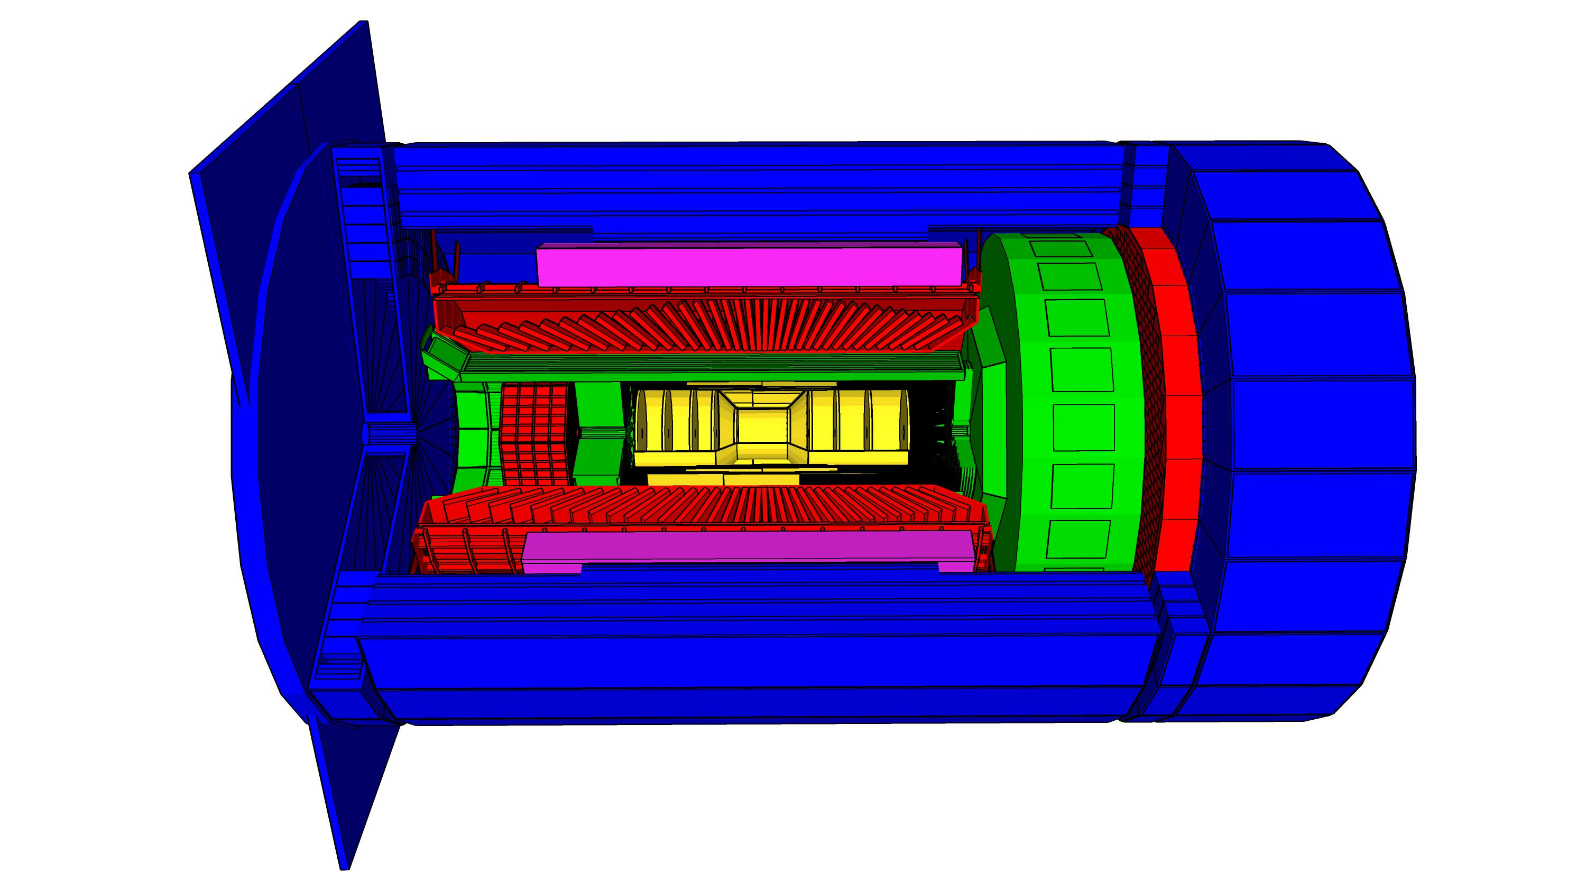
High Level Installation Schedule
Oct 2028
Jan 2029
early
CD-4A
04/2031
early CD-4
CD-4A
04/2032
CD-3
04/2025
April 2029
Dec 2029
CD-4
04/2034
June 2030
Oct 2030
Jan 2031
Construction
IR-6 ready
for installation
Transition into
Operations
Start of
Operations
&
Science
lower half
barrel Hcal
installed
Solenoid
delivered
Endcap HCals
completed
Solenoid
Field mapping
done in beam position
Hadron Endcap
Detectors
installed
Trackers, dRICH
ECal
done in IP-6 Assembly Hall
Barrel Ecal
ready
for installation
Barrel Hcal
& Solenoid
installed
followed by low
power test
Lepton Endcap
Detectors
installed
Trackers, bRICH
ECal
Barrel Detectors
installed
ECal, DIRC,
ToF, Trackers
Take Away:
Solenoid and Barrel HCal need to be ready by Jan 2029
all other subdetectors need to be ready between 06/29 to 09/30 depending on their location in the detector

Slide 9
EIC Experimental program preparation
Year-long EIC User Group driven EIC Yellow Report activity (December 2019 – February 2021
  Science Requirements and Detector Concepts for the EIC
  arXiv:2103.05419 & Nucl. Phys. A 1026 (2022) 122447 – 488 citations (03/31/2023)
BNL and TJNAF Jointly Leading Efforts Towards Experimental Program | BNL and TJNAF Jointly Leading Process to Select Project Detector
2020 | Call for Expressions of Interest (EOI) https://www.bnl.gov/eic/EOI.php | May 2020
 | EOI Responses Submitted | November 2020
 | Assessment of EOI Responses | On-going&
2021 | Call for Collaboration Proposals for Detectors https://www.bnl.gov/eic/CFC.php | March 2021
 | BNL/TJNAF Proposal Evaluation Committee | Spring 2021
 | Collaboration Proposals for Detectors Submitted | December 2021
2022 | Decision on Project Detector – baseline “ECCE” | March 2022
 | Process to consolidate ECCE & ATHENA to the EIC Project Detector | Spring 2022
 | ePIC Collaboration Formed – 160 institutions | July 2022
2023 | ePIC Charter ratified & elected Leadership Team | February 2023
 | Resources Review Board Meeting | April 2023
 | ePIC Detector remaining technology choices made | April 2023
&Remains ongoing until formal agreements are in place – it originally led to confirmation that in-kind level assumed for the EIC detector was in range.

Slide 10
Preparations for Resource Review Board
Introduced first ideas for EIC governance structure and Resource Review Board (RRB) at the March 12, 2021, DOE International Engagement meeting
  Meeting would have DOE Intro, Project Update, Short Collaboration reports, short reports from Advisory Committees, reports from engaged agencies, and discussion.
Feedback folded in and iteration presented at an EIC Council and Friends meeting on April 8, 2022.
  Main change was to fold in Computing Resources next to Detector.
Possible mandate for RRB was presented at follow-up meeting June 06, 2022.
RRB-like Kick-Off Meeting held October 11, 2022.
  Organized by Jim Yeck to expedite momentum
  Future RRB Meetings will have two co-chairs, one rotating between BNL and JLab Research Directors, and one appointed by International Funding Agencies.
  Draft charter completed.
Preparations for 1st RRB meeting
  Organized by host labs and EIC Project
  Collected names of funding agency representatives as initial members – much interest. Each agency could also point to a primary scientist to sit in as observers.
  Some countries invited as observers: Brazil, Chile, Israel, Senegal, South Africa, and Taiwan

Slide 11
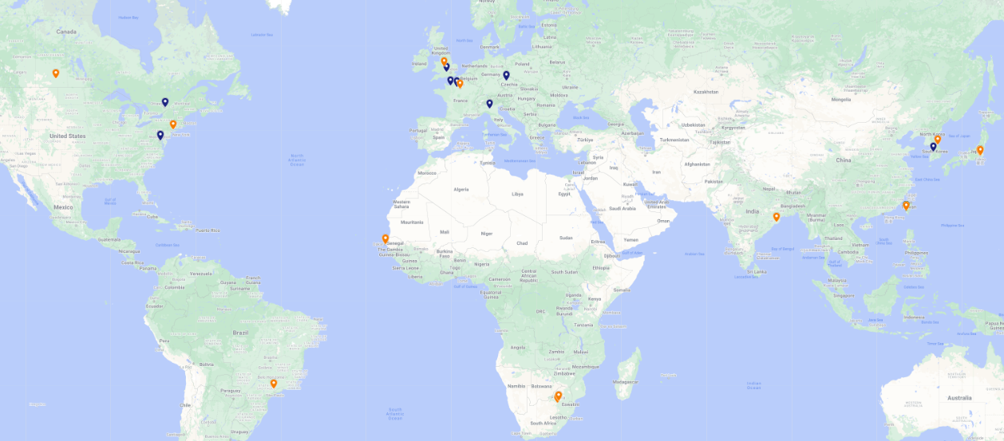
1st Resource Review Board Meeting
First meeting on April 3-4, 2023 at Stony Brook University.
DOE and the host labs are promoting the EIC as a facility that is “fully international in character.”
12 countries participating: Blue markers: RRB members; Orange markers: Observers
Agenda reflects what we expect to have in future RRB meetings.
RRB Charter was ratified at 1st meeting. Initial Co-Chairs are Haiyan Gao (BNL) and Diego Bettoni (INFN).

Slide 12
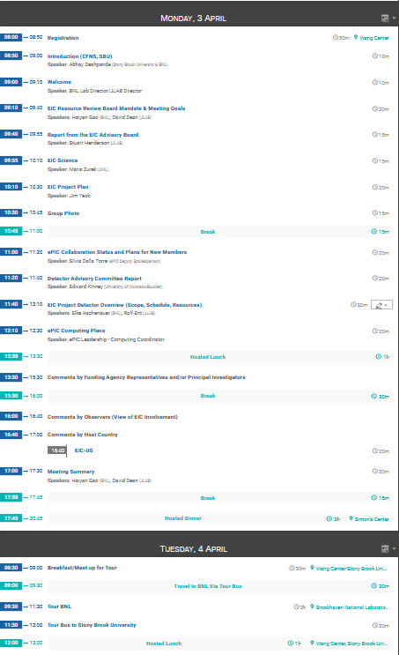
1st Resource Review Board Meeting
RRB meeting also provided good opportunity for various additional meetings with foreign agency representatives to discuss possible international interests

Slide 13
Detector: International Interest & In-Kind
Entity | Interest and Important Facts
NSF | NSF-MSRI pre-proposal submitted by 10 US universities – aims at full scope of backward EM calorimetry (eECal). Armenia, Czech, France/IN2P3 as unfunded contributors. Invited to submit proposal.
Armenia | Contributions, mainly labor to eECal and many EM calorimetry and particle id detectors component tests.
Canada | EIC included in 2022 Canadian Subatomic Physics Long-Range Plan; Interested in Compton Polarimetry, Electromagnetic Calorimetry and Software
China | Forward EM Calorimeter
Czech | Working with funding agency; Interested in eECal (PbWO4 crystals and glass) and Silicon
France/IRFU | Interested in SC magnet design, electronics and MPGD/tracking. Saclay/IRFU provided 30% design work for magnet as in-kind, contributions to 60% and ongoing 90% design.
France/IN2P3 | International contribution to backward EM calorimetry (including in-kind design) and to readout electronics (e.g., ASICs for AC-LGAD detectors and Calorimetry). IRFU & IN2P3 discussing together for higher-level contributions.
India | Consortium is working with Funding agency; Interested in detector software (non-project scientific contribution), contributions to DAQ/slow controls, and PID – ToF as hardware (investigating Forward AC-LGAD to make links with Si plants).
Italy/INFN | Working with INFN since a while; Aims at major scope of forward particle identification detector (dRICH), at (part of) the Si/MAPS tracker scope, and at photo-sensor contributions. Further investigating possible interest in EIC detector magnet scope.
Israel | B0 Detectors (Si tracking and PbWO4)
Japan | Interested in a US-Japan agreement; Aims at full scope of Zero-Degree Calorimeter in collaboration with Taiwan/Korea. Pursuit of full scope of barrel AC-LGAD detector as EIC-Asia consortium. Contribution to DAQ/streaming. Possible aerogel.
Korea | Fiber-based EM calorimetry (barrel and/or hadronic ZDC), Small work package for barrel AC-LGAD as part of EIC-Asia consortium (includes also Japan,Taiwan), collaboration on Si tracking detector (backward Si disks), Si-based hadronic calorimetry for ZDC.
Poland | Actively working with ministry/funding agency; Interested in detectors along the beam line (luminosity detector, Roman Pots)
Taiwan | Pursuit of full scope of barrel AC-LGAD as part of EIC-Asia consortium. LYSO-based EM calorimeter for ZDC, Also optical readout/fiber. Possible later interest in PCBs. Computing.
UK | STFC seed funding for UK detector R&D (3M£). Interest in Si/MAPS tracker, polarimetry and detectors along the beams (Low-Q2/TimePix). Follow-up grant request for 5-7 years submitted early 2023 (includes accelerator part).

Slide 14
Collider: International Interest & In-Kind
Country | Institution | Interests | Quantity
Canada | TRIUMF | 394 MHz SRF Cryo Modules | all (6)
 |  | Collaboration Fast Pulsed Kickers
CERN | CERN | Areas for collaboration FCC-EIC
France | CEA/Irfu-Saclay | Spin rotator SC magnets | 8 solenoid magnets (TBD)
 | IN2P3-IJCLab | Cryo module for 197MHz cavities (injector/ERL)
Italy INFN - Frascati |  | Electron Cloud Mitigation studies | 1 Turn-key apparatus for SEY measurements
UK - Accelerator UK- Detector | Lancaster Daresbury Lab | 1773MHz 5-cell cavities cryo modules | All cryomodules
 | Oxford/Lancaster Royal Holloway Lancaster/Liverpool | LLRF synchronization & feedback Beam Position Monitors ERL modelling and design | Models All ? design studies

Slide 15
2nd Resource Review Board Meeting
Next Resource Review Board meeting will be in person in Washington DC
Week of December 4-8
Topics will include: Common Fund (or not) discussion, Computing (What is expected from partners), Governance (How does change control work for in-kind contributions), Quality Assurance (how does that get folded in reviews and planning documents), International agreements.
DOE/NP will also “host” another international engagement meeting taking advantage of the annual EIC User Group Meeting on July 25 + 26, 2023 in Warsaw, Poland
https://indico.cern.ch/event/1238718/

