Slide 1
ePIC Collaboration Status
J. Lajoie, S. Dalla Torre
April 14, 2023

Slide 2
Hey John, start the recording….

Slide 3
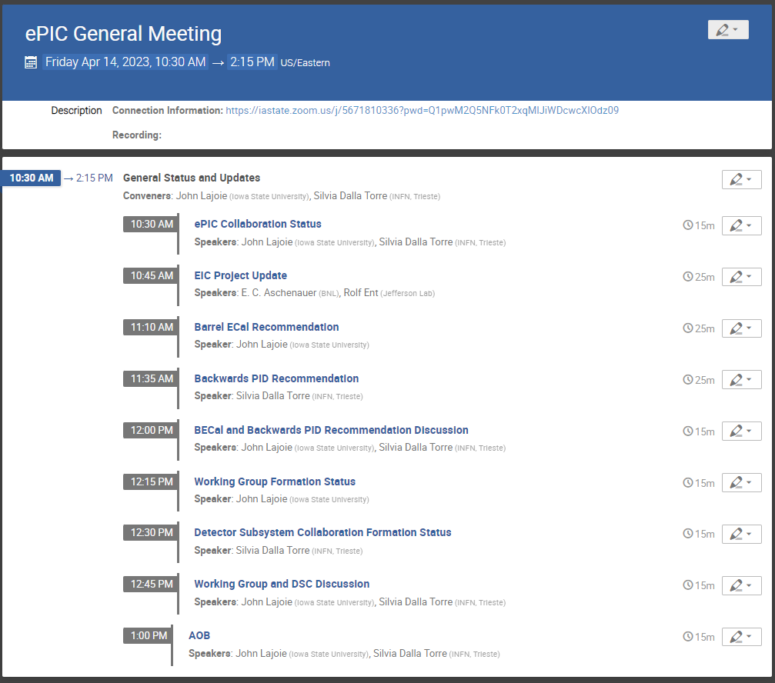
Today’s Agenda
Very busy agenda!
Lots of critical collaboration business…

Slide 4
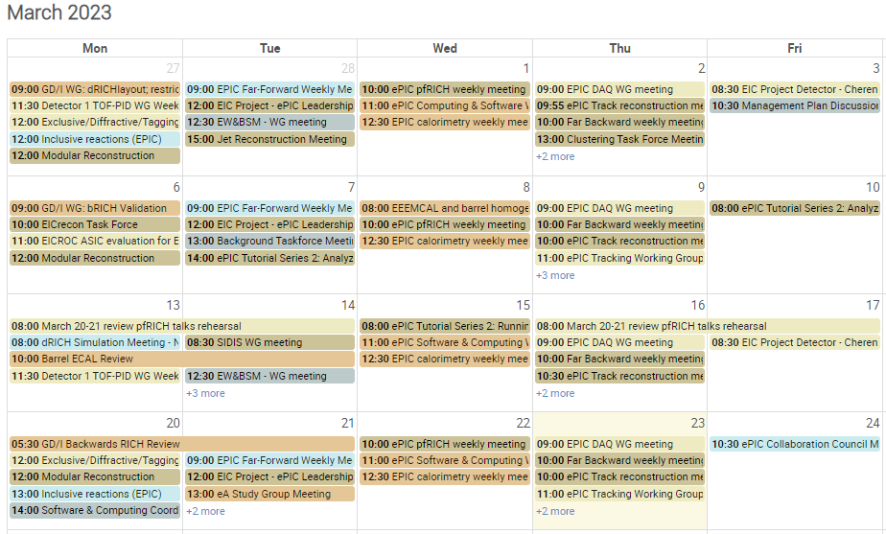
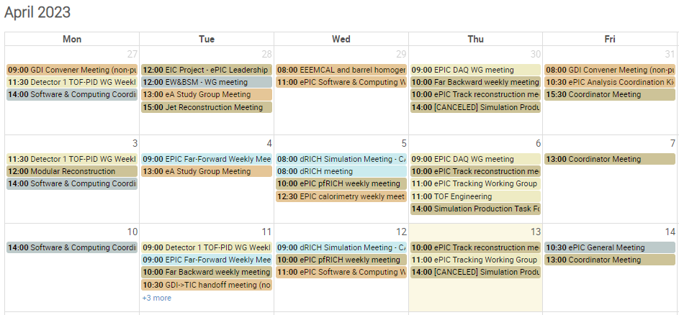
ePIC Collaboration Happenings
It continues to be a very busy time for ePIC!
March 13-14th – BECAL review
March 16-18th – EIC-Asia Meeting
March 20-21st – Backwards PID review
March 24th – Collaboration Council Meeting
April 3rd – Management plan ratified by CC
Spring Conferences (DIS, HP, GHP23, …)
April 3-4th - EIC Resource Review Board
April 21st – Next CC Meeting
April 24-25th – SP + PM Meeting @ CERN
Some more details in Project update, not enough time here…

Slide 5
ePIC at Conferences
DIS 2023, March 27-31st :
Invited talks by Richard Milner and Alex Jentsch
Seven additional talks by ePIC collaborators
Hard Probes
Invited talk by Friederike Bock
GHP ’23, April 11-14th :
Joerg Reinhold will give a talk on the ePIC Detector and Physics
Speaking Opportunity:
The organizers of SPIN 2023 have contacted us for a speaker to give a plenary talk on ePIC. The conference is Sept. 24-29th at Duke University: https://indico.jlab.org/event/663/
Contact Silvia, Ernst, Bernd or JGL to nominate/self-nominate
Submit abstracts!

Slide 6
ePIC Internal Review Process
March 13, 2022 – EIC Project encourages proto-collaboration to “… integrate new experimental concepts and technologies that improve physics capabilities without introducing inappropriate risk.”
Spring/Summer 2022 – Barrel ECal and backwards PID identified by GD/I as consolidation items requiring additional scrutiny.
October ’22 – March ‘23:
First ePIC simulation campaign with two geometry concepts (Arches and Bryce Canyon) to support simulation studies for competing technologies
Barrel ECal and backwards PID guidance to proponents, committee charge developed.
External review committee members identified.
GD/I review preparation meetings:
(ECal) https://indico.bnl.gov/event/17940/
(bRICH) https://indico.bnl.gov/event/18140/, https://indico.bnl.gov/event/18221/

Slide 7
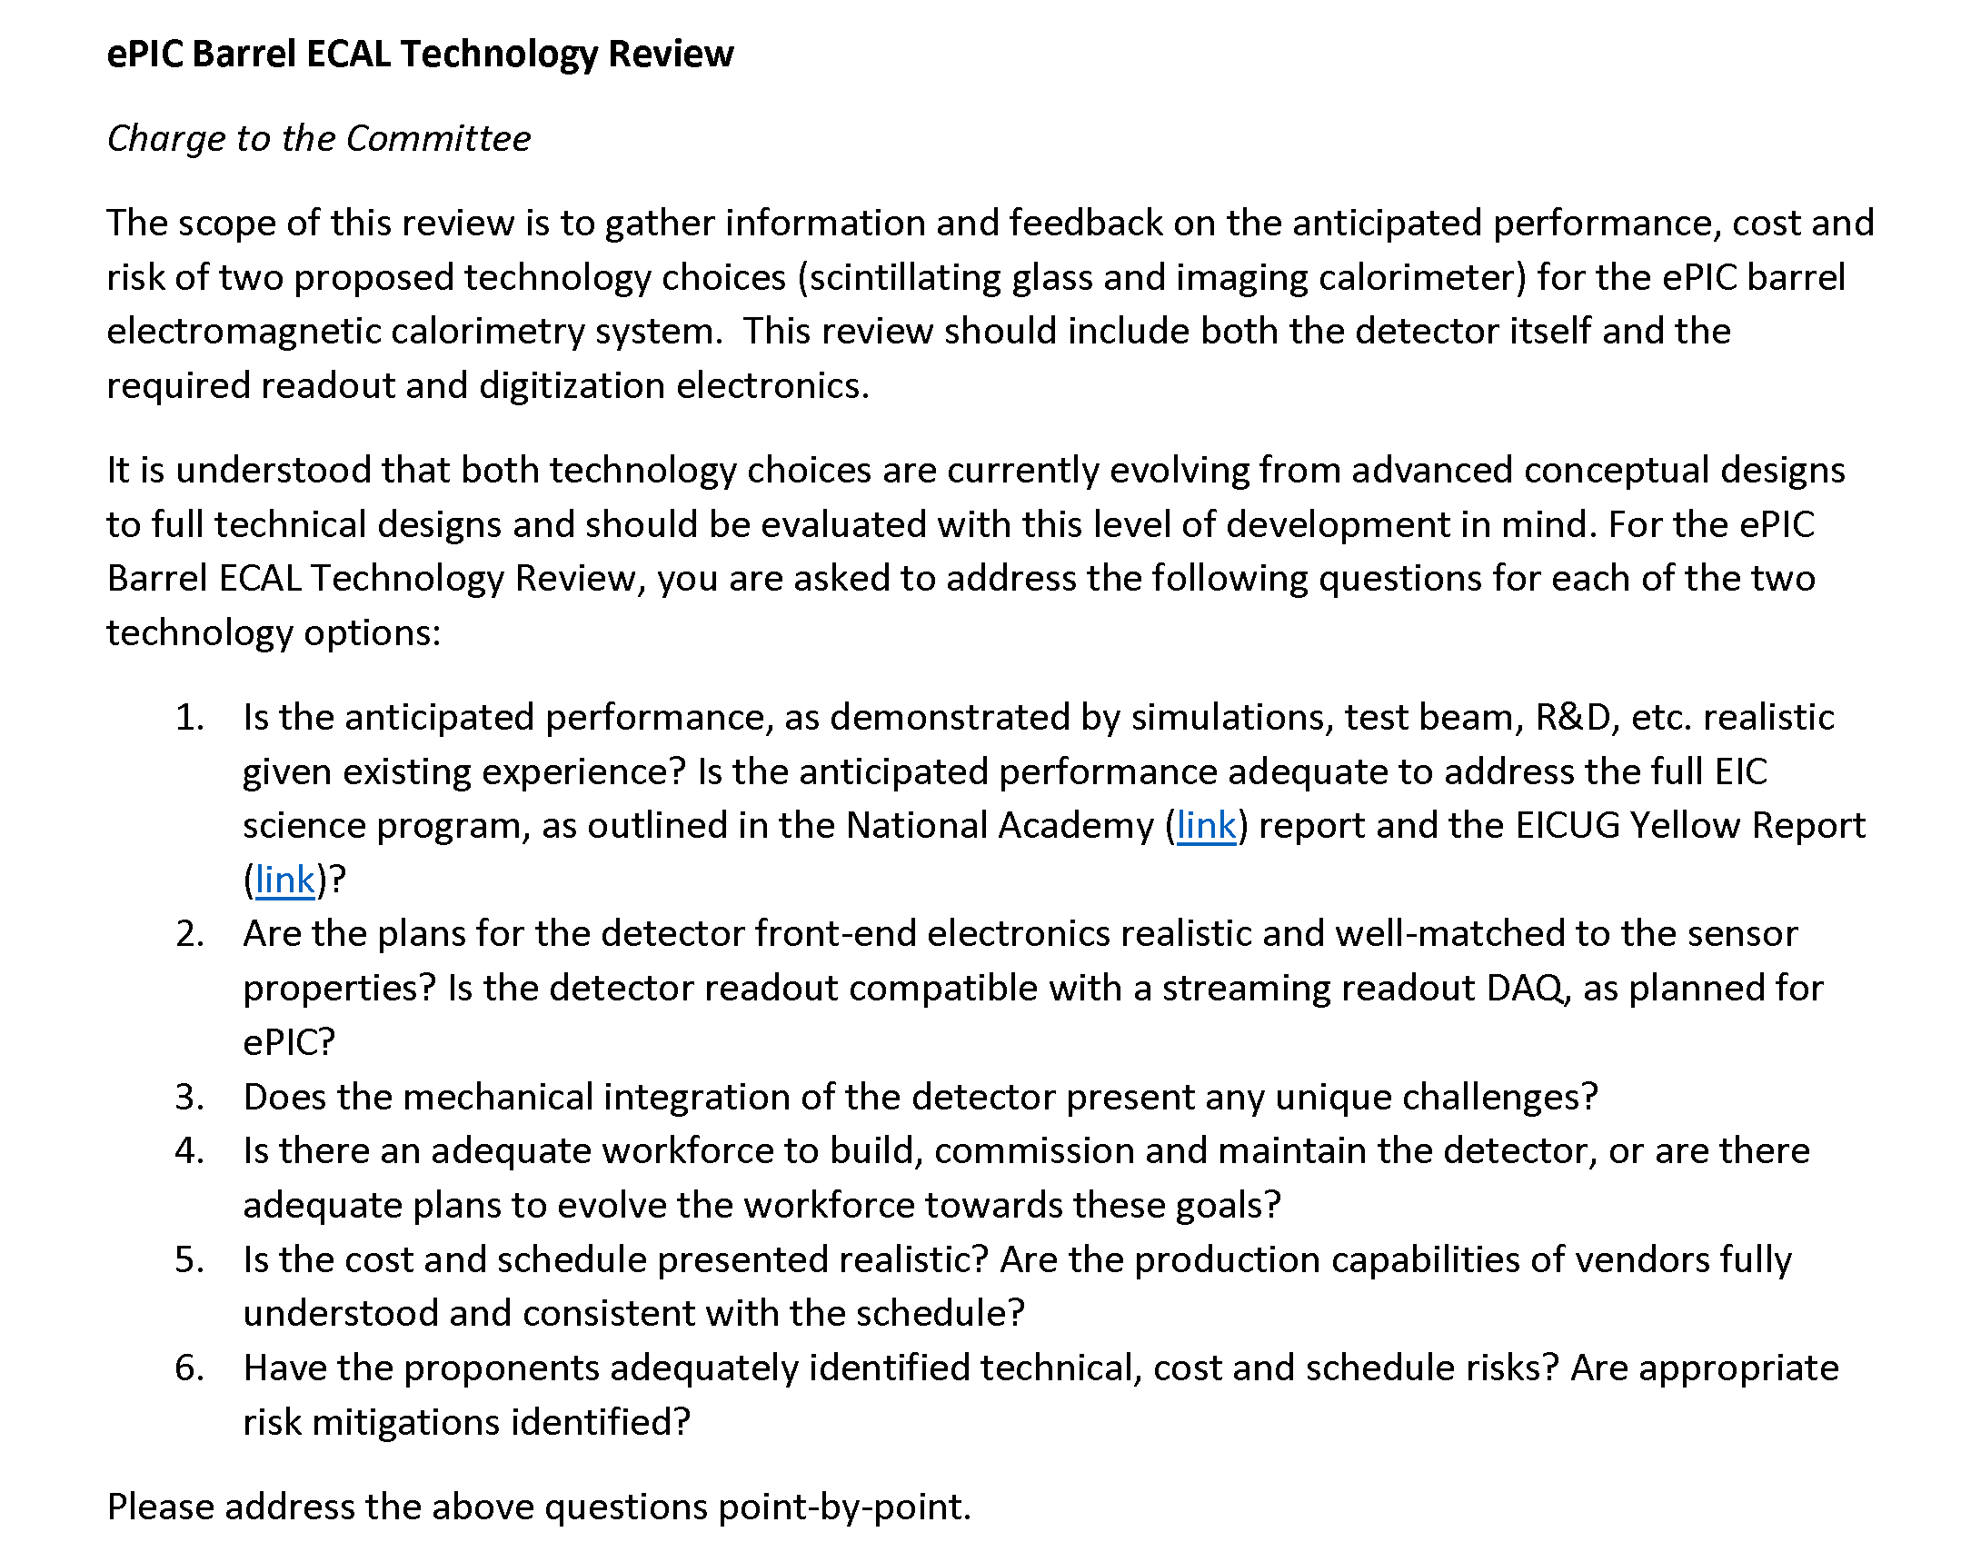
Barrel ECal Committee Charge
Review Committee was GD/I (Richard Milner excused himself) with external reviewers. Sasha Bazilevsky present as observer (L3 CAM).
Many thanks to our external reviewers:
Etiennette Auffray (CERN)
Tom LeCompte (SLAC)
Rainer Novotny (Univ. Giessen)
https://indico.bnl.gov/event/18517/

Slide 8
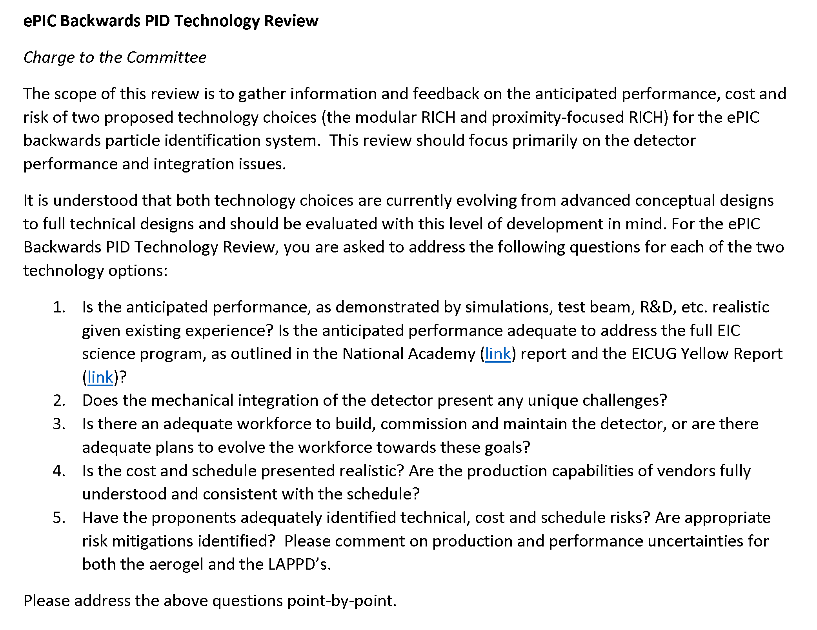
Backwards PID Committee Charge
Review Committee was GD/I (Silvia Dalla Torre and Thomas Ullrich excused themselves) with external reviewers. Beni Zihlmann present as an observer (L3 CAM).
Many thanks to our external reviewers:
Ichiro Adachi (KEK)
Roberta Cardinale (U. Genova)
Carmelo D'Ambrosio (CERN)
Antonello Di Mauro (CERN)
https://indico.bnl.gov/event/18499/

Slide 9
EB Meeting 4/7/2023
As discussed at the CC Meeting on 3/31, the Spokesperson’s Office convened a meeting of the Executive Board:
EB discussion of recommendations for technology selections for BEMCal and backwards particle ID needed
Included temporary members pending election of CC – elected members
First meeting of ePIC Executive Board:
Members: J. Lajoie, S. Dalla Torre, K. Dehmelt, M. Diefenthaler, R. Reed, S. Fazio
CC Chair/Vice Chair (invited): E. Sichtermann, B. Surrow
Temporary EB Members: B. Jacak, O. Evdokimov, T. Gunji, D. Higinbotham
External Input Solicited: P. Jones, P. Newman

Slide 10
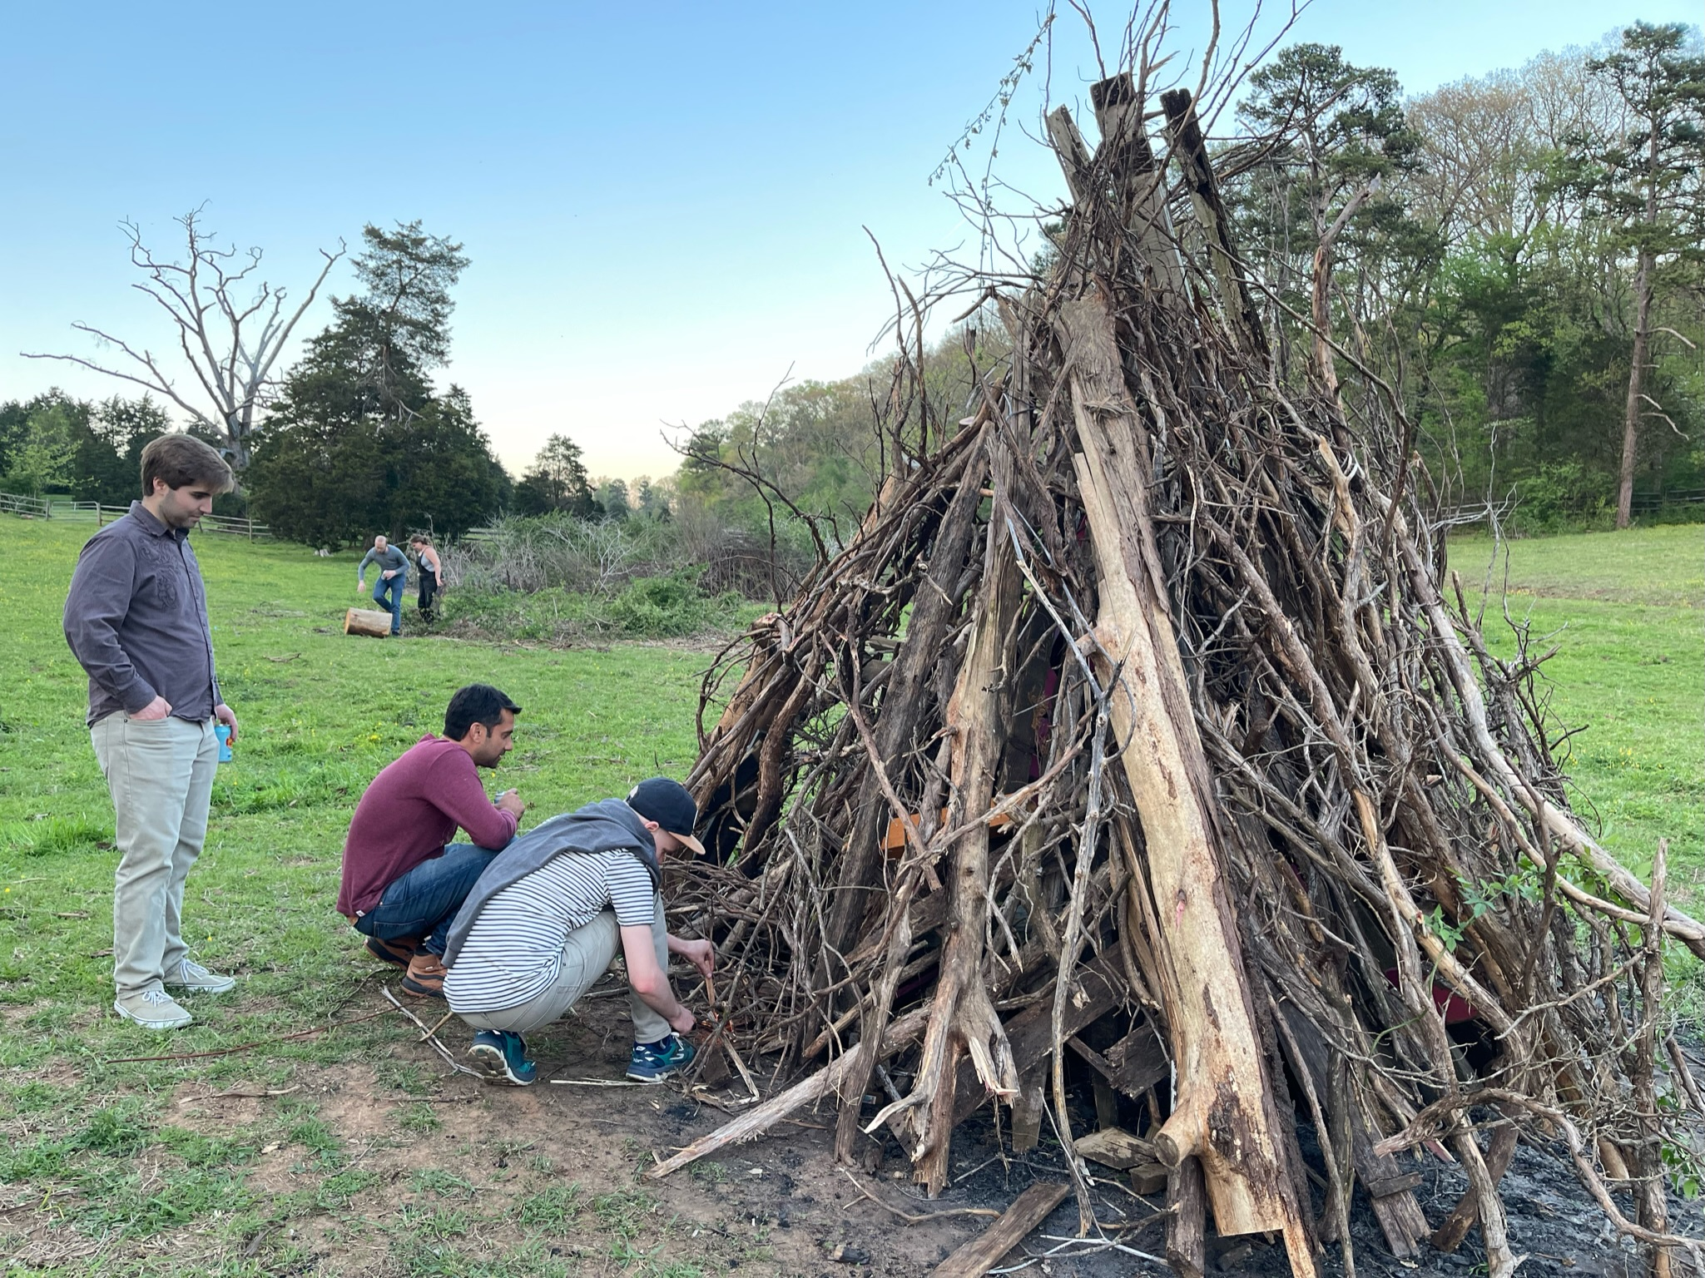
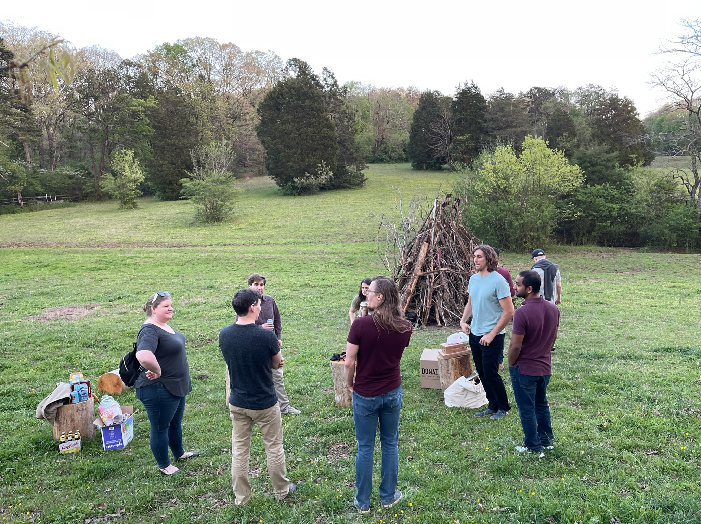
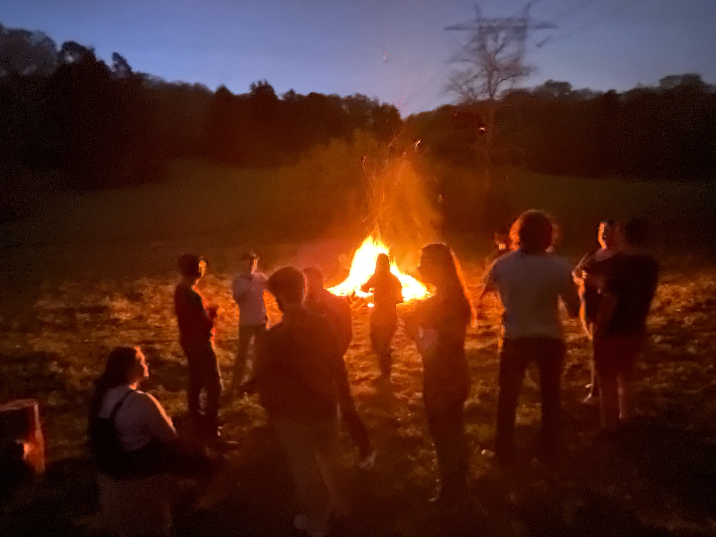
ePIC Calo. Clustering Workshop
ePIC Clustering Workshop held at ORNL 11-14 April
Lots of new activity on GitHub associated with this event!
Apparently, they also had a practical application of safety principles…
Will schedule and update at future General Meeting

Slide 11
Conclusions
ePIC remains as vibrant as ever, and activity within the collaboration is increasing:
Completing the consolidation process with the BECal and backwards PID reviews is a real milestone for the collaboration!
Substantial progress on reconstruction and simulation software in preparation for the second simulation campaign
No time to say more, go to the Software and Computing meetings!
Great ePIC talks at spring conferences!
Progress on growing the collaboration (EIC-Asia, EIC RRB meeting, …)
Occasionally, fun is spontaneously breaking out!

