Slide 1
ePIC Working Groups: Formation and Status
J. Lajoie, S. Dalla Torre
April 14, 2023

Slide 2
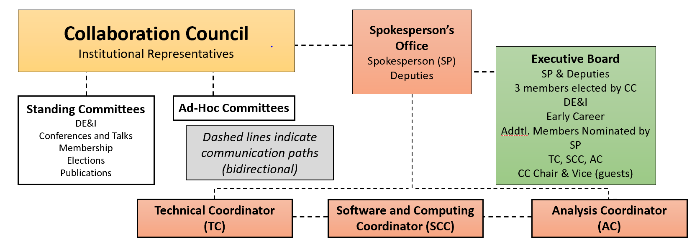
ePIC Management Structure - Coordinators

Slide 3
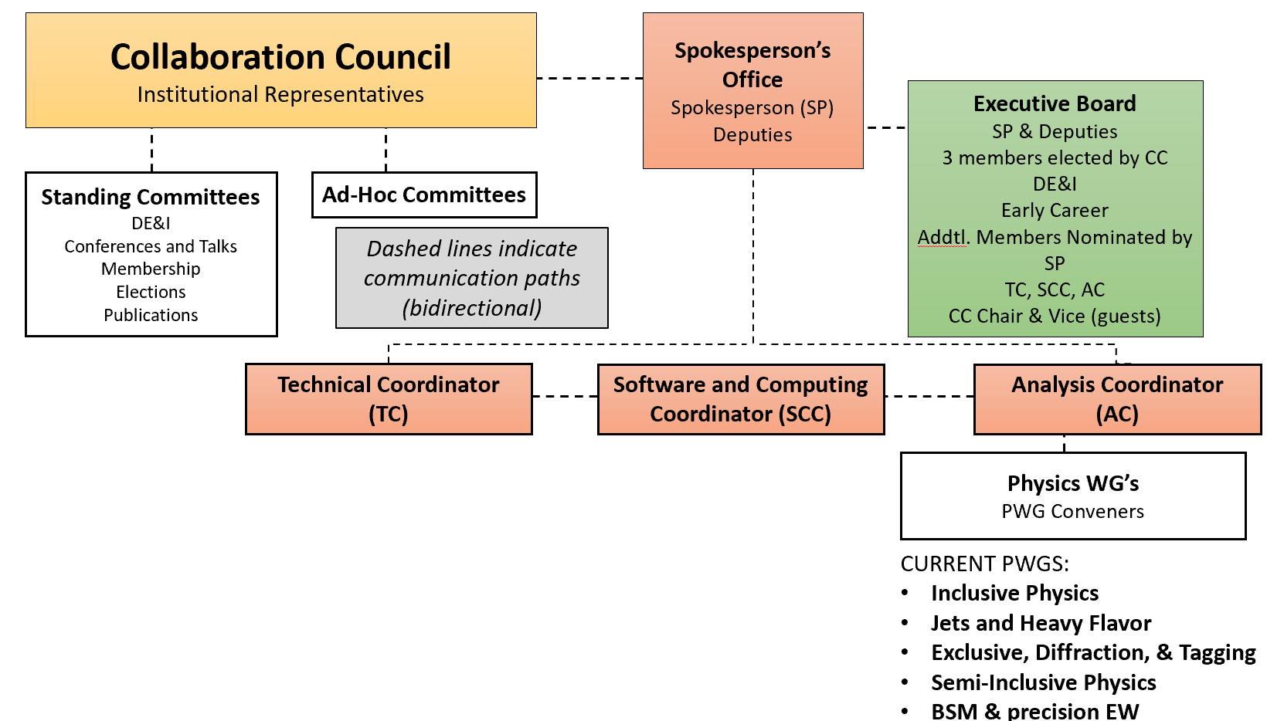
ePIC Management Structure – PWG’s
NOTE: Analysis coordinators propose staggered terms for PWG convenors, so one convenors in each PWG will change every year.

Slide 4
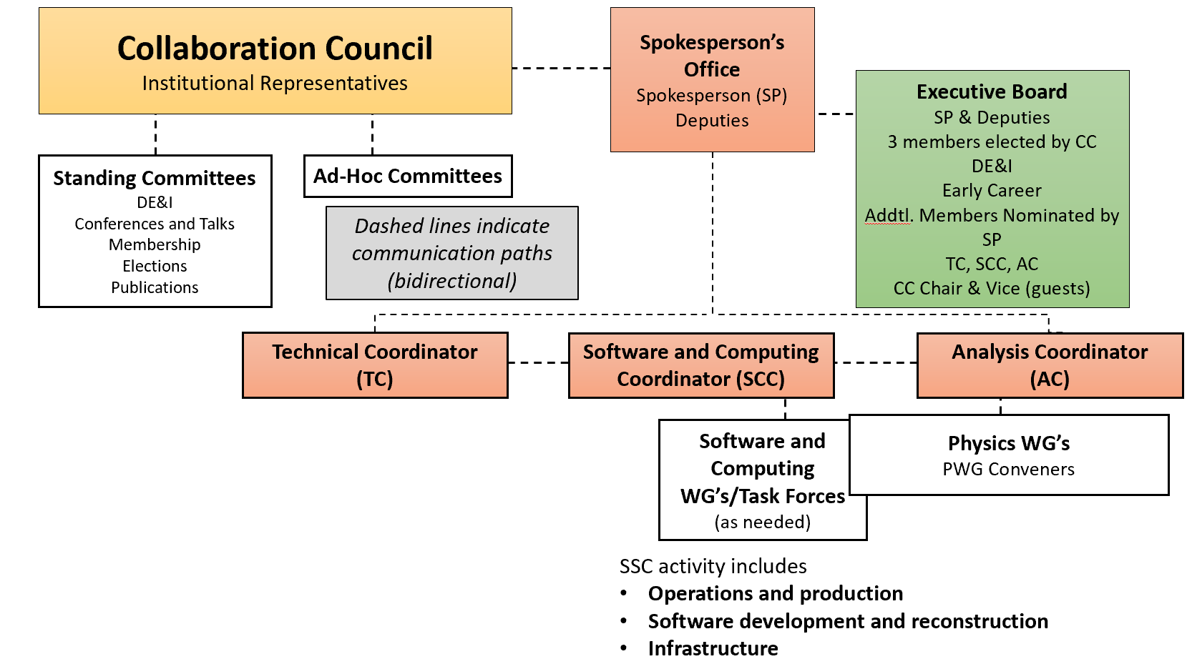
ePIC Management Structure – SCC WG’s
NOTE: Software and Computing proposes two-year terms. SCC wants to use WG’s to help drive engagement with the Software and Computing effort, consistent with the use of Task Forces prior to the management plan.

Slide 5
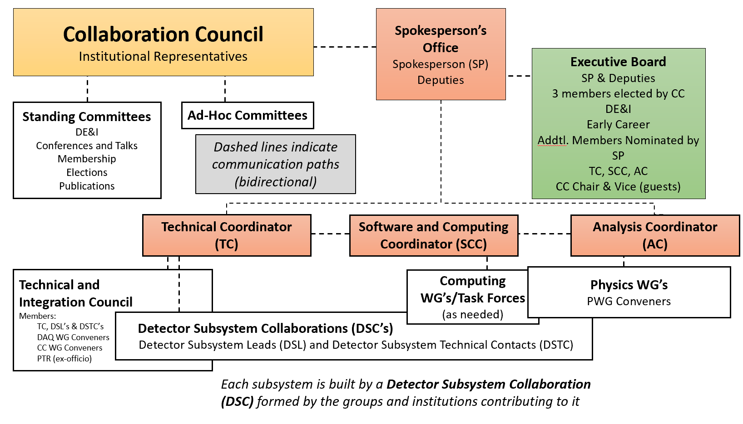
ePIC Management Structure – DSC’s and TIC
To be discussed in Silvia’s talk.

Slide 6
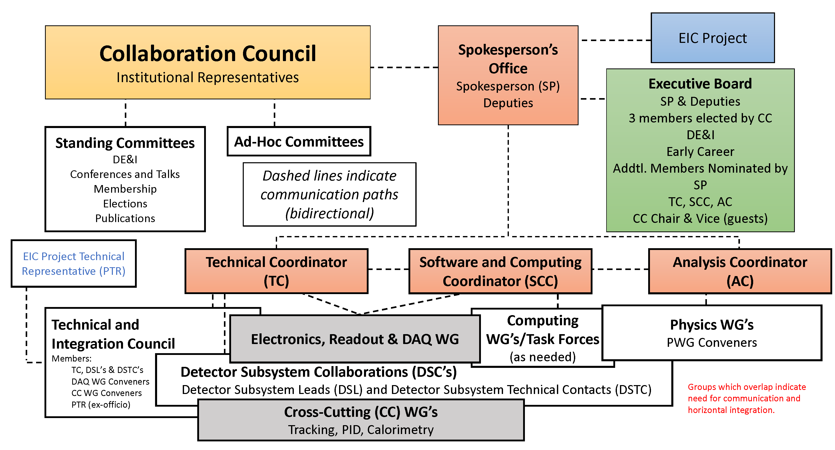
ePIC Management Structure – CC WG’s
CC WG’s are special things – they report to the TIC, they don’t sit between the TIC and the DSC’s!
Propose 2-year terms
To be discussed more in Silvia’s talk.

Slide 7
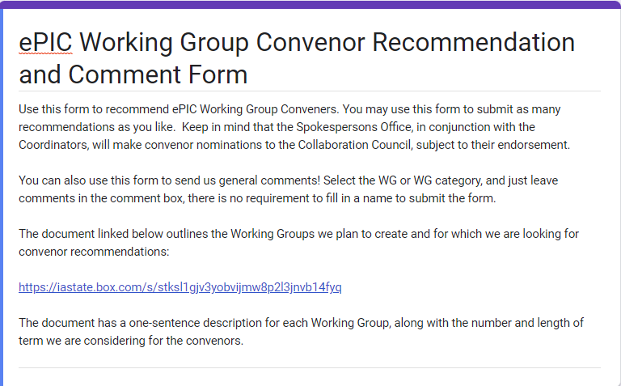
Reaching Out
Collaboration input sought on proposed WG’s and convenor recommendations:
Email sent 4/3/23
Google form accompanied by a list of proposed WG’s
One-sentence description of WG charge
116 responses!
Recommended WG convenors selected by Coordinators with this input in mind:
In addition to all the input already received during the development of the management plan.
This was a workforce optimization exercise!

Slide 8
Physics Working Groups
Inclusive Physics
Focus on measurements that involve detecting, identifying, and measuring the kinematics of the scattered electron.
Tyler Kutz (2-year)
Claire Gwenlan (1-year)
Exclusive, Diffraction and Tagging
Focus on measurement that require detecting the scattered proton/ion, whether it remains intact or not, together with all the final state produced particles, in addition to the scattered electron.
Raphael Dupré (2-year)
Rachel Montgomery (1-year)
BSM & Precision EW
Focus on measurements of the cross-sections, helicities of electroweak gauge bosons that can lead to a better understanding of quark-level electroweak couplings and the potential for measurements beyond the standard model.
Ciprian Gal (2-year)
TBD (1-year)
Semi-Inclusive Physics
Focus on measurements that require detecting, identifying and measuring a final state hadron or hadrons in addition to the scattered electron.
Charlotte Van Hulse (2-year)
TBD (1-year)
Jets and Heavy Flavor
Focus on measurements that involve high momentum exchanged processes, which could produce a spray of final state particles or hadrons that have one or more heavy quark constituents.
Olga Evdokimov (2-year)
Brian Page (1-year)
Physics Working Groups are encouraged to hold joint meetings where appropriate.

Slide 9
Software and Computing
Operations WGs:
Development WGs:
Infrastructure WGs:
Production
Responsible for the coordination and production of simulation campaigns based on priorities from the technical and analysis coordinators. Develop automated production workflows that scale with the needs of the collaboration.
Sakib Raman, Thomas Britton
Physics and Detector Simulation
Development of accurate MC simulations using a suite of physics and background generators and detector simulation based on Geant4 and DD4hep.
Kolja Kauder*, TBD (offer pending)
Streaming Computing Model
Development of the computing model for the compute-detector integration using streaming readout, AI/ML, and multi-architecture computing (CPU, GPU, …) with a specific focus on the data flows after the FEE layer.
Marco Battaglieri, TBD (offer pending)
User Learning
Responsible for support via documentation, help desk, and training. Ensure that software is discoverable (easy to use with only minimal instructions) and simulated data and metadata is findable.
Holly Szumila-Vance, Kolja Kauder*
Reconstruction
Development of a holistic and modular reconstruction for the integrated ePIC detector.
Shujie Li, Derek Anderson
Multi-Architecture Computing
Support for different types of processors or accelerators to optimize performance and efficiency.
Not activated at this time – placeholder for future
Analysis Tools
Integration of analysis methods and tools in central software and computing workflows.
Zhoudunming (Kong) Tu, TBD
Distributed Computing
Workflow and data management tools for using computing resources that are distributed worldwide.
Not activated at this time – placeholder for future
Validation
Responsible for the validation of the simulations via a suite of detector and physics performance plots. Develop autonomous checks and verification of the validation plots.
Torri Jeske, TBD (offer pending)
*Kolja Kauder is 100% on EIC

Slide 10
Cross-Cutting Working Groups
Electronics, Readout and DAQ
Oversee development of readout and DAQ from front end to storage.
Fernando Barbosa, Jeff Landgraf, TBD (offer pending)*
One each with analog electronics, digital electronics, and streaming readout emphasis
*Streaming Readout convenor shared with Streaming Computing Model WG under SCC
PID WG (TOF and Cerenkov)
Development of an integrated PID system for ePIC
Oskar Hartbrich, TBD
Tracking WG
Design and performance of an integrated tracking system for ePIC
Ernst Sichtermann, Matt Posik
Data and Analysis Preservation
Develop fully reproducible, re-usable, and re-interpretable analyses that are based on reusable software and are amenable to adjustments and new interpretations.
Not activated at this time – placeholder for future
Calorimetry WG
Address common concerns of calorimetry in ePIC
TBD (offer pending)

Slide 11
Motion to the Collaboration Council
SP Office and Coordinators will complete recommendations by next CC Meeting (April 21st)
We ask the Collaboration to welcome the new convenors and offer their support by being active participants in the new WG’s!
Additional input still welcome!
The Spokesperson’s Office requests that the Collaboration Council endorse:
The proposed Cross-Cutting, Software and Computing and Physics Working Groups
Specifically, those WG’s to be activated at this time.
The proposed conveners for each Working Group (by working group)
Worked hard to develop teams that can complement each other

