Slide 1

ePIC Barrel ECal
Spokesperson’s Office Recommendation
J. Lajoie, S. Dalla Torre
April 14, 2023

Slide 2
Introduction
The presentation was prepared from:
  The BECal review material and committee report
    https://indico.bnl.gov/event/18517/
  Conversations with committee members
  Conversations with proponents
  Additional material (solicited and unsolicited) from proponents
    This is noted throughout the presentation
  Cost information solicited from the EIC Project
  Input from EB discussions
This evaluation is broken into sections:
  Physics Performance
  SciGlass Concerns
  Imaging Calorimeter Concerns
  Cost Comparison
  Draft Recommendation

Slide 3
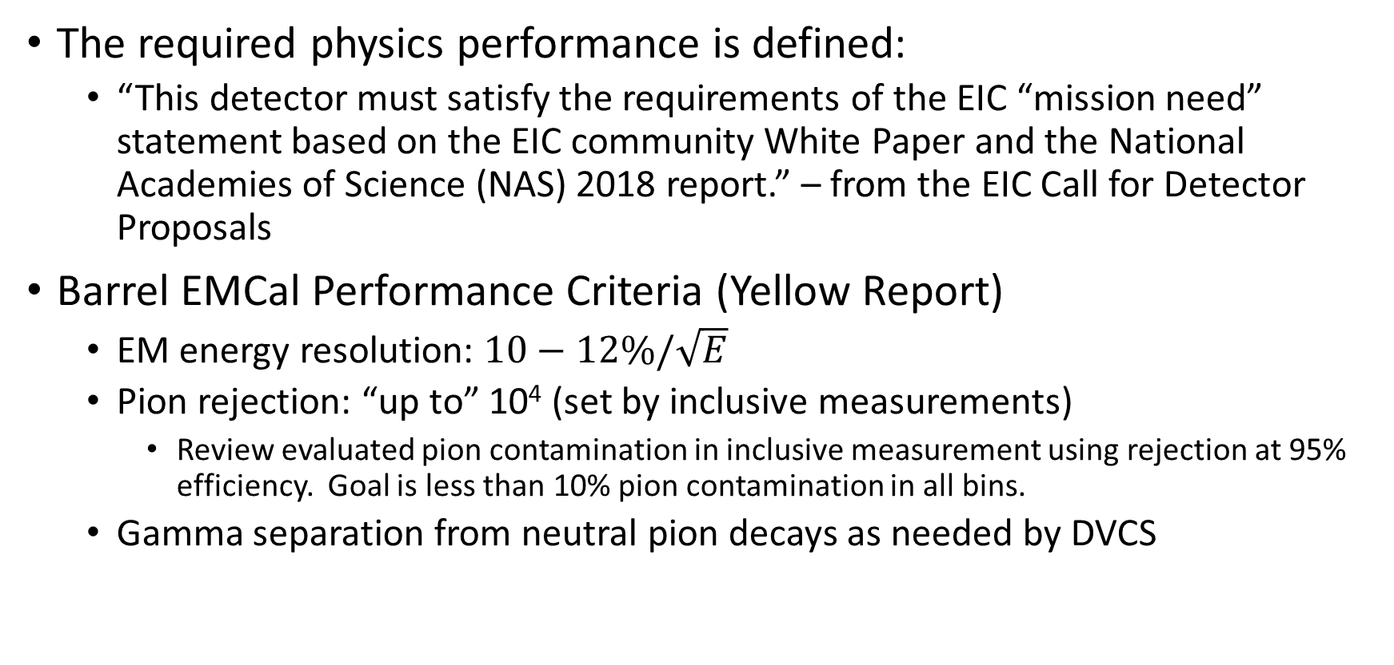
Barrel ECal Physics Performance Metrics
The required physics performance is defined:
  “This detector must satisfy the requirements of the EIC “mission need” statement based on the EIC community White Paper and the National Academies of Science (NAS) 2018 report.” – from the EIC Call for Detector Proposals
Barrel EMCal Performance Criteria (Yellow Report)
  EM energy resolution: $10−12\%/\sqrt{E}$
  Pion rejection: “up to” 10⁴ (set by inclusive measurements)
    Review evaluated pion contamination in inclusive measurement using rejection at 95% efficiency. Goal is less than 10% pion contamination in all bins.
  Gamma separation from neutral pion decays as needed by DVCS

Slide 4
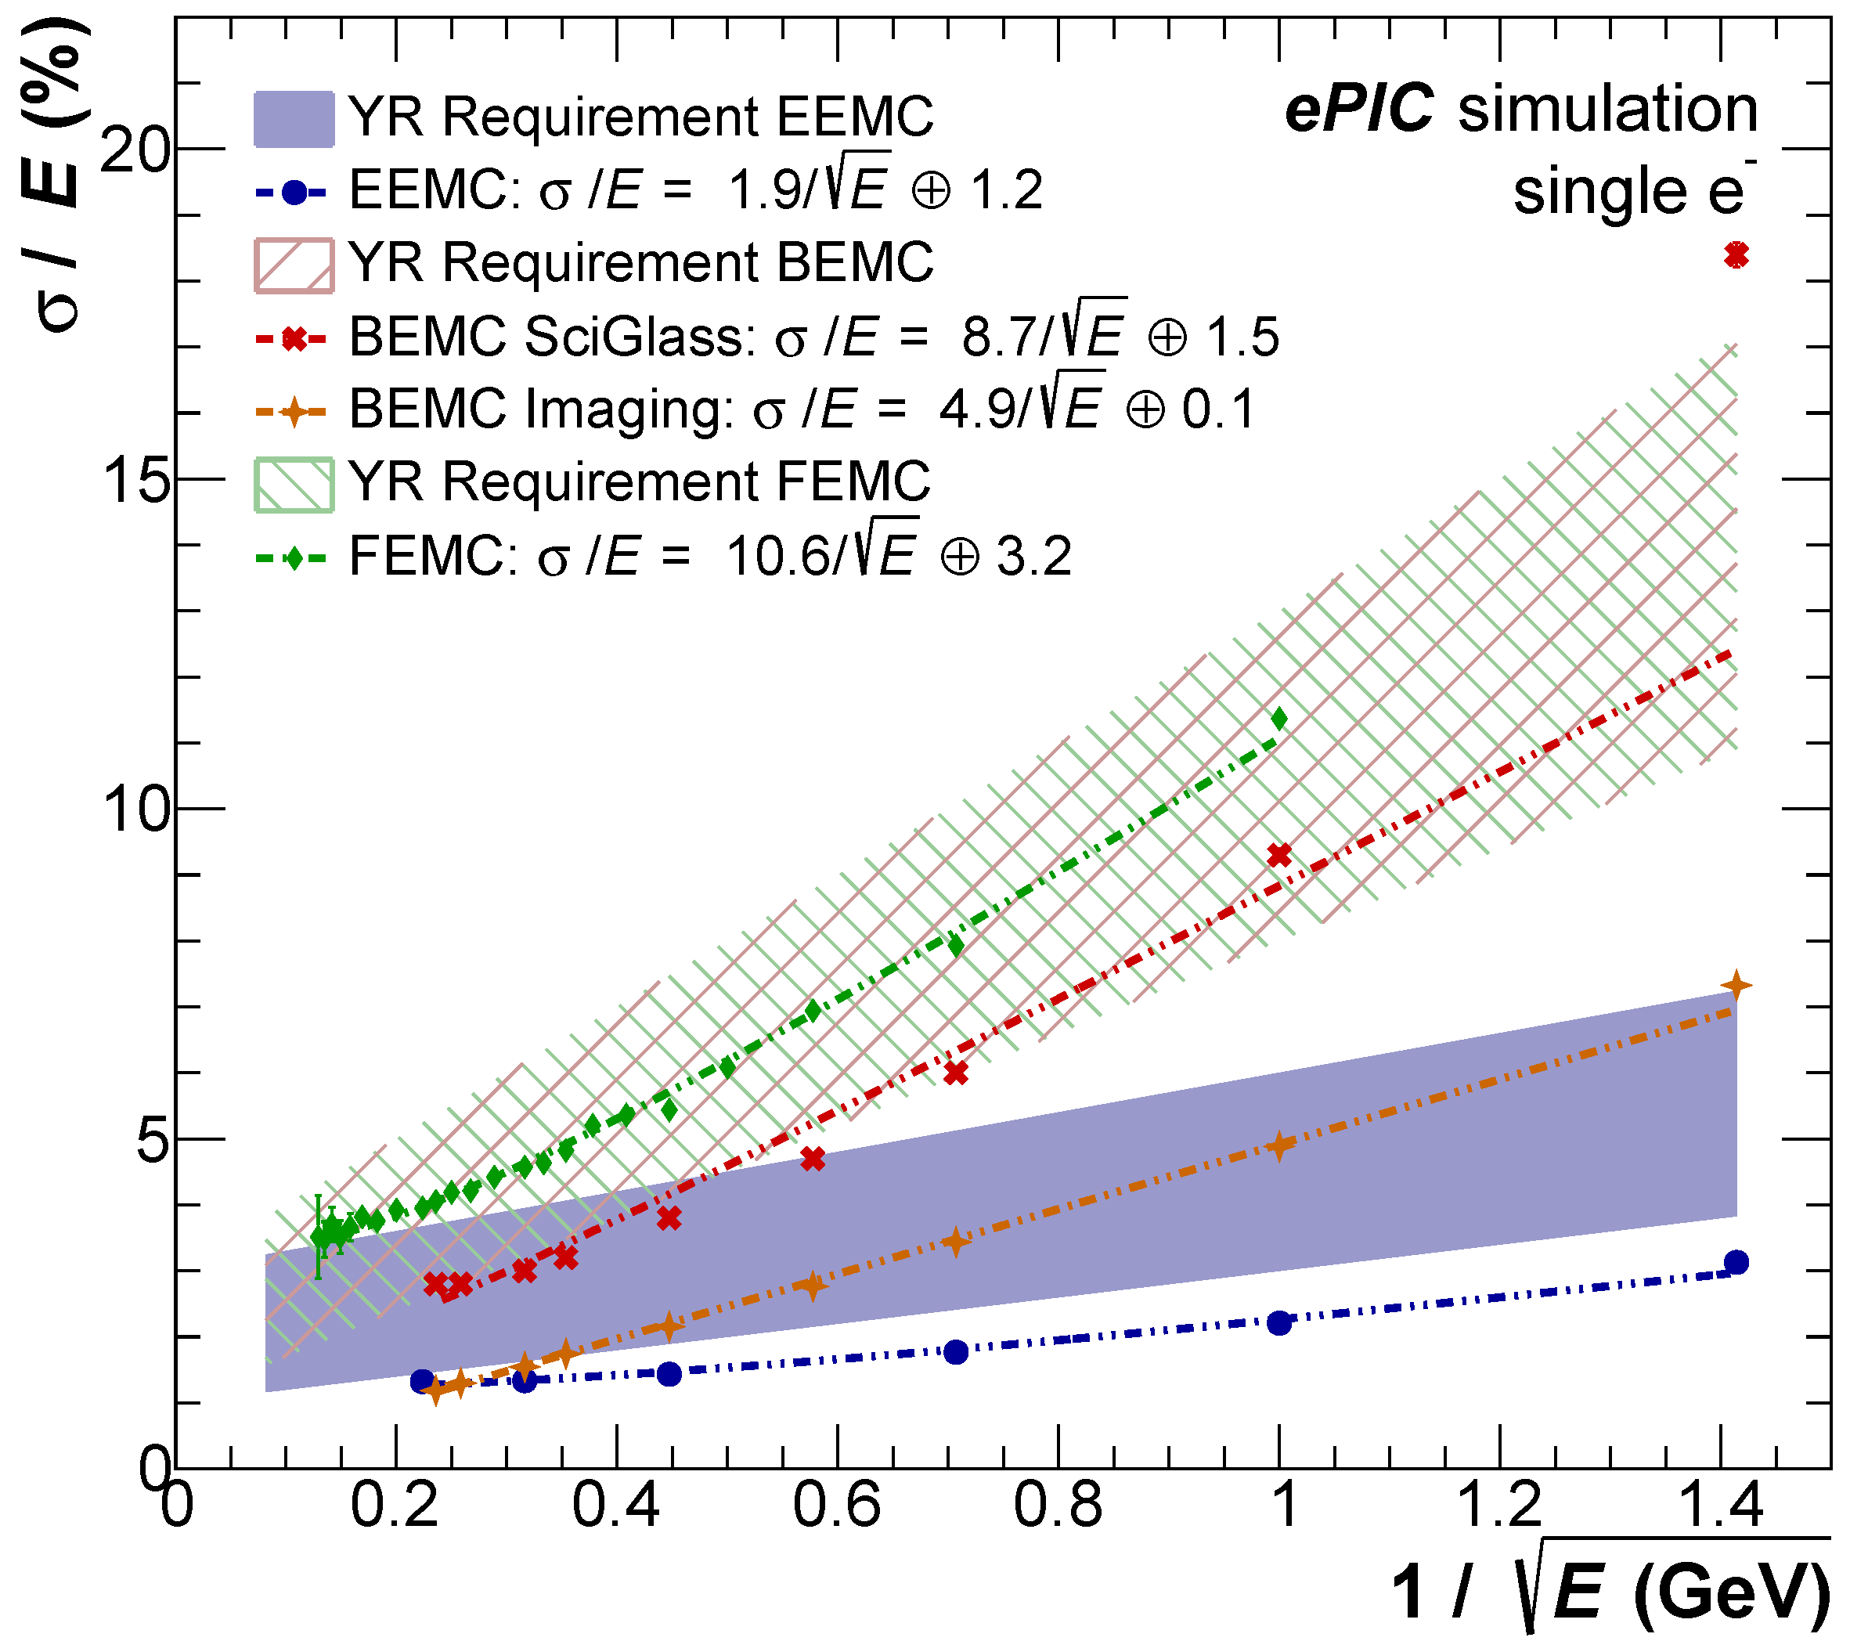
EMCal energy resolution plot from Fredierike Bock 3/30/2023
Both calorimeters meet the YR energy resolution requirement
SciGlass easily meets the YR requirement
Imaging EMCal does substantially better than the YR requirement

Slide 5
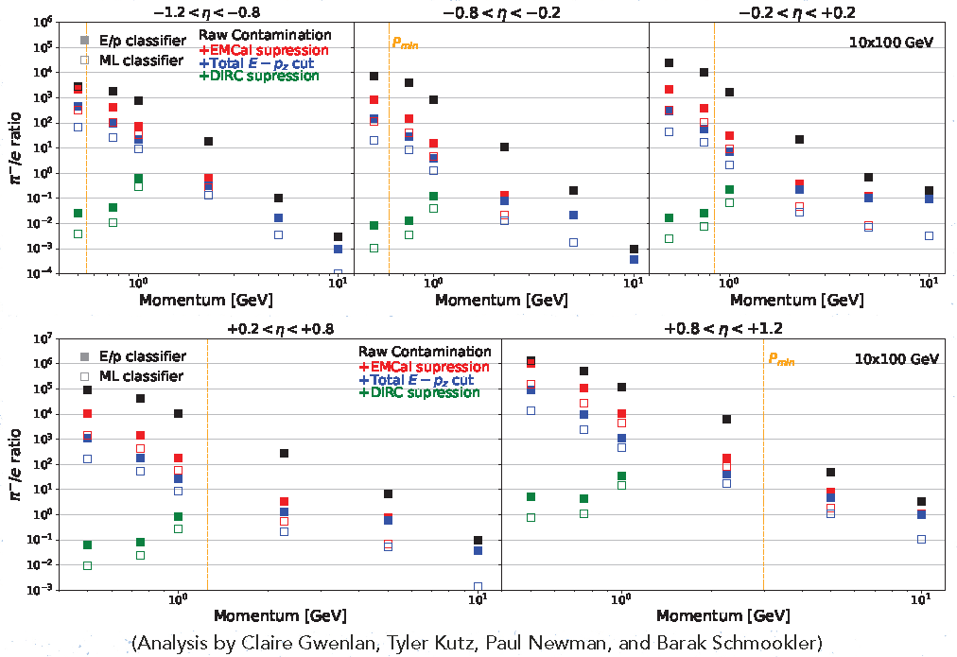
10 x 100 GeV
Plots use pion rejection at 95% electron efficiency
SciGlass EMCal Results (from review)
Imaging EMCal Results (from review)
Challenges at positive pseudorapidity, low p_{T} for both calorimeters

Slide 6
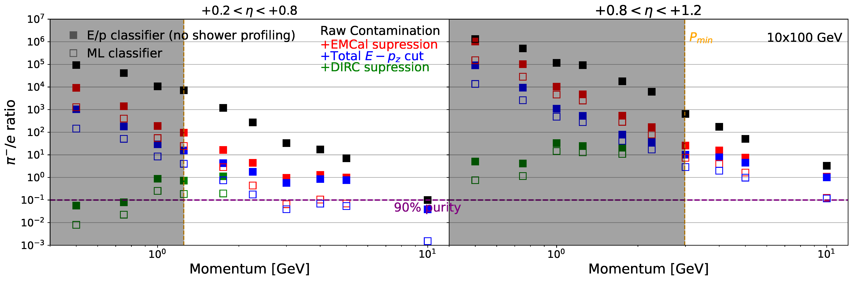
10 x 100 GeV
Imaging EMCal Results (from M. Zurek, email to committee, 3/17/2023) – additional points near p_{min} for positive pseudorapidity
Barak Schmookler confirmed 3/29/2023 that hpDIRC parametrization goes up to 2 GeV @ 95% efficiency, but agreed performance limit is 1.2 GeV (G. Kalicy 4/14/2023)
SciGlass EMCal Results
(from D. Kalinkin, 4/3/2023)

Slide 7
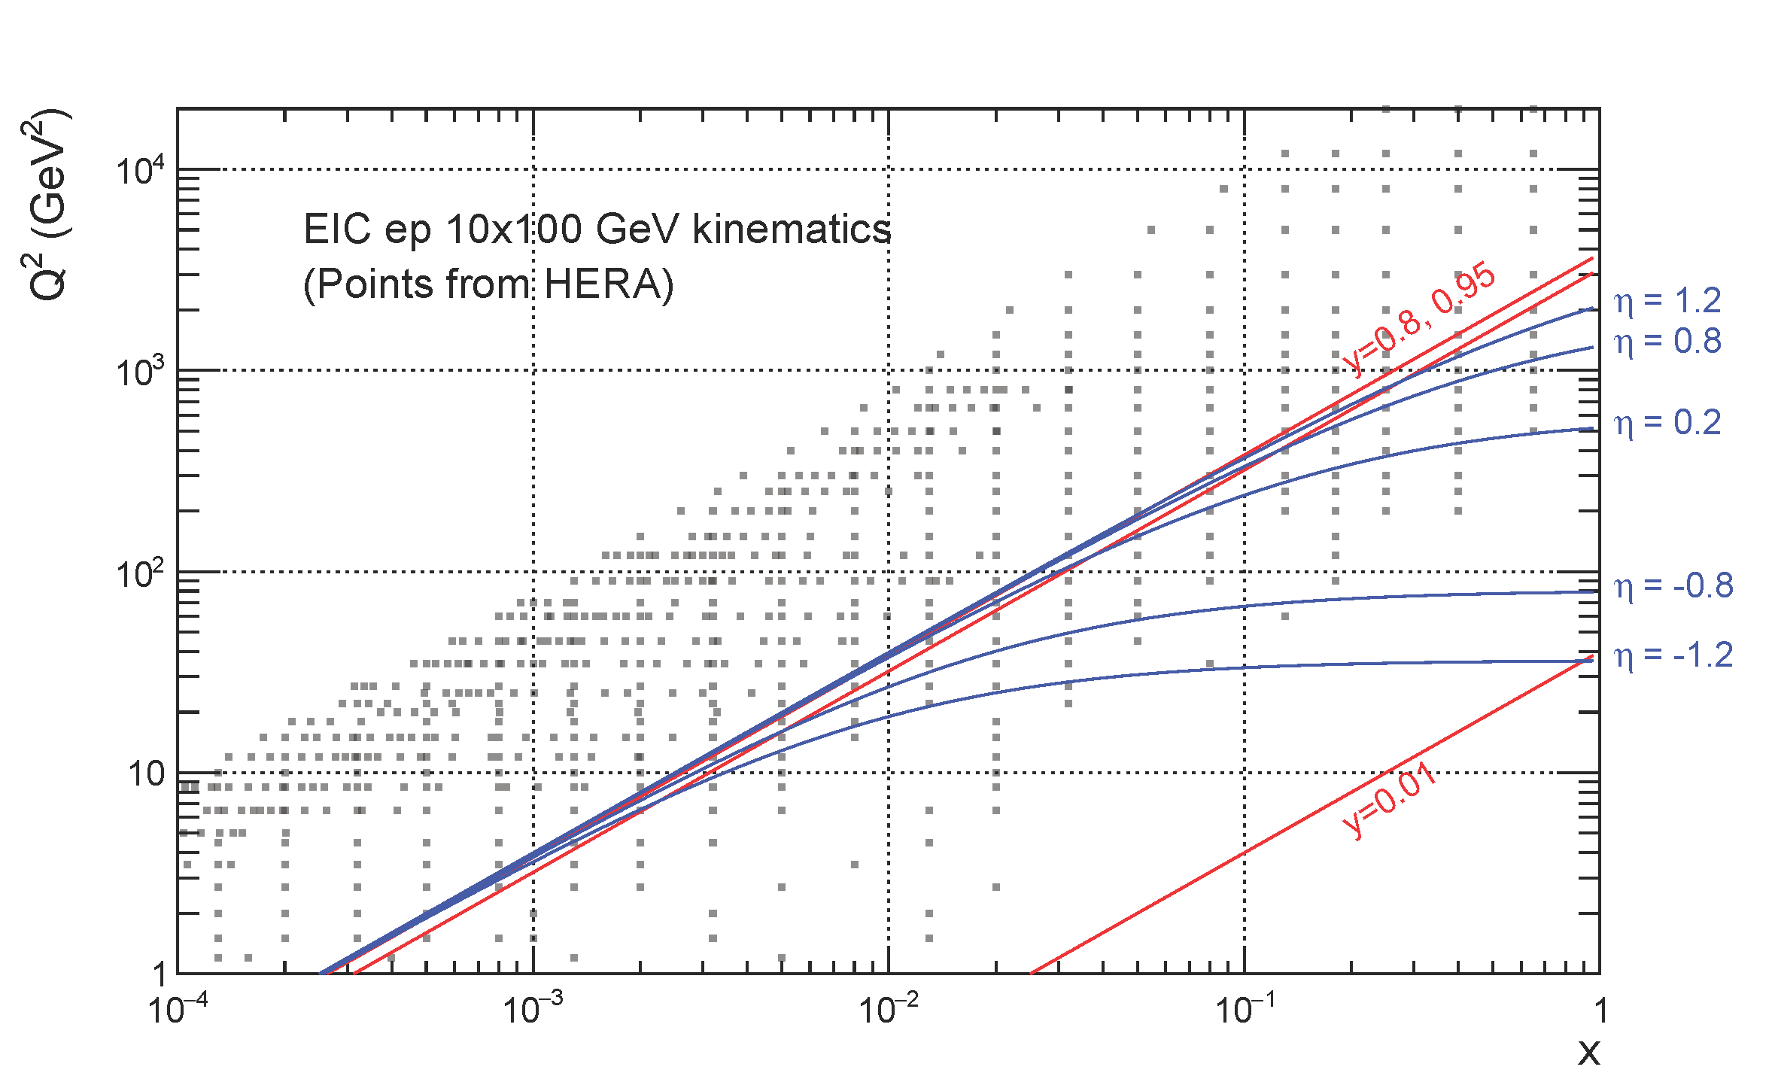
Performance Impact (10 x 100 GeV)
From Tyler Kutz – 4/12/2023
Band shows rapidity range in barrel overlaid with HERA data points.
The region +0.2 < η < +1.2 and electron energy of ~2 GeV is (y~0.8) is in region well-covered by HERA

Slide 8
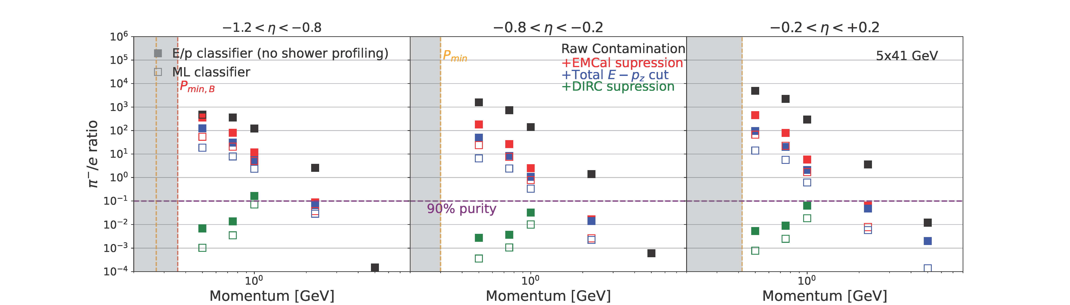
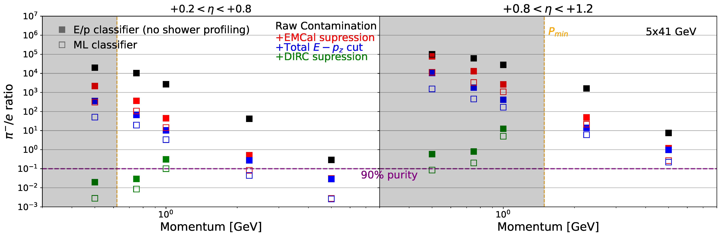
5 x 41 GeV
Note that the 5x41 GeV plots do not take advantage of the extended hpDIRC coverage
SciGlass EMCal Results
(from D. Kalinkin, 4/3/2023)
Imaging EMCal Results
(from M. Zurek, 4/6/2023)

Slide 9
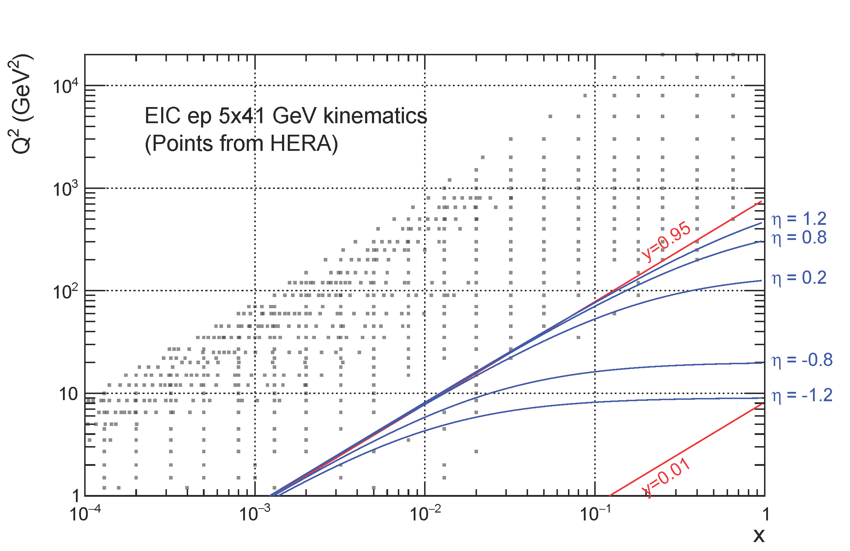
Performance Impact (5 x 41 GeV)
From Tyler Kutz – 4/2/2023
Band shows rapidity range in barrel overlaid with HERA data points.
The region +0.2 < η < +1.2 and electron energy of ~2 GeV is (y~0.8) is in region at the edge of what is covered by HERA

Slide 10
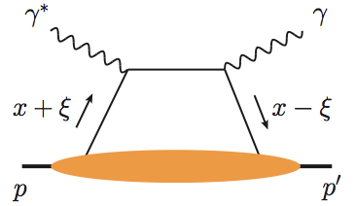
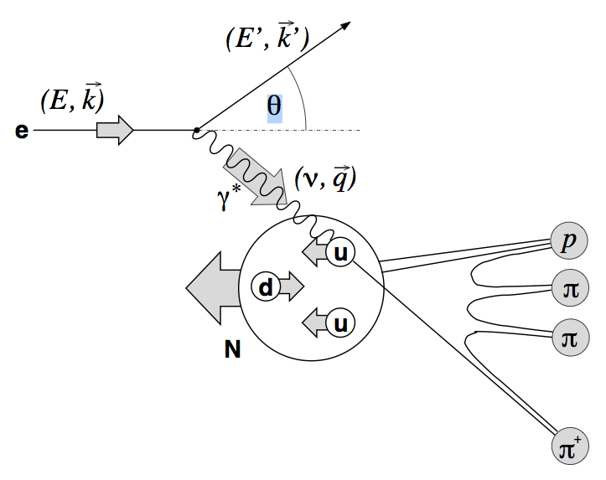
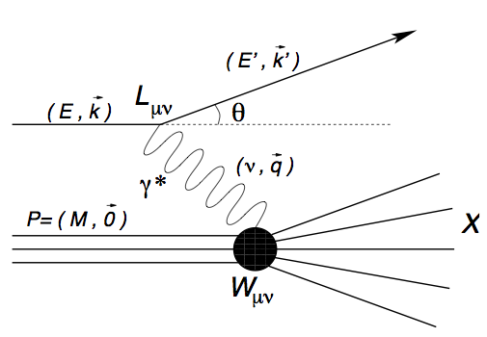
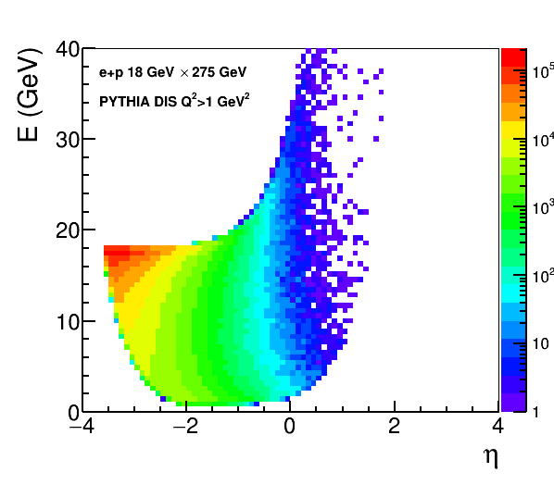
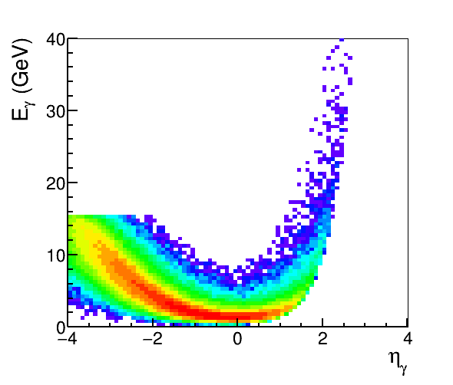
EM Calorimetry Requirements
DVCS photons that go into the Barrel EMCal are at predominantly low energies but plot is at generator level (no crossing angle). DVMP more important at higher positive pseudorapidity (higher x_{B}).
Electron/photon PID, energy, angle/position:
Coverage (in rapidity and energy), resolution, e/𝜋, granularity, projectivity
DIS e
DVCS photons
SIDIS π0
MILOU DVCS
e+p 18×275 GeV
PYTHIA
18 x 275 GeV
e-endcap
Barrel
h-endcap

Slide 11
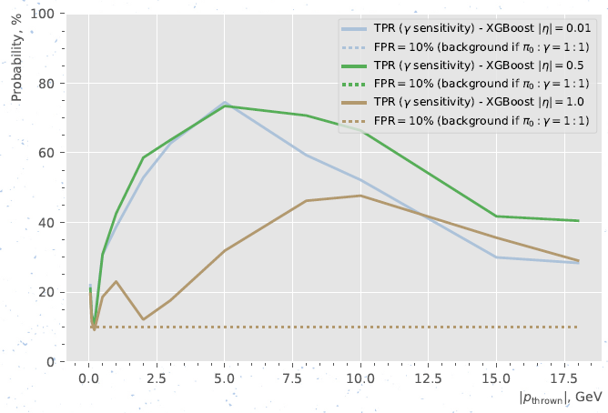
π⁰/gamma Separation
Additional work post-review to compare SciGlass and Imaging EMCal on the same footing!
From D. Kalinkin 4/13/2023:
Photon probability (efficiency) for 10% pion false positive.
SciGlass results for ML @ η=0 and 10 GeV:
photon efficiency ~45% for 10% π⁰ false positive.
From review:
Imaging EMCal results for CNN @ η=0 and 10 GeV: photon efficiency 90% for 8.65% π⁰ false positive.

Slide 12
Physics Capabilities: Conclusion
Both calorimeter designs are in principle capable of achieving the EIC science program, at the level of realism included in the current simulations, assuming performance as indicated in simulations:
  CAVEAT: Gamma/π⁰ rejection performance calls for an evaluation extended to physics performance:
    The overall effect on DVCS/DVMP measurements should be quantified in the future in a full physics simulation
  CAVEAT: Beam gas backgrounds not included
  CAVEAT: Both designs need realistic implementations of detector noise, etc. (following beam tests)

Slide 13
Scintillating Glass Concerns
Important properties of SciGlass that affect the simulated physics performance are not well-known:
  The review committee pointed out that a detailed characterization of the SciGlass material has not been presented (transmission and emission spectra, slow components of light output, non-uniformity along depth, etc.). In particular the transmittance and uniformity as a function of depth along the tower length is necessary to characterize linearity of response.
    This has important implications for the simulated pion rejection. In particular the linearity of response could make the pion rejection substantially worse.
    It was pointed out during the review that the transmittance could be adjusted by tuning the dopant, if necessary. However, this extends the R&D time required before SciGlass can go into production and creates schedule risk.
    Hadron response is not known/constrained
  The existing beam tests of the 3x3 20cm (7X₀) blocks that are compared to simulation results are leakage dominated, and therefore tell us little about how well the characteristics of the SciGlass are reproduced in simulation.
There is a risk that the required SciGlass R&D is not compatible with EIC project timelines. In addition, if risks are realized too late it may be extremely difficult to mitigate those risks without impacting project timelines.

Slide 14
Imaging EMCal Concerns (I)
Can the Imaging EMCal replace the outer MPGD layer?
  AstroPix hit resolution σ~500μm (pixel size)/sqrt(12) = 144μm
    MPGD position resolution is σ~100-150μm (angle dependent)
    AstroPix also potentially offers a good time resolution (needs further study)
  Imaging EMCal should be able to replace the MPGD layer with similar performance for both momentum resolution, pattern recognition, and angular resolution at hpDIRC
The AstroPix chip hit buffer will drop hits if it gets full:
  Data is daisy-chained from chip to chip
  Plausible argument this is OK for a full stave at
  EIC multiplicities
    Mitigation is to use more aggregators (small effect on cost)
From S. Joosten 4/13/2023
AstroPix max buffer occupancy (conservative study)

Slide 15
Imaging EMCal Concerns (II)
The SciFi technology is well-demonstrated and presents little technical risk. The imaging layers represent a large overall area of Si detectors, use a novel sensor in development, and this represents a technical, cost and schedule risk.
No studies shown at the review that demonstrate the optimal number of imaging layers:
  The current design over-performs for the physics performance requirements
  What is the minimal number of imaging layers required to achieve the physics goals of the EIC White Paper and NAS report, with any potential benefit of additional layers being reserved for an upgrade of the detector?
  Proponents note that imaging layers important to both pion rejection and gamma/π⁰ separation.
  Reducing the number of layers reduces risk.

Slide 16
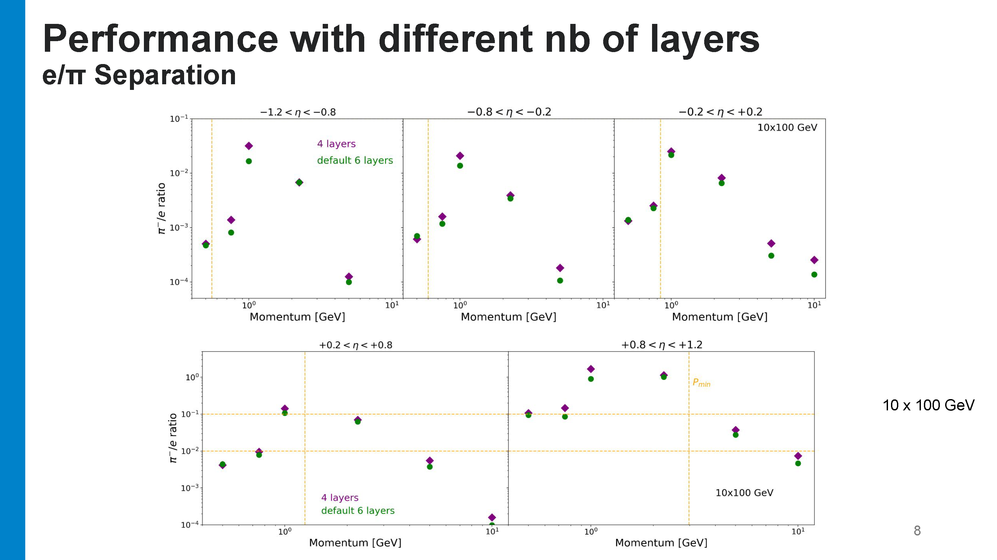
From Sylvester and Maria 4/6/2023
Performance includes all components –plots focus near p_{min}.
Performance at 10x100 still adequate.
Still meet performance criteria

Slide 17
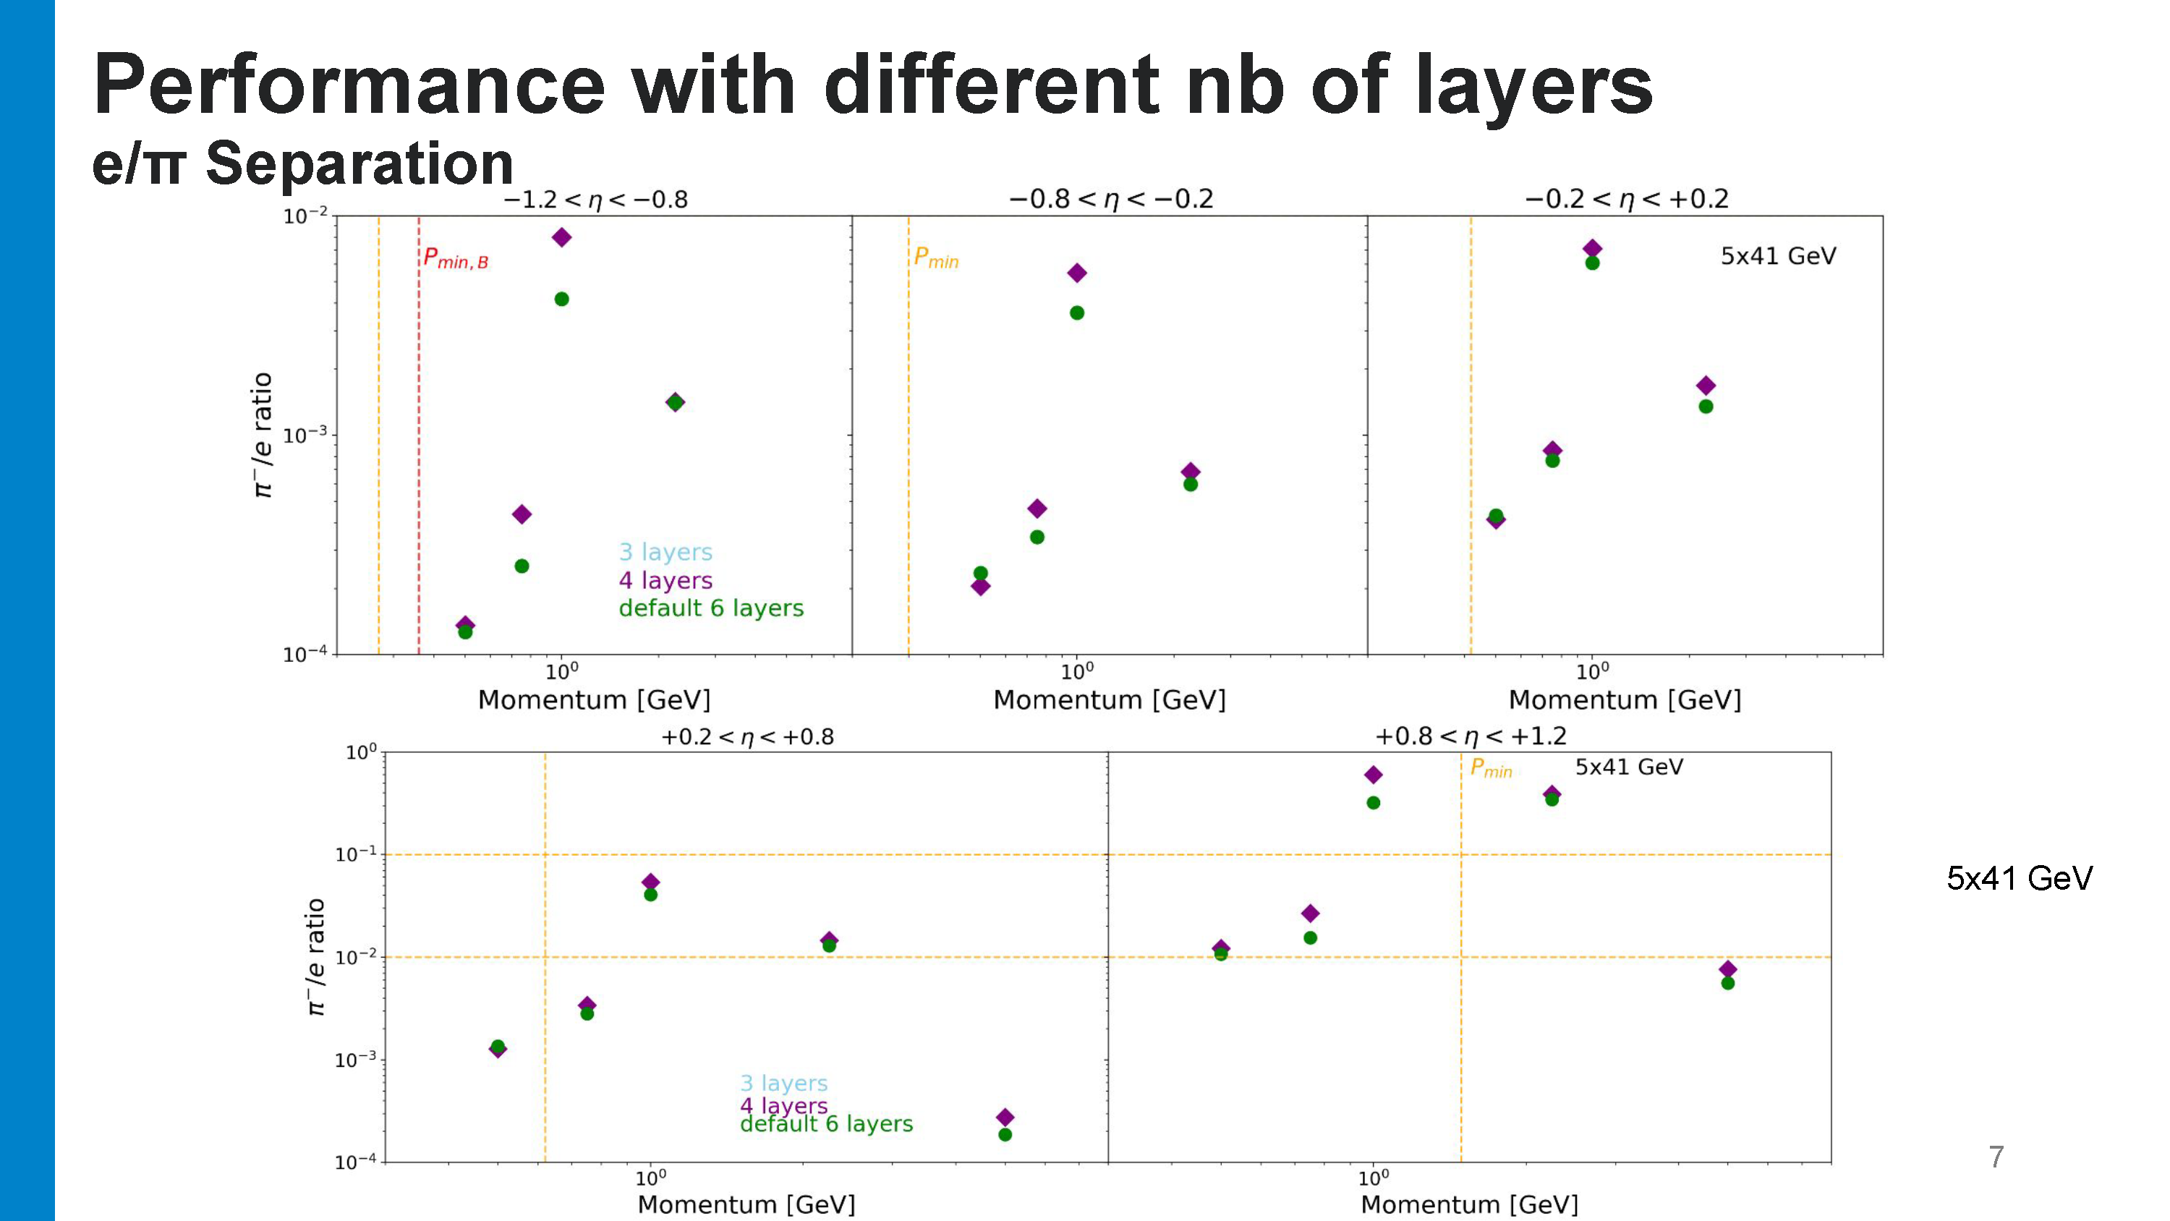
From Sylvester and Maria 4/6/2023
Performance includes all components – plots focus near p_{min}.
Performance at 5x41 still struggles just above p_{min} at highest rapidity – but no worse.

Slide 18
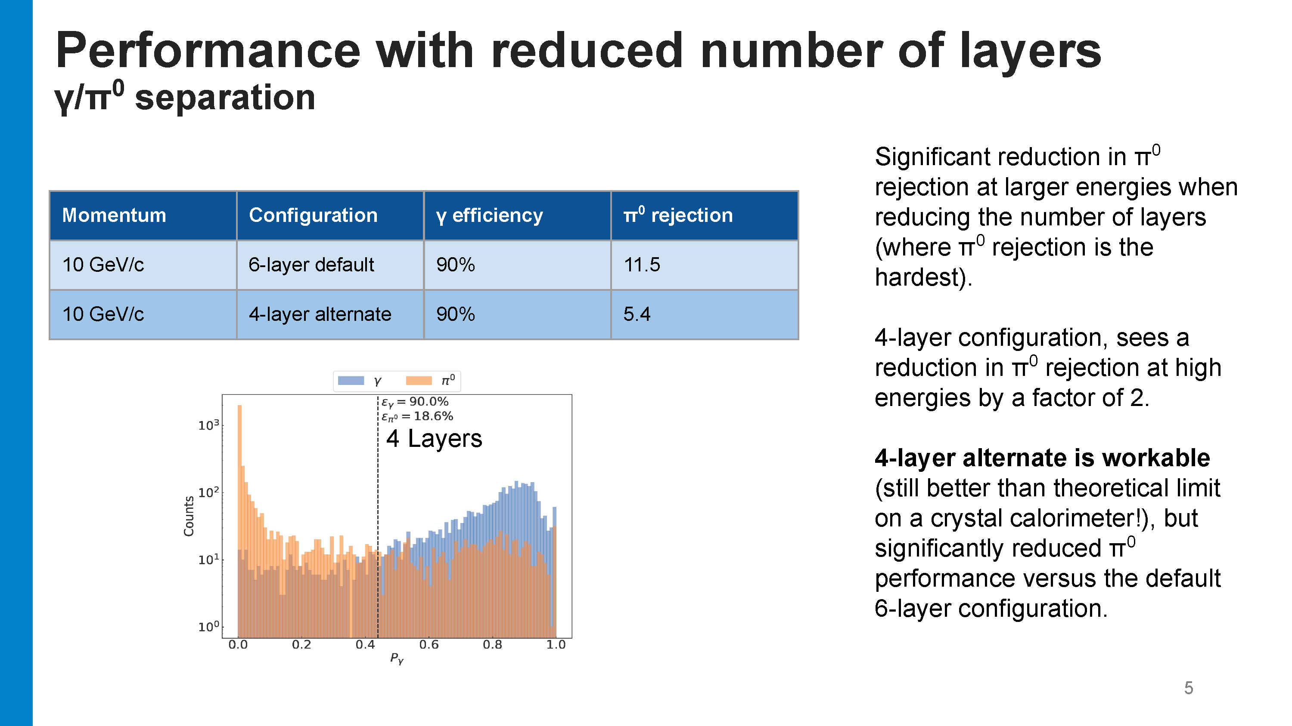
From Sylvester and Maria 4/6/2023
π⁰ background at 10 GeV increases by x2

Slide 19
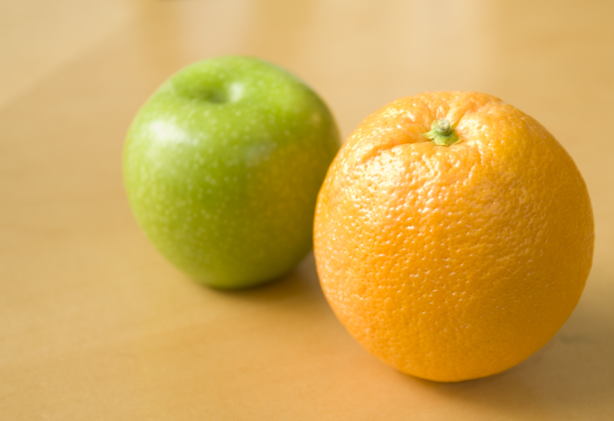
Cost Comparison
SciGlass:
Imaging:
Costs provided by Project (P6) 4/10/23:
(burdened and escalated)
Costs provided by proponents, using DPAP costing guidelines (no escalation):
Base Cost (6 layers): $27M
Remove two imaging layers:
  -$2.15M (AstroPix staves)
  -$0.5M (testing stations)
Add electronics:
  $1M SiPM readout, AstroPix aggregators
SciGlass EMCal + Outer MPGD Tracker: $23.4M
Does not include additional $4.5M in increased SciGlass material costs
(Dec 2022 review). These cannot be trivially added to escalated numbers.
Imaging EMCal: $25.4M
This is not an escalated number!
Escalation depends on profile and things like long-lead procurements, cannot be trivially estimated!

Slide 20
Cost Comparison
SciGlass:
Imaging:
Costs provided by Project (P6) 4/10/23:
(burdened and escalated)
Costs provided by proponents, using DPAP costing guidelines (no escalation):
Base Cost (6 layers): $27M
Remove two imaging layers:
  -$2.15M (AstroPix staves)
  -$0.5M (testing stations)
Add electronics:
  $1M SiPM readout, AstroPix aggregators
Conclusion:
Within the uncertainties in this comparison, the costs of the SciGlass and Imaging calorimeters are similar.
SciGlass EMCal + Outer MPGD Tracker: $23.4M
Does not include additional $4.5M in increased SciGlass material costs
(Dec 2022 review). These cannot be trivially added to escalated numbers.
Imaging EMCal: $25.4M
This is not an escalated number!
Escalation depends on profile and things like long-lead procurements, cannot be trivially estimated!

Slide 21
Thanks and Congratulations!
The SP Office would like to thank:
  The detector proponents
  The GD/I Convenors
  The external reviewers
  All the ePIC collaborators who contributed to develop and improve the simulations and analysis software
The amount of effort that went into the reviews was enormous, and this work is greatly appreciated by the collaboration!
This was a long process, but the ePIC collaboration came together to explore the options and followed a prescribed procedure to make a decision in the best interest of ePIC.

Slide 22
Recommendation
The SciGlass EMCal implementation carries substantial risk based on the need for continued R&D to determine the SciGlass characteristics
  This risk is fundamental to the technology choice and difficult to mitigate if realized.
The Imaging EMCal with four imaging layers meets or exceeds the performance requirements
  The detector can be built to accommodate additional AstroPix layers as a
  potential upgrade
Recommendation: ePIC should initiate the EIC change control process to make the Imaging Barrel EMCal with four imaging layers the baseline technology selection. The design should be upgradeable to six layers as a future (off-project) upgrade.
This recommendation was unanimously endorsed by the Executive Board.

Slide 23
A New Challenge
From the review committee report, regarding the Imaging EMCal:
“The schedule presented is very aggressive and the committee is concerned about possible delays that may impact the ePIC detector as a whole, as well as the EIC project.”
It will take an immediate, concerted effort on the part of the institutions working on the imaging EMCal to engage with the EIC Project to avoid delays:
  Identify any long-lead procurements for CD-3A
  Work out integration issues
  Integrate new collaborators and enlarge the workforce
  Rapidly develop ePIC expertise with AstroPix sensors

Slide 24


Slide 25
Email from Tom LeCompte
Here are some technical thoughts I have on SciGlass, if the collaboration decided to go this direction. It's not meant to be in the actual report, as that should be consensus based. These are just my thoughts.
(1) If e/h is the problem, cerium is the problem. Z=58 is tough to get around. Playing with gap geometry is nibbling around the edges - fundamentally the issue is the material and its low electron density.
(2) A 6mm sensor throws away a lot of light. If you can afford to do this, you can afford to use lead, no?
(3) E-705 was clobbered by long-lived light components. We never characterized the light, but it was at least microsecond-scale. It manifested itself as a pedestal shift, one that varoied throughout the spill. You probably don't want pedestals changing bunch-by-bunch and with beam species.
(4) E-705 was also clobbered by opacity. The thinking was that it was OK, because we had a preconverter, so we could tell when the showers developed. The problem with that is that when you linearize the equations, you realize you are double (or more) weighting the preconverter energy, so your resolution suffers. EPIC not having a preconverter makes this worse.
If someone were to put a gun to my head and say you must use cerium, and you must use tiny SiPMs and you must make this work somehow, I'd put multiple SiPMs on each block, with different wavelength filters on each one - certainly one to get the scintillation light, one to get more Cerenkov light, and whatever else I could do. (Wigmans published on this, which he called "dual readout", although this is more
mult-redaout) The idea is that color would help you address points 3 and 4. It also collects more photons. However, this would not be my first choice.

