Slide 1
NNL ENDF/B-VIII.1(β2) Validation Testing – ICSBEP Suite
Linden Cotchen, Adam Ney, Jason Thompson, Tim Trumbull, Michael Zerkle

Slide 2
NNL Validation
NNL ICSBEP benchmark suite: 108 benchmarks, 579 cases
Validation comparisons:
Reactivity change ($Δk$) relative to benchmark $k_{eff}$
Figure of merit indicating change in $\frac{C}{E}−1$
Positive FOM: 8.1βX closer to benchmark $k_{eff}$
Negative FOM: 8.1βX further from benchmark $k_{eff}$
Correlation of $\frac{C}{E}−1$ with ATLF, ATFF
$$Δk=k_{calc}−k_{bm}$$
$$FOM={\left|\frac{C}{E}−1\right|}_{8.0}−{\left|\frac{C}{E}−1\right|}_{8.1βX}$$

Slide 3
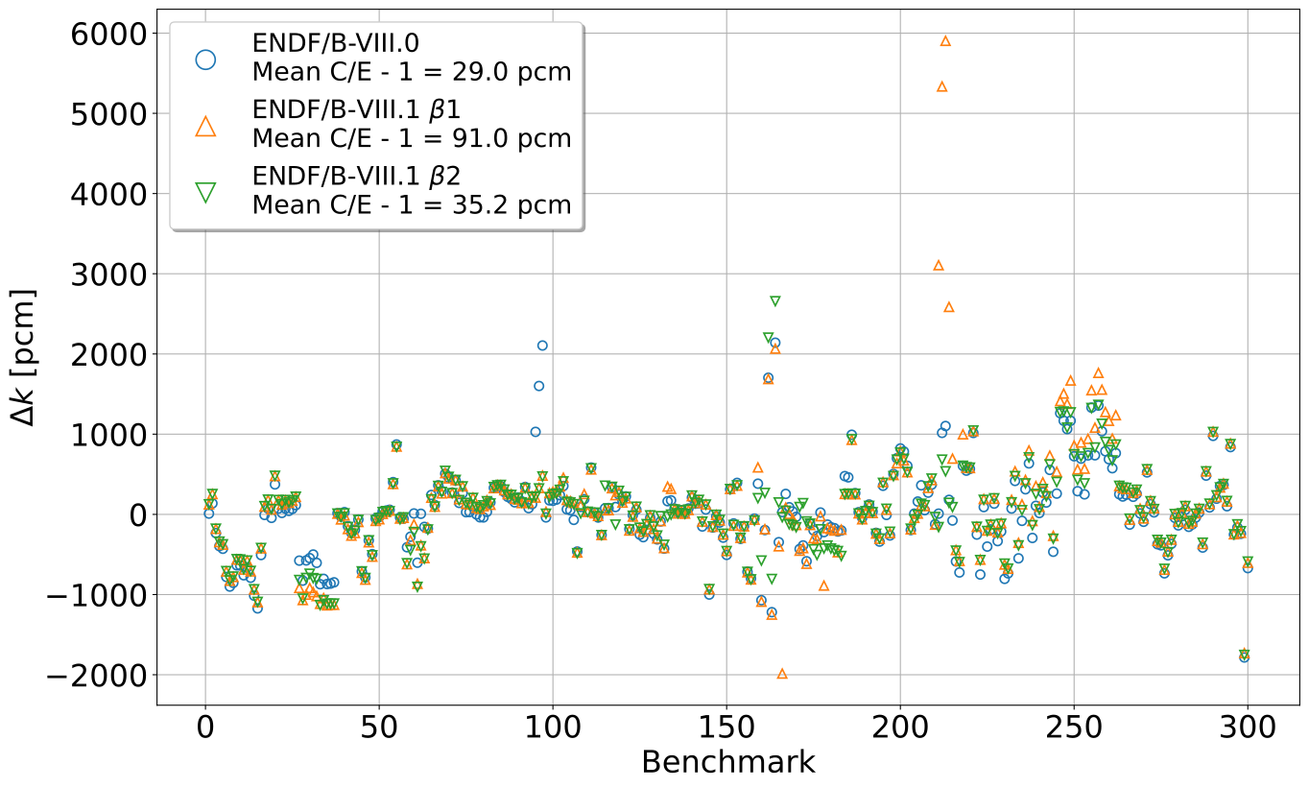
HEU Benchmarks $Δk$
HMF
HMM005 cases 01-04 (Silicon)
HFM057 cases 3 and 5 (Pb reflector)
HMF007 cases 32-34 (Fluorine)
HCM
HST
HMF058 case 1 (Be reflector)
HMI (4), HMM (11), HMT (4)
Notes:
These are the results for the entire HEU suite
B1 and B2 fluorine corrects historical bias on HMF007 Teflon cases
B2 lead leads to degraded performance for HM057 cases 3 and 5
B2 silicon addresses problems reported in B1 in HMM005 (and others)
B2 Be addresses problems reported in B1 in HMF058

Slide 4
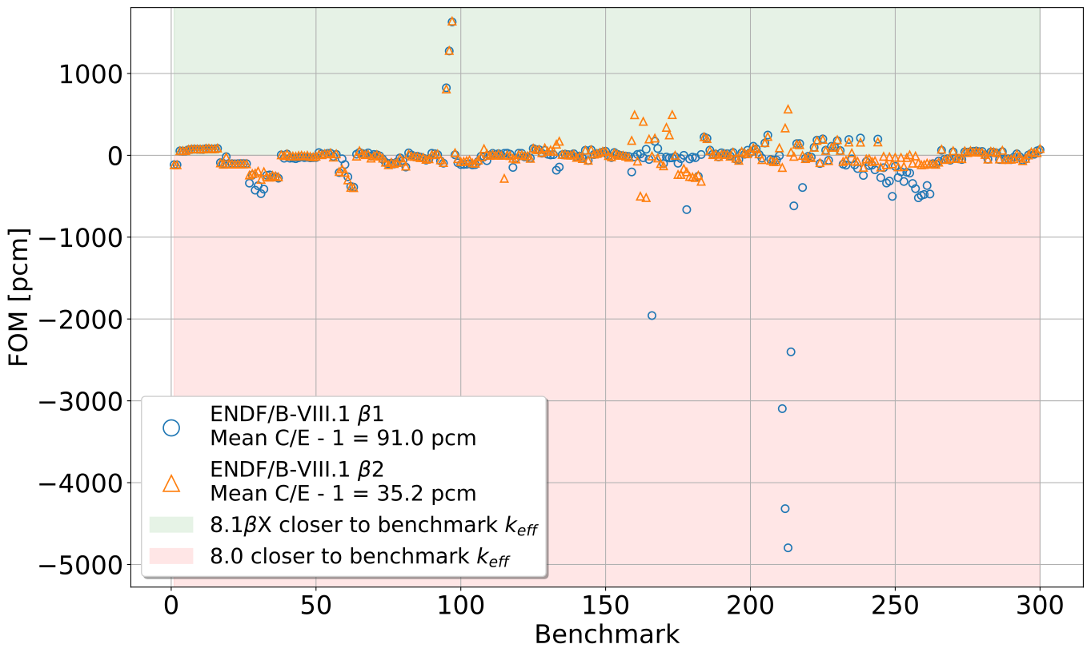
HEU Benchmarks FOM
HCM
HMF007 cases 32-34 (Fluorine)
HST
HMF
HST007 (Concrete reflected)
HMF058 case 1 (Be reflected)
resolved in β2
HMM005 cases 01-04 (Silicon) –
resolved in β2
HMI (4), HMM (11), HMT (4)
Notes:
Reiterate updates to fluorine, beryllium, silicon
Better demonstrates improvements to HST007 (concrete reflected, likely due to updates fixes in silicon in B2)

Slide 5
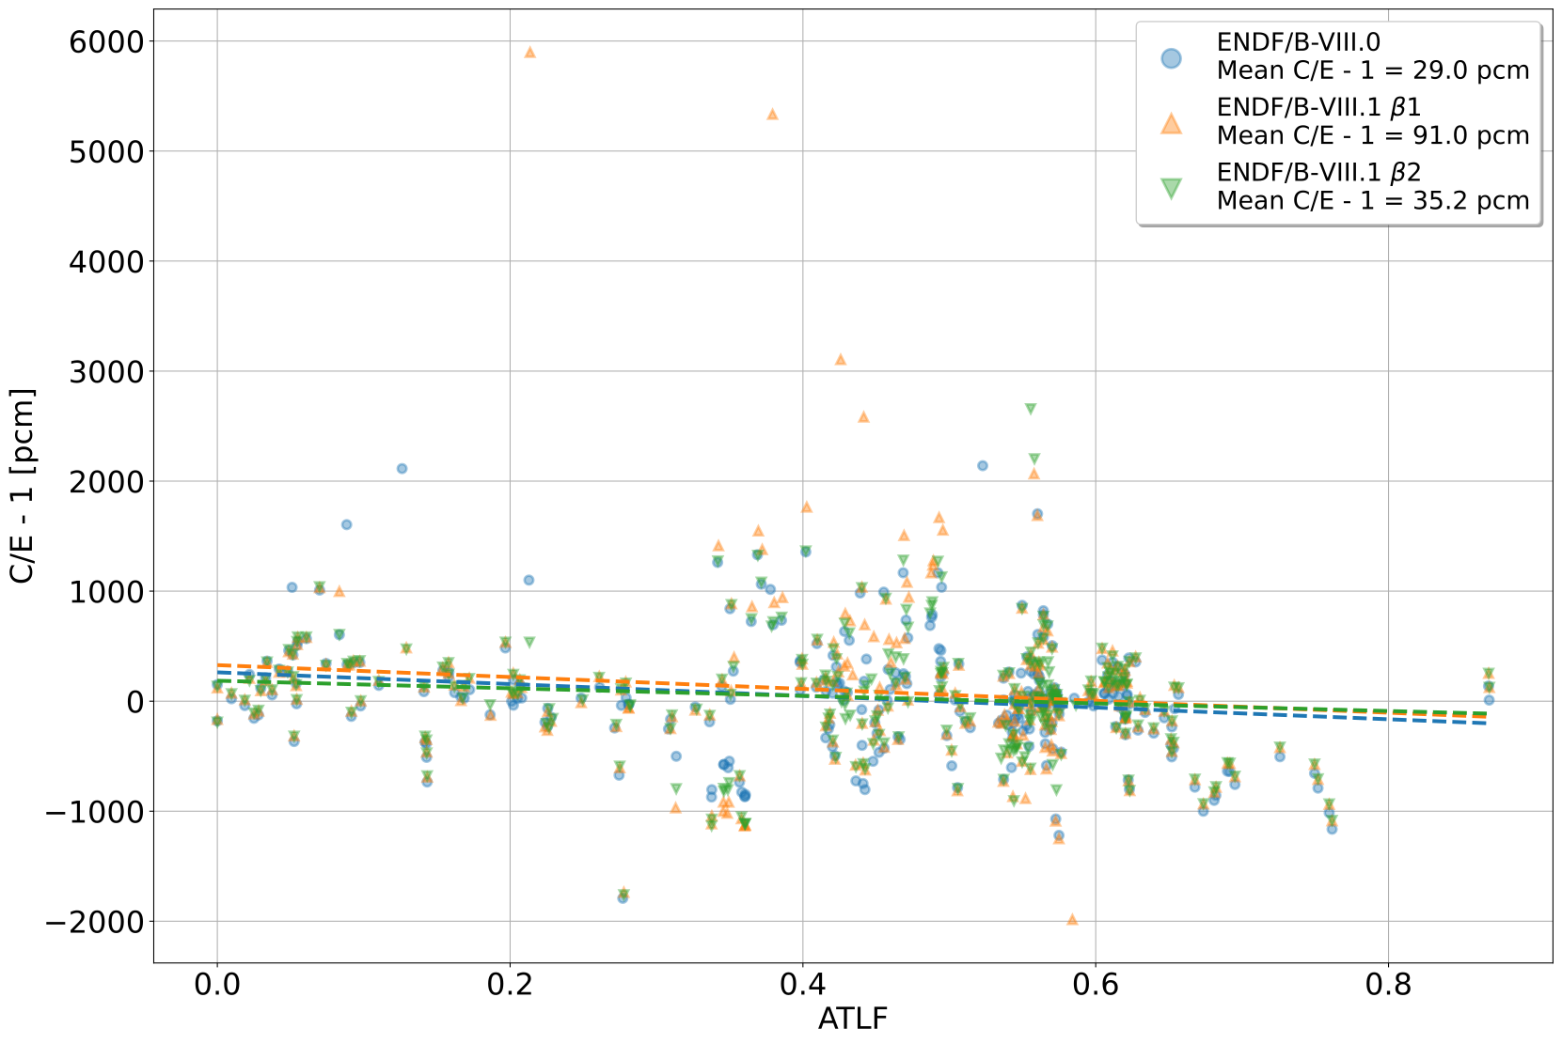
HEU Benchmarks ATLF vs. C/E – 1
Library | Slope | Intercept | R²
8.0 | -533.3 $±$ 152.6 | 262.2 $±$ 72.8 | 0.0393
8.1 β1 | -540.9 $±$ 225.8 | 327.8 $±$ 107.9 | 0.0189
8.1 β2 | -344.1 $±$ 153.5 | 185.9 $±$ 73.4 | 0.0166
Notes:
Increase in mean C/E – 1 in B1, partially corrected in B2, still higher than 8.0
Decreased ATLF slope, intercept for B2

Slide 6
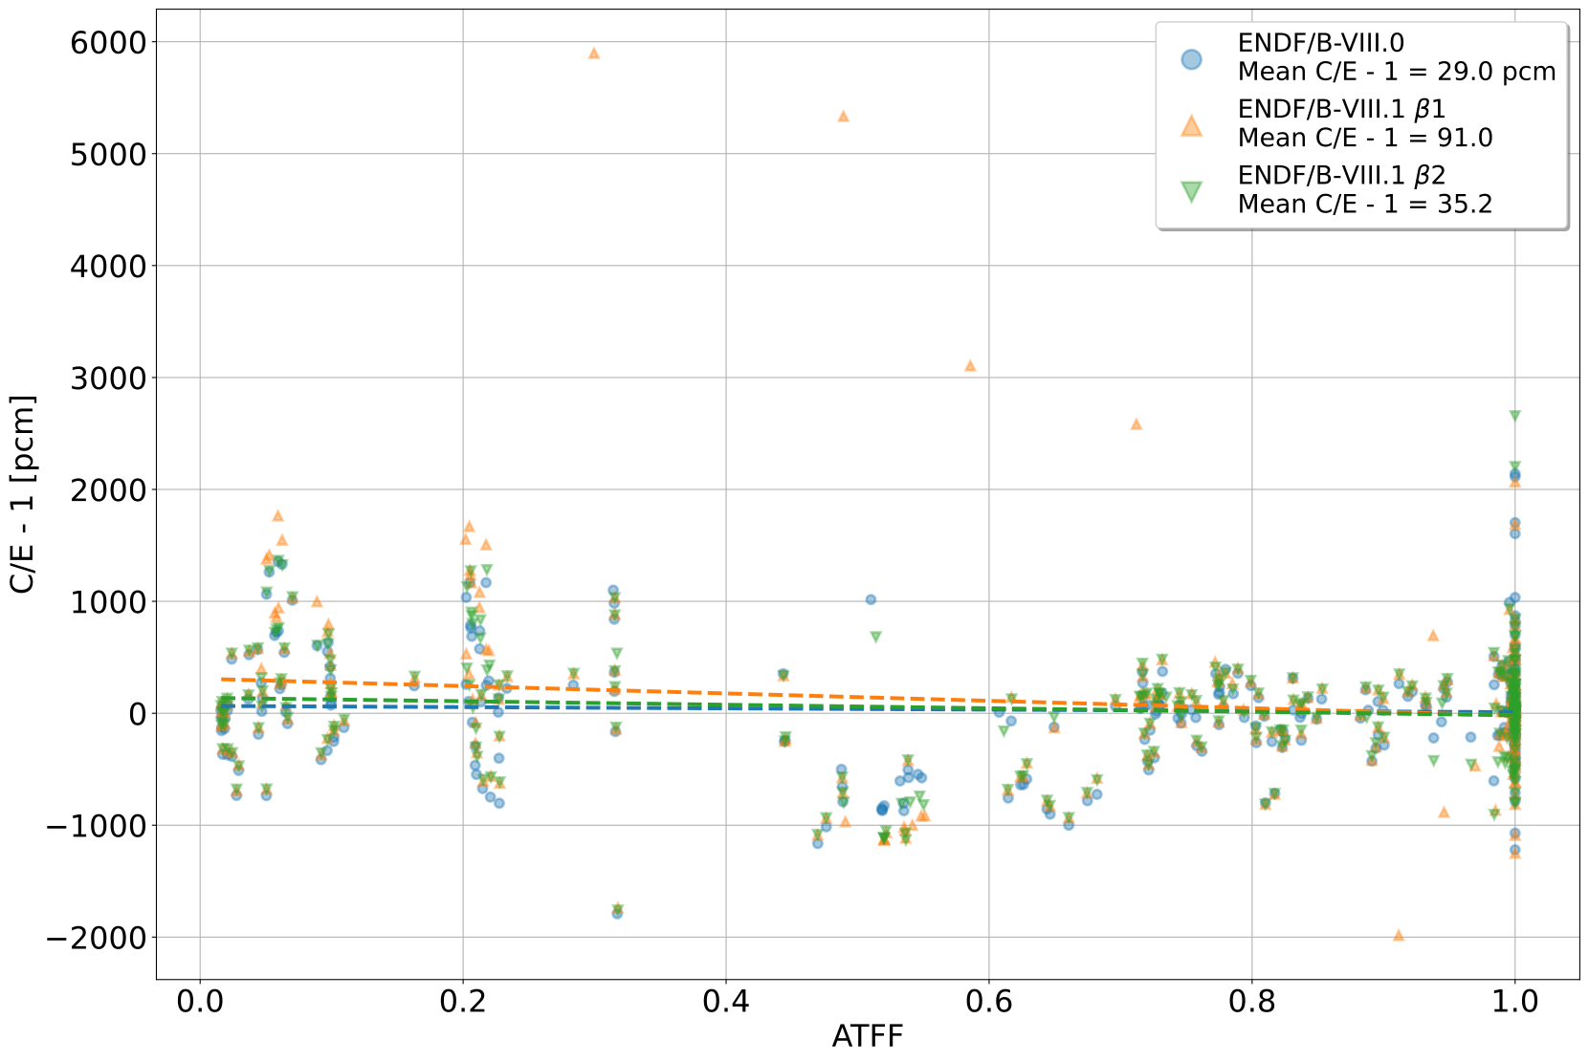
HEU Benchmarks ATFF vs. C/E - 1
Library | Slope | Intercept | R²
8.0 | -56.1 $±$ 82.2 | 66.1 $±$ 62.0 | 0.0016
8.1 β1 | -329.8 $±$ 119.0 | 309.1 $±$ 89.7 | 0.0251
8.1 β2 | -156.6 $±$ 81.3 | 138.8 $±$ 61.3 | 0.0123
Notes:
Increase in mean C/E – 1 in B1, partially corrected in B2, still higher than 8.0
Increased ATFF slope and intercept in B1, partially corrected in B2

Slide 7
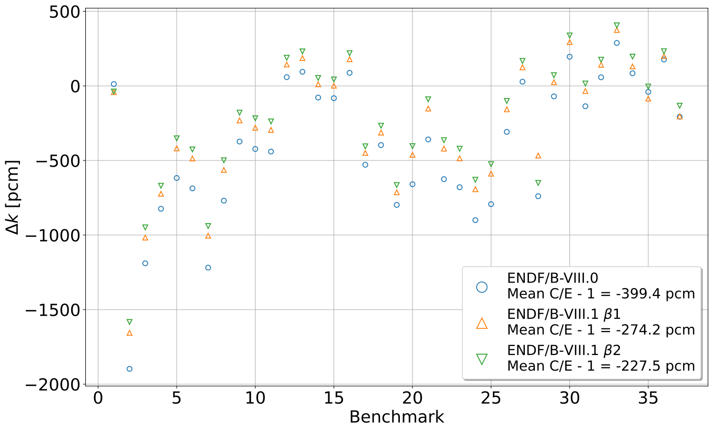
IEU Benchmarks $Δk$
ICF004 case 1
IMF
ICT015
Notes:
Results for entire IEU suite
B2 generally reduces the magnitude of $Δk$ for nearly all IEU benchmarks

Slide 8
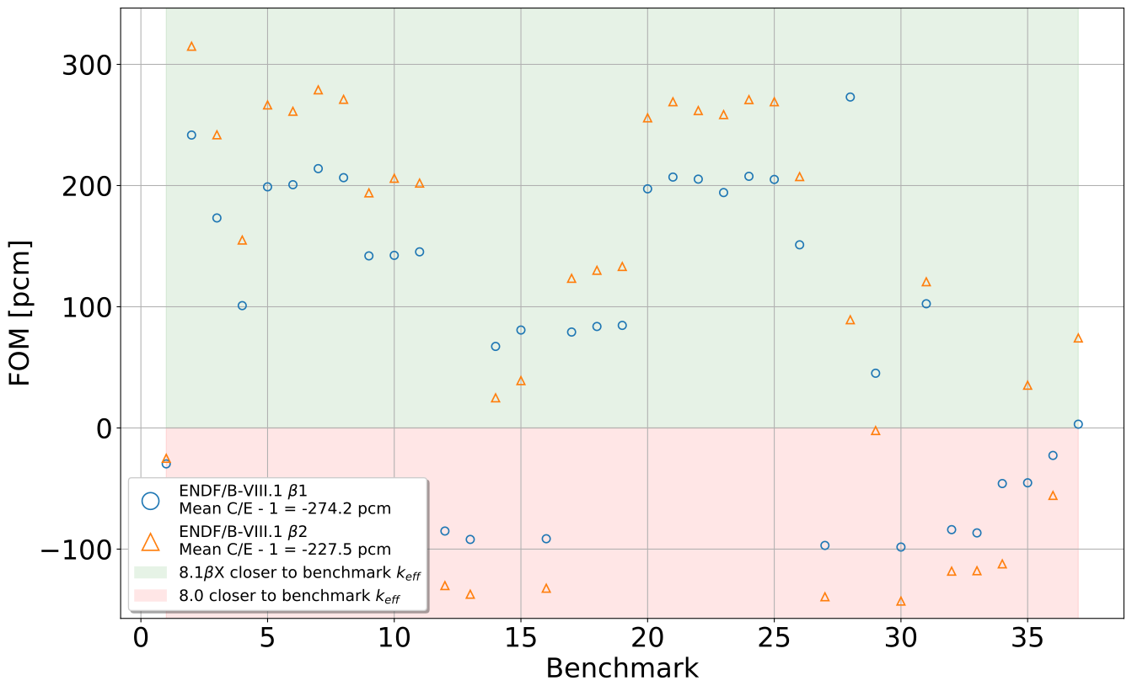
IEU Benchmarks $Δ$|C/E - 1|
ICT015 (various reflectors)
Poly
Beechwood + Cd
IMF
Bare
Concrete
Perspex
Beechwood
ICF004
case 1
Concrete + Cd
Poly
Notes:
Unsure of what is going on with last Perspex case – planning to test heavy paraffinic oil TSL for B3

Slide 9
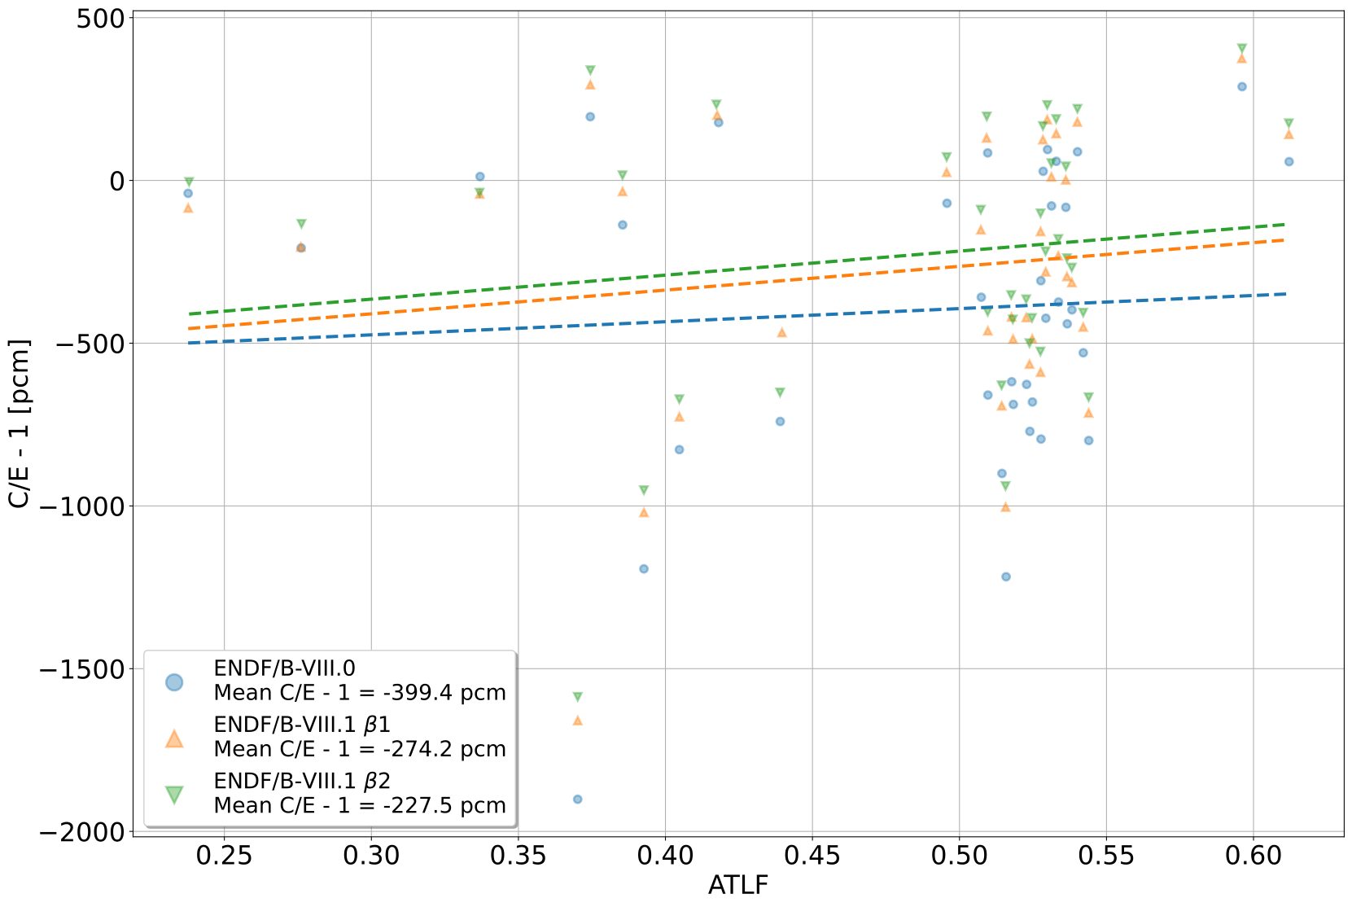
IEU Benchmarks ATLF vs. C/E - 1
Library | Slope | Intercept | R²
8.0 | 403.1 $±$ 947.9 | -595.3 $±$ 467.4 | 0.0051
8.1 β1 | 729.2 $±$ 841.4 | -628.6 $±$ 414.8 | 0.0210
8.1 β2 | 738.0 $±$ 835.2 | -586.1 $±$ 411.7 | 0.0218
Notes:
Incremental reduction in mean C/E – 1 in B1 and B2
Increased slope for B2, intercept roughly constant
Fit parameters have very high uncertainties

Slide 10
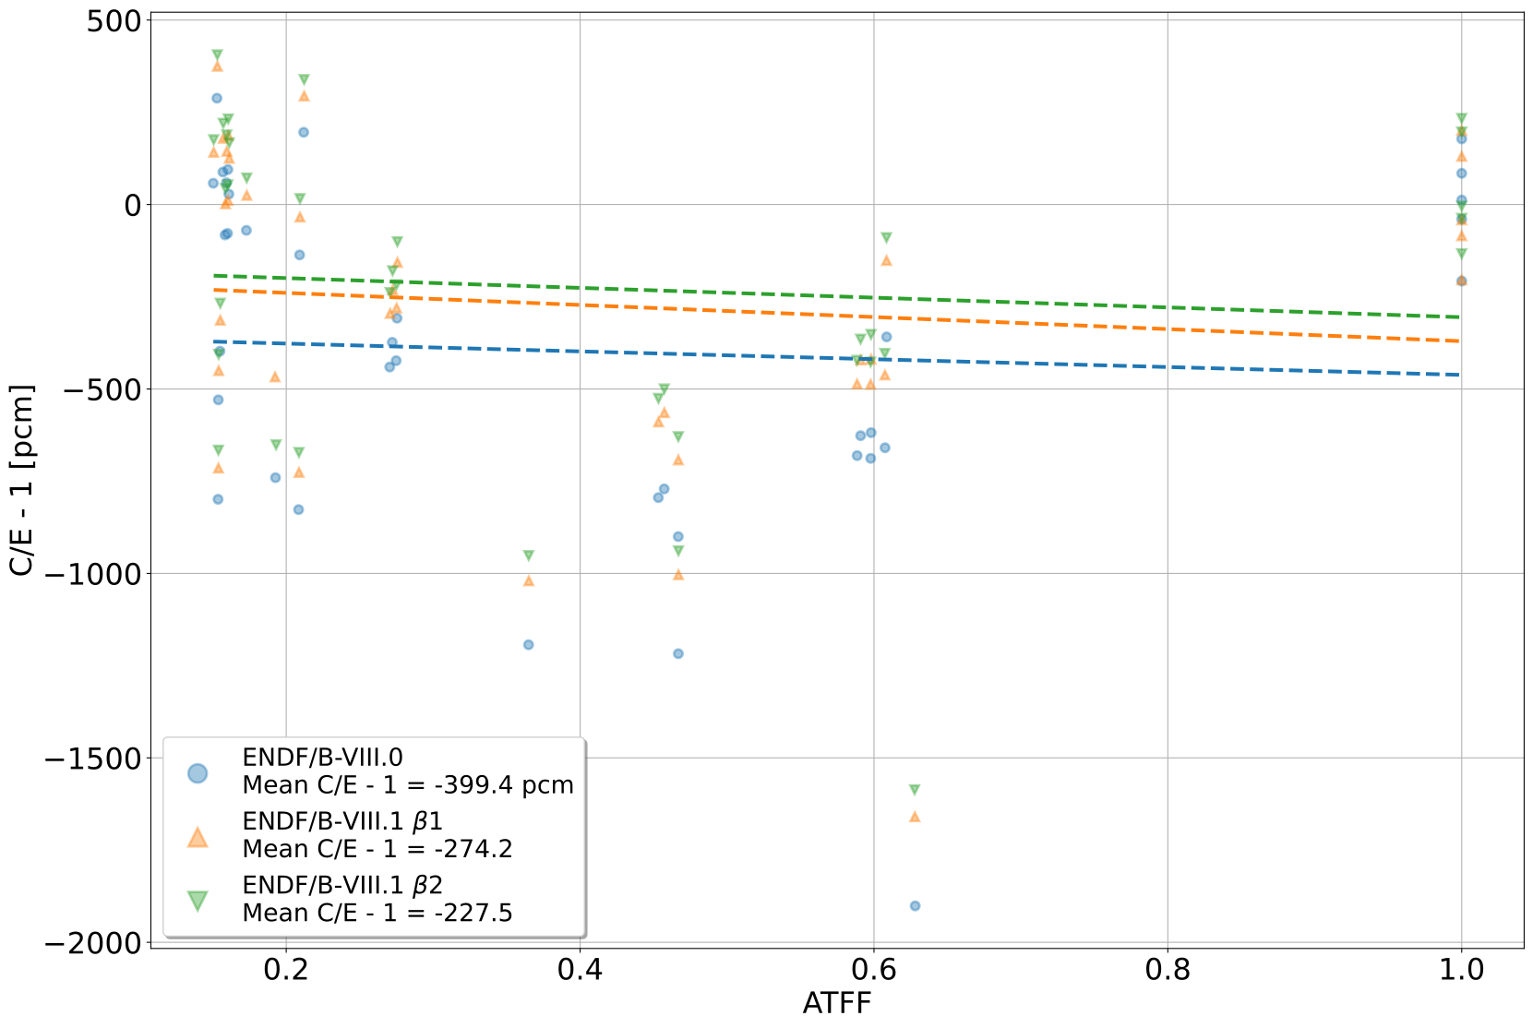
IEU Benchmarks ATFF vs. C/E - 1
Library | Slope | Intercept | R²
8.0 | -106.1 $±$ 276.5 | -355.7 $±$ 138.6 | 0.0042
8.1 β1 | -163.7 $±$ 246.4 | -206.8 $±$ 123.5 | 0.0125
8.1 β2 | -132.6 $±$ 245.1 | -172.9 $±$ 122.9 | 0.0083

Slide 11
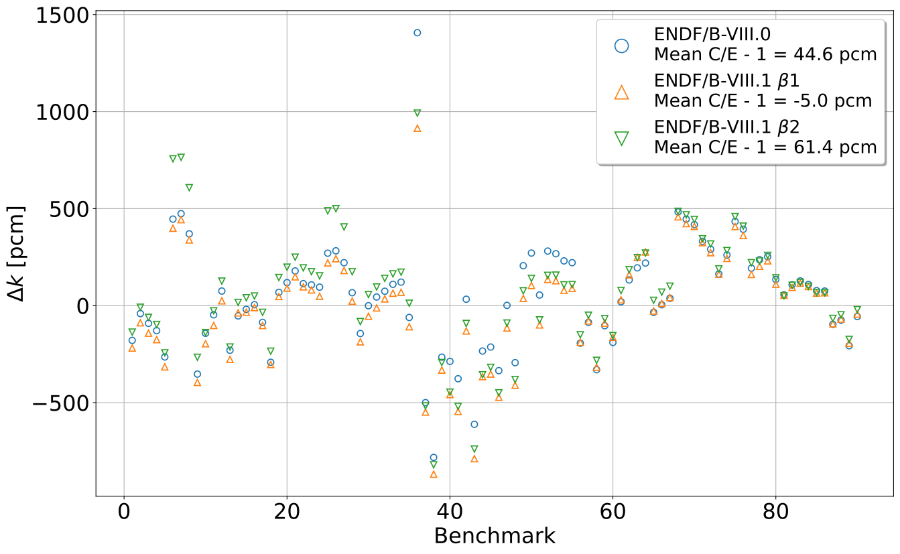
Thermal LEU Benchmarks $Δk$
LST001 case 1 (UO₂F₂)
LCT010 cases 1-3, 20-22 (Pb)
LCT
LST
Notes:
B1 and B2 fluorine corrects historical bias on LST001 UO₂F₂
Significant changes in LCT010 Pb-reflected cases in B2
Mean C/E-1 increase, likely driven by LCT010 changes

Slide 12
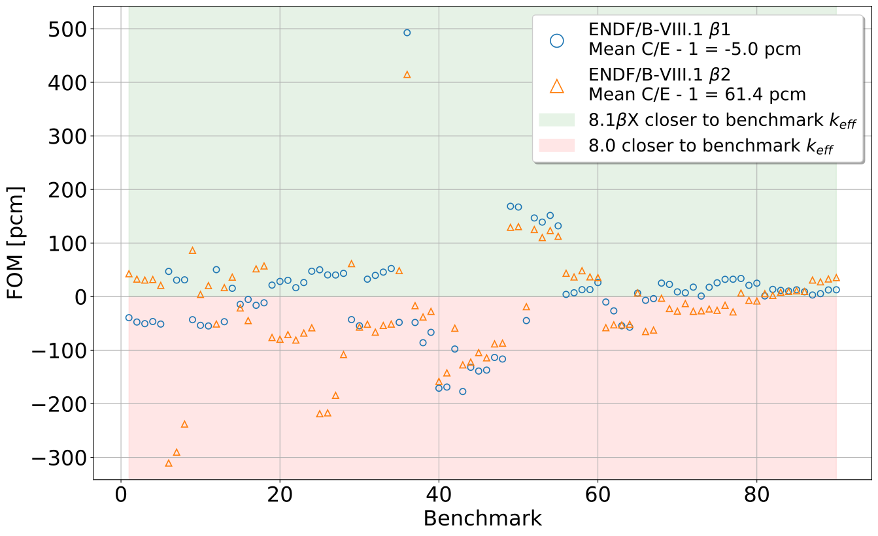
Thermal LEU Benchmarks FOM
LST001 case 1 (UO₂F₂)
LCT010
(Pb, U, steel reflectors)
LCT002
LST017
LST002
LST016
LST00(4,7,8,9),
(STACY reflected by water, bare, concrete, borated concrete)
Pb reflector
LST003
LST
Notes:
Reiterate improvement in LST001 due to B1 and B2 fluorine
Reiterate degraded performance of LCT010 Pb-reflected cases

Slide 13
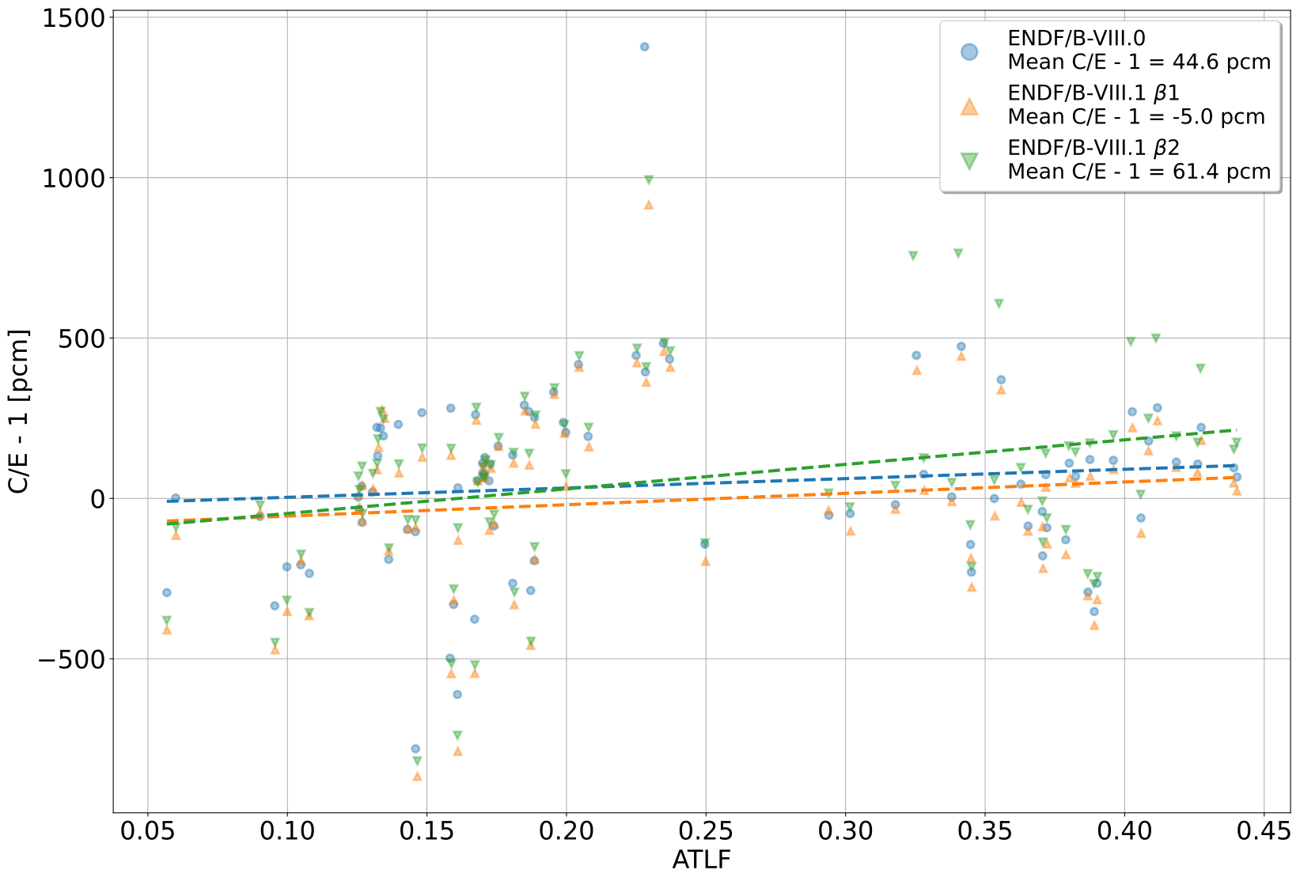
Thermal LEU Benchmarks ATLF vs. C/E - 1
Library | Slope | Intercept | R²
8.0 | 291.3 $±$ 269.8 | -25.8 $±$ 71.7 | 0.0131
8.1 β1 | 354.6 $±$ 263.4 | -90.8 $±$ 70.1 | 0.0202
8.1 β2 | 764.8 $±$ 278.4 | -123.5 $±$ 74.0 | 0.0790
Notes:
Mean C/E – 1 increase in B2
Trends indicating deteriorating performance – increased slope, intercept

Slide 14
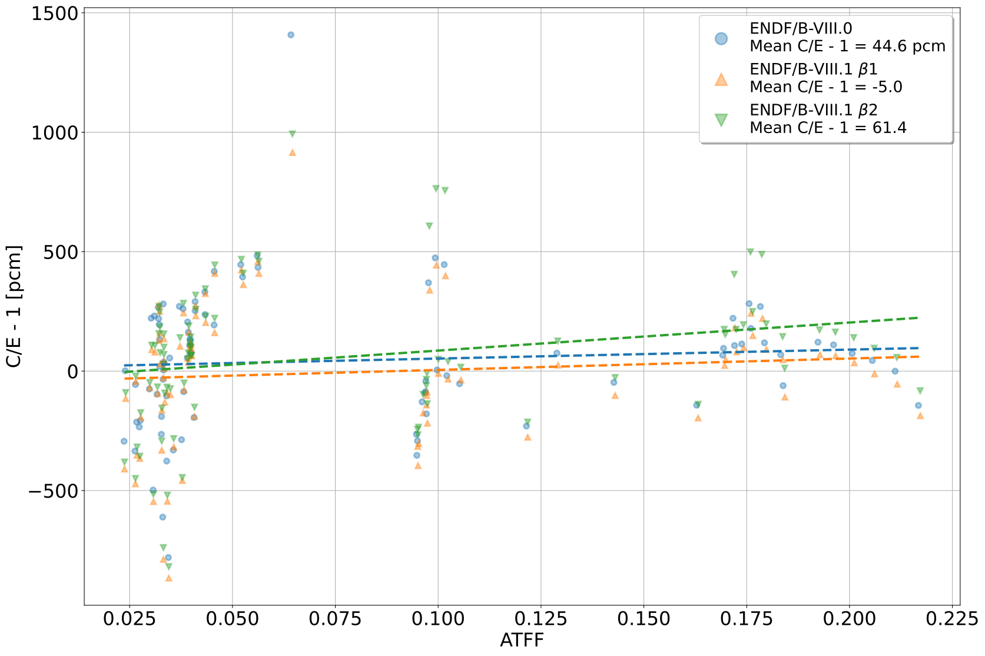
Thermal LEU Benchmarks ATFF vs. C/E - 1
Library | Slope | Intercept | R²
8.0 | 374.9 $±$ 50.6 | 15.0 $±$ 30.1 | 0.0063
8.1 β1 | 476.4 $±$ 64.2 | -42.7 $±$ 38.3 | 0.0106
8.1 β2 | 1174.4 $±$ 47.7 | -31.5 $±$ 28.4 | 0.0541
Notes:
Mean C/E – 1 increase in B2
Trends indicating deteriorating performance – increased slope, intercept

Slide 15
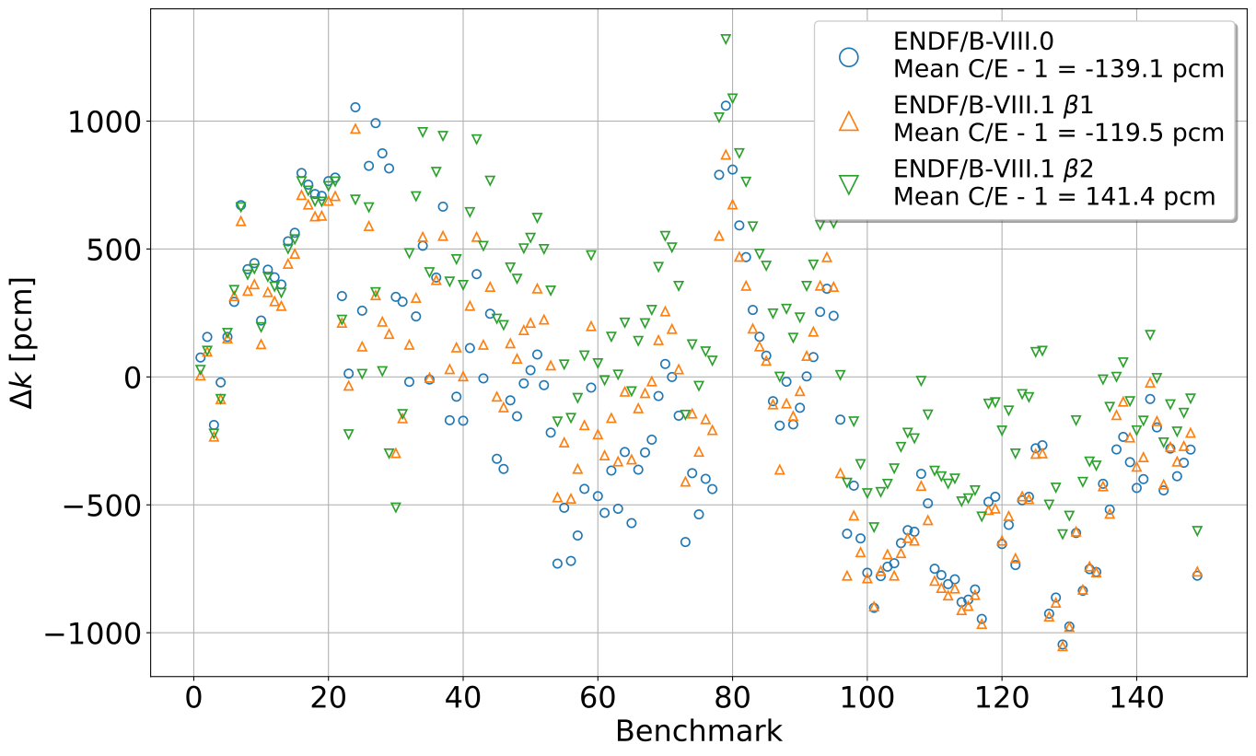
Pu Benchmarks $Δk$
PMF
PST
PST:
PST001 (6)
PST002 (7)
PST003 (7)
PST004 (13)
PST005 (9)
PST006 (3)
PST018 (9)
PST022 (17)
PST023 (33)
PST038 (5)
PST039 (8)
PMM002, PMM003
Notes:
B2 appears to trend high relative to 8.0 and B1 in PST benchmarks
Marginal increase in B2 mean C/E – 1 magnitude compared to 8.0
Sign flip indicates that 8.0 and B1 trended low, B2 trends high

Slide 16
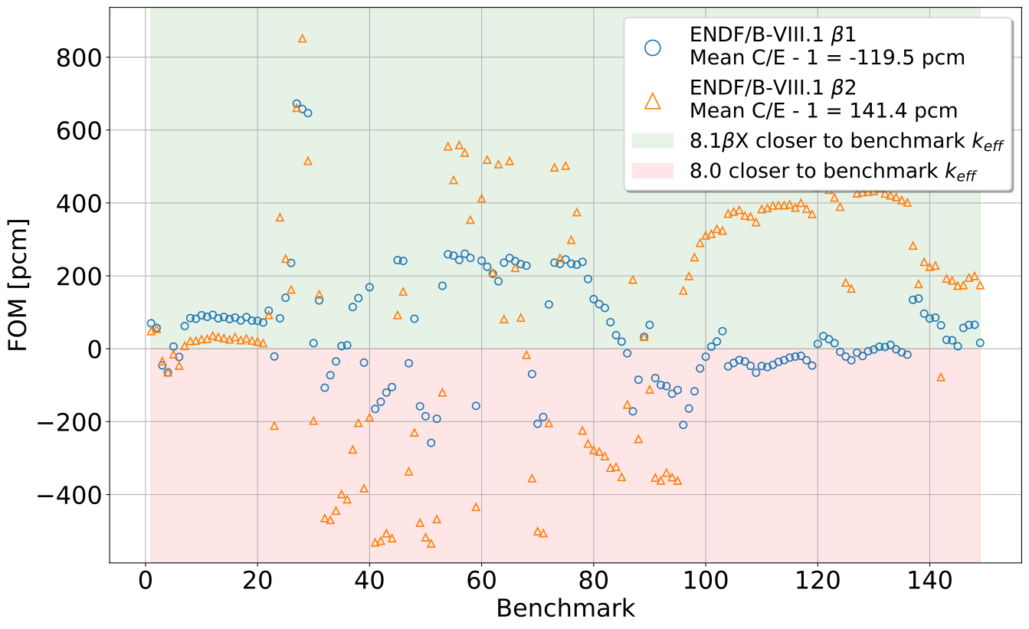
Pu Benchmarks $Δ$|C/E – 1|
PMF
PST
PST:
PST001 (6)
PST002 (7)
PST003 (7)
PST004 (13)
PST005 (9)
PST006 (3)
PST018 (9)
PST022 (17)
PST023 (33)
PST038 (5)
PST039 (8)
PST038
PMF042d
PST023
PST039
PMM002, PMM003
Notes:
B2 shows degraded performance for PMF, PST up to PST023
B2 shows improved performance for PST023/38/39 except for first case of PST039 – unclear as to cause
Marginal increase in B2 mean C/E – 1 magnitude compared to 8.0
Sign flip indicates that 8.0 and B1 trended low, B2 trends high

Slide 17
Pu Benchmarks ATLF vs. C/E - 1
Library | Slope | Intercept | R²
8.0 | 1186.7 $±$ 223.9 | -638.8 $±$ 105.6 | 0.1495
8.1 β1 | 788.7 $±$ 221.8 | -449.2 $±$ 99.8 | 0.0792
8.1 β2 | 312.0 $±$ 206.2 | 10.9 $±$ 92.8 | 0.0153
Notes:
Significant decreases in slope and intercept in B2

Slide 18
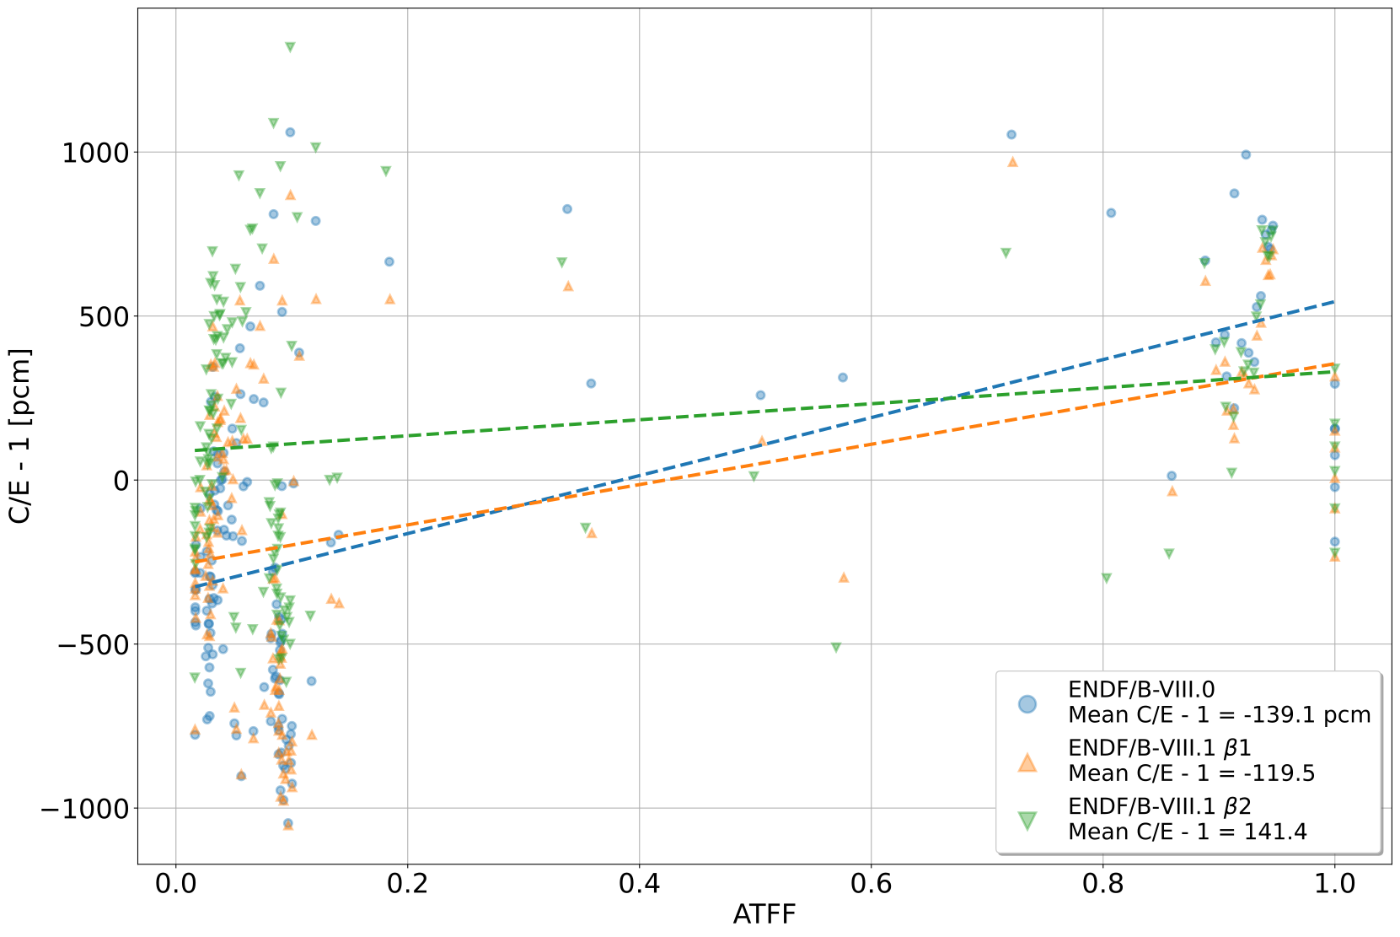
Pu Benchmarks ATFF vs. C/E - 1
Library | Slope | Intercept | R²
8.0 | 883.9 $±$ 100.4 | -339.9 $±$ 40.9 | 0.3451
8.1 β1 | 614.5 $±$ 100.9 | -259.5 $±$ 41.2 | 0.2013
8.1 β2 | 244.1 $±$ 100.1 | 86.2 $±$ 40.7 | 0.0389
Notes:
Significant decrease in slope and intercept for B2

Slide 19
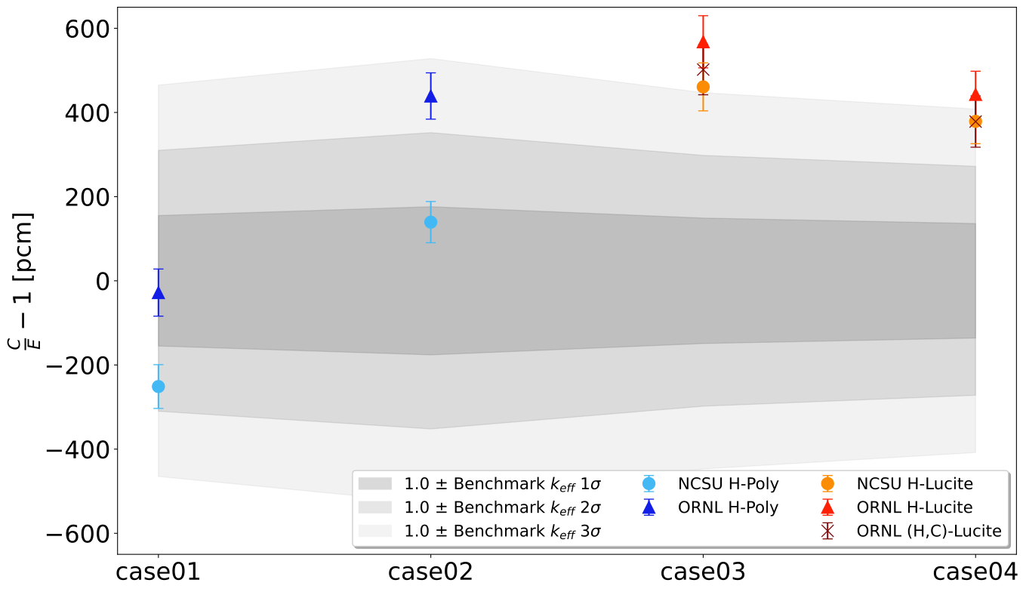
Poly and Lucite TSL – PMT004
Poly Moderator
Lucite Moderator
Notes:
A format issue in ORNL C-CH2 prevented NDEX processing and testing of ORNL (H,C) - Poly

Slide 20
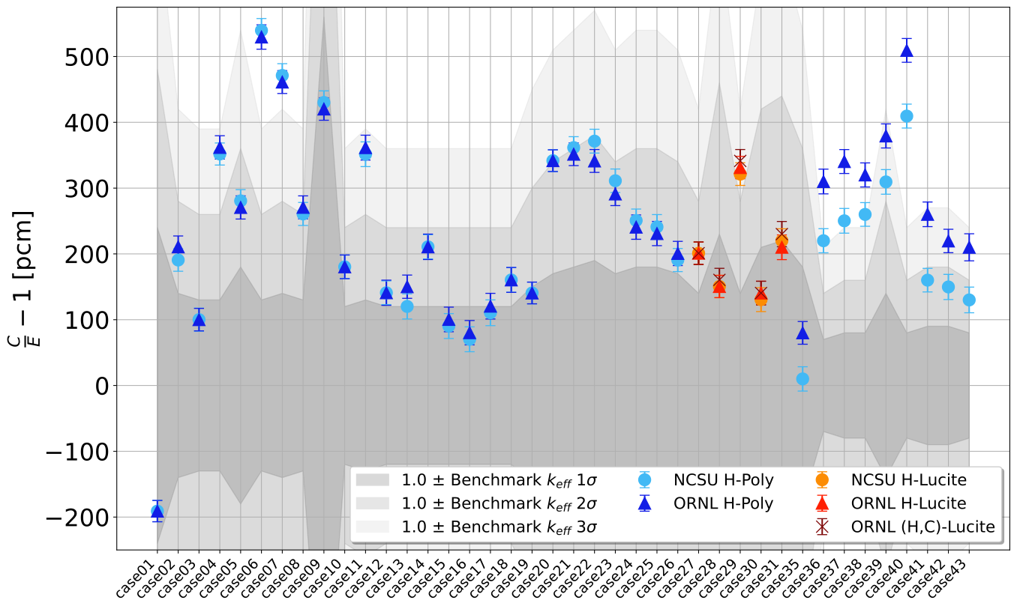
Poly and Lucite TSL – HMF007
Poly Moderator
Lucite Moderator
Poly Moderator and Reflector
Notes:
Similar performance for ORNL and NCSU in poly and lucite moderated configurations
Consistent with PMT004 findings that ORNL predicts higher keff in reflected configurations
A format issue in ORNL C-CH2 prevented NDEX processing and testing of ORNL (H,C) - Poly

Slide 21
Conclusions
Updates to fluorine in β1 and β2 yield significant improvements over 8.0
Errors introduced in beryllium and silicon in β1 resolved in β2
Be: HMF058
Si: HMM005, HMF057
Noted increased bias in LCT010 Pb-reflected cases
Reduction in mean C/E – 1 for HEU and IEU benchmarks, increase for LEU and Pu benchmarks in β2
Increase in LEU suite mean C/E – 1 due in part to degraded LCT010 performance
Pu benchmark suite bias flipped from under-predication to over-prediction on average

Slide 22
Additional Slides

Slide 23
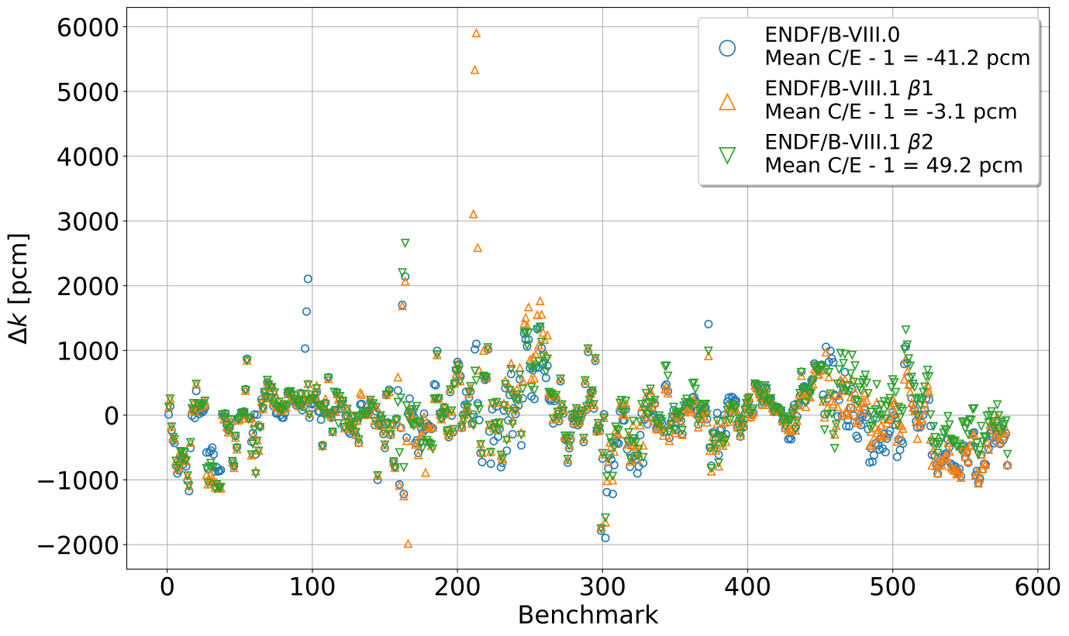
All Benchmarks $Δk$

Slide 24
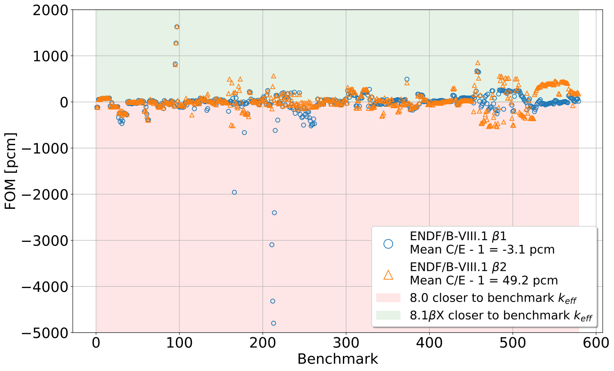
All Benchmarks FOM

Slide 25
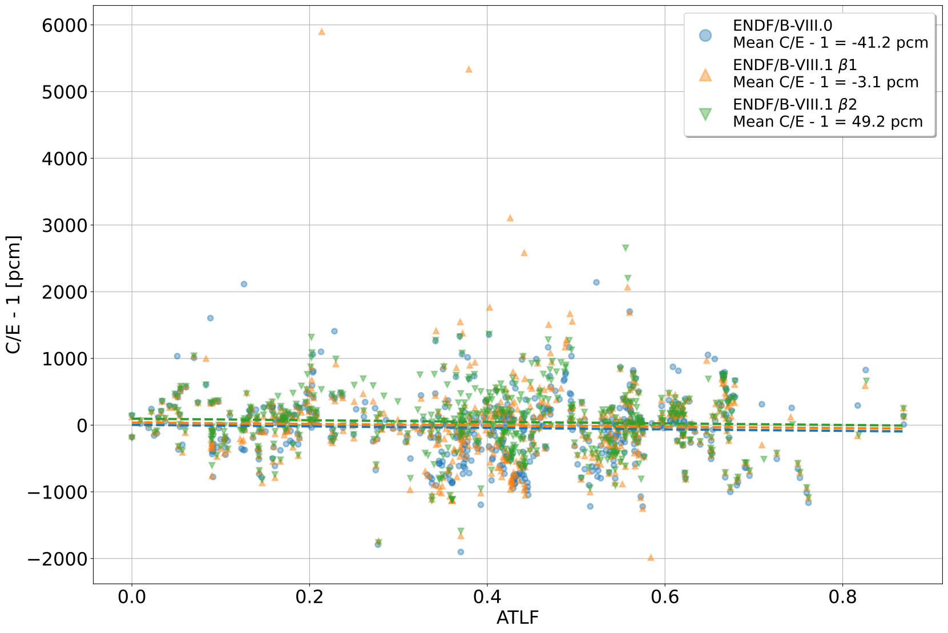
All Benchmarks ATLF vs. C/E - 1
Library | Slope | Intercept | R²
8.0 | -112.0 $±$ 111.8 | 4.0 $±$ 49.6 | 0.0017
8.1 β1 | -103.6 $±$ 140.2 | 38.7 $±$ 62.2 | 0.0009
8.1 β2 | -118.3 $±$ 104.1 | 97.0 $±$ 46.2 | 0.0022

Slide 26
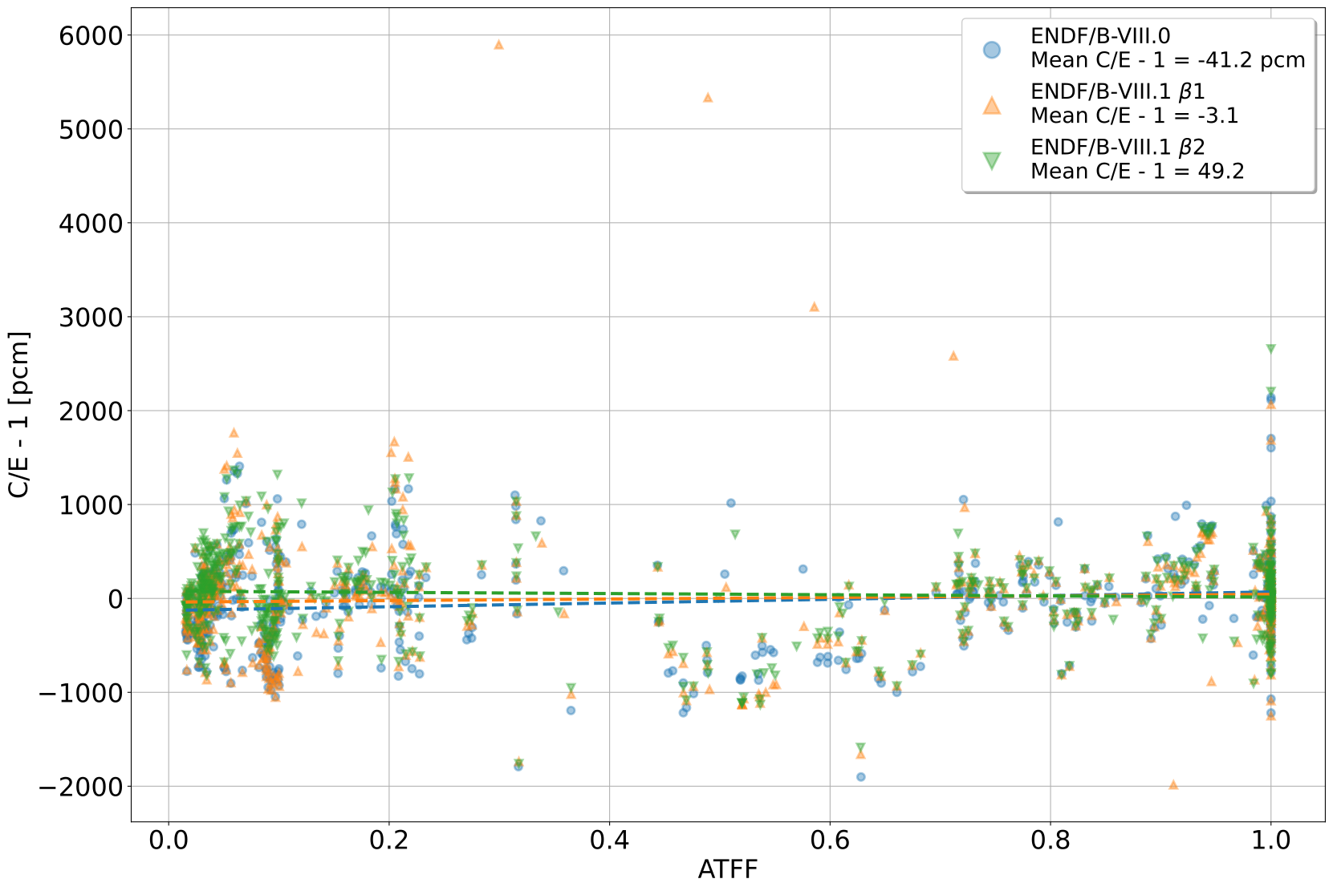
All Benchmarks ATFF vs. C/E - 1
Library | Slope | Intercept | R²
8.0 | 196.7 $±$ 50.6 | -127.8 $±$ 30.1 | 0.0255
8.1 β1 | 82.9 $±$ 64.2 | -39.6 $±$ 38.3 | 0.0029
8.1 β2 | -62.6 $±$ 47.7 | 76.8 $±$ 28.4 | 0.0030

Slide 27
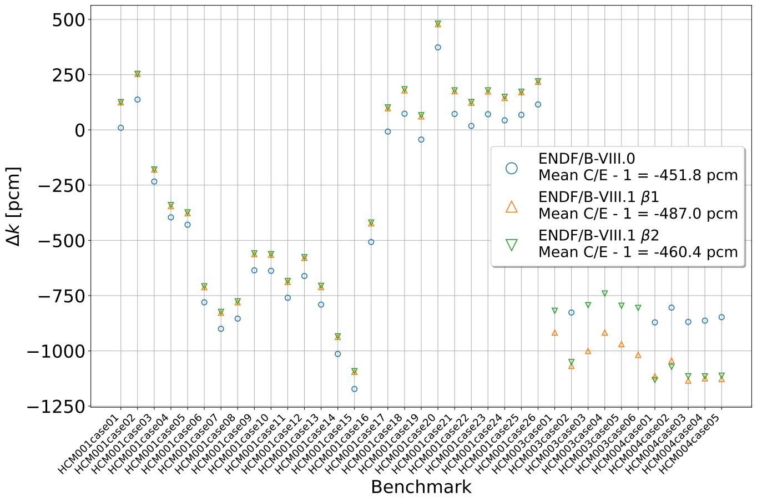
HCM Benchmarks $Δk$

Slide 28
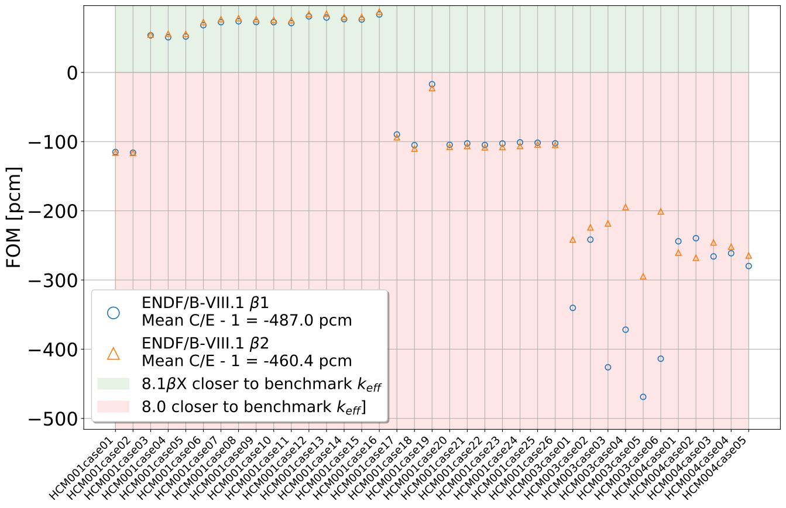
HCM Benchmarks FOM

Slide 29
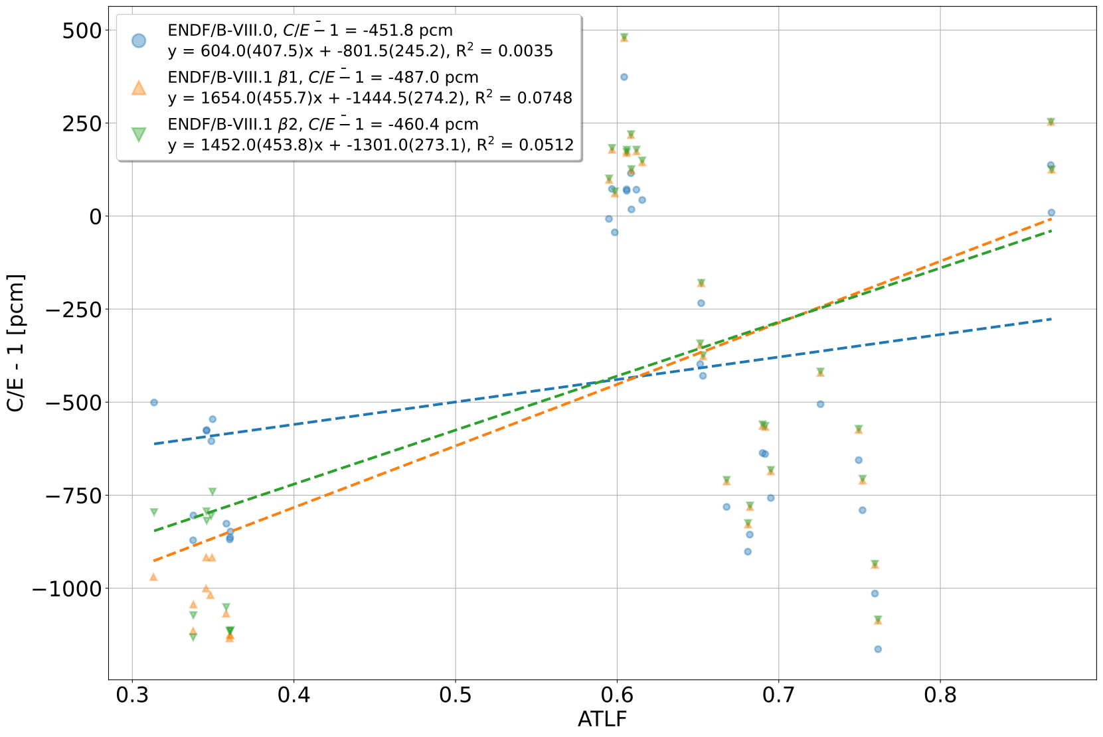
HCM Benchmarks ATLF vs. C/E - 1

Slide 30
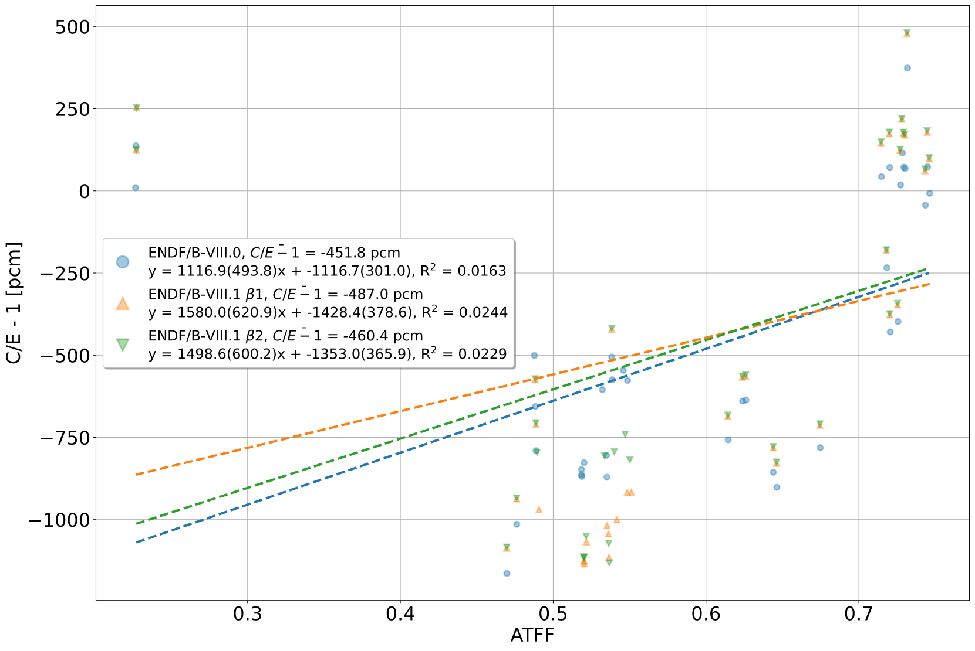
HCM Benchmarks ATFF vs. C/E - 1

Slide 31
HMF Benchmarks $Δk$

Slide 32
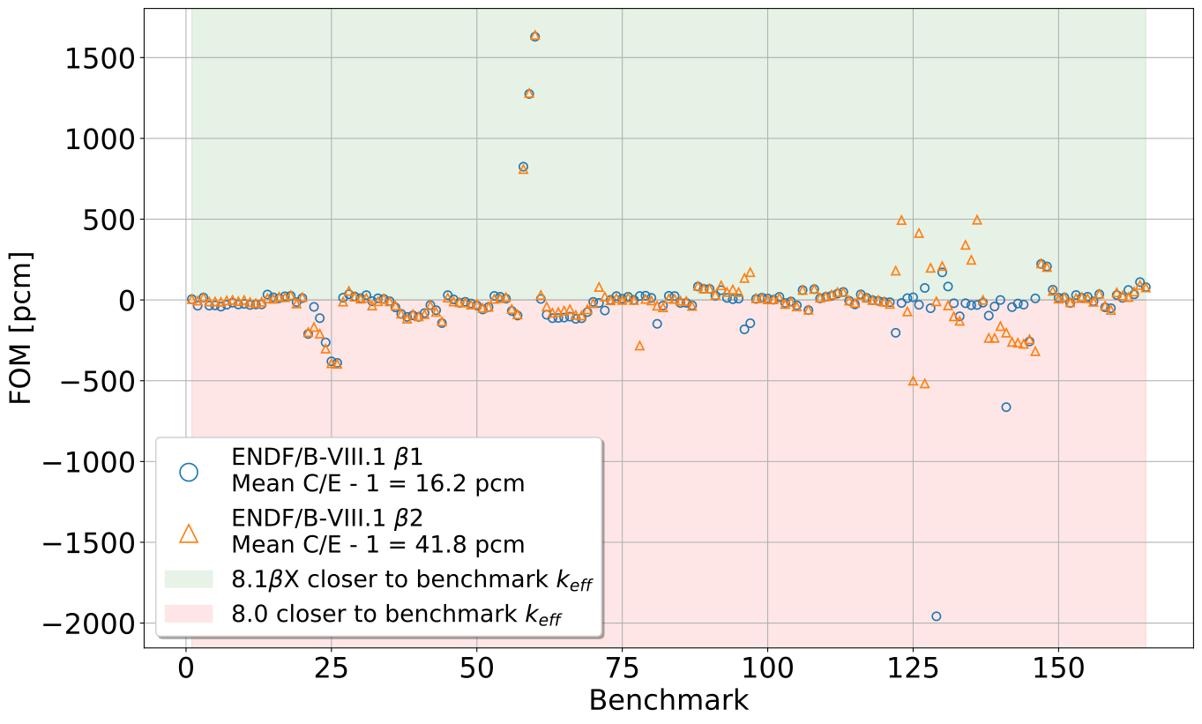
HMF Benchmarks FOM

Slide 33
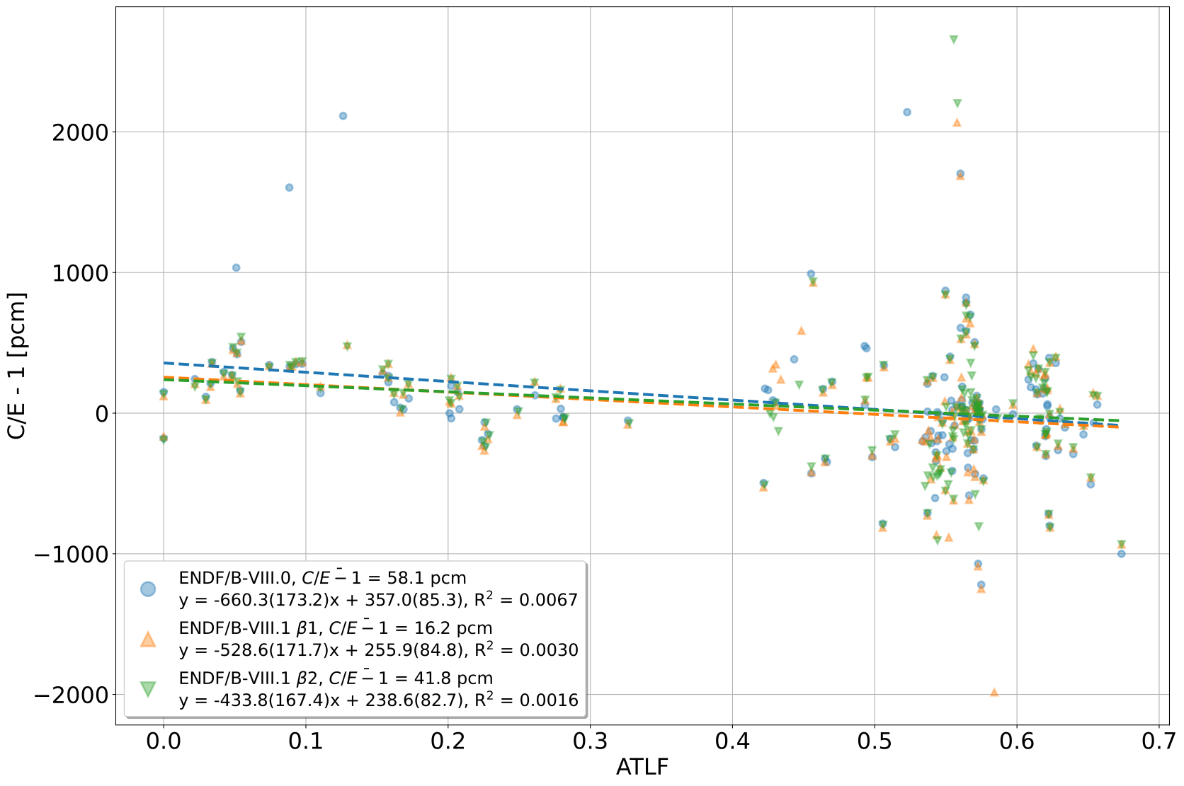
HMF Benchmarks ATLF vs. C/E - 1

Slide 34
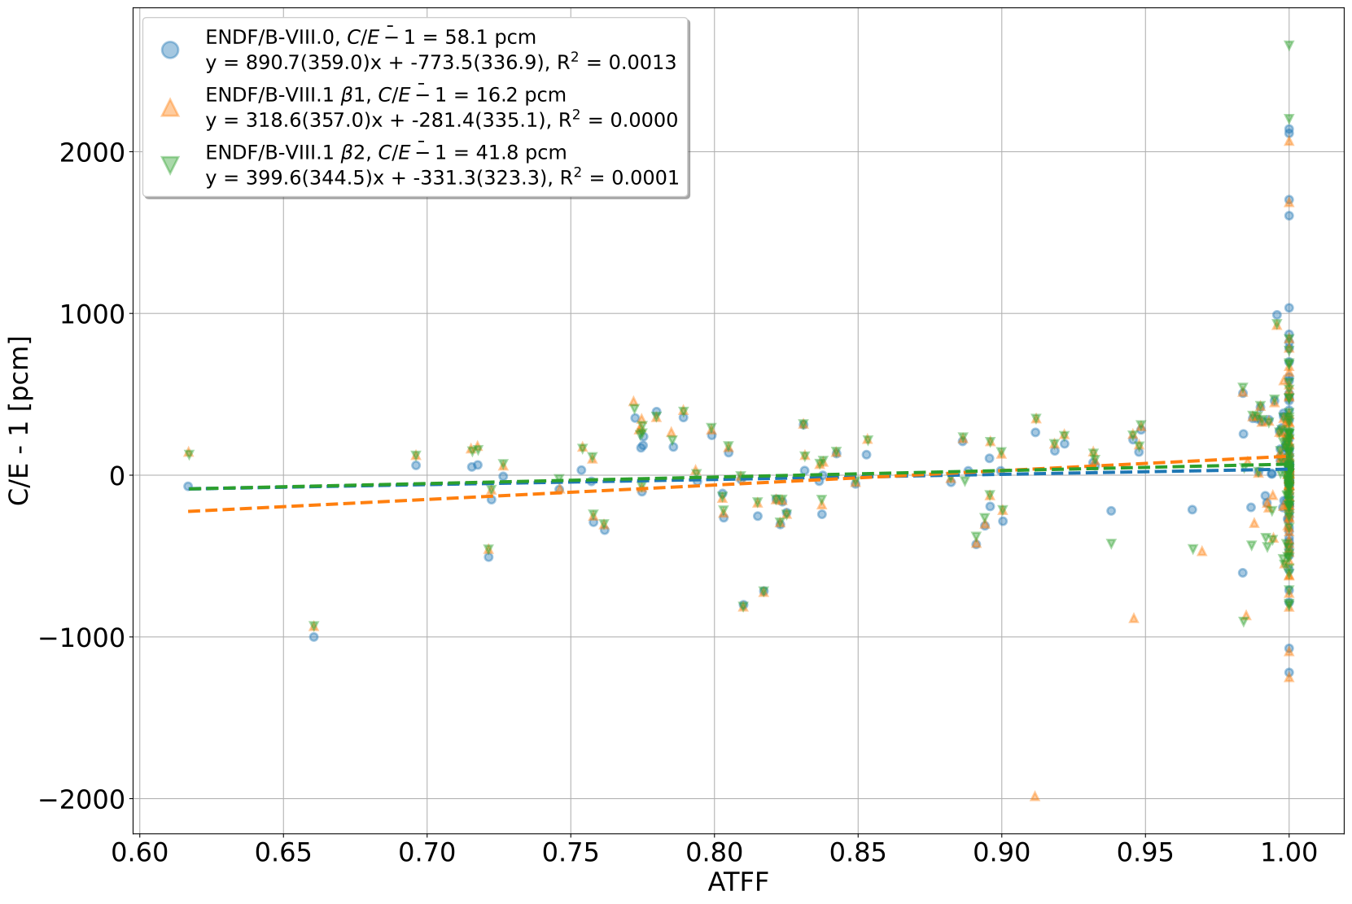
HMF Benchmarks ATFF vs. C/E - 1

Slide 35
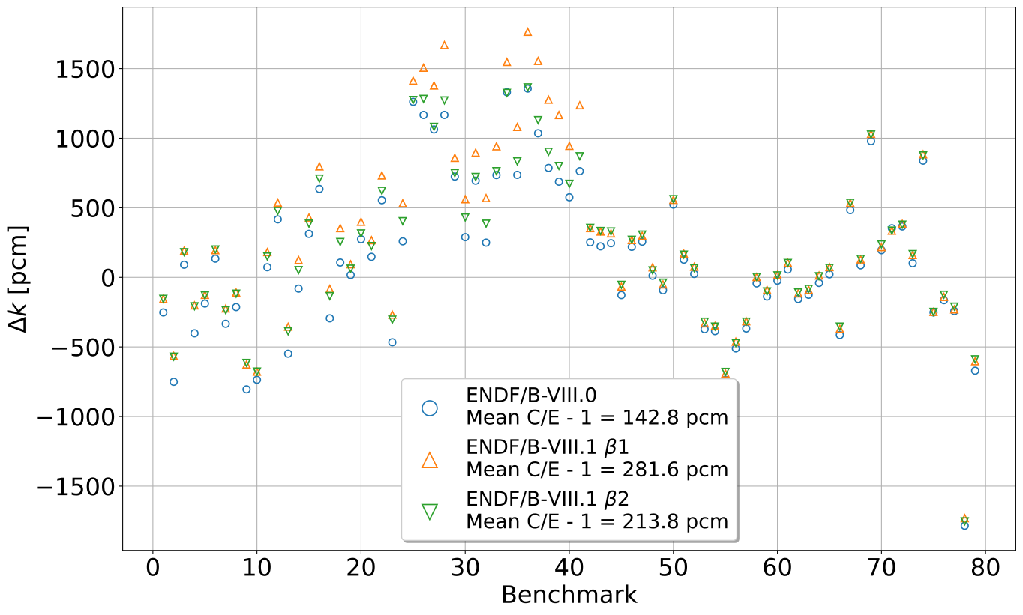
HST Benchmarks $Δk$

Slide 36
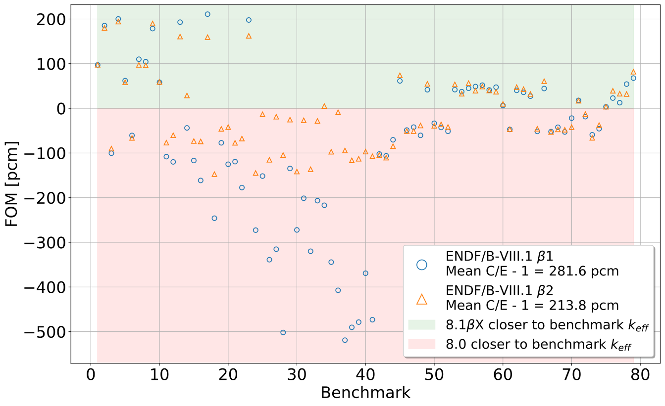
HST Benchmarks FOM

Slide 37
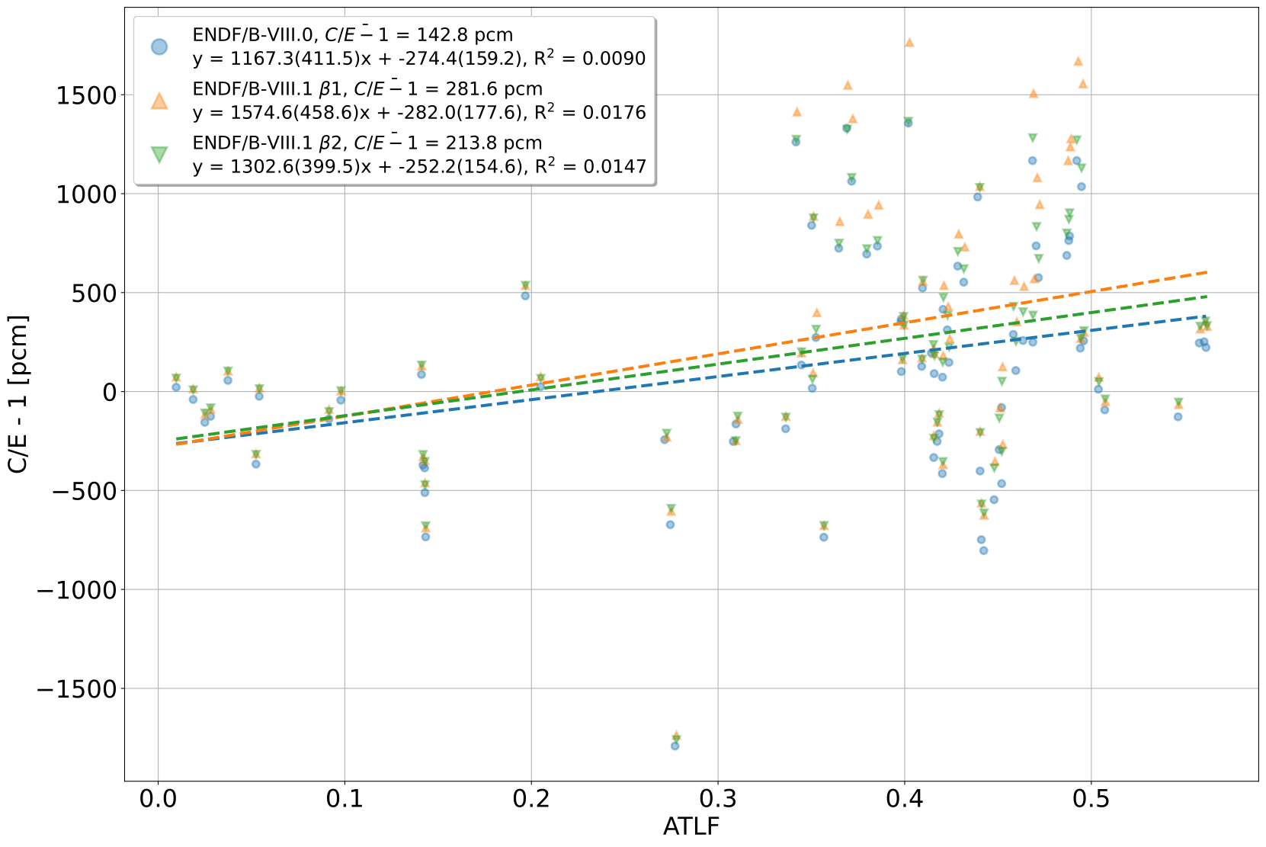
HST Benchmarks ATLF vs. C/E - 1

Slide 38
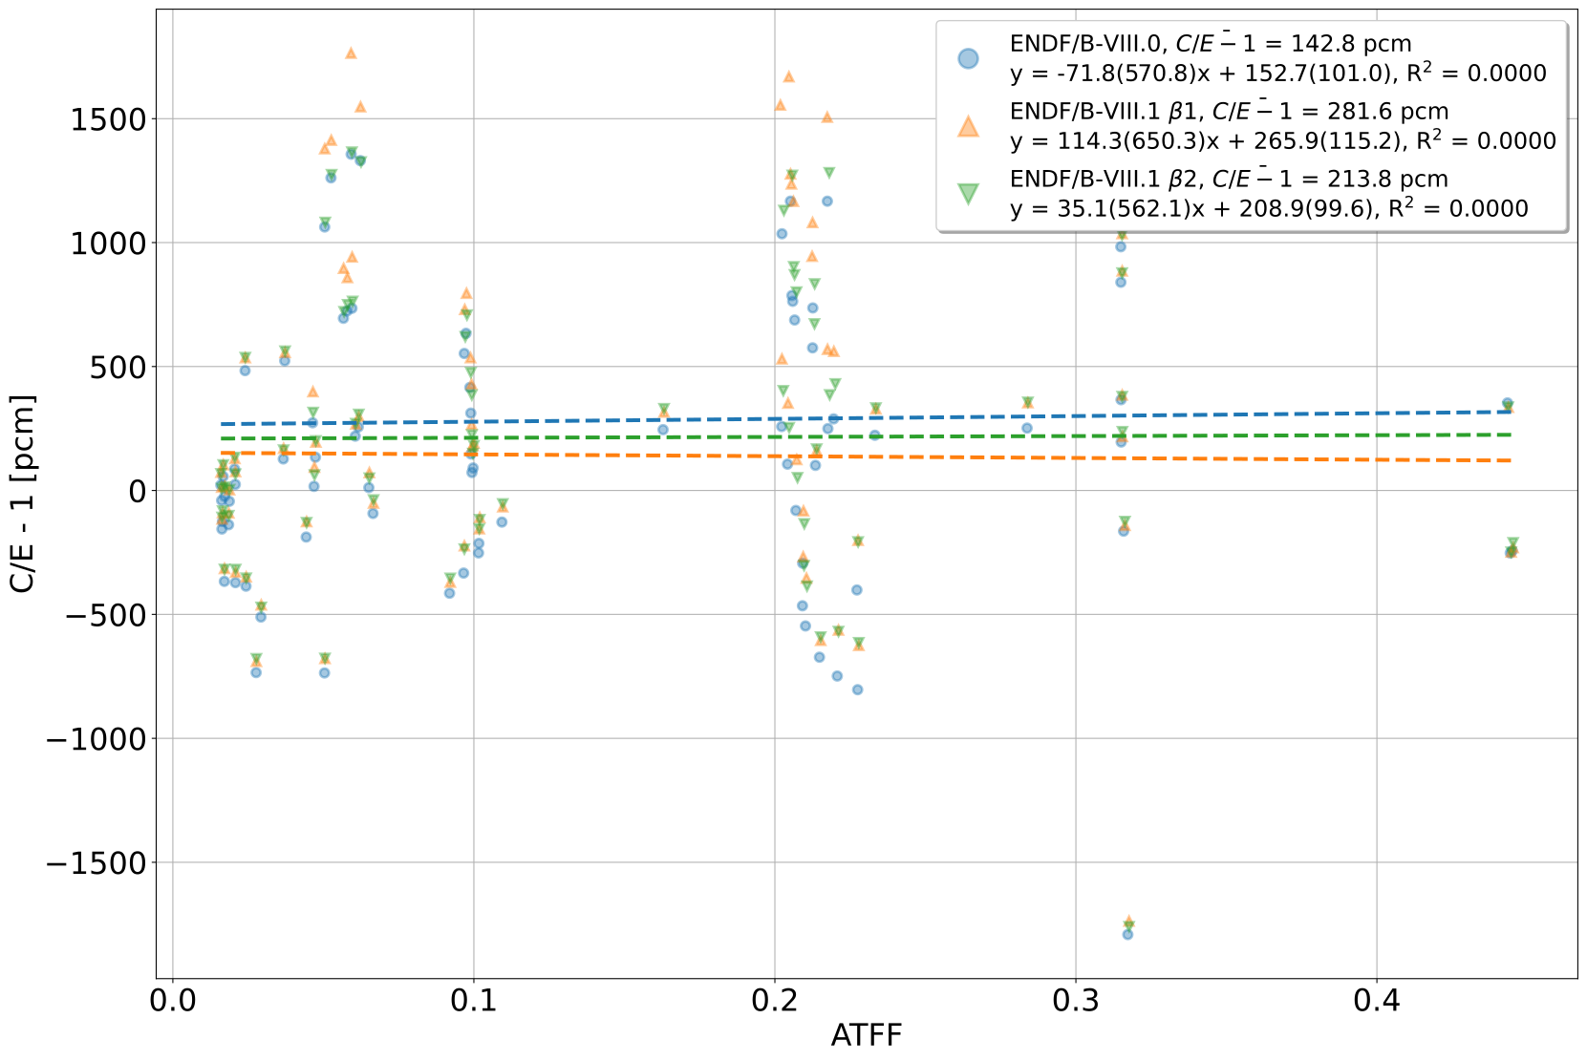
HST Benchmarks ATFF vs. C/E - 1

Slide 39
ICT Benchmarks $Δk$

Slide 40
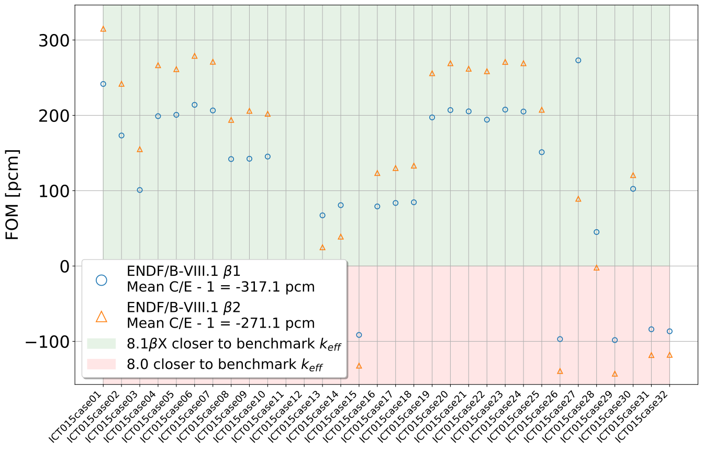
ICT Benchmarks FOM

Slide 41
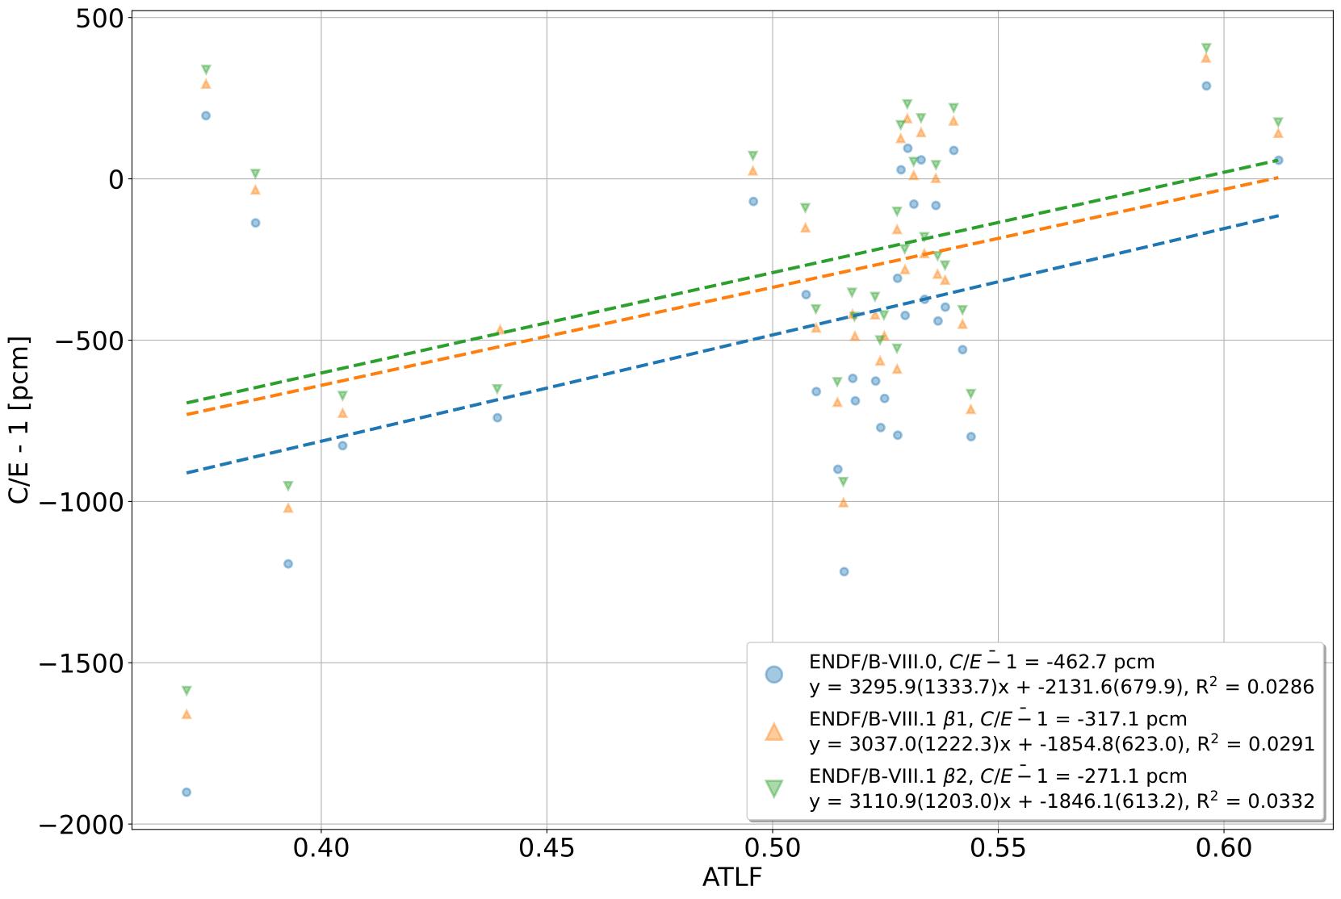
ICT Benchmarks ATLF vs. C/E - 1

Slide 42
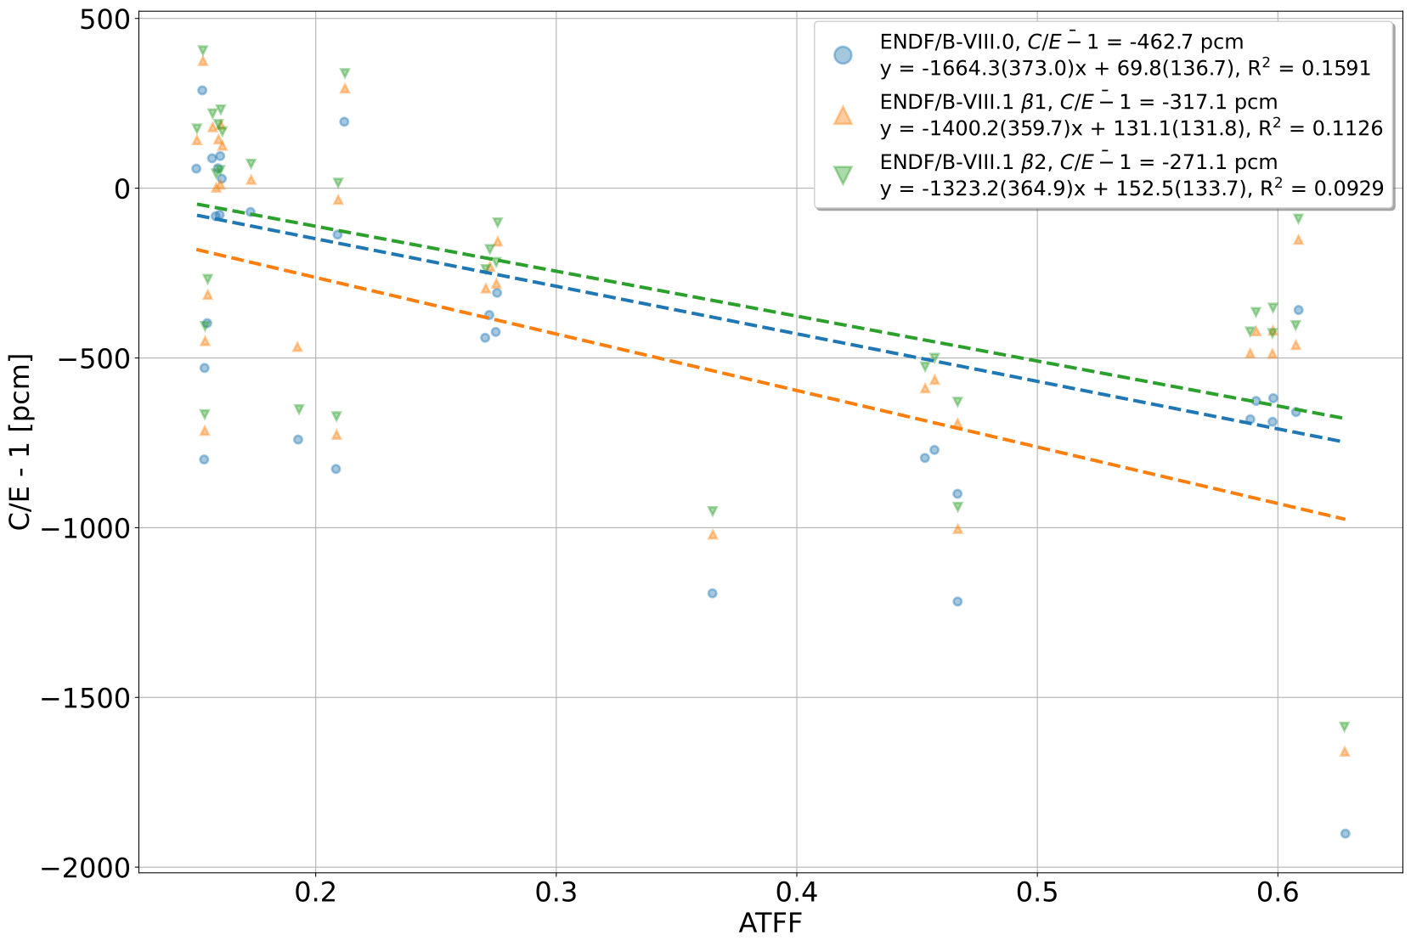
ICT Benchmarks ATFF vs. C/E - 1

Slide 43
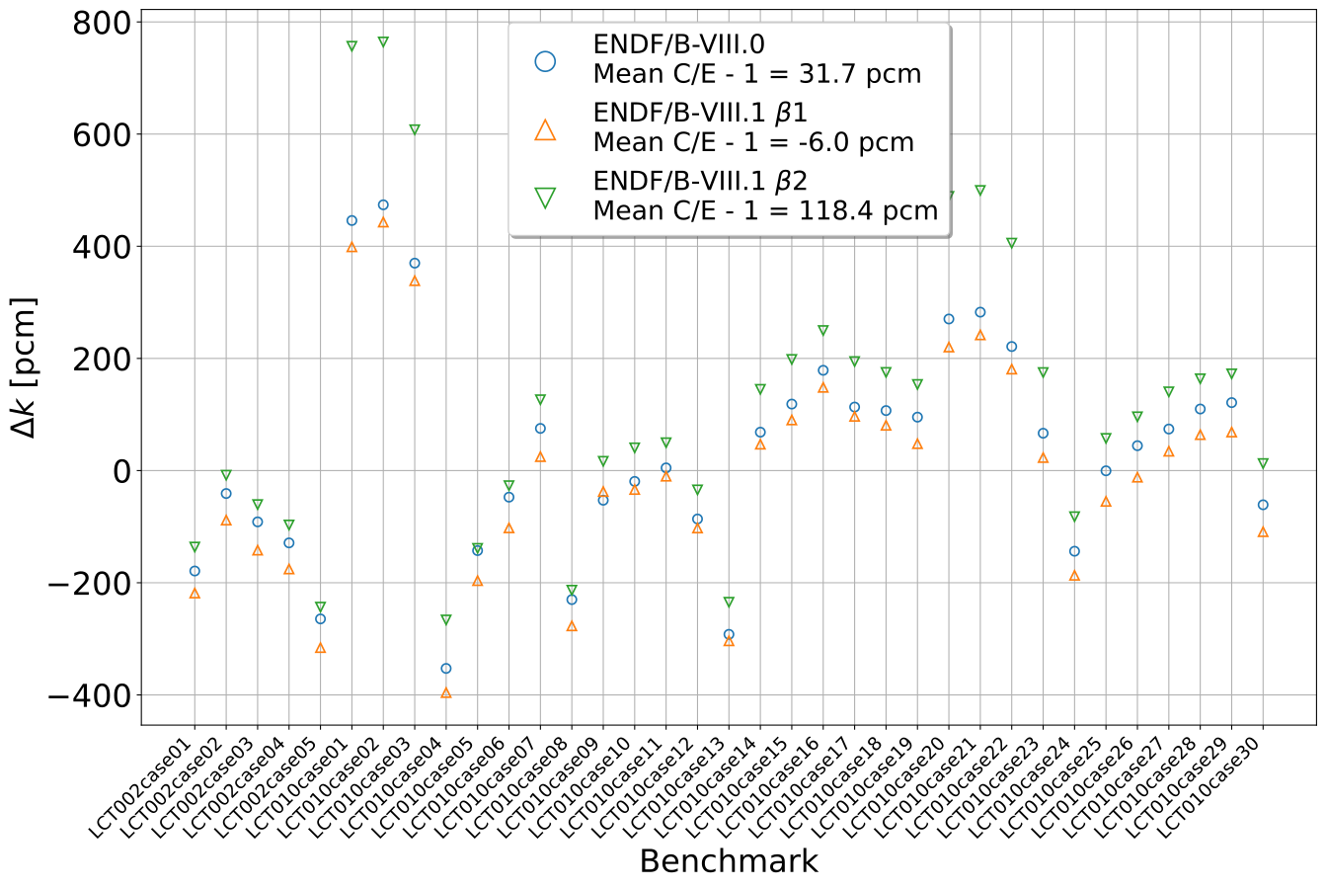
LCT Benchmarks $Δk$

Slide 44
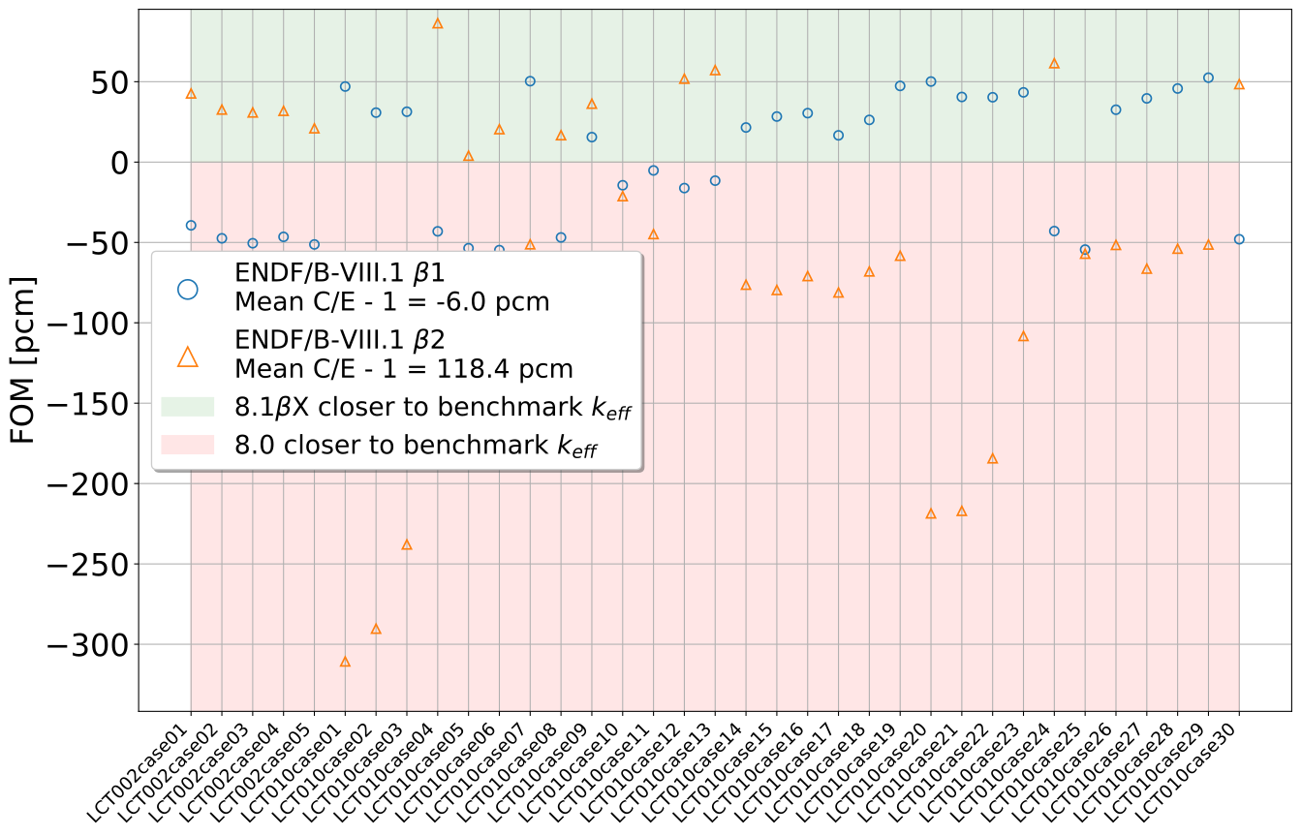
LCT Benchmarks FOM

Slide 45
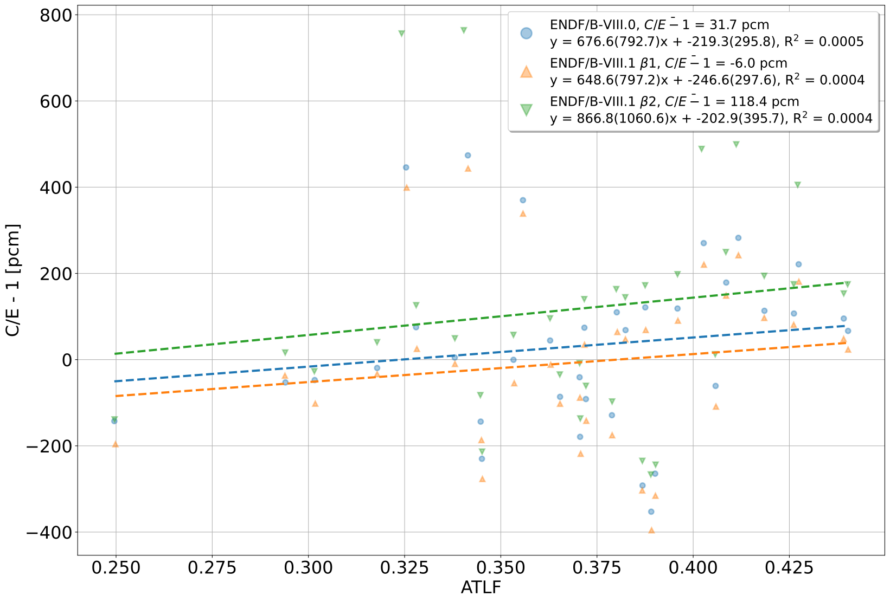
LCT Benchmarks ATLF vs. C/E - 1

Slide 46
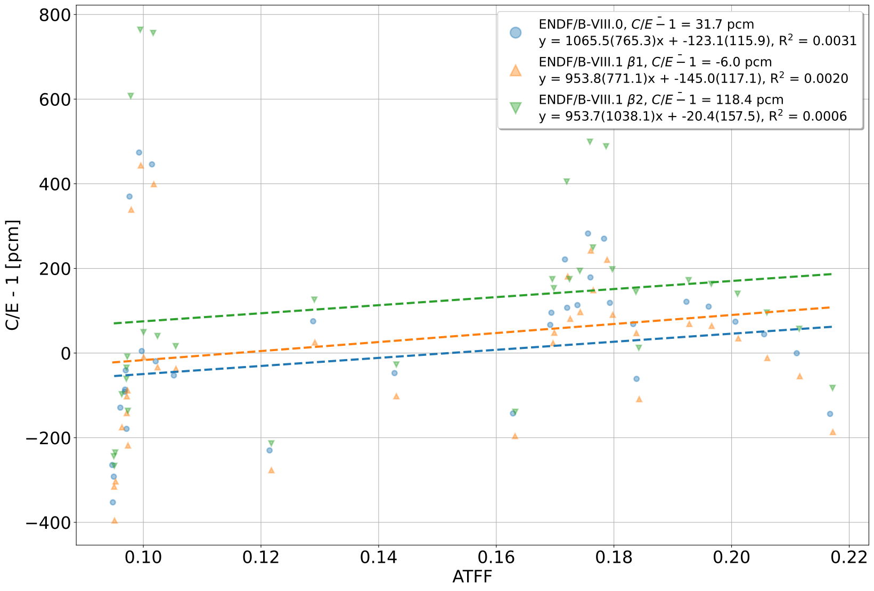
LCT Benchmarks ATFF vs. C/E - 1

Slide 47
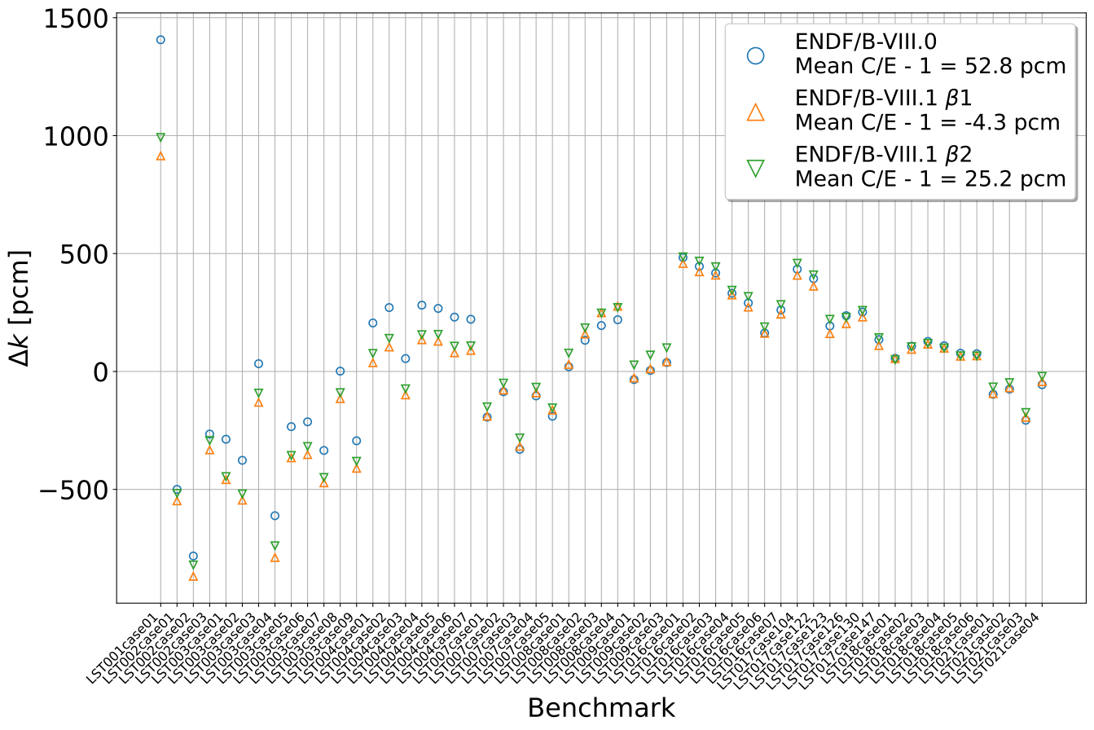
LST Benchmarks $Δk$

Slide 48
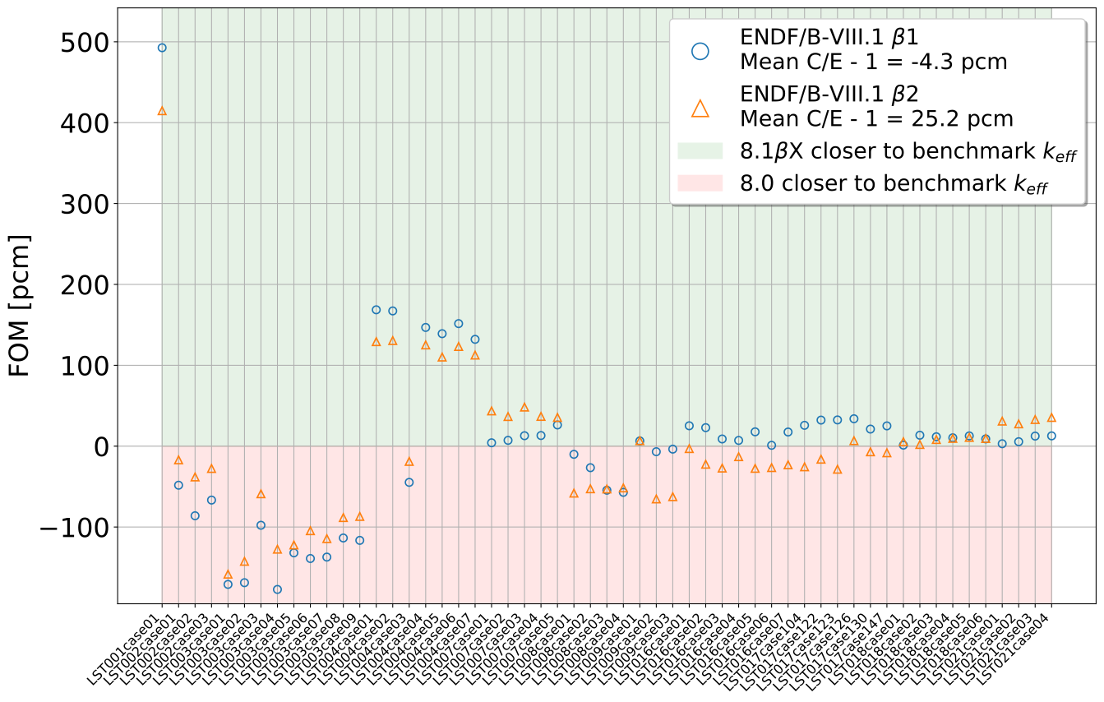
LST Benchmarks FOM

Slide 49
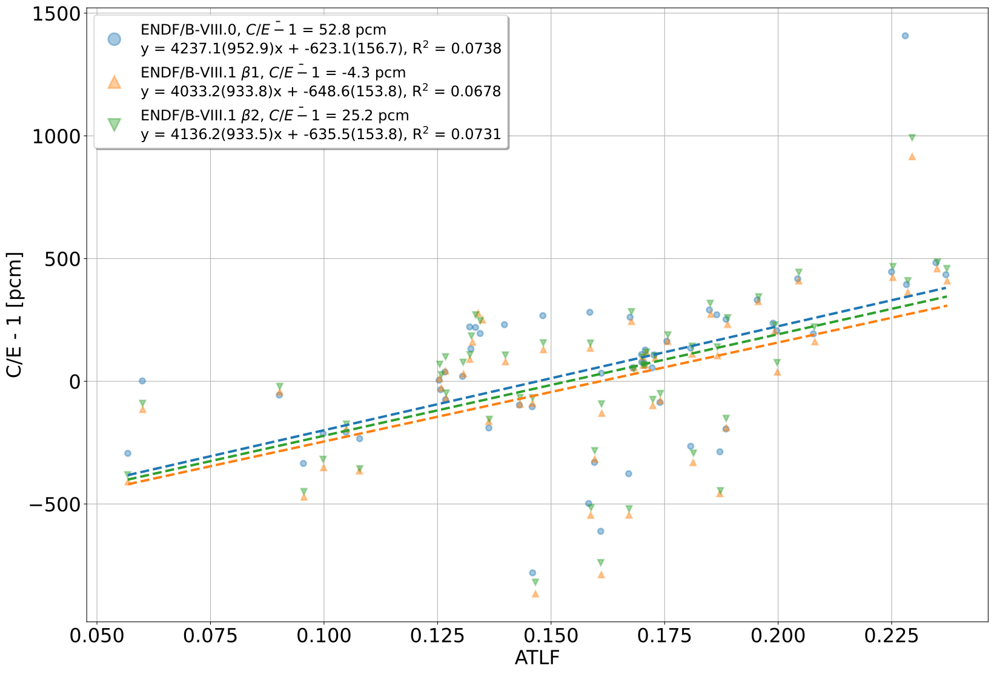
LST Benchmarks ATLF vs. C/E - 1

Slide 50
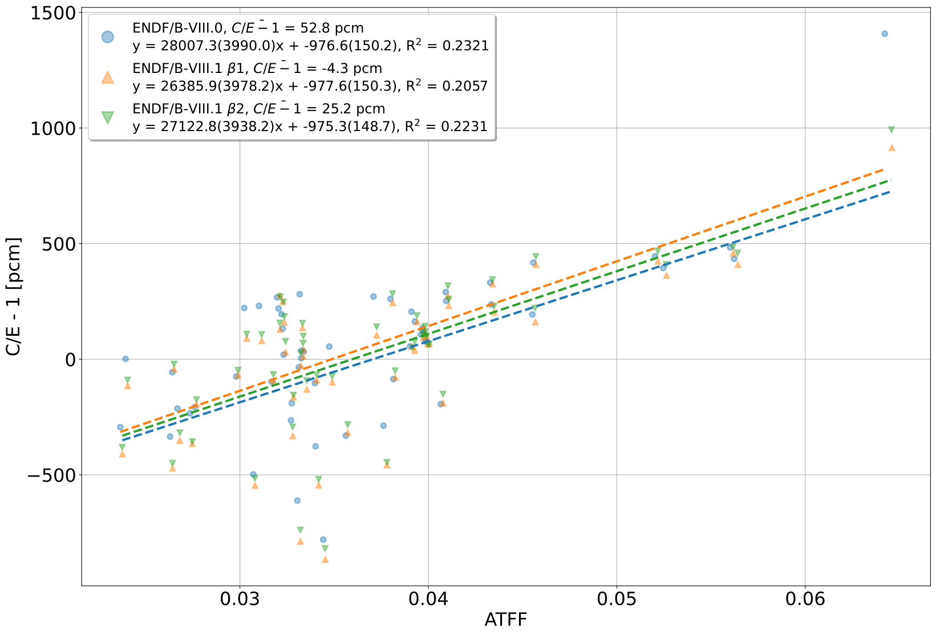
LST Benchmarks ATFF vs. C/E - 1

Slide 51
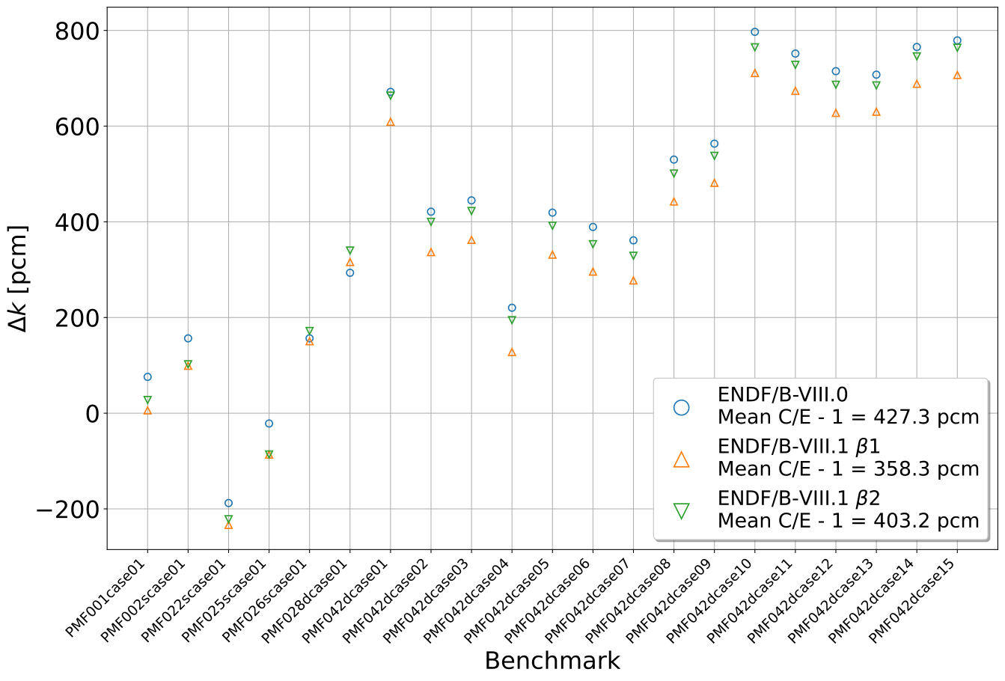
PMF Benchmarks $Δk$

Slide 52
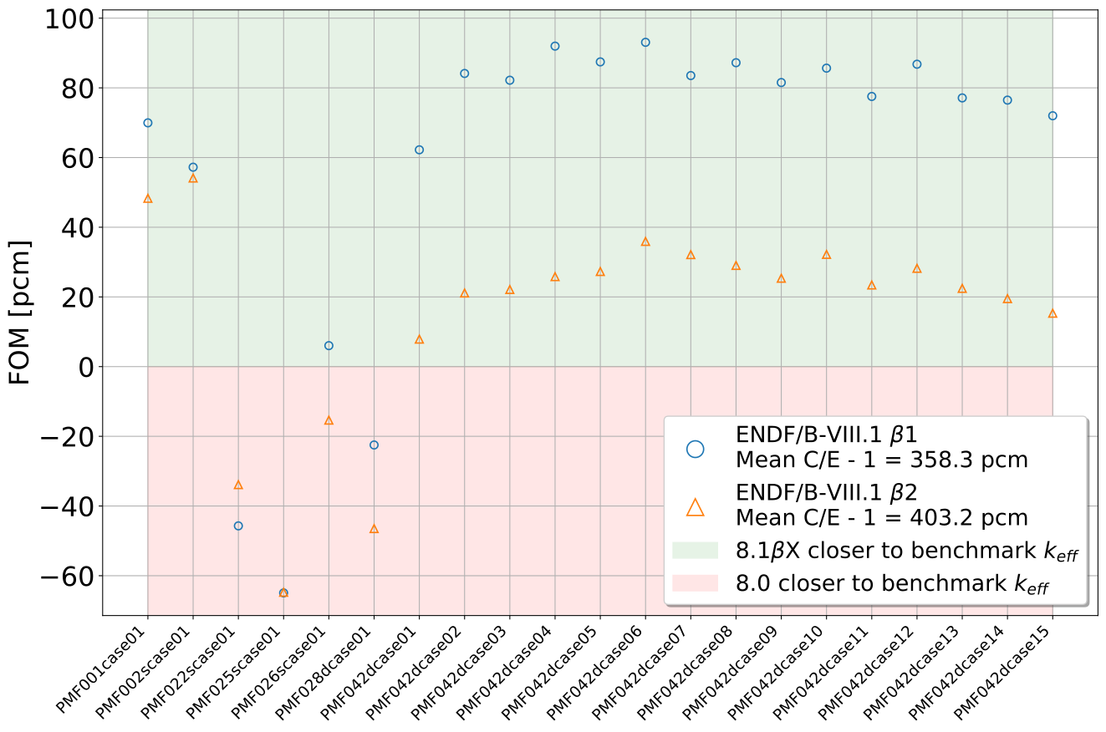
PMF Benchmarks FOM

Slide 53
PMF Benchmarks ATLF vs. C/E - 1

Slide 54
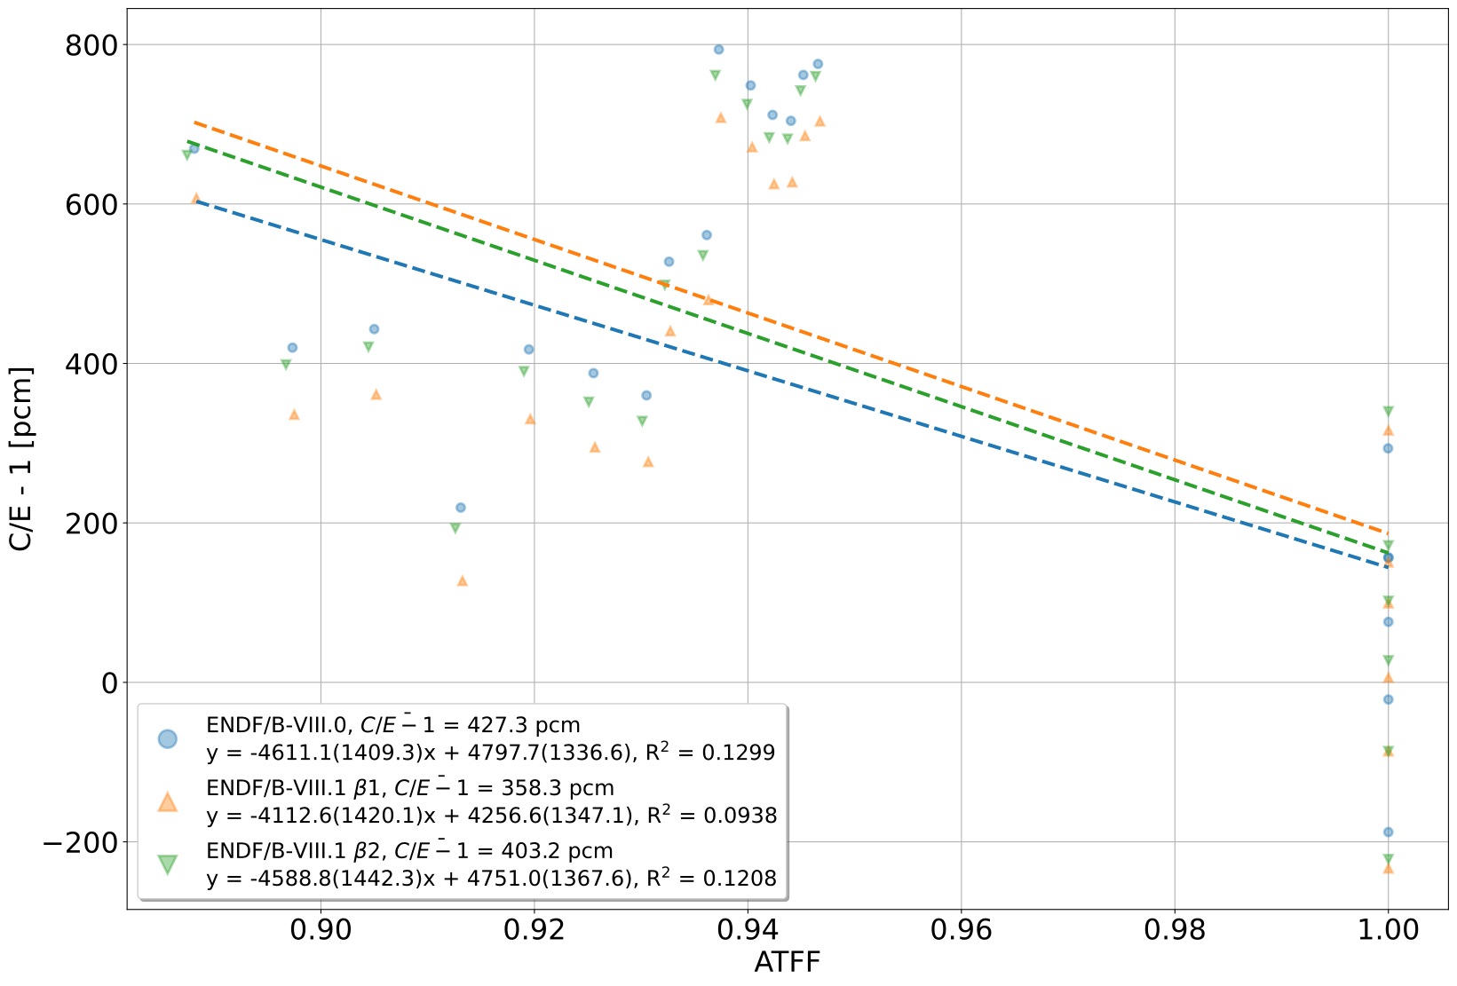
PMF Benchmarks ATFF vs. C/E - 1

Slide 55
PST Benchmarks $Δk$

Slide 56
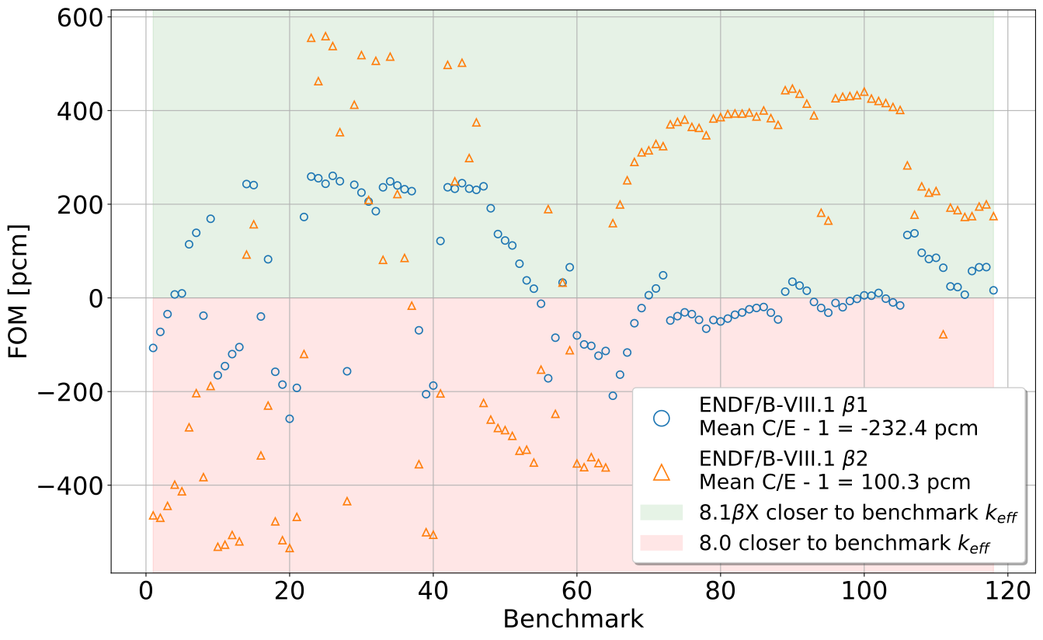
PST Benchmarks FOM

Slide 57
PST Benchmarks ATLF vs. C/E - 1

Slide 58
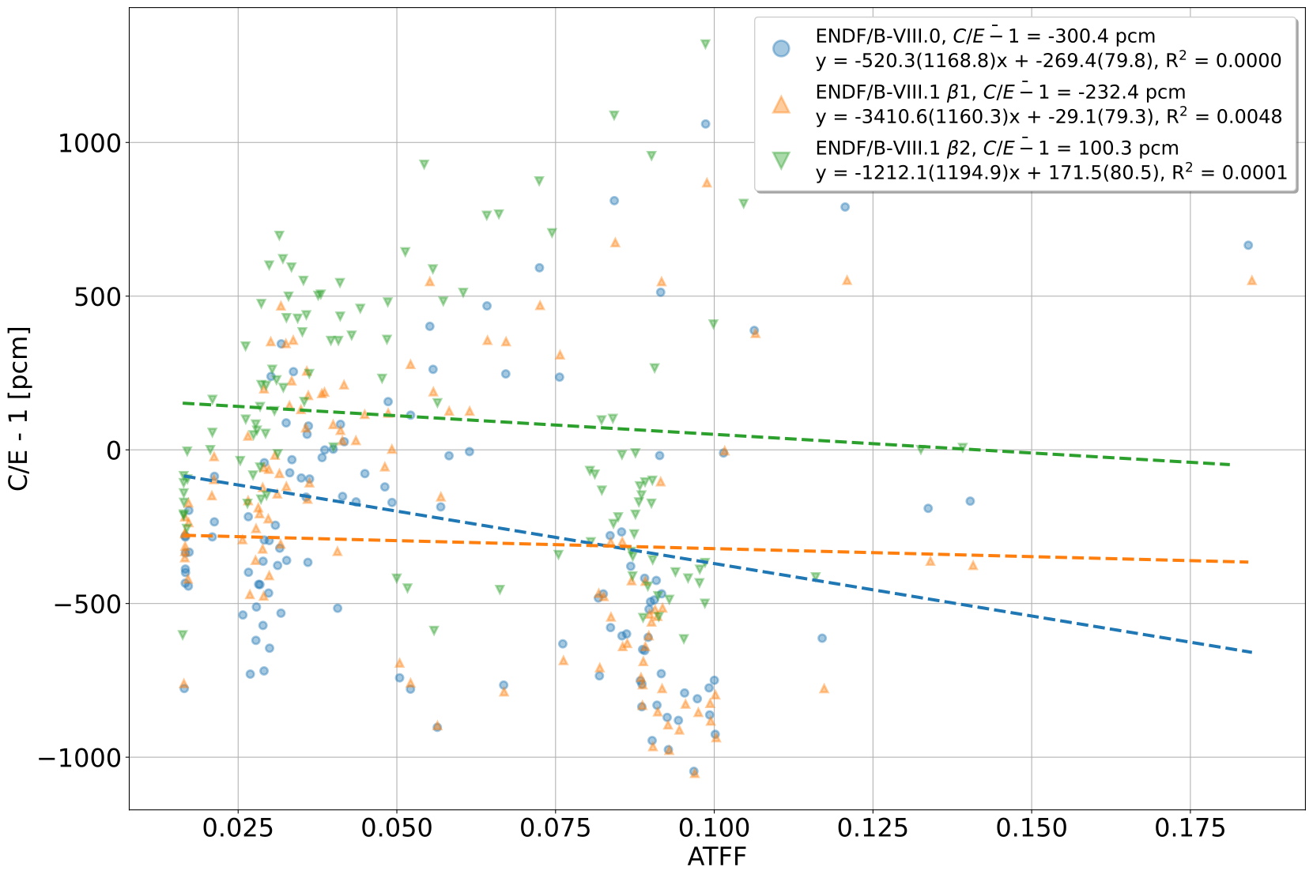
PST Benchmarks ATFF vs. C/E - 1

