Slide 1
Loss of Reactivity in Burnup Calculations Using Recent Data Libraries
Jan Malec and Andrej Trkov
Jožef Stefan Institute, Jamova cesta 39, 1000 Ljubljana, Slovenia

Slide 2
User feedback
Users in the USA reported that reactivity loss with burnup in LWR reactors was reasonable using ENDF/B-VII.1 data (ref: Kang-Seog Kim and William A. Wieselquist, “Neutronic Characteristics of ENDF/B-VIII.0 Compared to ENDF/B-VII.1 for Light-Water Reactor Analysis”)
Users in Europe were satisfied with the performance of JEFF-3.1, which shows similarity with ENDF/B-VII.1 (ref: Bernard et al. “Experimental Validation of the LWR Reactivity Loss with Burn up: Analysis of Spent Fuel Oscillation Experiments”)
Reactivity loss in burnup calculations using more recent libraries like ENDF/B-VIII.0 tends to be stronger by several hundred pcm.

Slide 3
Scope
Reactivity loss with burnup depends on:
Pu-239 production by capture in U-238 and Pu-239 absorption
Fission product yields, mainly of U-235 and Pu-239
Decay data – paths leading to strong absorbers
Fission energy release
Definition of burnup
In the present work we focus on cross sections

Slide 4
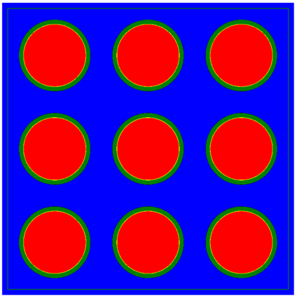
Test case
Representative 3x3 supercell array of PWR fuel assemblies as used at JSI for core design calculation for the Krsko NPP
Additional layer on the outside to preserve mass balance (spacer grids, inter-assembly gap)
UO2 fuel, 2.60 % or 4.75 % enrichment, up to 100 GWd/tHM burnup, 1000 K fuel temperature, 46.3476 MW/tHM power, 595 K moderator temperature, 300 ppm boron concentration
Zircalloy cladding and gap
Observables:
Isotopic concentrations
Absolute reactivity at BOL
Reactivity normalized at 500 MWd/tHM

Slide 5
Adoption of OpenMC for the calculations
Open source code
Extensively used in different laboratories
Verified (in literature) for burnup calculations (ref: Paul K. Romano et al., OpenMC and Serpent in Depletion capabilities in the OpenMC Monte Carlo particle transport code)
The package includes modules to generate complete application libraries Including
Fission product yields
Decay data
Notes:
Dodaj tabelo glede tega kaj je v kateri knjižnici

Slide 6
Data libraries used in the analysis
ENDF/B-VII.1 (reference)
ENDF/B-VIII.0
ENDF/B-VIII.1b2 (beta-2)
ENDF/B-VIII.1b2n similar to beta-2 with a small reduction of thermal nubar

Slide 7
Evolution of nuclide concentrations and reactivity loss with burnup
265 nuclides are tracked
Initial reactivity is checked
Reactivity gradient with burnup is checked
Reactivity is an additive quantity
Reactivity bias is added so that reactivities with all libraries are the same at 500 MWd/tU, when short-lived radionuclides reach equilibrium
thus, the effects of initial reactivity and the reactivity gradient with burnup can be separated

Slide 8
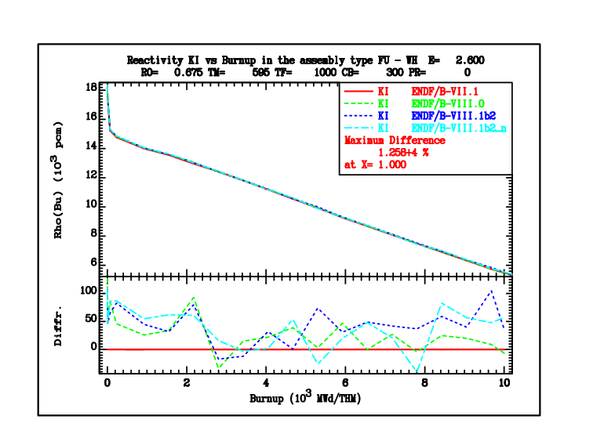
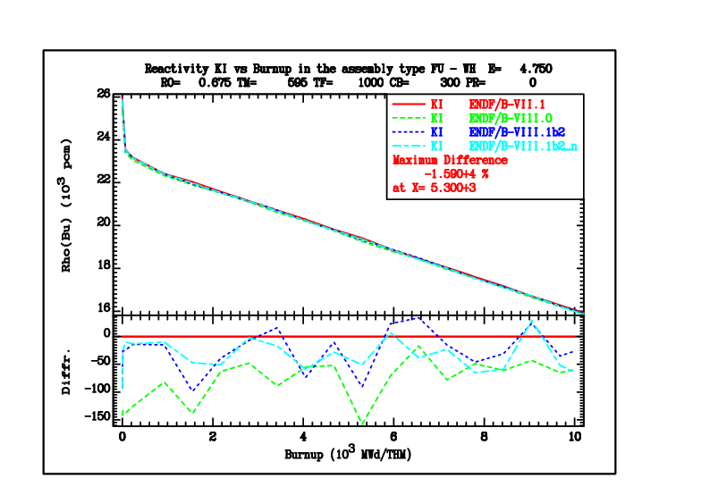
Effects on reactivity at BOL (absolute)
(differences due to thinner burnup mesh)

Slide 9
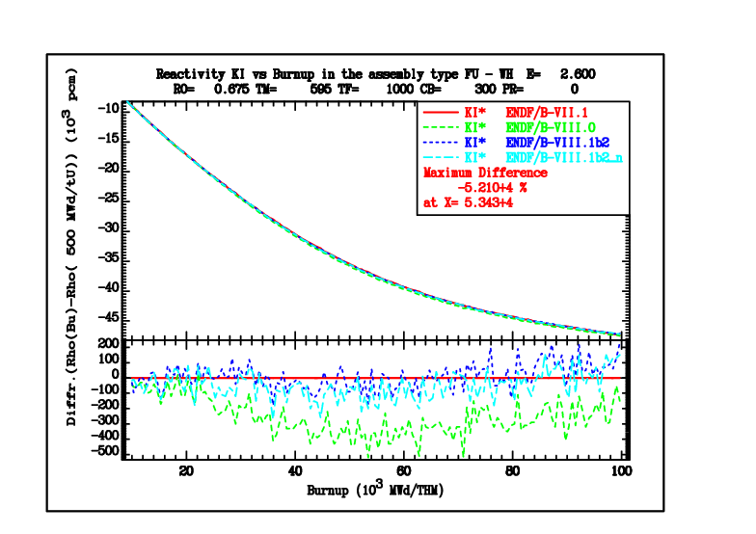
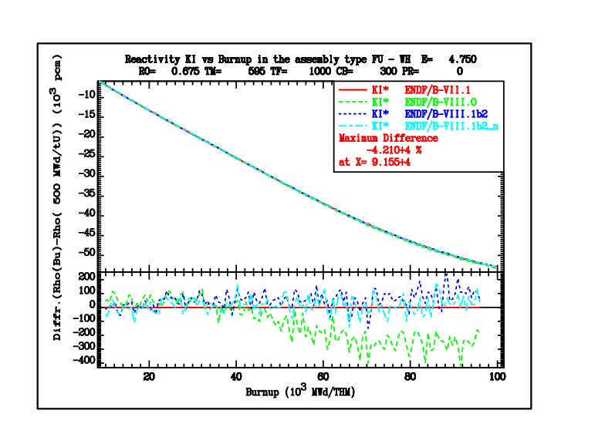
Effects on reactivity (normalized at 500 MWd/tU)
(differences due to thinner burnup mesh)

Slide 10
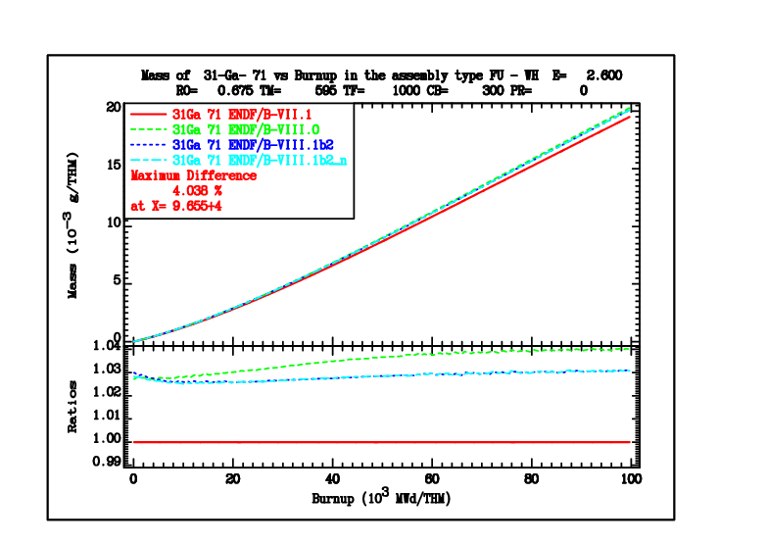
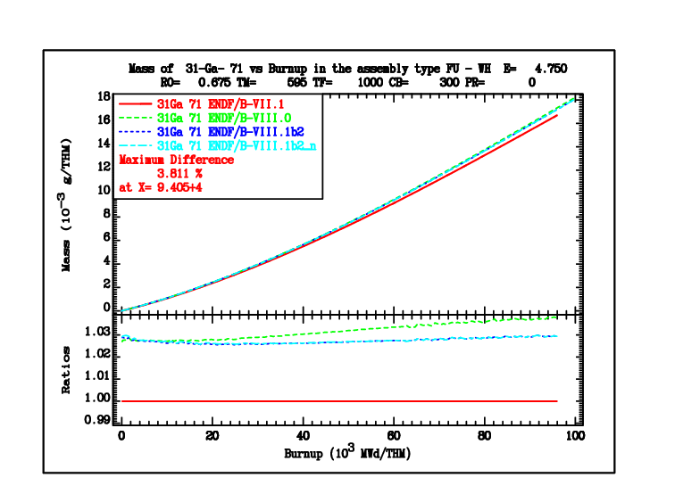
Isotopic composition (light nuclides)

Slide 11
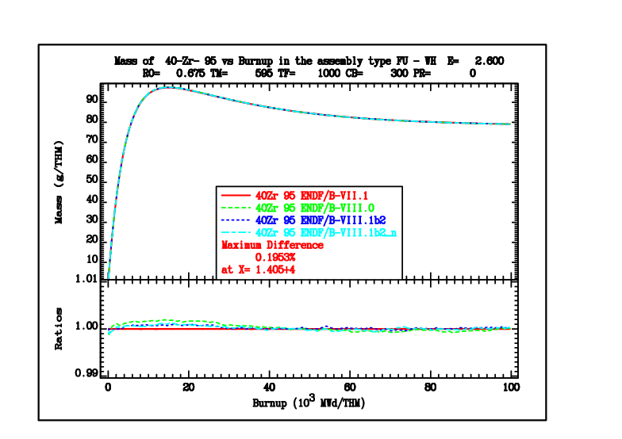
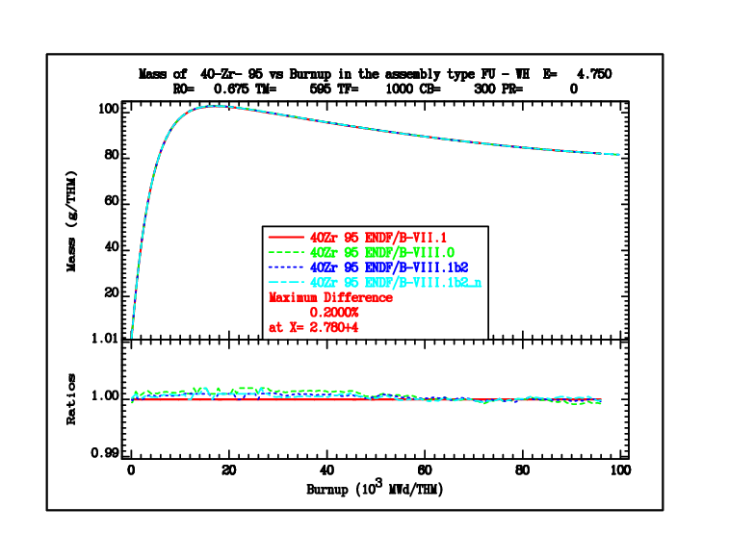
Isotopic composition (short-lived nuclides)

Slide 12
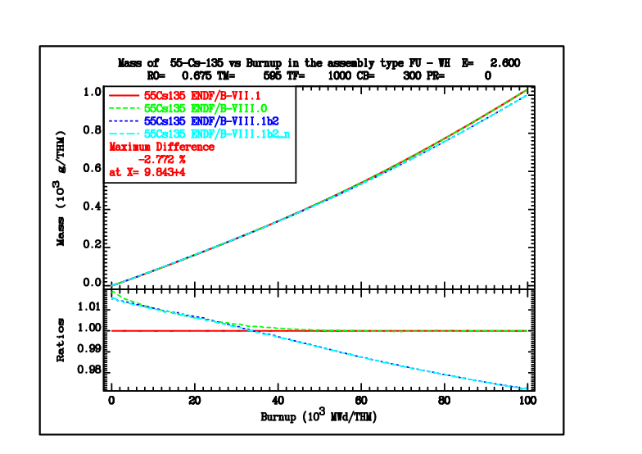
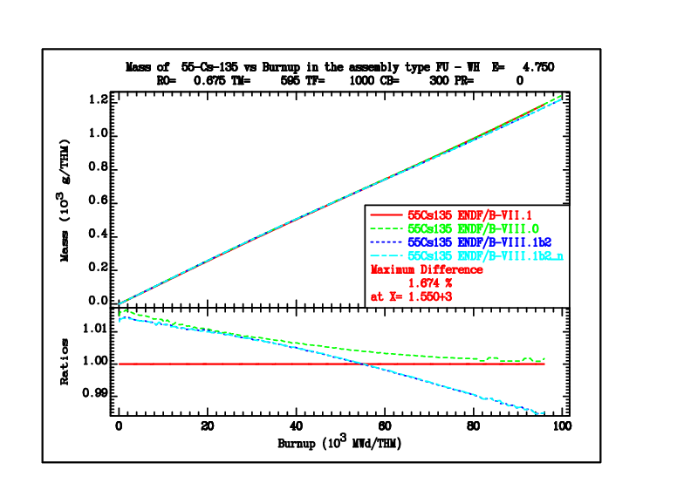
Isotopic composition (burnup monitors)

Slide 13
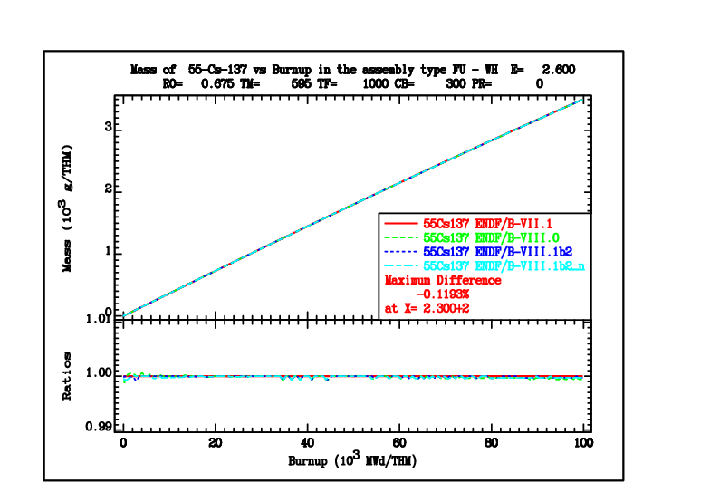
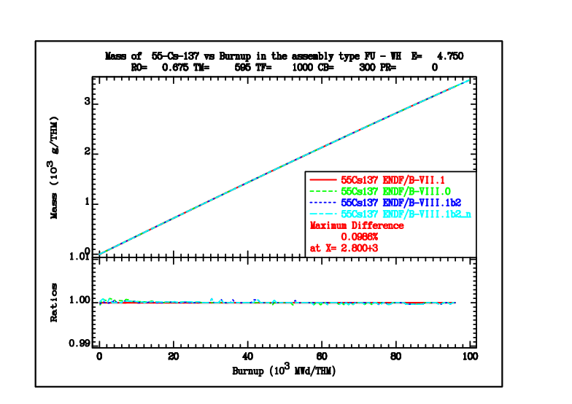
Isotopic composition (burnup monitors)

Slide 14
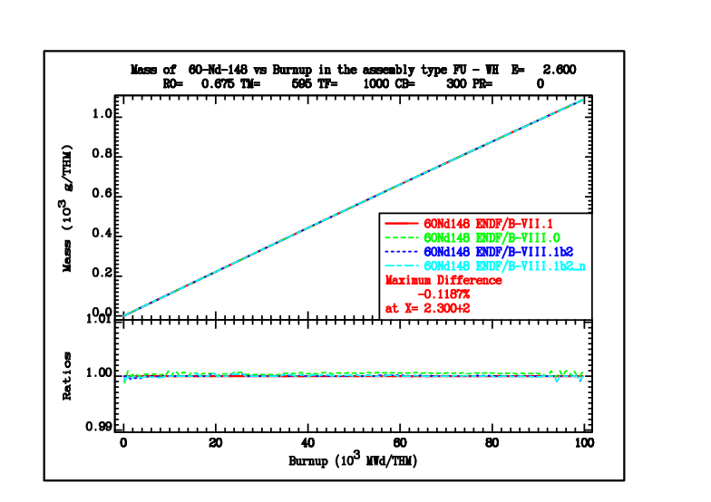
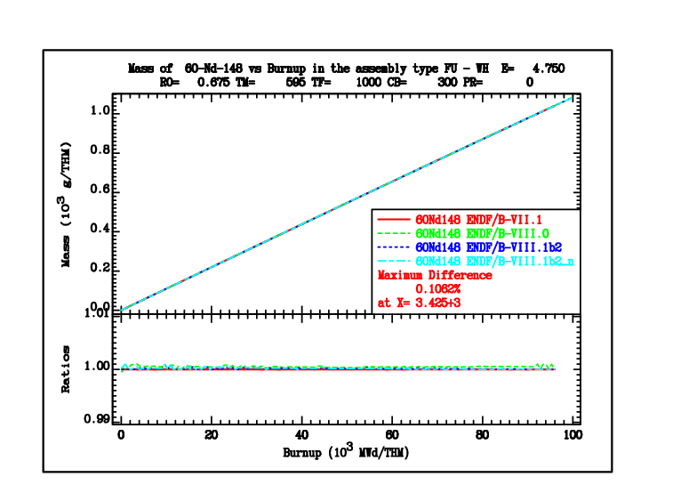
Isotopic composition (burnup monitors)

Slide 15
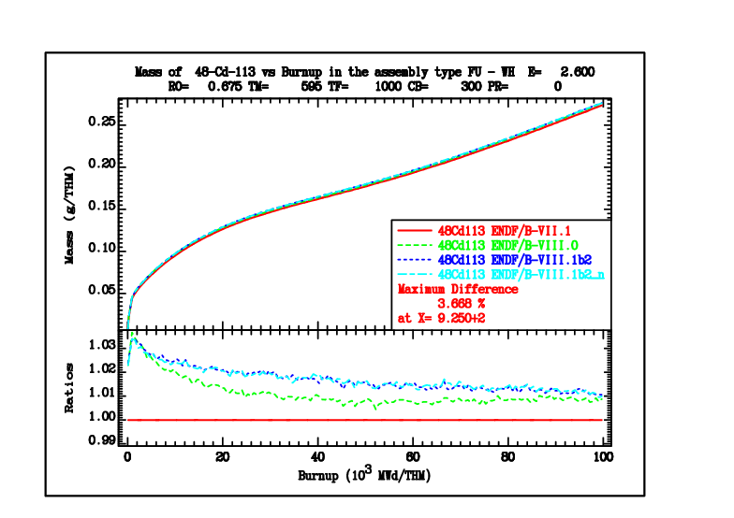
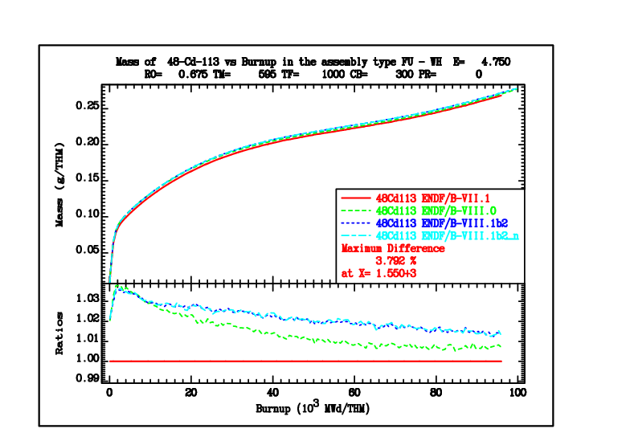
Isotopic composition (strong absorbers)

Slide 16
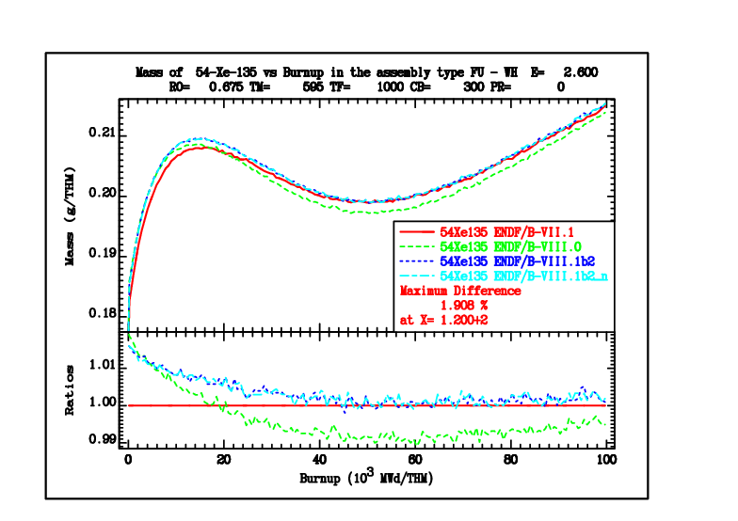
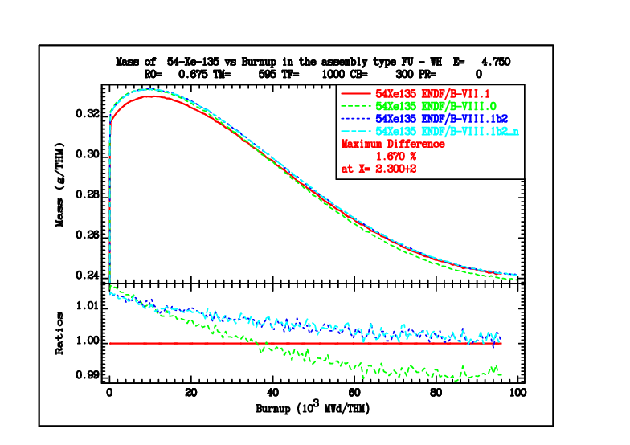
Isotopic composition (strong absorbers)

Slide 17
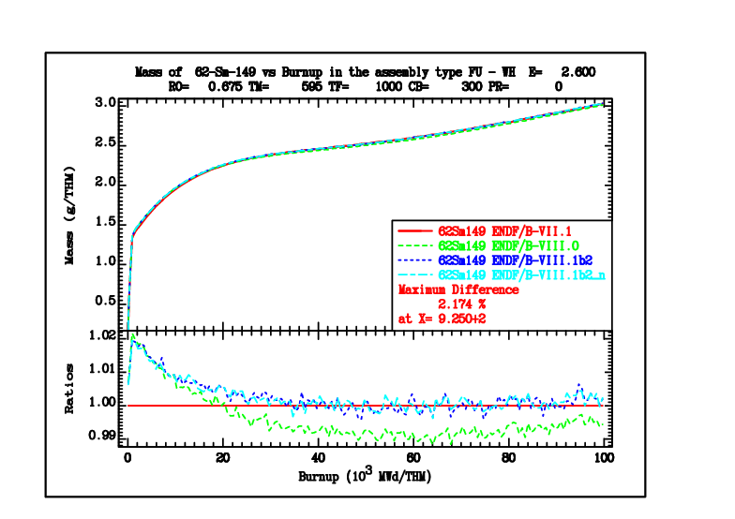
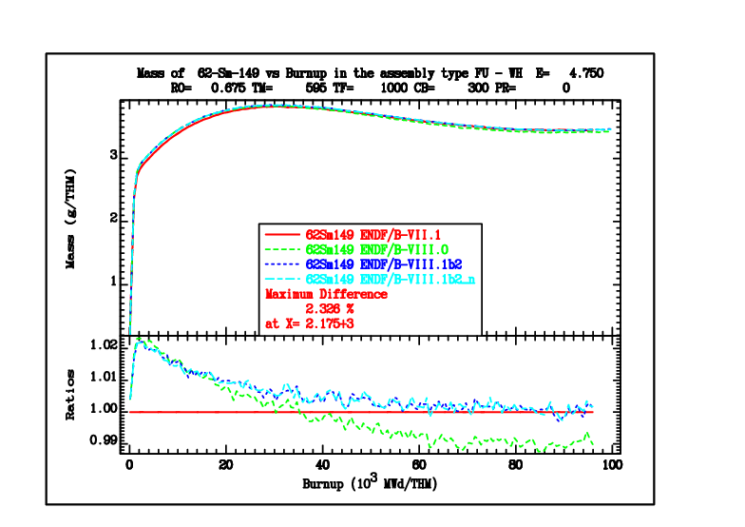
Isotopic composition (strong absorbers)

Slide 18
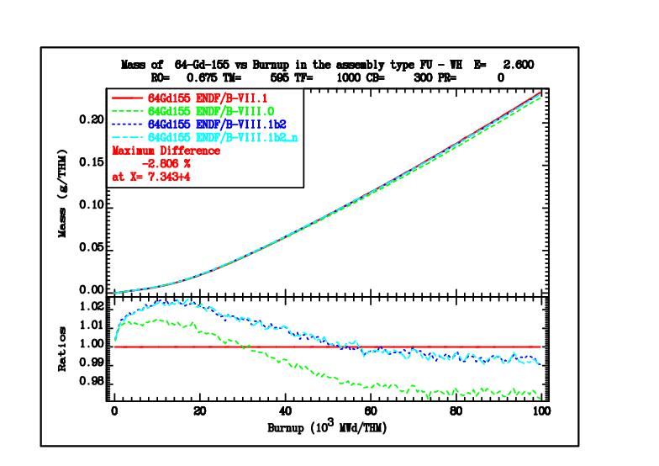
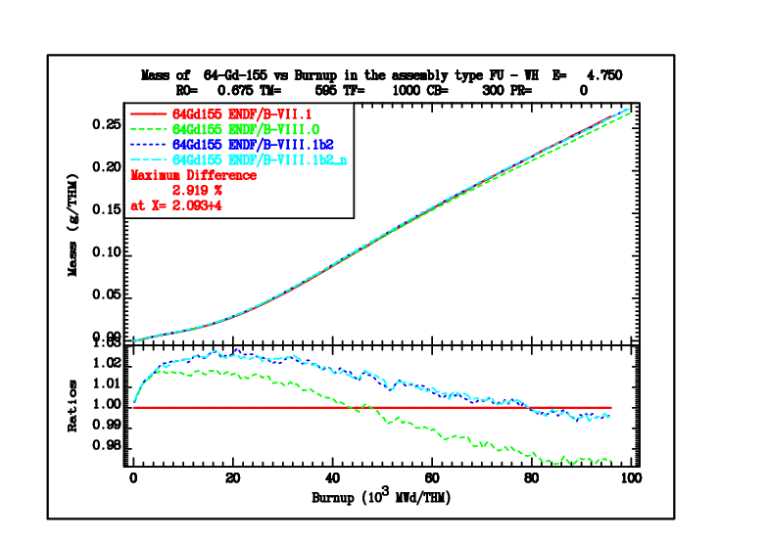
Isotopic composition (strong absorbers)

Slide 19
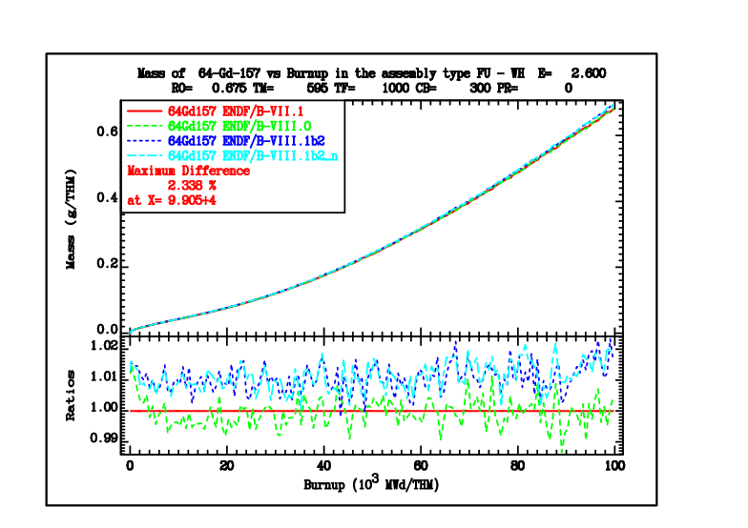
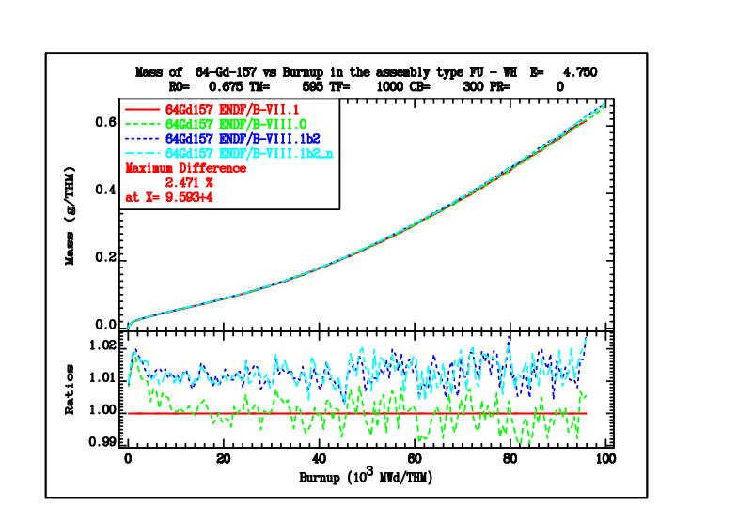
Isotopic composition (strong absorbers)

Slide 20
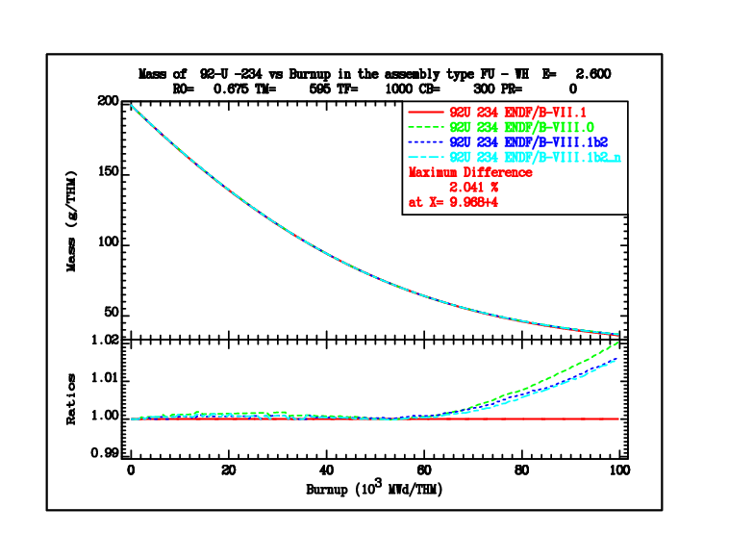
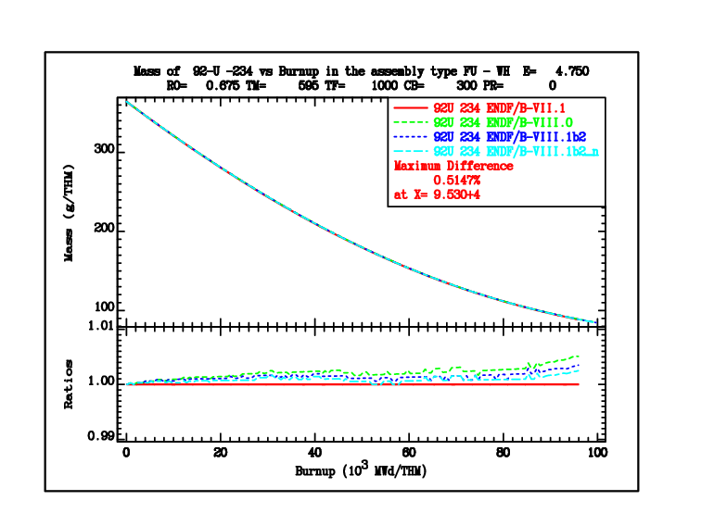
Isotopic composition (actinides)

Slide 21
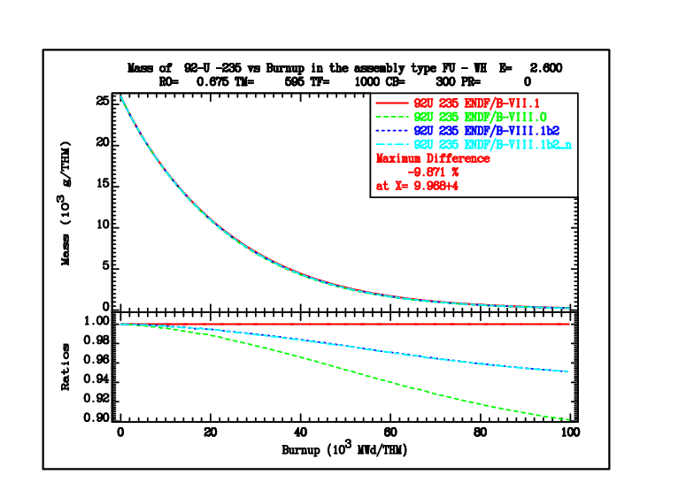
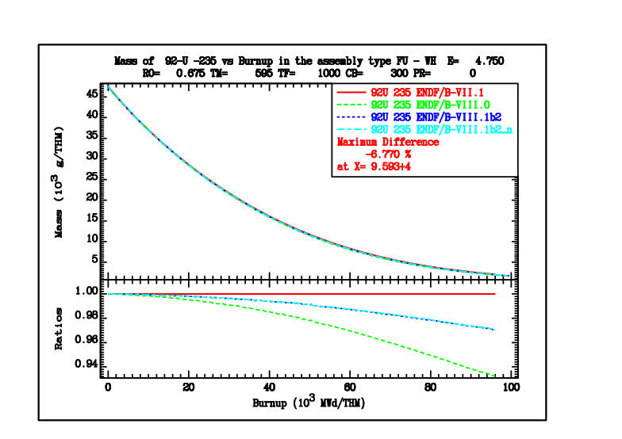
Isotopic composition (actinides)

Slide 22
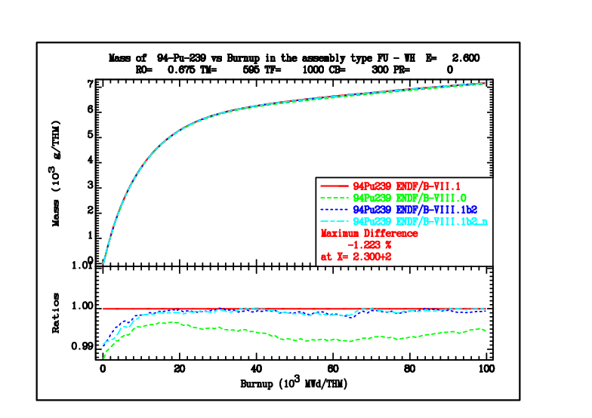
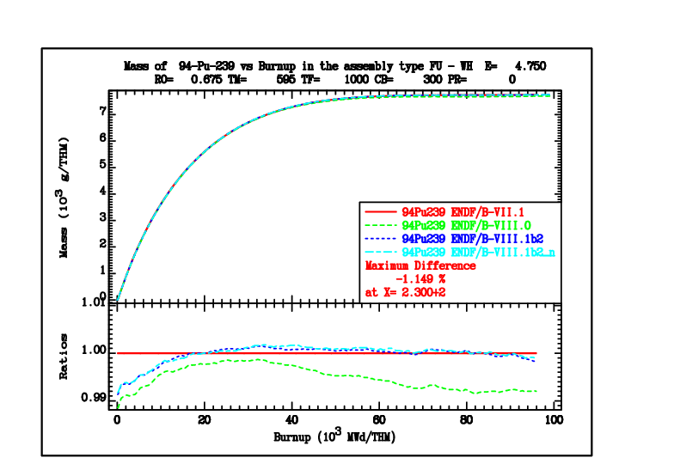
Isotopic composition (actinides)

Slide 23
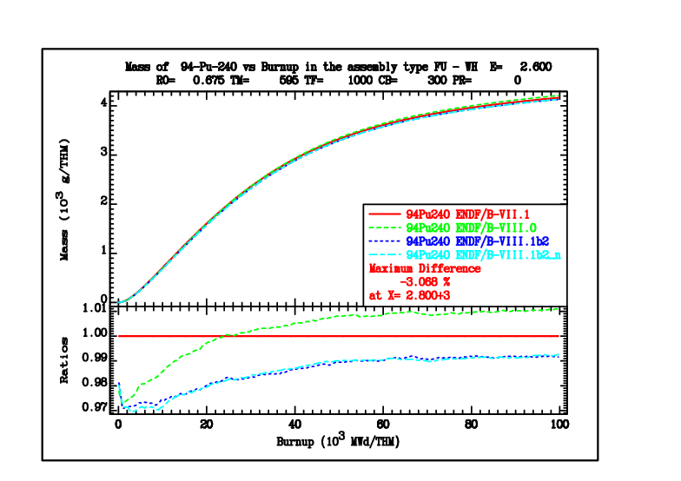
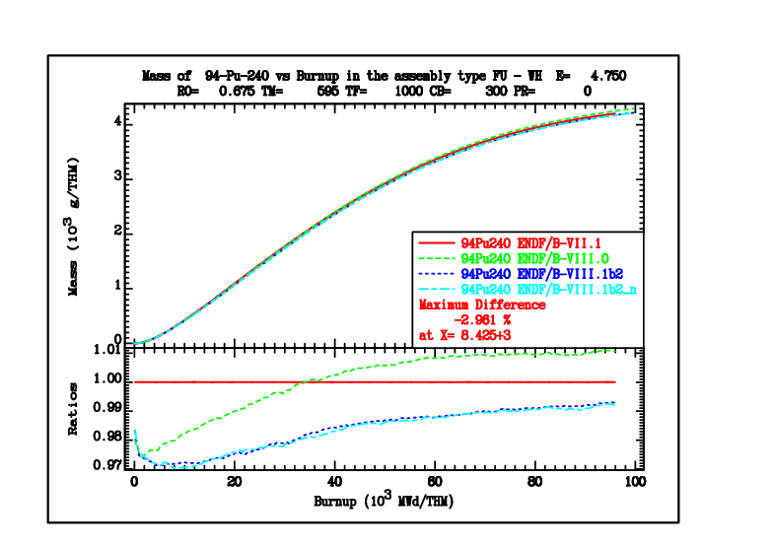
Isotopic composition (actinides)

Slide 24
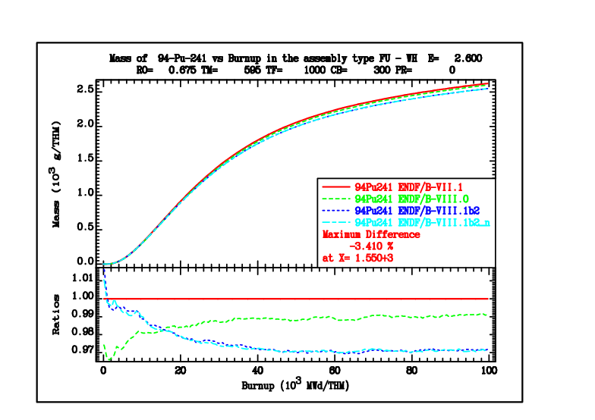
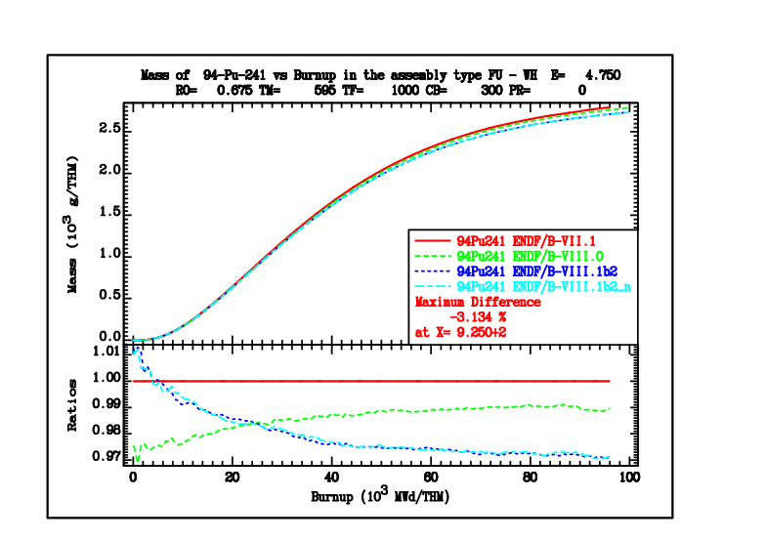
Isotopic composition (actinides)

Slide 25
Conclusions (general)
The reactivity loss with burnup using ENDF/B-VIII.1 b2 library is very similar to that of ENDF/B-VII.1 for the low-enriched (2.6 %) and the highly enriched (4.75 %) light water reactor fuel; the reactivity loss is less pronounced compared to ENDF/B-VIII.0
Although the accumulation of strong absorbers can be important, it seems that the dominant effect is the Plutonium build-up
Small changes in the Pu-239 nubar (introduced after “beta-2”, label suffix “n”) do not affect the results significantly
Feedback from the users on power reactor analysis is needed to verify the observation on the reactivity loss with burnup

Slide 26
Thank you!

Slide 27
Supplementary slides

Slide 28
Monte-carlo codes can produce (almost) identical results – if forced to
Paul K. Romano et. al. showed this for OpenMC and Serpent in Depletion capabilities in the OpenMC Monte Carlo particle transport code
The eqivalence of OpenMC results can be achieved after:
Predictor integrator scheme for solving the Bateman equations is unified
Same nuclear data are used (hdf5 library for OpenMC directly from the ACE files of Serpent)
Same data and model for nuclear heating is used (sometimes using a less accurate scheme to achieve parity)
Same interpolation scheme for fission yield data is used
Same or similar burnup chain is used
Same branching ratios are used

Slide 29
Energy release model
Both Serpent and OpenMC provide several choices regarding the heating models used in the calculation
The simplest models assume all heat is deposited locally, advanced models include photon transport
Simple models are appropriate for cross-code validation, if the goal is parity of results
OpenMC GitHub page provides a script to prepare Serpent-like Q values from ENDF data using the formula
$H_{i}=\frac{Q_{i}}{Q_{U235}}∗H_{U235}$,
where H_{U235}=202.27e6 eV

