Slide 1
ENDF/B-VIII.1β2 Validation Progress with ORNL VALID Critical Experiments
B.J. Marshall and Travis Greene
CSEWG
Brookhaven National Laboratory
November 16, 2023

Slide 2
Outline
Summary of k_{eff} results for CE calculations with VALID
More examination of results for:
LEU-COMP-THERM benchmarks
²³³U benchmarks
IEU and F benchmarks
Thermal Pu benchmarks

Slide 3
VALID benchmarks
VALID suite at ORNL has been expanded in recent years to include more ICSBEP benchmarks
More categories of experiments are covered, though some of them have very few cases
Deuterium- and polyethylene-moderated systems have been added, expanding validation basis for moderators beyond light water

Slide 4
Summary of results: Highlights relative to β1
Category | ce_v7.1 |  | ce_v8.0 |  | ce_v8.1b1 |  | ce_v8.1b2
 | Avg C/E | Unc | Avg C/E | Unc | Avg C/E | Unc | Avg C/E | Unc
HCT | 1.00503 | 0.00231 | 1.00184 | 0.00230 | 1.00282 | 0.00231 | 1.00202 | 0.00231
HMF* | 1.00090 | 0.00026 | 1.00016 | 0.00026 | 1.00026 | 0.00026 | 1.00000 | 0.00026
HMI | 0.99921 | 0.00042 | 1.00079 | 0.00042 | 0.99956 | 0.00042 | 0.99963 | 0.00042
HSI | 0.98602 | 0.00241 | 0.98728 | 0.00241 | 0.98966 | 0.00242 | 0.98952 | 0.00242
HST | 0.99822 | 0.00072 | 0.99847 | 0.00072 | 0.99948 | 0.00072 | 0.99915 | 0.00072
IMF | 1.00352 | 0.00082 | 1.00114 | 0.00081 | 1.00132 | 0.00081 | 1.00195 | 0.00082
IST | 1.00041 | 0.00077 | 1.00120 | 0.00077 | 1.00060 | 0.00077 | 1.00044 | 0.00077
LCT | 0.99962 | 0.00019 | 0.99912 | 0.00019 | 0.99874 | 0.00019 | 0.99935 | 0.00019
LMT | 1.00600 | 0.00158 | 1.00155 | 0.00157 | 1.00211 | 0.00157 | 1.00162 | 0.00157
LST | 0.99829 | 0.00083 | 0.99845 | 0.00083 | 0.99920 | 0.00083 | 0.99850 | 0.00083
MCF | 0.99887 | 0.00157 | 0.99797 | 0.00157 | 0.99989 | 0.00157 | 0.99786 | 0.00157
MCT | 0.99644 | 0.00058 | 0.99555 | 0.00058 | 0.99244 | 0.00058 | 0.99611 | 0.00058
MST | 0.99837 | 0.00158 | 0.99354 | 0.00157 | 0.99177 | 0.00157 | 0.99616 | 0.00158
PMF | 1.00003 | 0.00045 | 1.00011 | 0.00045 | 0.99978 | 0.00045 | 1.00015 | 0.00045
PMM | 1.00040 | 0.00108 | 1.00401 | 0.00108 | 1.00387 | 0.00108 | 1.00256 | 0.00108
PST | 1.00349 | 0.00051 | 0.99836 | 0.00051 | 0.99970 | 0.00051 | 1.00302 | 0.00051
UCT | 1.00077 | 0.00141 | 0.99818 | 0.00140 | 1.00368 | 0.00141 | 1.00465 | 0.00141
UMF | 0.99853 | 0.00051 | 0.99860 | 0.00051 | 0.99874 | 0.00051 | 0.99899 | 0.00051
USI | 0.98273 | 0.00124 | 0.97945 | 0.00123 | 0.98761 | 0.00124 | 0.98911 | 0.00124
USM | 0.97987 | 0.00215 | 0.97546 | 0.00214 | 0.98411 | 0.00216 | 0.98527 | 0.00216
UST | 1.00083 | 0.00052 | 0.99750 | 0.00052 | 1.00281 | 0.00053 | 1.00340 | 0.00053
* No TSL for BeO
Better
Worse
Different?

Slide 5
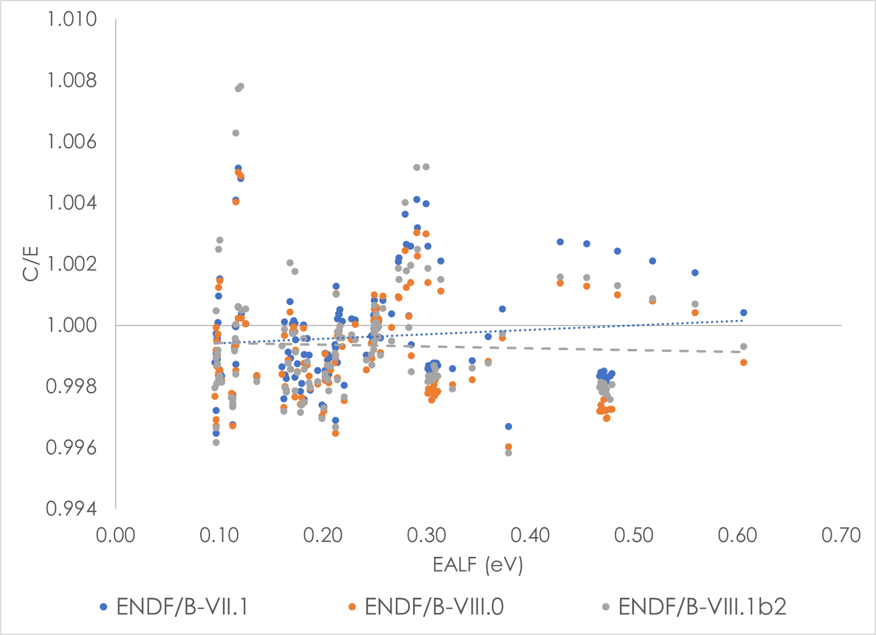
LEU-COMP-THERM results
β2 improves on average C/E value compared to β1
β2 average C/E better than ENDF/B-VIII.0, still not as good as ENDF/B-VII.1
β2 EALF trend very near 0, flatter than ENDF/B-VII.1

Slide 6
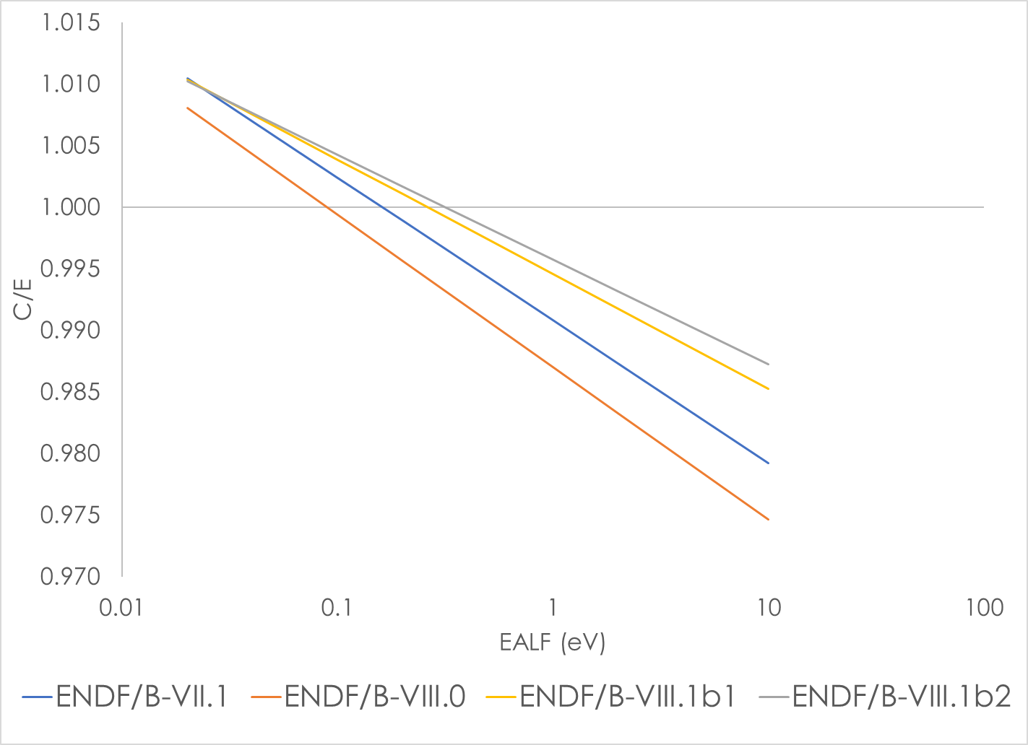
²³³U thermal and intermediate solutions
C/E values generally higher for β1 & β2 relative to prior releases
For USM and USI this is an improvement
For UST it creates a larger over-prediction
β2 trend is flattest yet

Slide 7
IEU benchmarks: UF₄/CF₂ and UO₂ (1/2)
ORNL investigated performance of UF₄/CF₂ experiments from ORCEF in 2021and published results at PHYSOR 2022
ICSBEP evaluations: ICT-001/ICM-001, ICI-003/ICM-003/ICT-011, ICM-002/ICI-004
Mike Zerkle indicated at ICNC that ENDF/B-VIII.1β2 improves performance for the UF₆ benchmark
IEU benchmarks tested with ENDF/B-VIII.1β2 to look at impacts and check UF₄/CF₂ versus other UO₂ IEU experiments
IEU evaluations: ICT-002 (light water), ICT-015/ICI-006/ICM-004 (UO₂/wax), ICT-016 (UO₂/wax)

Slide 8
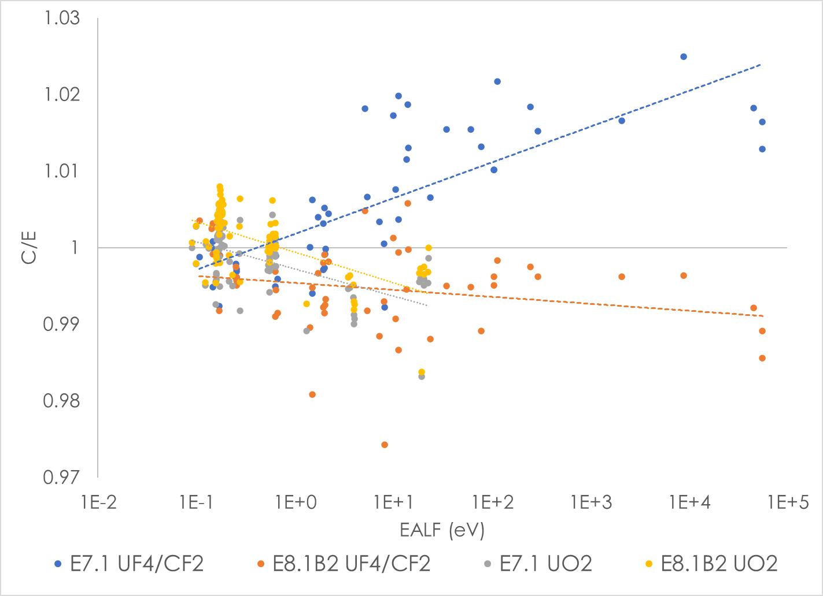
IEU benchmarks: UF₄/CF₂ and UO₂ (2/2)
Significant reduction in trend for fluoride cases
Oxide slope similar, level slightly improved
Average bias for fluoride systems has similar magnitude but opposite sign
Form | ENDF/B-VII.1 |  | ENDF/B-VIII.1β2
 | Avg C/E | σ | Avg C/E | σ
UF₄/CF₂ | 1.00586 | 0.00057 | 0.99462 | 0.00055
UO₂ | 0.99854 | 0.00055 | 1.00090 | 0.00055

Slide 9
Pu-driven thermal benchmarks
Mismatch between indications provided by pure Pu solutions and thermal mixed Pu/U solutions and oxide pin array systems
ENDF/B-VIII.0 reduced reactivity of PST systems to improve benchmark predictions
Degraded performance for MST and MCT benchmarks
Large change noted in thermal Pu systems in β2 compared to ENDF/B-VIII.0 and β1
Post-β2 nubar update improves PSTs a little but slightly degrades MCT/MST systems

Slide 10
Updated nubar results (1/2)
Category | ce_v7.1 |  | ce_v8.0 |  | ce_v8.1b1 |  | ce_v8.1b2 |  | Updated nubar
 | Avg C/E | Unc | Avg C/E | Unc | Avg C/E | Unc | Avg C/E | Unc | Avg C/E | Unc
MCT | 0.99644 | 0.00058 | 0.99555 | 0.00058 | 0.99244 | 0.00058 | 0.99611 | 0.00058 | 0.99489 | 0.00058
MST | 0.99837 | 0.00158 | 0.99354 | 0.00157 | 0.99177 | 0.00157 | 0.99616 | 0.00158 | 0.99480 | 0.00157
PMF | 1.00003 | 0.00045 | 1.00011 | 0.00045 | 0.99978 | 0.00045 | 1.00015 | 0.00045 | 1.00012 | 0.00045
PMM | 1.00040 | 0.00108 | 1.00401 | 0.00108 | 1.00387 | 0.00108 | 1.00256 | 0.00108 | 1.00290 | 0.00108
PST | 1.00349 | 0.00051 | 0.99836 | 0.00051 | 0.99970 | 0.00051 | 1.00302 | 0.00051 | 1.00146 | 0.00051
Updated nubar lowers reactivity, so PST bias is reduced but MST bias is more negative. MST bias is likely more negative as well, but the impact is not statistically significant.

Slide 11
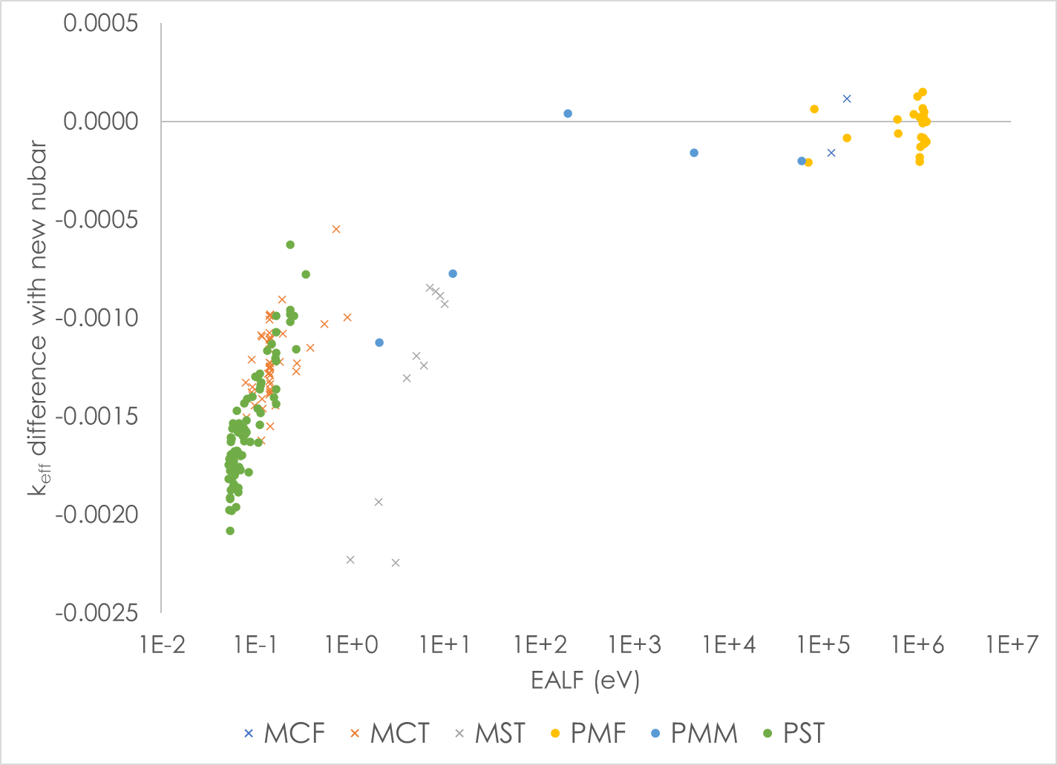
Updated nubar results (2/2)
Updated nubar does not impact intermediate or fast spectrum systems
Reactivity change is very similar for all thermal Pu-driven systems

Slide 12
Conclusions
Large differences in thermal Pu systems with β2
Post-β2 nubar adjustment moves partially back towards β1 and ENDF/B-VIII.0
New fluorine evaluation dramatically reduces the energy-dependent trend in ORCEF UF₄/CF₂ experiments
Bias now negative, magnitude may be slightly smaller
Impact on fluoride salt FHRs and MSRs
Improvement on energy-dependent trends in LCT and ²³³U
Bias improvement for LCTs, still not as good as ENDF/B-VII.1

Slide 13
Acknowledgment
This presentation was supported by the Nuclear Criticality Safety Program, funded and managed by the National Nuclear Security Administration for the Department of Energy.

Slide 14
Questions?

