Slide 1
Feedback on ENDF/B-VIII.1b2
on a selection of Benchmarks
Oscar Cabellos (UPM)
Universidad Politécnica de Madrid (UPM), Madrid, Spain
E-mail: oscar.cabellos@upm.es

Slide 2
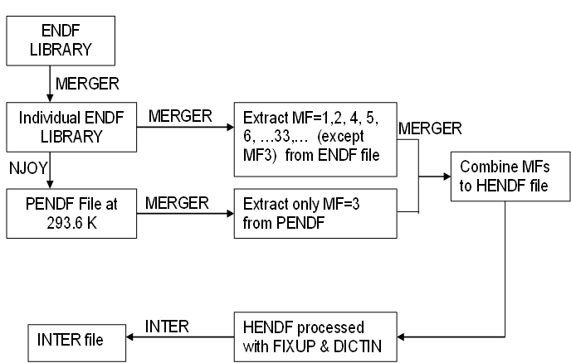
1. Processing in JANIS format
Processing ENDF/B-VIII.1b2 into JANIS format:
  HENDF + INTER + BOXER
Figure. Example of input deck to process in PENDF format
moder /tape20 from MERGER
20 -31
reconr /Reconstruct XS data
-31 -32
' PENDF tape ' /
9437 2 /
.005 /
' MAT=pu239 ENDF Library:JENDL-5.0upd' /
' Processed NJOY2016-UPM,2023 '
0/
broadr /Doppler broaden XS
-31 -32 -33
9437 1 /
.005 /
293.60
0/
thermr / Add thermal scattering data
0 -33 -34
0 9437 12 1 1 0 0 1 221 0
293.60
0.005 10.0
unresr
-31 -34 -35
9437 1 1 0 /
293.60
1.0e+10 /
0/
heatr / Add heating kerma and damage energy
-31 -35 -36 40/
9437 7 0 0 0 2/
302 303 304 318 401 403 407 /
heatr / Add heating kerma and damage energy
-31 -36 -37 41/
9437 6 0 0 0 2 0 1/
442 443 444 445 446 447 /
gaspr /Gas production
-31 -37 -38
moder
-38 26
stop
tape20 = ENDF file
=====================
Figure. Flowchart of processing JANIS database from ENDF tapes
NJOY2016.72
BOXER file
MF31/32/33/34 and MF35
VERSION 7.01

Slide 3
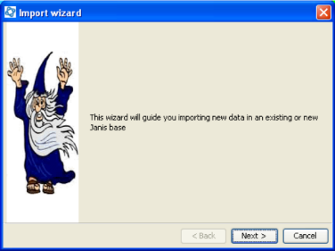
1. Processing in JANIS format
Processing ND libraries into JANIS format:
JEFF-4T2.2
JENDL-5.0-upd
ENDF/B-VIII.1b2
  “In115” failed in HEATR module
  Logs reported when importing JANIS database (Sep. 15th, 2023)
  # - HENDF: Hybrid format ENDF+PENDF including KERMA and DAMAGE cross-sections
  # - INTER
  # - BOXER: covariances MF31, MF32/MF33, MF34 and MF35
  Download at the following link:
    https://drive.upm.es/s/E4KBmhbtrI5yWQI
    password: janis
  See the “Readme.txt” file, it explains how to download and import the database in JANIS
Import WIZARD tool: Use the “Database > Import Wizard”
Steps:
- Use “JANIS toolbar -> Database –> Load” function
- Set “.h2.db file” to select the downloaded “h2.db” file
- Set “Root Folder” to the folder where the “h2.fb” is located
(Leave the other default options are they are)

Slide 4
1. Processing in JANIS format
JANIS command line… “the Great Unknown”
JANIS (after version 4.2)
  Firstly, download “Janis_all.jars.zip” at http://www.oecd-nea.org/janis/webstart/
  Run “JANIS” in your computer… you need java installed or a JAVA pre-installed package
Examples (in Windows)
  0) Help command
  C:\Your_Folder_with_JANIS_Jars> java -jar janis.jar -help
  1) List the content of the local database
  C:\Your_Folder_with_JANIS_Jars> java -jar janis.jar -list UPM_E81b2 N ENDFB8.1b2 SIG
  2) Extract data in a Table
  C:\Your_Folder_with_JANIS_Jars> java -jar janis.jar -table NEA N JEFF-3.1.2 SIG N15 MT1 xs
  3) Create a Plot from a JNS file: “File.jns”
  C:\Your_Folder_with_JANIS_Jars> java -jar janis.jar -o FILE.png -render File.jns png 1024 768
In “File.jns”, the JANIS databases are linked as follows:
  <data refs="NEA~N~ENDF/B-VIII.0~SIG~Fe56~MT444~damage">
  <data refs="UPM_E81b2~N~ENDFB8.1b2~SIG~Fe56~MT444~damage">

Slide 5
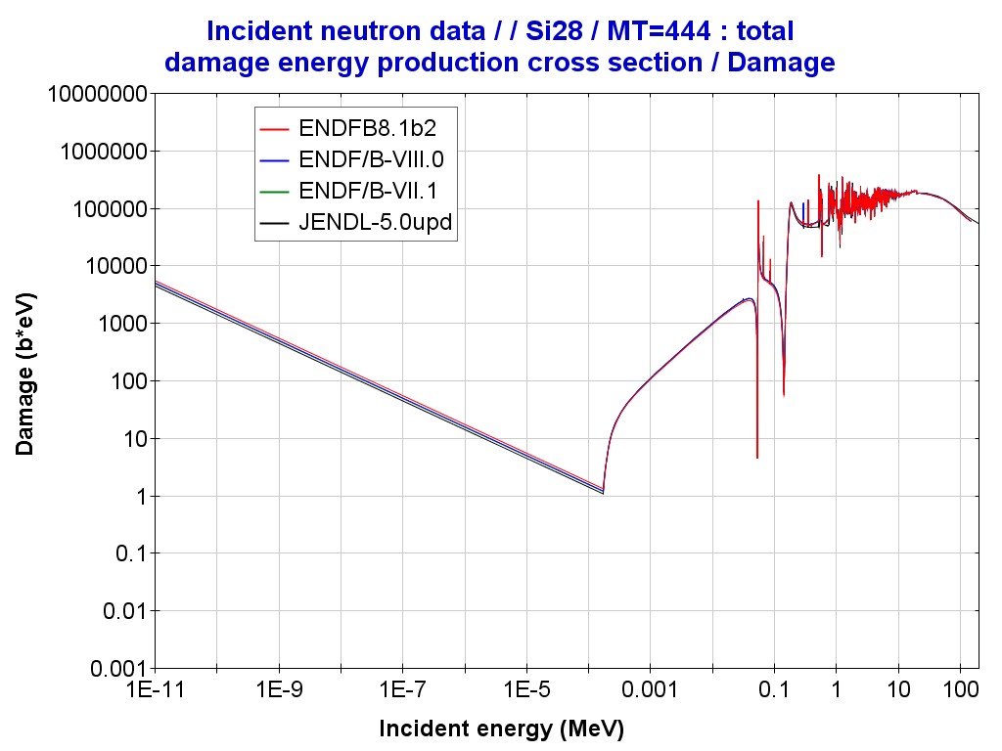
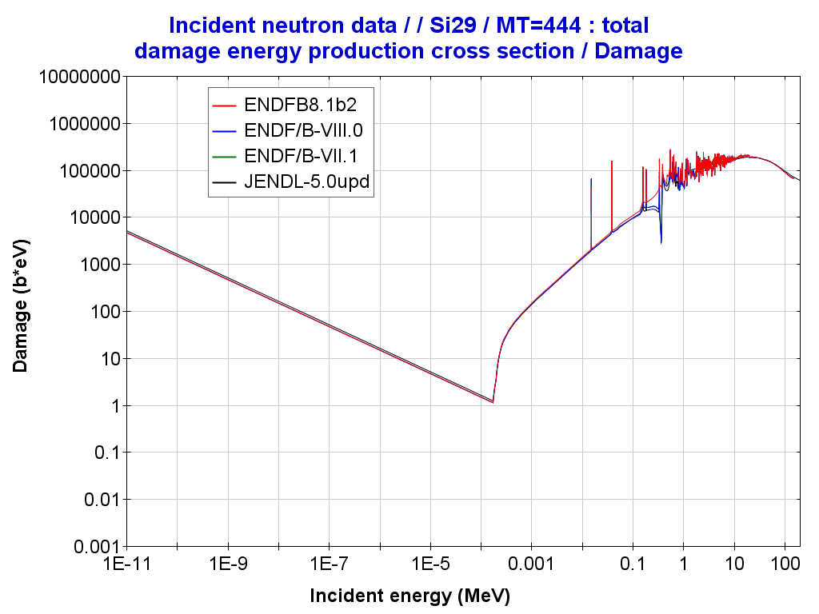
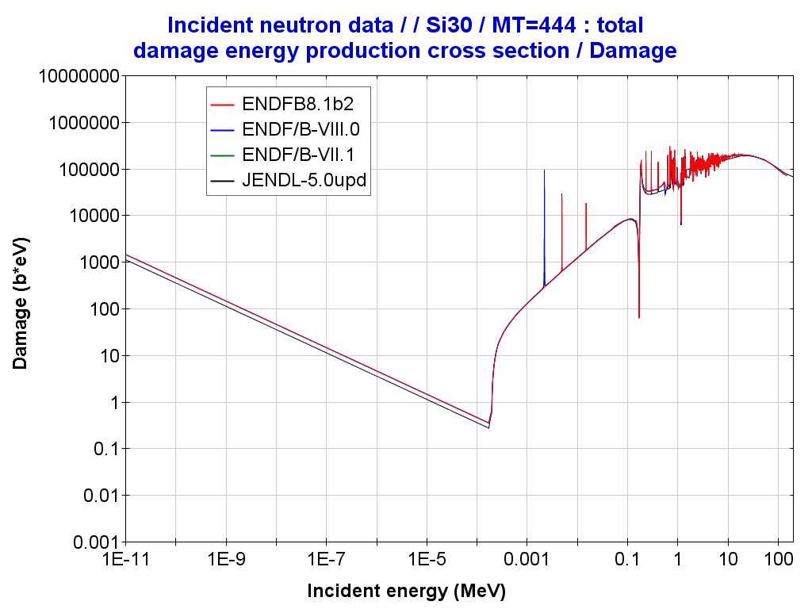
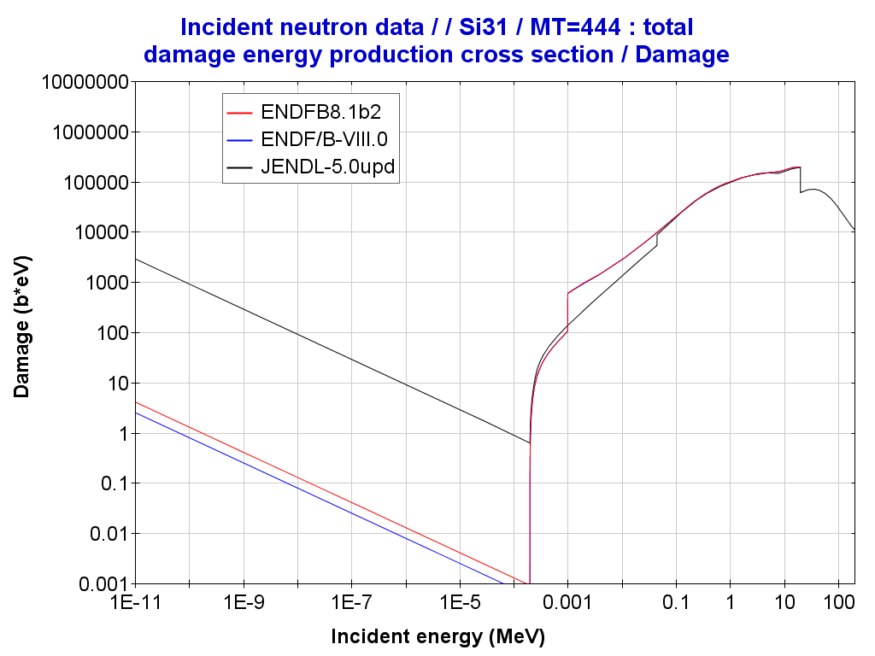
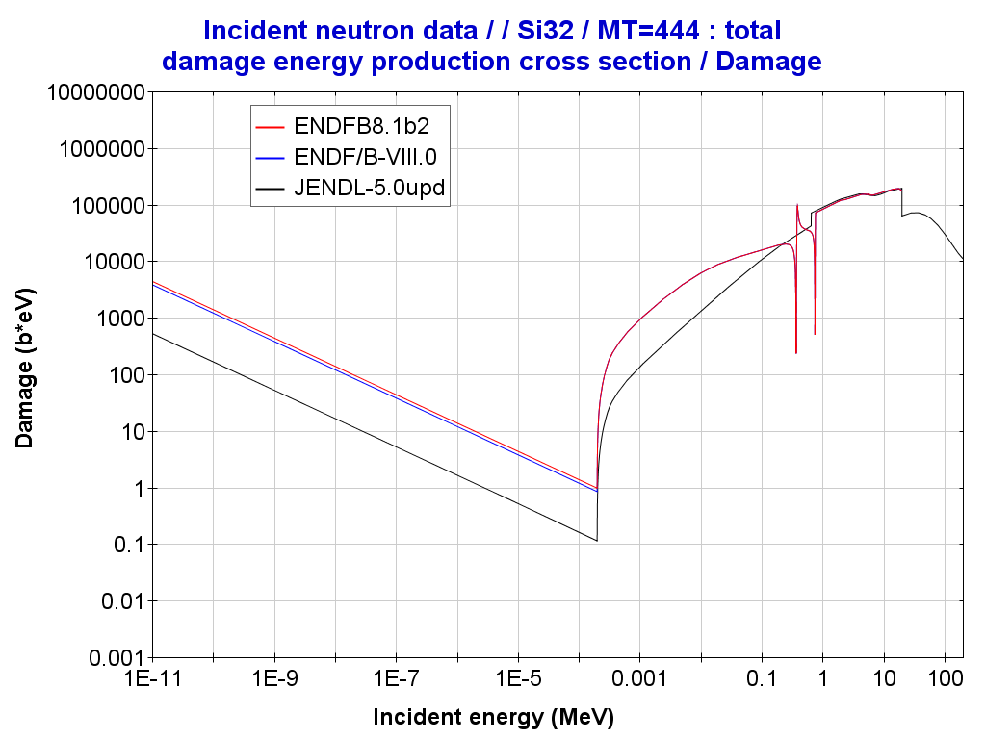
1. Processing in JANIS format
JANIS command line… “the Great Unknown”
Put the “JANIS command line” in a script ….and Voilà!
You will get “rendered” plots in your computer! Or data……
Incident energy ;
Incident energy ;
Incident energy ; ?(E)
1.0E-5 ; 65.16037
1.0625E-5 ; 63.22256
1.125E-5 ; 61.44878
1.1875E-5 ; 59.81714
1.25E-5 ; 58.30972
…
…
1.825E7 ; 1.684
1.85E7 ; 1.717
1.875E7 ; 1.718
1.9E7 ; 1.749
1.925E7 ; 1.755
1.95E7 ; 1.75
1.975E7 ; 1.763
2.0E7 ; 1.761

Slide 6
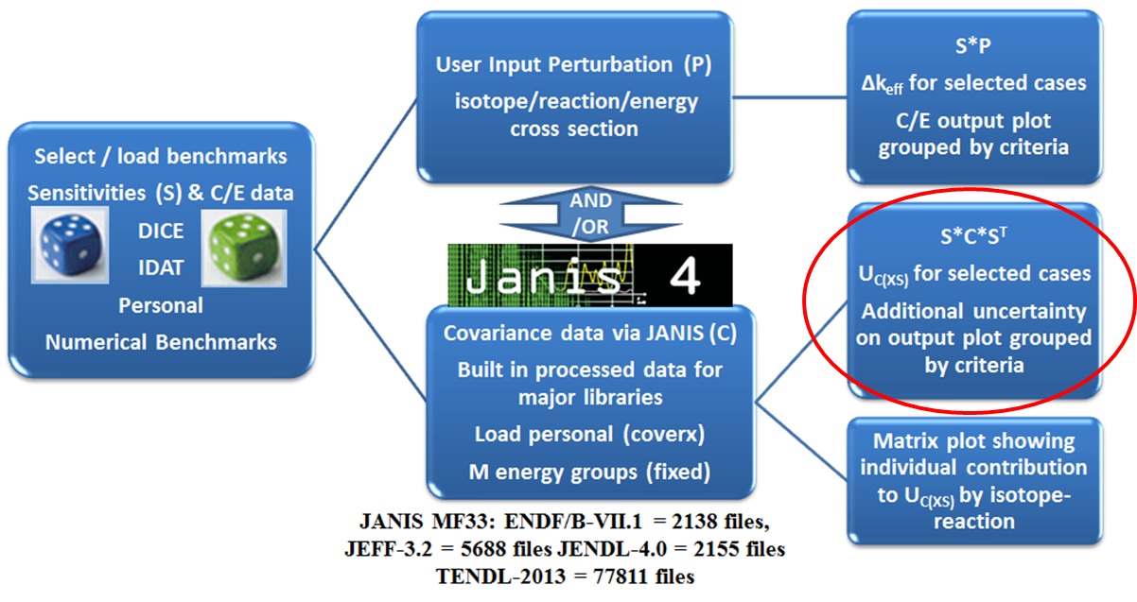
1.1 Verification and Perturbation Analysis
Verification ND Uncertainties in ICSBEP Benchmarks using NDAST Tool
  HENDF - ENDF/B-VIII.1b2: Perturbation Analysis with ICSBEP using NDaST tool
  The impact of perturbation in:
    XSs
    Nubar
    CHI
http://www.oecd-nea.org/ndast/

Slide 7
2. Processing into ACE format
UPM template == NEA template
Processing ENDF/B-VIII.1b2 into ACE format
moder / Convert data
20 -21
reconr / Reconstruct XS for neutrons
-21 -22
'pendf for material ngeniso’/
MAT/
0.001/
0/
moder
-22 42
broadr / Doppler broaden neutron xs
-21 -22 -23
MAT 1/
0.001/
293.6/
0/
thermr
0 -23 -24
0 MAT 20 1 1 0 0 1 221 0/
293.6/
0.001 10/
moder
-24 44
purr / Process Unresolved Resonance Range
-21 -24 -25
MAT 1 1 20 64/
293.6/
1.e+10/
0 /
acer / Prepare ACE files
-21 -25 0 32 33/
1 1 1 0.40 0/
'Ace for MAT '
MAT 293.6
1 1/
/
acer
0 32 34 38 39/
7 1 1 -1/
'Ace for MAT - check 1'/
viewr
34 48/
moder
-23 36
stop
Figure 1. Input deck to generate
ACE “fast” files
tape20 = ENDF file
tape38 = ACE
=====================
Figure 2. Input deck to generate
ACE “thermal” files: H in H2O
tape30 = ENDF file
tape34 = ENDF/TSL file
=====================
moder
30 -31
reconr
-31 -32
'pendf tape for h-1 from ENDFB8.1b2 '/
125 1/
0.001 0.0/
'1-h-1 from jeff4T22'/
0/
broadr
-31 -32 -33
125 1 0 0 0.0 /
.001/
293.6
0/
thermr
34 -33 -35
1 125 16 1 2 0 0 2 222 2 /
293.6
0.001 10.0 /
acer
-31 -35 0 60 61
2 1 1 .33 /
'* H(H2O)-ENDFB8.1b2 and TSL- ENDFB8.1b2, processed NJOY2016.72 ’/
125 293.6 'lw00' /
1001 0 0 /
64 0 0 1 10.0 0 /
moder
-32 70
stop

Slide 8
3. Criticality Benchmarking –
Mosteller’s suite with 123 Benchmarks
Mosteller’s Suite 123 CASES
Table 3. Reduced-chi squared values in the Extended (123) Criticality Mosteller’s suite
 | JEFF-3.3 | ENDF/B-VIII.0 |  | ENDF/B-VIII.1b2
PU | 3.05 | 2.23 |  | 3.30
HEU | 2.64 | 4.11 |  | 16.87*
IEU | 3.33 | 1.86 |  | 1.74
LEU | 2.14 | 1.37 |  | 1.46
U233 | 1.55 | 2.05 |  | 2.16
MIX | 0.91 | 1.03 |  | 0.50
SPEC (C/E) Δexp=0.00340 | 0.99173 | 0.99596 |  | 0.99544
All | 2.25 | 2.22 |  | 4.24
Values predicted with DICE tool -”keff trends plots”
Case HMF4.1: Δkeff EXP=0 !!!
JEF/DOC-2041 (O. Cabellos, “Overview of Processing, Verification and Benchmarking activities at UPM”, 2021)

Slide 9
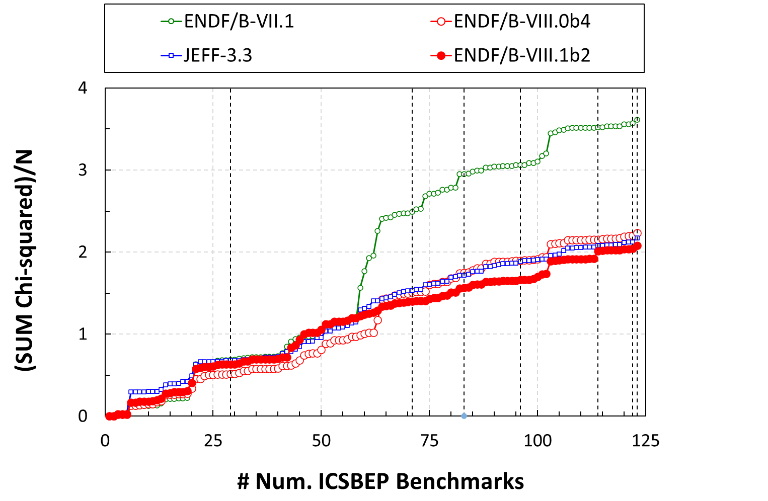
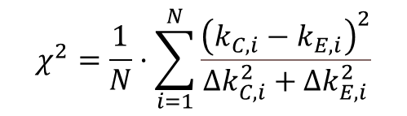
3. Criticality Benchmarking –
Mosteller’s suite with 123 Benchmarks
Mosteller’s Suite - 123
IEU
LEU
U233
MIX
HEU
PU
UCT1-3
HMF9-1,2
UMF4-2
PST9-1,3
PMF8-1
HMF4-1
Case HMF4.1: Δkeff EXP=30 pcm

Slide 10
3. Criticality Benchmarking –
Mosteller’s suite with 123 Benchmarks
Mosteller’s Suite - 123
Table 2. Cases with largest Chi2 values in ENDF/B-VIII.1b2
#Z | CASE | Δkexp (in pcm) | ENDF/B-VIII.0 |  | ENDF/B-VIII.1b2 |  | Δkeff (in pcm)
 |  |  | Chi2 | C/E | Chi2 | C/E
21 | PU-SOL-THERM-009-003 | 330 | 14.4 | 1.01252 | 20.8 | 1.01507 | +255
20 | PU-SOL-THERM-009-001 | 330 | 7.3 | 1.00902 | 11.9 | 1.01139 | +237
103 | U233-MET-FAST-004-002 | 80 | 19.2 | 0.99629 | 18.4 | 0.99655 | +26
6 | PU-MET-FAST-008-001 | 60 | 13.4 | 0.99756 | 17.3 | 0.99748 | -8
43 | HEU-MET-FAST-004-001 | 30* | 0.6 | 1.00033 | 13.6 | 1.00118 | +85
114 | U233-COMP-THERM-001-003 | 240 | 0.1 | 0.99939 | 11.3 | 1.00807 | +868
46 | HEU-MET-FAST-009-002 | 150 | 7.2 | 0.99589 | 8.5 | 0.99562 | -27
45 | HEU-MET-FAST-009-001 | 150 | 4.3 | 0.99682 | 8.2 | 0.99570 | -112

Slide 11
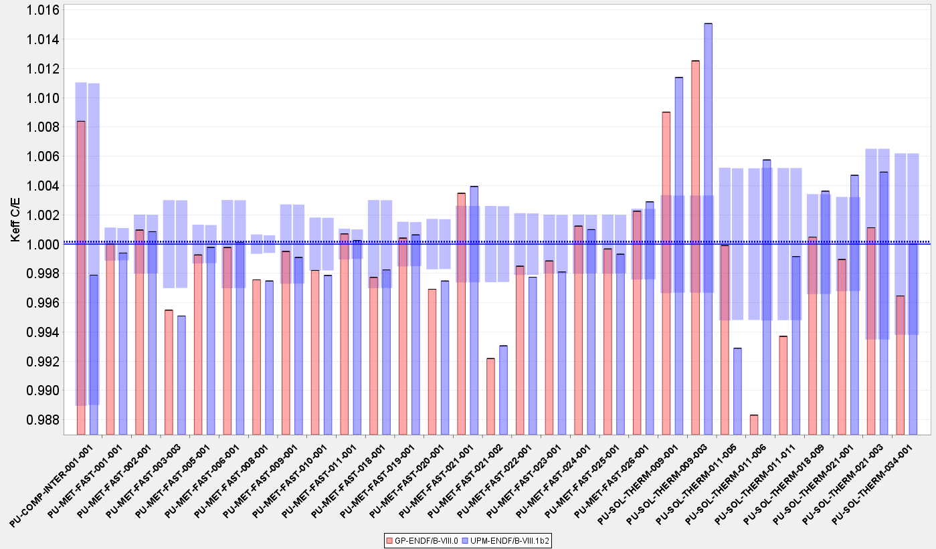
3.1 PU Cases
Mosteller’s Suite – PU cases
PST-9: Pu239 (…good Benchmark for ND? )

Slide 12
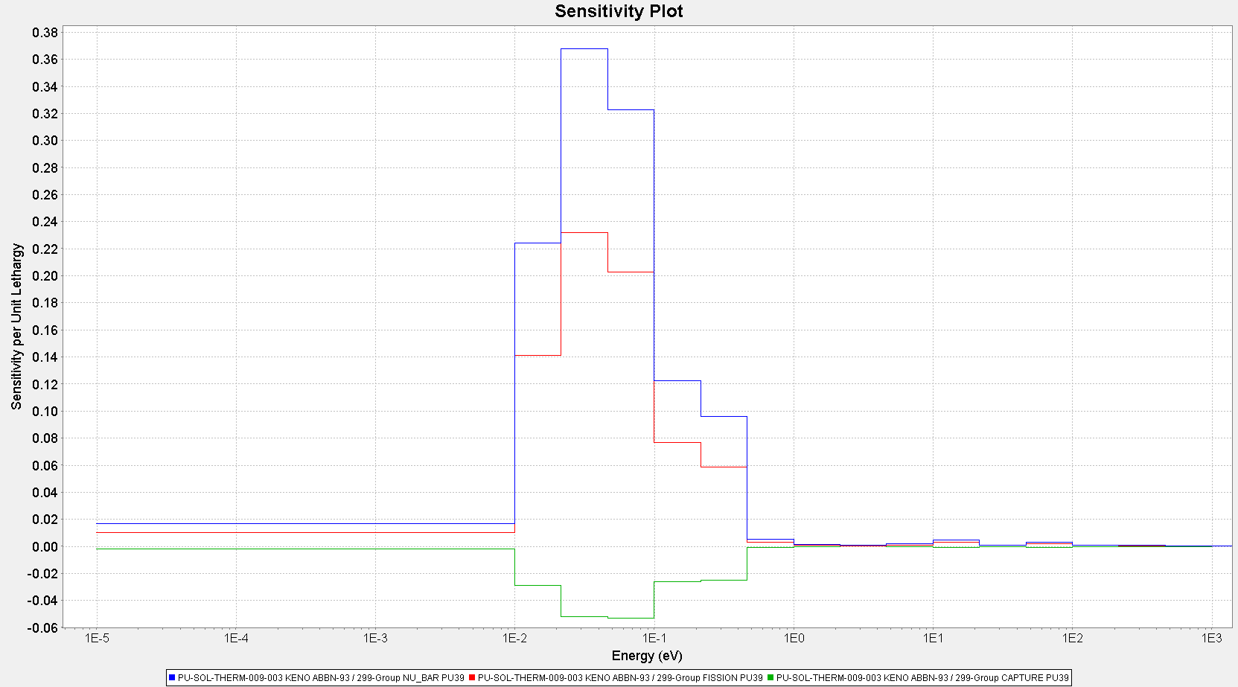
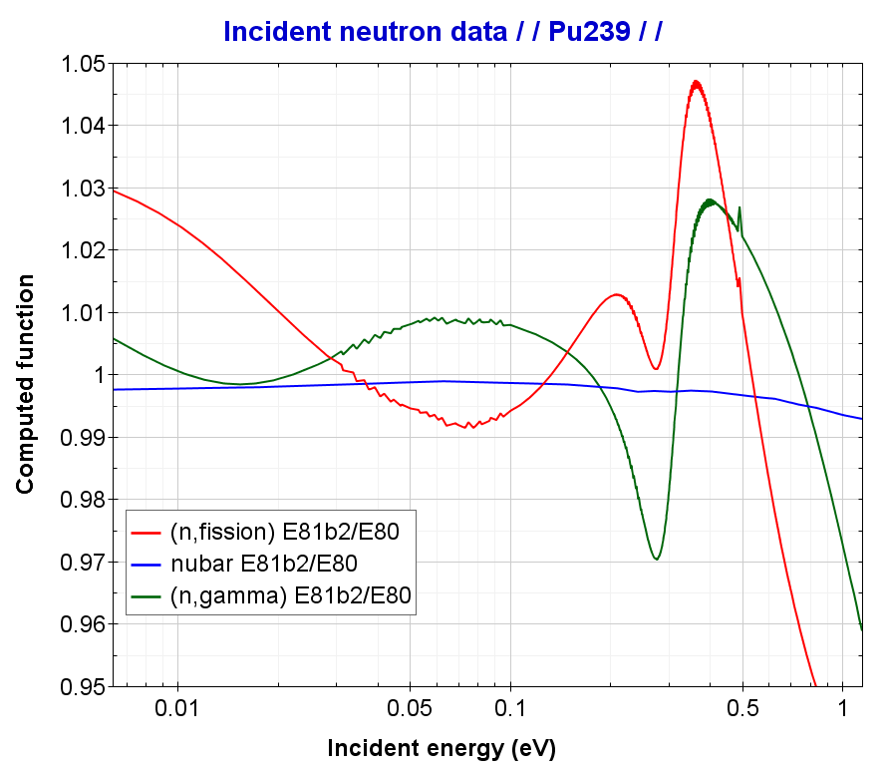
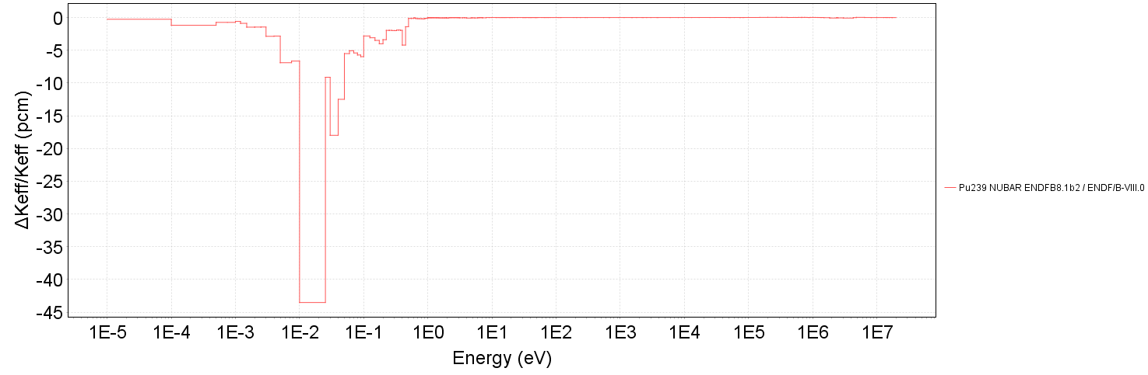
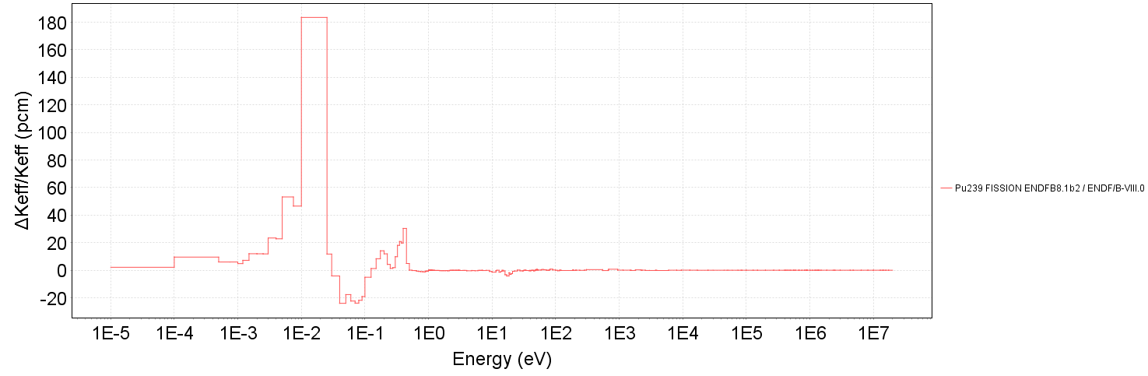
3.1.1 PU Cases: PST9
PU-SOL-THERM-009-C1,2
0.01 eV – 0.5 eV
Δkeff/keff | nubar | fission
PST9-C1 | -178 | +379
PST9-C3 | -178 | +385

Slide 13
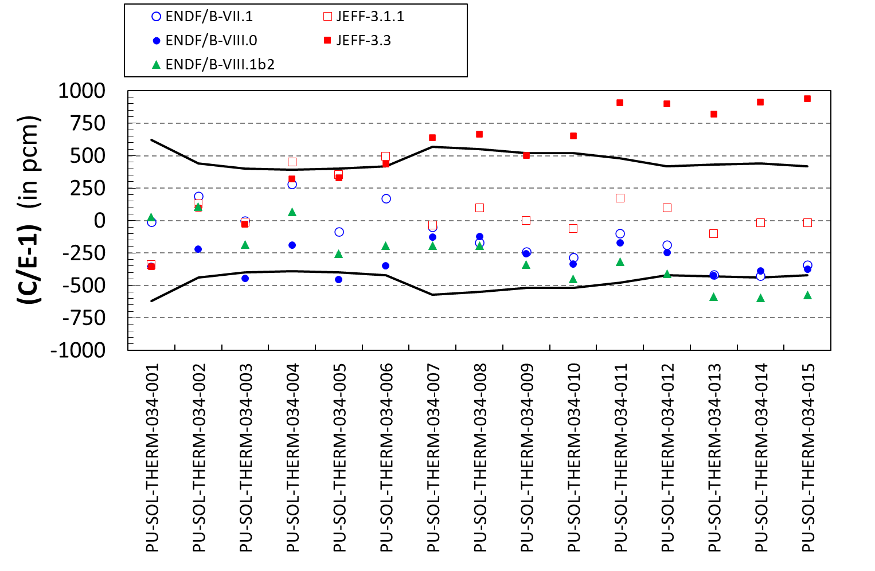
3.1.2 PU Cases: PST34
PU-SOL-THERM-034-C001-0015
slope = f(Gd content)

Slide 14
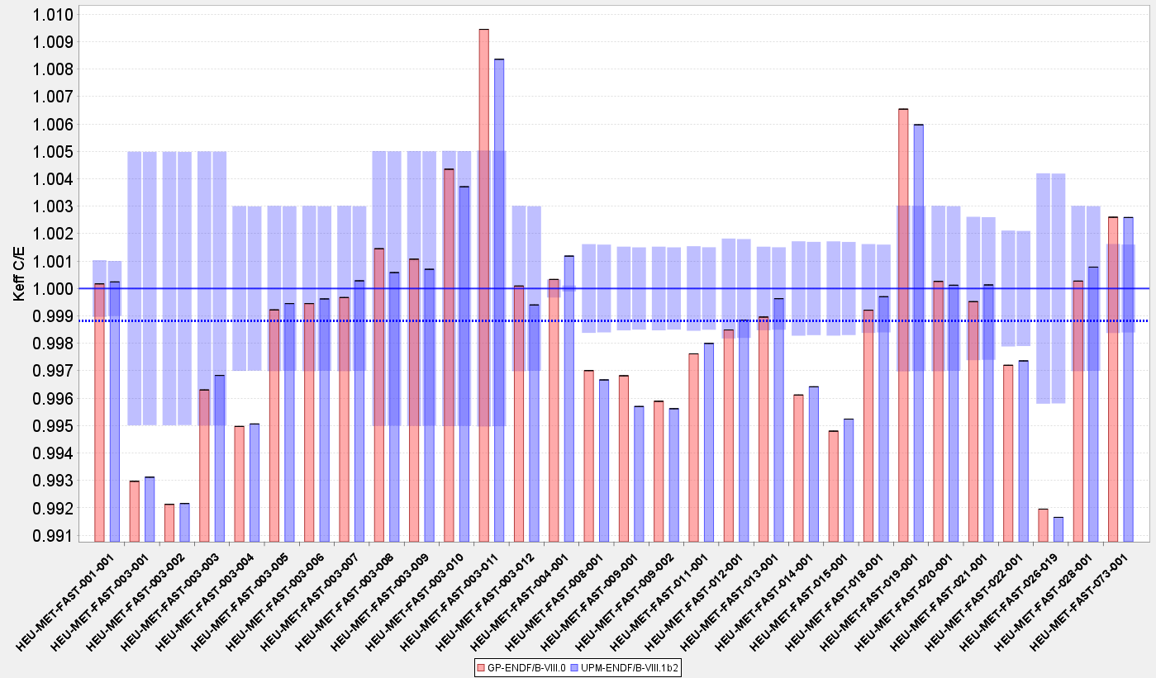
3.2 HEU Cases
Mosteller’s Suite – HEU -FAST cases
HMF-9 (Be?)
HMF-4*

Slide 15
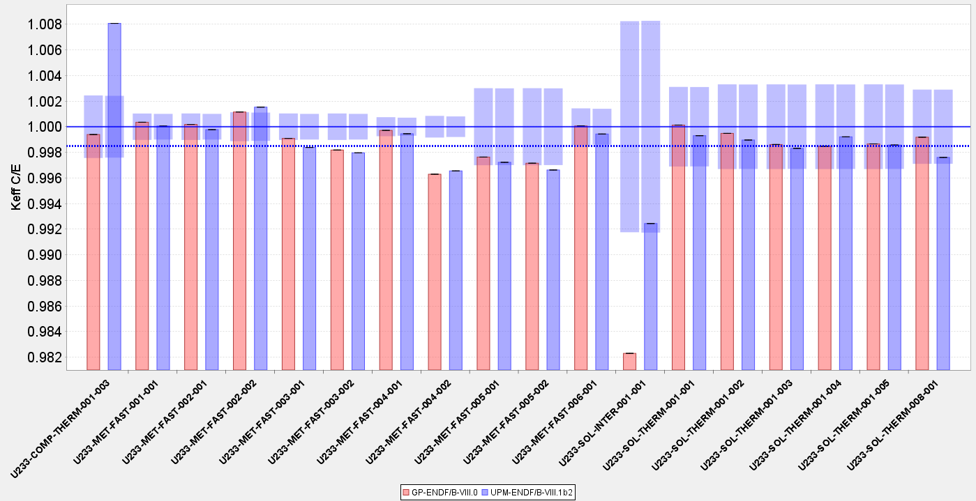
3.3 U233 Cases
Mosteller’s Suite – U233 cases
UCT-1 (U233?)

Slide 16
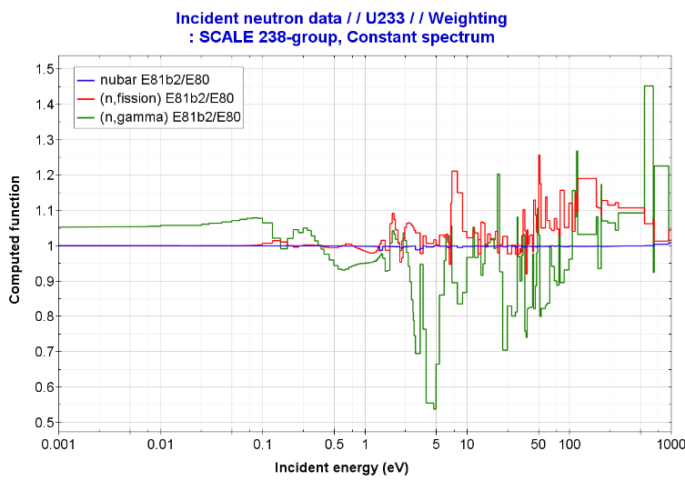
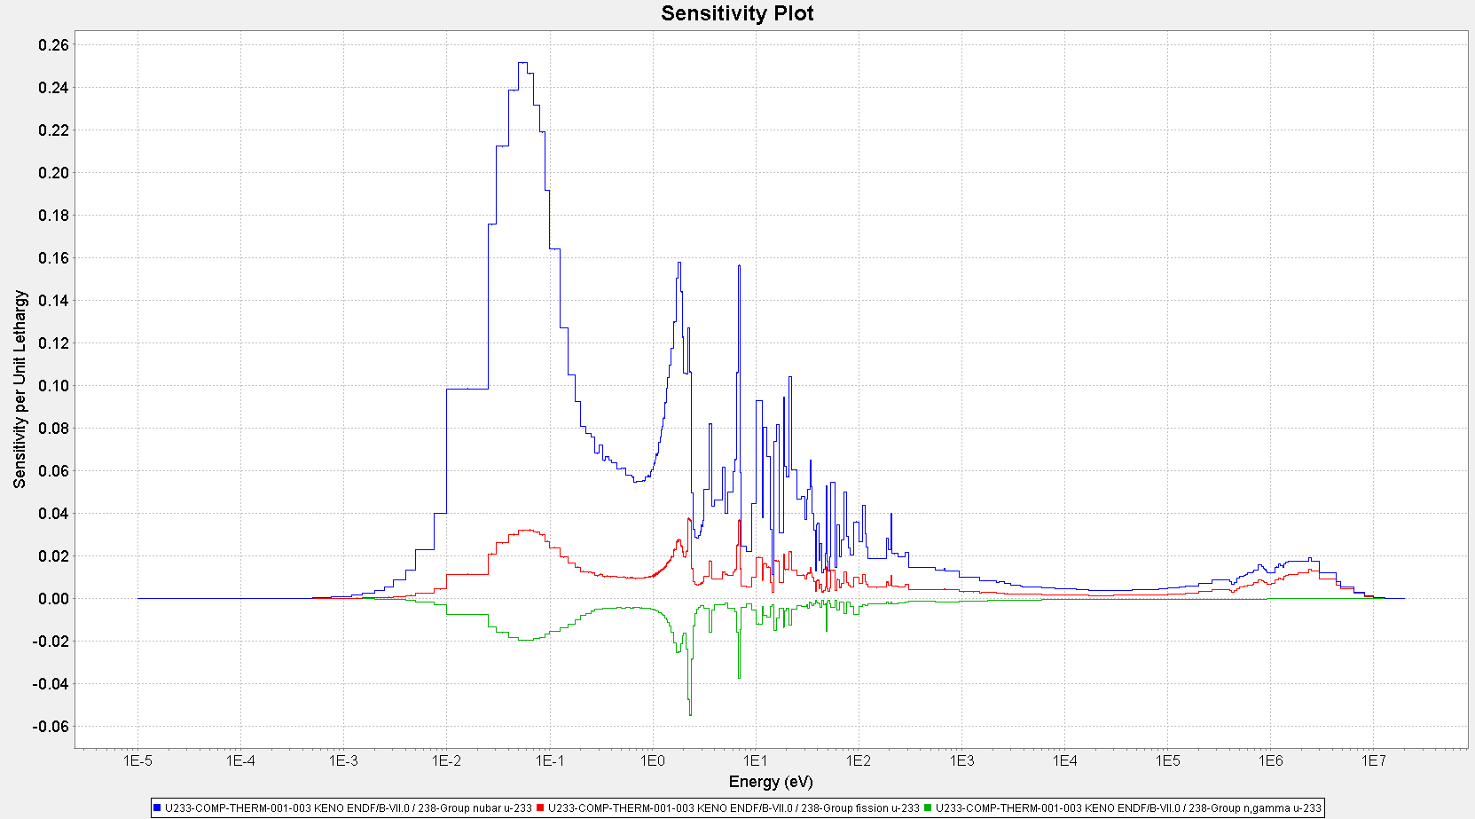
3.3.1 U233 Cases: UCT1-3
U233-COMP-THERM-001-003 … calculations with MCNP6-1.0!!
 |  |  | ENDF/B-VIII.0 |  | ENDF/B-VIII.1b2 |  | Δkeff (in pcm)
CASE | keff-EXP | Exp Unc | Calc Keff | Calc. Dkeff | Calc Keff | Calc. Dkeff | E8.1b2 – E8.0
U233-COMP-THERM-001-003 | 1.00000 | 0.00240 | 0.99939 | 0.00046 | 1.00807 | 0.00014 | +868 pcm
SENSITIVITY – CASE “All isotopes – EVIII.1b2” with U233…
All ND “ENDF/B-VIII.0” |  |  |  |  | 1.00035 | 0.00014 | -772
only nubar “ENDF/B-VIII.0” (MF1) |  |  |  |  | 1.00950 | 0.00015 | +143
only PFNS “ENDF/B-VIII.0” (MF5/18) |  |  |  |  | 1.00108 | 0.00014 | -699
only XSs “ENDF/B-VIII.0” (MF2/MF3) |  |  |  |  | 1.00568 | 0.00014 | -239
NDaST is not able to give a good Sensitivity Analysis:
1) Large differences in the RRR
Then … make perturbation by hand in ENDF file and run again MCNP!!

Slide 17
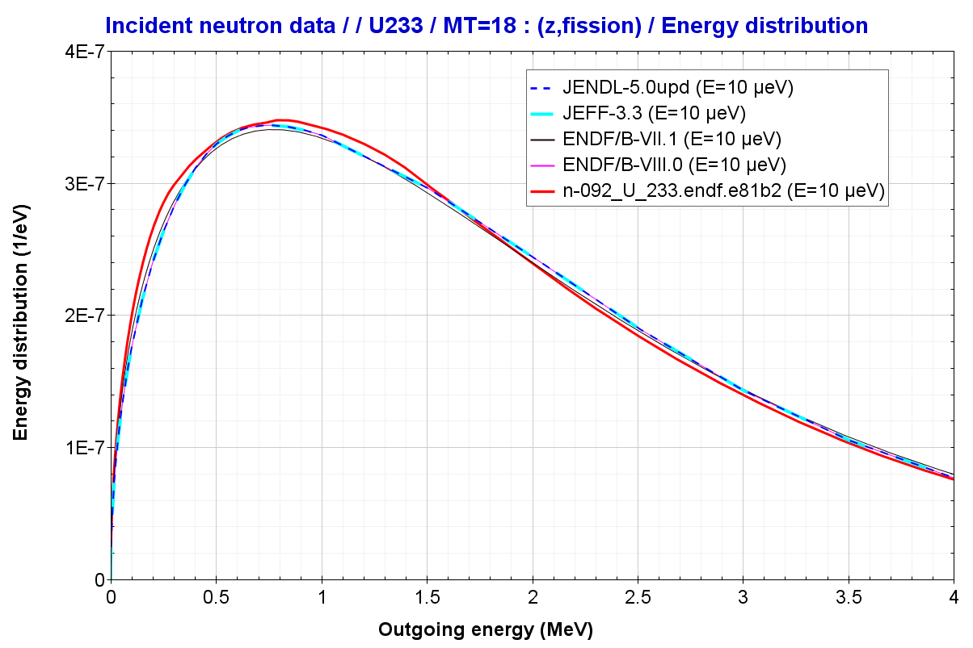
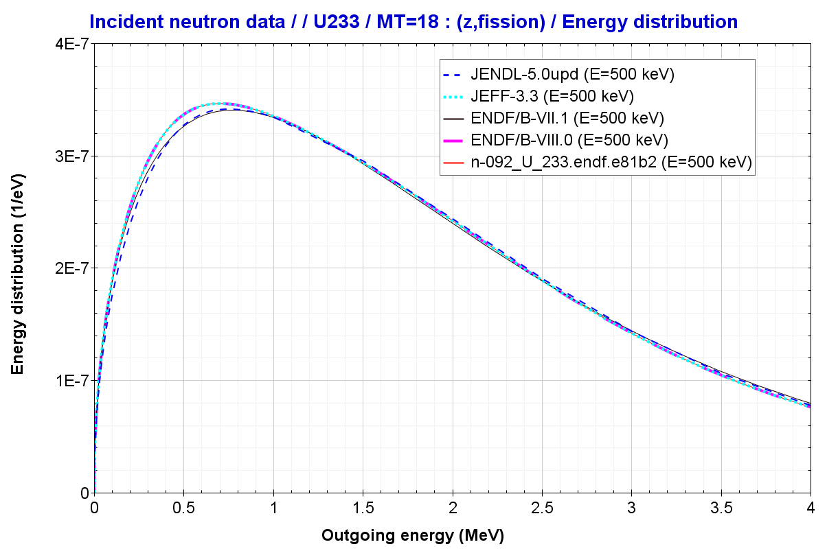
3.3.1 U233 Cases: UCT1-3
U233-COMP-THERM-001-003 … calculations with MCNP6-1.0!!
U233/PFNS Ein (n_thermal)
U233/PFNS Ein (n_500keV)
E81.b2
To be reviewed …E81b2/U233/PFNS Ein (n_thermal)!!!

Slide 18
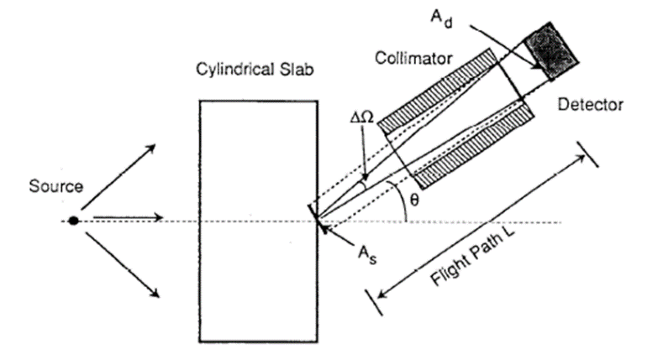
4. SHIELDING: FNS-TOF
JEF/DOC-1844 (K. Takise, “Testing JEFF-3.3T3 in TOF Shielding Benchmarks”, 2017)
FNS-TOF Benchmarks
( 17 cases x 5 angles)
Geometry, materials |  | Detector Position
Beryllium | FNS-TOF/31.4 CM(R)*15.24 CM(Z) | Angle= 0.0 deg Angle= 12.20 deg Angle= 24.90 deg Angle= 41.80 deg Angle= 66.80 deg
 | FNS-TOF/31.4 CM(R)*5.06 CM(Z)
Graphite | FNS-TOF/31.4 CM(R)*20.24CM(Z)
 | FNS-TOF/31.4 CM(R)*40.48CM(Z)
 | FNS-TOF/31.4 CM(R)*5.06CM(Z)
Iron | FNS-TOF/50.0 CM(R)*20.0 CM(Z)-Iron
 | FNS-TOF/50.0 CM(R)*40.0 CM(Z)-Iron
 | FNS-TOF/50.0 CM(R)*5.0 CM(Z)-Iron
 | FNS-TOF/50.0 CM(R)*60.0 CM(Z)-Iron
Li2O | FNS-TOF/31.4 CM(R)*20.0 CM(Z)-Li2O
 | FNS-TOF/31.4 CM(R)*40.0 CM(Z)-Li2O
 | FNS-TOF/31.4 CM(R)*4.8 CM(Z)-Li2O
N2 | FNS-TOF/ N2 SLAB-TOF
O2 | FNS-TOF/ LO2 SLAB-TOF
Lead | FNS-TOF/31.4 CM(R)*20.32CM(Z)-Lead
 | FNS-TOF/31.4 CM(R)*40.64CM(Z)-Lead
 | FNS-TOF/31.4 CM(R)*5.06CM(Z)-Lead
1. TOF
Detector was located to observe leakage neutrons from cylindrical slabs at several angles.
Reference: F. Maekawa et al., “Collection of Experimental Data for Fusion Neutronics Benchmark”, JAERI, 1994.

Slide 19
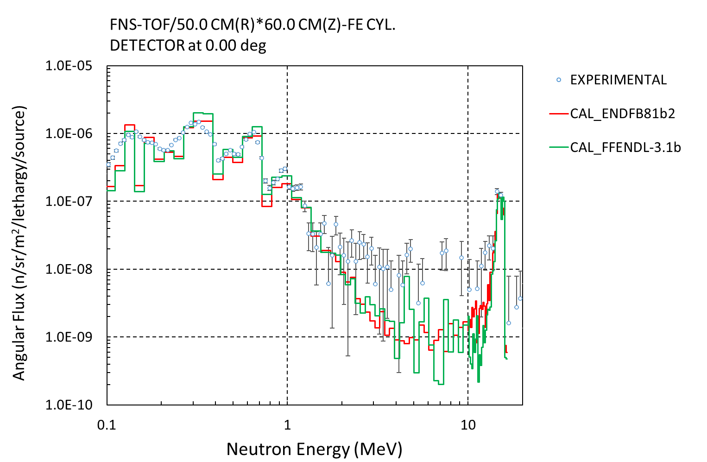
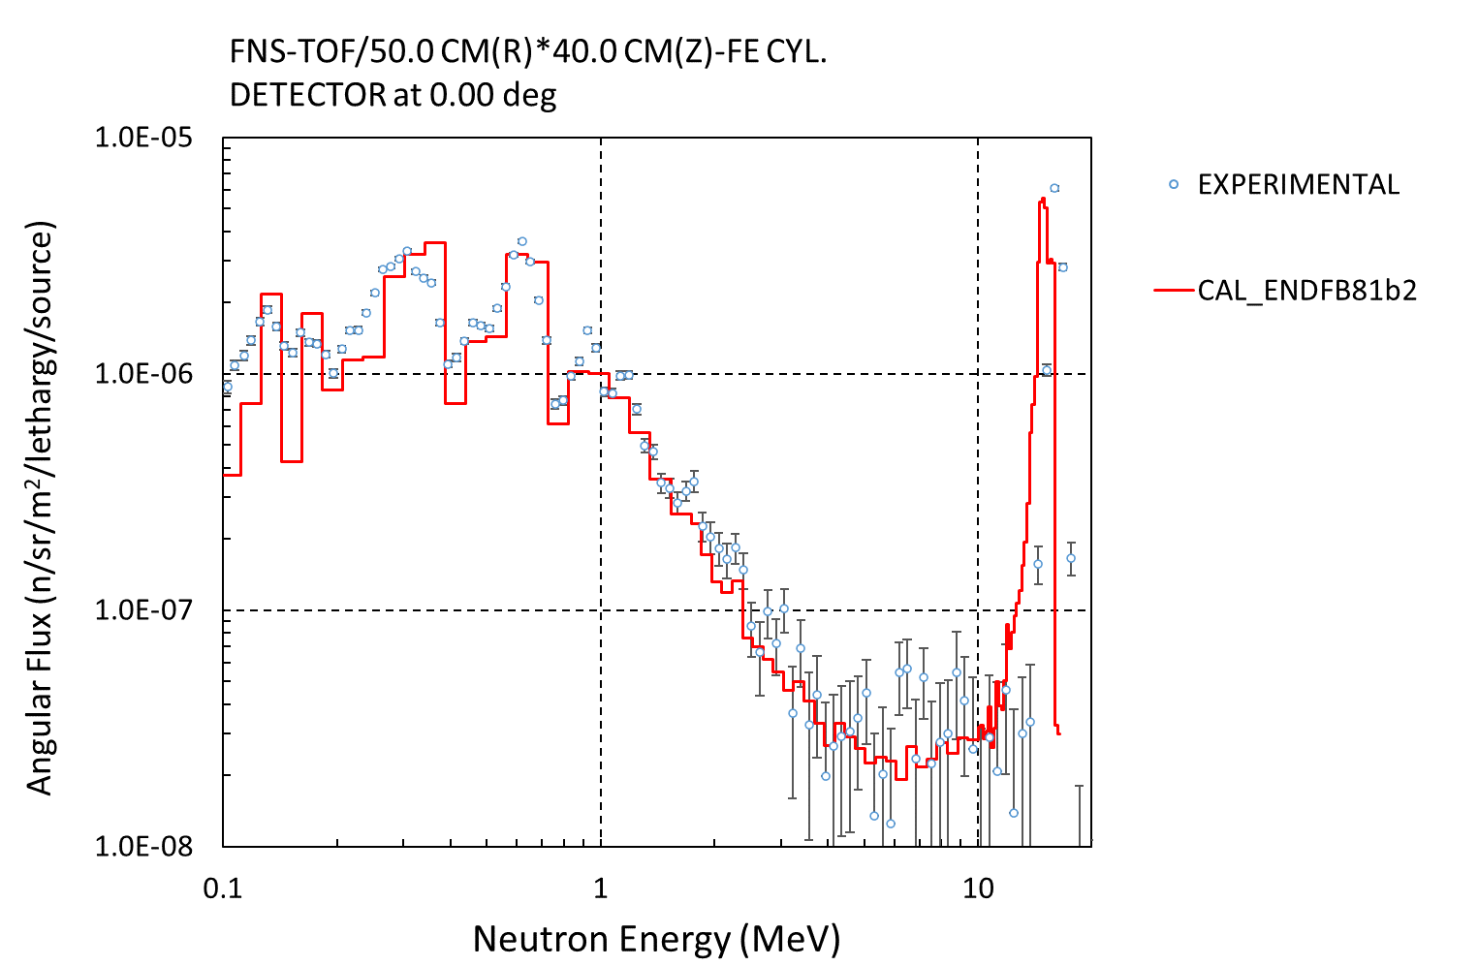
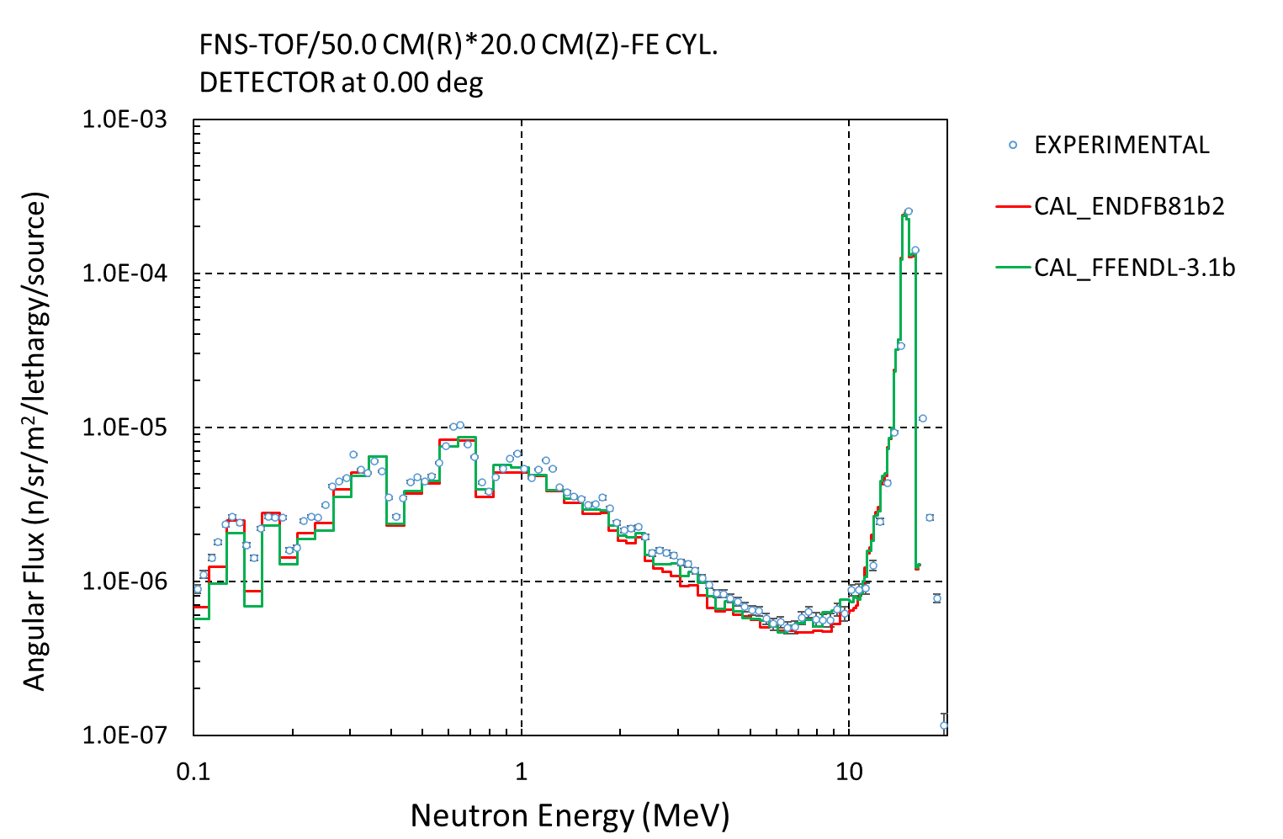
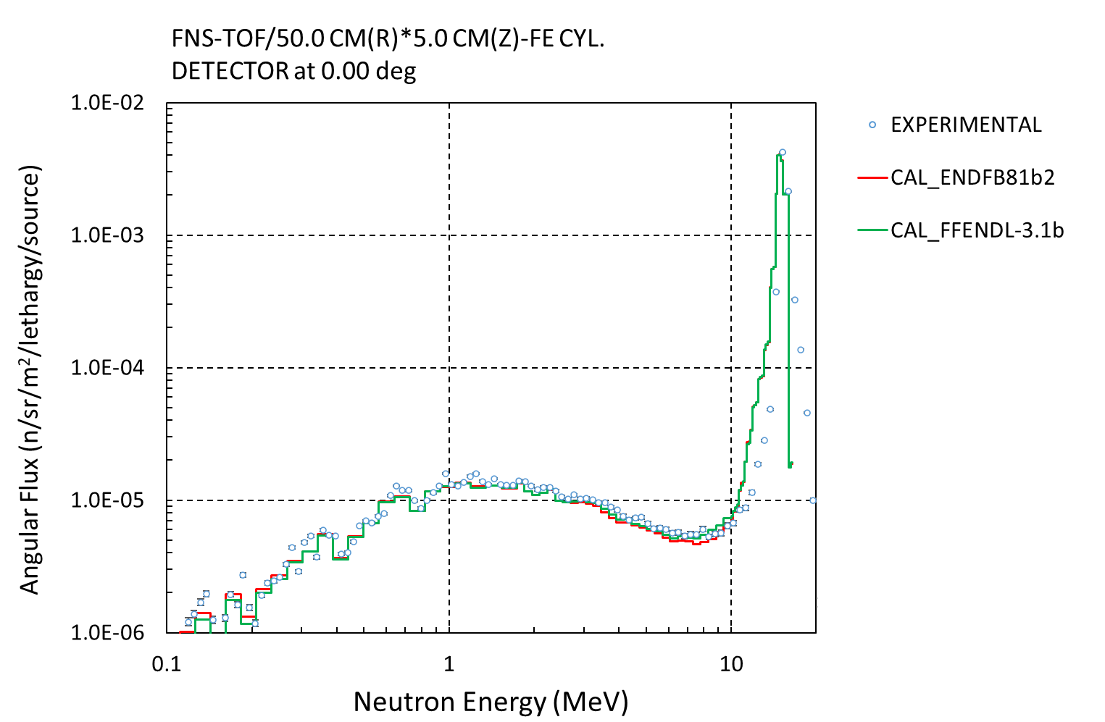
4. SHIELDING: FNS-TOF
FNS-TOF Benchmarks : Good agreement with other evaluations and Experiments
Fe – 60cm
Fe – 40cm
Fe – 20cm
Fe – 5cm

Slide 20
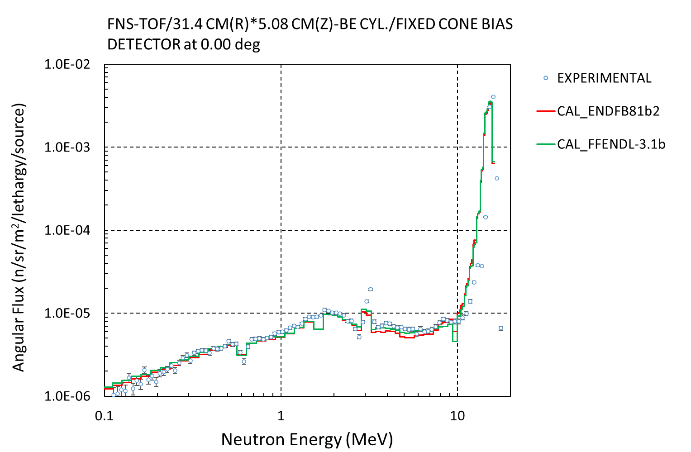
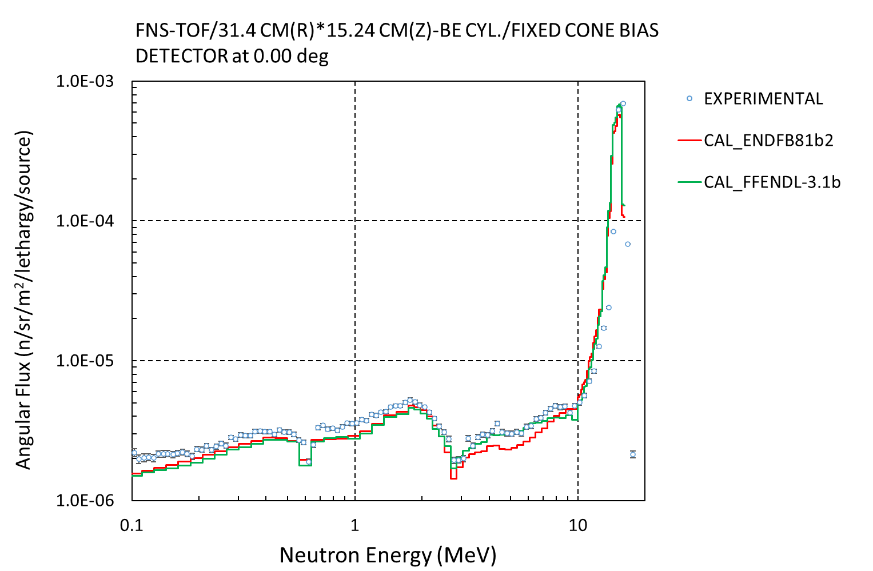
4. SHIELDING: FNS-TOF
FNS-TOF Benchmarks : Be

Slide 21
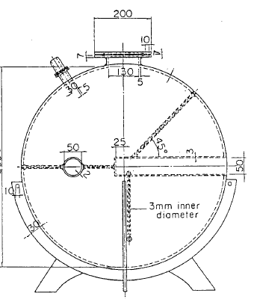
5. SHIELDING. OKTAVIAN
JEF/DOC-1844 (K. Takise, “Testing JEFF-3.3T3 in TOF Shielding Benchmarks”, 2017)
OKTAVIAN TOF Benchmarks
(15 cases)
Geometry | Type-I 61 cm diameter vessel | Type-II 40 cm diameter vessel | Type-III 60 cm diameter vessel | Type –IV 28 cm diameter vessel
 | Cu | Al | Si | Nb
 | LiF | As
 | Mn | Co
 | Mo | Cr
 | Zr | Se
 |  | Teflon
 |  | Ti
 |  | W
Figure: Neutron leakage from OKTAVIAN pulsed sphere Ex) 61 cm sphere: Type I
Neutron source spectra
CASE 1 (Table 4.2) | LiF, Mn , Cu, Mo, W
CASE 2 (Table 4.3) | Teflon, Si, Co
CASE 3 (Table 4.4) | Al
CASE 4 (Table 4.5) | Ti, As, Se, Zr
CASE 5 (Table 4.6) | Cr, Nb
Reference: F. Maekawa et al., “Collection of Experimental Data for Fusion Neutronics Benchmark”, JAERI, 1994.

Slide 22
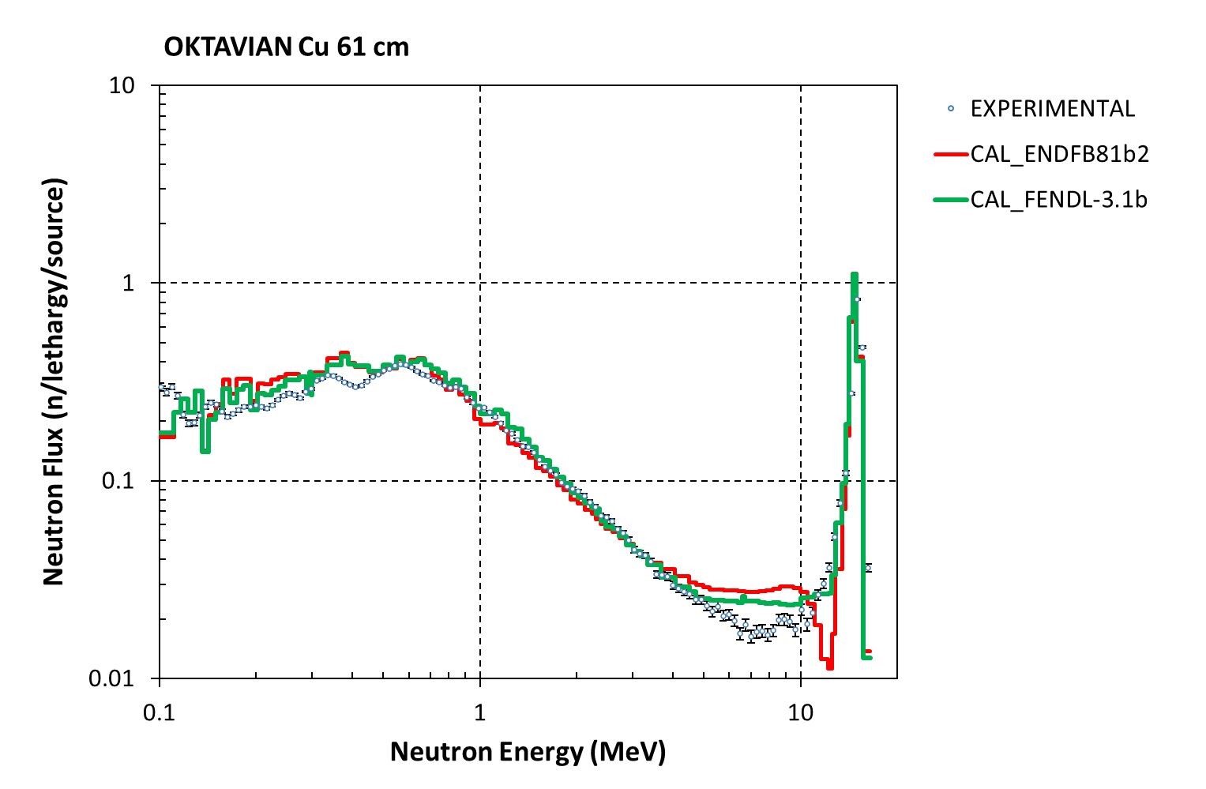
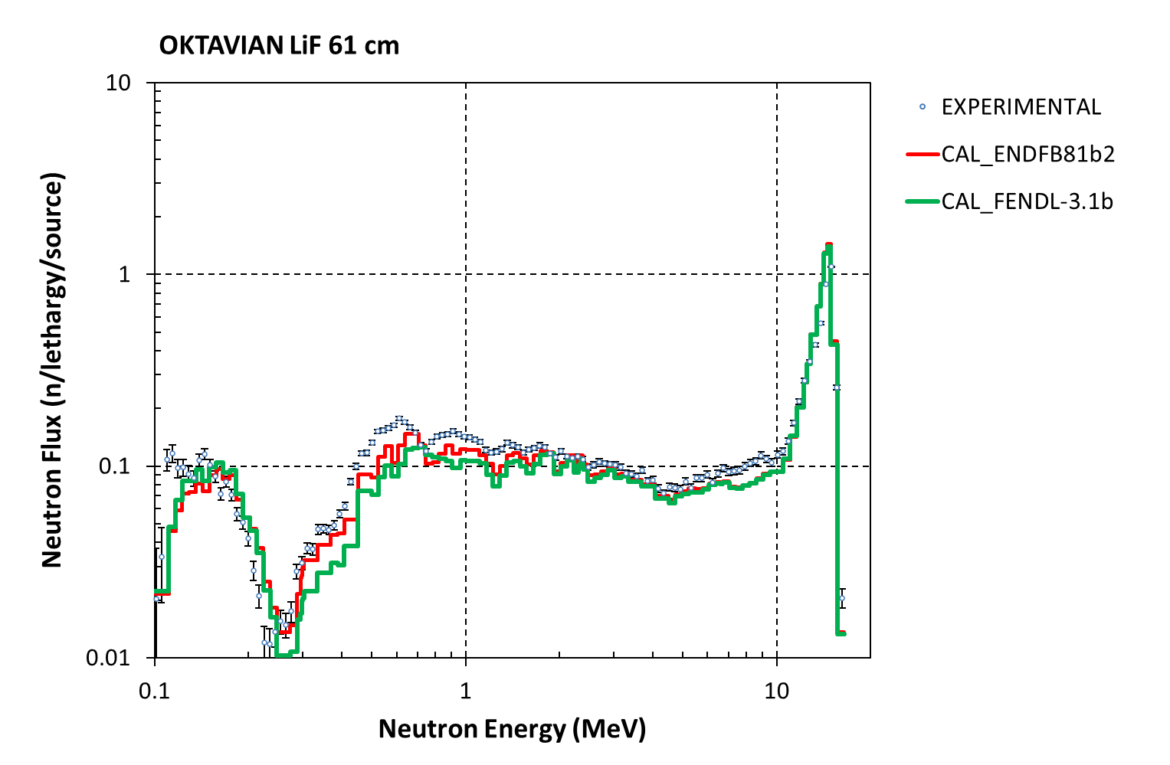
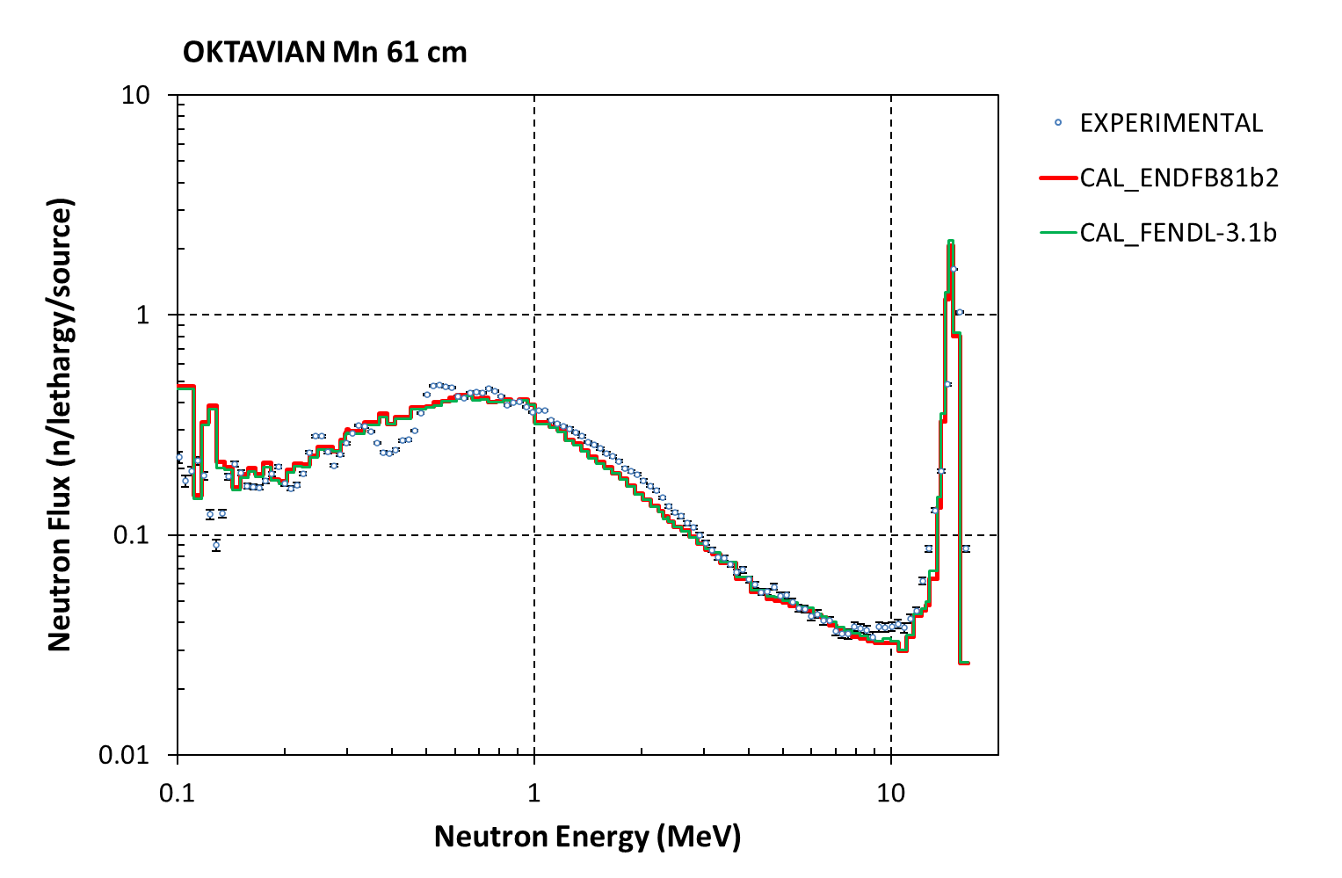
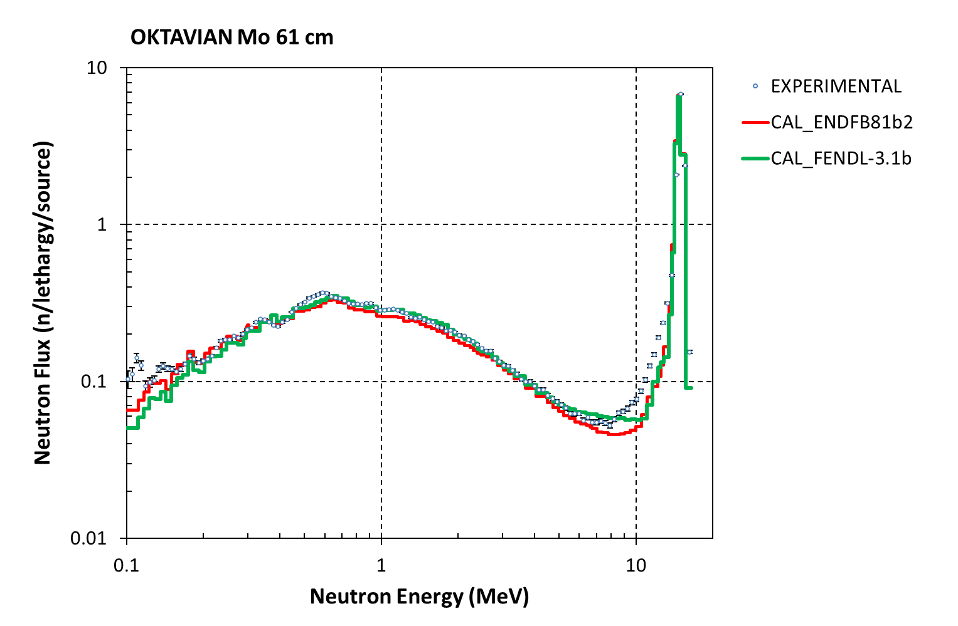
5. SHIELDING: OKTAVIAN
OKTAVIAN -TOF Benchmarks : Some results

Slide 23
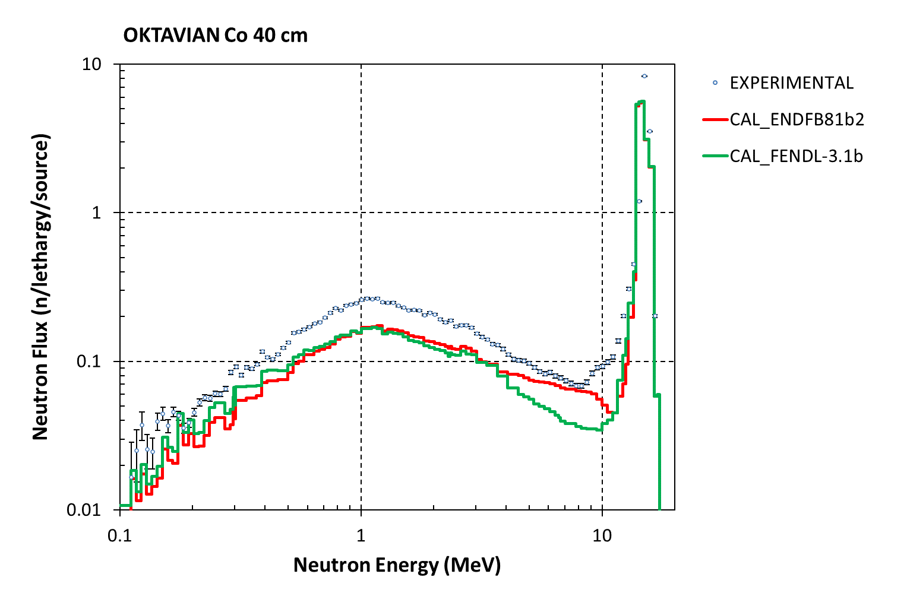
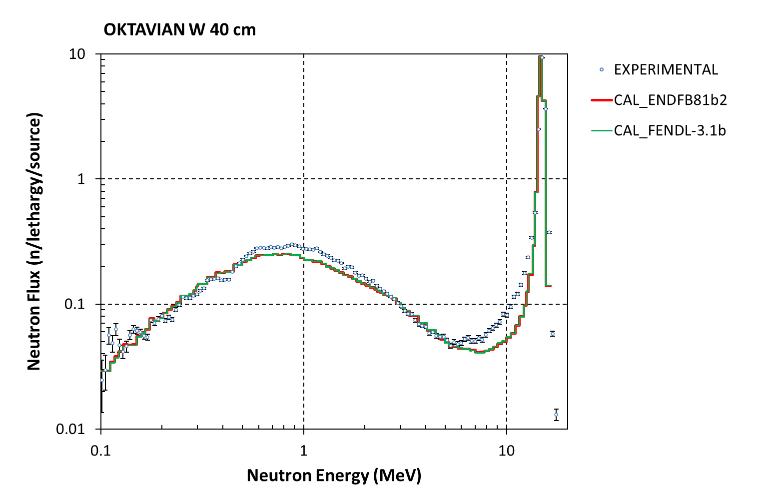
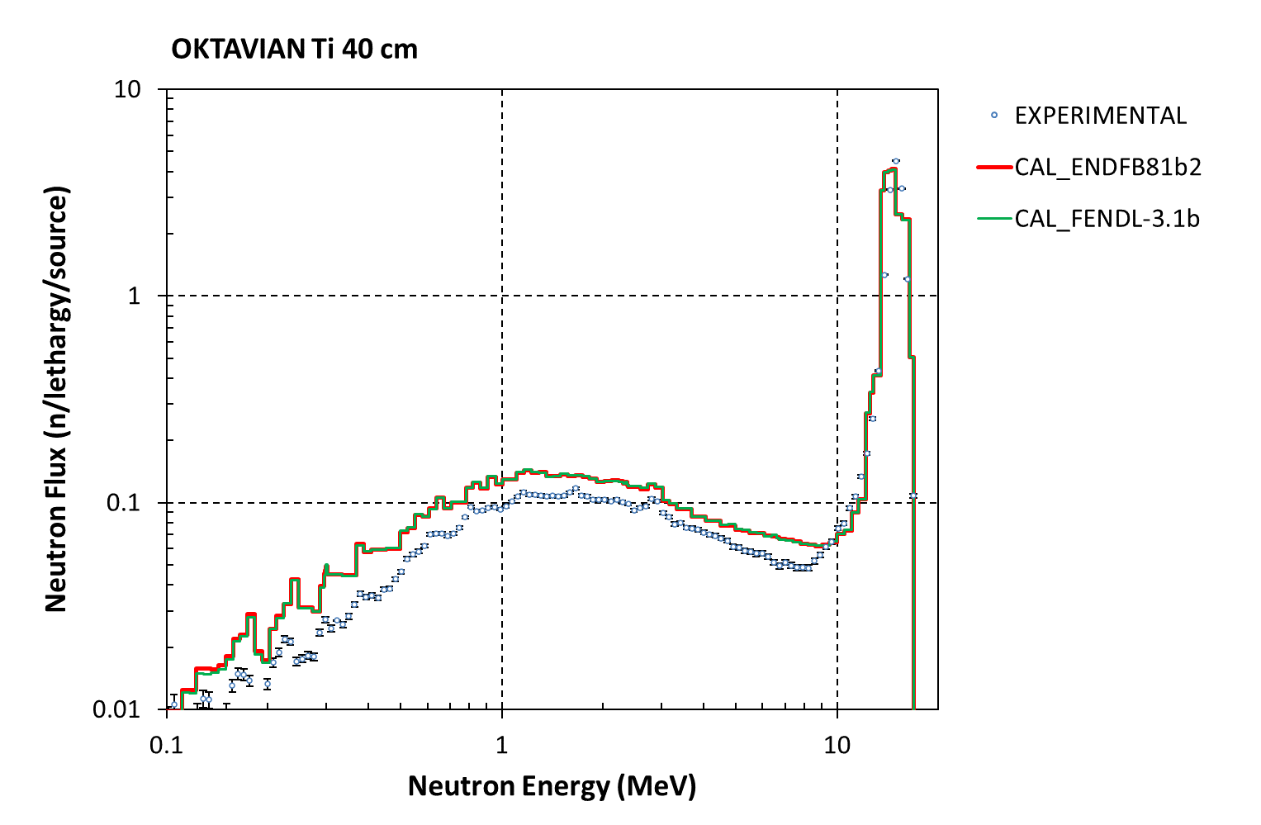
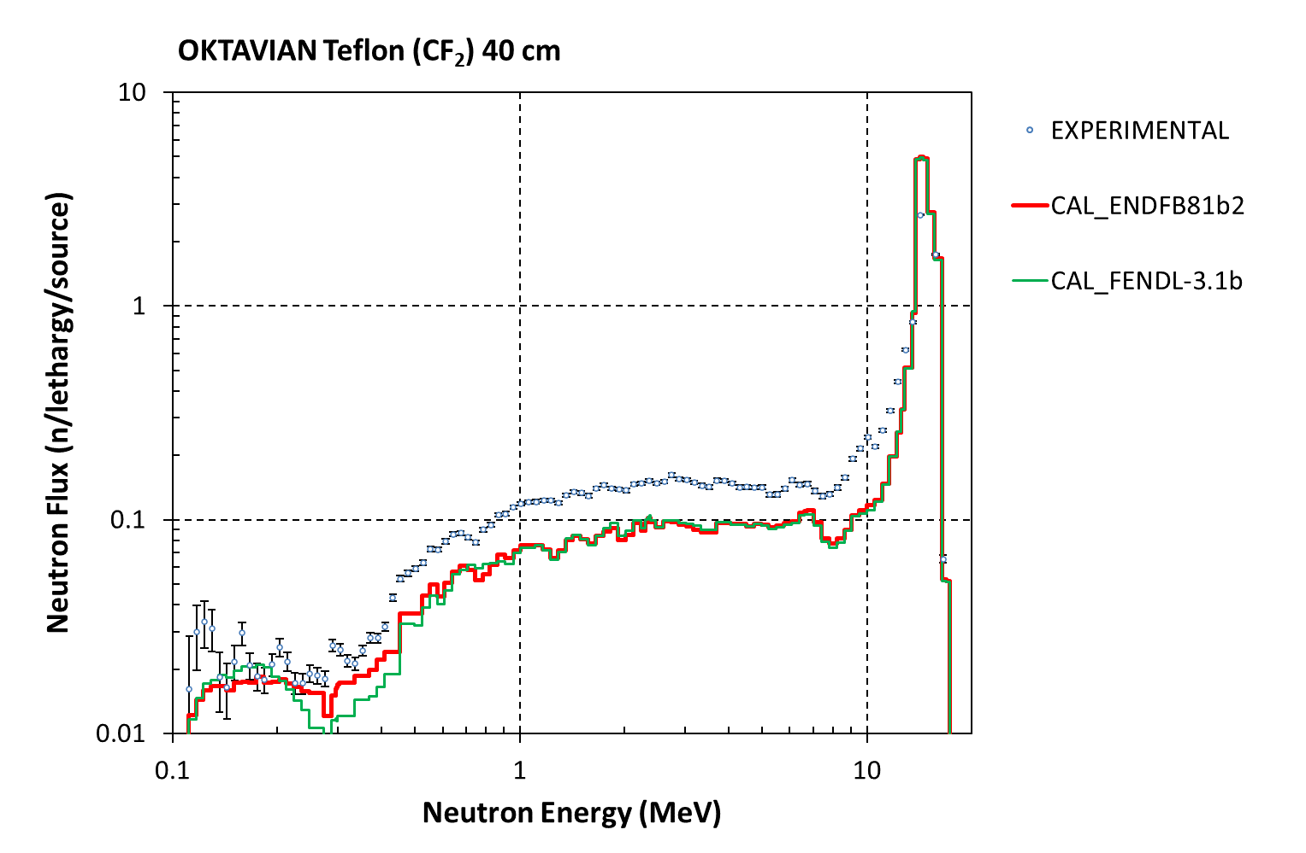
5. SHIELDING: OKTAVIAN
OKTAVIAN -TOF Benchmarks : Some results

Slide 24
6. Benchmark Phase-VII
JEF/DOC-1844 (O. Cabellos, “Testing JEFF-3.3T3 in the computational PHASE-VII Benchmark”, 2017)
PWR UO2 discharge fuel compositions for decay calculations
21FA, 4.5-wt% 235U initial enrichment
50 GWd/MTU burnup
Figure. Cask model (top view)
Figure. Cask model (side view)
Reference: John C. Wagner and Georgeta Radulescu, Specification for Phase VII Benchmark UO2 Fuel: Study of spent fuel compositions for long-term disposal, NEA Expert Group on Burn-up Credit, November, 2008

Slide 25
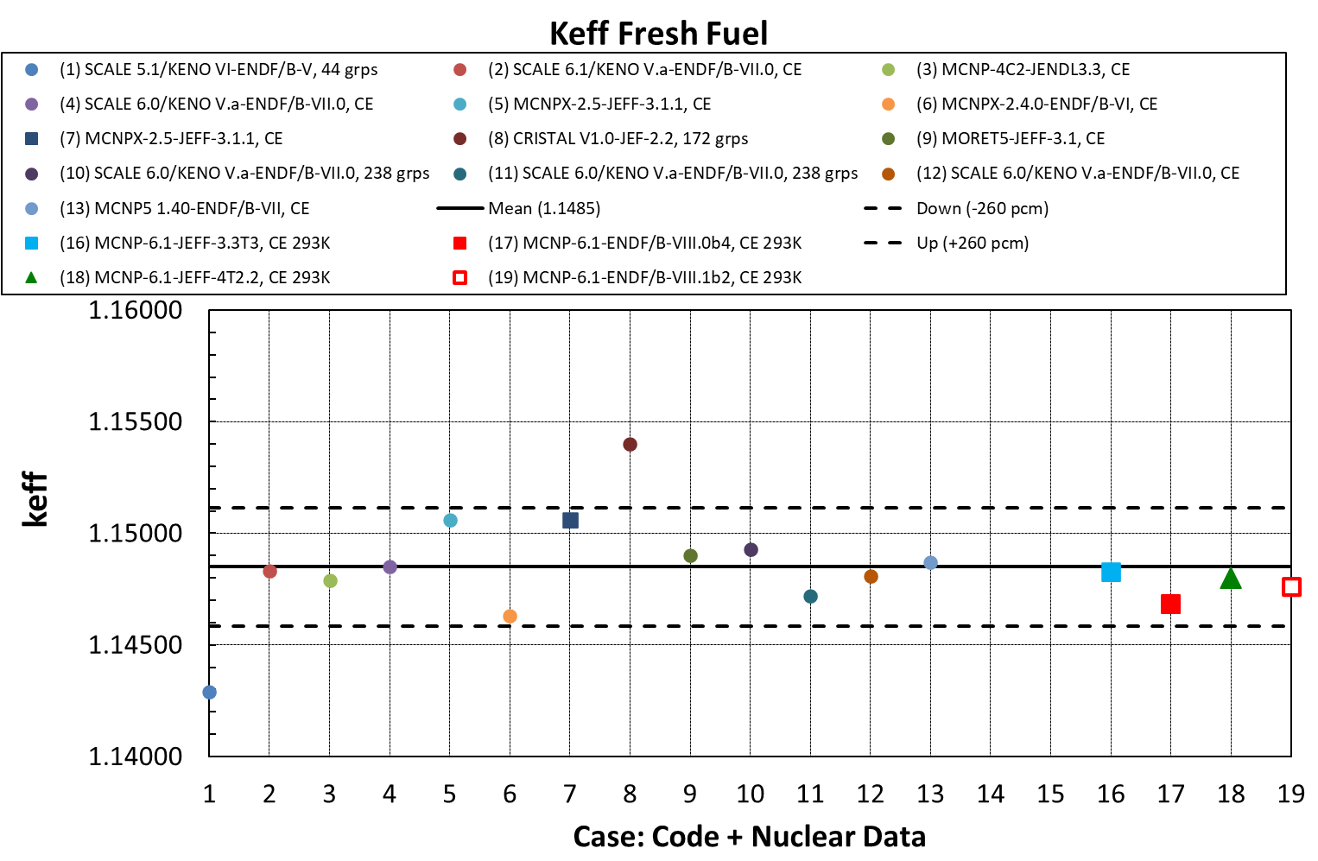
6. Benchmark Phase-VII
Keff values – mean value and std.: CASE “Keff Fresh Fuel”
ENDF/B-VIII.1b2

Slide 26
7. Testing ND FPDH
FPDH- good agreement ENDF/B-VIII.0 and ENDF/B-VIII.1b2
Few changes in 235U &239Pu FYs (44-In-109, 44-In-109m, 45-Sn-109, 45-Sn-109m) do not change FPDH!
FAST U235, total energy
FAST Pu239, total energy

Slide 27
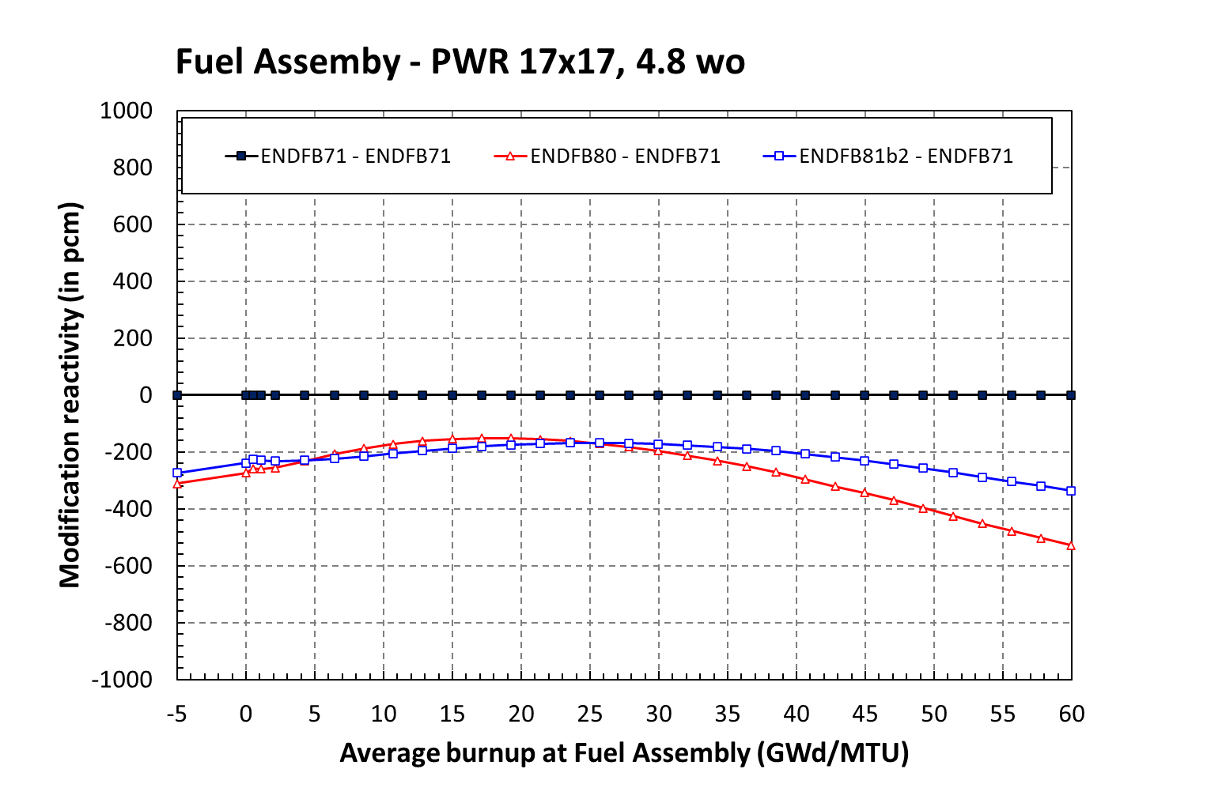
8. Application in LWR – Depletion
Fuel Assembly – PWR 17x17, 4.8 wo
Modification in reactivity (pcm): ENDF/B-VII.1 as reference
Nuclear Data:
Case ENDF/B-VIII.0
Case ENDF/B-VIII.1b2
XS + TSL
DD and FYs
BOC- Xenon eq.
~ BOC-EOC: 50pcm
~ 200pcm
BOC- No Xenon
Reactivity modification at Fuel Assembly Level
Calculation with WIMSD5b lattice code
0

Slide 28
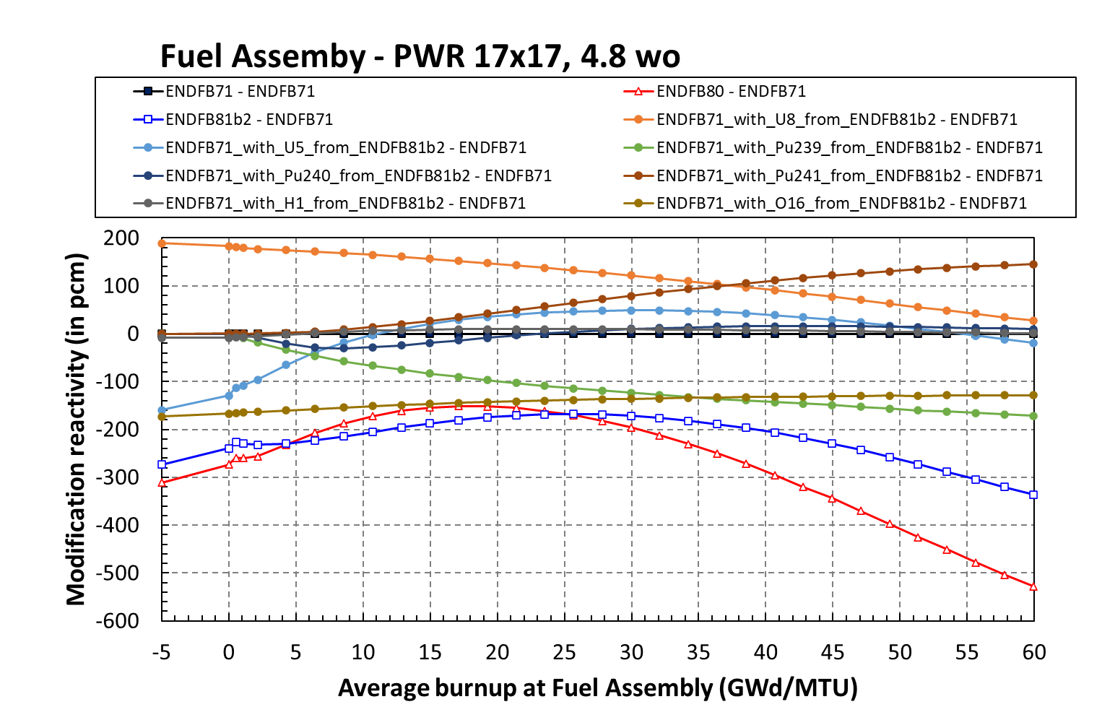
8. Application in LWR – Depletion
Fuel Assembly – PWR 17x17, 4.8 wo
Modification in reactivity (pcm): ENDF/B-VII.1 as reference
BOC- Xenon eq.
BOC- No Xenon
0

Slide 29
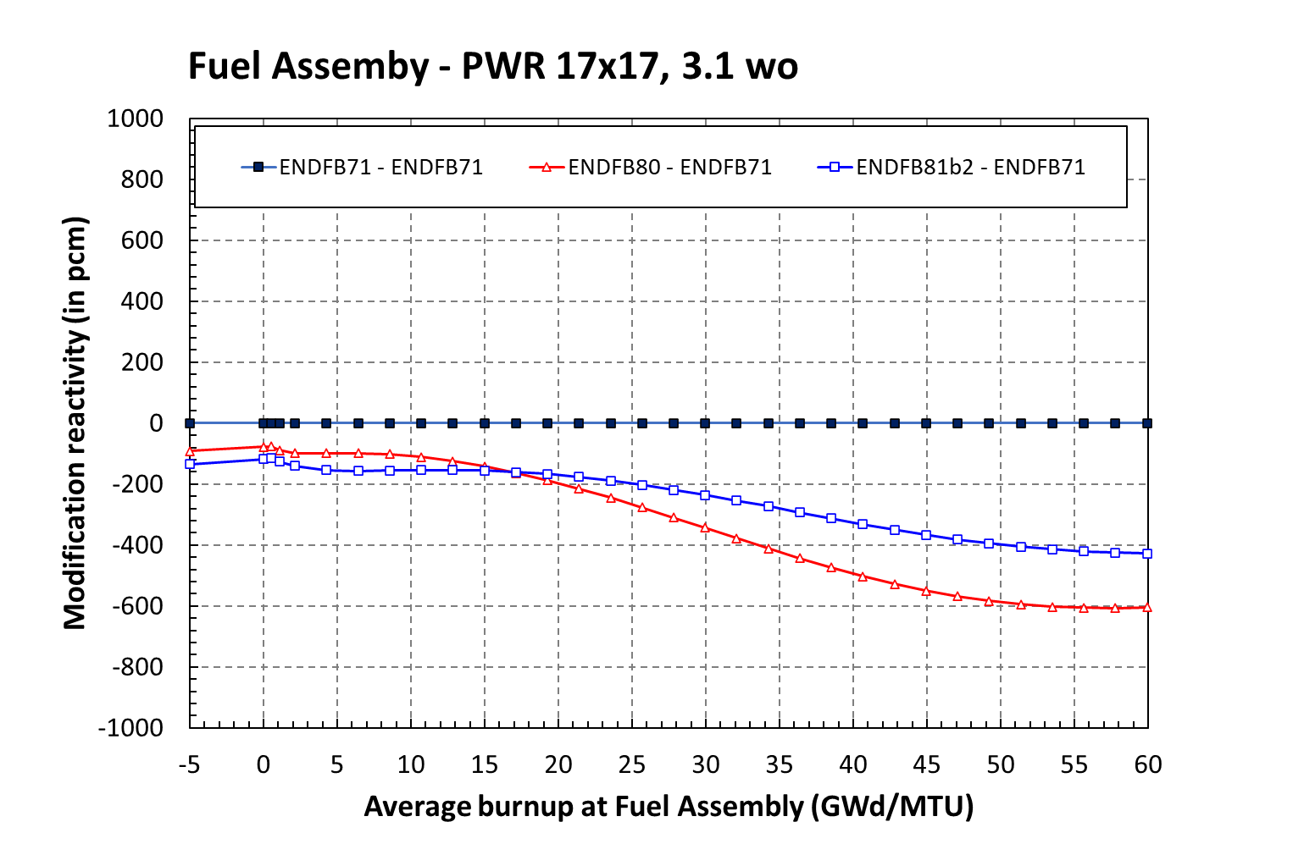
8. Application in LWR – Depletion
Fuel Assembly – PWR 17x17, 3.1 wo
Modification in reactivity (pcm): ENDF/B-VII.1 as reference
Nuclear Data:
Case ENDF/B-VIII.0
Case ENDF/B-VIII.1b2
XS + TSL
DD and FYs
BOC- Xenon eq.
~ BOC-EOC: 250pcm
BOC- No Xenon
~ 200pcm
Reactivity modification at Fuel Assembly Level
Calculation with WIMSD5b lattice code
0

Slide 30
Model, input parameters and ND libraries
Pincell model similar (but not identical…) to Jefdoc-1996 (CEA/D. Bernard; April 2020)
Calculation options
NDL
  ENDF/B-VII.1
  ENDF/B-VIII.0
  ENDF/B-VIII.1b2
 | Fuel | Cladding | Moderator
Temperature | 900K | 600K | 600K
material | UO2 (3.2% U-235 enrichment) | zirconium | 500 ppm H2O
Size | Outer-radius 0.4096cm | Outer-radius 0.475cm | 1.26cm
Library format | DRAGLIB-295
Resonance method | Subgroup
Self-shielding | Space dependent
Transport method | MOC
EOL | 50 MWd/kg (55 steps)

Slide 31
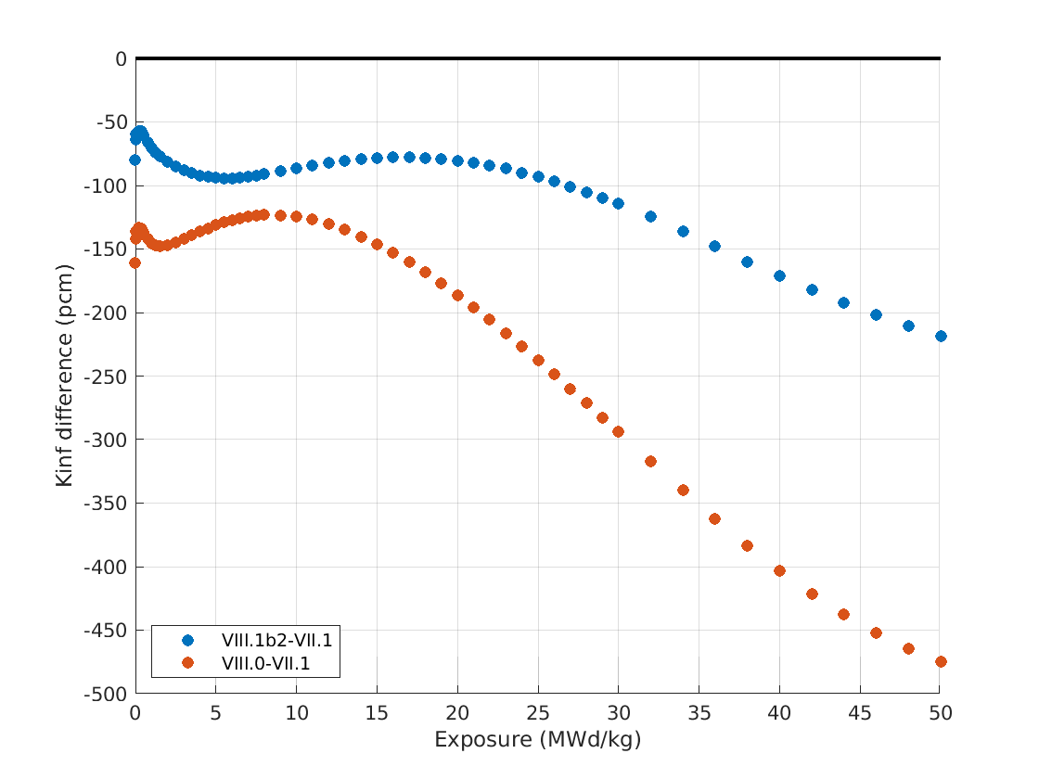
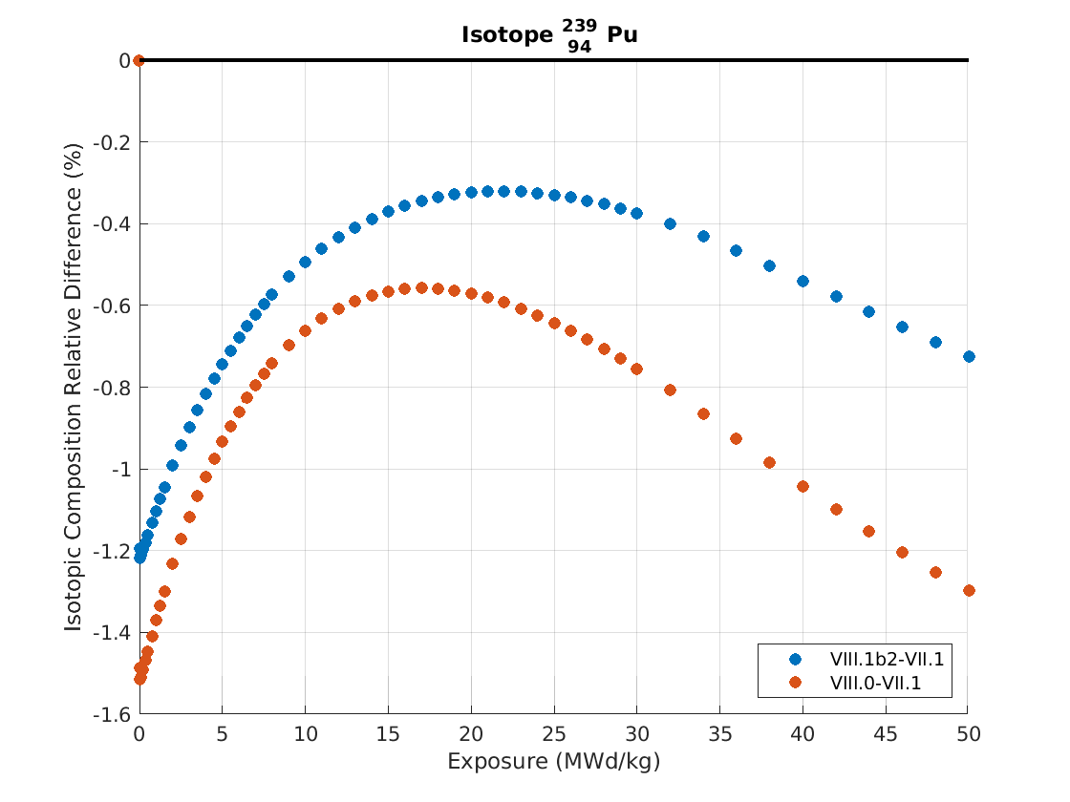

Global Assessment
Reference is ENDF/B-VII.1
${\text{Δ}R}_{rel}={\left(R_{}^{ENDF/B−X.Y}−R_{}^{ENDF/B−VII.1}\right)}/{R_{}^{ENDF/B−VII.1}}$
Preliminary

Slide 32
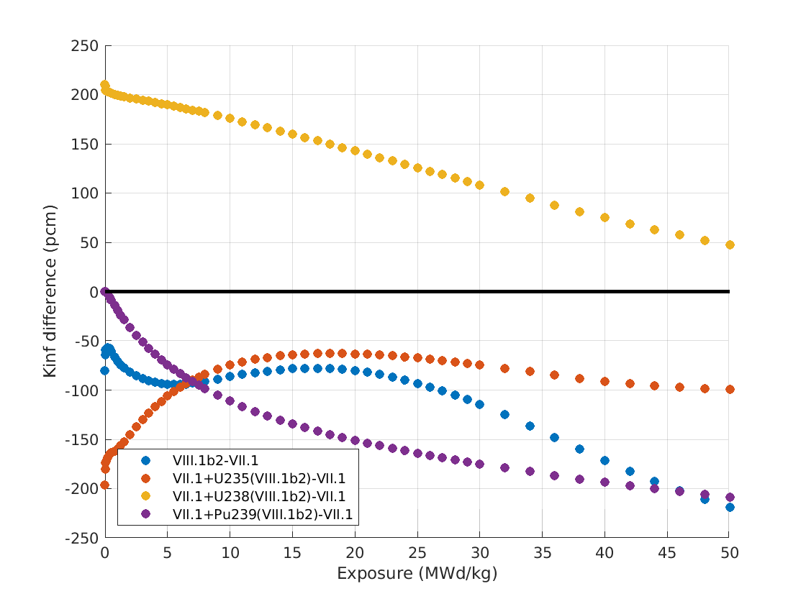
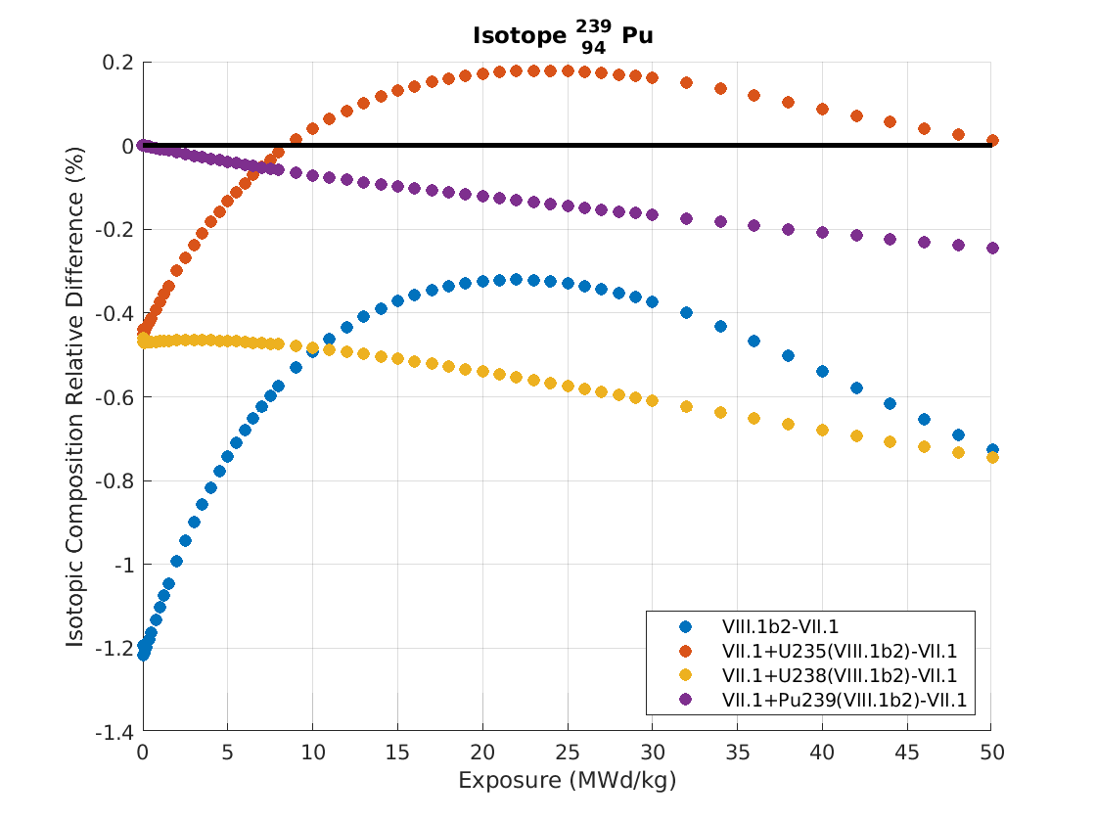

Sensitivity Analysis; ENDF/B-VIII.1b2
Reference is ENDF/B-VII.1
${\text{Δ}R}_{rel}={\left(R_{}^{ENDF/B−X.Y}−R_{}^{ENDF/B−VII.1}\right)}/{R_{}^{ENDF/B−VII.1}}$
Pu changes leads to similar performances than JEFF-3.1.1
Trends result mostly from changes in U-238 file
Preliminary

Slide 33
CONCLUSION
Processing in JANIS format
  ENDF/B-VIII.1b2 into JANIS Database
Processing into ACE format
  ENDF/B-VIII.1b2 into ACE format using NEA options
Criticality Benchmarking – Mosteller’s suite with 123 Benchmarks
  Pu239 : PU-SOL-THERM-009-003 and PU-SOL-THERM-009-001 … impact of nubar/fission Pu239 between 0.01eV-0.5eV
  U233: U233-COMP-THERM-001-003 …. U233/PFNS with Ein thermal??
  Be: HEU-MET-FAST-009-002 and HEU-MET-FAST-009-001
  PU-MET-FAST-008-001 ??
  U233-MET-FAST-004-002 ??
  HEU-MET-FAST-004-001: Δkeff_exp=0.0??
  PST34 cases : Gd effect??
SHIELDING: FNS and OKTAVIAN
  OKTAVIAN: Cu, Mo, Ti, Co, W, Teflon, Al, Nb
Benchmark WPNCS/BUC Phase-VII
  Good agreement!
Testing ND FPDH
  No changes!
Application in LWR – Depletion: Fuel Assembly – PWR 17x17, 4.8w/o, 3.1 w/o and 2.1 wo
  Still burnup issue?!

Slide 34

Acknowledgments
This work is part of the SANDA project (Supplying Accurate Nuclear Data for energy and non-energy Applications) that has received funding from the European Union’s H2020/Euratom under grant agreement No. 847552

Slide 35
Backup slides

Slide 36
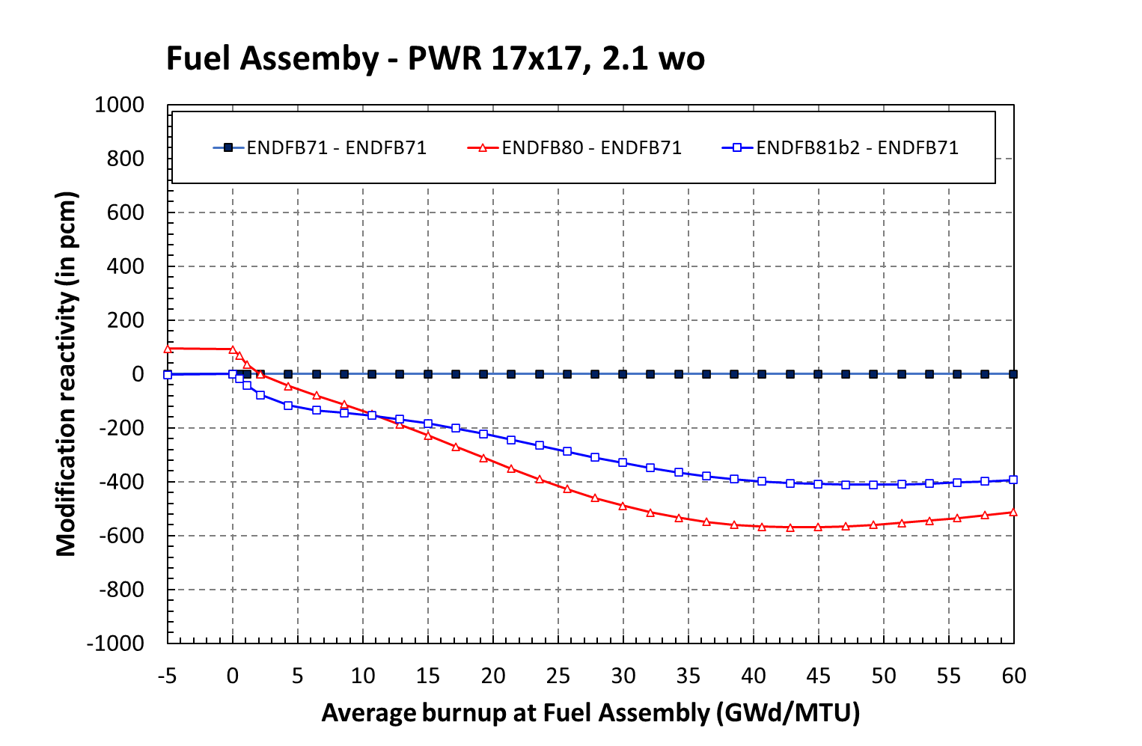
8. Application in LWR – Depletion
Fuel Assembly – PWR 17x17, 2.1 wo
Modification in reactivity (pcm): ENDF/B-VII.1 as reference
Nuclear Data:
Case ENDF/B-VIII.0
Case ENDF/B-VIII.1b2
XS + TSL
DD and FYs
BOC- Xenon eq.
~ BOC-EOC: 400pcm
~ 150pcm
BOC- No Xenon
Reactivity modification at Fuel Assembly Level
Calculation with WIMSD5b lattice code
0

Slide 37
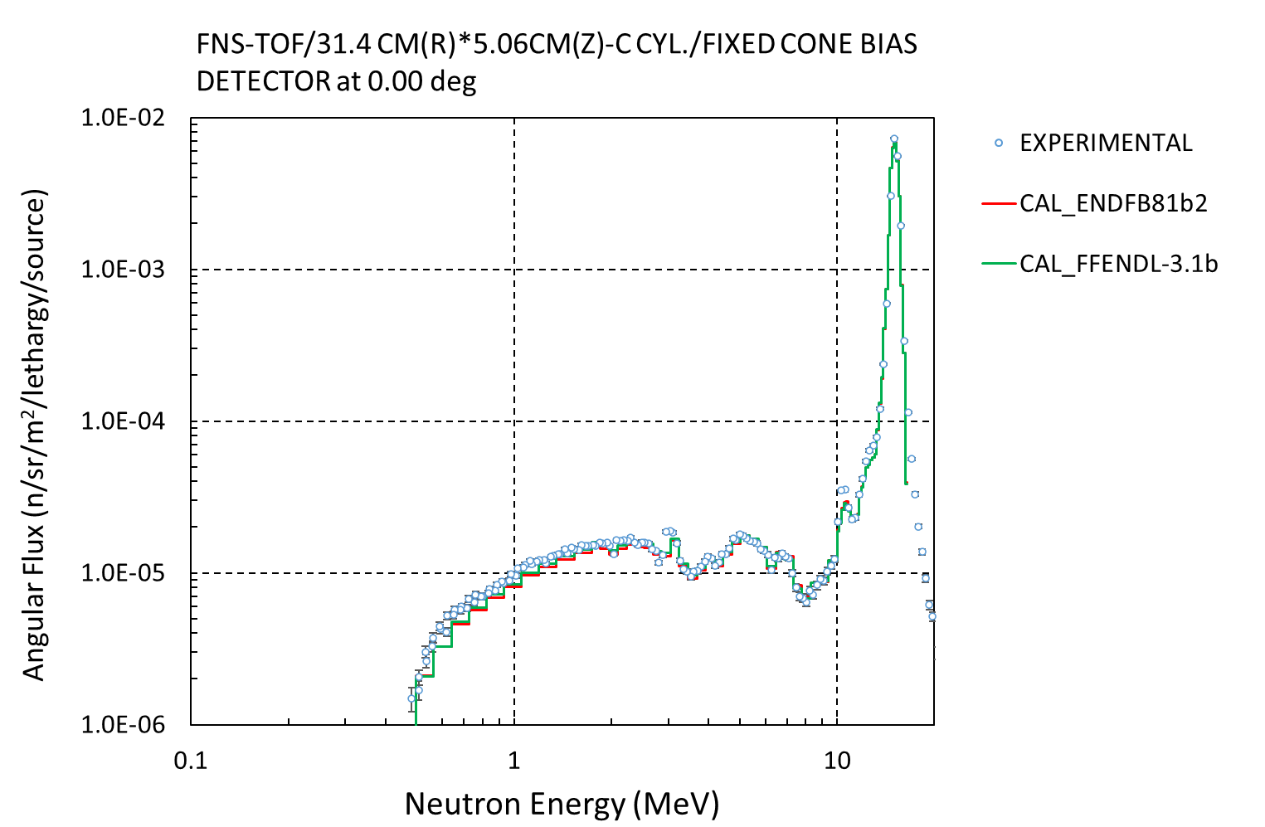


4. SHIELDING: FNS-TOF
FNS-TOF Benchmarks : C

Slide 38



4. SHIELDING: FNS-TOF
FNS-TOF Benchmarks : Pb

Slide 39


4. SHIELDING: FNS-TOF
FNS-TOF Benchmarks : O2 and N2

Slide 40



4. SHIELDING: FNS-TOF
FNS-TOF Benchmarks : LiO2

Slide 41

5. SHIELDING: OKTAVIAN
OKTAVIAN -TOF Benchmarks : Some results

Slide 42




5. SHIELDING: OKTAVIAN
OKTAVIAN -TOF Benchmarks : Some results

Slide 43


5. SHIELDING: OKTAVIAN
OKTAVIAN -TOF Benchmarks : Some results

