Slide 1
Examining Beryllium Scattering using RPI Quasi-Differential Measurements and ENDF Evaluations
Adam Daskalakis
Naval Nuclear Laboratory
CSEWG – November 16, 2023
Notes:
Hello, my name is Adam Daskalakis and I am a scientist at the Naval Nuclear Laboratory. My presentation today discusses the beryllium quasi-differential data collected at Rensselaer Polytech Institute and the latest endf evaluations.

Slide 2
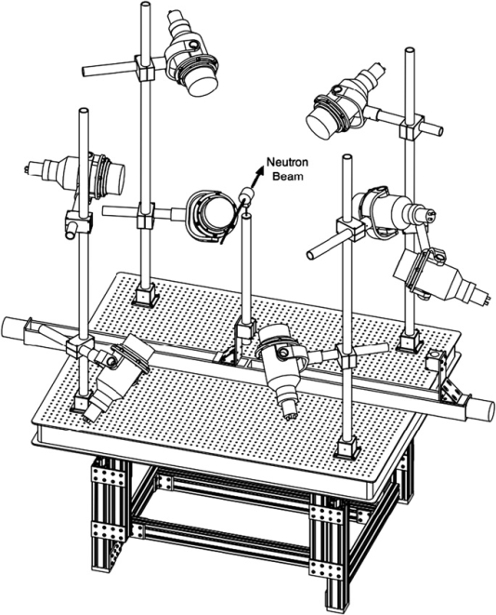
Outline
RPI Gaerttner LINAC Center
  High Energy Scattering System
  Data Processing
Results
  4 and 8 cm beryllium
  Forward, 90 degree, and back positioned detectors
  Total cross section
Conclusions
Acknowledgements
Notes:
Here’s a brief outline of my presentation. I’ll briefly introduce (or reintroduce) the RPI Gaerttner LINAC center, the high energy scattering system, and how that data is processed
Then I’ll jump right into the results from a beryllium scattering measurement and how that data compared to ENDF/B-VIII.0 and ENDF/B-VIII.1b2

Slide 3
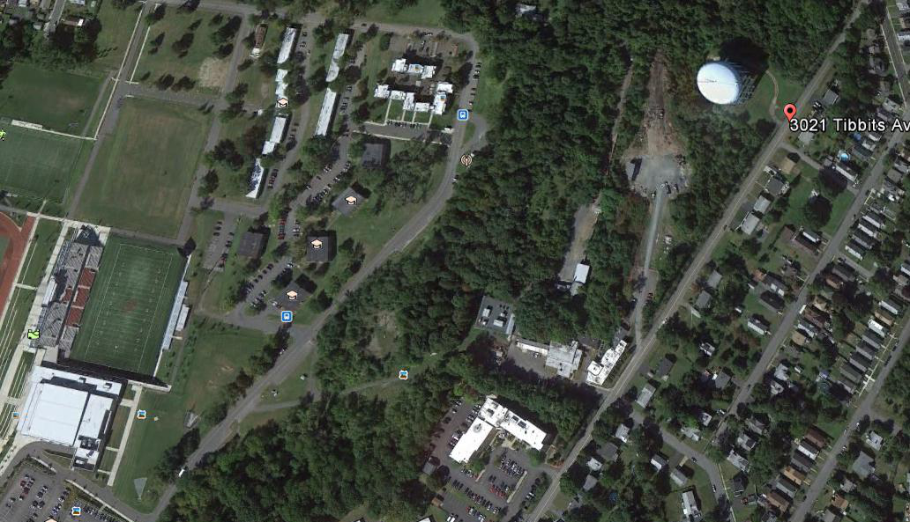
Where is the Gaerttner LINAC Center
It is on the highest point in Troy, NY
RPI Main
Campus
Flight
Stations
LINAC
NES
Offices
Notes:
Here’s an areal view of the RPI Gaerttner LINAC center. The LINAC itself is buried under a mount of earth. There are evacuated neutron flight tubes that provide an unpreterbed path to detector systems located in the 25-, 40-, 100-, and 250-meter stations. It’s a little difficult to see but the main campus is down the hill.

Slide 4
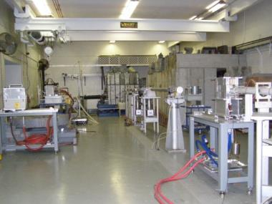
The RPI Gaerttner LINAC Center
Electron LINAC
Neutron Production Target
Target room
Detection Stations at:
15 - 250 m
Lead Slowing Down Spectrometer
Notes:
Here’s a schematic of the Gaerttner LINAC Center. Electrons are accelerated towards the neutron producing target, which from this perspective is from the top down. Once the electrons strike the tantalum plates, bremmstrahlung x-rays are produced, and some of those x-rays liberate neutrons from the tantalum. Only the small fraction of neutrons that escape in the direction of the flight tubes can be used for our measurements.

Slide 5
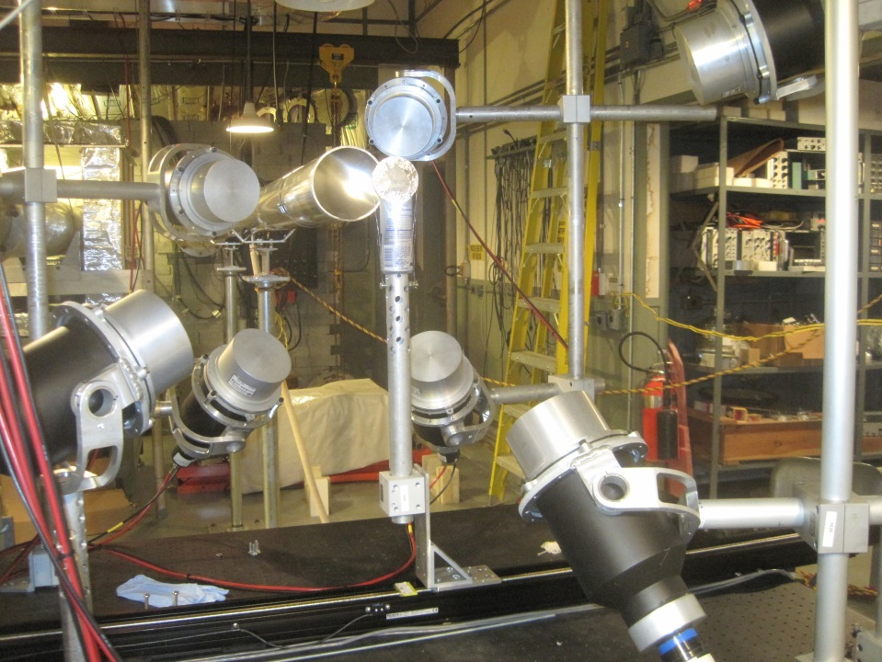
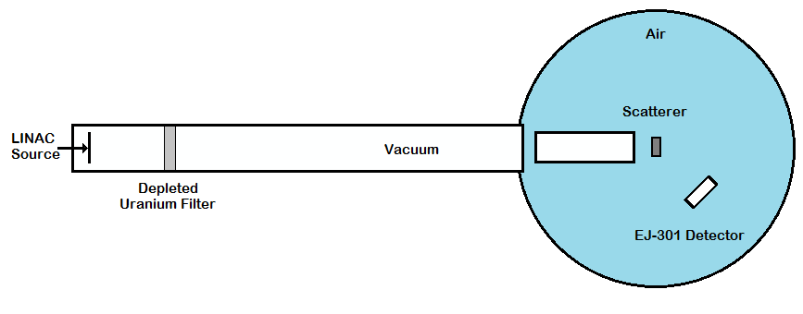
High Energy Scattering System
Four sets of Be measurements collected three sets of data:
  Beryllium, either 4cm or 8cm
  Graphite Reference Sample
  Open Beam
Fluctuations in neutron intensity recorded
by beam monitors
Experiments were modeled in MCNP
  Sample library was varied between ENDF/B-VIII.0 and ENDF/B-VIII.1β2
Upstream vacuum *
Low mass sample holder
*Present after 2011
Notes:
The high energy scattering system consists of eight EJ301 liquid scintillators mounted at specific angles relative to the incident neutron beam. Detectors were adequately spaced to minimize crosstalk between them. Samples were placed on low mass sample holders, visible in the picture to the right. Both beryllium and graphite were periodically cycled into the neutron beam. All together there were four sets of beryllium data collected, each set contained three sets of data: Beryllium, either from a 4cm or 8 cm sample, a graphite which is used as a reference, and open beam.
The lower right image is a rendering of our simplified geometry use with MCNP calculations.
Note, the vacuum pipe was added in 2011 and did not exist when the beryllium measurements were conducted.

Slide 6
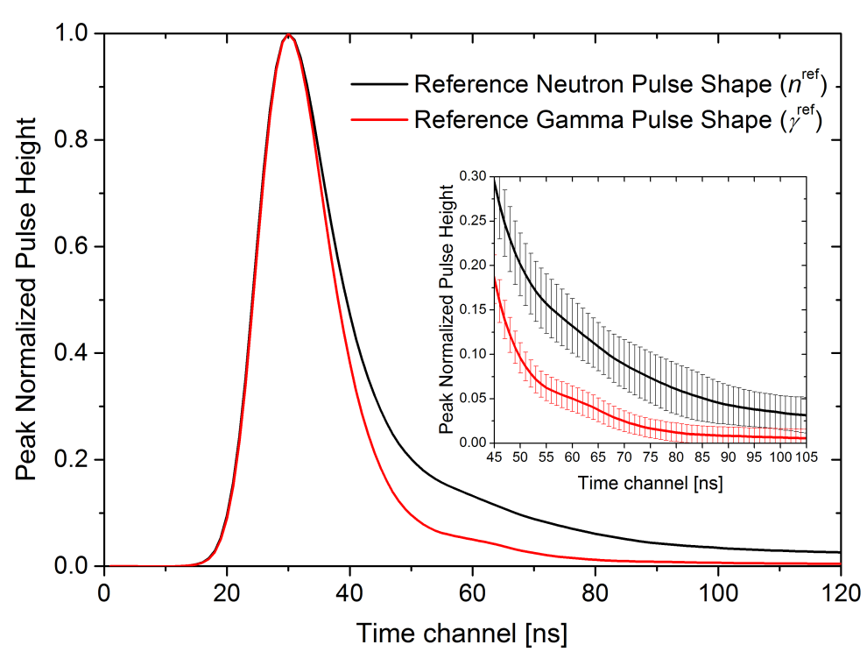
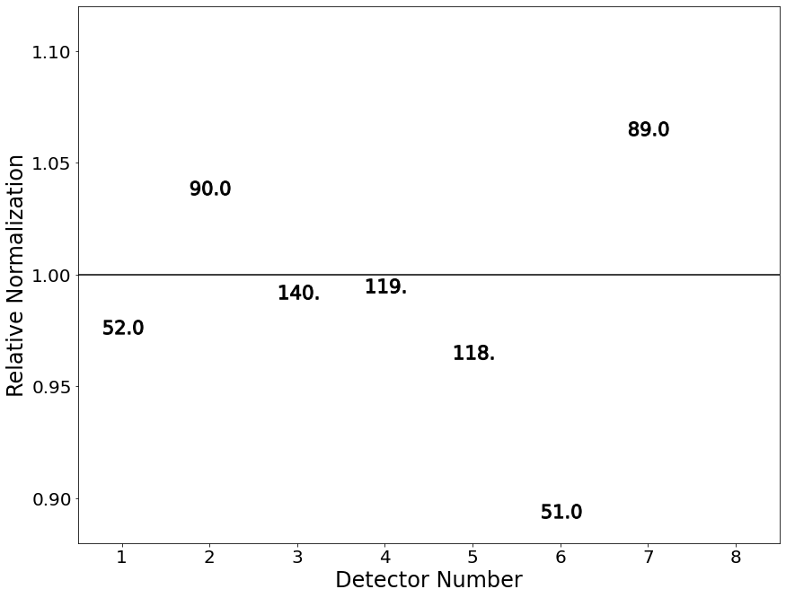
Data Processing
All events recorded by each detector were filtered then classified as neutrons or gammas
Open beam contribution removed from graphite and beryllium data
MCNP calculations normalized to measured data for each detector
  Difference between normalizations used to quantify systematic uncertainty
Notes:
A very broad overview of how data from the high energy scattering system is processed. All events are filtered to remove double events, saturated pulses, and pulses that just have odd shapes. All in all that represents a small fraction of events. The remainder bulk are compared with reference neutron and gamma shapes that are used to classify each event as neutron or gamma. Reference shapes are displayed in the figure to the upper right. The neutron events in time-of-flight are binned and the open beam contribution is removed from the graphite and beryllium data.
Systematic uncertainty was calculated as the difference between the normalizations needed to align the measured data for each detector with their respective graphite mcnp calculation. The relative normalizations for one of the four weeks is visible to the lower right.
(Note: The lower right figure sig. fig. are purposely set to have 4 characters, which resulted in a period as the last character for angles greater than 100. This is needed because the symbol size would be drastically different if a different number of characters were used, i.e., 2 vs 3 vs 4)

Slide 7
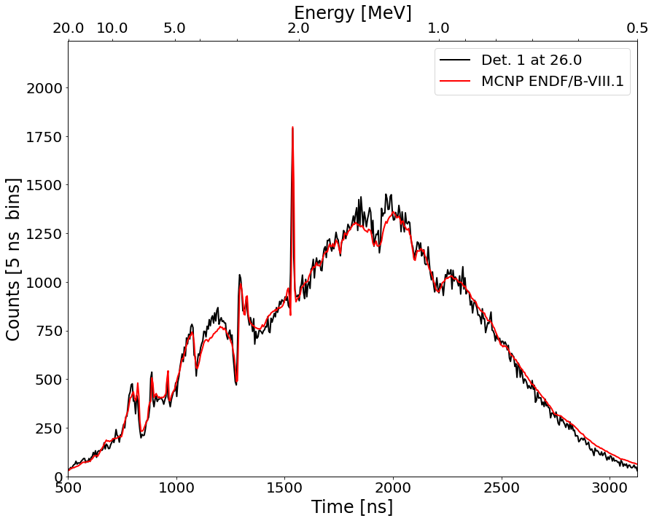
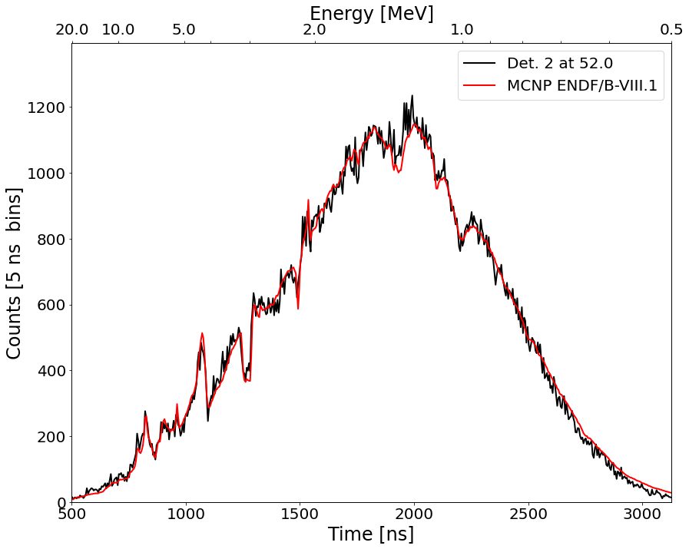
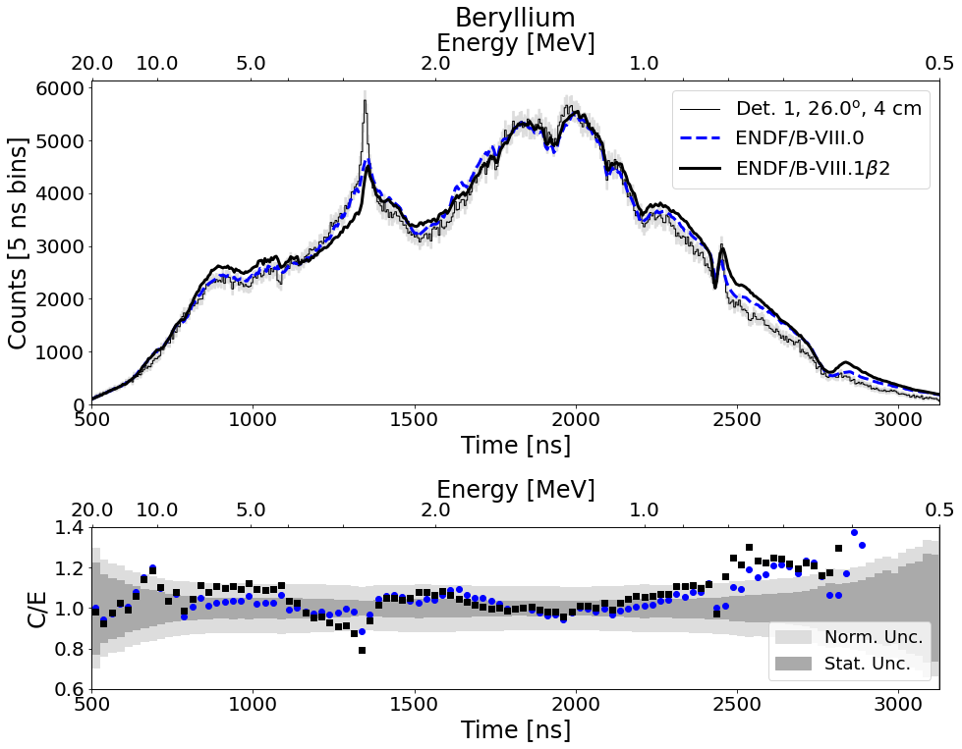
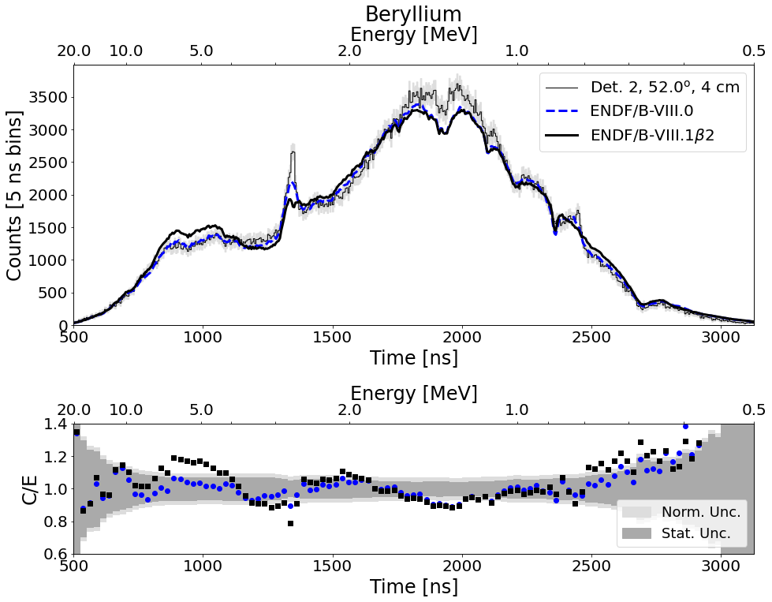
Results – Forward Detectors
Graphite
4 cm beryllium
Graphite
Notes:
Data for forward positioned detectors with beryllium (larger images at the bottom) and graphite (smaller images in the upper corners).
Detectors were at 26 (left) and 52 (right) degrees. There is generally good agreement between the graphite and the Monte Carlo calculation, this suggests that the observed discrepancies are likely due to the beryllium cross section.
Looking at the beryllium there seems to be some discrepancy just below 3 MeV, then beta2 rides higher than ENDF between 4 and 8 MeV and at lower energies between about 0.7 and 1 MeV.

Slide 8
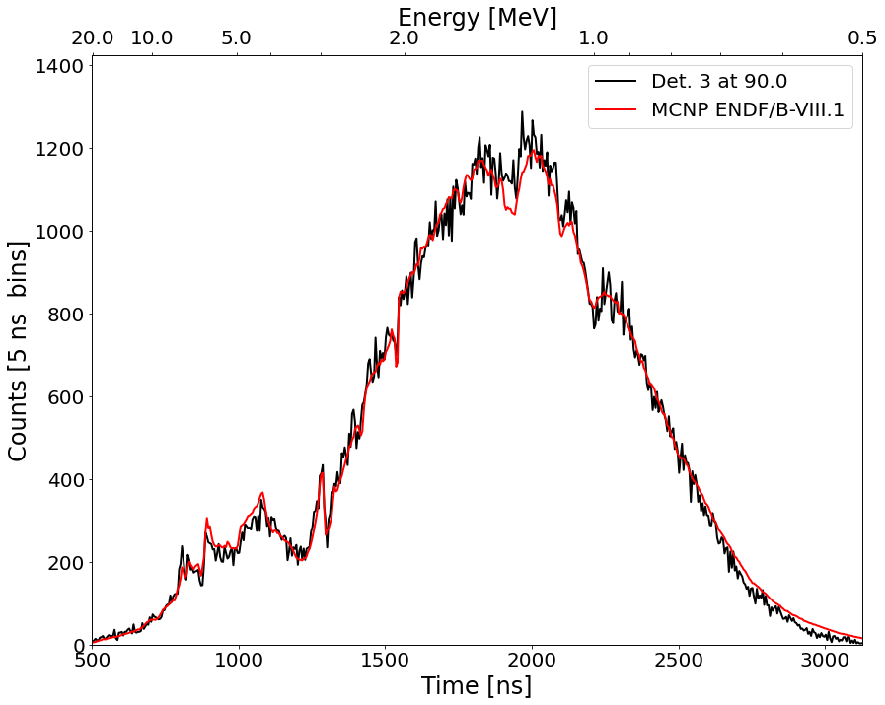
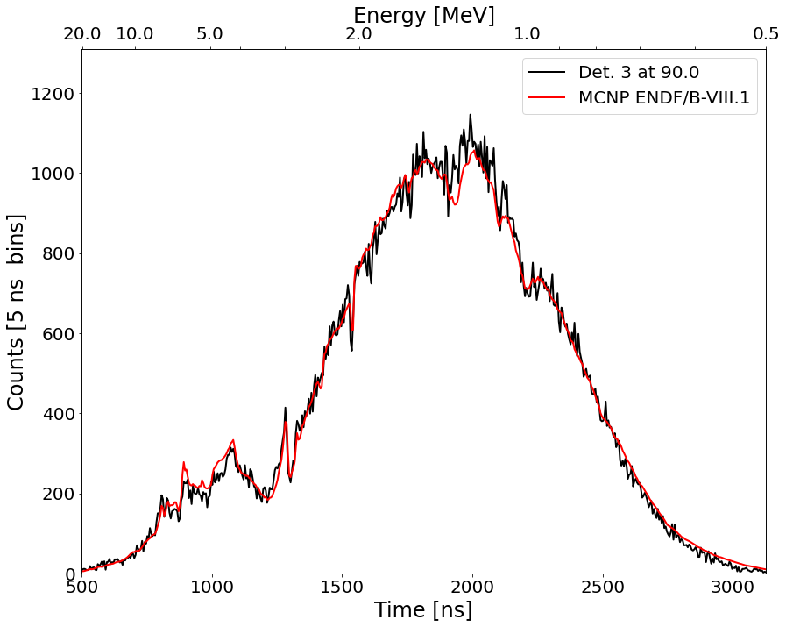
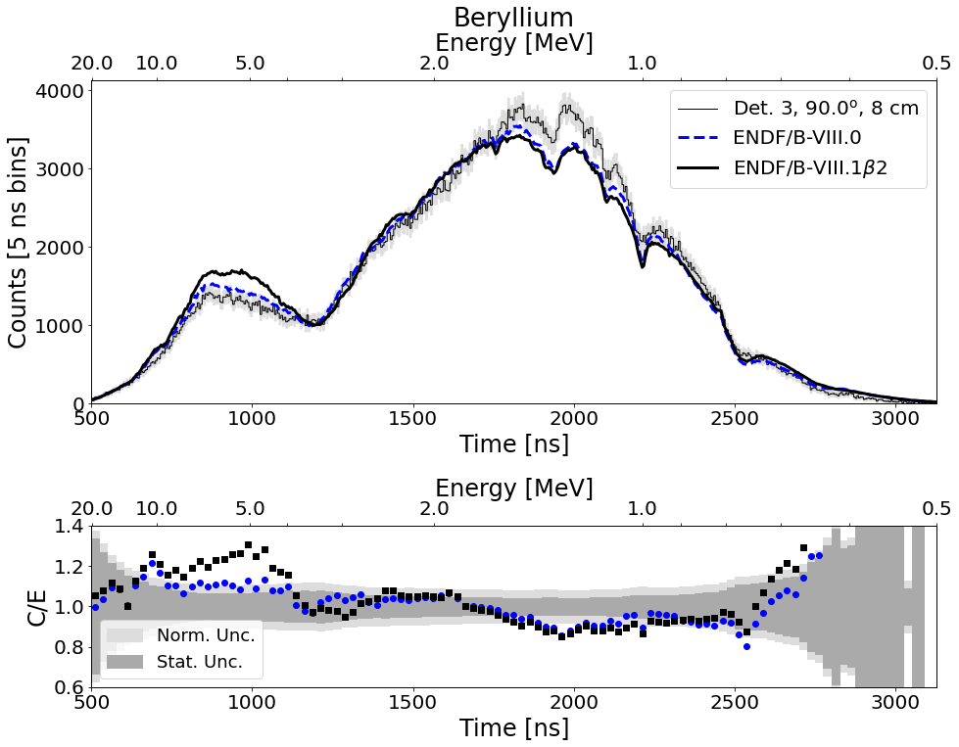
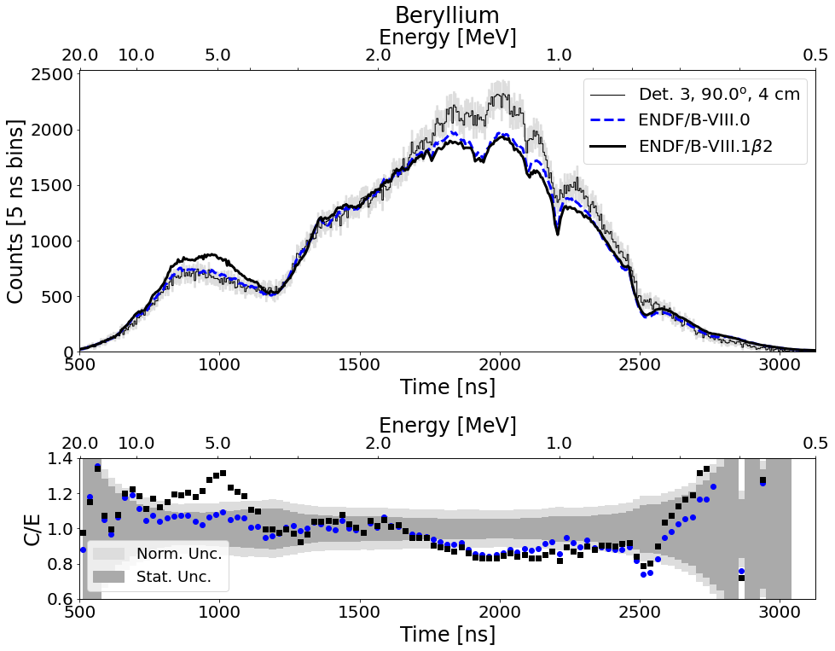
Results – Side Detectors
Graphite
Graphite
8 cm beryllium
4 cm beryllium
Notes:
Here’s data from the same detector with both the 4 cm and 8 cm beryllium sample. The graphite results do not change between datasets. Again, the beta2 results are high above 4 MeV. These data were collected at 90 degrees

Slide 9
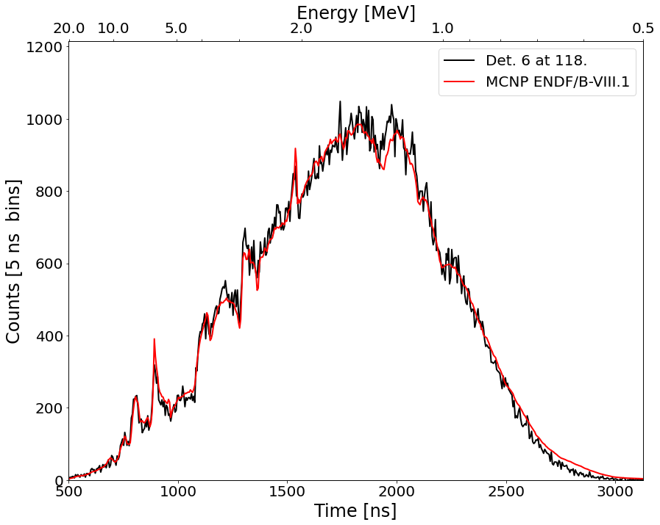
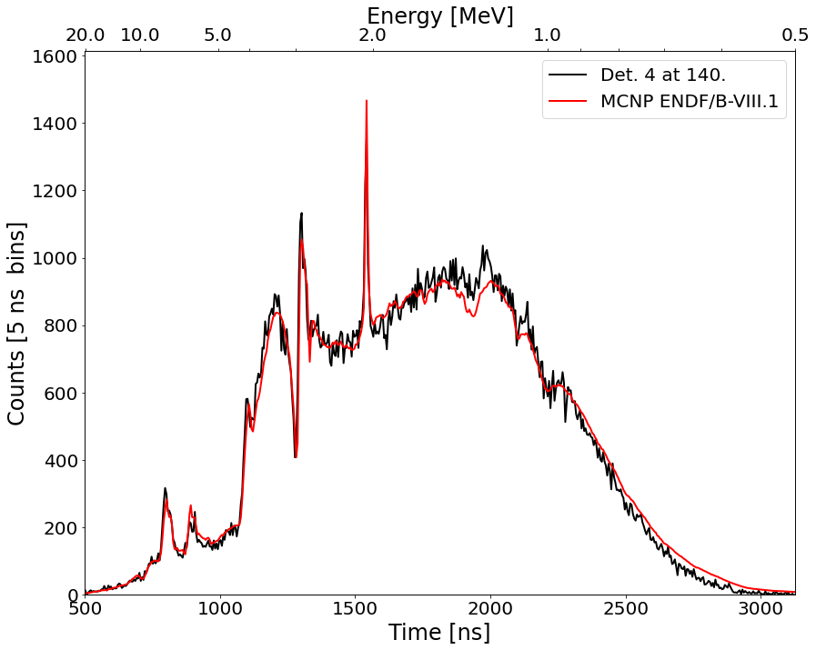
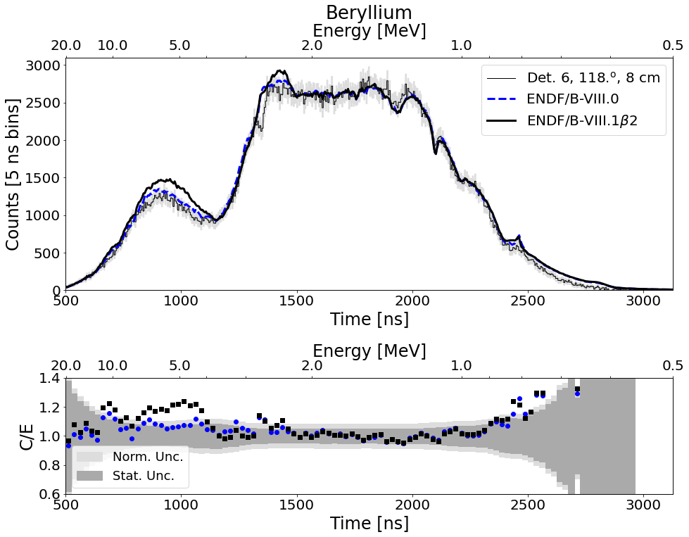
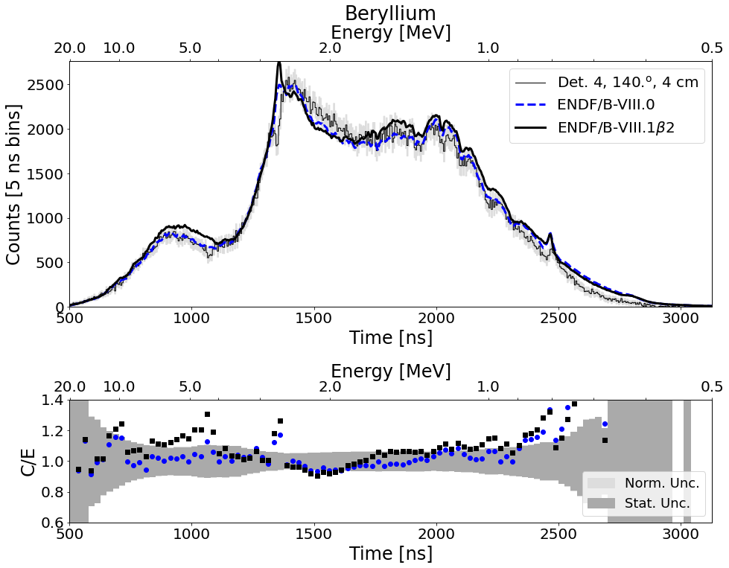
Results – Back Detectors
Graphite
Graphite
8 cm beryllium
4 cm beryllium
Notes:
Slowly moving towards back angles we see the same pattern above 4 MeV. In addition, the resonance just below 3 MeV is off w/ beta2.

Slide 10
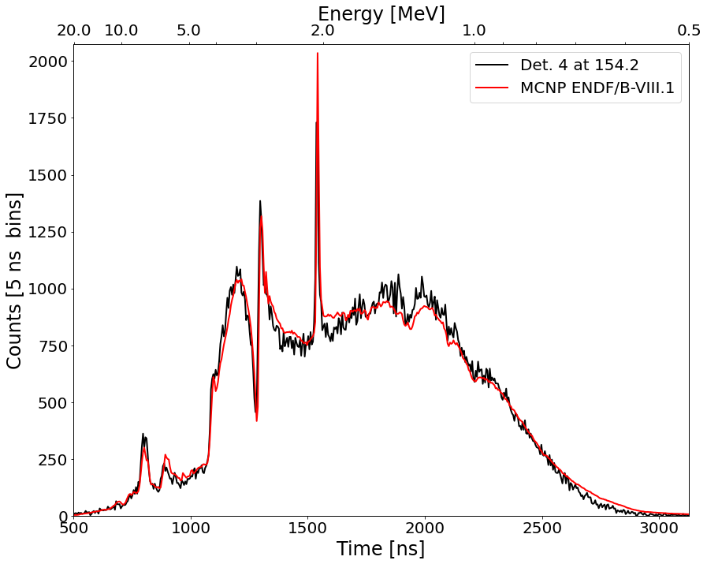

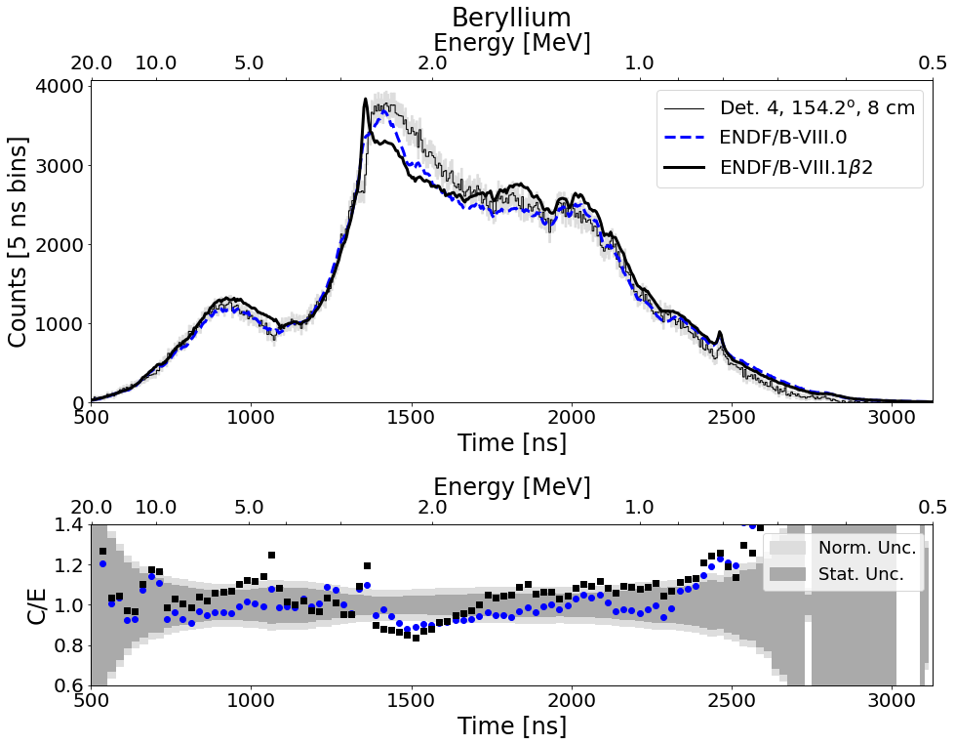
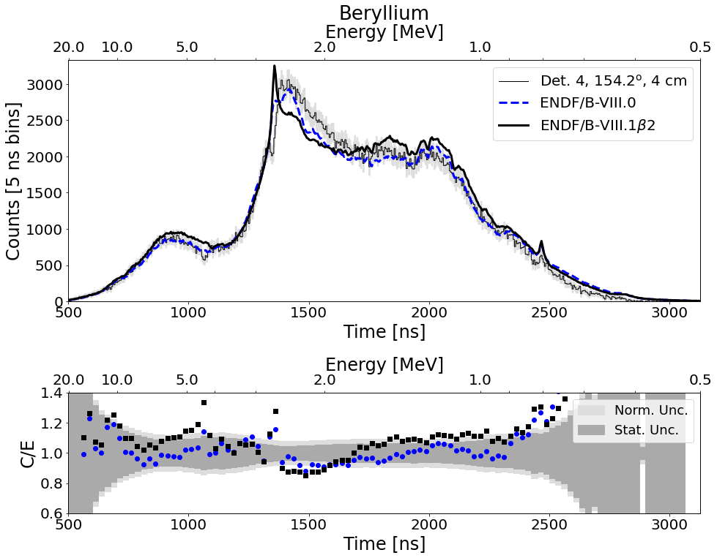
Results – Back Detectors
Graphite
Graphite
8 cm beryllium
4 cm beryllium
Notes:
And finally, data from both sample thicknesses at the detector located closest to 180 degrees. Overall ENDF/B-VIII.0 looks better than beta2.

Slide 11
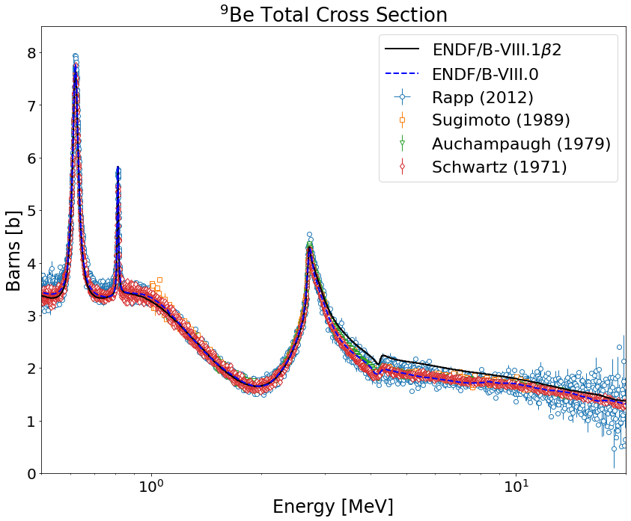
Total Cross Section - Source of Discrepancies
⁹Be total cross section comparison
  Data are in good agreement
  Discrepancies between ENDF/B versions occur above ~2.5 MeV
Differences observed in scattering attributed to MT24 and MT52 both describing n,2n
Figure generated with support from Greg Siemers, RPI graduate student
Notes:
Looking at the endf files themselves, the total cross section is different between endf-8 and beta2. Above about 2.5 it’s clearly visible and was attributed to something going on with MT24 and MT52 both representing n,2n. This is known to the evaluators putting together beryllium and I believe are working towards fixing this.
Note: The differences observed above ~2.5 is due to MT24 and MT52 both describing the n ->2n + a + a reaction.

Slide 12
Conclusions
Data collected by the RPI high-energy scattering system was used to compare ENDF/B-VIII.0 and ENDF/B-VIII.1b2
Discrepancies were observed at several energies and angles
  Forward detectors - below 1 MeV
  90 degree - between 3 and 7 MeV
  Back detectors - between 2 and 3 MeV
Differences attributed to MT24 and MT52
Notes:
In conclusions, data collected from the rpi high energy scattering system was used as validation, or in this case, a means suggest reevaluation should occur, for the latest beryllium ENDF release.
Possible question: Was this fed back to those compiling evaluation. Answer – Yes, they are aware and have made some adjustments (removing MT52) Nate Gibson, Mark Paris, and Gerry Hale are aware of this. (they can speak more to this if they are present/on call).

Slide 13

Acknowledgements
Data presented herein were collected and analyzed in collaboration with Rensselaer Polytechnic Institute
Notes:
Lastly, I want to thank my collaborators, that’s Yaron Danon, his graduate students, and the LINAC technical staff.

