Slide 1


Thermal Scattering Law Data of Zirconium Hydride
Ingrid Švajger and Andrej Trkov
Jožef Stefan Institute, Jamova cesta 39, 1000 Ljubljana, Slovenia
CSEWG Meeting, November 2023

Slide 2
Motivation
ZrH is of significant interest for thermal reactor applications. Admixed with fuel it results in prompt negative temperature coefficient
TRIGA type research reactors have been using such fuel for decades
ZrH is also of interest for innovative fuel design in new generation reactors
The thermal scattering law data in legacy libraries are fairly old
Benchmark results for assemblies containing ZrH are discrepant

Slide 3
Objectives
Several TSL evaluations for H in ZrH are available:
  Legacy evaluations from ENDF/B-VII.1, ENDF/B-VIII.0 (JEFF-3.3 similar to ENDF/B-VII.1)
  NNL evaluation (USA)
  JSI evaluation (Slovenia)
  XJTU evaluation (China)
Test the performance of available TSL evaluations for H in ZrH on criticality benchmarks
  15 cases from the ICSBEP Handbook were identified
Compare cross sections in different TSL evaluations

Slide 4
List of Benchmarks from the ICSBEP Handbook
No. ICSBEP Label Short name Common name Comment
-----------------------------------------------------------------------------
1 HEU-COMP-MIXED-003 hcm003-001 Narcis-M-1 ZrH moderator
2 HEU-COMP-MIXED-003 hcm003-002 Narcis-M-2 ZrH moderator
3 HEU-COMP-MIXED-003 hcm003-003 Narcis-M-3 ZrH moderator
4 HEU-COMP-MIXED-003 hcm003-004 Narcis-M-4 ZrHmoderator
5 HEU-COMP-MIXED-003 hcm003-005 Narcis-M-5 ZrH moderator
6 HEU-COMP-MIXED-003 hcm003-006 Narcis-M-6 ZrH moderator
7 HEU-COMP-THERM-007 hct007-001 RRCt-1 U-Cu/ZrH fuel, SS_clad
8 HEU-COMP-THERM-007 hct007-002 RRCt-2 U-Cu/ZrH fuel, SS_clad
9 HEU-COMP-THERM-007 hct007-003 RRCt-3 U-Cu/ZrH fuel, SS_clad
10 IEU-COMP-THERM-003 ict003-001 TRIGA - JSI H(ZrH), SS_clad
11 IEU-COMP-THERM-003 ict003-002 TRIGA - JSI H(ZrH), SS_clad
12 IEU-COMP-THERM-013 ict013-001 NRAD_TRIGA_56 ZrH Er U(20 %)
13 IEU-COMP-THERM-013 ict013-002 NRAD_TRIGA_60 ZrH Er U(20 %)
14 IEU-COMP-THERM-013 ict013-003 NRAD_TRIGA_62 ZrH Er U(20 %)
15 IEU-COMP-THERM-013 ict013-004 NRAD_TRIGA_64 ZrH Er U(20 %)
-----------------------------------------------------------------------------

Slide 5
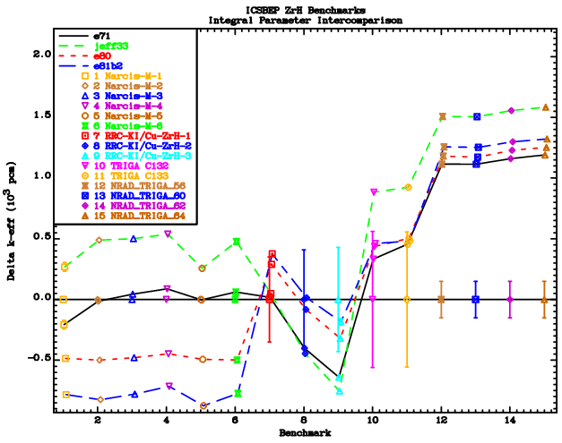
Benchmark Results for Different Major Libraries

Slide 6
Benchmark Characteristics
NARCIS (HCM003)
  No experimental uncertainties are given
  Differences in results are most likely not only due to TSL
NRAD TRIGA (ICT013)
  All libraries give similar results
  Fuel contains erbium
  The bias is large – probably too large to explain by TSL data
RCT cases (HCT007) seem to be insensitive to TSL
TRIGA-JSI (ICT003) are within (or close to) experimental uncertainties

Slide 7
Comparison of the Capture Cross Sections for Natural Erbium Between
ENDF/B-VII.1, ENDF/B-VIII.0 and the Data in EXFOR

Slide 8
Comparison of the Capture Cross Sections for Natural Erbium Between
ENDF/B-VII.1, ENDF/B-VIII.0 and the Data in EXFOR in the Narrow Energy Interval 170-320 eV

Slide 9
Details of H in ZrH Evaluation: ε-phase
The following ε-phase comparisons include:
original SAB2 from LANL (independent of the H content in the crystal lattice)
JEFF-3.3 evaluation (independent of the H content in the crystal lattice)
JSI evaluation for ZrH2
XJTU evaluation for ZrH2
NNL evaluation for ZrH2

Slide 10
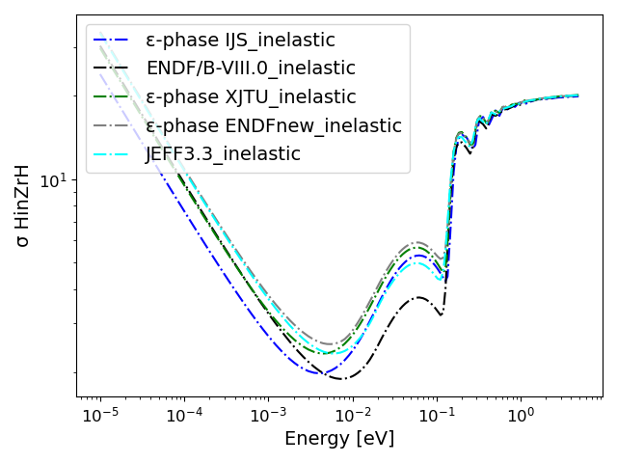
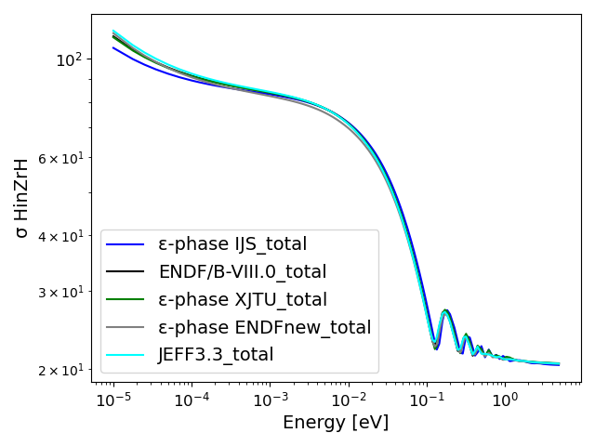
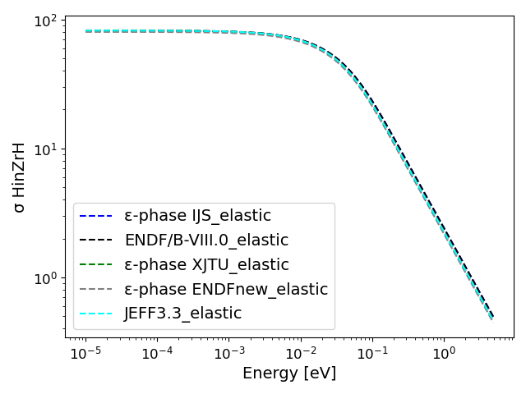
Thermal Scattering
Cross Sections

Slide 11
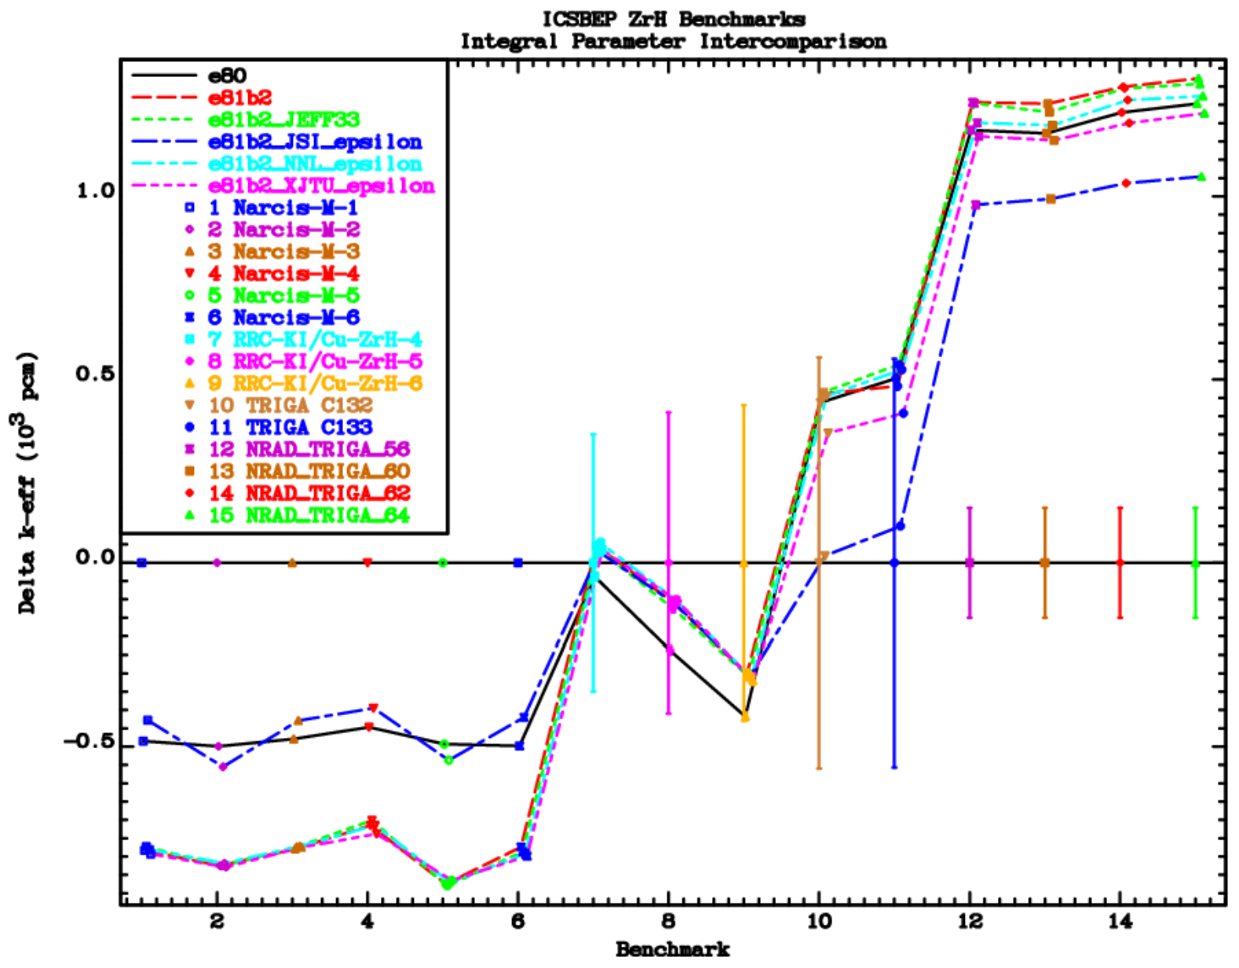
Benchmark Results for ε-phase

Slide 12
Details of H in ZrH Evaluation: δ-phase
The following δ-phase comparisons include:
Original SAB2 from LANL (independent of the H content in the lattice)
JEFF-3.3 evaluation (independent of the H content in the lattice)
JSI evaluation for ZrHx
XJTU evaluation for ZrHx
NNL evaluation for ZrHx

Slide 13
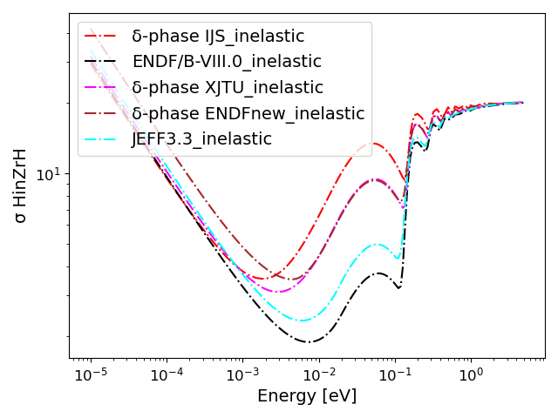
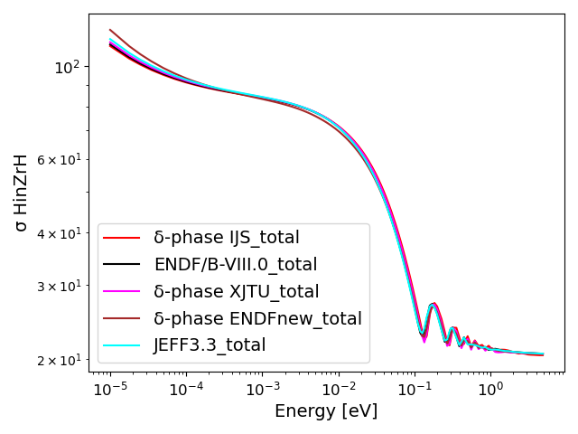
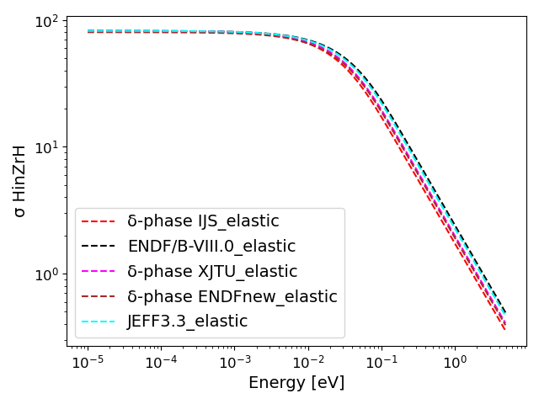
Thermal Scattering
Cross Sections

Slide 14
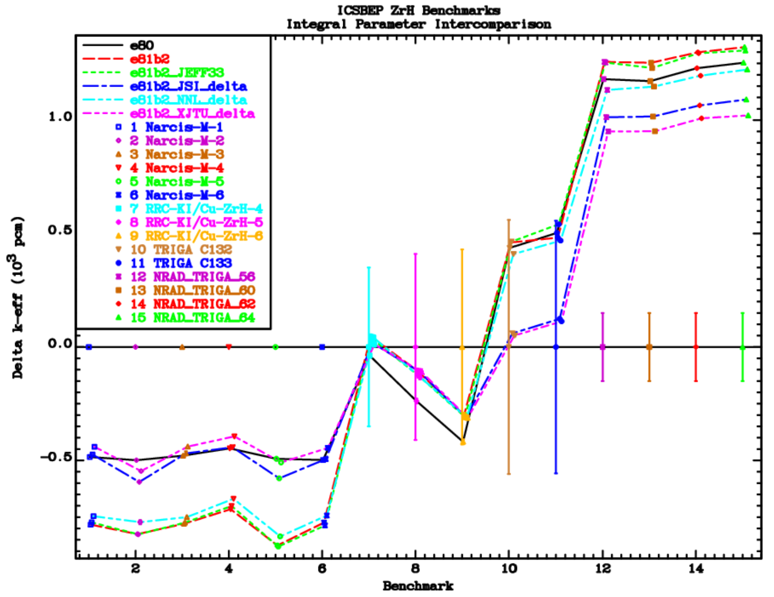
Benchmark Results for δ-phase

Slide 15
CONCLUSIONS
JSI and NNL evaluations predict small dependence on the crystal structure of ZrH, but the results for reactivity prediction differ.
XJTU evaluations for the two phases produce different results: those for the δ-phase agree with JSI, while those for the ε-phase agree with NNL.
NNL evaluations and the XJTU evaluation for the ε-phase produce results very similar to the older TSL evaluations from ENDF/B-VIII.0.
Overall, the JSI evaluations tend to decrease the spread in the results, but the discrepancies are still rather large and require a more detailed investigation.

