Slide 1
ENDF/B-VIII.1b2
Covariance Testing
Oscar Cabellos (UPM)
Universidad Politécnica de Madrid (UPM), Madrid, Spain
E-mail: oscar.cabellos@upm.es

Slide 2
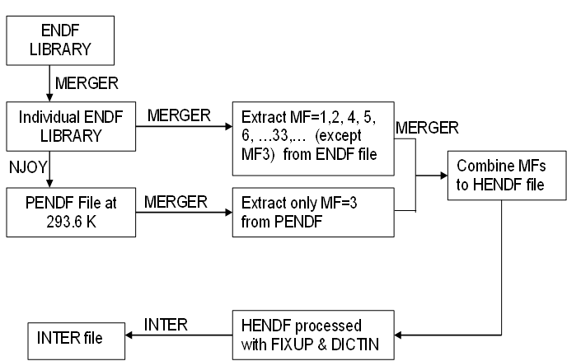
1. Processing in JANIS format
Processing ENDF/B-VIII.1b2 into JANIS format:
HENDF + INTER + BOXER
Figure. Example of input deck to process in PENDF format
moder /tape20 from MERGER
20 -31
reconr /Reconstruct XS data
-31 -32
' PENDF tape ' /
9437 2 /
.005 /
' MAT=pu239 ENDF Library:JENDL-5.0upd' /
' Processed NJOY2016-UPM,2023 '
0/
broadr /Doppler broaden XS
-31 -32 -33
9437 1 /
.005 /
293.60
0/
thermr / Add thermal scattering data
0 -33 -34
0 9437 12 1 1 0 0 1 221 0
293.60
0.005 10.0
unresr
-31 -34 -35
9437 1 1 0 /
293.60
1.0e+10 /
0/
heatr / Add heating kerma and damage energy
-31 -35 -36 40/
9437 7 0 0 0 2/
302 303 304 318 401 403 407 /
heatr / Add heating kerma and damage energy
-31 -36 -37 41/
9437 6 0 0 0 2 0 1/
442 443 444 445 446 447 /
gaspr /Gas production
-31 -37 -38
moder
-38 26
stop
tape20 = ENDF file
=====================
Figure. Flowchart of processing JANIS database from ENDF tapes
NJOY
BOXER file
MF31/32/33/34 and MF35
VERSION 7.01

Slide 3
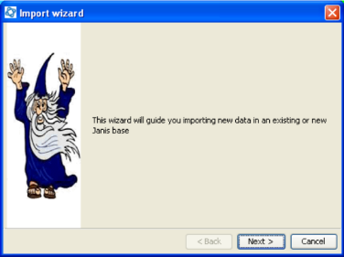
1. Processing in JANIS format
Processing ND libraries into JANIS format:
JEFF-4T2.2
JENDL-5.0-upd
ENDF/B-VIII.1b2
“In115” failed in HEATR module
Logs reported when importing JANIS database (Sep. 15th, 2023)
# - HENDF: Hybrid format ENDF+PENDF including KERMA and DAMAGE cross-sections
# - INTER
# - BOXER: covariances MF31, MF32/MF33, MF34 and MF35
Download at the following link:
https://drive.upm.es/s/E4KBmhbtrI5yWQI
password: janis
See the “Readme.txt” file, it explains how to download and import the database in JANIS
Import WIZARD tool: Use the “Database > Import Wizard”
Steps:
- Use “JANIS toolbar -> Database –> Load” function
- Set “.h2.db file” to select the downloaded “h2.db” file
- Set “Root Folder” to the folder where the “h2.fb” is located
(Leave the other default options are they are)

Slide 4
2. Verification ND Uncertainties
Verification ND Uncertainties in ICSBEP Benchmarks using NDAST Tool
HENDF - ENDF/B-VIII.1b2: Uncertainty Quantification in ICSBEP using NDaST
U233 – U235 - U238 – Pu239
The impact of uncertain in:
XSs
nubar
PFNS
http://www.oecd-nea.org/ndast/

Slide 5
Uncertainty Quantification with ENDF/B-VIII.1b2: ICSBEP/Pu cases
Verification ND uncertainties: PU cases
Fissile material |  | PU | PU
Spectrum |  | FAST | INTER | MIXED | THERM
Number of Benchmarks |  | 152 | 4 | 9 | 624
Experimental Uncertainty (pcm) |  | 334 | 710 | 587 | 426
Total (pcm) | ENDF/B-VIII.1b2 | 931 | 551 | 536 | 643
 | ENDF/B-VIII.0 | 921 | 1403 | 1055 | 1099
 | ENDF/B-VII.1 | 436 | 565 | 459 | 625
Cross-sections (with correlations) | ENDF/B-VIII.1b2 | 841 | 360 | 224 | 105
Cross-sections | ENDF/B-VIII.0 | 857 | 1368 | 983 | 998
 | ENDF/B-VII.1 | 409 | 546 | 356 | 500
P1-elastic | ENDF/B-VIII.1b2 | 66 | - | - | -
P1-elastic | ENDF/B-VIII.0 | 66 | - | - | -
 | ENDF/B-VII.1 | - | - | - | -
nubar | ENDF/B-VIII.1b2 | 390 | 389 | 479 | 631
nubar | ENDF/B-VIII.0 | 300 | 271 | 275 | 308
 | ENDF/B-VII.1 | 76 | 88 | 114 | 168
PFNS | ENDF/B-VIII.1b2 | 27 | 25 | 53 | 58
PFNS | ENDF/B-VIII.0 | 117 | 106 | 265 | 297
 | ENDF/B-VII.1 | 118 | 106 | 265 | 297
Uncertainty Quantification in ICSBEP using NDaST
only Pu239 covariances
↓
↓
↑
↓

Slide 6
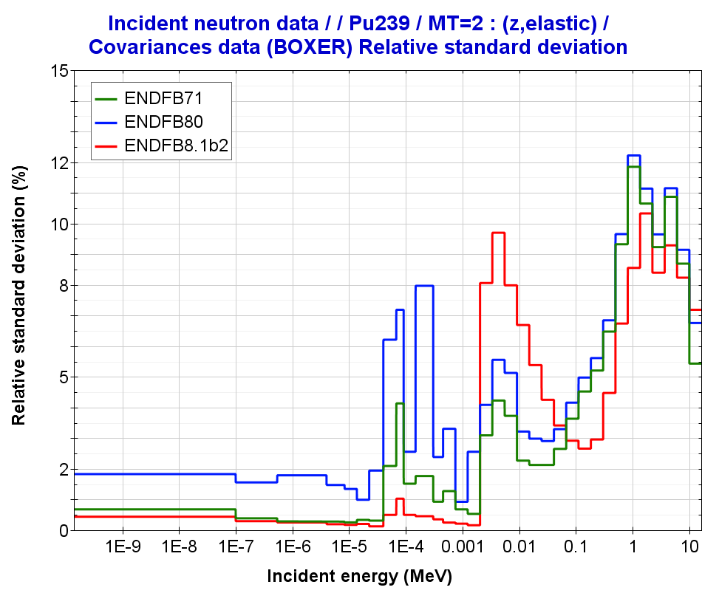
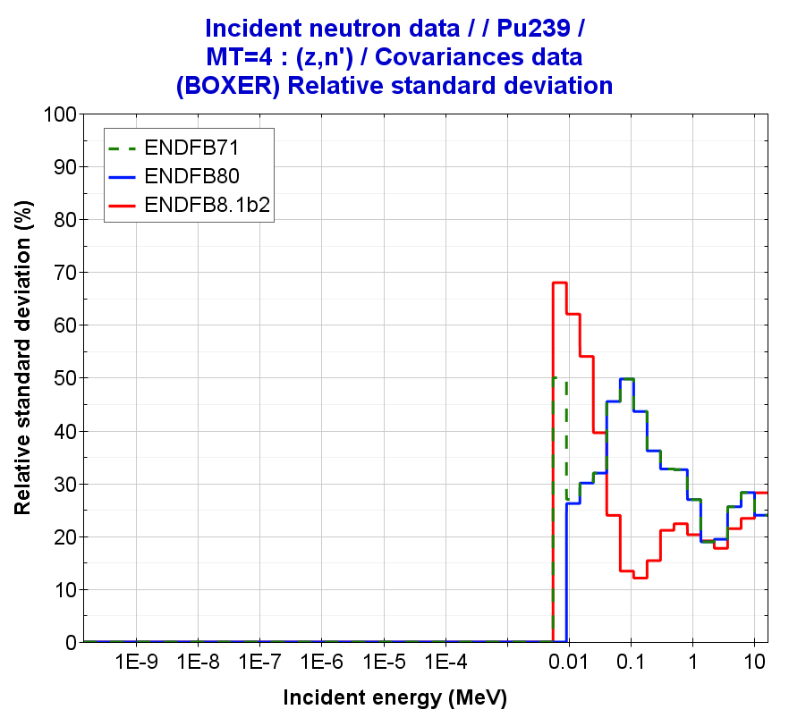
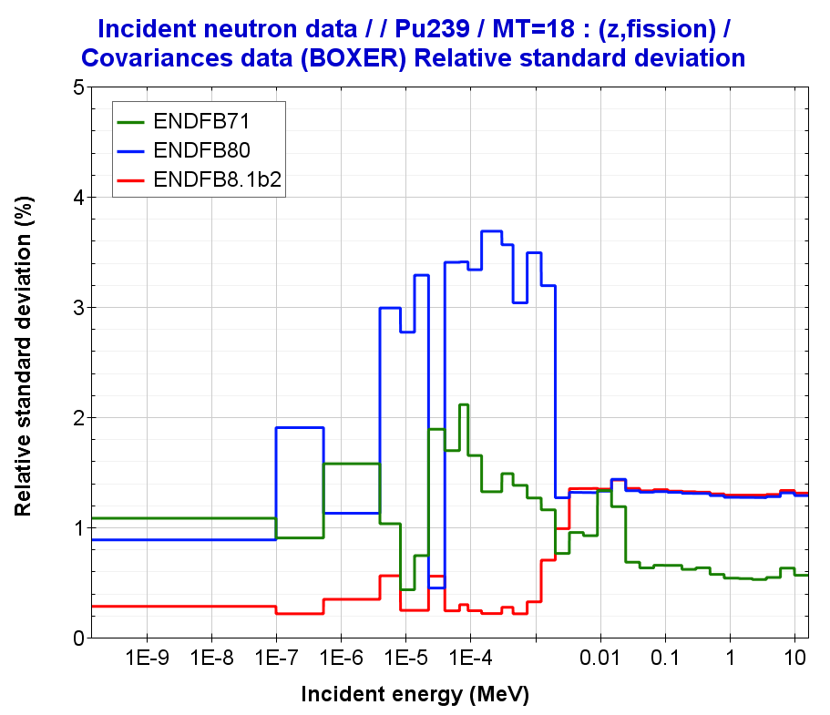
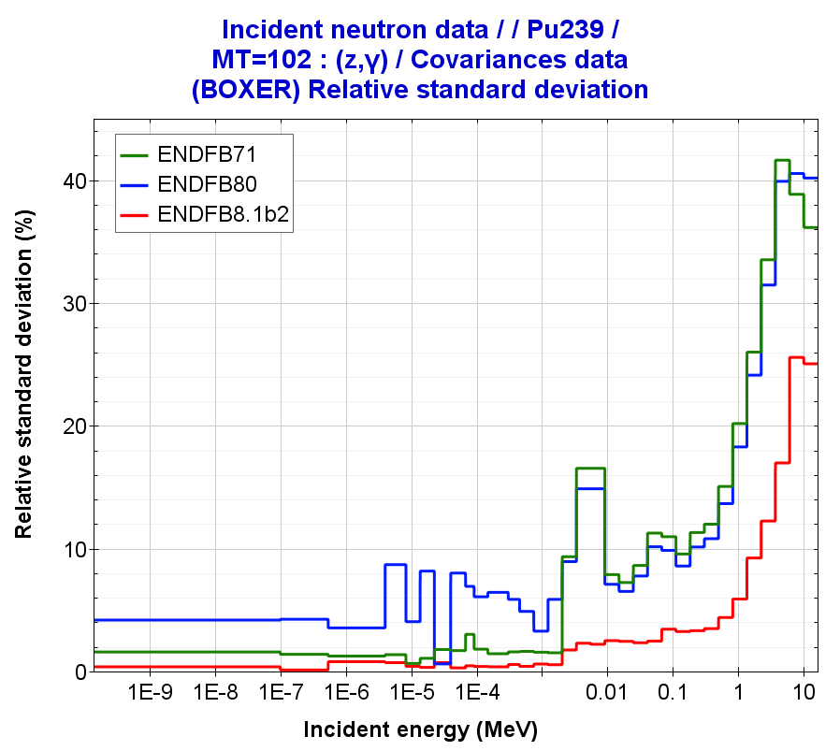
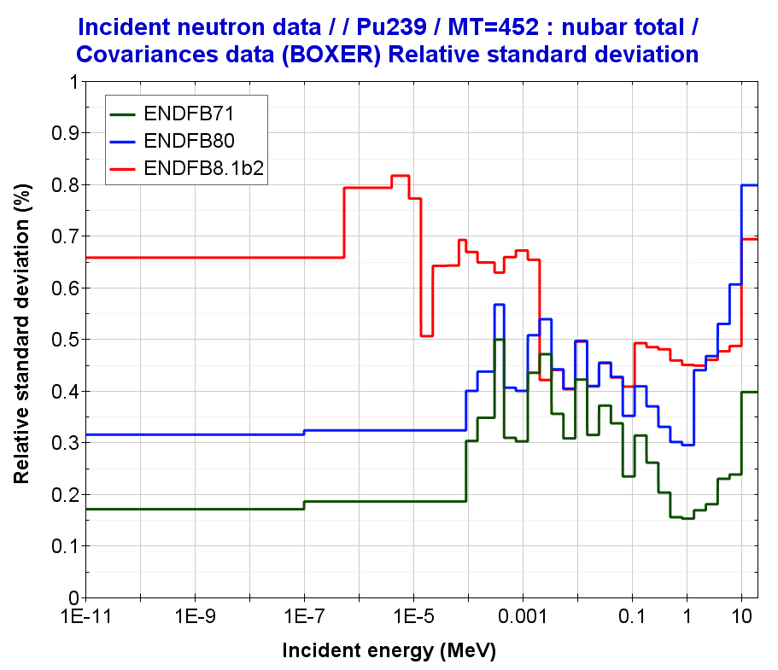
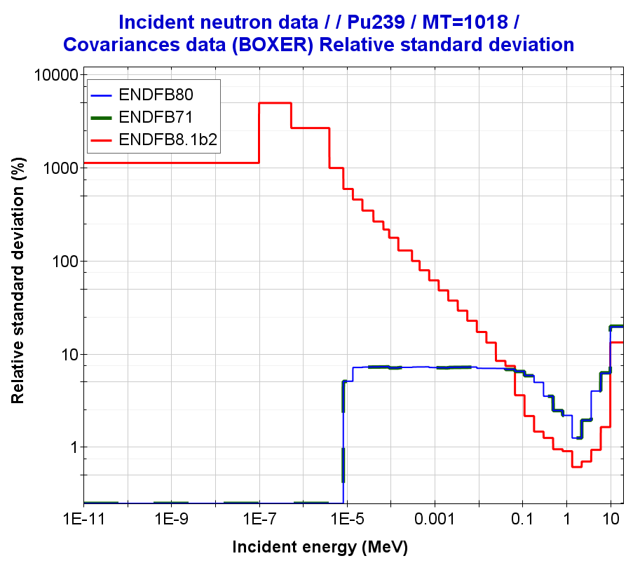
PU239 covariances
Pu239(n,elastic)
Pu239(n,inelastic)
Pu239(n,fission)
1
2
Pu239(n,gamma)
Pu239(nubar)
Pu239(PFNS)
3
4

Slide 7
Table. Bias and nuclear data uncertainties in PU-MET-FAST-001 (Jezebel)
 | JEFF-3.3 | ENDF/B-VIII.0 | ENDF/B-VIII.1b2 | JENDL-4.0u1 | JENDL-5.0
Exp. Uncertainty | ±110 | ±110 | ±110 | ±110 | ±110
|C-E|* | 15 | 68 | 61 | 185 | 61
 | UNCERTAINTIES in keff
Nubar | 413 | 318 | 419 | 209 | 210
PFNS | 443 | 181 | 39 | 286 | 273
Fission | 305 | 903 | 917 | 434 | 668
Elastic | 90 | 460 | 341 | 198 | 195
Inelastic | 150 | 789 | 651 | 250 | 250
Capture | 30 | 67 | 19 | 59 | 60
elasticP1 | - | 150 | 150 | - | 150
Correlated Sum | 645 | 1054 | 1060 | 648 | 832
↑
↓
↓
↓
↓
Note: (values in pcm)
NDAST – Uncertainty Quantification using 1st-order approximation “Sandwich formula”
* Calculations (C) performed with MCNP6-1.0

Slide 8
Uncertainty Quantification with ENDF/B-VIII.1b2: ICSBEP/U233 cases
Verification ND uncertainties: U233 cases
Fissile material |  | U233 | PU
Spectrum |  | FAST | INTER | MIXED | THERM
Number of Benchmarks |  | 8 | 29 | 8 | 194
Experimental Uncertainty (pcm) |  | 174 | 670 | 601 | 600
Total (pcm) | ENDF/B-VIII.1b2 | - | - | - | -
 | ENDF/B-VIII.0 | 810 | 1132 | 1155 | 1131
 | ENDF/B-VII.1 | 754 | 486 | 472 | 495
Cross-sections (with correlations) | ENDF/B-VIII.1b2 | - | - | - | -
Cross-sections | ENDF/B-VIII.0 | 640 | 315 | 329 | 514
 | ENDF/B-VII.1 | 724 | 364 | 297 | 206
P1-elastic | ENDF/B-VIII.1b2 | - | - | - | -
P1-elastic | ENDF/B-VIII.0 | - | - | - | -
 | ENDF/B-VII.1 | - | - | - | -
nubar | ENDF/B-VIII.1b2 | - | - | - | -
nubar | ENDF/B-VIII.0 | 484 | 496 | 501 | 508
 | ENDF/B-VII.1 | 211 | 319 | 367 | 447
PFNS | ENDF/B-VIII.1b2 | - | - | - | -
PFNS | ENDF/B-VIII.0 | 95 | 967 | 987 | 837
 | ENDF/B-VII.1 | - | - | - | -
Uncertainty Quantification in ICSBEP using NDaST
only U233 covariances

Slide 9
Uncertainty Quantification with ENDF/B-VIII.1b2: ICSBEP/HEU cases
Verification ND uncertainties: HEU cases
HENDF/ENDF/B-VIII.1b2: Uncertainty Quantification in ICSBEP using NDaST
Fissile material |  | HEU | PU
Spectrum |  | FAST | INTER | MIXED | THERM
Number of Benchmarks |  | 477 | 21 | 78 | 798
Experimental Uncertainty (pcm) |  | 225 | 310 | 415 | 473
ENDF/B-VIII.1b2 only U235 covariances | Total (pcm) | 883 | 649 | 588 | 667
KJE | Cross-sections* | 811 | 514 | 442 | 143
 | P1-elastic | - | - | - | -
 | nubar | 346 | 333 | 364 | 640
 | PFNS | 29 | 60 | 61 | 98
ENDF/B-VIII.1b2 only U238 covariances | Total (pcm) | 51 | 63 | 13 | 6
 | Cross-sections* | 47 | 61 | 11 | 6
 | P1-elastic | - | - | -
 | nubar | 16 | 10 | 6 | 1
 | PFNS | 5 | 3 | 1 | 0
U235 covariances
U238 covariances
Calculations with NDaST: only U235/238 covariances
NOTE: *Cross-sections (with correlations)

Slide 10
Uncertainty Quantification with ENDF/B-VIII.1b2: ICSBEP/HEU cases
Verification ND uncertainties: HEU cases
Fissile material |  | HEU | PU
Spectrum |  | FAST | INTER | MIXED | THERM
Number of Benchmarks |  | 477 | 21 | 78 | 798
Experimental Uncertainty (pcm) |  | 225 | 310 | 415 | 473
Total (pcm) | ENDF/B-VIII.1b2 | 883 | 649 | 588 | 667
 | ENDF/B-VIII.0 | 911 | 758 | 649 | 497
 | ENDF/B-VII.1 | 1350 | 1920 | 1266 | 978
Cross-sections (with correlations) | ENDF/B-VIII.1b2 | 811 | 514 | 442 | 143
Cross-sections | ENDF/B-VIII.0 | 816 | 545 | 470 | 155
 | ENDF/B-VII.1 | 1207 | 1748 | 1062 | 233
P1-elastic | ENDF/B-VIII.1b2 | - | - | - | -
P1-elastic | ENDF/B-VIII.0 | - | - | - | -
 | ENDF/B-VII.1 | - | - | -
nubar | ENDF/B-VIII.1b2 | 346 | 333 | 364 | 640
nubar | ENDF/B-VIII.0 | 402 | 501 | 435 | 457
 | ENDF/B-VII.1 | 544 | 597 | 550 | 658
PFNS | ENDF/B-VIII.1b2 | 29 | 60 | 61 | 98
PFNS | ENDF/B-VIII.0 | 29 | 60 | 61 | 98
 | ENDF/B-VII.1 | 210 | 334 | 346 | 622
Uncertainty Quantification in ICSBEP using NDaST
only U235 covariances
↓
↓
↓
↑
Differences in XS-correlations
↓
↓
↓
↑

Slide 11
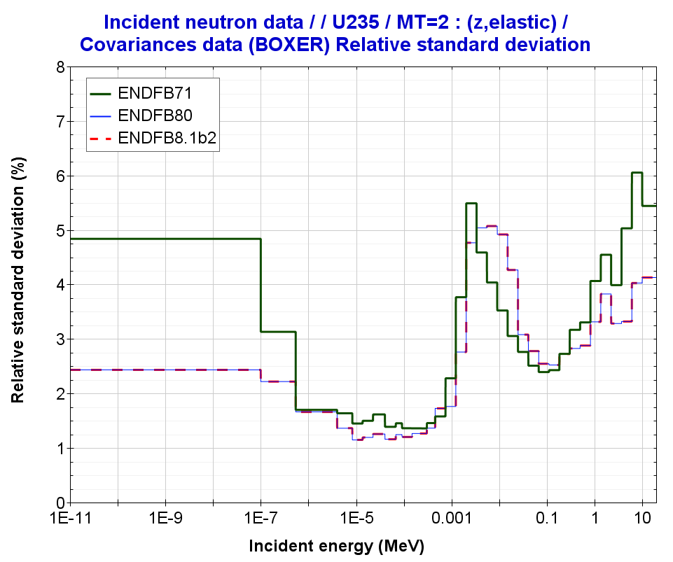
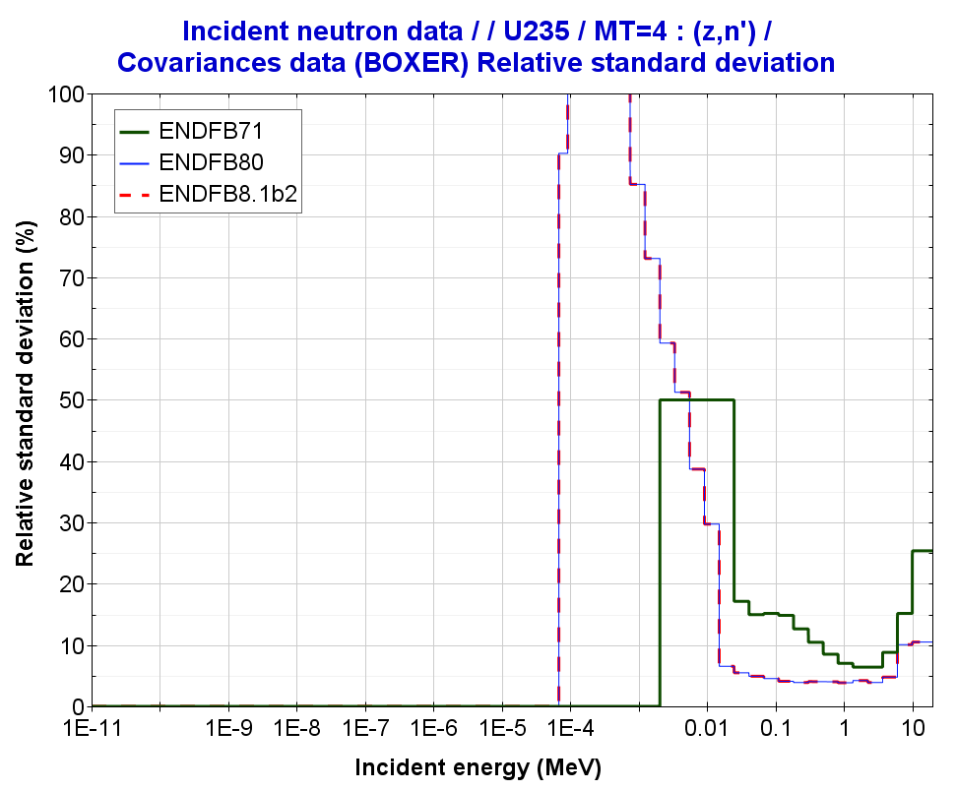
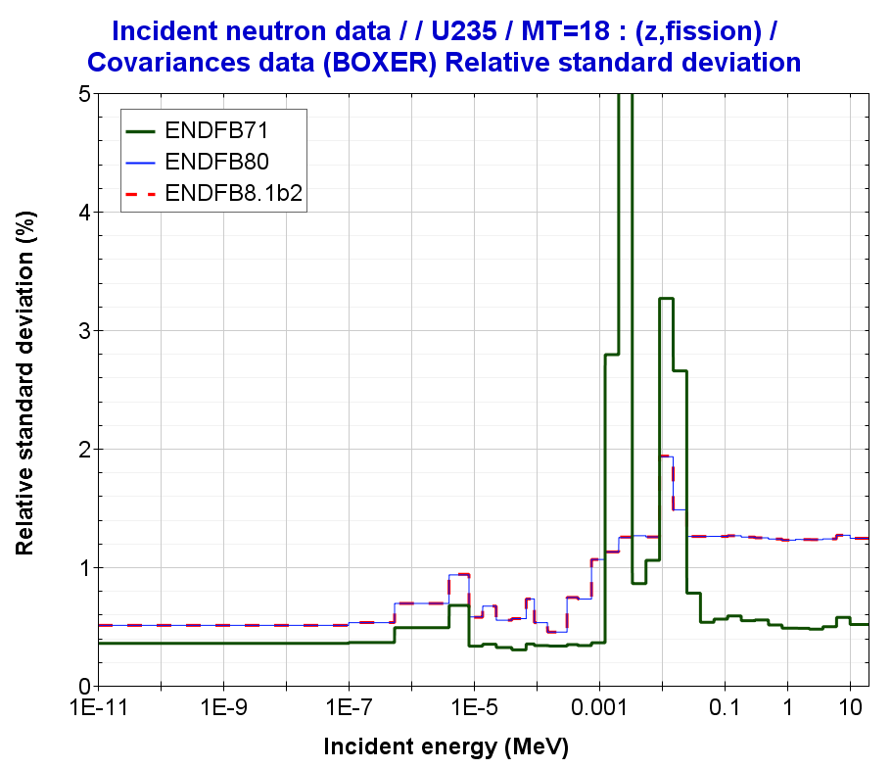
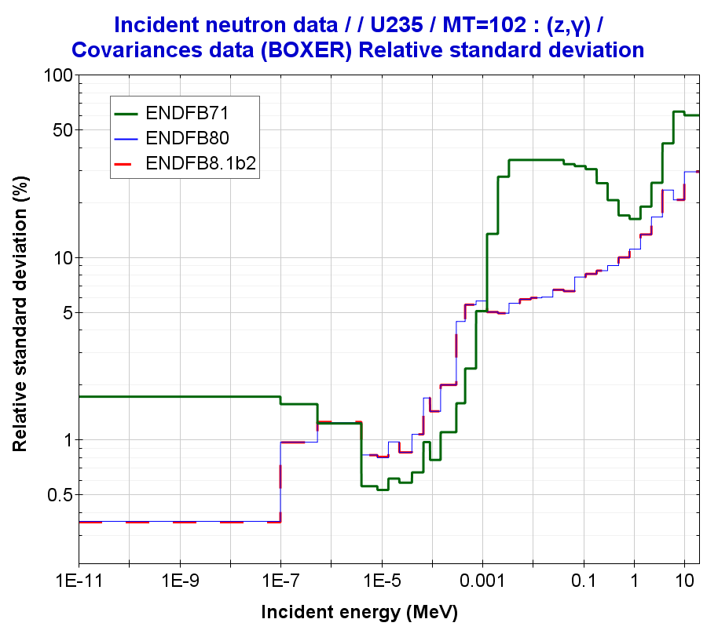
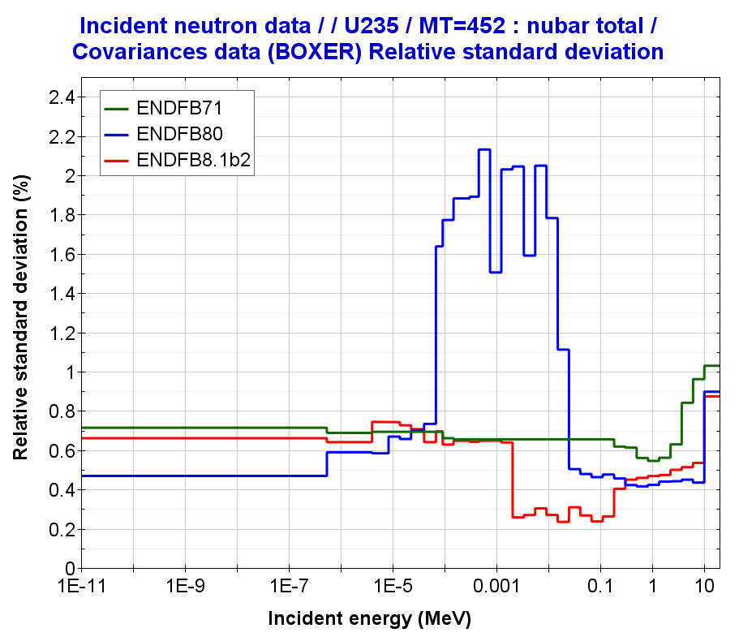
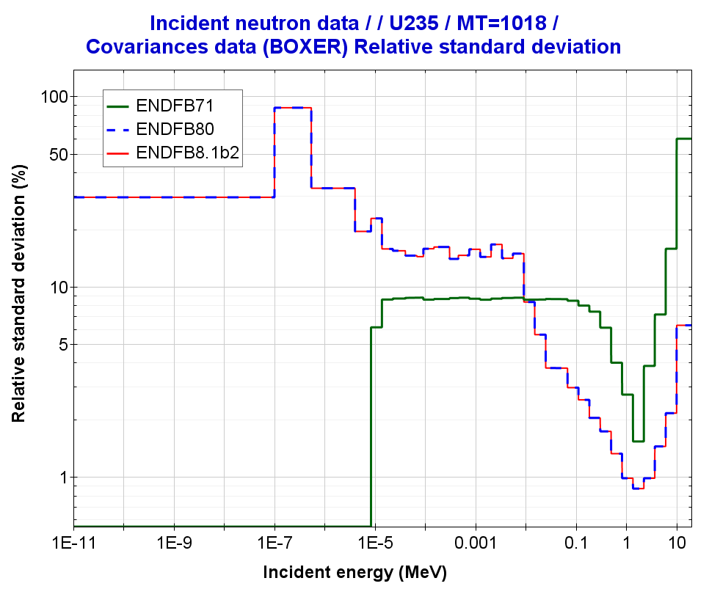
U235 covariances
U235(n,elastic)
U235(n,inelastic)
U235(n,fission)
U235(n,gamma)
U235(nubar)
U235(PFNS)
2
1

Slide 12
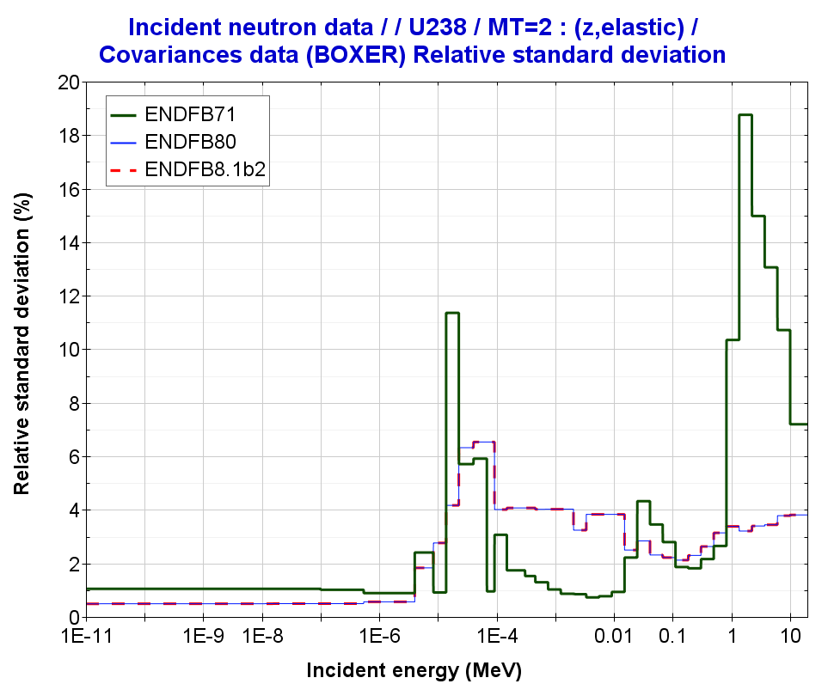
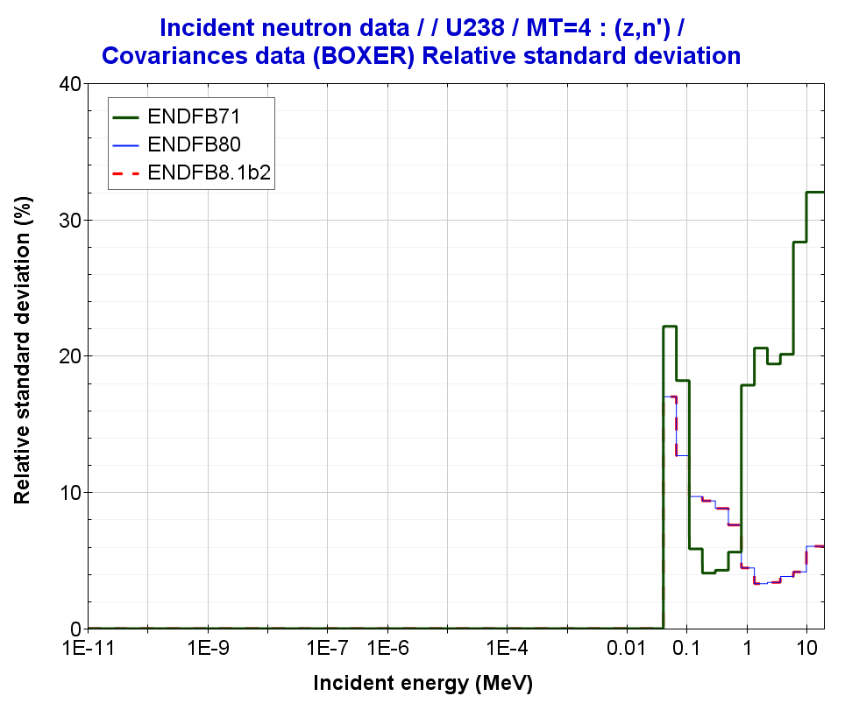
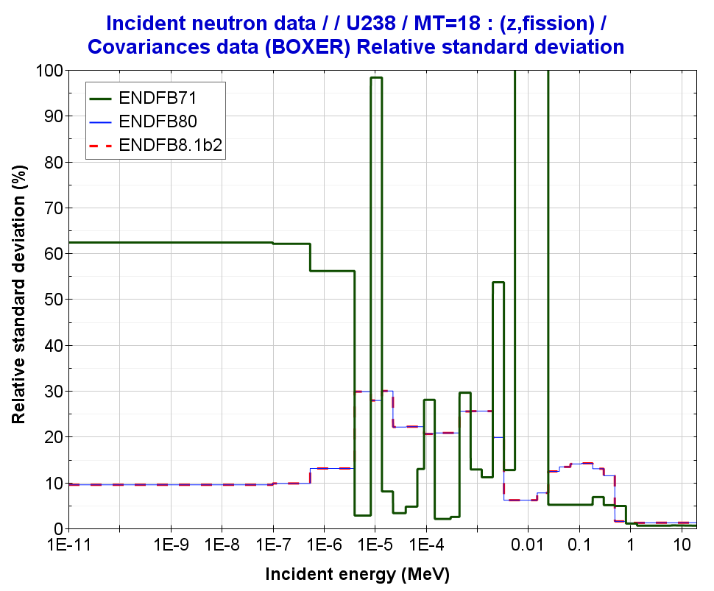
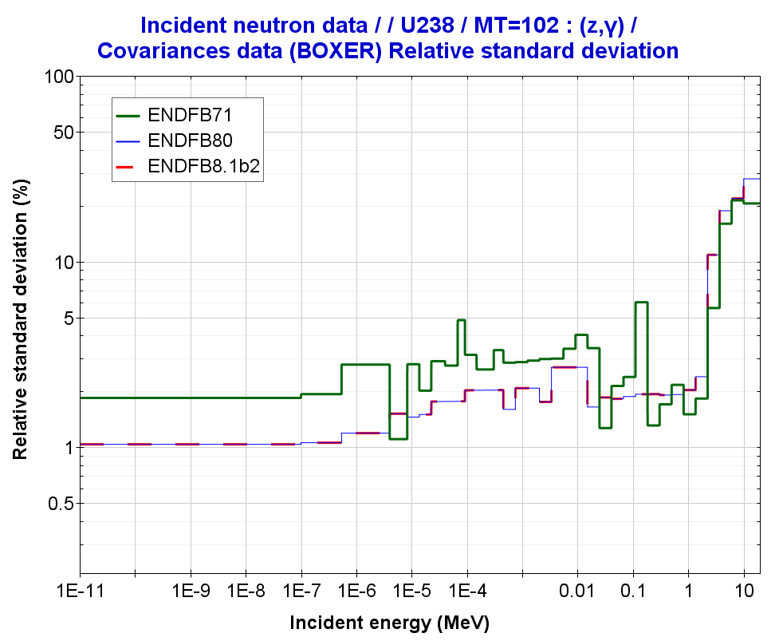
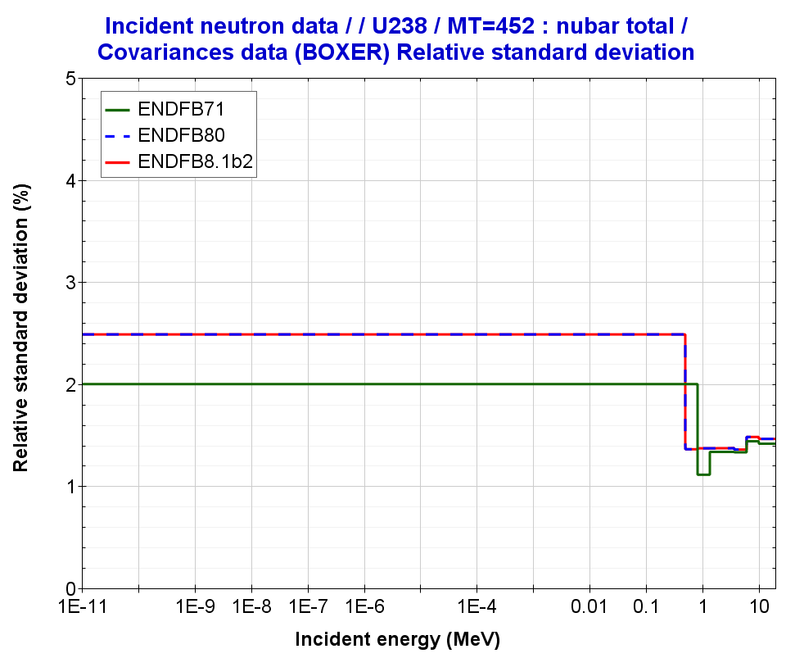
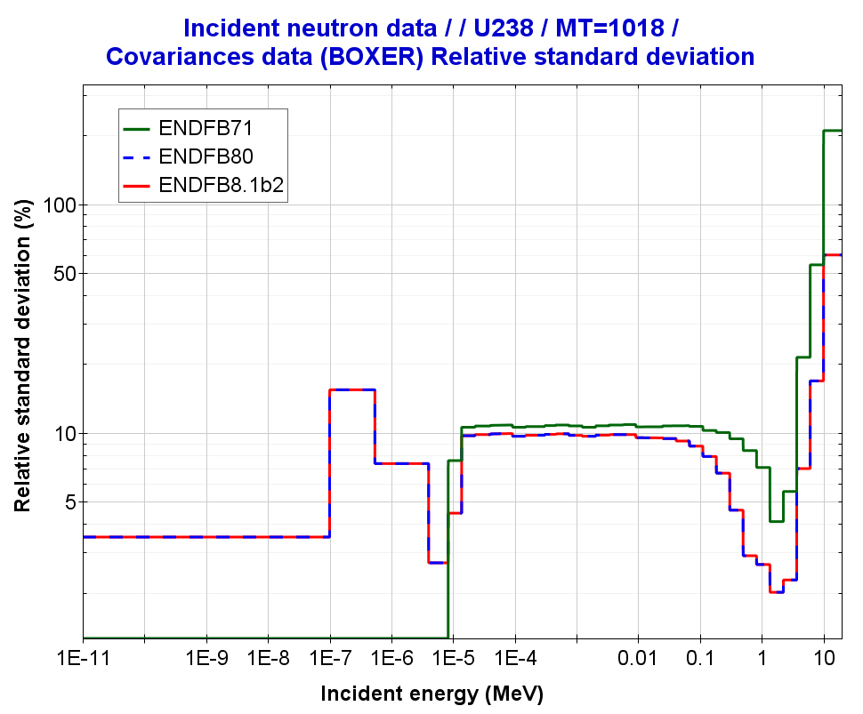
U238 covariances
U238(n,elastic)
U238(n,inelastic)
U238(n,fission)
U238(n,gamma)
U238(nubar)
U238(PFNS)

Slide 13
Table. Bias and nuclear data uncertainties in HEU-MET-FAST-001 (Godiva)
 | JEFF-3.3 |  | ENDF/B-VIII.0 | ENDF/B-VIII.1b2 | JENDL-4.0u1 | JENDL-5.0
Exp. Uncertainty | ±100 |  | ±100 | ±100 | ±100 | ±100
|C-E| | 16 |  | 6 | 24 | 167 | 74
 | UNCERTAINTIES
 | NDAST | SANDY | NDAST | NDAST | NDAST | NDAST
Nubar | 510 | 503 | 400 | 383.5 | 274 | 272
PFNS | 364 | 216 | 124 | 31 | 176 | 169
Fission | 648 | 643 | 788 | 788 | 320 | 475
Elastic | 109 | - | 276 | 276 | 426 | 421
Inelastic | 698 | - | 244 | 244 | 681 | 679
Capture | 375 | - | 281 | 282 | 269 | 272
elasticP1 | - | - | - | - | - | 422
Correlated Sum | 1342 | 1262 | 1036 | 1013 | 962 | 1104
↓
↓
Note: (values in pcm)
NDAST – Uncertainty Quantification using 1st-order approximation “Sandwich formula”
Monte Carlo sampling using SANDY with 300 random samples

Slide 14
Uncertainty Quantification with ENDF/B-VIII.1b2: ICSBEP/IEU cases
Verification ND uncertainties: IEU cases
HENDF/ENDF/B-VIII.1b2: Uncertainty Quantification in ICSBEP using NDaST
Fissile material |  | IEU | PU
Spectrum |  | FAST | INTER | MIXED | THERM
Number of Benchmarks |  | 58 | 8 | 8 | 143
Experimental Uncertainty (pcm) |  | 175 | 166 | 360 | 514
ENDF/B-VIII.1b2 only U235 covariances | Total (pcm) | 753 | 589 | 564 | 657
KJE | Cross-sections* | 714 | 528 | 220 | 131
 | P1-elastic | - | - | - | -
 | nubar | 229 | 233 | 492 | 631
 | PFNS | 65 | 40 | 70 | 121
ENDF/B-VIII.1b2 only U238 covariances | Total (pcm) | 409 | 292 | 130 | 57
 | Cross-sections* | 336 | 246 | 119 | 55
 | P1-elastic | - | - | - | -
 | nubar | 206 | 149 | 49 | 12
 | PFNS | 101 | 41 | 14 | 6
U235 covariances
U238 covariances
Calculations with NDaST: only U235/238 covariances
NOTE: *Cross-sections (with correlations)

Slide 15
Uncertainty Quantification with ENDF/B-VIII.1b2: ICSBEP/IEU cases
Verification ND uncertainties: IEU cases
Fissile material |  | IEU | PU
Spectrum |  | FAST | INTER | MIXED | THERM
Number of Benchmarks |  | 58 | 8 | 8 | 143
Experimental Uncertainty (pcm) |  | 175 | 166 | 360 | 514
Total (pcm) | ENDF/B-VIII.1b2 | 753 | 589 | 564 | 657
 | ENDF/B-VIII.0 | 800 | 726 | 521 | 492
 | ENDF/B-VII.1 | 1688 | 1853 | 938 | 1045
Cross-sections (with correlations) | ENDF/B-VIII.1b2 | 714 | 528 | 220 | 131
Cross-sections | ENDF/B-VIII.0 | 716 | 561 | 254 | 143
 | ENDF/B-VII.1 | 1539 | 1740 | 598 | 264
P1-elastic | ENDF/B-VIII.1b2 | - | - | - | -
P1-elastic | ENDF/B-VIII.0 | - | - | - | -
 | ENDF/B-VII.1 | - | - | - | -
nubar | ENDF/B-VIII.1b2 | 229 | 233 | 492 | 631
nubar | ENDF/B-VIII.0 | 348 | 454 | 554 | 543
 | ENDF/B-VII.1 | 486 | 540 | 436 | 650
PFNS | ENDF/B-VIII.1b2 | 65 | 40 | 70 | 121
PFNS | ENDF/B-VIII.0 | 65 | 40 | 70 | 121
 | ENDF/B-VII.1 | 474 | 288 | 413 | 768
Uncertainty Quantification in ICSBEP using NDaST
only U235 covariances
↓
↓
↑
Differences in XS-correlations
↓
↓
↑

Slide 16
Uncertainty Quantification with ENDF/B-VIII.1b2: ICSBEP/IEU cases
Verification ND uncertainties: IEU cases
Fissile material |  | IEU | PU
Spectrum |  | FAST | INTER | MIXED | THERM
Number of Benchmarks |  | 58 | 8 | 8 | 143
Experimental Uncertainty (pcm) |  | 175 | 166 | 360 | 514
Total (pcm) | ENDF/B-VIII.1b2 | 409 | 292 | 130 | 57
 | ENDF/B-VIII.0 | 466 | 309 | 157 | 63
 | ENDF/B-VII.1 | 795 | 365 | 365 | 137
Cross-sections (with correlations) | ENDF/B-VIII.1b2 | 336 | 246 | 119 | 55
Cross-sections | ENDF/B-VIII.0 | 403 | 267 | 148 | 61
 | ENDF/B-VII.1 | 689 | 300 | 360 | 135
P1-elastic | ENDF/B-VIII.1b2 | - | - | - | -
P1-elastic | ENDF/B-VIII.0 | - | - | - | -
 | ENDF/B-VII.1 | - | - | - | -
nubar | ENDF/B-VIII.1b2 | 206 | 149 | 49 | 12
nubar | ENDF/B-VIII.0 | 206 | 149 | 49 | 12
 | ENDF/B-VII.1 | 199 | 144 | 48 | 12
PFNS | ENDF/B-VIII.1b2 | 101 | 41 | 14 | 6
PFNS | ENDF/B-VIII.0 | 101 | 41 | 14 | 6
 | ENDF/B-VII.1 | 320 | 131 | 36 | 18
Uncertainty Quantification in ICSBEP using NDaST
only U238 covariances
↓
↓

Slide 17
Uncertainty Quantification with ENDF/B-VIII.1b2: ICSBEP/LEU cases
Verification ND uncertainties: LEU cases
HENDF/ENDF/B-VIII.1b2: Uncertainty Quantification in ICSBEP using NDaST
Fissile material |  | LEU | PU
Spectrum |  | FAST | INTER | MIXED | THERM
Number of Benchmarks |  | 1 | - | 5 | 1565
Experimental Uncertainty (pcm) |  | 274 | - | 353 | 240
ENDF/B-VIII.1b2 only U235 covariances | Total (pcm) | 788 | - | 624 | 638
KJE | Cross-sections* | 721 | - | 536 | 156
 | P1-elastic | - | - | - | -
 | nubar | 317 | - | 312 | 616
 | PFNS | 29 | - | 25 | 47
ENDF/B-VIII.1b2 only U238 covariances | Total (pcm) | 125 | - | 158 | 171
 | Cross-sections* | 118 | - | 140 | 160
 | P1-elastic | - | - | - | -
 | nubar | 41 | - | 72 | 59
 | PFNS | 7 | - | 11 | 11
U235 covariances
U238 covariances
Calculations with NDaST: only U235/238 covariances
NOTE: *Cross-sections (with correlations)

Slide 18
Uncertainty Quantification with ENDF/B-VIII.1b2: ICSBEP/LEU cases
Verification ND uncertainties: LEU cases
Fissile material |  | LEU | PU
Spectrum |  | FAST | INTER | MIXED | THERM
Number of Benchmarks |  | 1 | - | 5 | 1565
Experimental Uncertainty (pcm) |  | 274 | - | 353 | 240
Total (pcm) | ENDF/B-VIII.1b2 | 788 | - | 624 | 638
 | ENDF/B-VIII.0 | 832 | - | 685 | 471
 | ENDF/B-VII.1 | 1253 | - | 1019 | 752
Cross-sections (with correlations) | ENDF/B-VIII.1b2 | 721 | - | 536 | 156
Cross-sections | ENDF/B-VIII.0 | 734 | - | 562 | 163
 | ENDF/B-VII.1 | 1110 | - | 857 | 237
P1-elastic | ENDF/B-VIII.1b2 | - | - | - | -
P1-elastic | ENDF/B-VIII.0 | - | - | - | -
 | ENDF/B-VII.1 | - | - | - | -
nubar | ENDF/B-VIII.1b2 | 317 | - | 312 | 616
nubar | ENDF/B-VIII.0 | 392 | - | 388 | 437
 | ENDF/B-VII.1 | 532 | - | 509 | 640
PFNS | ENDF/B-VIII.1b2 | 29 | - | 25 | 47
PFNS | ENDF/B-VIII.0 | 29 | - | 25 | 47
 | ENDF/B-VII.1 | 231 | - | 203 | 290
Uncertainty Quantification in ICSBEP using NDaST
only U235 covariances
↓
↑
Differences in XS-correlations
↓
↑

Slide 19
CONCLUSION
Processing in JANIS format
ENDF/B-VIII.1b2 into JANIS Database
Testing Covariances using NDaST in ICSBEP
 |  | Comments: U233 cases
U233 | PFNS | No covariances
Pu239 | Nubar | No covariances
 | Cross-sections | No covariances
 |  | Comments: PU cases
Pu239 | PFNS | Lower values than ENDF/B-VIII.0 ~25-60 pcm
Pu239 | Nubar | Higher values than ENDF/B-VIII.0 THERM: Significant change…. 308 pcm → 631 pcm
 | Cross-sections | Ver low values in INTER, MIXED and THERM cases !! Similar values in FAST case
Isotope | ND | Comments: HEU, IEU and LEU cases
U235 | PFNS | No changes with ENDF/B-VIII.0
Pu239 | Nubar | FAST/MIXED/INTER: lower values than ENDF/B-VIII.0 THERM: higher values than ENDF/B-VIII.0
 | Cross-sections | Similar values to ENDF/-VIII.0 … small differences due to cross-correlations

Slide 20
Acknowledgments
This work is part of the SANDA project (Supplying Accurate Nuclear Data for energy and non-energy Applications) that has received funding from the European Union’s H2020/Euratom under grant agreement No. 847552

Slide 21
Backup slides

Slide 22
Uncertainty Quantification with ENDF/B-VIII.1b2: ICSBEP/HEU cases
Verification ND uncertainties: HEU cases
Fissile material |  | HEU | PU
Spectrum |  | INTER
Number of Benchmarks |  | 21
Experimental Uncertainty (pcm) |  | 310
 |  |  | ENDF/B-VIII.1b2 | ENDF/B-VIII.0
Cross-sections (with correlations) | All |  | 514 | 545
Cross-sections | (n,elastic) |  | 48 | 48
 | (n,inelastic) |  | 73 | 73
 | (n,2n) |  | 7 | 7
 | (n,fission) |  | 369 | 369
 | (n,gamma) |  | 328 | 328
 | (n,fission)+(n,gamma) |  | 496 | 528
 | (n,elastic) +(n,inelastic) |  | 89 | 100
Uncertainty Quantification in ICSBEP using NDaST
only U235 covariances
Differences in XS-correlations

Slide 23
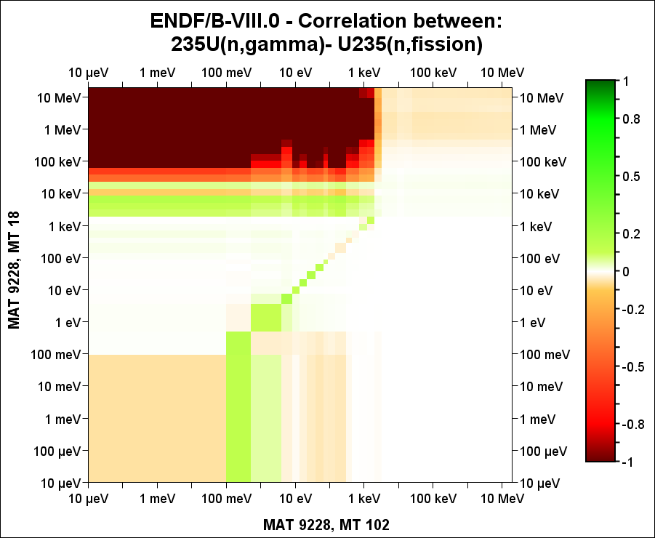
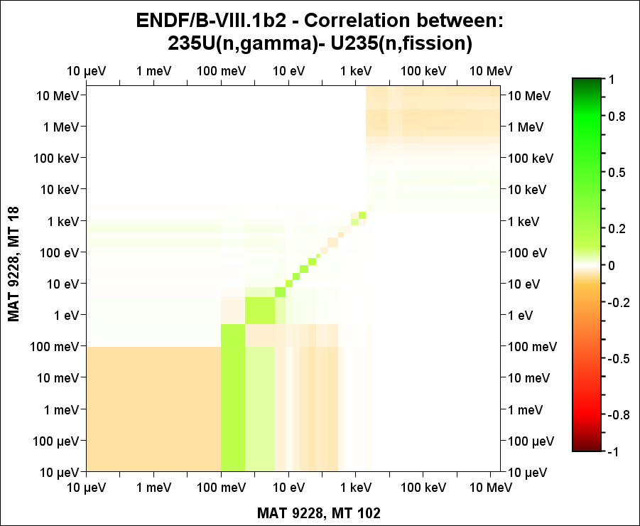
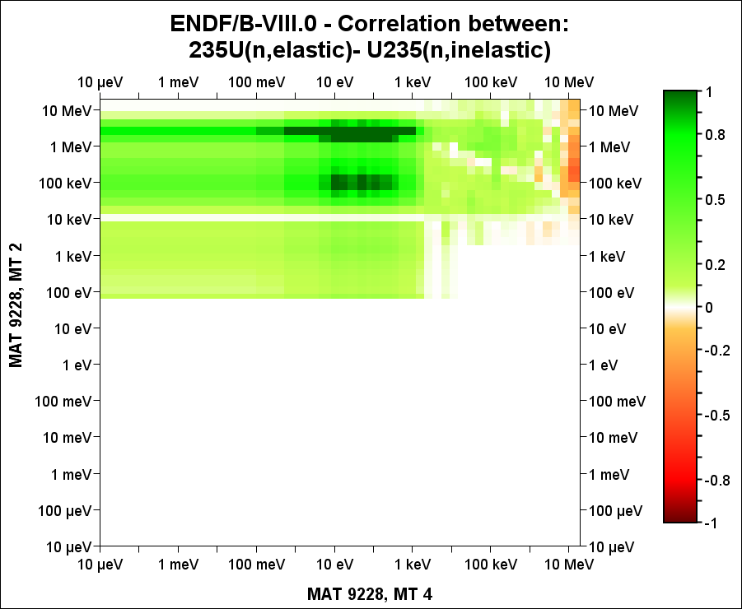
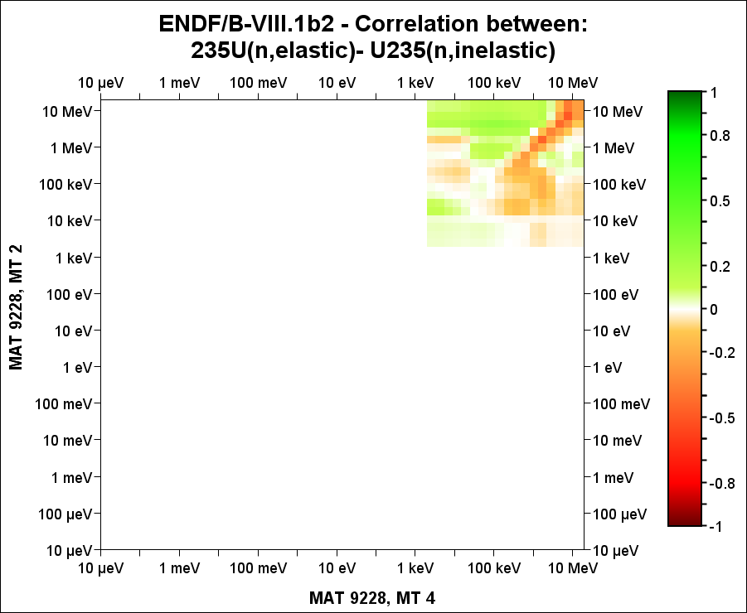

Slide 24
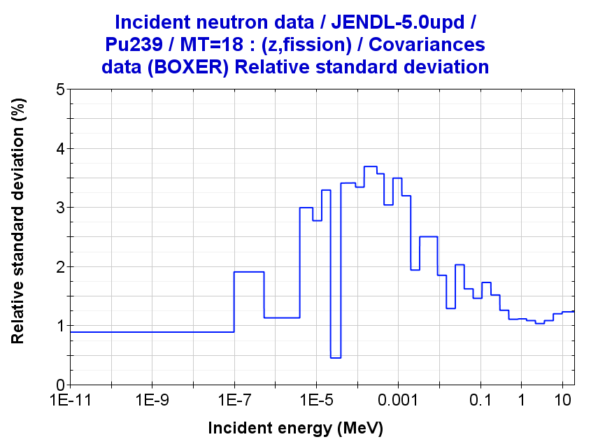
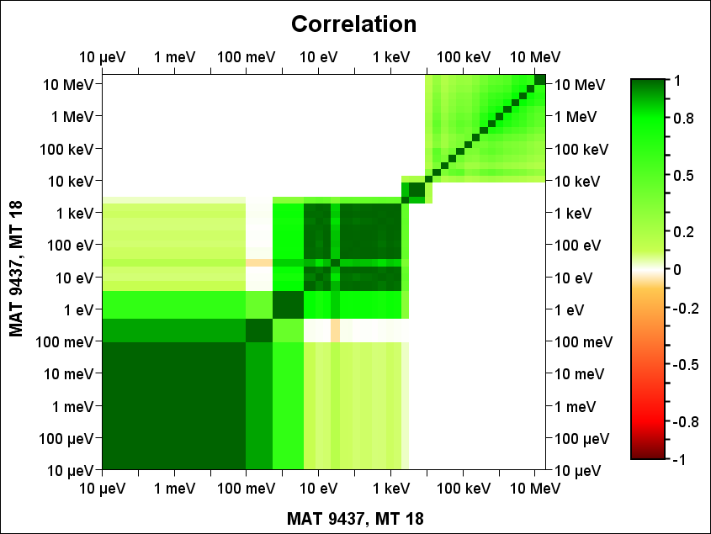
Processing into BOXER format
Processing ND/MF32+MF33 in BOXER format
moder /
1 21
'094-Pu-239 '
20 9437 /
0/
reconr /
21 22
'094-Pu-239 '
9437 2 /
0.005 /
'Reconstructed'/
'Processed'/
0/
broadr /
21 22 23
9437 1 0 0 0./
0.005 /
300.0 /
0/
unresr /
21 23 24
9437 1 1 0 /
300.0 /
1.0E+10 /
0 /
groupr /
21 24 0 31/
9437 1 0 2 0 1 1 1 /
'GENDF- 238g' /
300.0
1.E10
238 /
1.00000E-05
1.00000E-04
5.00000E-04
…
1.73300E+07
2.0000E+07 /
3/
3 18/
3 251/
3 452 nubar_t/
3 455 nubar_d/
3 456 nubar_p/
5 455 nubar_spc/
0/
0/
errorr
21 24 0 77 /
9437 1 2 1 1 /
1 300.0 / Just only one temperature
0 33 /
33 /
1.00000E-05
1.00000E-01
…
6.06531E+06
1.00000E+07
1.9640E+07 /
covr
77 0 81 /
1/
/
/
9437 0 0 0 /
viewr
81 82
covr
77 78 /
4 1
'LIB_JENDL-5.0upd ' /
'BOXER format'/
9437 0 0 0 /
stop
Figure 5. Input deck to process MF32/33 covariances
tape20 = ENDF Pu239
=====================

Slide 25
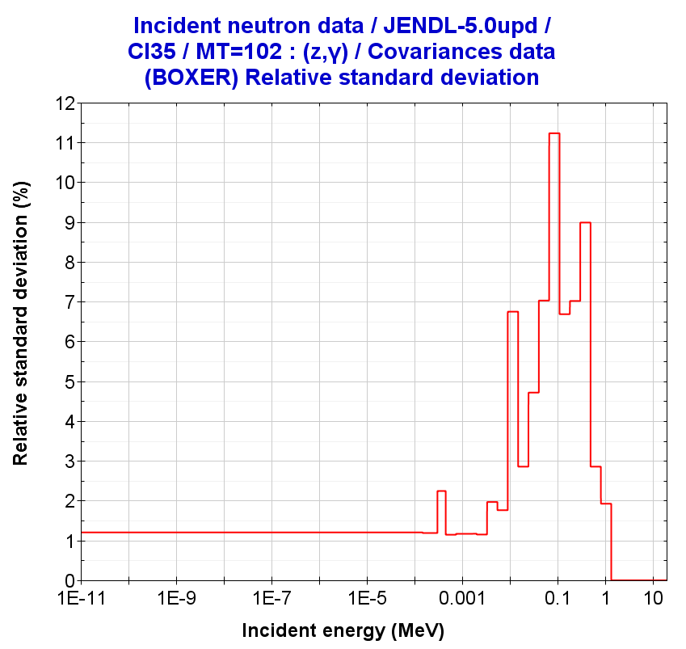
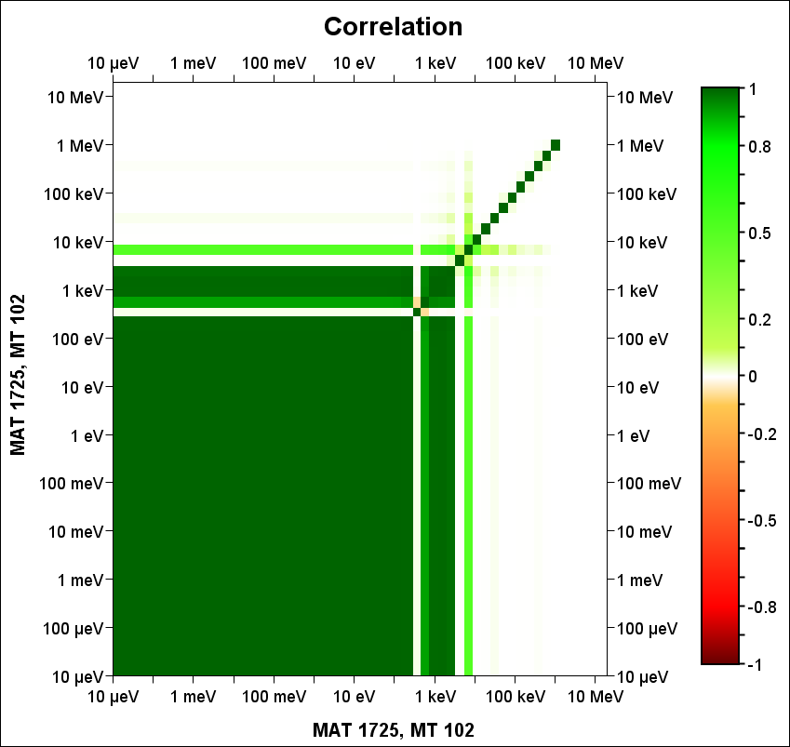
Processing into BOXER format
Processing ND/MF32 “only” in BOXER format
Figure 6. Input deck to process covariances in files with MF32-only
moder
1 21
'017-Cl-35 '
20 1725 /
0/
reconr
21 22
'017-Cl-35 '
1725 2 /
0.005 /
'Reconstructed'/
'Processed'/
0/
broadr
21 22 23
1725 1 0 0 0./
0.005 /
300.0 /
0/
unresr
21 23 24
1725 1 1 0 /
300.0 /
1.0E+10 /
0 /
errorr
999/
21 88/
1 / MT1
2 / MT2
102 / MT102
600 / MT600
0/
errorr
88 24 0 77 /
1725 1 2 1 1 /
1 300.0 / Just only one temperature
0 33 /
33 /
1.00000E-05
1.00000E-01
5.40000E-01
…
1.00000E+07
1.9640E+07 /
covr
77 0 81 /
1/
/
/
1725 0 0 0 /
viewr
81 82
covr
77 78 /
4 1
'LIB_JENDL-5.0upd ' /
'BOXER format'/
1725 0 0 0 /
stop
Materials only MF32
JENDL-5.0:
Cl35, Cr50, Cr54
JEFF-4T2.2
Cl35, Cl37
Cu63, Cu65
Pa231, Pa233
Pu240, Am241
tape20 = ENDF Cl35
==================

Slide 26
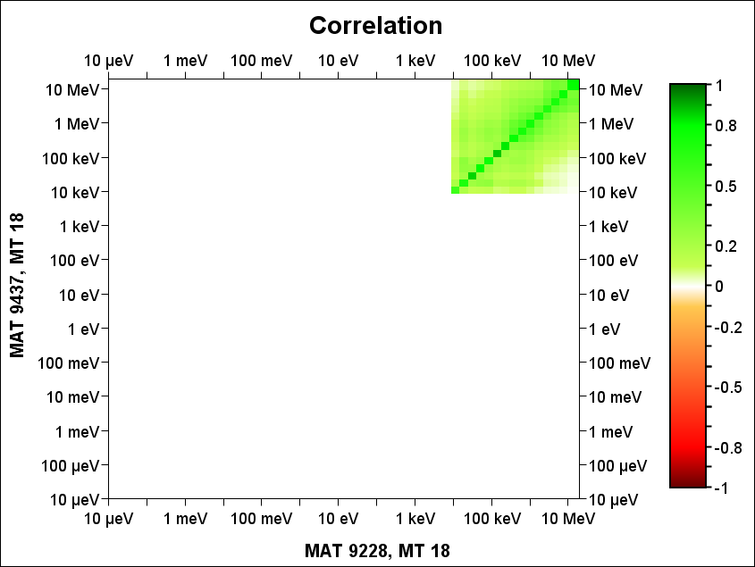
Processing into BOXER format
Processing ND/MF33 –cc in MATs in BOXER format
moder /
2 99
' 9437 and 9228' /
91 9437 /
92 9228 /
0/
errorr
21 0 99 26 61 /
9437 1 2 1 1 /
1 300.0 / Just only one temperature
2 33 /
9228 18 /
0 /
33 /
1.00000E-05
1.00000E-01
…
1.00000E+07
1.9640E+07 /
covr
26 0 81 /
1/
/
/
9437 18 9228 18 /
viewr
81 82
covr
26 27 /
4 1
'LIB_JENDL-5.0upd ' /
'BOXER format'/
9437 18 9228 18 /
stop
Figure 7. Input deck to process MF33 covariances between different materials
tape21 = ENDF Pu239
tape91 = GENDF-238g Pu239
tape92 = GENDF-238g U235
tape61 = input cov. tape77(ERRORR output) for U235
=====================================================

Slide 27
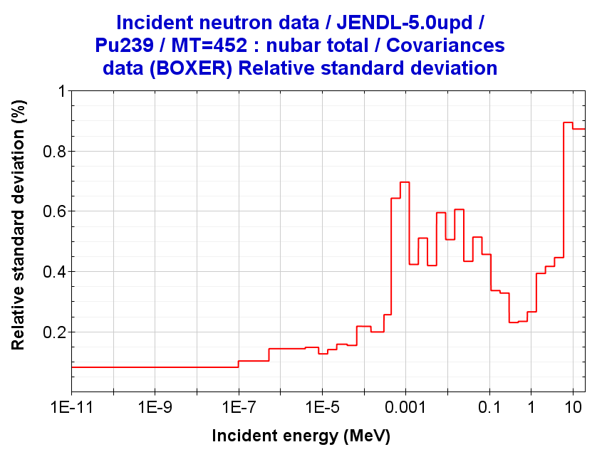
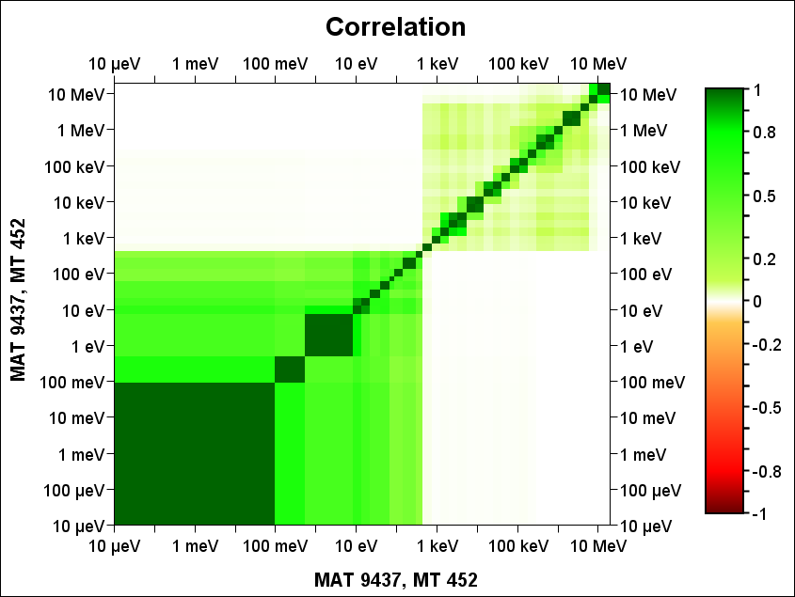
Processing into BOXER format
Processing ND/MF31 in BOXER format
groupr /
21 24 0 31/
9437 1 0 2 0 1 1 1 /
'GENDF- 33g' /
300.0
1.E10
33 /
1.00000E-05
1.00000E-01
…
3.67879E+06
6.06531E+06
1.00000E+07
1.9640E+07 /
3/
3 452 nubar_t/
3 455 nubar_d/
3 456 nubar_p/
5 455 nubar_spc/
0/
0/
errorr
21 0 31 41 /
9437 1 2 1 1 /
1 300.0 / Just only one temperature
0 31 /
33 /
1.00000E-05
1.00000E-01
…
6.06531E+06
1.00000E+07
1.9640E+07 /
covr
41 0 81 /
1/
/
/
9437 0 0 0 /
viewr
81 82
covr
41 71 /
4 1
'LIB_JENDL-5.0upd ' /
'BOXER format'/
9437 0 0 0 /
stop
Figure. Input deck to process MF31 covariances
tape21 = ENDF Pu239
tape24 = PENDF Pu239
=====================

Slide 28
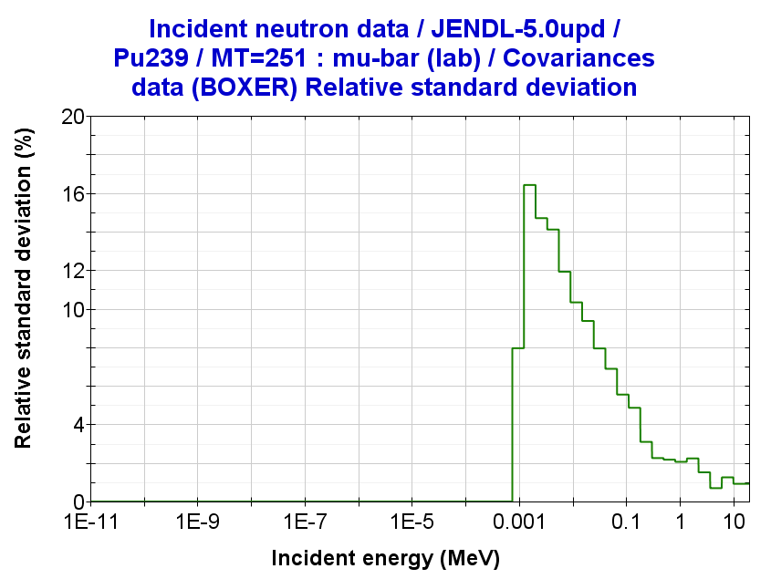
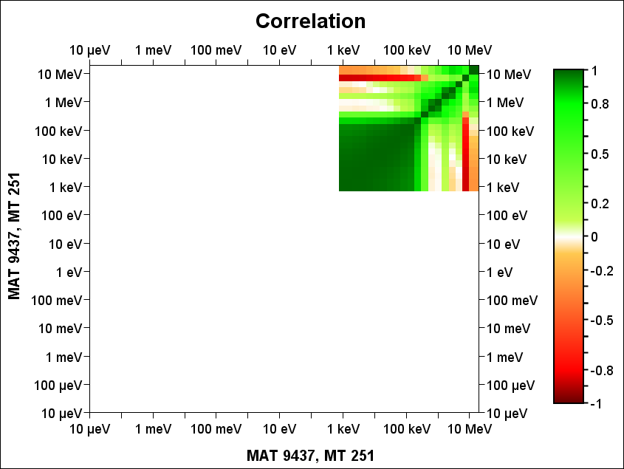
Processing into BOXER format
Processing ND/MF34 in BOXER format
groupr
21 24 0 31/
9437 1 0 2 5 1 1 1 /
'GENDF- 33g' /
300.0
1.E10
33 /
1.00000E-05
1.00000E-01
..
1.00000E+07
1.9640E+07 /
3/
3 251/
0/
0/
errorr
21 0 31 42 /
9437 1 2 1 1 /
1 300.0 / Just only one temperature
0 34 /
33 /
1.00000E-05
1.00000E-01
..
6.06531E+06
1.00000E+07
1.9640E+07 /
covr
42 0 81 /
1/
/
/
9437 0 0 0 /
viewr
81 82
covr
42 72 /
4 1
'LIB_JENDL-5.0upd ' /
'BOXER format'/
9437 0 0 0 /
stop
Figure. Input deck to process MF34 covariances
tape21 = ENDF Pu239
tape24 = PENDF Pu239
=====================

Slide 29
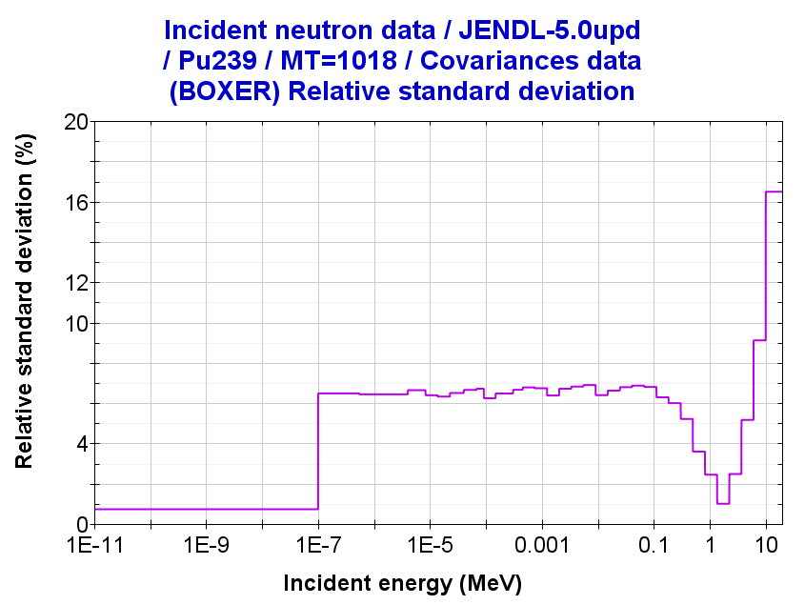
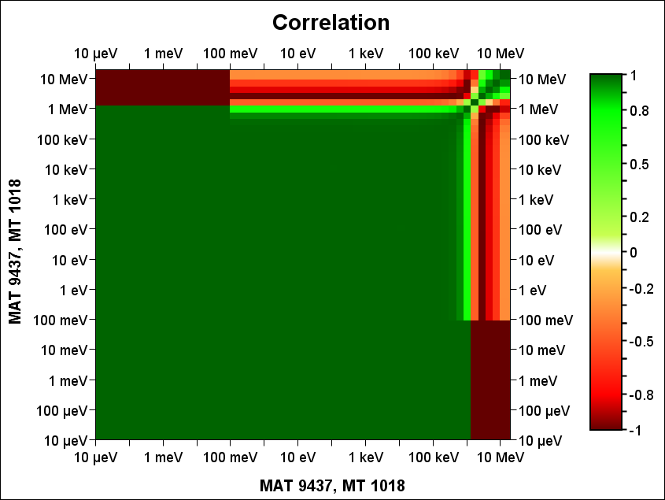
Processing into BOXER format
Processing ND/MF35 in BOXER
Figure. Input deck to process MF35 covariances
groupr /
21 24 0 31/
9437 1 0 2 0 1 1 1 /
'GENDF- 33g' /
300.0
1.E10
33 /
1.00000E-05
1.00000E-01
..
1.00000E+07
1.9640E+07 /
3/
3 18/
3 452 nubar_t/
3 455 nubar_d/
3 456 nubar_p/
5 455 nubar_spc/
5 18 nubar_spc/
3 452 nubar_t/
3 455 nubar_d/
3 456 nubar_p/
5 455 nubar_spc/
5 18 nubar_spc/
0/
0/
errorr
21 0 31 40 /
9437 1 2 1 1 /
1 300.0 / Just only one temperature
0 35 1 1 -1 1.0000E+05 /
33 /
1.00000E-05
1.00000E-01
..
1.00000E+07
1.96400E+07 /
covr
40 0 81 /
1/
/
/
9437 0 0 0 /
viewr
81 82
covr
40 70 /
4 1
'LIB_JENDL-5.0upd ' /
'BOXER format'/
9437 0 0 0 /
stop
tape21 = ENDF Pu239
tape24 = PENDF Pu239
=====================

