Slide 1
Covariance Testing Progress for ENDF/B-VIII.1β1 at ORNL
B.J. Marshall
CSEWG
Brookhaven National Laboratory
November 15, 2023

Slide 2
Outline
Summary of results presented for β1 at mini-CSEWG
Detailed results for HMF-001 and PMF-001

Slide 3
Data-induced uncertainty in VALID benchmarks
Historically a check ORNL has used to compare predicted variability with observed variability from benchmarks
TSUNAMI-IP propagates covariance data with sensitivities from benchmarks
The uncertainty is determined by reaction-nuclide pair and summed to determine the total data-induced uncertainty in k_{eff}
Examination of results highlights potential concerns with covariance data

Slide 4
Results by benchmark category
Category | Number of Cases | Avg C/E (CE_V8.1) | Avg Exp. Unc. (pcm) | St. Dev. Of C/Es (pcm) | Avg 1σ XS Unc (pcm) |  | % of Cases Within
 |  |  |  |  | E8+SCALE | E8.1+SCALE | Exp. Unc. Band | E8.1+SCALE XS Band
HMF | 50 | 1.00002 | 193 | 467 | 979 | 950 | 34.0 | 96.0
HST | 52 | 0.99900 | 494 | 615 | 652 | 792 | 75.0 | 96.2
IMF | 13 | 1.00132 | 269 | 362 | 1027 | 1003 | 46.2 | 100
LCT | 140 | 0.99874 | 195 | 162 | 603 | 737 | 56.4 | 100
LST | 19 | 0.99920 | 318 | 283 | 824 | 944 | 57.9 | 100
MCT | 49 | 0.99244 | 400 | 313 | 973 | 758 | 18.4 | 51.0
MST | 10 | 0.99177 | 452 | 384 | 1323 | 1019 | 0 | 50.0
PMF | 12 | 0.99902 | 207 | 133 | 1022 | 1038 | 66.7 | 100
PST | 81 | 0.99927 | 497 | 429 | 1344 | 937 | 76.5 | 92.6
It appears that the covariance changes are generally having much larger impacts on thermal systems than on fast systems.

Slide 5
Small changes…
HMF systems show small differences in general: ~3%
HMF systems reflected with DU appear to have significant reductions in ²³⁵U nubar uncertainty (~400 pcm in E8.0 → ~225 pcm in E8.1)
IMF system uncertainties ~2% lower with ENDF/B-VIII.1β1
PMF systems a little less than 2% higher on average

Slide 6
Big uranium changes
HST, LCT and LST systems see ~15-20% increases in uncertainty
Directly attributable to ~40% increase in nubar contribution to uncertainty in thermal uranium systems
ORNL still disagrees with the ¹H covariance introduced in ENDF/B-VIII.0 and its associated significant increase in data-induced uncertainty
Neutron scatter off a proton has measured uncertainty more similar to the older data, references provided by Goran in the past
Plot on next slide shows comparison of ENDF/B-VIII.0 and ENDF/B-VIII.1β1 nubar

Slide 7
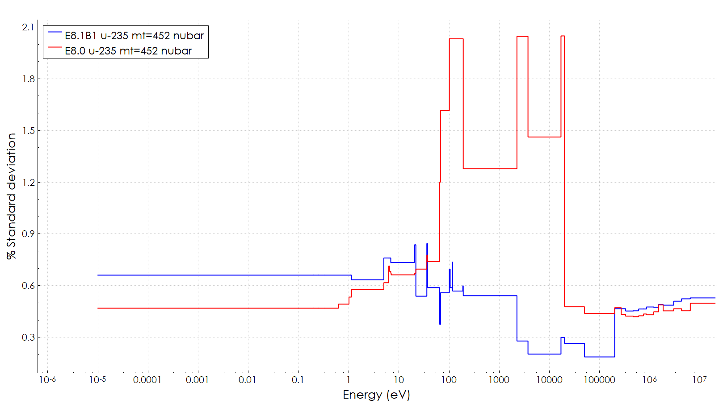
Comparison of ²³⁵U nubar uncertainty data

Slide 8
Big Pu changes
MST, MCT, and PST systems see ~20-30% decreases in uncertainty
All the ²³⁹Pu covariance data is totally different
n,gamma (leading contributor in E8.0) down by 95%
Nubar uncertainty up by 167%
Chi down by 80%
Fission down by >85%

Slide 9
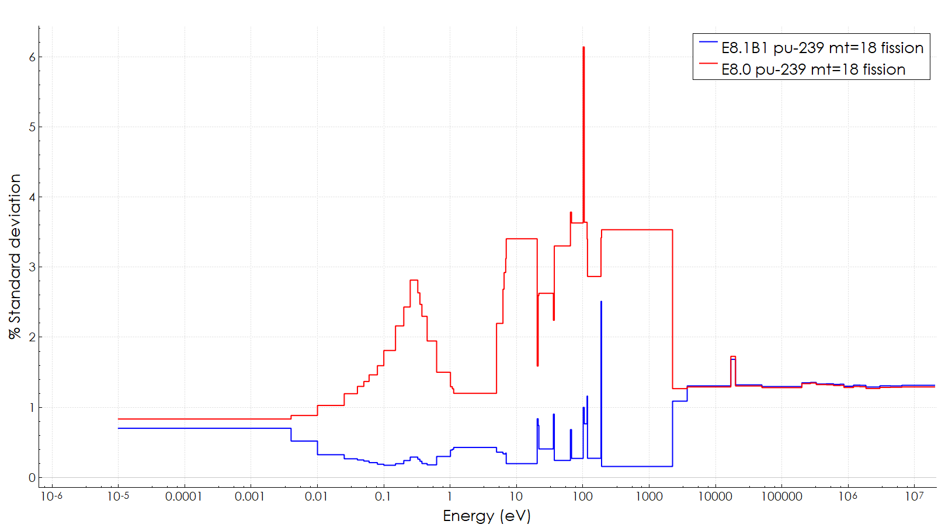
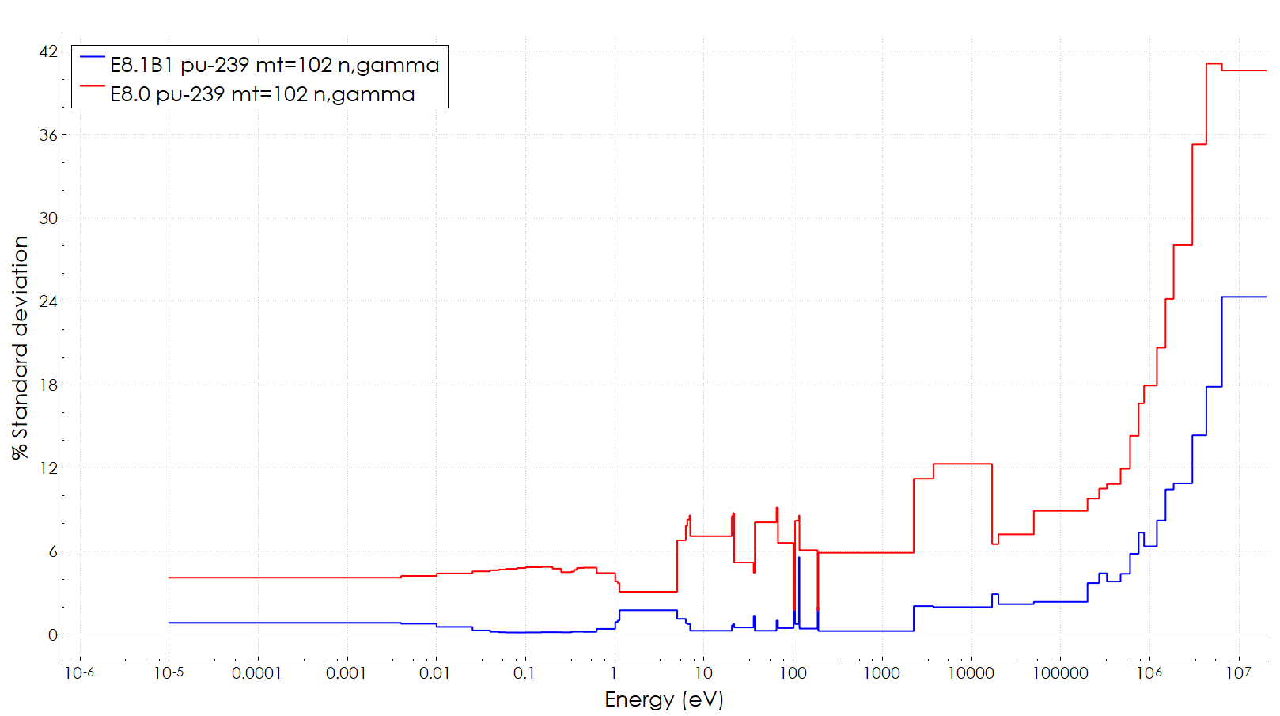
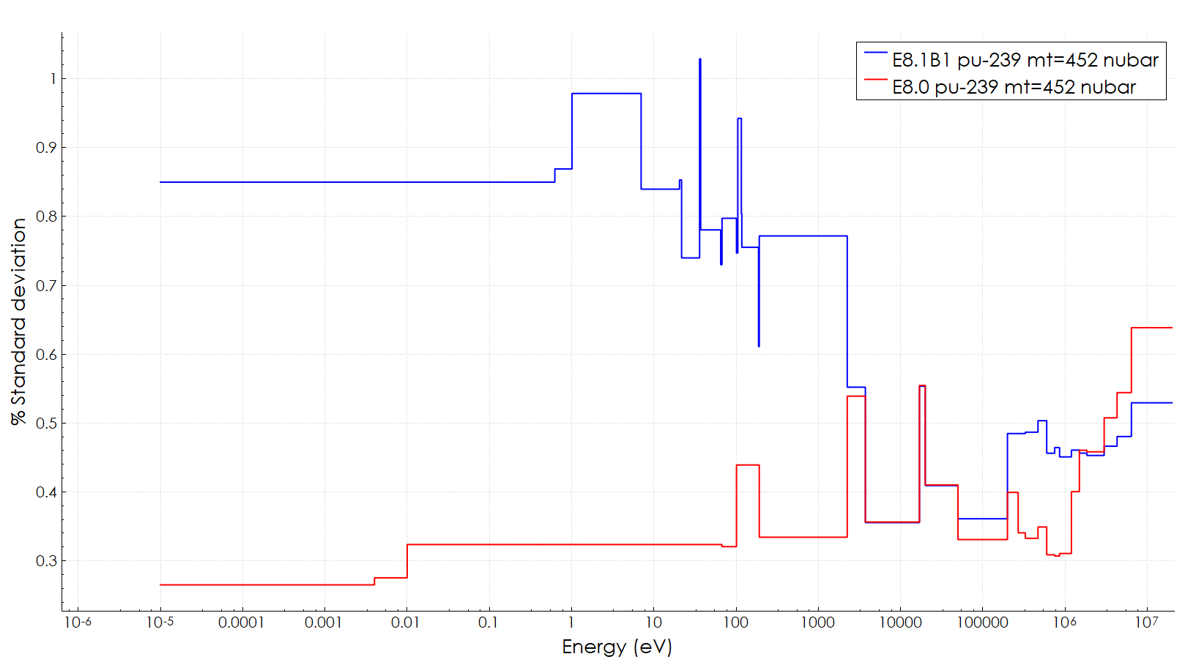
²³⁹Pu fission, nubar, and n,gamma uncertainties
More than a factor of 10!
More than a factor of 30!
Only a factor of about 2.5.

Slide 10
Questions on VALID results?

Slide 11
Detailed results for HMF-001 (“Godiva” simple sphere)
 | ENDF/B-VIII.0 uncertainty (pcm) | ENDF/B-VIII.1β1 uncertainty (pcm)
²³⁵U Fission | 787 | 787
²³⁵U Nubar | 399 | 382
²³⁵U Chi | 33 | 33
²³⁵U Elastic† | 224 | 224
²³⁵U Inelastic | 239 | 239
²³⁵U Capture | 277 | 277
²³⁵U Sum | 982 | 975
Exp. Uncertainty | 100 | 100
C-E | 14 | 0
†Accounting for cross correlation with fission

Slide 12
Detailed results for PMF-001S (Jezebel simple sphere)
 | ENDF/B-VIII.0 uncertainty (pcm) | ENDF/B-VIII.1β1 uncertainty (pcm)
²³⁹Pu Fission | 877 | 920
²³⁹Pu Nubar | 317 | 416
²³⁹Pu Chi | 179 | 37
²³⁹Pu Elastic | 484 | 360
²³⁹Pu Inelastic | -119* | 165
²³⁹Pu Capture | 64 | 19
Sum | 1061 | 1085
Exp. uncertainty | 130 | 130
C-E | -28 | -116
* Cross correlation between elastic and inelastic is larger than inelastic with itself
Resulting total scattering uncertainty is 469 pcm in ENDF/B-VIII.0 and 396 pcm with ENDF/B-VIII.1β1

Slide 13
Conclusions
Data-induced uncertainty significantly increased for thermal ²³⁵U-fueled systems
Dramatic changes in ²³⁹Pu covariance changes for thermal systems are worrying
Were these the changes that were intended?
Impact of changes on HMF-001 and PMF-001 is small

Slide 14
Acknowledgment
This presentation was supported by the Nuclear Criticality Safety Program, funded and managed by the National Nuclear Security Administration for the Department of Energy.

Slide 15
Questions?

