Slide 1
Towards rigorous and reproducible uncertainty quantification in resonance evaluation
Noah Walton¹, Vladimir Sobes¹, Oleksii Zivenko¹, Jesse Brown², Jake Forbes¹, Cole Fritsch¹, Aaron Clark¹, Dave Brown³ , Denise Neudecker⁴ , Mike Grosskopf⁴
The University of Tennessee¹
Oak Ridge National Laboratory²
Brookhaven National Laboratory³
Los Alamos National Laboratory⁴
Notes:
Introduce myself
Working on resonance eval & UQ for ~3 yrs
Great colleagues and mentors
ND evaluation has a lot of choices...

Slide 2
Evaluator Choices
Dataset quality
Correlations
Normalization
Evaluated Parameters
Experimental Conditions
Uncertainty Quantification
Bayes Prior
Use of integral data?
Notes:
For example:
which dataset do you favor if there is disagreement beyond uncertainty?
how should you incorporate prior knowledge and does that bias your result?
or because assumptions in Bayes are violated, how do you reconcile?
Difficult to do this in justifiable/reproducible way
I believe that computational solutions exist
Goal of this project and my thesis to explore
Limited to resonance evaluations

Slide 3
Evaluator Choices
Dataset quality
Automated Procedure
Correlations
Normalization
Evaluated Parameters
Experimental Conditions
Uncertainty Quantification
Bayes Prior
Use of integral data?
Notes:
Big idea: automate section of Eval
Some can't be automated > need expert evaluator
If curated inputs > we can do neat things > Contributing to reproducibility efforts is just one part

Slide 4
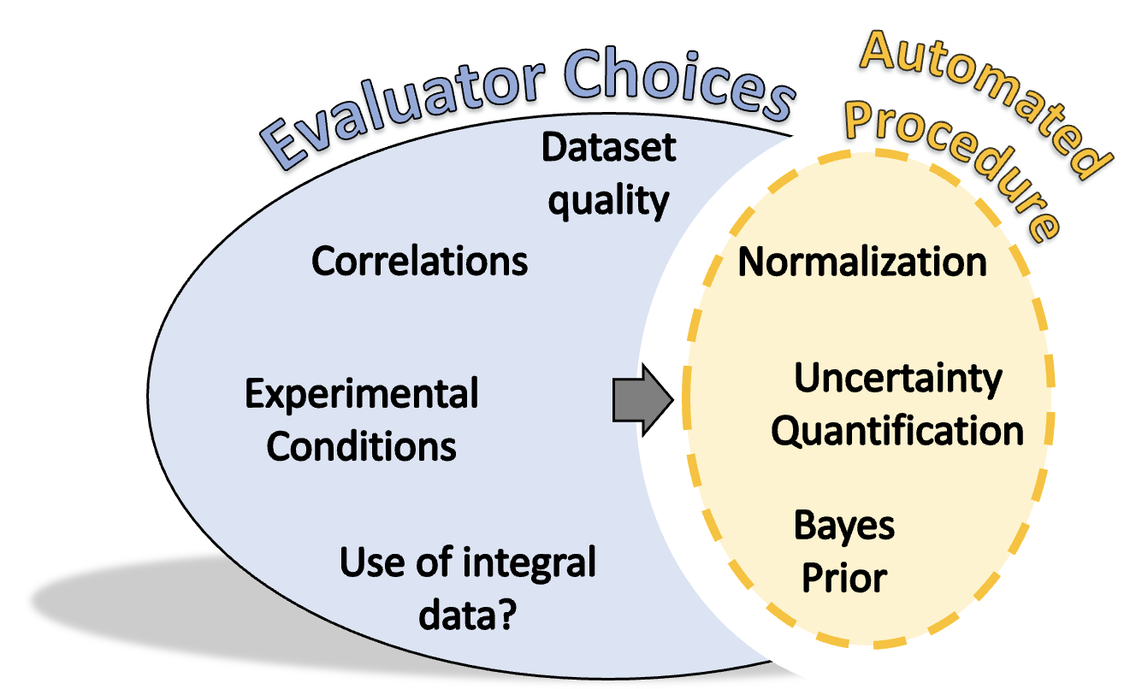
Two primary efforts
Develop automated tool
Augment evaluators
Computational experiments
Benchmark tool
Improve tool
Learn new physics
Notes:
Two primary efforts
Develop an automated tool and potentially augment evaluators
Use this tool in larger computational framework to do computational experiments
We have some specific investigations, but I believe the methodology has the potential to contribute to a wide range of scientific & engineering efforts surrounding nuclear data evaluation
Second effort is the focus, briefly talk about tool

Slide 5
Automated Tool
Methods
SAMMY
Robust, non-linear least squares algorithm
Feature selection
Results
Accurate resonance I.D.
No spin groups (yet)
Notes:
Sammy for theo/exp model
Around Sammy:
robust non-linear least squares algorithm
feature selection routine to identify resonances
Great results, working on spin groups now

Slide 6
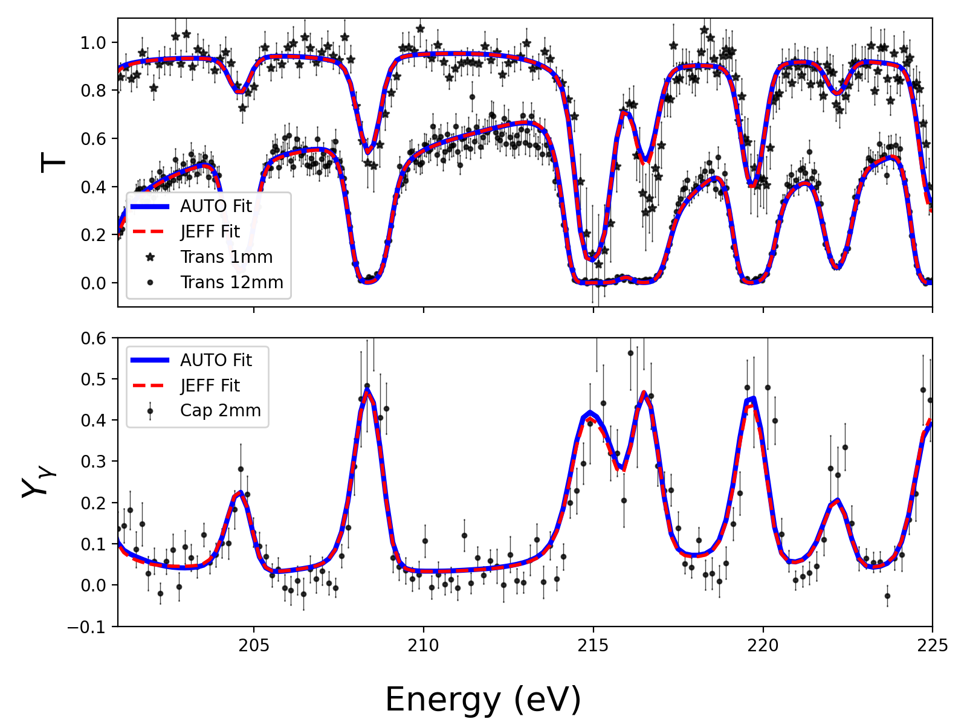
Automated Tool
Methods
SAMMY
Robust, non-linear least squares algorithm
Feature selection
Results
Accurate resonance I.D.
No spin groups (yet)
Notes:
Demonstrated on Jesse’s Ta-181 measurements
Fit w/ automated approach (no prior)
Fit from evaluated Jeff 3.0 prior and
Point is accurate ID at push of button without dependency on prior
Note spin groups
So, how are we using this?

Slide 7
Computational Framework – ML approach
Goal
Benchmark at differential level
Improve performance
Test choices & assumptions
ML Approach
Synthetic data
Transmission last year
Capture yield this year
Notes:
Goal – clarify benchmarking
ML approach leveraging synthetic data
T last year, added capture Y
High level overview and more on how were using it in computational framework

Slide 8
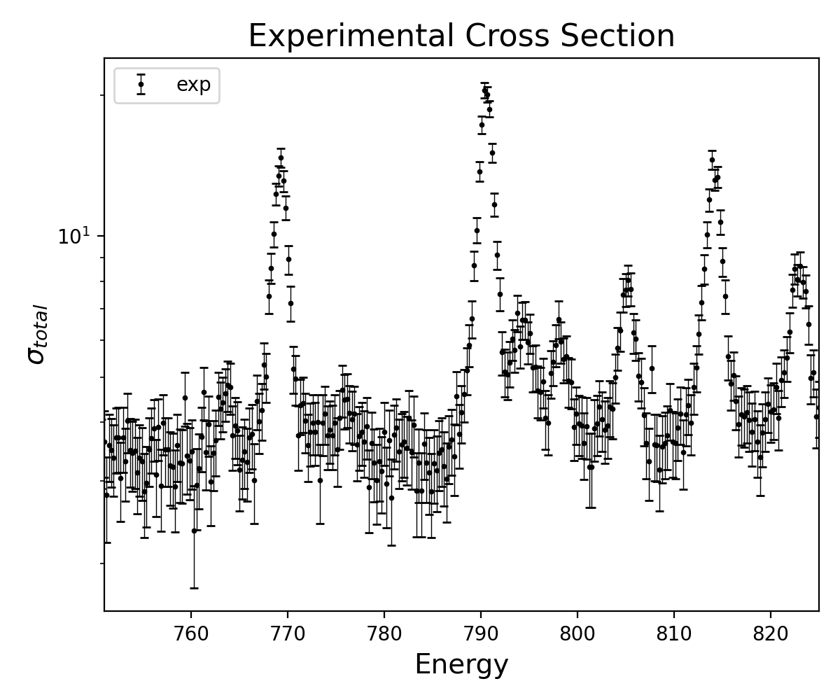
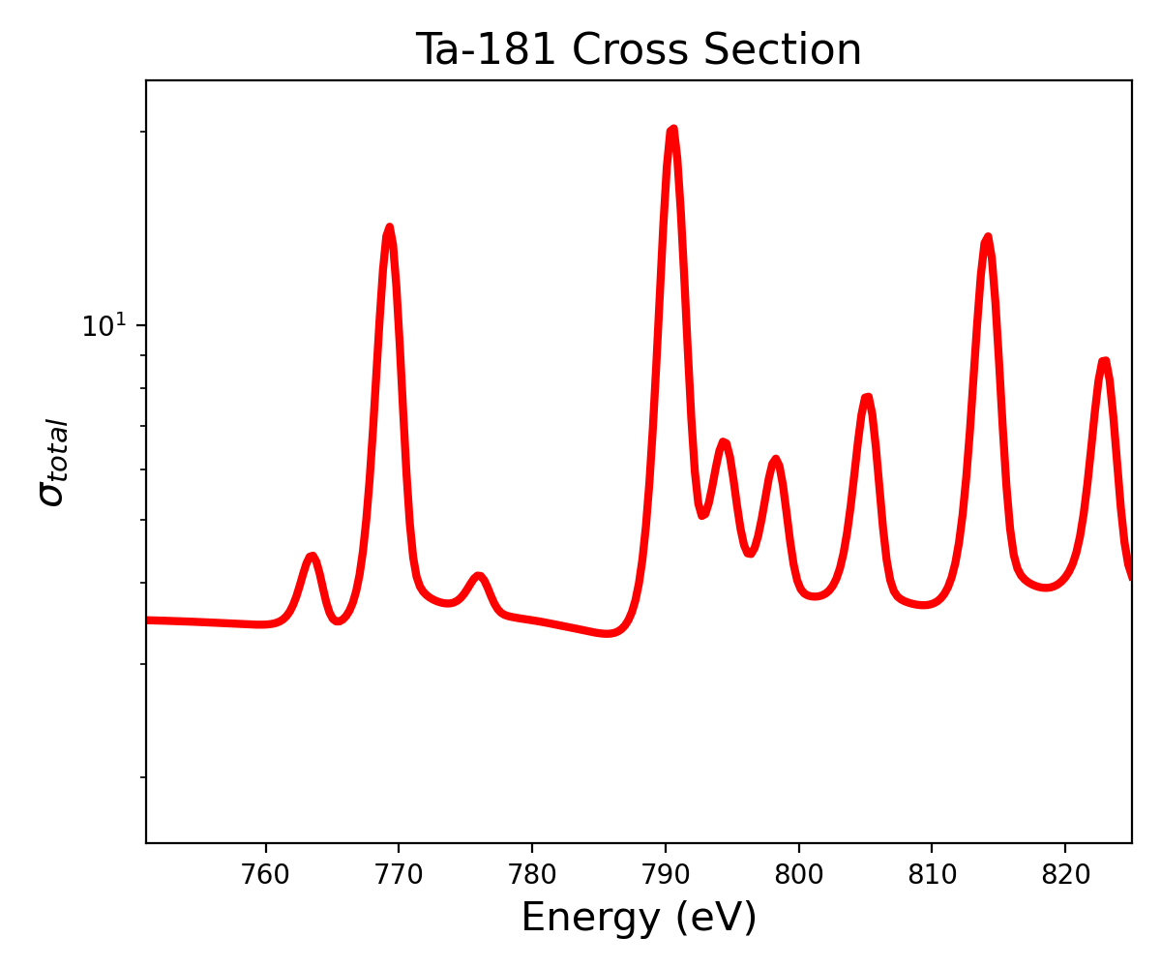
True cross section in nature
$$Γ_{i}$$
$$Γ_{j}$$
$$Γ_{i−1}$$
Experimental process
$$E_{i−1}$$
$$E_{i}$$
$$E_{j}$$
8
Notes:
True cross section in nature
Raw experimental observables
Reduced based on experimental model
Cross section measurement data
Generative statistical model for this picture

Slide 9
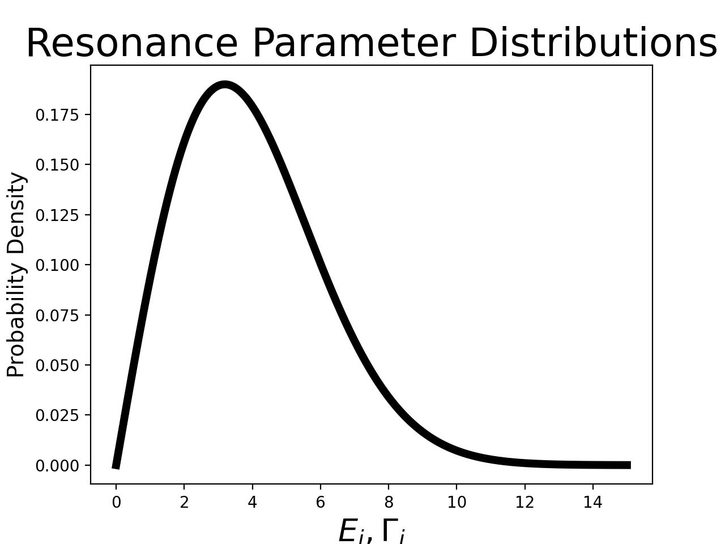
PDFs for resonance parameters known a-priori
$$Γ_{i}{, E}_{i}$$
Synthetic cross section realizations
$$Γ_{i}$$
$$Γ_{j}$$
$$Γ_{i−1}$$
Experimental process
$$E_{i−1}$$
$$E_{i}$$
$$E_{j}$$
9
Notes:
2 generative models
First leverages resonance parameter distributions known a-priori to get statistical realizations of true cross sections
Second leverages physics and random sampling to generatively model experimental process

Slide 10
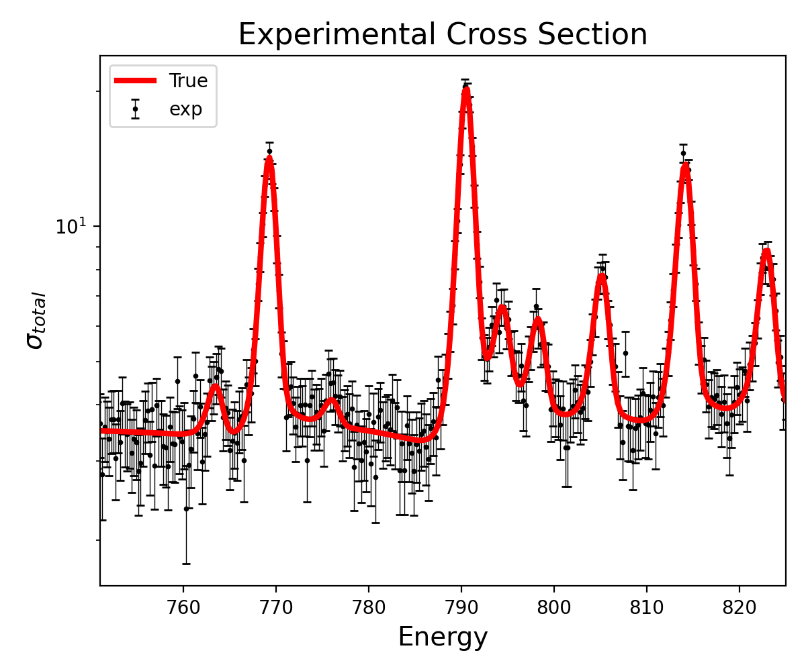
PDFs for resonance parameters known a-priori
$$Γ_{i}{, E}_{i}$$
Synthetic cross section realizations
$$Γ_{i}$$
$$Γ_{j}$$
$$Γ_{i−1}$$
Probabilistic generative model
$$E_{i−1}$$
$$E_{i}$$
$$E_{j}$$
Walton, N.A.W., Brown, J., Fritsch, W., Brown, D., Nobre, G., Sobes, V., Methodology for physics-informed generation of synthetic neutron time-of-flight measurement data, Computer Physics Communications, Vol 294, 2024, 108927, ISSN 0010-4655, https://doi.org/10.1016/j.cpc.2023.108927.
10
Notes:
Result: experimental data + corresponding parameters/solution
ML perspective: labelled data, training, validation
Journal article for transmission
Statistical tests support utility
Allows extrapolation
Implemented for capture yield data - need both for eval
How are we using this?

Slide 11
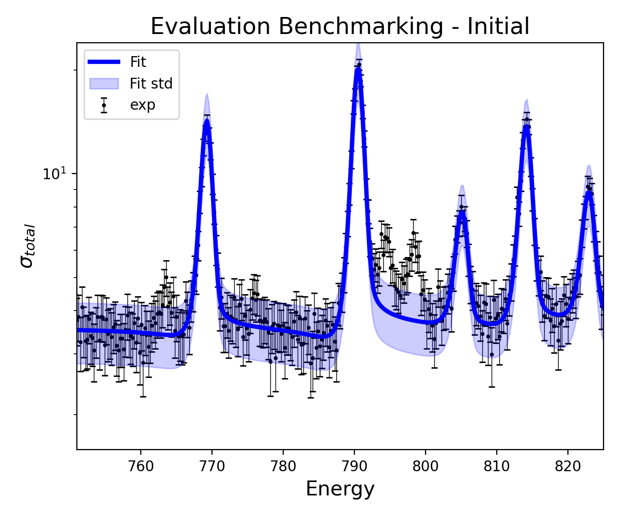
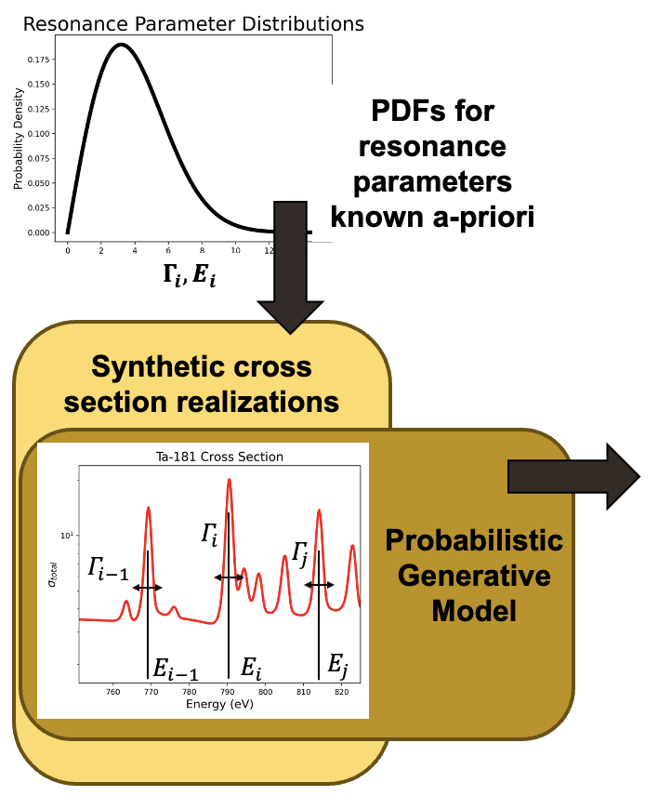
Synthetic data generator
Automated procedure
Notes:
Hide solution
Get automated estimate/uncertainty

Slide 12
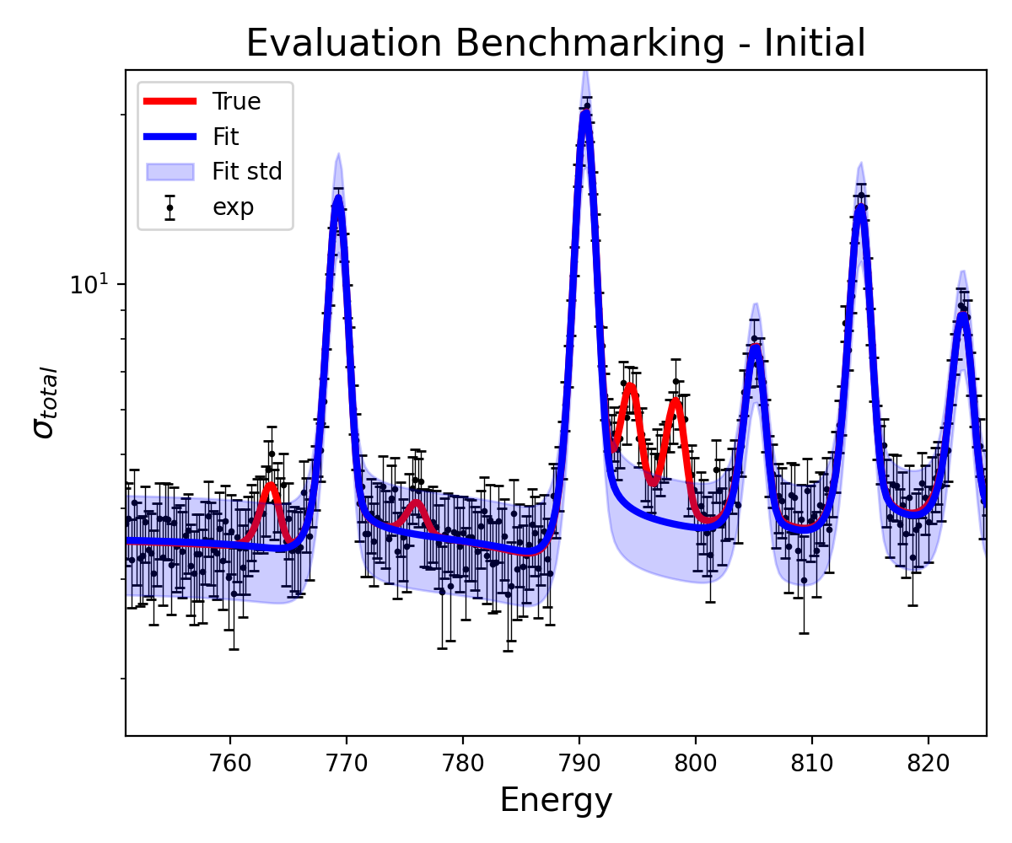
Synthetic data generator
Automated procedure
Notes:
Estimates can be compared to the solution (red)
Give us ability to quantitatively benchmark tool at the differential level
Beyond benchmarking…

Slide 13
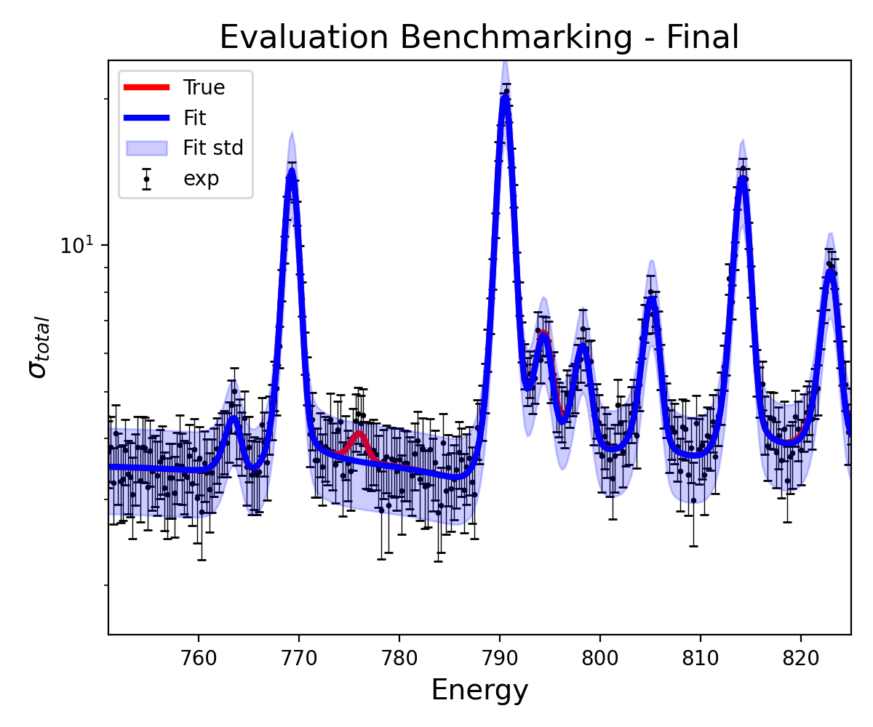
Learn hyperparameters optimize & benchmark accuracy
Synthetic data generator
Automated procedure
Notes:
Tool can be improved/developed by repeating and learning
Repeat w/different parameters
Note that synthetic data never see’s real data
Unlimited data for training/validation
Extrapolate to real data
Test sensitivity to assumptions by explicitly including them in the generative model
Give examples for theoretical and experimental models
USU: underestimated correlation - *specific example
Theo: resonance distributions - *specific example
Metric for training
Different for mean and UQ
We selected SE – transition to next slide
The second way in which we plan to benchmark this tool’s performance is by testing sensitivity to assumptions in our models.
Perhaps the most relevant example I can give is the assumption that uncertainties are properly reported in the experimental model.
What this workflow allows is the following:
- We can hypothesize one or several potentially unknown sources of uncertainty
- These can be embedded in the synthetic data we are generating and intentionally left out of the evaluation.
- The impact of these unreported uncertainties can then be quantitatively described by having access to the red line.
A similar set of investigations will be done for assumptions in the theoretical model.
The immediate example is to test our sensitivity to the resonance parameters distributions.
I chose this case as a leading example: The current assumption is that there are around 10-20% of resonances that are too small to detect experimentally
- Again, we can generate data from a range of different transformations on these distributions
- Then, we can benchmark our ability to resolve these changes and give a quantitative justification for when we are overfitting this data
We have already begun some of these analyses and hope to report more on this soon.

Slide 14
Performance Metric
Cross Section
Notes:
Pose question for mean and uncertainty

Slide 15
Performance Metric
Cross Section
Notes:
Uncertainty performance metric

Slide 16
Performance Metric
$$Error=\int{dE{\left(σ_{fit}−σ_{true}\right)}^{2}}$$
Cross Section
Notes:
Have not found a way to say we ‘found’ a resonance
Chose to measure performance in integral SE of theoretical cross section
Want feedback, deciding on an objective function at differential level is uniquely enabled by our framework
Haven’t gotten to UQ objective yet but would love to discuss

Slide 17
Performance Metric
Synthetic data allows quantitative performance testing
What should the metric be?
Cross Section
This material is based upon work supported by the Department of Energy National Nuclear Security Administration through the Nuclear Science and Security Consortium under Award Number DE-NA0003996.
Notes:
In conclusion
We have a synthetic data framework that allows quantitative performance testing
We get estimated and solution parameters
We decided on how to compare the two, but is there something else that the community can agree on

Slide 18
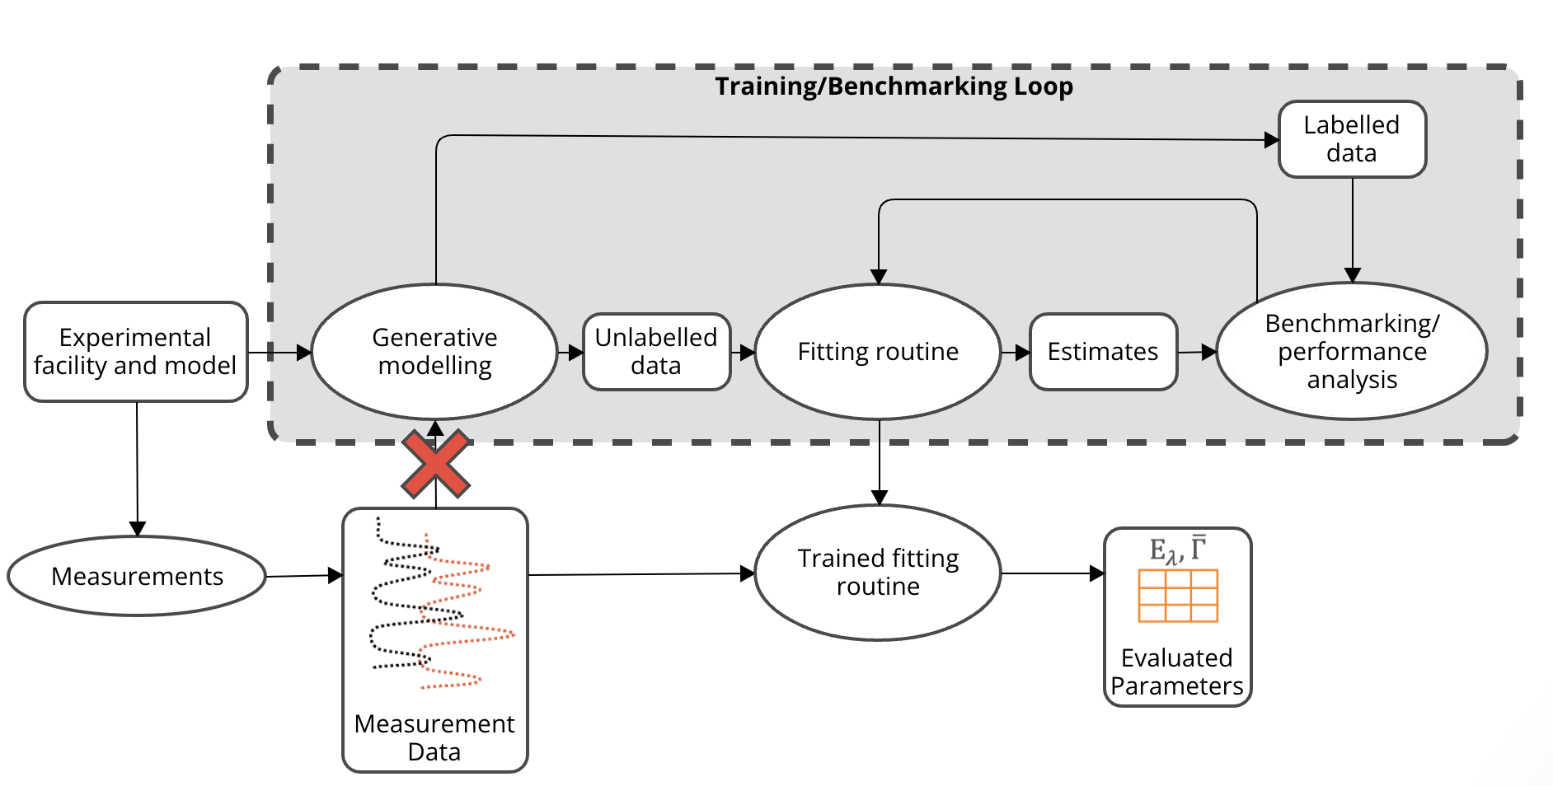
Computational Framework

Slide 19
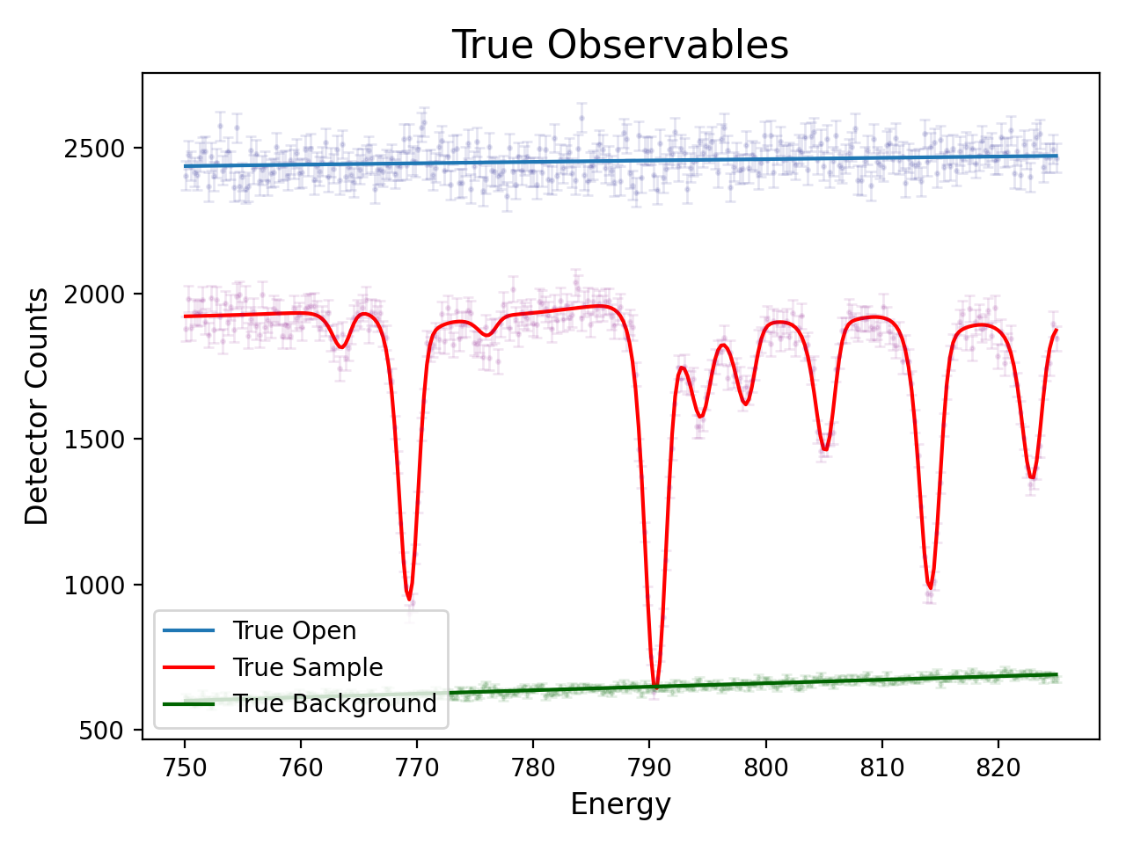
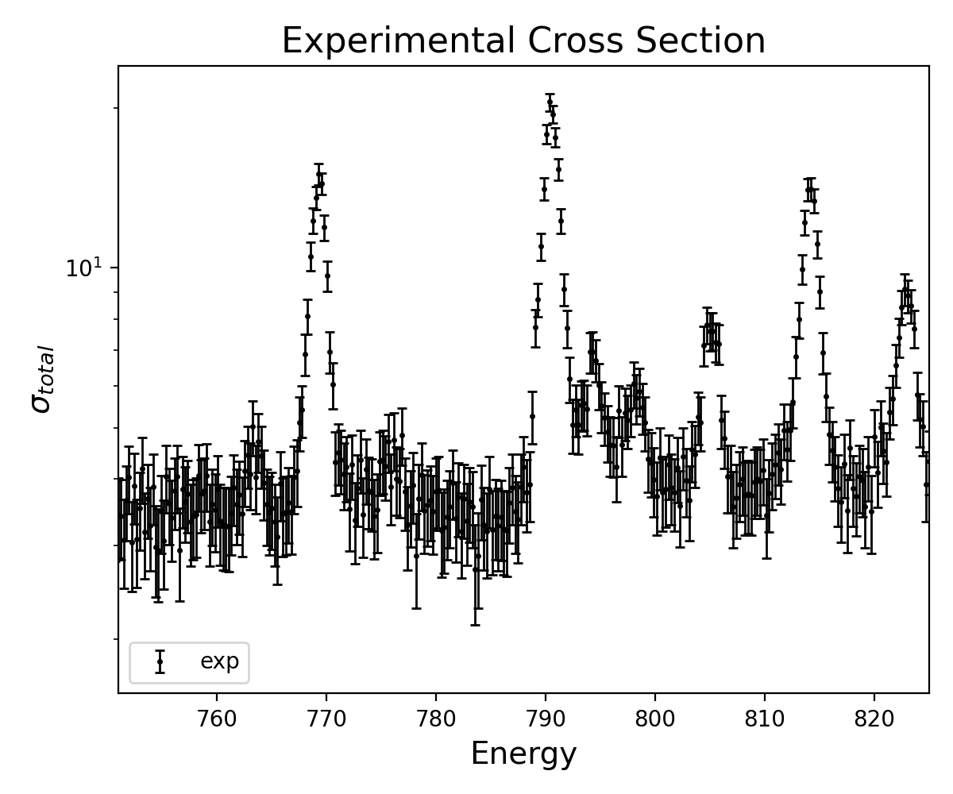
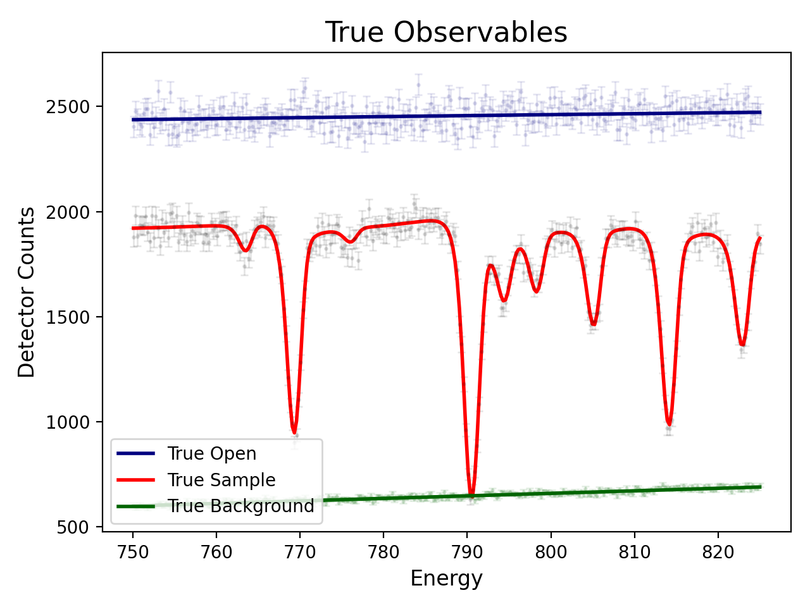
Developing a generative model for the resonance experiments
PDFs for resonance parameters known a-priori
$$Γ_{i}{, E}_{i}$$
Data Reduction
Synthetic cross section realizations
Novel method for inverse reduction using random sampling
$$Γ_{i}$$
$$Γ_{j}$$
$$Γ_{i−1}$$
$$E_{i−1}$$
$$E_{i}$$
$$E_{j}$$
Notes:
Its basically an inversion of the data reduction process and I’ve also introduced random sampling to emulate uncertainty in the experiment.
This result is true, or expected observables that correspond to an exact cross section.

Slide 20
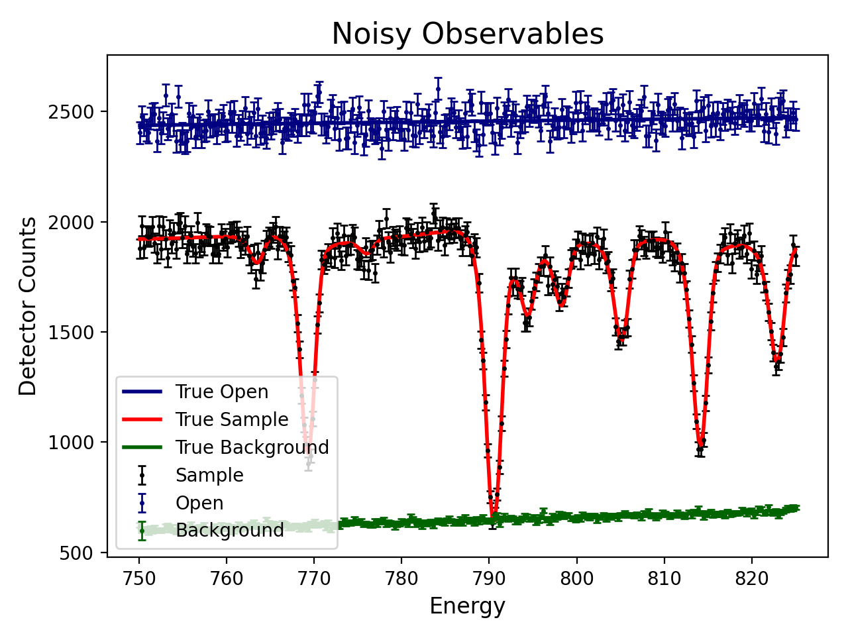
Developing a generative model for the resonance experiments
PDFs for resonance parameters known a-priori
Noise model given by counting statistics
$$Γ_{i}{, E}_{i}$$
Data Reduction
Synthetic cross section realizations
Novel method for inverse reduction using random sampling
$$Γ_{i}$$
$$Γ_{j}$$
$$Γ_{i−1}$$
$$E_{i−1}$$
$$E_{i}$$
$$E_{j}$$
Notes:
At this point, we know what the noise model is.
Detector counts are independent from one another and follow the Poisson distribution

Slide 21
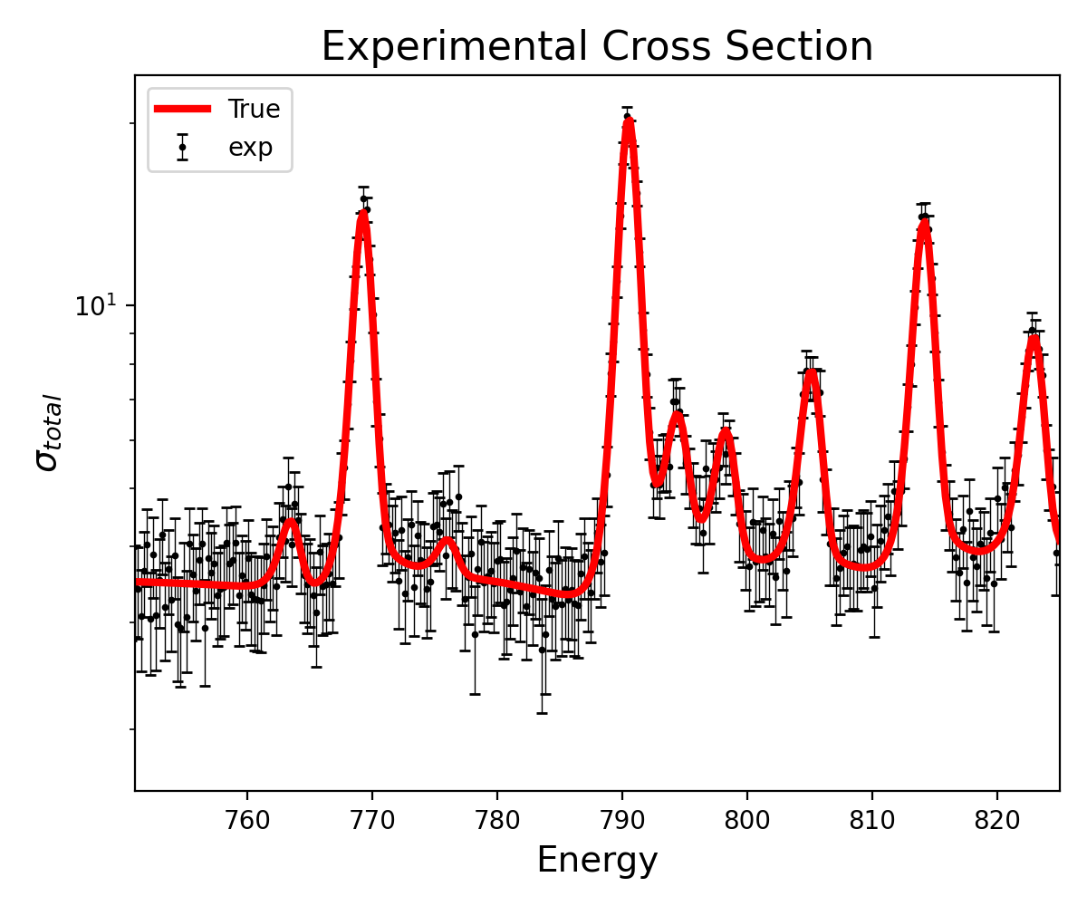
Developing a generative model for the resonance experiments
PDFs for resonance parameters known a-priori
Noise model given by counting statistics
$$Γ_{i}{, E}_{i}$$
Data Reduction
Synthetic cross section realizations
Novel method for inverse reduction using random sampling
$$Γ_{i}$$
$$Γ_{j}$$
$$Γ_{i−1}$$
$$E_{i−1}$$
$$E_{i}$$
$$E_{j}$$
Notes:
Now, we can use the established data reduction process to convert to cross section data that corresponds an exact set of resonance parameters.
And the idea is that you can repeat this process, generating essentially unlimited, labelled training data.

Slide 22
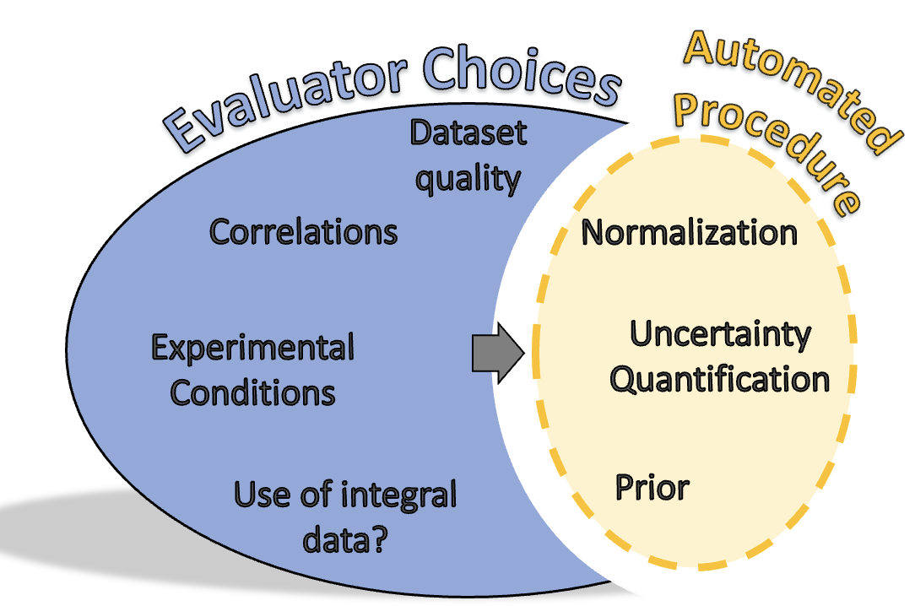
Leveraging AI/ML to benchmark region of automation
Benchmarking the automation:
Quantitative assessment at differential level
Sensitivity to assumptions
Theoretical: parameter distributions
Experimental: unknown uncertainties
Notes:
Firstly, I want to be clear that the term benchmarking here is not referring to integral benchmark experiments, rather, I am using it more generally to describe a characterization of the performance our automated algorithm.
This benchmarking can be split into two major efforts.

Slide 23
Experiment
Processing
Validation
Evaluation
Evaluator Choices
Dataset quality
Correlations
Normalization
Region of Automation
Experimental Conditions
Uncertainty Quantification
Use of integral data?
Prior
Notes:
We want to clearly define a set of reportable inputs, curated by the expert judgement of an evaluator, that yield a set of parameters that are reproducible by anyone on any machine.
We are doing this by clearly defining a section of the evaluation process that can be automated.
Secondly, as we develop a tool to do this, we want to completely and properly benchmark it.

Slide 24
Evaluator Choices
Dataset quality
Correlations
Automated Procedure
Prior
Experimental Conditions
Normalization
Uncertainty Quantification
Use of integral data?
Notes:
Evaluation of experimental nuclear data provides suggested values and uncertainties that are a vital input to many applications.
One of the most important pieces of which is the neutron cross section in the resolved resonance range.
For evaluation of these RRR cross section, the default method for UQ is known to underpredict uncertainties.
The solution to this is non-systematic, requires expert judgement to inflate uncertainties in order to be more appropriate.

