Slide 1
The JEFF Project Snapshot: Overview, Developments, and Status
Daniela FOLIGNO
CSEWG
15 November 2023

Slide 2
1) From JEFF-3.3 to JEFF-4.0

Slide 3
JEFF-4.0 Timeline
2017
2020
2021
2022
2023
2024
JEFF-3.3
Release
JEFF-4T0
Test Library
JEFF-4T1
Test Library
JEFF-4T2
Test Library
JEFF-4T3
Test Library
JEFF-4.0
Release

Slide 4
JEFF-4.0 Test versions
2017
2020
2021
2022
2023
2024
JEFF-3.3
Release
JEFF-4T0
Test Library
JEFF-4T1
Test Library
JEFF-4T2
Test Library
JEFF-4T3
Test Library
JEFF-4.0
Release

Slide 5
JEFF-4.0 Test versions
2017
2020
2021
2022
2023
2024
JEFF-3.3
Release
JEFF-4T0
Test Library
JEFF-4T1
Test Library
JEFF-4T2
Test Library
JEFF-4T3
Test Library
JEFF-4.0
Release
28 new evaluations
5 from JENDL-4u
9 from ENDF/B-VIII.0
6 from JEFF-3.1.1
100 from JEFF-3.3
414 from TENDL-2019
(of which 302 were TENDL-2015)
28 new evaluations
1 from JENDL-5
1 from ENDF/B-VIII.0
TENDL-19 --> TENDL-21
14 new evaluations
1 new FY
1 from JENDL-5
17 from INDEN
Minor corrections
7 new evaluations
2 new FY
1 from JENDL-5
6 restore 8 groups DN data
8 from ENDF/B-VIII.1
6 from INDEN
3 from TENDL-2023
Minor corrections

Slide 6
JEFF-4.0 New Evaluations
43-Tc-99 | 45-Rh-103 | 45-Rh-105 | 47-Ag-107 | 47-Ag-109
54-Xe-124 | 54-Xe-126 | 54-Xe-128 | 54-Xe-129 | 54-Xe-130
54-Xe-131 | 54-Xe-132 | 54-Xe-134 | 54-Xe-135 | 54-Xe-135m
55-Cs-133 | 55-Cs-135 | 57-La-139 | 61-Pm-147 | 62-Sm-151
63-Eu-151 | 63-Eu-153 | 63-Eu-154 | 63-Eu-155 | 64-Gd-155
64-Gd-156 | 64-Gd-157 | 64-Gd-158 | 64-Gd-160 | 69-Tm-171
71-Lu-173 | 71-Lu-175 | 71-Lu-176 | 73-Ta-181 | 74-W-180
74-W-182 | 74-W-183 | 74-W-184 | 74-W-186 | 76-Os-186
76-Os-187 | 76-Os-188 | 83-Bi-209 | 92-U-235 | 92-U-238
93-Np-237 | 94-Pu-238 | 94-Pu-239 | 94-Pu-240 | 94-Pu-241
 | 94-Pu-242 | 95-Am-241 | 95-Am-241
HinH2O
UO2
PuO2
HinCH2
CinCH2
HinC5O2H8
CinC5O2H8
OinC5O2H8
HinC8H8
CinC8H8
2017
2024
JEFF-3.3
Release
JEFF-4.0
Release
Provided by ORNL
FYs U-235 thermal | FYs Pu-239 thermal

Slide 7
JEFF-4.0: The Big 5
U-235
Pu-241
JEFF-3.3
U-238
Pu-239
Pu-240
U-235
Pu-239
JEFF-4T0
Pu-240
Pu-240
JEFF-4T1
U-235
U-238
U-238
Pu-239
JEFF-4T2
U-235
U-238
Pu-239
Pu-240
Pu-241
JEFF-4T3
U-235

Slide 8
JEFF-4.0: The Big 5
U-235
Pu-241
JEFF-3.3
U-238
Pu-239
Pu-240
U-235
Pu-239
JEFF-4T0
Pu-240
Pu-240
JEFF-4T1
U-235
U-238
U-238
Pu-239
JEFF-4T2
U-235
U-238
Pu-239
Pu-240
Pu-241
JEFF-4T3
U-235

Slide 9
T2 to T3
For further information about the these evaluations, contact gilles.noguere@cea.fr
U-238
Pu-239
Pu-241
JEFF-4T2
U-235
Pu-240
RRR
ν_{p}
Continuum
RRR
ν_{p}
Continuum
Continuum
Thermal
PFNS
from
CRP
MF6/MT102
for thermal
point
U-238
Pu-239
Pu-240
Pu-241
JEFF-4T3
U-235

Slide 10
T2 to T3: an alternative path
For further information about the GLLS adjustment, contact dimitri-alexandre.rochman@psi.ch
U-238
Pu-239
Pu-240
Pu-241
JEFF-4T2
U-235
RRR
Nup
Continuum
RRR
ν_{p}
Continuum
Thermal
PFNS
from
CRP
Thermal
PFNS
from
JEFF-3.3
MF6/MT102
for thermal
point
Continuum
Simultaneous GLLS adjustment of all resonance parameters and Pu-239 ν_{p} to reproduce JEFF-3.1.1 performances
U-238
Pu-239a
Pu-240u
Pu-240a
Pu-241u
Pu-241a
JEFF-4T3
U-235
Pu-239u

Slide 11
JEFF-4.0 Fission Yields
Thermal neutron induced fission of U-235 and Pu-239
At each step of the evaluation process, correlations induced mainly by the conservation laws are given and the full variance-covariance matrix can then be determined
As data points from the experimental datasets (used for the isobaric fission yields evaluation) were not always compatible with each other, it was necessary to apply a “regularization” method
Conservative sorting (C)
All the datasets are used by adding 2.5% uncertainty to all data points, in order to make them compatible.
Strict sorting (S)
Instead of adding independent uncertainty, only consistent experiments are selected. Measurements that did not pass the tests per datasets and the tests per mass were excluded.
The main difference between the two methods is the uncertainty
For further information about the FY evaluations, contact olivier.serot@cea.fr

Slide 12
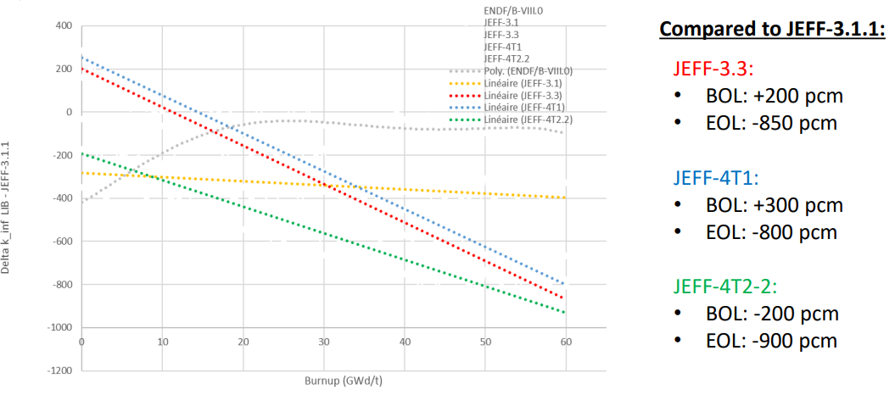
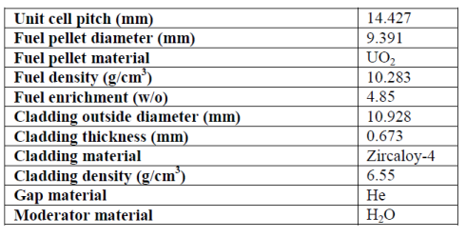
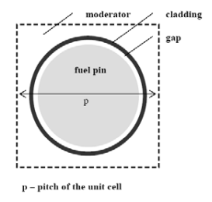
JEFF-4Tx BU issue
VESTA 2.2 UAM Pin cell calculation
PWR UOX fuel pin
Irradiated during 1 cycle
BU= 61.28 GWd/tHM
2D model
For further information about this work, contact raphaelle.ichou@irsn.fr
The strong k_inf bias with burn-up observed with JEFF-3.3 and JEFF-4.T0, JEFF-4.T1, is still present using new JEFF-4T2.2
https://www.oecd-nea.org/dbdata/nds_jefdoc/jefdoc-2233.pdf

Slide 13
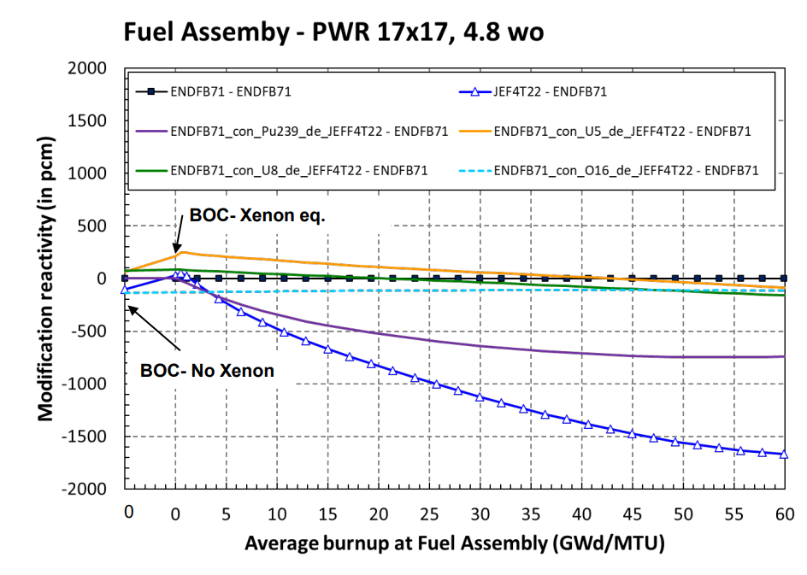
JEFF-4Tx BU issue contributions
Contribution of different isotopes at high BU:
Low contribution of U-238
Large impact of Pu-239
Large contribution of Fission Products
For further information about this work, contact oscar.cabellos@upm.es
https://www.oecd-nea.org/dbdata/nds_jefdoc/jefdoc-2239.pdf

Slide 14
JEFF-4.0 Timeline
https://www.oecd-nea.org/dbdata/jeff/jeff40/t3/
JEFF-4T3 is available. First feedbacks will be given at
the next JEFF Nuclear Data Week
2017
2020
2021
2022
2023
2024
JEFF-3.3
Release
JEFF-4T0
Test Library
JEFF-4T1
Test Library
JEFF-4T2
Test Library
JEFF-4T3
Test Library
JEFF-4.0
Release

Slide 15
2) Integrated, Automated, and Reproducible Nuclear Data Processing at the NEA

Slide 16
The NEA Processing pipeline
The main YAML (pipeline definition) is maintained in its own repository
After every commit, the pipeline is automatically triggered
The pipeline is identical for all isotopes
Codes are built into Docker images, stored in the Harbor, and pulled by the pipeline

Slide 17
The NEA Processing pipeline
Format checks
Internal consistency checks
Additional checks
Reconstruction of cross sections from RP
Creation of PENDF on a unionized energy grid
Doppler-broadening of the cross sections in PENDF
Self-shielding in the URR
Generation of heat production XS and radiation damage energy production
ENDF → GNDS
Produce probability tables for the URR self-shielded XS
Create the ACE file
Reconstruction of cross sections from RP
Doppler-broadening of the cross sections in ENDF-6
Generation of activation cross sections (MF=10)
Calculation of self-shielded, multigroup cross sections and multi-band parameters in the ENDF format
Convert the ACE files into HDF5 format
Thanks to J-C Sublet for providing his processing routine

Slide 18
The NEA Processing pipeline
MCNP
Serpent
The pipeline is designed by the JEFF community for the JEFF community
TRIPOLI-4
AMPX
FISPACT-II
SCALE
OpenMC
For further information about AMPX processing, contact andrew.holcomb@oecd-nea.org

Slide 19
3) Past and future meetings

Slide 20
The current ND path
Experiments
New evaluations
Processing & Verification
USER
Release
Benchmarking & Validation

Slide 21
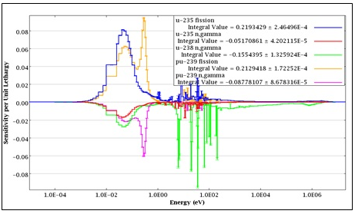
An alternative possibility
USER’s needs
Identification of the problem
Nuclear data need (HPRL)
Processing & Verification
New evaluations
Experiments
Benchmarking & Validation
Release

Slide 22
Stakeholder meeting
September 20th, 2023
Nuclear Physics Needs for Nuclear Energy Technology
Goal: Listen to the nuclear data needs from a great variety of stakeholders

Slide 23
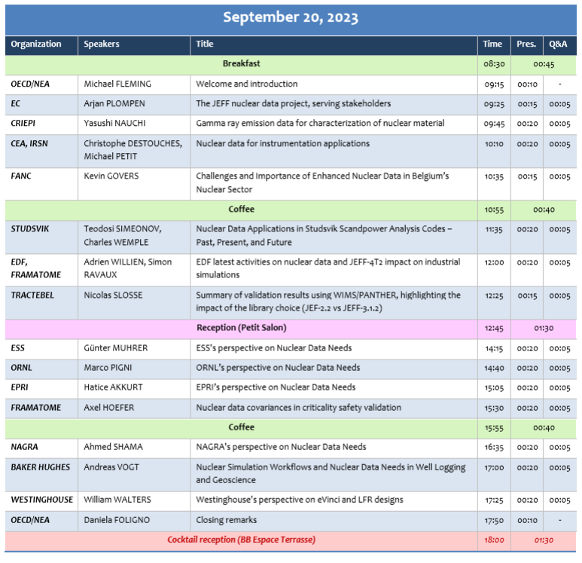
Stakeholder meeting
14 speakers
91 participants
19 countries

Slide 24
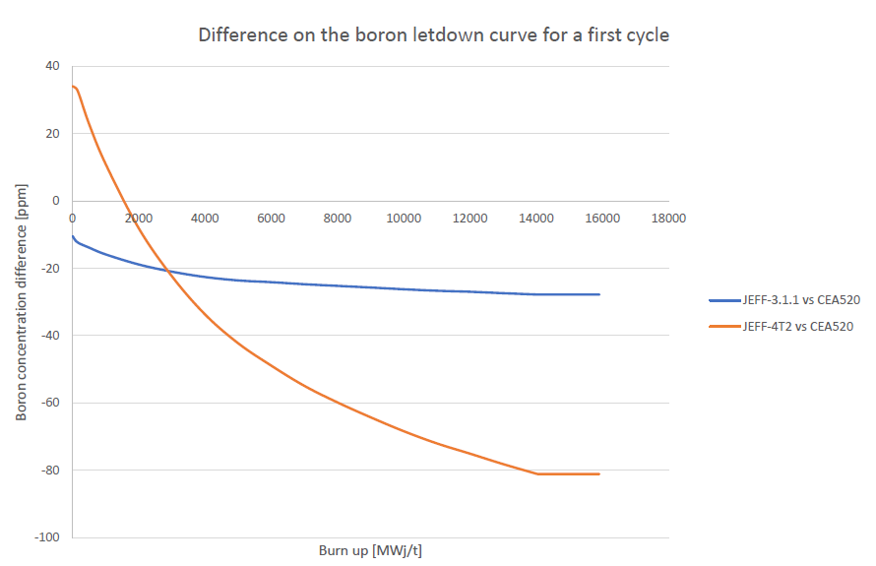
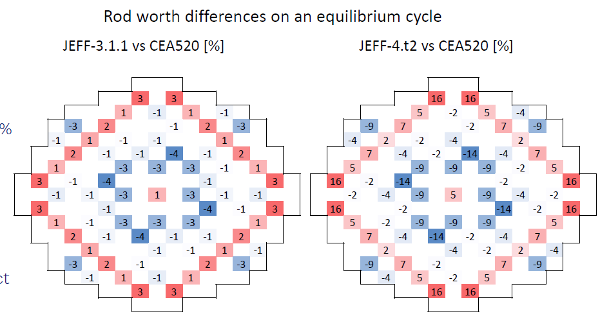
Stakeholder meeting
Unexpected achievment:
Industrial feedbacks on the quality of our test library
Involvement of the industry, who engaged to give us preliminary feedbacks at every test version and a more detailed feedback before the official JEFF-4.0 release !

Slide 25
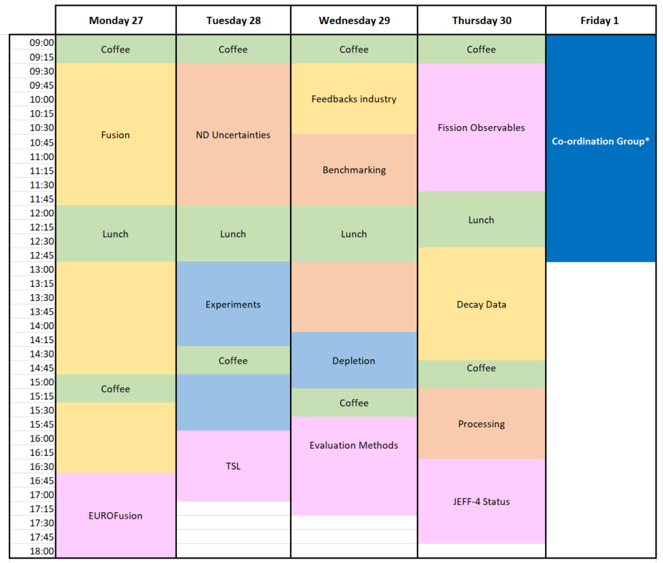
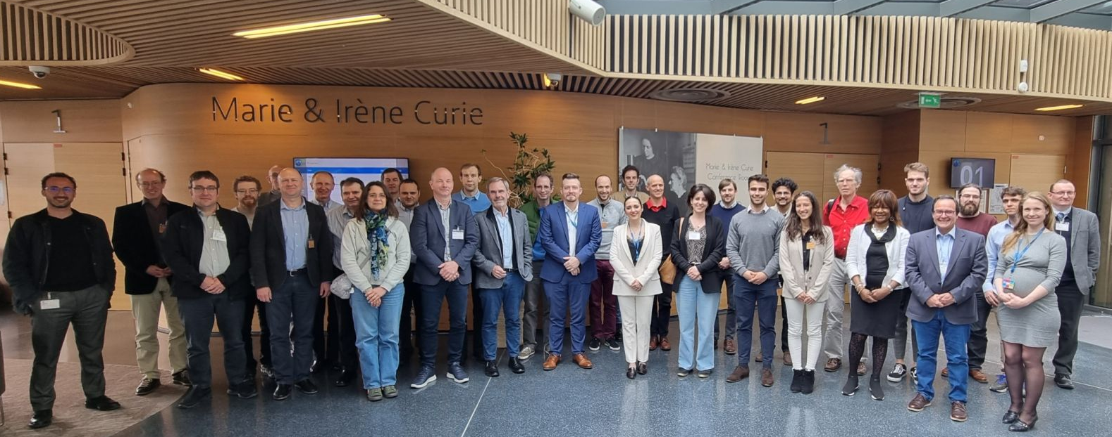
JEFF Nuclear Data Week
November 27th to December 1st
115 participants
57 presentations
12 sessions
New session “Feedbacks from Industry”

Slide 26
Thank you for your attention
Please contact me (daniela.foligno@oecd-nea.org) if you have any questions or comments.
Title page photo: Dry storage facilities (Creative Commons, NRCgov)

Slide 27
Pu-adjustment
Generalized Linear Least-Squares Adjustment
The following quantities were adjusted:
Pu-239: all resonance parameters up to (and including) 49.46 eV and nubar from 0 to 16 eV
Pu-240: all resonance parameters up to (and including) 41.69 eV
Pu-241: all resonance parameters up to (and including) 48.10 eV
During the GLLS adjustment, the following calculations were considered:
Pincell burnup calculation (keff and Pu-239 concentration)
Alpha ratio for Pu-239
PST benchmarks (1, 4, 5, 6, 7, 9, 12, 34, 38)
Kritz benchmark (LWR-RESR-001, case 1 and 2)
Thermal standard values (fission, capture) for Pu-239 and Pu-240
The goal was to reproduce the performances of JEFF-3.1.1.
It was additionally checked with the DUKE-PWR-POWER-001 from IRPhE
For further questions, ask S. van der Marck (NRG), M. Hursin (EPFL), and D. Rochman (PSI)

