Slide 1
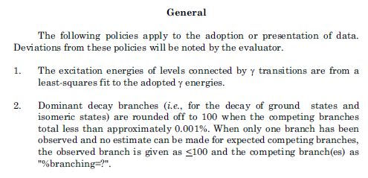
Policy on decay modes
For ground-states, isomeric states and particle bound levels this is usually straightforward
A bit confusing, should each level above a new particle emission threshold be labeled with a new %branching=?: this would be terribly repetitive.

Slide 2
How should one approach this issue for particle resonances?
I suggest if a resonance is observed to be populated by:
only one particle resonance via (n,n),(p,p) or (a,a),
and energetically forbidden or not observed in a sufficient number of studies involving other resonant particles,
then, for example, %N = 100
If a resonance is observed to be populated via (X,g):
(X,g): X=p, n, a, etc. (i.e. only one (n,g),(p,g) or (a,g))
and energetically forbidden or not observed in a sufficient number of other studies
then, for example, %N AP 100 $ %IT GT 0 (real values if known)
If a resonance is observed to be populated via (X,Y):
(X, Y): X=n, p, a, and Y=n, p, a,
or (X,g) and (Y,g)
then, for example, %N GT 0 $ %P GT 0
or %N GT 0 $ %P GT 0 $ %IT GT 0 (real values if known)

