Slide 1
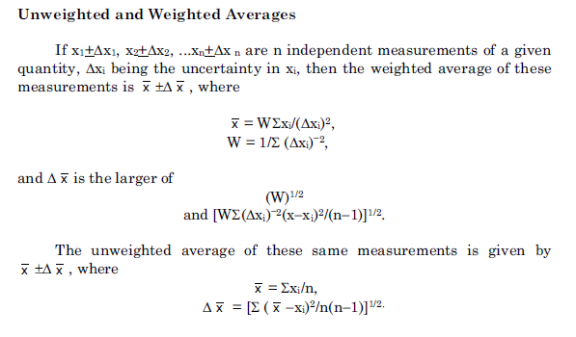
Policy on Uncertainty for Weighted Averages
Differing views on weighted averages are impacting the evaluations and reviews.
The policy needs to be clear.

Slide 2
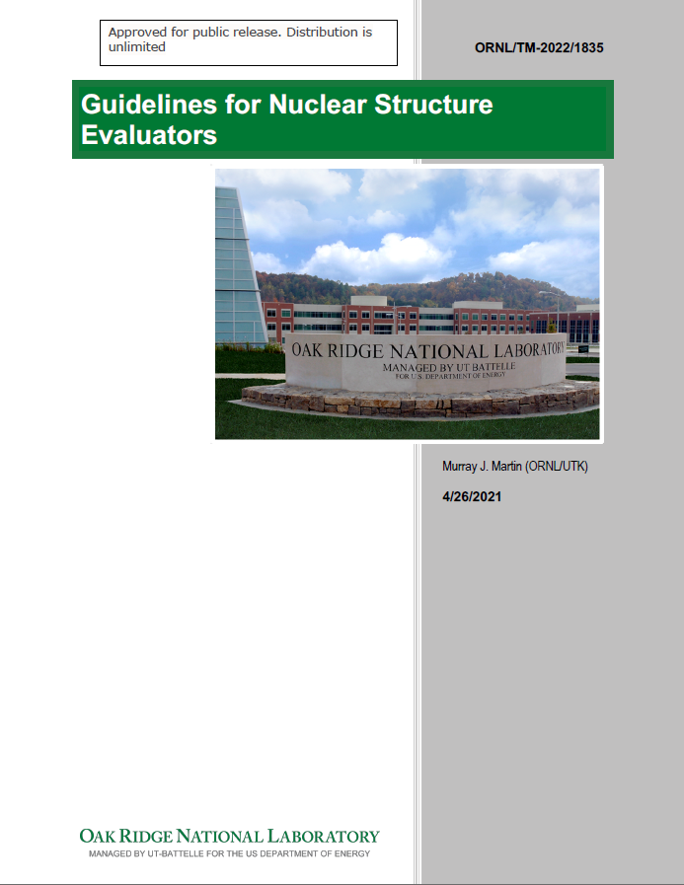
Policy on Uncertainty for Weighted Averages
How is the policy unclear?

Slide 3
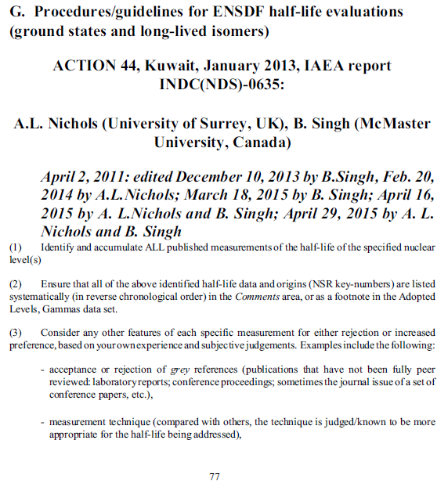
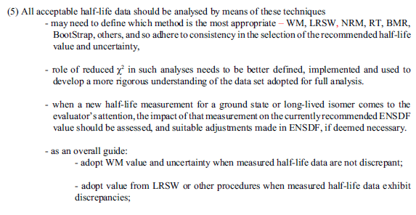
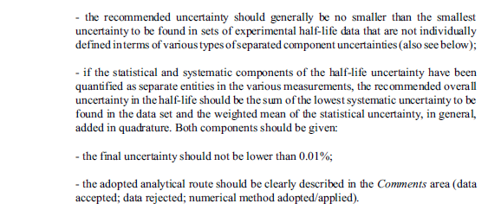
Exception for T_{1/2} measurements

Slide 4
Policy on Uncertainty for Weighted Averages
Discussion

Slide 5
Policy on Uncertainty for Weighted Averages
Can you add digits when averaging?
What is the average of 10.0 20 and 11.0 20? 10.5 14
What is the average of 10 2 and 11.0 20? 10.5 14?
?
What is the average of 10 2 and 11 2? 10.5?

Slide 6
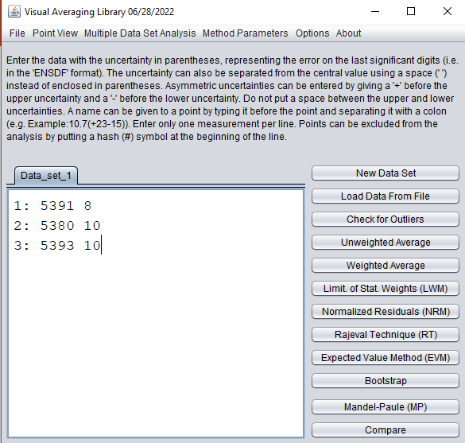
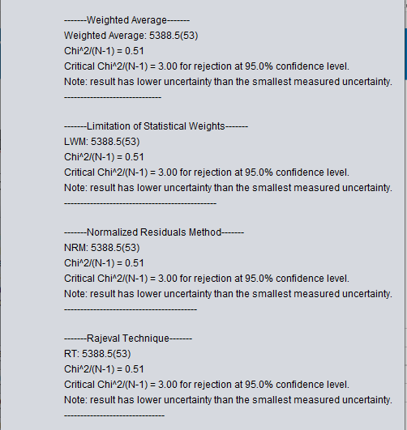
Policy on Uncertainty for Weighted Averages
Caution with VisualAveragingLibrary
You can only round one time!
You want to say the average is 5389…
…But you’d be wrong.

