Slide 1
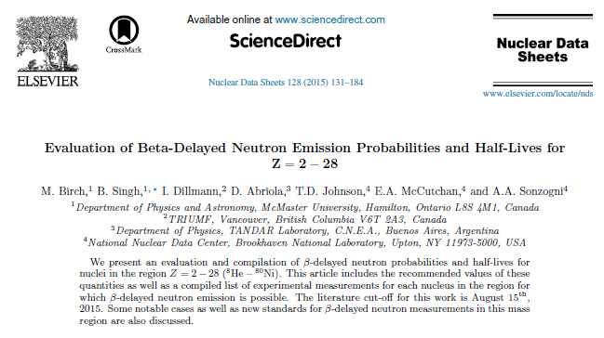
Comments on Pn
Some observations

Slide 2
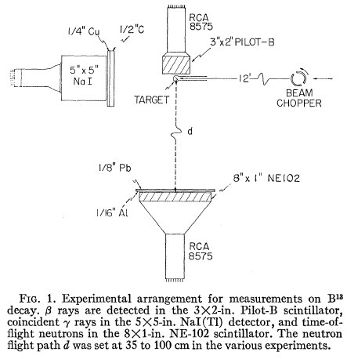
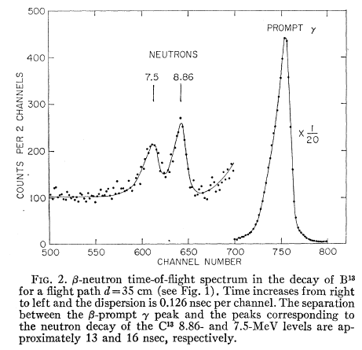
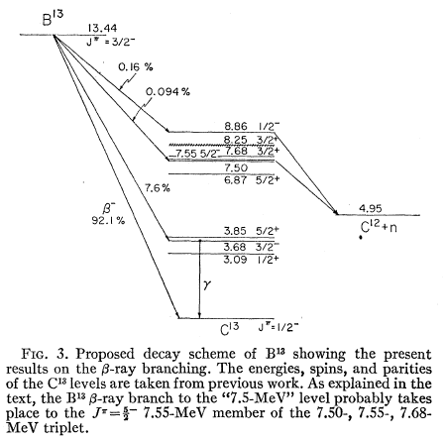
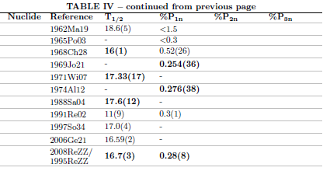
13B b-n decay
0.254 | 0.036 | 195.9877 | 771.6049
0.276 | 0.038 | 191.1357 | 692.5208
0.28 | 0.08 | 43.75 | 156.25
 |  | 430.8734 | 1620.376 | 0.26591

Slide 3
13B b-n decay
0.254 | 0.036 | 195.9877 | 771.6049
0.276 | 0.038 | 191.1357 | 692.5208
0.28 | 0.08 | 43.75 | 156.25
 |  | 430.8734 | 1620.376 | 0.26591
This interpretation is fundamentally flawed

Slide 4
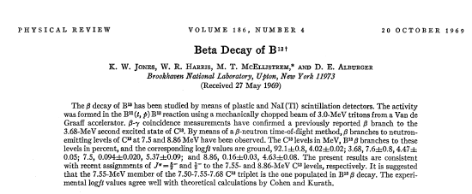
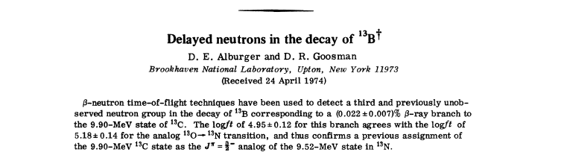
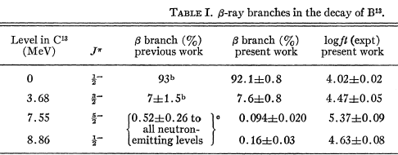
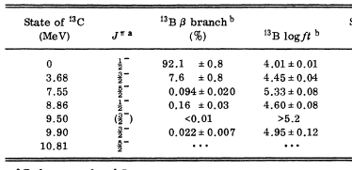
13B b-n decay: 1969Jo21, 1974Al12
These should never be averaged

Slide 5
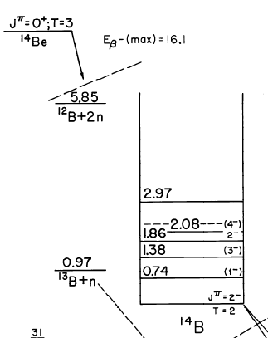
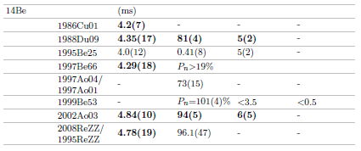
14Be decay

Slide 6
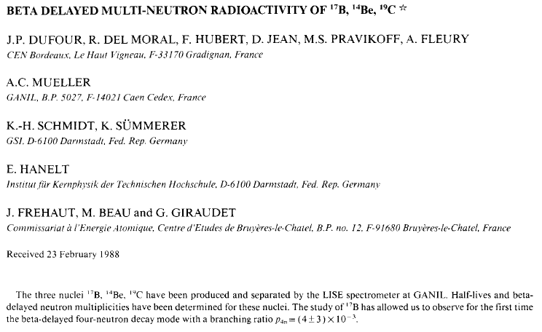



14Be decay: 1988Du09
Predicted 1+ state at 0.94 MeV
?
?
Inconsistent with forbidden decay

Slide 7
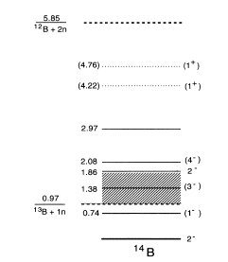
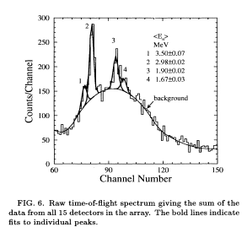
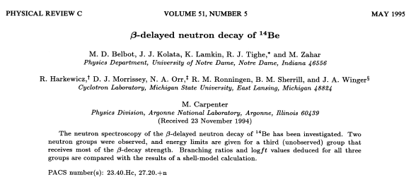
14Be decay: 1995Be25
Data are known to be in error because of a En>800 keV threshold
¹³B γs at 3528 and 3680 are observed.
No evidence of ¹⁴B(740 keV)
Deduce most decay through a near threshold ¹⁴N level Ex~0.97-1.8 MeV
%β-2n is assumed from the spectrum shape
Similar threshold error in 1997Be66

Slide 8
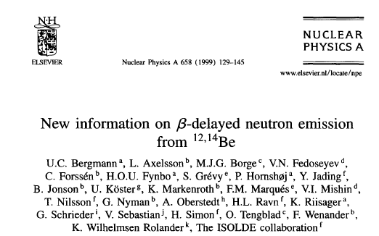
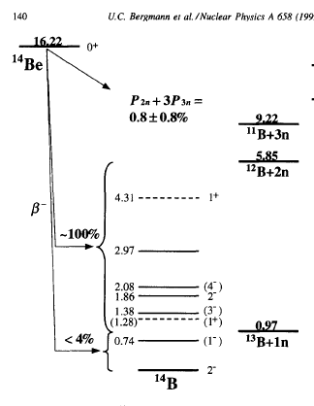
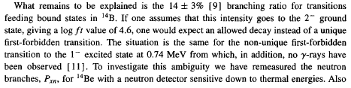
14Be decay: 1998KoZP, 1999Be53, 2002Be53
The tabulated results are incomplete.
P_{n}=P_{1n}+2P_{2n}+3P_{3n}… combined with 1=P_{0n}+P_{1n}+P_{2n}+P_{3n}…
Using P_{n}=101% (4), P_{2n}<3.5% and P_{3n}<0.5%, they deduced P_{1n}>96% (consistent with 100%), P_{2n}+3P_{3n}<2.4% (95%confidence) and P_{0n}<4%
This significant discrepancy could most probably be explained by an overestimated detection efficiency for low-energy neutrons as deduced in Ref. [9] from a calibration using a californium source.
1σ
P0n=14 (3)

Slide 9
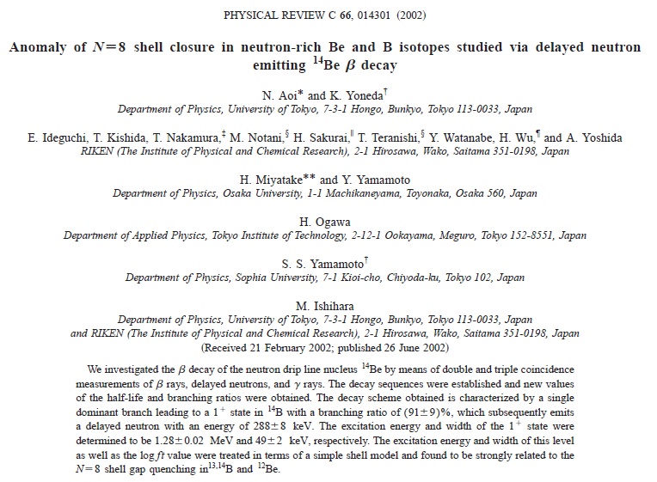
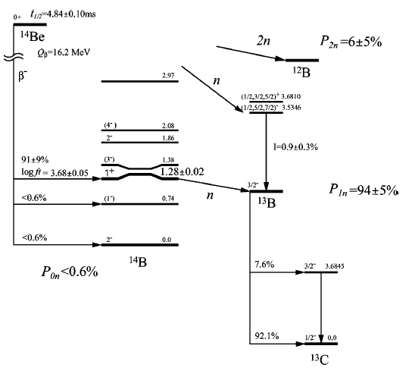
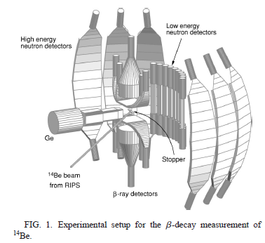
14Be decay: 1997Ao01, 1997Ao04, 2002Ao03:
Followed daughter and granddaughter decays
No evidence of any bound ¹⁴B decay P_{0n}<0.6%
Deduced from 100=P_{0n}+P_{1n}+P_{2n}

Slide 10
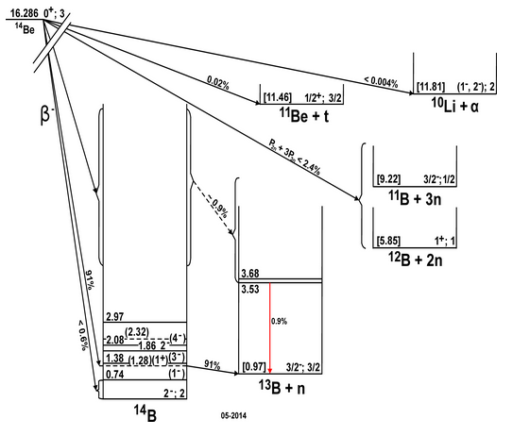

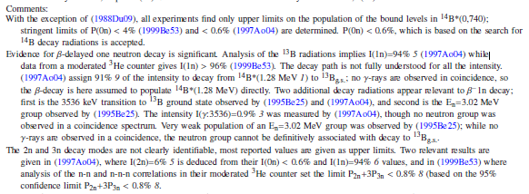
14Be decay
What is left?
 | Pn | %0n | %1n | %2n | %3n
1988Du09 |  | 14(4) | 81(4) | 5(2) |  | This study has systematic errors
1995Be25 |  |  | dominant | 5(2) |  | no participation from the ¹⁴B first state
 |  |  |  |  |  | 2n has assumptions
1999Be53 | 101(4) | <4 | >96 | <1.6 | <0.6 | measured, but correlated; P_{2n}+3P_{3n}<1.6
2002Ao03 |  | <0.6 | 94(5) | 6(5) |  | %2n=1-%1n: no ¹²B grand daughter decay observed

