Slide 1
IAEA Nuclear Data Activities
Paraskevi (Vivian) Dimitriou
Nuclear Data Section
Division of Physical and Chemical Sciences International Atomic Energy Agency

Slide 2
Balraj Singh 1941 - 2023
1970: PhD at Toronto Univ.
1971: Post-doctoral fellow at McMaster Univ. with John Martin
1975 – 1983: visited LBNL, ORNL for the nuclear data project
1980: Canadian NSERC grant to start data evaluation project at McMaster Univ.
2013: retired from McMaster Univ. but continued with USNDP contracts
A total of 80 published mass chains out of 300 in ENSDF ~ 27% of all the mass chains
Published in total over 100 mass chain evaluations (more than any other ENSDF evaluator)
Contributed 6538 out of a total of 10584 datasets to the XUNDL database ~ 62% of the database
Lead all the horizontal compilation/evaluation efforts: logft systematics, BE2, Atlas of isomers, beta-delayed neutrons, alpha-decay r0 parameters, etc.
His ENSDF productivity was unmatchable – his dedication to teaching and mentoring new evaluators invaluable

Slide 3
Status
Nuclear Structure and decay data network – coordination activities
Horizontal compilations – evaluations
Beta-delayed neutrons
Nuclear moments, nuclear charge radii
Nuclear structure and decay data portals and webtools
Decay data portal
LiveChart/Nubase interactive chart
MyEnsdf Webtools, X4-NSR pdf database
Projects
TAGS data for decay heat applications
Decay Data for Monitoring Applications
Decay data for Reactor Antineutrino Applications
New: Nuclear Level Densities
Other tools
Photon Strength Functions, Stopping Powers
Meetings

Slide 4
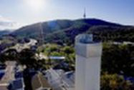
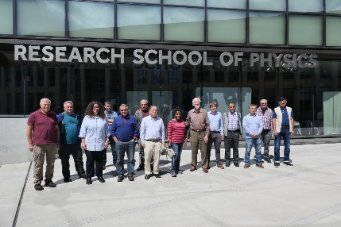
Nuclear Structure and Decay Data network
24th TM: Canberra, Australia, 2022 (Australian National University)
Total of 36 participants; 16 in person
INDC(NDS)-0867
Joint IAEA-ICTP NSDD Workshop 2022
2 weeks: 3 – 14 October 2022; 13 students
7 XUNDL datasets in XUNDL database
A = 222 mass chain evaluation; to be published in Nuclear Data Sheets (2023)
Balraj Singh:
Coordinator, Supervisor; lead compiler
and evaluator

Slide 5
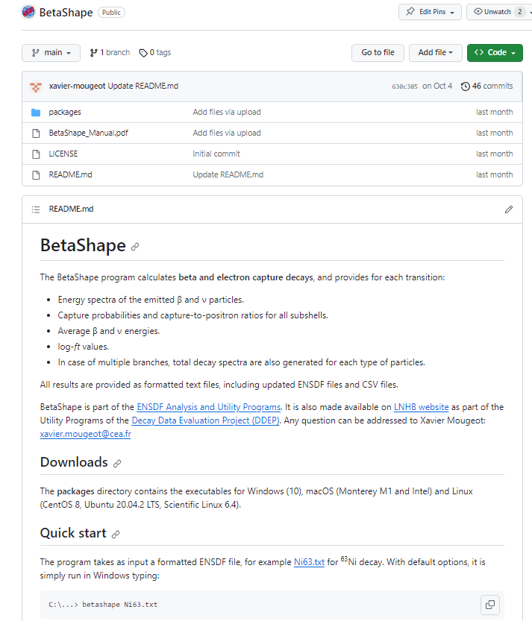
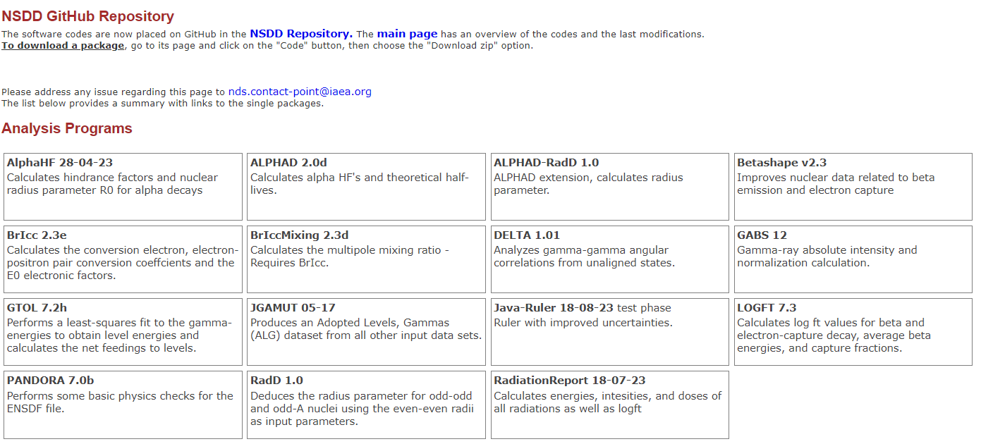
Recommendation/Action from 24th NSDD meeting
Extend BetaShape code to treat non-numerical uncertainties for ENSDF evaluations
X. Mougeot (LNHB – CEA) delivered the updated code
Evaluators (B. Singh, J. Chen, T. Kibedi, F. Kondev, and A.L. Nichols) performed extensive tests
BetaShape v2.3 is available on NSDD GitHub, via the IAEA ENSDF Webpage and from the LHNB website

Slide 6
Enhancement of international NSDD effort
Europe
NuPECC Meeting, Vienna, Dec 2022
NUPECC Long Range Plan
IAEA Consultant’s Meeting on “Needs for a Comprehensive European Plan to acquire and curate nuclear data”, 25-27 April 2023; INDC(NDS)-0875
IAEA General Conference Side Event
New Euratom Funding Project
India
Grant awarded to Anagha Chakraborty for ENSDF evaluation (2023-2026)
Japan
Support Letter for H. Iimura in Division of Nuclear Safety, JAEA
Coordination with Nuclear Data Group, JAEA, to hire new ENSDF evaluator
Nuclear Data Outreach Workshop, Japan Physics Conference, 2024
China
Coordination with CNDC/CIAEL: train new ENSDF evaluators starting in 2024

Slide 7
NuPECC Long Range Plan

Slide 8
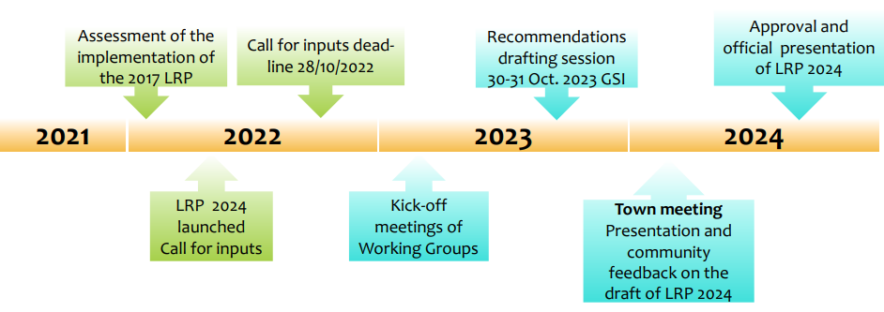
NuPECC Long Range Plan
To be published in 2024 (159 contributions by >400 scientists, collaborations, infrastructures, and research institutions in Europe)
9 thematic areas (TWG):
Hadron physics; Strongly interacting matter at extreme conditions; Nuclear Structure and Reaction Dynamics; Nuclear Astrophysics; Symmetries and Fundamental Interactions; Infrastructures; Applications and Societal Benefut; Nuclear Physics Tools; Open Science and Data; Nuclear Science – People and Society
TWG 9: Open Science and Data
Coordinator: Antoine Lemasson (GANIL)
Section on Nuclear Data and Evaluation: P (Vivian) Dimitriou
Timeline:
From M. Lewitowicz

Slide 9
Consultant’s Meeting on Needs for a Comprehensive European Plan to acquire and curate Nuclear Data
25-27 April 2023, IAEA
Participants: Roger Garbil (EURATOM), Marek Lewitowicz (NuPECC Chair), S. Koerner (NuPECC Secretary), E. Widmann (AAS), S. Leray (CEA), A. Boeltzig (HZDR), E. Gonzalez (CIEMAT), D. Ridikas (IAEA/Physics), A. Koning (IAEA/NDS)
Guest (remote) presentation: Keith Jankowski (DoE)
Report: INDC(NDS)-0875; https://conferences.iaea.org/event/347/
Some key recommendations:
establish priorities for nuclear data measurements and evaluations for applications that will be addressed by a comprehensive European nuclear data programme - the priorities should be based on existing priority lists maintained by the different stakeholders
establish a sustainable source of funding of measurements and data evaluation, including well-defined career paths in nuclear data that will involve national funding agencies and the European Commission (EC) (EURATOM and all other relevant EU work programmes)
One of 6 proposed actions:
Consider organizing a side event at the IAEA General Conference 2023 to highlight the importance of nuclear data programmes for basic sciences, nuclear energy development and other applications worldwide

Slide 10
IAEA 67th General Conference –
Side Event on Providing the best nuclear data for tomorrow's nuclear solutions
26 September 2023, IAEA
Lead organiser: Joint Research Center – EC (Arjan Plompen)
Co-organisers: Keith Jankowski (DoE); Enrique Gonzales (CIEMAT); Sylvie Leray (CEA);
Facilitated and supported by IAEA/Nuclear Data Section
https://www-nds.iaea.org/index-meeting-crp/GC67-SideEvent/
Innovation, research and development for tomorrows’ nuclear
solutions
Yolanda Benito (CIEMAT, Director General)
Heloise Goutte (CEA, Scienitific Director for Energy)
Michael Fleming (OECD-NEA, on behalf of the DG)
Opportunities, challenges and ways forward for nuclear data
Arjan Koning (IAEA) – Introducing nuclear reaction and decay data
Arjan Plompen (JRC-EC) – A European perspective
Keith Jankowski (DoE) – A United States perspective
Tokio Fukahori (JAEA) – A Japanese perspective
Wenming Wang (CIAE) – A Chinese perspective

Slide 11
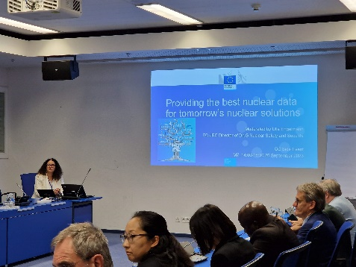
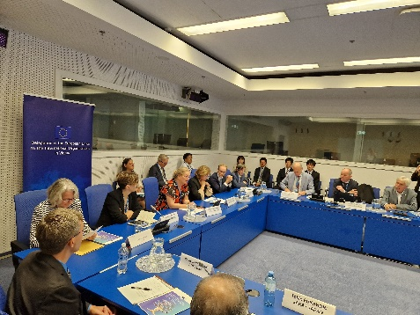
Key takeaways:
How to raise the awareness of funding agencies of the benefits of nuclear data for nuclear applications with the objective of getting the required resources to invest in a stable and long-term workforce and infrastructures
Coordination of different funding sources and agencies
Create stable conditions to attract the required data experts (evaluators), i.e. career paths
Actions:
Brochure promoting nuclear data: examples showing the economic value of nuclear data
Nuclear Physics News Newsletter piece
Discuss possible European Nuclear Data Advisory Committee

Slide 12
European Funding for Nuclear Data
Only source: fixed-term projected funded by EURATOM Nuclear Fission
SANDA project funded by EURATOM (2019 – 2024)
Funding for ENSDF evaluations for the first time
Total amount: 60kEuro split among 3 Data Centers: BUL, HUN, ROM
Evaluations: ¹¹⁷Sn, A = 1-107, A = 86,
APEND (2024 - )
New approach: concentrate funding on one Data Center to get maximum efficiency
BUL: ~60kEuro for 1 new evaluator 0.5 FTE
HUN, ROM: ~10kEuro each for travel funds

Slide 13
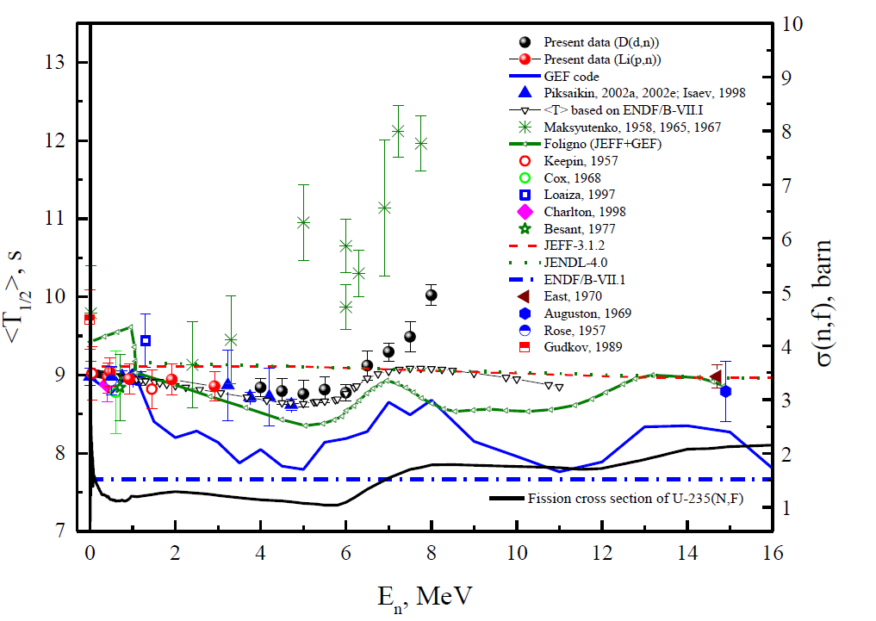
Beta-delayed neutron database
https://www-nds.iaea.org/beta-delayed-neutrons/database.html
Microscopic (T_{1/2}, P_{n}) data. All contributions from Balraj Singh (partially supported by IAEA):
2020 – 2022: update of Z>28 nuclei
2023: Z = 2-28; Z>57; Z>28 by end of 2023
Macroscopic DN groups. All contributions from Vladimir Piksaikin (IPPE) (partially supported by IAEA):
2022: DN group spectra (8-group)
2023: group constants (T_{i},a_{i}) for ²³⁵U (0.4-8 MeV); ²³²Th, ²³⁶U, ²³⁷Np, ²⁴¹Am (fast)
Verification of fission FPYs using delayed neutron temporary data
The energy dependence of the average half-life of DN precursors from neutron-induced fission of 235U.

Slide 14
Delayed neutron decay constants
6- or 8-group models:
T_{i}: half-life (ln2/λ_{i}) $<T> = \sum_{i=1}^{N}{a_{i}∙T_{i}}$, $\sum_{i=1}^{N}{a_{i}=1}$
a_{i}: abundance
Keepin’s data (6-group, 1957)
Brady & England (1989) evaluation based on summation method (ENDF/B-VII & VIII)
Recommended group constants from WPEC/SG-6 (2002): 8-group model (Spriggs and Campbell, 2002)
Measurements: Piksaikin et al. over several decades – all data compiled in the IAEA Reference Database
Latest recommendations from IAEA CRP (2021): 6- and 8-group models by Piksaikin et al.

Slide 15
Comparison with Evaluated Libraries
14.7 MeV values are used at 20 MeV
JEFF-3.3
JENDL-5
Keepin’s model
WPEC/SG-6
Brady & England(1989)
based on summation calculations of DN activity for FAST fission
Keepin’s values:
Thermal:
T₁ = 55.72 ± 1.28 s
<T> = 9.02 ± 0.34 s
Fast:
T₁ = 54.51 ± 0.94 s
<T> = 8.82 ± 0.25 s
CRP rec values based on integral DN N(t) measurements:
Thermal: 14.7 MeV:
T₁ = 53.95 ± 0.28 s T₁ = 54.6 ± 0.5 s
<T> = 8.98 ± 0.11 s <T>=8.97 ± 0.15 s
Fast (0.81 MeV) 20 MeV:
T₁ = 54.90 ± 0.15 s T₁ = 54.6 ± 0.5 s
<T> = 8.96 ± 0.06 s <T>=8.97 ± 0.15 s
≠
Keepin’s values
IAEA CRP
JEFF and JENDL

Slide 16
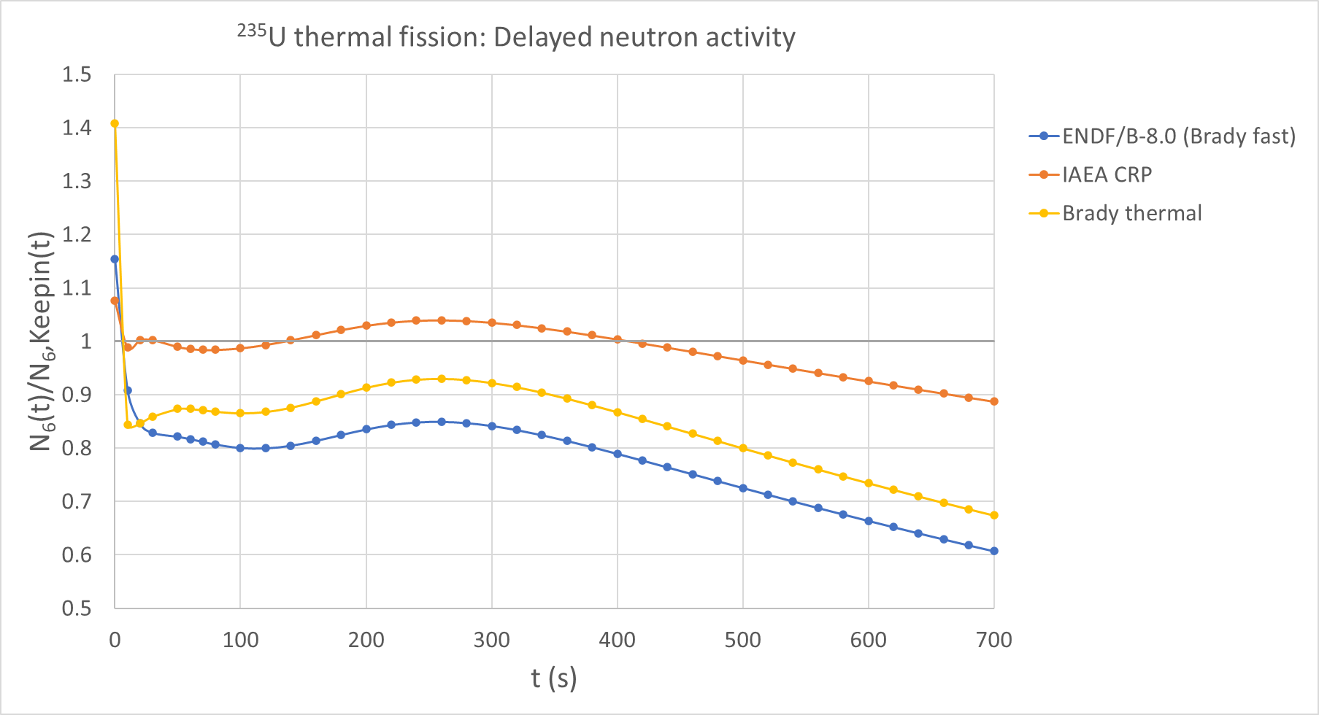
DN emission N(t) following a fission pulse: ratio of DN emission wrt Keepin’s 6-group model

Slide 17
Other horizontal compilations/evaluations
Nuclear Moments (magntic dipole, electric quadrupole)
Compilation tables are being updated (Nick Stone) - to be completed and published in 2024 (partially supported by IAEA)
Nuclear charge radii
Update of 2013 recommendations by Angeli & Markova
Evaluation responsibility will be taken over by Endre Takacs, Clemson Univ.
IAEA meeting, 2024

Slide 18
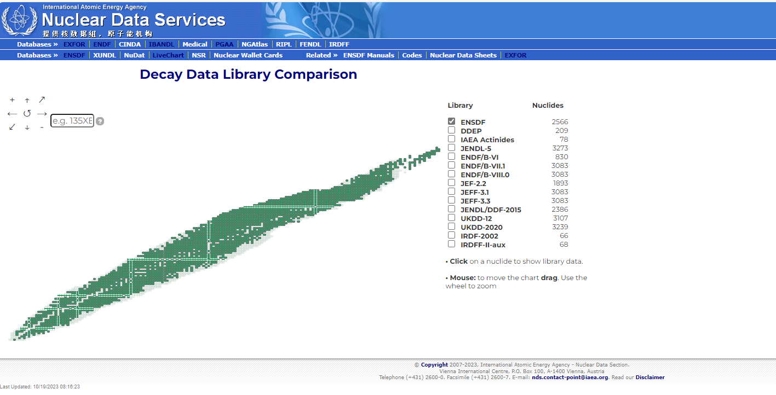
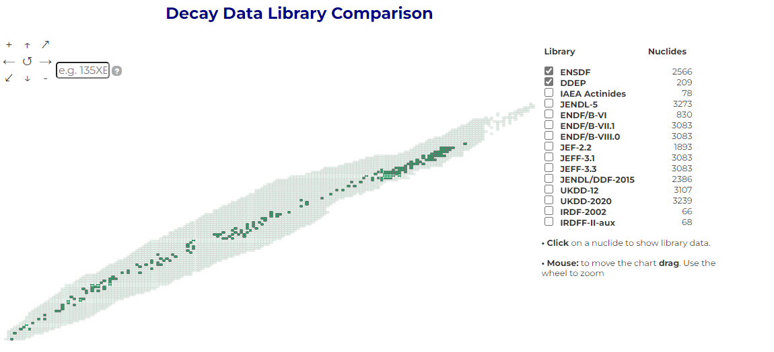
Decay Data Portal

Slide 19
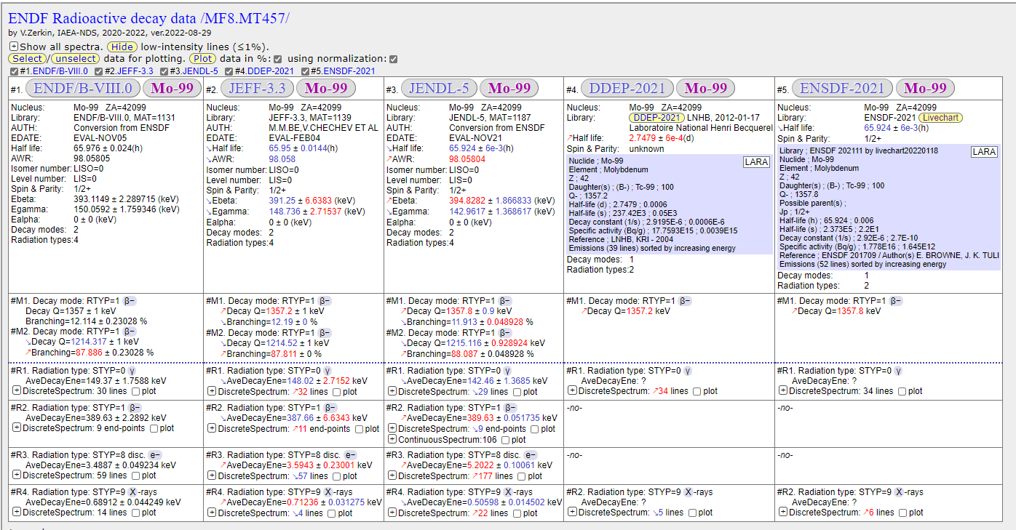
Decay Data Portal

Slide 20
MyEnsdf Webtools, X4-NSR PDF database
Maintenance plan (following V. Zerkin’s retirement)
MyEnsdf Webtools: is now up to date but doubtful if it will be maintained in the future
X4-NSR PDF database: will be maintained by IAEA/NDS, status also depends on NSR database being updated
EXFOR will also be maintained by IAEA/NDS

Slide 21
Decay Data for Decay Heat Applications
Series of IAEA meetings (2009, 2014, 2018) concluded with a publication:
Includes tables with assessments (status of measurements and evaluations) for 120 fission products
Comparisons of all available pulse decay heat data with existing evaluated libraries to study impact of TAGS data

Slide 22
Decay Data for Monitoring Applications
Project ends in 2024:
A library of adopted decay data for 30 top priority fission products (CTBTO priority)
Atomic radiation data from NS_Radlist (BrIccEmis spectra)
Technical report to be published in peer-reviewed journal
Participants: F. Kondev (technical coordinator), Jun Chen, P. Dimitriou, T. Kibedi, S. Lalkovski, A. Negret, A. Nichols, B. Singh, J. Tuli, M. Verpelli

Slide 23
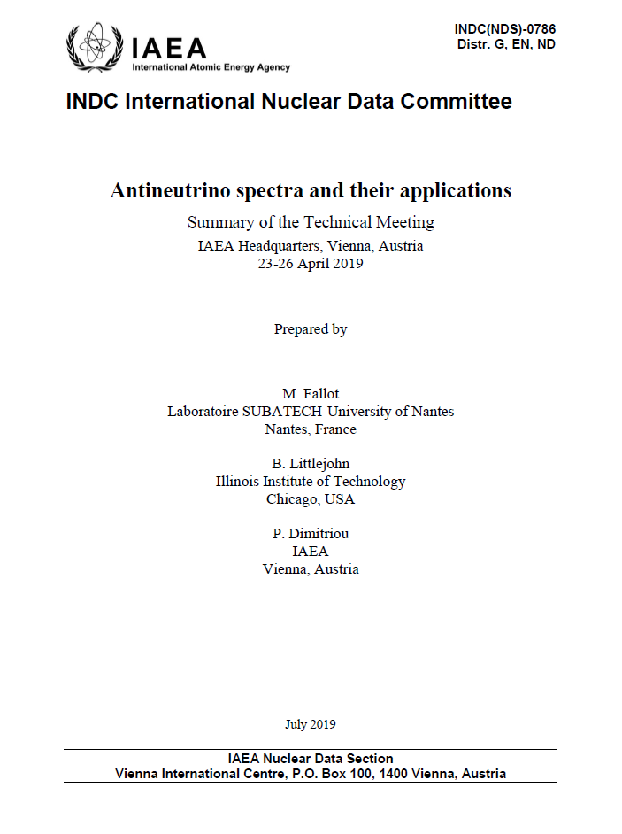
Nuclear data for Reactor Antineutrino Applications
1st IAEA Technical Meeting on Antineutrino spectra and their applications, 23-26 April 2019
37 participants from 11 countries
Topics
Reactor antineutrino measurements for basic
science and applications (nonproliferation)
Flux and spectrum modeling
Nuclear data and reactor data needs
Summary report: INDC(NDS)-0786

Slide 24
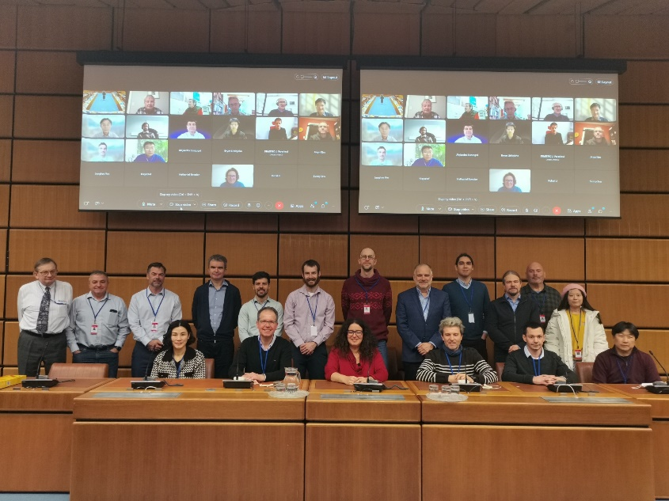
Follow-up: 2nd IAEA Technical Meeting on Reactor Antineutrino spectra and applications, 16 – 20 January 2023
Purpose:
follow up on progress
revise status and data needs
address data preservation and dissemination
needs for coordination
Participants: 56 registered; 18 in person
Countries: China, France, Germany, Korea, Poland, Spain, Russia, US
Report: in preparation
https://conferences.iaea.org/event/337/

Slide 25
Inter-disciplinary
Presentations – Q&A
Roundtable discussions
Recommendations
Common statements - Report
Understand and Resolve anomalies
Reactor antineutrino measurements
Modelling
Conversion Summation
Nuclear data
Decay+Fission
Theory
Reactor data
New ideas
New collaborations
New meetings

Slide 26
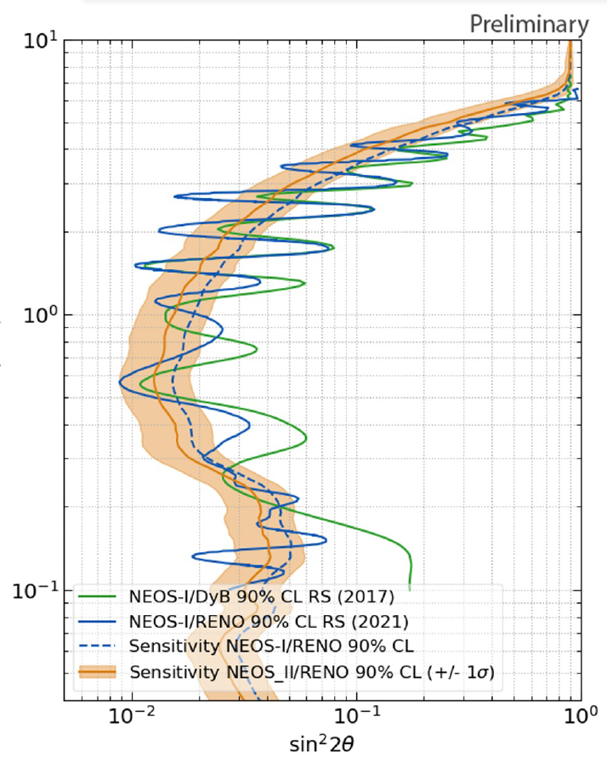
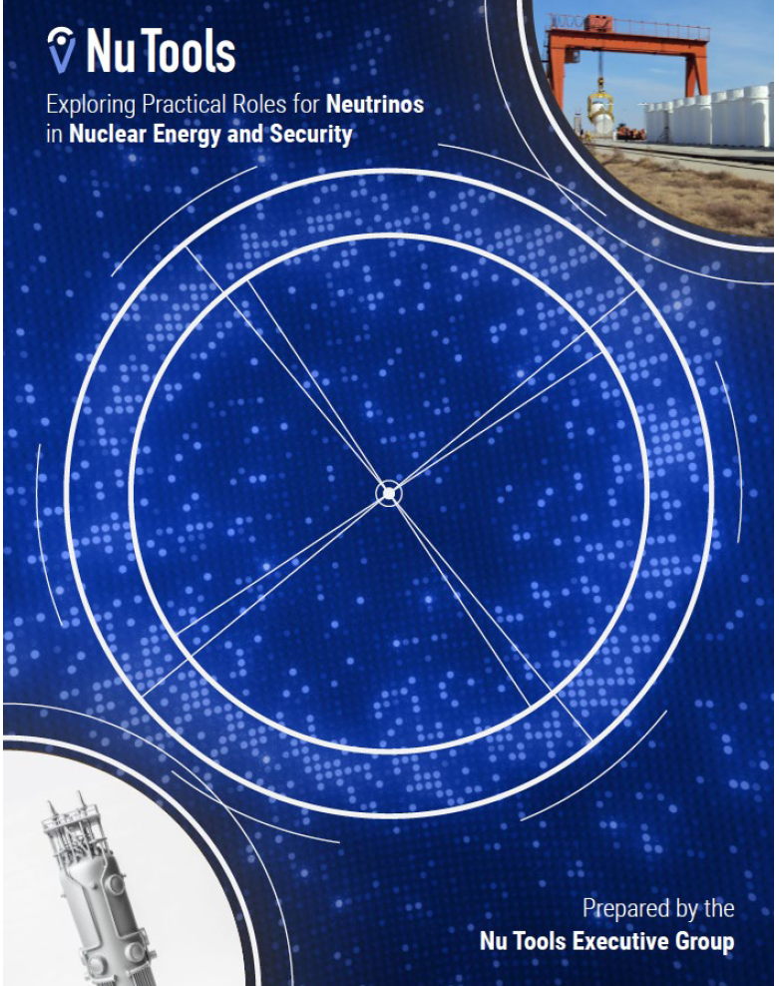
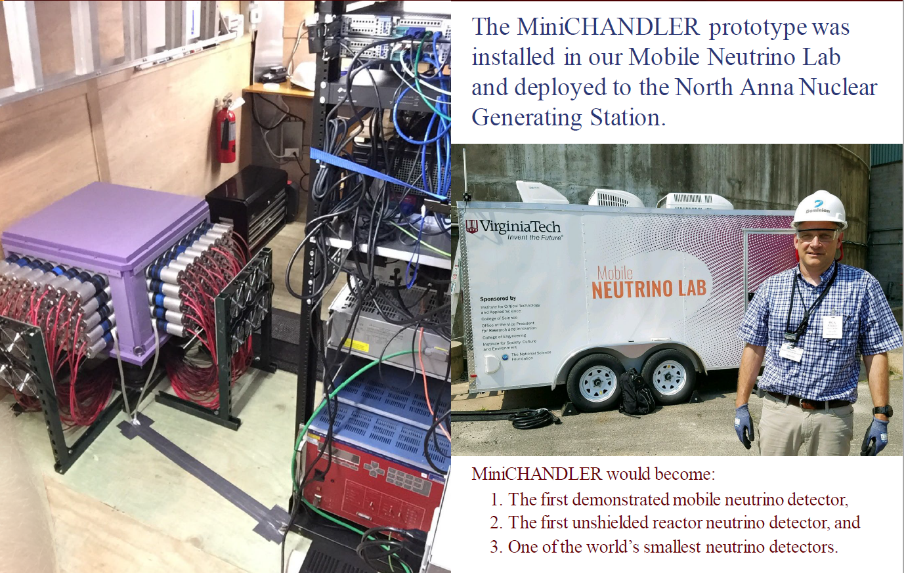
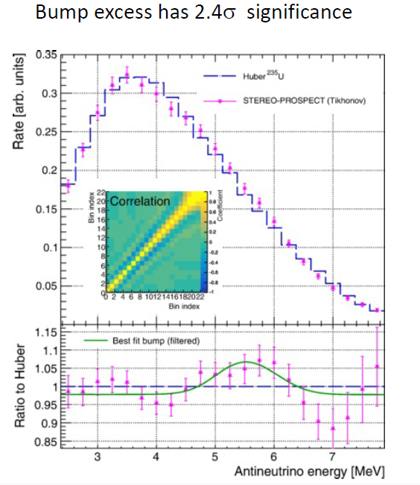
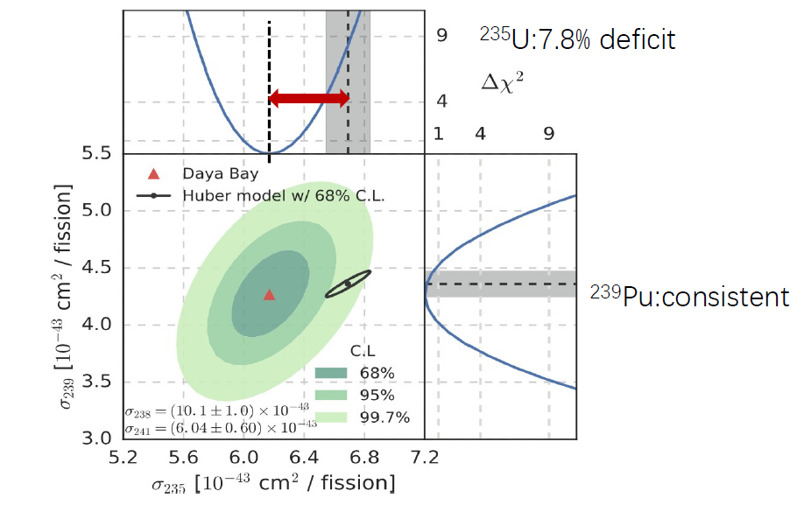
Reactor antineutrino experiments
Highlights
Sterile neutrino phase space have been narrowed down – not entirely ruled out
ILL beta spectra measurements could be root cause of RAA supported by DB fuel evolution measurements
Spectral distortion is not yet understood
Number of experiments in the final stages of analysis and further joint analysis planned
On-surface and mobile detectors are being developed
Antineutrino applications: reactor monitoring, spent fuel
Clear observation of residual antineutrinos (Double CHOOZ)
Nu Tools report: discussion of the utility of actual uses cases in the US – engagement with end-users
Antineutrino detectors as on/off monitors demonstrated
New detector materials - potentially at industrial level
NEOS II : sterile neutrino search
Double CHOOZ : sin² 2θ₁₃
PROSPECT/STEREO Joint Spectrum Analysis
Daya Bay: data point to ²³⁵U as main responsible for RAA

Slide 27
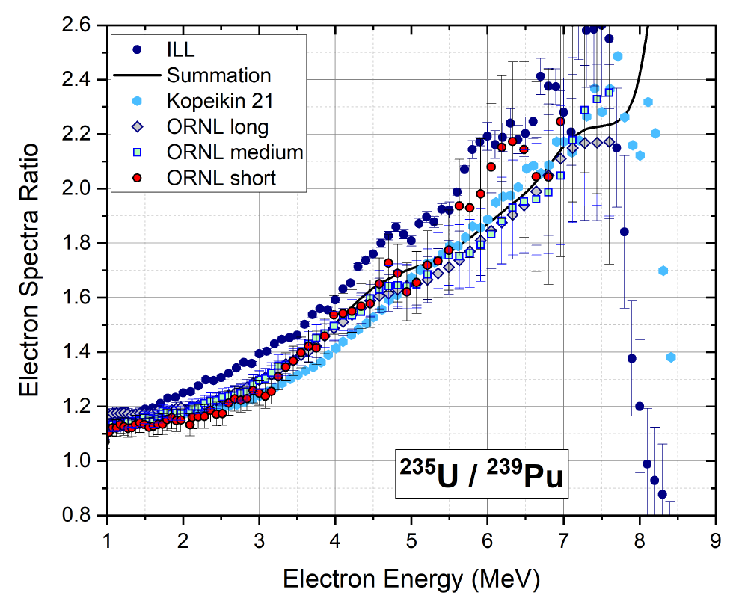
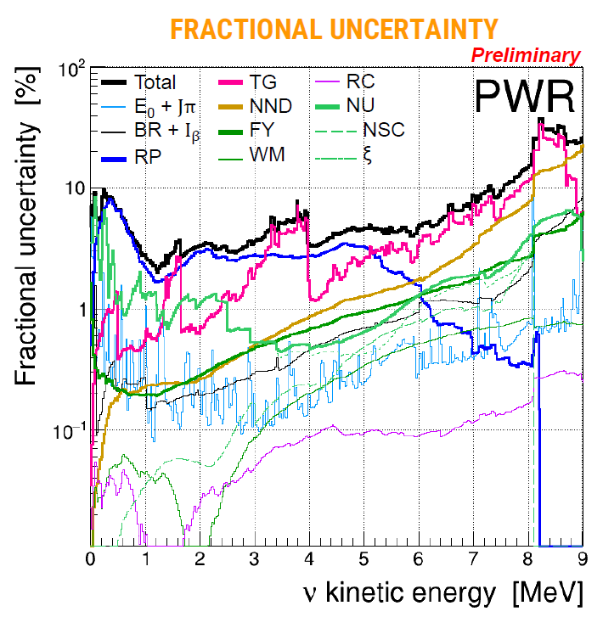
Modeling flux and spectrum
Modeling flux and spectrum
Significant progress in summation calculations
agree with flux evolution from Daya Bay
New U235/Pu239 measurement proves that
(Kurchatov)
Steps towards quantifying uncertainties
New open computational tools developed -
ConFlux
Challenges
Uncertainty quantification
Better input data: decay data, fission yields,
covariances, long range correlations
Access to standardised experimental data
formats
Future
New and improved input data (fission yields with
covariances)
Inter-comparison of summation models
Theoretical predictions (nuclear)
Calculated spectra for new/other reactor types
Shared open computational tools – easy to
validate input data and enhance exchanges
btw groups
Latest summation results
Fallot et al.
New beta spectra, Sonzogni et al.
Summation with uncertainty budget, Perisso et al.
Xianyi Zhang et al.

Slide 28
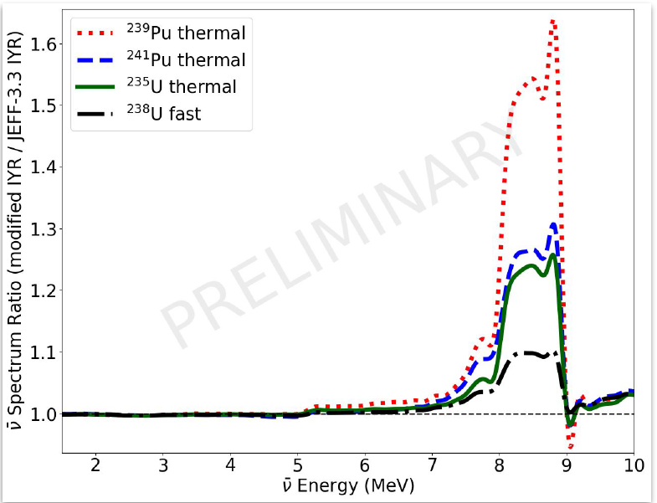
Nuclear data
Rykaczweski et al.
Highlights
New TAGS measurements – improved decay data
Improved treatment of non-unique forbidden transitions
Recommended isomeric fission yield ratios
Challenges
TAGS data related to high energy part of spectrum are difficult to measure
Disentangle isomers and grounds state spins
Covariance matrices associated with the measurements
Future
New integral beta measurements to compare with ILL
Individual beta spectra measurements
New evaluated fission yields with uncertainties
Improved beta shapes – microscopic nuclear models
Complete TAGS measurements and perform High
Resolution Spectroscopy measurements where needed
Mass measurements/Q values, for identification of isomers
Algora et al.
Mattera et al.

Slide 29
Final recommendation
Basic science goals: high precision data - almost there
Applications: identify use cases ‒ R&D needed – resources
Modeling: improve nuclear theory – open computational tools
Nuclear data: improve nuclear data – uncertainties – beta spectra
Data preservation and dissemination: standardisation – sharing of data following FAIR principles
Progress limited by available resources – coordination is needed
Recommendation: form a Working Group under the auspices of the IAEA
Role: to coordinate and provide advice
Membership: international

Slide 30
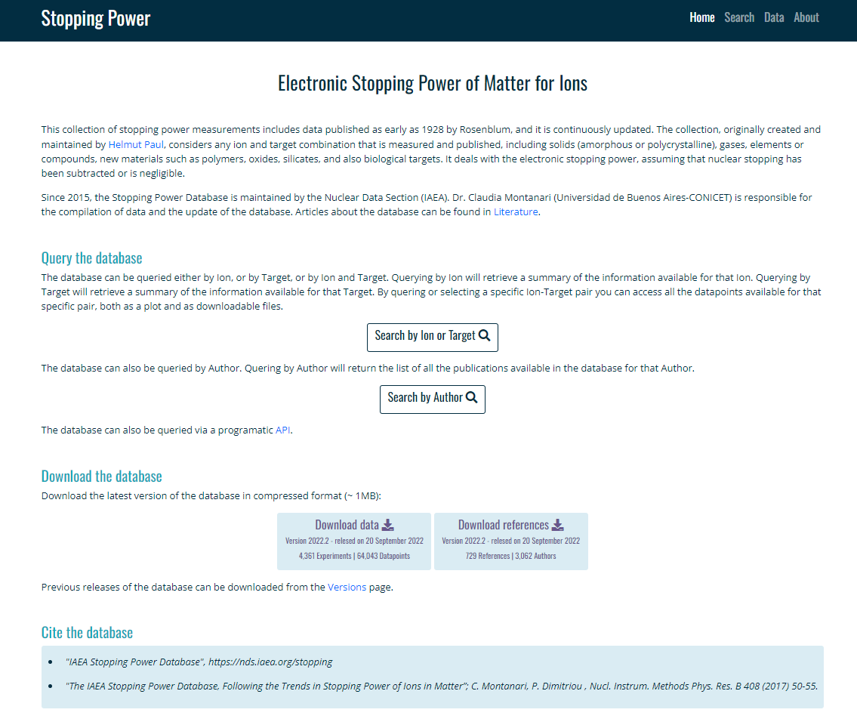
Stopping Power Database
static
interactive
DOI links

Slide 31
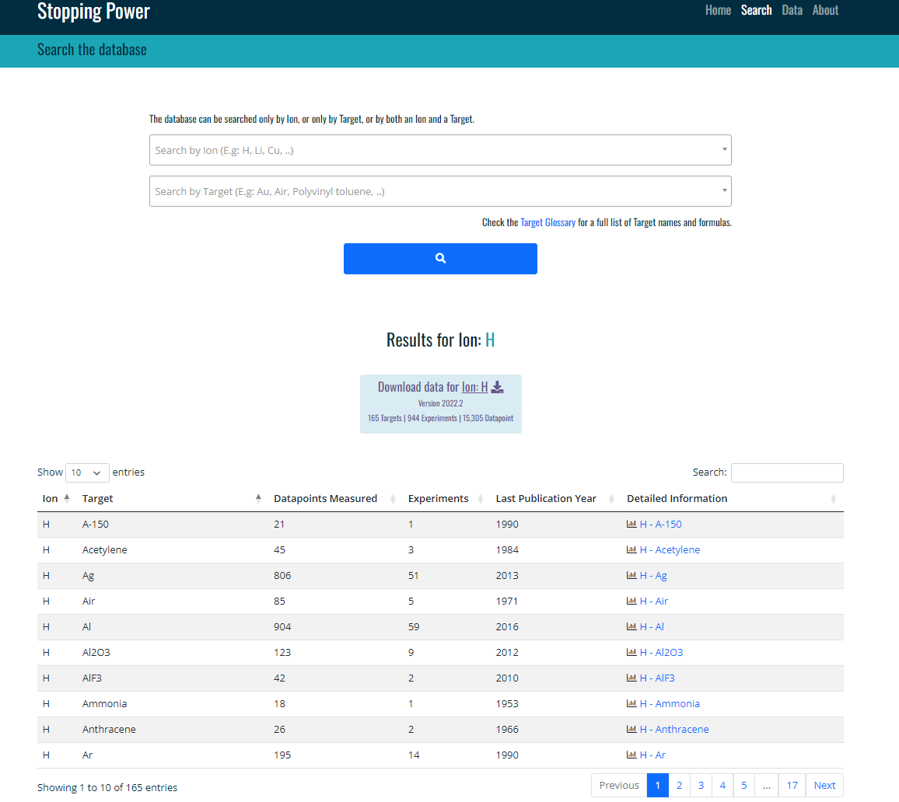
Stopping Power Database cont’d
easy to search data and literature
Identify trends
search
Download all data in one csv file

Slide 32
Stopping cont’d
plotly
change units
DOI links
Format options

Slide 33
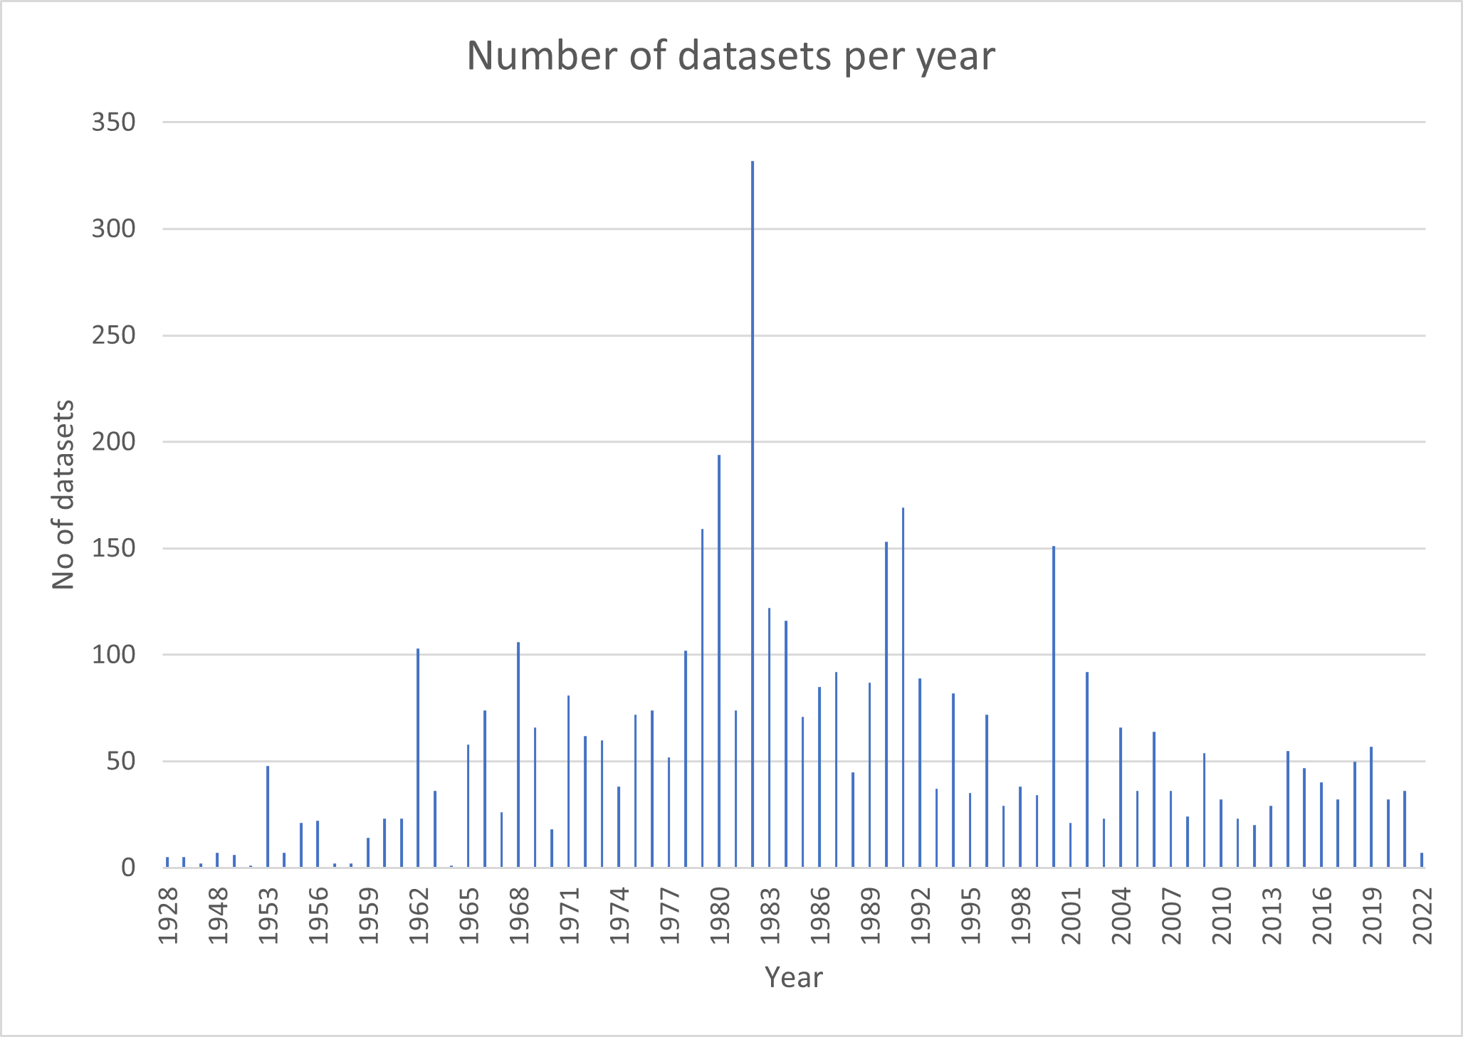
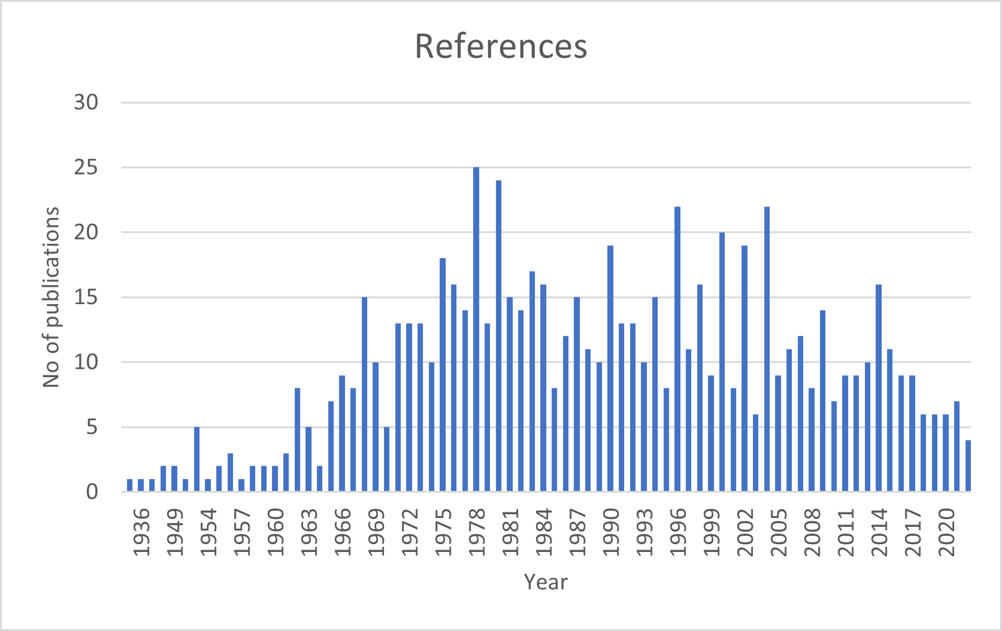
Stopping cont’d
plotly
change units
DOI links
Format options

Slide 34
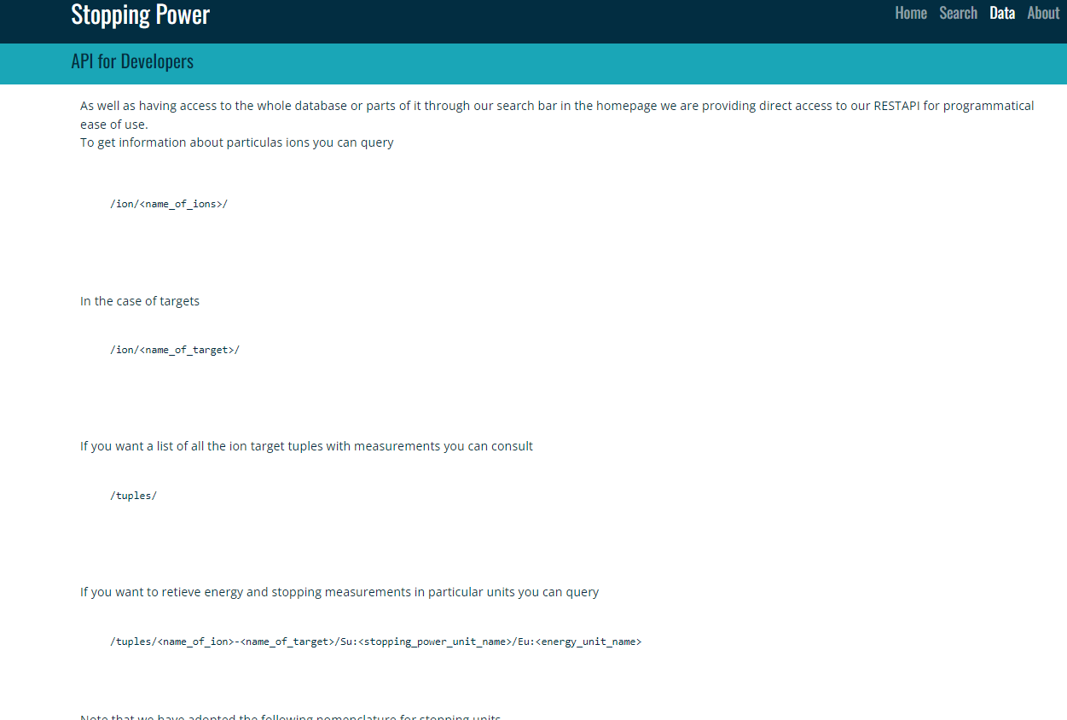
Stopping cont’d
plotly
change units
DOI links
Format options

Slide 35
Photon Strength Function Database
Compilation of all experimentally derived Photon Strength Functions (CRP 2016-2019)

Slide 36
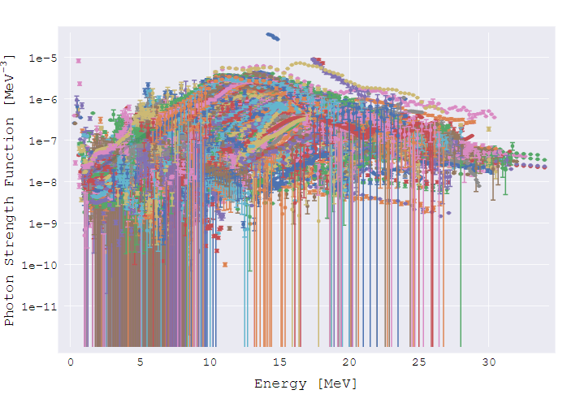
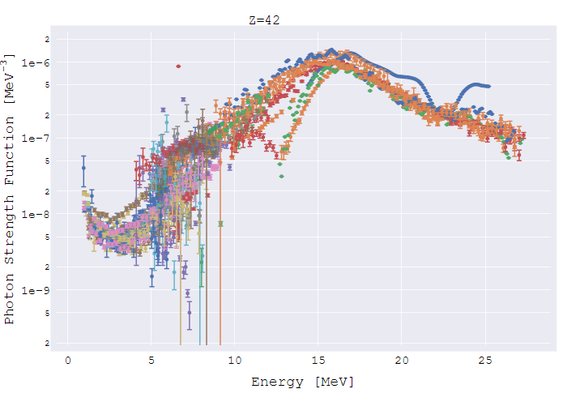
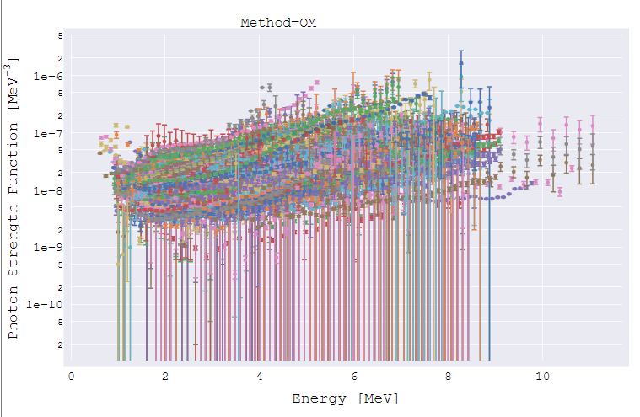
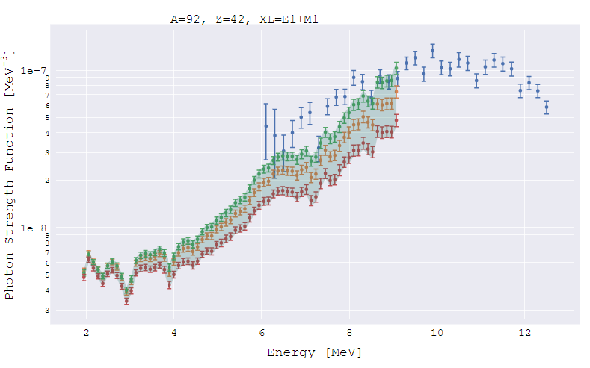
Photon Strength Function cont’d

Slide 37
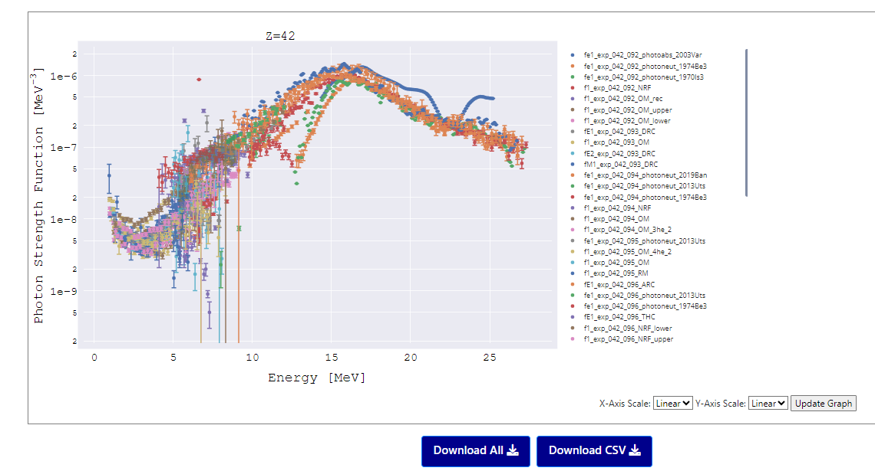
Photon Strength Function cont’d

Slide 38
Photon Strength Function cont’d
In progress
DOI links
Theoretical curves
API
Also:
Ongoing effort to evaluate PSF data to provide recommended values

Slide 39
Upcoming in 2023-2024
2nd TM on (alpha,n) reaction nuclear data evaluation and data needs, 27 Nov - 1 Dec 2023, virtual
Purpose: to review status of (alpha,n) reaction data at low energies up to 10 MeV relevant for applications in
nuclear fuel cycle (with emphasis on ¹⁷O compound system),
spent fuel management, nonproliferation
low background experiments
nuclear astrophysics
fusion applications.
We will also review the status of model and applications codes, as well as of evaluated libraries.
https://conferences.iaea.org/event/366/

Slide 40
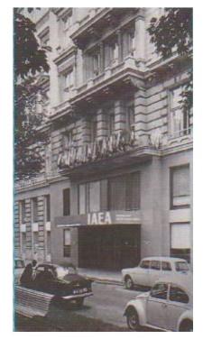
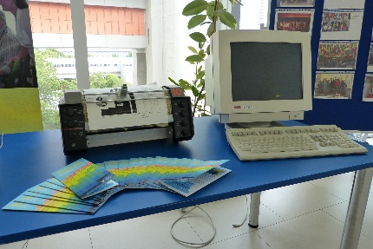
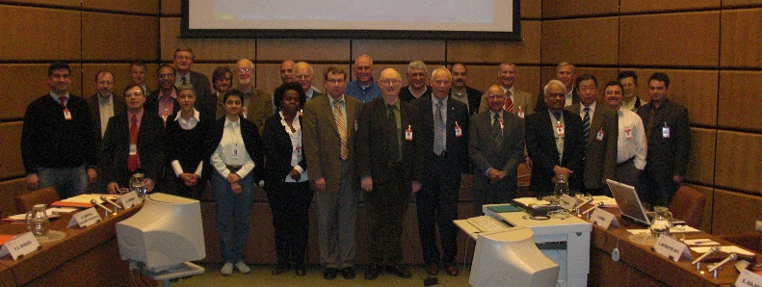
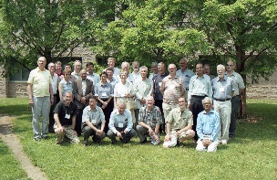
2024: 60th Anniversary of the
Nuclear Data Section
25th TM of the NSDD network
IAEA, 15-19 April 2023
50th NDS Anniversary
50th Anniversary of the NSDD network
Kuwait 1990
McMaster 2004
IAEA 2009

Slide 41
Upcoming in 2024
NEW CRP: Improving Nuclear Level Densities for Applications
Consultant’s Meeting on Nuclear Level Densities, 26 – 28 June 2023
To discuss the scope, methods, outputs, work program of a new CRP on Improving Nuclear Level Densities for Applications
Participants: Goriely, Guttormsen, Herman, Krticka, Voinov, Wiedeking
Report in preparation
https://conferences.iaea.org/event/358/

Slide 42
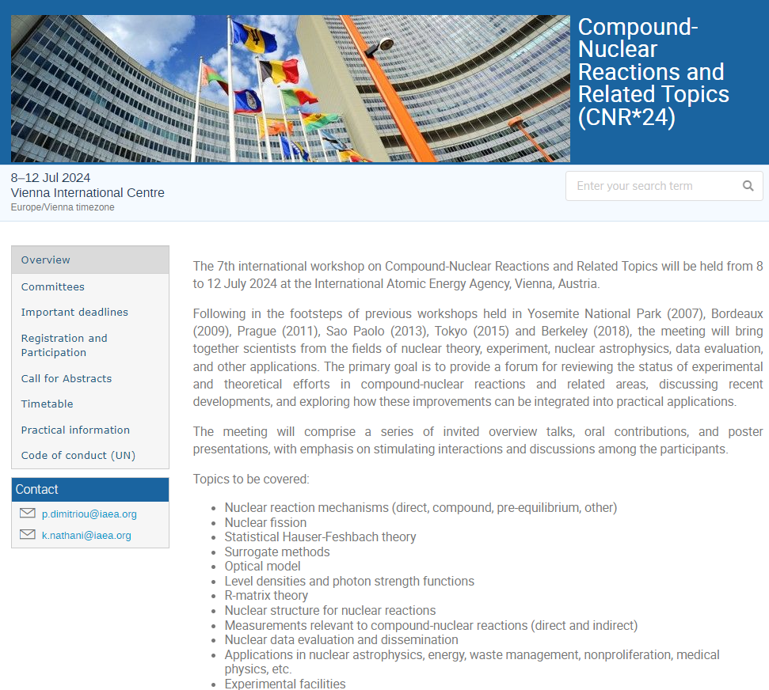
Also in 2024
7th Workshop on Compound-Nuclear Reactions and Related Topics (CNR*24)
Keynote talks
Oral/poster presentations
Proceedings
No registration fees
Registration: 1 Dec 2023
Abstracts: 1 Dec 2023
Organisers:
Vivian Dimitriou
Roberto Capote
Georg Schnabel

Slide 43
Other 2024 meetings
1st Research Coordination Meeting of the new CRP on nuclear level densities
INDEN meetings: Major Actinides, Structural material and light elements
Standards
Thermal capture and gamma emission
Stopping Powers

Slide 44
Thank you!
Notes:
Thank you!

Slide 45
Comparison cont’d: ENDF-6 formats
ENDF-6 format: MT=455
ENDF/B-8.0:
Energy independent T_{i} (λ_{i})
Energy independent a_{i}
JEFF-3.3, JENDL:
Energy independent T_{i} (λ_{i})
Energy dependent a_{i}
IAEA CRP:
Energy dependent T_{i} (λ_{i})
Energy dependent a_{i}
LDG=0; λ_{i} in MF=1 only and a_{i} in MF=5
LDG=0; λ_{i} in MF=1 only and a_{i} in MF=5
LDG=1; (λ_{i},a_{i}) in MF=1 and MF=5
Note: Brady & England (1989) also recommend energy-dependent (λ_{i},a_{i})

