Slide 1
R-Matrix analysis of ¹⁴⁹Sm + n in the resolved resonance region
Experiendo cognoscitur
Th. Stamatopoulos¹, P. Koehler¹, A. Couture¹, G. Rusev², B. DiGiovine³
Physics Division, Los Alamos National Laboratory, 87545, NM, USA
Chemistry Division, Los Alamos National Laboratory, 87545, NM, USA
Weapons Stockpile Modernization Division, Los Alamos National Laboratory, 87545, NM, USA
LA-UR-23-32965

Slide 2
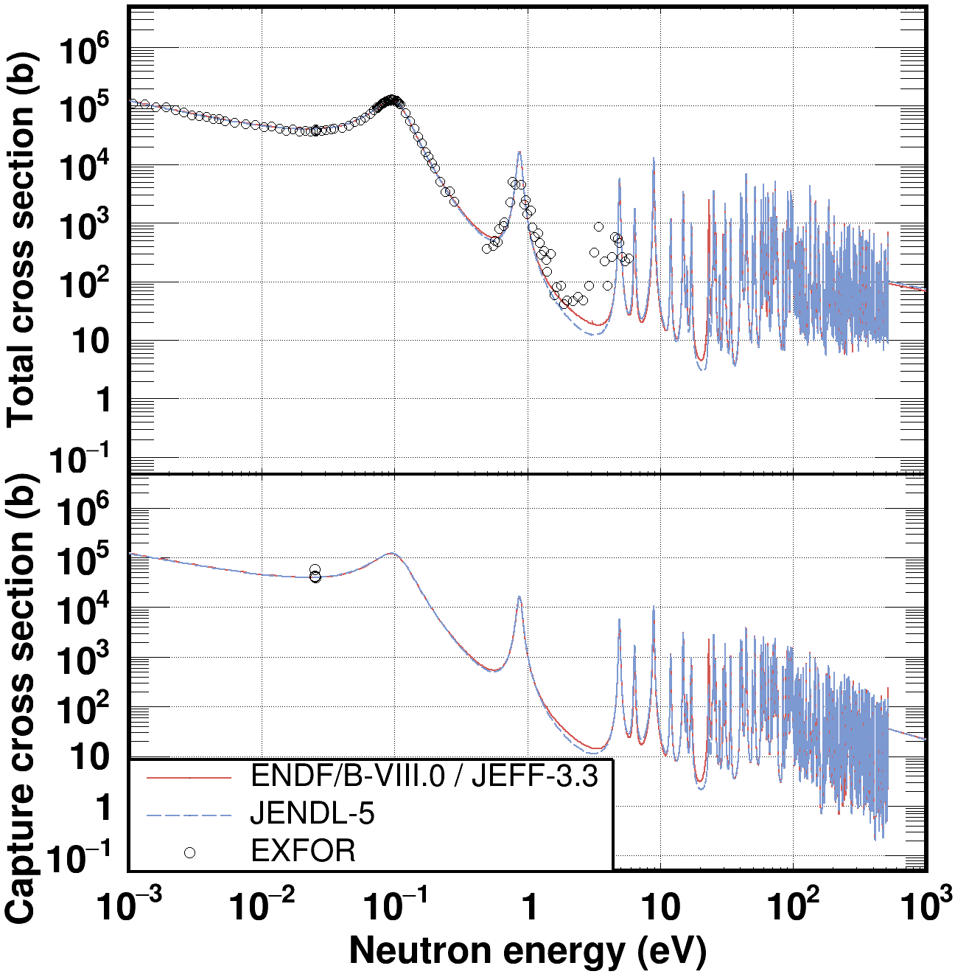
Introduction: Motivation
According to a report by L. Leal (ORNL/TM-2005/065) ¹⁴⁹Sm capture rate underestimates measured capture rates for PWR experiments by 4.8%
Only a few data sets in EXFOR
Resonance parameters do exist but better uncertainties and covariances are needed

Slide 3
Introduction: Summary
We performed capture and transmission measurements with:
the DANCE (Detector for Advanced Neutron Capture Experiments) instrument
Capture data from 8 eV – 1 keV
and DICER (Device for Indirect Capture Experiments on Radionuclides) instruments
Transmission data from 1meV – 1 keV
Additional measurements of ¹⁴⁷Sm
Contaminant in the samples
3.4 eV strong resonance
Data analysis is complete
R-Matrix analysis is complete

Slide 4
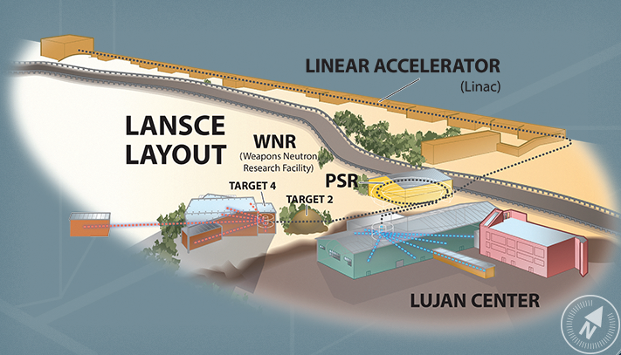
The Los Alamos Neutron Science Center - LANSCE
500-800 MeV protons
keV – MeV neutrons
meV – keV neutrons

Slide 5
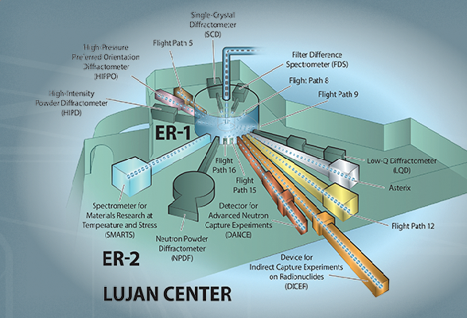
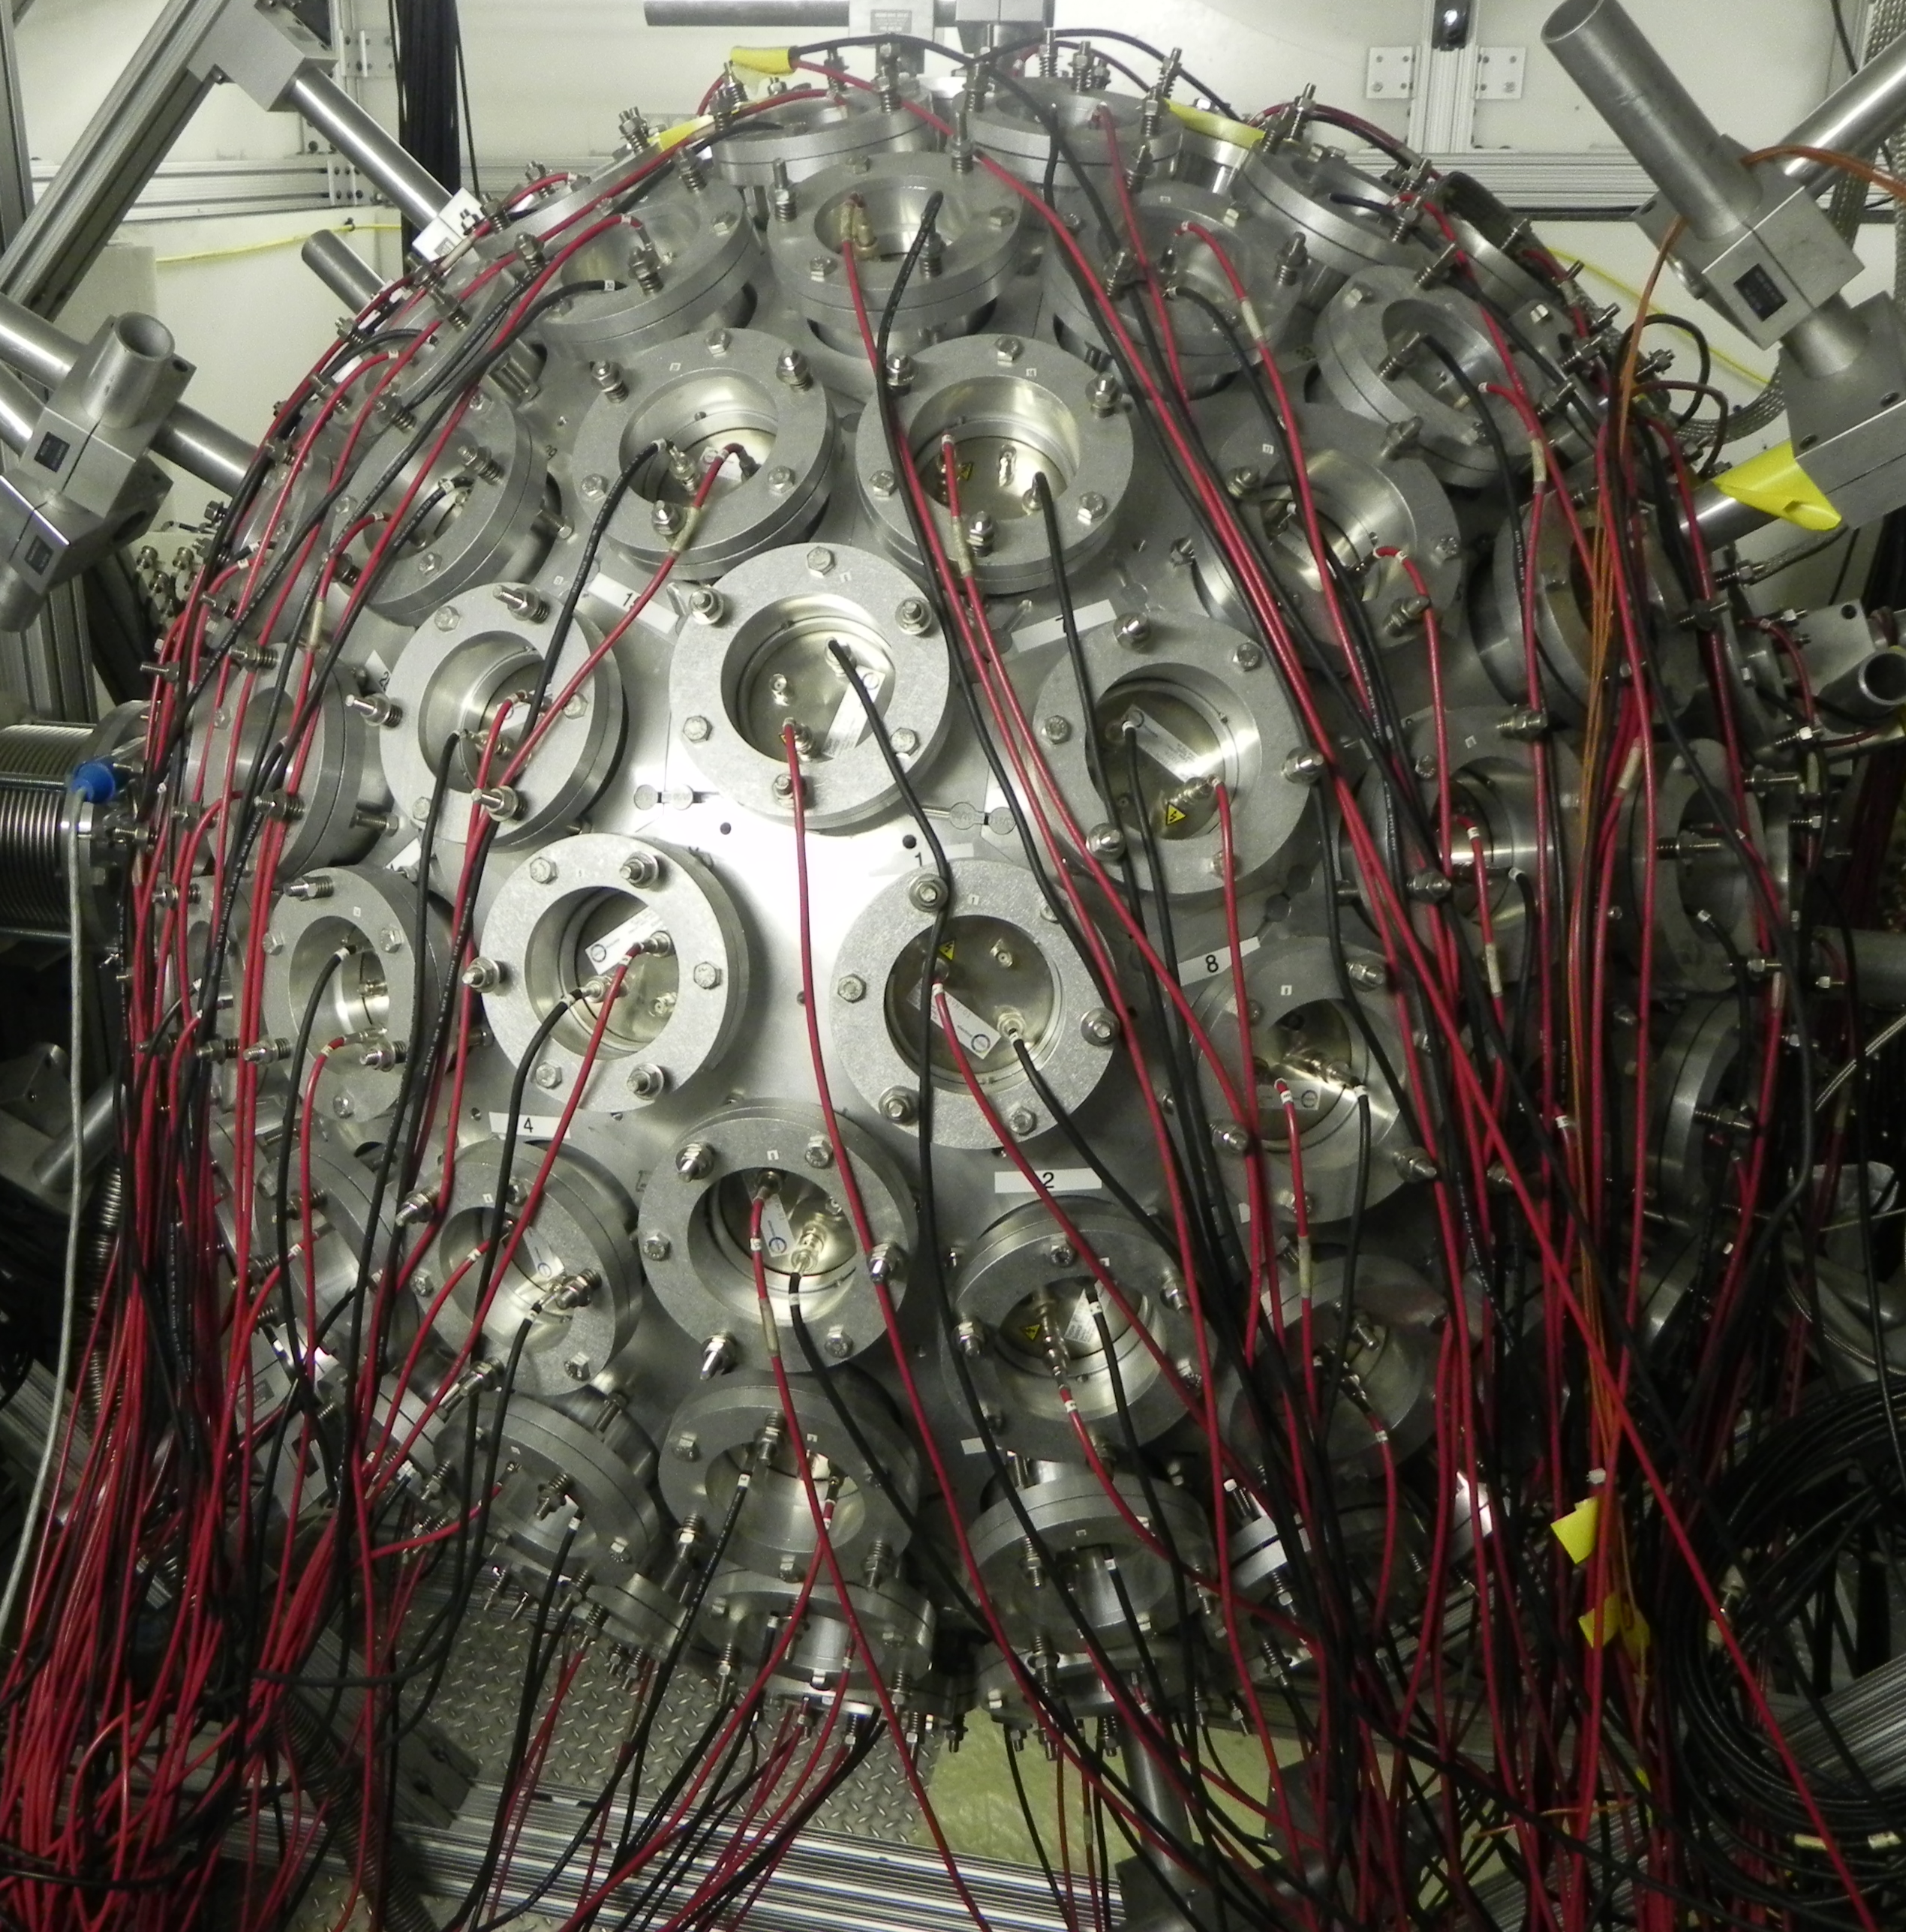
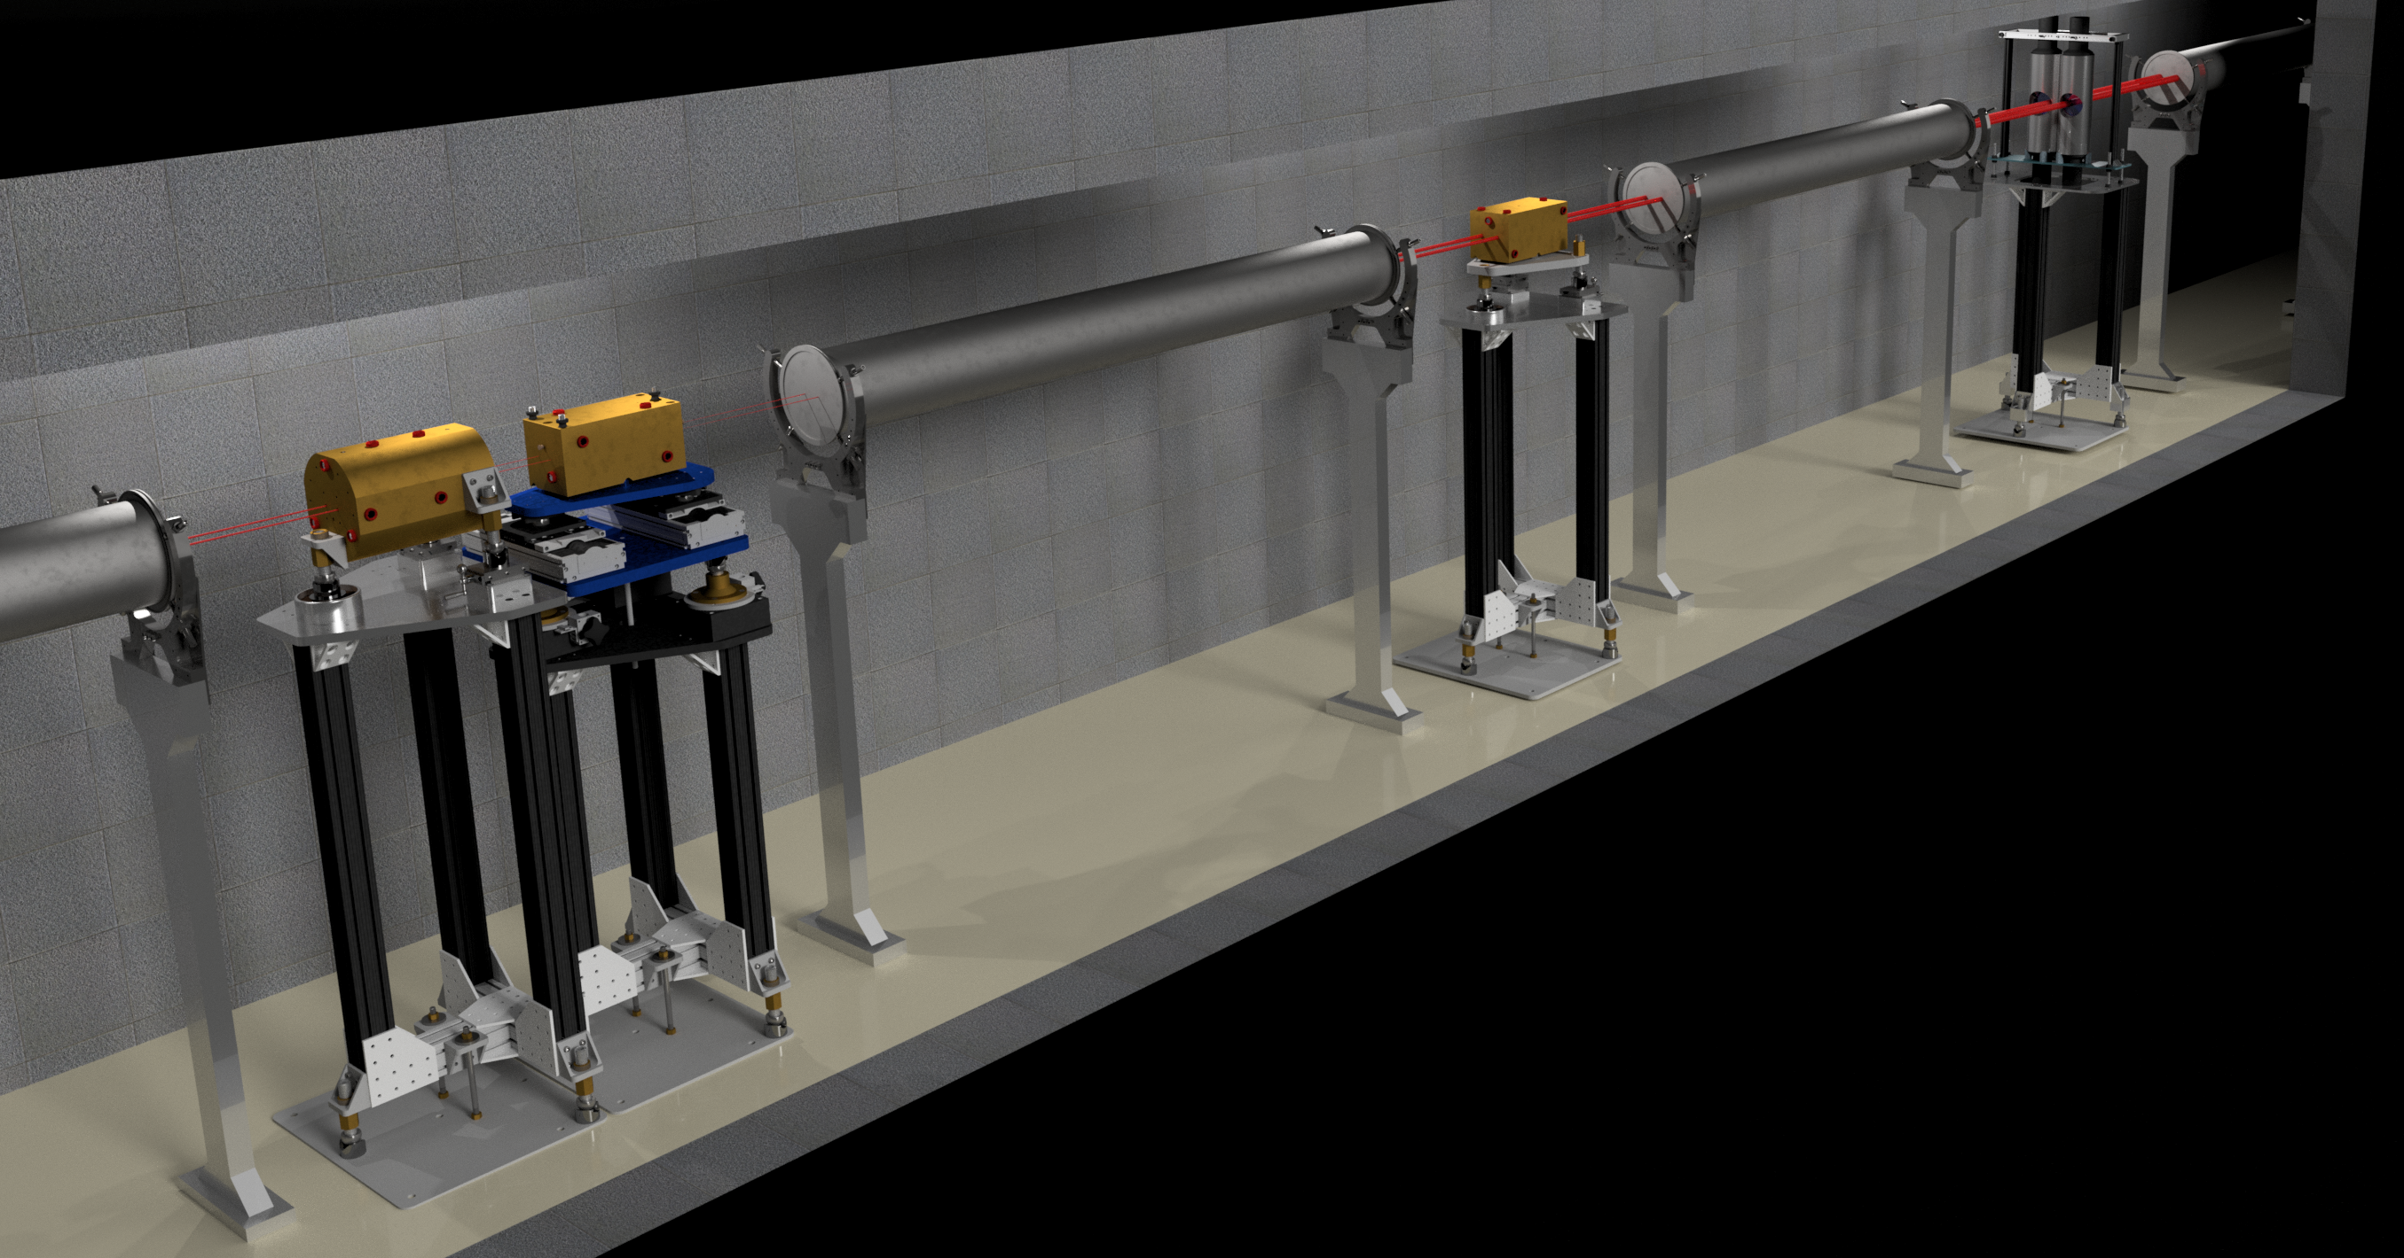
The Los Alamos Neutron Science Center – LANSCE
Lujan Center – Low energy neutrons
DICER (n,tot), “(n,γ)”
DANCE (n,γ)(?)
Lujan Center

Slide 6
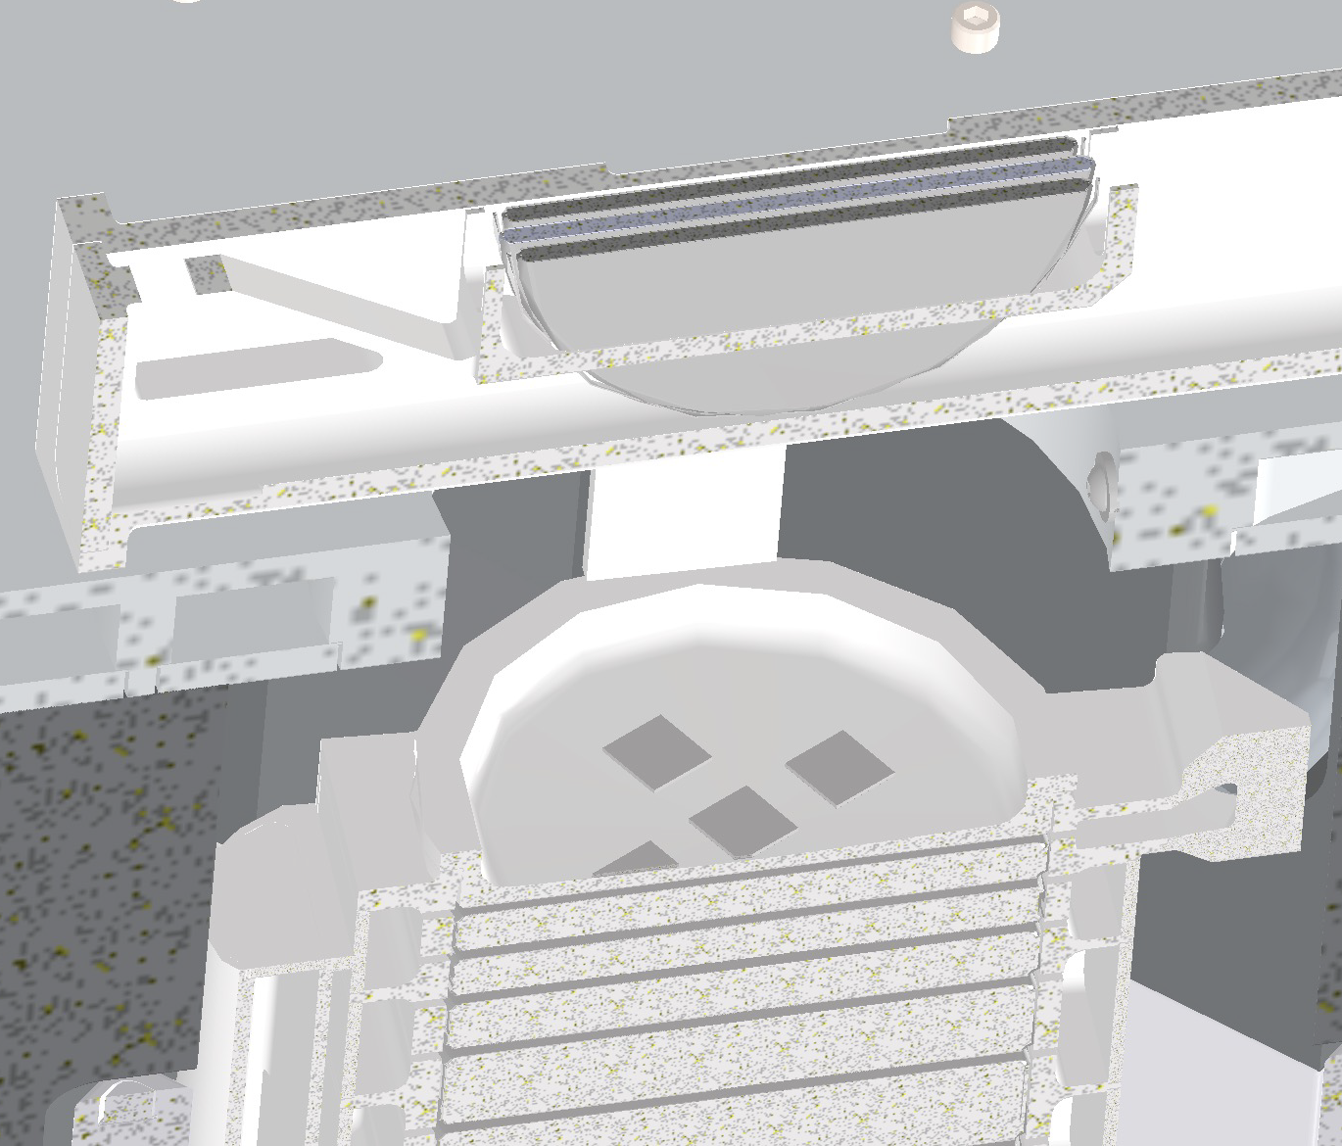
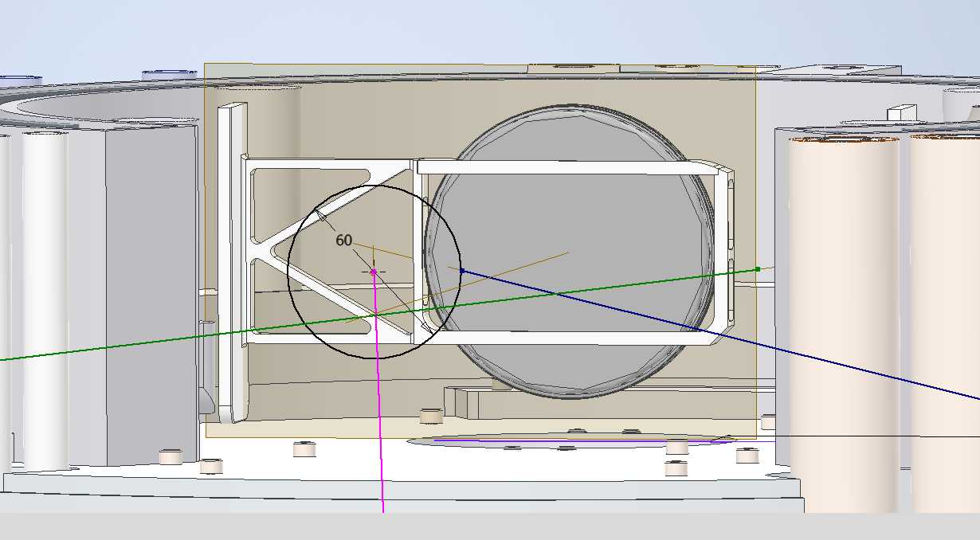
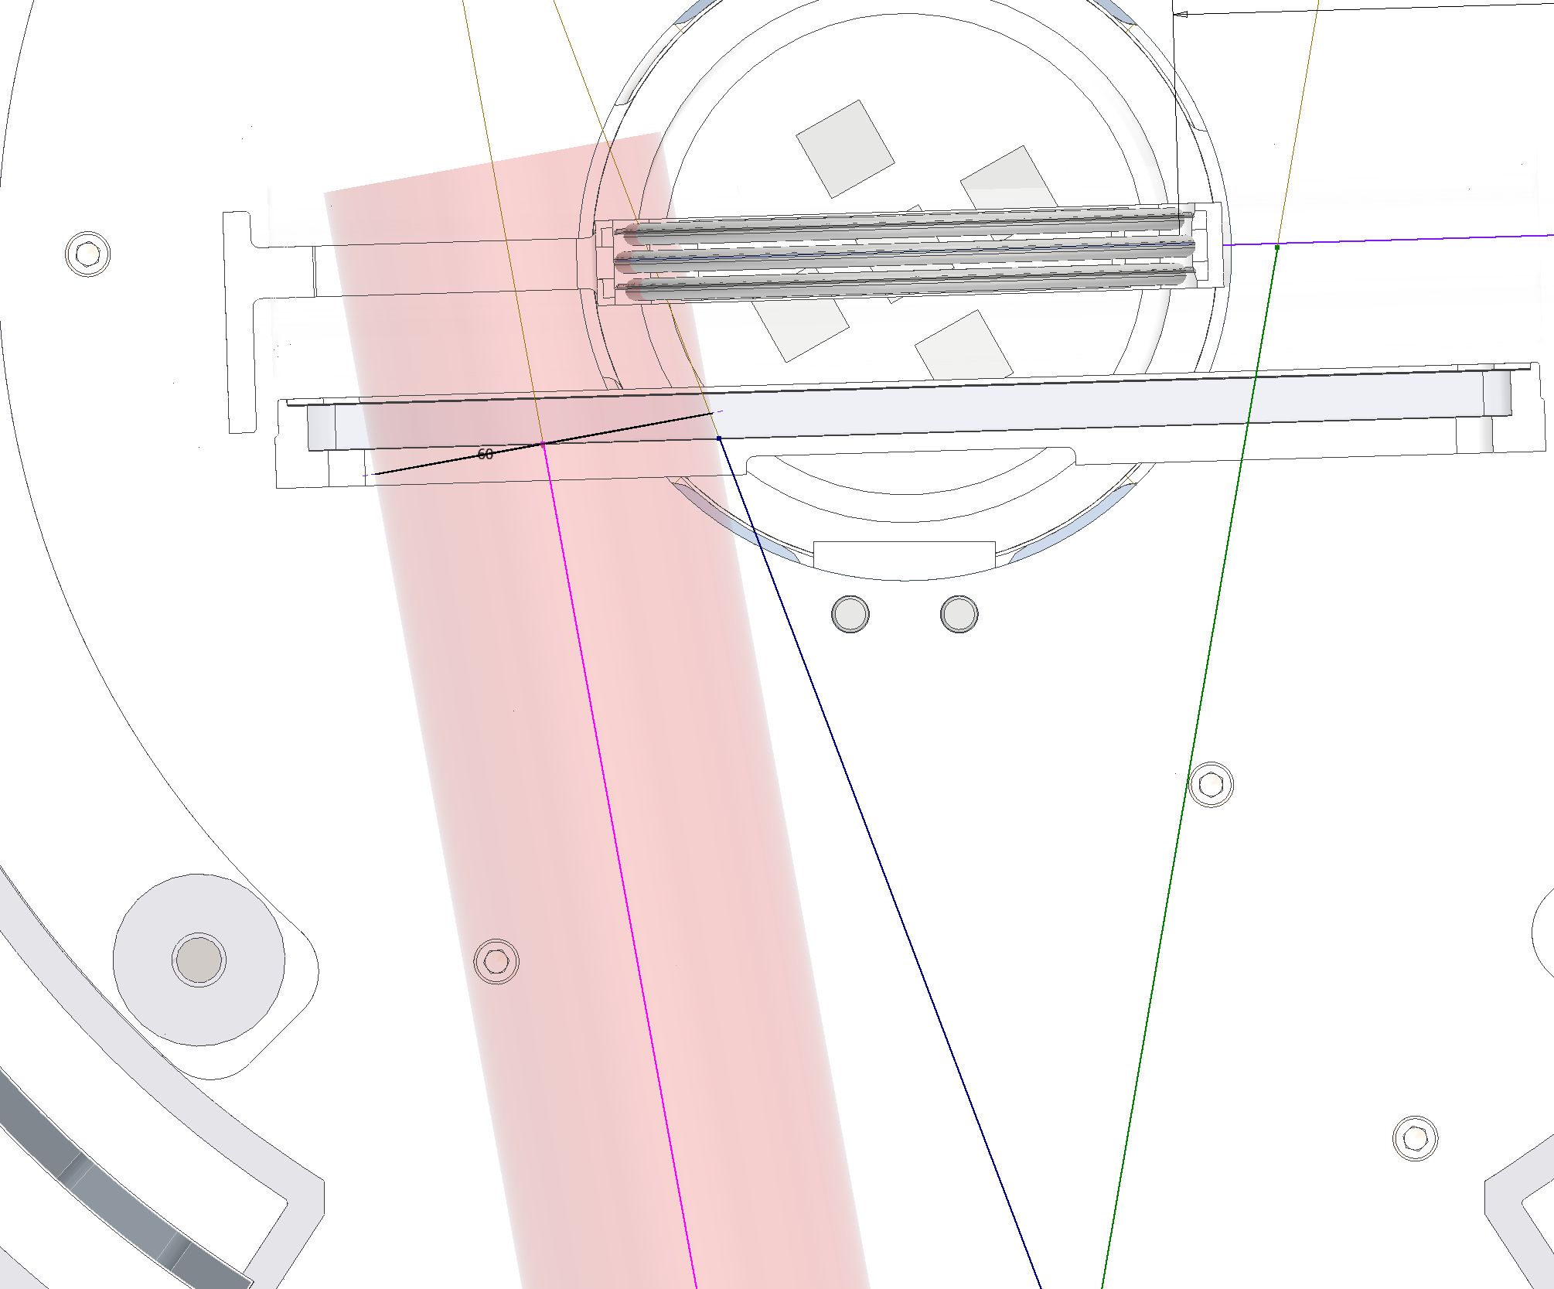
New neutron target at Lujan (Mark-IV)
800 MeV protons impinge on a W target at a 20 Hz duty cycle.
Current is nominally 100 μA
Water moderator
Flux spans from 5 meV – 100 keV

Slide 7
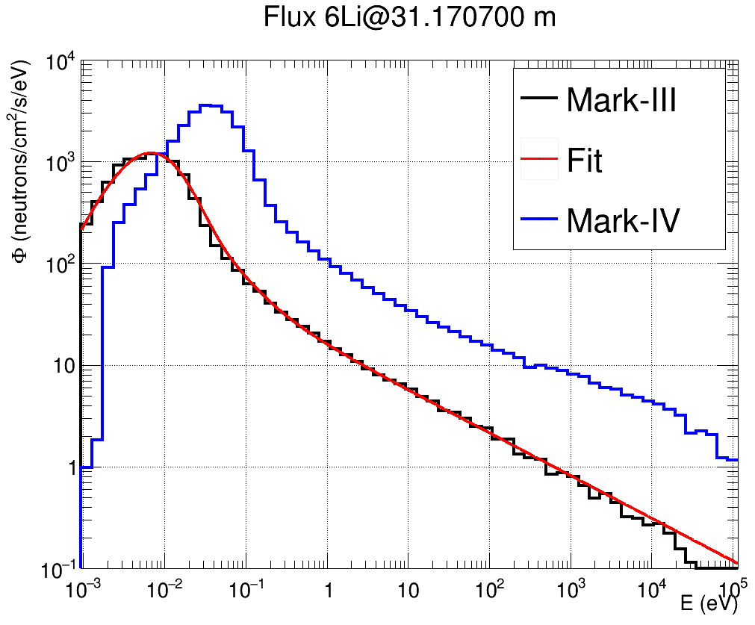
Neutron spectrum @ Lujan
Mark-IV provides an enhanced keV spectrum compared to Mark-III
Mark-IV is expected to improve the neutron energy resolution
The 149Sm experiments were performed using the Mark-III spectrum
Preliminary

Slide 8
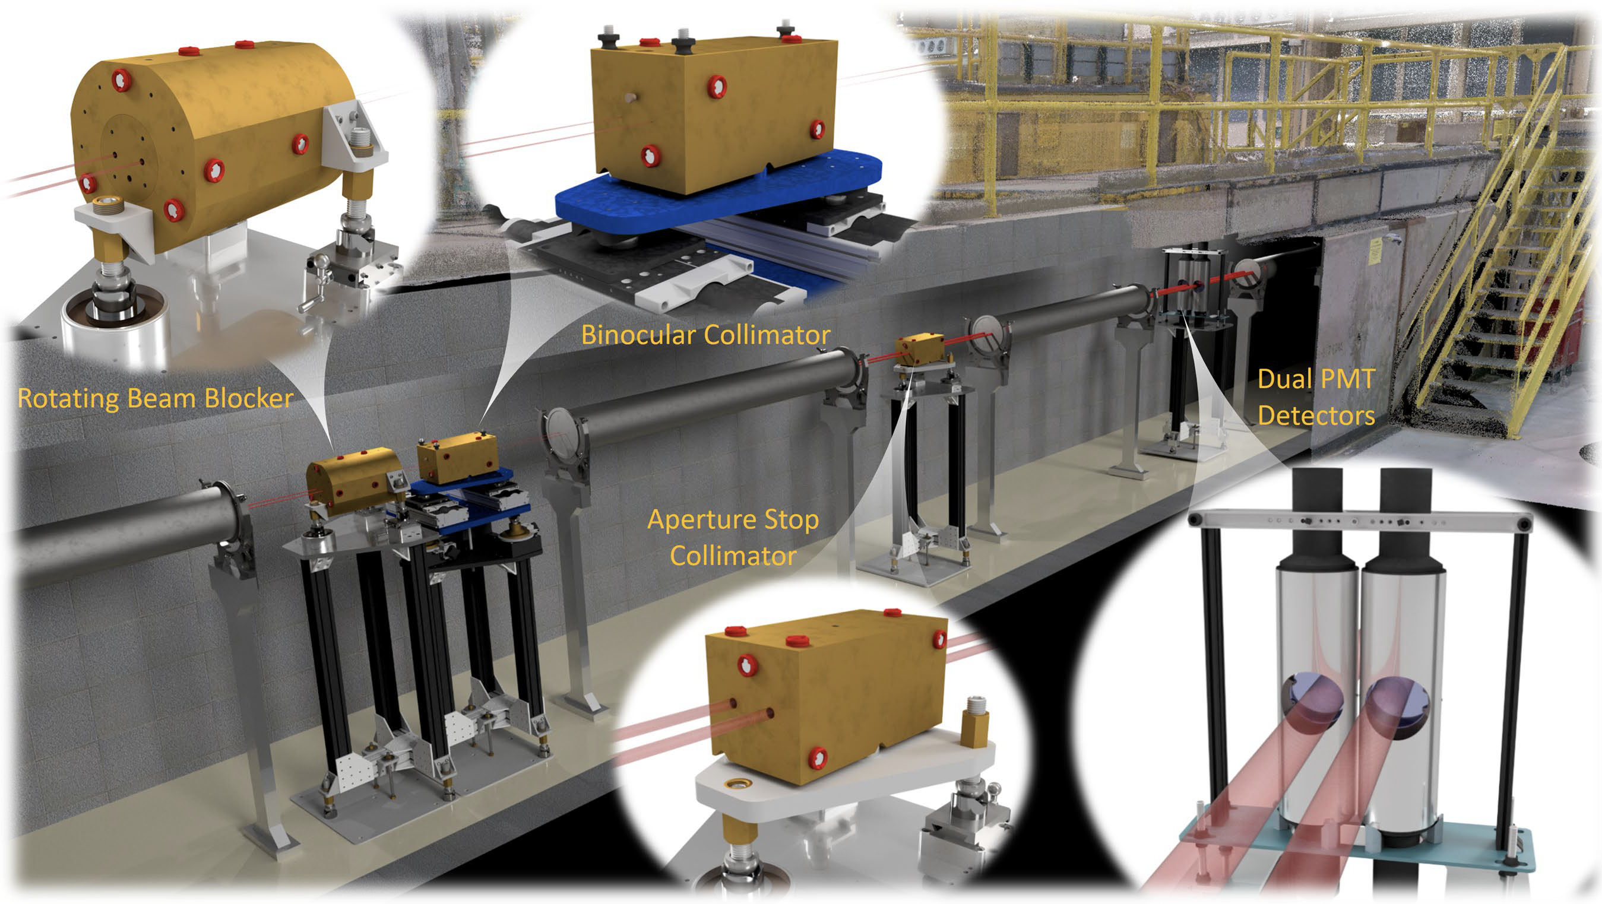
Experiments @ DICER
~5mg ^{149,147}Sm thin sample
~12mg ^{149,147}Sm thick sample
1 mm diameter
Powder stuffed in capillary tubes
Capillary tubes inserted in Al canisters

Slide 9
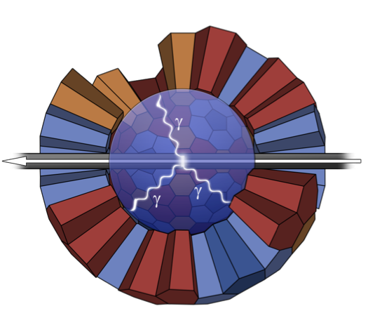
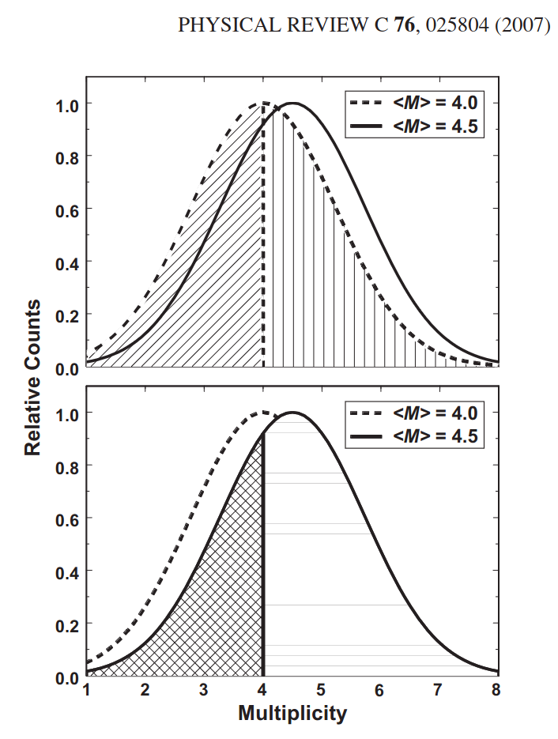
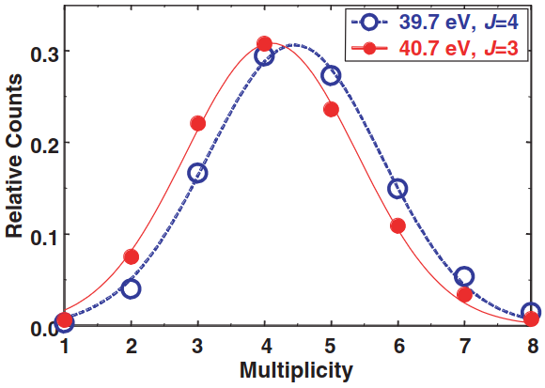
Experiment @ DANCE
DANCE to get the capture yield
DANCE also provides multiplicities
Different multiplicity distributions for different spins
DANCE is used as a spinometer

Slide 10
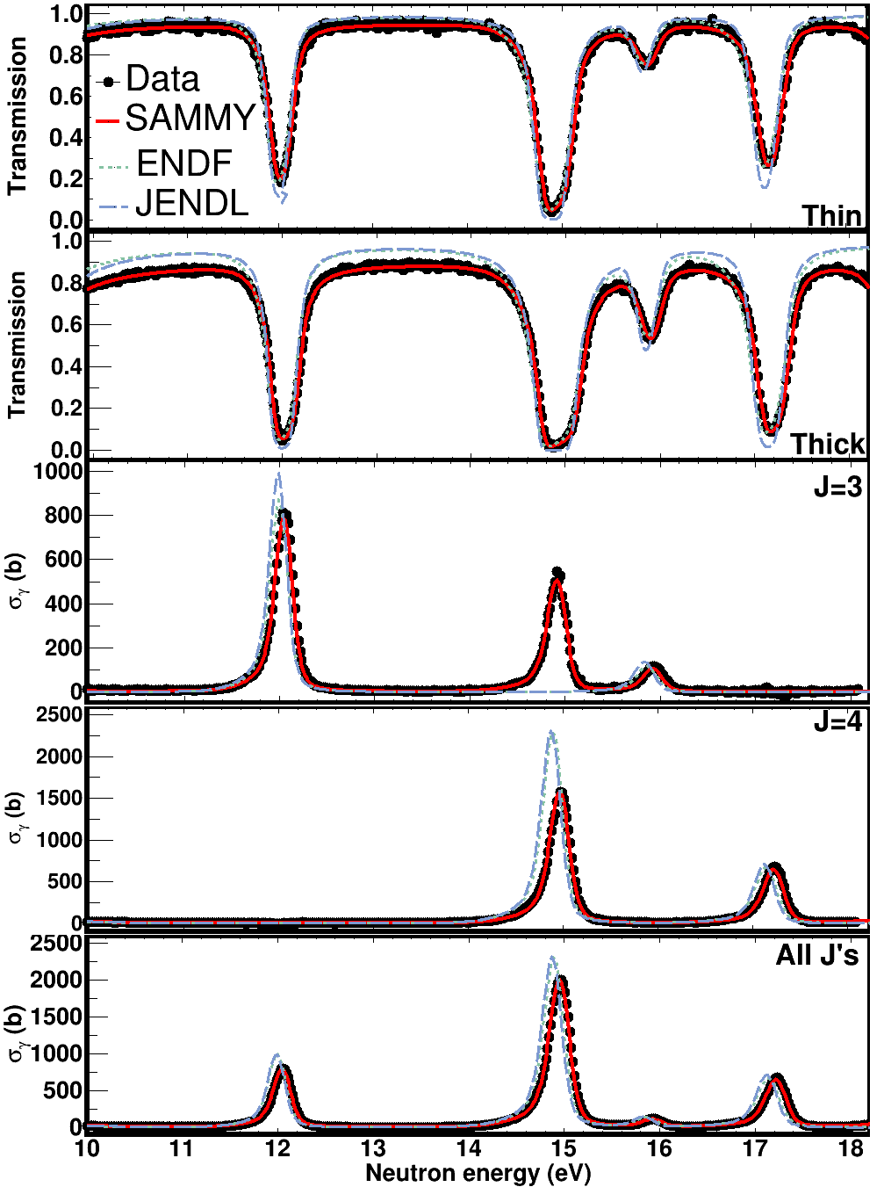
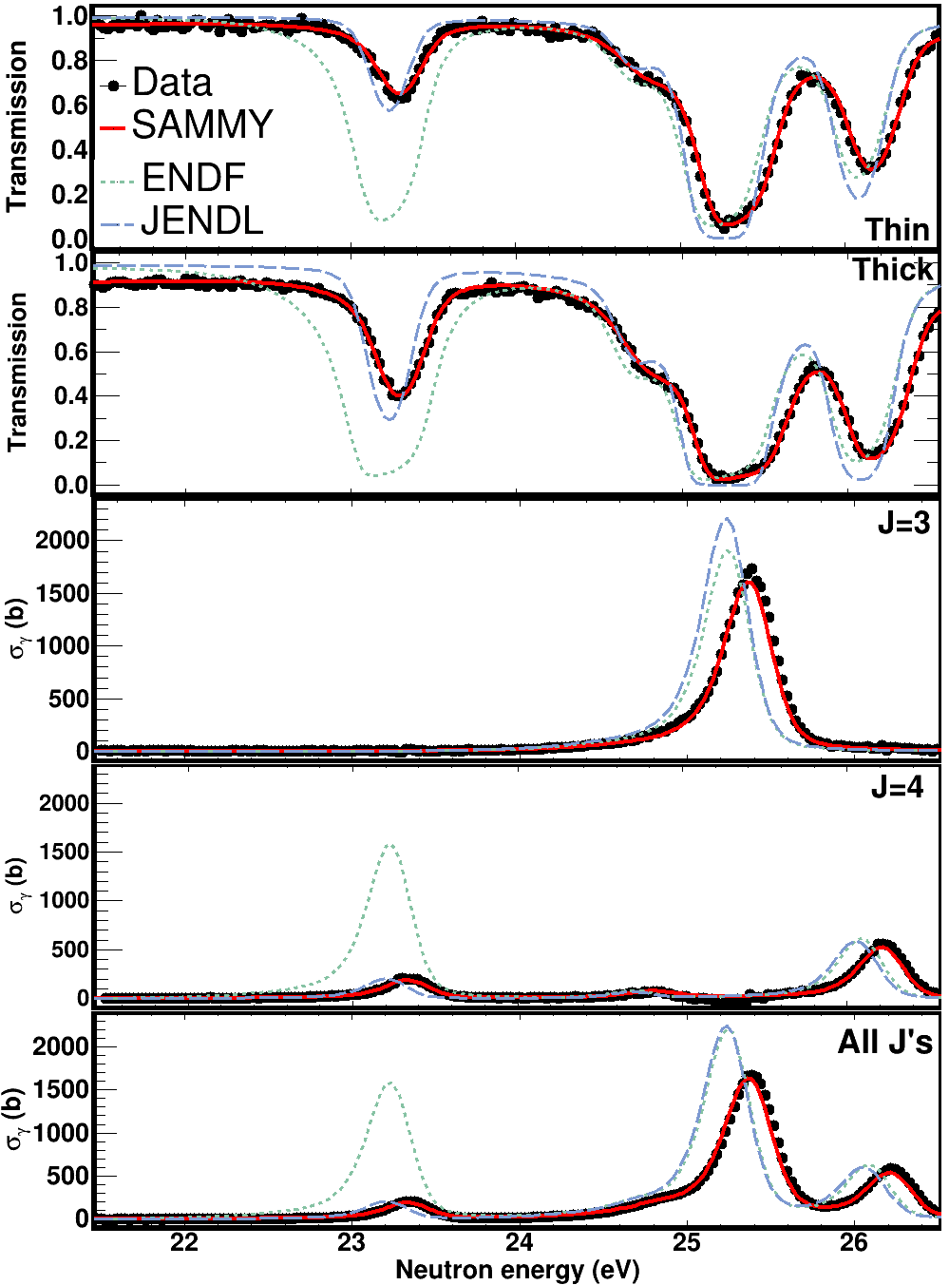
R-Matrix analysis : Resonance parameters
Fits in capture and transmission data using SAMMY
Resolved doublet @ 15 eV
Too large evaluated Γ_{n}

Slide 11
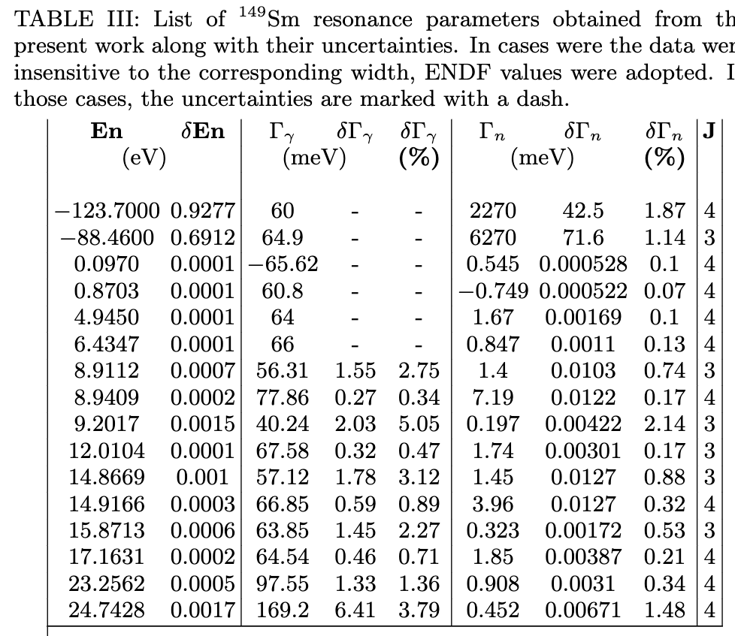
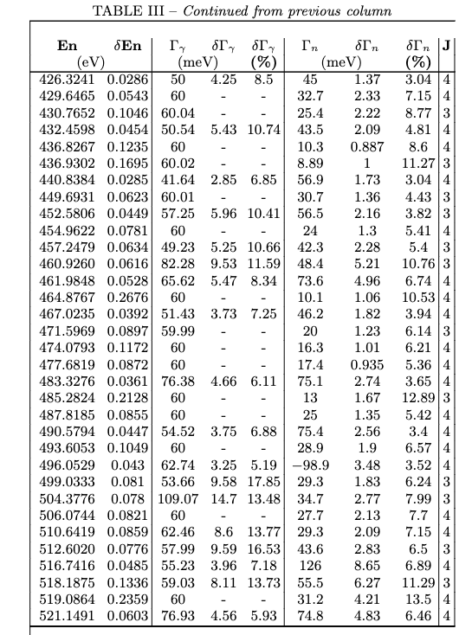
R-Matrix analysis : Resonance parameters
163 resonances were resolved, up to ~521 eV
Uncertainties on Γ_{γ} : less than 13%, average uncertainty: ~3.5%
Uncertainties on Γn : less than 18%, average uncertainty: ~3.8%

Slide 12
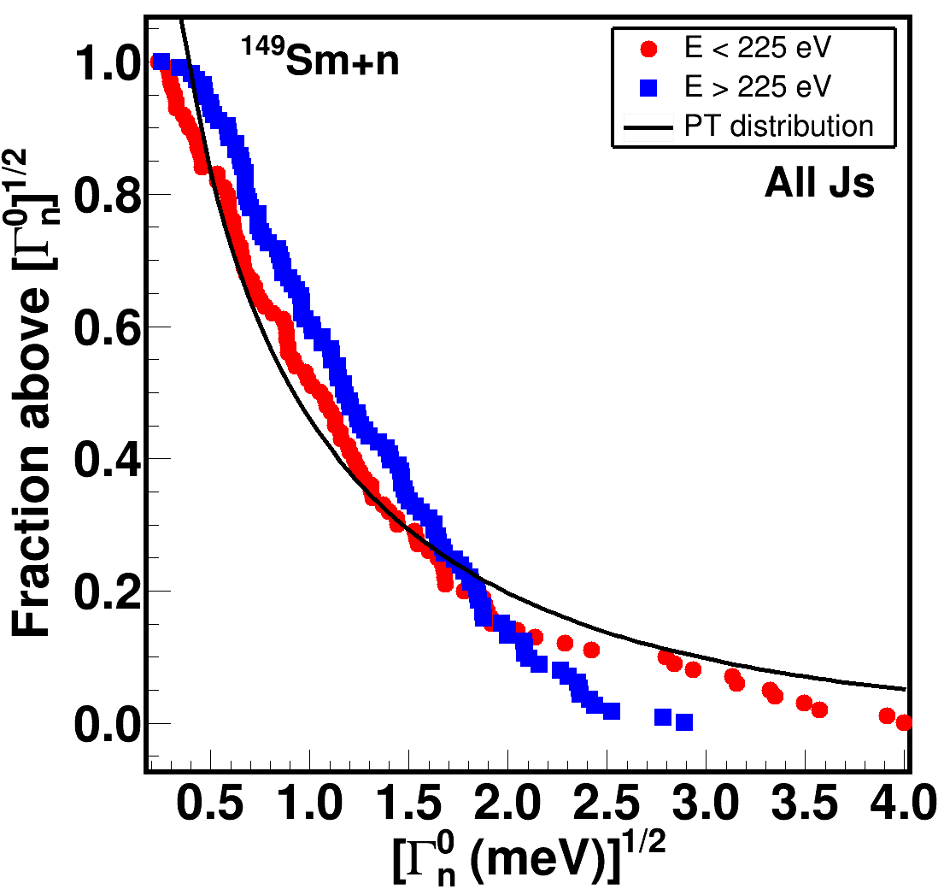
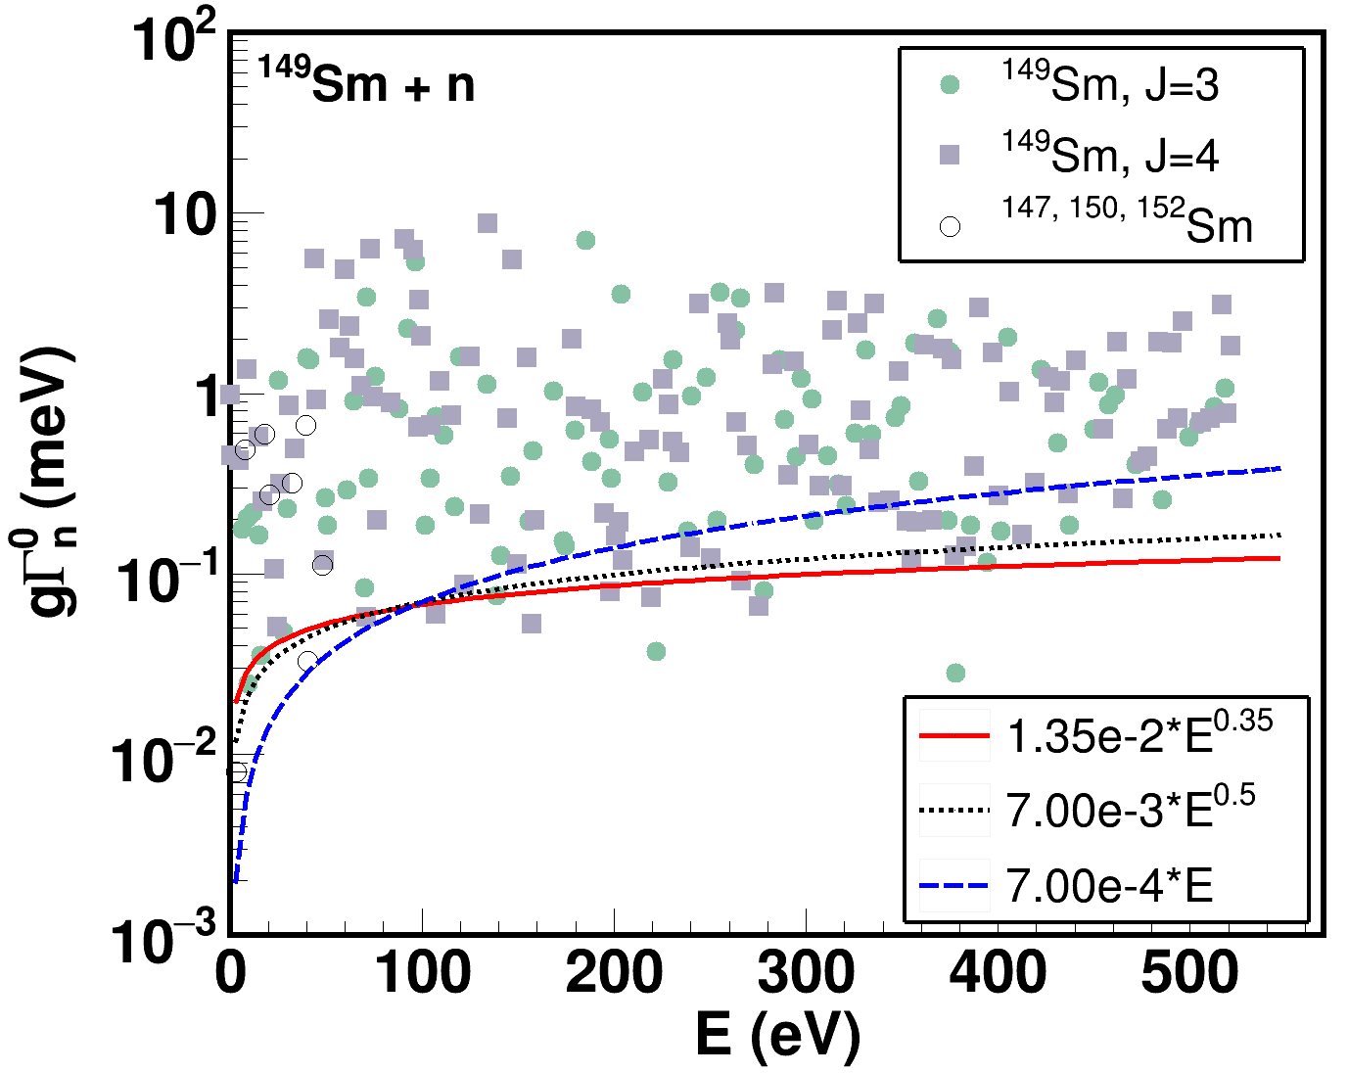
Corrections
The experiments definitely missed some resonances
Correction methods assuming that the resonance properties exhibit known distributions (i.e. Porter-Thomas for “neutron widths” )
That was the case in ¹⁴⁹Sm (Kolmogorov-Smirnov test)
Correction using Fuketa-Harvey method: Provides corrected number of resonances, strength functions and level spacings.

Slide 13
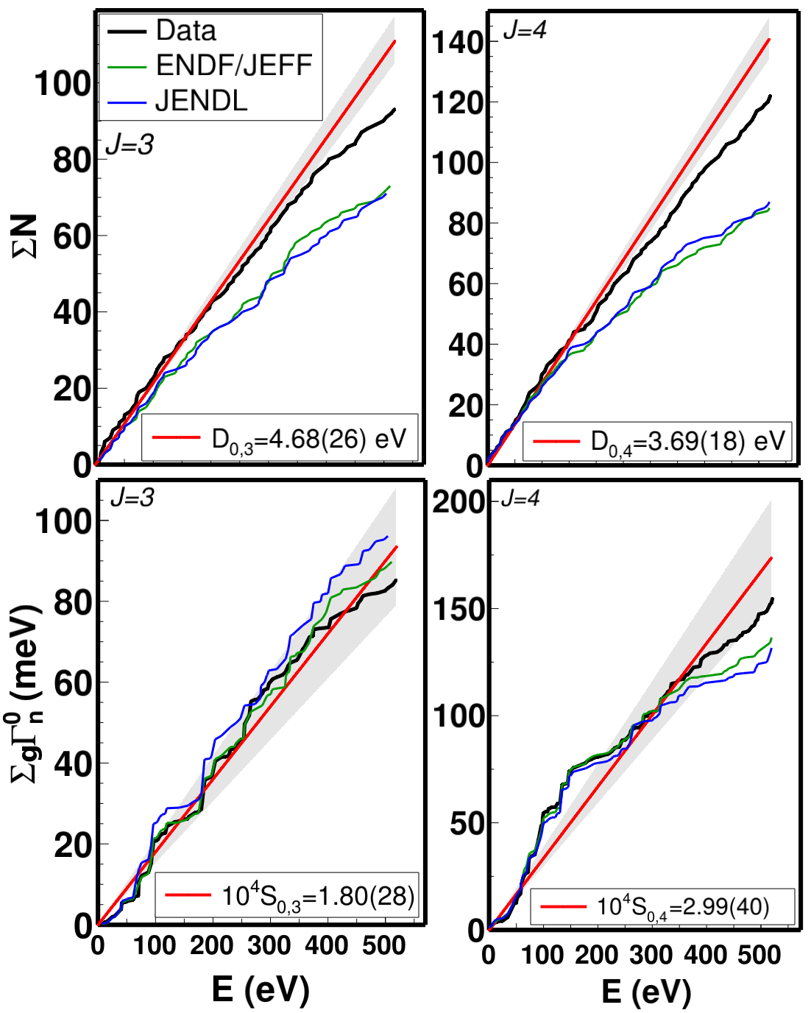
Level spacings, strength functions, comparison with evaluations
Our data indicate that:
38 spins are incorrectly assigned in the ENDF-VIII.0 and JEFF-3.3 evaluations
41 spins are incorrectly assigned in the JENDL-5 evaluation
58 new resonances were resolved
We resolved 215 resonances
Evaluations include 157 resonances
Differences in resonance parameters up to 400%

Slide 14
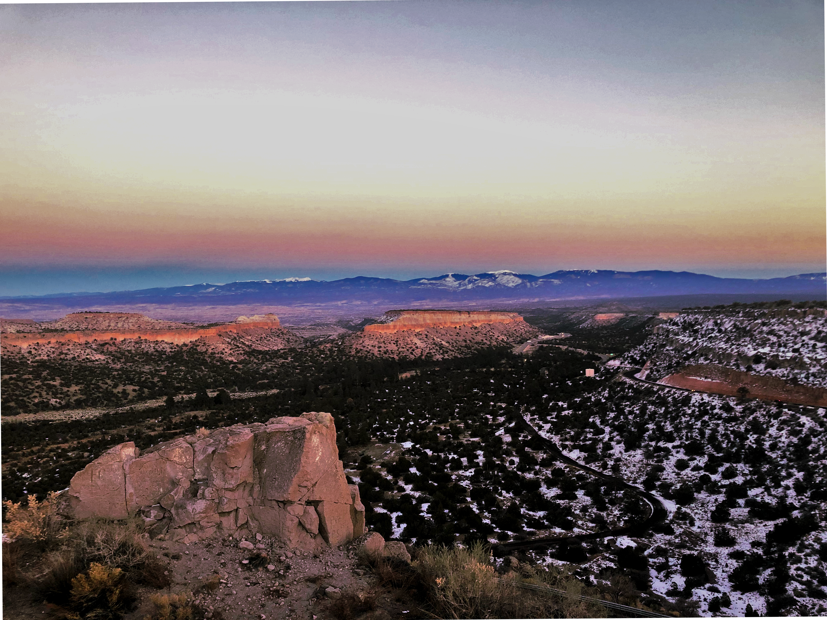
Thank you for
your attention!

Slide 15
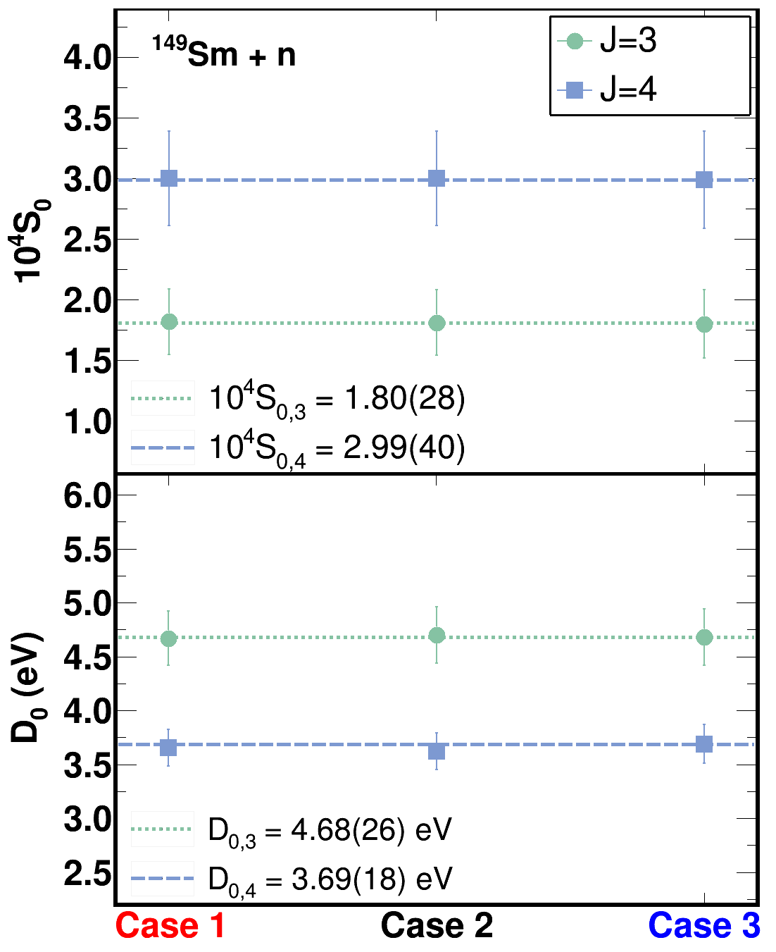
Nuclear properties : Level spacings and strength functions
Unfortunately there isn’t estimated uncertainty for the corrections
Want to find time to work the math out
We can do sensitivity studies, though

