Slide 1


Opportunities at Kentucky
Jeff Vanhoy
US Naval Academy, Annapolis, Maryland
Supported by U.S. DoE FY20/21/22/23 awards
SC0021424, SC0021243, SC0021175, SSC000056
Today’s Members
University of Kentucky, Chemistry
Erin Peters, ½ lecturer
Jackson Dowie, postdoc
Steven Yates, lab director
University of Dallas
Sally Hicks, emeritus
University Kentucky, Physics
Mississippi State University
Daniel Araya, grad student
Jayden Ratcliffe, grad student
Stephan Vajdic, grad student
Ben Crider, prof
US Naval Academy
Jeff Vanhoy, prof
FiberTek, Inc & Army Res Lab - Adelphi
Jarrod Marsh
, lab director, PI
ugrad & grad students
4
NSF 1913028 / 2209178
Recent Players
learning neutrons
for govt research
University of Kentucky, Chemistry
Yongchi Xiao, postdoc
University of Dallas
Elizabeth Chouinard, undergrad
Sarah Evans, undergrad
US Naval Academy
Avi Perkoff, undergrad
Madison Roskos, undergrad
LLNL
Anthony Ramirez
Staffing
(n,n’)
(n,n’γ)
(n,n’γ−γ) & (n,n’−γ)
Side Projects
DANCE capture
Mississippi State University
‘Tutu’ Assumin-Gyimah, grad student
People about to be Invited

Slide 2
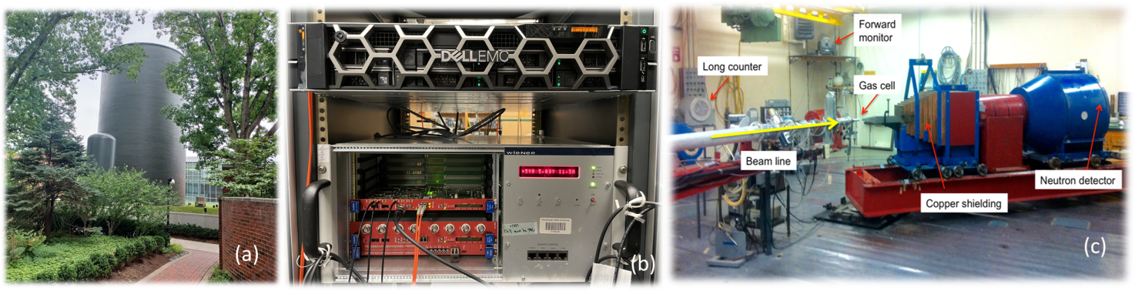

silo
digital DAQ
exptl bay 1
Accelerator
  HVEC Model CN: 7 MV
  rf source
  p, d, ³He, α, … ions
  Authorized for ³H gas targets
  measure exit neutron energy
  1 ns pulse widths every 533 ns
Basic Nuclear Science
  Nuclear Structure via (n,n'γ)
    Level Schemes & Transitions
    Spectroscopic Information
    DSAM Lifetimes
  (³He,nγ)
Applied Nuclear Science
  Differential (n,n') Cross Sections
    ^{12,13}C, ⁷Li, ¹⁹F , ^{54,56}Fe , ²³Na , ²⁸Si
  Detector Development
    Univ Guelph / TRIUMF
  measurements for ‘friends’
historically
~50d BOT/y

Slide 3
Staffing
(n,n’)
(n,n’γ)
(n,n’γ−γ) & (n,n’−γ)
Side Projects
DANCE capture

Slide 4
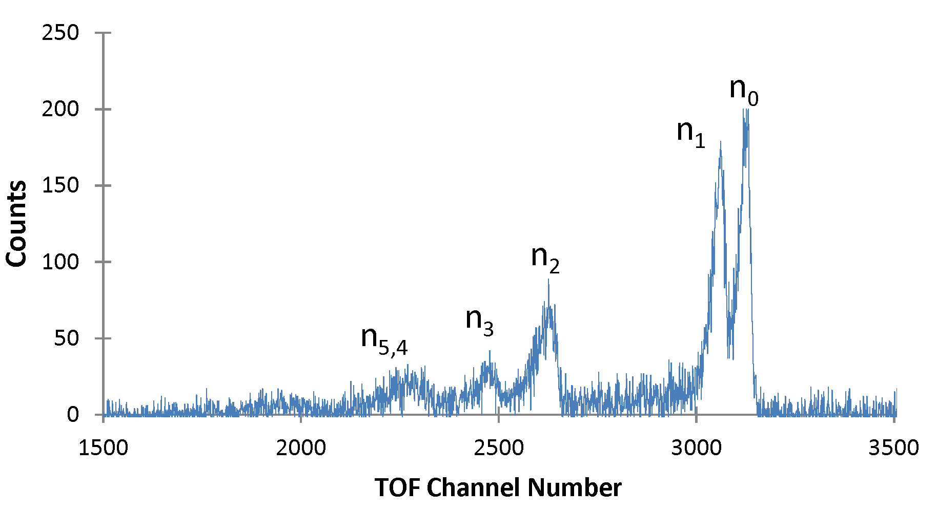
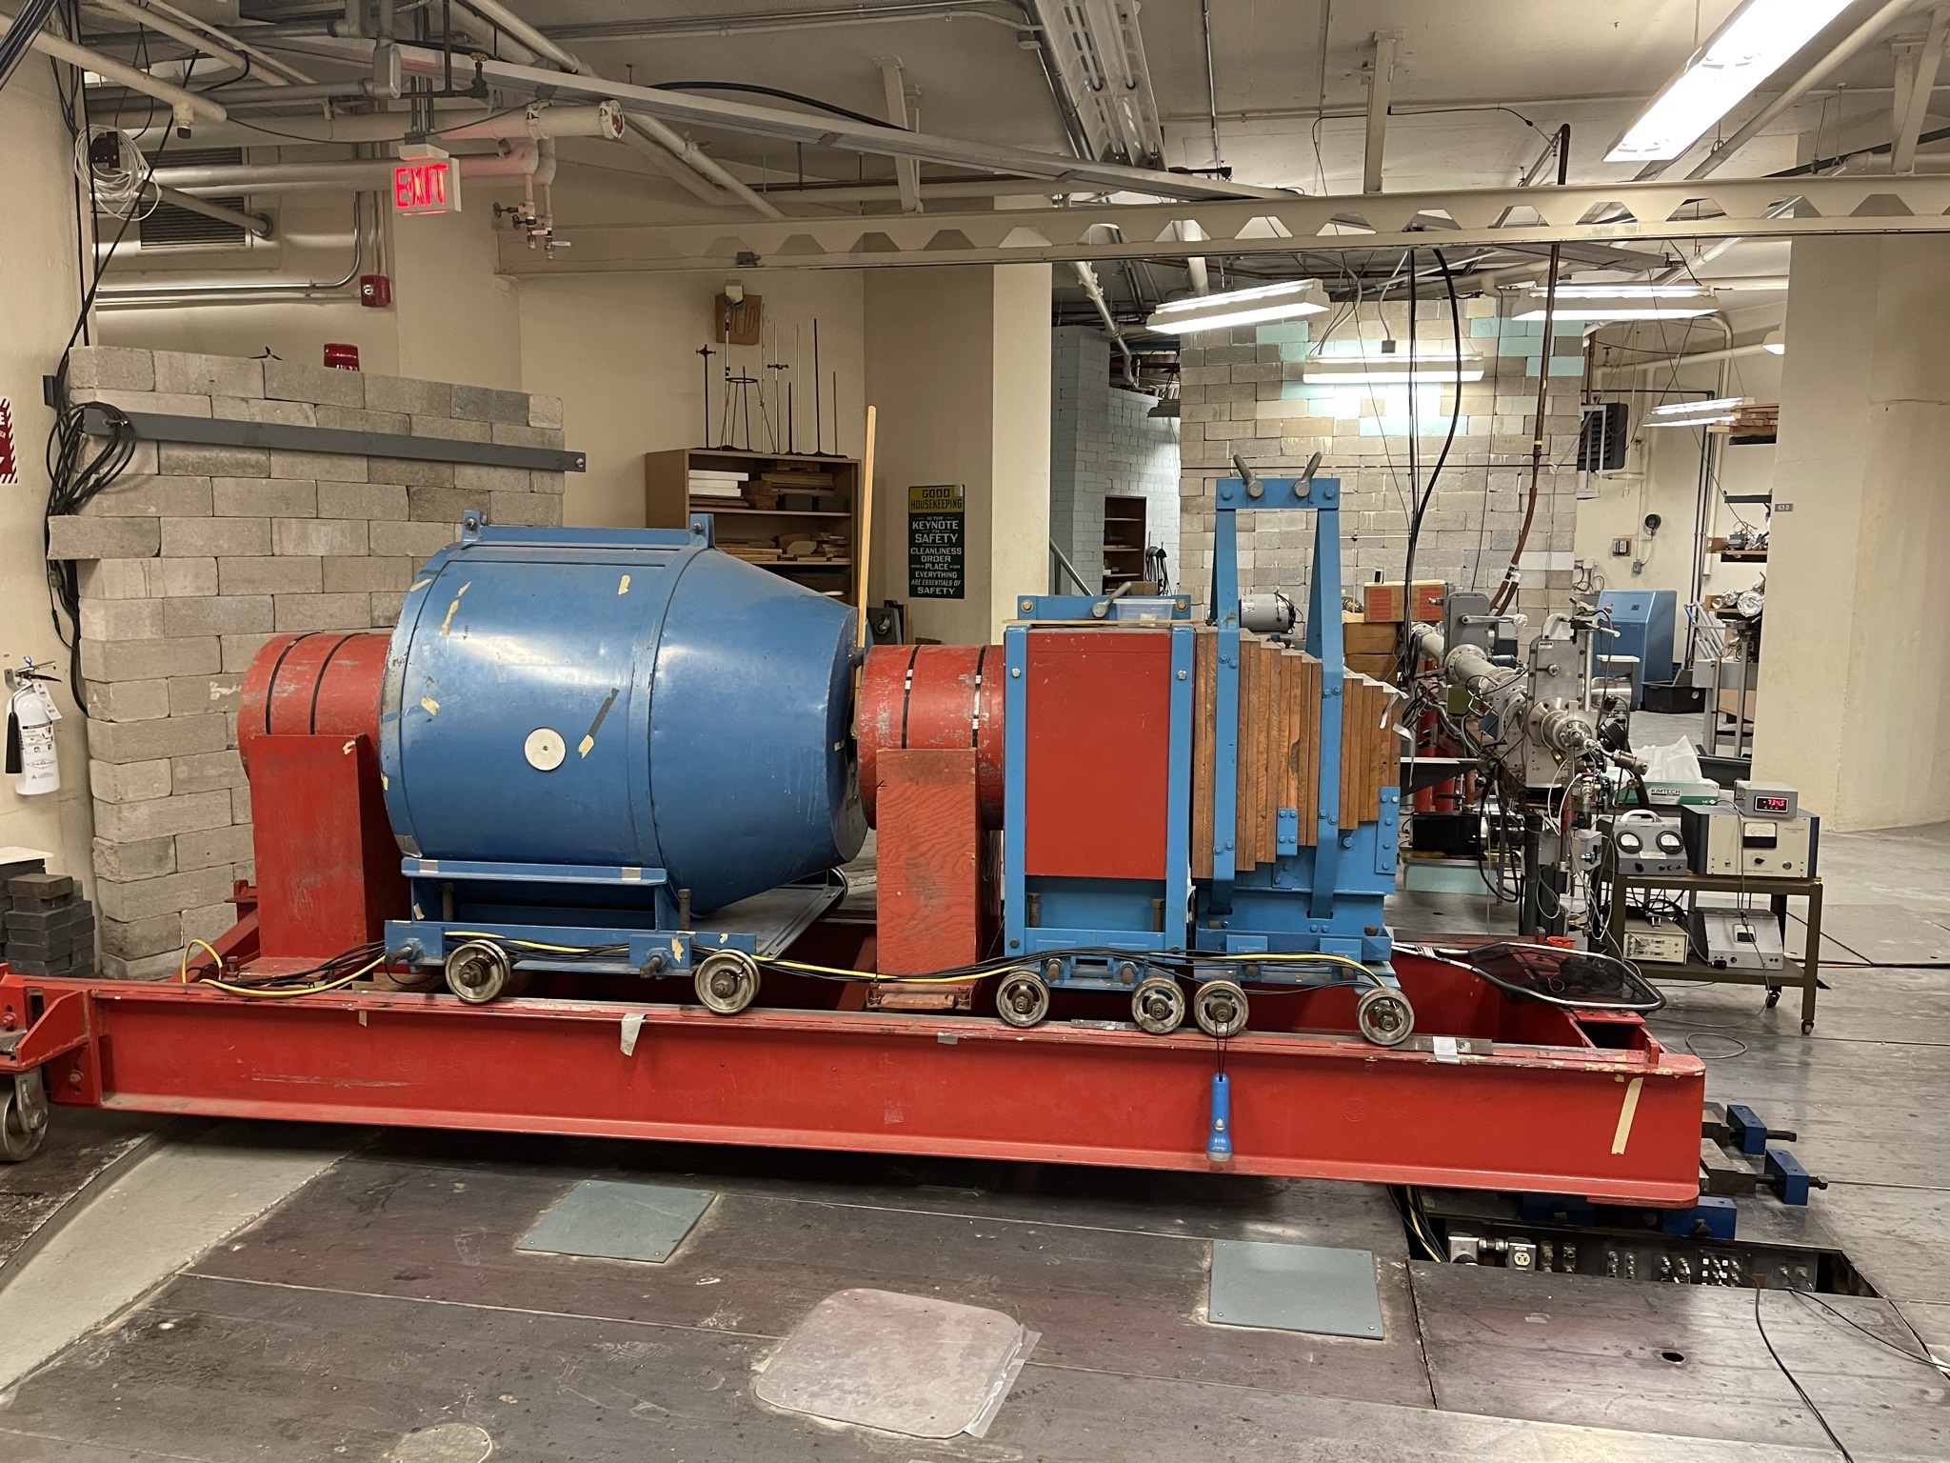
Neutron Time-of-Flight
Pulsed beam. PSD.
Exit channel neutrons sort by flight time.
²³Na(n,n_{k})
MAIN
n detector
13C
7Li
27Al & 51V
others?
19F, 20xPb, 24Mg , 9Be
Anthony
Ramirez
LLNL
goniometer rotates 0 to ~155 deg
(n,n’)

Slide 5
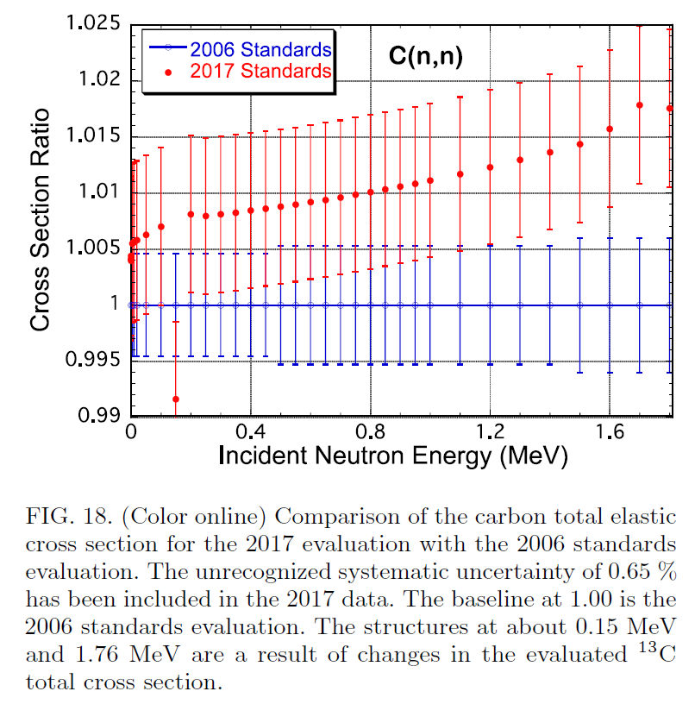
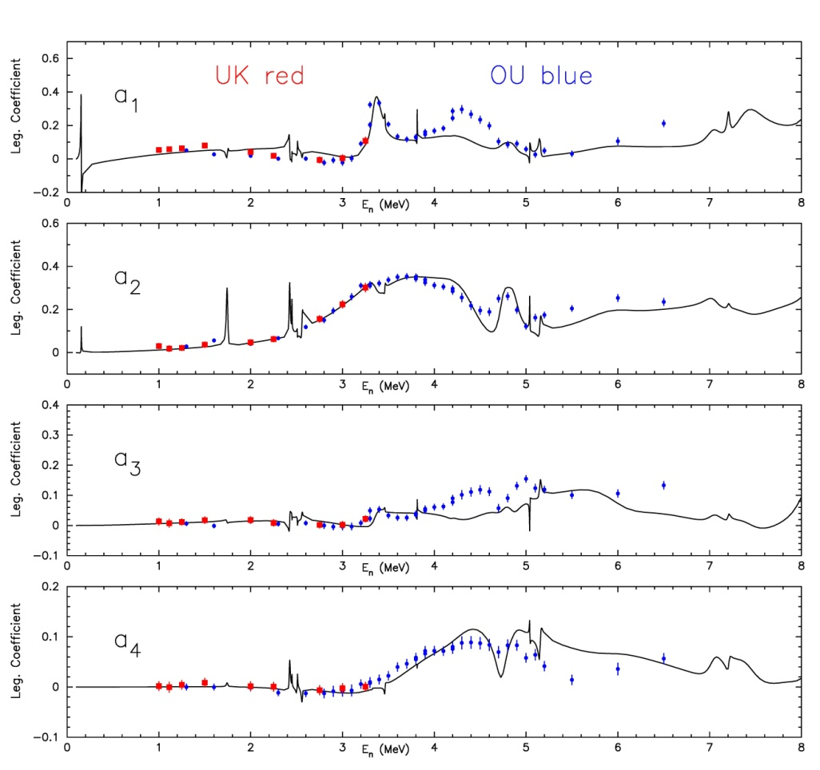
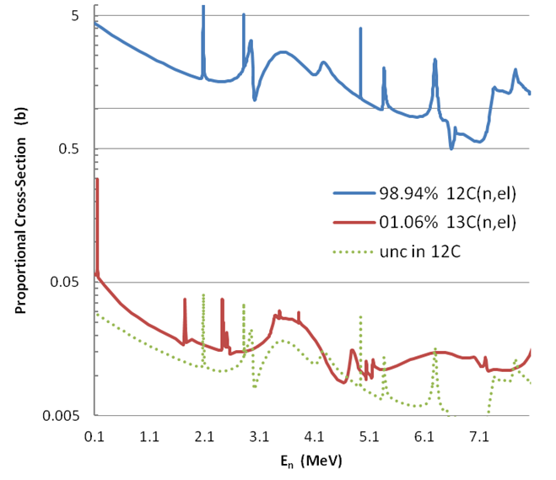
. Alan Carlson “Recent Standards Work”, CSEWG 2023 @ BNL Nov 2022
¹³C
Thanks to OU & LANL
Originally the Lane 1981 samples
Allan Carlson
Thomas Massey
Matt Devlin
Notes:
1. Worries that the 2017 & 2006 values differ by more than the uncertainty
2. Alan Carlson “Recent Standards Work”, CSEWG 2023 @ BNL Nov 2022, Differences are due to addition of 13C information

Slide 6
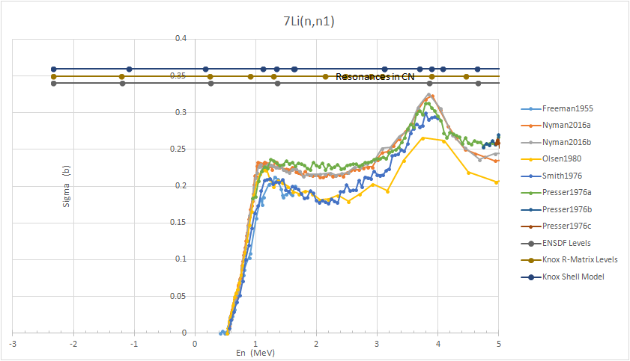

⁷Li
a difference of opinions
IRMM/GELINA measurements favor high road
UKAL natLi(n,n’) measurements 2018, 2019
nELBE 2017 (2023) measurements favor low road
Price of enriched Li goes up 3x
OhioU loaned us enriched targets 2022
- - - targets didn’t have matching empty container.
Re-canned in March 2023
Re-measured in July 2023 with dDAQ, analysis w ROOT.
-- one of the largest samples we’ve ever done: atten & MS
-- challenges with (sample-container) subtr at forward angles.
Arnd
Junghans
WINS2023
Daniel Araya
MS State

Slide 7
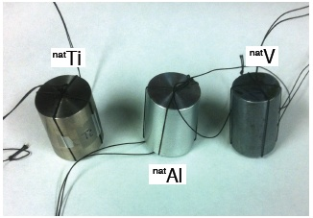
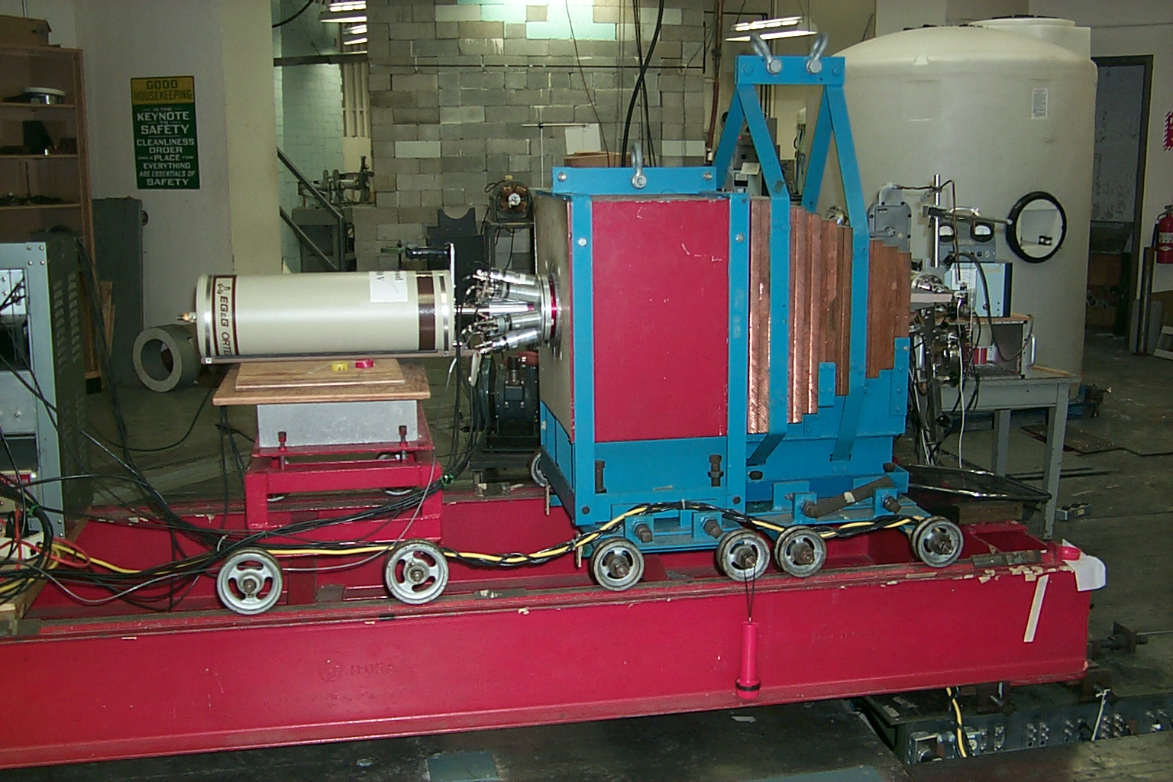
(n,n’γ)
BGO
HPGe

Slide 8
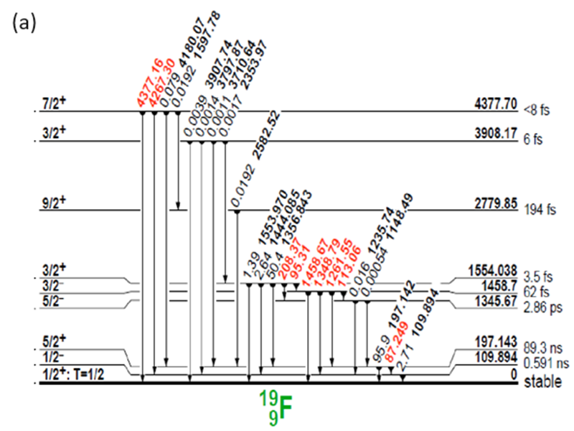
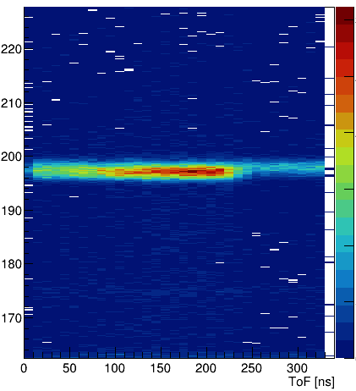
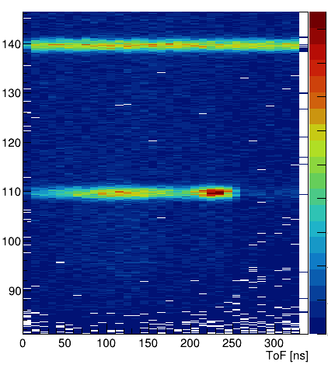
¹⁹F
WINS2018 mtg
-- problems w both UKAL & GELINA
measurements
GELINA status
UKAL
22-29 Oct 2023
Ge 140 keV
197 keV
Energy (keV*)
110 keV
contaminated
clean
Time

Slide 9

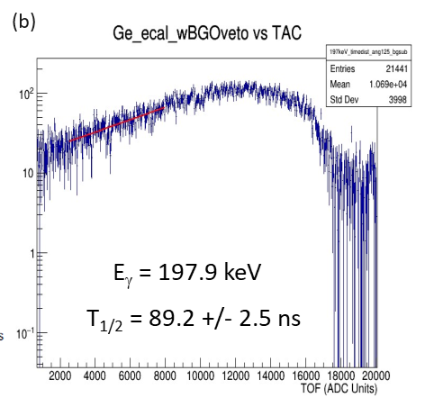
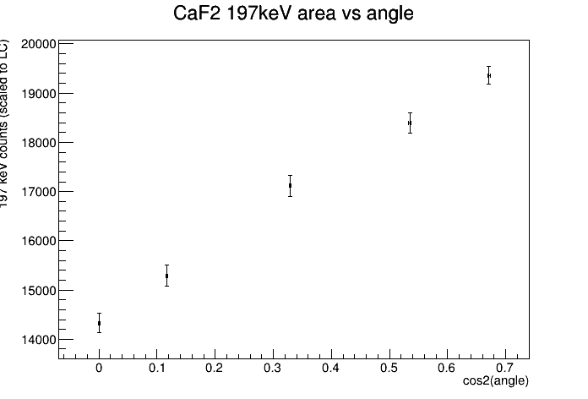
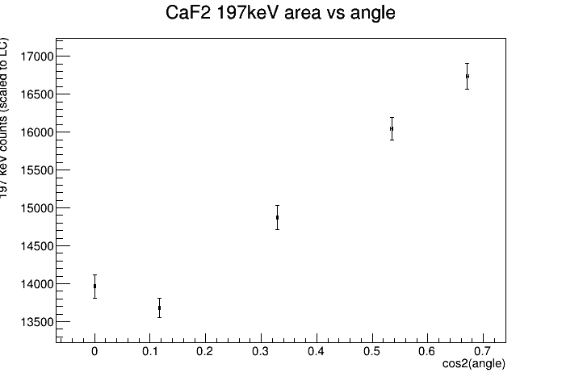
¹⁹F
2
weeks
ago
UKAL
22-29 Oct 2023
ExcFn 1.2-2.3 MeV
CaF₂, ⁵⁶Fe, ^{nat}Ti, ^{nat}C, blank
5 pt AngDist to detect a4s
sample change every 20 min
Determined γ-ray a₄s ¹⁹F, ^{nat}Ti & ⁵⁶Fe
displayed values
un-corrected for
n γ atten
& MS
If plot
yield vs cos²
then a₄
jumps out at you
ENSDF 89.3(10) ns

Slide 10
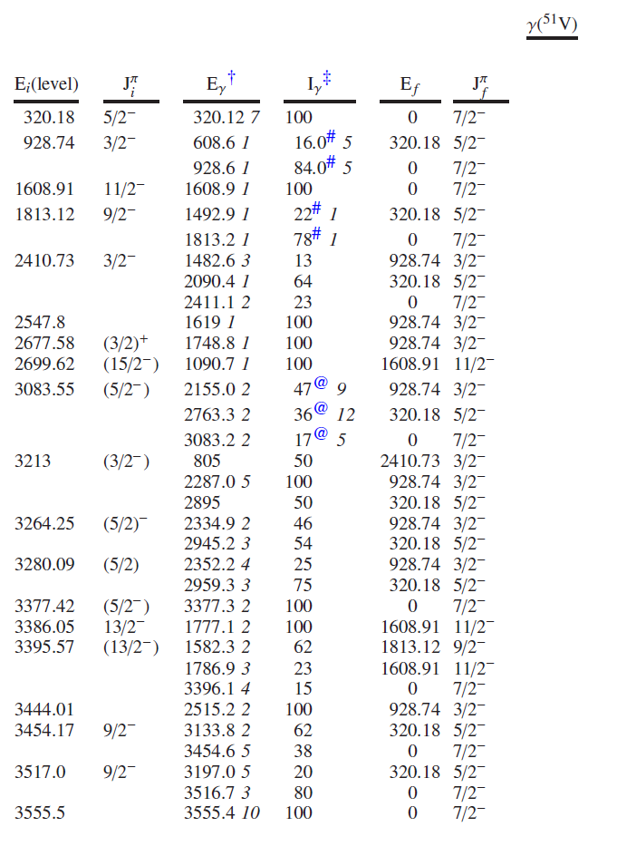
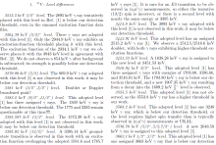
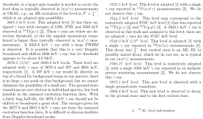
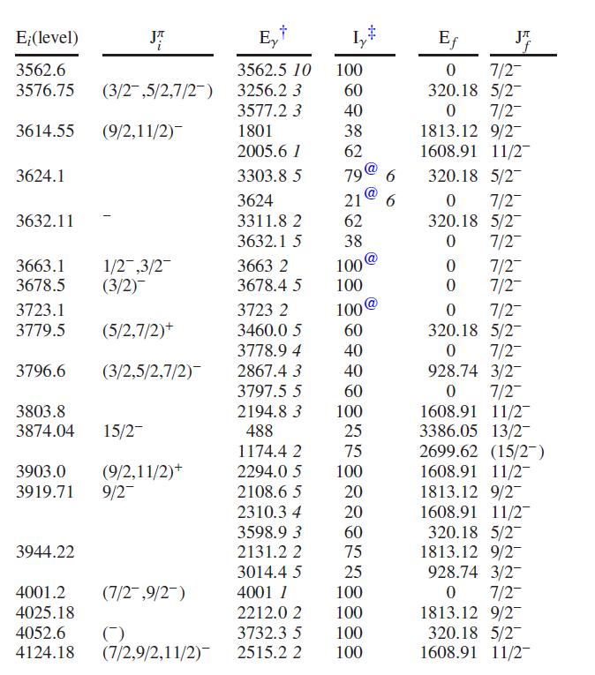
51V Level differences
From attempts to use 51V(n,n’γ) as an xs normalization, something ain’t right.
⁵¹V
Something’s wrong here.
ENSDF Eval, Jimin & Xiaolong, Mar 2016
Anthony Ramirez LLNL

Slide 11
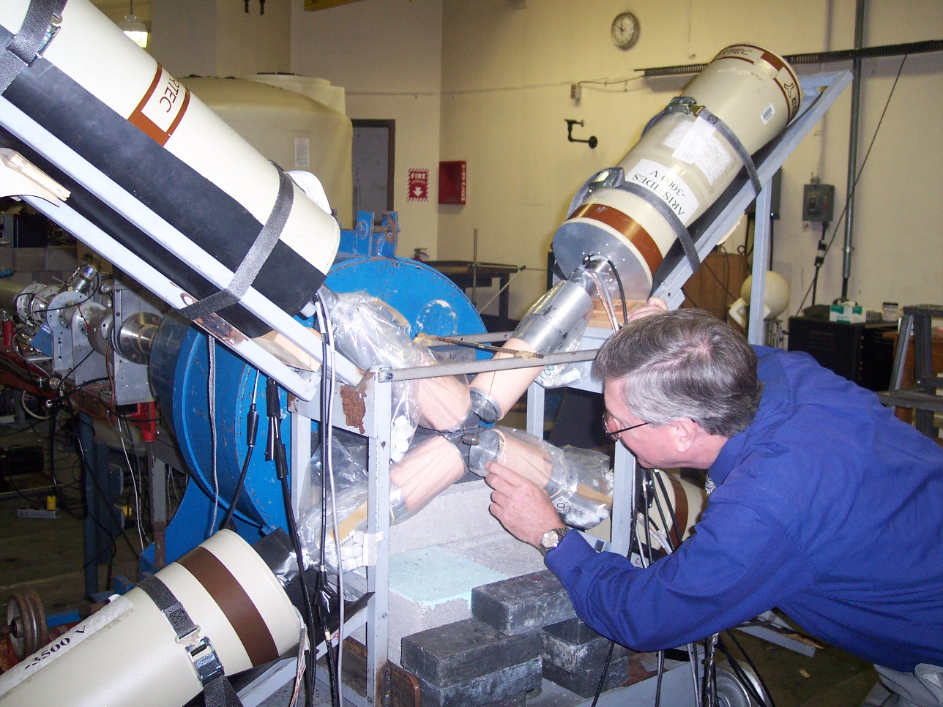
Return of (n,n’γγ) coincidence
1999-2004
natCd,natXe Chris McGrath nat,126Te
130Xe(n,n’γ−γ)
51V(n,n’γ−γ)
γ-tagged neutron spectra?

Slide 12
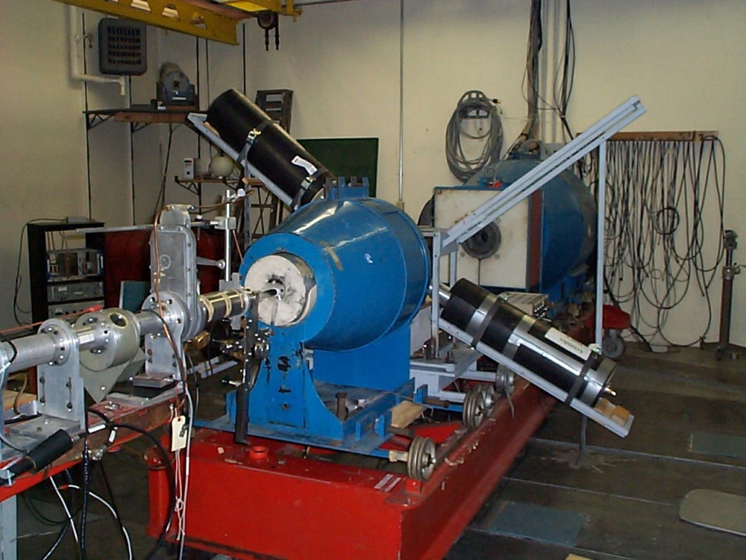
Return of (n,n’γγ) coincidence
1999-2004

Slide 13
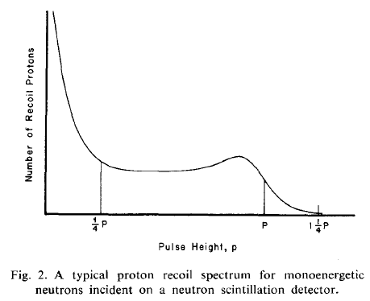
SIDE PROJECTS
Can the technique of Dynamic Biasing help in the
modern world?
→ LLD & ULD = fn (E deposited in scintillator)
the idea:
Each channel in a nTOF spectrum is intended to
represent a specific energy of scattered neutrons.
1960 Boring γ-ray atten in samples
1971-x dynamic biasing becomes popular
1970-1 Englebrecht methods for
neutron atten and MS corrections.
1975 Velkey describes Monte Carlo methods
for correcting ang dist
1980-y McEllistrem writes MULCAT
1980 MULCAT-BRC Lilley & MTM
1984 GAMBIT has been written by now.
Scintillator fluid
n’
Using signals from forward recoiling protons reduces bckgnd & sharpens TOF peaks, especially for low energy n.
Brandenberger & Grandy, NIM 93, 495 (1971)

Slide 14

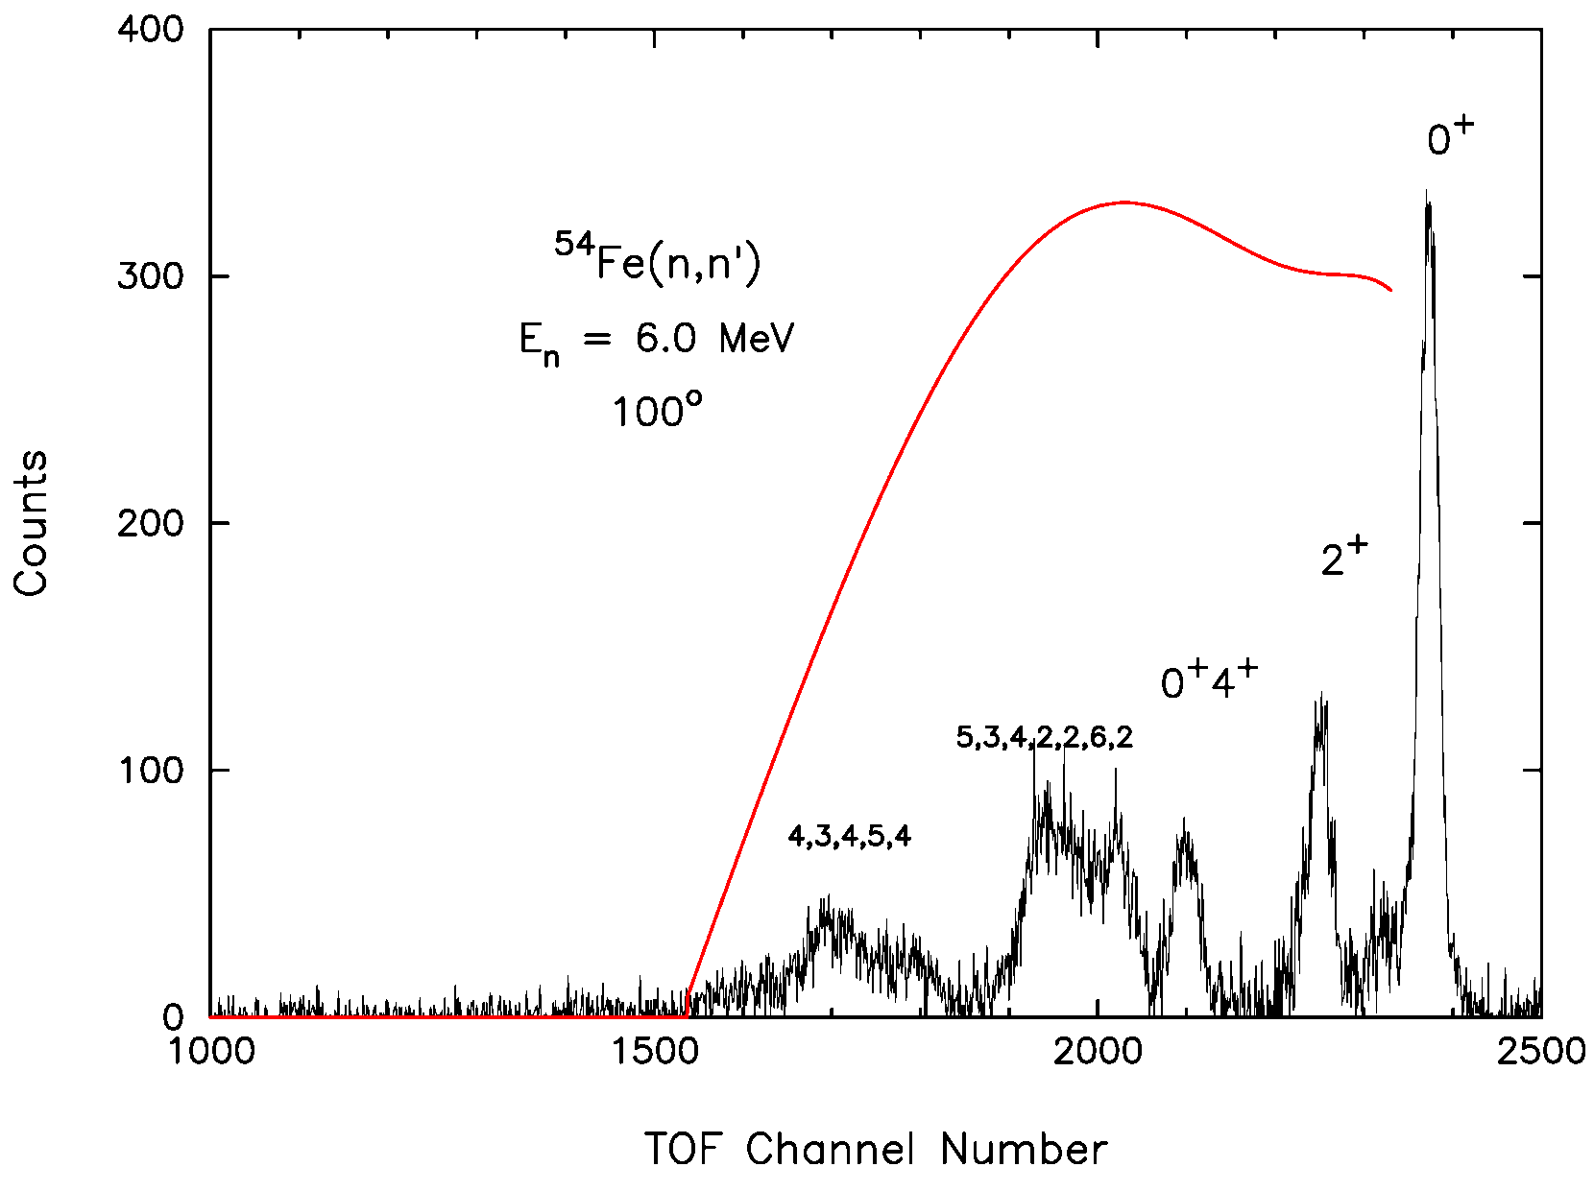
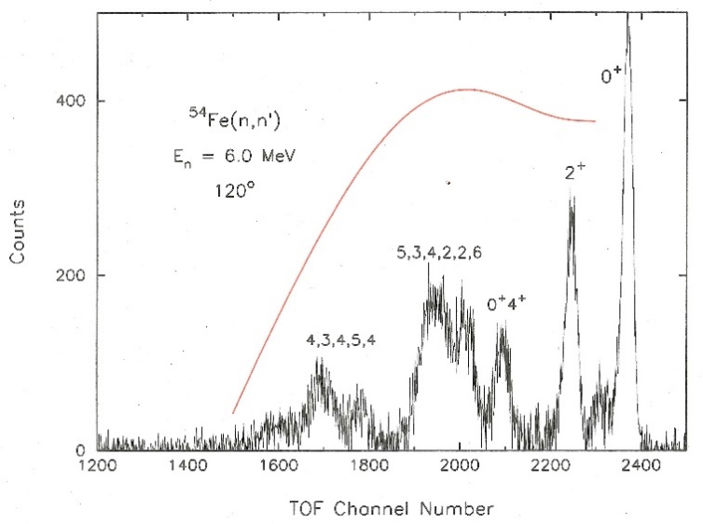
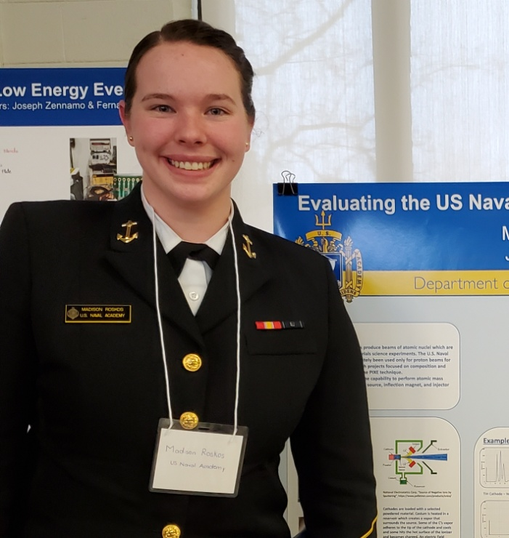
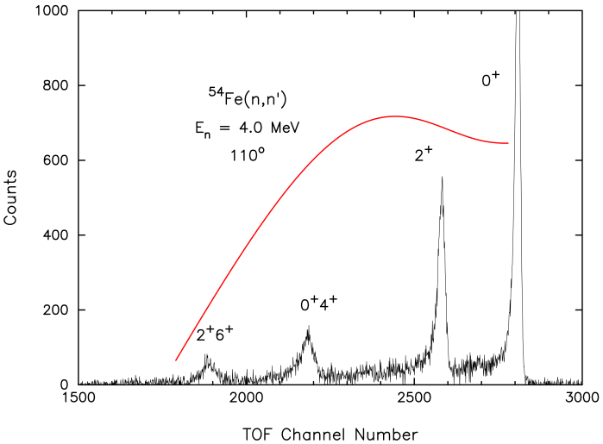
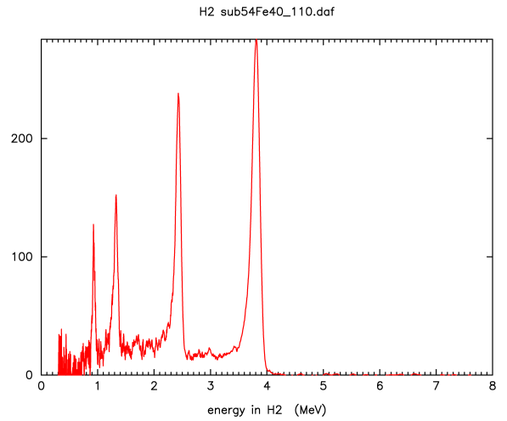
Transforming tof histograms → energy domain
i.e. Emission Spectra
(efficiency corrected and normalized)
Templates: Arjan Koning (?): Only 5 entries into EXFOR DDX in last 5 years
What generates the peak-Shirley effect in neutron detectors, and why is it masked in nTOF spectra?
Johansson and Campbell, “PIXE: A Novel Technique for Elemental Analysis”, JWiley&Sons

Slide 15
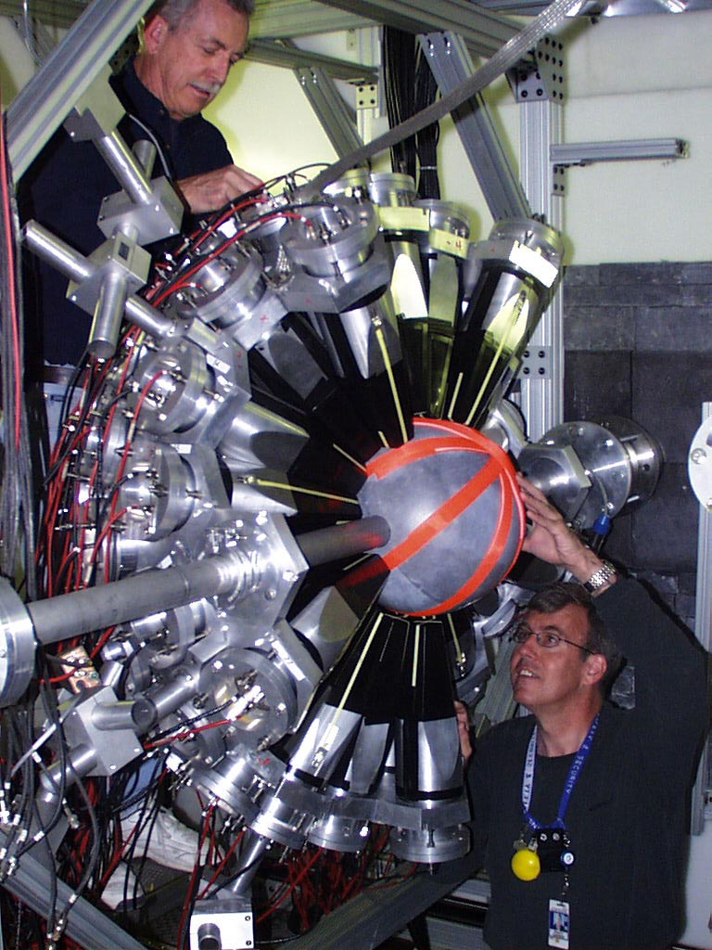
Kentucky at DANCE
Staffing
(n,n’)
(n,n’γ)
(n,n’γ−γ) & (n,n’−γ)
Side Projects
DANCE capture
4π BaF₂ array
^{110,11,112,114}Cd(n,γ)
^{several in 130, 132,134,136}Xe(n,γ)
^{50,53}Cr(n,γ)
measurements completed,
students analyzing
limboed by accel & LiH problems
Not yet proposed

Slide 16
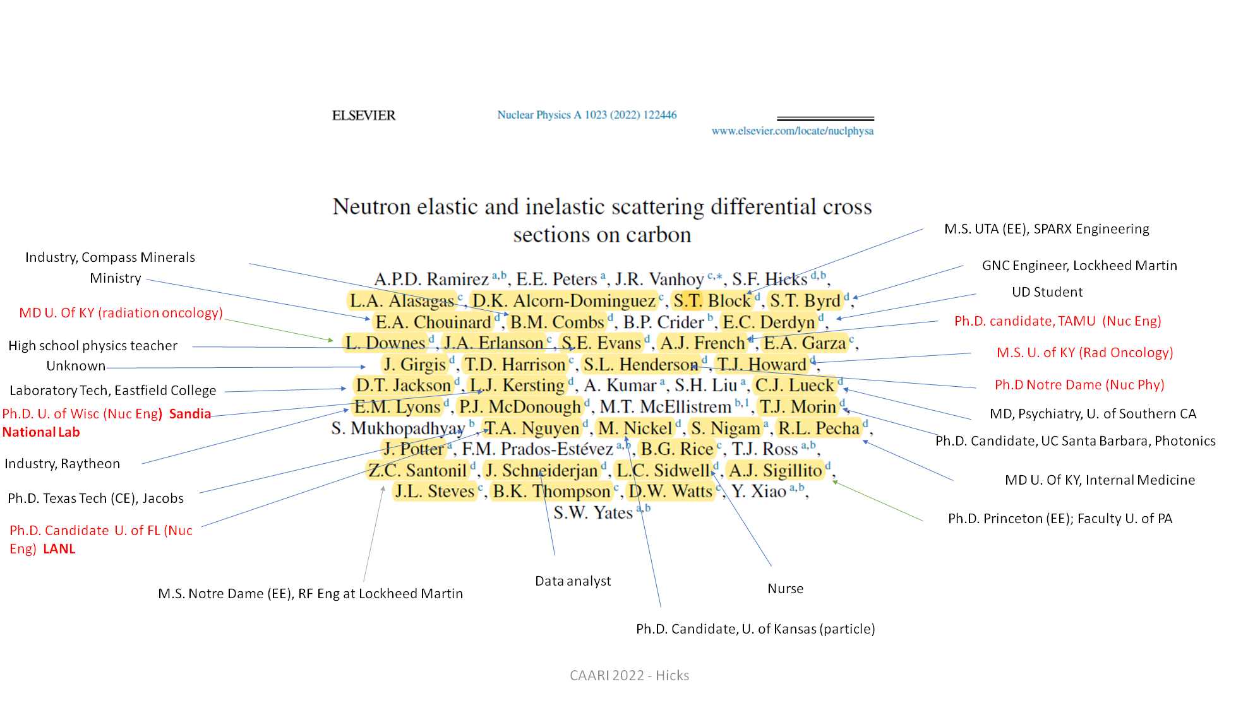
^{nat}C
from Sally Hicks
nat
Undergraduate students on the Carbon paper
data taken 2011-2016 & 2016-2020
a monster project
64 (n,n’) ang distrib at 45 incident energies btw 0.5 - 8 MeV
+ 12 (n,n’γ) btw 5.6-7.8 MeV
Ramirez, Phys Rev C 1023, 122446 (2022)

Slide 17
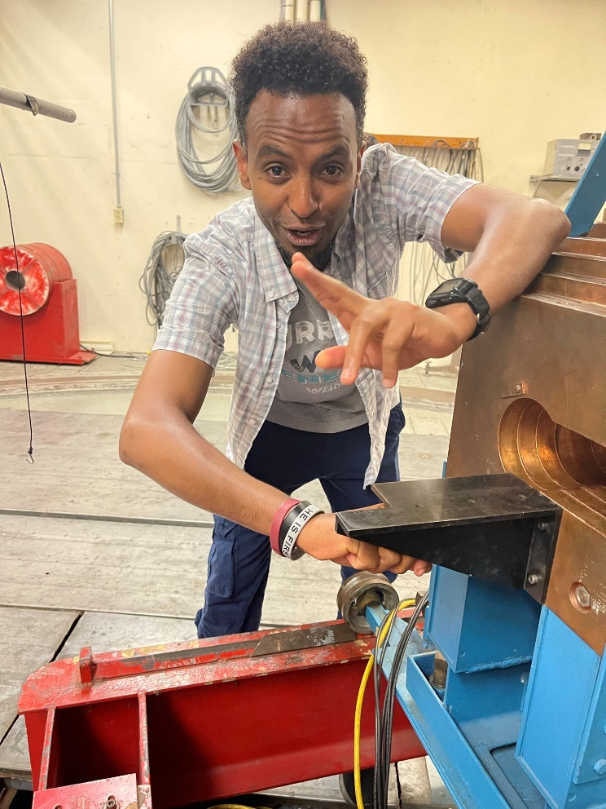

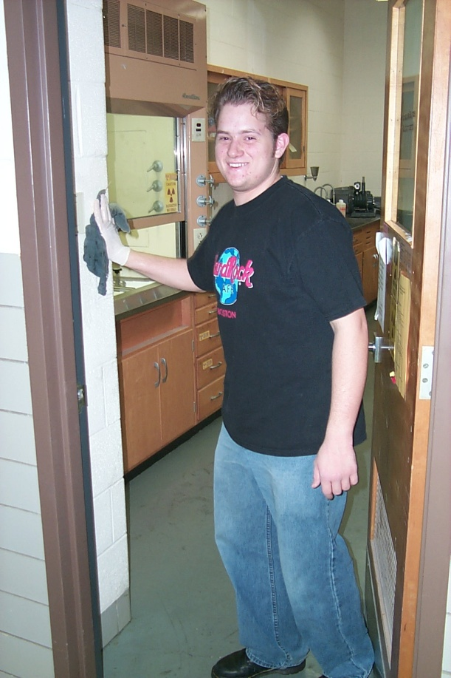
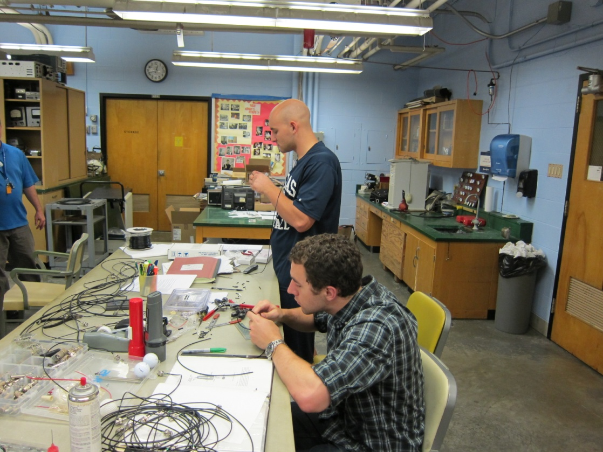
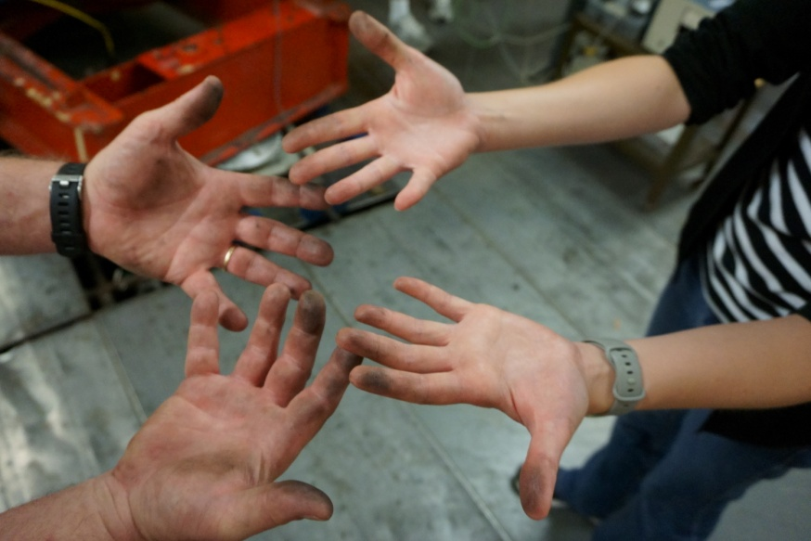
Dirty Hands
Laboratory Skills
Operation, Maintenance, Repair, Design
brought to you by

Slide 18
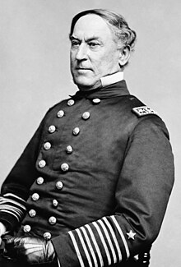
Conclusion
Damn the torpedoes, full speed ahead!
“This powerful phrase isn’t about underwater weapons or blasphemy but rather a defiant call to take risks and push forward, no matter the odds.”
Candace Osmond
“Damn the Torpedoes – Idiom, Origin & Meaning”
https://grammarist.com/idiom/damn-the-torpedoes/#:~:text=Origin%20and%20Etymology%20Behind%20Damn%20the%20Torpedoes&text=The%20phrase%20is%20attributed%20to,to%20a%20very%20surprising%20victory.
RADM David Farragut (1801-1870)
US Public Domain
Retrieved from:
https://en.wikipedia.org/wiki/David_Farragut#/media/File:Admiral_Farragut2.jpg
Story at: US Naval Institute:
https://www.usni.org/magazines/naval-history-magazine/2014/july/damn-torpedoes

