Slide 1
Recent Standards Work
Allan D. Carlson
NIST Associate
Presented at
The CSEWG Meeting
Nov. 13-17, 2023

Slide 2
The Neutron Cross Section Standards
Reaction Energy Range
_________________________________________________
H(n,n) 1 keV to 20 MeV
³He(n,p) 0.0253 eV to 50 keV
⁶Li(n,t) 0.0253 eV to 1 MeV
¹⁰B(n,α) 0.0253 eV to 1 MeV
¹⁰B(n,α₁γ) 0.0253 eV to 1 MeV
C(n,n) 10 eV to 1.8 MeV
Au(n,γ) 0.0253 eV, 0.2 to 2.5 MeV, 30 keV MACS
²³⁵U(n,f) 0.0253 eV, 7.8-11 eV, 0.15 MeV to 200 MeV
²³⁸U(n,f) 2 MeV to 200 MeV

Slide 3
Outline of Recent Work on the Neutron Standards
Measurements of Neutron Cross Section Standards Proposed, Underway or Completed
Including results presented at the Oct 2023 Standards meeting
Due to time limitations for this presentation mostly very recent work will be discussed. The reference cross section areas will not be shown:
Prompt γ-ray production Reference cross section measurements
⁷Li(n, n’)γ and ⁴⁸Ti(n,n’)γ Reference cross sections

Slide 4
Previous CSNS Measurements
The measurements at the Chinese Spallation Neutron Source discussed last year have been published
Light element standards
Measurements by Jiang, et al. of the hydrogen angular distribution from 6-52 MeV *
Measurements of the ⁶Li(n,t) angular distribution by Bai et al. for energies from 1 eV to 3 MeV*
Angular distribution data obtained by Jiang et al. for the boron standards from 1 eV to 2.5 MeV*
Ratios of the ¹⁰B(n, α)⁷Li reaction to the ⁶Li(n, t)⁴He reaction by Liu et al. to several MeV*
Fission Data
The ²³⁵U(n,f) and ²³⁸U(n,f) cross sections relative to n-p scattering by Chen et al from 10 to 66 MeV*
All the experiments above (with*) were done using the double bunch mode for the accelerator.
That mode has 2 bunches of pulse width ~ 41 ns: 410 ns was the interval between proton bunches.
the neutron energy distribution caused by the double proton bunches was unfolded using an
iterative unfolding method.
The ²³⁸U(n,f)/²³⁵U(n,f) cross section ratio by Wen, et al. from 1 to 20 MeV.
This is the only experiment done using the single-bunch mode with ~ 41 ns width .
Differential cross section data were obtained at 10 angles from 10 to 55 degrees. The shape measurements extend from 6 MeV to 52 MeV with 23 energy points. The flight path was 57.99m.
The measurements generally agree well compared with existing measurements, evaluations and theoretical calculations (H. Jiang et al., Eur. Phys. J. A 57 6 (2021))
The hydrogen standard is limited to 20 MeV at the present time. The Jiang et al. data combined with the database being developed by Paris and Hale at LANL will allow an evaluation with an extended energy range to be produced. Their objective is to extend the evaluation to about 350 MeV the threshold for neutral pi production.
It has been decided to wait until the next evaluation of the standards before extending the hydrogen energy range.

Slide 5
⁶Li(n,t) Measurements
Measurements are being made by Anastasiou et al. of the ²³⁵U(n,f)/⁶Li(n,t) cross section ratio with the NIFFTE fission TPC.
The expected energy range is from about 0.1 MeV up to 3 MeV (possibly 4 MeV). The data will impact evaluations of both the ²³⁵U(n,f) and ⁶Li(n,t) cross sections.
Some results of this work were given by Anastasiou at the ND2022 conference and the 2023 standards meeting .
Preliminary results were given that agree well with the standards evaluation and suggest a rise in the ratio above 1 MeV.

Slide 6
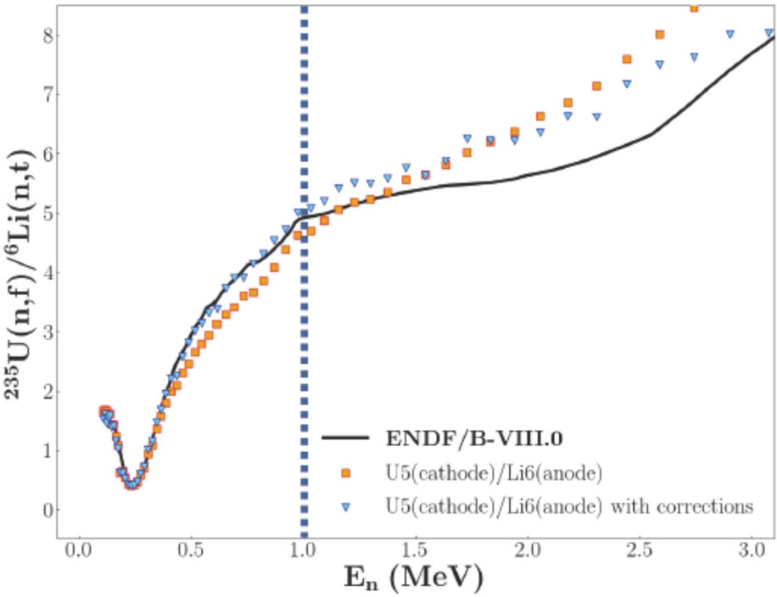
²³⁵U(n,f)/6Li(n,t) Cross Section Ratio Measurements by Anastasiou et al.

Slide 7
Measurements Directly Related to the ¹⁰B(n,α) Standardand ¹⁰B(n,α₁γ) Measurements
Massey et al. have measured ¹⁰B(n,Z) reactions for neutron energies from 2 to 20 MeV.
The work was done at the LANSCE WNR facility (Phys. Rev. C 105, 054612 (2022))
More work by Massey et al.
Several measurements of the ¹⁰Be(p,n)¹⁰B reaction by Massey and Jones-Aberty at Ohio University.
They include two angular distributions at 2.5 and 3.5 MeV.
All of these data can be used in R-matrix fits to improve the ¹⁰B(n,α) standards

Slide 8
¹⁰B(n,x)⁷Li and Li Measurements
Extension in the energy ranges to above 1 MeV of the ⁶Li(n,t) and ¹⁰B standards may be possible with the work by Anastasiou et al., Bai et al., Jiang et al. and the Massey et al. data.
The It is important to extend the energy range of these standards to above 1 MeV, the present limit of this standard. That would allow convenient overlap with the H(n,n) standard.

Slide 9
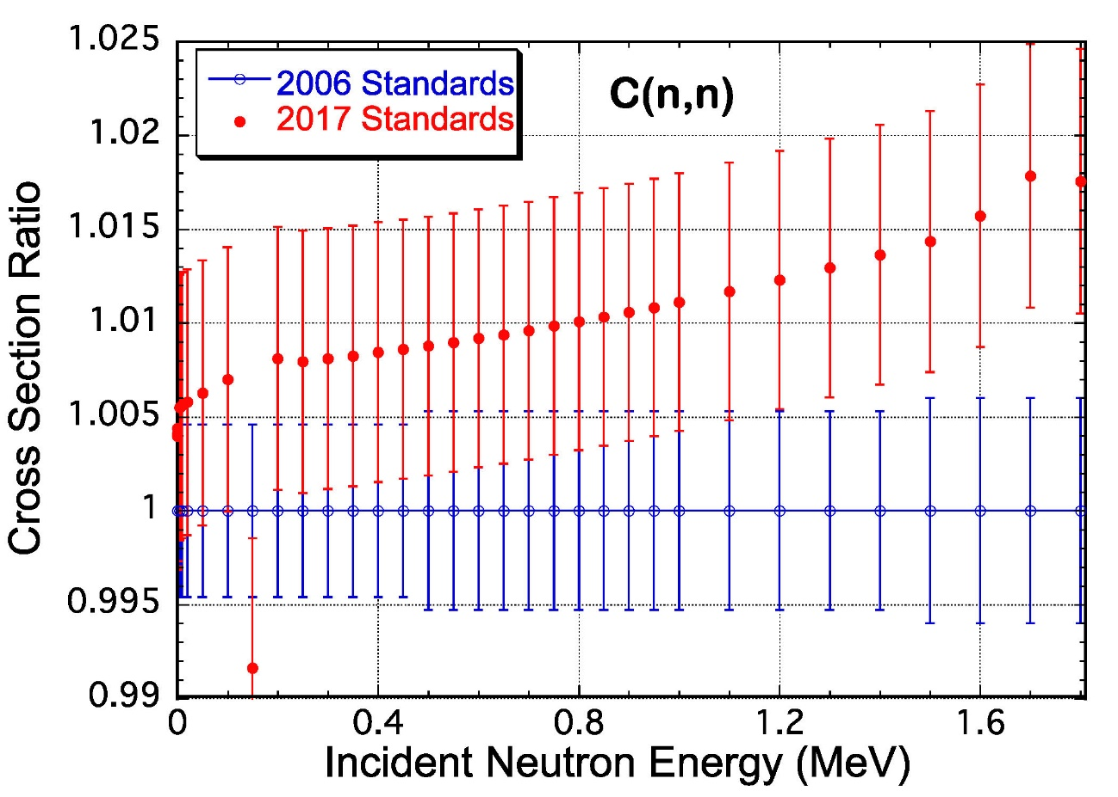
C(n,n) Cross Section
The most recent evaluation of the carbon standard by Hale was done by combining ¹²C and ¹³C R-matrix evaluations to obtain the elemental cross section that is the standard. That evaluation, the ENDF/B-VIII standards evaluation (the 2017 standard), is somewhat higher than the ENDF/B-VII standards evaluation (the 2006 standard). The difference is most noticeable at the highest energies.
At the standards meeting in October, Hale indicated he is working on a new evaluation of neutrons on carbon.
The use of high energy data in the evaluation has caused an decrease in the C(n,n) cross section in the standards energy region by about a percent .
So now it is closer to the 2006 standards values
in the higher energy region
Measurements have been made by Vanhoy on ¹³C
that should improve the new evaluation of the carbon
Standard.
Carbon scattering measurements by Kelly at LANL
are also underway that should impact the new evaluation.

Slide 10
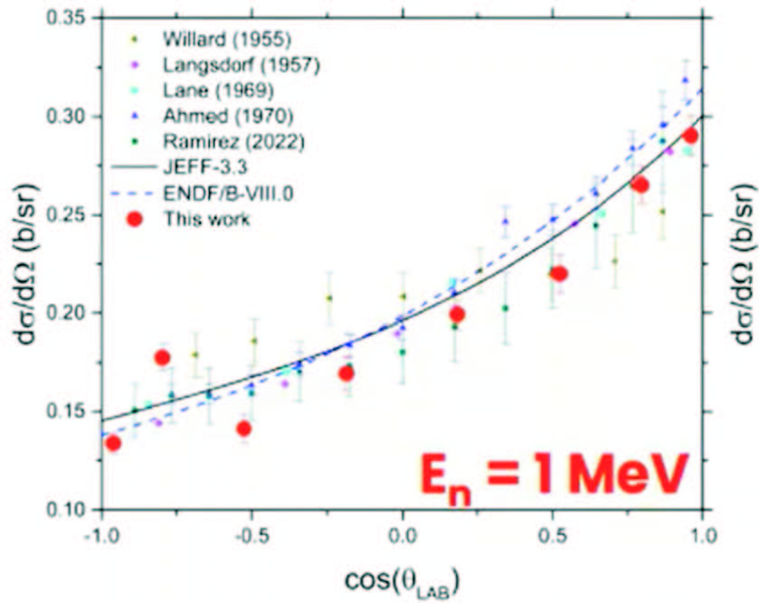
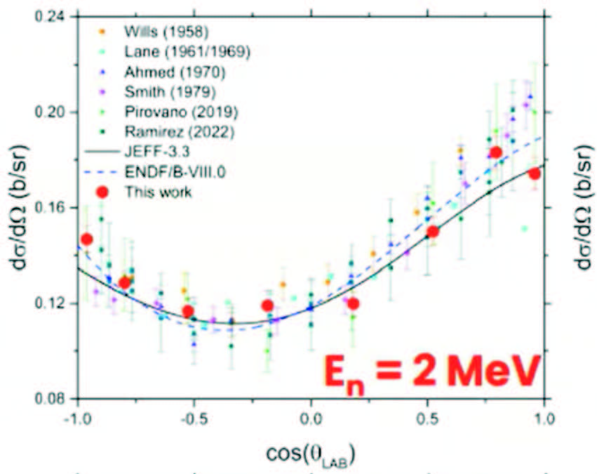
C(n,n) Cross Section
Angular distribution measurements have recently been completed at GELINA by Gkatis et al.
The data were obtained with the ELISA setup
Energies from 10 mV to 20 MeV ( thus covering the standards energy range)
With 8 angles between 16.2 and 163.8 degrees

Slide 11
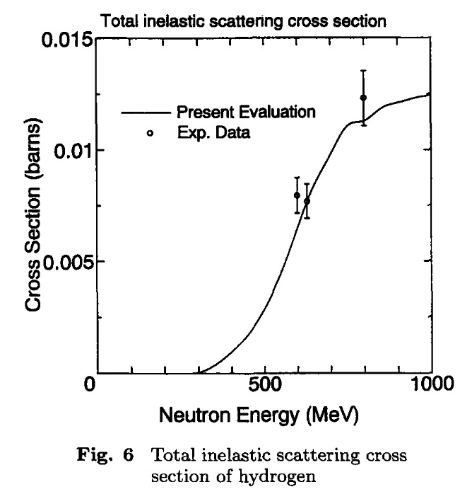
Absolute measurements by the n_TOF collaboration were made of the ²³⁵U(n,f) cross section relative to hydrogen scattering from 20 MeV to about 1 GeV.
The status of the analysis of the data was discussed by Manna et al. at the October standards meeting. The analysis is essentially completed for the energy region up to 450 MeV.
The results up to 450 MeV are similar to those of the ²³⁵U(n,f) Reference cross section The present standard is limited to 200 MeV. There is a strong need for an extension to higher neutron energies that may be possible with these data if high accuracy can be obtained.
Their plan is to have a further “campaign” to
Improve the accuracy (reduce the statistical uncertainty)
Go to higher neutron energy
The fission fragment detectors already extend to 1 GeV
Getting to higher proton energy data will require being
able to separate the elastic and inelastic protons since
inelastic scattering is a problem at the higher neutron energies
Uranium Fission Cross Section Measurements

Slide 12
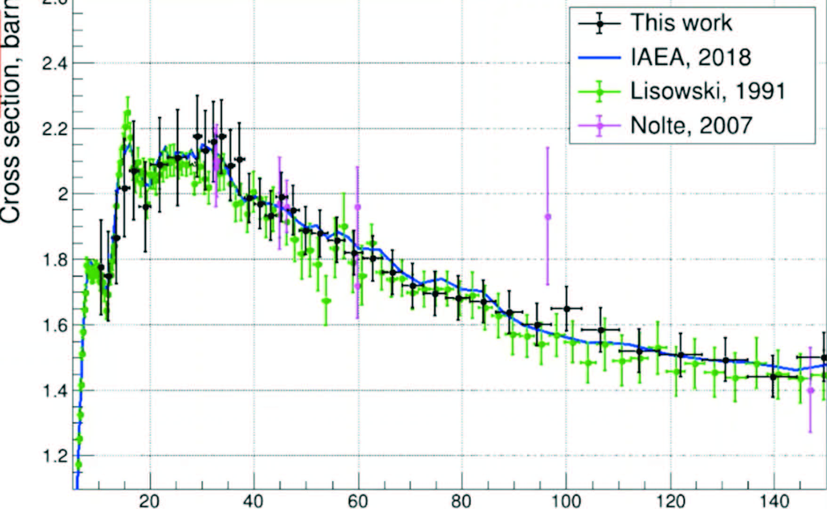
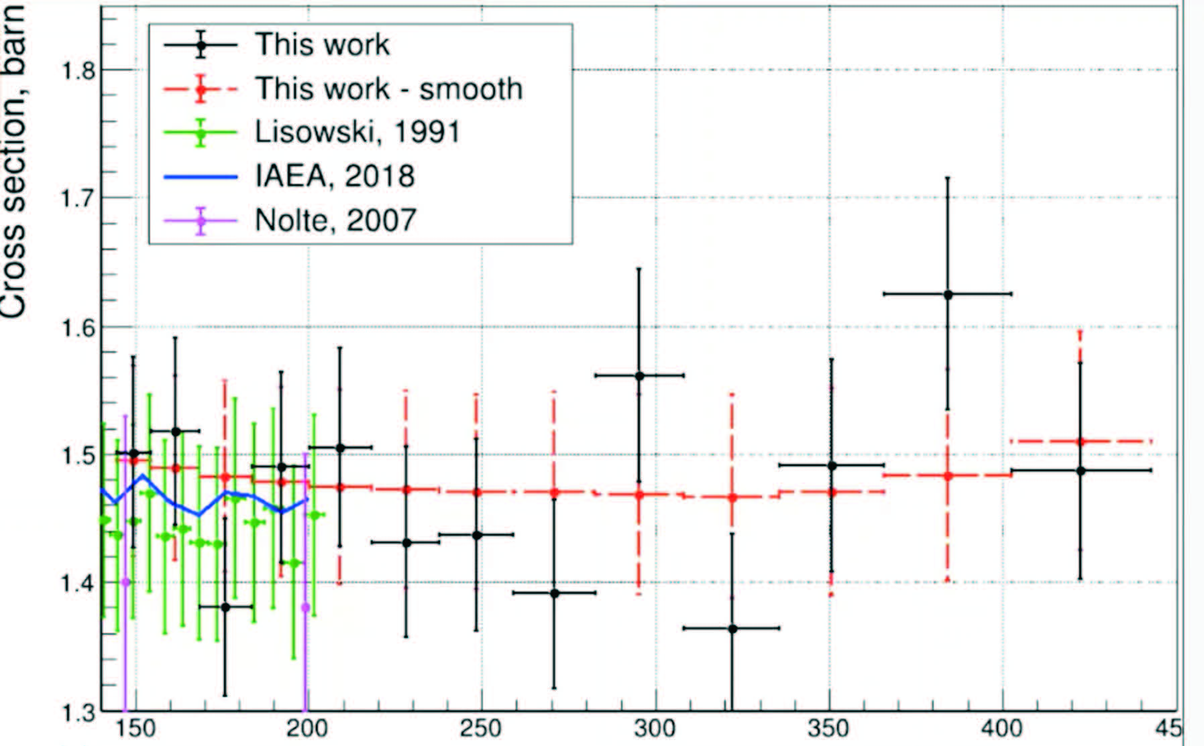
²³⁵U(n,f) Cross Section Measurements by Manna et al.
E_{n} (MeV)
E_{n} (MeV)

Slide 13
²³⁵U(n,f) Cross Section Uncertainties for Manna et al. Measurement

Slide 14
²³⁵U(n,f) and ²³⁸U(n,f) cross sections measurements at CSNS
Shown by Chen. at the October standards meeting.
Relative to the hydrogen scattering standard-shape data
For the extension up to 70 MeV problems were noted due to the use of double bunches. The unfolding causes a problem that is worsened when statistical uncertainties are large.
More work is planned
They now extend from 10 to 66 MeV
Uranium Fission Cross Section Measurements

Slide 15
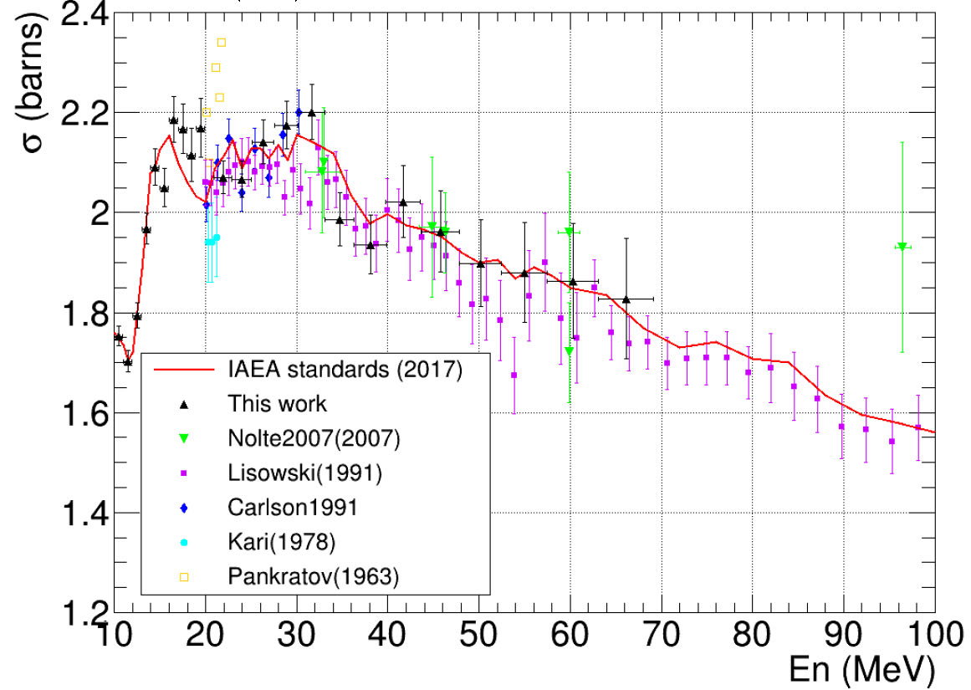
²³⁵U(n,f) Cross Section Measurements by Chen at CSNS Facility

Slide 16
Beginning with the standards for the ENDF/B-VI evaluation, very “clean” integral data were used.
The data used were measurements of the ²³⁵U(n,f) and ²³⁹Pu(n,f) cross sections in the ²⁵²Cf spontaneous fission (neutron spectrum (Spectrum Averaged Cross Sections, SACSs).
Since there is a relatively small change in the cross section for these nuclides over most of the energy range of the ²⁵²Cf spectrum, an accurate determination of the cross section is possible. The result is also only weakly dependent on the uncertainty in the spectrum shape. These integral data basically help provide normalization for the standards evaluation.
An improvement in use of these SACS would be possible if ratios can be used.
With ratios, the dependence on neutron fluence is removed.
GMAP unfortunately can not handle SACS ratios
A new Python based code was written by Schnabel (GMA-py) so that ratios can now being used.
Using the the ²³⁹Pu(n,f)/ ²³⁵U(n,f) SACS ratio data and the ²³⁸U(n,f)/ ²³⁵U(n,f) SACS ratio data and the data in the GMA data base has led to a new preliminary evaluation of the standard cross sections.
For example, more than a 0.6% increase in the ²³⁹Pu(n,f) /²³⁵U(n,f) cross section ratio occurs.
Use of Integral Data

Slide 17
²³⁹Pu(n,f)/²³⁵U(n,f) cross section ratio measurements by Snyder et al. made at LANSCE by the NIFFTE collaboration have been published (L. Snyder, Nuclear Data Sheets 178 1 (2021) ). These data are higher than the standards evaluation by slightly less than 2%. They are recommended to be used as ratio shape data. They agree in shape with the 2017 standards evaluation. New measurements have been made with an improved sample. They were shown at the ND2022 conference and at the recent Oct. standards meeting by Snyder. The new data look identical to the former measurements. But each of those measurements was normalized at the same low energy. It’s normalization is still under investigation.
As noted previously, work with GMA-py led to a new preliminary standards evaluation that yielded a ²³⁹Pu(n,f)/²³⁵U(n,f) cross section ratio with a value that is more than 0.6% larger than the value obtained with the 2017 standards evaluation. So the difference now instead of 2% it is just slightly more than 1% compared with the present preliminary standards evaluation.
Also measurements have been made of the ²³⁹Pu(n,f)/⁶Li(n,t) cross section ratio with the NIFFTE fission TPC.
These data will impact evaluations of both the ²³⁹Pu(n,f) and ⁶Li(n,t) cross sections. These data are not finalized.
Plutonium Fission Cross Section Related Measurements

Slide 18
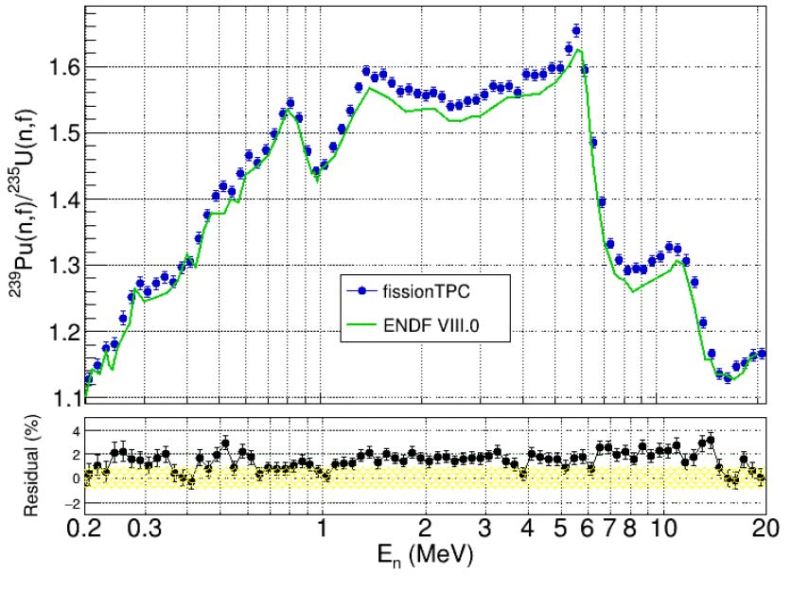
Comparison of the Published NIFFTE ²³⁹Pu(n,f)/ ²³⁵U(n,f) Cross Section Ratio with the Standards Evaluation

Slide 19
Nuclear Reaction Activities- Measurements
Comparison of measurements of neutron source emission rate CRR(III)-K9.Cf 2016
NIST is a participant in an international project measuring source intensity
A single ²⁵²Cf is sent to a number of laboratories throughout the world
Brazil, Canada, China, England, France, Italy, Russia, S. Korea and USA
The measured rate at each laboratory using their techniques is sent to a pilot institute
The results are being tabulated leading to a publication in Metrologia
Such work is valuable to ensure that each laboratory is obtaining consistent results
Results that deviate from the mean require investigation to find sources of error

Slide 20
Summary-what is needed
Improved experimental work is necessary for all the standards
Especially the boron and lithium standards so the upper energy bound can be increased
Also for gold capture that has some of the largest uncertainties for the standards
Extension of the hydrogen standard to about 150 MeV and possibly higher (work is underway by Hale and Paris)
It is now 20 MeV but there are cross section ratio data to much higher energies
Note that changes to a standard are not allowed for a given version but extensions are allowed
Further work on unrecognized sources of uncertainty
An understanding of the energy dependence of USU
Consider improved evaluation techniques for the standard cross sections

Slide 21
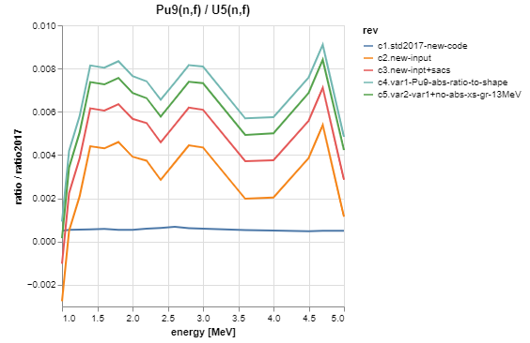
Pu9f/U5f: 2017 vs current – GMA-py
@ 1.5 MeV
+0.2% due to SACS
+0.3% rel. to INDEN p57

