Slide 1
Status of the EXFOR Project
B. Pritychenko
National Nuclear Data Center, Brookhaven National Laboratory, Upton, NY 11973-5000, USA
November 17, 2023
Nuclear Data Week 2023 (CSEWG-USNDP-NDAG)

Slide 2
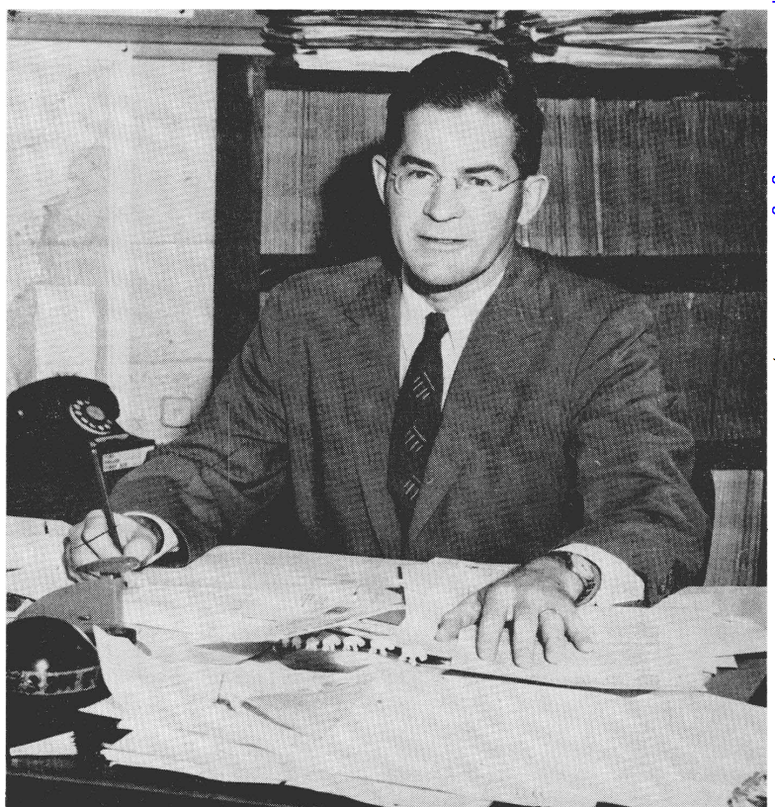
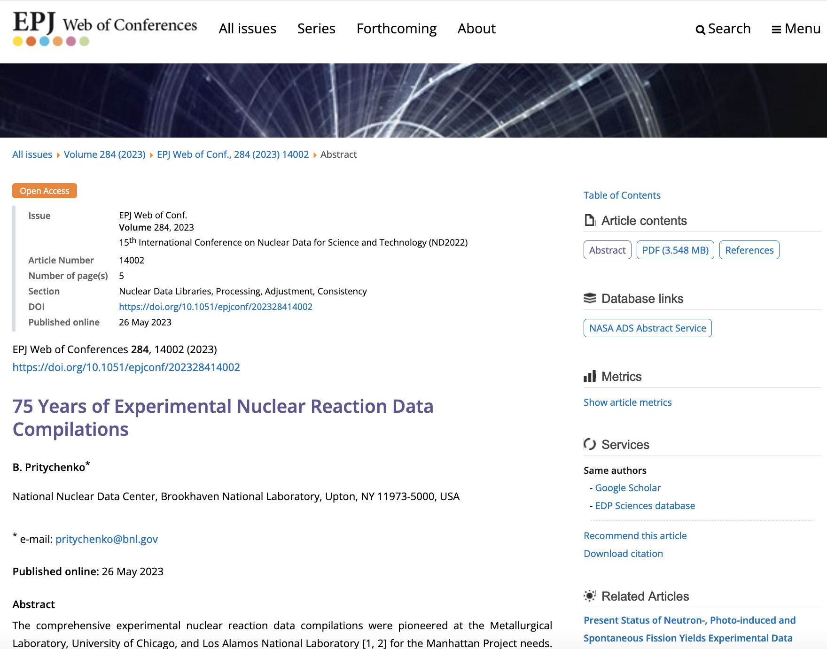
Outline of Nuclear Reaction Data Compilations in USA & Worldwide
Experimental neutron reaction data compilations have been pioneered at the Metallurgical Laboratory, University of Chicago and Los Alamos National Laboratory in 1945-1947.
1947 - Publicly available compilations.
Donald J. Hughes (1915-1960) was behind the BNL-170 (1952); it is a precursor of BNL-325 (Atlas of Neutron Resonances).
SCISRS (Sigma Center Information and Retrieval System) at BNL (1964) was a precursor of EXFOR.
Other data centers were created in Paris, France (NEA-Databank), Vienna, Austria (NDS-IAEA), and Obninsk, USSR (IPPE) in 1963-1964.
Around 1970 four neutron data centers agreed on the data interchange format (EXFOR). The four centers could store data locally in its formats. The Nuclear Data Centres Reaction (NRDC) network was founded in 1979 under the auspices of the IAEA.
75 Years of Experimental Nuclear Reaction Data Compilations

Slide 3
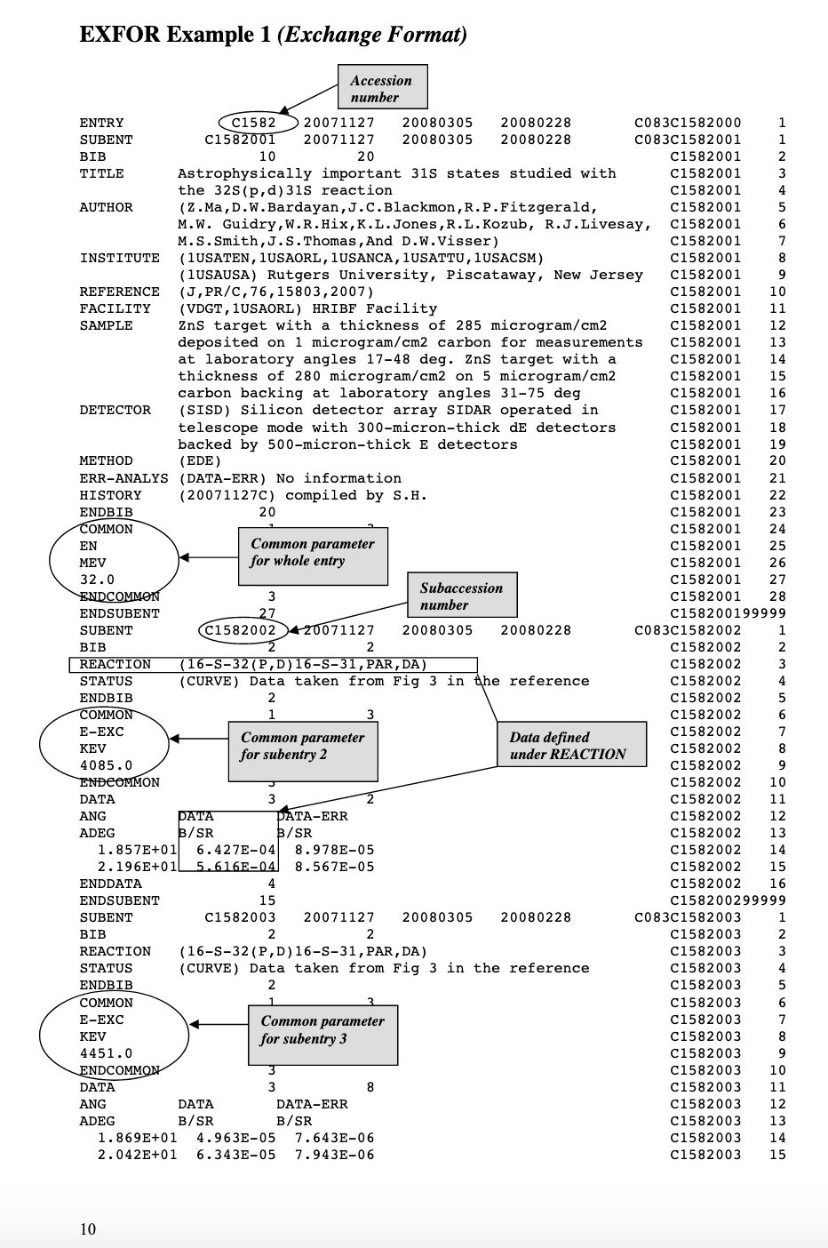
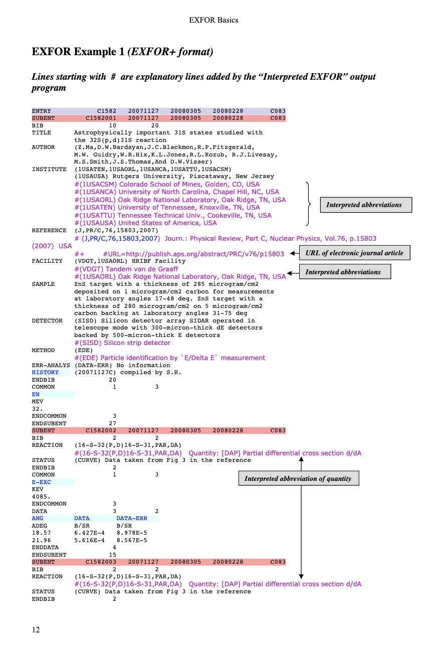
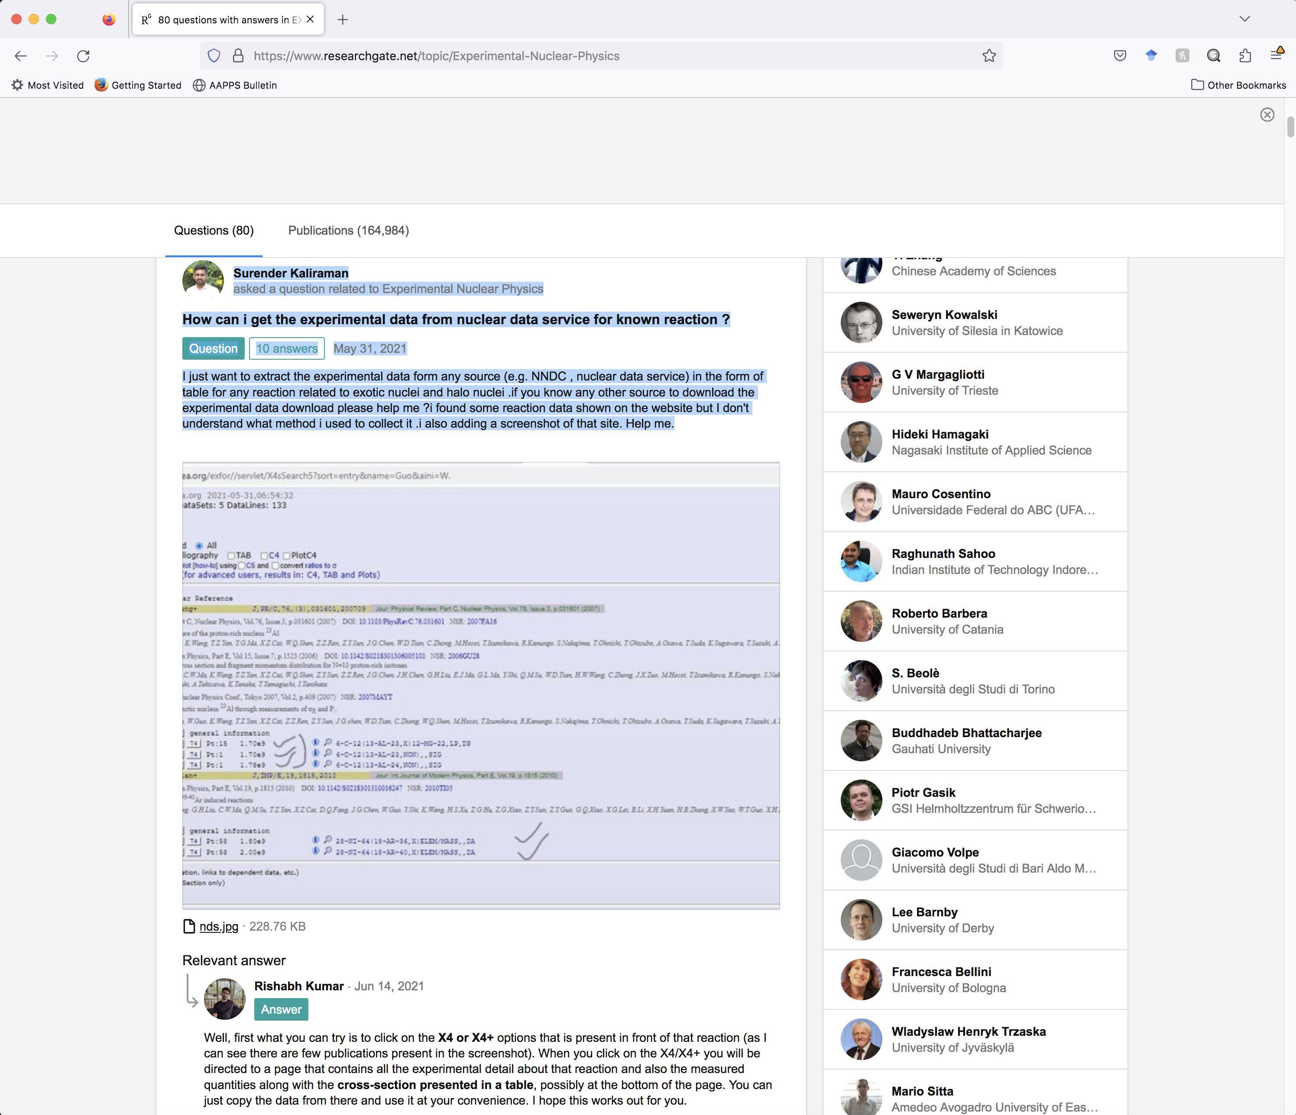
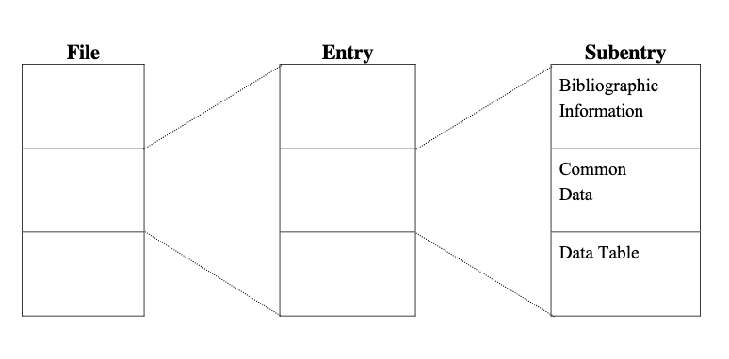
EXFOR DB Structure
EXFOR File (database)
EXFOR Entries (experiments)
EXFOR SubEntries (data sets)
NRDC Refereed Compilations.

Slide 4
Area #1 FY 2023 Statistics
Team effort: B.Pritychenko (BNL), O.Schwerer, S.Hlavac, O.Gritsay (Contractors).
EXFOR | FY2022 | FY2023
New Compilations | 158 | 152
Updated Compilations | 210 | 181
Preliminary Transmissions | 29 | 19
Final Transmissions | 31 | 22
Database Updates | 41 | 40

Slide 5
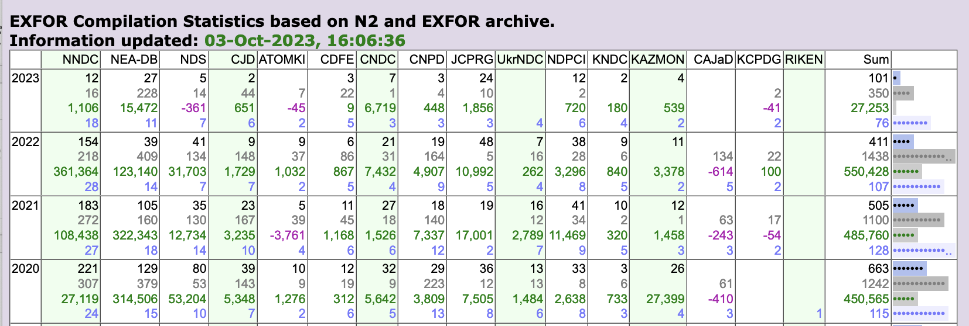
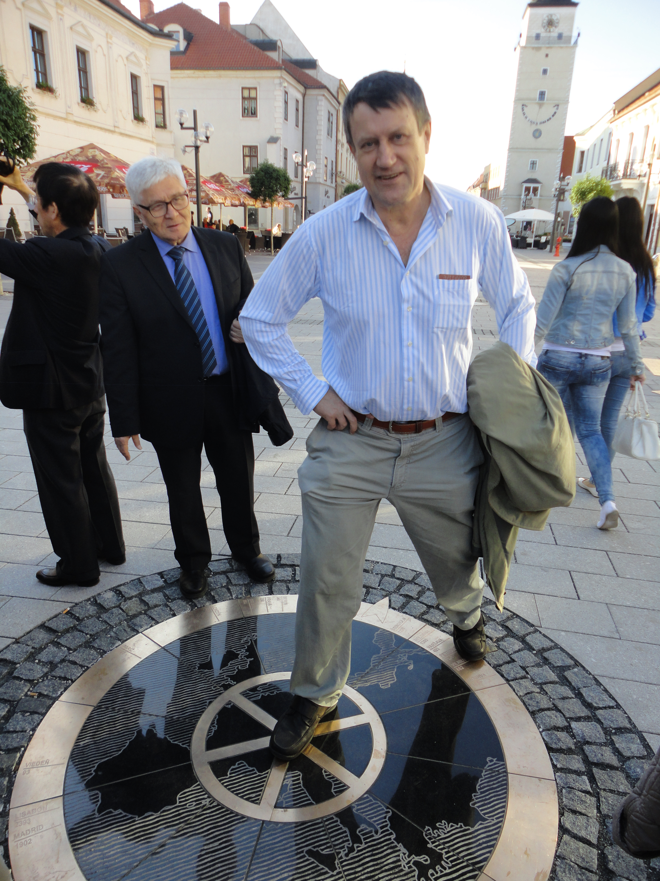
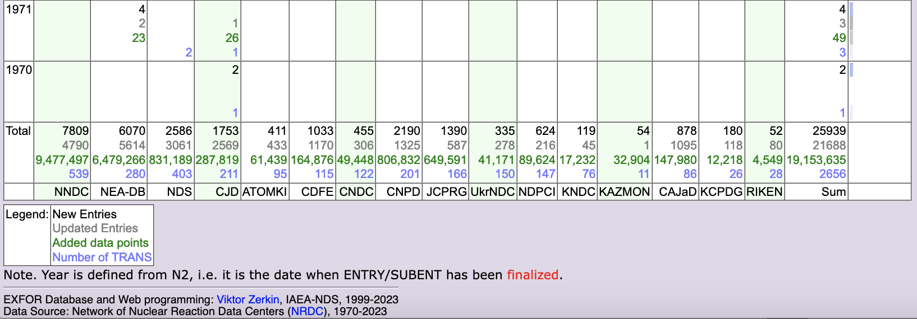
The IAEA EXFOR compilation control system
EXFOR compilation control system is one of the tools used for this co-ordination (Developed by Viktor Zerkin, IAEA, retired on October 31, 2023).
Top panel: New entries only.
Bottom panel: New and Updated entries, number of data points and transmissions.
Overall performance of the Area #1 is very good.
Potential issue is EXFOR maintenance or correction of existing entries.
Area #1 has the largest number of entries -7,809: 4,790 (~61.3%) of entries were corrected.

Slide 6
AIACHNE Project
Why EXFOR corrections are important???
AIACHNE (AI/ML Informed cAlifornium CHi Nuclear data Experiment): “Designing Nuclear-data Measurements that Resolve Discrepancies in Existing Data”.
EXFOR library analysis is often the key starting point for nuclear data evaluations.
We used NRDC network plot digitization software GSYS to obtain input used by Mannhart.
Mannhart input vs. EXFOR: 2 uncovered experiments for Area#2 are being included. Metadata found for existing EXFOR compilations will be included.
Curated data sets serve for standards and NEA WPEC SG-50 library as blue-print.
The SG-50 aims to store data as used for evaluations (profound effect on reproducibility).

Slide 7
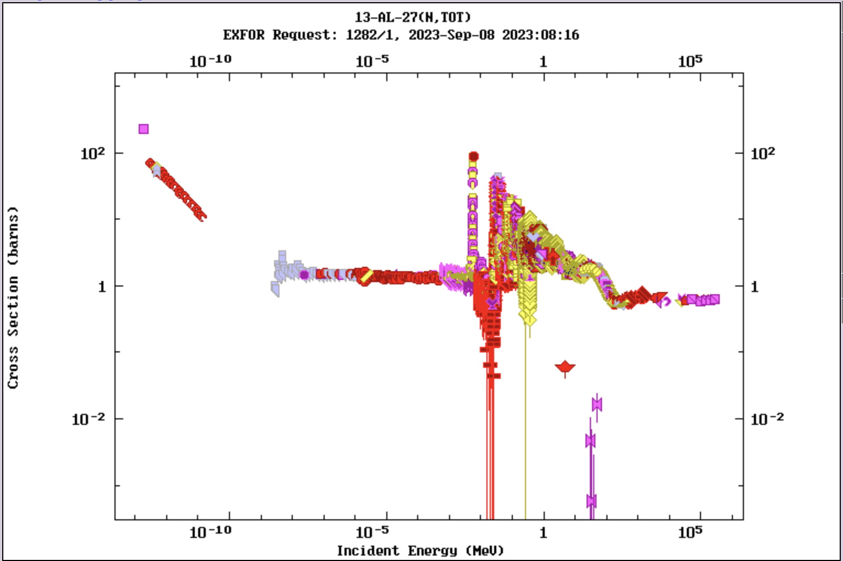
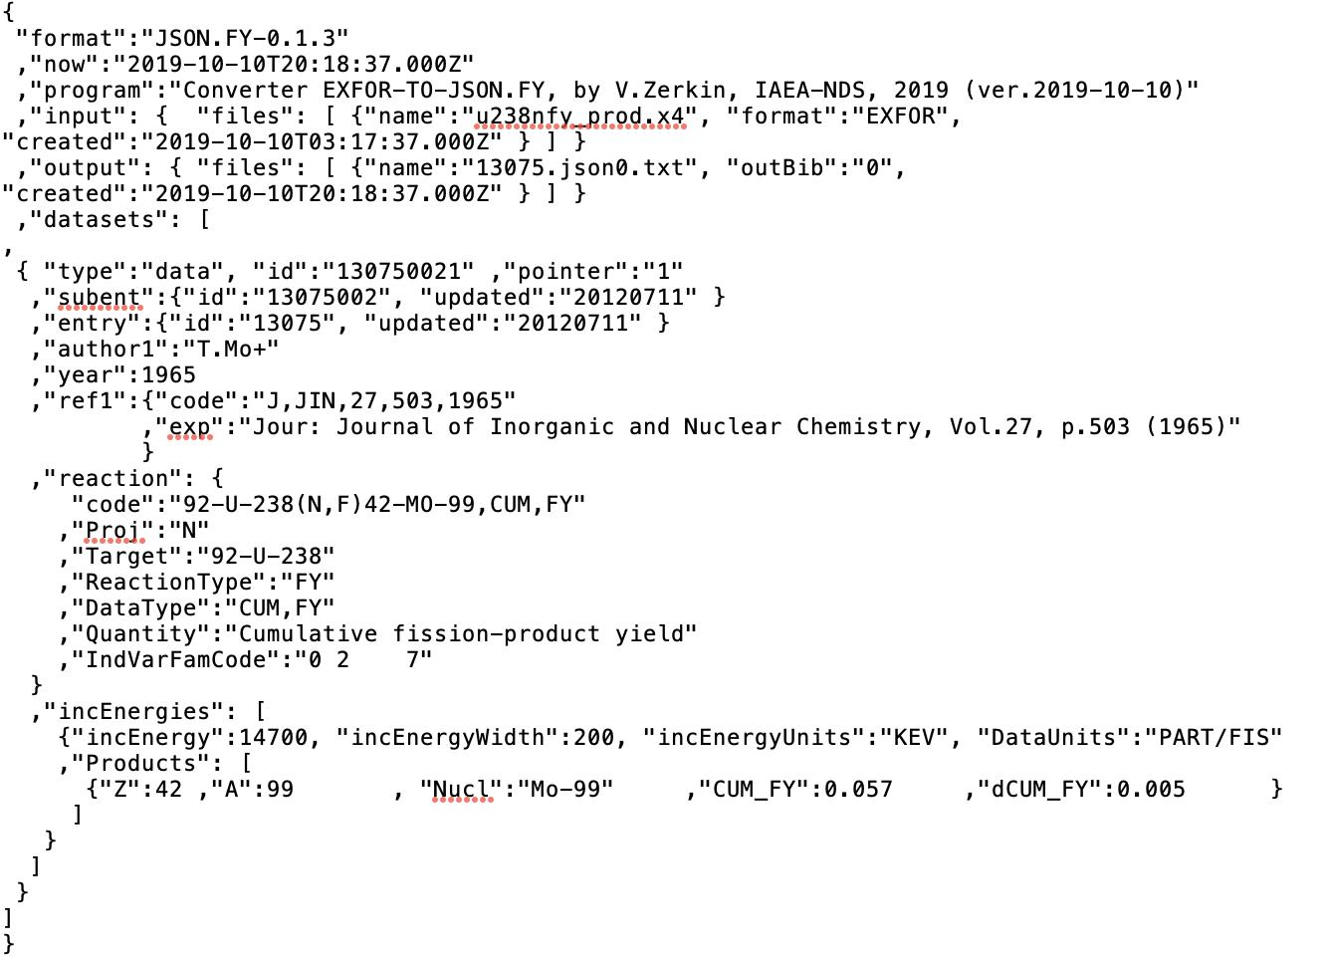
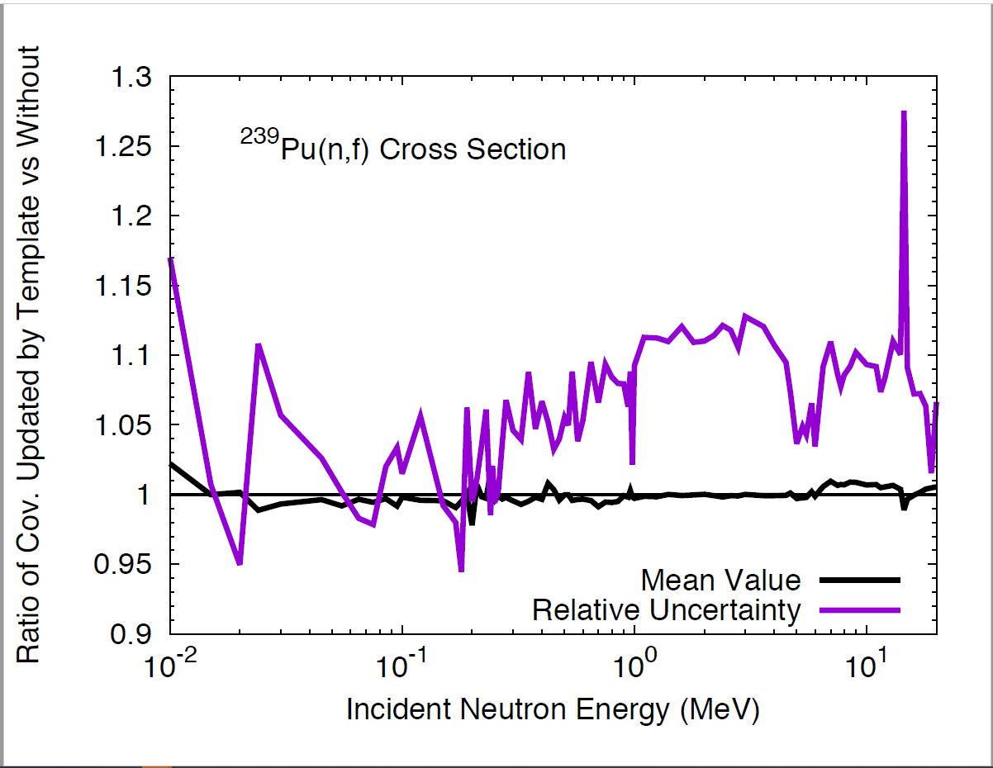
EXFOR Database Modernization
EXFOR is 75-year old, and it accumulated many issues.
It has to capitalize on modern computer technologies: Automatization of the EXFOR life and production cycle
Development of EXFOR Application Programming Interface (API): IAEA X4Pro, …
New data formats: JSON (JavaScript Object Notation) lightweight data interchange format for EXFOR is now in progress at the NNDC and IAEA-NDS.
Implementation of uncertainty templates developed by Denise Neudecker et al. (LANL) for resolving issues with missing uncertainties and covariances.
Potential collaboration: BNL, Los Alamos, IAEA, LBNL, NEA-DB, LLNL, …
Proposal was presented to NDAC on September 14, 2023.

Slide 8
Takeaways
NNDC EXFOR compilation efforts are complex and well-organized: B. Pritychenko (BNL), O. Schwerer, S. Hlavac, O. Gritzay (Under contract with BNL), V. Zerkin (IAEA).
EXFOR modernization proposal was reported to NDAC.
U.S. government funding issues may have a negative impact in FY 2024.

