Slide 1
NDEX Overview
Jason Thompson

Slide 2
Philosophy Statement
NDEX should provide the most physically accurate and “true to evaluation” processing as possible while also processing nuclear data in a way which has a beneficial impact to MC21’s performance. Moreover, the physics represented in NDEX should match that implemented in MC21 to as great a degree as reasonably possible to ensure a consistent physical representation through all nuclear design calculations. NDEX should be as user-friendly as possible to minimize the learning curve, minimize error-prone steps, and simplify the overhead of performing checks on input and output. NDEX should be designed in a way to be easily understood, extended, and maintained, and be thoroughly tested.

Slide 3
Current Team
Jason Thompson (NDEX Lead)
Andrew Pavlou (MC21 Lead, 50% NDEX)
Amelia Trainer (Rickover Fellow, started 2023)

Slide 4
Past and Current Task Drivers
Fully functional ND processor
Support MC21 development
(alpha,n)
X-ray fluorescence
Improve development practices
Codifying development practices
CI/CD pipeline
New evaluation library support
User requests and maintenance
Porting onto new computers
Performance improvements
Ancillary items
Parallelization
TSL improvements
Photoatomic incoherent scattering
Removing pre-processed files
Stability

Slide 5
Fully Functional ND Processor
Previously we use NJOY for many of the processing steps
No need to reinvent the wheel … except when there was
Installation difficulties and the number of times we needed to update NJOY during ENDF/B-VIII.0 testing soured our perspective of being dependent on external codes
A large potion of the work over the past 5+ years has mainly been driven by the desire to create a fully independent nuclear data processing code
Progress (done before this effort, done as part of this effort, still working)
Doppler broadening
Processing TSL
URR probability tables
Secondary particle distributions
Reconstructing RRR/URR/HER into a 0 K cross section
KERMA generation

Slide 6
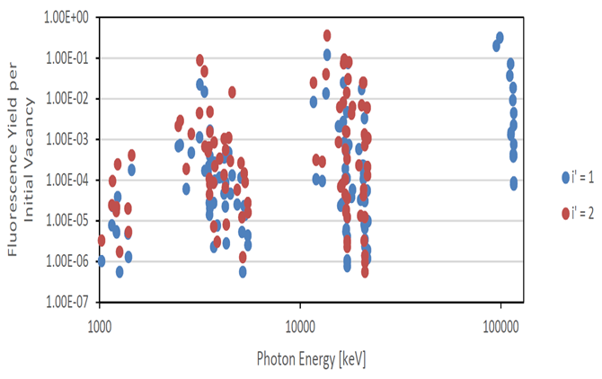
NDEX Features – X-ray Fluorescence
Using data from the EADL, NDEX generates x-ray fluorescence yields for incoherent scattering and photoelectric events

Slide 7
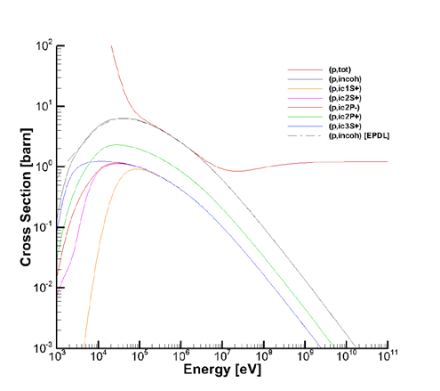
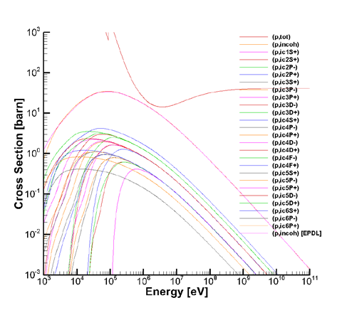
NDEX Features – Incoherent Scatter Cross Sections
Using only the electron momentum distributions from MCPLIB04, NDEX generates the photon incoherent scattering cross sections for each subshell
Notes:
Magnessium and

Slide 8
NDEX Features – Parallelization
Parallelization routines follow an assigner/worker scheme
Each material is processed mostly on a single process
Certain steps (TSL temperatures and URR probability tables) can be outsourced to other worker processes
The assigner process is permitted to process a materials which should process quickly
Dummy nuclides and nuclides which do not have incident neutron data

Slide 9
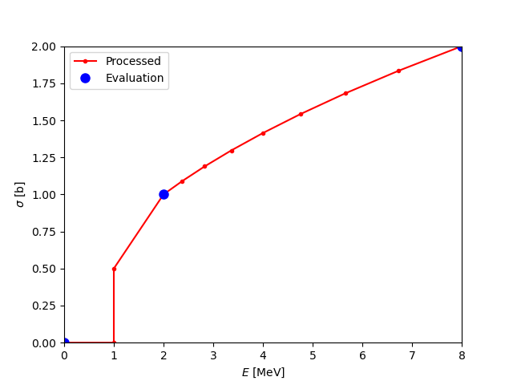
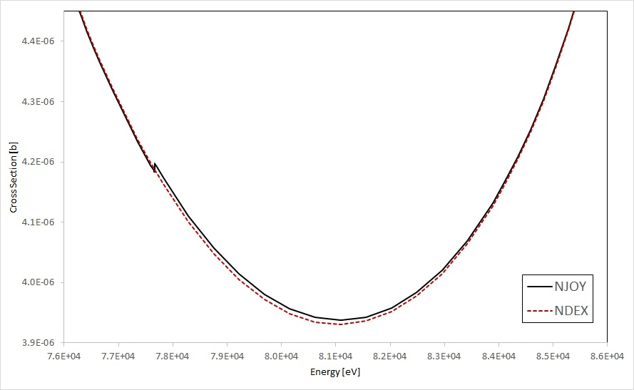
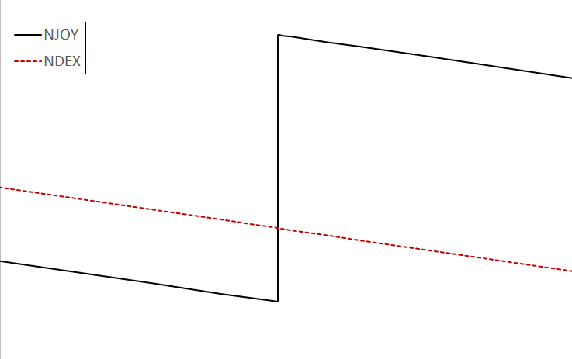
NDEX Features – 0 K Reconstruction
Adjustment of threshold value
and linearization
Switching to asymptotic function forms
log-log
Shift
lin-lin
Threshold

Slide 10
NDEX v11
Fully independent nuclear data processor
Eliminated all preprocessed files (legacy performance improvement scheme)
TSL improvements
Modernization of the URR probability table routines
Performance and stability improvements

Slide 11
Tentative NDEX v12 Plans
CE library refactor to improve MC21’s library read time
Native calculation of ARC-DPA parameter
Matplotlib
Blatt Biedenharn formalism
Improved performance
GNDS support
TSL refactor (remove the last Cython module)
Finish a complete Technical Specifications manual

Slide 12
Thanks!

