Slide 1
FRIB Nuclear Data Center
Jun Chen, Physicist chenj@frib.msu.edu
Nuclear Data Advisory Committee
13 September 2023, BNL

Slide 2
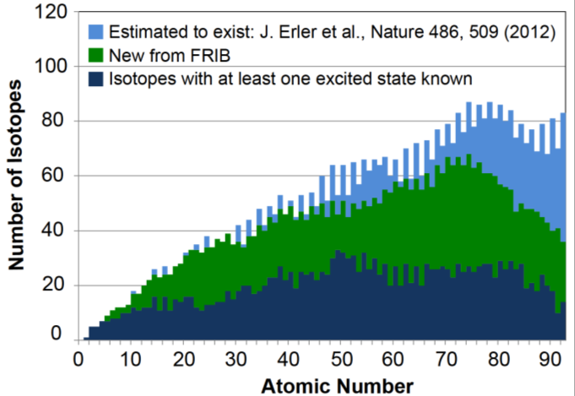
Overview of Nuclear Data Center at FRIB
In the FRIB era, the data evaluation effort adjusts to the data produced and the turnaround is rapid to facilitate discoveries; nuclear data are evaluated and processed to have any scientific impact in nuclear structure and nuclear astrophysics
Established in 2015
Funded independently by US DOE/NP since 2017
Current personnel
Jun Chen (PI, 1.0 FTE)
Main Data Projects
ENSDF mass-chain evaluations (A=31-44 and 60-73 except 62,67-70)
XUNDL compilations including data review of PRC and EPJA manuscripts
Code development and modernization for facilitating & improving compilations and evaluations
FRIENDS (FRIB Integral Experimental Nuclear Data Services) data support to FRIB users

Slide 3
Nuclear Data Program at FRIB
Provides data support to FRIB users throughout the stages of proposal preparation, data taking, data analysis, and publication of results under the framework of the FRIENDS project
FRIB data staff communicates with the spokesperson prior to a scheduled experiment about available data support and users’ data need specifically for the experiment
Data support is also provided on a regular basis to FRIB researchers including customized searches, consultations and discussions for data of interest
Reviews data in proposals submitted to FRIB PAC, as part of the FRIENDS services, for correctness, consistency, validity, currency as well as format and presentation
63 proposals containing nuclear structure and decay data, out of all 82 proposals for PAC1, were reviewed by the FRIB data staff
Evaluates existing data in mass regions of FRIB research interests and performs pre-publication checking and compiling of data in manuscripts submitted to collaborative journals, with priority given to FRIB data
Responsible for evaluating data of all nuclides in mass regions of A=31 to 44 and A=60 to 73 plus additional ones in collaboration with other data center (evaluated 2 to 3 mass chains per year; 25 mass chains evaluated in total since 2015)
942 datasets for 477 papers (680 nuclides) were compiled since 12/2014, including 176 datasets for 91 manuscripts for data checking for Physical Review C and European Physical Journal A since 10/2018

Slide 4
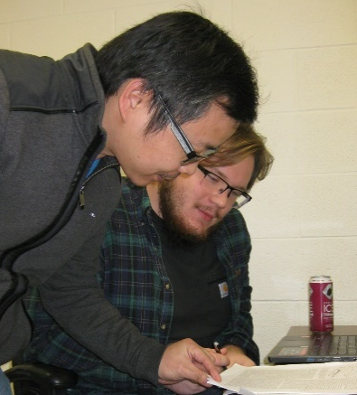
Nuclear Data Program at FRIB (cont.)
Participates in data-related experiments at FRIB to stay current in the state-of-the-art nuclear measurement techniques and to keep close connections with researchers
Makes effort in the education and training of MSU students for nuclear data activities, such as reading, extracting and compiling data in newly-published journal papers for XUNDL, in alignment with involvements of MSU students in FRIB research activities
Since 2018, four top undergraduates from Honors College of MSU have been selected and recruited by Prof. H. Iwasaki from his class, and trained by the FRIB data staff
A total of 38 datasets from 26 papers on experiments of various reactions and decays have been compiled by the students
Amani Ahnuar
Pranjal Dangwal
Dave Lempke
Luke Hixson
2-3 top undergraduates from Honors College of MSU are expected starting this semester
(supported by MSU Professorial Assistantship (PA) or course credits of Honors Research Seminars)

Slide 5
ENSDF code development and modernization at FRIB
To streamline and automate evaluation process, ensure evaluation quality and improve evaluation efficiency
KeynumberCheck
ConsistencyCheck
Validation
GLSC ● Java-RULER
ConsistencyCheck
Evaluation
EXCEL2ENSDF (ENSDF2ENSDF)format conversion
Compilation
Dissemination
Java-NDS
FormatCheck
AlphaHF
RadiationReport
AME-NUBASE viewer
All new codes developed in Java (platform independent)
Work Flow of ENSDF Evaluation
All legacy Fortran codes have been modernized and replaced by new Java codes (~200,000 lines)
Size of circle indicates roughly the amount of workload and effort relatively in each step of an evaluation

Slide 6
ENSDF evaluations at FRIB
Current MSU/FRIB responsibilities (23 mass chains): A=31-44, 60-73 except 62,67-70
A=31-44 assigned initially when the center was established in 2015
A=60-73 (except 62,67-70) assigned upon request in 2021, for interest of FRIB researches
(McMaster data center agrees to transfer A=74-80 to MSU after the data person retires)
Also work on other mass chains (mostly in collaboration with Balraj Singh from McMaster center)
Completed: A=48, 50, 98, 100, 123, 138, 149, 165, 167, 194
Ongoing: A=80 and 151
Current goal settings: 2-3 mass-chains per year (1.0 FTE)
An additional ENSDF evaluator will be needed and expected for compiling growing data and evaluating assigned mass chains to ensure them up-to-date in a 10-year (or 6-7) update cycle
Number of ENSDF evaluations each year at MSU, including collaboration work (1-2 per year) with Balraj Singh

