Slide 1
Status of Texas A&M - Cyclotron Institute USNDP Evaluation Center N. Nica, NDAC 2023 Meeting
Scope – Mission Statement:
Production: Promote and accomplish mass-chain nuclear structure data evaluation at Texas A&M University - Cyclotron Institute as regular activity and foresee future developments
Research: Address gaps in data through targeted experiments and other data-driven research projects
2005-2017: under contract with BNL/NNDC
67% FTE Mass Chain Evaluation
N. Nica (PI, evaluator), J.C. Hardy (scientific adviser)
2018-present: USNDP Data Center
100% FTE Mass Chain Evaluation
N. Nica (PI, evaluator), J.C. Hardy (scientific adviser)
Major Contribution to USNDP: A-chain Nuclear Data Evaluation Production
19 publications
Important Contribution to USNDP: Precision ICC Measurements
BrIcc adopted the “Frozen Orbitals” calculations
⁹³Nb, ¹⁰³Rh, ¹²⁵Te, ¹²⁷Te, ¹¹¹Cd, ¹¹⁹Sn, ¹³⁴Cs, ¹³⁷Ba, ¹⁹¹Os, ¹⁹³Ir, ¹⁹⁷Pt
18 publications
Texas A&M Contribution to Precision Nuclear Data Production: Precision β-γ Measurements (Standard Model, CKM matrix)
T_{1/2} , Branching Ratios, Efficiency calibration
21 publications
Texas A&M Medical Radioisotopes
⁶⁷Cu, ⁹⁹Mo
4 publications
Direct Contribution to USNDP: Data-based Physics Research
Level scheme re-concept based on a newly found data evidence: REPEATABILITY

Slide 2
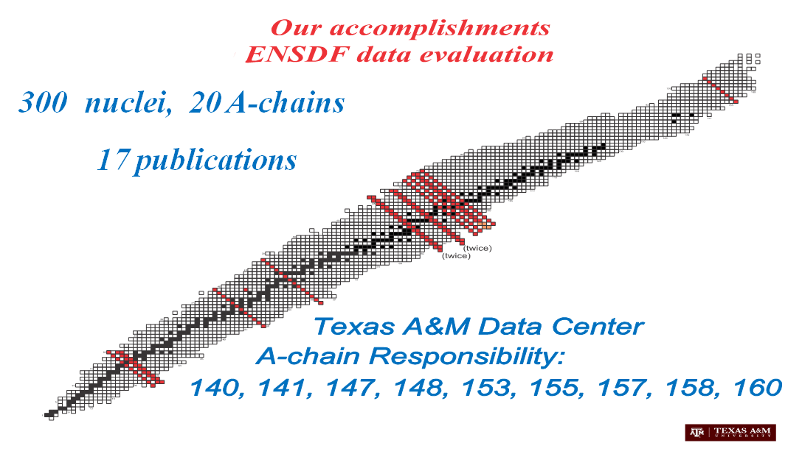
Texas A&M Mass Chain Evaluation: >300 nuclei, 22 A-chains
1. N.Nica, Nuclear Data Sheets for A = 252, Nucl.Data Sheets 106, 813 (2005)
8 nuclei: Cm, Bk, Cf, Es, Fm, Md, No, Lr
2. N.Nica, Nuclear Data Sheets for A = 140, Nucl.Data Sheets 108, 1287 (2007)
16 nuclei: Te, I, Xe, Cs, Ba, La, Ce, Pr, Nd, Pm, Sm, Eu, Gd, Tb, Dy, Ho
3. D.Abriola et al., Nuclear Data Sheets for A = 84, Nucl.Data Sheets 110, 2815 (2009)
1 nucleus: Y
4. N.Nica, Nuclear Data Sheets for A = 147, Nucl.Data Sheets 110, 749 (2009)
16 nuclei: Xe, Cs, Ba, La, Ce, Pr, Nd, Pm, Sm, Eu, Gd, Tb, Dy, Ho, Er, Tm
5. N.Nica, Nuclear Data Sheets for A = 97, Nucl.Data Sheets 111, 525 (2010)
14 nuclei: Br, Kr, Rb, Sr, Y, Zr, Nb, Mo, Tc, Ru, Rh, Pd, Ag, Cd
6. J.Cameron, J.Chen, B.Singh, N.Nica, Nuclear Data Sheets for A = 37, Nucl.Data Sheets 113, 365 (2012)
10 nuclei: Na, Mg, Al, Si, P, S, Cl, Ar, K, Ca
7. N.Nica, J.Cameron, B.Singh, Nuclear Data Sheets for A = 36, Nucl.Data Sheets 113, 1 (2012)
10 nuclei: Na, Mg, Al, Si, P, S, Cl, Ar, K, Ca
8. N.Nica, B.Singh, Nuclear Data Sheets for A = 34, Nucl.Data Sheets 113, 1563 (2012)
11 nuclei: Ne, Na, Mg, Al, Si, P, S, Cl, Ar, K, Ca
9. B.Singh, N.Nica, Nuclear Data Sheets for A = 77, Nucl.Data Sheets 113, 1115 (2012)
12 nuclei: Ni, Cu, Zn, Ga, Ge, As, Se, Br, Kr, Rb, Sr, Y
10. N.Nica, Nuclear Data Sheets for A = 148, Nucl.Data Sheets 117, 1 (2014)
16 nuclei: Xe, Cs, Ba, La, Ce, Pr, Nd, Pm, Sm, Eu, Gd, Tb, Dy, Ho, Er, Tm
11. N.Nica, Nuclear Data Sheets for A = 141, Nucl.Data Sheets 122, 1 (2014)
16 nuclei: Te, I, Xe, Cs, Ba, La, Ce, Pr, Nd, Pm, Sm, Eu, Gd, Tb, Dy, Ho
12. N.Nica, Nuclear Data Sheets for A = 157, Nucl.Data Sheets 132, 1 (2016)
15 nuclei: Nd, Pm, Sm, Eu, Gd, Tb, Dy, Ho, Er, Tm, Yb, Lu, Hf, Ta, W
13. N.Nica, Nuclear Data Sheets for A = 158, Nucl.Data Sheets 141, 1 (2017)
15 nuclei: Nd, Pm, Sm, Eu, Gd, Tb, Dy, Ho, Er, Tm, Yb, Lu, Hf, Ta, W
14. N.Nica, Nuclear Data Sheets for A = 140, Nucl.Data Sheets 154, 1 (2018)
17 nuclei: Sb, Te, I, Xe, Cs, Ba, La, Ce, Pr, Nd, Pm, Sm, Eu, Gd, Tb, Dy, Ho
15. N.Nica, A =155, Nuclear Data Sheets for A = 155, Nucl.Data Sheets 160, 1 (2019)
16 nuclei: Ce, Pr, Nd, Pm, Sm, Eu, Gd, Tb, Dy, Ho, Er, Tm, Yb, Lu, Hf, Ta
17. N.Nica, A =153, Nuclear Data Sheets for A = 153, Nucl.Data Sheets 170, 1 (2020)
16 nuclei: La, Ce, Pr, Nd, Pm, Sm, Eu, Gd, Tb, Dy, Ho, Er, Tm, Yb, Lu, Hf
16. N.Nica, A =160, Nuclear Data Sheets for A = 160, Nucl.Data Sheets 176, 1 (2021)
17 nuclei: Pr, Nd, Pm, Sm, Eu, Gd, Tb, Dy, Ho, Er, Tm, Yb, Lu, Hf, Ta, W, Re
18. N.Nica , B.Singh, Nuclear Data Sheets for A = 147, Nucl.Data Sheets 181, 1 (2022)
16 nuclei: Xe, Cs, Ba, La, Ce, Pr, Nd, (Pm Balraj Singh), Sm, Eu, Gd, Tb, Dy, Ho, Er, Tm
19. N.Nica, Nuclear Data Sheets for A = 141, Nucl.Data Sheets 187, 1 (2023)
17 nuclei : Sb, Te, I, Xe, Cs, Ba, La, Ce, Pr, Nd, Pm, Sm, Eu, Gd, Tb, Dy, Ho
20. N.Nica, Nuclear Data Sheets for A = 162, – post-editorial review with evaluator, Aug 8, 2023 (FY21)
17 nuclei: Nd, Pm, Sm, Eu, Gd, Tb, Dy, Ho, Er, Tm, Yb, Lu, Hf, Ta, W, Re, Os,
21. N.Nica, , Nuclear Data Sheets for A = 154 – post-technical review with evaluator, Feb 9, 2023 (FY2022)
17 nuclei: Ba, La Ce, Pr, Nd, ¹⁵⁵Pm, Sm, Eu, Gd, Tb, Dy, Ho, Er, Tm, Yb, Lu, Hf
22. N.Nica, , Nuclear Data Sheets for A = 148 – submitted to NNDC, Sept 6, 2023 (FY2023)
17 nuclei: Ba, La Ce, Pr, Nd, ¹⁵⁵Pm, Sm, Eu, Gd, Tb, Dy, Ho, Er, Tm, Yb, Lu, Hf
1. Review: A = 212, Review of full mass chain evaluation, FY2020
12 nuclei: Hg, Tl, Pb, Bi, Po, At, Rn, Fr, Ra, Ac, Th, Pa
2. Review: A = 245, Review of full mass chain evaluation, FY2021
9 nuclei: U, Pu, Am, Cu, Bk, Cf, Es, Fm, Md
3. Review: A = 31, Review of full mass chain evaluation, FY2022
11 nuclei: F, Ne, Na, Mg, Al, Si, P, S, Cl, Ar, K
4. Review: A = 200, Review of full mass chain evaluation, FY2023
12 nuclei: Os, Ir, Pt, Au, Hg, Tl, Pb, Bi, Po, At, Rn, Fr
-SIZE is very large for all nuclei!
-VERY COMPLEX
-1 A-chain/FY
140, 141, 147, 148, 153, 155, 157, 158, 160, 154, 162

Slide 3
A-Chain Evaluation Currency Status @Texas A&M University
Responsibility:
140, 141, 147, 148, 153, 155, 157, 158, 160, 154, 162
Status:
147 (Mar-2022)
160 (May 2021)
153 (Aug 2020)
155 (Oct-2019)
140 (Nov 2018)
158 (Feb 2017)
157 (Dec 2015)
141 (Jan 2023)
148 (Oct 2013, new full mass chain evalution submitted to NNDC, Sept 6, 2023)
FY2021: 162 (Mar 2007 – post-editorial review, with evaluator, Aug 8, 2023)
FY2022: 154 (May 2008 – post-technical review, with evaluator, Feb. 2, 2023)
FY2024: 156, (Mar 2012 – NNDC responsibility)
Good Standing@Texas A&M University CI
HELP GENERAL EFFORT

Slide 4
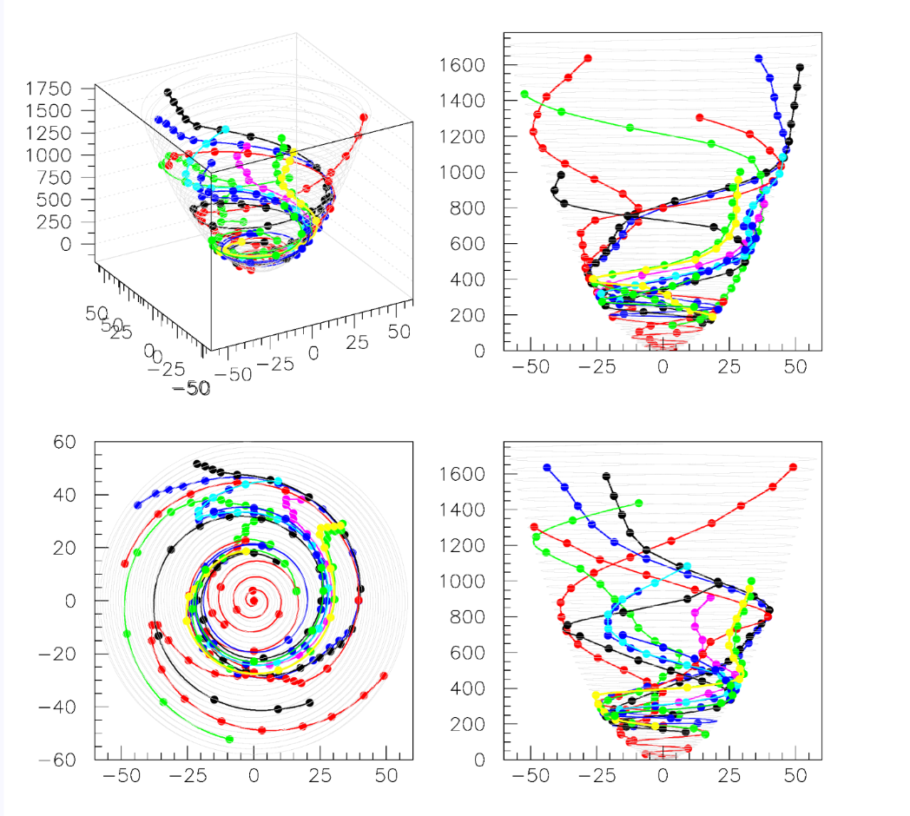
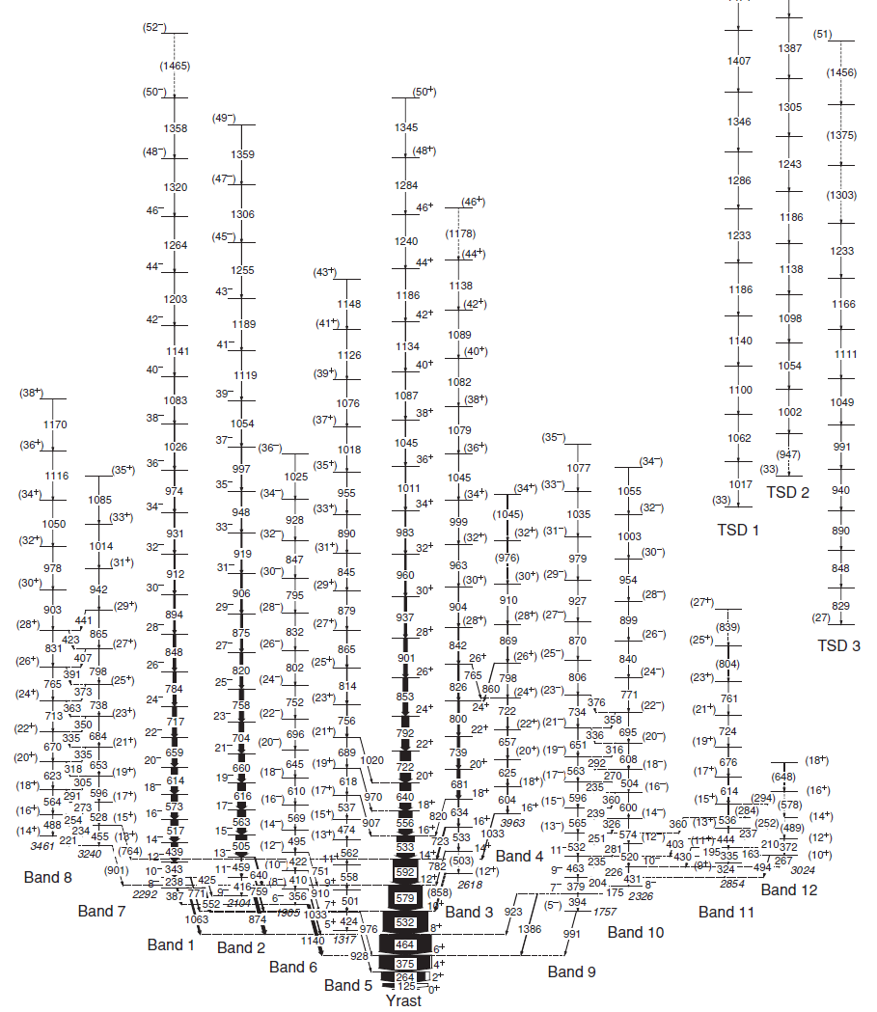
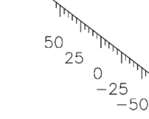
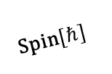
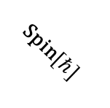
¹⁶⁰Er
Highlitght: Data-based Physics Research Level Scheme Re-Concept
y
b1
b2
b2
Level enery[2c]
b3
b1
b8
y
b5
Level enery[2c]
b4
b9
b7
b10
b8
b3
b6
b10
b5
b6
b7
b9
b4
b11
b11
b5
Spin$[ℏ]$
b5
y
Spin$[ℏ]$
Spin$[ℏ]$
Spin$[ℏ]$
b2
b8
b1
b2
y
b4
b1
b7
Level enery[2c]
b3
b11
b10
b5
b9
b5
b2
b8
b6
b9
b6
b10
y
b7
b4
b5
b11
y
b6
b3
b5
y
J. Ollier et al., Phys.Rev. C 83, 044309 (2011)
Spin$[ℏ]$
Spin$[ℏ]$
Notes:
As described in reangle_vol_parabola_exe_160Er.kumac (look in higher directories like C:\ninel\repet\drafts\160Er\5 for last version):
!!!!!NO “PEDESTAL” treatment !!!!!
* chi^2=min & "-2J" case in 160Er_4trans_analysis.xlsx,
* for Dm0=0 for ALL the linking |g to yrast (no "pedestal");
* this the general treatment for all nuclei.
*
* Dm0_0 is not correct, these is cases done with "column L" for the linking transitions,
* which is Dm0+Dm1, not only Dm0 done with Dm1 only (and Dm0 taken into 2c)
fort/file 10 C:\ninel\repet\drafts\160Er\test_elicoid_c_vol_reangle_vol_all_160Er_2-2J_Dm0_0.eps

