Slide 1
National Nuclear Data Center
ORNL Nuclear Data Program
Nuclear Data Advisory Committee
September 13th, 2023
Michael Smith
ORNL Physics Division
David Brown, NNDC - BNL

Slide 2
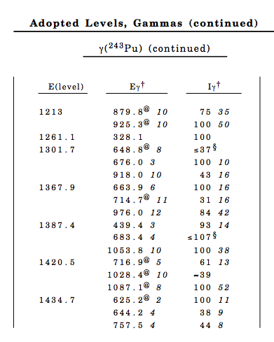
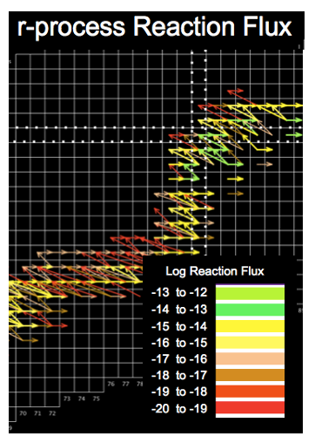
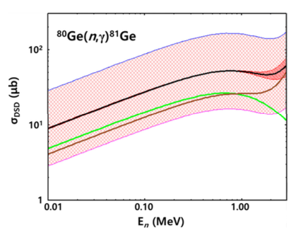
ORNL – Focus of Efforts
Evaluation of nuclear structure data
Mass chain evaluations for ENSDF (C. Nesaraja)
ORNL A-chain responsibility A = 241 – 249 and A = 69
Other A-chains from ENSDF priority list (41, 58, 66, 137…)
Reviewing mass chains
Assessment of astro reaction rates
Focus on stellar explosions (M. Smith, L. Zhang)
Online software systems (M. Smith, E. Lingerfelt, L. Zhang)
Unique nuclear astro data pipeline for researchers
rate assessment

Slide 3
ORNL – Staff
Special Session
Caroline Nesaraja – ENSDF Evaluations [1.0 FTE staff]
Michael Smith – Nuclear Astro Data & Software [0.2 FTE staff]
Larry Zhang – Nuclear Astro Data & Software [student]
Eric Lingerfelt – Software [subcontractor]
Murray Martin – pioneering evaluator [passed away 3/9/22]
265K circulation

Slide 4
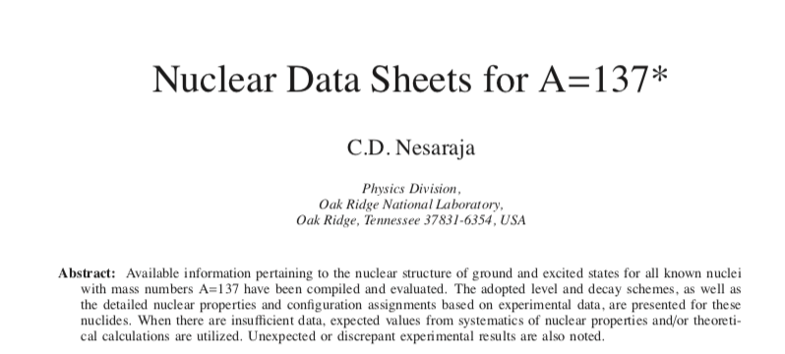
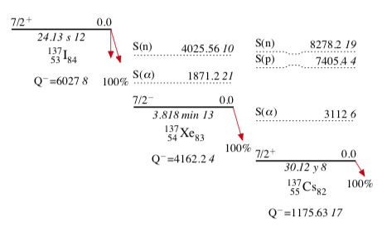
ORNL Highlights – Nuclear Structure
A = 137 Evaluation (C. Nesaraja)
16 nuclides, 420 pages, 360 references, 15840 lines
inspired a separate Phys Rev C paper
Updated Guidelines for Evaluators (M. Martin)
Nearly 90 pages of detailed procedures for structure evaluations
Murray Martin. April 2021

Slide 5
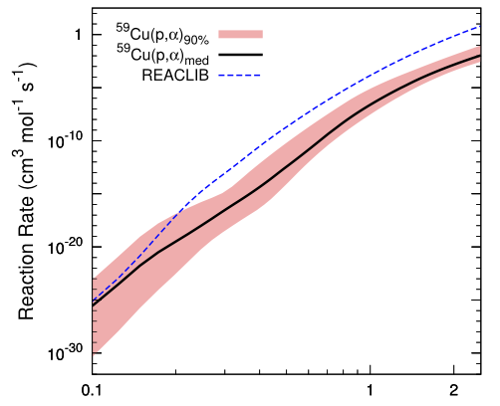
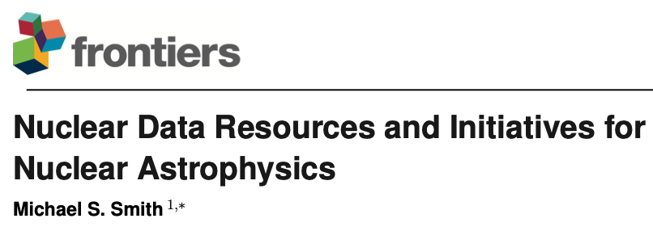
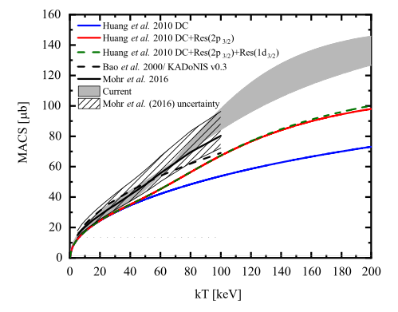
ORNL Highlights – Nuclear Astrophysics
⁵⁹Cu(p,γ) & ⁵⁹Cu(p,α) assessments for X-ray bursts
¹⁶O(n,γ) assessment for red giants
Nuclear Data Review Articles
nuclear astrophysics data
data for space exploration
machine learning
in press (2023)
in press (2023)

Slide 6
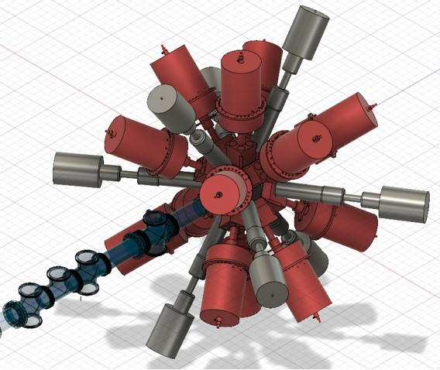
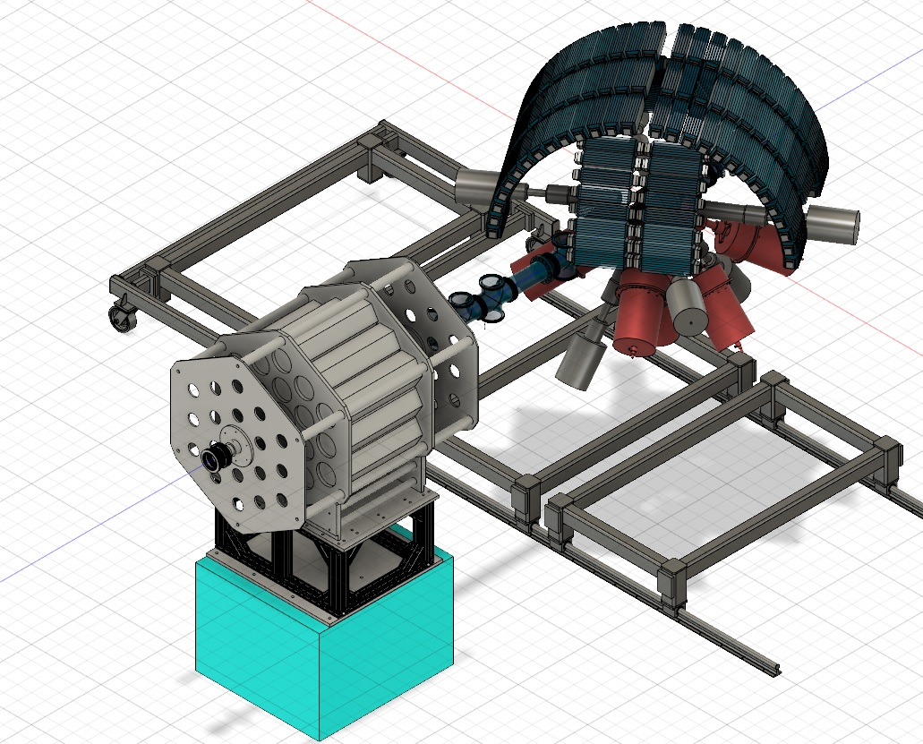
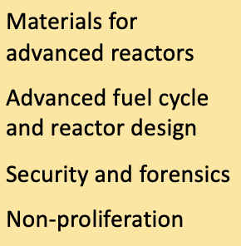
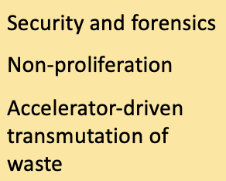
ORNL Future Possibilities
Nuclear structure evaluator / HFIR decay station physicist
capitalize on new unique opportunities to measure & evaluate decays, branching ratios, level properties of exotic n-rich heavy isotopes
online evaluator training modules
based on Murray Martin’s Guide for Evaluators
UQ modules for online astro software system
robust propagation of nuclear data uncertainties through simulations
Adding uncertainties to REACLIB rate library
lack of uncertainties limits utility of database

