Slide 1
US Nuclear Data Program review Livermore National Lab overview
NDAC review, September 2023
Ian Thompson

Slide 2
LLNL Nuclear Data Program
Disseminate LLNL nuclear data efforts
Especially GNDS (Generalized Nuclear Data Structure)
Contribute to CSEWG functions
Leverage LLNL programmatic funding to provide evaluations for inclusion in ENDF
Make, Verify and Validate R-matrix evaluations
With IAEA, R-matrix workshops, and GNDS-interchange codes (Ferdinand on github)
Apply GPU learning methods (Rflow on github)

Slide 3
LLNL staff (FY20 – FY23)
Permanent Staff
Ian Thompson (0.25 FTE)
New staff at LLNL to join USNDP in FY24
Gregory Potel (standards)
External Collaborators
James DeBoer (U. Notre Dame), Mark Paris (LANL), Gerry Hale (LANL), Dave Brown (BNL), Vivian Dimitriou (IAEA), Marco Pigni (ORNL).

Slide 4
Adding exit channels in ENDF/B-VIII.0
LLNL Highlight #1
There are missing exit distributions: transport codes fail.
In 201 evaluations for incident neutrons
For 140 exit photons
For 414 exit protons
For 259 exit deuterons
For 204 exit tritons
For 84 exit helions
For 397 exit alphas
Submitted ENDF files with distributions & multiplicities from TENDL2019
No changes to cross-sections
Incoming forms are MT=102, 103, 104, 105, 106, 107
No change to two-body exit channels
Excluding 18 evaluations with gammas already in MT=3 (inclusive).
Generally improves energy balances!!
No sources yet for some light (Z<10) targets
these will need R-matrix evaluations

Slide 5
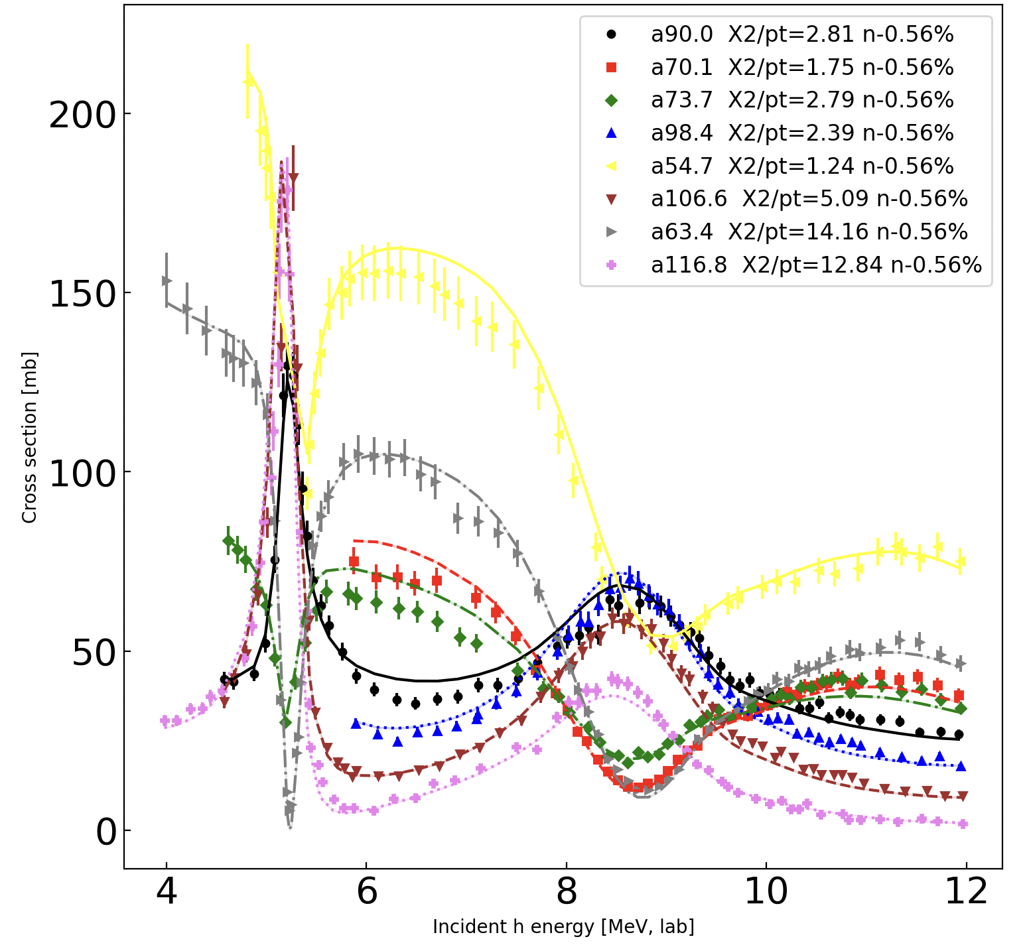
R-matrix evaluation h+α, p+⁶Li*, γ+⁷Be
LLNL Highlight #2
Model light-ion reactions without statistical approximations:
only that forces inside R-radius
Fit levels and partial widths to known EXFOR data:
elastic, inelastic, transfer, capture
Extend early models from 2.5 MeV to 20 MeV.
Part of international IAEA collaboration
Verified many of the current research codes
Submitted for ENDF/B-VIII.1

