Slide 1






























Actinide evaluations below 100 keV:
toward ENDF/B-VIII.1
R. Capote, A. Trkov
on behalf of the INDEN collaboration
https://www-nds.iaea.org/INDEN

Slide 2
Outlook
Changes in the URR for U-235 and Pu-239
New information driving changes in the RRR
Changes in the RRR (see also Marco’s talk)
U-235 evaluation in the RRR
Depletion issue:
  U-238 evaluation in the RRR/URR
  Pu-239 evaluation in the RRR

Slide 3
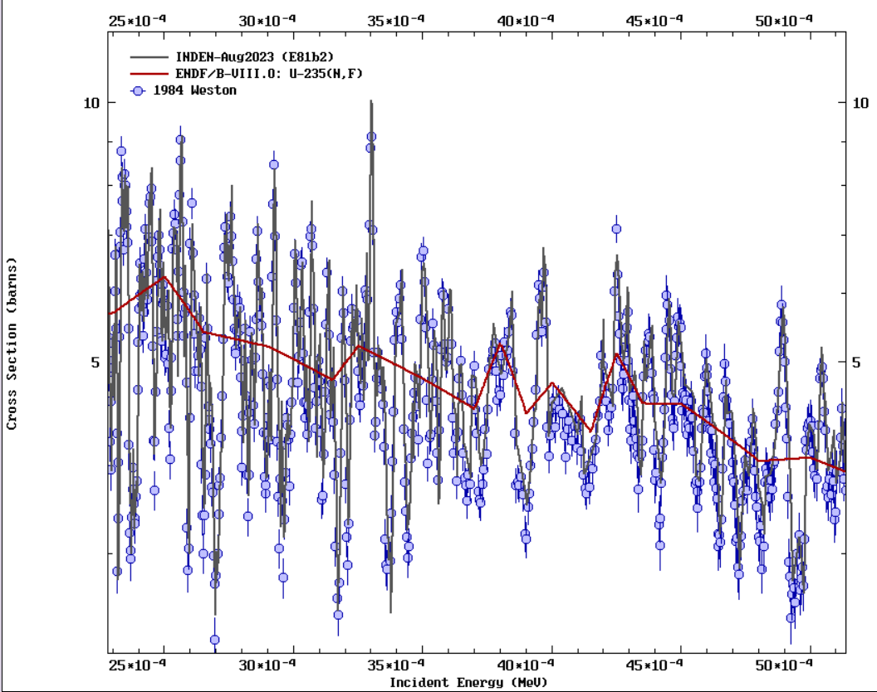
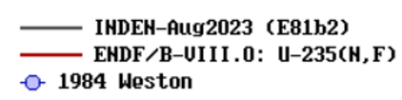
U-235 URR fission (~2.25-40keV): change important for criticality
ENDF/B-VIII.0 (red)
XS do not reproduce
high-res experimental data
INDEN (gray) uses
High-res Weston 1984 data
Renormalized to STD
Better criticality!! with
similar self-shielding
(n,f) URR: 2.5-5 keV
ENDF/B-VIII.0 are the reference XS (broad average XS)

Slide 4
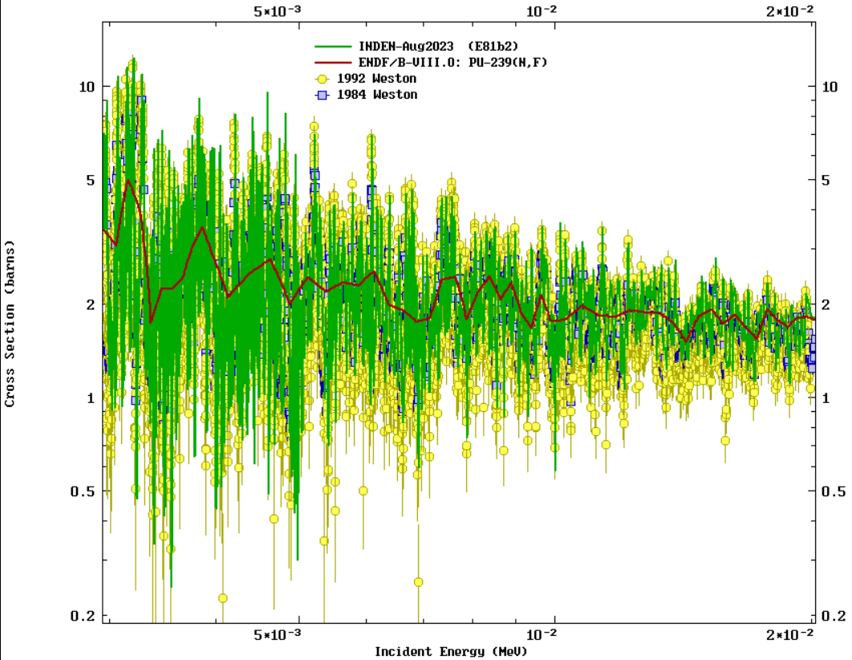
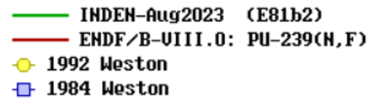
Pu-239 URR fission (~2-20keV): change important for criticality
ext RRR
ENDF/B-VIII.0 (red)
XS do not reproduce
high-res experimental data
INDEN (green) uses
High-res Weston data
Renormalized to STD
Better criticality!! with
similar self-shielding
(n,f) URR: 5-20 keV
ENDF/B-VIII.0 are the reference XS (broad average XS)

Slide 5
Resolved Resonance Region:
Thermal Neutron Constants (TNC)
new ORNL/IAEA/JSI eval.
U3- softer thermal PFNS
Pu9- softer thermal PFNS
following the IAEA CRP recommendations already adopted for U5.

Slide 6
New integral constraints for RP fit of fissile targets
All measured ToF
high-resolution data
(1955-2019)
Derived σ_{f}(th)
Duran et al TNC-2018 E81β2 E80
U3: 533.0(0.7) 533.0(2.2) 533.0 534.1
U5: 586.1(2.6) 587.3(1.4) 586.1 586.7
Pu9: 751.0(1.9) 752.4(2.2) 751.1 747.4
Pu1*: 1019(3) 1024(11) 1024 1012
*From G. Noguere (JEFF-T4 work)
Good consistency with TNC
and Duran et al indep. eval.
Duran et al, to be published in NDS, Jan.2024
Discussed at INDEN CMs since November 2021

Slide 7
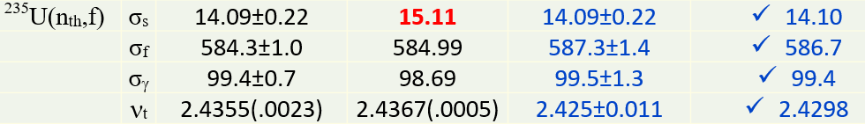
INDEN ST25 (E81b2) vs ENDF/B-VIII.0 vs TNC
 |  | JEFF-3.3 | ENDF/B-VII.1 | Standards 2017 (2200 m/s) | ENDF/B-VIII.0
²³⁹Pu(n_{th},f) | σ_{s} | 7.8 | 7.99 | 7.8±1.0 | 8.1
 | σ_{f} | X 749.3 | X 747.91 | 752.4±2.2 | X 747.4
 | σ_{γ} | 271.4 | 270.7 | 269.8±2.5 | 270.1
 | ν_{t} | 2.8664 | 2.8807 | 2.878±0.013 | 2.8769
U5 ST25 thermal neutron constants:
fission: 586.1 b (-0.11% decrease rel. to B8)
in excellent agreement with Duran et al
capture: 99.4 b, elastic: 14.1 b
ν_{tot}= 2.42685 (-0.13% decrease rel. to B8)
INDEN U5 ST25 thermal constants are closer to Standard
thermal neutron constants (but are in agreement with ENDF/B-VIII.0) fission cross section and nubar are slightly reduced

Slide 8
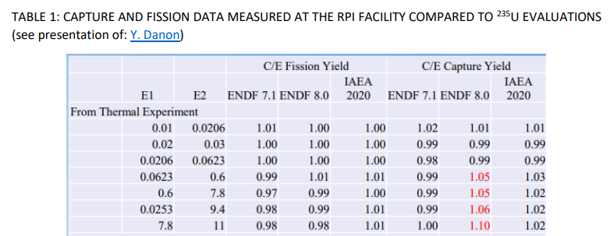
INDEN ST25 contains new resonance
parameter set from ORNL
RRR: additional work undertaken below 20eV to improve agreement with RPI data
Marginal impact on HEU solution criticality (slight increase of high-leakage solutions)
See INDC(NDS)-0810, INDEN-ACT III meeting report
ST25 RRR evaluation in better agreement with new RPI data
than B8 (capture reduced by 8% from 7.8-11eV, by 3-4% from 0.6-9.4eV)

Slide 9
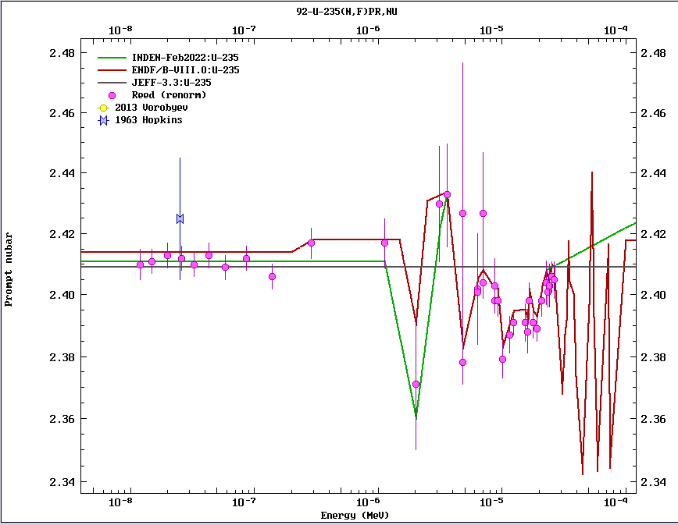
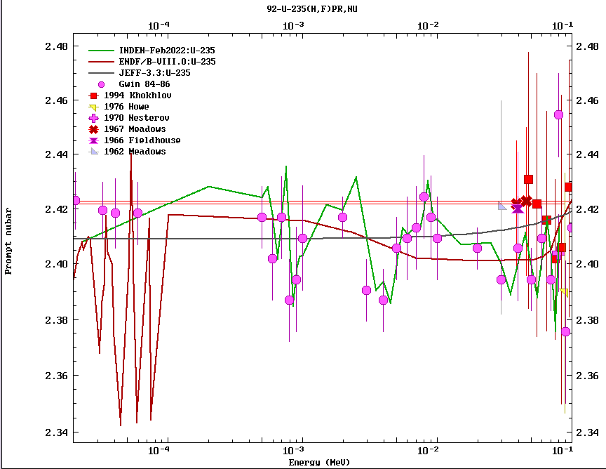
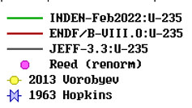

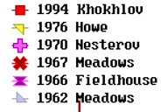
U-235: changes in nubar below 100 keV
Thermal nubar ν_{tot}= 2.42685 (-0.13% from ENDF/B-VIII.0 ν_{tot}=2.4298)
TNC value : 2.425±0.011, A.D. Carlson et al, Nucl. Data Sheets 148 (2018) 143-188
2. B8 tweak at 2eV eliminated, better description of Reed data in that region
Nubar fluctuations from ~20eV up to 500eV replaced by lin interpolation, Gwin nubar data used from 500eV up to 200 keV (nubar uncertainty significantly reduced in that region).
(E81b2)
(E81b2)
nubar, En ≤ 100 eV
nubar, 20eV ≤ En ≤ 100 keV
ST25 agrees better with Reed data below 3 eV
ST25 uses Gwin data, nubar unc. greatly reduced

Slide 10
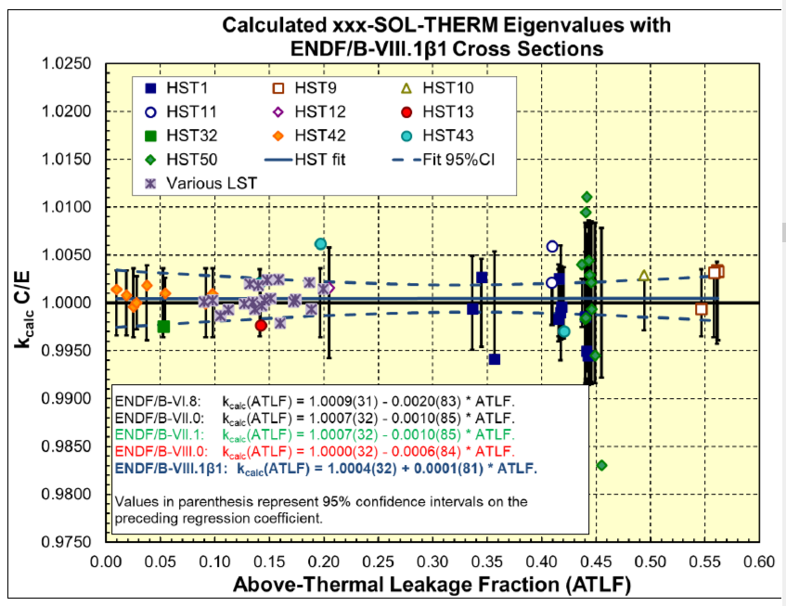
Validation of U-235 RRR with HST
N.A. Kleedtke and A.C.(Skip) Kahler (miniCSWEG & Noah today)
confirmed by our own testing (Trkov), NNL

Slide 11
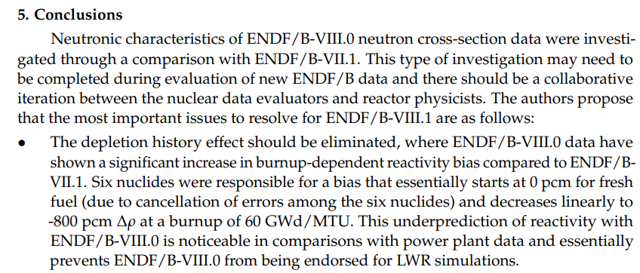
Depletion issues in ENDF/B-VIII.0 ( JEFF-3.3)
Kang-Seog Kim and William A. Wieselquist, ”Neutronic Characteristics of ENDF/B-VIII.0 Compared to ENDF/B-VII.1 for Light-Water Reactor Analysis”.
J. Nucl. Eng. 2021, 2, 318–335. https://doi.org/10.3390/jne2040026

Slide 12
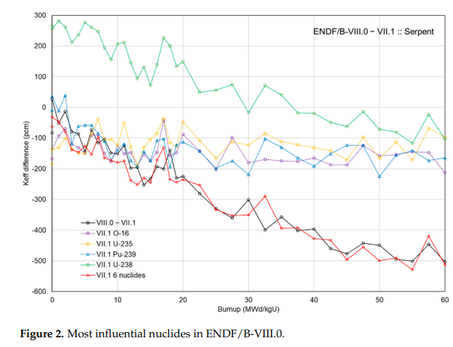
Depletion issues in ENDF/B-VIII.0 ( JEFF-3.3)
Kang-Seog Kim and William A. Wieselquist, ”Neutronic Characteristics of ENDF/B-VIII.0 Compared to ENDF/B-VII.1 for Light-Water Reactor Analysis”.
J. Nucl. Eng. 2021, 2, 318–335. https://doi.org/10.3390/jne2040026
U-238 (-400pcm)
JEFF-33 WG ident.
a similar but larger issue
( ΔKeff = -1500pcm)
INDEN initial focus: U8
JEFF WG initial focus: Pu9
U5, O16, Pu9
-100pcm each
Overall: -500pcm

Slide 13
Summary: INDEN e80V03i4 evaluation
Update of the ENDF/B-VIII.0 evaluation (IAEA CIELO)
INDEN e80V03i4 @ https://www-nds.iaea.org/INDEN/data/u238e80u8V03i4_ENDF.zip
The ENDF/B-VIII.0 RRR is replaced by JENDL-5 RRR evaluation
This update preserves the ENDF/B-VIII.0 BOC criticality but
eliminates the U-238 depletion trend at high burnup
(due to higher capture above 100eV -> higher Pu239 accumulation).
A new nubar evaluation was produced by LANL colleagues
(Neudecker et al). Nubar was tweaked @ IAEA to better reproduce
Jemima trend.
e80V03i4 eliminates the ENDF/B-VIII.0 trend with burnup, and preserves ENDF/B-VIII.0 criticality at BOC. Check LCT006 for nice trend in INDEN!
Improvements of IMF (e.g., Bigten) and Jemimas

Slide 14
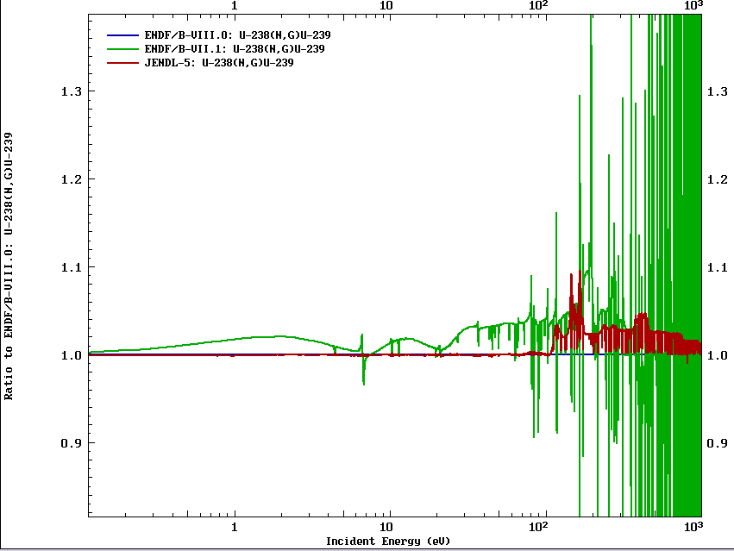
INDEN e80V03i4 RRR changes
e80V02 – B71
e80V03i4 – JENDL5
A revised B8 evaluation from
Kopecky done for JEFF-4

Slide 15
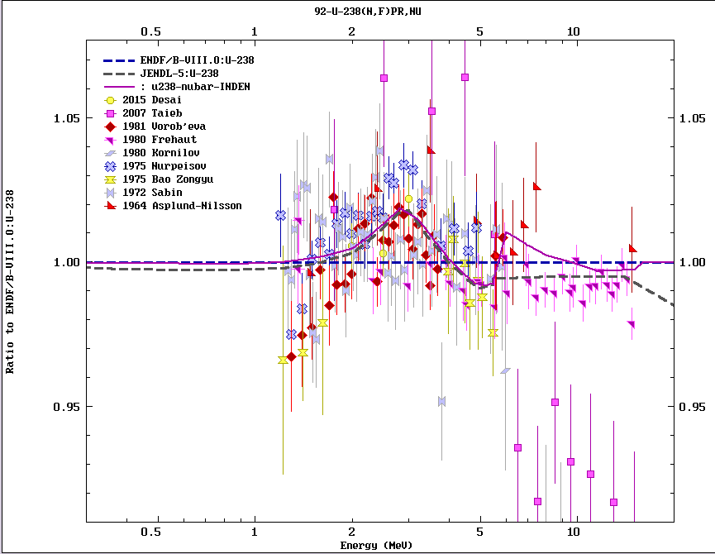
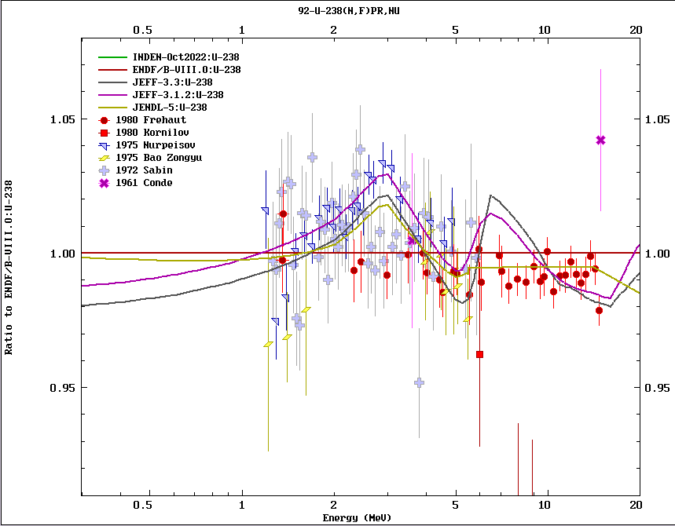
U-238 nubar dependence
Convergence between JEFF & INDEN evaluations observed
INDEN latest : u238e80u8V03i4 -> B81beta2

Slide 16
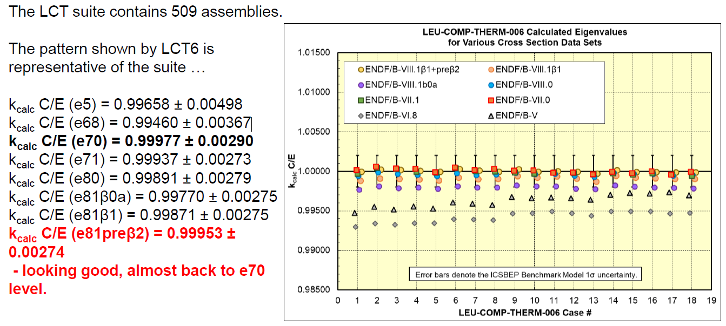
Validation of U-238 RRR - LCT
k_{calc} C/E (e81β2)=0.99953±0.00274
2.6% U5, UO2 pellets, water, Al, lattice
miniCSWEG-2023, A.C.(Skip) Kahler and N. A. Kleedtke
e81β0a: ENDF/B-VII.1 RRR (u238e80v02) -200pcm relative to B70
e81β1: ENDF/B-VII.1 RRR (u238e80v02) -100pcm relative to B70 ~B8
e81β2: JENDL-5 RRR + new U-238 (tweaked not to this benchmarks) nubar
Improvements confirmed by independent validations (LANL, ORNL, NNL, UPM)

Slide 17
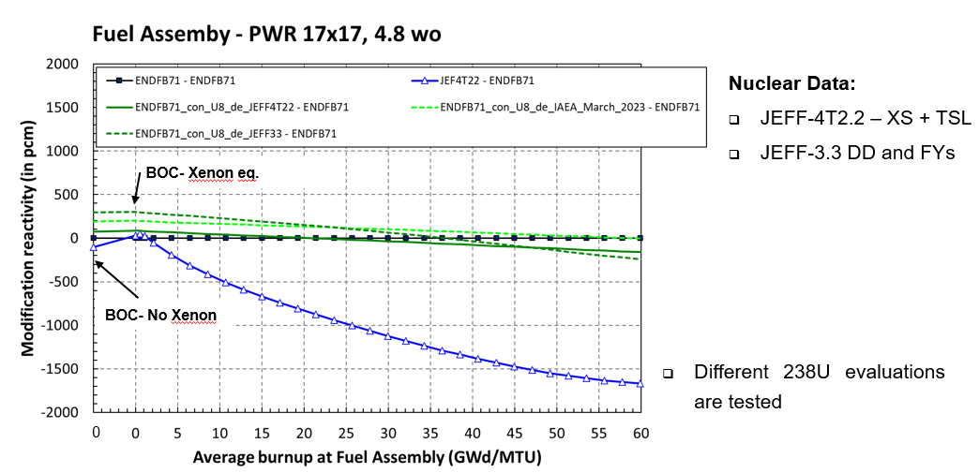
Depletion studies (O. Cabellos)
=U238 B8
=INDEN U238 (post b1)
Uses U238 from B8

Slide 18
U-238 burnup issue seems solved,
Pu-239 issue remained
(@ mini-CSWEG 2023)
INDEN CM @ IAEA, May 2023
ORNL/CEA/IAEA collaboration
To produce new Pu239 RP
New RPs for Pu240 and Pu241 provided by G. Noguere (developed for JEFF-4)

Slide 19
Summary: New ²³⁹Pu resonance parameters
ENDF/B-VIII.0 evaluation in the RRR represented a significant performance improvement over ENDF/B-VII.1 for Pu solution benchmark (PST) due to the use of WPEC SG34 resonance parameter set
However, IAEA thermal PFNS recommendation was not used: <E_{PFNS}>(B8)=2.11 MeV vs recommended <E_{PFNS}>=2.08 MeV)
The ENDF/B-VIII.0 σ_{f} = 747.91 b was lower than TNC-752.4(2.2) b.
________________________________________________________________
A new resonance parameter set ORNL10 was found by Pigni et al (ORNL/IAEA/JSI) that preserves good performance for PST benchmarks (see slide 10) , while matching the TNC within uncertainties and the new softer thermal PFNS derived using a GMA fit which appears well founded.
Constraints:
Differential: TNC, PFNS
Integral: PST (ATLF), RTC (reactivity temp. coeff), burnup

Slide 20
INDEN p53 contained new resonance
parameter set ORNL10 (B81β1)
B81β1 good for PST
INDEN p53 (E81β1)

Slide 21
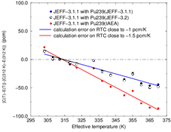
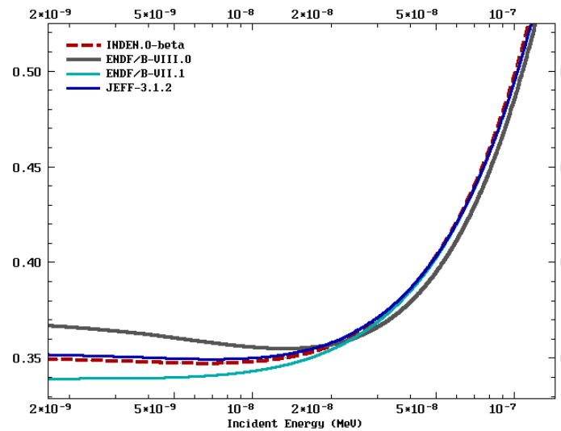
²³⁹Pu RTC-MISTRAL2 experiment, CEA
²³⁹Pu α( E)
B81β1 worse
for RTC
Presented by G. Noguere @ INDEN meet.
Modifications to the INDEN p10 (pu239E81β1) RR fit needed:
↑subthermal α, ↓ α till 1eV (closer to B8)
To improve RTC and ↑ crit. @ high burnup
NOTE: In the light of latest U-238, we must solve Pu239!

Slide 22

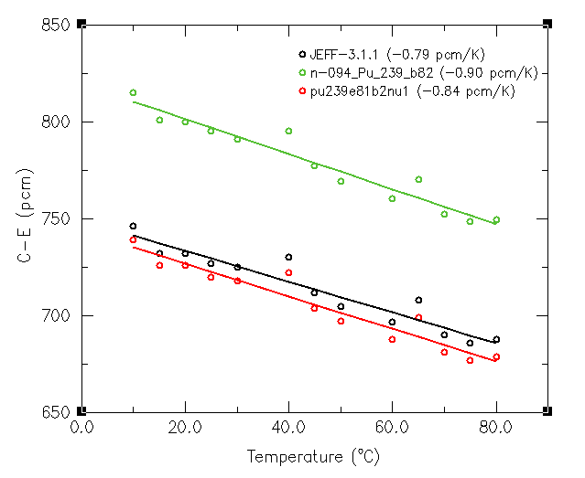
²³⁹Pu RTC-MISTRAL2 experiment, CEA
B81β2 too
high
B81β1 worse
for RTC
B81β3?
ENDF/B-VII.1=JEFF-311: RTC gradient = -0.8 pcm/K - REF
INDEN p10 (E81β1): RTC gradient = -1.5 pcm/K
E81β2 (INDEN TM, May 2023): RTC gradient = -0.9 pcm/K
pu239E81nu1 (INDEN): RTC gradient = -0.84 pcm/K (good!)

Slide 23
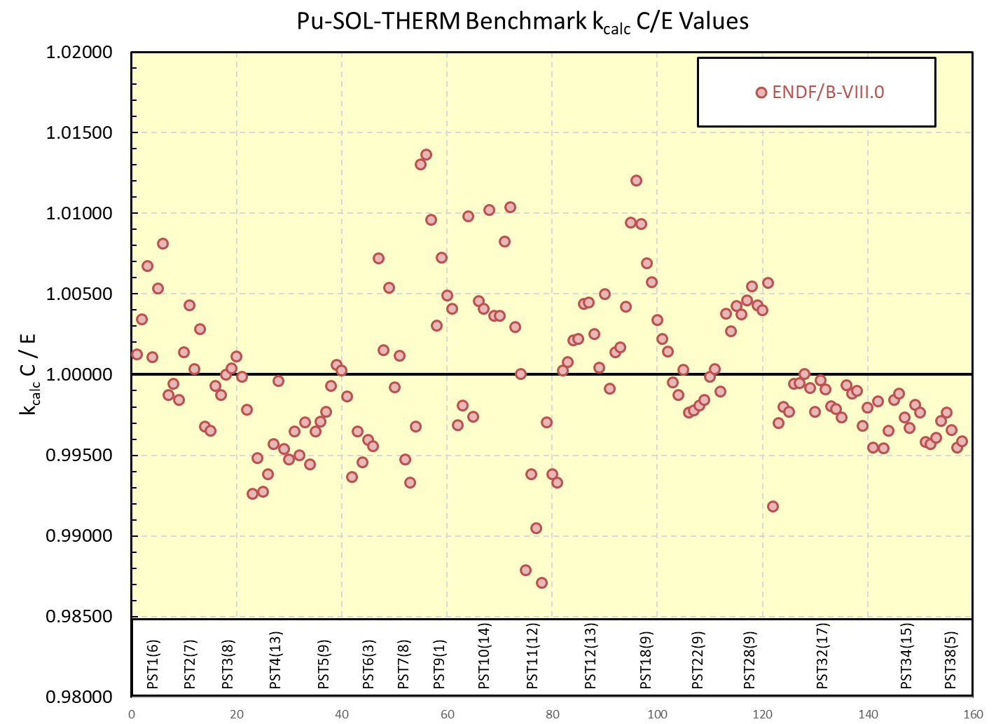
pu239e81b2 (E81βb2) tested by Skip
B81β2 bias +500pcm, reverted nice B8 perform.
Further work needed -> post-β2 (nu1)
Also shown in morning talks (Noah, NNL)

Slide 24
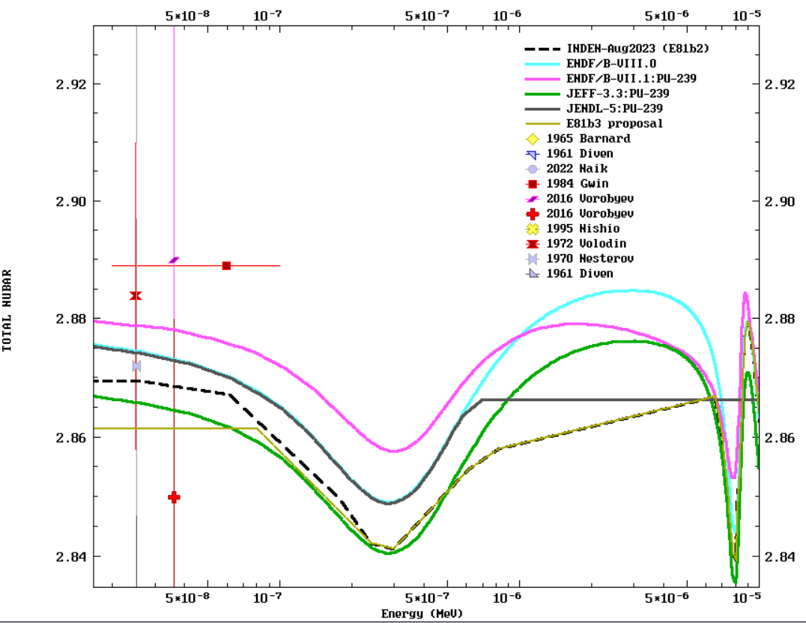
pu239e81b2nu1 vs E81βb2 changes
E81b2 (pst +500pcm)
STD: 2.878 (0.013)
E81b3? (pst +200pcm)

Slide 25
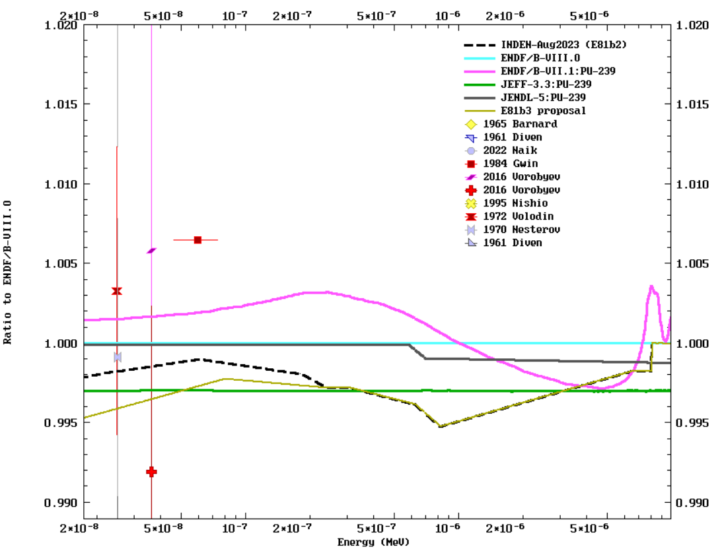
pu239e81b2nu1 vs E81βb2 changes
E81b2 (-0.2% from B8)
STD unc.
0.45%
E81b3 (up to -0.4% below 0.25eV)

Slide 26
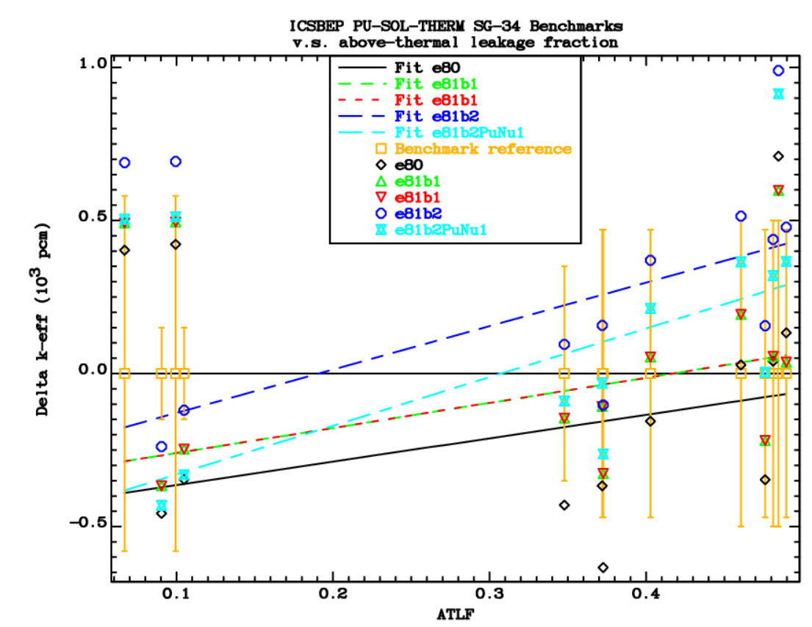
INDEN pu239e81nu1 is a new solution
to improve thermal (only) criticality
pst012
WPEC SG34
Benchmarks
To check
Trend vs ATLF
pst038
High-leakage PST
~e.g., pst001
Thermal

Slide 27
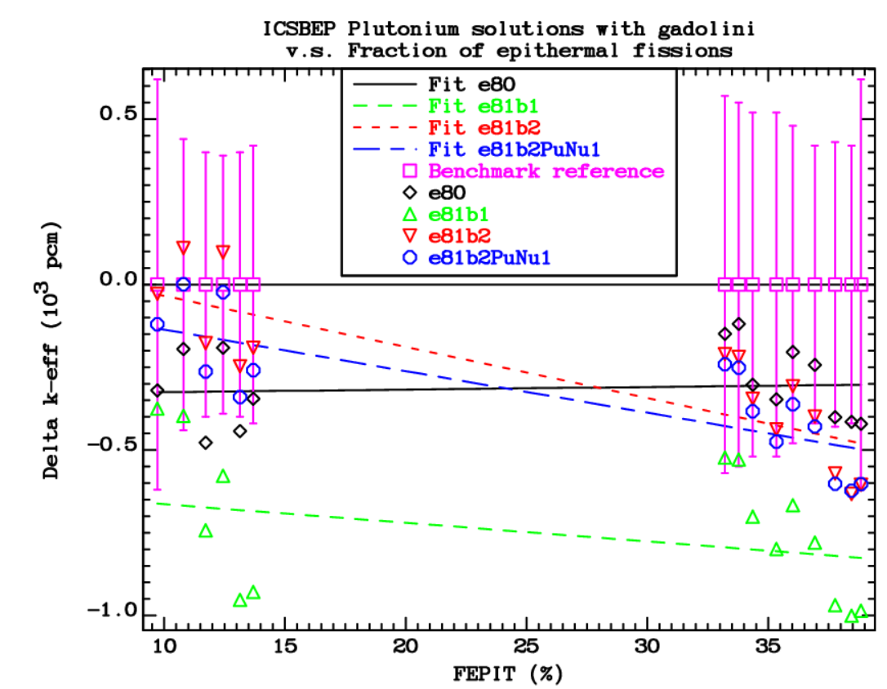
INDEN pu239e81nu1 is a new solution
to improve thermal (only) criticality
Pst034
Pu+Gd
High FEPIT
B81β2
B81β3?
X B81β1

Slide 28
INDEN & E81β2 summary @nds.iaea.org/INDEN/
U-235 and U-238 in E81beta2 are ready/validated !
Latest Pu-239,240,241 INDEN/CEA evaluations in B81β2 are a compromise: better for depletion (not perfect) but worse for PST
U-233 needs improvement (UCT)
INDEN also delivered Si, F-19, Fe, Cr, Cu evals to B81β2
Validation talks today showed improvement over ENDF/B-VIII.0
Additional comments:
Cu testing showed improvement for HMF (Ealf) benchmarks
O-16: improvement in the evaluated total XS from 5 to 8 MeV needed to improve description of both diff. & integral data

Slide 29
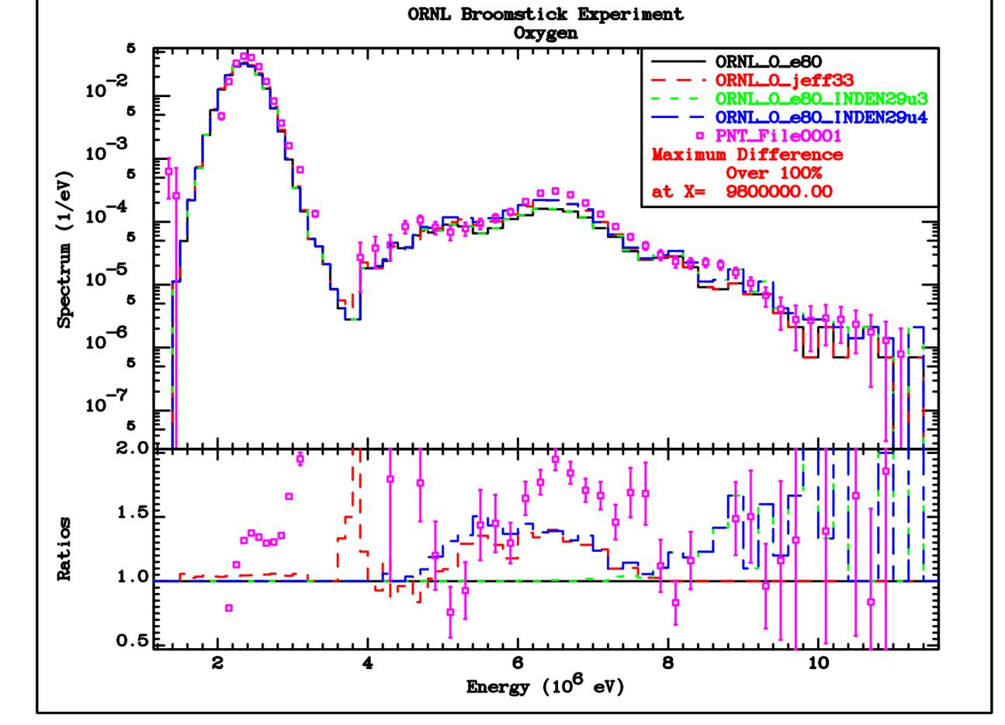
Attached are the resuts for the ORNL Broomstick experiment:
INDEN29u3 Original LANL Beta2 file (equal to “e80” up to 7.8 MeV)
INDEN29u4 INDEN file with renormalized by 0.968 Cierjacks’ total in the energy range 5.2 - 7 MeV (renormalized using Yaron’s value).
The current INDEN29u4 file performance is similar to JEFF-3.3 for this benchmark up to 7.8 MeV, and equal to LANL Beta2 above this energy. Overall, the performance of INDEN29u4 is the best.
O-16: ORNL Broomstick experiment
Need to decrease σ_{tot} from 5 to 7 MeV
INDEN29u3 Original LANL Beta2 file (equal to “e80” up to 7.8 MeV)
INDEN29u4 INDEN file with renormalized by 0.968 Cierjacks’ total from 5.2-7 MeV (renormalized using Yaron’s value).
Broomstick experiment C/E problem 5-7MeV

Slide 30
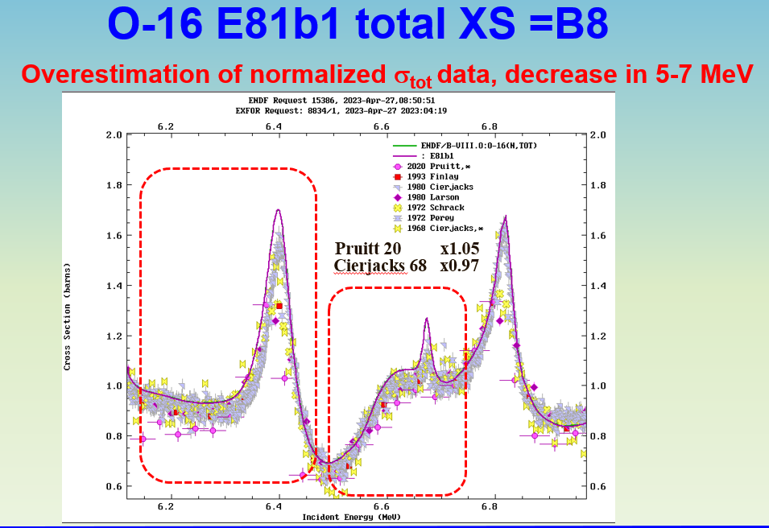

Slide 31
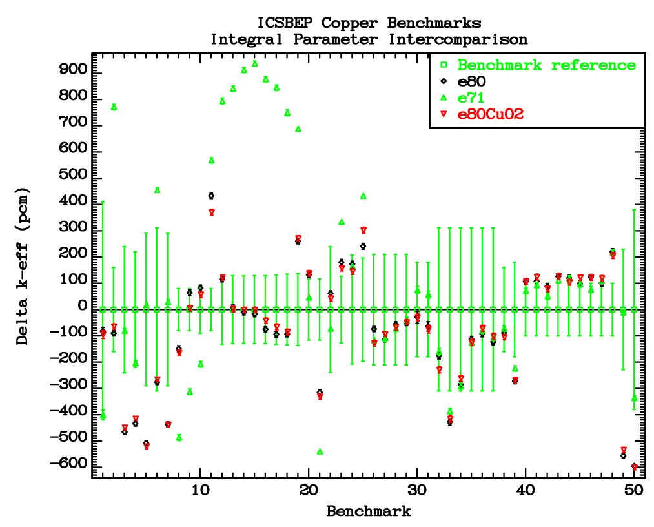
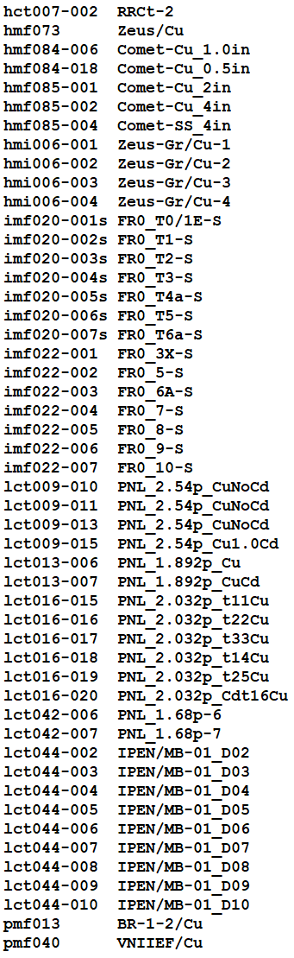
Criticality validation of INDEN Cu adopted in B81b2
Very
fast
Very sensitive to AD
from 80-300keV (RRR-URR)
ZEUS
IMF020 , 022
LCT9, 13, 16, 42, 44
ENDF/B-VIII.0 good criticality preserved (blue vs black)

Slide 32
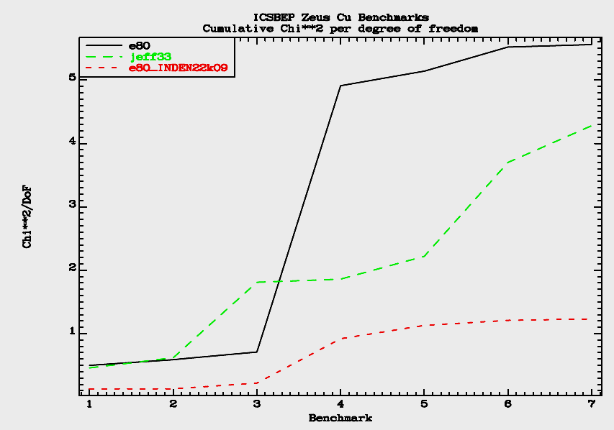
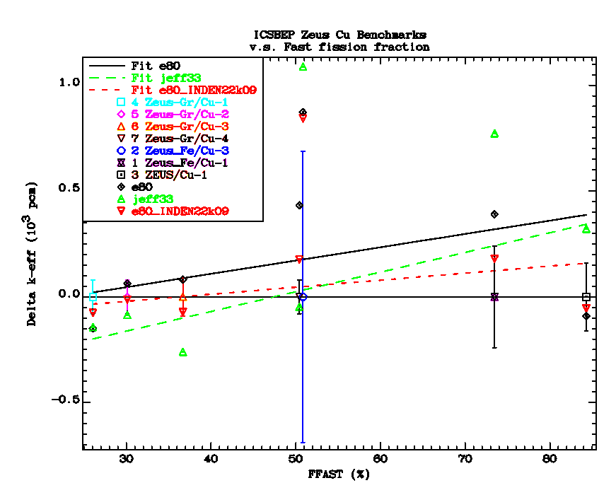
INDEN Cu evaluation (E81b2):
Zeus benchmarks
fast HEU (ZEUS)

