Slide 1
ENDF/B-VIII.1β2 Library Nuclear Astrophysics Testing
Presenter(s) Boris Pritychenko
National Nuclear Data Center, Brookhaven National Laboratory
November 16, 2023
Nuclear Data Week 2023 (CSEWG-USNDP-NDAG)

Slide 2
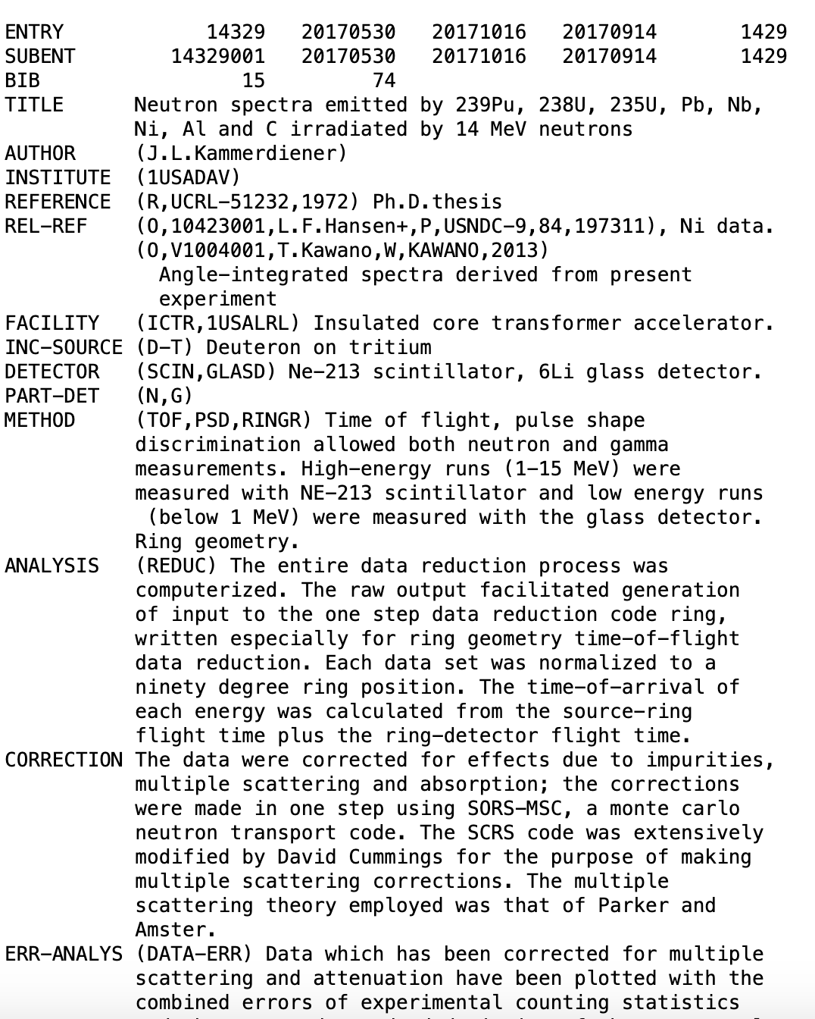
Nuclear Reaction Data Workflow
Experiment => Compilation (EXFOR) => Evaluation (ENDF) => Applications
EXFOR entry #14329, Ph.D. Thesis of John L. Kammerdiener
ENDF contains evaluated (recommended) cross sections, spectra, angular distributions, fission product yields, thermal neutron scattering, and photo-atomic and other data, with an emphasis on neutron-induced reactions.
ENDF library evaluations are based on theoretical calculations normalized to experimental data with an exception of neutron resonance region, where priority is given to experimental data.
ENDF/B-VIII.1 is in progress.

Slide 3
ENDF/B-VIII.1β2
Thermal Neutron Cross Sections

Slide 4
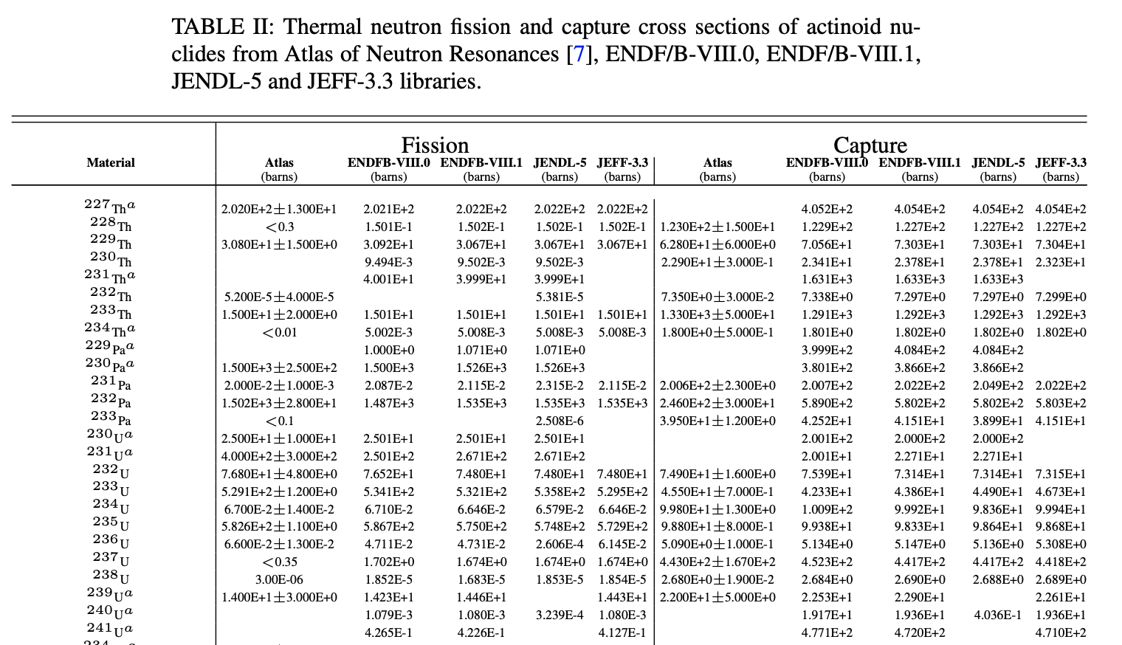
ENDF/B-VIII.1 Thermal Cross Section Numerical Values
In the present work, the ENDF/B-VIII.1 library was Doppler broaden at T=293.16 K using the PREPRO 2021/2023 code.
Two other libraries JEFF-3.3 and JENDL-5 were also broaden under the identical conditions; BROND-3.1 and CENDL-3.2 are in progress.
The large disagreement of theoretical ²⁴⁰U capture cross sections between ENDF/B-VIII.1 and JENDL- 5 libraries is noticeable.

Slide 5
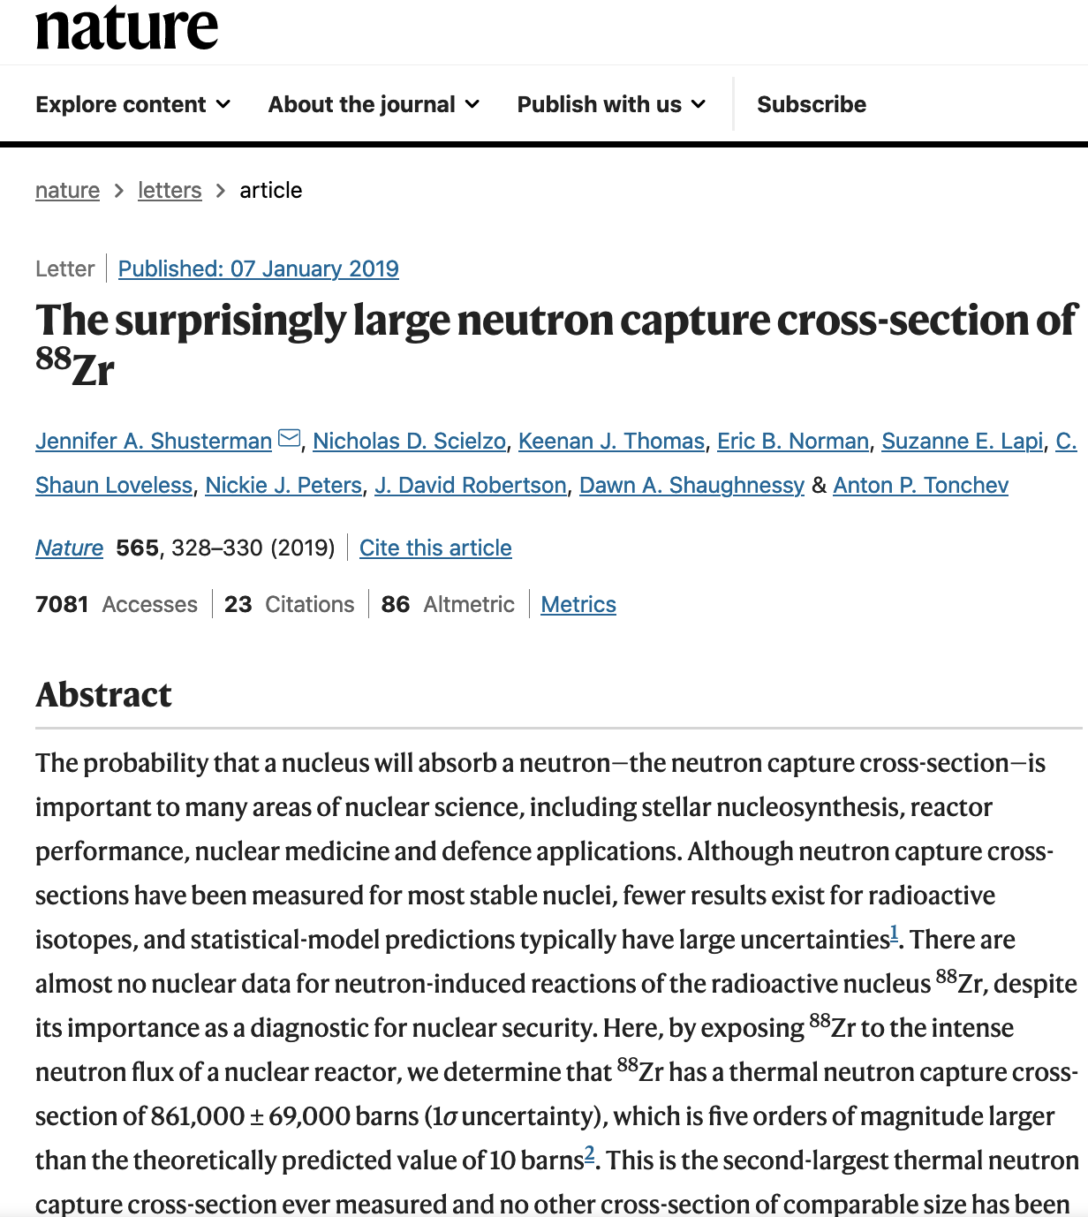
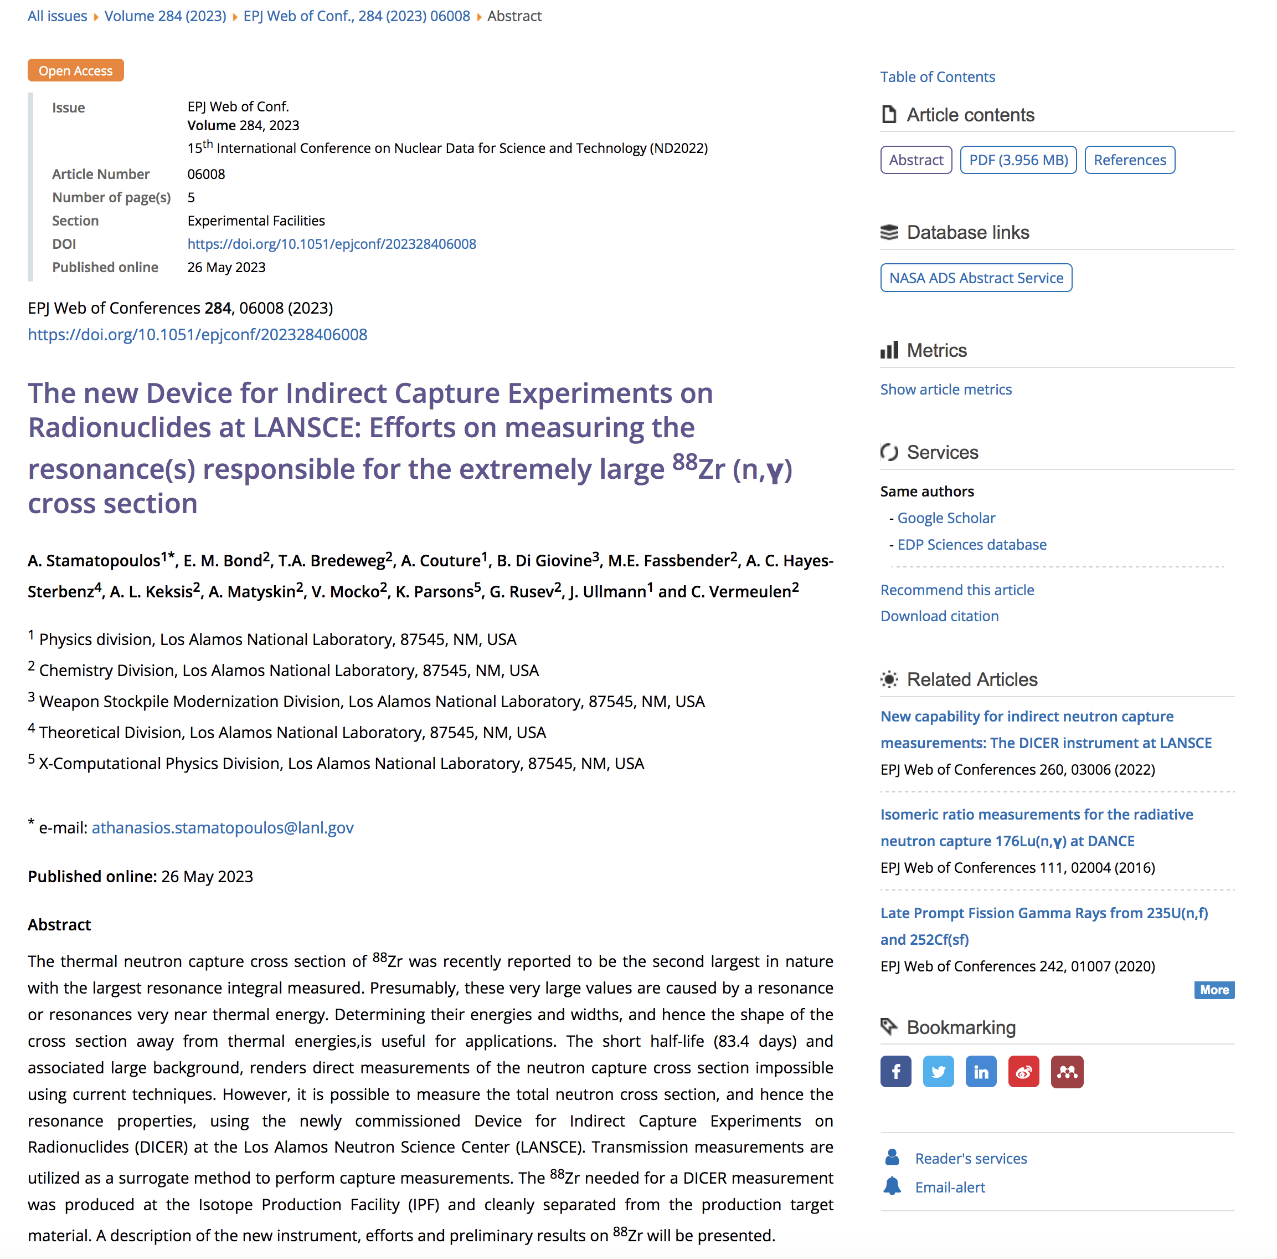
Thermal Neutron Cross Sections
The perfect agreement between two or more ENDF libraries indicates that evaluated nuclear data libraries adopted the same evaluation for a particular target nucleus.
The large disagreement of theoretical ²⁴⁰U capture cross sections between ENDF/B-VIII.1 and JENDL-5 libraries is noticeable (factor 50 for capture).
The similar situation was observed between calculated and measured capture cross section in ⁸⁸Zr (5 orders of magnitude).
Recent measurement confirms large thermal cross section in ⁸⁸Zr but disagrees on resonance integral (LECM 2023).
These cases underline issues with theoretical modeling at thermal energies when no experimental resonance data are available (R. Capote: R-matrix is not working without experimental data).
Experimental research and EXFOR project are essential.

Slide 6
ENDF/B-VIII.1β2
Westcott or g-factors

Slide 7
Westcott Factors
Westcott factors for ENDF/B-VIII.1β2, JEFF-3.3, JENDL-5, BROND-3.1, and CENDL-3.2 libraries have been calculated.
Resonance integrals are also calculated.
Analysis is in progress.

Slide 8
ENDF/B-VIII.1β2
Maxwellian-averaged Cross Sections for Stellar Nucleosynthesis

Slide 9
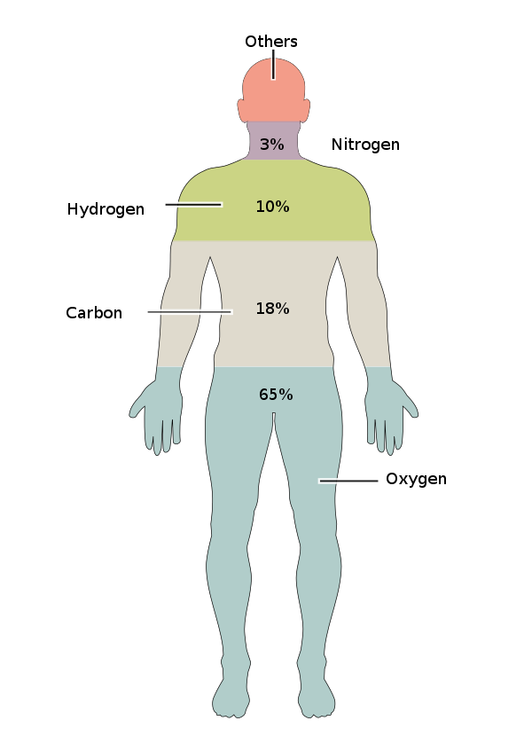
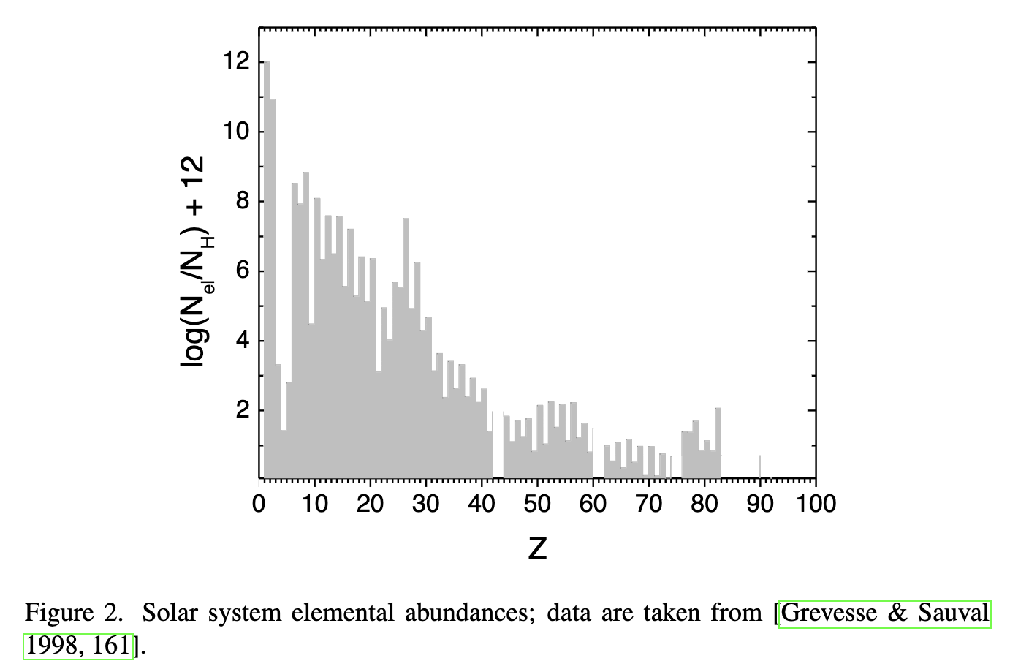
Human Body & Stellar Nucleosynthesis
Stellar Nucleosynthesis
Oxygen 65%
Carbon 18%
Hydrogen 10%
Nitrogen 3%
Calcium 1.4%
Phosphorus 1.1%
Others 1.5%
CNO Cycle
Big Bang
α+α->⁸Be+α->¹²C
¹²C+α->¹⁶O

Slide 10
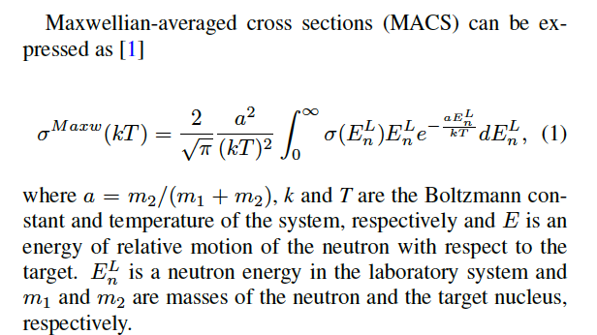
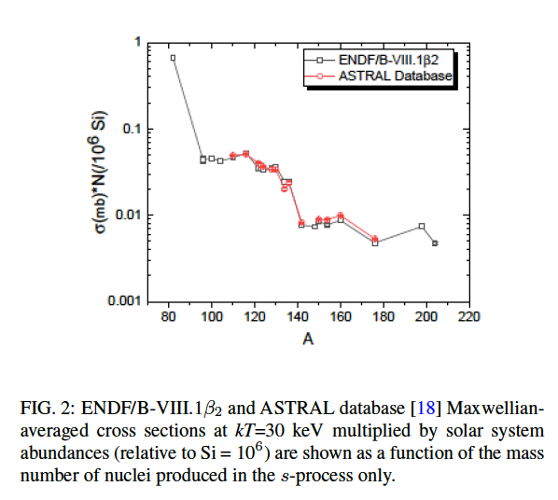
Maxwellian-averaged Cross Sections (MACS)
ENDF/B-VIII.1β2 library
c.m. vs. lab ENDF/B cross sections.
σN products for s-process only target nuclides.

Slide 11
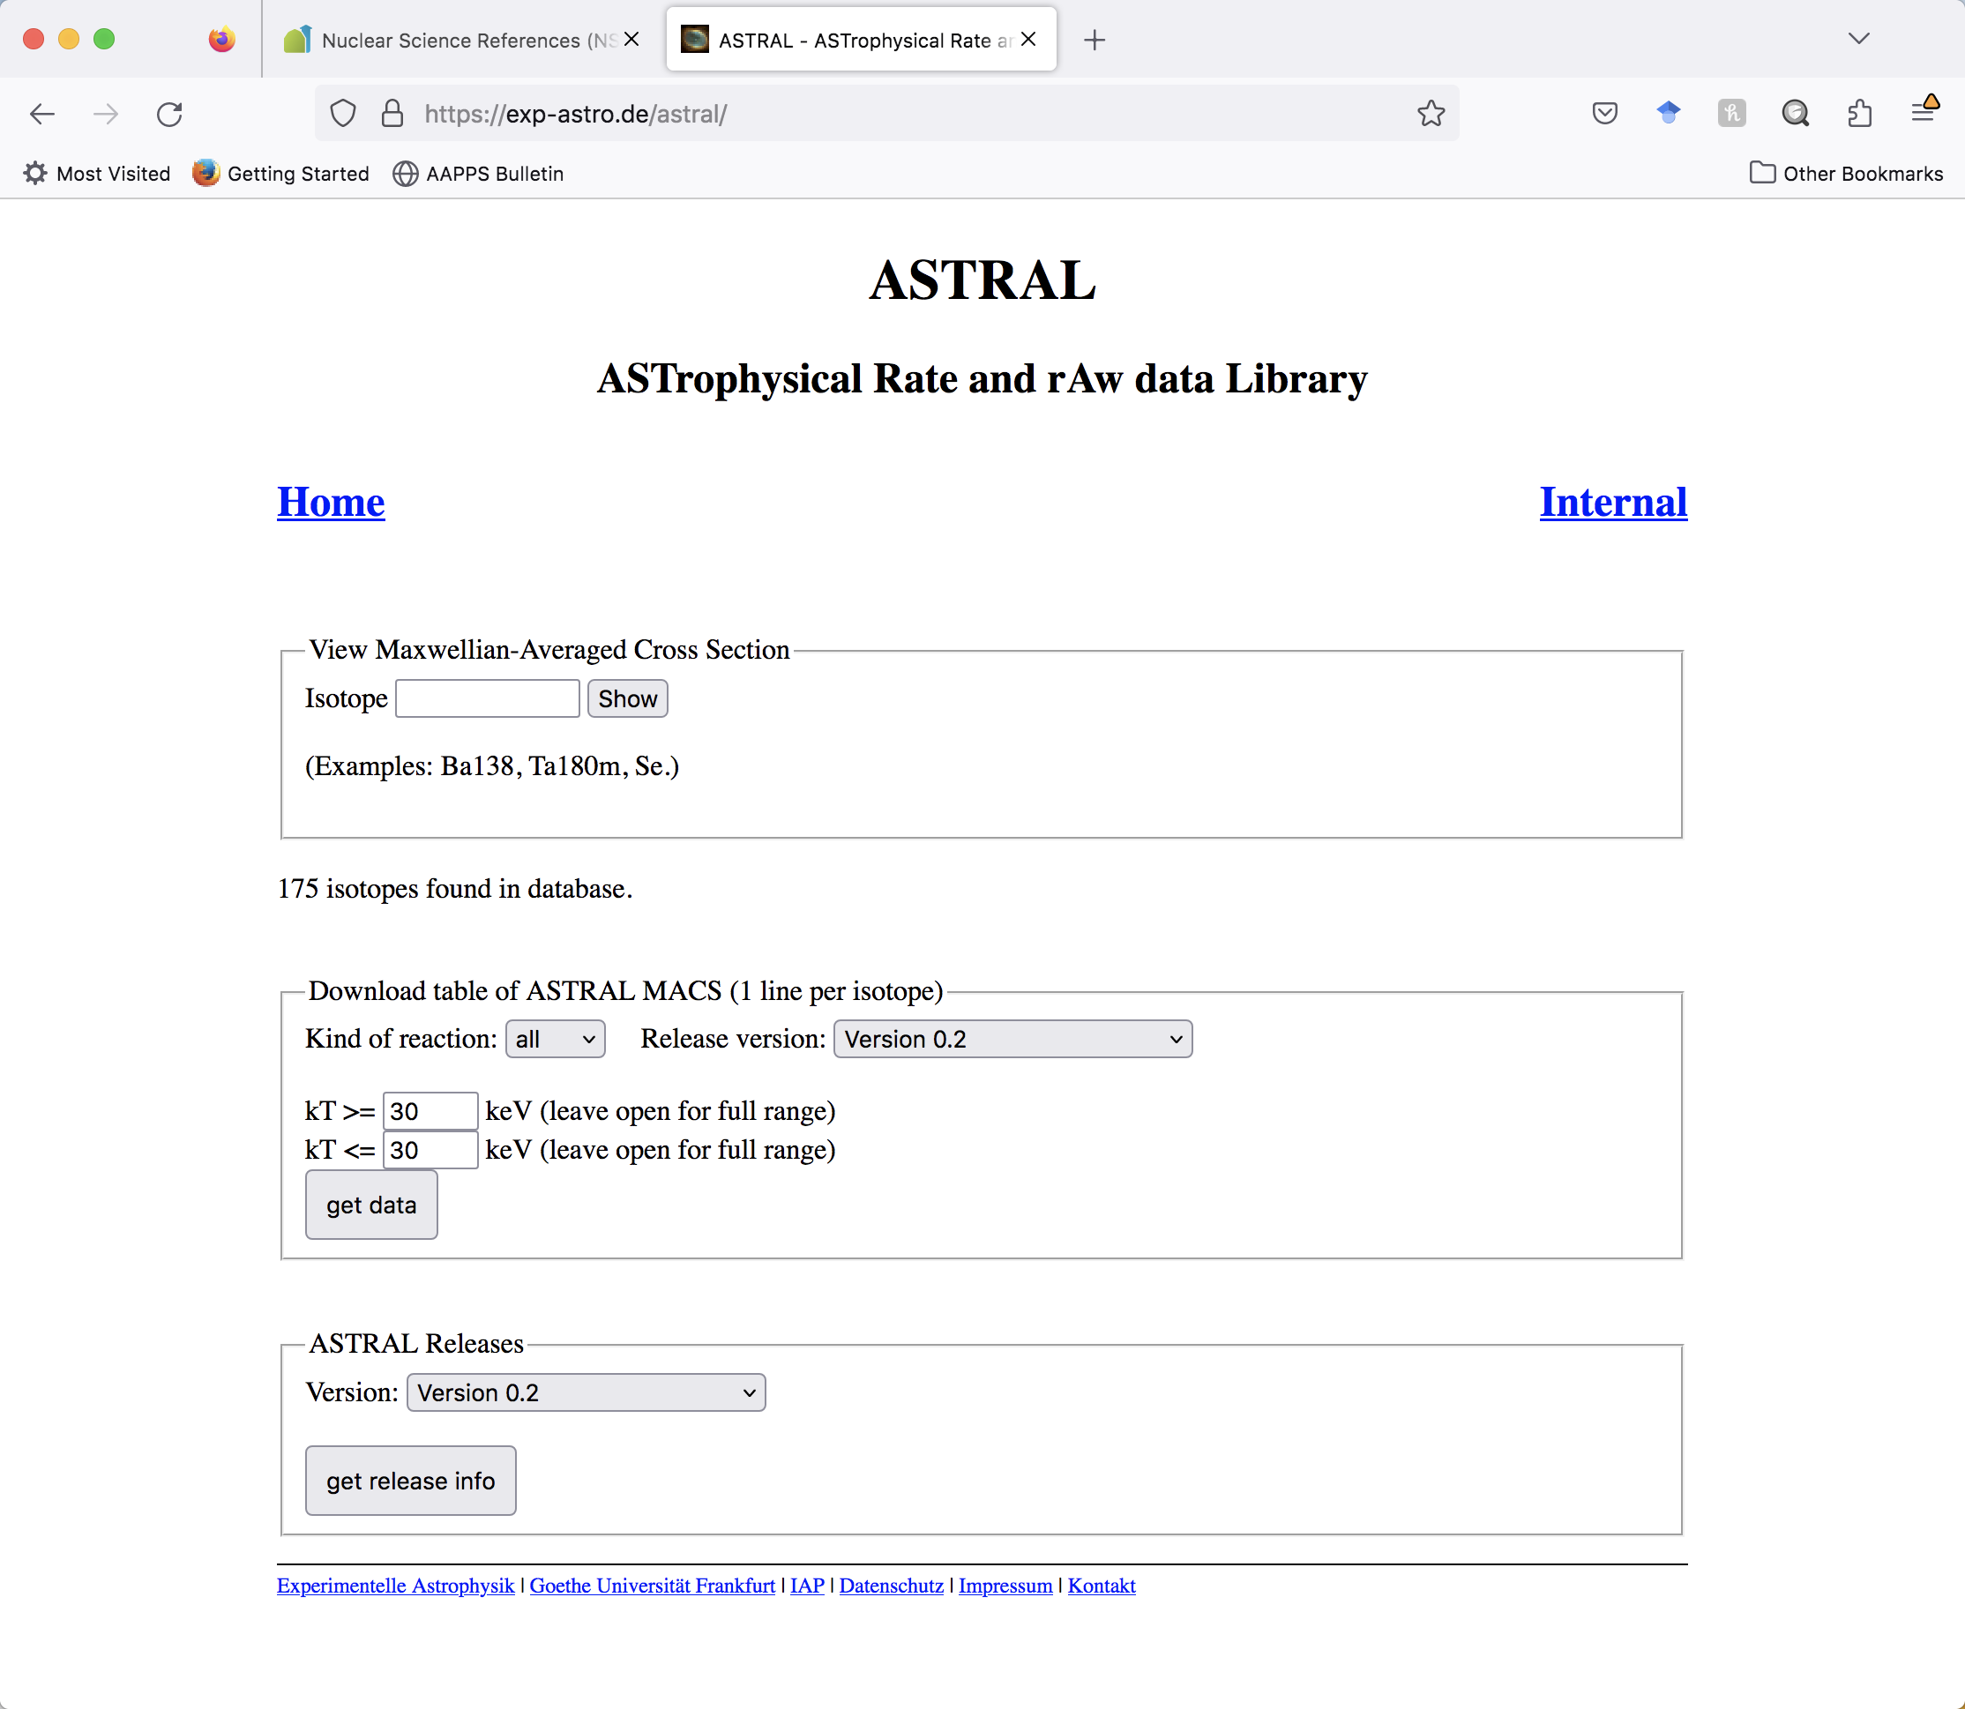
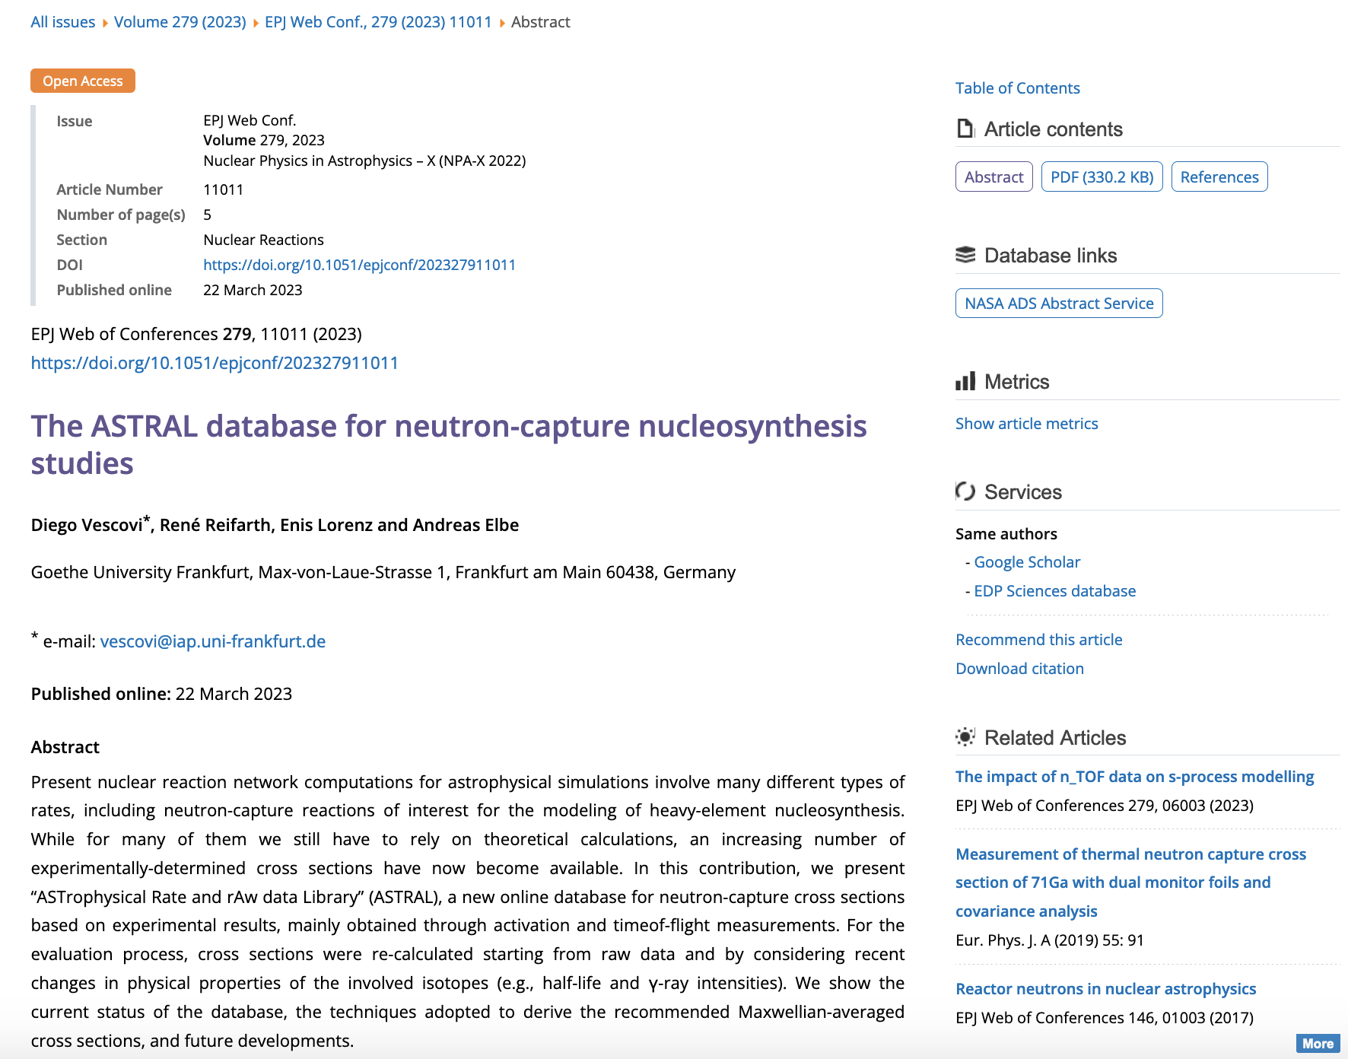
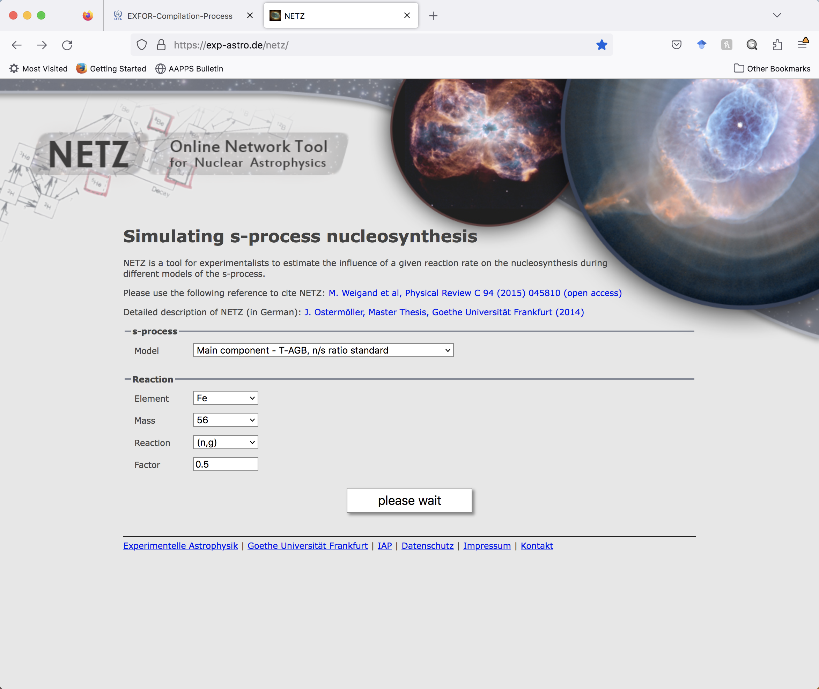
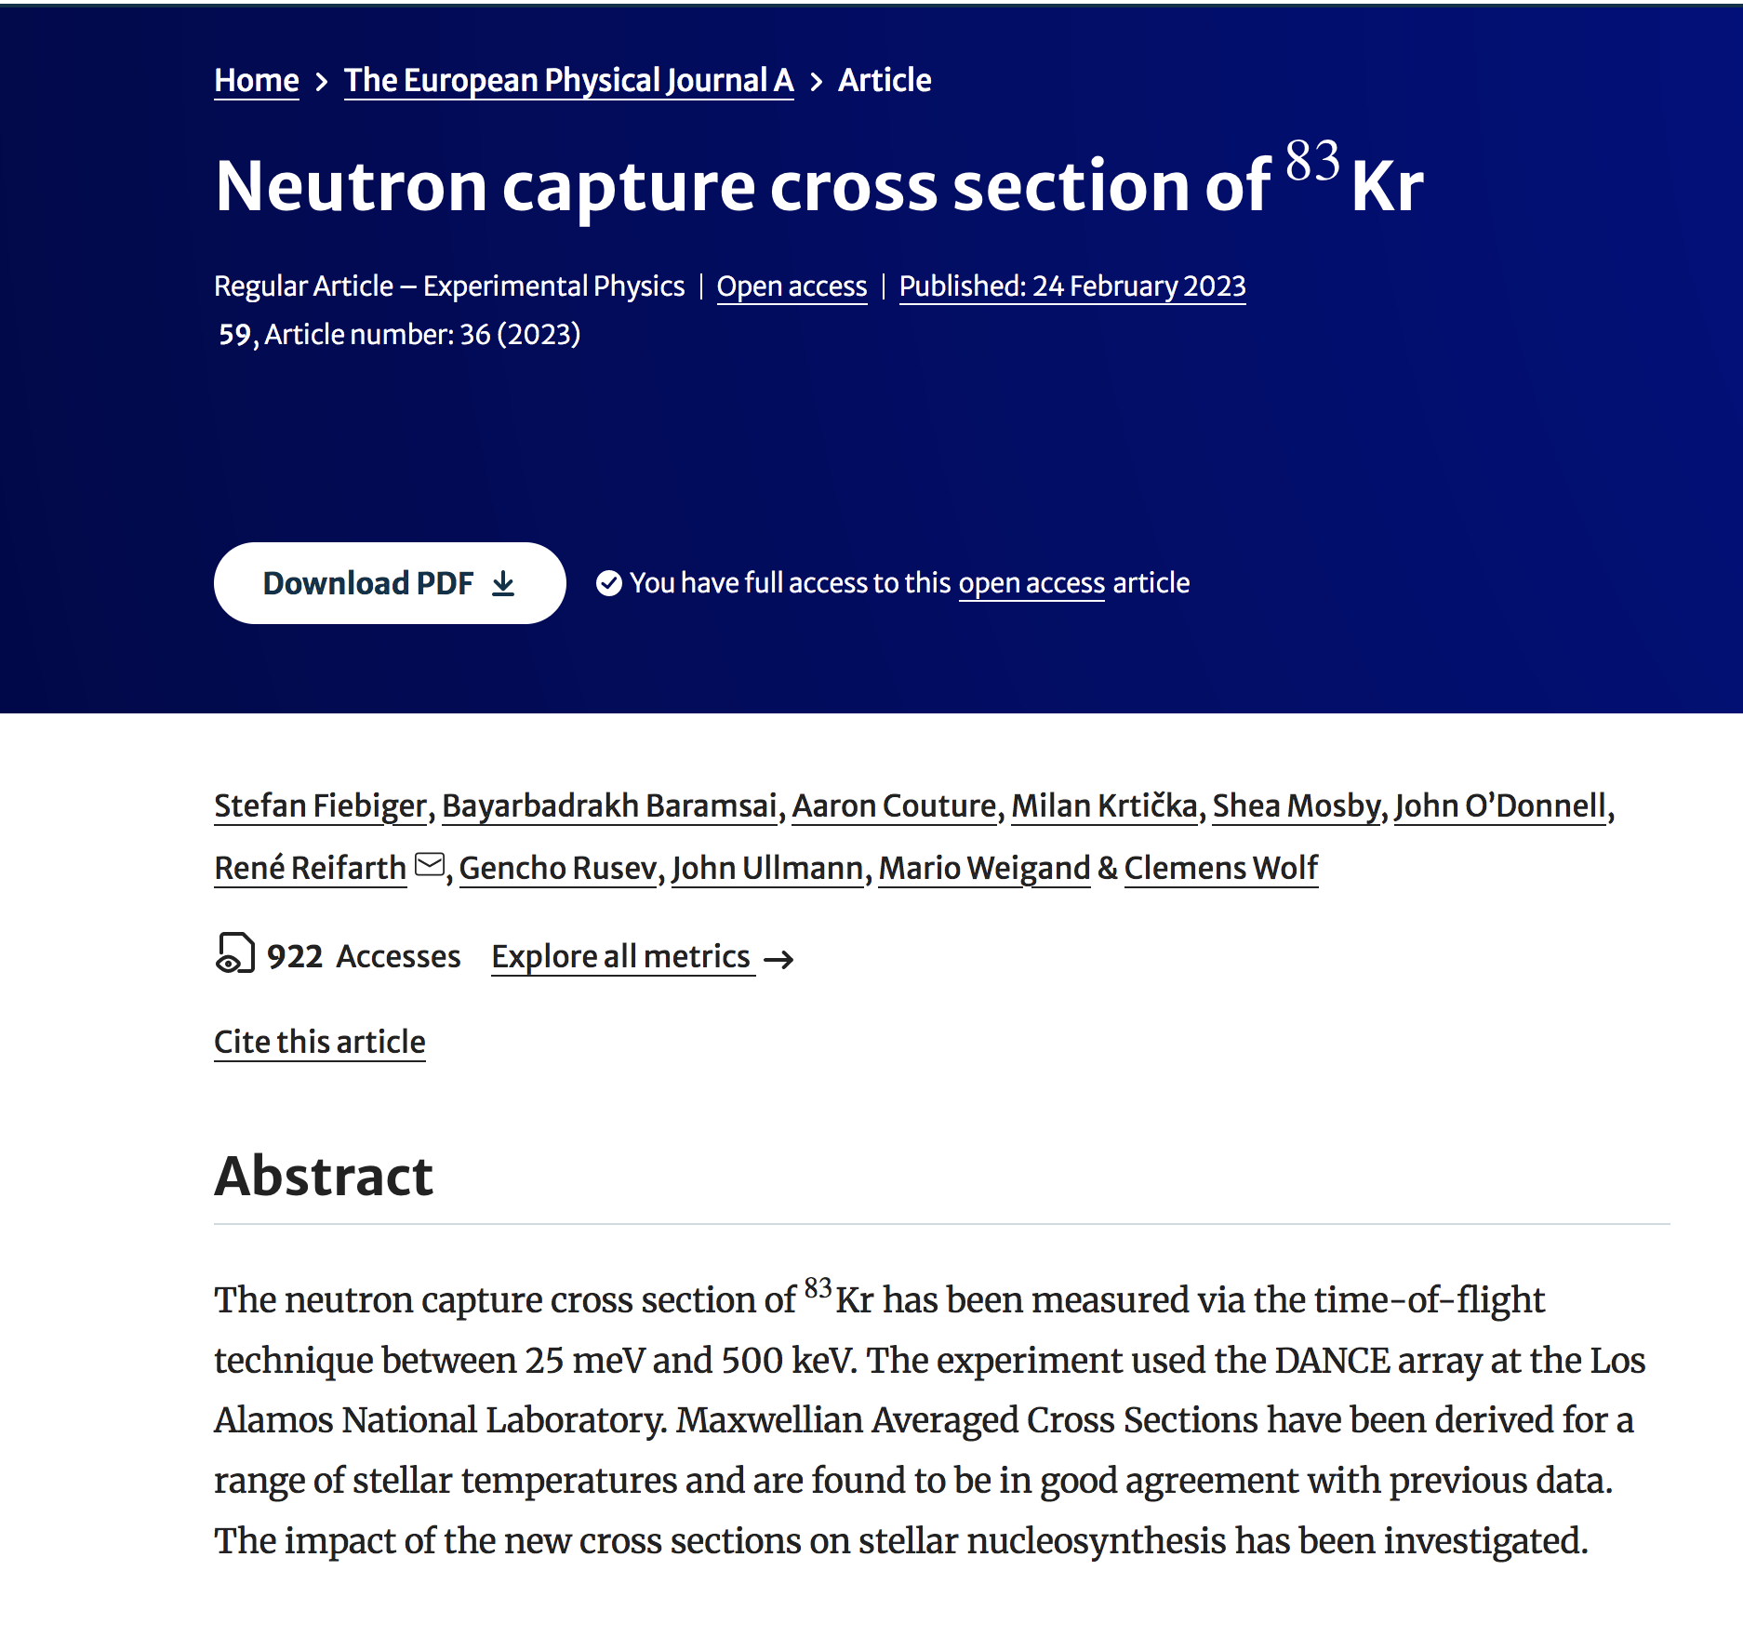
ASTRAL Database
Recent re-analysis of the ¹⁹⁷Au cross sections by the international evaluation of neutron cross-section standards revealed problems with systematic errors, and it impacts the majority of KADoNiS cross sections where the Karlsruhe measurements were adopted as recommended. This issue has been recognized by the Karlsruhe group, and affected values were revised.
Furthermore, the KADoNiS database effort was abandoned in favor of the ASTrophysical Rate and rAw data Library (ASTRAL) database (https://exp-astro.de/astral/ ) at the Goethe Universität Frankfurt.
The ASTRAL database is used in the current work to compare calculated ENDF library MACS with astrophysical data.
s-process simulations from the same source (https://exp-astro.de/netz/).
⁸³Kr measurement and calculations.

Slide 12
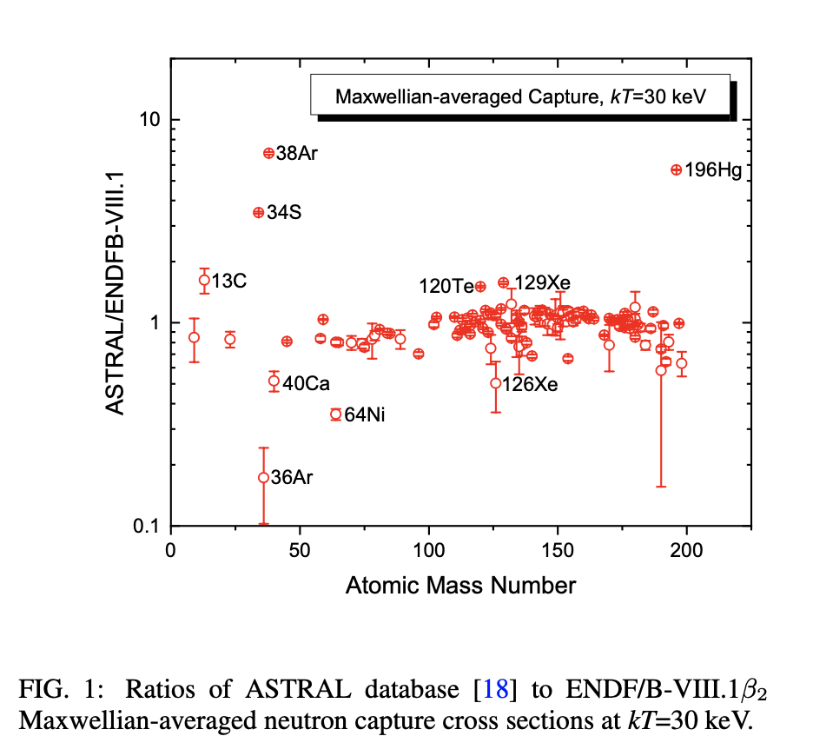
ENDF/B-VIII.1 MACS Analysis
The analysis of the ratios shows agreements in most cases and strong deviations in ¹³C, ³⁴S, ^{36,38}Ar, and ¹⁹⁶Hg and minor deviations in ⁴⁰Ca, ⁶⁴Ni, ¹²⁰Te, and ^{126,129}Xe cases.
The analysis of the EXFOR database shows that there are no experimental data for ^{36,38}Ar and ¹²⁶Xe above thermal region, and the observed differences are due to the previously-discussed issues with theoretical modeling.
For ¹²⁹Xe and ¹⁹⁶Hg, ASTRAL results are based on single measurements.
In ⁴⁰Ca we need to consider three contradictory measurements and choices of ENDF and ASTRAL evaluators.
In the remaining cases, the situation is very similar, the detailed discussion is beyond the scope of this work.
Next, I will calculate the main (strong) component of s (slow neutron capture) process and extract abundances.

Slide 13
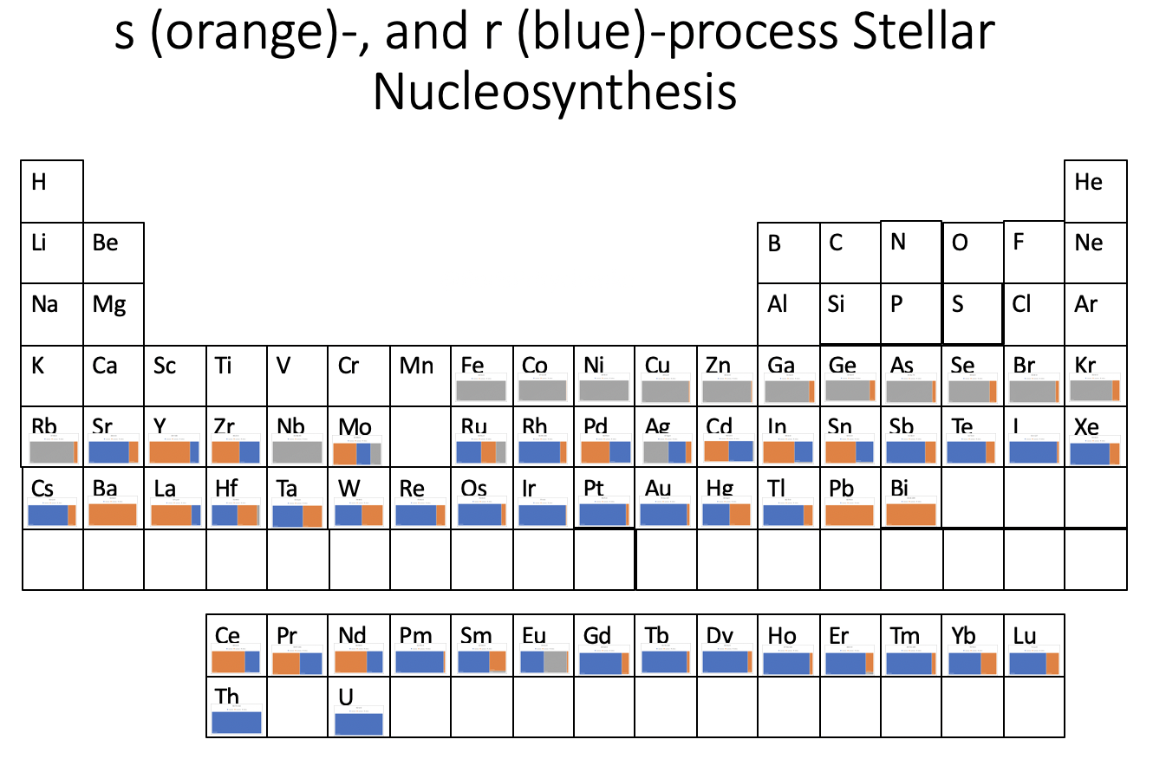
Stellar Nucleosynthesis with ENDF/B-VIII.1β2, Current Work
The s-process (strong) abundances are subtracted from the solar system abundances (see B. Pritychenko, J. Phys.(London) G48, 08LT01 (2021)).
¹⁴⁰Ce is fixed, ¹³⁸Ba needs re-evaluation (Resonances from NEA-WPEC-23 (2009)).
Re, Os, Ir, Pt, Au are mostly produced by an r-process (rapid neutron capture), third r-process peak. Sb, Te, I, Xe, Cs - second r-process peak.

Slide 14
Outlook
The ENDF/B is the most comprehensive evaluated nuclear data library for applications developed by Cross Section Evaluation Working Group (CSEWG).
ENDF/B-VIII.1β2 library has great astrophysical potential.
ENDF/B-VIII.1 library is scheduled for release in February 2024.
The library release will be accompanied by Nuclear Data Sheets article.

