Slide 1
EXFOR & NSR Report
Boris Pritychenko
National Nuclear Data Center, Brookhaven National Laboratory, Upton, NY 11973-5000, USA
November 13, 2023
Nuclear Data Week 2023 (CSEWG-USNDP-NDAG)

Slide 2
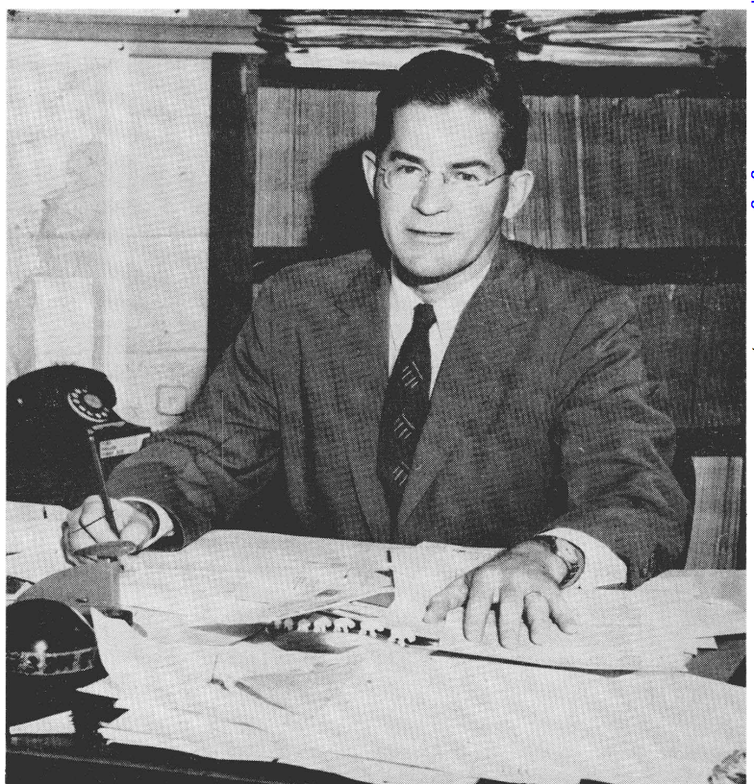
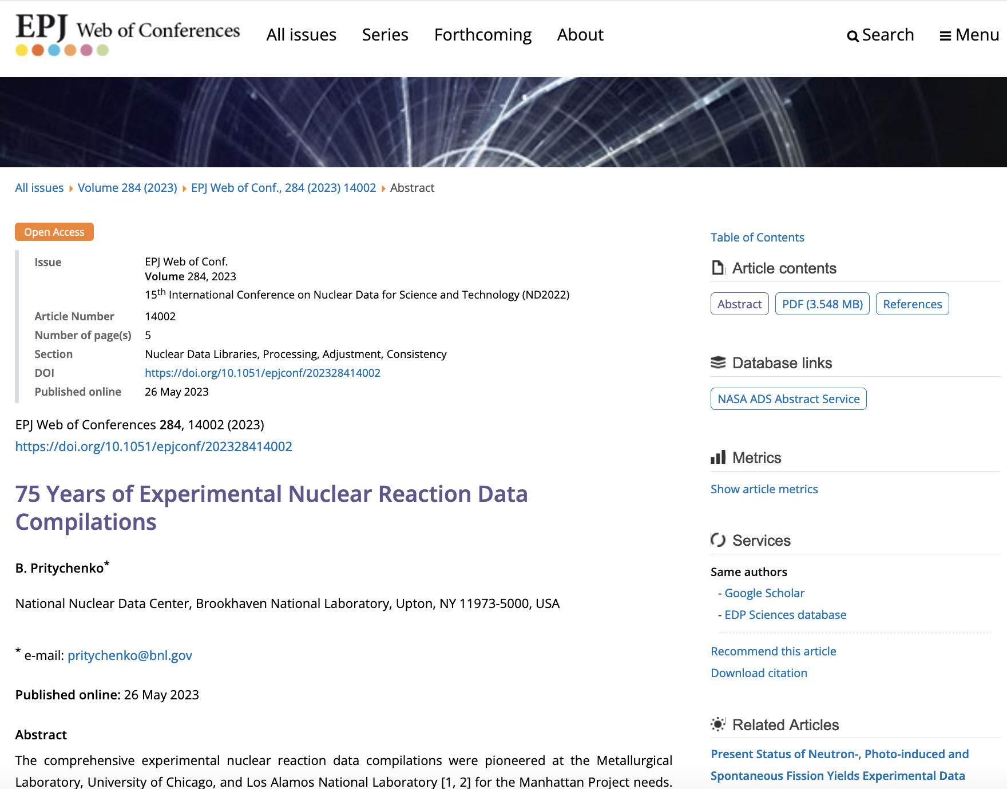
Outline of Nuclear Reaction Data Compilations in USA & Worldwide
Experimental neutron reaction data compilations have been pioneered at the Metallurgical Laboratory, University of Chicago and Los Alamos National Laboratory in 1945-1947.
1947 - Publicly available compilations.
Donald J. Hughes (1915-1960) was behind the BNL-170 (1952); it is a precursor of BNL-325 (Atlas of Neutron Resonances).
SCISRS (Sigma Center Information and Retrieval System) at BNL (1964) was a precursor of EXFOR.
Other data centers were created in Paris, France (NEA-Databank), Vienna, Austria (NDS-IAEA), and Obninsk, USSR (IPPE) in 1963-1964.
Around 1970 four neutron data centers agreed on the data interchange format (EXFOR). The four centers could store data locally in its formats. The Nuclear Data Centres Reaction (NRDC) network was founded in 1979 under the auspices of the IAEA.
75 Years of Experimental Nuclear Reaction Data Compilations

Slide 3
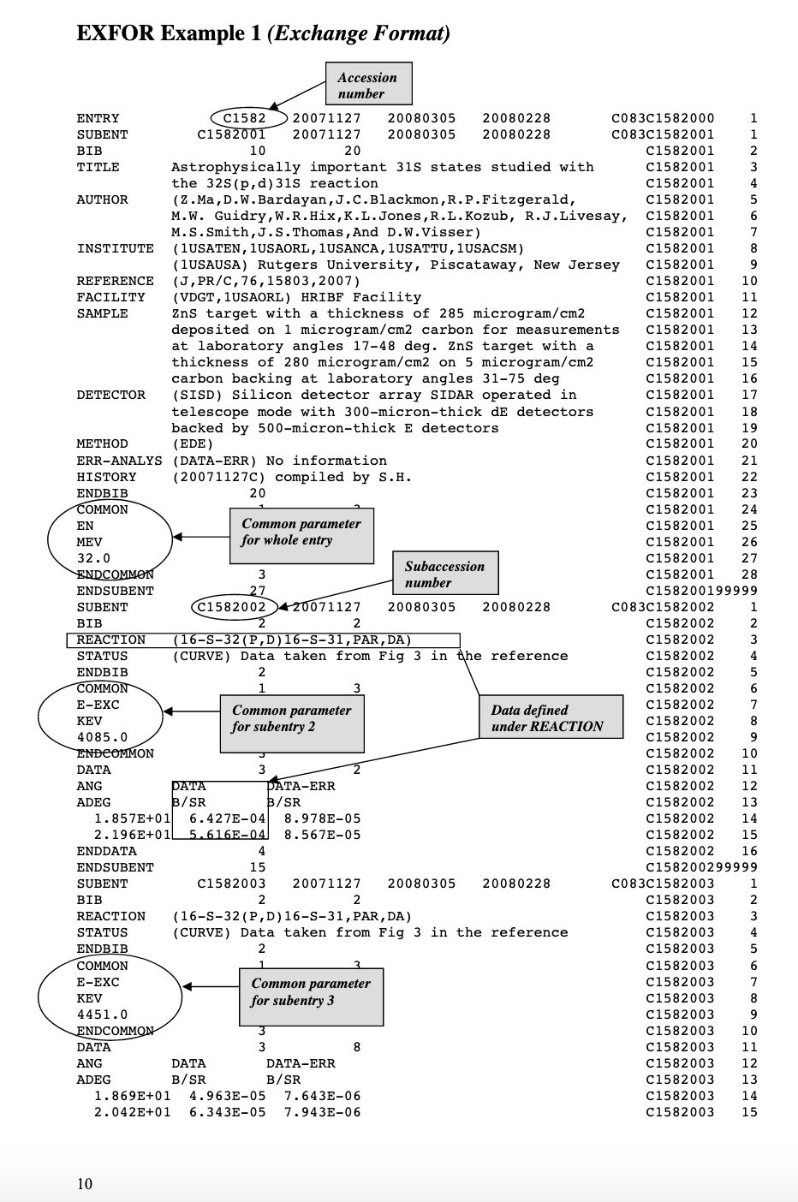
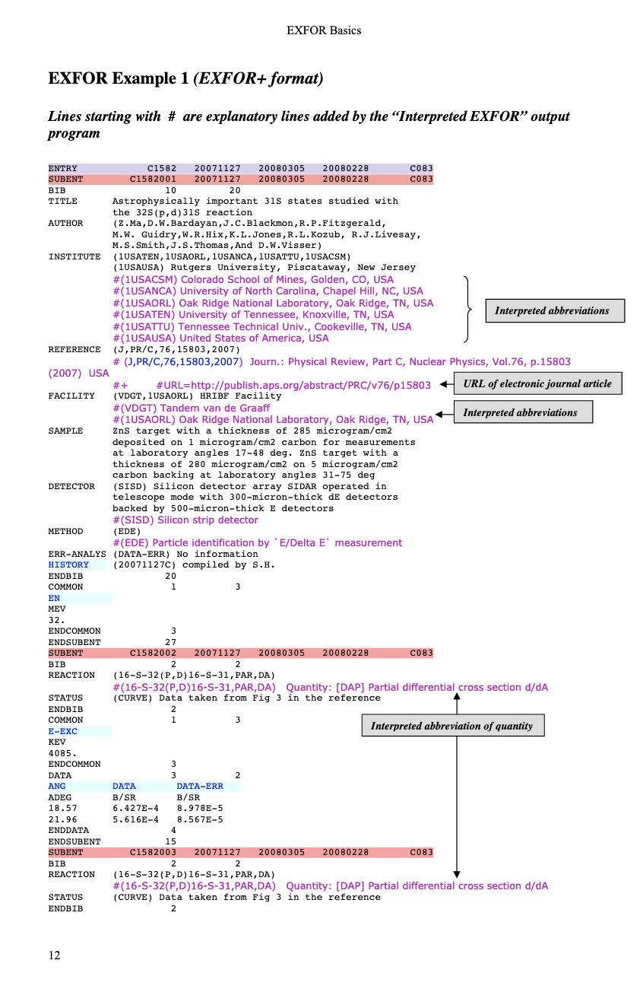
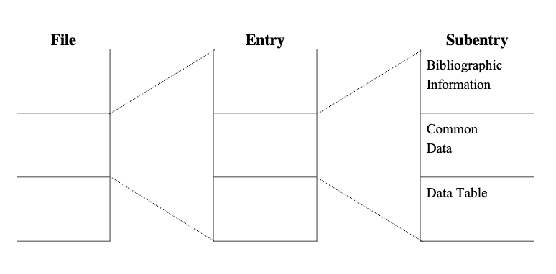
EXFOR DB Structure
EXFOR File (database)
EXFOR Entries (experiments)
EXFOR SubEntries (data sets)
NRDC Refereed Compilations.

Slide 4
Area #1 FY 2023 Statistics
Team effort: B.Pritychenko (BNL), O.Schwerer, S.Hlavac, O.Gritsay (Contractors).
EXFOR | FY2022 | FY2023
New Compilations | 158 | 152
Updated Compilations | 210 | 181
Preliminary Transmissions | 29 | 19
Final Transmissions | 31 | 22
Database Updates | 41 | 40

Slide 5
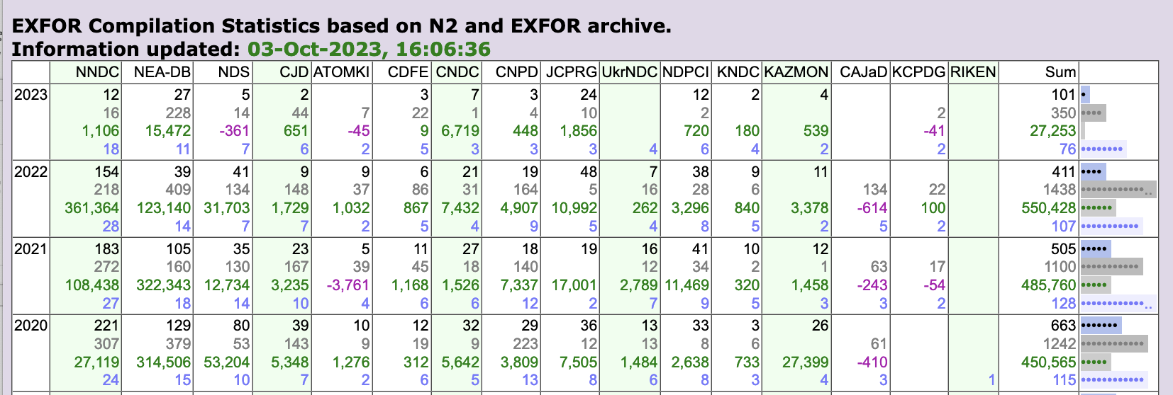
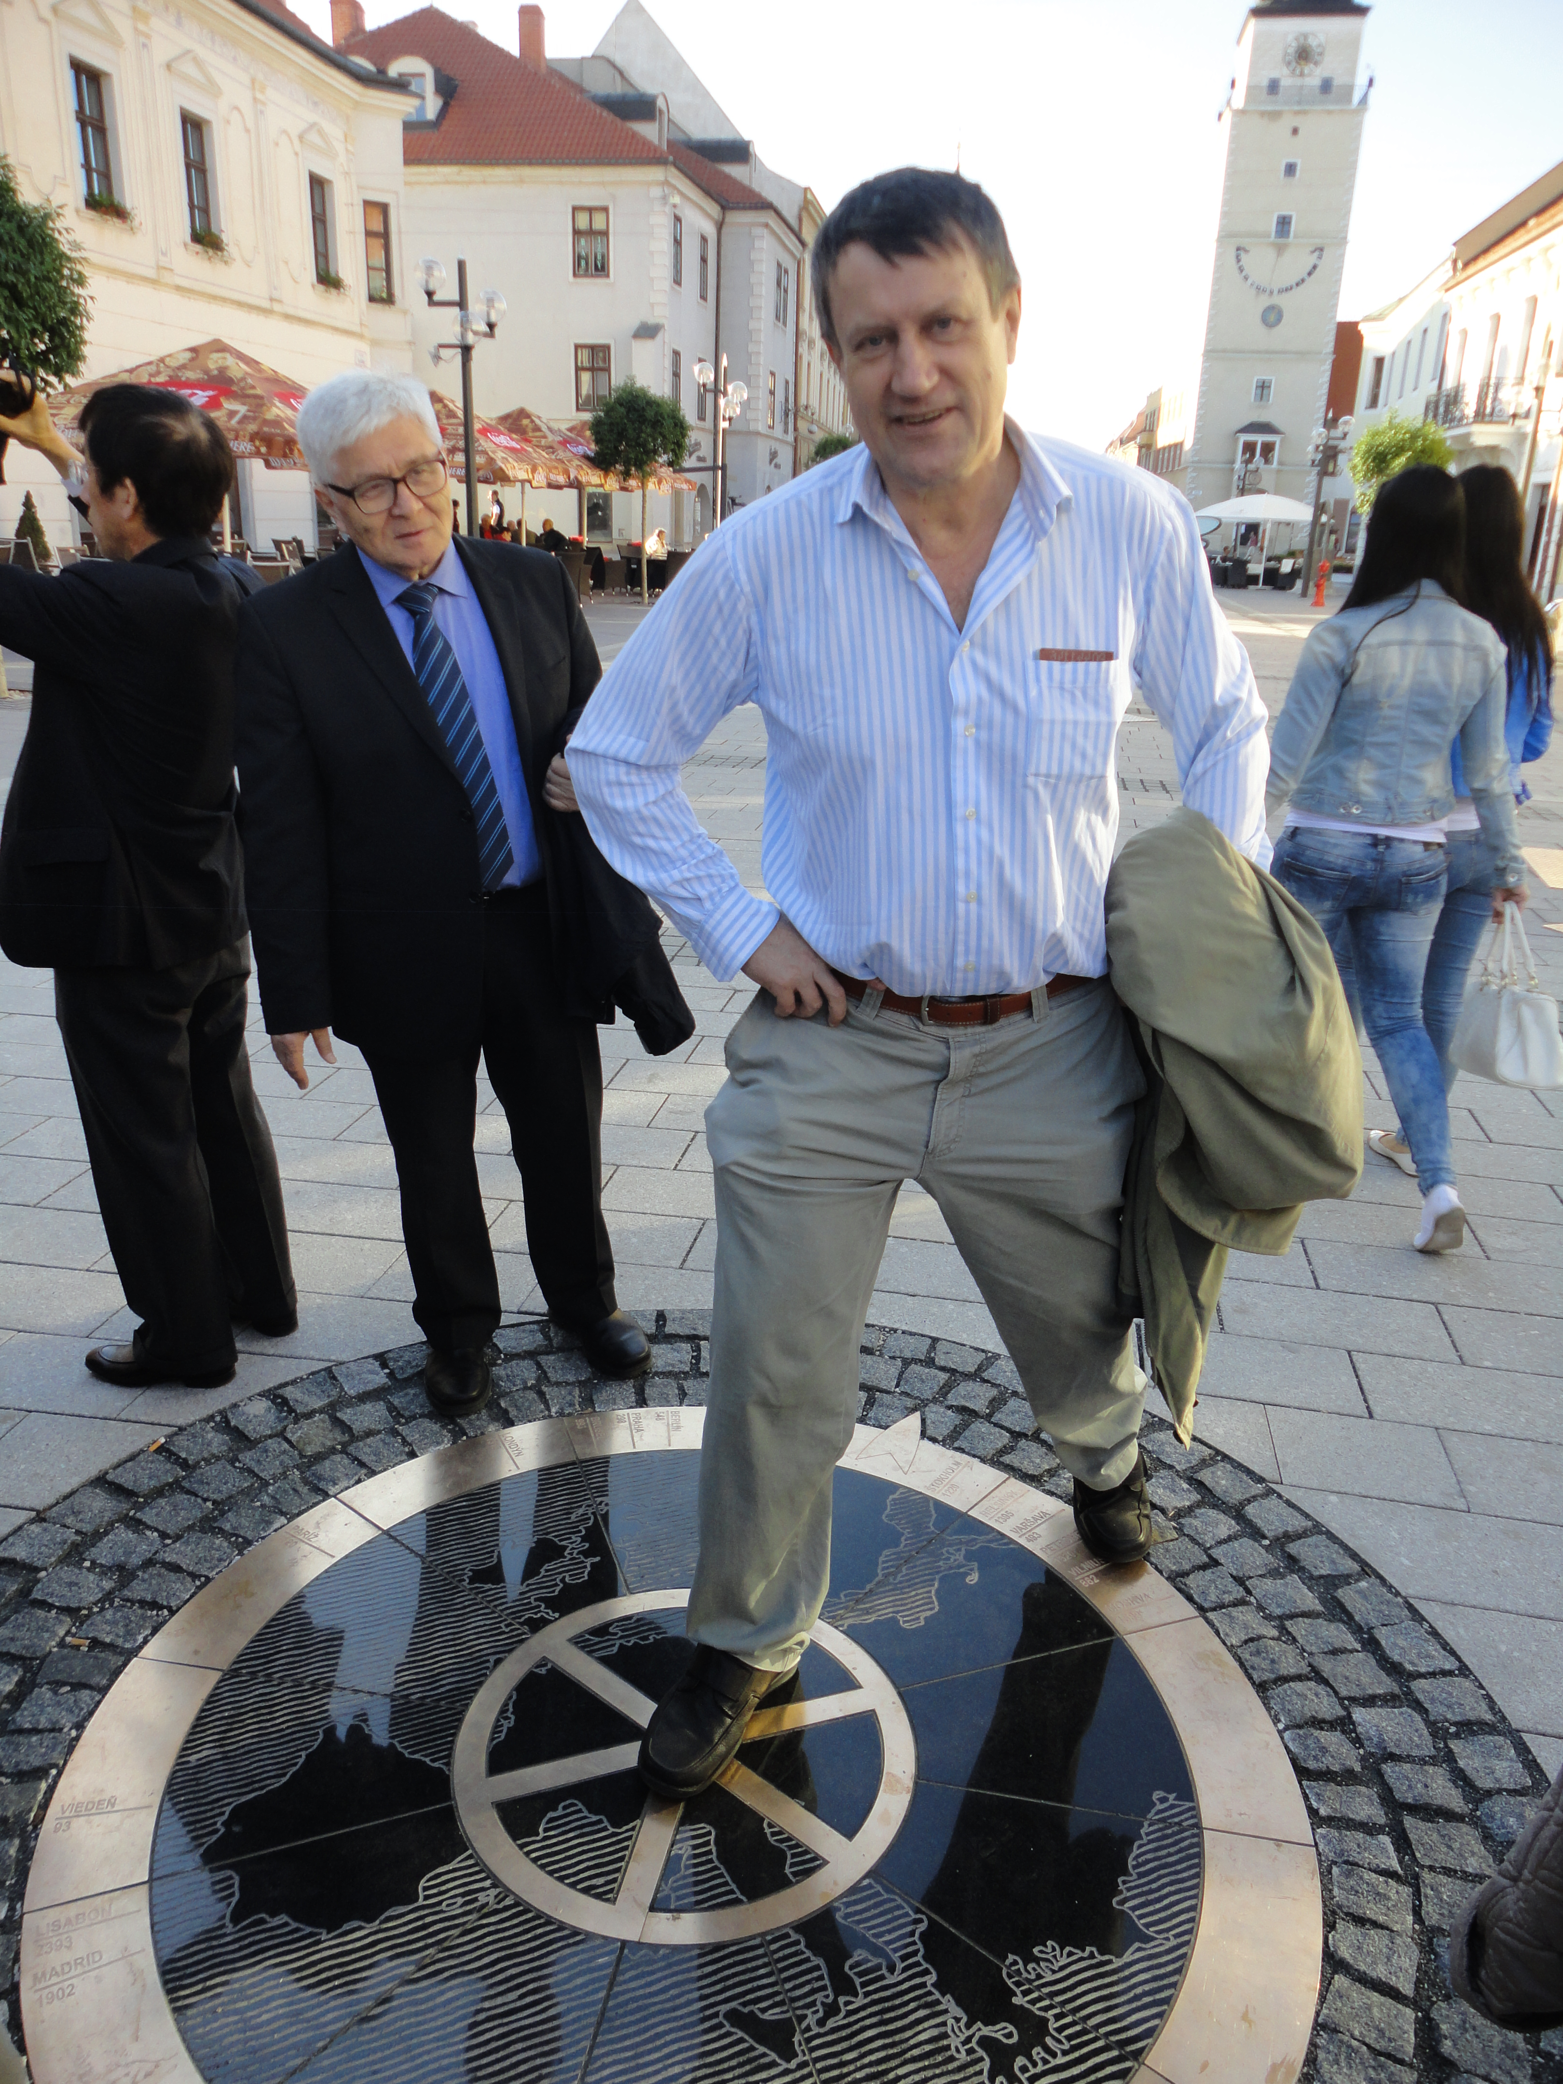
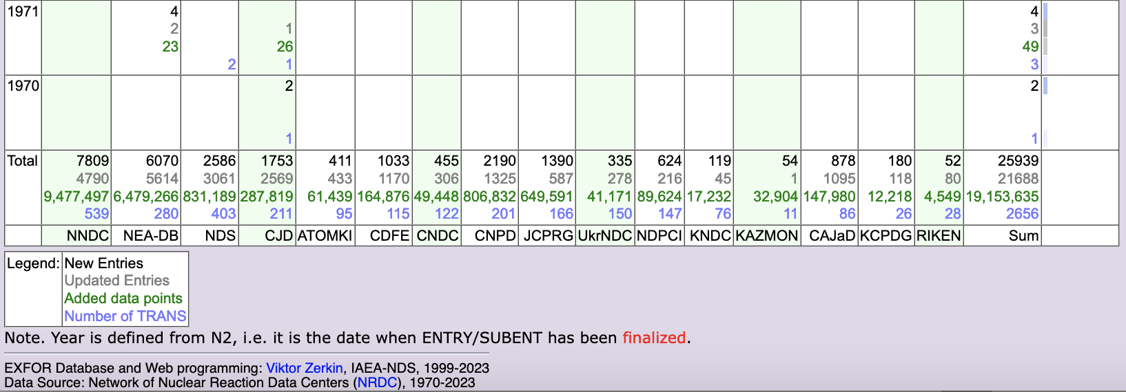
The IAEA EXFOR compilation control system
EXFOR compilation control system is one of the tools used for this co-ordination (Developed by Viktor Zerkin, IAEA, retired on October 31, 2023).
Top panel: New entries only.
Bottom panel: New and Updated entries, number of data points and transmissions.
Overall performance of the Area #1 is very good.
Potential issue is EXFOR maintenance or correction of existing entries.
Area #1 has the largest number of entries -7,809: 4,790 (~61.3%) of entries were corrected.

Slide 6
AIACHNE Project
Why EXFOR corrections are important???
AIACHNE (AI/ML Informed cAlifornium CHi Nuclear data Experiment): “Designing Nuclear-data Measurements that Resolve Discrepancies in Existing Data”.
EXFOR library analysis is often the key starting point for nuclear data evaluations.
We used NRDC network plot digitization software GSYS to obtain input used by Mannhart.
Mannhart input vs. EXFOR: 2 uncovered experiments for Area#2 are being included. Metadata found for existing EXFOR compilations will be included.
Curated data sets serve for standards and NEA WPEC SG-50 library as blue-print.
The SG-50 aims to store data as used for evaluations (profound effect on reproducibility).

Slide 7
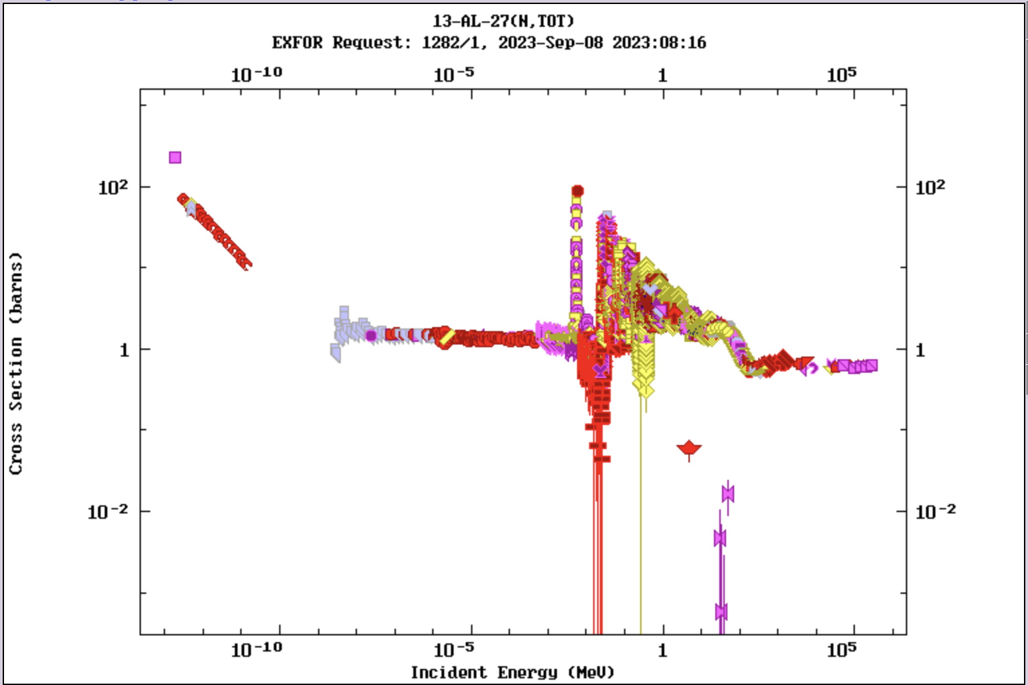
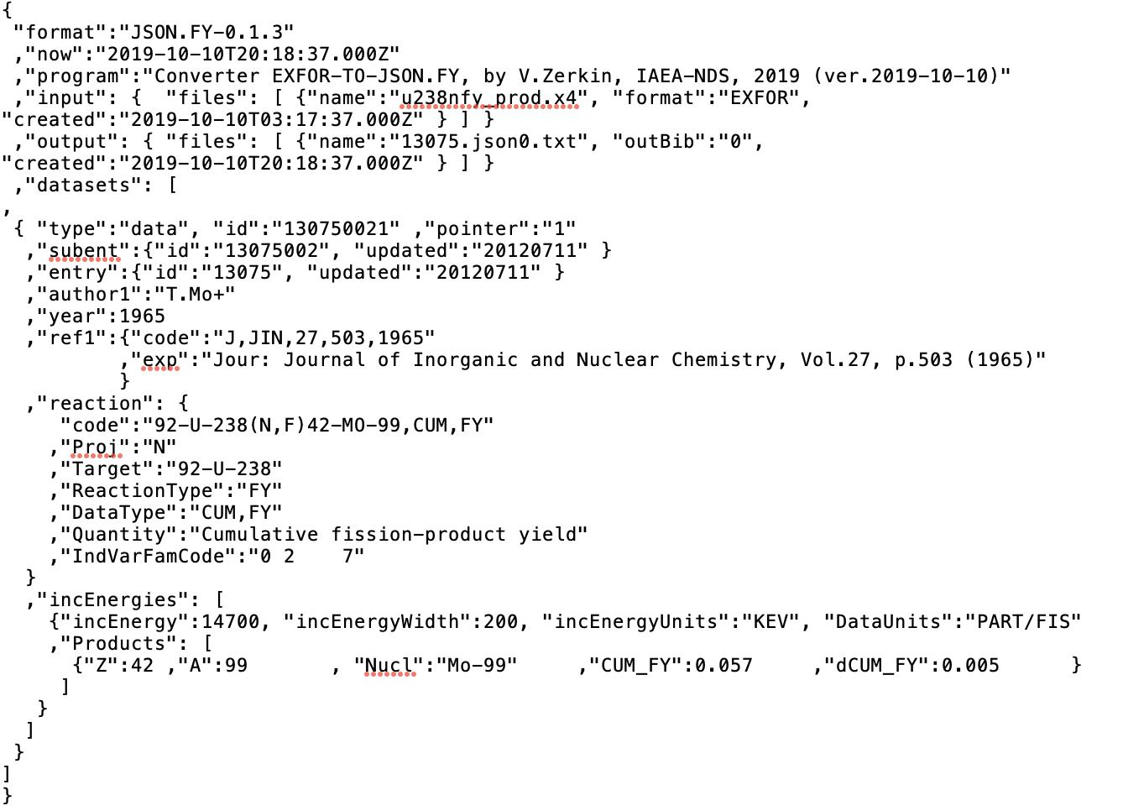
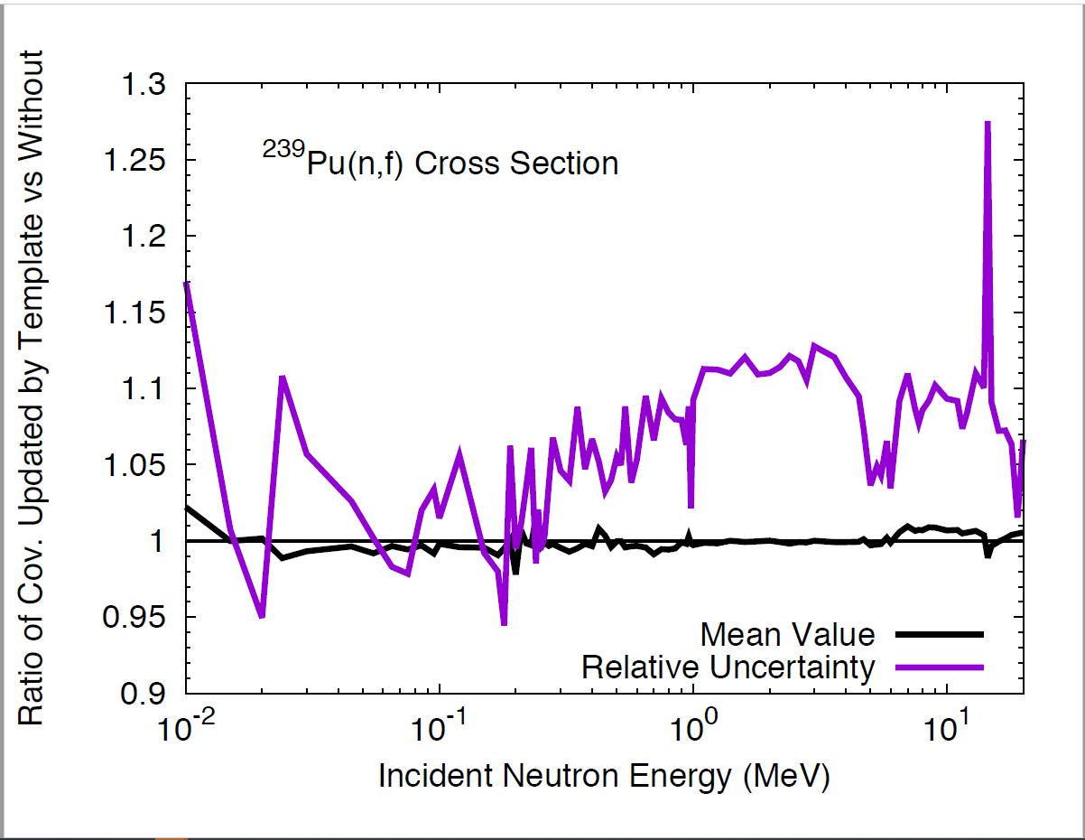
EXFOR Database Modernization
EXFOR is 75-year old, and it accumulated many issues.
It has to capitalize on modern computer technologies: Automatization of the EXFOR life and production cycle
Development of EXFOR Application Programming Interface (API): IAEA X4Pro, …
New data formats: JSON (JavaScript Object Notation) lightweight data interchange format for EXFOR is now in progress at the NNDC and IAEA-NDS.
Implementation of uncertainty templates developed by Denise Neudecker et al. (LANL) for resolving issues with missing uncertainties and covariances.
Potential collaboration: BNL, Los Alamos, IAEA, LBNL, NEA-DB, LLNL, …
Proposal was presented to NDAC on September 14, 2023.

Slide 8
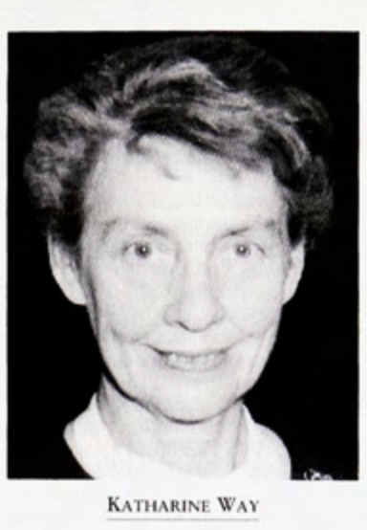
Nuclear Science References (NSR)
Katherine Way (formerly at Met Lab, Chicago) recognized the importance of keywords and convinced several journals to include them.
Oak Ridge NSR entry consisted of authors, journal and simple nuclear structure keywords; title was often missing.
References were stored at the ORNL library.
In 1980 NSR operation was transferred from Oak Ridge to Brookhaven.
In subsequent years the database was integrated with XUNDL/ENSDF and EXFOR.
NSR is unique, constantly-maintained bibliographic USNDP/international database.

Slide 9
NSR FY 2023 Statistics
Total number of new compilations: 3,624 (3,284-FY22)
……..
Coverage of conferences: Proceedings of Helsinki, Budapest, China-Japan; ND 2022, Nuclear Physics In Astrophysics 2022, Covariance workshop 2022 were added among others.
Discovery of Nuclides references were added.
NSR | FY 2022 | FY 2023
New Entries | 3,280 | 3,624
Corrected Entries | 315 | 400
Keyworded Entries | 2,457 | 2,705
Database Updates | 169 | 177
New Authors | 2,371 | 2,072
New Journals | 14 | 23
New Nuclides | 573 | 252
New Decays | 123 | 7
New Reactions | 573 | 252

Slide 10
Nuclear Science Progress in the Last Ten Years
NSR, October 1, 2013 – September 30, 2023, vs. prior October 1, 2023
Entries, Authors, Journals, Reactions: 14-20%
Nuclei, Decays: 40-65%
Total number of nuclei is 9,029; Z<119=7,910; Z<101=6,508 nuclei
All parameters exceed the percentage of entries (Less publications, more contents)
NSR | Total | Last 10 years | Last 10 years, %
Entries | 247,293 | 35,496 | 14.35
Authors | 111,386 | 19,996 | 17.95
Journals | 615 | 122 | 19.83
Nuclei | 9,029 | 3,864 | 42.79
Decays | 553 | 363 | 65.64
Reactions | 9,117 | 1,727 | 18.94

Slide 11
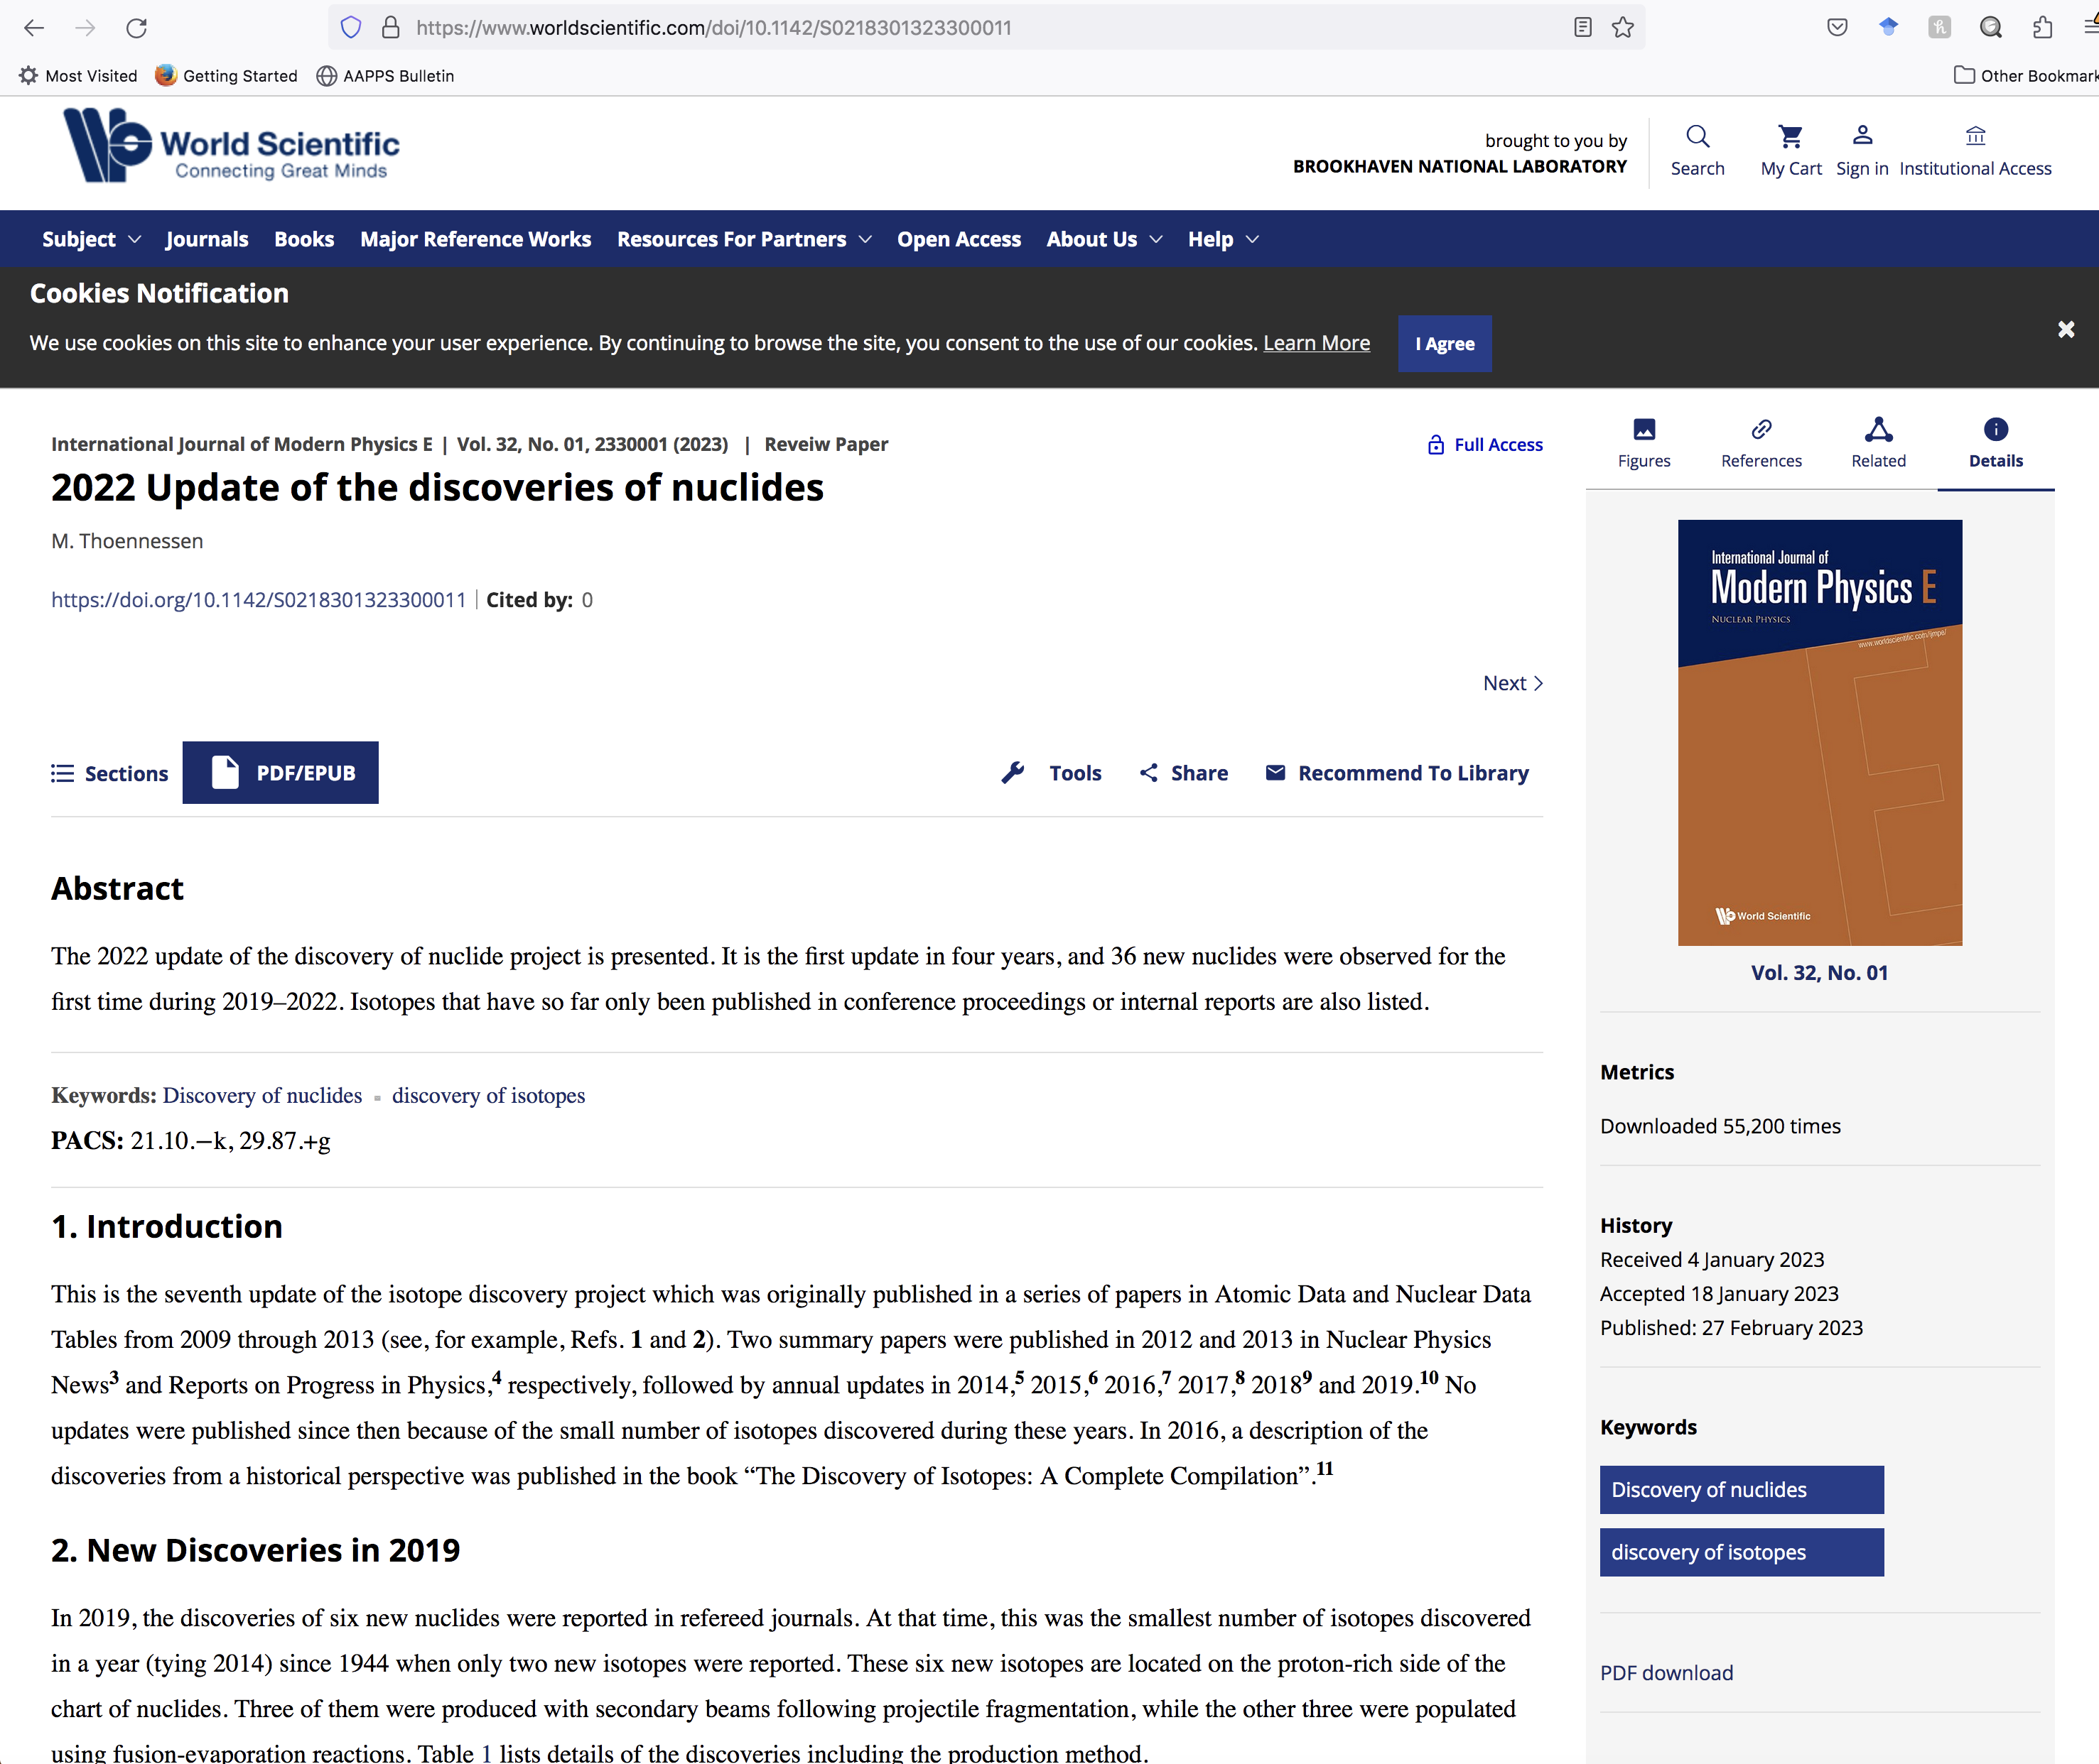
Missing References for Discovery of Nuclides Project
NNDC worked with M. Thoennessen (FRIB) on matching NSR with the Discovery of Nuclides Project references.
271 new references were added to NSR.
200 NSR references were corrected.
Many of them are of interest to the ENSDF project.

Slide 12
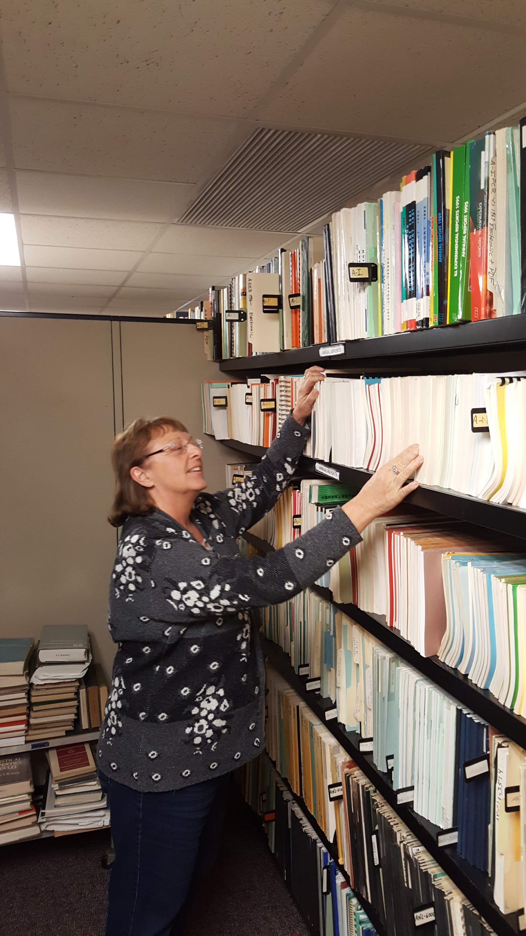
Ongoing Contribution of Joann Totans to NSR
The most important nuclear data resource is people.
Joann works on NSR since 2002.
Joann intends to retire at the end of 2023 and continue to to contribute as an NSR contractor.
Total number of new entries since 2002 is 81,668 vs. 247,389.
Every third new NSR entry was processed by Joann!!!
Addition of corrected entries will bring Joann’s contribution to 100,000.
We will celebrate 250,000 NSR entries in FY 2024.

Slide 13
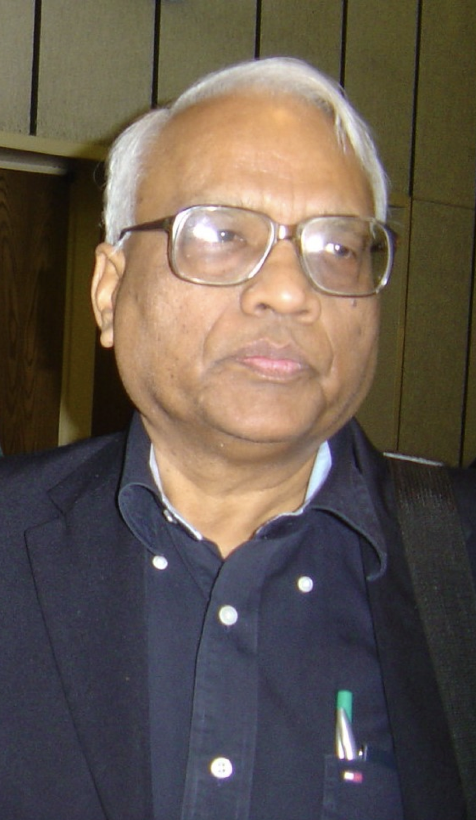
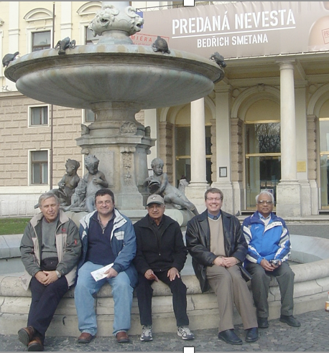
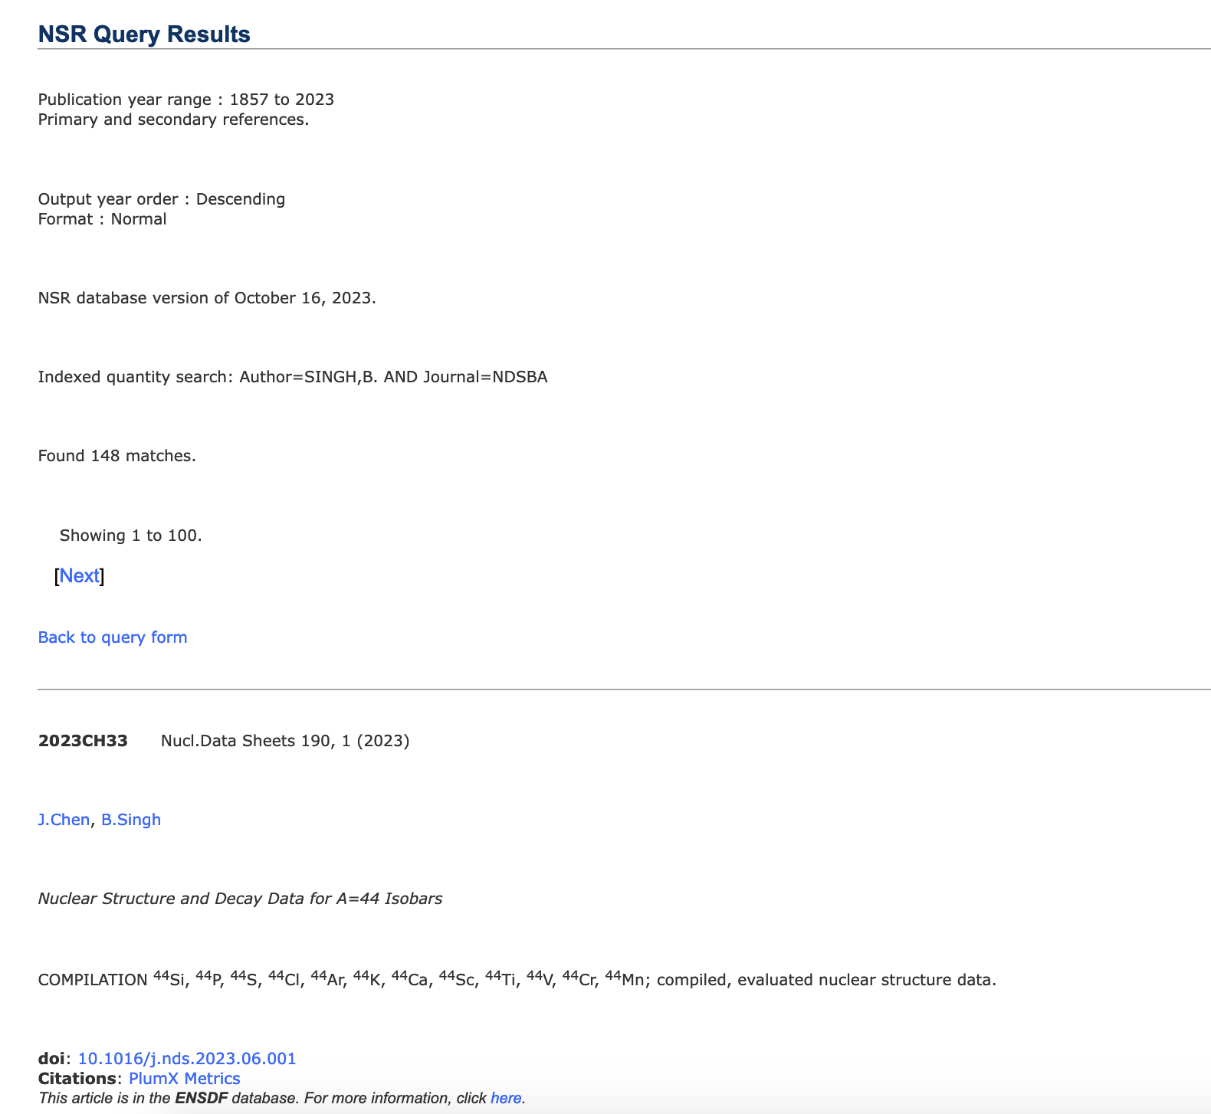
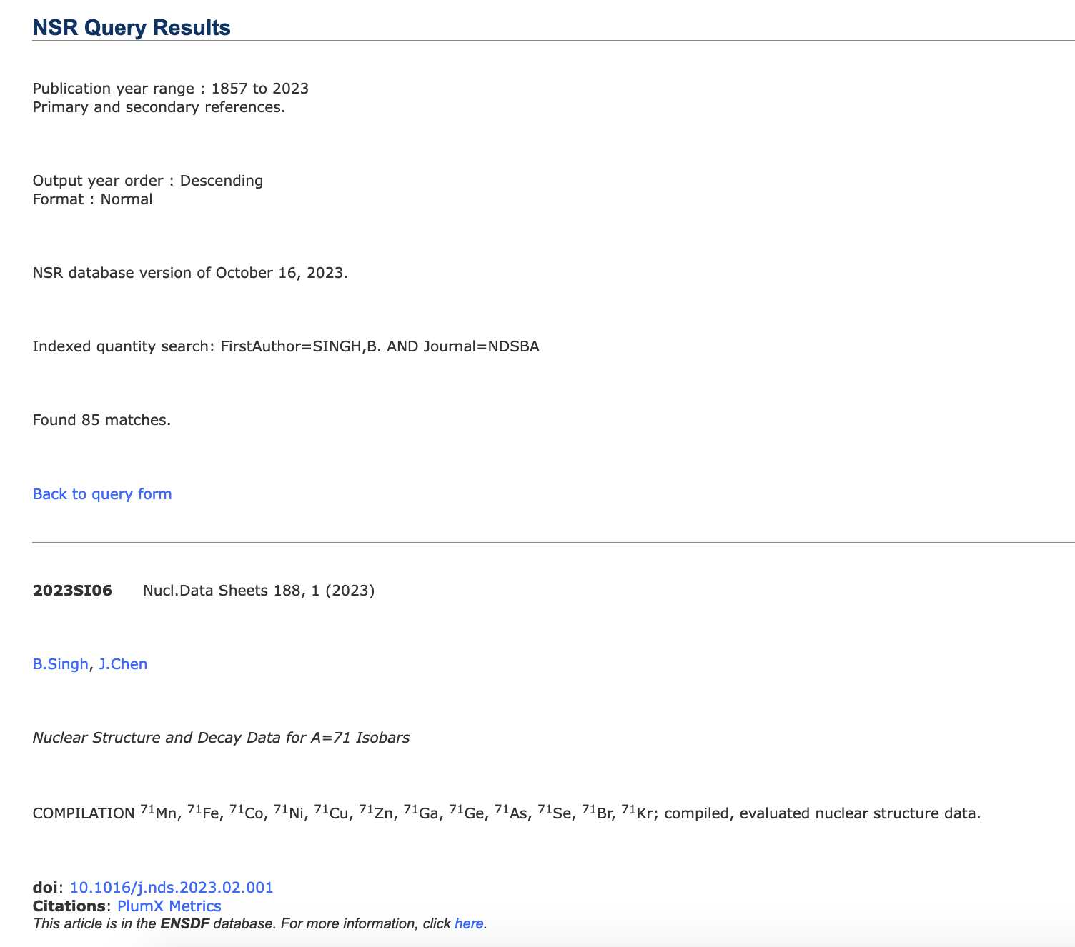
Balraj Singh’s Contribution to NSR
Dr. Balraj Singh (1941-2023): “I have three friends: ENSDF, XUNDL, and NSR.”
2007-2022 PR/C in NSR: 16,413 articles, 10,970 keyworded.
He helped enormously with NSR, mentored me, and taught Dima Symochko who is currently working on PR/C.
148 publications in Nuclear Data Sheets, 85 as a first author: 4,615 total or 31.2 citations per article as of October 24, 2023.
Enormous contributions to three databases. Balraj was a unique scientist (as Mike Thoennessen concluded) and the important nuclear data resource.

Slide 14
Takeaways
NNDC EXFOR compilation efforts are complex and well-organized: B. Pritychenko (BNL), O. Schwerer, S. Hlavac, O. Gritzay (Under contract with BNL), V. Zerkin (IAEA).
EXFOR modernization proposal was reported to NDAC.
NNDC NSR compilation efforts are complex and well-organized: B. Pritychenko, J. Totans (BNL),
late B. Singh, D. Symochko (Contractors).
People is the most important resource in nuclear data.
U.S. government funding issues may have a negative impact in FY 2024.

