Slide 1




Nuclear Data for Fusion Meeting at the Office of Science Technology Policy
Lee Bernstein
Department of Nuclear Engineering
UC-Berkeley
Nuclear Science Division
Lawrence Berkeley National Laboratory
Nuclear Data Week 2023
November 15, 2023

Slide 2
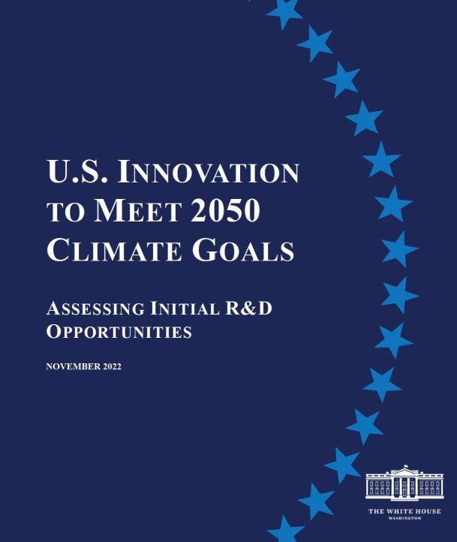
Nuclear Data for Fusion Energy Systems
Fusion energy has received an increasing amount of attention from the Biden Administration and due to the achievement of Lawson’s criterion¹ and Ignition² at the NIF.
DOE Fusion Energy Sciences sponsored a new FOA to accelerate fusion energy development.
Rian Bahran (now Office of Science and Technology Policy) convened a meeting to address one of the longest lead time items in advancing fusion research – Nuclear Data
¹Abu-Shawareb et al PRL. 129, 075001 (2022).
²A.B. Zylstra et al Nature 601, pages 542–548 (2022)

Slide 3
Nuclear Data for Fusion Energy Systems
Low-GHG Building Heating and Cooling, including refrigerants with low global warming potential
Net-Zero Aviation, cost-competitive with conventional aviation, including electric and hybrid aircraft and sustainable aviation fuels production
Net-Zero Power Grid and Electrification, including advanced transmission and distribution systems
Alternative Pathways and Circular Economy for Industrial Processes and Fuel Synthesis, including secure supply chains, circular economy innovation and low-carbon steel, aluminum, cement, chemicals, industrial heat, clean water, and electrofuels
Fusion Energy at Scale, cost-competitive with conventional energy
Only place where nuclear shows up

Slide 4


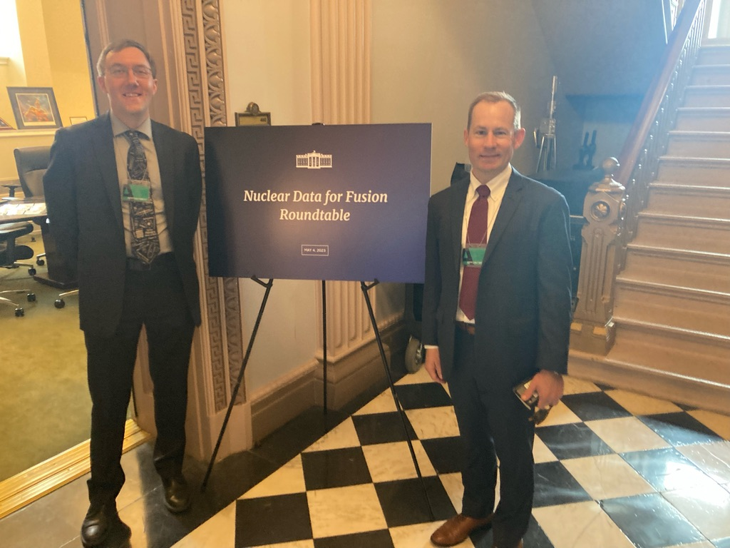
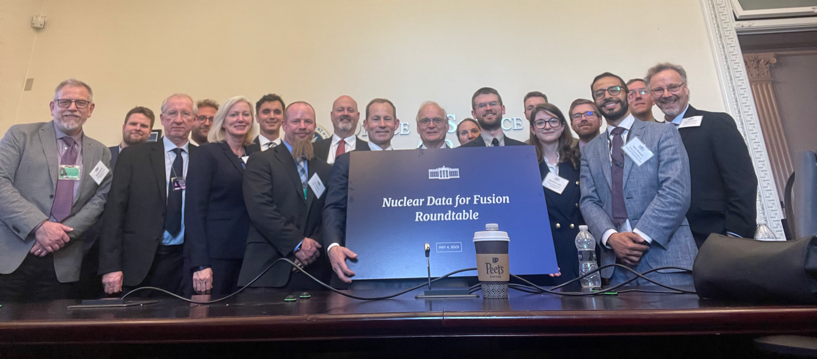
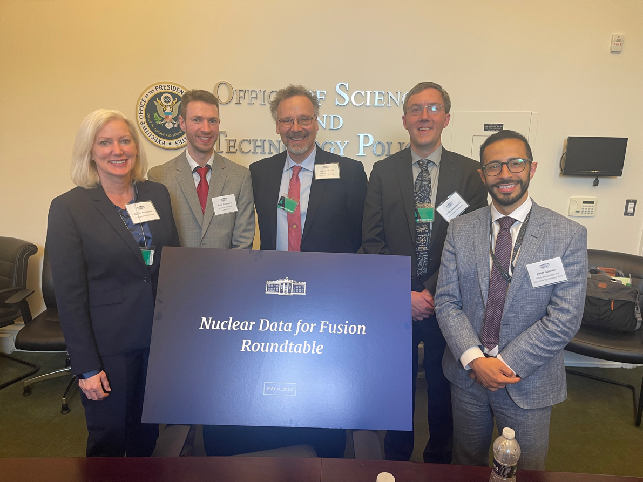
Materials Damage in Fusion and Nuclear Data | Paul Romano (ANL)
Recent WANDA Discussion (Material Damage) | Cathy Romano (Aerospace)
Relevant International Nuclear Data CRPs | J-C. Sublet (IAEA-NDS)
Discussion | All Participants
BREAK
Path Forward | All Participants
Welcome/General Overview | Rian Bahran (White House Asst. Dir. for Nucl. Tech. & Strategy)
Fusion Technology Overview | Scott Hsu (DOE Fusion Lead)
Interagency Nuclear Data Working Group (NDWG) Overview | Keith Jankowski (DOE-NP)
Fusion and the Current State of Nuclear Data | Lee Bernstein (UCB/LBNL)
Discussion | All Participants
BREAK
Fusion Nuclear Data Roundtable
Office of Science & Technology Policy
May 4, 2023

Slide 5
BLUF: Several Nuclear Data Needs have already been identified
What new energy differential measurements are needed?
Tritium breeding
  (n,t) cross sections
  Multiplying materials
Neutron-induced damage, gas production & activation
  Containment vessel (All)
  Magnets (MCF)
  Optics (ICF)
Electronics/Sensor damage
  Ion stopping powers (All)
TN reactions
  Polarized D+³H (Helion)
What sort of integral benchmarks are needed?
Are there significant holes in the compiled data?
Who are the domestic partners (e.g., stewardship science, fast reactors, nonproliferation)?
Who are the international partners?
A number to keep in mind:
A 2 GWe fusion power plant will liberate 106 g of 14 MeV neutrons every day!

Slide 6
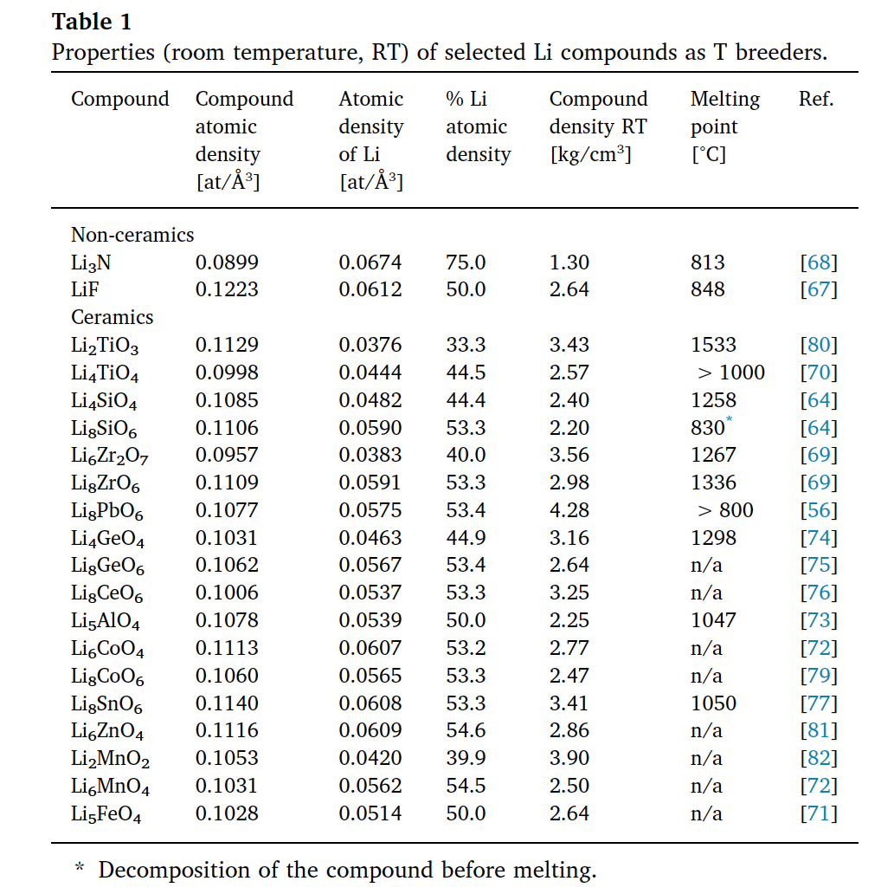
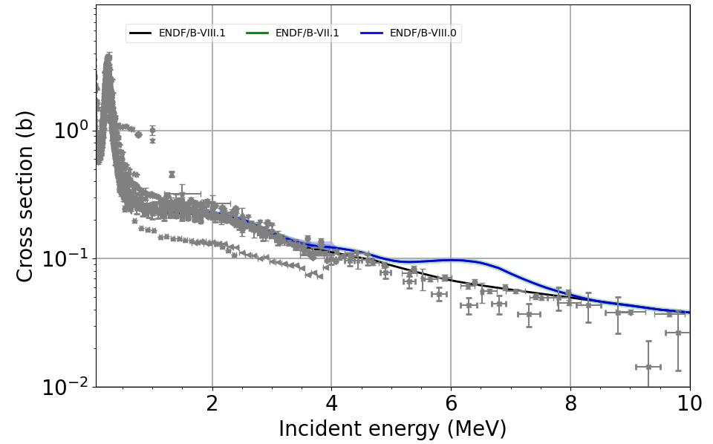
Tritium Breeding is one of the top issues identified by the fusion community
Goal is to produce 1.1-1.2 ³H per neutron!
  Multiplication is a MUST → data for Pb, Zr…
First principles review of options for tritium breeder and neutron multiplier materials for breeding blankets in fusion reactors
F.A. Hernandez⁎, P. Pereslavtsev
How well do we know these cross sections?
  Do we need measurements?
  Do we need improved compilation?
The ⁶Li(n,t)α evaluation is a recent success:
Old Evaluation
New Evaluation
⁶Li(n,t)α
Thanks to Mark Paris (LANL)
Thanks to Mike Loughlin & Paul Humrickhouse (ORNL)

Slide 7
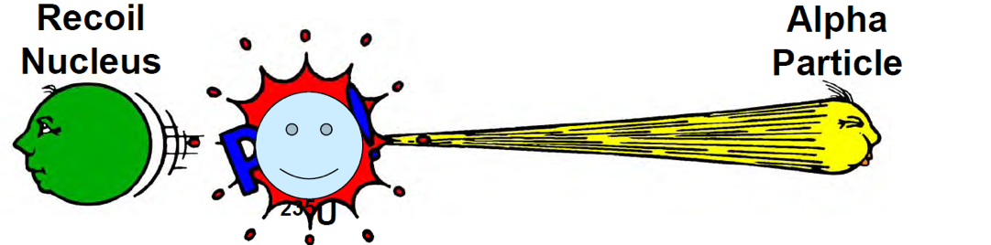
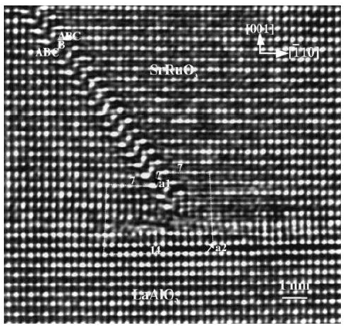
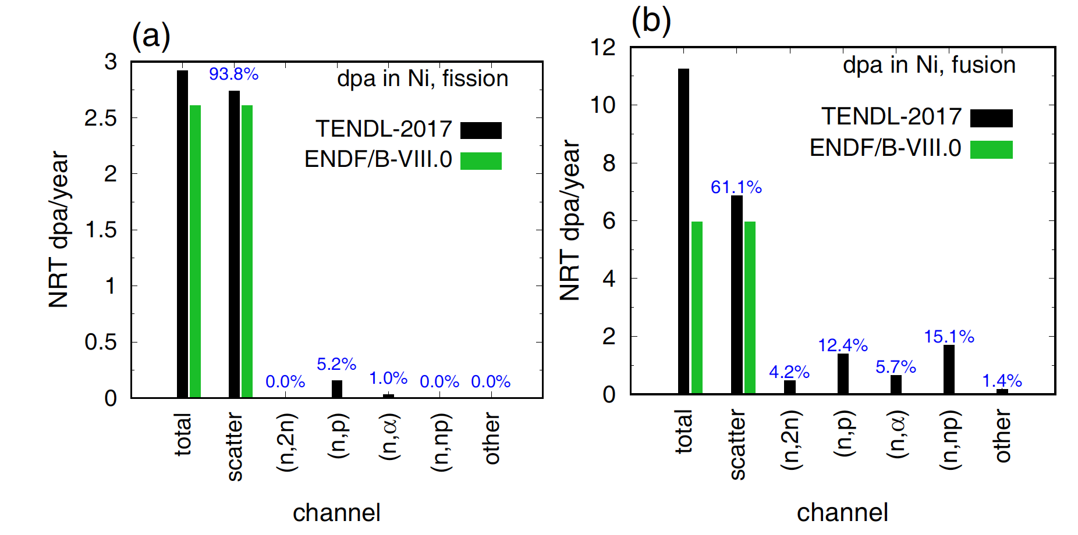
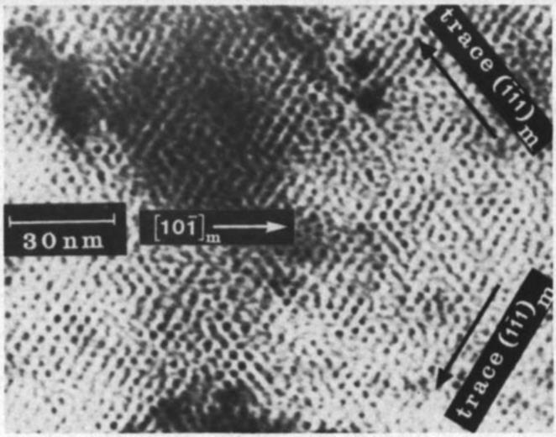
Fusion displacement damage and gas production will be MUCH larger than fission and involve different (n,x) reactions
neutron
J.-Ch. Sublet et al., Eur. Phys. J. Plus (2019) 134: 350

Slide 8
Cathy Romano reviewed the Findings and Recommendations from the WANDA 2019 Materials Damage Session
ENDF is missing data for recoils and (n,α)
      Inaccurate (n,α) data caused serious miscalculation of materials lifetimes
Need to understand how changed materials properties change the neutronics
      Transmutation, Porosity and Chemical bonds
Processing of the data in NJOY needs modernization to meet the needs of the fusion community
Current models do not determine the size of vacancies
Stopping Powers are not well understood
Radionuclides produced under transmutation might create further Primary Knock-on Atoms (PKAs) as they decay, and so the rate of these must also be quantified.
      Gilbert, Mark & Sublet, Jean-Christophe. (2016). PKA distributions: Contributions from transmutation products and from radioactive decay. Nuclear Materials and Energy. 9. https://doi.org/10.1016/j.nme.2016.02.006
Inelastic Scatter cross sections need to be improved for fast neutron transport calculations
Secondary particle production is not well known and requires measurement and theory development
GRIN

Slide 9
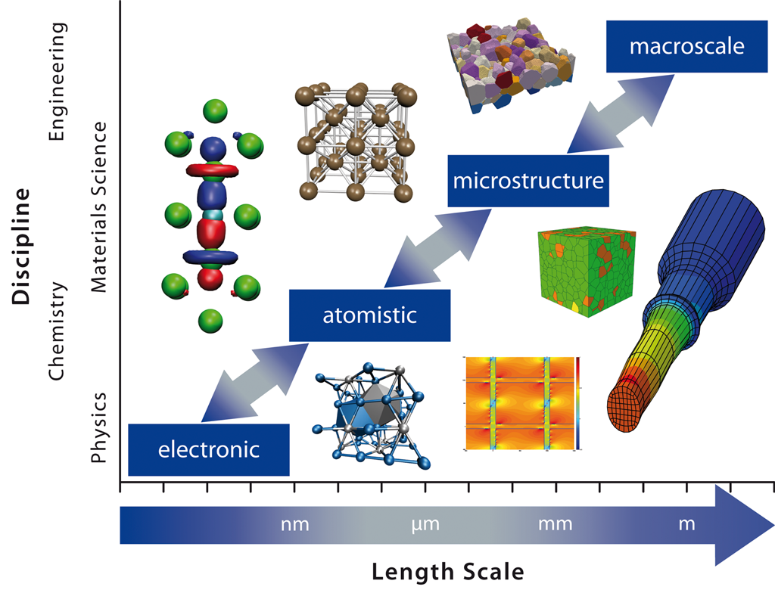
WANDA 2019 stated that the goal would be an integrated model using current data to guide the design of nuclear energy systems
Integrated models with correct data (including nuclear data!) at different length scales together with links to neutronics and thermal properties are needed to provide an advanced modeling capability
Sublet, J.C., Bondarenko, I.P., Bonny, G. et al. Neutron-induced damage simulations: Beyond defect production cross-section, displacement per atom and iron-based metrics. Eur. Phys. J. Plus 134, 350 (2019). https://doi.org/10.1140/epjp/i2019-12758-y

Slide 10
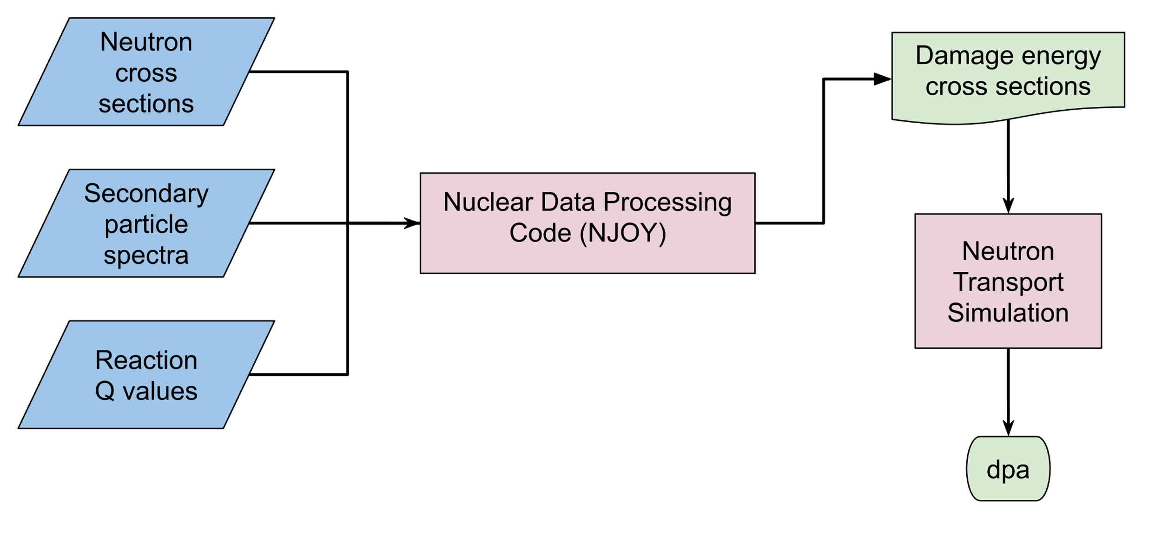
Paul Romano (ANL) described how we get from nuclear data to dpa
Thanks to Paul Romano (ANL)

Slide 11
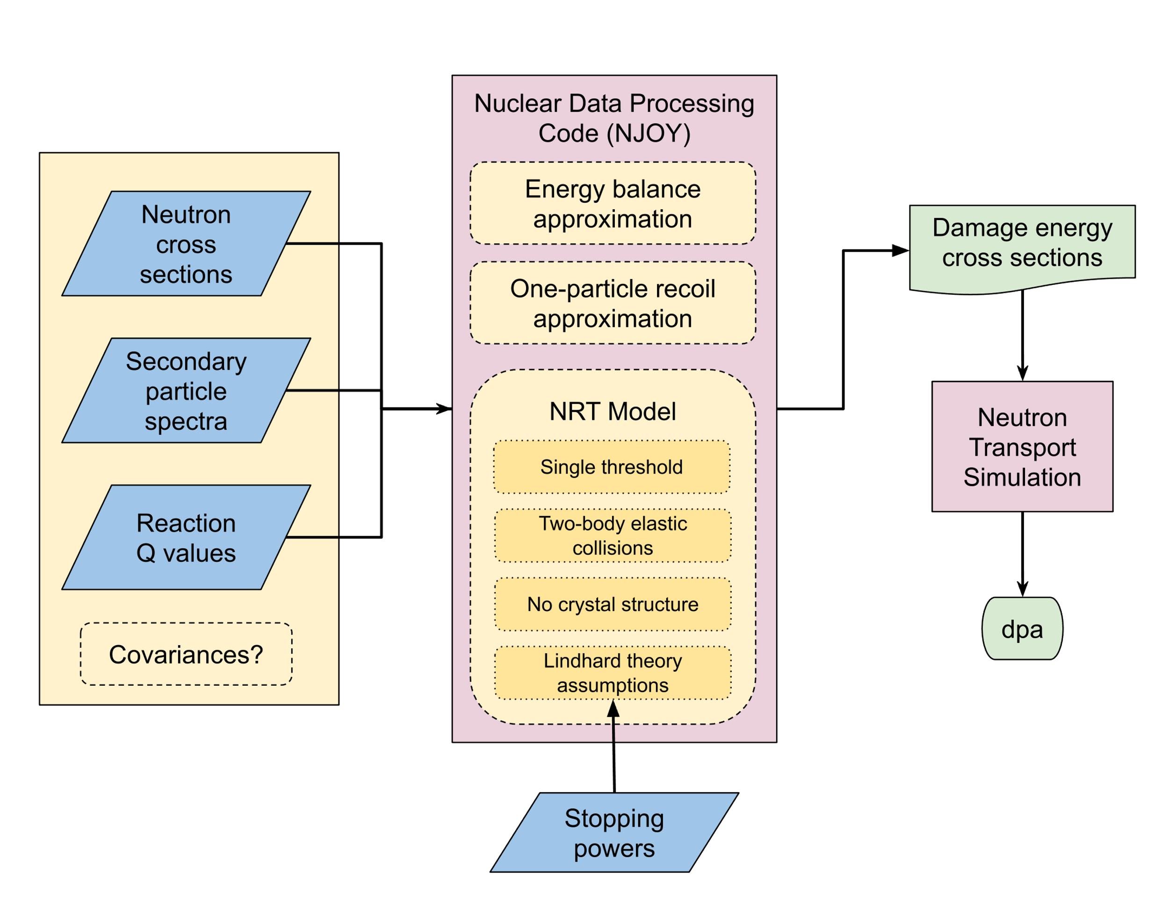
Paul Romano (ANL) described how we get from nuclear data to dpa
Can we get data that includes both the nuclear and atomic data?
Thanks to Paul Romano (ANL)

Slide 12
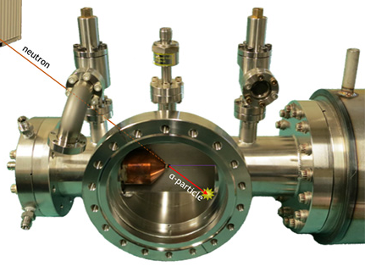
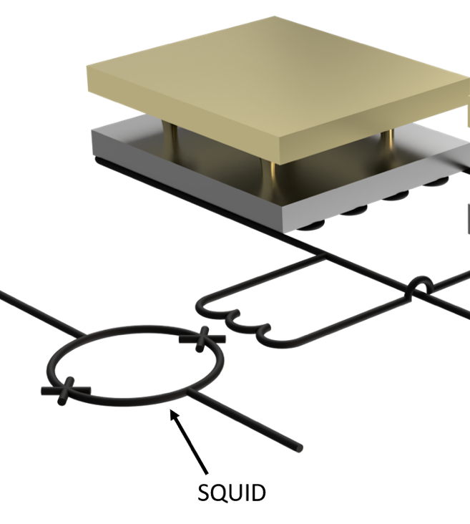
Microcalorimeters together with DT-Associated Particle Imaging neutron source could measure σ_{DPA} and gas production measurements including stopping power info
DT neutron sources with Associated Particle Imaging (DT-API)
Etcheverry Hall
Sample Irradiation
Vault (UCB)
α
neutron
Absorber
Multi-MeV
(n,p) & (n,α)
ejecta
Sensor
Note that σ_{DPA} has never been measured directly before...
10’s of keV recoils
…and these sorts of measurements would include stopping powers
SQUID
Cryogenic µcalorimeter

