Slide 1
WANDA 2024 – CSEWG Discussion
Amy Lovell¹, Jesse Brown², Todd Bredeweg¹, Jo Ressler³, Cathy Romano⁴
¹Los Alamos National Laboratory
²Oak Ridge National Laboratory
³Lawrence Livermore National Laboratory
⁴Aerospace Corporation
CSEWG 2023: Nov 15th – 17th, 2023

Slide 2
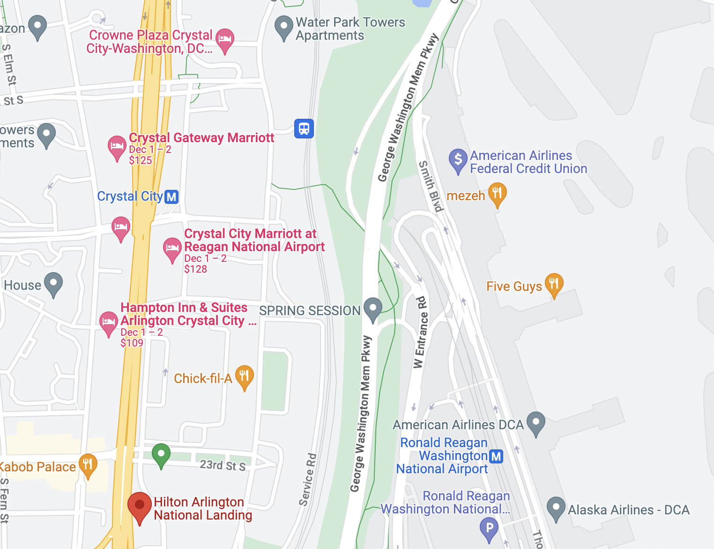
WANDA 2024 location: Hilton Arlington National Landing
•Feb 26th-29th, 2024
Close to DCA and metro stations (shuttle from the airport)
Newly renovated as of fall 2023
Poster session for WANDA 2024, have a dedicated space for the posters all week

Slide 3
WANDA 2024 Contacts
WANDA chairs: Jesse Brown (brownjm@ornl.gov, ORNL) and Amy Lovell (lovell@lanl.gov, LANL)
Logistics point of contact: Lisa Felker (felker7@llnl.gov, LLNL)
Nuclear Data Working Group chair: Todd Bredeweg (toddb@lanl.gov, LANL)
Nuclear Data Working Group vice chair: Jo Ressler (ressler2@llnl.gov, LLNL)

Slide 4
Sessions
ND for Fusion Energy
Rxn's and Transport for Fusion
Tritium Production
Material Damage
Isotope Production & Targetry
Uncertainty Quantification
Monday
Tuesday
Wednesday
Thursday
Friday
Tritium Production
Project Reports
8am-12pm
Intro & PMs
Isotopes
Restricted
Rxn's & Transport for Fusion
Material Damage
Uncertainty Quantification
Project Reports & Session Wrap-up
1-5pm

Slide 5
ND for FE: Reactions & Transport for Fusion
NDWG contact: Cathy Romano (Aerospace Corp)
Chairs: Keegan Kelly (LANL), Laura Gustad (MDA), Mike Loughlin (ORNL)
Summary:
Modeling and simulation of fusion energy sources will involve a range of charged particle and neutron reactions. Fusion energy reactors based on D-T fusion reactions will produce intense sources of high energy (14 MeV) neutrons, where these neutrons will interact with the surrounding materials causing potential radiological and engineering hazards. What are the anticipated reactions for energy production, and do specific data needs exist? What are the products of these reactions, and are there data needs for understanding secondary reactions? Are there gaps in current neutronics code capabilities to accurately model the interactions? ND must accurately predict shielding, activation, dose rates, and neutron diagnostics. What data are necessary to operate neutron sources (IFMIF, FPNS, etc.)?

Slide 6
ND for FE: Tritium Production
NDWG contact: Cathy Romano (Aerospace Corp)
Chairs: Stephanie Lyons (PNNL), Paul Humrickhouse (ORNL)
Summary:
Fusion-based reactors are anticipated to breed tritium (³H) needed to fuel energy production. However, quantities of this isotope will be needed during reactor startup, and it may be in short supply. Tritium is currently produced in Canadian Deuterium Uranium (CANDU) nuclear reactors as a waste product. However, about half of the current 19 reactors will be retiring in the next decade and the tritium supply will quickly decline. Are there other production processes or reactor materials that can be used to establish a new source of tritium for fusion energy applications? Which nuclear data are necessary to support testing and operation of liquid blankets? Ceramic blankets? What are the uncertainties and sensitivities to tritium breeding ratio?

Slide 7
ND for FE: Material Damage
NDWG contact: Cathy Romano (Aerospace Corp)
Chairs: TBD
Summary:
The intense neutron fields produced in fusion energy reactors can affect the materials in the reactor, changing the performance and safety over time. Nuclear data may be needed to improve predictive capabilities that may affect reactor material choices and costs. For example, what nuclear data needs exist for estimates of displacement-per-atom (DPA) rates that may cause material embrittlement or failure? Are there gas-producing reactions (e.g. H, He products) that may affect material swelling or fracture?

Slide 8
Isotope Production & Targetry
NDWG contact: Etienne Vermeulen (LANL)
Chairs: Ellen O’Brien (LANL), Matt Gott (ORNL), Khachatur Manukyan (Notre Dame)
Summary:
This session will be focused on cross-cutting developments, challenges, and needs in the field of targetry for nuclear data applications, including the availability of enriched stable and radioactive isotopes. Invited talks and discussion will be focused on target needs for a variety of nuclear data application spaces, the availability of these targets, and novel targetry fabrication techniques. The intent of this session is to discuss unmet needs and identify areas in which investment would benefit the quality and availability of targets for end users to generate nuclear data.

Slide 9
Uncertainty Quantification
NDWG contact: Nathan Gibson (LANL)
Chairs: Robert Casperson (LLNL), Denise Neudecker (LANL), TBD
Summary:
Following last year’s Nuclear Data Uncertainty Quantification Working Meeting and a handful of related previous WANDA sessions, this session seeks to highlight the identified biggest needs to enable proper uncertainty quantification of nuclear data from theory and experiment through evaluation and all the way to end users. The incomplete and inconsistent quality of existing covariance information poses a large challenge for those well-versed in the UQ field. For those newer to this field, complications as to the meaning and trustworthiness of covariance data, as well as the complexity of techniques for forward propagation, require training and resources from those established in the community. By hearing from those that have pioneered many of the important aspects of this work and from those that would benefit from future work, this session will make the case for the exciting and modern approach of UQ-oriented nuclear data work.

Slide 10
Acknowledgements
WANDA is sponsored by the Nuclear Data Interagency Working Group (NDIAWG).

