Slide 1
Thermal neutron capture primary gamma-rays: Issue and repair
Emanuel V. Chimanski
GRIN (Gamma-Ray Induced by Neutrons)
Apr 25, 2023

Slide 2
Outline
“capture” state
1/2+
Triage of differences in thermal capture spectrum between GNDS and ENSDF (and EGAF):
One should have one primary capture emission for each neutron capture event
Summary and repair strategy;
7/2+
5/2+
3/2+
GS
1/2+
Primaries
Secondaries
"continuum"
Multiplicity (prob per capture)
Branching ratio
Probability per capture
Eout (MeV)
[in bins]
Eout (MeV)
Eout (MeV)

Slide 3
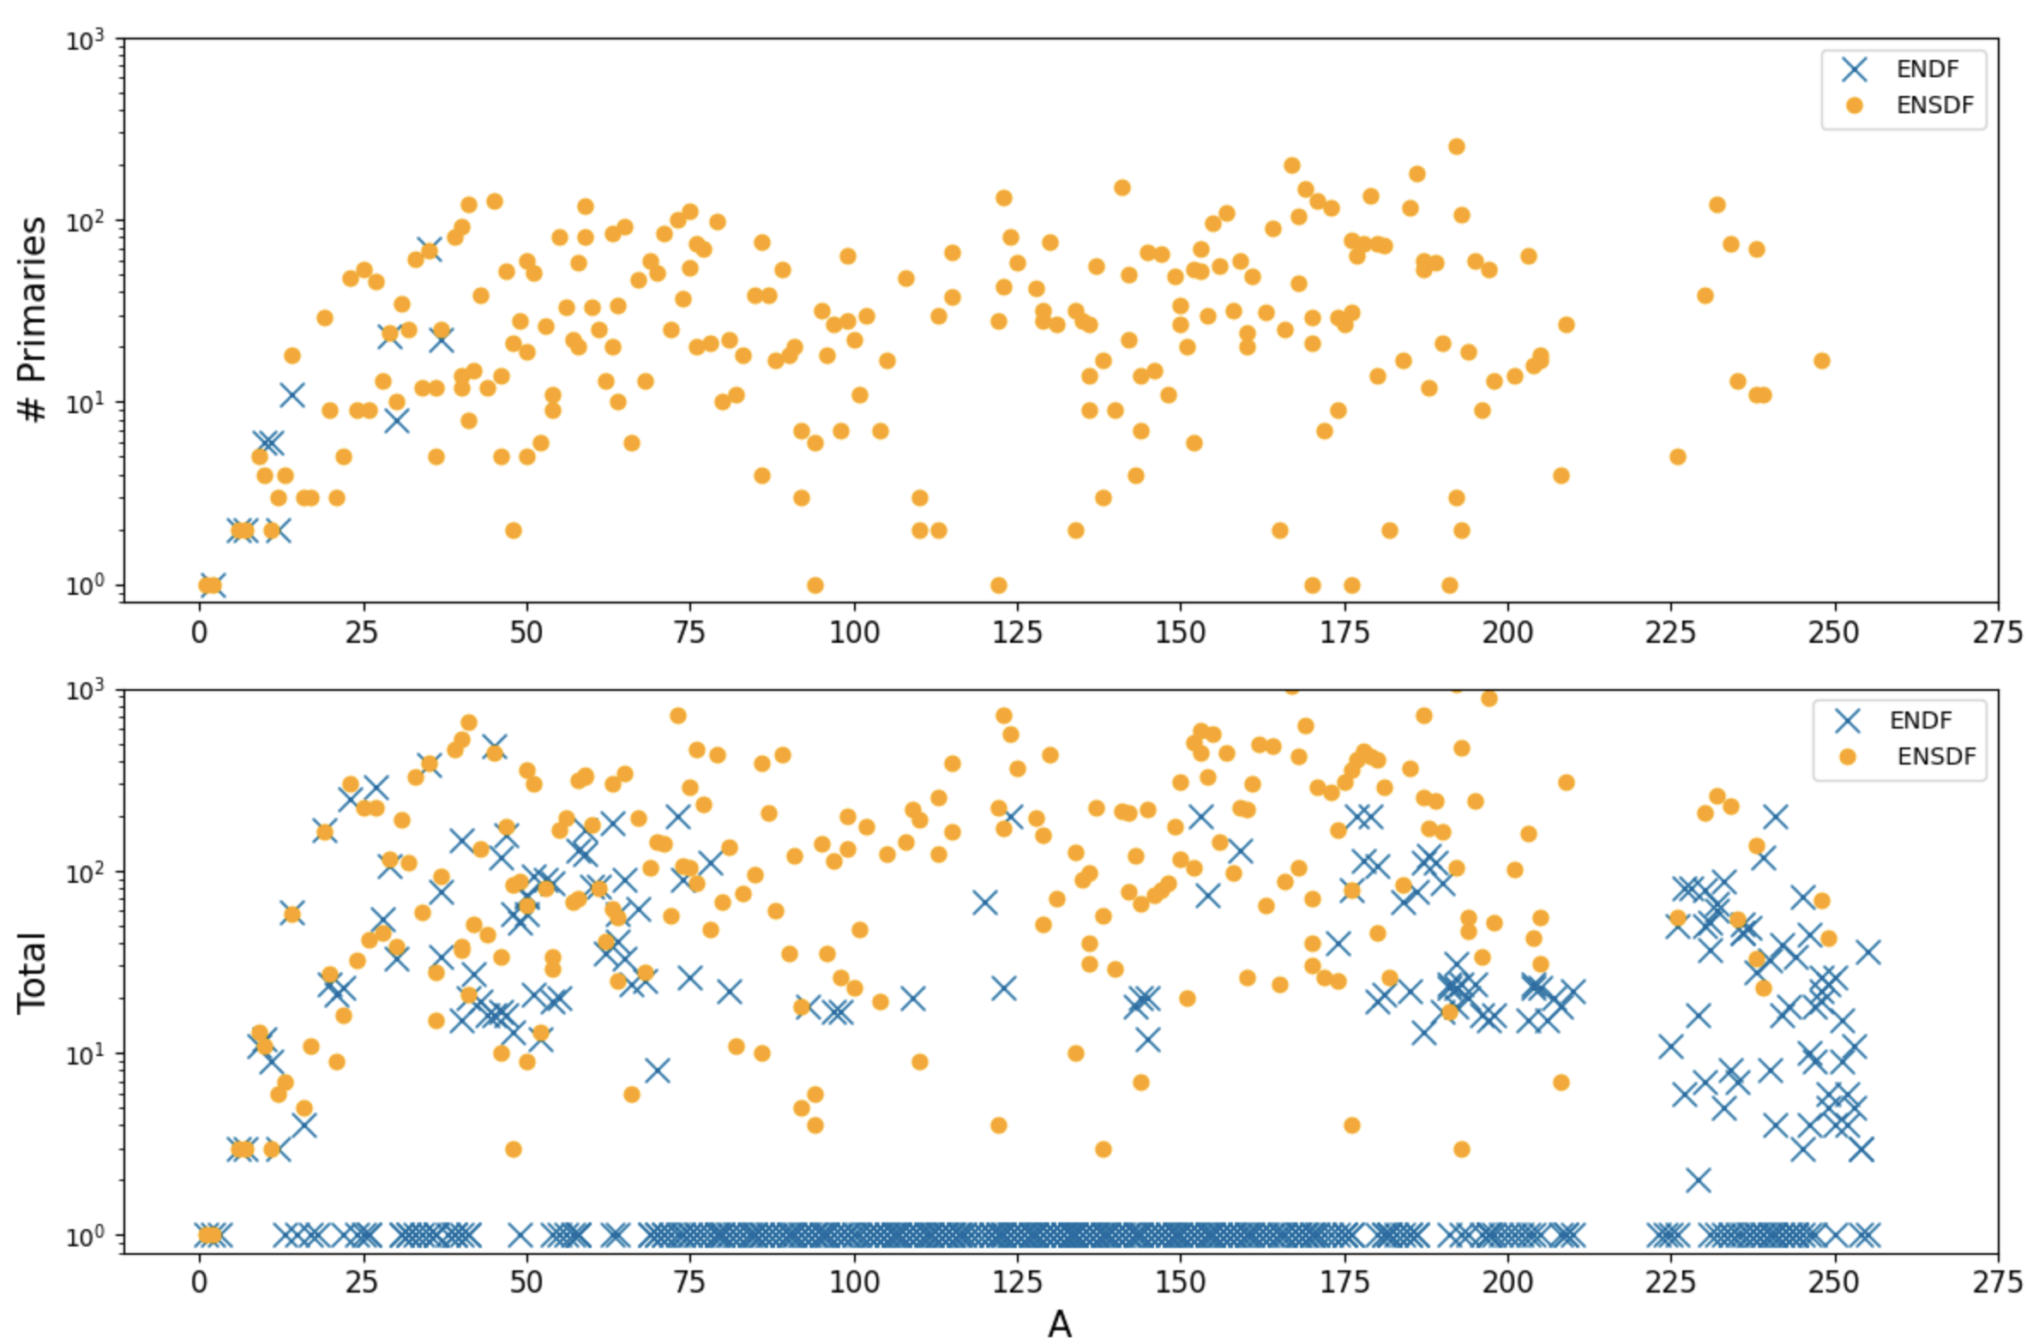
Photon (gamma) distributions (@termal)
ENDF/VIII.0
144 targets with no photon data for capture in ENDF
11 with primary + discrete photons
161 with only discrete photons
Most isotopes in ENDF do not have flagged primary transitions separately but seem to include them all into the discrete type or into the "continuum"

Slide 4
Some selected cases with highlighting differences
Secondary emissions
¹⁶O(n,γ)
⁶⁵Cu(n,γ)
ENDF does not always flag primaries
Sometimes ENDF includes primaries into the “continuum” spectrum
Likely to require new cascade simulation

Slide 5
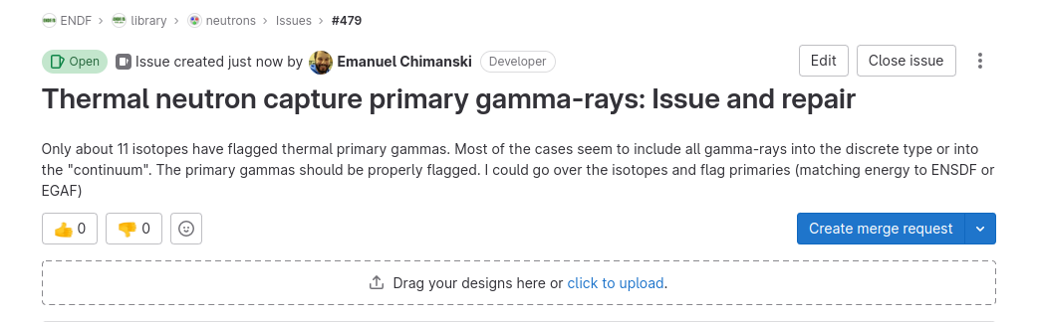
Repair strategy
Do not change ENDF capture gamma structure (MF-6, MF-12)
Use FUDGE to Flag primaries accordingly to ENSDF-Thermal or EGAF

Slide 6
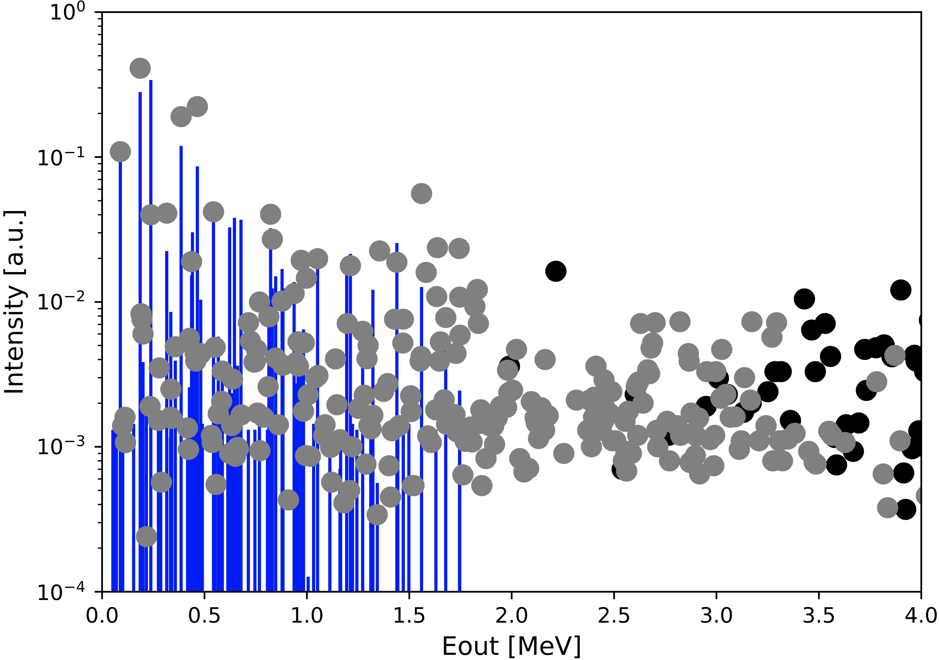
Some selected cases with highlighting differences
Secondary emissions
⁶⁵Cu(n,γ)
³¹P(n,γ)
¹⁹⁷Au(n,γ)
ENDF includes primaries into “continuum” spectrum
ENDF does not flag primaries or secondaries.
Some peaks at high energy attempt to include primary emission
ENDF includes only a “continuum” spectrum.
Primaries are not present
Secondaries seem to be included in the continuum spectrum
About half of secondary emissions are present in ENDF: Some with mismatches

