Slide 1
Format Proposal for Isotopic Distribution in TSL Files for ENDF/B-VIII.1
Chris W. Chapman¹, Doro Wiarda¹
¹Oak Ridge National Laboratory
Mini-CSEWG – 25 April 2023

Slide 2
Proposed Format: MF7/MT451 File
A ‘footer’ file for ENDF6-format TSL files
Would contain several pieces of pertinent information for the scattering atom:
Number of scattering atoms in molecule
Isotopic distribution within scattering atom
Free atom and atomic weight ratios for each isotope
Will not require significant changes to processing codes or to other sections of the MF7 file

Slide 3
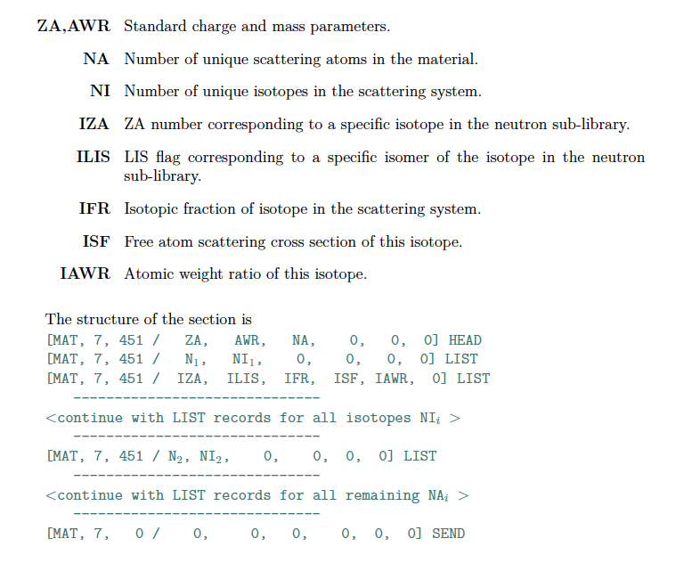
Proposed Format

Slide 4
Example 1 – HinH2O
N_1, NI_1
NA
IZA, ILIS, IFR, IS, IAWR

Slide 5
Example 2 – ZrinZrH2

Slide 6
Example 3 – SiO2-beta

Slide 7
This work was supported by the Nuclear Criticality Safety Program, funded and managed by the National Nuclear Security Administration for the Department of Energy.

