Slide 1
Covariance Testing Progress for ENDF/B-VIII.1β1 at ORNL
B.J. Marshall
Mini-CSEWG
Livermore, CA
April 25-27, 2023

Slide 2
Outline
Data-induced uncertainty in VALID benchmarks
Data-induced uncertainty for fission products in SNF
C_{k} values for SNF validation

Slide 3
Data-induced uncertainty in VALID benchmarks
Historically a check ORNL has used to compare predicted variability with observed variability from benchmarks
TSUNAMI-IP propagates covariance data with sensitivities from benchmarks
The uncertainty is determined by reaction-nuclide pair and summed to determine the total data-induced uncertainty in k_{eff}
Examination of results highlights covariance data issues

Slide 4
Results
Category | Number of Cases | Avg C/E (CE_V8.1) | Avg Exp. Unc. (pcm) | St. Dev. Of C/Es (pcm) | Avg 1σ XS Unc (pcm) |  | % of Cases Within
 |  |  |  |  | E8+SCALE | E8.1+SCALE | Exp. Unc. Band | E8.1+SCALE XS Band
HMF | 50 | 1.00002 | 193 | 467 | 979 | 950 | 34.0 | 96.0
HST | 52 | 0.99900 | 494 | 615 | 652 | 792 | 75.0 | 96.2
IMF | 13 | 1.00132 | 269 | 362 | 1027 | 1003 | 46.2 | 100
LCT | 140 | 0.99874 | 195 | 162 | 603 | 737 | 56.4 | 100
LST | 19 | 0.99920 | 318 | 283 | 824 | 944 | 57.9 | 100
MCT | 49 | 0.99244 | 400 | 313 | 973 | 758 | 18.4 | 51.0
MST | 10 | 0.99177 | 452 | 384 | 1323 | 1019 | 0 | 50.0
PMF | 12 | 0.99902 | 207 | 133 | 1022 | 1038 | 66.7 | 100
PST | 81 | 0.99927 | 497 | 429 | 1344 | 937 | 76.5 | 92.6

Slide 5
Small changes…
HMF systems show small differences in general: ~3%
HMF systems reflected with DU appear to have significant reductions in ²³⁵U nubar uncertainty (~400 pcm in E8.0 → ~225 pcm in E8.1)
IMF system uncertainties ~2% lower with ENDF/B-VIII.1β1
²³⁵U nubar ~10% lower, 3rd highest contribution to uncertainty
PMF systems a little less than 2% higher on average

Slide 6
Big changes (1): HST, LCT, and LST
HST, LCT and LST systems see large increases in uncertainty
Average uncertainty increased ~22% for HST and LCT systems and ~15% for LST systems
Directly attributable to ~40% increase in nubar contribution to uncertainty in thermal uranium systems
ORNL still disagrees with the ¹H covariance introduced in ENDF/B-VIII.0 and its associated significant increase in data-induced uncertainty
Plot on next slide shows comparison of ENDF/B-VIII.0 and ENDF/B-VIII.1β1 nubar

Slide 7
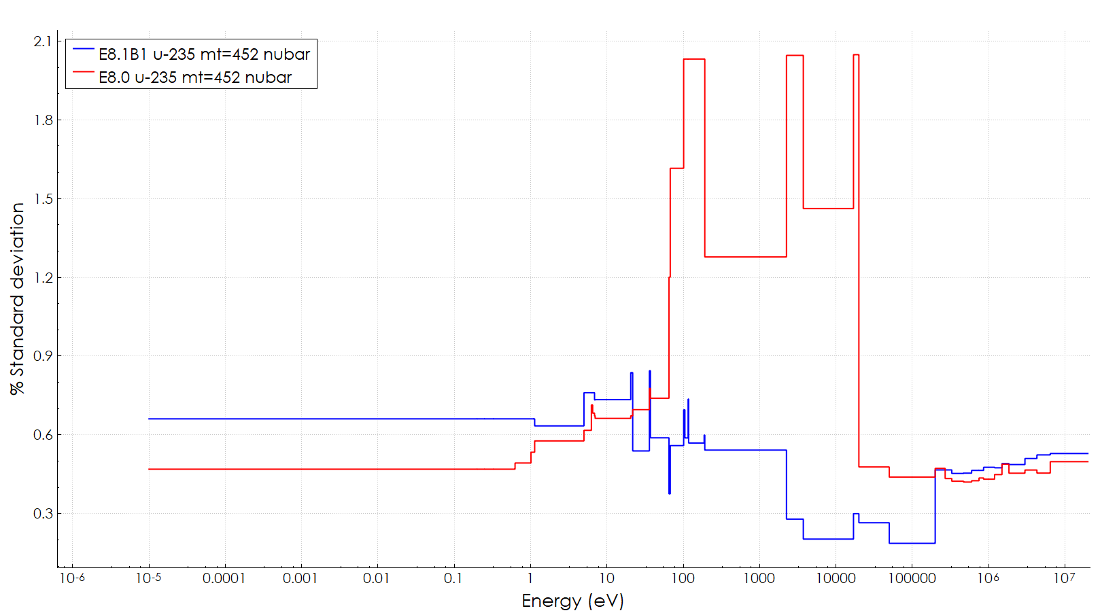
²³⁵U nubar comparison

Slide 8
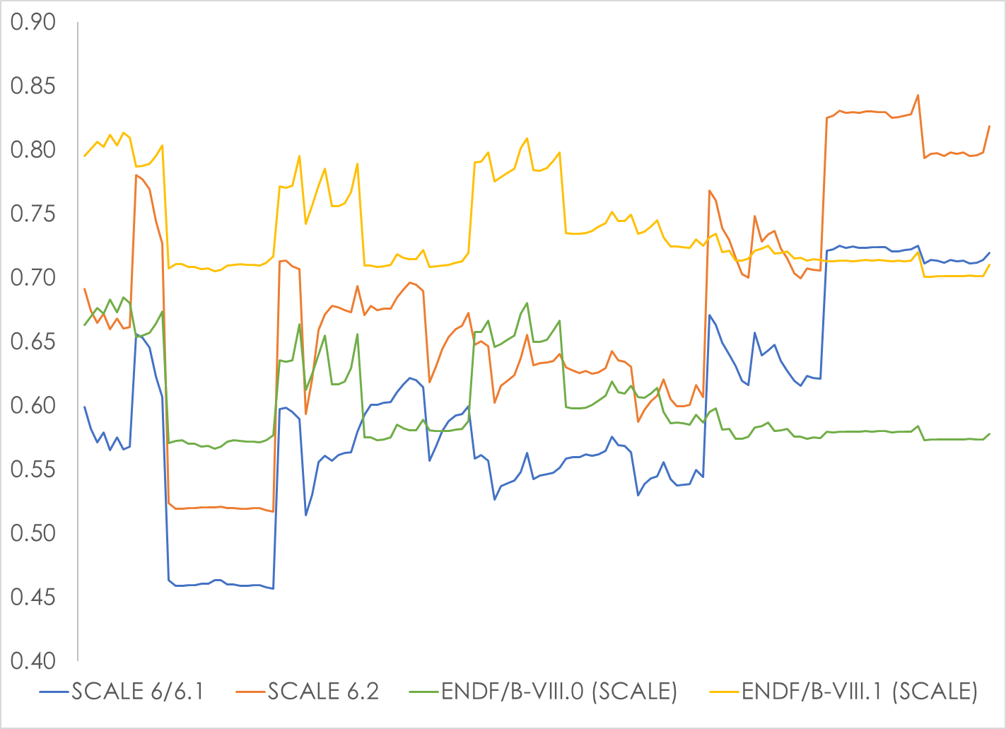
Historical perspective on LCTs

Slide 9
Big changes (2): MCT, MST, and PST
MST, MCT, and PST systems see large decreases in uncertainty
Average uncertainty decreased ~22% for MST and MCT systems and ~30% for PST systems
Basically all the ²³⁹Pu covariance data is totally different
Nubar uncertainty up by 167%
Chi down by 80%
Fission down by >85%
n,gamma (leading contributor in E8.0) down by 95%
1130 pcm → 50 pcm

Slide 10
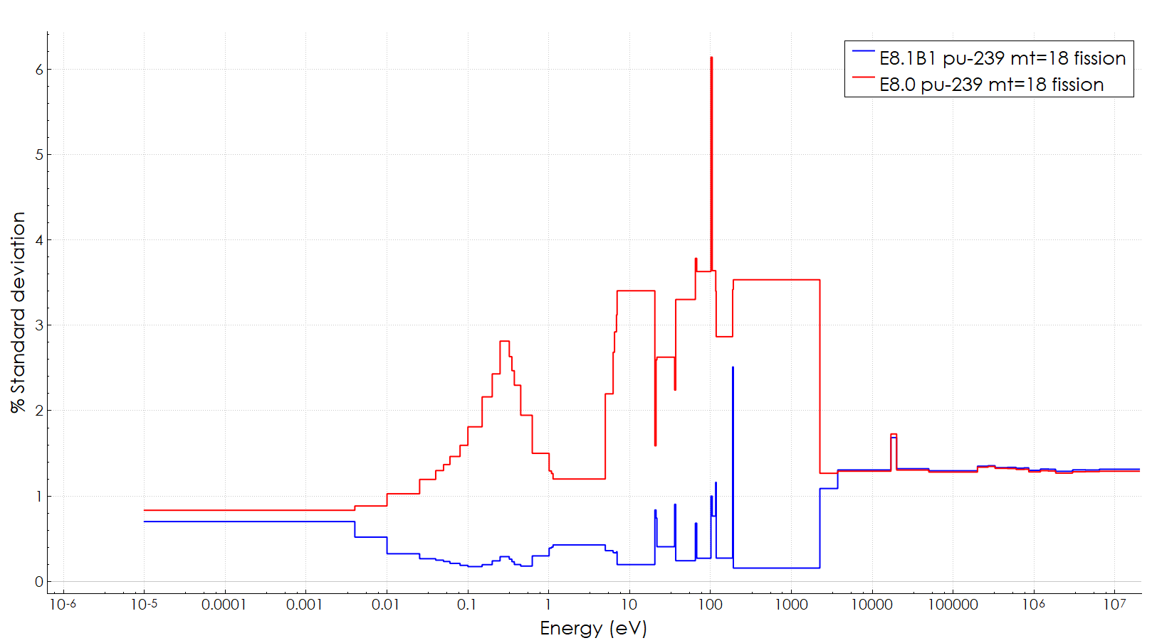
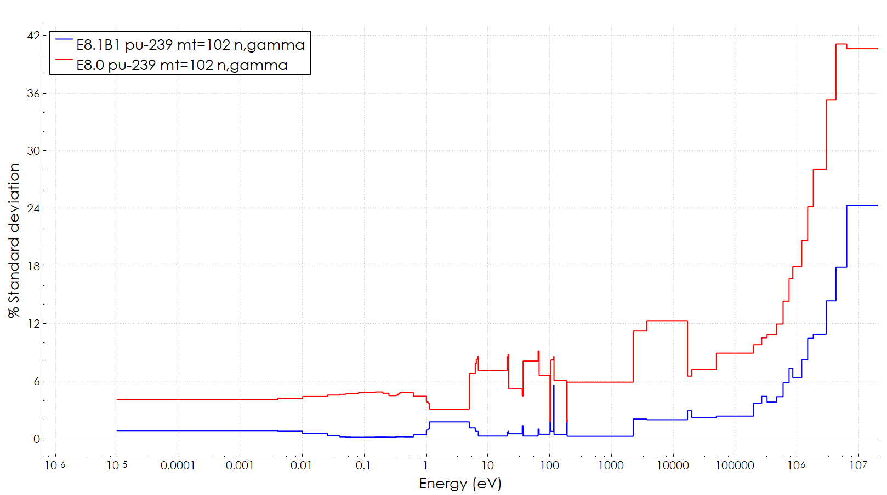
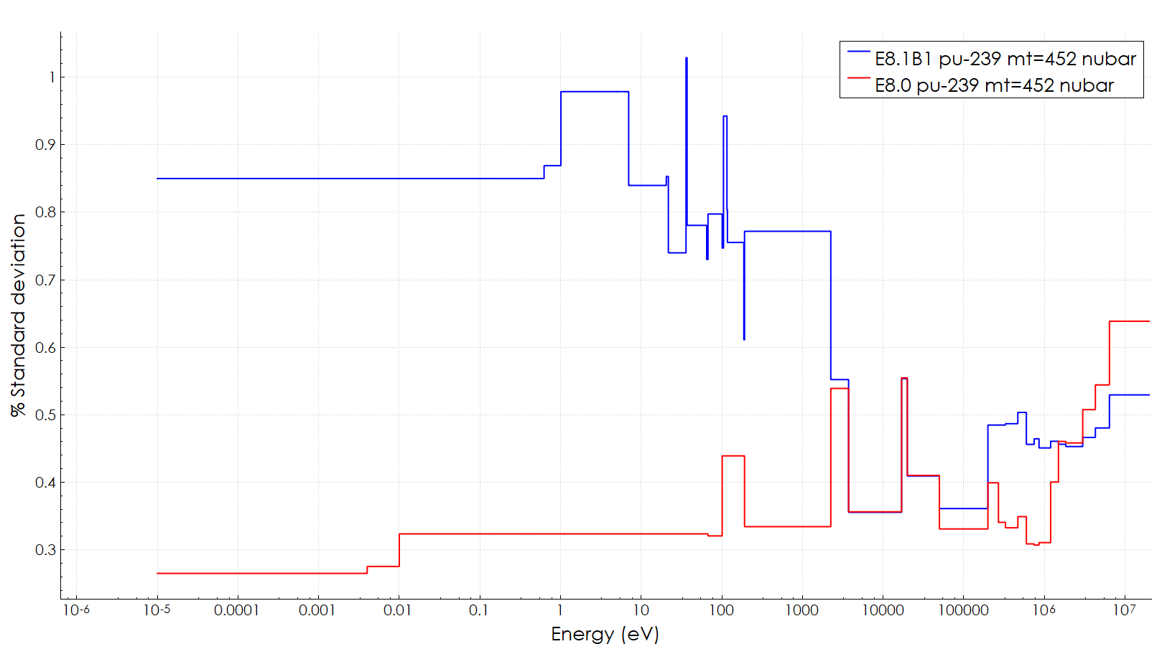
²³⁹Pu fission, nubar, and n,gamma uncertainties
More than a factor of 10!
More than a factor of 30!
Only a factor of about 2.5.

Slide 11
Questions on VALID results?

Slide 12
Data-induced uncertainty in SNF k_{eff}
Data-induced uncertainty in minor actinides and fission products used to determine a potential validation penalty in NUREG/CR-7109
Currently incorporated in NUREG-2215, Appendix 7A, and NUREG-2216, Appendix 6A
Penalty based on uncertainty as a fraction of fission product worth
Work on-going to re-evaluate entirely in ENDF/B-VII.1 and ENDF/B-VIII.0
Covariance testing looks only at how much the uncertainty has changed

Slide 13
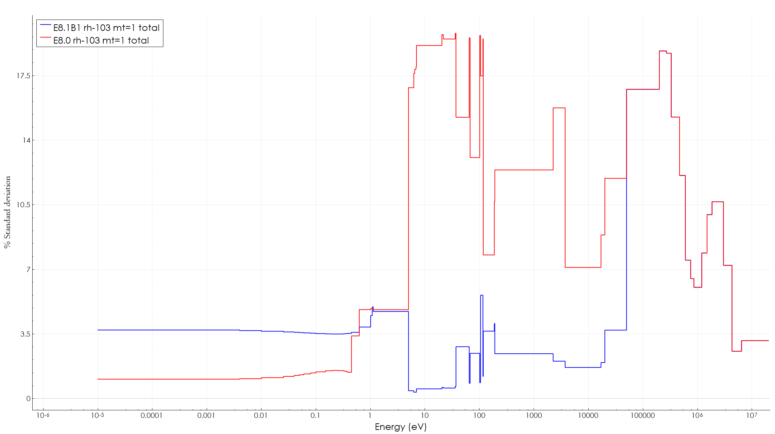
Results
Nuclide | E8.0 Unc. (% Δk) | E8.1 Unc. (% Δk) | Difference (%)
mo-95 | 0.00499 | 0.00499 | 0.06%
tc-99 | 0.00990 | 0.00990 | 0.00%
ru-101 | 0.00788 | 0.00788 | 0.00%
rh-103 | 0.02118 | 0.02735 | 29.11%
ag-109 | 0.00232 | 0.00232 | 0.00%
cs-133 | 0.01693 | 0.01693 | 0.00%
sm-147 | 0.00549 | 0.00549 | 0.00%
sm-149 | 0.02050 | 0.02050 | 0.00%
sm-150 | 0.00521 | 0.00521 | 0.00%
sm-151 | 0.01234 | 0.01234 | 0.00%
sm-152 | 0.00617 | 0.00617 | 0.00%
nd-143 | 0.03510 | 0.03510 | 0.00%
nd-145 | 0.01818 | 0.01818 | 0.00%
eu-151 | 0.00024 | 0.00024 | 0.00%
eu-153 | 0.00805 | 0.00805 | 0.00%
gd-155 | 0.01236 | 0.01236 | 0.00%
total | 0.05808 | 0.06060 | 4.34%
Red: Big change Orange: SCALE data not in ENDF

Slide 14
Questions on fission product uncertainty data?

Slide 15
SNF cask c_{k} calculations
The integral index c_{k} is used to assess similarity between an application system and potentially applicable benchmarks
Calculated as the Pearson correlation coefficient of nuclear data induced uncertainty in k_{eff}
Covariance data changes the relative contribution of different sensitivities to the overall similarity assessment
Impacts are typically assessed on PWR SNF at 40 GWd/MTU
Included in the regulatory basis documents discussed earlier
$$c_{k}=\frac{σ_{R_{1},R_{2}}^{2}}{σ_{R_{1}}σ_{R_{2}}}$$
$$S_{R_{1},Σ_{x}} ∙ {Cov}_{Σ_{x},Σ_{y}} ∙ S_{R_{2},Σ_{y}}^{T} = σ_{R_{1},R_{2}}^{2}$$

Slide 16
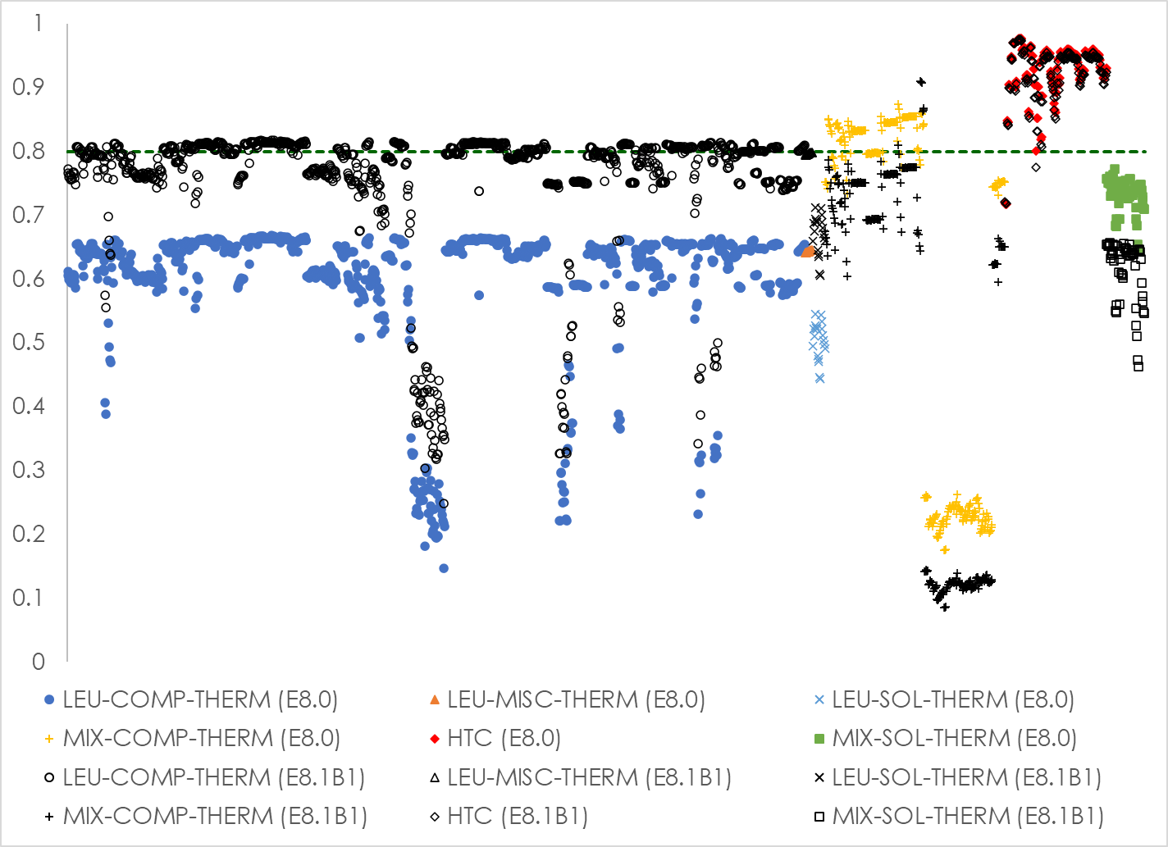
Results: ENDF/B-VIII.1β1 vs. ENDF/B-VIII.0

Slide 17
Conclusions
Data-induced uncertainty significantly increased for thermal ²³⁵U-fueled systems
²³⁹Pu covariance changes are worrying
¹⁰³Rh only significant important fission product change
Impact of ENDF/B-VIII.1β1 on burnup credit similarity assessments similar to ENDF/B-VII.1 data

Slide 18
Acknowledgment
This presentation was supported by the Nuclear Criticality Safety Program, funded and managed by the National Nuclear Security Administration for the Department of Energy.

Slide 19
Questions?

