Slide 1
Recent corrections to the covariances of U-235
Andrej Trkov, Jozef Stefan Institute, Ljubljana, Slovenia
on behalf of the INDEN Collaboration, IAEA, Vienna, Austria

Slide 2
Summary
ENDF/B-VIII.1_beta1 library was released for testing
U-235 version “u235ib46o28t6DNcnu5ef0ST25t” from INDEN was adopted
Through extensive testing a number of small bugs were identified and corrected

Slide 3
Corrections
Some cross-covariance terms in MF34 were in error. The errors were corrected. All cross-correlation terms between the resonance region and the region above were deleted because variances in the resonance region were overwritten with the resonance contribution.
Similarly, cross-correlation terms between the resonance region and the region above for elastic, fission and capture were zeroed for the same reason because they could give rise to negative eigenvalues. The same corrections apply to U-238.
MF35 was missing due to an error in the file assembly script. The data were restored.
Angular distributions for the discrete alfa particles were missing due to a processing error. They were inserted as isotropic at LLNL using MF4 representation. The proposal to use of MF4 for incident charged particles was rejected at a previous CSEWG Meeting, arguing that the data for two-body reactions of incident charged particles should be given in MF6. The original data that got missed by mistake are being restored.
Originally, the nubar uncertainties below 20 keV were large. Later, Gwin data were found and experimental uncertainties could be adopted.
A couple of uncertainties in nubar were found to be smaller than the uncertainty of the nubar of Cf-252. An ad-hoc correction is made, fixing the minimum uncertainty to 0.5%.
NOTE: eigenvalues are very sensitive to numerical roundoff errors. Transforming the covariance matrices to a different energy grid can lead to (small) negative eigenvalues.

Slide 4
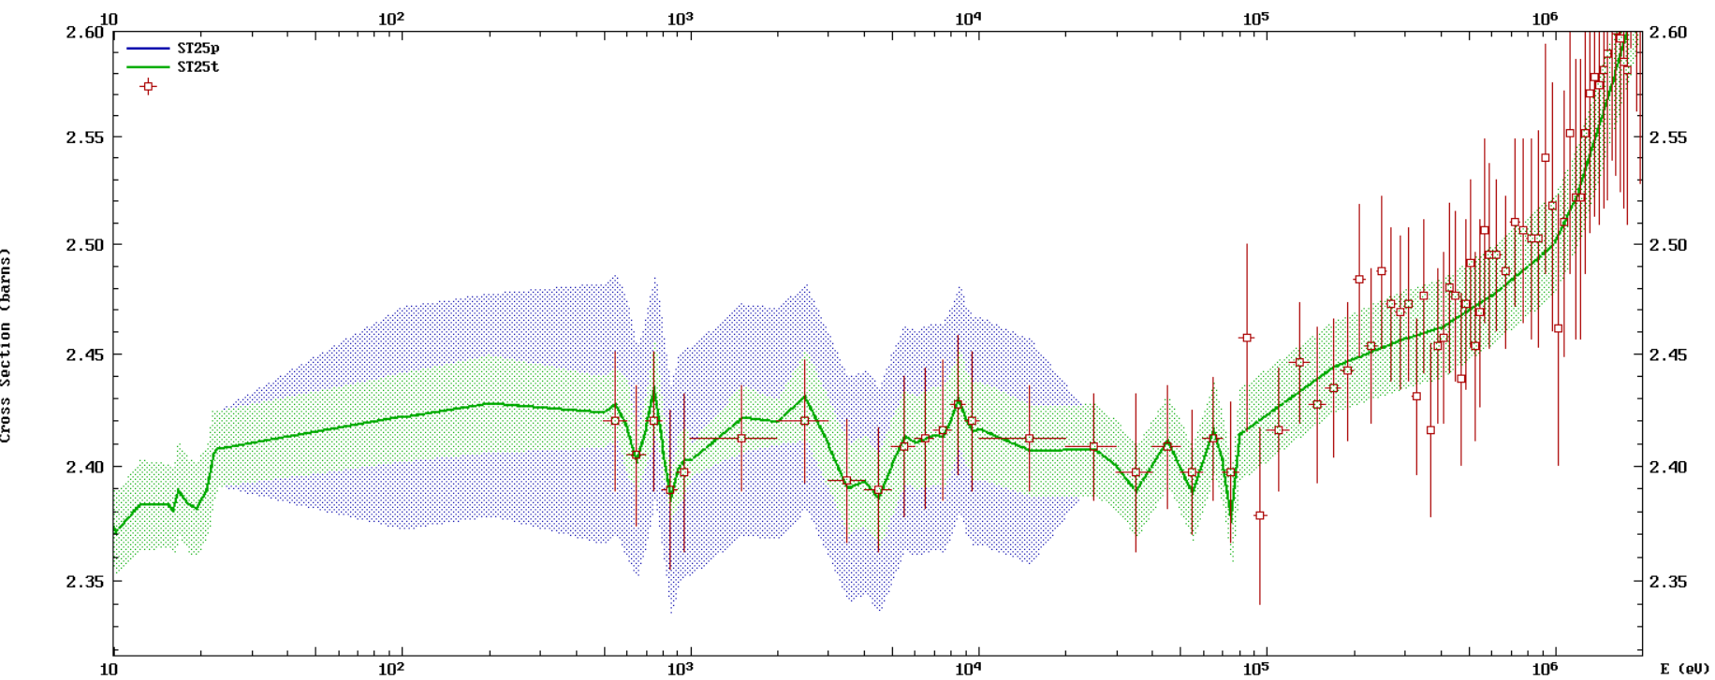
Comparison of nubar in the U-235 evaluation against the data by Gwin: - Resonance region uncertainties provided by ORNL - High energy (>0.1 MeV) evaluated at LANL - Adopted from measured data in between

