Slide 1
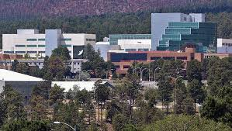
Photonuclear evaluations for ENDF8.1
Mark B. Chadwick
Chief Scientist & Chief Operating Officer for Weapons Physics
Los Alamos National Laboratory
April 27, 2023
+ Thanks also for help from
Nathan Gibson and Ajeeta
for some exp data comparisons

Slide 2
Background
Late 1990s first IAEA CRP on photonuclear. Chadwick chair.
- LANL developed evaluations for D, C, N, O, Al, Si, Ca, Ta, W, 235U, 238U, 239Pu, 241Am. (and some of these were included in the IAEA database)
- LANL-CEA collaboration results documented in 3 ANS/NSE papers and in ENDF/B-VII.0 big paper (2007)
- LANL’s evaluations were released in ENDF/B-VII.0 together with 100+ others from the IAEA 1999 library.
2019 IAEA 2nd CRP. Kawano chair
- No USA-authored evaluations are part of this IAEA2019 file
Our ENDF8=ENDF7 library is widely used in LANL-LLNL NNSA photonuclear applications today
- we can’t afford to screw up

Slide 3
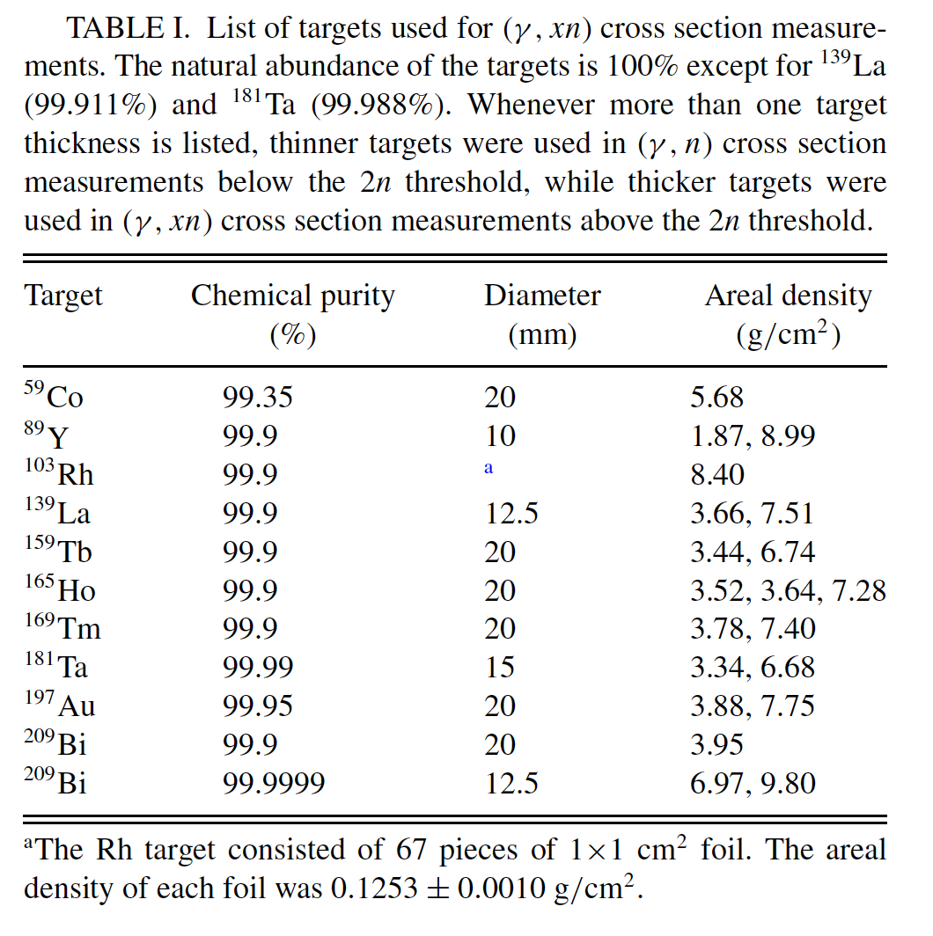
BLUF
 | Action | Recent data?
100s of others | Use IAEA2019. (but 9Be should be studied) –generally making an assumption that IAEA2019 are better than IAEA1999.
9Be | Was Chinese, now consider using NNL (+merging) | yes
1D | Use from ENDF8 (Hale) / not Japan | no
12C | Use from ENDF8. / not China | no
14N | Use from ENDF8 /not China | no
16O | Use from ENDF8/not China | no
27Al | Use from ENDF8//not China | no
28Si | Use from ENDF8/not Korea | no
40Ca | Use from ENDF8/not Korea | no
63Cu | Use from ENDF8/not Japan | no
181Ta | Use from IAEA2019/Romania | newSUBARU
184W | Use from ENDF8/not China | no
206,207,208Pb | Use from ENDF8/not Japan | no
237Np | Use from ENDF8/not Japan | no
235U | Use from ENDF8/not Japan | LLNL/Duke. ratios
238U | Use from ENDF8/not Japan | LLNL/Duke. ratios
239Pu | Use from ENDF8/not Japan | LLNL/Duke. ratios
New SUBARU
Previously from LANL, 2—25 years ago
~Keep

Slide 4
Issues in making ENDF photonuclear files
Typically we start by evaluating the photo-absorption data from measurements
- make evaluation choices
- try to resolve discrepancies
- often fit with (double) Lorenzian + QD parameters, but modifications often needed
The (γ,abs) is then split into partial cross sections (γ,F), (γ,1n), (γ,2n), …
- often using a model, but modifications often needed owing to model deficiencies
Longstanding discrepancy challenges in photonuclear measurement
Magnitudes (LLNL v. Saclay v. Russian, v …)
Multiplicity sorting
These require real care and study. Conclusions were derived in 1999 on – for example – how to normalize LLNL 1980 (Caldwell-Berman) data v. Saclay (Veyssiere) v Russian brem (Gurevich).
Like all science, such conclusions are provisional, but attention is needed
I have seen no discussions that would challenge the conclusions from Varlamov in 1999 (adopted by ENDF7=8 & IAEA2019 & Obninsk) as to the magnitude of the 235U photonuclear data. New LLNL u5/pu9 support this.

Slide 5
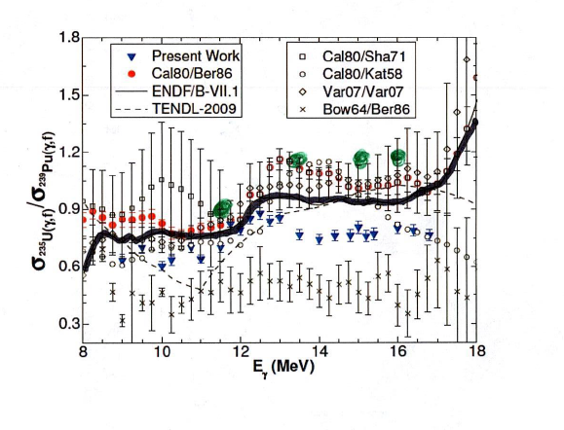
Some reasons why IAEA2019 should not be adopted in all cases
For 239Pu it looks like ENDF is better
For 235U, discrepant data. ENDF and IAEA2019 made different choices
-new LLNL(Tonchev) – Duke Univ (Higs) data don’t support IAEA2019
Actinides are a big deal for us ….
New exp work is ramping up
in the US, driven by our NNSA
applications, and it makes sense to
wait for these data before we make
ENDF changes
²³⁵U(γ,F)/²³⁹Pu(γ,F), PRC98 (2018)
But most importantly, don’t make a change until due diligence has been done to assure it is an improvement

Slide 6
Principles for making changes to ENDF
We don’t just update an ENDF evaluation without a detailed study to convince ourselves a new proposed evaluation is “better”
- that would be reckless in the extreme
- also, giving up US (LANL) evaluations to all-foreign doesn’t sound right
IAEA2019 shows some/many comparison plots of IAEA2019 v IAEA1999, but for the LANL files in ENDF this doesn’t help much, since in most cases IAEA1999 =/= ENDF7=ENDF8
- we need to compare ENDF v IAEA2019 if we want to sub some IAEA2010 file
- I have just started this, with some help from Nathan. It takes time.
To update an ENDF file, we should remember key Chadwick Top 10 CSEWG evaluation principles:
- do no harm
- be cognizant of our history and previous evaluation decisions
- convince ourselves that proposed changes are better
- adequately anticipate problems that can arise & do V&V testing
- matching measured data is our highest priority

Slide 7
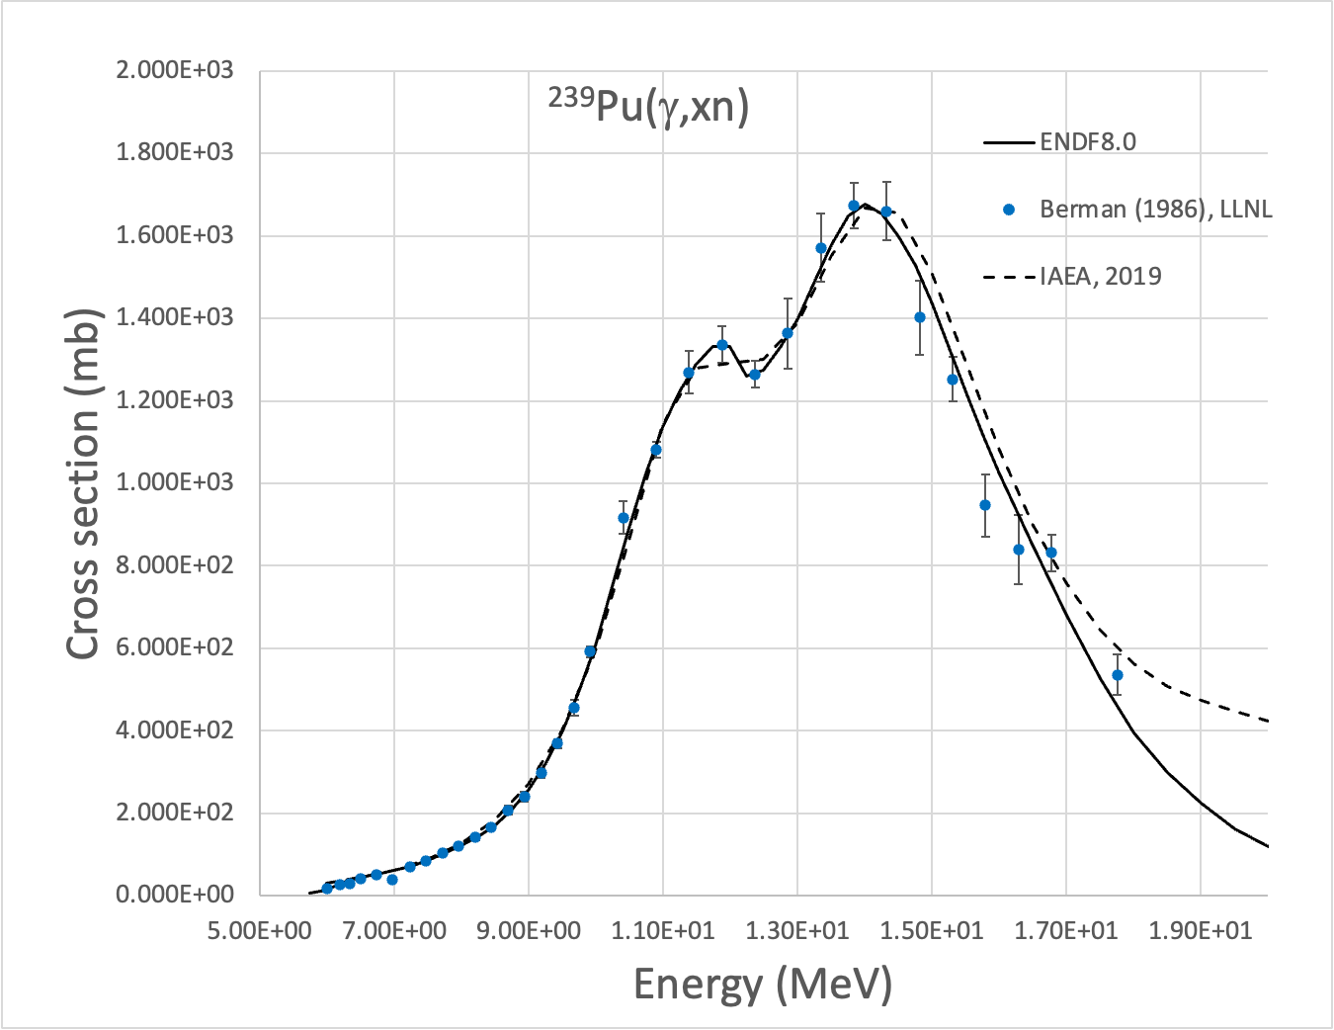
²³⁹Pu – ENDF8 is a better fit to the Berman LLNL data
Chi²/deg
1.2, ENDF
2.4, IAEA2019
(data 10-17 MeV)
Integral v. data, 7-17 MeV
ENDF/data =1.01
IAEA2019/data=1.025

Slide 8
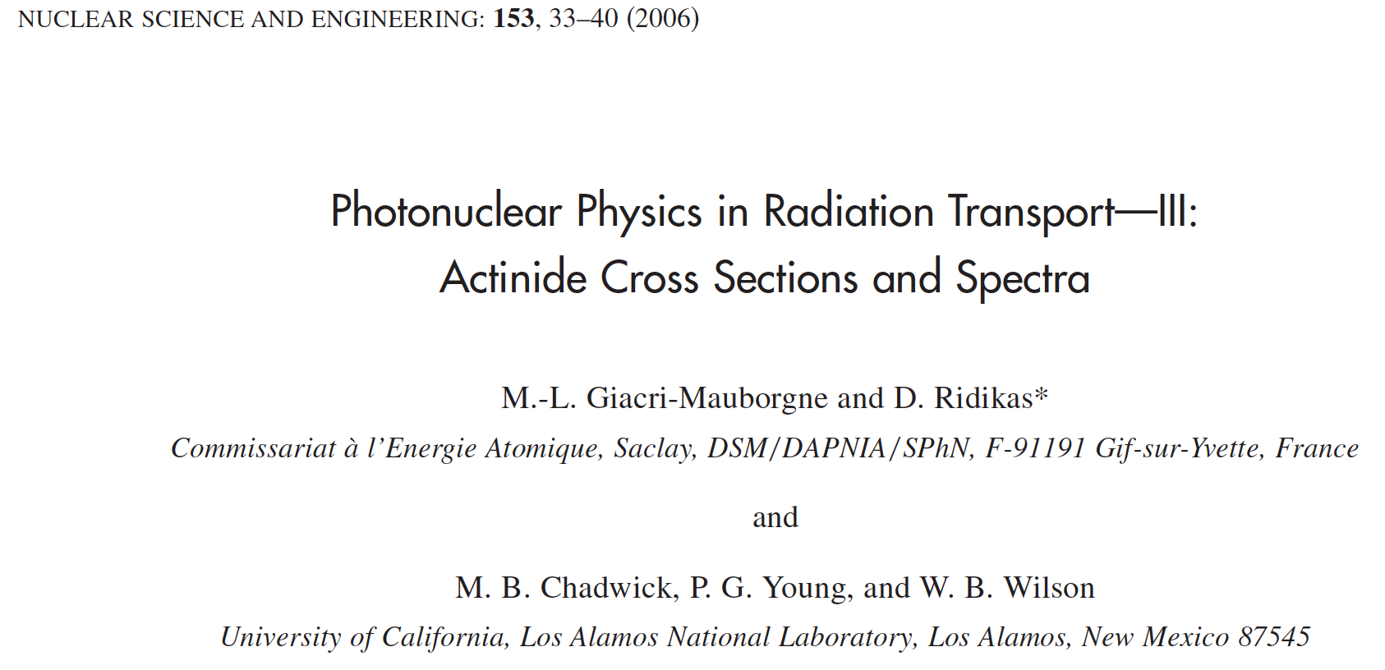
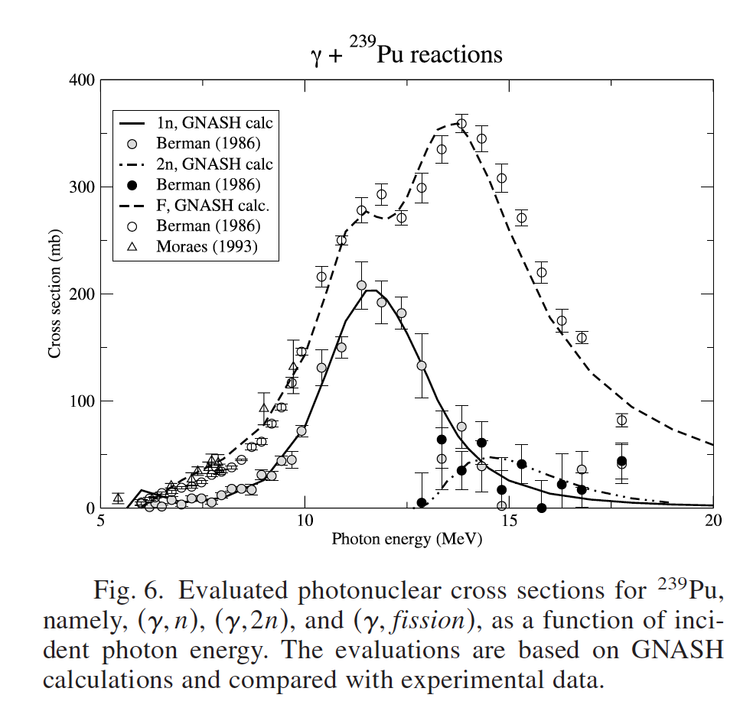
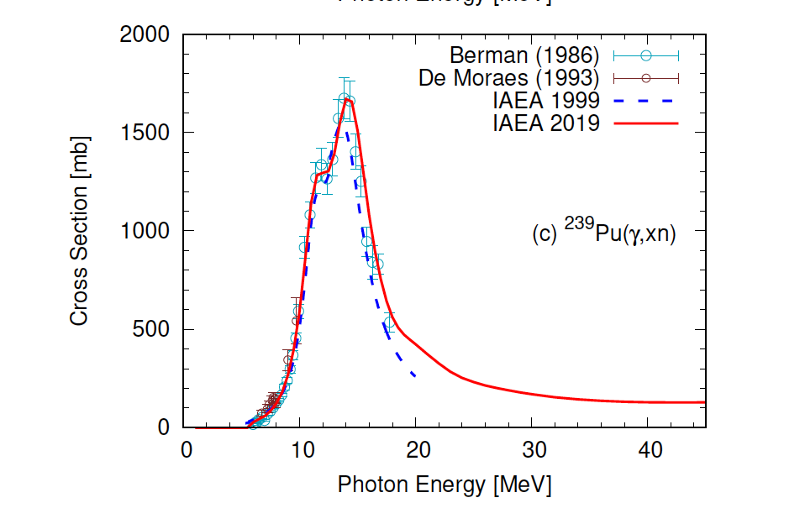
²³⁹Pu – both evaluations aimed to model the LLNL Berman data
IAEA 2019 (from JEND/PD 2016)
aimed to fit LLNL Berman 1986 data
IAEA 2019
ENDF
Previous slide examined in detail how these two evaluations compare to the LLNL Berman 1986 data

Slide 9
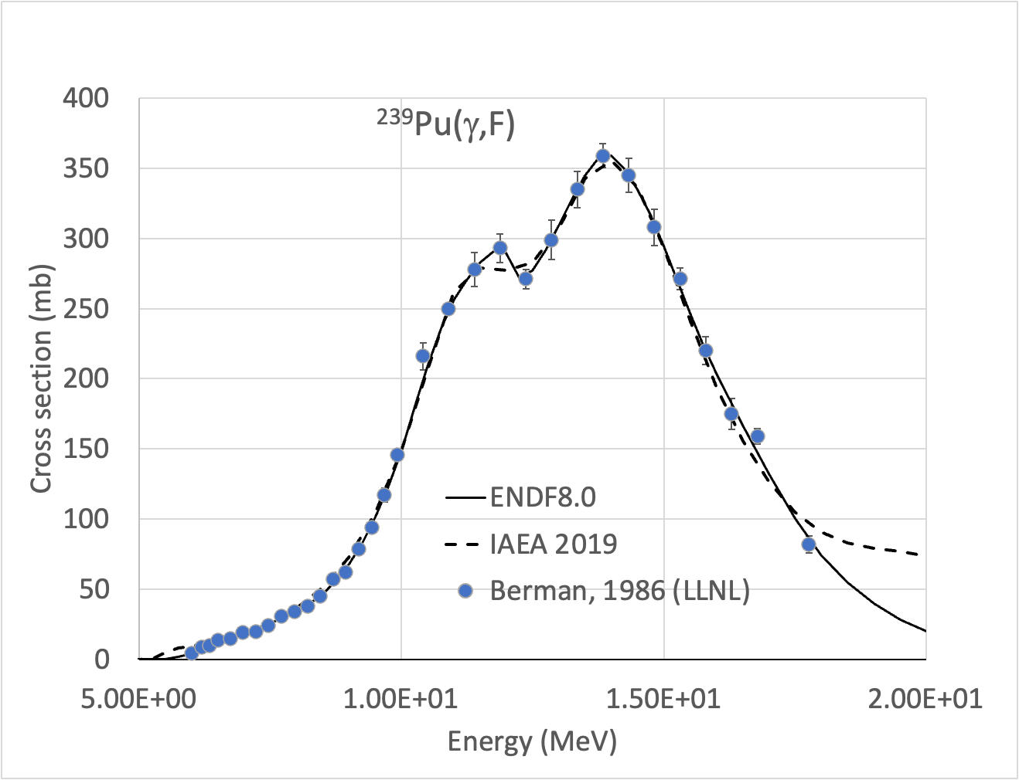
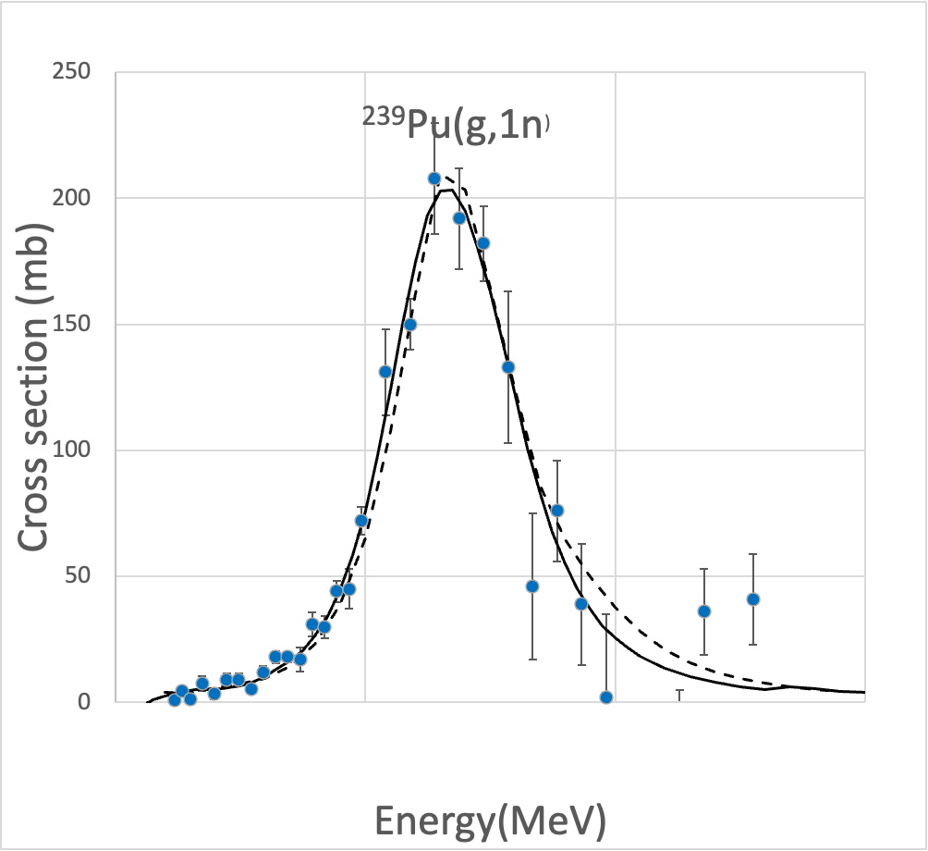
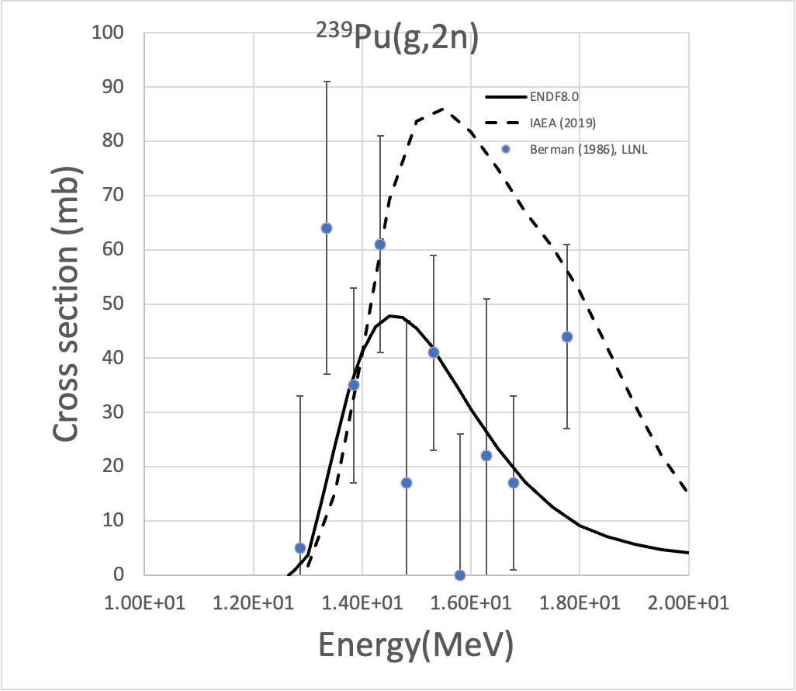
²³⁹Pu – ENDF8 is a better fit to the Berman LLNL data (& both aimed to fit Berman)

Slide 10
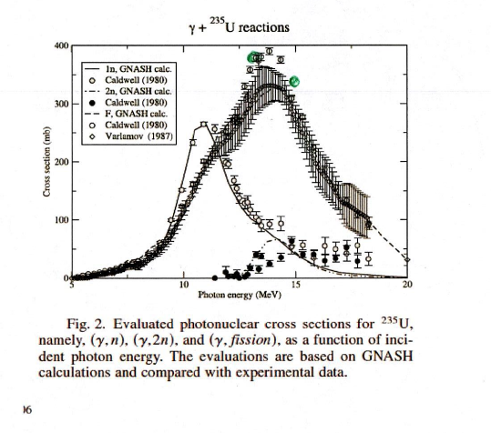
^{comparisons}
New IAEA2019 is higher, matching Caldwell 1980 data. But this is not supported by the recent LLNL/TUNL Tonchev measurement.
(and why change from Varlamob?)

Slide 11
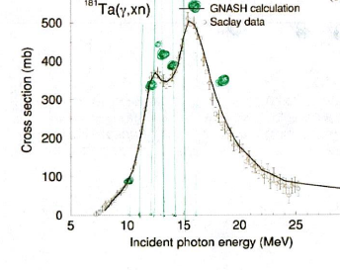
Tantalum-181
New IAEA2019 evaluation
But a decision was made to follow some new NewSUBARU data, which seems reasonable
More testing is warranted owing to the wide usage of 181Ta in shielding
But tentatively, adopt IAEA2019 here

Slide 12
Other cases – D,C,B,O,Al,Si,Ca,W, actinides
I have performed quick reviews
I see no reason not to keep LANL/ENDF7=9
No recent data have come since 1999 (accept LLNL/Duke – see earlier)

Slide 13
Backup

Slide 14
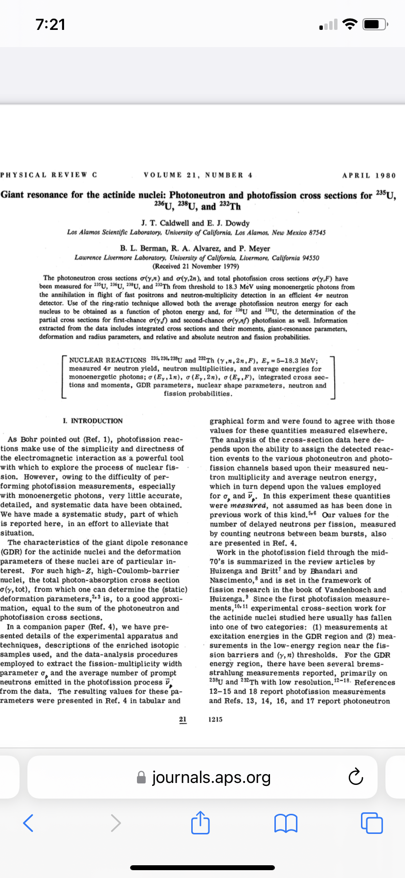
²³⁹Pu – ENDF8 is a better fit to the Berman LLNL data

Slide 15
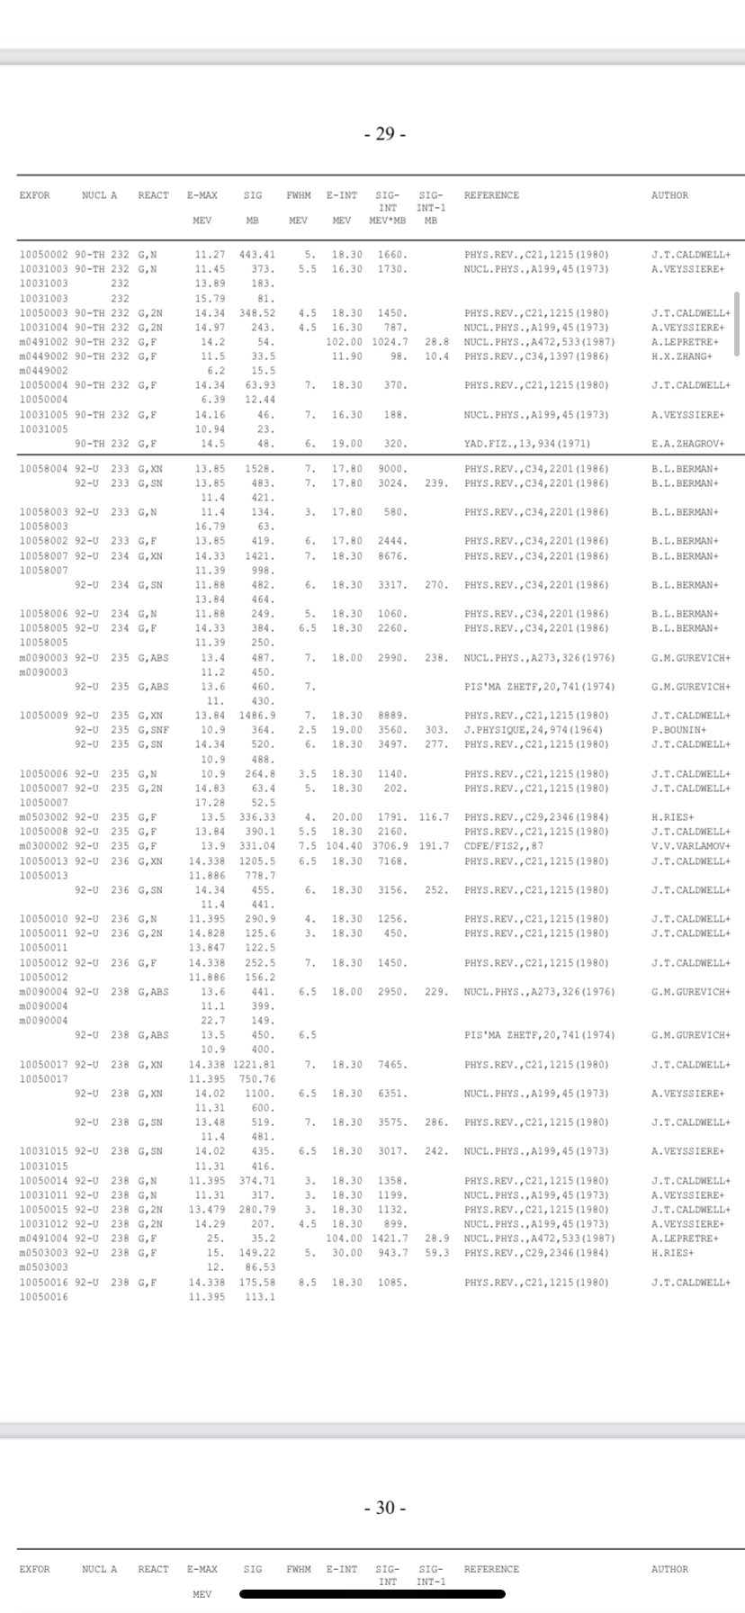
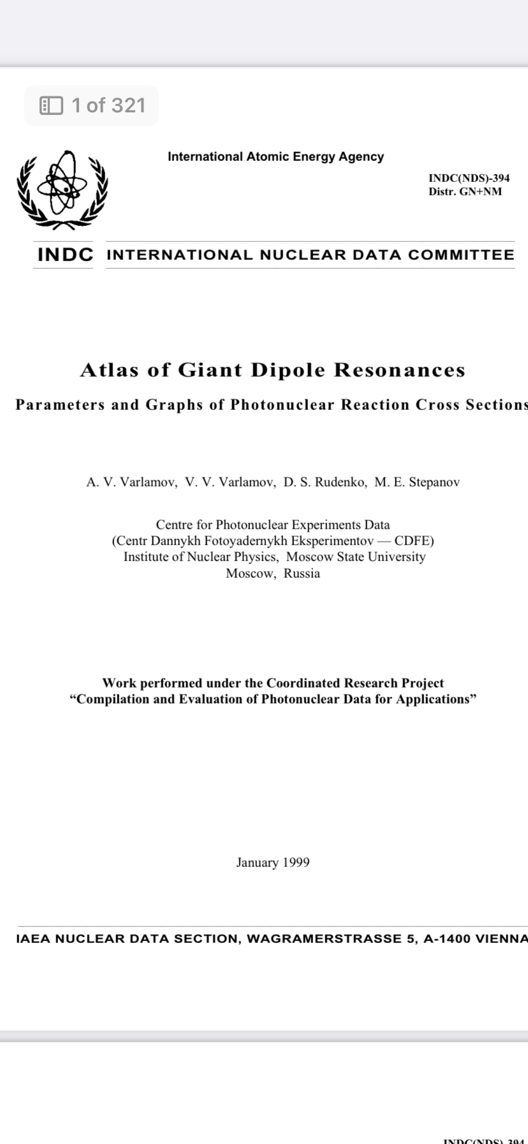
²³⁹Pu – ENDF8 is a better fit to the Berman LLNL data

Slide 16
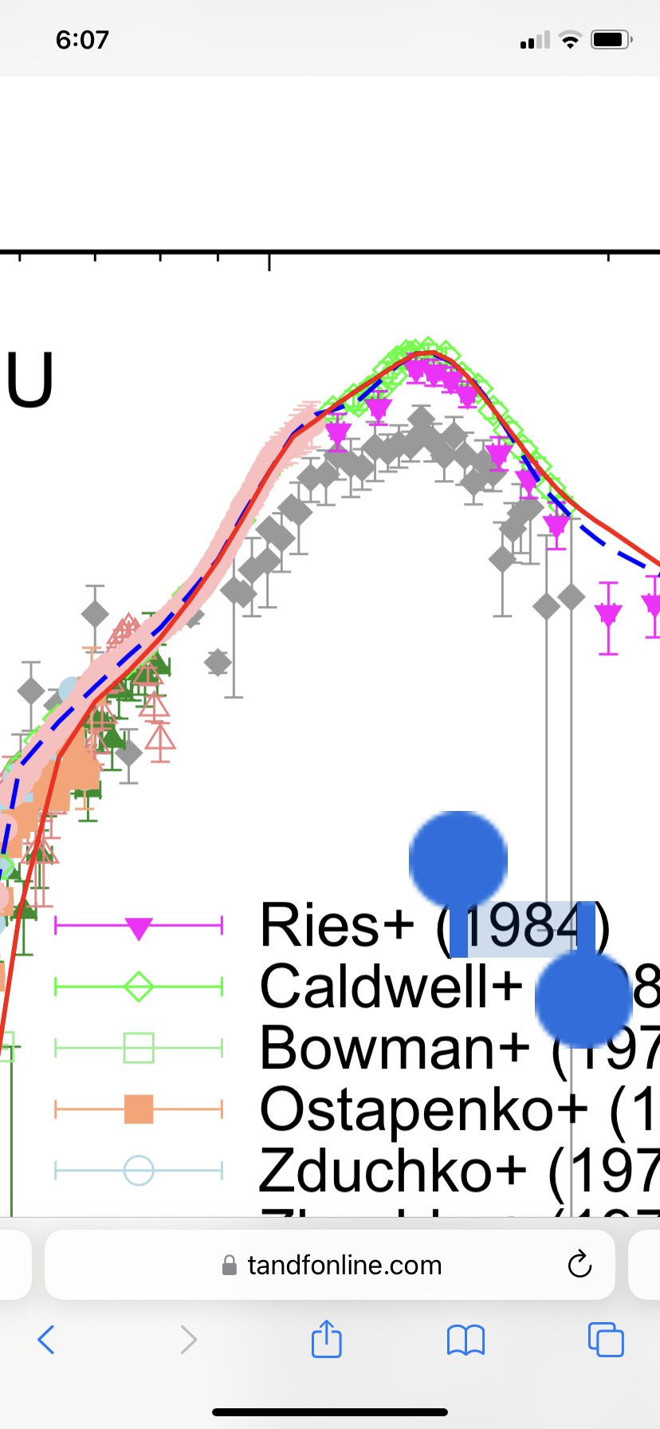
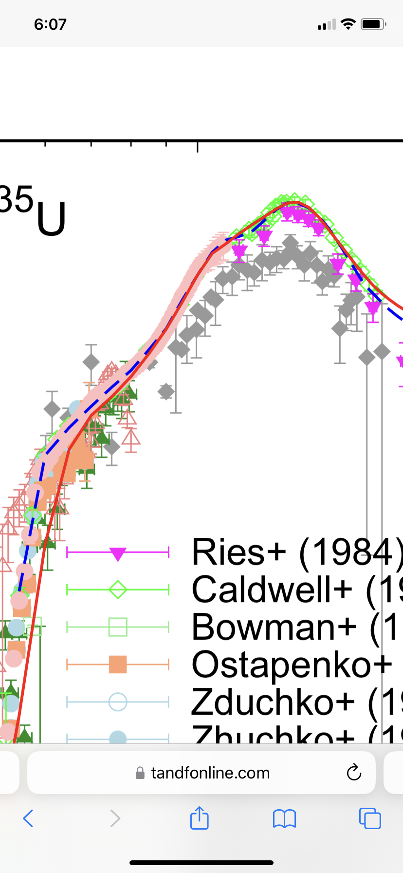

Slide 17
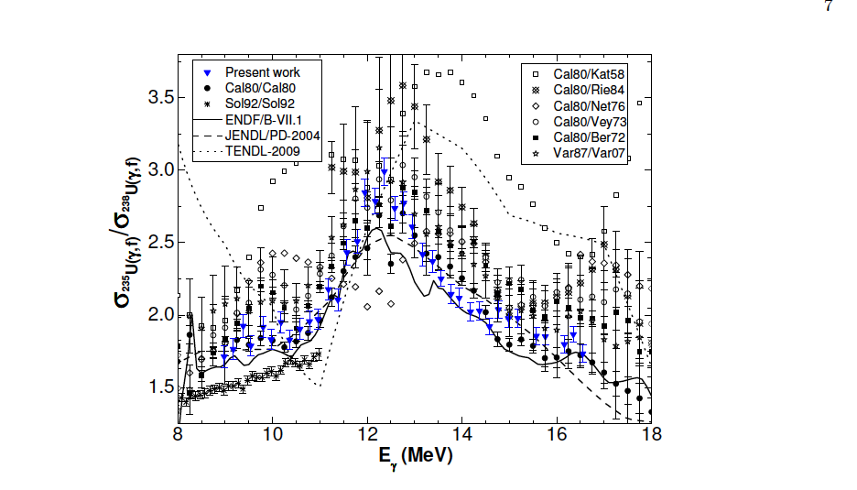

Slide 18
