Slide 1
Adding Exit Distributions for photon and charged particles Missing in ENDF/B-VIII.0
Ian Thompson
LLNL
Hye Young Lee
LANL
April 25, 2023

Slide 2
Many exit channels in ENDF/B-VIII.0 have missing distributions for photons and charged particles
There are missing exit distributions: transport codes fail.
In 245 evaluations for incident neutrons
For 155 exit photons
For 446 exit protons
For 288 exit deuterons
For 220 exit tritons
For 100 exit helions
For 429 exit alphas
Propose to transplant distributions & multiplicities from TENDL2019
No changes to cross-sections
Incoming forms are MT=102, 103, 104, 105, 106, 107
Not two-body exit channels
9 photon exit channels already in inclusive, so now remove from inclusive:
For targets Yb168, 170-174, 176, Hf181,182. No other photons, no other ejectiles.
Generally improves energy balances!!
No sources yet for some light (Z<10) targets
these will need R-matrix evaluations

Slide 3
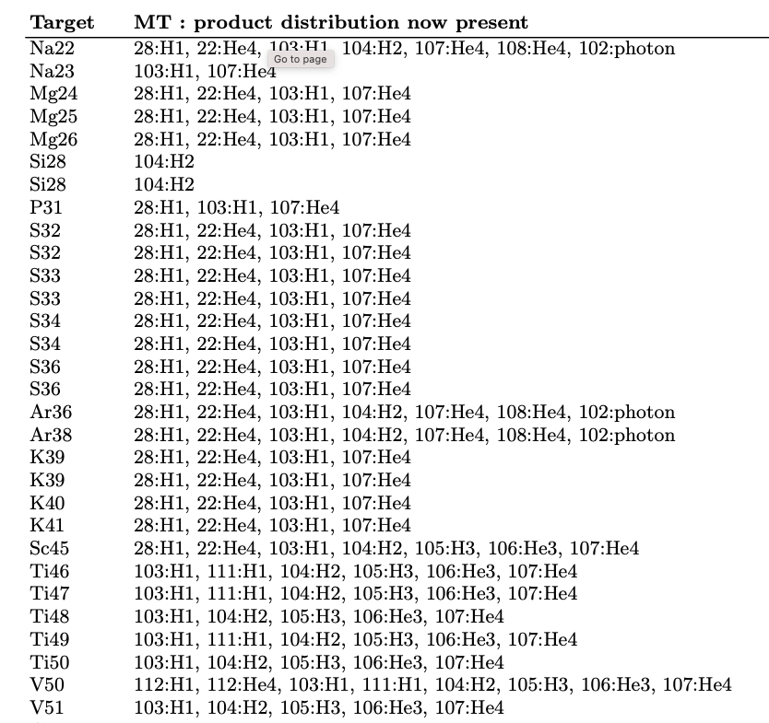
Beginning of table of changes – light targets
All in git branch
exit_distributions

Slide 4
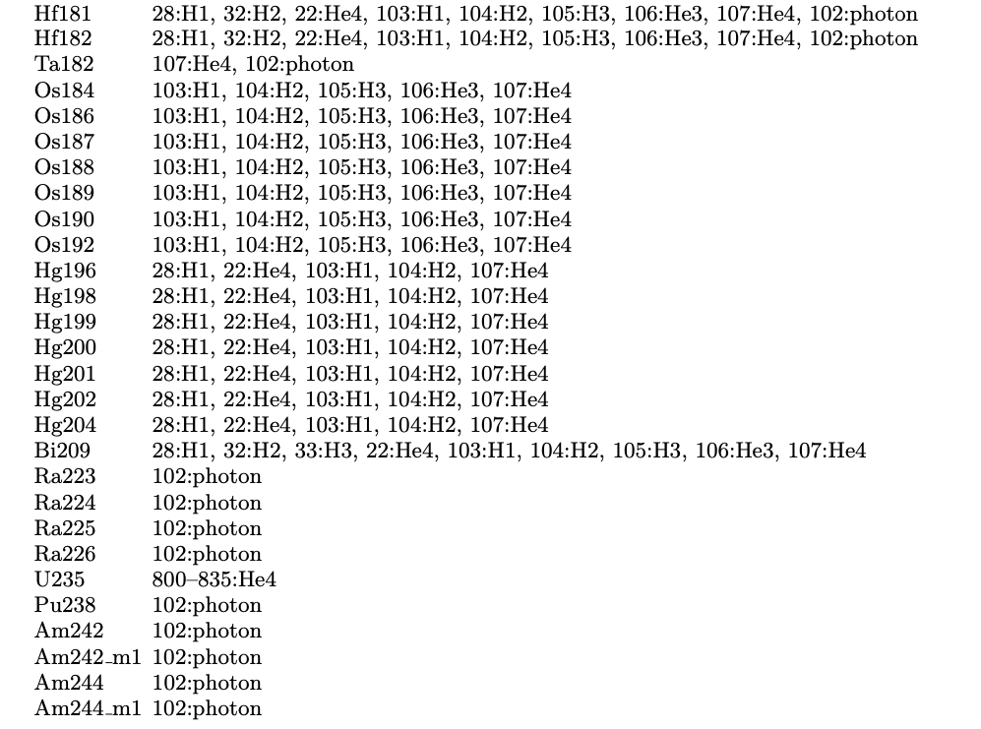
End of table of changes – heavy targets
All in git branch
exit_distributions
Some of the exit photon
distributions will be
improved by the GRIN
project.

Slide 5
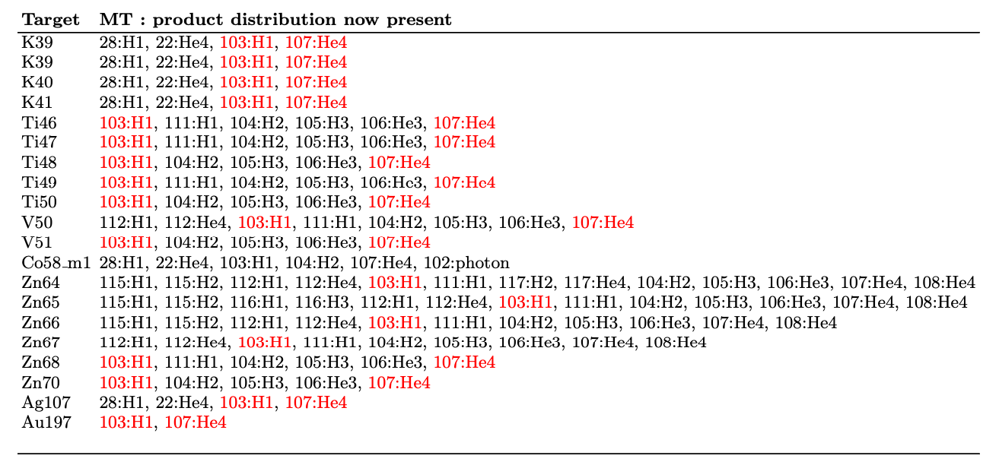
LANL has better distributions to add for exit p, α
plus further distributions updating existing ENDF/B-VIII.0 forms

Slide 6
Disclaimer
This document was prepared as an account of work sponsored by an agency of the United States government. Neither the United States government nor Lawrence Livermore National Security, LLC, nor any of their employees makes any warranty, expressed or implied, or assumes any legal liability or responsibility for the accuracy, completeness, or usefulness of any information, apparatus, product, or process disclosed, or represents that its use would not infringe privately owned rights. Reference herein to any specific commercial product, process, or service by trade name, trademark, manufacturer, or otherwise does not necessarily constitute or imply its endorsement, recommendation, or favoring by the United States government or Lawrence Livermore National Security, LLC. The views and opinions of authors expressed herein do not necessarily state or reflect those of the United States government or Lawrence Livermore National Security, LLC, and shall not be used for advertising or product endorsement purposes.

