Slide 1
Validation Progress and Plans for ENDF/B-VIII.1β1 at ORNL
B.J. Marshall and T.M. Greene
Mini-CSEWG
Livermore, CA
April 27, 2023

Slide 2
Outline
ORNL definition of ENDF/B-VIII.1β1
k_{eff} results for CE calculations with VALID
Preliminary RCA result
Future plans for additional validation

Slide 3
ORNL Definition of 8.1-beta1
neutrons : commit 9611a57, tag = version.VIII.1-Beta1
gammas : commit dd78fe0, <no tags>, phase2 (unused!)
thermal_scatt : no beta1, attempt was made to predict
phase1
*ZrHx*
H-H₂O
Si
Mg
H-Mesitylene
H-Toluene
ORNL_TSL_EVALUATIONS
C₈H₈
CH₂
C₅O₂H₈
phase2
Everything not listed above
ENDF/B-VIII.1-beta1 (as of Apr. 4th, 2023)

Slide 4
VALID benchmarks
VALID suite at ORNL has been expanded in recent years to include more ICSBEP benchmarks
More categories of experiments are covered, though some of them have very few cases
Deuterium- and polyethylene-moderated systems have been added, expanding validation basis for moderators beyond light water

Slide 5
HEU Results
Category | Number of Cases | ENDF/B-VIII.0 |  | ENDF/B-VIII.1β1
 |  | C/E | σ | C/E | σ
HMF | 91 | 1.00016 | 0.00026 | 1.00026 | 0.00026
HMI | 6 | 1.00079 | 0.00042 | 0.99956 | 0.00042
HMF/HMI (ZEUS) | 8 | 1.00320 | 0.00101 | 1.00192 | 0.00101
HST (¹H) | 57 | 0.99904 | 0.00075 | 0.99996 | 0.00075
HST/I (²H) | 6 | 0.98936 | 0.00182 | 0.99161 | 0.00183
HCT (²H) | 9 | 1.00184 | 0.00230 | 1.00282 | 0.00231
HST/HCT (²H) | 15 | 0.99685 | 0.00156 | 0.99834 | 0.00157

Slide 6
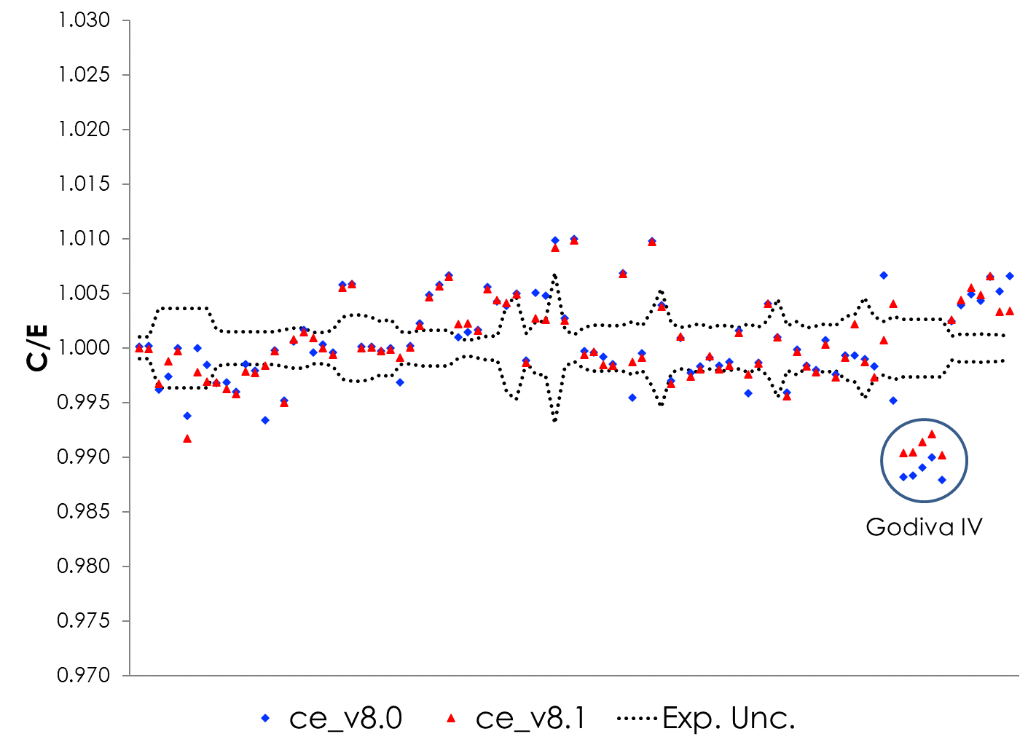
HMF results

Slide 7
LEU and IEU results
Category | Number of Cases | ENDF/B-VIII.0 |  | ENDF/B-VIII.1β1
 |  | C/E | σ | C/E | σ
LCT | 144 | 0.99911 | 0.00019 | 0.99868 | 0.00019
LST | 19 | 0.99845 | 0.00083 | 0.99920 | 0.00083
IST | 59 | 1.00120 | 0.00077 | 1.00060 | 0.00077
LCT results may be degraded slightly (-0.00043 ± 0.00027)
LST results potentially improved (0.00075 ± 0.00117)
IST results may be slightly improved (-0.00060 ± 0.00109)

Slide 8
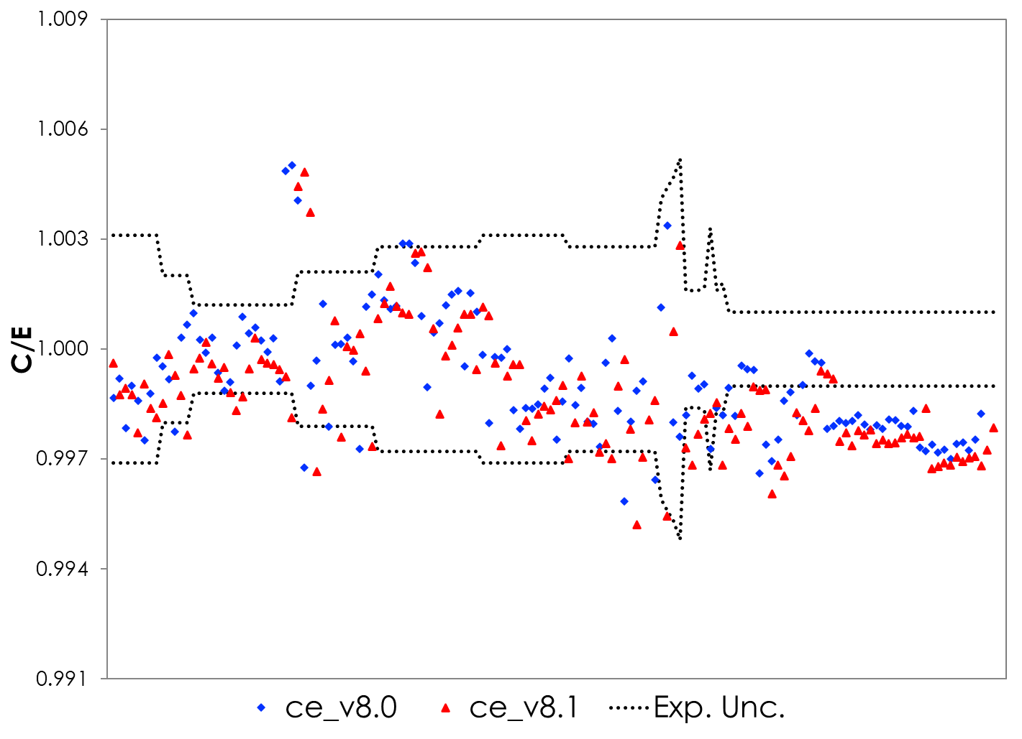
LCT results plot

Slide 9
MIX results
Category | Number of Cases | ENDF/B-VIII.0 |  | ENDF/B-VIII.1β1
 |  | C/E | σ | C/E | σ
MCT | 49 | 0.99555 | 0.00058 | 0.99244 | 0.00058
MST | 10 | 0.99354 | 0.00157 | 0.99177 | 0.00157
Degraded performance in both MCT and MST experiments
MCT: -0.00311 ± 0.00082
MST: -0.00177 ± 0.00222

Slide 10
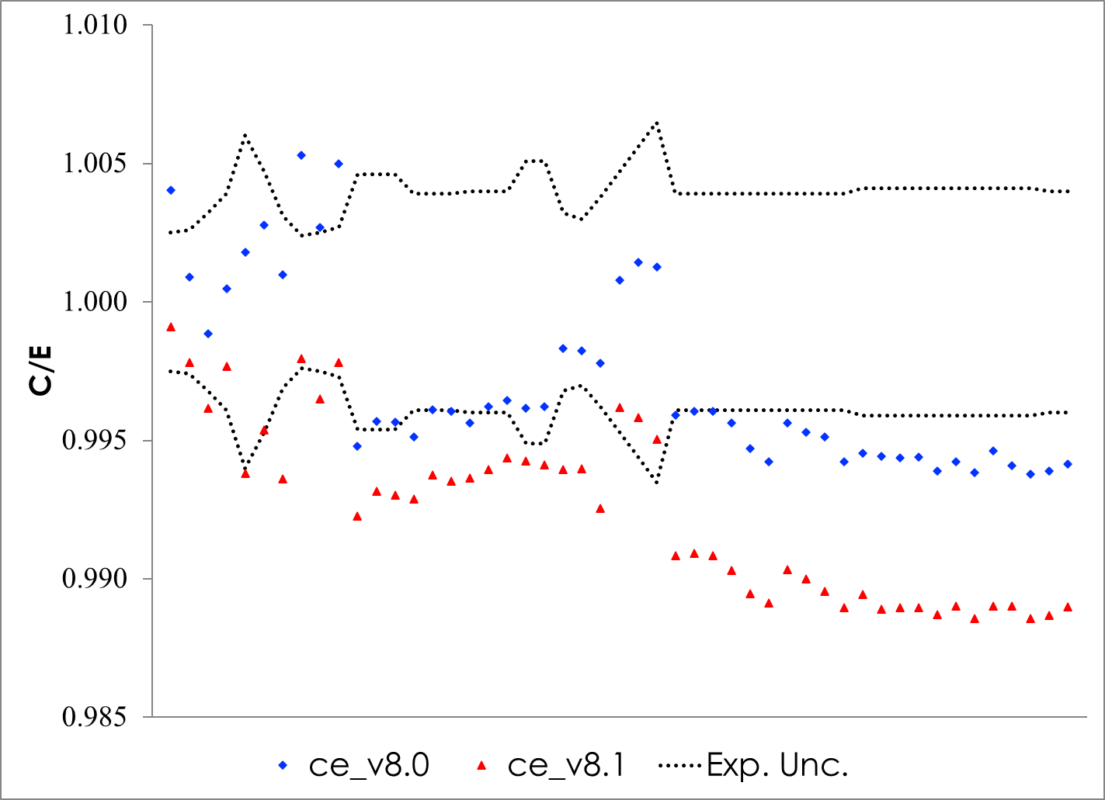
MCT results plot

Slide 11
PU results
Category | Number of Cases | ENDF/B-VIII.0 |  | ENDF/B-VIII.1β1
 |  | C/E | σ | C/E | σ
PMF | 25 | 1.00011 | 0.00045 | 0.99997 | 0.00045
PST | 92 | 0.99836 | 0.00051 | 0.99970 | 0.00051
PMM | 5 | 1.00422 | 0.00108 | 1.00408 | 0.00108
Little change in fast, intermediate, or mixed systems
Slight improvement in thermal systems (0.00134 ± 0.00072)

Slide 12
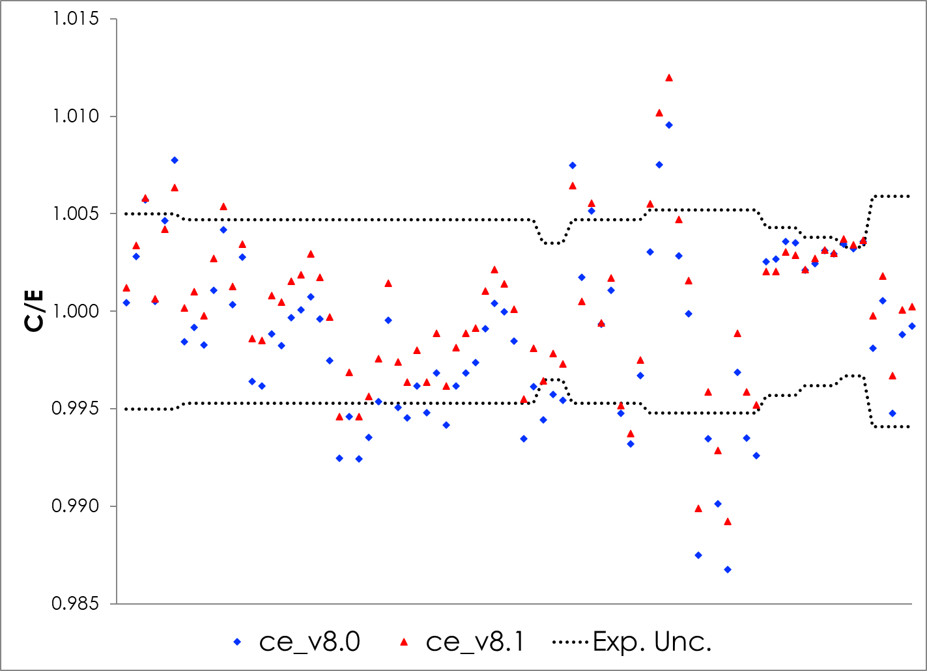
PST results plot

Slide 13
²³³U results
Category | Number of Cases | ENDF/B-VIII.0 |  | ENDF/B-VIII.1β1
 |  | C/E | σ | C/E | σ
UCT | 3 | 0.99818 | 0.00140 | 1.00368 | 0.00140
UMF | 10 | 0.99860 | 0.00051 | 0.99874 | 0.00051
USI | 29 | 0.97945 | 0.00123 | 0.98761 | 0.00124
USM | 8 | 0.97546 | 0.00214 | 0.98411 | 0.00216
UST | 140 | 0.99750 | 0.00052 | 1.00281 | 0.00053
Generally better performance for mixed and intermediate solution systems
Thermal solutions significantly more reactive, with similar magnitude bias

Slide 14
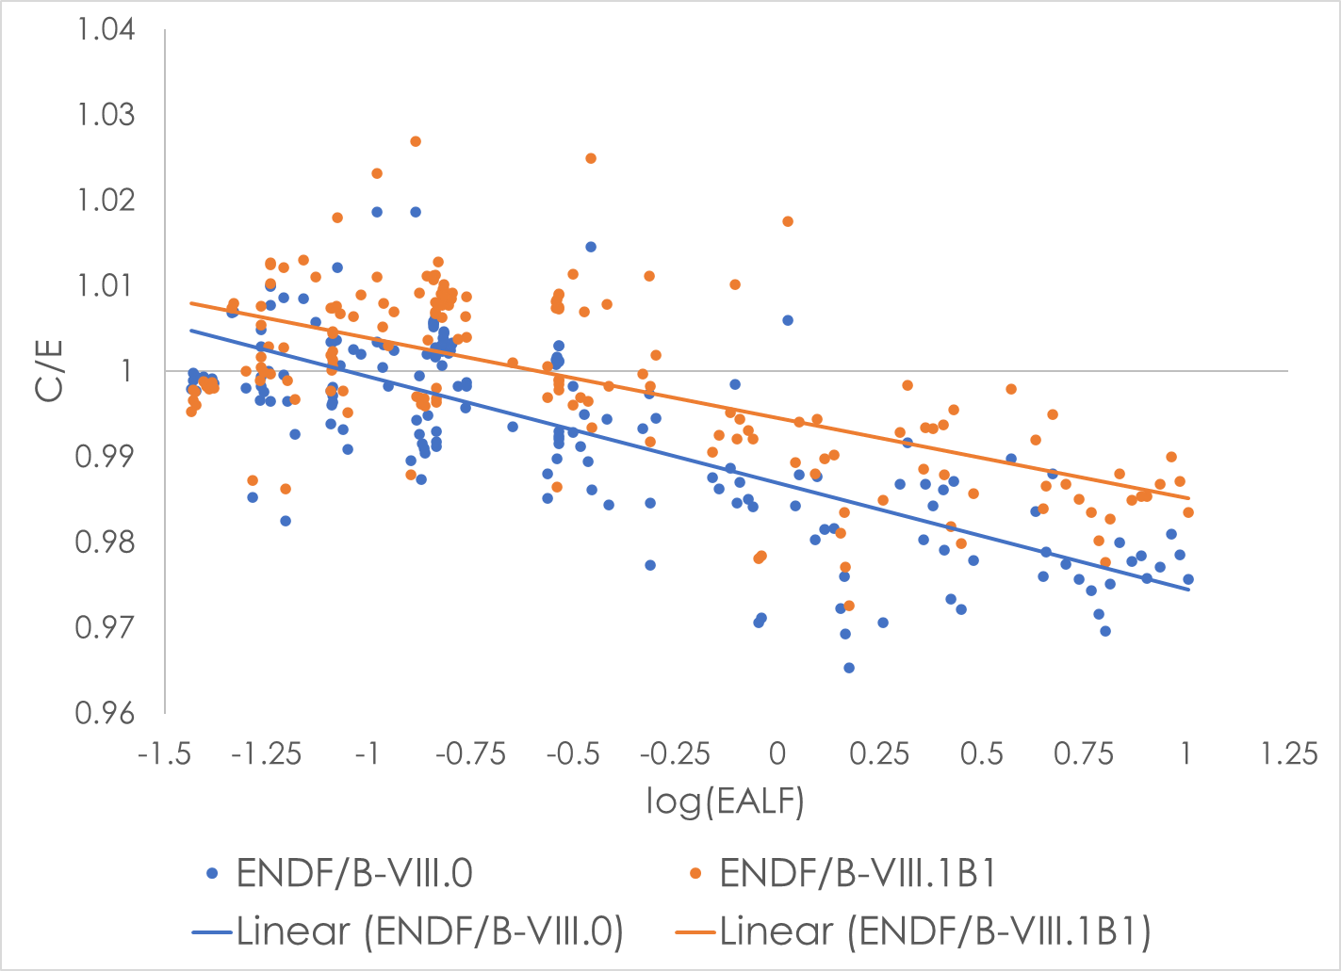
²³³U solutions trend with neutron spectrum

Slide 15
VALID summary
Performance of ENDF/B-VIII.1β1 is improved for ²³³U and PST systems
Trend in ²³³U solutions not greatly improved, but overall level is better
Small performance decrement in LCT systems
Cumulative χ²/DF metric is better for ENDF/B-VIII.1β1 than for ENDF/B-VIII.0 for VALID benchmarks
2.85 for ENDF/B-VIII.0 vs 2.63 for ENDF/B-VIII.1β1
Driven by improvement in ²³³U cases
More analysis on-going to provide more detailed feedback

Slide 16
Preliminary RCA assessment for GKN sample
These results are relative to ENDF/B-VII.1
Small improvement in performance!
ENDF/B-VII.1 <C/E> = 1.04891
ENDF/B-VIII.1 <C/E> = 1.04203
Marked improvement for U-235
ENDF/B-VIII.0 will be included in further testing

Slide 17
Future validation plans
Depletion validation
(More) RCA samples
Decay heat
Shielding validation
Benchmarks in SCALE validation report
Transmission testing
Reactor physics validation
Core reactivity trajectory
CASL/VERA test suite
Advanced reactor test cases

Slide 18
Acknowledgment
This presentation was supported by the Nuclear Criticality Safety Program, funded and managed by the National Nuclear Security Administration for the Department of Energy.

Slide 19
Questions?

