Slide 1
PMT-004 Validation Testing for Thermal Scattering Laws and Some Interesting Temperature-Dependent Implications
Presented at the
Mini-Cross Section Evaluation Working Group Meeting
April 26, 2023
Catherine Percher, Jesse Norris

Slide 2
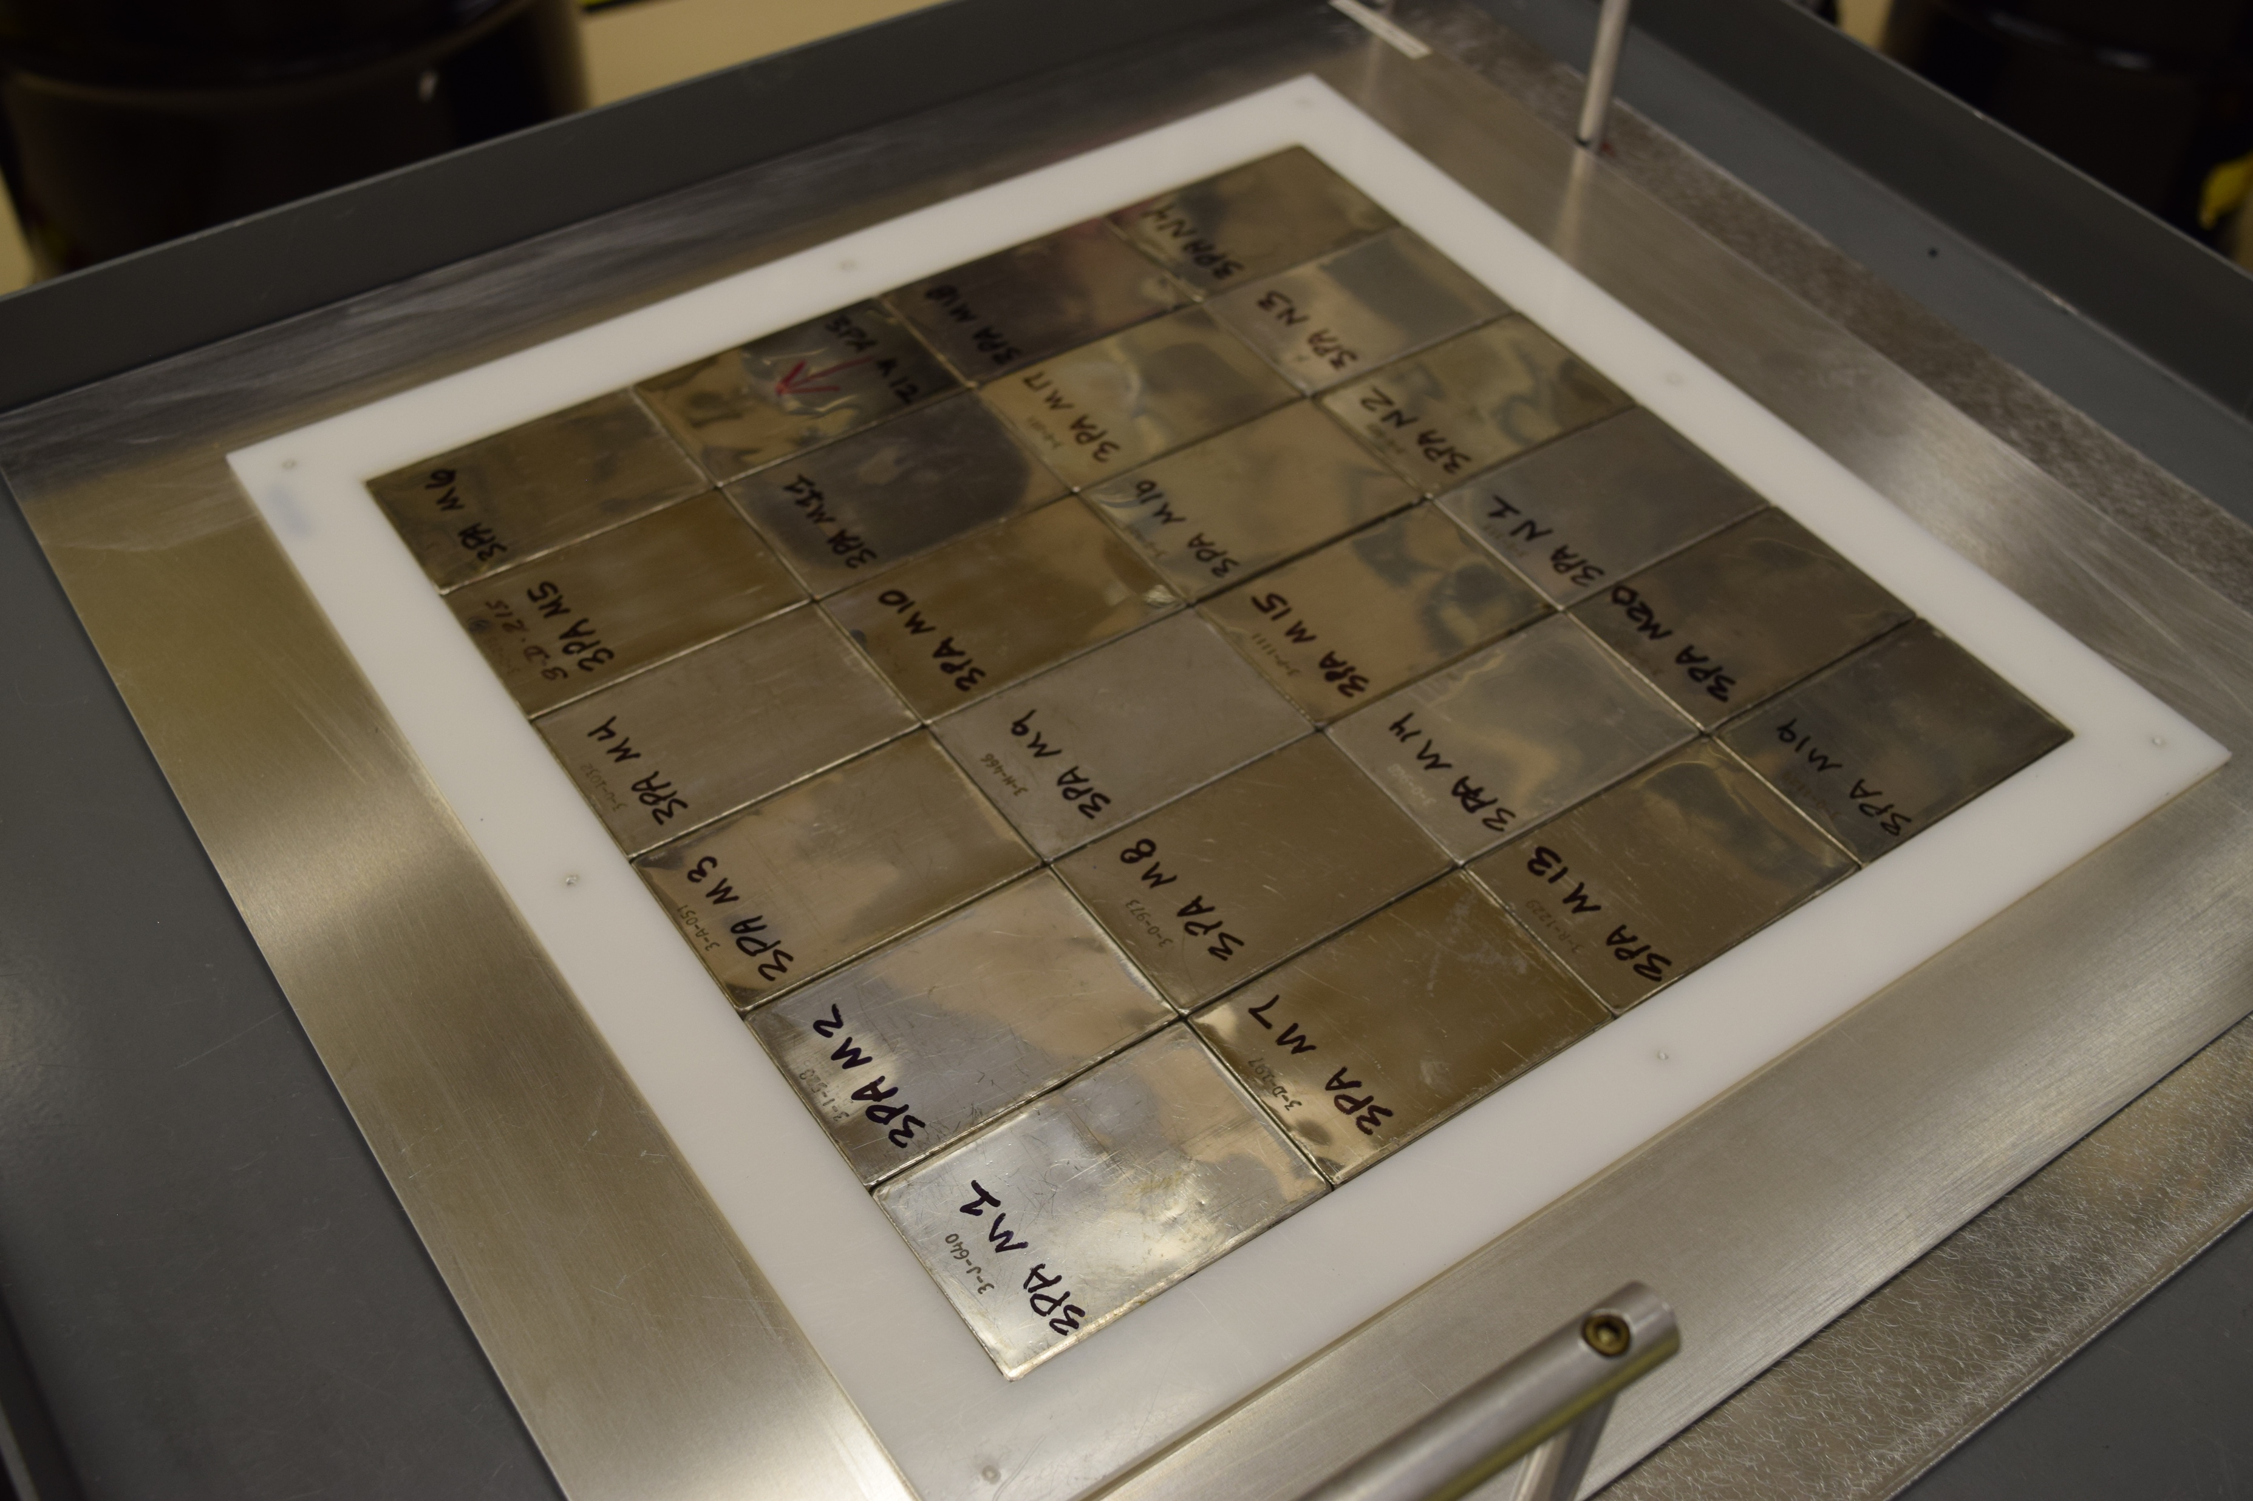
PU-MET-MIXED-002
Plutonium-fueled benchmark accepted into the International Criticality Safety Benchmark Evaluation Project (ICSBEP) Handbook
Fuel was plutonium/aluminum Zero Power Physics Reactor (ZPPR) plates
Pu plates arranged in 12” x 12” layers (6 plates by 4 plates)
First Benchmark for the Thermal/ Epithermal eXperiments (TEX) Project
Minimum of materials
Designed to span multiple neutron fission energy spectra (fast through thermal) using polyethylene moderator
Assembly designed to be easily modified to test materials of interest

Slide 3
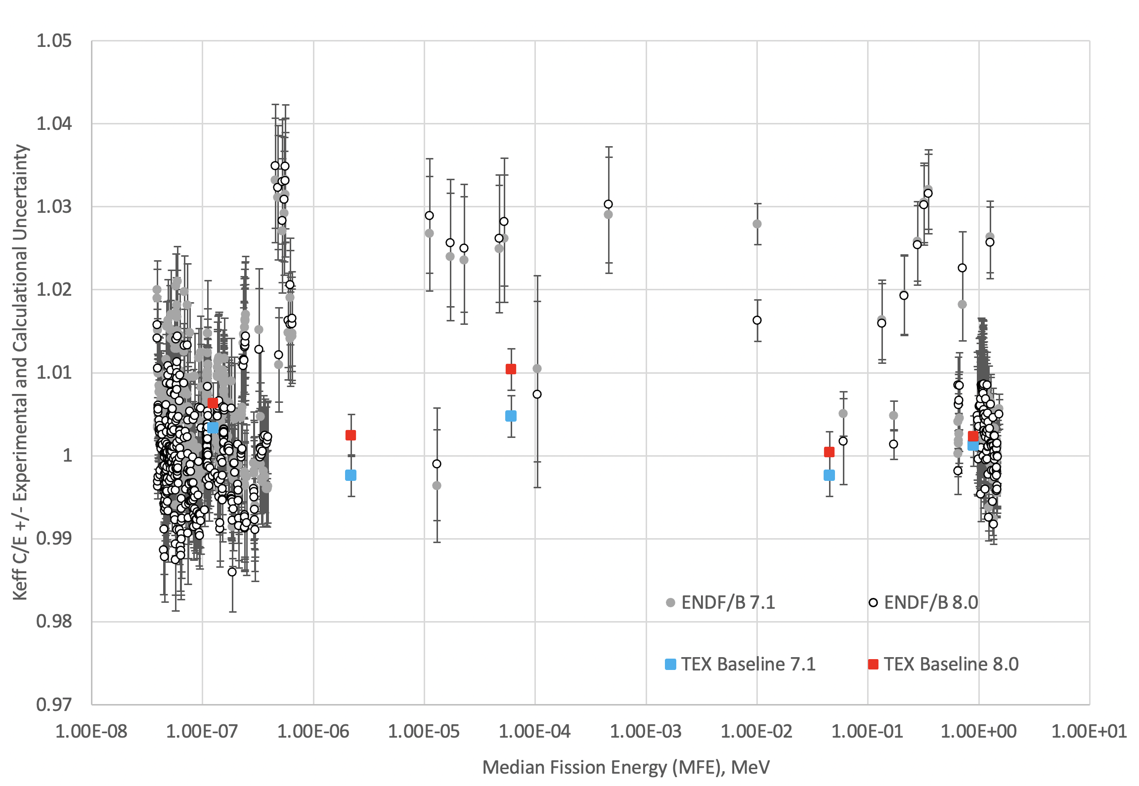
PMM-002 Results Against ICSBEP Pu Benchmarks- MCNP6.1
3
4
2
1
5

Slide 4
Region of Interest for TEX TSL Experiments
3
4
2
1
5

Slide 5
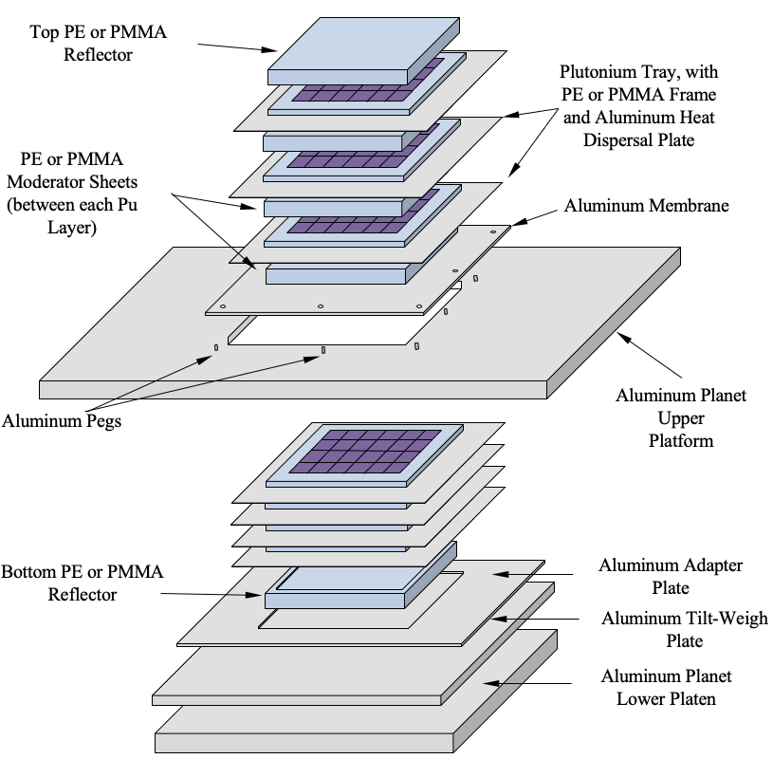
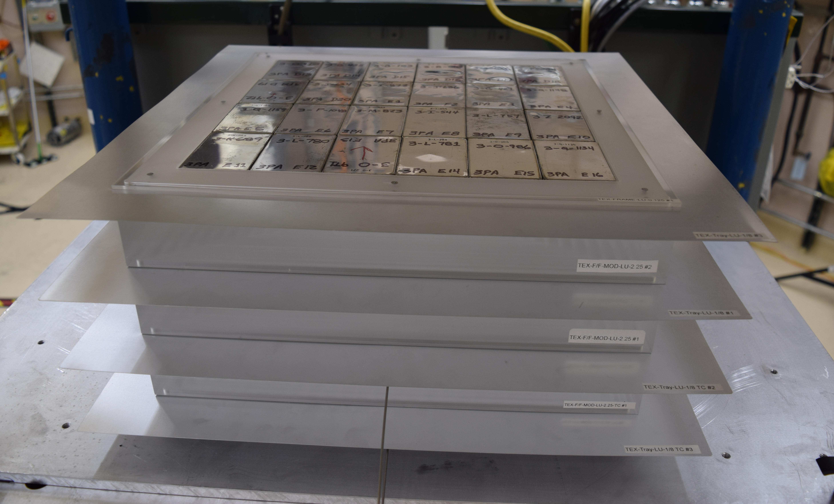
Experimental Set-up

Slide 6
Four Additional Thermal TEX-Pu Experiments- Completed in September 2021
Moderator Material | Moderator Thickness (cm) | Pu Layers | Average Temperature (°C) | Temperature Correction to 20°C, Δk_{eff} | Δk_{eff}/°C
PE | 4.264 | 6 | 23.8 ± 3.0 | -0.00131 | 0.00034
PE | 5.080 | 9 | 26.4 ± 3.0 | -0.00355 | 0.00055
PMMA | 4.922 | 7 | 29.3 ± 3.0 | -0.00245 | 0.00026
PMMA | 5.313 | 8 | 29.5 ± 3.0 | -0.00287 | 0.00030
Temperature had a large impact on reactivity of the critical configuration
Experimental measurements showed 1 °C change produced reactivity differences of ~0.00025 in k_{eff}
Consistent with findings from design calculations from thermal cases of temperature-dependent critical experiments
Effect dominated by TSL temperature dependence

Slide 7
Preliminary PMT-004 Benchmark Results
Case | Moderator Thick (cm) | Mod Type | Preliminary C/E ENDF/B-VIII.0 | Estimated Uncertainty
1 | 4.264 | PE | 0.99921 | 0.00152
2 | 5.080 | PE | 1.00312 | 0.00172
3 | 4.922 | PMMA | 1.00869* | 0.00146
4 | 5.313 | PMMA | 1.00830* | 0.00132
*For ENDF/B-VIII.0, Lucite TSL at 27 ºC used, as it is the only temperature included in the library for Lucite.

Slide 8
ENDF/B-VIII.1 Lucite TSL is an Small Improvement, Large Temperature Dependence

Slide 9
Larger Implications of TSL Temperature Dependence
Not all benchmarks are at 20 °C, but we’re validating (and likely adjusting!!!) using mostly (only?) 20 °C data
PST-001
PST-002
PST-012

Slide 10
PST Temperatures versus Pu Solution Conc

Slide 11
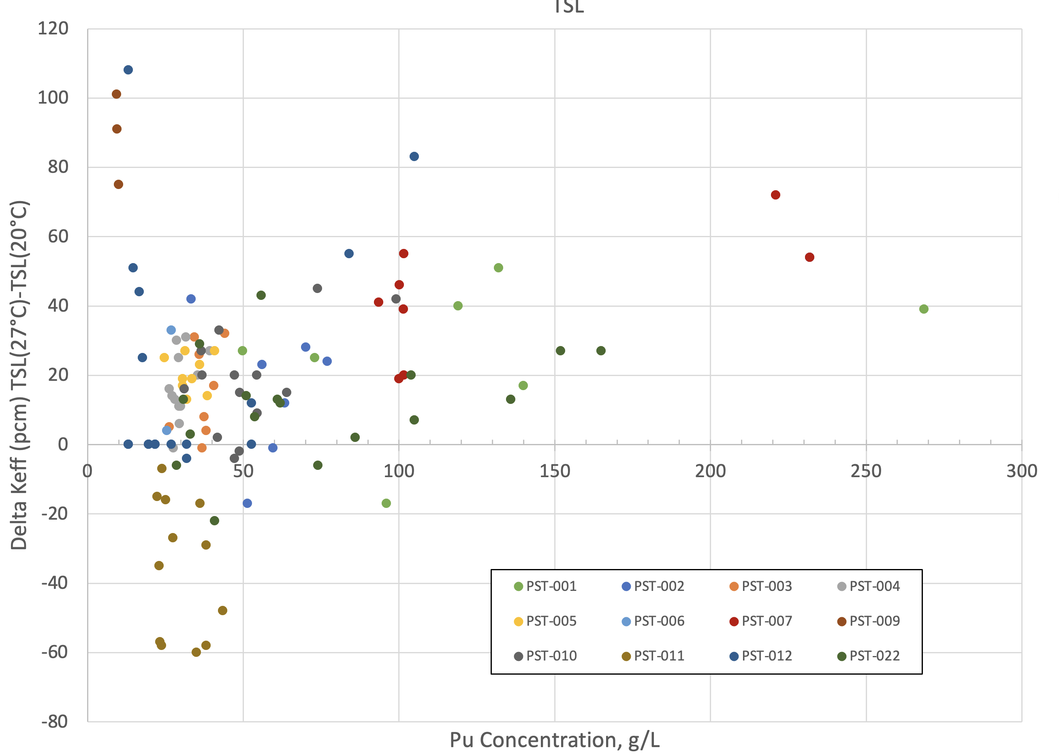
K_{eff} Effect of TSL Temp on Subset PST Benchmarks

Slide 12
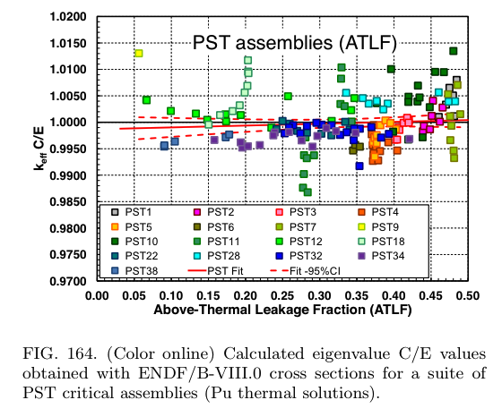
K_{eff} Effect of TSL Temp on Subset PST Benchmarks

Slide 13
Conclusions and Future Work
PMT-004 has four new benchmark cases highly sensitive to PE TSL (2 cases) and PMMA TSL (2 Cases)
PE cases were well predicted using MCNP6.2 and ENDF/B-VIII.0
PMMA cases overpredicted by approximately 0.6-0.7% in k_{eff} likely due to the lack of integral benchmarks sensitive to PMMA
NCSU ENDF/B-VIII.1 PMMA TSL is an improvement over VIII.0
Accepted at last ICSBEP meeting pending comment resolution, should be published in 2024 version of the Handbook
Temperature had a large impact on reactivity of the critical configuration
Implications for validation work for thermal cases- need to adjust TSL data to correct temperature as it can have hundreds of pcm effects for a few °C
Future thermal experiments should try and measure reactivity at multiple temperatures to add in data testing and benchmark adjustment

Slide 14
Acknowledgements
This work was funded by the United States Department of Energy’s Nuclear Criticality Safety Program (NA-511).
The experiments were a joint effort by Lawrence Livermore National Laboratory and Los Alamos National Laboratory and were completed at the National Criticality Experiments Research Center (NCERC).
Personnel from the Institut de Radioprotection et de Sûreté Nucléaire (IRSN), Sandia National Laboratories (SNL), and the Naval Nuclear Laboratory (NNL) provided design and review assistance for the TEX experiments.

Slide 15
Disclaimer
This document was prepared as an account of work sponsored by an agency of the United States government. Neither the United States government nor Lawrence Livermore National Security, LLC, nor any of their employees makes any warranty, expressed or implied, or assumes any legal liability or responsibility for the accuracy, completeness, or usefulness of any information, apparatus, product, or process disclosed, or represents that its use would not infringe privately owned rights. Reference herein to any specific commercial product, process, or service by trade name, trademark, manufacturer, or otherwise does not necessarily constitute or imply its endorsement, recommendation, or favoring by the United States government or Lawrence Livermore National Security, LLC. The views and opinions of authors expressed herein do not necessarily state or reflect those of the United States government or Lawrence Livermore National Security, LLC, and shall not be used for advertising or product endorsement purposes.

