Slide 1



Incoherent J/$ψ$ Production
Zvi Citron, Michael Pitt, Eden Mautner
eA Study Meeting
BGU RHI Group
30.5.2023

Slide 2
Overview
Reminder.
Past studies - Vetoing Incoherent VM production in ECCE. (arXiv:2108.01694)
Vetoing Incoherent VM production in ePIC. (This study)
Initial vetoing results.
Detour – BeAGLE/eStarLight analysis of Ion’s behavior.
Future work.

Slide 3
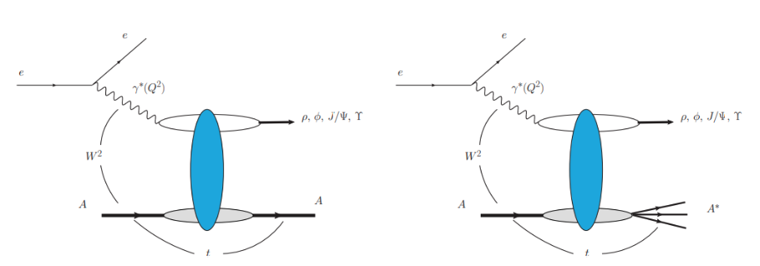
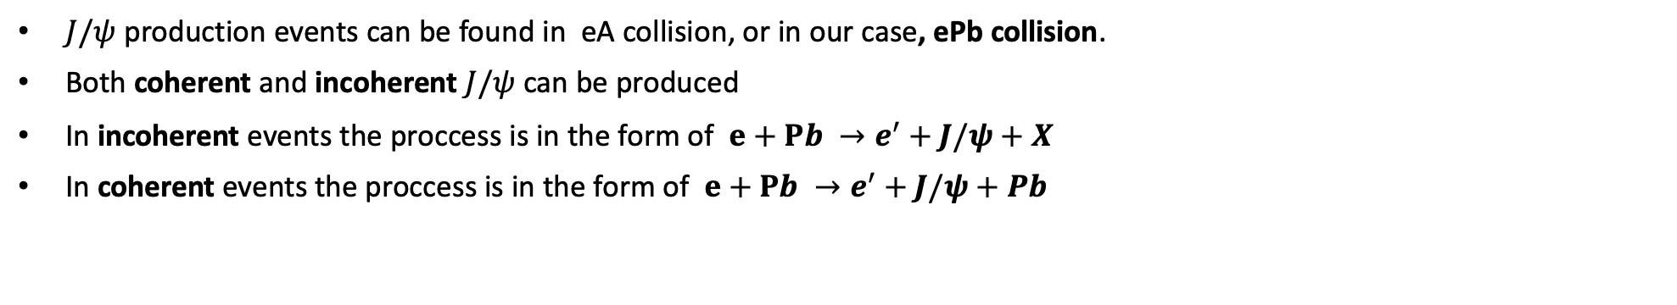
Reminder
$J/ψ$ production events can be found in eA collision, or in our case, ePb collision.
Both coherent and incoherent $J/ψ$ can be produced
In incoherent events the proccess is in the form of $e+Pb →e^{′}+J/ψ+X$
In coherent events the proccess is in the form of $e+Pb →e^{′}+J/ψ+Pb$
Coherent
Incoherent

Slide 4
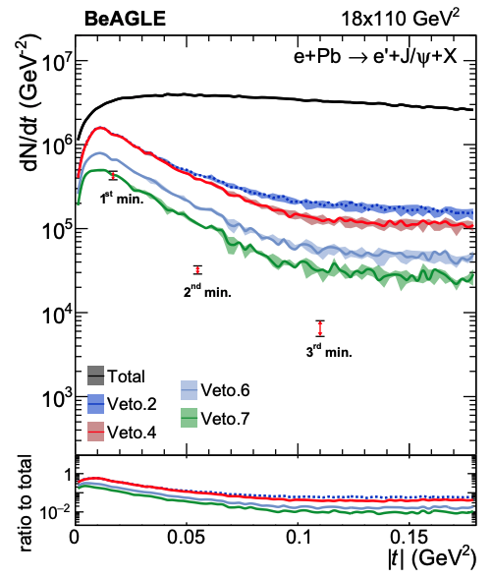
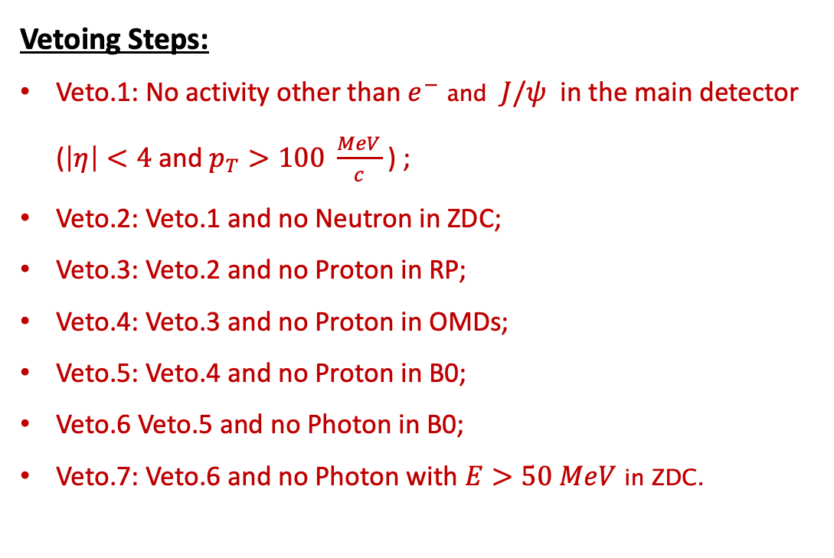
Past Studies with ECCE
Objective:
Creating a vetoing algorithm to significantly reduce the signals from events with incoherent $J/ψ$ production in ePb collisions.
This was originaly proposed for ECCE geometry: arXiv:2108.01694
Vetoing Steps:
Veto.1: No activity other than $e^{−}$ and $J/ψ$ in the main detector ($\left|η\right|<4$ and $p_{T}>100 \frac{MeV}{c}$ ) ;
Veto.2: Veto.1 and no Neutron in ZDC;
Veto.3: Veto.2 and no Proton in RP;
Veto.4: Veto.3 and no Proton in OMDs;
Veto.5: Veto.4 and no Proton in B0;
Veto.6 Veto.5 and no Photon in B0;
Veto.7: Veto.6 and no Photon with $E>50 MeV$ in ZDC.

Slide 5
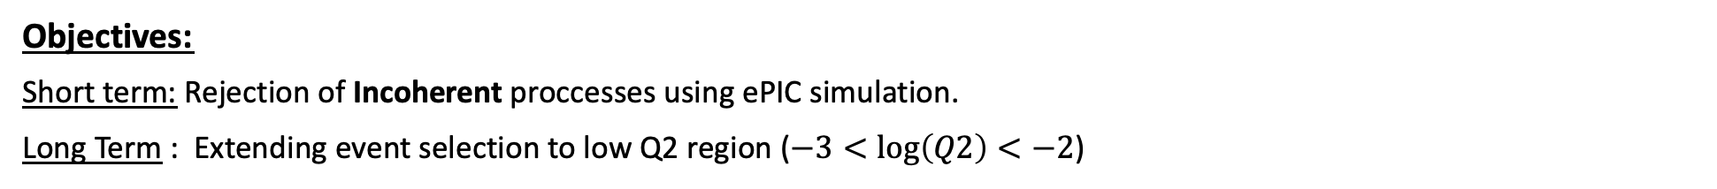
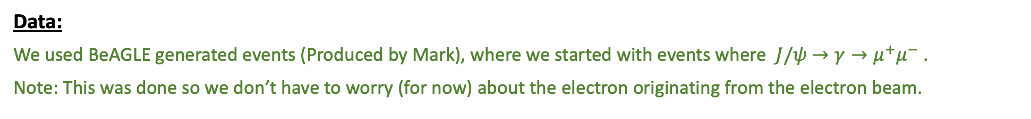
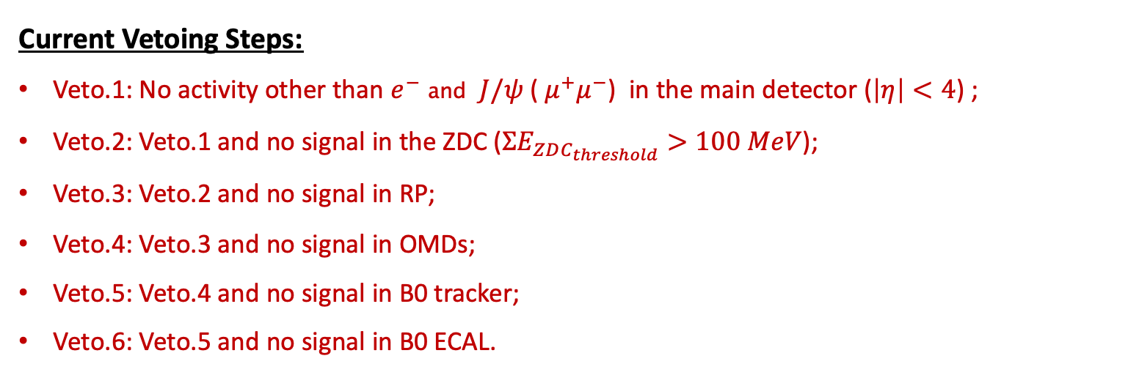
Vetoing Incoherent Events in ePIC
Objectives:
Short term: Rejection of Incoherent proccesses using ePIC simulation.
Long Term : Extending event selection to low Q2 region ($−3<\log\left(Q2\right)<−2$)
Data:
We used BeAGLE generated events (Produced by Mark), where we started with events where $J/ψ$ $→γ→μ^{+}μ^{−}$ .
Note: This was done so we don’t have to worry (for now) about the electron originating from the electron beam.
Current Vetoing Steps:
Veto.1: No activity other than $e^{−}$ and $J/ψ$ ($μ^{+}μ^{−}$) in the main detector ($\left|η\right|<4$) ;
Veto.2: Veto.1 and no signal in the ZDC ($ΣE_{ZDC_{threshold}}>100 MeV$);
Veto.3: Veto.2 and no signal in RP;
Veto.4: Veto.3 and no signal in OMDs;
Veto.5: Veto.4 and no signal in B0 tracker;
Veto.6: Veto.5 and no signal in B0 ECAL.

Slide 6
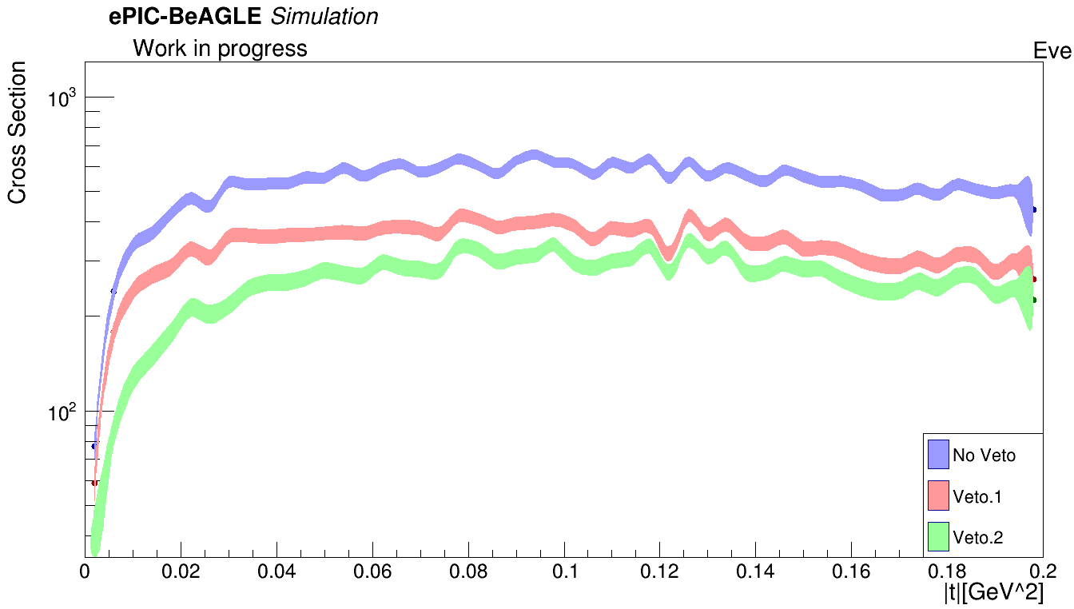
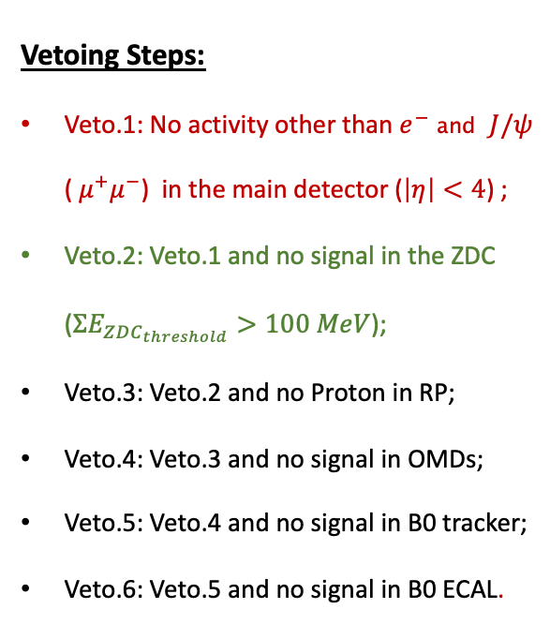
Initial Results
Vetoing Steps:
Veto.1: No activity other than $e^{−}$ and $J/ψ$ ($μ^{+}μ^{−}$) in the main detector ($\left|η\right|<4$) ;
Veto.2: Veto.1 and no signal in the ZDC ($ΣE_{ZDC_{threshold}}>100 MeV$);
Veto.3: Veto.2 and no Proton in RP;
Veto.4: Veto.3 and no signal in OMDs;
Veto.5: Veto.4 and no signal in B0 tracker;
Veto.6: Veto.5 and no signal in B0 ECAL.
Unexpected: Proton signal in RP appear in 100% of the events.

Slide 7
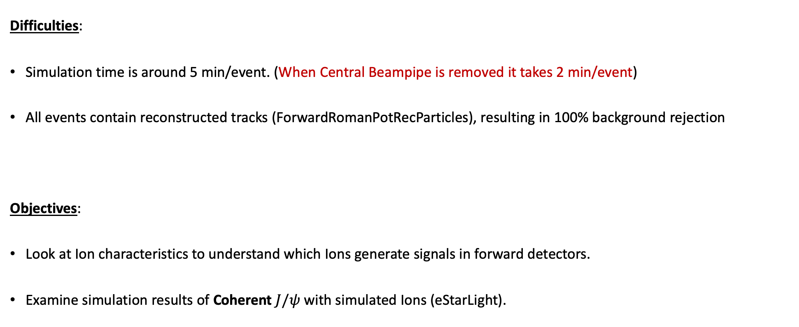
Simulating Ions Through DDSIM and EICRecon
Difficulties:
Simulation time is around 5 min/event. (When Central Beampipe is removed it takes 2 min/event)
All events contain reconstructed tracks (ForwardRomanPotRecParticles), resulting in 100% background rejection
Objectives:
Look at Ion characteristics to understand which Ions generate signals in forward detectors.
Examine simulation results of Coherent $J/ψ$ with simulated Ions (eStarLight).

Slide 8
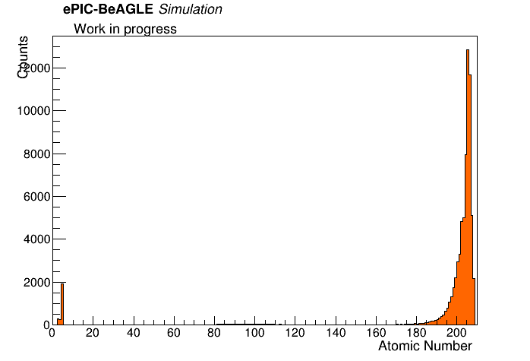
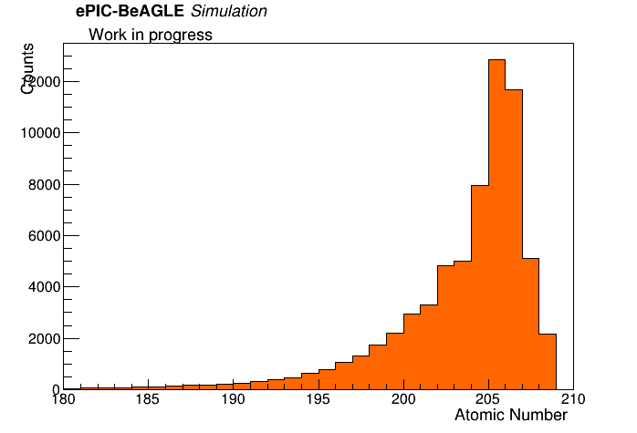
Ions Behavior
Let’s look at the BeAGLE output data for the Ion’s generated in the Incoherent production process.
Ions Total AAA Distribution
Close-Up Region
* Events with Ions PDG of 1000822080 don’t have a change in their net charge during the Incoherent VM production process.
The Hadron beam initially consists of Pb Ion’s with Z = 082, A = 208. Therefore, PDG = 1000822080.
Ion’s that remain with PDG = 1000822080 discribe a Pb Ion that was excited in the ePb collision.
Net charge does not change

Slide 9
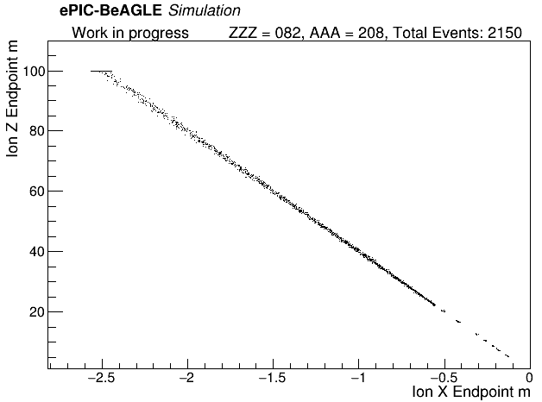
Ions Behavior
We expect the Ion’s that don’t have a change in their net charge, to continue with the Hadron beam, and stop at 100 meters.
From the ePIC simulation we notice a different behavior:
What we expected.
Interesting.... Seems like most of these Ions don’t reach the end of the beampipe.

Slide 10
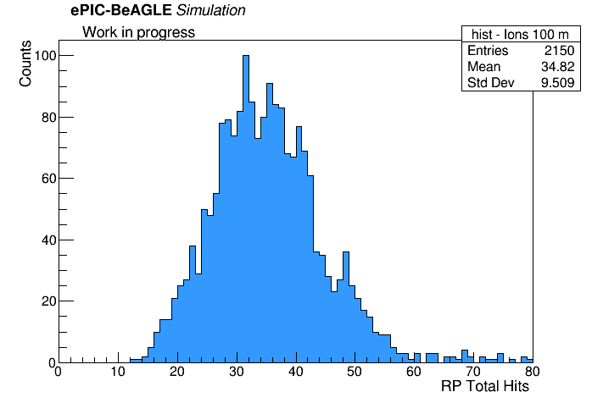
Ions Behavior
We can see that for all events we have hits in the RP.

Slide 11
eStarLight Ions Behavior
Since the results from the BeAGLE Ion’s seem odd, we decided to use data of Coherent $J/ψ$ prodcution, generated from eStarLight, to check that there is indeed no signal in the RP.
Steps:
Produced events using eStarLight
Simulated through ePIC geometry (DDSIM)
Reconstruction
Analyzing the Pb Ions behavior

Slide 12
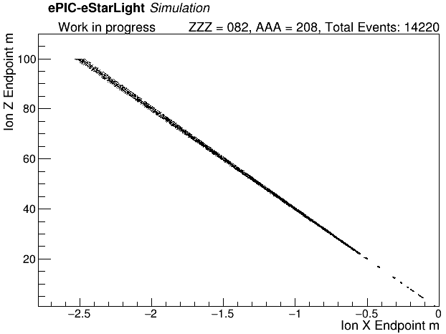
eStarLight Reconstructed Ions Behavior
Since we are now looking at coherent event’s we expect:
All the Pb Ion’s to reach the end of the world volume (ePIC geometry) at 100 meters.
No tracks in the RP’s
Once again, not what we expected…

Slide 13
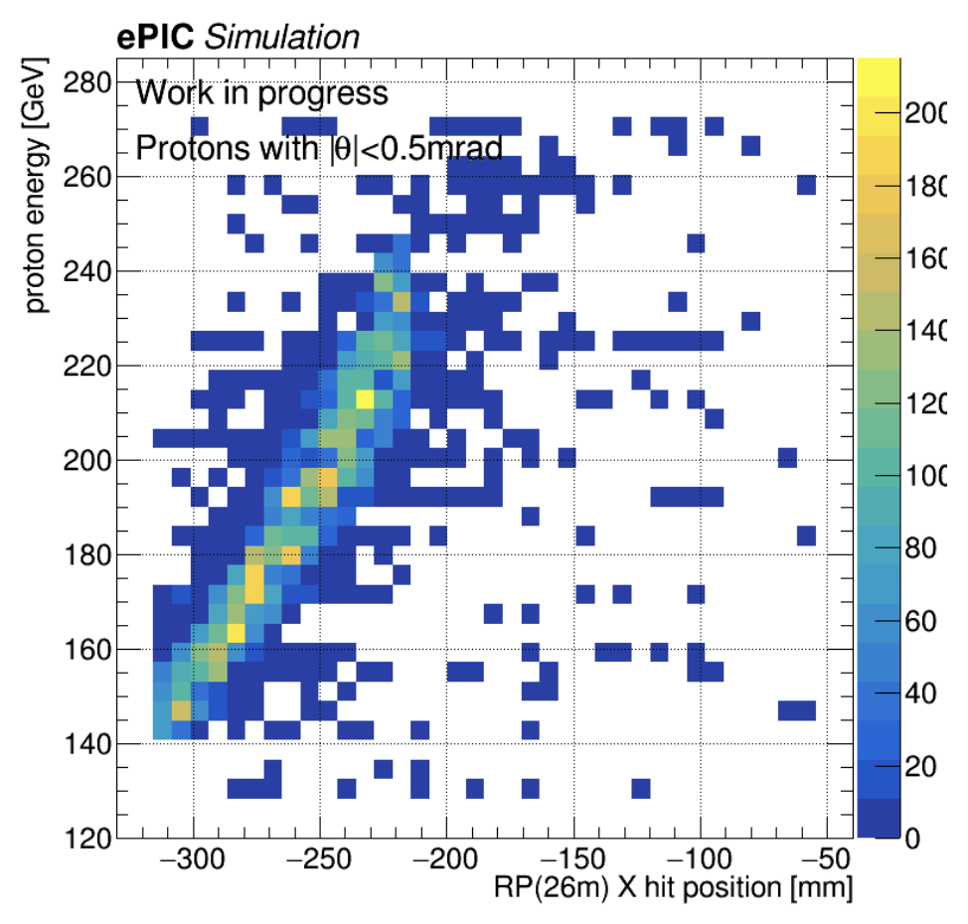
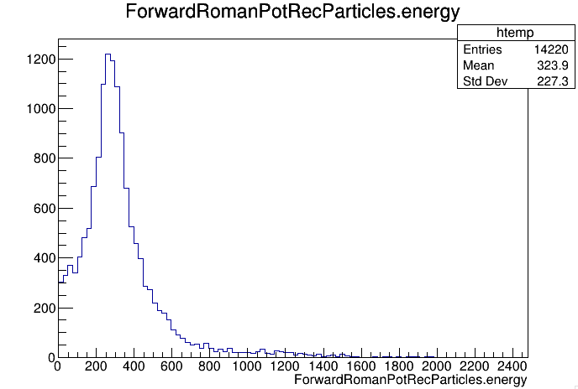

Track Kinematics Reconstructed by RP in Coherent Events
Since we are now looking at coherent event’s we expect all the Pb Ion’s to reach the end of the beampipe (z = 100 m).
RP particles reconstructed energy
Particles Energy GeV
The energy scale of the reconstructed particles seem to be to high according to the RP energy acceptence.

Slide 14
Conclusions
There is 100% signal rejection using the forward RP → Not sure why this is the case (looking into it).
Some Ion’s have characteristics that I did not expect.
Particles energy, reconstructed in the RP, don’t match the RP energy acceptance plot (produced by Michael).
Questions:
How can I know if the Ion’s are simulated properly through ePIC?
Any other suggestions?

