Slide 1


Soft Photons Studies in ePb Collisions
Zvi Citron, Michael Pitt, Eden Mautner
eA Study Meeting
BGU RHI Group
18.7.2023

Slide 2
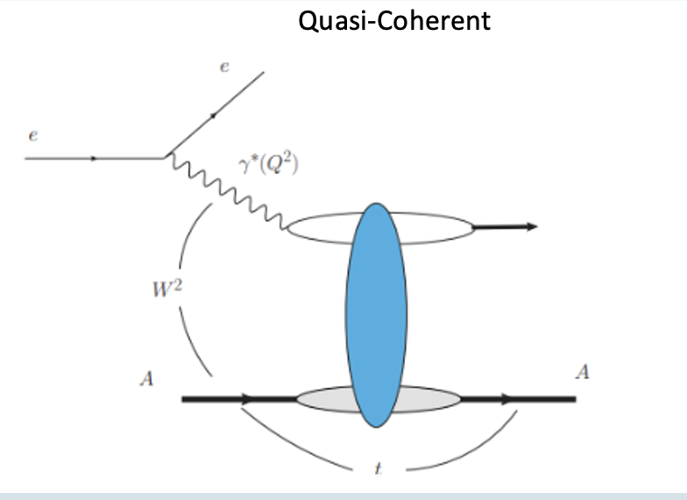
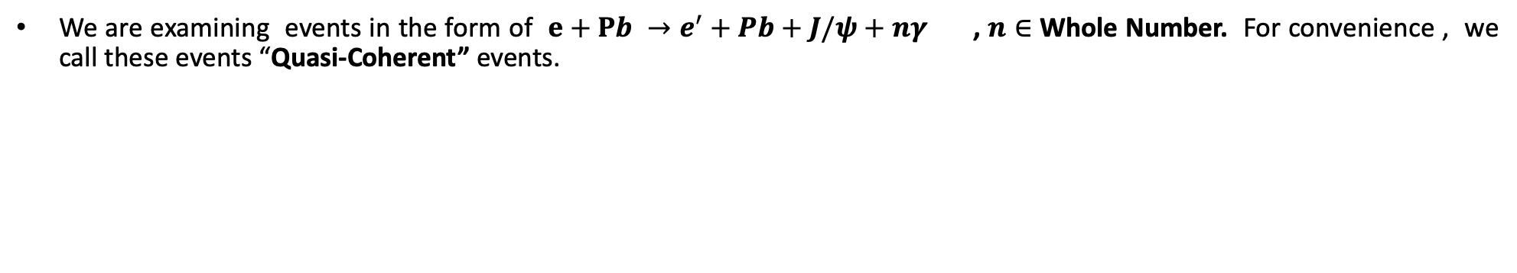

Process
We are examining events in the form of $e+Pb →e^{′}+Pb+J/ψ+nγ$ , $n∈$ Whole Number. For convenience , we call these events “Quasi-Coherent” events.
“Quasi-Coherent”
$J/ψ$+$nγ$

Slide 3
Objectives
To follow Michael’s previous studies regarding soft photons in ePb collisions (using his toy model) by analyzing BeAGLE data. (https://indico.bnl.gov/event/18761/contributions/78067/attachments/48260/81978/LowEphotons_BGU_2023_06_27.pdf)
Understand the characteristics (truth level) and kinematics of each soft photon (1,2,..,Etc. photons per event) generated from “Quasi-Coherent” events.

Slide 4



Analyses Steps
Filter only Quasi-Coherent events with $Pb_{82}^{208}$ final state Ion from the BeAGLE HEPMC (no ab) files (Mark Baker’s data). **Filter == Only events with fianl state $Pb_{82}^{208}, γ$, $μ^{+}$, $μ^{−}$ particles.
Use the HEPMC files to analyze the different kinematics in the events.
Analysis Configurations:
$H_{beam energy}$= 275 GeV
$Z_{Pb}$ = 82
$A_{Pb}$= 208
Original data with
$≈$ 6.7 milion events.
Only “Quasi-Coherent”
events, $≈$230k events (3.5%).
Understand the kinematics of these events.
Filter
Analyze
Nucleon Energy (lab frame): ${ H}_{beam}∗\frac{Z_{Pb}}{A_{Pb}}=108.4$ GeV
Note: No rotation of 25 mrad needed since we did not simualte through ePIC.

Slide 5
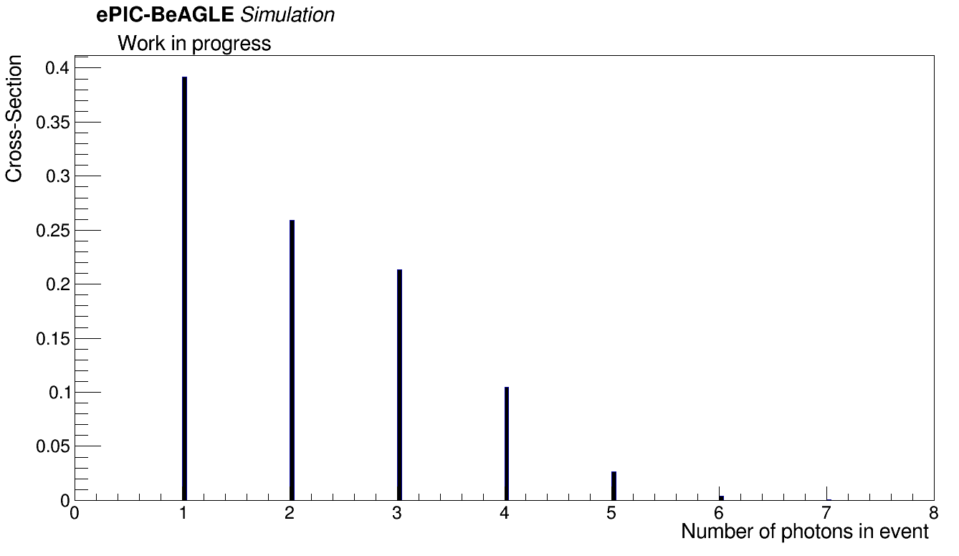
Number of Photons per Event
In total we analyzed $≈$230K Quasi-Coherent events. The distribution of the number of photons per event is shown below:
Note: These are all final state photons, that is, genPar_status == 1.

Slide 6
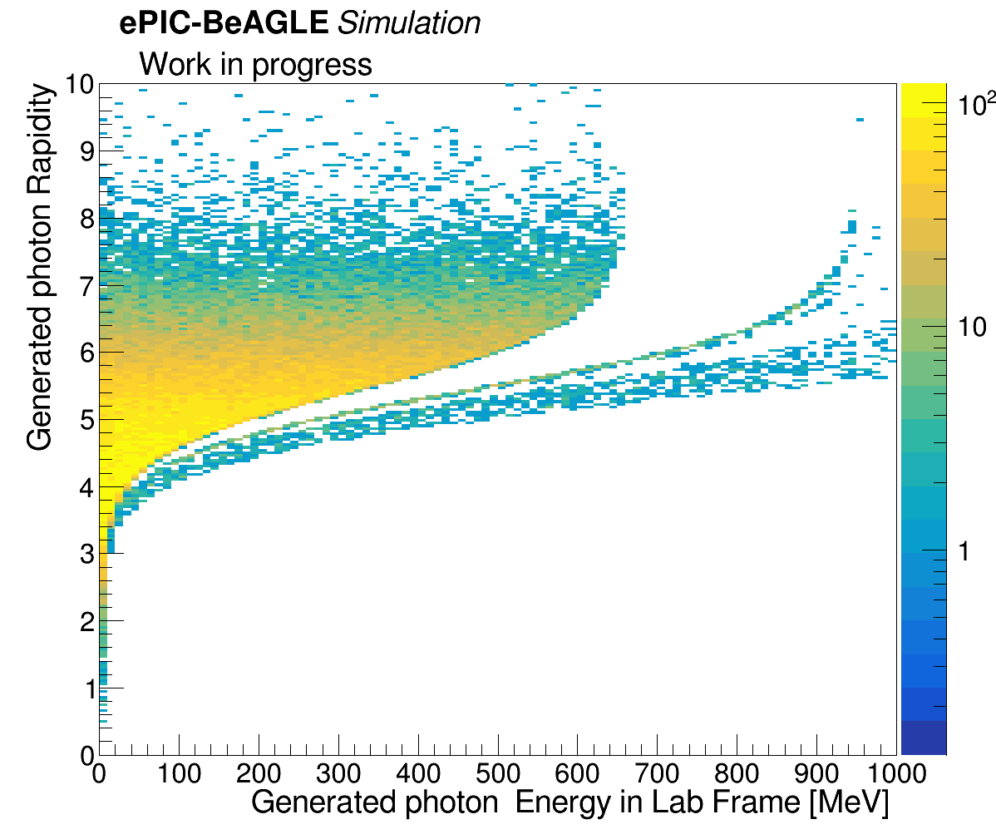

1 Photon “Quasi-Coherent” Events
Total number of 1 photon “Quasi-Coherent” events: 90045 ($≈39\%$)
First, we were interested in understanding the rapidity and energy (lab frame) distribution of the generated photons.
B0 acceptance

Slide 7

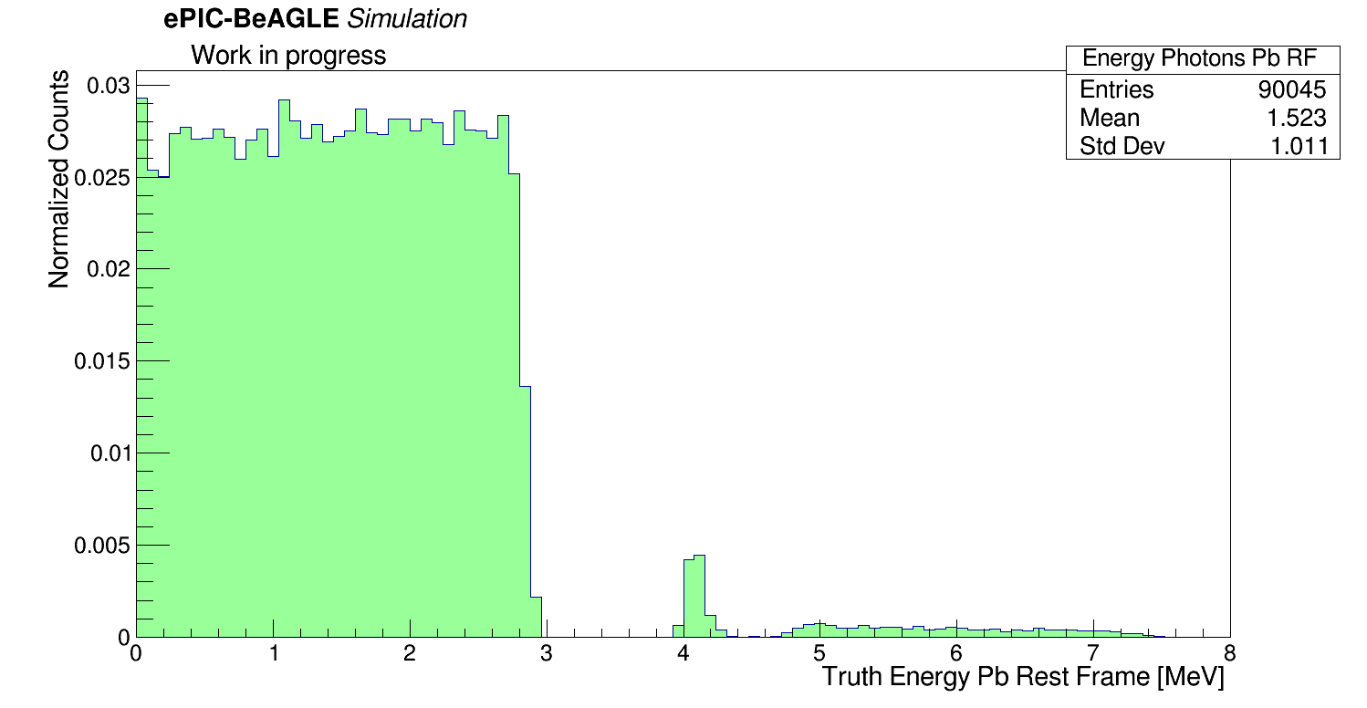
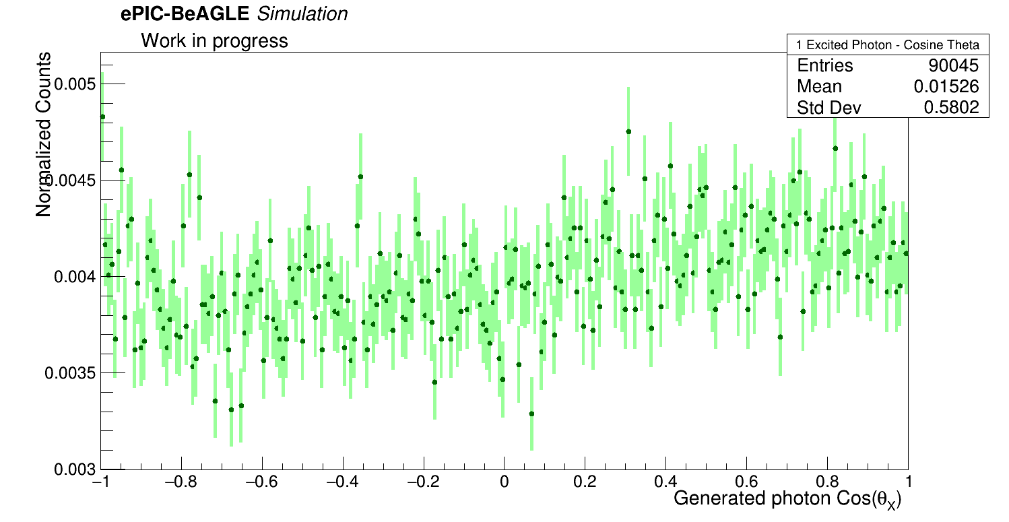
1 Photon “Quasi-Coherent” Events
Photons were boosted to the Pb’s rest frame:

Slide 8

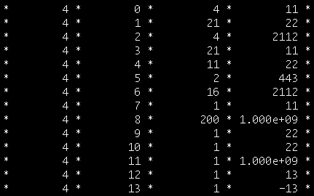

2 Photon “Quasi-Coherent” Events
Total number of 2 photon “Quasi-Coherent” events: 59463 ($≈26\%$ )
We were interested in understanding the rapidity and energy (lab frame) distribution, per generated photon. We decided to call the first generated photon as “1st photon”, and the second generated photon “2nd photon”. We chose them as explained below:
genPar_PDG = 22 → photon.
genPar_status = 1 → Final state particle.
genPar_PDG = 1000822080 → Pb Ion
genPar_status = 200 → Excited state?
1st photon
2nd photon
**Note: All the status 1 photons share the same vertex.

Slide 9
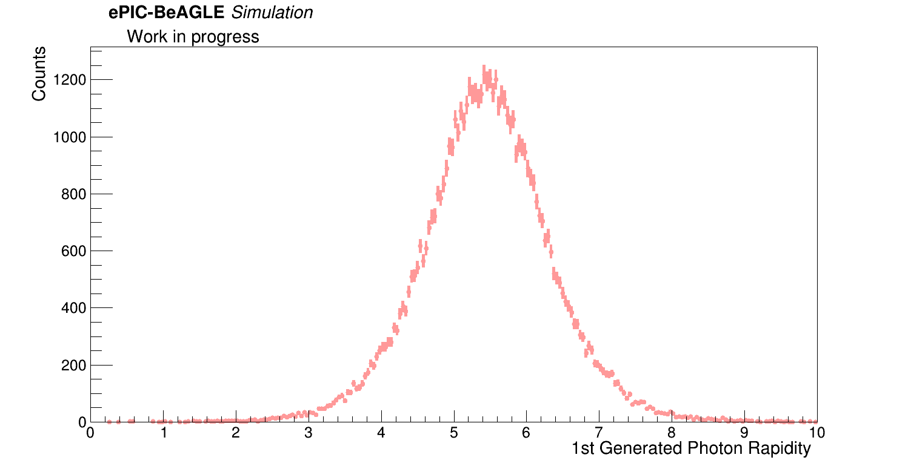
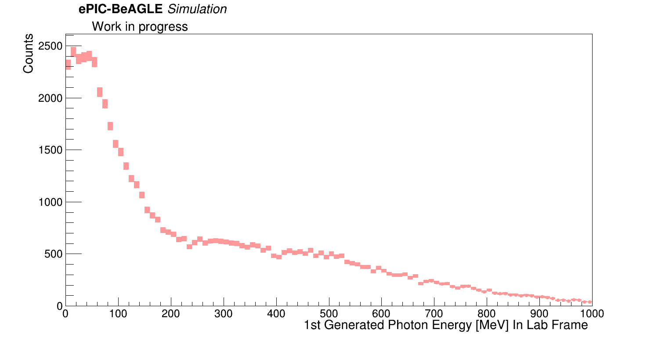
2 Photon “Quasi-Coherent” Events
Rapidity and Energy (lab frame) plots for both photons where generated.
For 1st photon:
1st Photon
1st Photon
B0 rapidity acceptance

Slide 10
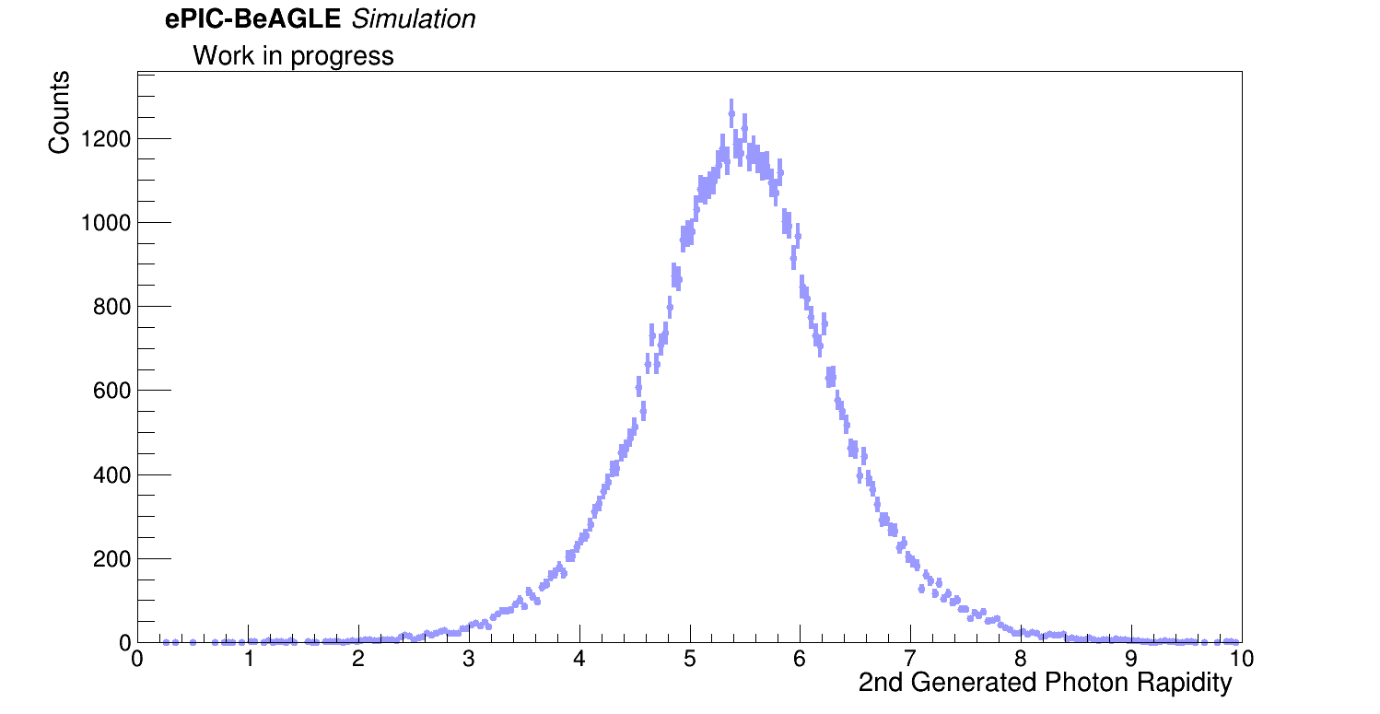
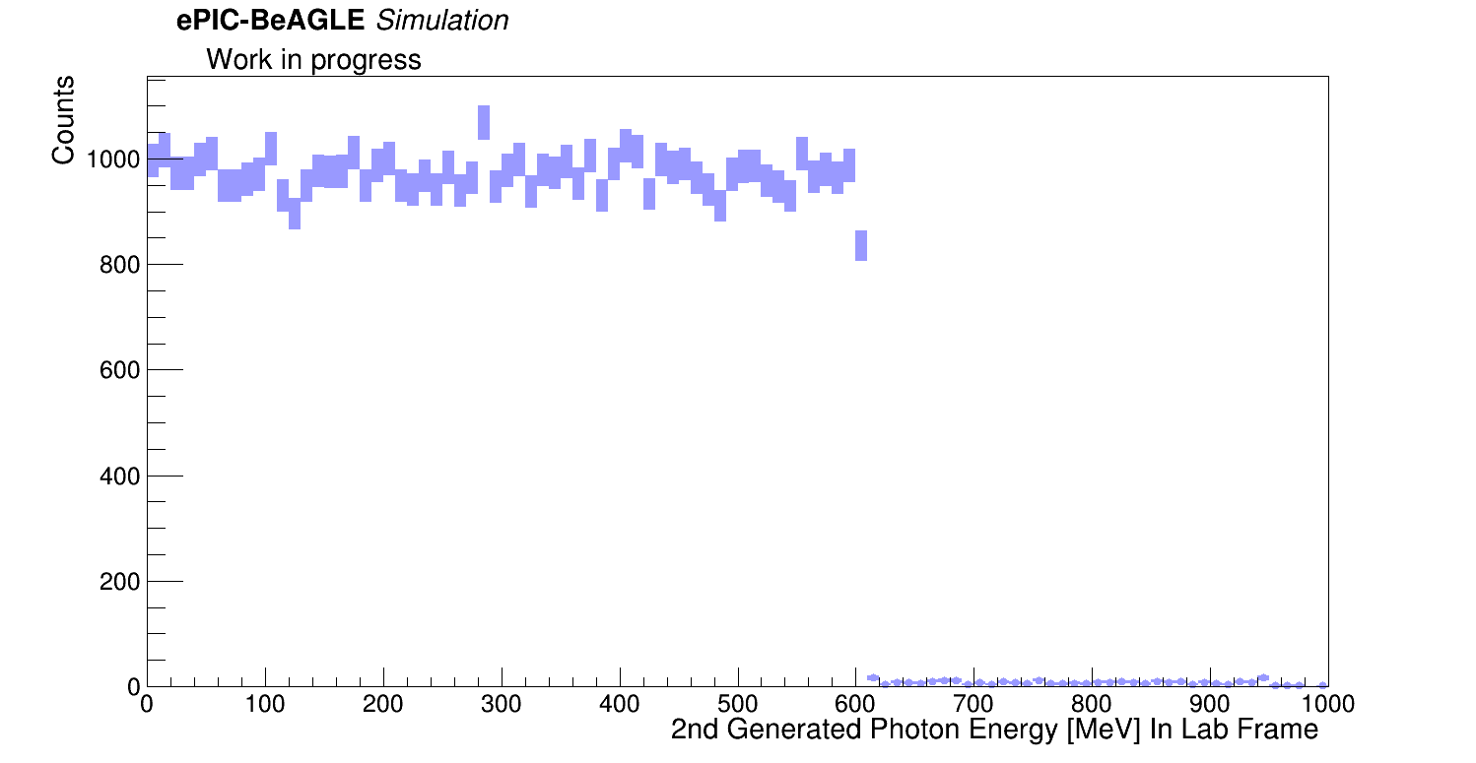
2 Photon “Quasi-Coherent” Events
2nd photon
And for the 2nd photon:
2nd Photon
2nd Photon
B0 rapidity acceptance

Slide 11
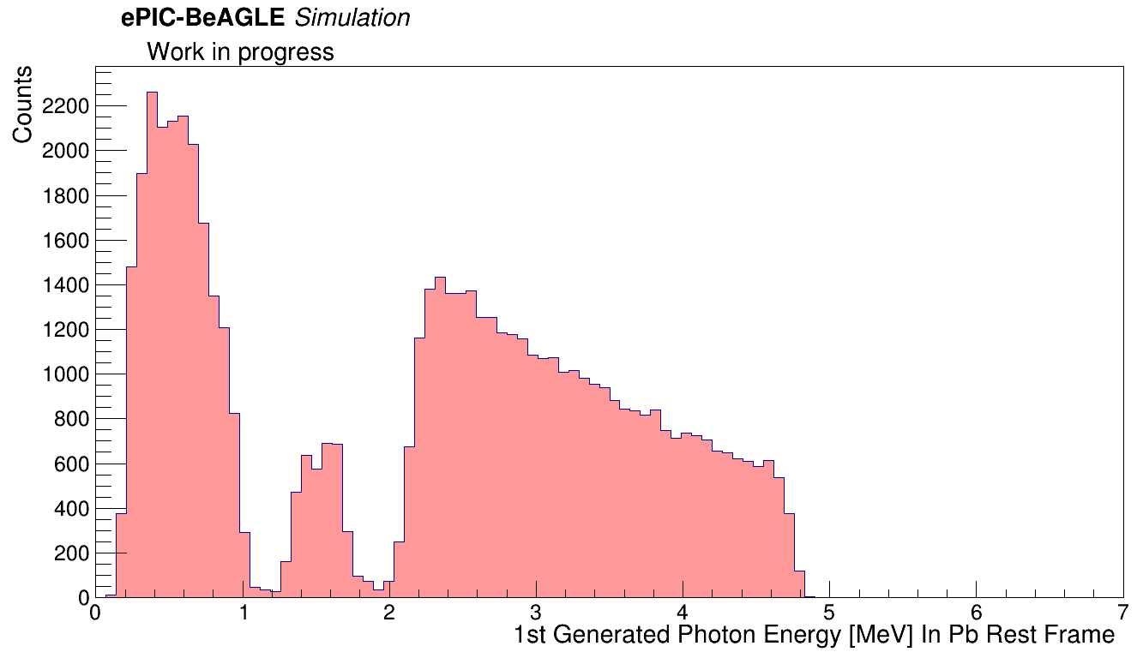
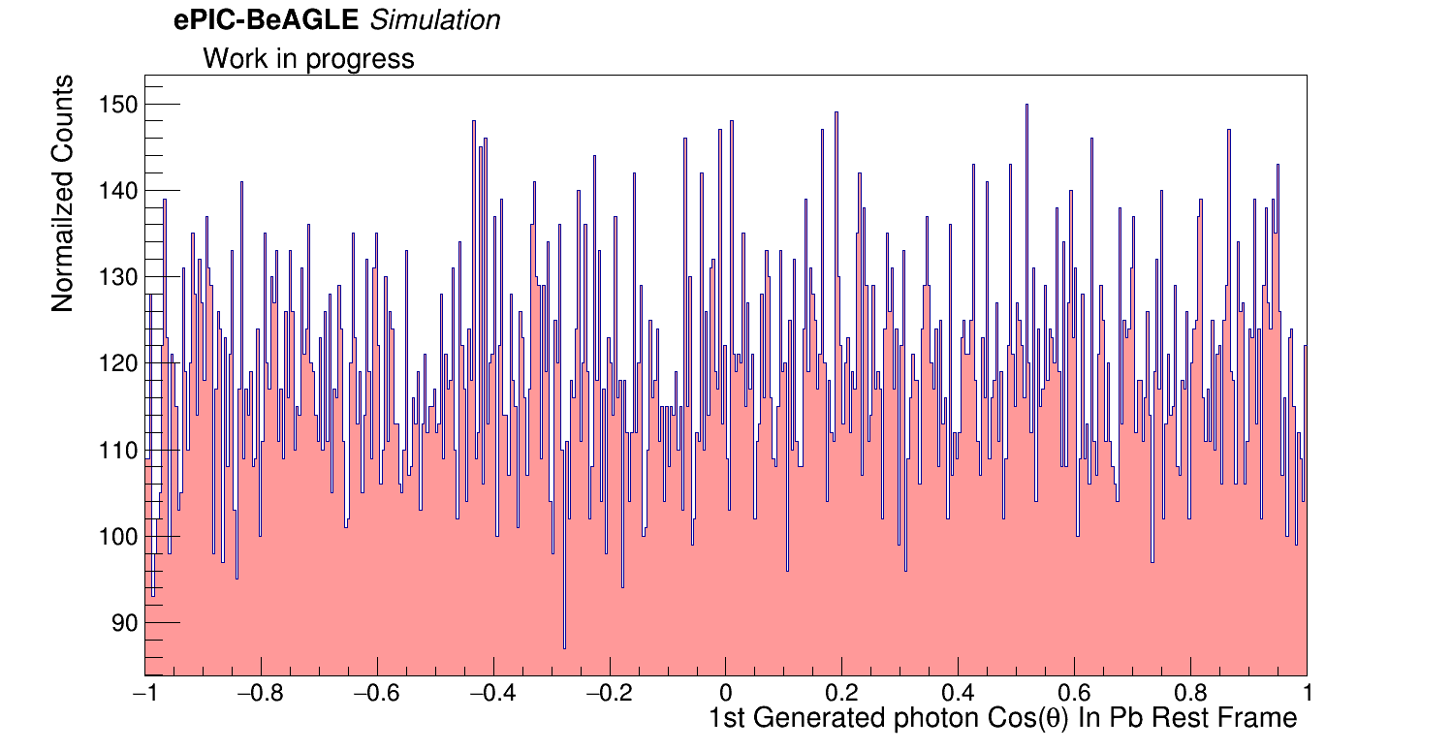
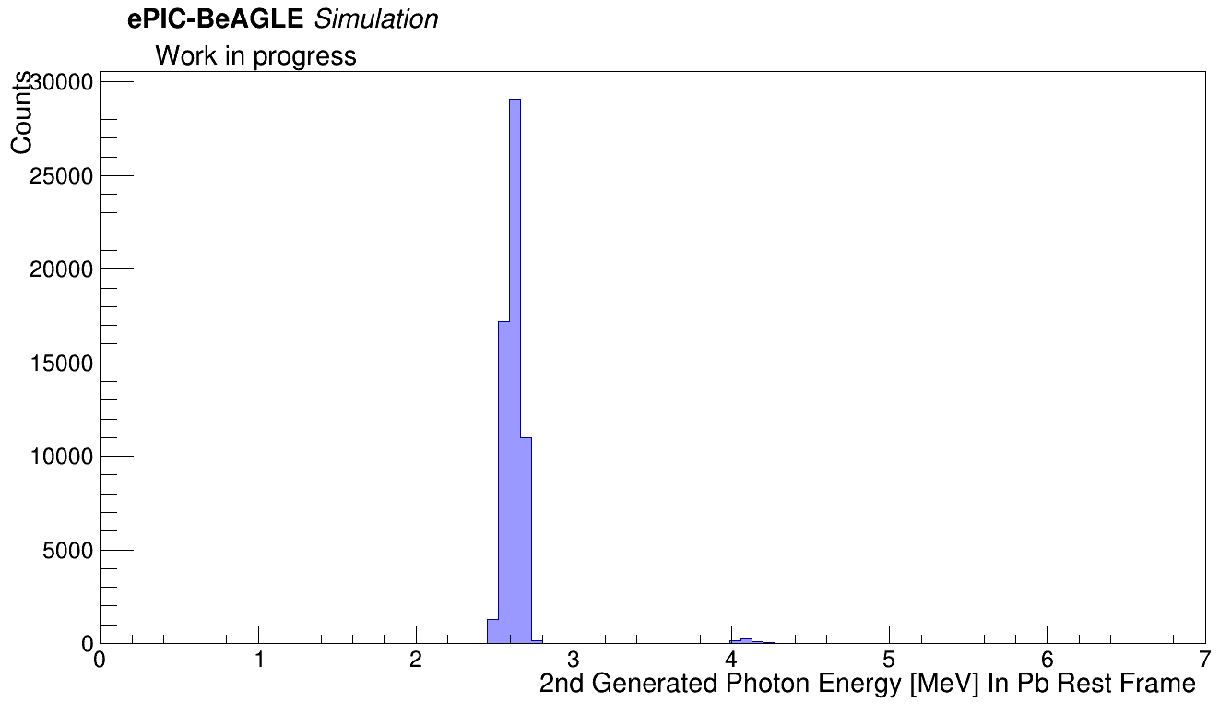
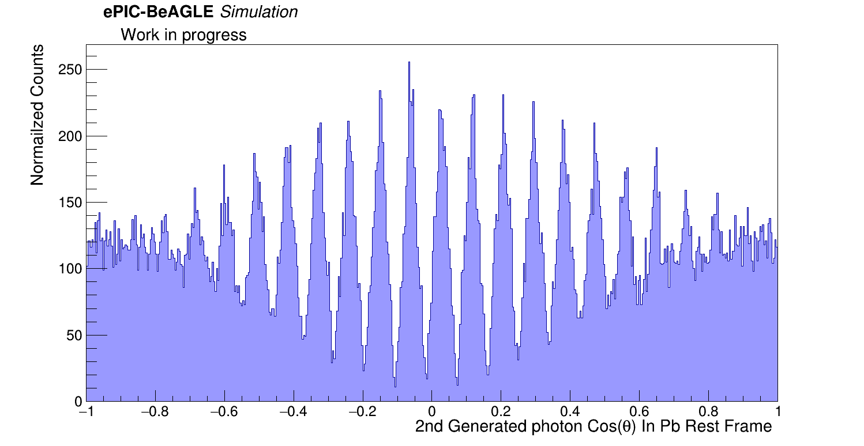

2 Photon “Quasi-Coherent” Events
We generated Energy (Pb rest frame) and $cos⁡(θ)$ distribution plots for the 1st and 2nd emitted photons.
1st Photon
1st Photon
2nd Photon
2nd Photon
**Note: Something weird is going on here… Might be that the second photon needs to be boosted to the 1st photons rest frame?

Slide 12
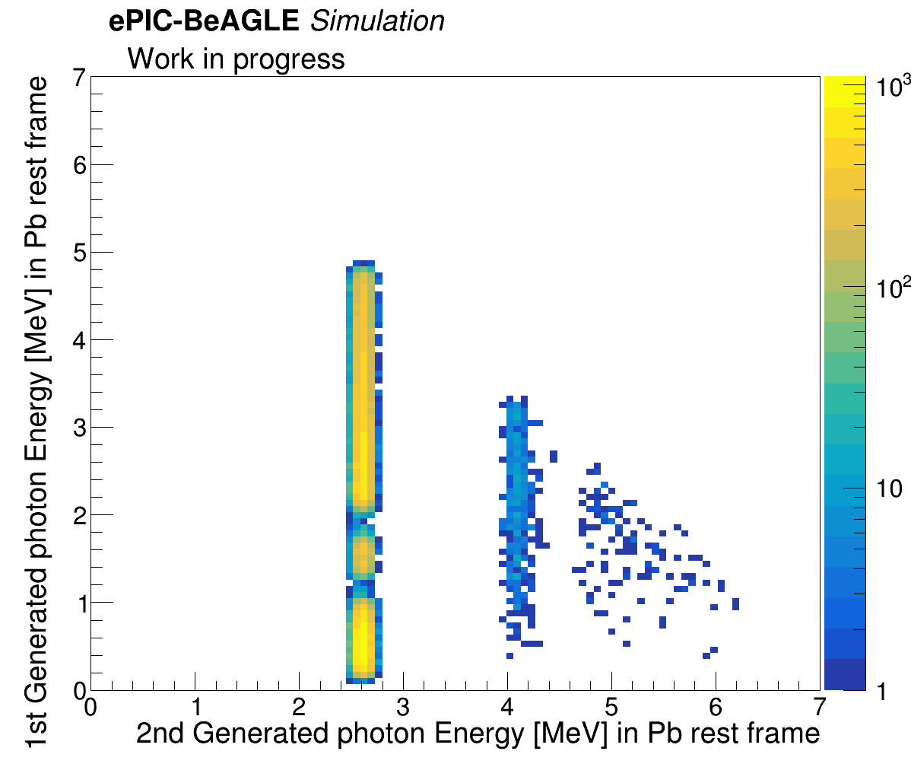
2 Photon “Quasi-Coherent” Events
We can see that there is no correlation between the photons energy in the Pb’s rest frame.

Slide 13
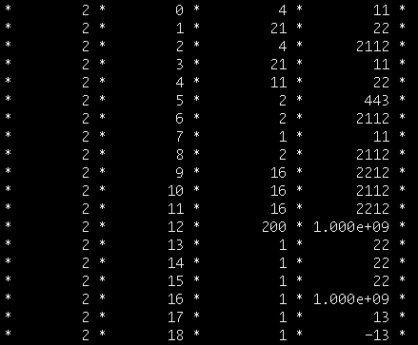

3 Photon “Quasi-Coherent” Events
Total number of 3 photon “Quasi-Coherent” events: 49098 ($≈21\%$ of all events.)
As done previously, we decided to call the first generated photon as “1st photon”, the second generated photon “2nd photon”, and the thrid generated photon as “3rd photon”, and we chose them similarly as for the 2 photon events:
genPar_PDG = 22 → photon.
genPar_status = 1 → Final state particle.
genPar_PDG = 1000822080 → Pb Ion
genPar_status = 200 → Excited state?
1st photon
2nd photon
3rd photon
**Note: All the status 1 photons share the same vertex.

Slide 14
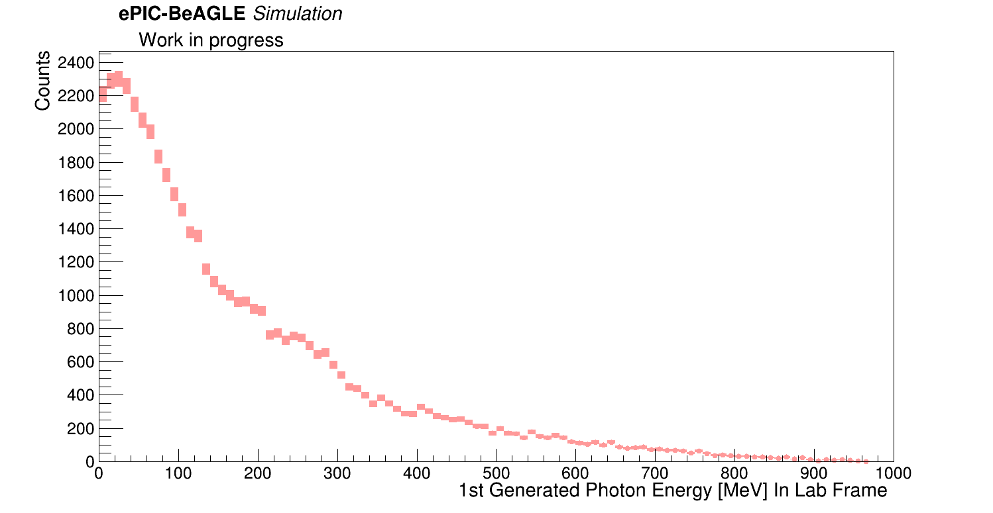
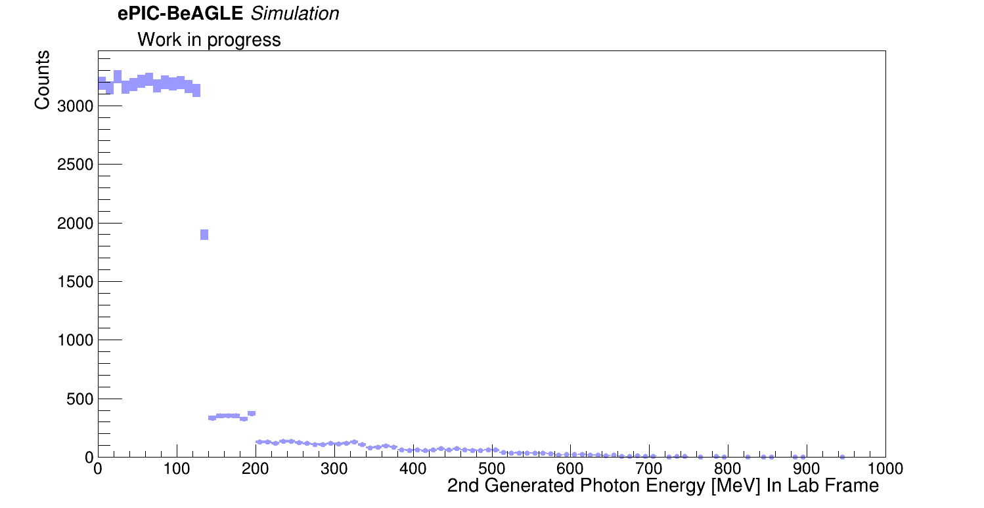
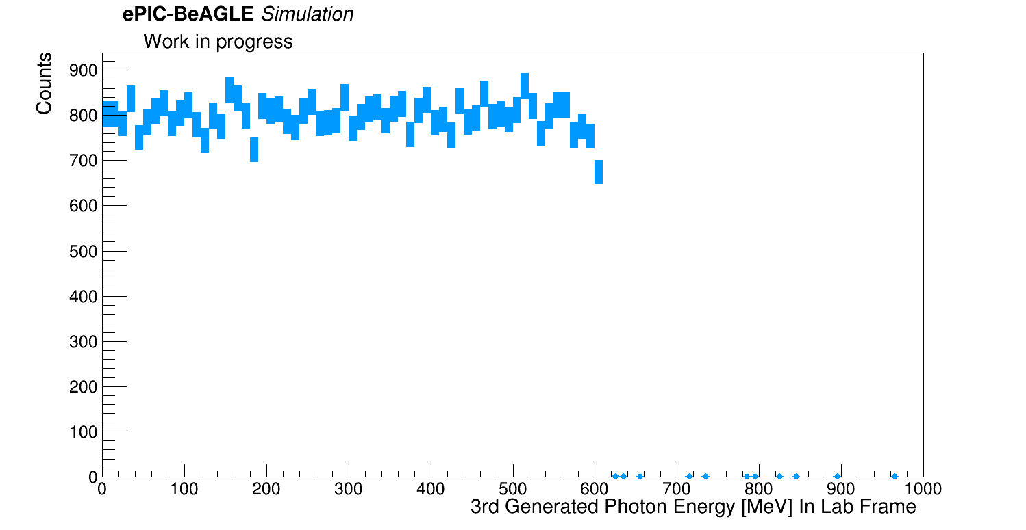
3 Photon “Quasi-Coherent” Events
Basically, the rapidity and emission plot’s look similar as in the previous plots. Let’s look at the lab frame energies for each photon:
1st Photon
2nd Photon
3rd Photon

Slide 15
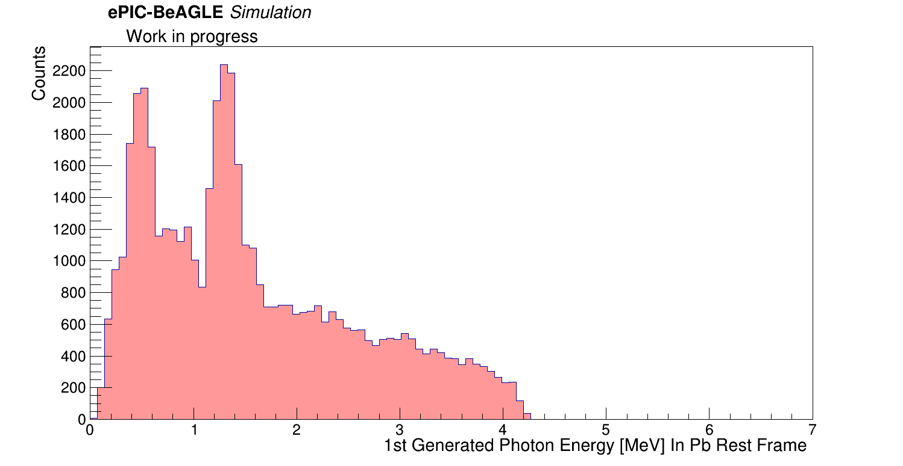
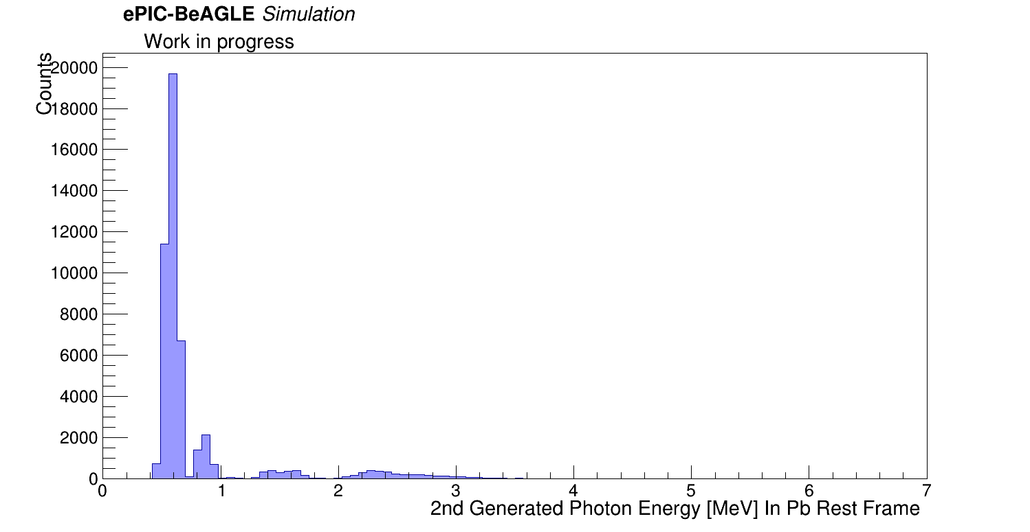
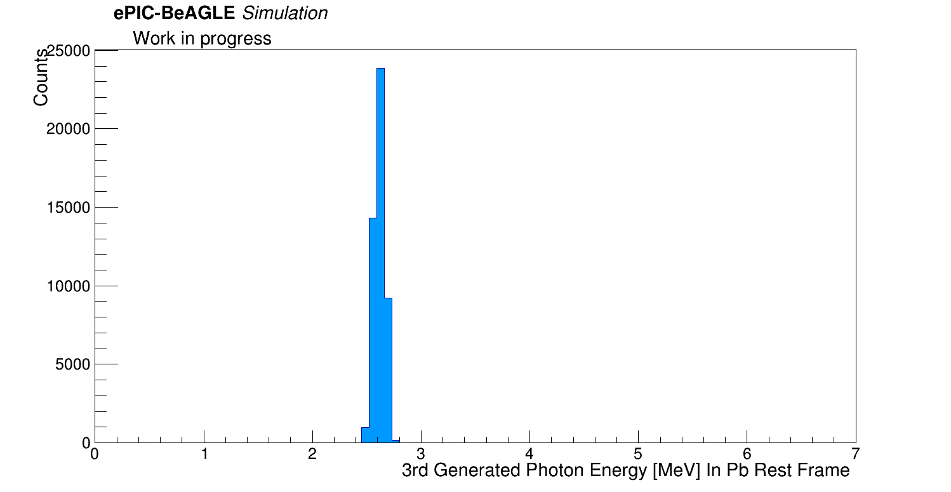
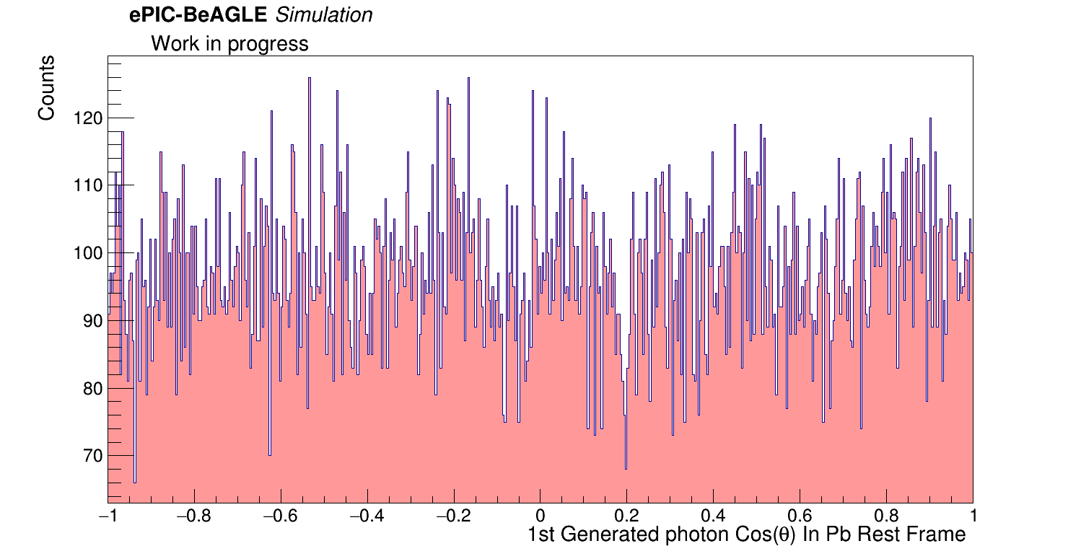
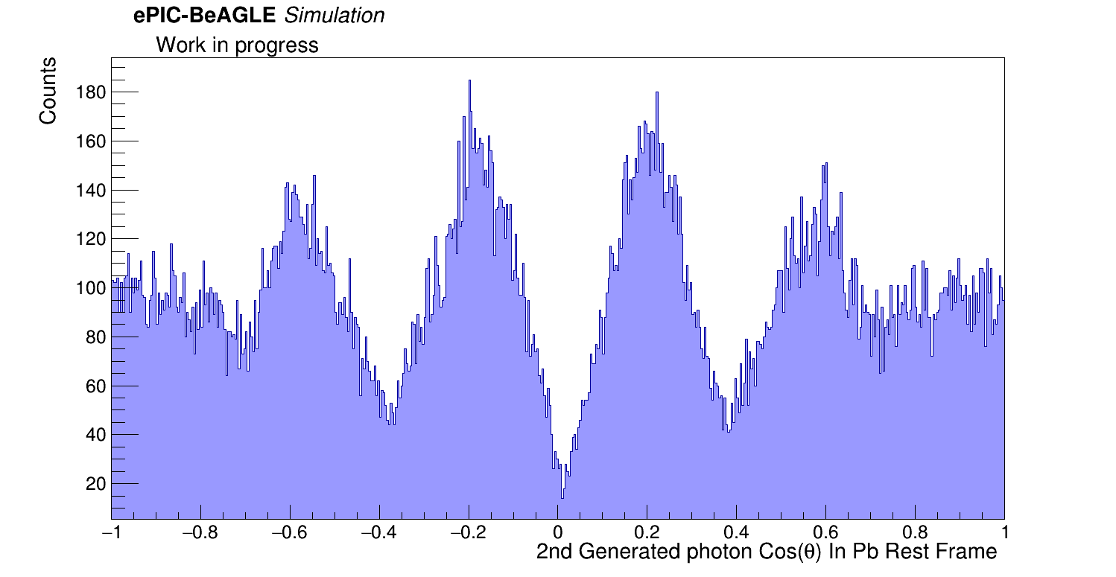
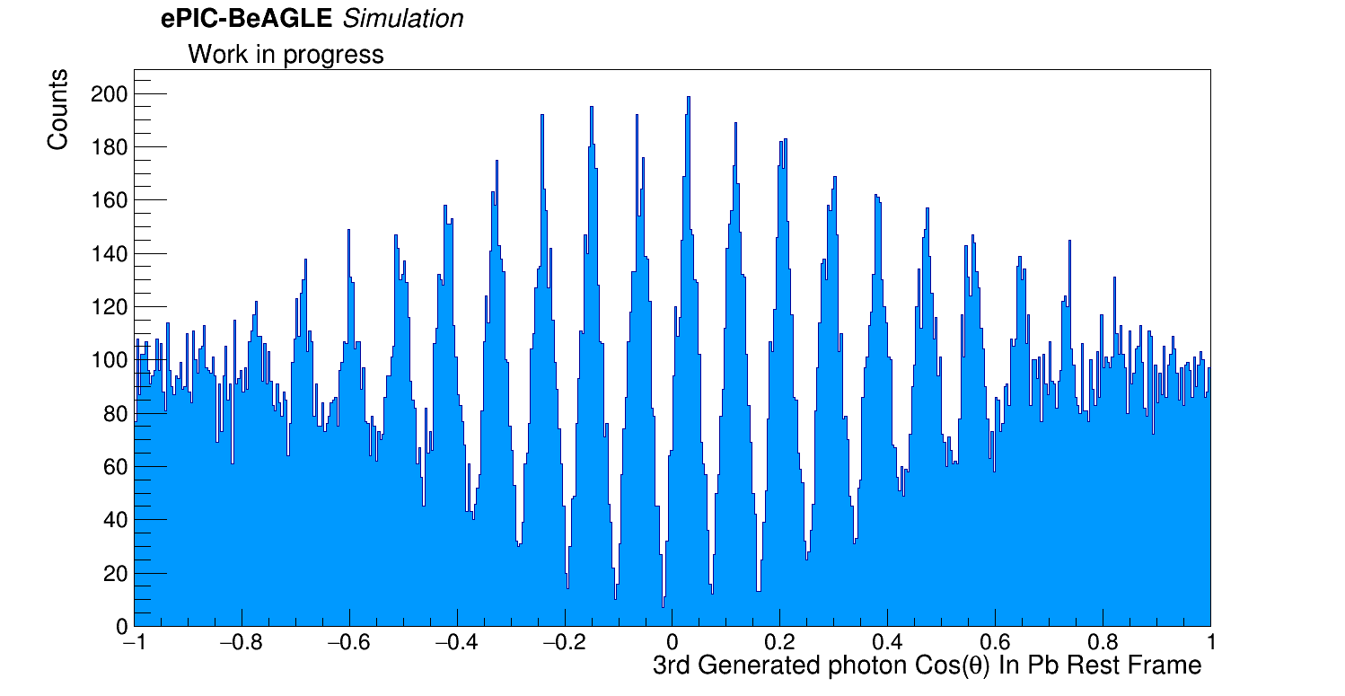
3 Photon “Quasi-Coherent” Events
And in the Pb rest frame:
1st Photon
2nd Photon
3rd Photon
1st Photon
2nd Photon
3rd Photon

Slide 16
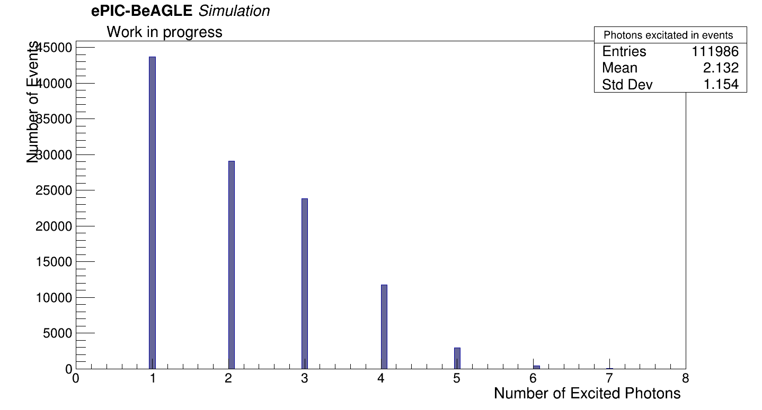
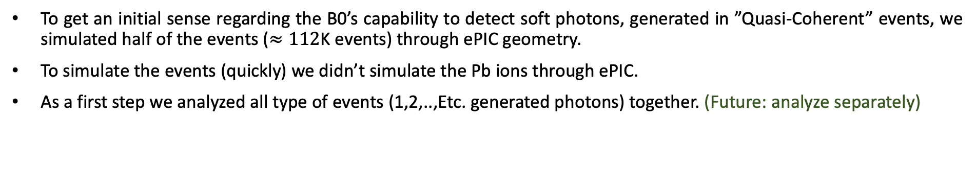
Initial B0 Detector Analysis
To get an initial sense regarding the B0’s capability to detect soft photons, generated in ”Quasi-Coherent” events, we simulated half of the events ($≈112$K events) through ePIC geometry.
To simulate the events (quickly) we didn’t simulate the Pb ions through ePIC.
As a first step we analyzed all type of events (1,2,..,Etc. generated photons) together. (Future: analyze separately)
Number of Photons

Slide 17
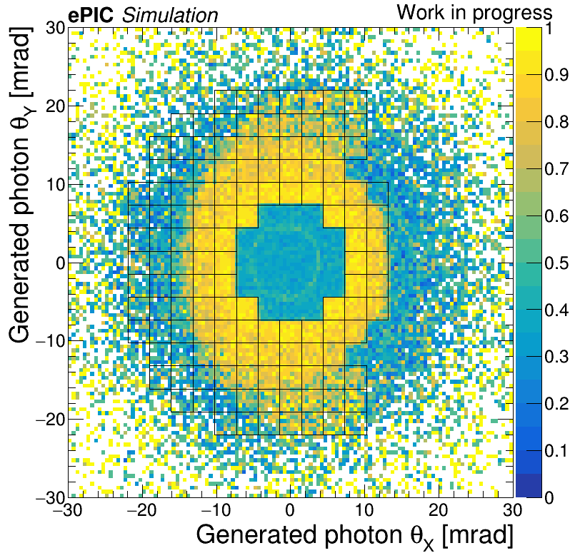

Initial B0 Detector Analysis
We generated an acceptance plot:
Acceptance
Acceptance $==\frac{E_{ deposited}}{{E }_{generated}}$

Slide 18
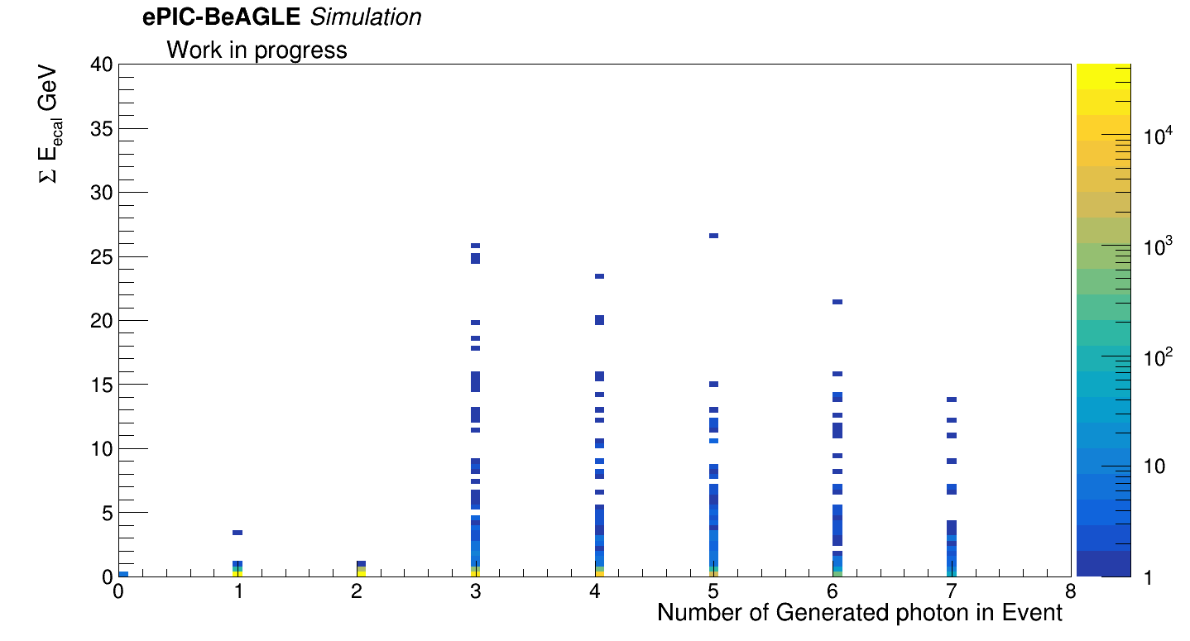
Initial B0 Detector Analysis
We were also interested in understanding how the deposited energy (B0 Ecal) of the soft photons depends on the type of “Quasi-Coherent” event:

Slide 19
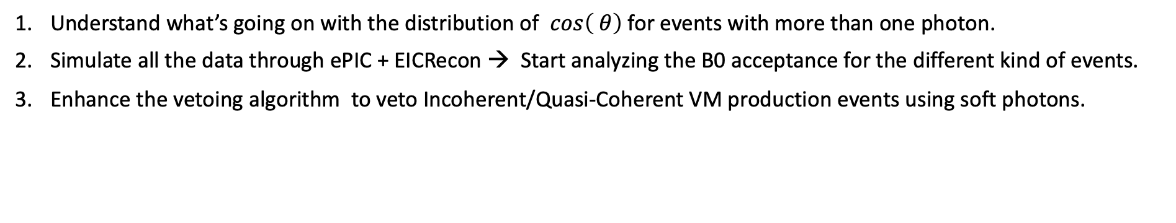
Summary
Conducted ”truth level” analyses for “Quasi-Coherent” events, where we worked on each type of event separately. (1,2,..,Etc. photons per event)
We encountered some weird behavior in events with more than 1 photon generated. Seems like the second photon, and higher, might be in the last photons frame.
First signs that the B0 would be able to detect soft photons.
Future Work:
Understand what’s going on with the distribution of $cos\left( θ\right)$for events with more than one photon.
Simulate all the data through ePIC + EICRecon → Start analyzing the B0 acceptance for the different kind of events.
Enhance the vetoing algorithm to veto Incoherent/Quasi-Coherent VM production events using soft photons.
Thanks!

Slide 20
Backup Slides

Slide 21
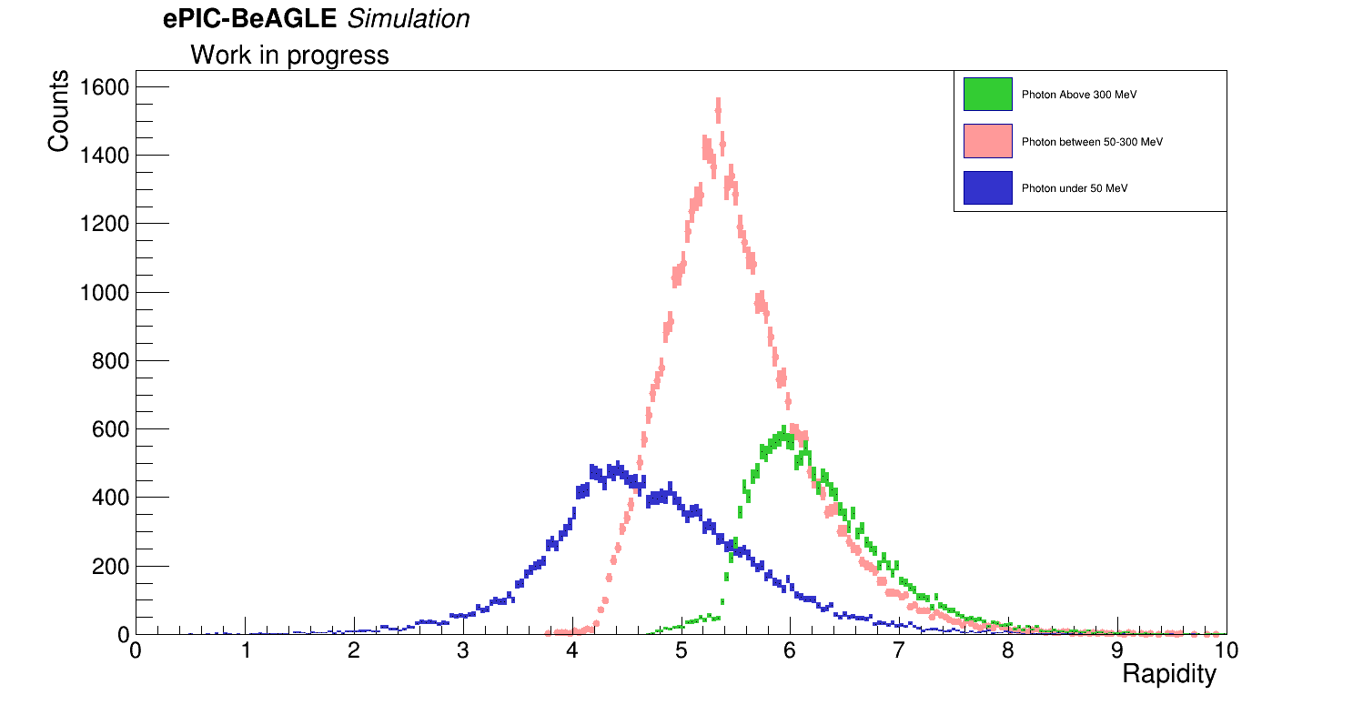
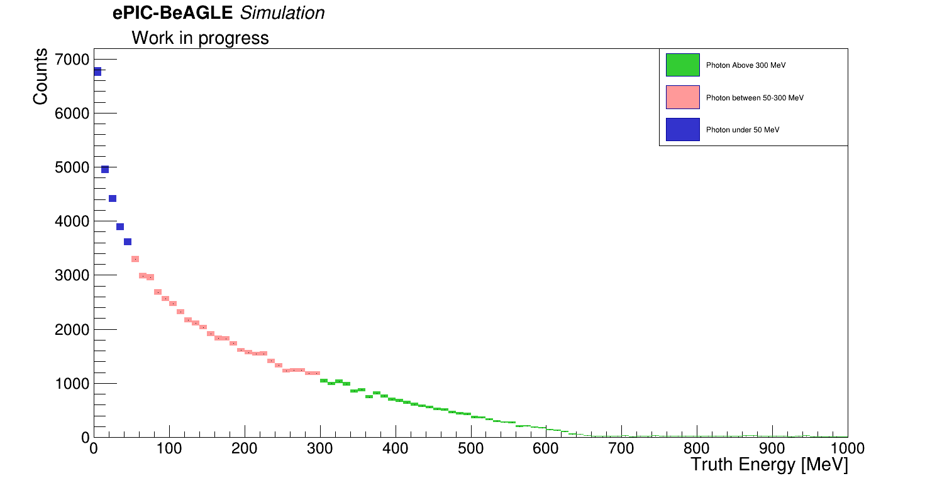
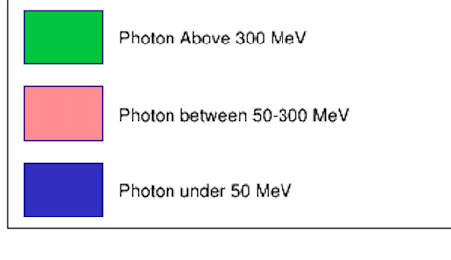
1 Photon “Quasi-Coherent” Events
This time we looked at the rapidity distribution for different regions of the lab frame energy:
B0 rapidity acceptance

Slide 22
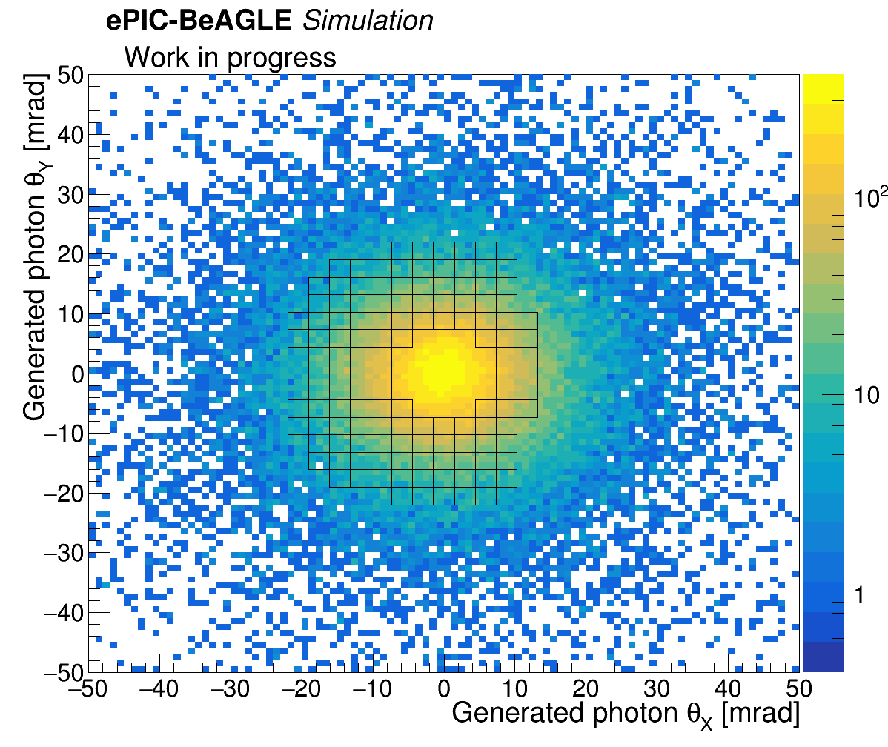
1 Photon “Quasi-Coherent” Events
We generated the emissions pattern of the photons in this type of event:

Slide 23
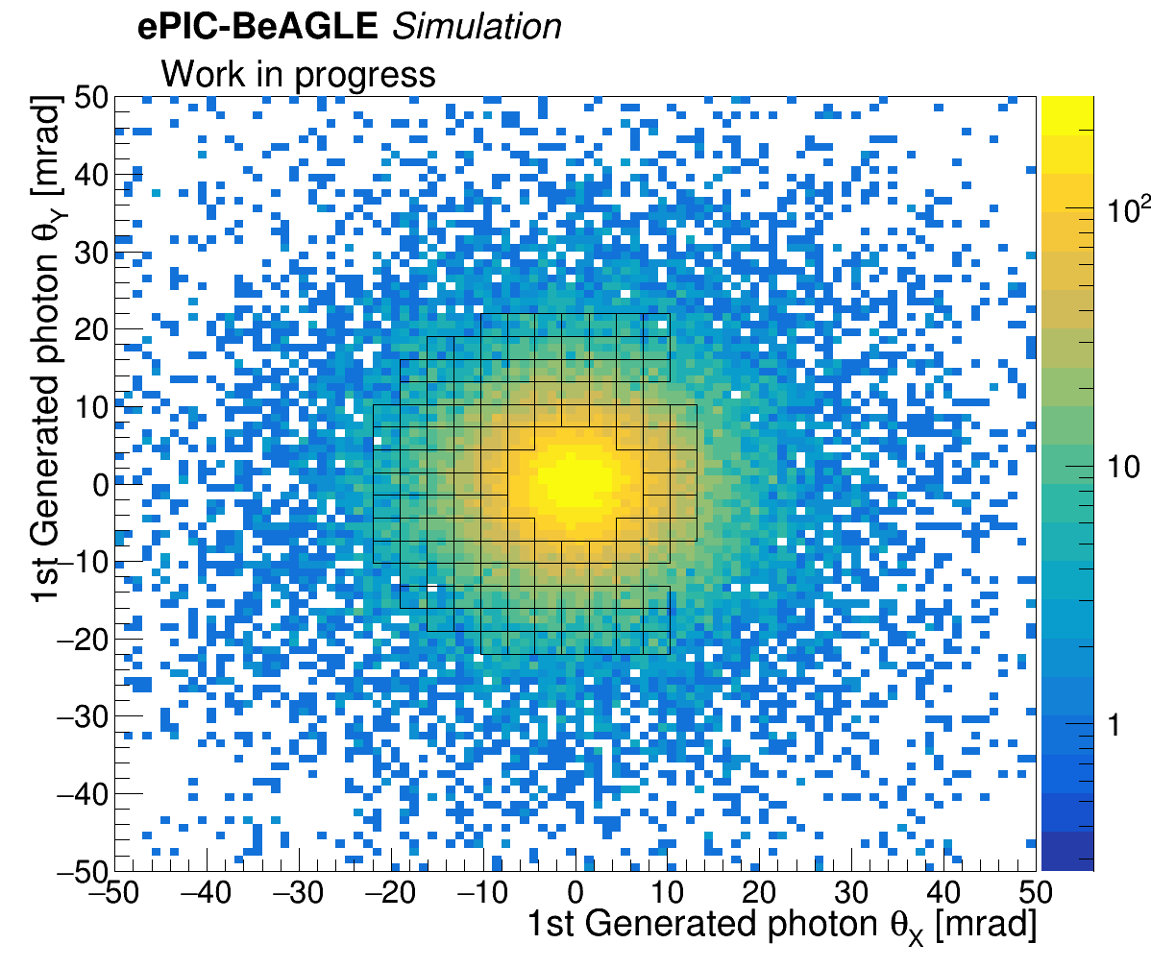
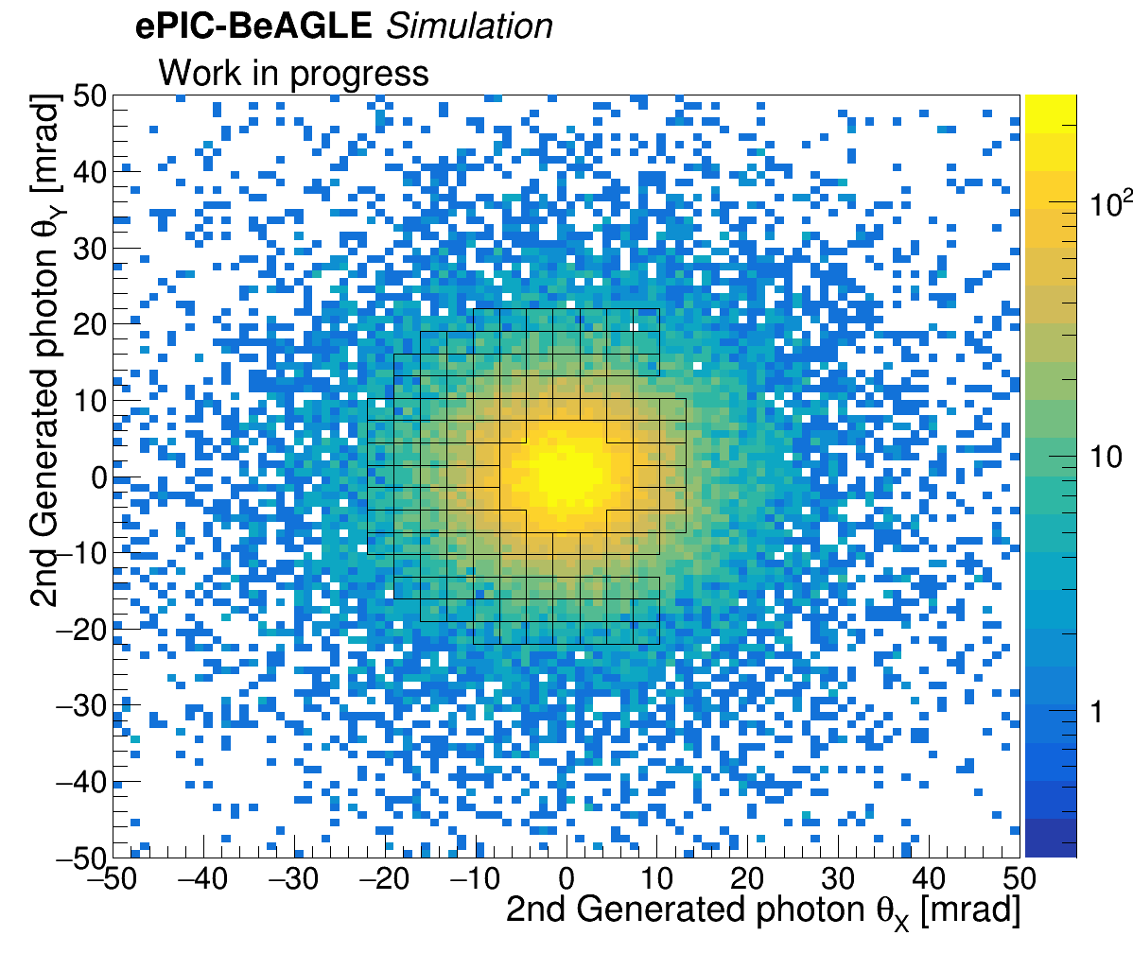
2 Photon “Quasi-Coherent” Events
Photon emission pattern plots look essentially the same for both generated photons in the event:
1st Photon
2nd Photon

Slide 24
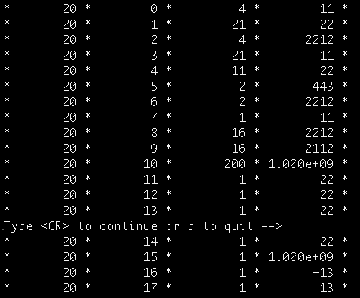

4 Photon “Quasi-Coherent” Events
Total number of 4 photon “Quasi-Coherent” events: 24038 ($≈10\%$ of all events.)
As done previously, we decided to call the first generated photon as “1st photon”, the second generated photon “2nd photon”, the thrid generated photon as “3rd photon”, and the fourth generated photon as “4th photon”. We chose them similarly as in previous “Quasi-Coherent” events.
genPar_PDG = 22 → photon.
genPar_status = 1 → Final state particle.
genPar_PDG = 1000822080 → Pb Ion
genPar_status = 200 → Excited state?
1st photon
2nd photon
3rd photon
4th photon
**Note: All the status 1 photons share the same vertex.

Slide 25
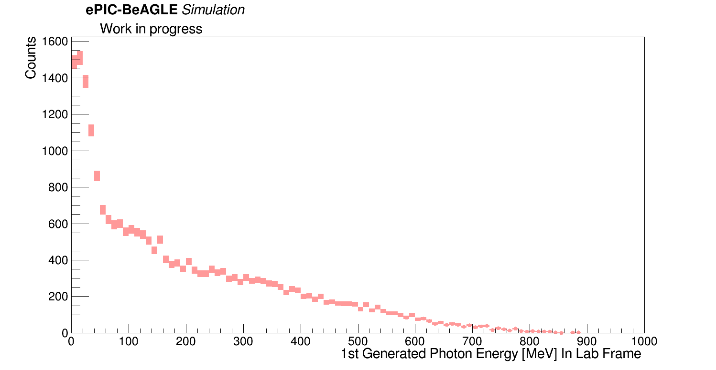
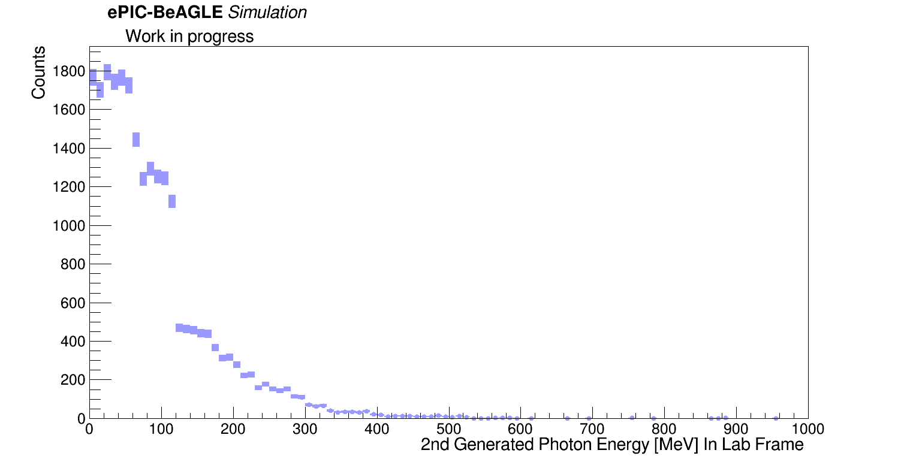
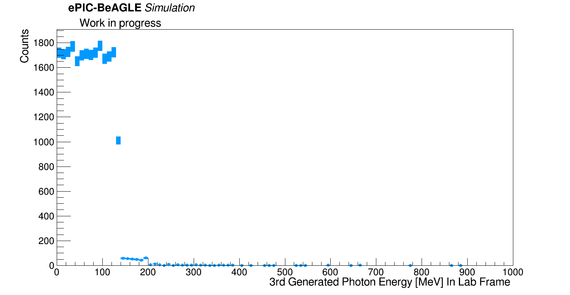
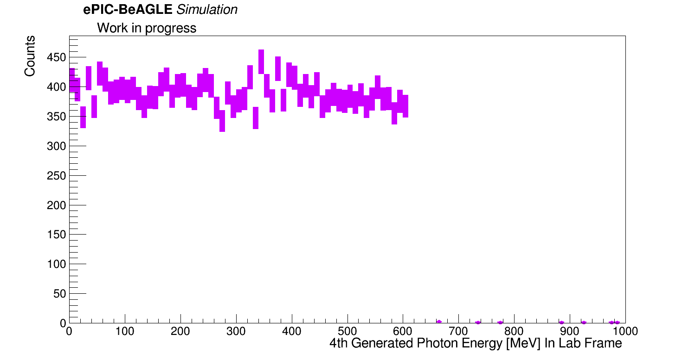
1st Photon
2nd Photon
3rd Photon
4th Photon

Slide 26




1st Photon
1st Photon
2nd Photon
2nd Photon

Slide 27




3rd Photon
3rd Photon
4th Photon
4th Photon

