Slide 1
Searching for saturation signals in UPC
Huachen (Brian) Sun
in collaboration with Yuri Kovchegov and Zhoudunming Tu

Slide 2
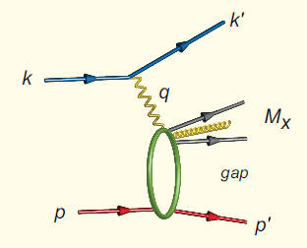
Diffractive scattering as a probe for saturation
Characterize by a rapidity gap between the produced hadron and the target
Color neutral exchange in the t-channel (pomeron) between the virtual photon and the target proton
Diffractive cross sections are more sensitive to saturation phenomena

Slide 3
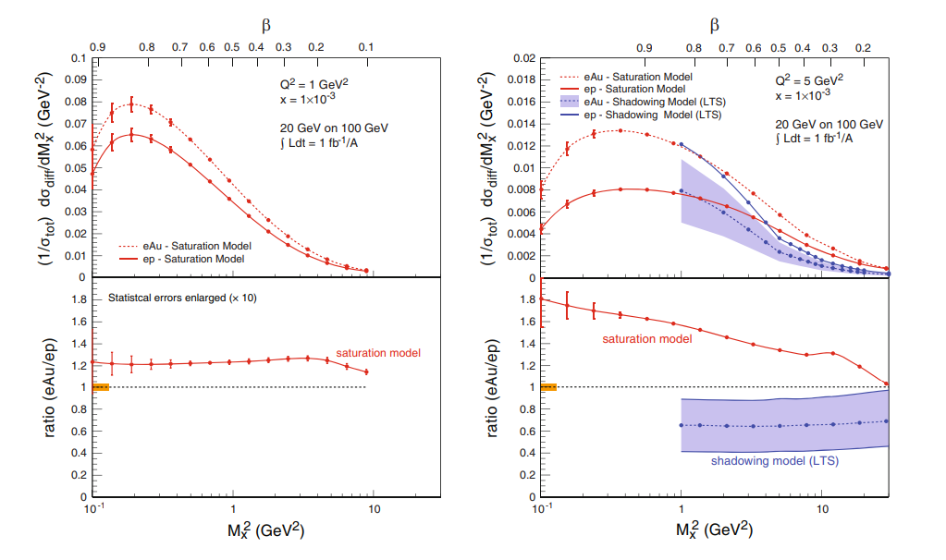
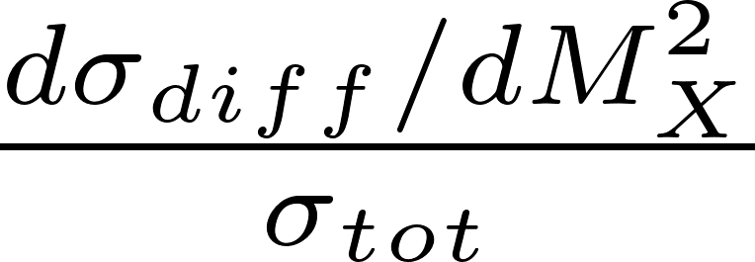
Some measurements in diffractive scattering

Slide 4
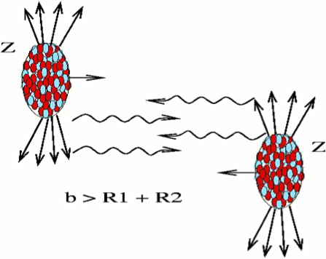
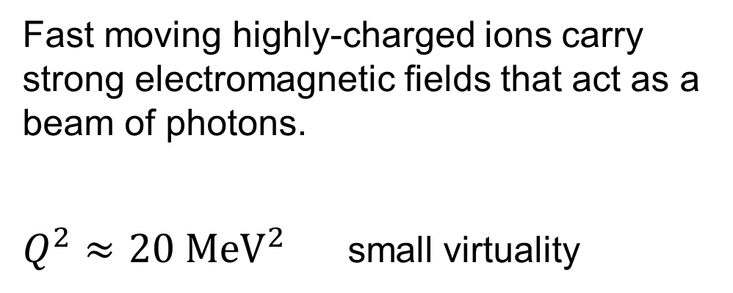
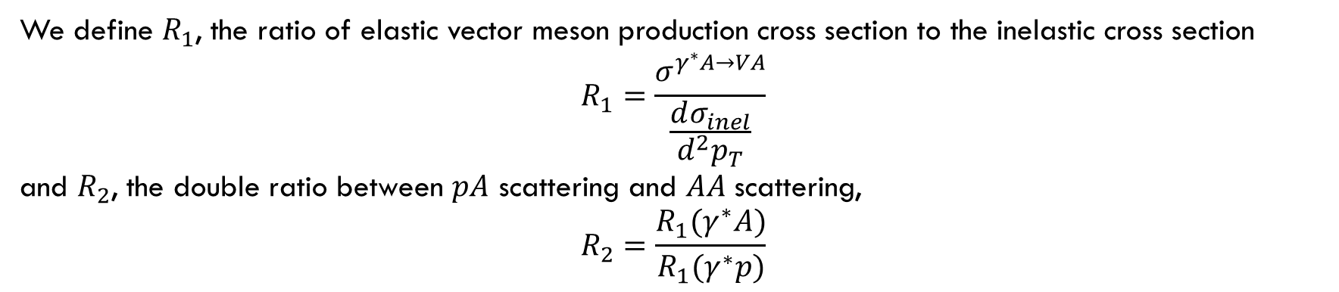
Ultra peripheral collision (Ap or AA)
Fast moving highly-charged ions carry strong electromagnetic fields that act as a beam of photons.
$Q^{2}≈20 {MeV}^{2}$ small virtuality
We define $R_{1}$, the ratio of elastic vector meson production cross section to the inelastic cross section
$$R_{1}=\frac{σ^{γ^{∗}A→VA}}{\frac{dσ_{inel}}{d^{2}p_{T}}}$$
and $R_{2}$, the double ratio between $pA$ scattering and $AA$ scattering,
$$R_{2}=\frac{R_{1}(γ^{∗}A)}{R_{1}(γ^{∗}p)}$$

Slide 5
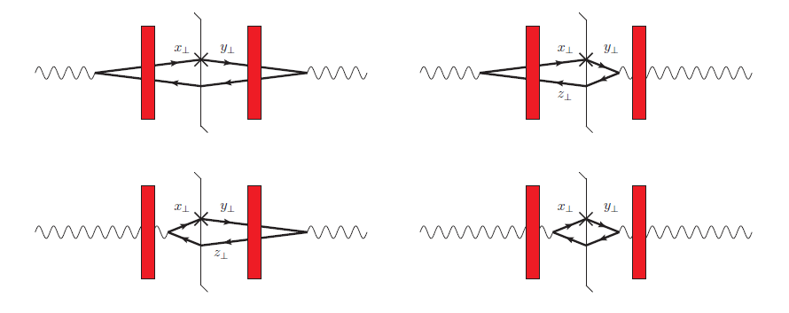
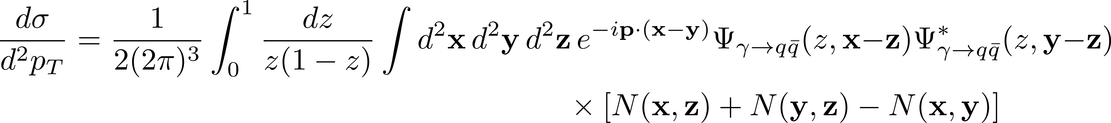
Inelastic cross section
Kovchegov and Sievert (2015)

Slide 6
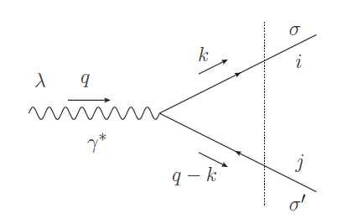
Virtual photon wave function
Transversely polarized
Longitudinally polarized

Slide 7
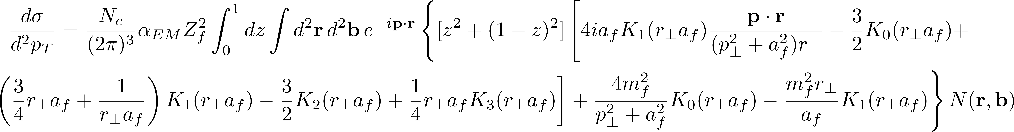
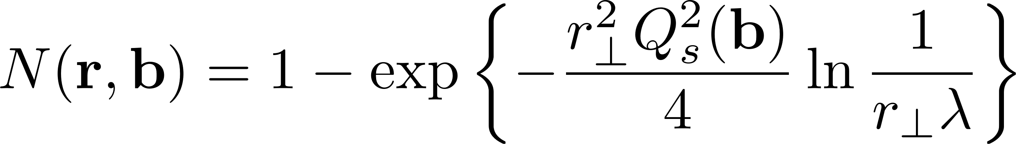
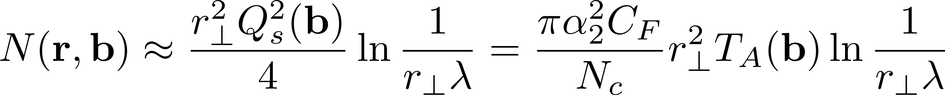
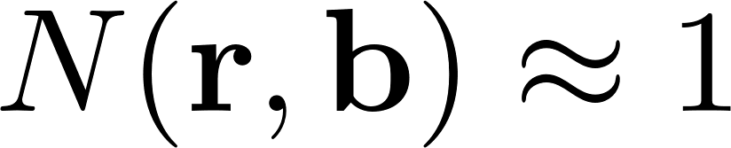
The dipole amplitude $N(r,b)$ is given by
, leading order calculation, no small-x evolution included
(i) $p_{T}>Q_{s}$, i.e. transverse momentum of the produced quark is outside the saturation regime.
(ii) $p_{T}<Q_{s}$, i.e. transverse momentum of the produced quark is inside the saturation regime.

Slide 8
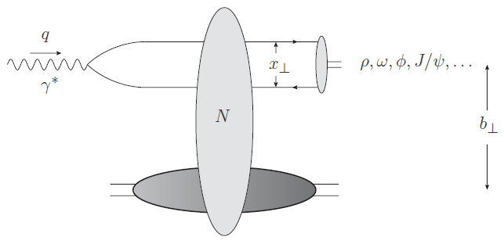
Elastic vector meson production

Slide 9
Vector meson wave function (Kowalski, Motyka, Watt 2006)
The simplest approach is to assume that the vector meson is predominantly a quark-antiquark state that has the same spin and polarization structure as the virtual photon.
Start with a wave function that is Gaussian distributed in transverse momentum in the rest frame of the vector meson.
Assume that the wave function is Lorentz invariant, so we can boost the vector meson to a frame with large longitudinal momentum.
Fourier transform into transverse coordinate space.
Transversely polarized photons can only produce transversely polarized vector mesons, assuming they have the same spin and polarization structures.

Slide 10
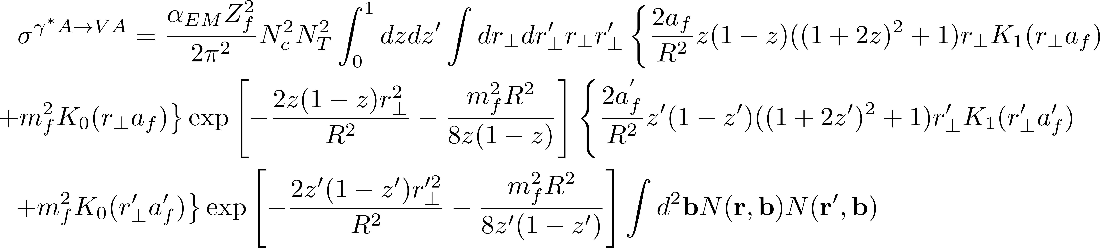
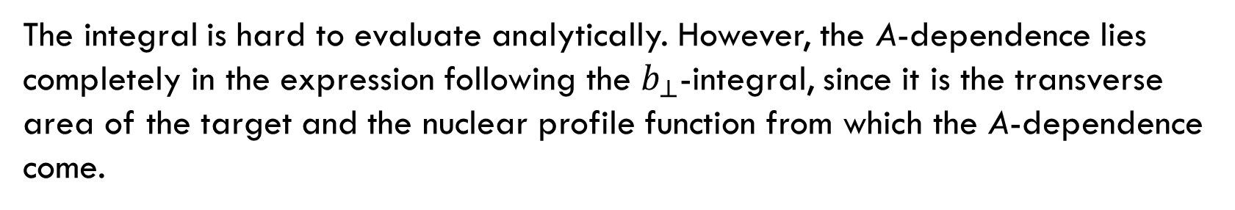
Cross section for exclusive vector production
The integral is hard to evaluate analytically. However, the A-dependence lies completely in the expression following the $b_{⊥}$-integral, since it is the transverse area of the target and the nuclear profile function from which the A-dependence come.

Slide 11
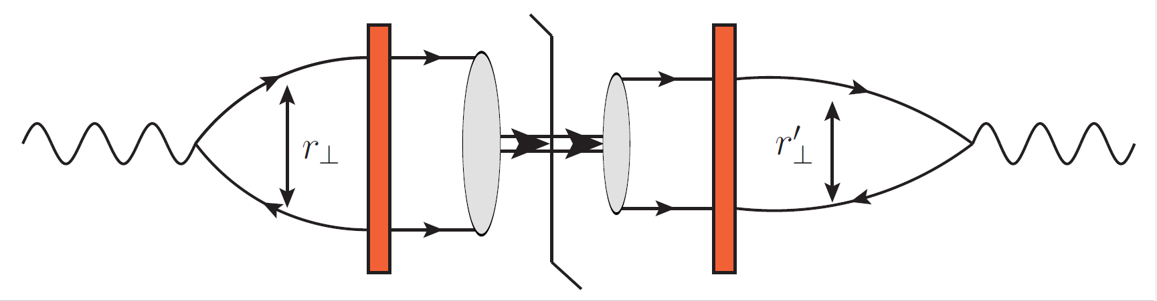
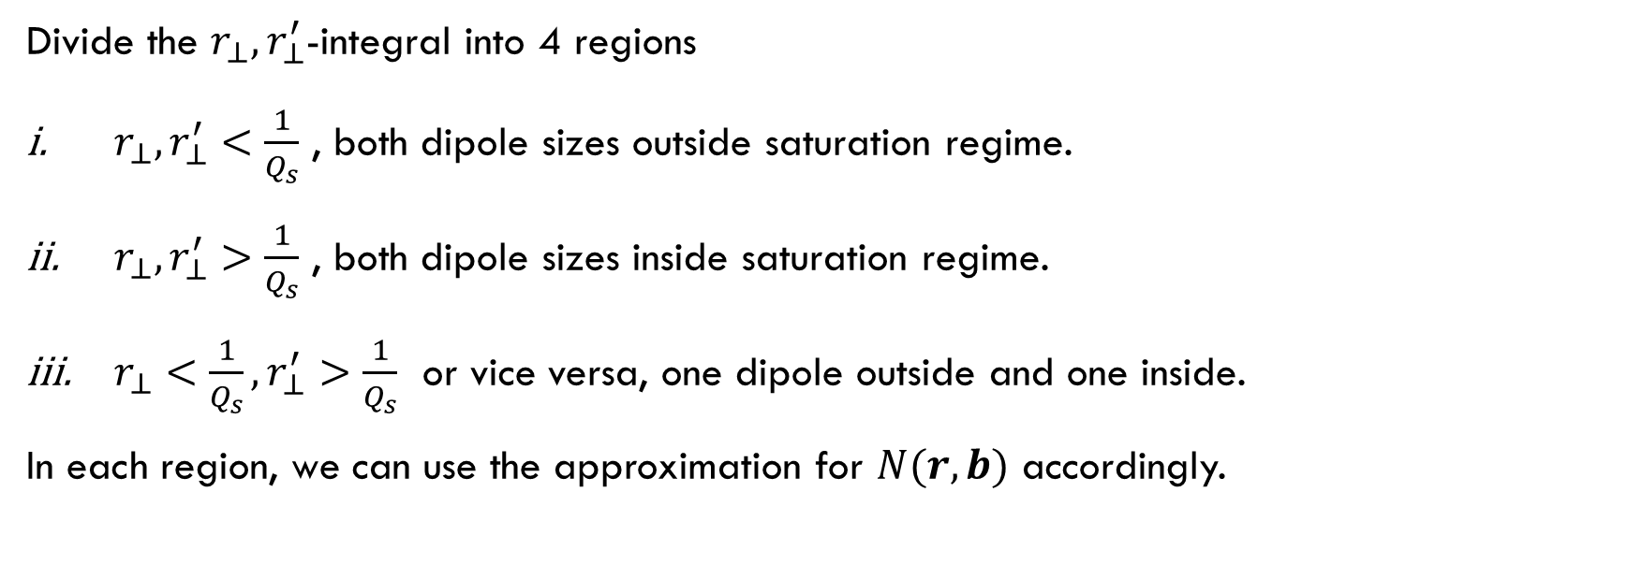
Divide the $r_{⊥},r_{⊥}^{′}$-integral into 4 regions
$r_{⊥},r_{⊥}^{′}<\frac{1}{Q_{s}}$ , both dipole sizes outside saturation regime.
$r_{⊥},r_{⊥}^{′}>\frac{1}{Q_{s}}$ , both dipole sizes inside saturation regime.
$r_{⊥}<\frac{1}{Q_{s}}, r_{⊥}^{′}>\frac{1}{Q_{s}}$ or vice versa, one dipole outside and one inside.
In each region, we can use the approximation for $N(r,b)$ accordingly.

Slide 12
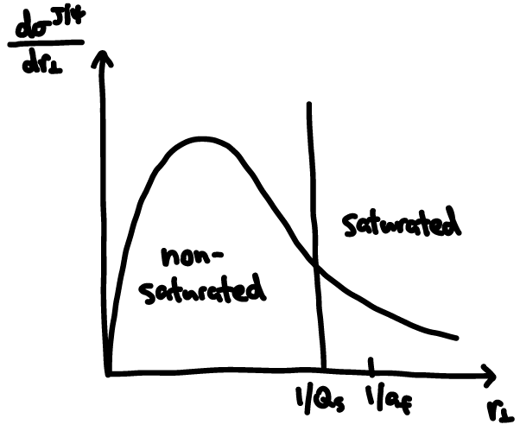
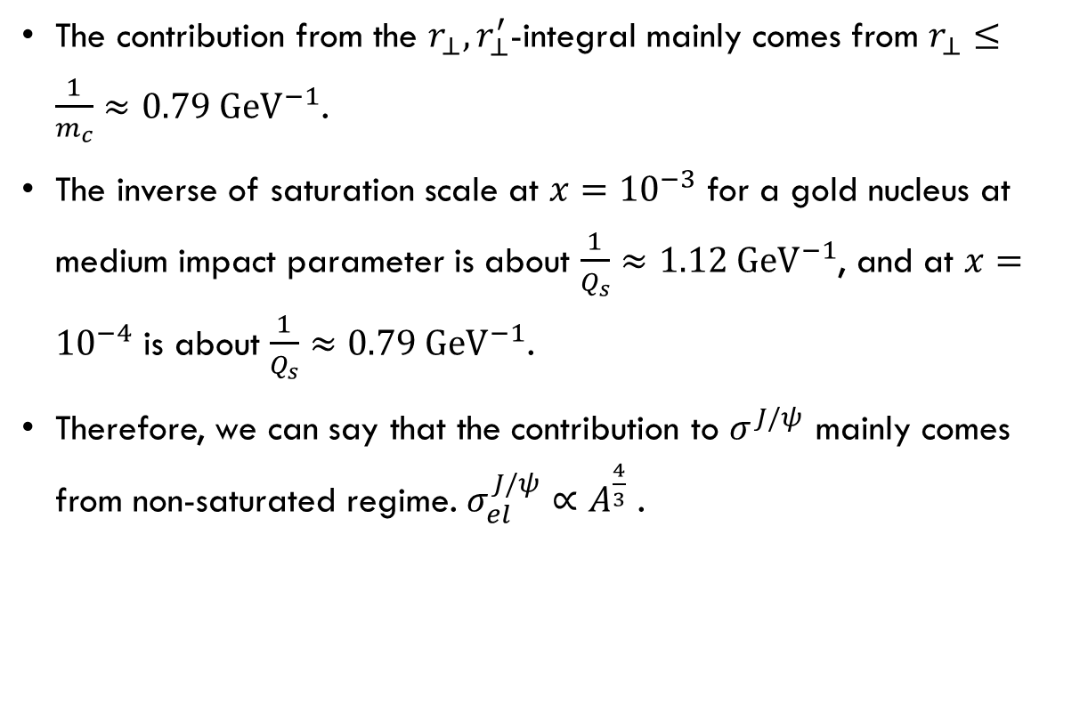
Exclusive $J/ψ$ production
The contribution from the $r_{⊥},r_{⊥}^{′}$-integral mainly comes from $r_{⊥}≤\frac{1}{m_{c}}≈0.79 {GeV}^{−1}$.
The inverse of saturation scale at $x={10}^{−3}$ for a gold nucleus at medium impact parameter is about $\frac{1}{Q_{s}}≈1.12 {GeV}^{−1}$, and at $x={10}^{−4}$ is about $\frac{1}{Q_{s}}≈0.79 {GeV}^{−1}$.
Therefore, we can say that the contribution to $σ^{J/ψ}$ mainly comes from non-saturated regime. $σ_{el}^{J/ψ}∝A^{\frac{4}{3}}$ .

Slide 13
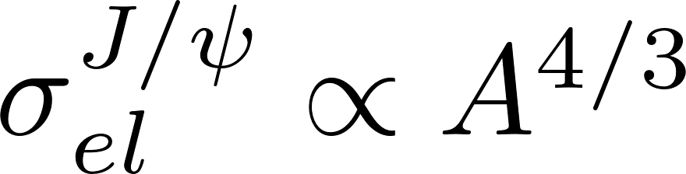


Double ratio for Au+p and Au+Au for J$/ψ$ production
Inelastic quark production
Elastic $J/ψ$ production
$R_{1}(J/ψ)=\frac{σ^{γ^{∗}A→J/ψ A}}{\frac{dσ_{inel}}{d^{2}p_{T}}}\text{=}\left\{\begin{aligned}f_{1}\left(p_{T}\right)A^{\frac{1}{3}} , p_{T}>Q_{s} \\ f_{2}\left(p_{T}\right)A^{\frac{2}{3}} , p_{T}<Q_{s}\end{aligned}\right.$
$R_{2}(J/ψ)=\frac{R_{1}(γ^{∗}A)}{R_{1}(γ^{∗}p)}=\left\{\begin{aligned}A^{\frac{1}{3}}≈6 , p_{T}>Q_{s} \\ A^{\frac{2}{3}}≈34 , p_{T}<Q_{s}\end{aligned}\right.$

Slide 14
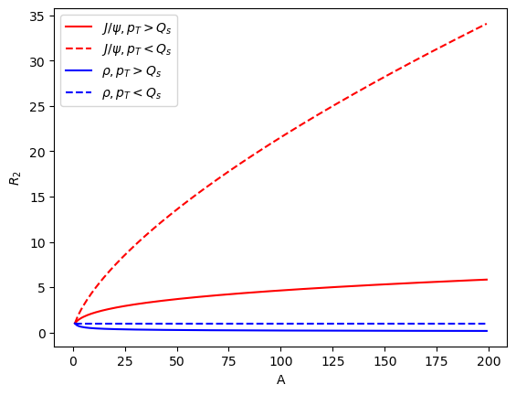

Double ratio for Au+p and Au+Au for $ρ$ meson production
$R_{1}(ρ)=\frac{σ^{γ^{∗}A→ρA}}{\frac{dσ_{inel}}{d^{2}p_{T}}}\text{=}\left\{\begin{aligned}f_{1}\left(p_{T}\right)A^{−\frac{1}{3}} , p_{T}>Q_{s} \\ f_{2}\left(p_{T}\right)A^{0} , p_{T}<Q_{s}\end{aligned}\right.$
$R_{2}(ρ)=\frac{R_{1}(γ^{∗}A)}{R_{1}(γ^{∗}p)}=\left\{\begin{aligned}A^{−\frac{1}{3}}≈0.17 , p_{T}>Q_{s} \\ A^{0}≈0 , p_{T}<Q_{s}\end{aligned}\right.$

Slide 15
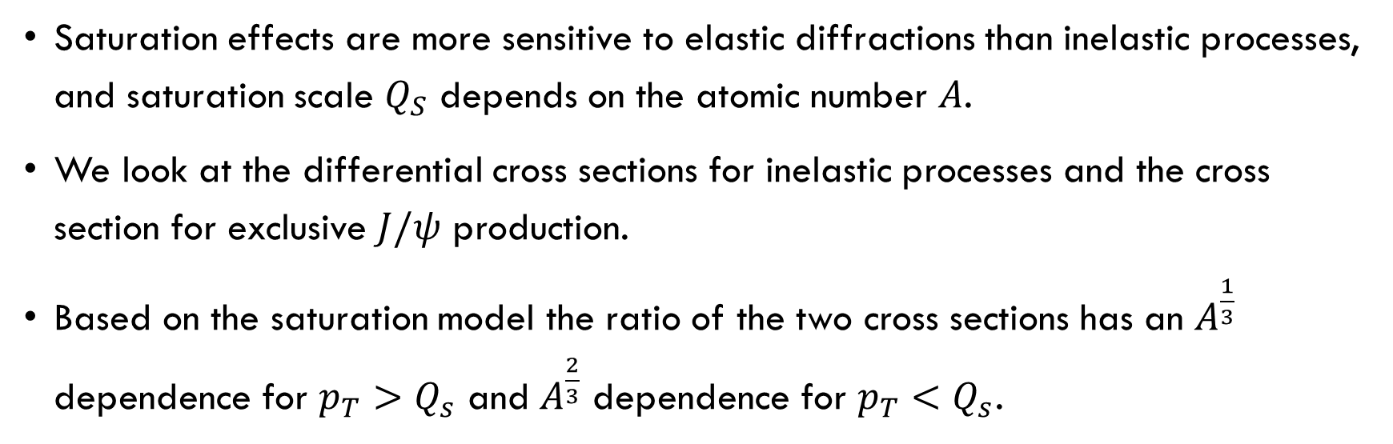
Summary
Saturation effects are more sensitive to elastic diffractions than inelastic processes, and saturation scale $Q_{S}$ depends on the atomic number $A$.
We look at the differential cross sections for inelastic processes and the cross section for exclusive $J/ψ$ production.
Based on the saturation model the ratio of the two cross sections has an $A^{\frac{1}{3}}$ dependence for $p_{T}>Q_{s}$ and $A^{\frac{2}{3}}$ dependence for $p_{T}<Q_{s}$.

Slide 16
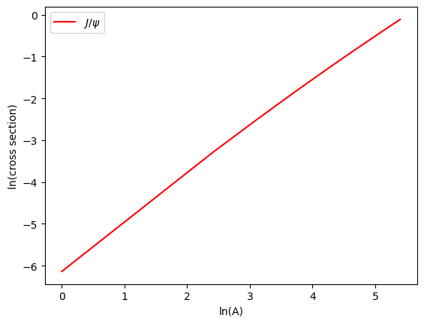
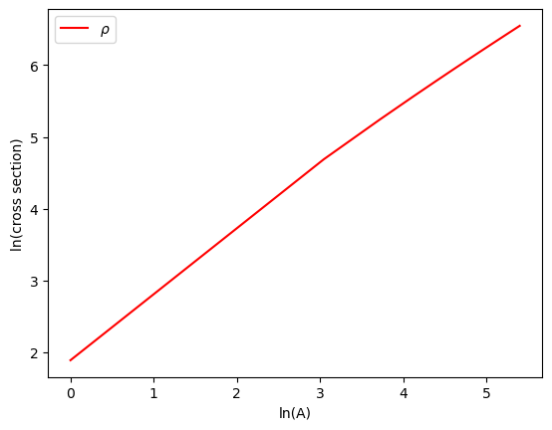

Slide 17
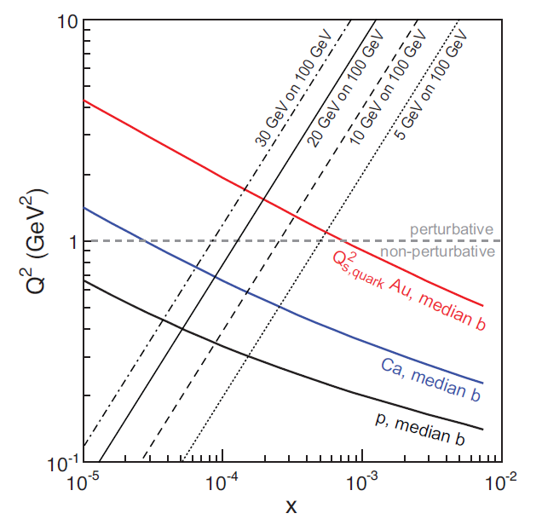
Saturation scale Qs vs. x

