Slide 1
VM Vetoing Update
eA Group Meeting
Zvi Citron, Michael Pitt, Eden Mautner
BGU RHI Group
28.11.2023

Slide 2
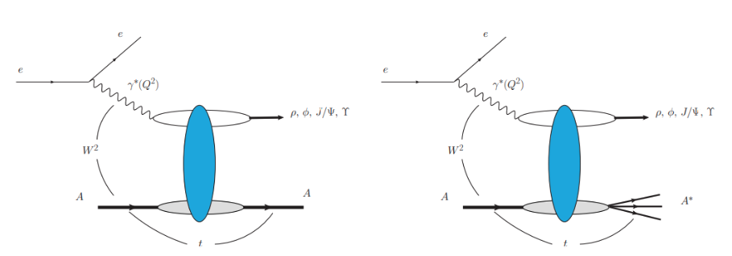
Reminder
$J/ψ$ production events can be found in eA collision, or in our case, ePb collision.
Both coherent and incoherent $J/ψ$ can be produced
In incoherent events the proccess is in the form of $e+Pb →e^{′}+J/ψ+X$
In coherent events the proccess is in the form of $e+Pb →e^{′}+J/ψ+Pb$
Coherent
Incoherent

Slide 3
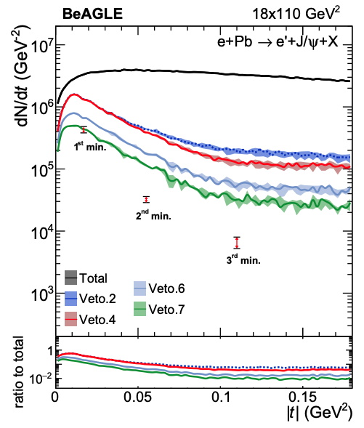
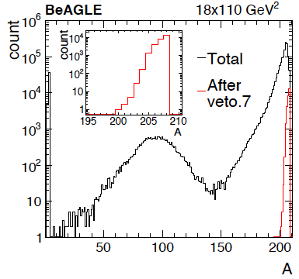
Past Studies (Pre-ePIC)
Objective:
Creating a vetoing algorithm to significantly reduce the signals from events with incoherent $J/ψ$ production in ePb collisions.
This was originaly proposed for ECCE geometry: arXiv:2108.01694
Note - 1.3M events were used in arXiv:2108.01694.
Vetoing Steps:
Veto.1: No activity other than $e^{−}$ and $J/ψ$ in the main detector ($\left|η\right|<4$ and $p_{T}>100 \frac{MeV}{c}$ ) ;
Veto.2: Veto.1 and no Neutron in ZDC;
Veto.3: Veto.2 and no Proton in RP;
Veto.4: Veto.3 and no Proton in OMDs;
Veto.5: Veto.4 and no Proton in B0;
Veto.6 Veto.5 and no Photon in B0;
Veto.7: Veto.6 and no Photon with $E>50 MeV$ in ZDC.

Slide 4
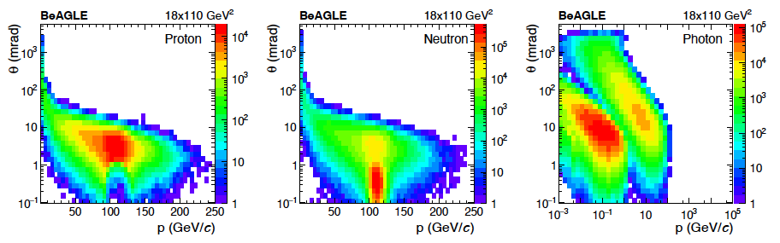
Past Studies (Pre-ePIC)
Particle kinematics before vetoing:
Particle kinematics after vetoing:
Originaly shown in: arXiv:2108.01694

Slide 5
Vetoing Incoherent Events in ePIC
Objectives:
Studying vetoing cuts in incoherent $J/ψ$ production events using the up-to-date ePIC detector simulation.
Data:
We use BeAGLE generated events (~$770$k), starting with the $J/ψ→μ^{+}μ^{−}$ decay channel.
Note: This was done so we don’t have to worry (for now) about the electron originating from the electron beam.
Up-to-date Vetoing Steps:
Veto.1: No activity other than $e^{−}$ and $J/ψ$ ($μ^{+}μ^{−}$) in the main detector ($\left|η\right|<4 , P_{T}>100 \frac{MeV}{c}$) ;
Veto.2: Veto.1 and no signal in the ZDC;
Veto.3: Veto.2 and no tracks in RP;
Veto.4: Veto.3 and no tracks in OMDs;
Veto.5: Veto.4 and no tracks in B0 tracker;
Veto.6: Veto.5 and no signal in B0 ECAL.

Slide 6
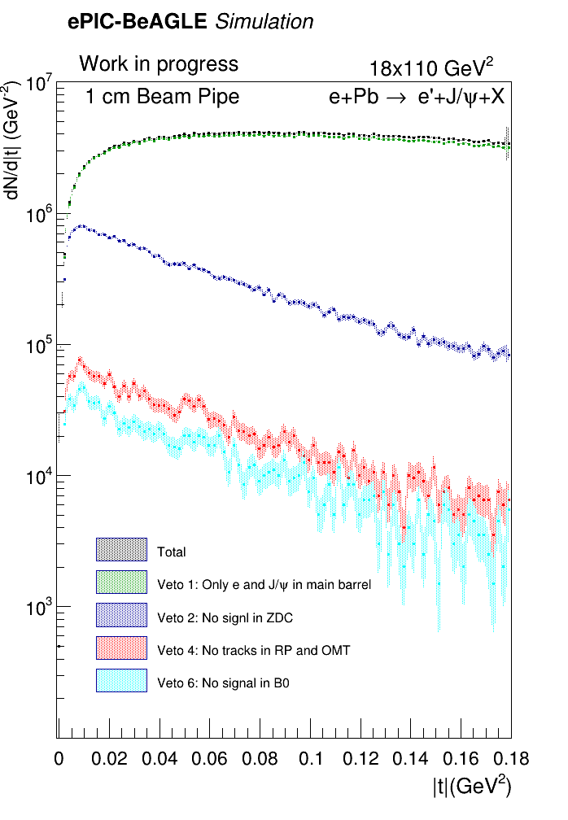
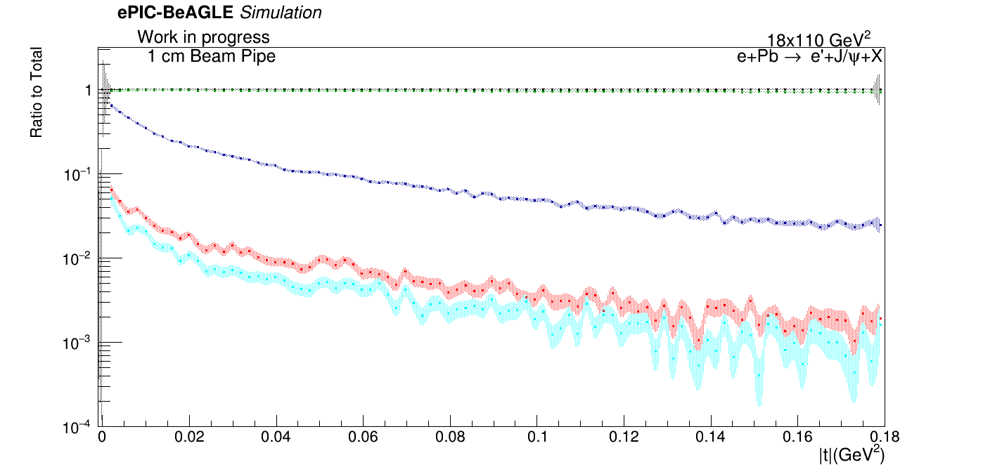
Up-to-date Vetoing Steps:
Veto.1: No activity other than $e^{−}$ and $J/ψ$ ($μ^{+}μ^{−}$) in the main detector ($\left|η\right|<4 , P_{T}>100 \frac{MeV}{c}$) ;
Veto.2: Veto.1 and no signal in the ZDC;
Veto.3: Veto.2 and no tracks in RP;
Veto.4: Veto.3 and no tracks in OMDs;
Veto.5: Veto.4 and no tracks in B0 tracker;
Veto.6: Veto.5 and no signal in B0 ECAL.
Results – 1cm Beam Pipe
Survived Event Ratio
Total Events | 774068 | 100 %
Veto 1 | 734482 | ~ 94.89%
Veto 2 | 55349 | ~ 7.15%
Veto 3 | 4449 | ~ 0.57%
Veto 4 | 4336 | ~ 0.56%
Veto 5 | 4295 | ~ 0.55%
Veto 6 | 2514 | ~ 0.32%

Slide 7
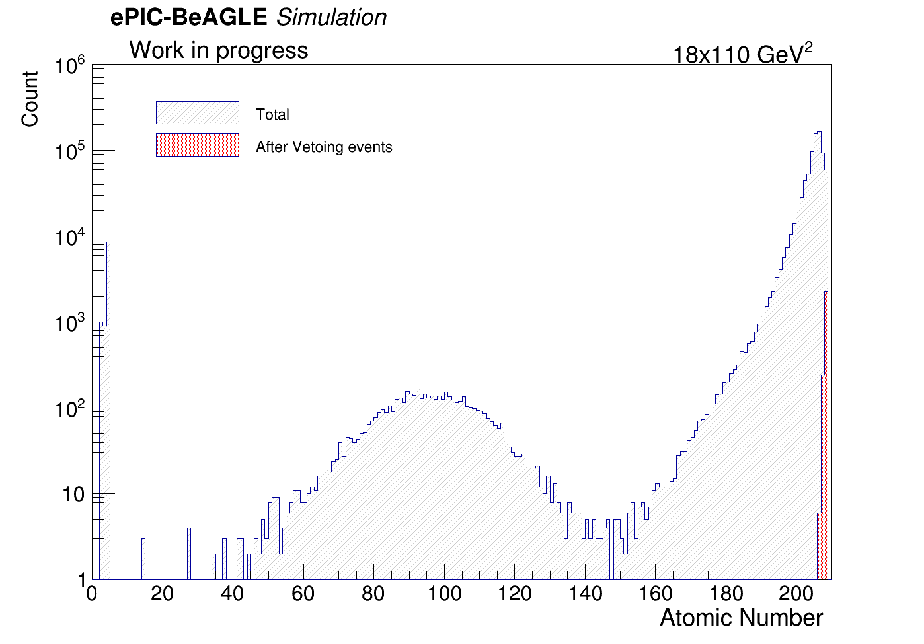
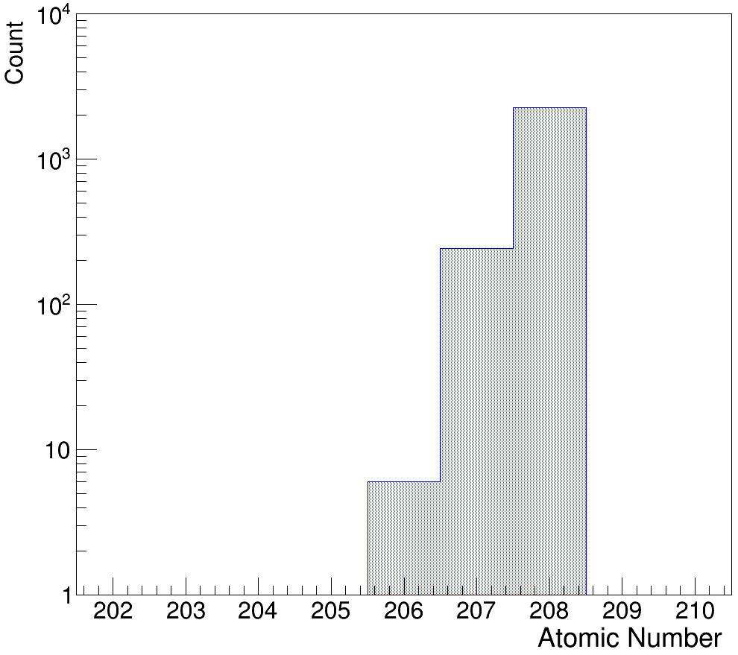
Results – 1cm Beam Pipe
After vetoing incoherent events we are left mainly with quasi-coherent events.
Reminder - Quasi-coherent process are events where the nucleus is excited and “soft” photons are emitted in the deexcitation process ($e+Pb →e^{′}+Pb+J/ψ+nγ$).

Slide 8
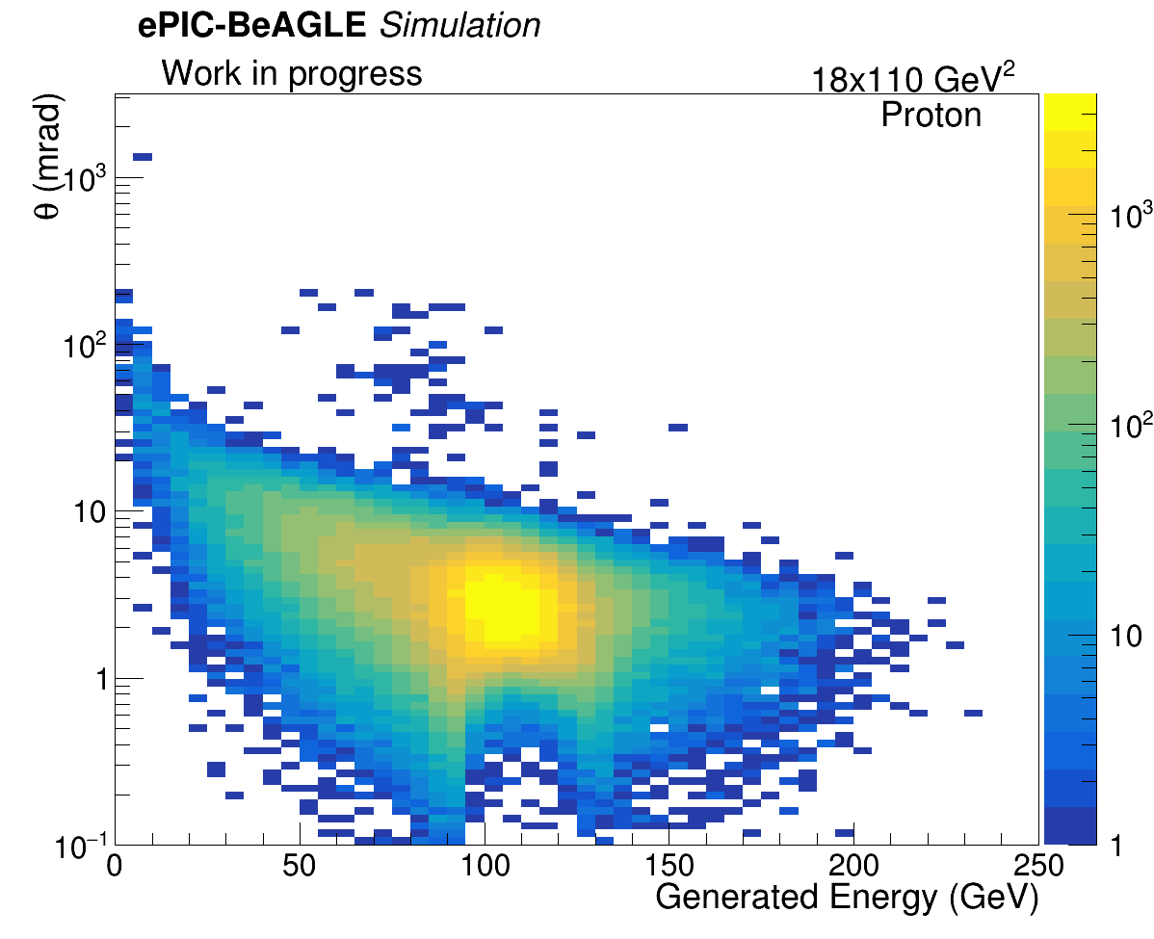
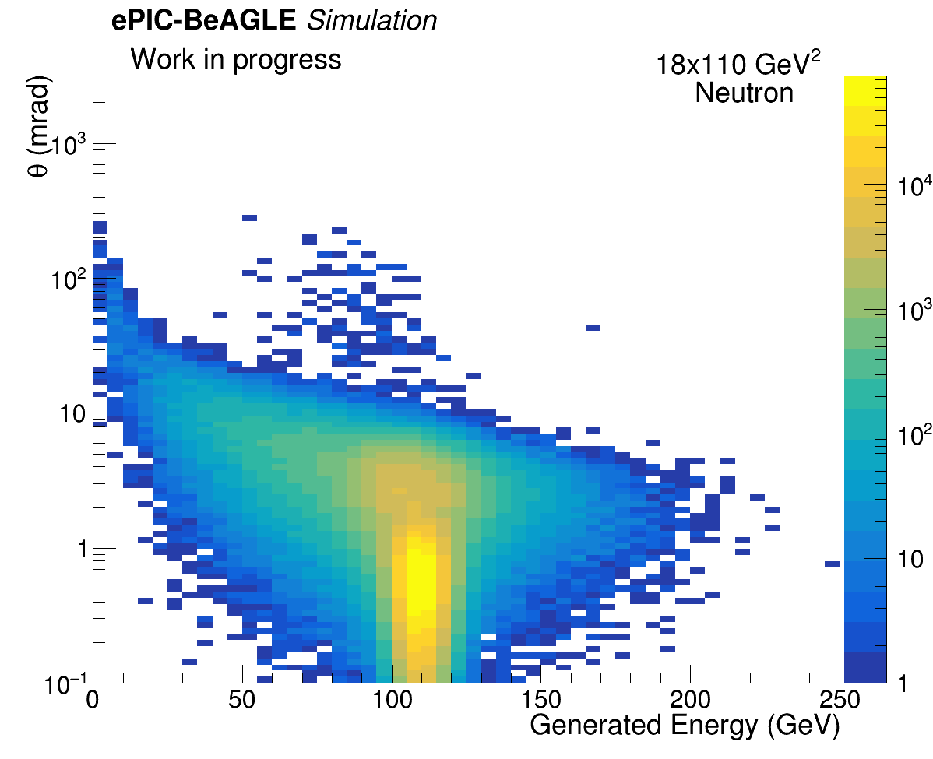
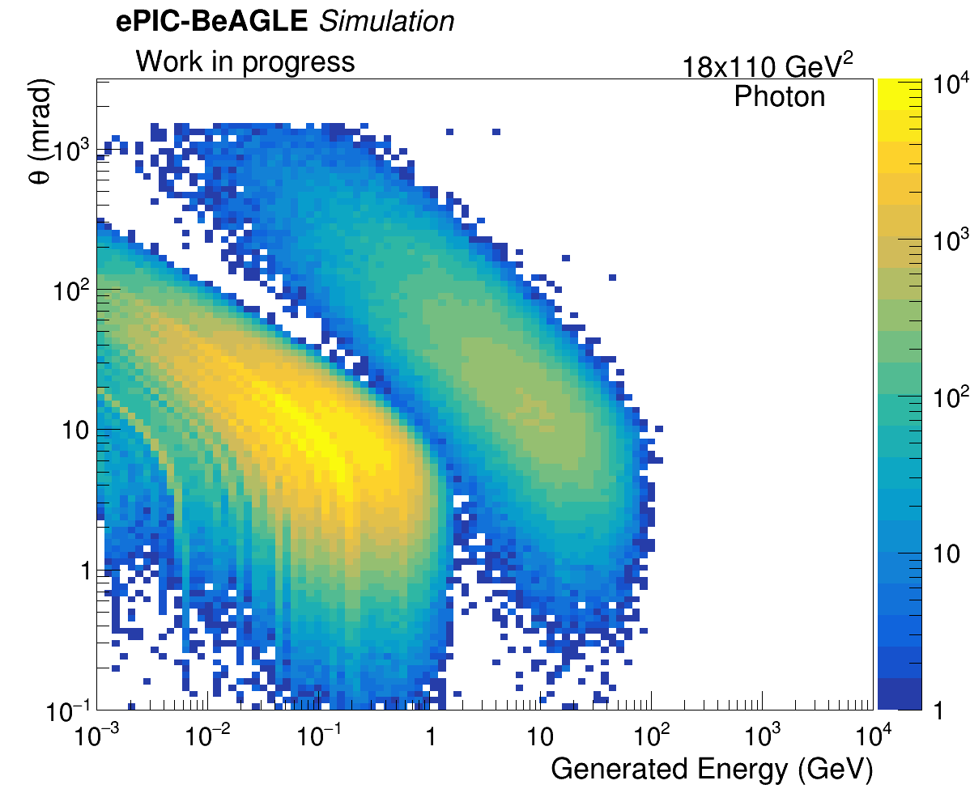
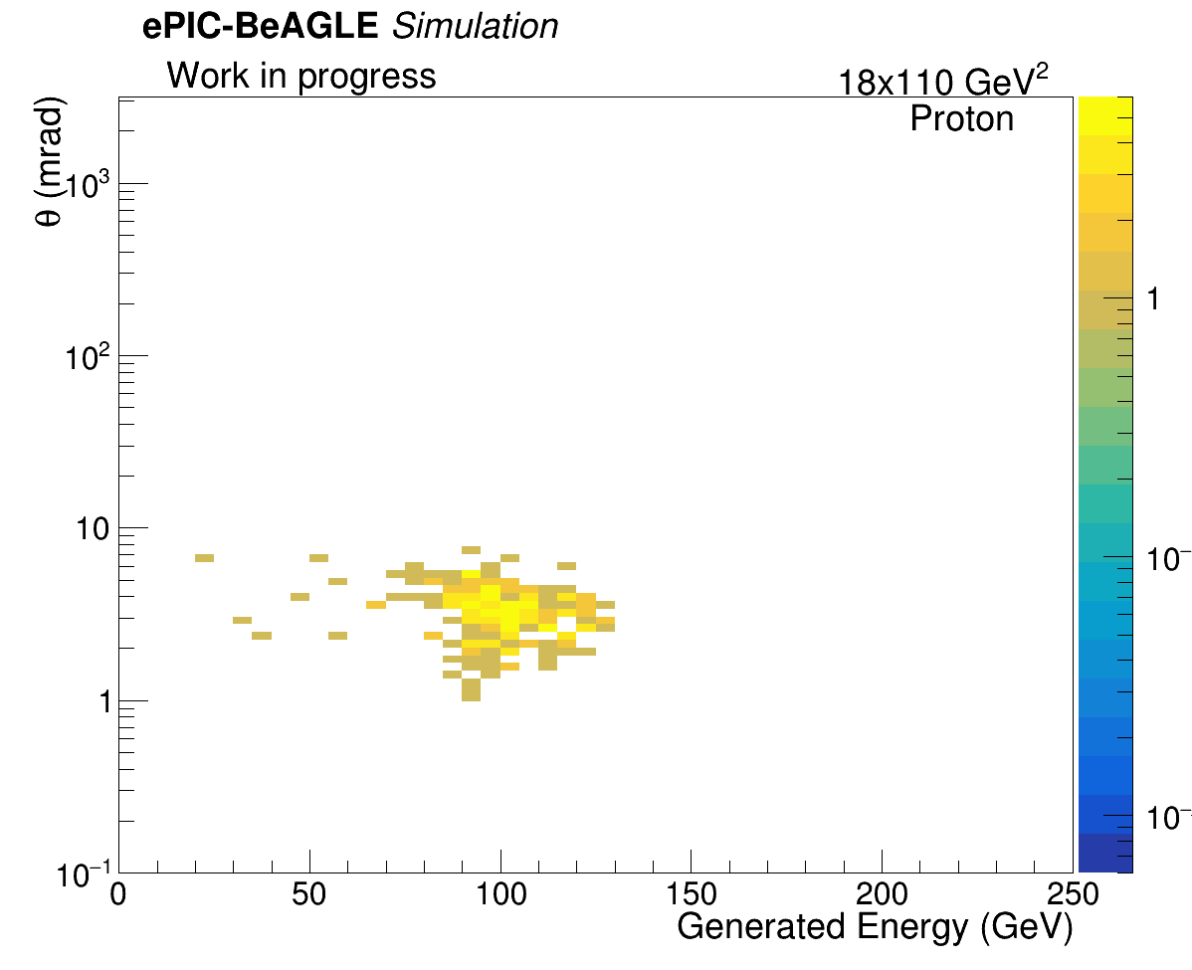
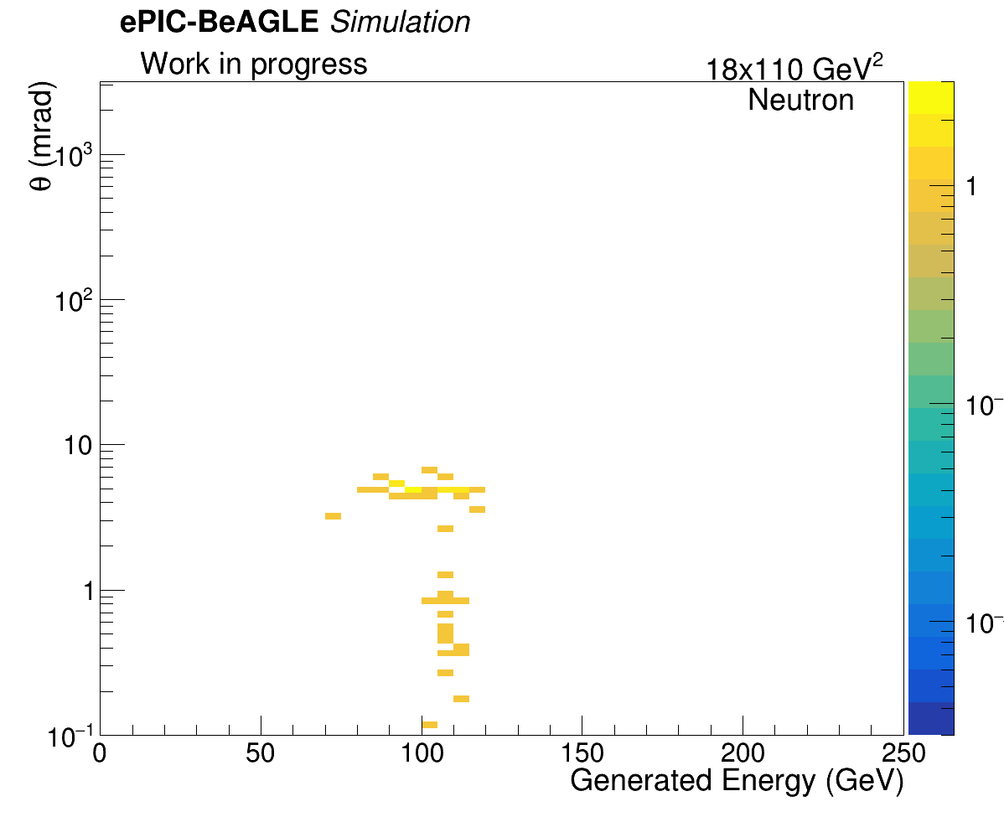
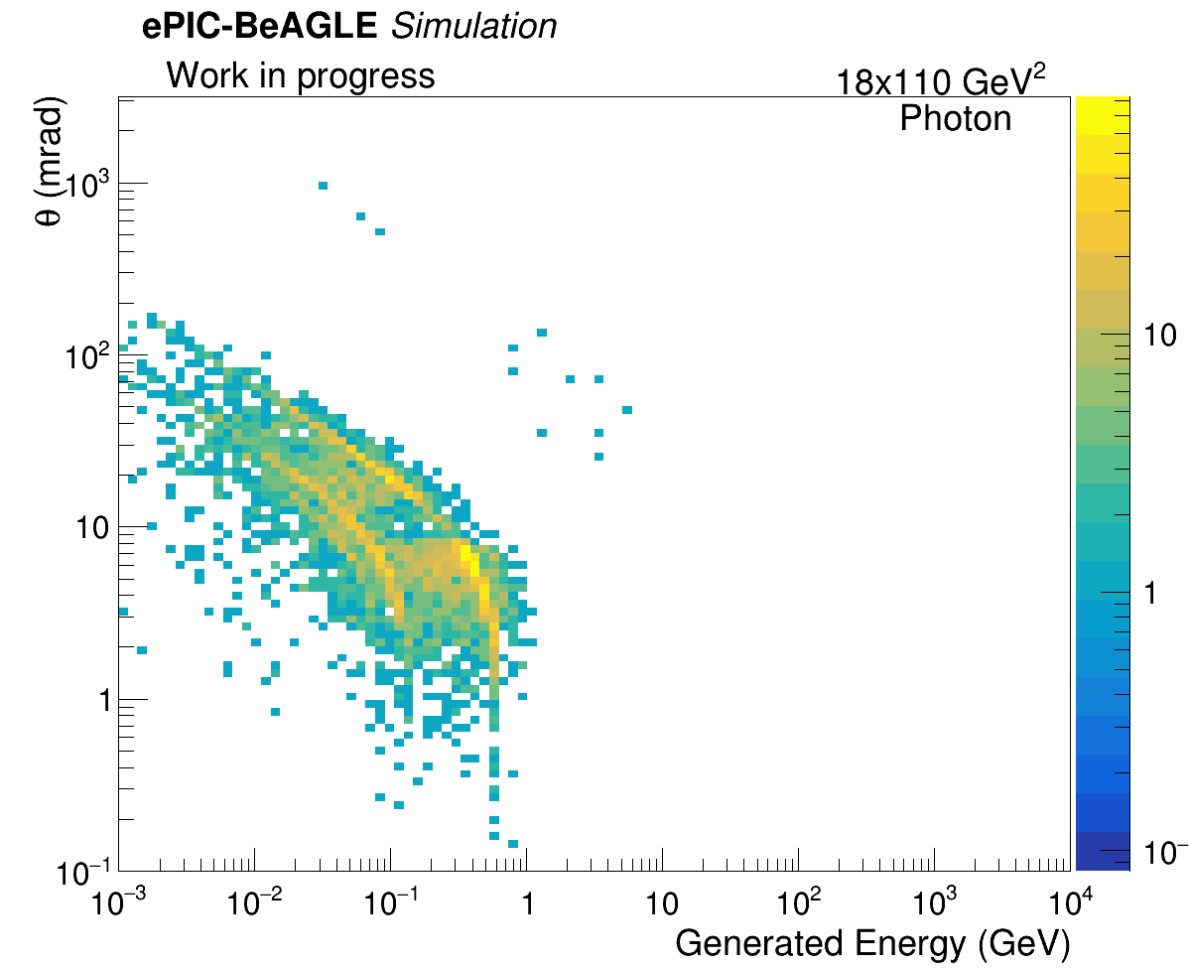
Results – 1cm Beam Pipe
Particle kinematics before vetoing:
Particle kinematics after vetoing:

Slide 9
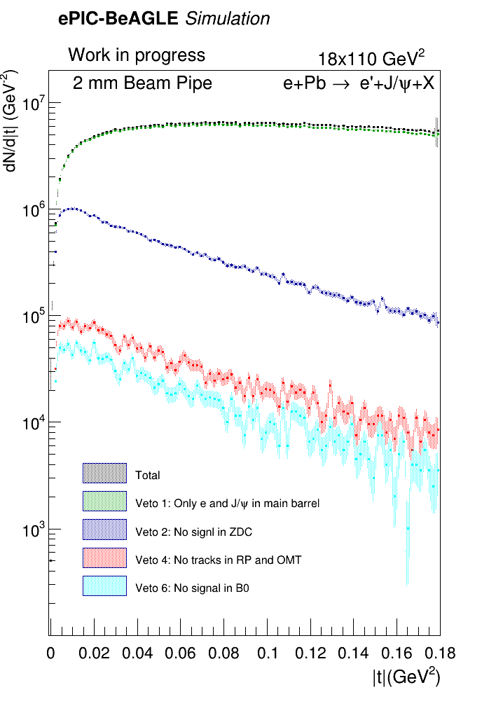
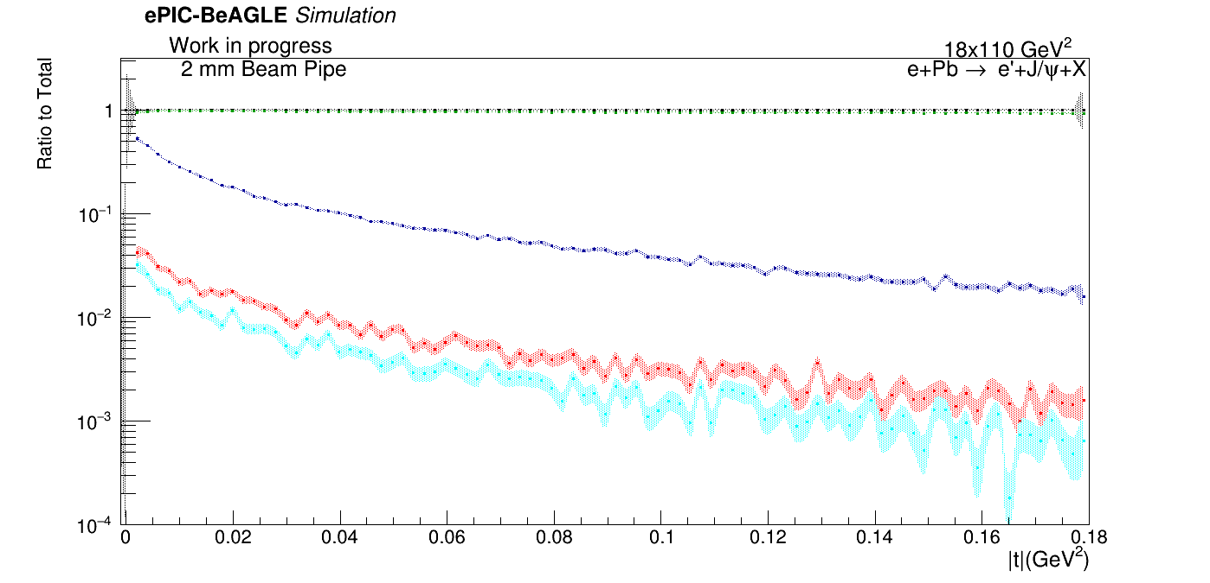
Up-to-date Vetoing Steps:
Veto.1: No activity other than $e^{−}$ and $J/ψ$ ($μ^{+}μ^{−}$) in the main detector ($\left|η\right|<4 , P_{T}>100 \frac{MeV}{c}$) ;
Veto.2: Veto.1 and no signal in the ZDC;
Veto.3: Veto.2 and no tracks in RP;
Veto.4: Veto.3 and no tracks in OMDs;
Veto.5: Veto.4 and no tracks in B0 tracker;
Veto.6: Veto.5 and no signal in B0 ECAL.
Results – 2mm Beam Pipe
No impact when changing the beam pipe width from 1cm to 2mm.
Survived Event Ratio
Total Events | 1212548 | 100 %
Veto 1 | 1151429 | ~ 94.95%
Veto 2 | 68759 | ~ 5.67%
Veto 3 | 6062 | ~ 0.50%
Veto 4 | 5863 | ~ 0.48%
Veto 5 | 5820 | ~ 0.48%
Veto 6 | 3271 | ~ 0.27%

Slide 10
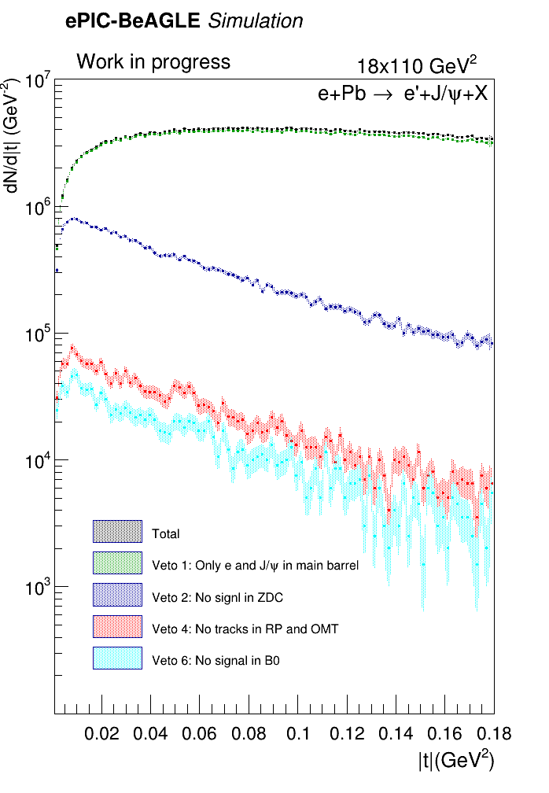
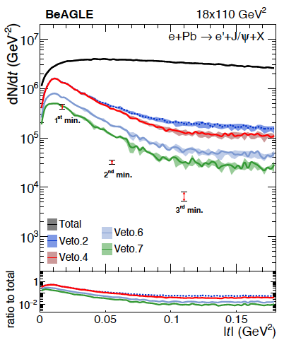
Comparison
The shape of the “tales” starting from veto 2 forward seems different. Any ideas why?
Would expect ratio of survived events to be same after veto1. This is not the case..
Up-to-date Vetoing Steps:
Veto.1: No activity other than $e^{−}$ and $J/ψ$ ($μ^{+}μ^{−}$) in the main detector ($\left|η\right|<4 , P_{T}>100 \frac{MeV}{c}$) ;
Veto.2: Veto.1 and no signal in the ZDC;
Veto.3: Veto.2 and no tracks in RP;
Veto.4: Veto.3 and no tracks in OMDs;
Veto.5: Veto.4 and no tracks in B0 tracker;
Veto.6: Veto.5 and no signal in B0 ECAL.
With beam pipe
Veto 1 | ~ 94.89%
Veto 2 | ~ 7.15%
Veto 3 | ~ 0.57%
Veto 4 | ~ 0.56%
Veto 5 | ~ 0.55%
Veto 6 | ~ 0.32%
Without beam pipe
Veto 1 | 86.9%
Veto 2 | 5.81%
Veto 3 | 5.81%
Veto 4 | 5.09%
Veto 5 | 4.32%
Veto 6 | 2.29%
Veto 7 | 1.06%

Slide 11
Comparison
The shape of the “tales” starting from veto 2 forward seems different. Any ideas why?
Would expect ratio of survived events to be same after veto1. This is not the case..
Veto 4 reduces one order of magnitude more than in past studies. When including the beam pipe there are many events that leave tracks in the OMD and RP due to showers originating from interaction with the beam pipe.
Up-to-date Vetoing Steps:
Veto.1: No activity other than $e^{−}$ and $J/ψ$ ($μ^{+}μ^{−}$) in the main detector ($\left|η\right|<4 , P_{T}>100 \frac{MeV}{c}$) ;
Veto.2: Veto.1 and no signal in the ZDC;
Veto.3: Veto.2 and no tracks in RP;
Veto.4: Veto.3 and no tracks in OMDs;
Veto.5: Veto.4 and no tracks in B0 tracker;
Veto.6: Veto.5 and no signal in B0 ECAL.
With beam pipe
Veto 1 | ~ 94.89%
Veto 2 | ~ 7.15%
Veto 3 | ~ 0.57%
Veto 4 | ~ 0.56%
Veto 5 | ~ 0.55%
Veto 6 | ~ 0.32%
Without beam pipe
Veto 1 | 86.9%
Veto 2 | 5.81%
Veto 3 | 5.81%
Veto 4 | 5.09%
Veto 5 | 4.32%
Veto 6 | 2.29%
Veto 7 | 1.06%

Slide 12
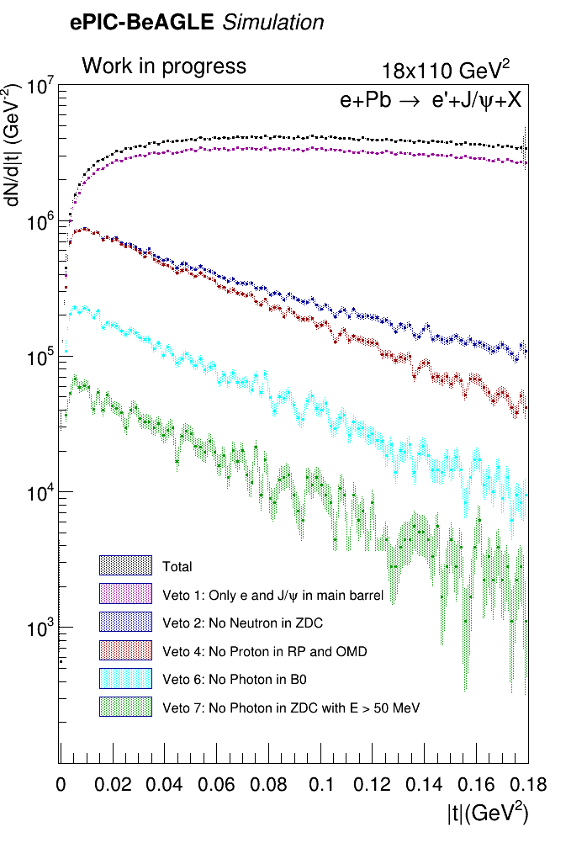
Reproducing Past Results
Objectives:
Follow the vetoing steps as done in the past (arXiv:2108.01694) to check if the results we obtain are as expected from the paper.
Understand what causes the differences between both methods.
Data:
We use same BeAGLE generated events (~$770$k).
Vetoing Steps:
Veto.1: No activity other than $e^{−}$ and $J/ψ$ in the main detector ($\left|η\right|<4$ and $p_{T}>100 \frac{MeV}{c}$ ) ;
Veto.2: Veto.1 and no Neutron in ZDC;
Veto.3: Veto.2 and no Proton in RP;
Veto.4: Veto.3 and no Proton in OMDs;
Veto.5: Veto.4 and no Proton in B0;
Veto.6 Veto.5 and no Photon in B0;
Veto.7: Veto.6 and no Photon with $E>50 MeV$ in ZDC.
12

Slide 13
Discussion
The “tails” of the events still have a different shape from past studies.
When vetoing truth level events we see that peek of veto.4 (no proton in RP and OMD) look as we would expect from previous results.
The differences between vetoing truth level events to events which were simulated through the ePIC geometry is mainly due to seconderies from the beam pipe (?).
The difference in the event survive rate between past studies and truth level vetoing can be explained by the fact that we did not include the electron decay channel of the Jpsi VM. In the electron decay channel there might be more radiation effects that will contribute to total surviving rates after each veto.
Truth level vetoing
Veto 1 | 81.46%
Veto 2 | 8.28%
Veto 3 + 4 | 6.78%
Veto 5 | 6.78%
Veto 6 | 1.59%
Veto 7 | 0.40%
Without beam pipe
Veto 1 | 86.9%
Veto 2 | 5.81%
Veto 3 | 5.81%
Veto 4 | 5.09%
Veto 5 | 4.32%
Veto 6 | 2.29%
Veto 7 | 1.06%
*** Electron channel will be added soon to verify the claim.
13

