Slide 1
CCT Fabrication Method Development: paraffin-wax based CCT subscale magnet
J. L. Rudeiros Fernandez* D. Arbelaez, L. Brouwer, P. Ferracin, S. Prestemon
US Magnet Development Program
Lawrence Berkeley National Laboratory
US-MDP Collaboration Meeting 2023

Slide 2
Table of contents
01
Introduction and motivation
02
Development of the wax VPI for CCT
03
The wax CCT coil
04
Conclusions and next steps
J. L. Rudeiros Fernandez et al.

Slide 3
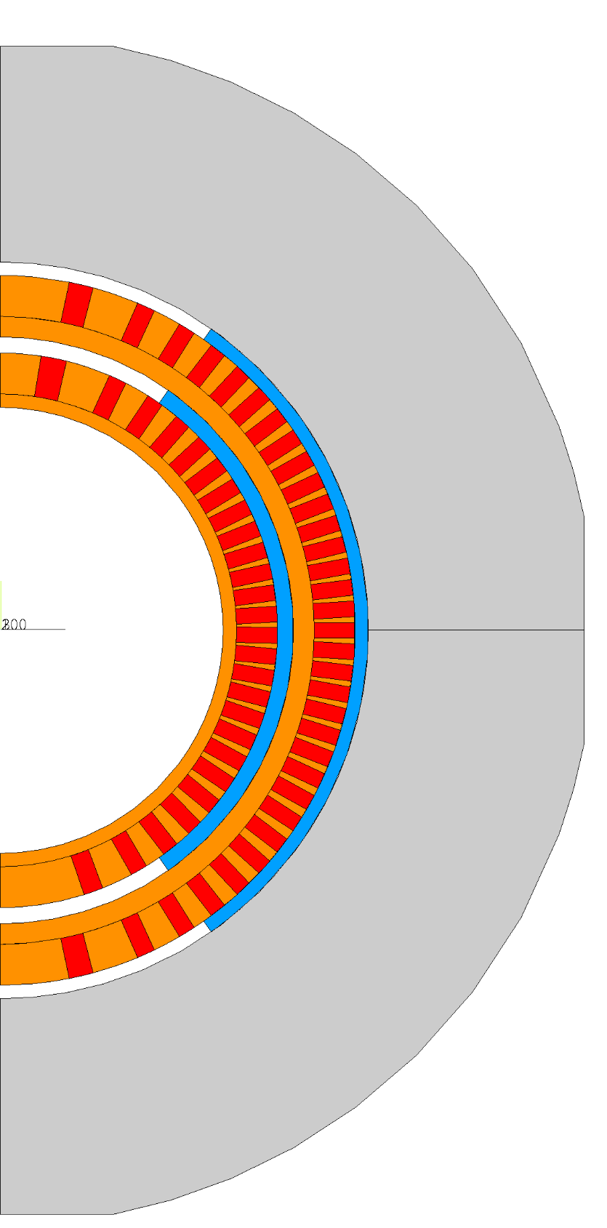
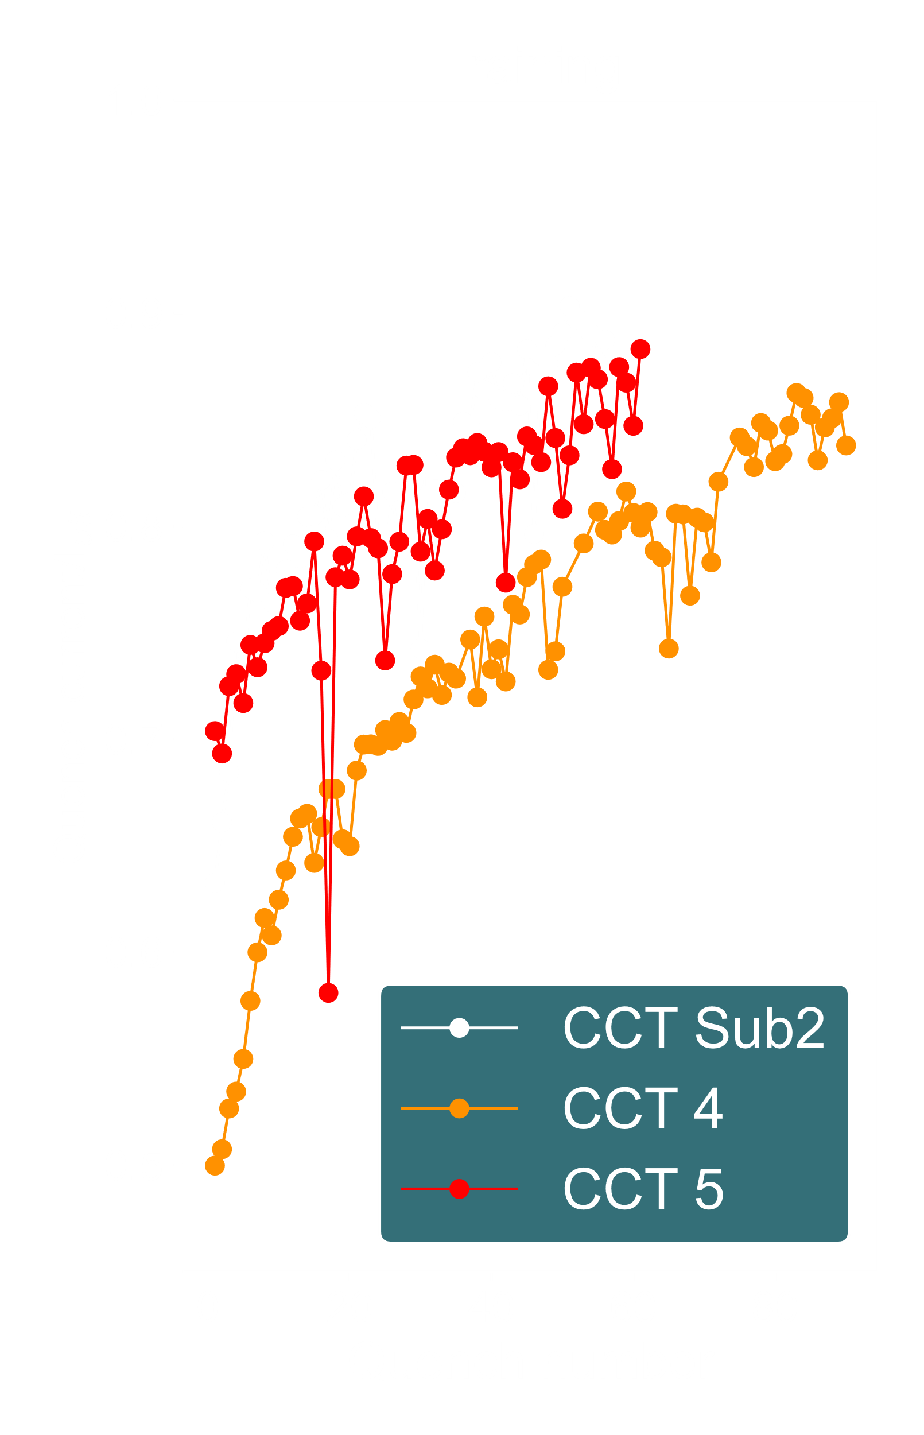
1. Introduction and motivation
Layer 1
Layer 2
Aluminum shell
CCT subscale magnet has been demonstrated as an agile platform to investigate fundamental aspects of CCT magnets.
Fundamental iterations on the manufacturing of the coils and structural assemblies have a higher turn-around rate.
Smartshim
Spar
Strain gauge location
Nb₃Sn individual turn
Rib
CCT subscale fundamental structure
J. L. Rudeiros Fernandez et al.

Slide 4
1. Introduction and motivation
Resins used for the subscale program
Epoxy resin Mix61
CTD-701X*
Training might be related to interfacial mechanisms (heat dissipation due to frictional motion, debonding, crack propagation…) and therefore the change of resin might play a big role.
CCT sub2
CCT sub3
CCT sub4
*Haight, A., Haynes, M. M., Krave, S. T., Rudeiros-Fernandez, J. L., & Shen, T. (2021). Characterization of Candidate Insulation Resins for Training Reduction in High Energy Physics Magnets. Submitted for Publication at the CEC-ICMC.
*Krave, S., Shen, T., & Haight, A. (2021). Exploring New Resin Systems for Nb3Sn Accelerator Magnets. IEEE Transactions on Applied Superconductivity, 31(5), 1-4.
CCT sub2
J. L. Rudeiros Fernandez et al.

Slide 5
1. Introduction and motivation
Interfacial mechanisms might play a key role, can we compare the apparent adhesion between different resin systems and a representative material?
$$F$$
Paraffin wax
Stycast 2850 MT
CTD-101K
Mix 61
Pull-out frame
Resin
*3LPo1A-05 [L5]: Interface characterization for superconducting magnets
J. L. Rudeiros Fernandez et al.

Slide 6
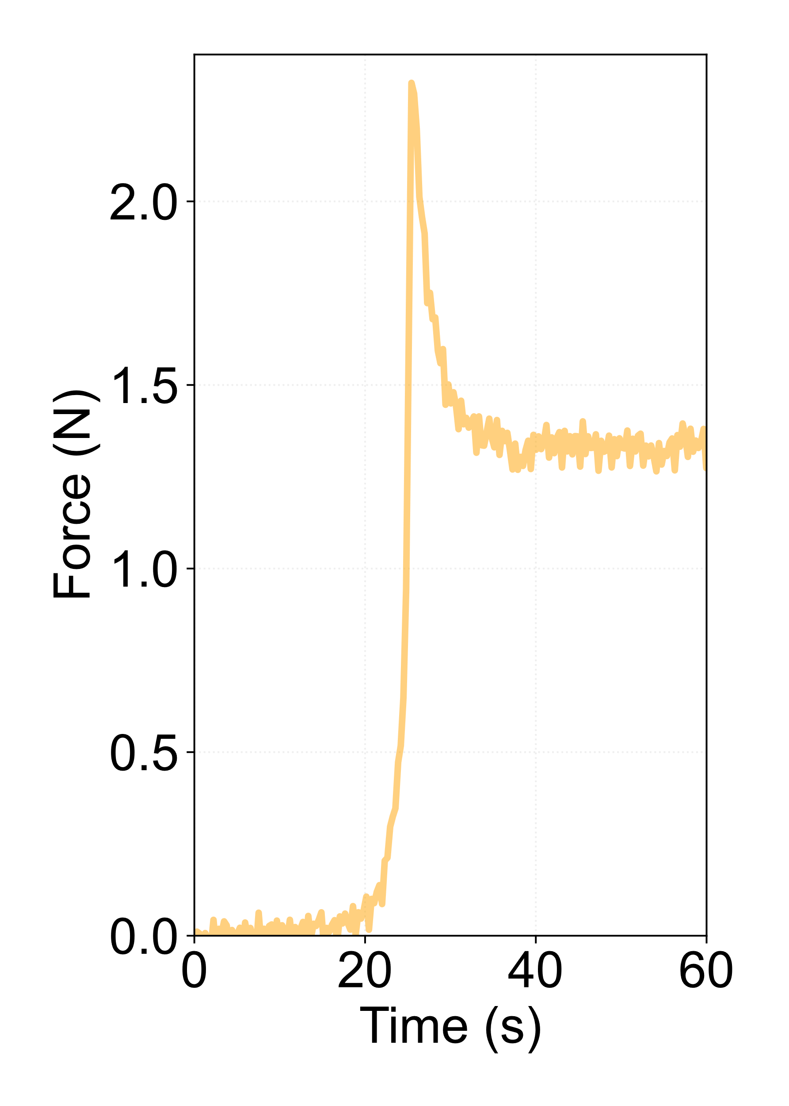
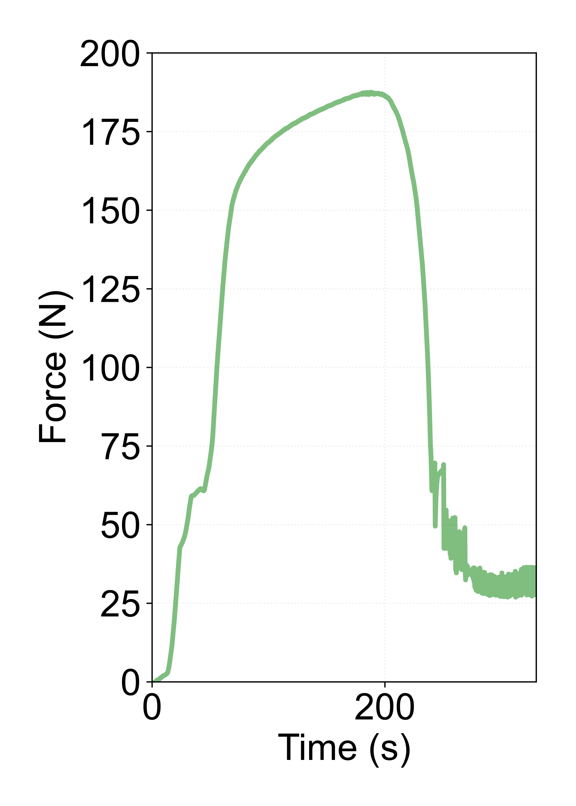
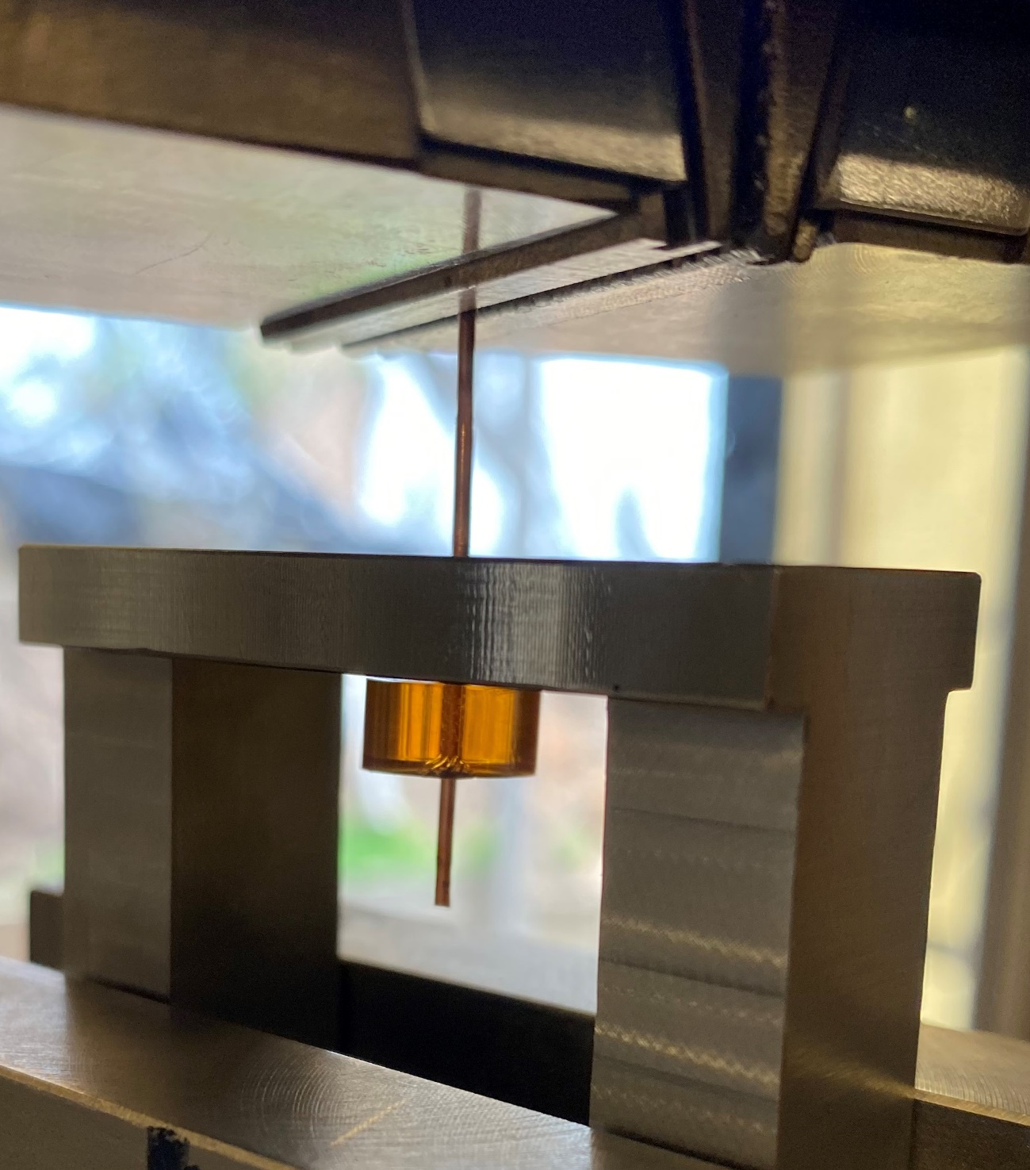
1. Introduction and motivation
Characterization of the apparent interfacial shear strength
Crack propagation
Interface failure
Interface failure
$$F$$
Friction driven
Friction driven
Paraffin wax
Mix 61
J. L. Rudeiros Fernandez et al.

Slide 7
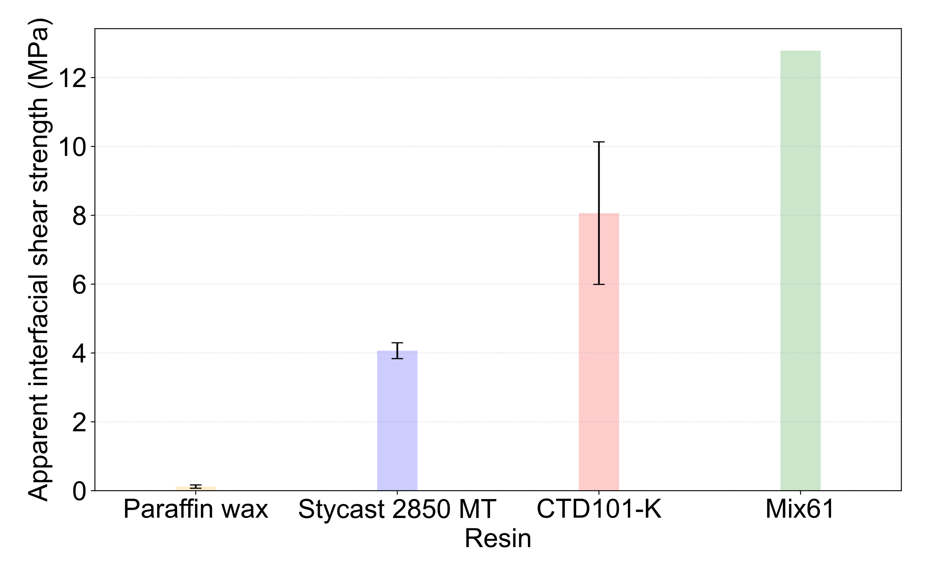
1. Introduction and motivation
Energy release due to interfacial debonding, cracking and relative motion friction will be significantly reduced in the case of a paraffin wax system:
Low energy dissipation during cracking.
Low bonding strength (leading to low energy debonding events).
Creation of low friction interfaces between main coil constituents (i.e. mandrel, cable strands and cable).
The paraffin wax systems has been proven successful in the box sample [1].
Characterization of the apparent interfacial shear strength
[1] Daly, Michael, et al. "Improved training in paraffin-wax impregnated Nb3Sn Rutherford cables demonstrated in BOX samples." Superconductor Science and Technology 35.5 (2022): 055014.
J. L. Rudeiros Fernandez et al.

Slide 8
Table of contents
01
Introduction and motivation
02
Development of the wax VPI for CCT
03
The wax CCT coil
04
Conclusions and next steps
J. L. Rudeiros Fernandez et al.

Slide 9
2. Development of the wax VPI for CCT
General sequence of CCT for vacuum pressure impregnation (VPI) using epoxy resins (e.g. Mix61, CTD-101K) or polyolefin-based resin (e.g. CTD-701X*)
Top reservoir
Outgassing of the coil under vacuum.
Resin mixing and degassing.
Resin transfer to the coil until the reservoir is filled.
Vacuum open to atmospheric pressure.
Curing of the coils within a furnace.
Compressed air
Coil
Vacuum chamber
Resin mixer
Vacuum pump
J. L. Rudeiros Fernandez et al.

Slide 10
2. Development of the wax VPI for CCT
The paraffin-wax process implies additional challenges with respect to traditional resins:
High uniform temperature is required in all parts of the system.
High volumetric contraction during phase transformation.
Top reservoir
Compressed air
Coil
Vacuum chamber
Resin mixer
Vacuum pump
J. L. Rudeiros Fernandez et al.

Slide 11
2. Development of the wax VPI for CCT
air
Diagram of the impregnation bag system
Temperature
Cooling by convection
Mandrel
$$T_{1}$$
$$T_{2}$$
$$T_{2}$$
$$∆T$$
$$T_{1}$$
Cable
$$∆T$$
Paraffin wax melting point
Mandrel OD
Mandrel ID
Glass fiber tape
Peel ply
Time
Flow media
Vacuum bag
External heating elements
Cooling pipe
J. L. Rudeiros Fernandez et al.

Slide 12
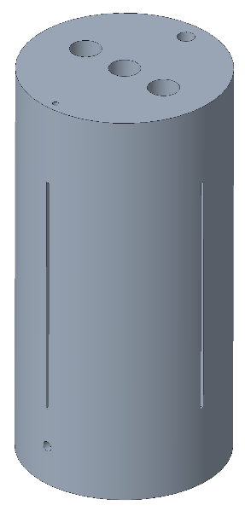
2. Development of the wax VPI for CCT
Aluminum-bronze
Aluminum
Aluminum
Phase 1
Phase 2
Phase 3 (Final coil)
Development
J. L. Rudeiros Fernandez et al.

Slide 13
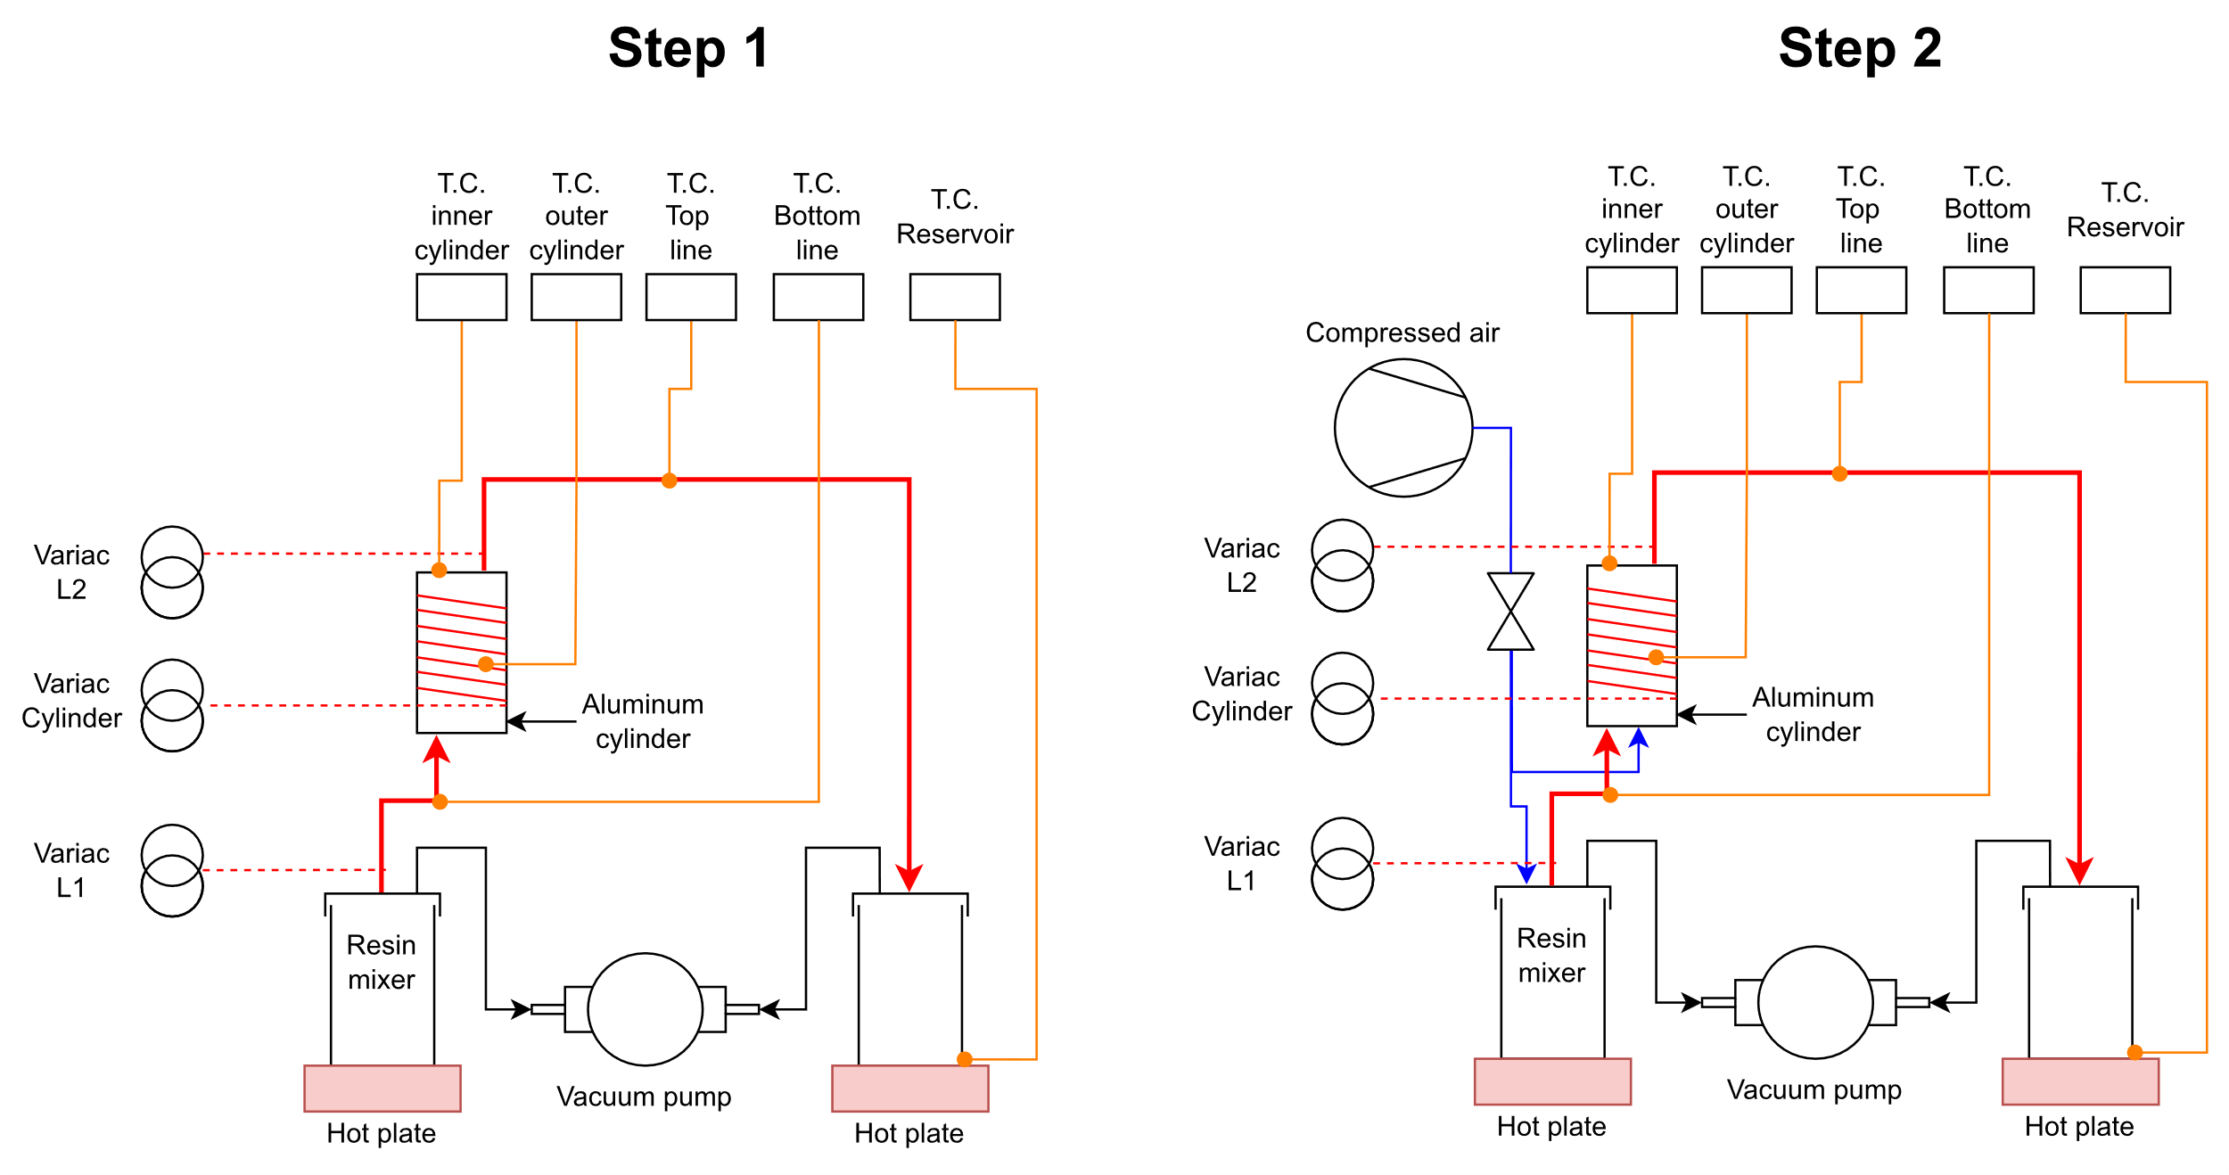
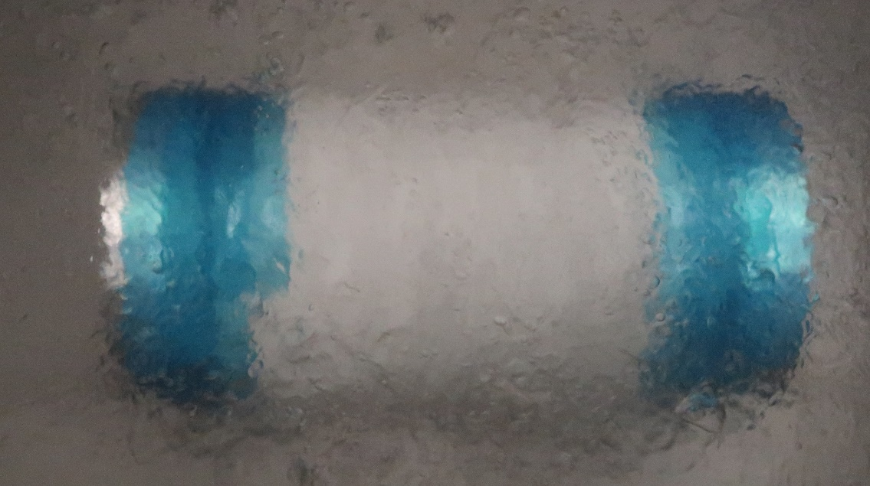
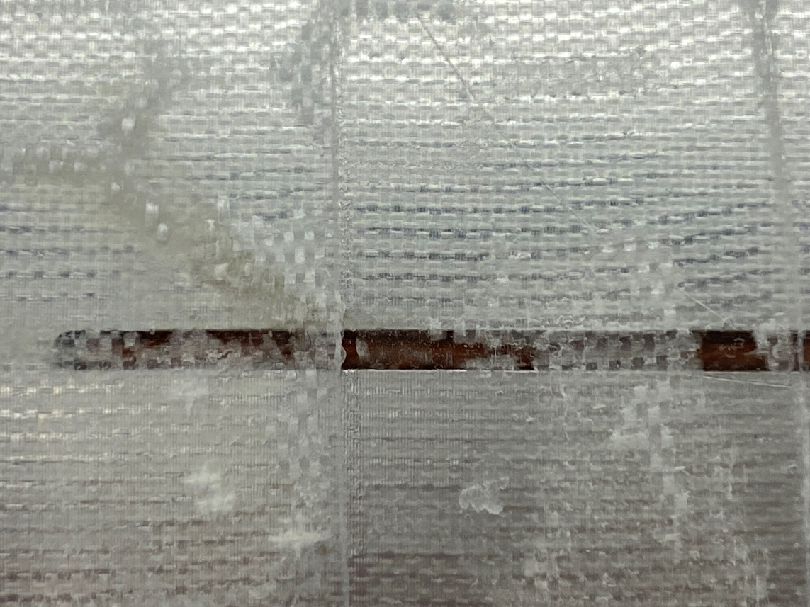
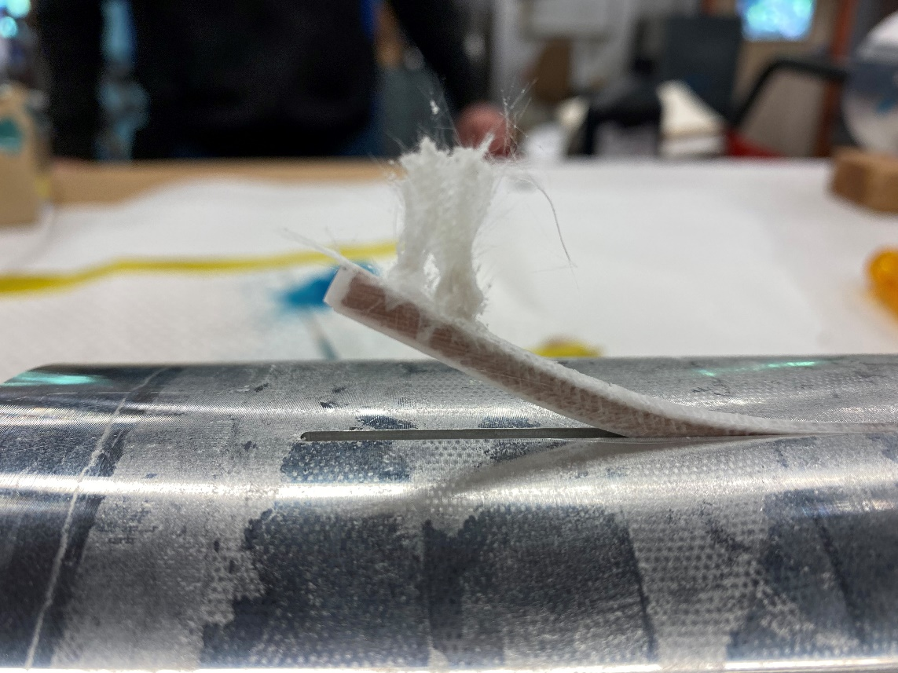
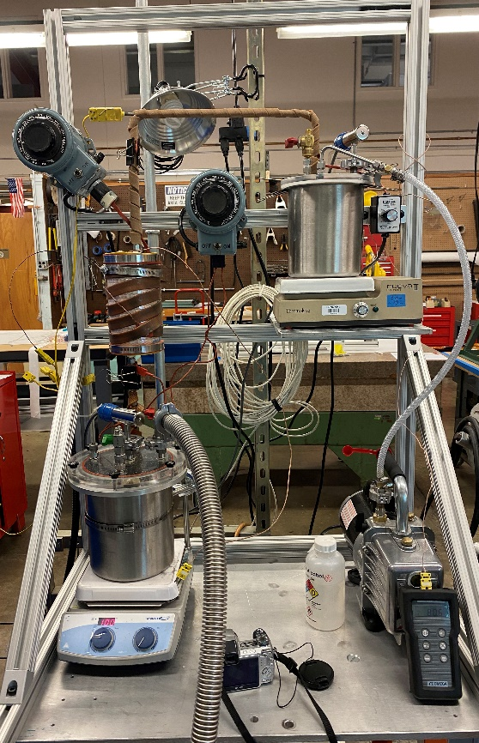
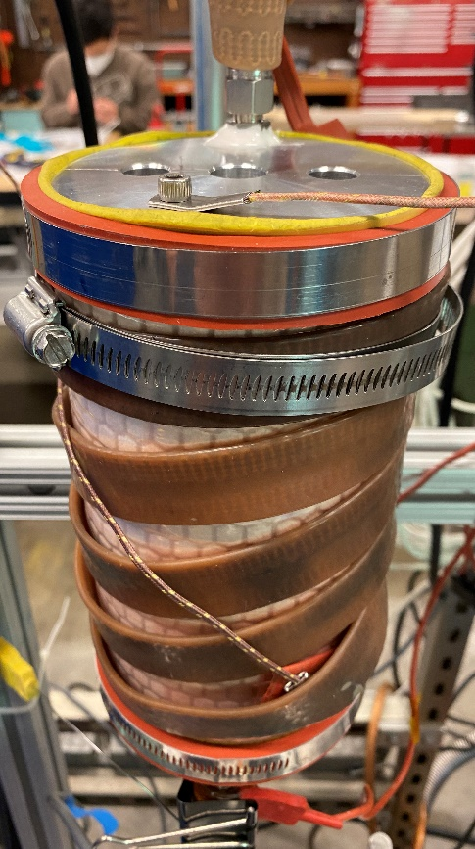
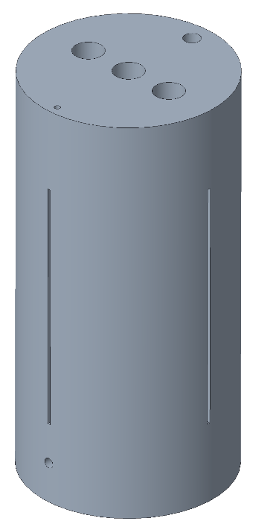
2. Development of the wax VPI for CCT
Liquid nitrogen test
Successful filling of the grooves and cable.
No apparent cracking after the liquid nitrogen test.
The exhibited bonding strength between the filled cable and the aluminum mandrel was very low.
Nb₃Sn cable
J. L. Rudeiros Fernandez et al.

Slide 14
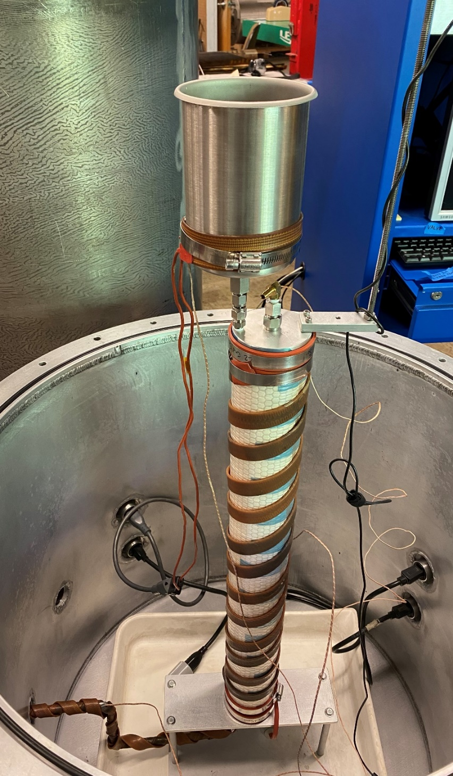
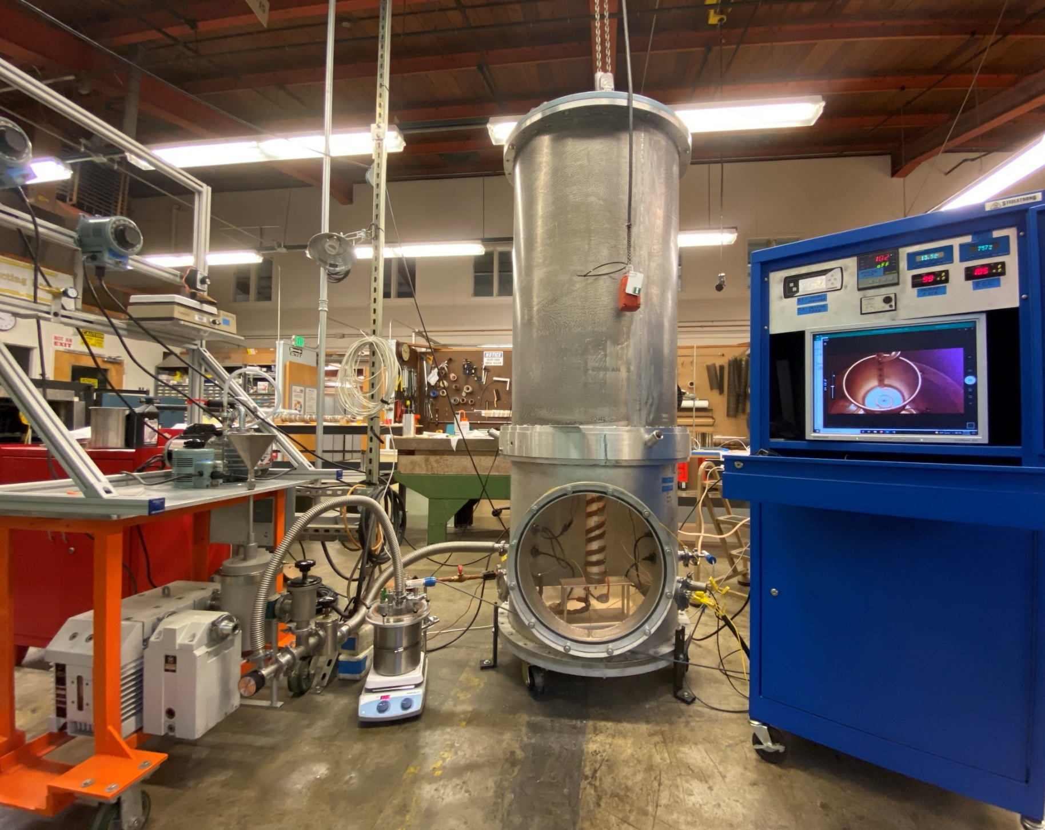
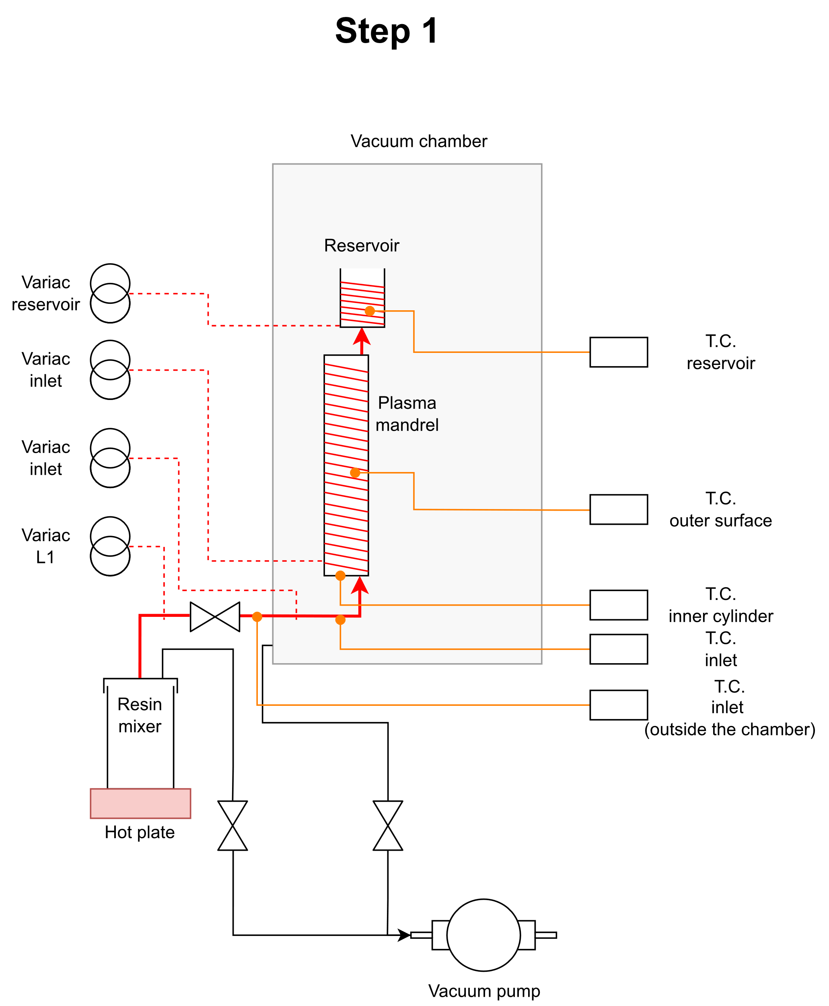
2. Development of the wax VPI for CCT
Phase 2 – Iteration 1
Main set-up
Vacuum chamber
Aluminum (subscale outer-layer)
Vacuum pump
Mixer
J. L. Rudeiros Fernandez et al.

Slide 15
Table of contents
01
Introduction and motivation
02
Development of the wax VPI for CCT
03
The wax CCT coil
04
Conclusions and next steps
J. L. Rudeiros Fernandez et al.

Slide 16
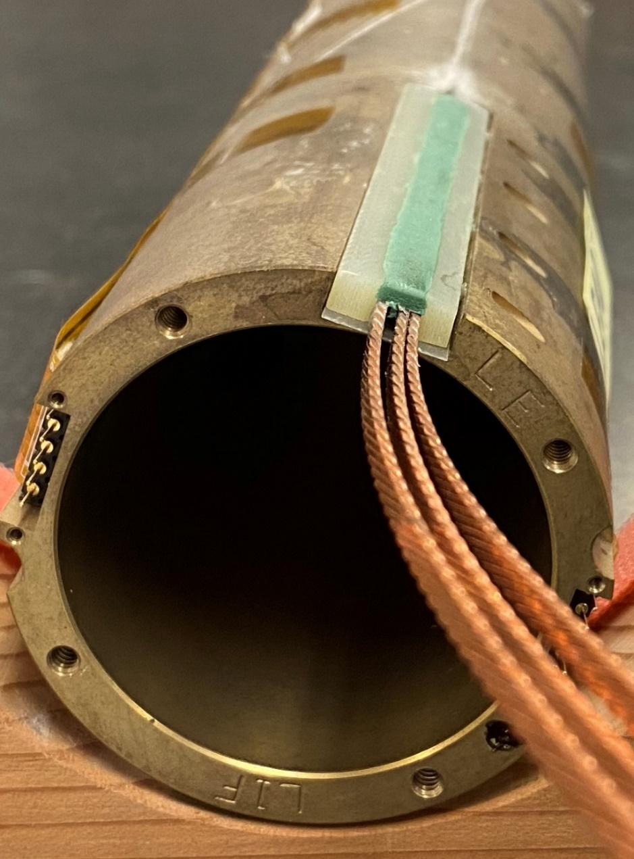
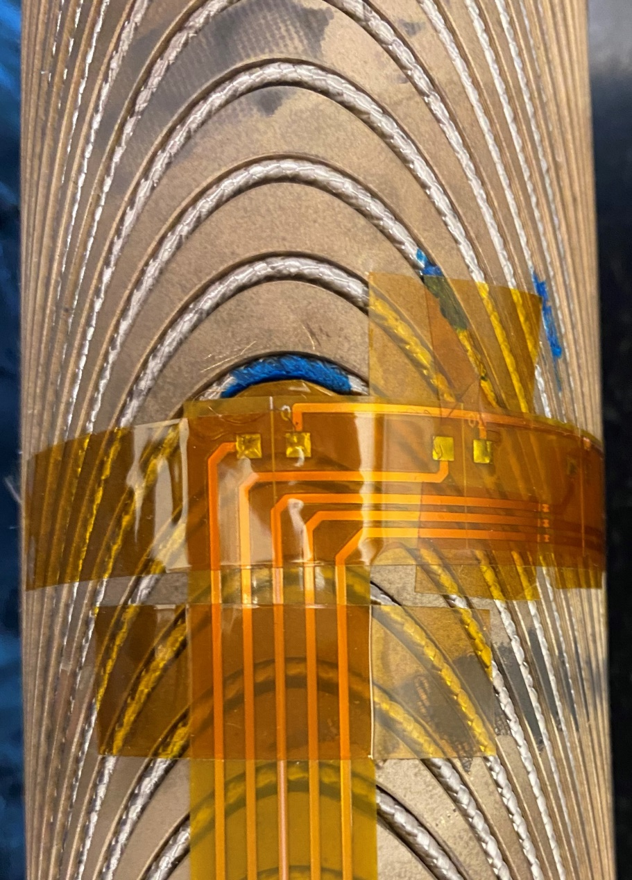
3. The wax CCT coil
New features in the CCT wax coil
New design of the G10 splice support pieces in order to minimize the volume of wax in the region and ensure mechanical protection of the splice.
New heaters were installed directly in contact with the cable for quench studies. Heaters attached with Stycast 2850 (* Work by D. Arbelaez and R. Teyber).
J. L. Rudeiros Fernandez et al.

Slide 17
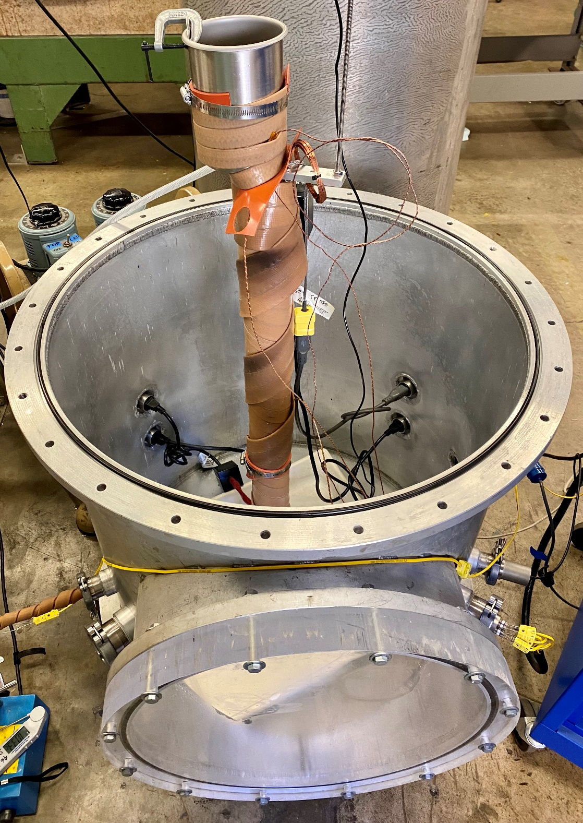
3. The wax CCT coil
Impregnation
Diagram of the impregnation bag system
Cooling by convection
Mandrel
$$T_{1}$$
$$T_{2}$$
$$∆T$$
Cable
Mandrel OD
Paraffin wax melting point
Mandrel ID
Glass fiber tape
Peel ply
Flow media
Vacuum bag
External heating elements
J. L. Rudeiros Fernandez et al.

Slide 18
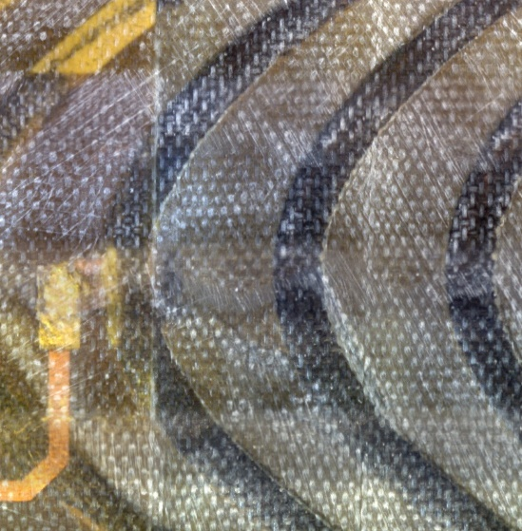
3. The wax CCT coil
Impregnated coil - surface
0°
Mix 61
(CCT Sub2)
PC
Microscope
Linear translation stage
90°
Axial rod
180°
Rotation
Coil
Support
2.5 mm
270°
Smartmotor
A microscope moves along a linear stage taking images of the outer surface of the coils, row by row. The angular displacement of the coil is provided by a smart-motor.
An algorithm reconstructs the full image which is planned to be used to search for differences between pristine and tested coils.
360°
Paraffin wax
(CCT Sub5)
J. L. Rudeiros Fernandez et al.

Slide 19
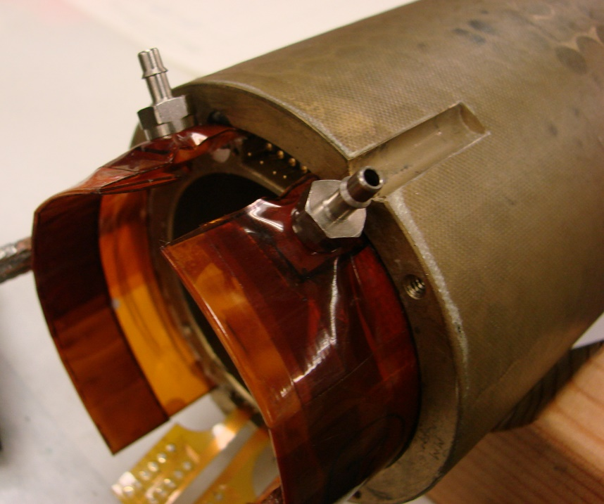
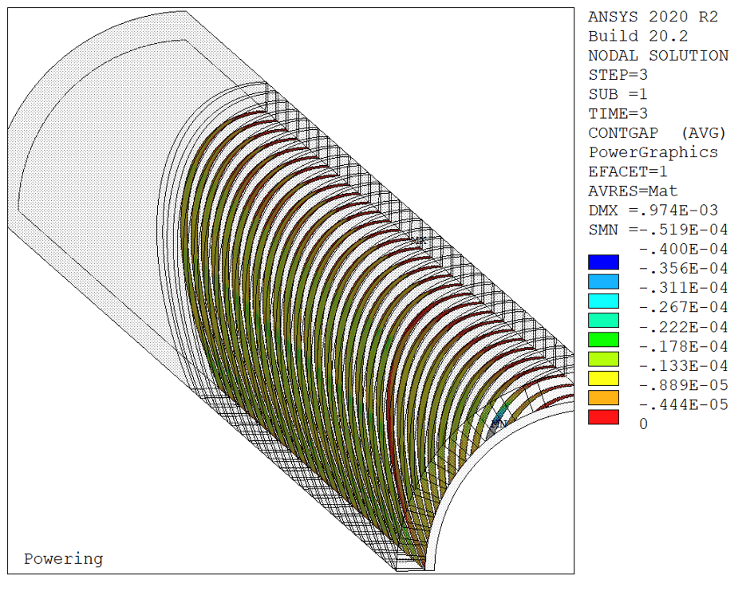
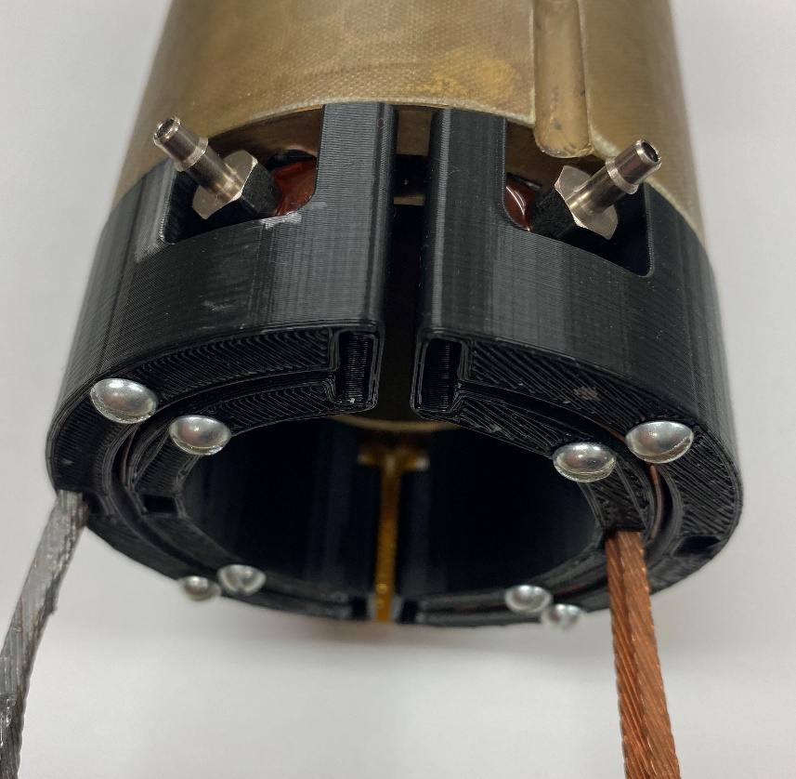
3. The wax CCT coil
Developments for the wax-based CCT assembly: paraffin wax inner layer + mix61 outer layer (from Sub3)
a
Increase in the smartshims angle to increase conductor support during energization
Miniaturization of the elements for fabrication of the smartshims allows for a new 3D printed structure during assembly.
b
*Courtesy of G. Vallone
Compressed air
a
Smartshim left
a
a
b
b
Smartshim right
b
Vacuum pump
Resin mixer
Overflow
CCT Sub2, 3, and 4
CCT Sub5 (wax)
J. L. Rudeiros Fernandez et al.

Slide 20
Table of contents
01
Introduction and motivation
02
Development of the wax VPI for CCT
03
The wax CCT coil
04
Conclusions and next steps
J. L. Rudeiros Fernandez et al.

Slide 21
4. Conclusions and next steps
A method to successfully impregnate CCT magnets based on the VPI method has been developed.
The paraffin wax interfacial strength with copper wire has been characterized, showing two orders of magnitude lower adhesion in relation to the epoxy resin used for previous CCT magnets (i.e. Mix61).
A low friction system has the potential to reduce some of the phenomena normally associated with training.
The test of magnet showed no training in the wax layer!
Towards a “full” wax subscale (inner + outer layer).
J. L. Rudeiros Fernandez et al.

Slide 22
Thanks!
J. L. Rudeiros Fernandez et al.

Slide 23
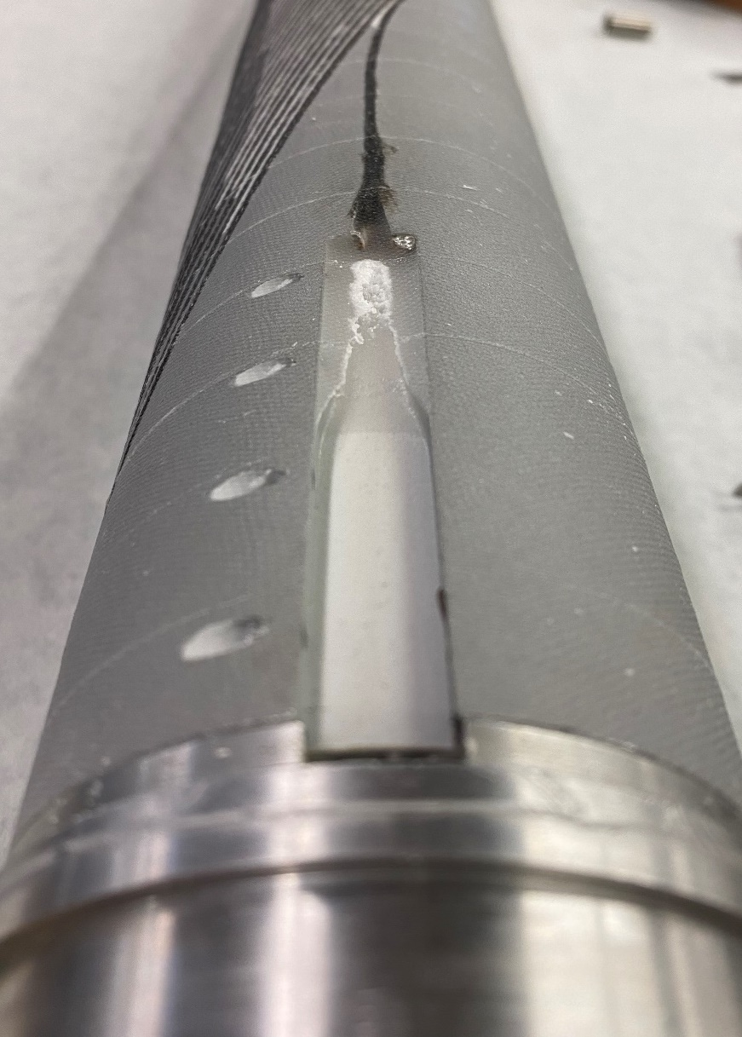
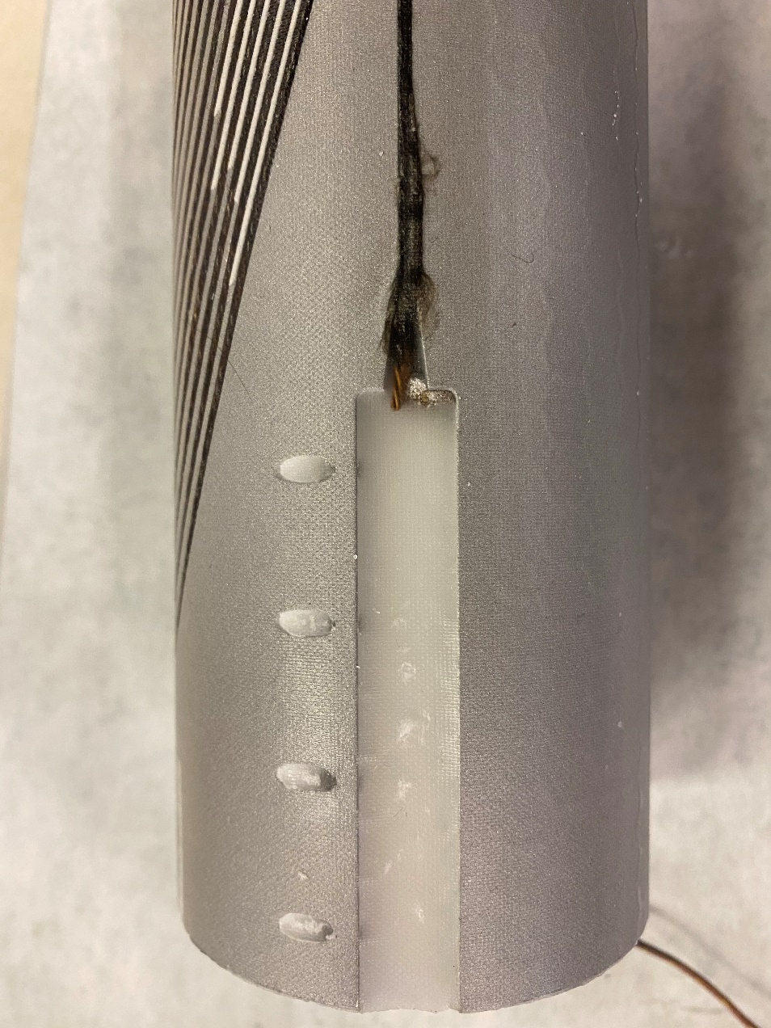
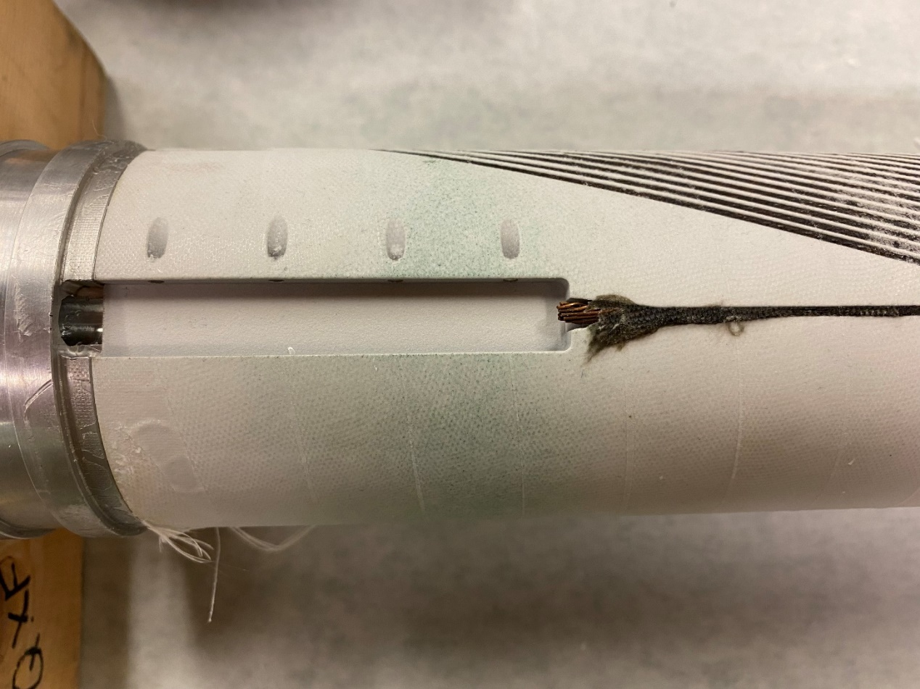
Additional slides
Iterative progress on the wax VPI
Iteration 1
Iteration 2
Iteration 3
The overall filling of the grooves and cable improved with each iteration.
The incremental improvements in the set-up lead to the complete filling of all the main cavities.
The higher temperature uniformity led to a uniform flow of wax along the outer surface of the mandrel.
J. L. Rudeiros Fernandez et al.

Slide 24
Additional slides
J. L. Rudeiros Fernandez et al.

