Slide 1
Computing Training and Strength of Nb₃Sn Coils
G. Vallone, E. Anderssen, D. Arbelaez, B. Bordini,
L. Brower, JL Rudeiros Fernandez, P. Ferracin
MDP Collaboration Meeting
Brookhaven National Laboratory
21 March 2023

Slide 2
Outline
Introduction
  Coil Mechanical Properties
  Coil Mechanical Strength
Modeling Training in Nb₃Sn Magnets
Conclusion

Slide 3
Outline
Introduction
  Coil Mechanical Properties
  Coil Mechanical Strength
Modeling Training in Nb₃Sn Magnets
Conclusion

Slide 4
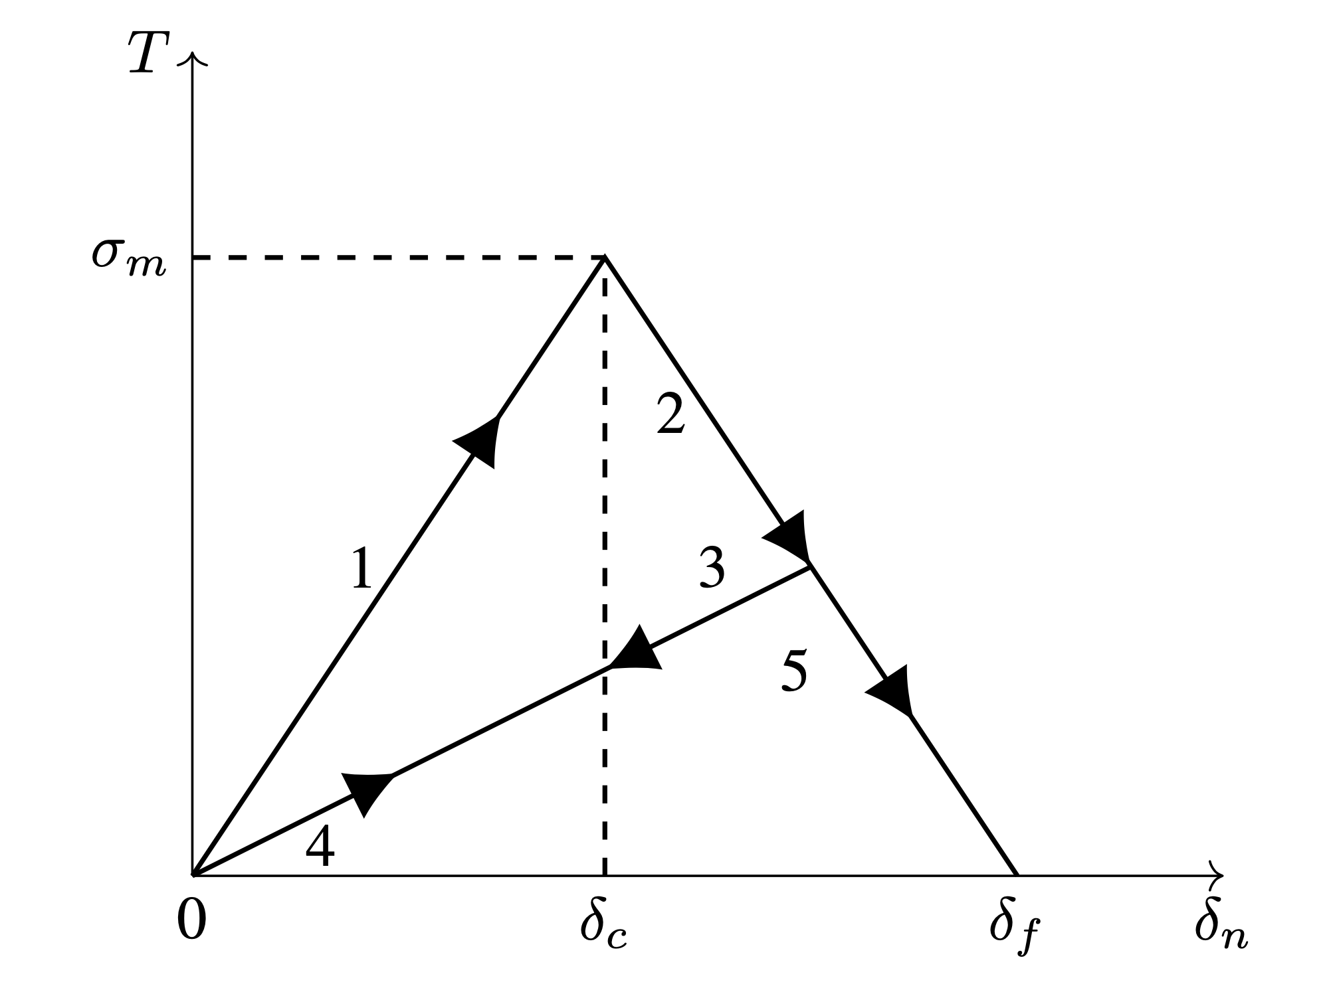
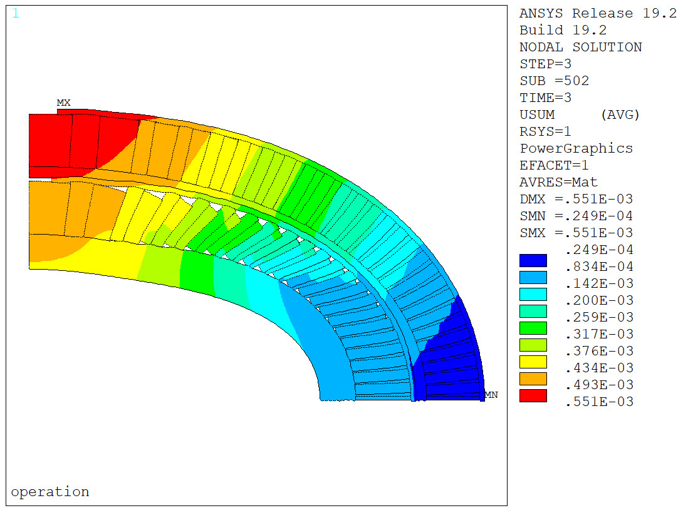
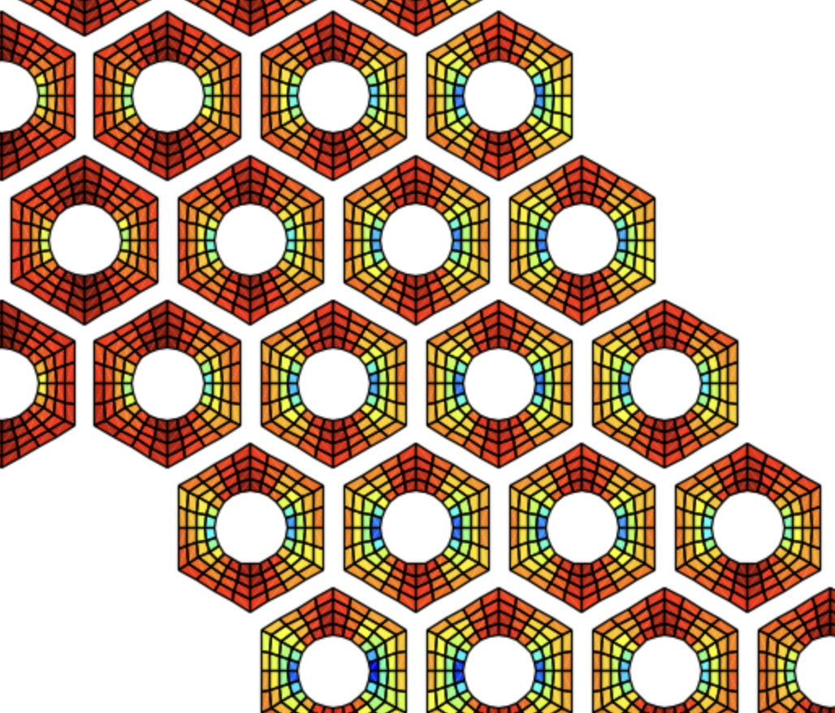
Introduction
In recent years, we have tried to improve the available modeling tools used for Nb₃Sn magnet design and analysis:
MDP2021 - Modeling the progressive detachment of the interfaces during CCT magnets operation, with a tentative ‘event’ training model
MDP2022 - Debonding model validation against measured strain variation during training
MDP2022 - Proposed multiscale models to predict the coil mechanical properties. Constitutive models accurate in 2D, but no understanding on how to apply them in 3D
MDP2023:
  Constitutive models for 3D magnet models; identify/compute the strength limits
  Predict training quenches as a function of the local energy releases due to interfacial failure

Slide 5
Outline
Introduction
  Coil Mechanical Properties
  Coil Strength
      An Empirical Orthotropic Failure Criterion
      Modeling Coil Strength Limits
Modeling Training in Nb₃Sn Magnets
Conclusion

Slide 6
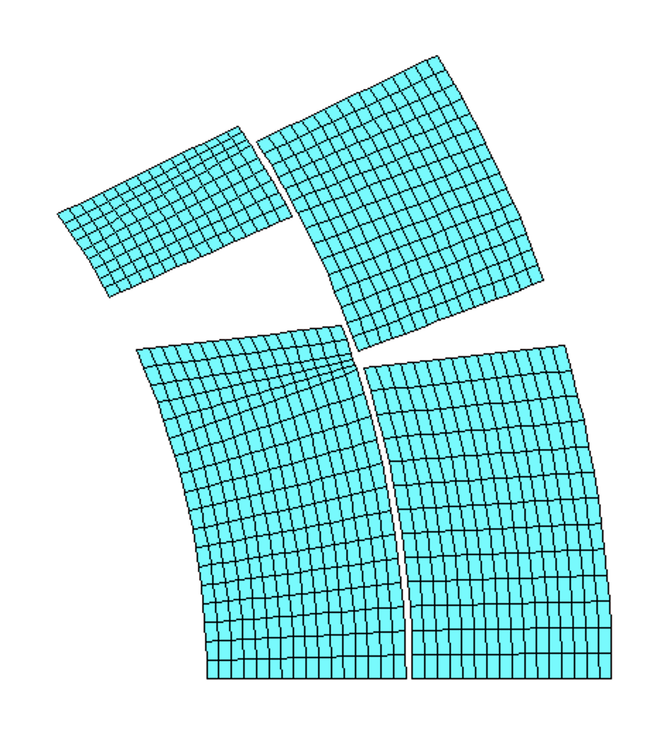
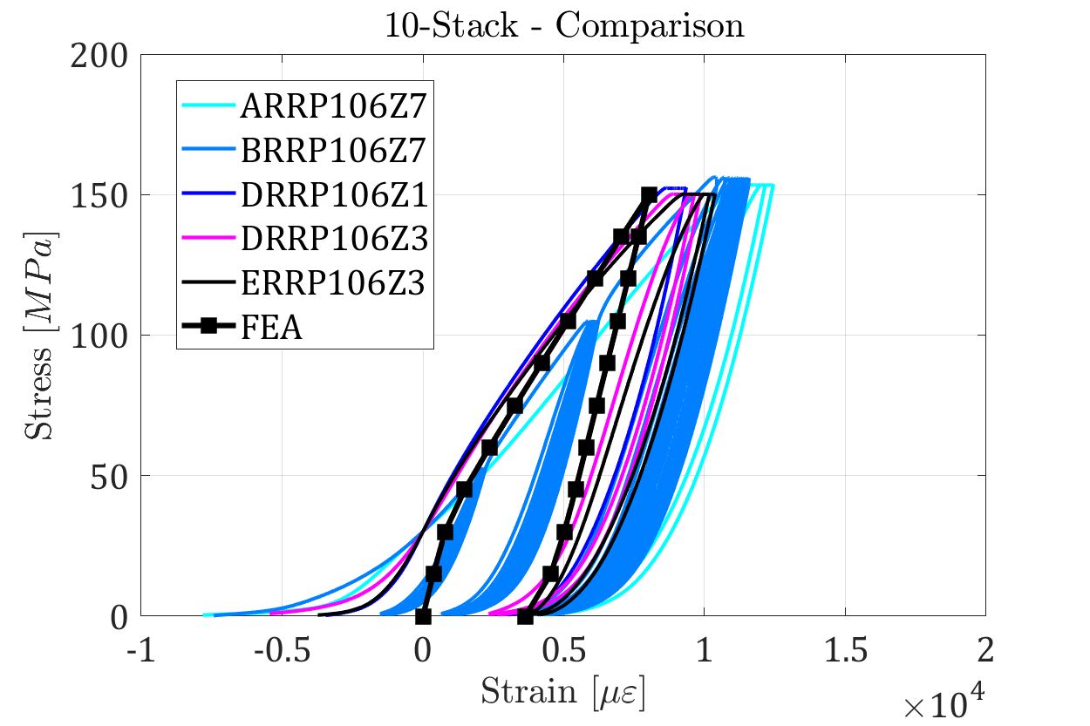
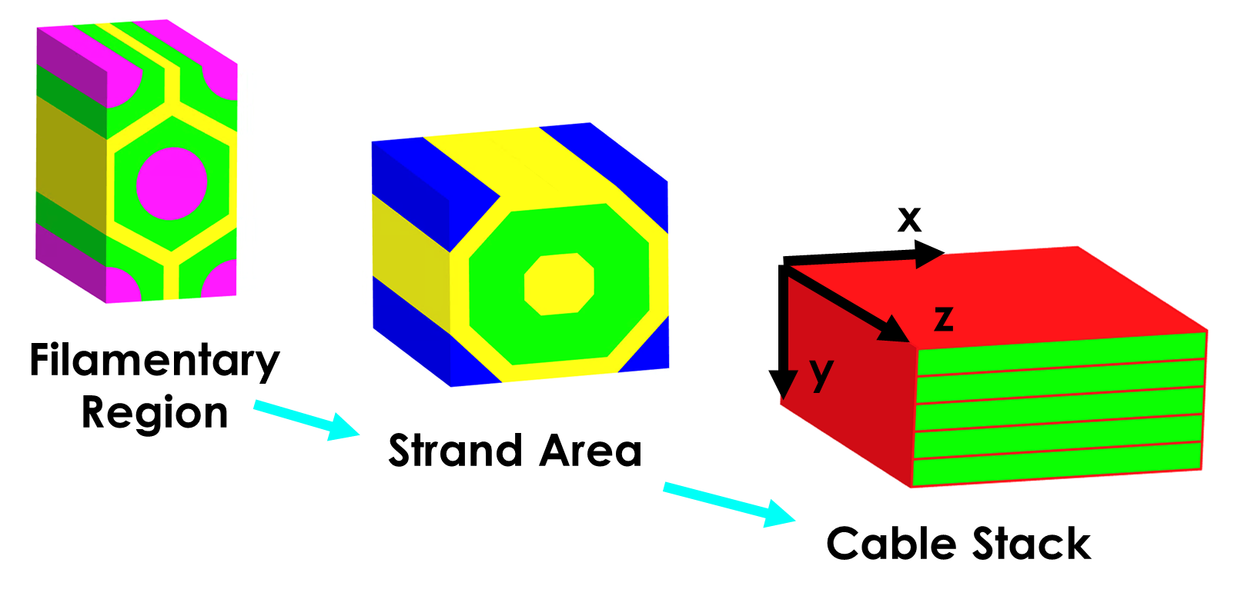
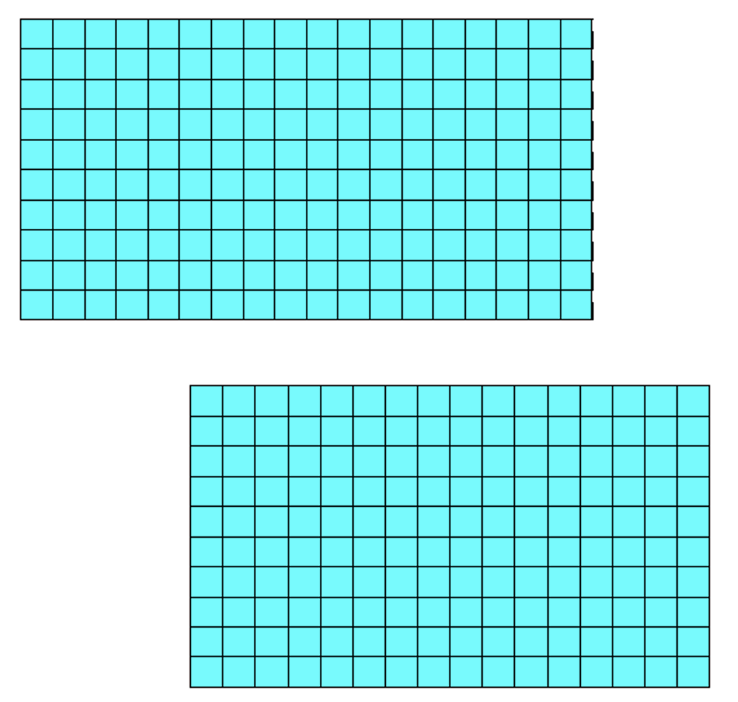
Cable Stack Model
Multiscale (RVE) modeling to extract coil properties:
      7 virtual ‘experiments’: uniaxial loading (x3), shear loading (x3), thermal contraction in free conditions
      Material properties extracted from literature
  Can be implemented in 2D block models using orthotropic properties + Von Mises yield criterion + simple hardening models
    Can match the stiffness of different cable geometries
      It also matches closely the measurements on magnets (MQXF)

Slide 7
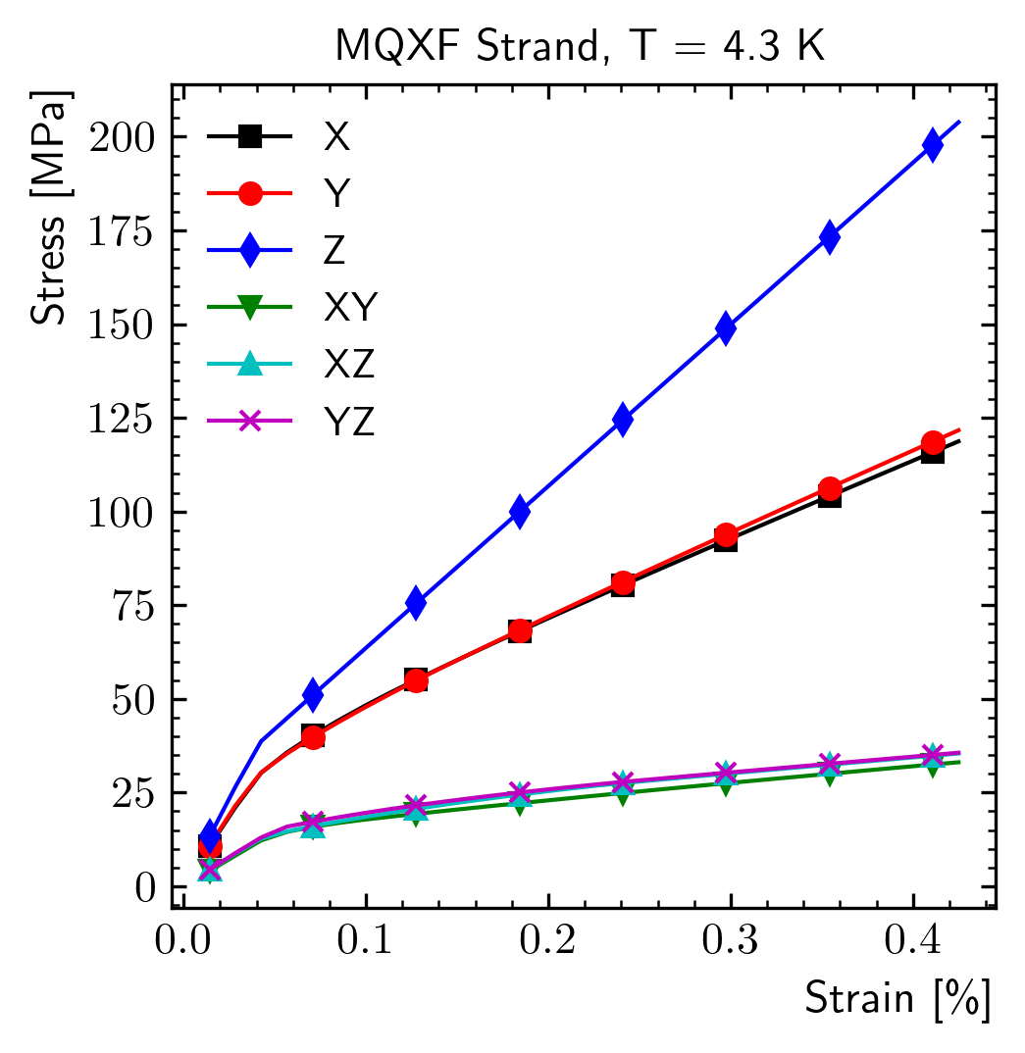
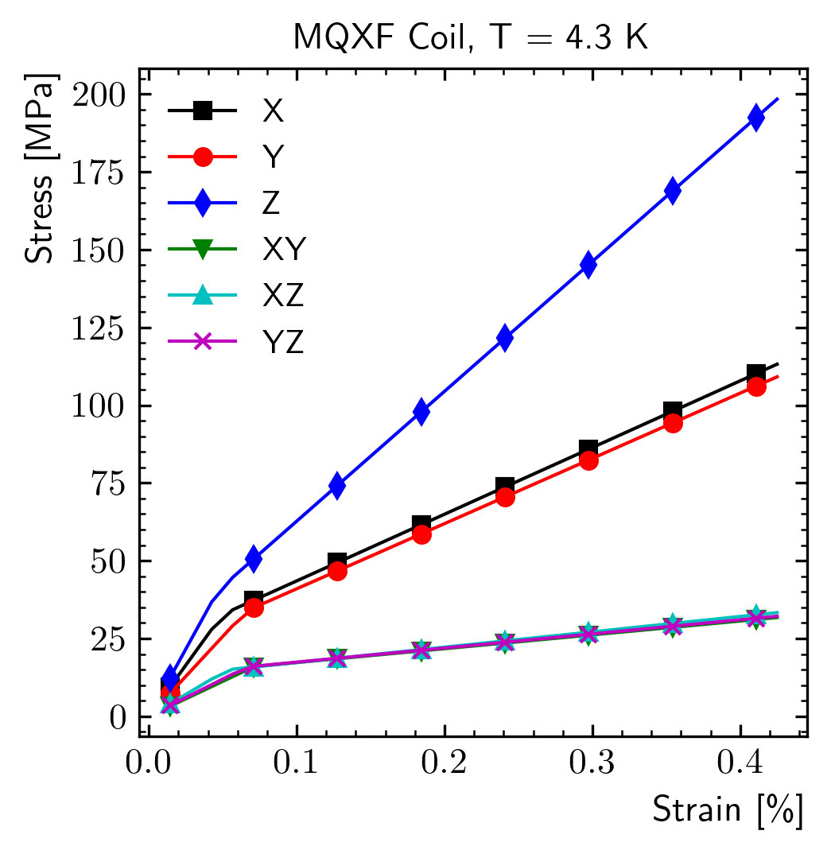
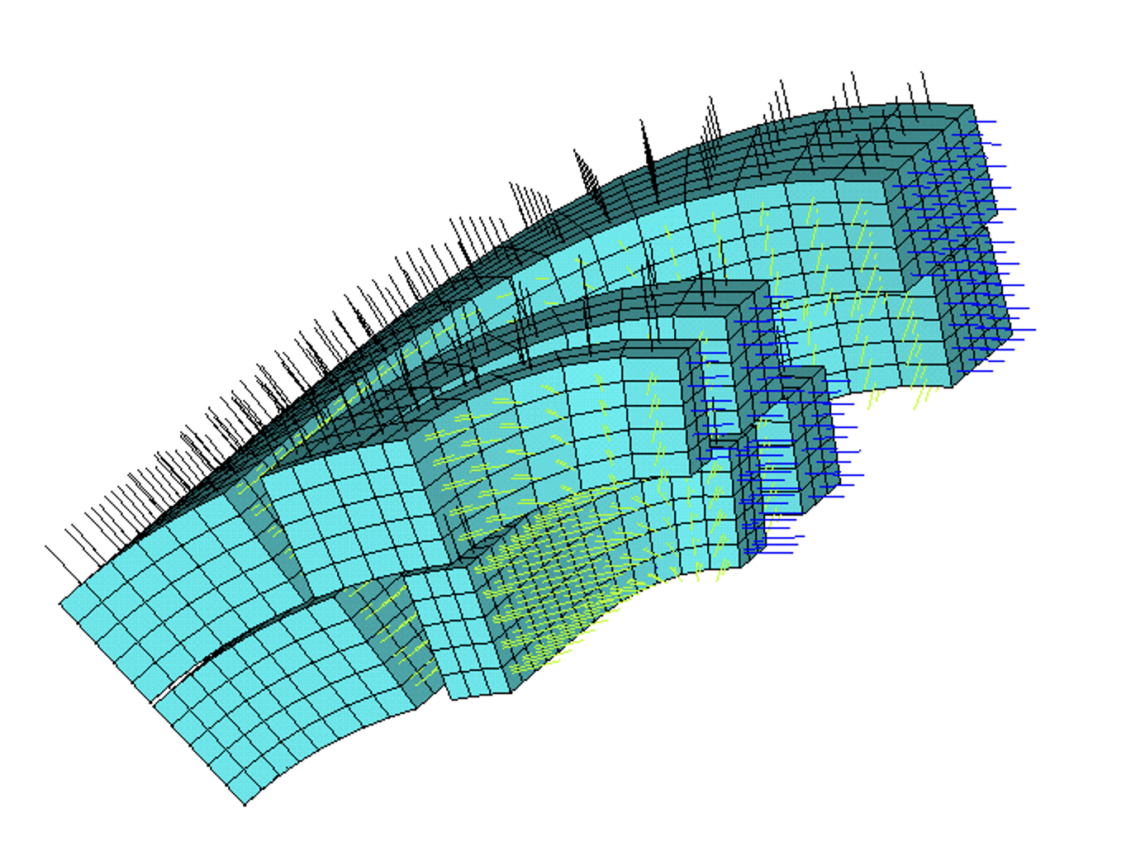
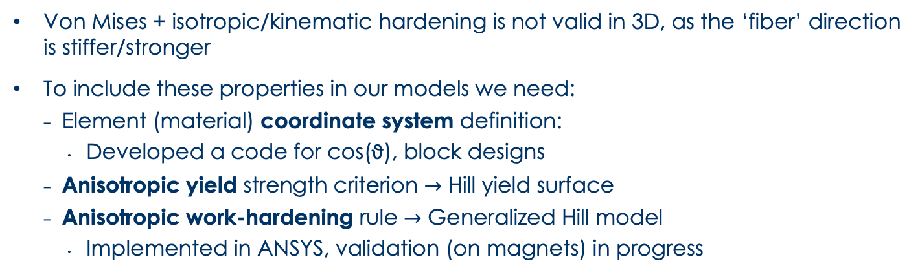
3D RVE Model
Von Mises + isotropic/kinematic hardening is not valid in 3D, as the ‘fiber’ direction is stiffer/stronger
To include these properties in our models we need:
    Element (material) coordinate system definition:
      Developed a code for cos(ϑ), block designs
    Anisotropic yield strength criterion $→$ Hill yield surface
    Anisotropic work-hardening rule $→$ Generalized Hill model
      Implemented in ANSYS, validation (on magnets) in progress

Slide 8
Outline
Introduction
  Coil Mechanical Properties
  Coil Mechanical Strength
Modeling Training in Nb₃Sn Magnets
Conclusion

Slide 9
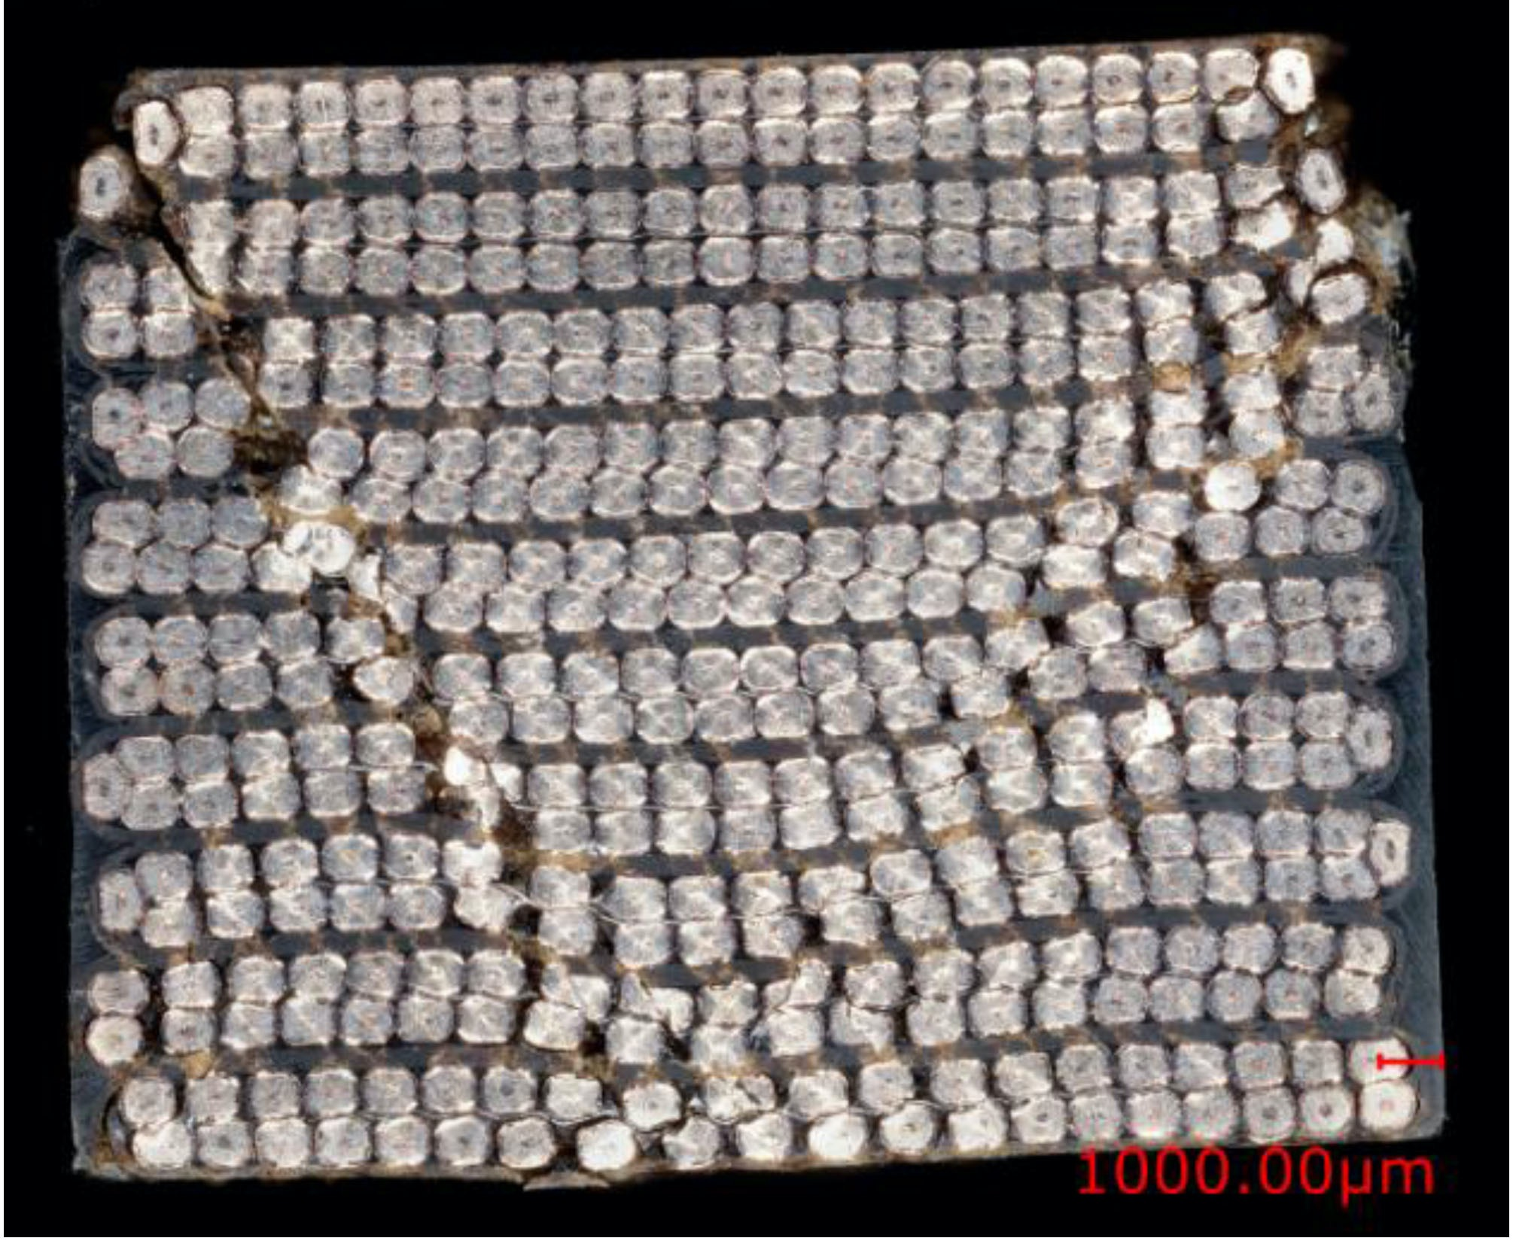
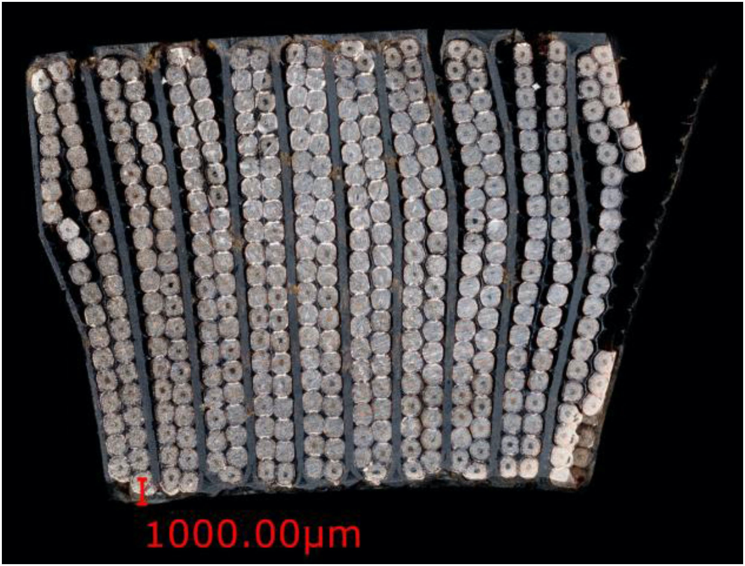
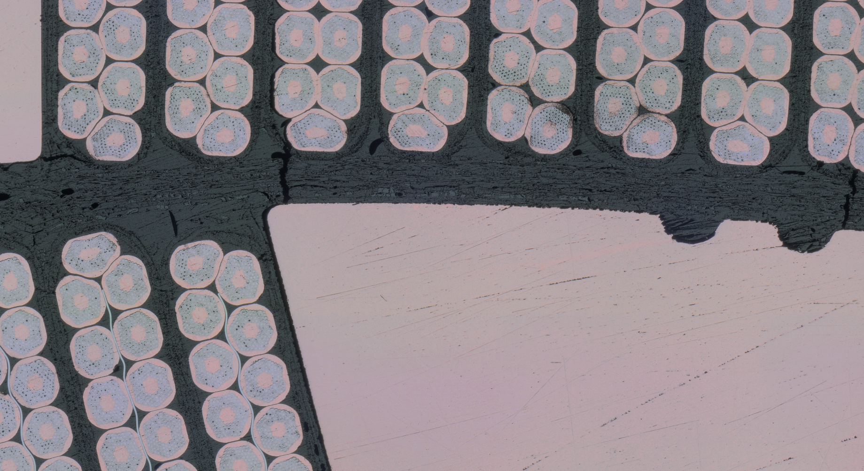
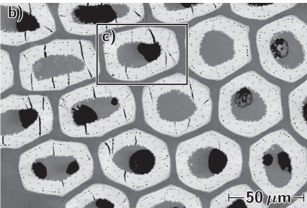
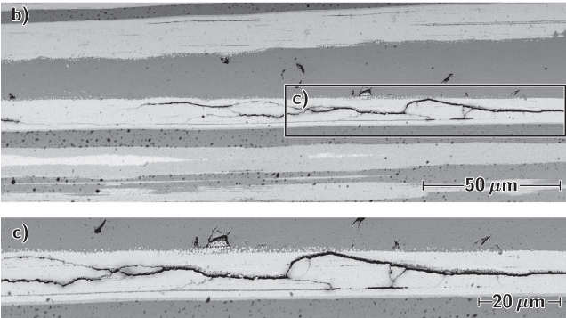
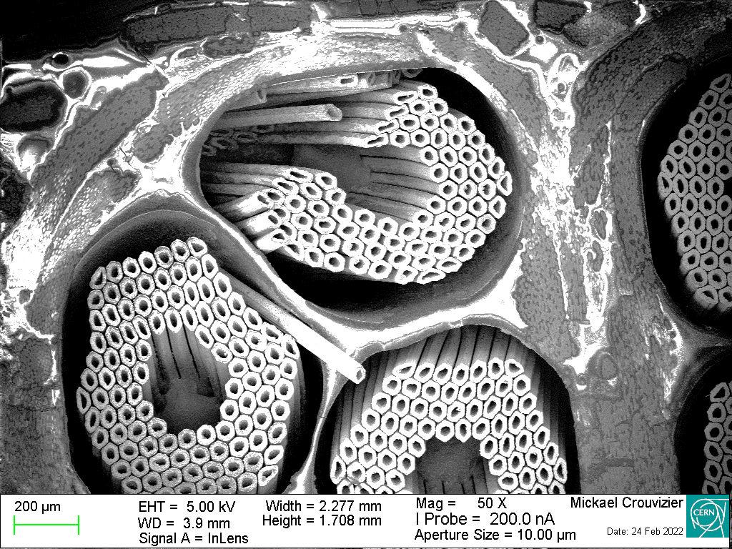
Coil Failure Modes – Work in Progress
Shear/Mixed
Delamination/Debonding
Insulation Failure
‘Radial’ Filament Cracks
Longitudinal Filament Cracks
‘Chopped’
Filaments

Slide 10
Coils – Failure Criteria – State-of-art
What can we define as ‘strength’ in superconducting coils?
    Actual failure of some part of the composite:
      Filament cracking/failure, insulation damage, epoxy cracking, debonding…
    Anything that would reduce magnet performance:
      This does not imply mechanical failure, as the critical current is a function of the applied strain even before irreversible effects appear
  Current ‘state-of-art’ failure criteria:
    Von Mises equivalent stress < 150:200 MPa
      Comparison between ‘consistent block models’ and magnet performance allowed to define this empirical limit
    Transverse/Azimuthal stress < 150/175 MPa
      Measurements on transversally loaded cables: (reversible/irreversible)
    Interfacial debonding under normal loading (e.g. coil/winding pole):
      20 MPa maximum, sometimes excluding corners or considering the average

Slide 11
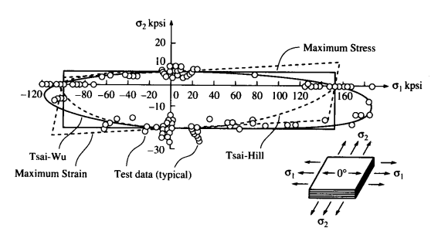
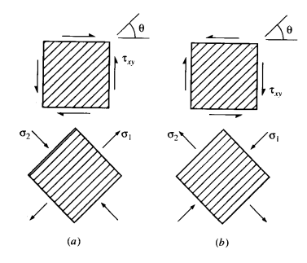
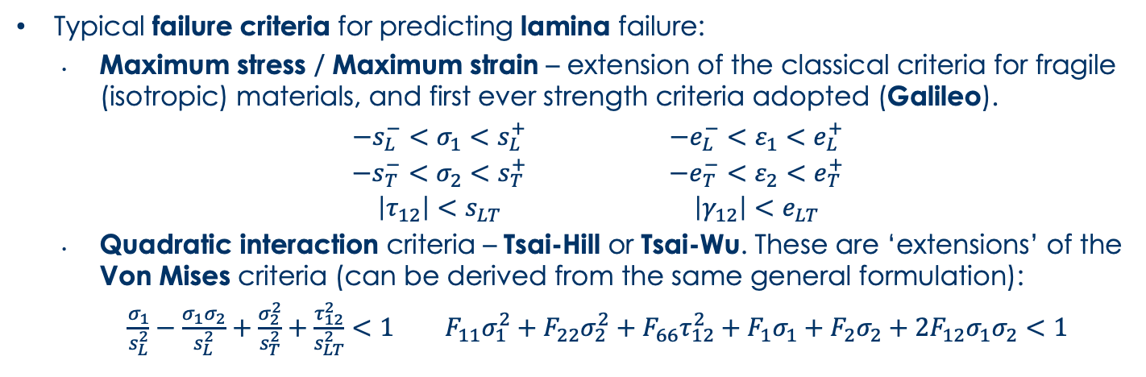
Composite Strength - Criteria
Typical failure criteria for predicting lamina failure:
      Maximum stress / Maximum strain – extension of the classical criteria for fragile (isotropic) materials, and first ever strength criteria adopted (Galileo).
      $\begin{matrix}−s_{L}^{−}<σ_{1}<s_{L}^{+} \\ −s_{T}^{−}<σ_{2}<s_{T}^{+} \\ \left|τ_{12}\right|<s_{LT}\end{matrix}$ $\begin{matrix}−e_{L}^{−}<ε_{1}<e_{L}^{+} \\ −e_{T}^{−}<ε_{2}<e_{T}^{+} \\ \left|γ_{12}\right|<e_{LT}\end{matrix}$
      Quadratic interaction criteria – Tsai-Hill or Tsai-Wu. These are ‘extensions’ of the Von Mises criteria (can be derived from the same general formulation):
      $\frac{σ_{1}}{s_{L}^{2}}−\frac{σ_{1}σ_{2}}{s_{L}^{2}}+\frac{σ_{2}^{2}}{s_{T}^{2}}+\frac{τ_{12}^{2}}{s_{LT}^{2}}<1$ $F_{11}σ_{1}^{2}+F_{22}σ_{2}^{2}+F_{66}τ_{12}^{2}+F_{1}σ_{1}+F_{2}σ_{2}+2F_{12}σ_{1}σ_{2}<1$

Slide 12
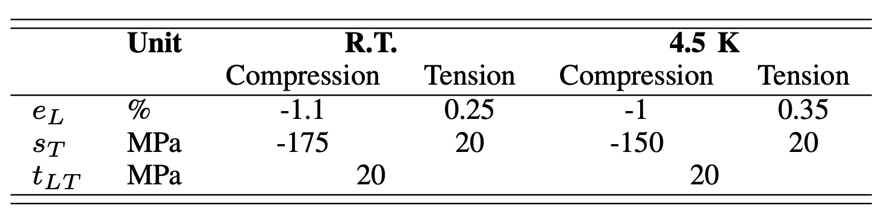
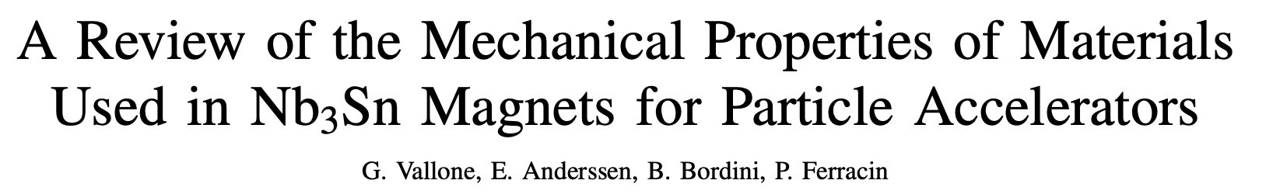
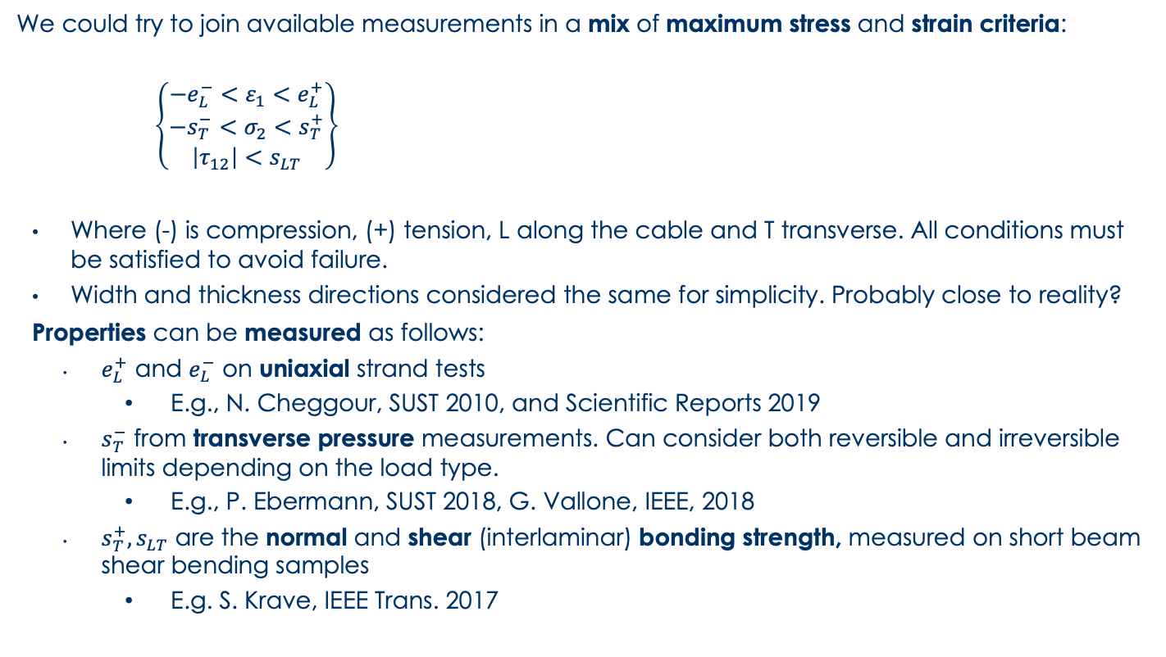
An Orthotropic Failure Criterion
  We could try to join available measurements in a mix of maximum stress and strain criteria:
      $\left\{\begin{matrix}−e_{L}^{−}<ε_{1}<e_{L}^{+} \\ −s_{T}^{−}<σ_{2}<s_{T}^{+} \\ \left|τ_{12}\right|<s_{LT}\end{matrix}\right\}$
    Where (-) is compression, (+) tension, L along the cable and T transverse. All conditions must be satisfied to avoid failure.
    Width and thickness directions considered the same for simplicity. Probably close to reality?
    Properties can be measured as follows:
      $e_{L}^{+}$ and $e_{L}^{−}$ on uniaxial strand tests
        E.g., N. Cheggour, SUST 2010, and Scientific Reports 2019
      $s_{T}^{−}$ from transverse pressure measurements. Can consider both reversible and irreversible limits depending on the load type.
        E.g., P. Ebermann, SUST 2018, G. Vallone, IEEE, 2018
      $s_{T}^{+}, s_{LT}$ are the normal and shear (interlaminar) bonding strength, measured on short beam shear bending samples
        E.g. S. Krave, IEEE Trans. 2017

Slide 13
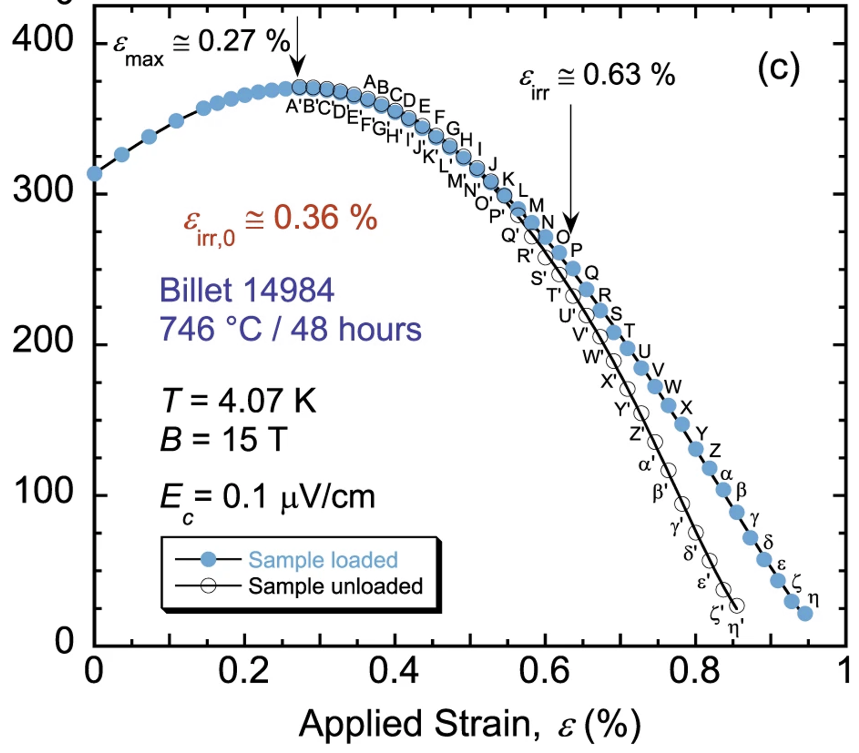
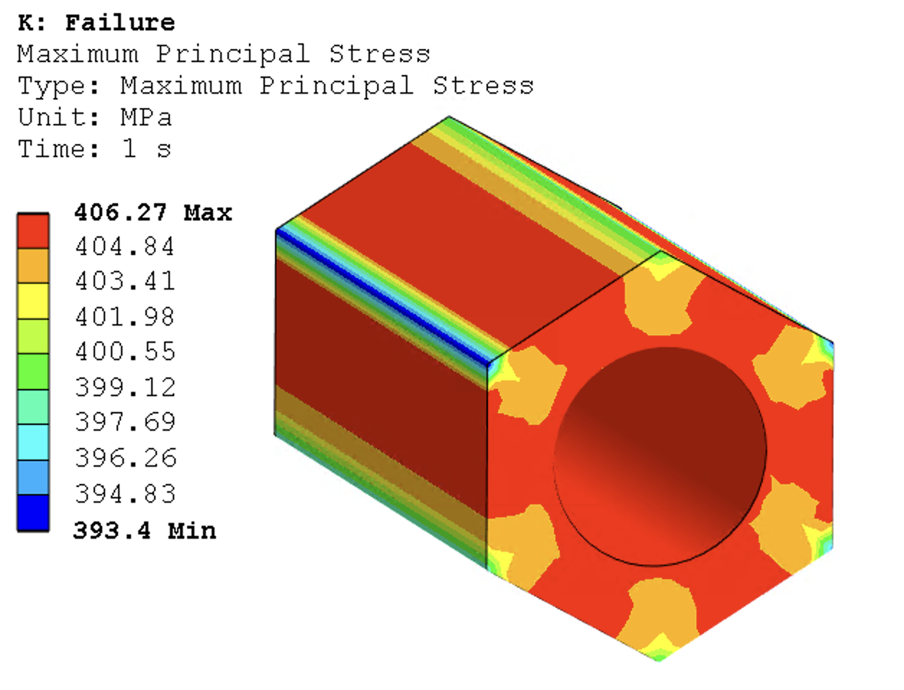
Strand Strength – Longitudinal Loads
Measurements on uniaxially loaded strands show irreversible degradation starting from an intrinsic strain of 0.35% (at 4 K)
In the filament model, this means a first principal stress of 405 MPa
We might be able use this information to compute the limits in all directions…
Plot from N. Cheggour, 2019

Slide 14
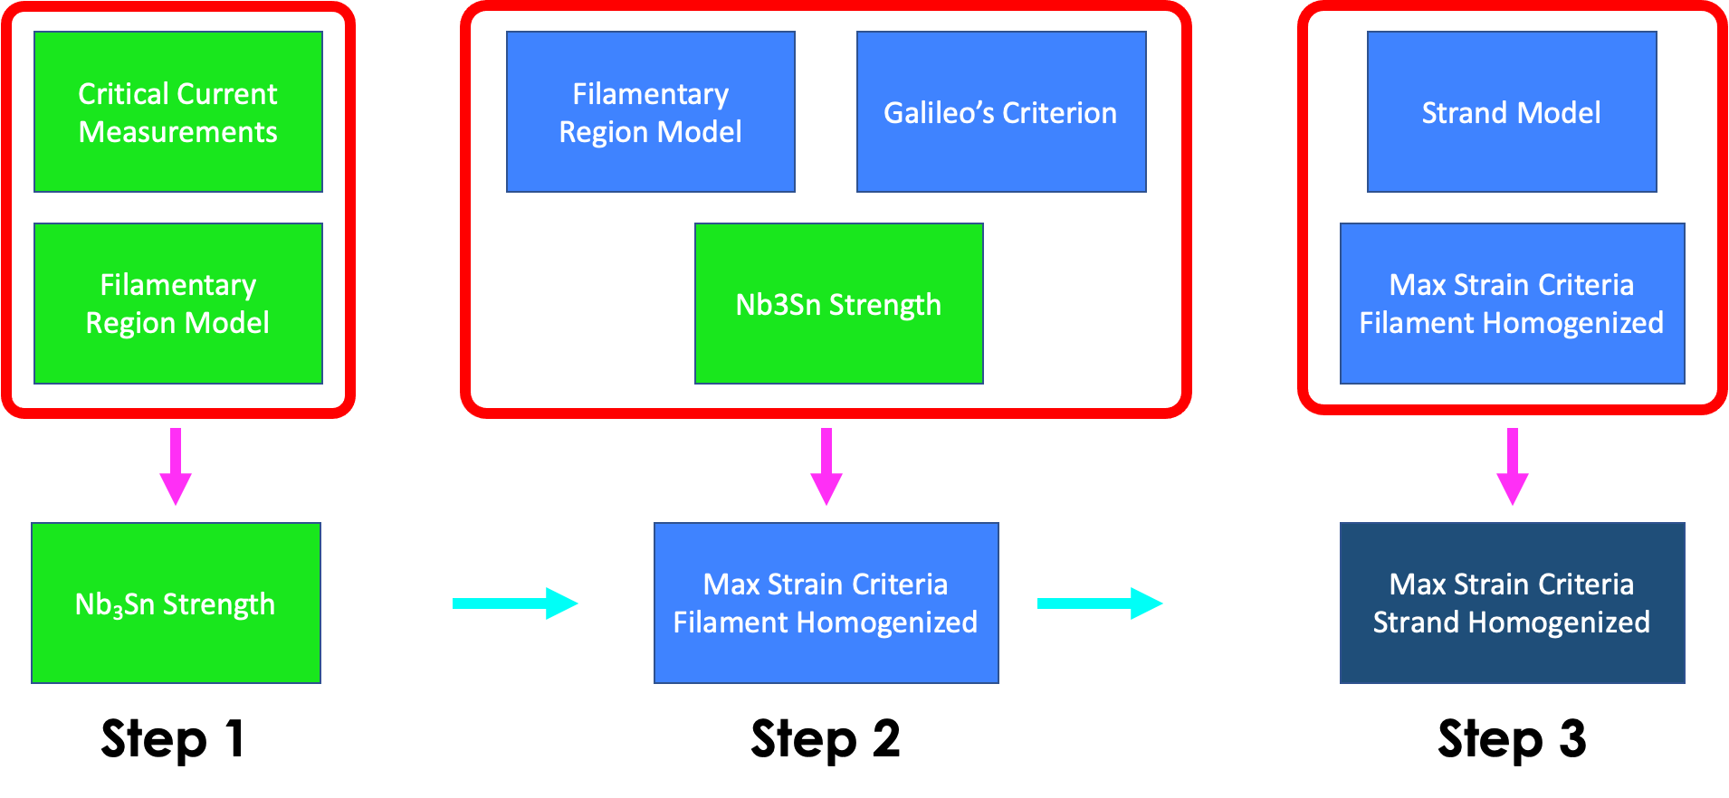
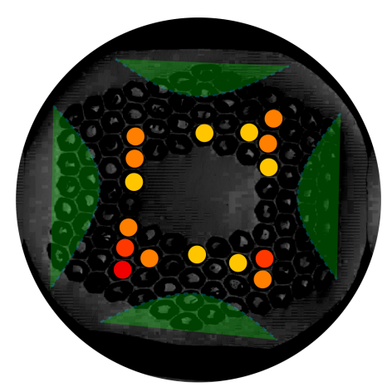
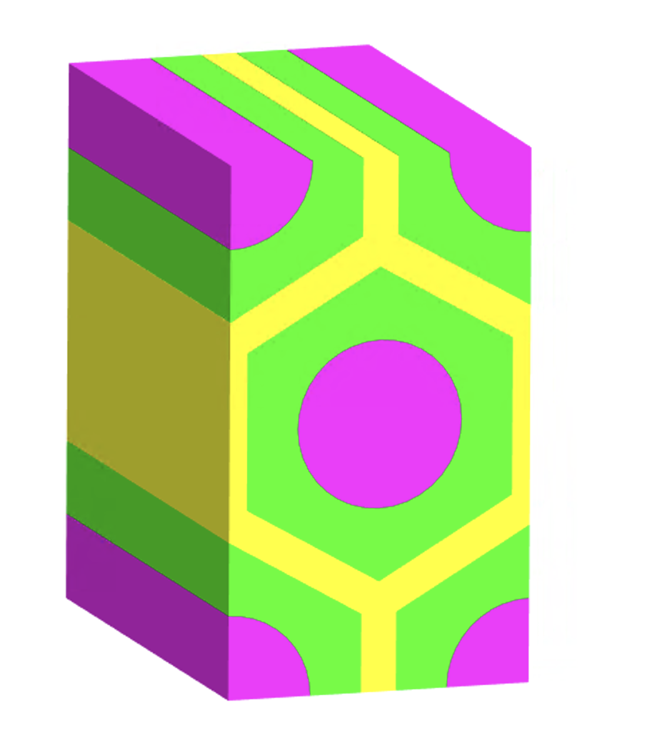
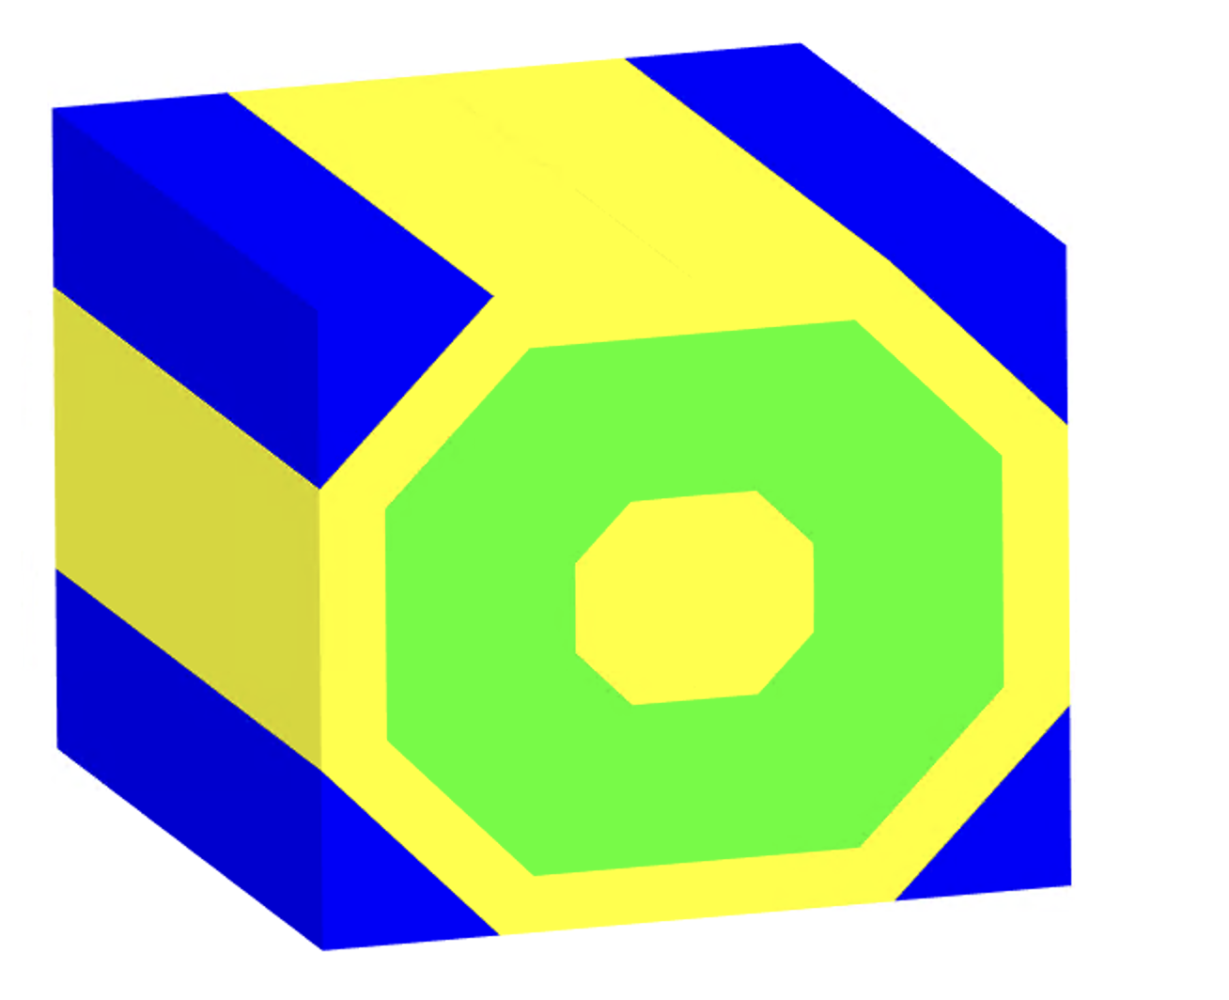
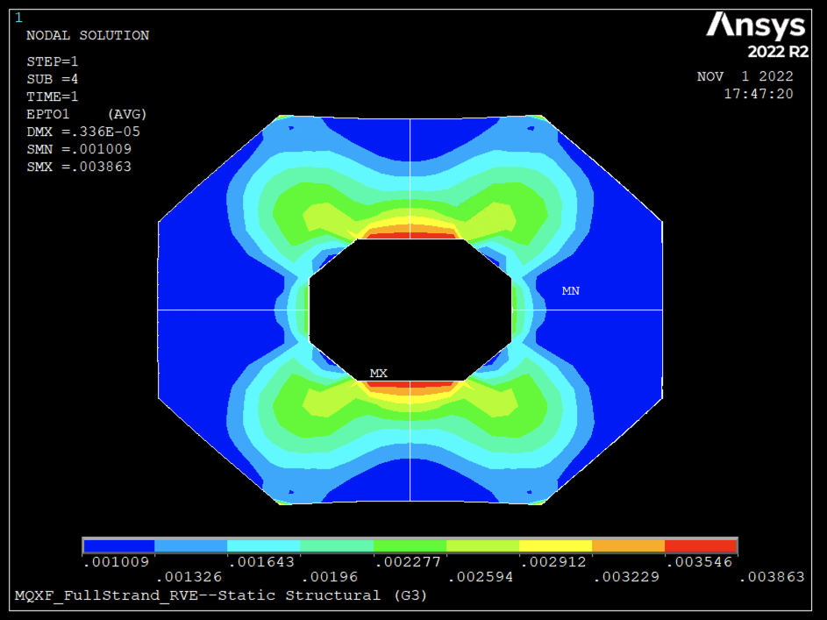
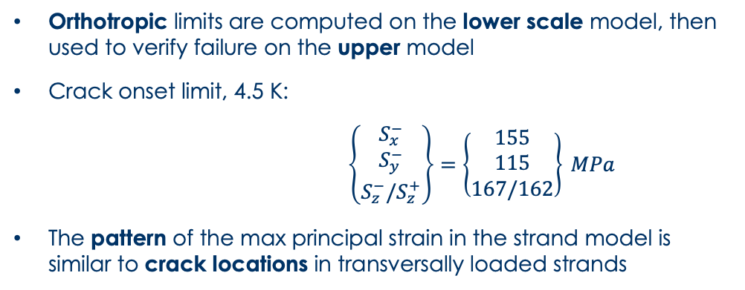
Strength Computation – 1D Loading
K. Puthran et al., 2022
Orthotropic limits are computed on the lower scale model, then used to verify failure on the upper model
Crack onset limit, 4.5 K:
$\left\{\begin{matrix}S_{x}^{−} \\ S_{y}^{−} \\ S_{z}^{−}/S_{z}^{+}\end{matrix}\right\}=\left\{\begin{matrix}155 \\ 115 \\ 167/162\end{matrix}\right\} MPa$
The pattern of the max principal strain in the strand model is similar to crack locations in transversally loaded strands

Slide 15
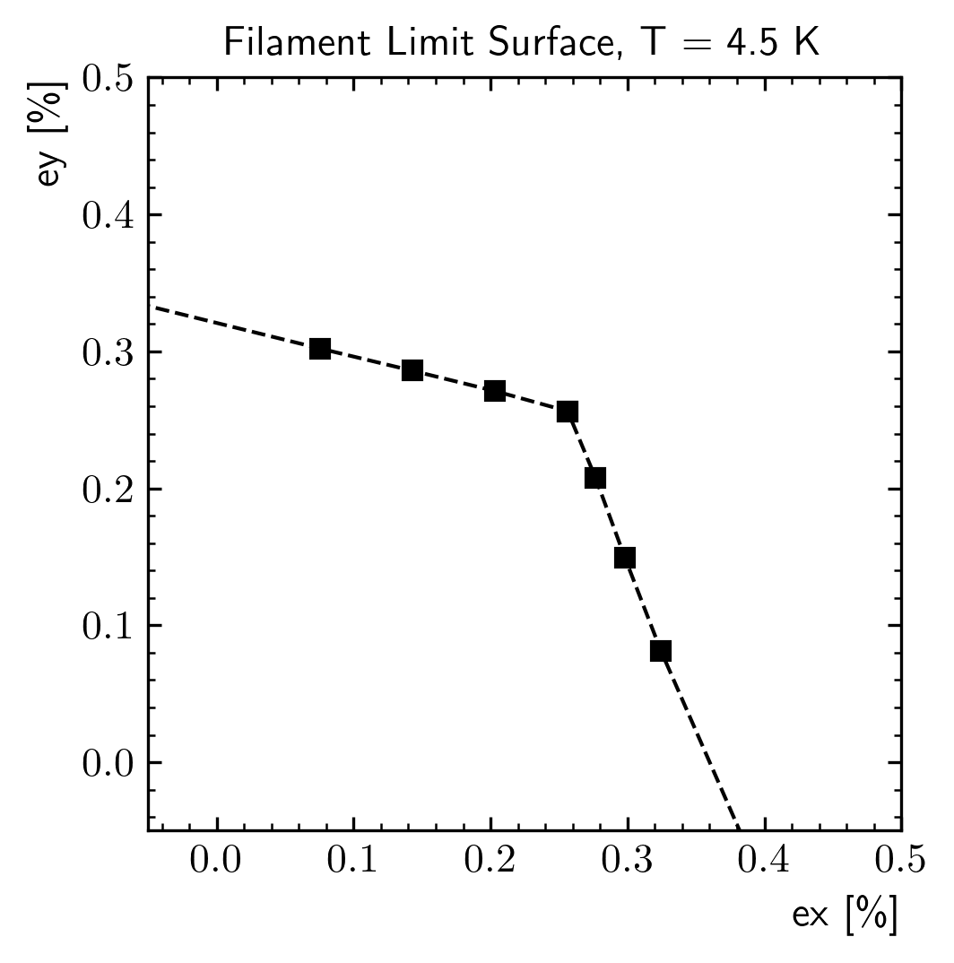
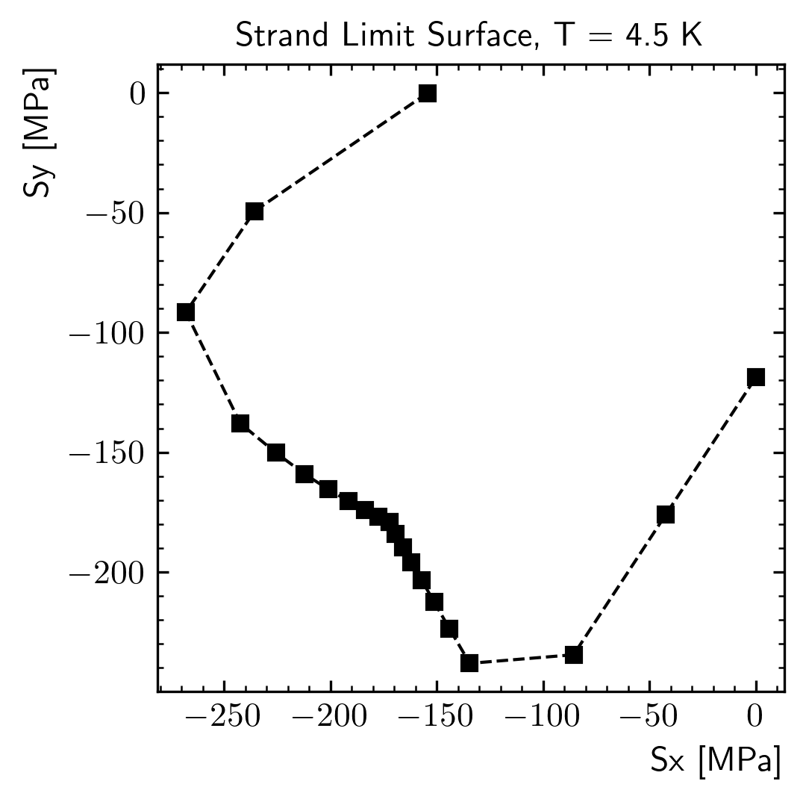
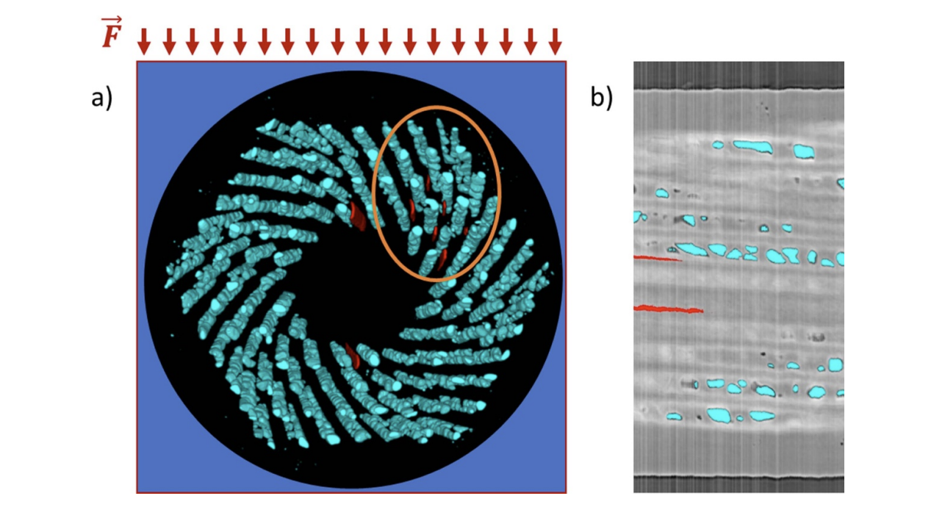
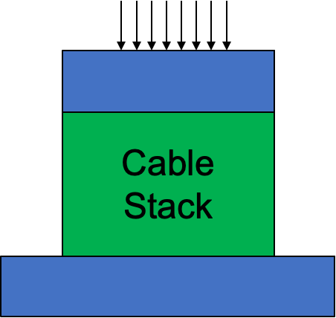
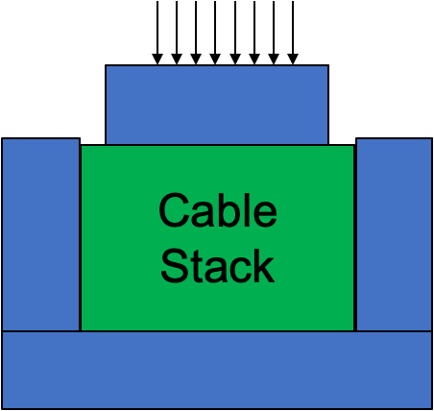
Strength Computation – 2D Loading
T. Bagni et al., 2022
  Significant computed strength increase under 2D loading
      ‘Hydrostatic’ loads are less dangerous, maybe using Von Mises criterion is not completely wrong
      This seems consistent with measurements on ‘strand in groove’ – no filaments failed at 238 MPa
    Multi-axial testing (and failure criterion) might be needed to identify the real limits of our coils
      Preliminary tests in progress at LBNL to confirm this result

Slide 16
Outline
Introduction
  Coil Mechanical Properties
  Coil Mechanical Strength
Modeling Training in Nb₃Sn Magnets
Conclusion

Slide 17
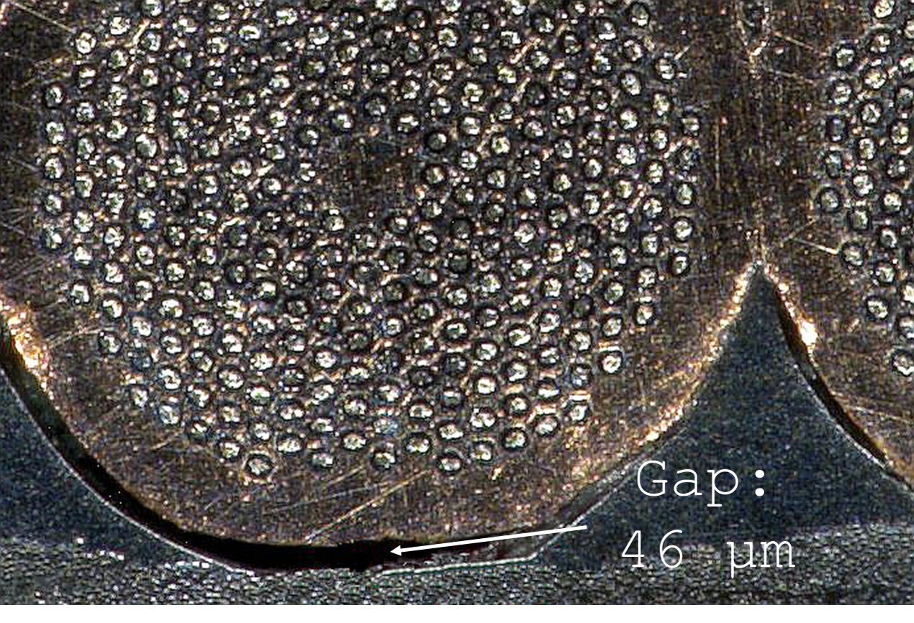
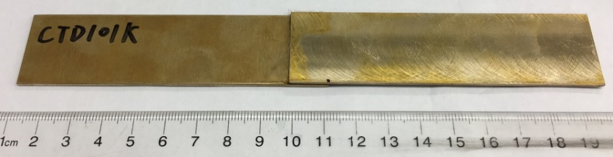
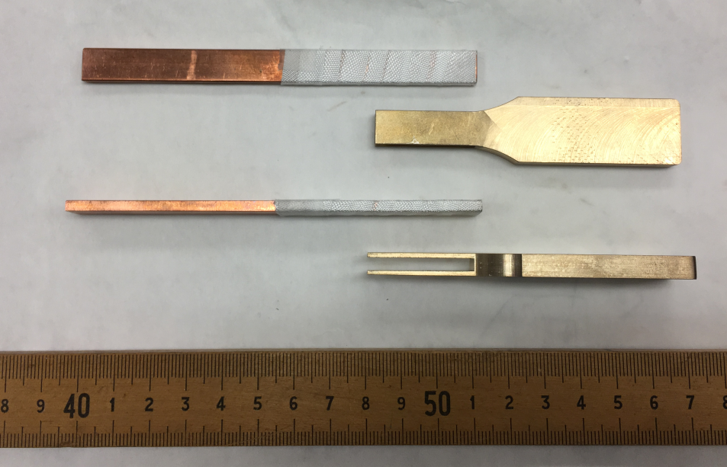
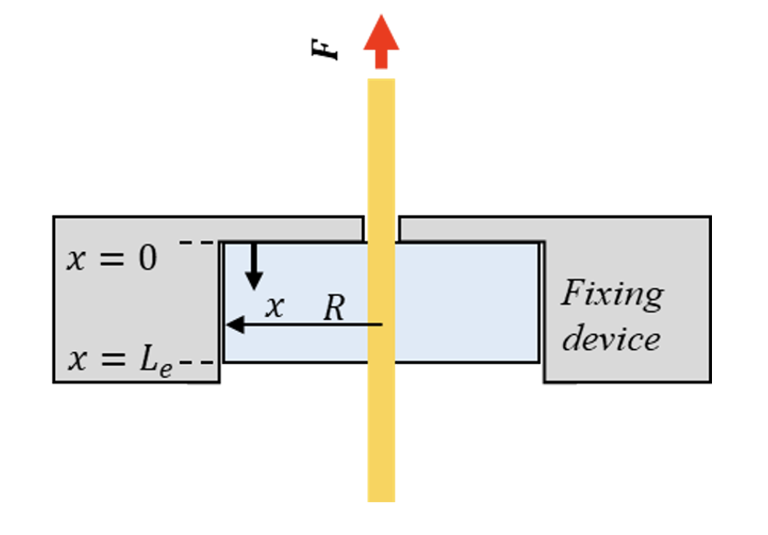
Debonding and Training
Bonded joints (interfaces) are commonly used in Nb₃Sn coils:
    E.g. Coil/Spacers (wedge or winding pole), spar/cable and rib/cable in CCT magnets
These interfaces can fail:
    Their failure is considered a possible cause of training
    Interface failure can change the stress distribution in the coil, leading to strand failure
Cohesive Zone Model (CZM) can be used to model the progressive interface failure under operation
    It allow to simulate mixed mode failure, glue plasticity
    Material properties (strength, fracture toughness) can be measured on lap shear or pull-out samples
Single/Double lap shear samples (T. Shen)
Pull-out test (JL. Rudeiros Fernandez)

Slide 18
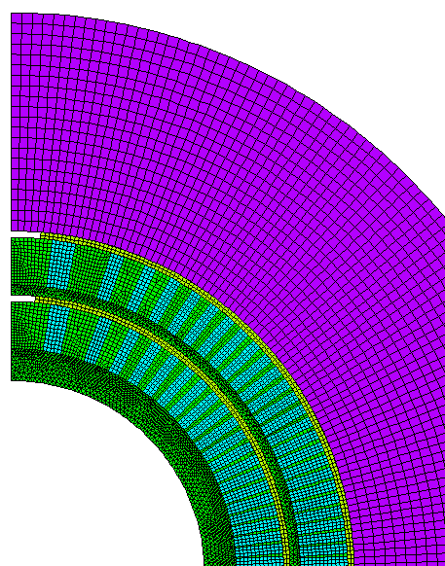
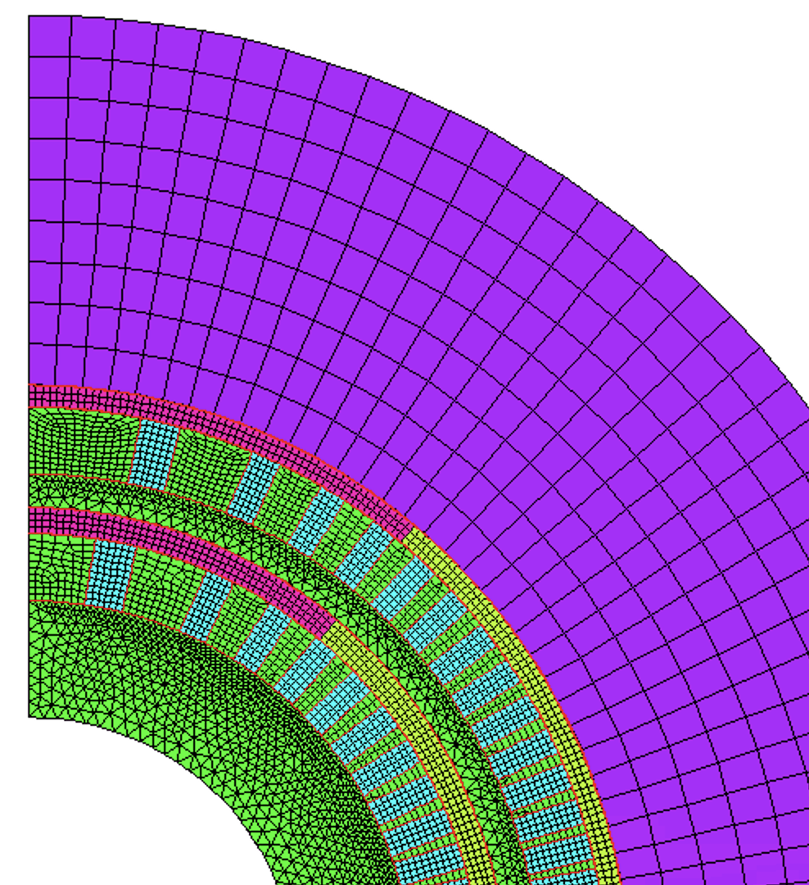
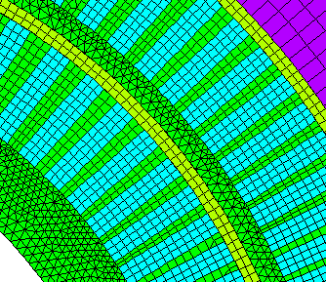
CCT FE Model Description
Soft shims
CZM elements
Contact elements (bonded/frictional/CZM) around the cable (cable/spar, cable/rib)
With the ‘real’ shim configuration, in 2D the conductor flies away during powering
    Additional ‘soft’ shim. E = 0.5 GPa.
Elasto-plastic material model for the conductor, extracted from RVE models of the cable
  Prestress (<1 MPa) added to improve convergence at cooldown start

Slide 19
CCT – Interface Failure During Powering
Some ‘small’ detachment after cooldown at the outer radius
  This is what you might see looking at the coil after a test…
  Almost no damage inside
Significant damage on the inner layer – negligible on the outer layer
  Most of the spar/cable interface failed (from ~20 to 75 deg approx.)
  The rib/cable interface fails on both sides (completely on the side in tension)
Failure propagates slowly from the outer edge, then suddenly propagates at around 12 kA
  Impossible to say if this would be one or multiple events in a real magnet
  This is quite close to where most CCT5 quenches were…

Slide 20
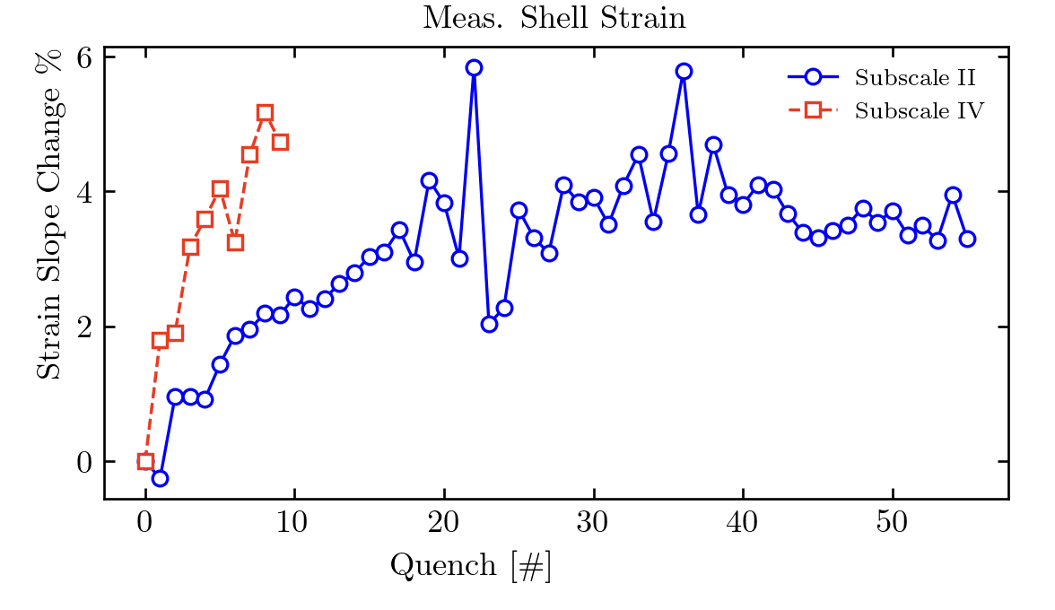
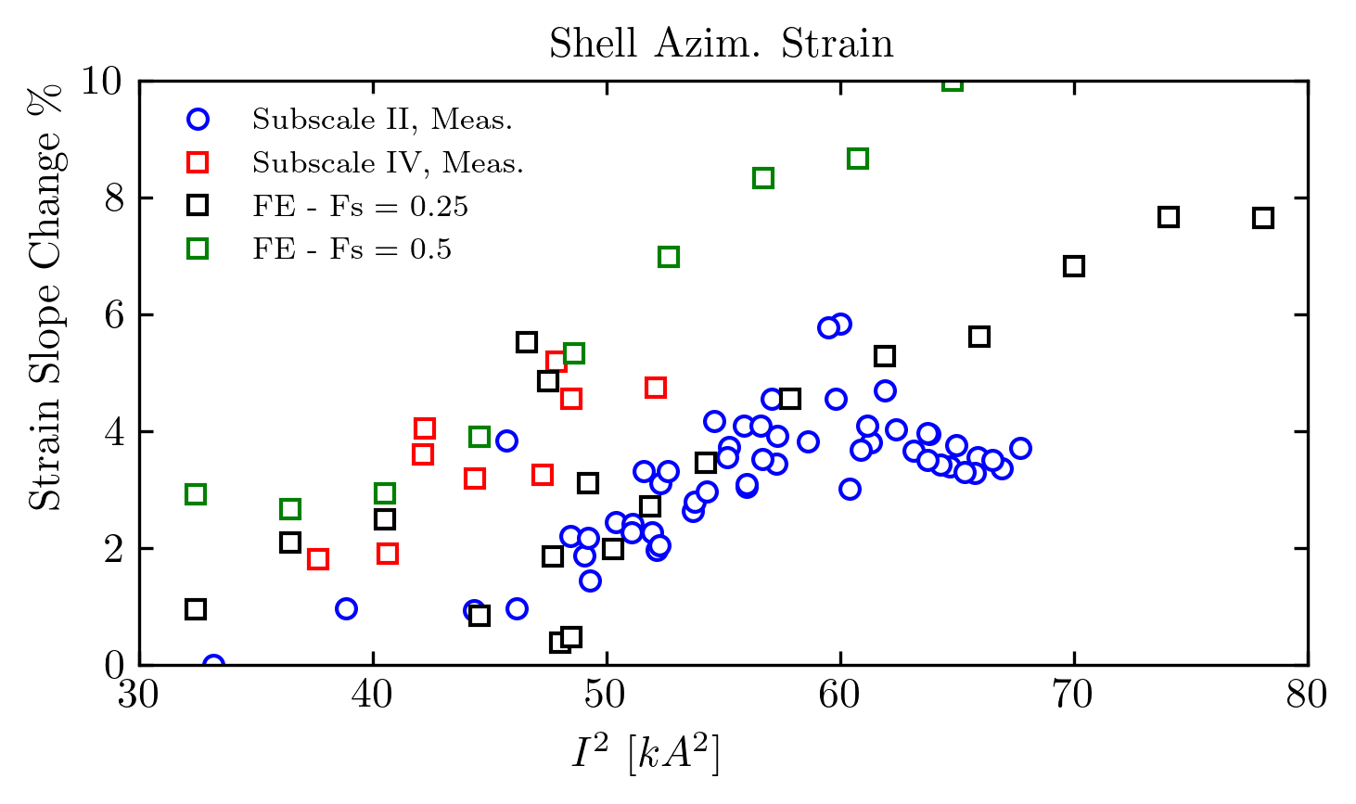
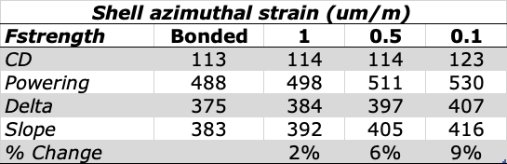
Strain Gauge Comparison
Slope changes during training: gradually increasing quench after quench
The debonding model shows that the slope is proportional to the amount of detachment at the cable/mandrel interface
Similar measured/computed slope variation as training progresses

Slide 21
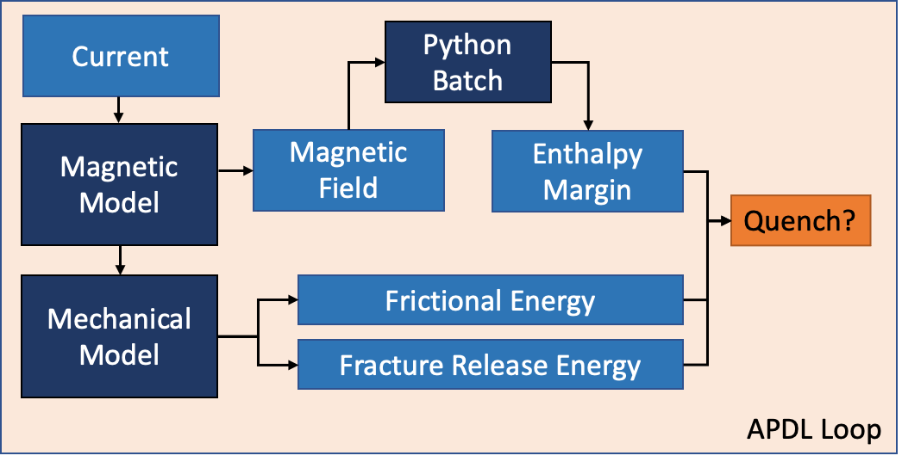
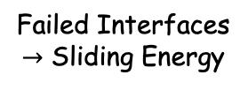
CCT Training Model
Debonding
Energy
Cable
Failed Interfaces
$→$ Sliding Energy
Mandrel
CCT training model:
    Energy released by debonding, friction compared against the enthalpy margin
    Two approaches to check the temperature increase/quench:
      Enthalpy margin computed ’smearing’ cable constituents. Last step energy released ‘instantaneously’, and distributed in a ~0.125 um deep region.
      Temperature increase computed on a thermal model
    ’Python in the loop’ block called by the solver to compute the margin

Slide 22
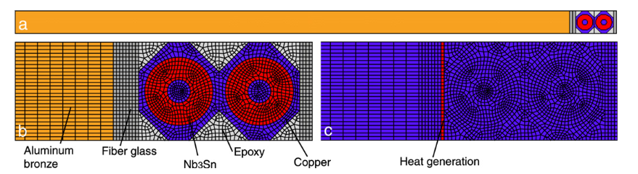
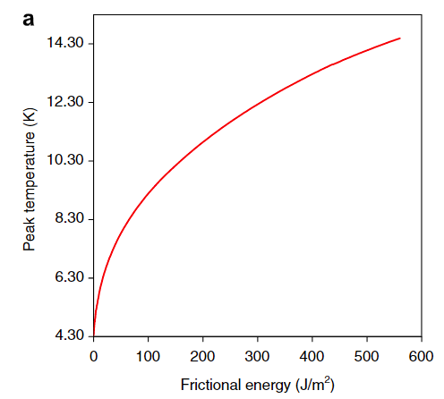



Enthalpy Margin - Thermal Model
Model 1
Model 1
Model 2
P. Ferracin, S. Caspi, IEEE Trans. 2007
Thermal submodel following SQ02 approach:
Input: released energy, magnetic field.
Output: Peak temperature in the superconducting region
  Field dependence not very important (1st order)
  Model 1: consistent with SQ02 model, but the temperature is low w.r.t. computed energy releases
  Model 2: all the energy is absorbed by the cable

Slide 23



CCT Training Model – Steps
Convert ‘model time’ (q) to ‘physical time’ (t):
$$ΔE_{f}=\left\{\frac{∂E_{f}}{∂q}\frac{α}{β}\frac{1}{\sqrt{q}}\right\}Δt$$
Ramp in two phases to reduce the number of steps:
    ‘Quick’ until a threshold, then ‘slow’ (100 A/load step)
      Threshold increased during training (checking energy releases in past ramps)
      ANSYS automatically decreases the step size near non-linearities (debonding)
  Code checks the temperature/enthalpy margin after each step. This is a function of the energy release duration:
    Friction is progressive (release rate), easy to link to the thermal model
    Debonding is ‘instantaneous’ (fails at a certain force/instant in the simulation)
      Different/unknown release duration. For simplicity we amplify the energy release.

Slide 24

CCT Training Model - Results
    Decent agreement…?
    Results seem to suggest that debonding and friction can at least partially explain training quenches in CCT4
    Model A: virtual magnet gets ‘stuck’ at ~14.5 kA
      ‘Instant’ release assumption probably not true for small events
    Model B: in progress…

Slide 25


CCT Training Model - Energies
Peak local released energy during the ramps (Model A):
    Each ramp has a different colour, black line is the enthalpy margin
    Frictional energy can be released only after debonding
    Large events, then small events and small margin
      In the last part the ‘instant’ assumption of Model A is probably not true anymore

Slide 26
Outline
Introduction
  Coil Mechanical Properties
  Coil Mechanical Strength
Modeling Training in Nb₃Sn Magnets
Conclusion

Slide 27




MDP Software
Coil Properties
Python/APDL
Coil ESYS Macro
APDL
Strand/Cable
Parameters
[E], [Y], [H], [S]
Training Simulation
Python/APDL
Nb₃Sn
Python Package
compute_seps(eps_1, eps_2, eps_3, eps_12, C1, eps_l0)
critical_current_function(spar,B,Ts,C,Bc20,Tc0)
critical_temperature_function(I,seps,B,C0,Bc20,Tc0)
enthalpy_margin_function(B,Tstrand,Tcs,cable_geo,strand_par)
cp_cond_function(T,RRR,Bf,CP_Option,Tc0,Bc20,cond_area,strand_area,cable_area,factor_pitch,Cu2SC_ratio)
Code developed with efforts to make it ‘usable/useful’ by/for the community
  Plan to create a shared APDL/Python package/repository with all the code developed:
      Critical surface computation (s(eps), Ic(B,T,eps), Tcs, enthalpy margin…)
      Parametric RVE coil model to compute mechanical properties and strength limits
      Automatic element reference system generation for 3D models
      Training modelling package (to quickly code training simulations for APDL magnet models)

Slide 28


Conclusion
  Constitutive equations computed with RVE approach:
    Validated on magnet measurements in 2D
    3D plastic behavior can be introduced with Hill + anisotropic hardening
Two approaches proposed to define structural limit criterion:
    Mixed max stress/strain criteria with limits gathered from measurements
    Computed limits on a multiscale model
      Limits for ‘hydrostatic’ loading conditions might be significantly higher
  Training model:
    Failure of the bonded interfaces can be modeled using cohesive elements
    Two training models proposed, with increasing complexity of the quench condition definition
    Model results suggests that CCT training might be partially due to debonding and consequent sliding at the interfaces

Slide 29
Extra

Slide 30



Magnet Modelling Strategies
Block Model
Cable Model
S. Caspi et al., IEEE Trans 2006
Strand Model
M. Daly et al., IEEE Trans 2018
Many modelling strategies were proposed in the past. They can be divided in the following families:
Block (2D, 3D): single material model for the coil
Cable model (2D, 3D): each bare/insulated cable is modelled independently
    Insulation can be modelled with contact elements
Strand model (2D) : simplified strand (filamentary region as single material)
Cable block + 2D Insulation
E. Sun, SUST 2022

Slide 31


Constitutive Equations in Magnet Models
2006 – M. Pojer
Multi-linear elastic, Orthotropic
2006 – S. Caspi
Elastic, Isotropic
Hill + Gasket Material
E. Sun, SUST 2022
Some material models used in the past:
2006 – M. Pojer et al. – Multi-linear elastic (orthotropic)
2006 - S. Caspi and P. Ferracin, 3D linear elastic
2018 – M. Daly et al., Strand model with elasto-plastic properties of the constituents
2022 - E. Sun, Anisotropic (Hill) Plasticity + non-linear insulation (gasket) properties

Slide 32

FE Coil Models
In 2022, we proposed a multi-scale approach to predict stiffness and strength of coils. The main ingredients required are:
Modelling strategy
    ‘Block’ models are the most (only?) reasonable assumption for a 3D magnet model
Constitutive equations (material model)
    Connect stress/strain inside the simplified model
Strength limits
    Depending on the modelling strategy, the definition of these limits might be different

Slide 33



Cable Stacks – Typical Measurements
Transverse/Azimuthal direction:
  ‘Virgin’ loading: ‘peak’ modulus ~20 GPa, then ~10/15 GPa
  Unloading: slope keeps changing
  Reloading: increases in the initial part, then ‘flattens’ around 30 GPa
  Probably linear properties are not enough… But where this non-linearity is coming from?
Measurements by O. Sacristan

Slide 34


I_{c} Reduction – Sample Holder
B. Bodrini et al., IEEE Trans. (2013)
Electro-magnetic-mechanical model of the sample holder
  Cable stack modelled with the mechanical approach validated from 10-stack measurements
  Exponential scaling law applied to compute the critical surface position
Quench currents are matched reasonably well
  At 155 MPa there was some irreversible degradation – not modelled…
G. Vallone et al., IEEE Trans. (2018)

Slide 35


MQXF - I_{c} Reduction
G. Vallone et al., SUST (2020)
MQXF strand model:
  Model/approach validated on 10 stacks + FRESCA sample holder + MQXF meas.
  Refined short sample estimation (critical strands in the mid-plane cable)
  Inner layer, 2nd turn: local strain concentration reduces the available margin
    The impact of local effects was difficult to evaluate with block models
    Filaments in this area were found broken in some MQXFB magnets

Slide 36


TFD - Load Line Margin with Strain
Same approach, applied to the Test Facility Dipole
Working Point/Short sample limit for each strand:
    80% in the high field / low stress region
    70% in the low field / high stress region. This would be 56% with no strain effects.
G. Vallone et al., IEEE Trans., under review

Slide 37


Strain Function as Degradation Limit
By N. Cheggour
Critical
area
Test Facility Dipole in development at LBNL (targets 16 T, 144 mm wide aperture)
    For assembly and cool-down, we focus on potential irreversible degradation
$s{\left(ε\right)}_{irr}$ is the strain function at $ε_{l}=ε_{irr,0}$, equal to 0.85
    We assume this as ‘limit’ for irreversible degradation onset
The critical area: $s{\left(ε\right)}_{CD}$= 0.83, slightly over the limit
Best guess, but no theoretical/experimental evidence that this works

Slide 38

Interfaces – Measurements
Preliminary measurements on single lap and double lap shear samples
  Single lap useful for mixed mode (tension+shear) failure (likely to occur in magnets)
  Double lap useful for verification of shear failure
These tests tried to reproduce as close as possible the coil/structure interfaces
  Copper/copper (single-lap), impregnated insulation/Aluminum bronze (double-lap)
Still missing some effects:
  Reaction impact on bonding, effect of temperature, insulation thickness, etc.
Released energy during crack propagation?

Slide 39

CCT4 – Interface Failure During Powering

Slide 40


Reinforced Composites – Failure Modes
Fiber reinforced composites can fail in multiple ways: fiber breakage, matrix cracking, delamination (and interlaminar shear)
First ply failure can be used as conservative criteria:
    ‘Load at which the linear load-displacement curve first changes’
    Under this assumption, the laminate does not necessarily fail, because other undamaged plies can still carry the load. The load at ultimate failure might be considerably higher than first ply failure
      Similar to using ‘yield strength’ as limit for certain metals.

Slide 41



CCT Magnets for the MDP Program
Canted cos(ϑ) magnets built as part of the US Magnet Development Program (MDP)
Main parameters:
    Target field: approximately 10 T at short sample
    2 layers, 90 mm diameter aperture, 1 m long
Nb₃Sn coils:
Resin: CTD-101 K (CCT3/4) or NHFML Mix 61 (CCT5)
Mechanical design/assembly:
    Stress managed coils, surrounded by a 54.7 mm thick aluminum shell
    CCT3/4: reacted coils wrapped in fiberglass and impregnated
    CCT5: impregnated coils assembled using epoxy filled Kapton bags (smart shims)
D. Arbelaez et al., IEEE Trans. 2021

